Slide 1
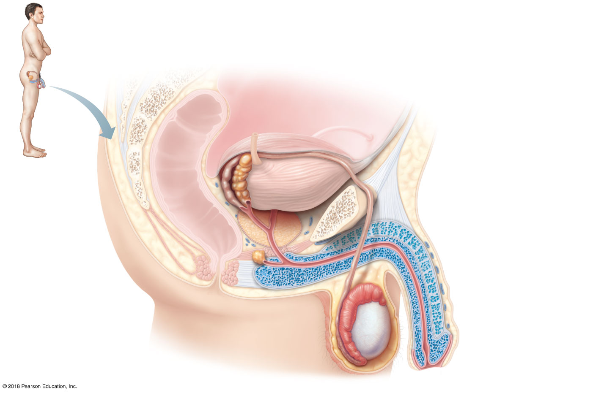
Ureter
Urinary bladder
Seminal vesicle
Prostatic urethra
Ampulla of
Pubis
ductus deferens
Membranous urethra
Ejaculatory duct
Urogenital diaphragm
Rectum
Prostate
Erectile tissue
of the penis
Bulbo-urethral gland
Spongy urethra
Ductus (vas) deferens
Shaft of the penis
Epididymis
Glans penis
Testis
Prepuce
Scrotum
External urethral
(a)
orifice
© 2018 Pearson Education, Inc.

Slide 2
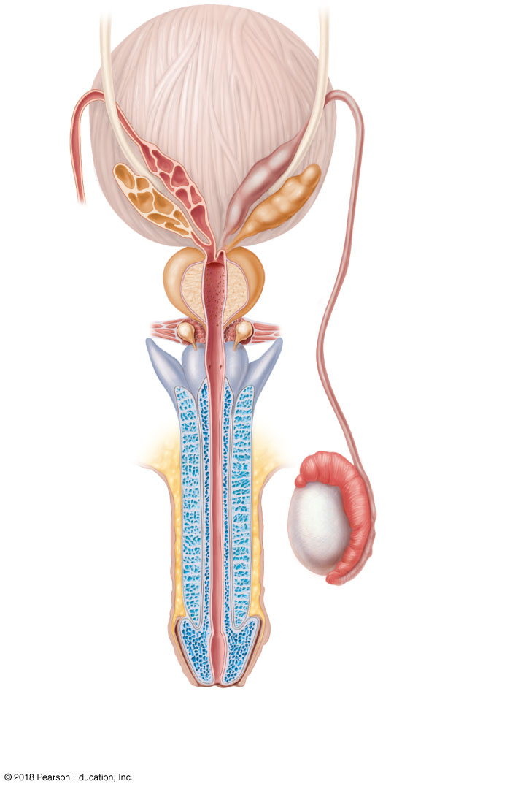
Urinary
bladder
Ureter
Ampulla
of ductus
deferens
Seminal
vesicle
Ejaculatory
duct
Prostate
Prostatic
urethra
Bulbourethral
gland
Membranous
urethra
Ductus
deferens
Root of
penis
Erectile
tissues
Epididymis
Shaft (body)
of penis
Testis
Spongy
urethra
Glans penis
Prepuce
External
urethral
orifice
(b)
© 2018 Pearson Education, Inc.

Slide 3
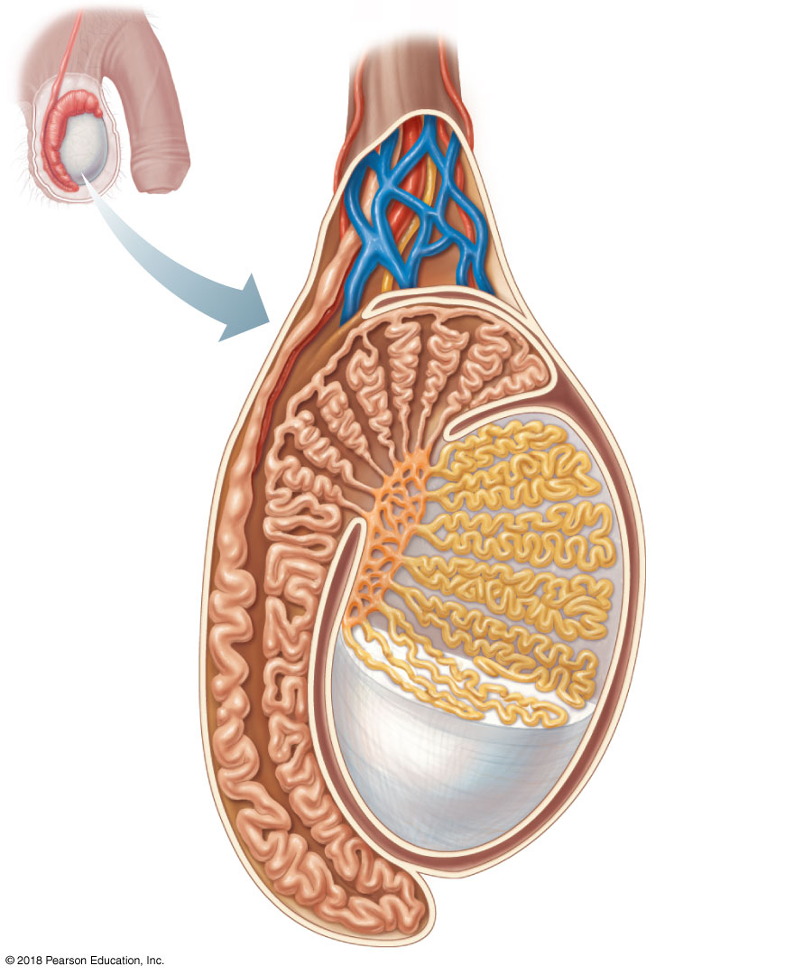
Spermatic cord
Blood vessels
and nerves
Seminiferous
tubule
Rete testis
Ductus (vas)
deferens
Lobule
Septum
Tunica
albuginea
Epididymis
© 2018 Pearson Education, Inc.

Slide 4
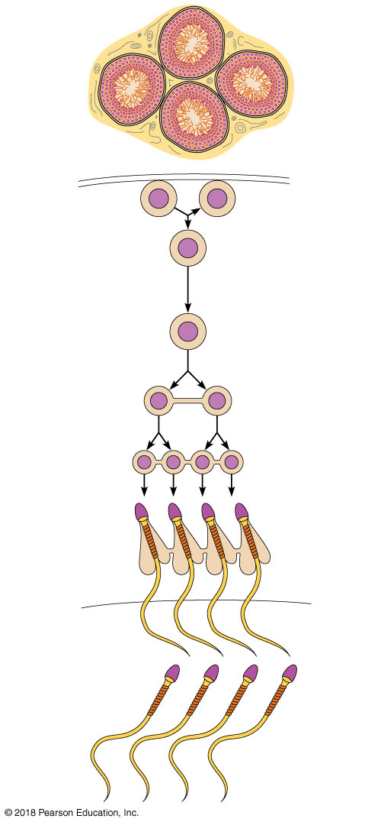
Seminiferous
tubule
Basement membrane
Spermatogonium
(stem cell)
2n
2n
Daughter cell
type A (remains
at basement
membrane
as a stem cell)
Mitosis
2n
Growth
Daughter cell type B
(moves toward tubule
lumen)
Enters
prophase of
meiosis I
Meiosis
2n
Primary
spermatocyte
Meiosis I
completed
n
n
Secondary
spermatocytes
Spermatogenesis
Meiosis II
n
n
n
n
Early
spermatids
Spermiogenesis
n
n
n
n
Late
spermatids
n
n
n
n
Sperm
Lumen of
seminiferous
tubule
© 2018 Pearson Education, Inc.

Slide 5
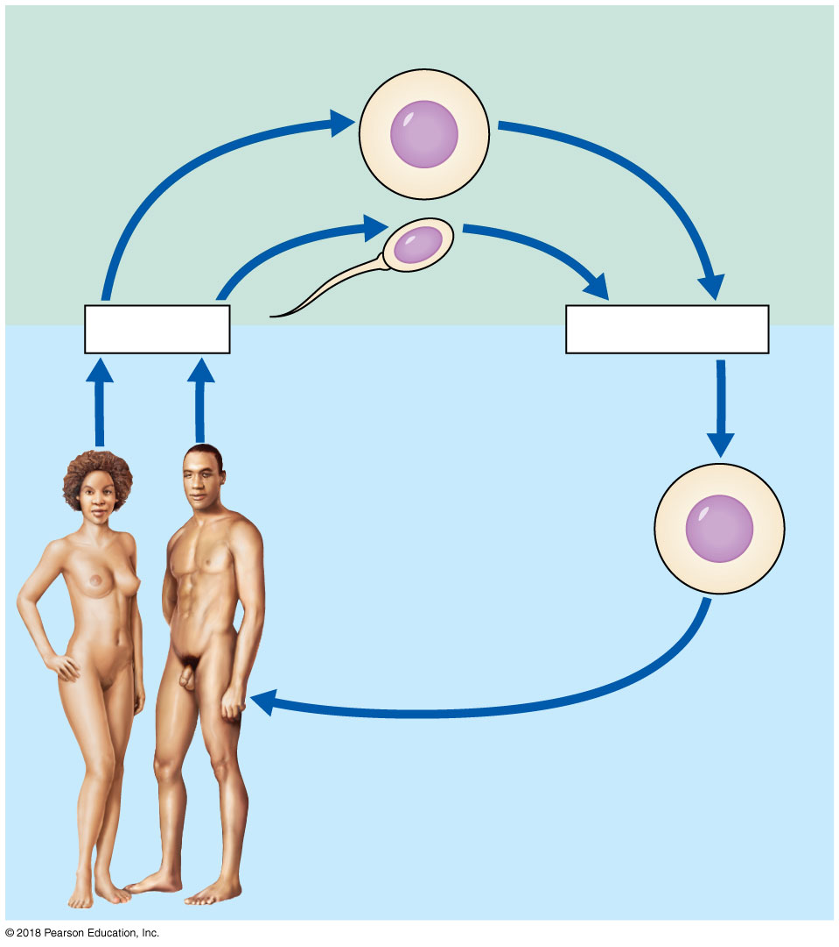
Gametes (n = 23)
n
Egg
n
Sperm
Meiosis
Fertilization
Multicellular
adults
(2n = 46)
Zygote
(2n = 46)
2n
Mitosis and
development
© 2018 Pearson Education, Inc.

Slide 6
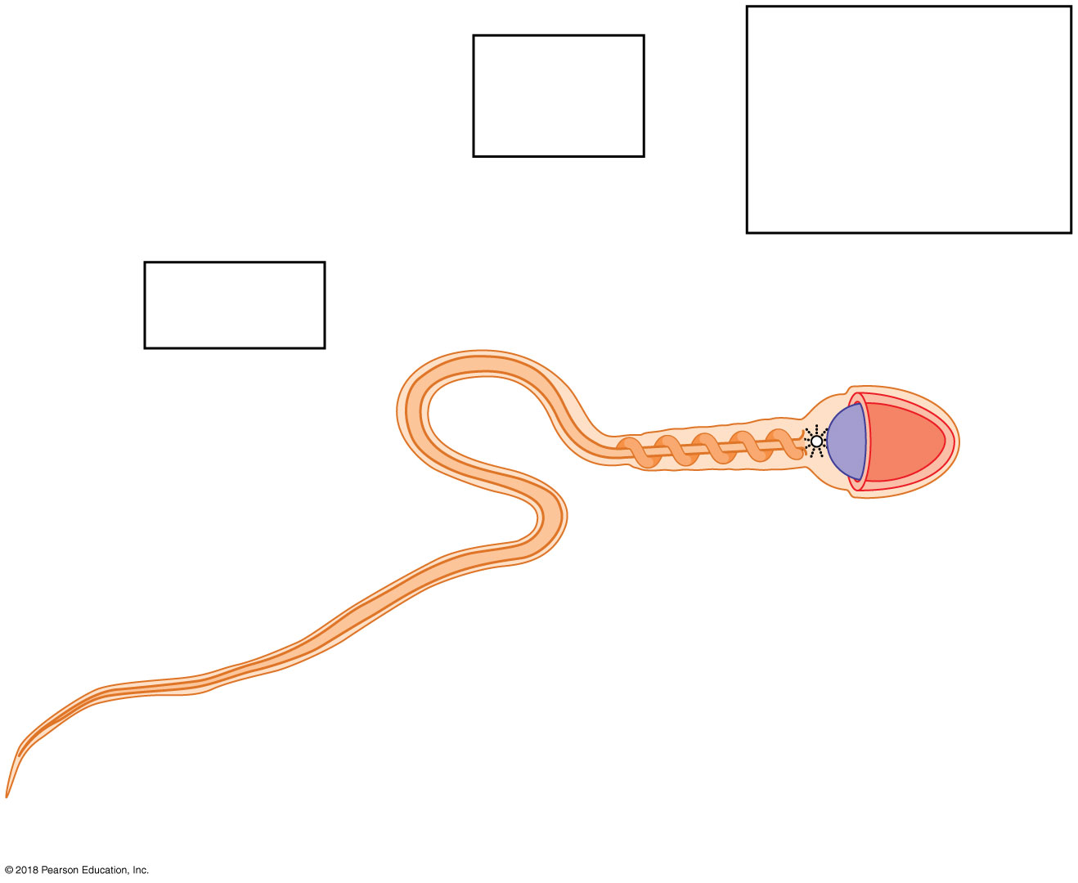
Provides genetic
instructions and a
means of penetrating
the follicle cell
capsule and
oocyte membrane
Provides
energy for
mobility
Plasma membrane
Neck
Provides
for mobility
Tail
Head
Midpiece
Axial filament
of tail
Acrosome
Nucleus
Mitochondria
Proximal centriole
(b)
© 2018 Pearson Education, Inc.

Slide 7
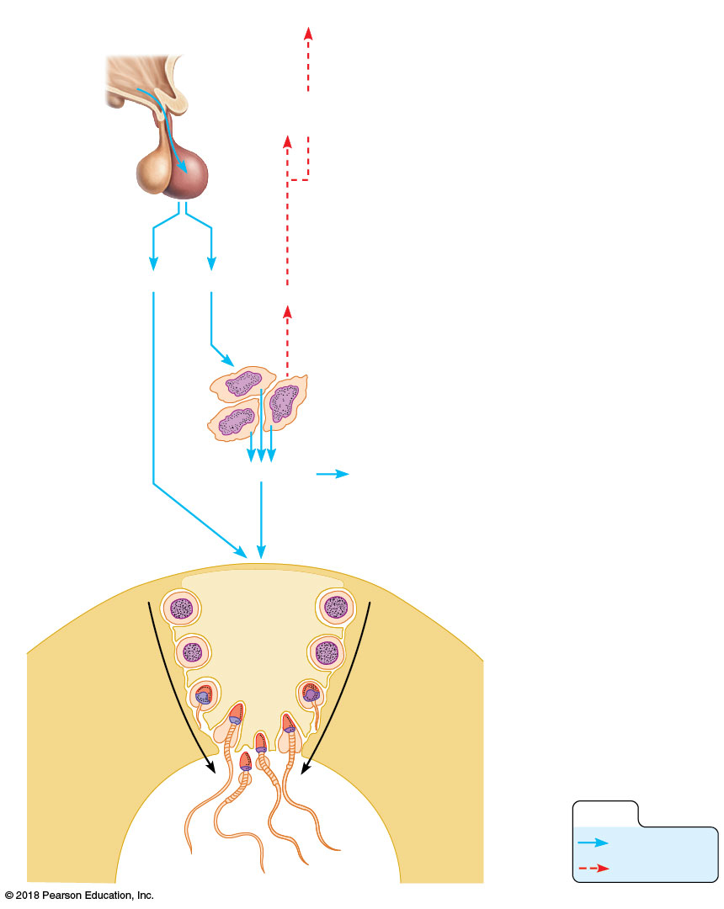
Hypothalamus
1
The hypothalamus releases
gonadotropin-releasing hormone
(GnRH).
1
GnRH
2
Anterior
pituitary
GnRH stimulates the anterior
pituitary to release gonadotropins
—FSH and LH.
3
FSH stimulates
spermatogonia to produce sperm.
2
5
4
LH stimulates the interstitial
cells to release testosterone,
which serves as the final trigger
for spermatogenesis.
Testosterone then enhances
spermatogenesis.
FSH
LH
Testosterone
3
4
5
5
The rising level of
testosterone exerts negative
feedback control on the
hypothalamus and pituitary.
Testosterone
Primary and secondary
sex characteristics
Supporting cell
Seminiferous
tubule in testis
FSH and
testosterone
stimulate
sperm
production
Spermatogonia
Spermatogenesis
KEY:
Stimulates
Inhibits

Slide 8
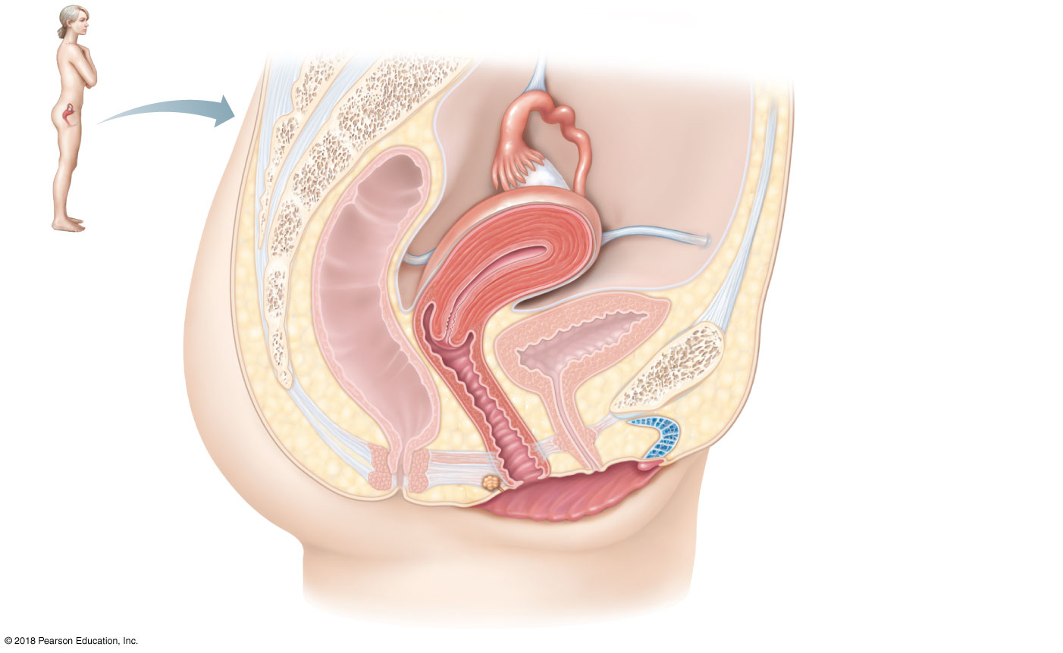
Suspensory ligament
of ovary (part of broad
ligament)
Infundibulum
Uterine tube
Ovary
Fimbriae
Uterus (fundus)
Uterosacral
ligament
Round ligament
Urinary bladder
Rectum
Pubic symphysis
Mons pubis
Cervix
Urethra
Vagina
Clitoris
Anus
Hymen
Greater vestibular gland
Labium minus
Labium majus
(a)
© 2018 Pearson Education, Inc.

Slide 9
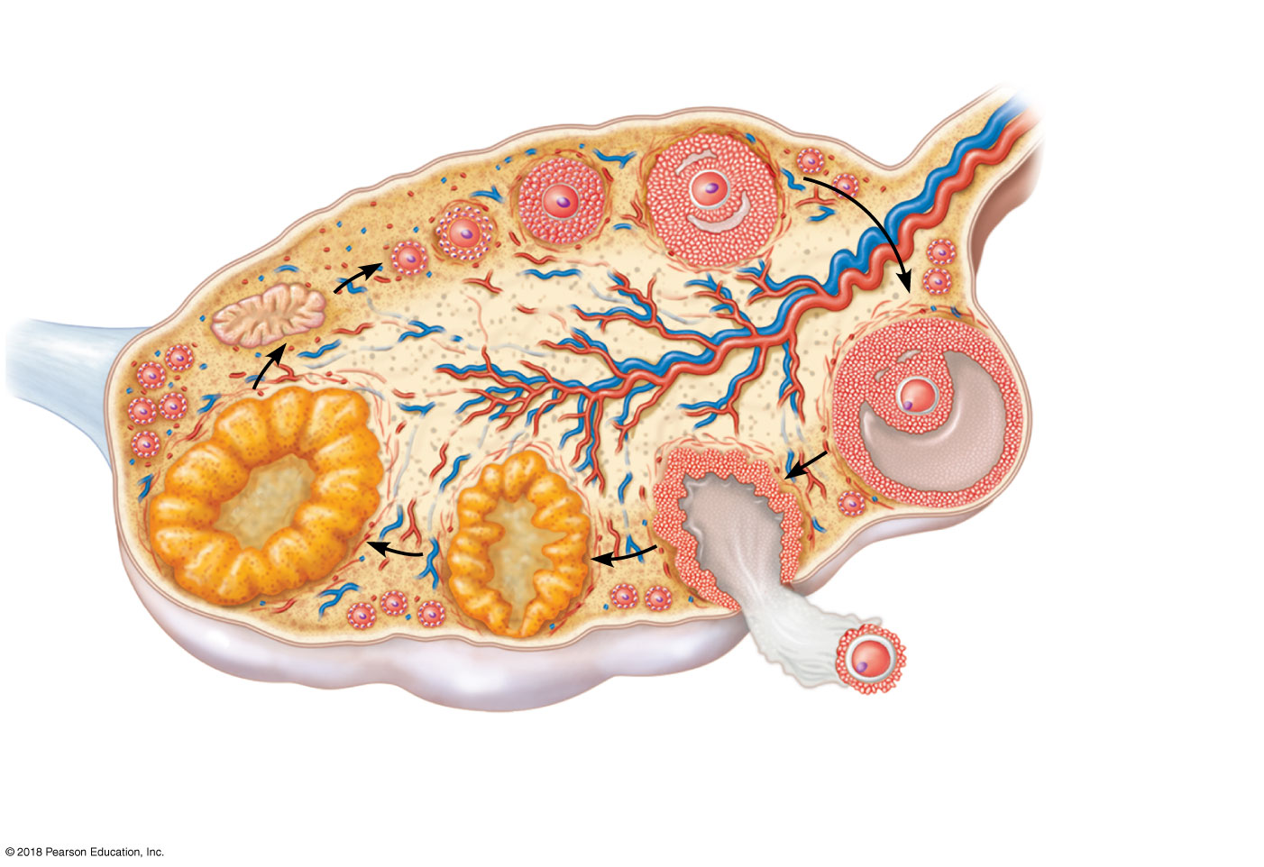
Primary follicle
Growing follicles
Degenerating
corpus luteum
Blood
vessels
Antrum
Corona
radiata
Mature vesicular
(Graafian) follicle
Germinal
epithelium
Corpus luteum
Developing
corpus luteum
Ruptured
follicle
Ovulation
Secondary oocyte
© 2018 Pearson Education, Inc.

Slide 10
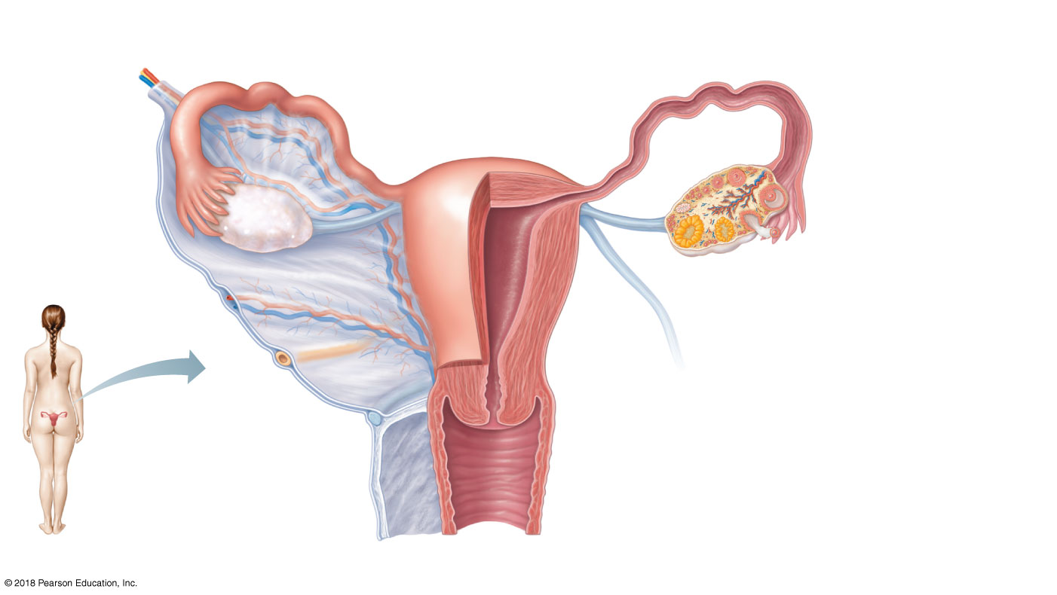
Suspensory
ligament of ovary
Uterine (fallopian) tube
Fundus
of uterus
Lumen (cavity)
of uterus
Ovarian
blood
vessels
Ovary
Broad
ligament
Infundibulum
Uterine
Fimbriae
tube
Ovarian ligament
Round ligament of uterus
Body of
uterus
Endometrium
Myometrium
Wall of
uterus
Perimetrium
Ureter
Uterine blood
vessels
Cervical canal
Uterosacral
ligament
Cervix
Vagina
(b)
© 2018 Pearson Education, Inc.

Slide 11
Mons pubis
Labia majora
Prepuce of
clitoris
Clitoris
Vestibule
Urethral orifice
Vaginal orifice
Opening of duct
of greater
vestibular gland
Labia minora
Perineum
Anus
© 2018 Pearson Education, Inc.

Slide 12
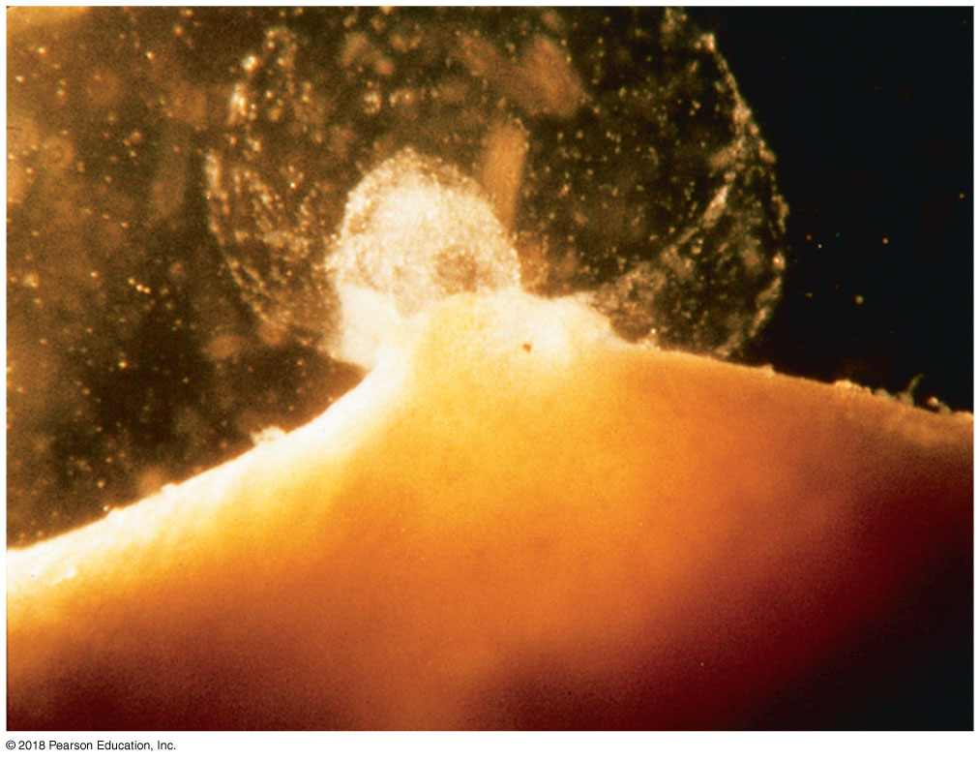
Oocyte
© 2018 Pearson Education, Inc.

Slide 13
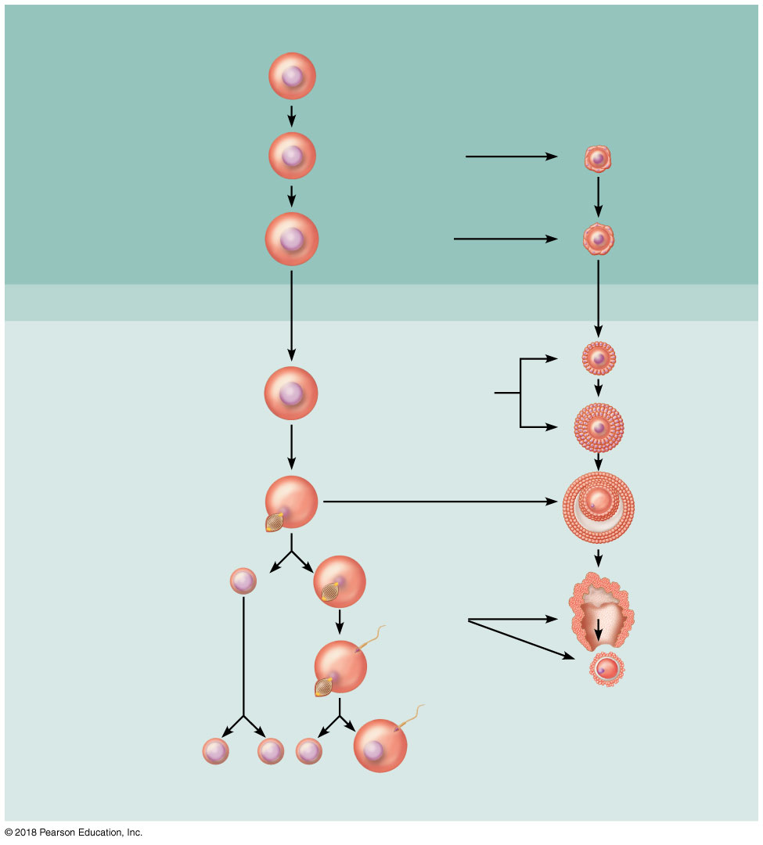
Meiotic Events
Follicle Development
in Ovary
Before birth
2n
Oogonium (stem cell)
Mitosis
Follicle cells
Oocyte
2n
Primary oocyte
Primary
follicle
Growth
2n
Primary oocyte
(arrested in prophase I;
present at birth)
Primary
follicle
Childhood
(ovary inactive)
Monthly from
puberty to menopause
Primary
follicle
2n
Primary oocyte (still
arrested in prophase I)
Growing
follicle
Mature
vesicular
(Graafian)
follicle
Meiosis I (completed by one
primary oocyte each month)
Secondary oocyte
(arrested in
metaphase II)
First polar body
n
Ovulation
Sperm
Ovulated
secondary
oocyte
Meiosis II of polar body
(may or may not occur)
Meiosis II completed
(only if sperm
penetration occurs)
Polar bodies
(all polar bodies
degenerate)
n
n
n
n
Second
polar body
Ovum
© 2018 Pearson Education, Inc.

Slide 14
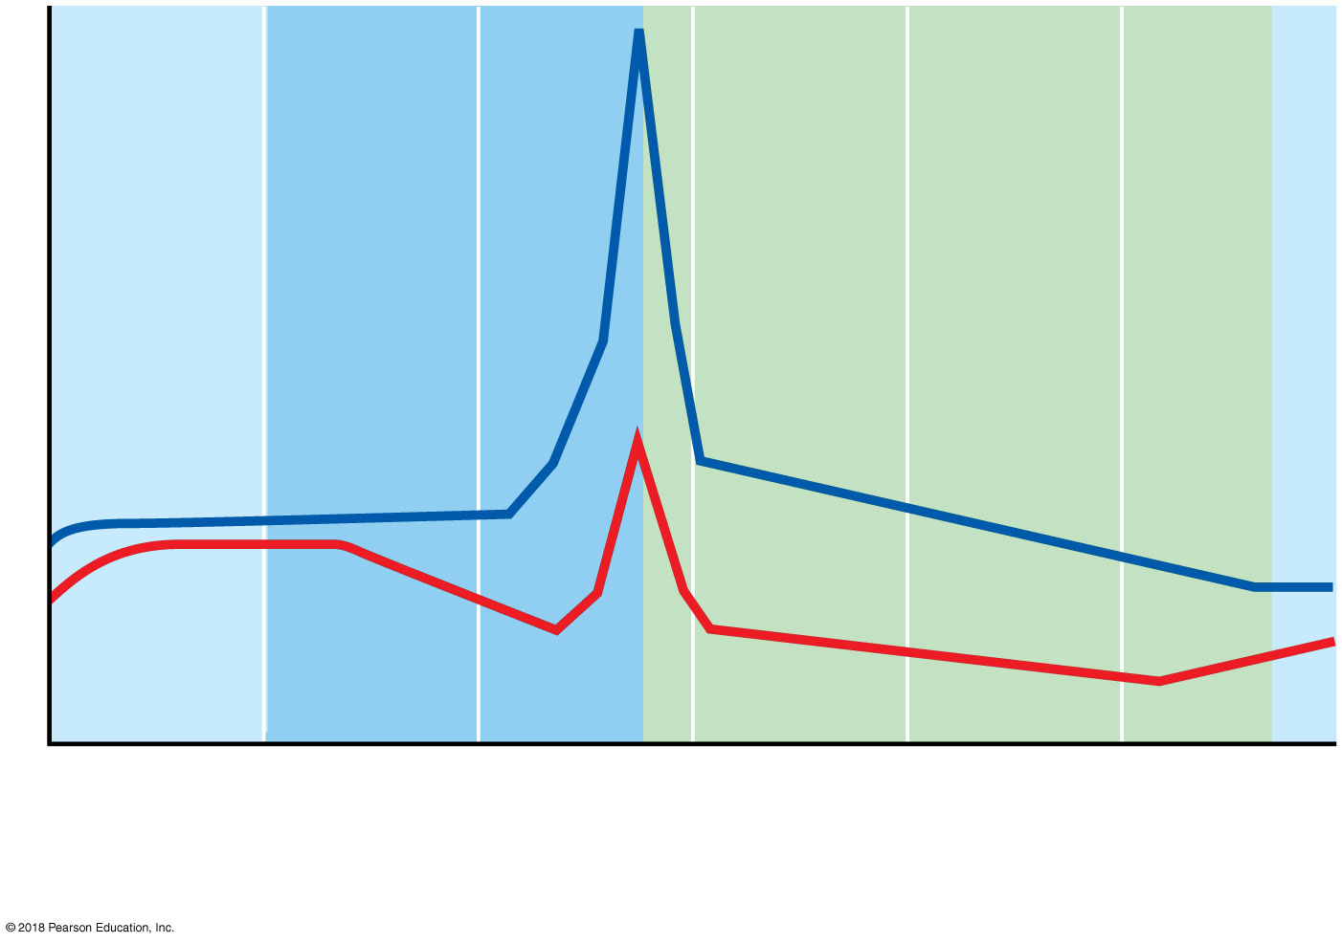
Plasma hormone level
LH
FSH
(a) Fluctuation of gonadotropin levels: Fluctuating levels of pituitary gonadotropins (FSH and LH) in the blood regulate the events of the ovarian cycle.
© 2018 Pearson Education, Inc.

Slide 15
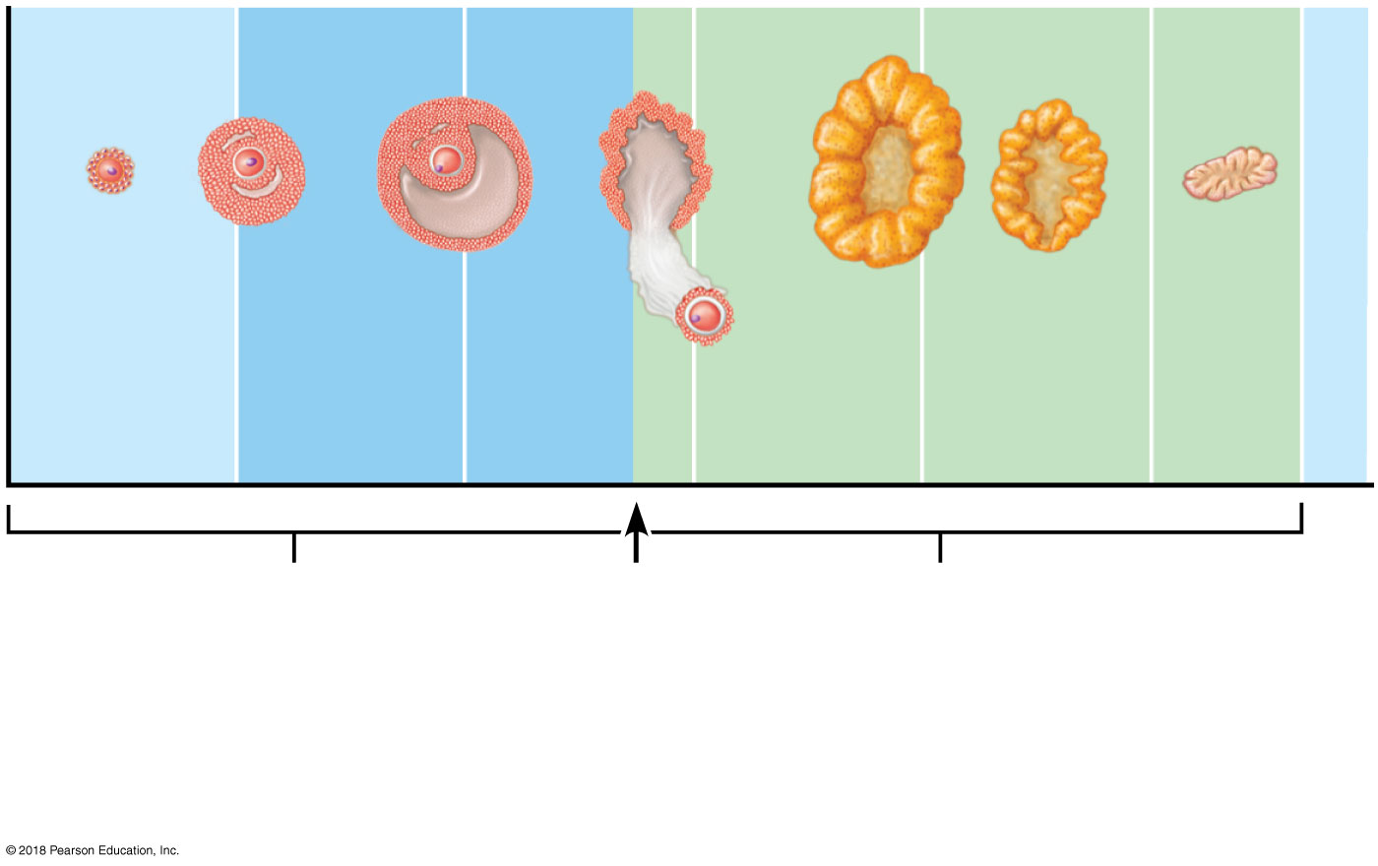
Primary
follicle
Secondary follicle
Vesicular
follicle
Ovulation
Corpus
luteum
Degenerating
corpus luteum
Follicular
phase
Ovulation
(Day 14)
Luteal
phase
(b) Ovarian cycle: Structural changes in the ovarian follicles during the ovarian cycle are correlated with (d) changes in the endometrium of the uterus during the uterine cycle.
© 2018 Pearson Education, Inc.

Slide 16
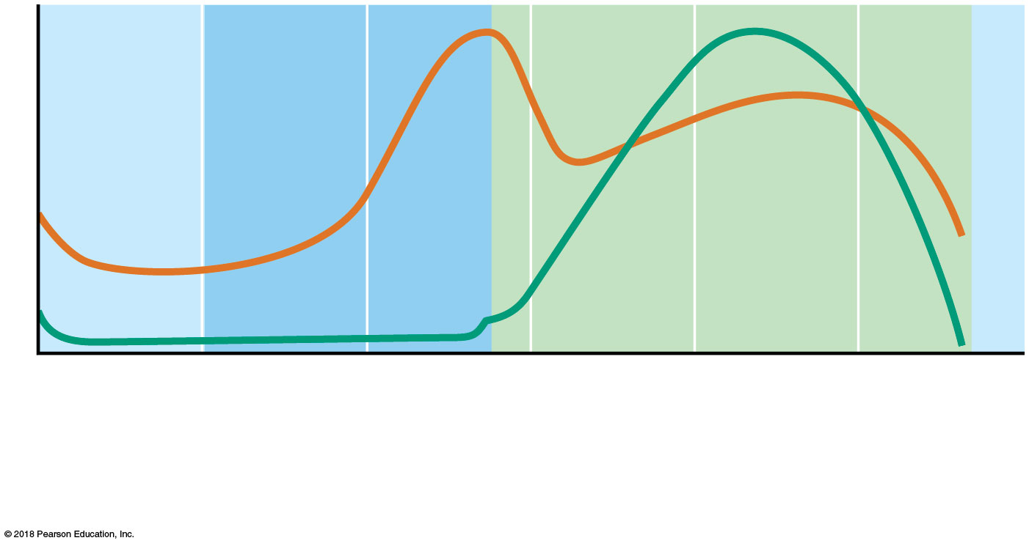
Plasma hormone level
Estrogens
Progesterone
(c) Fluctuation of ovarian hormone levels: Fluctuating levels of ovarian hormones (estrogens and progesterone) cause the endometrial changes of the uterine cycle. The high estrogen levels are also responsible for the LH/FSH surge in (a).
© 2018 Pearson Education, Inc.

Slide 17
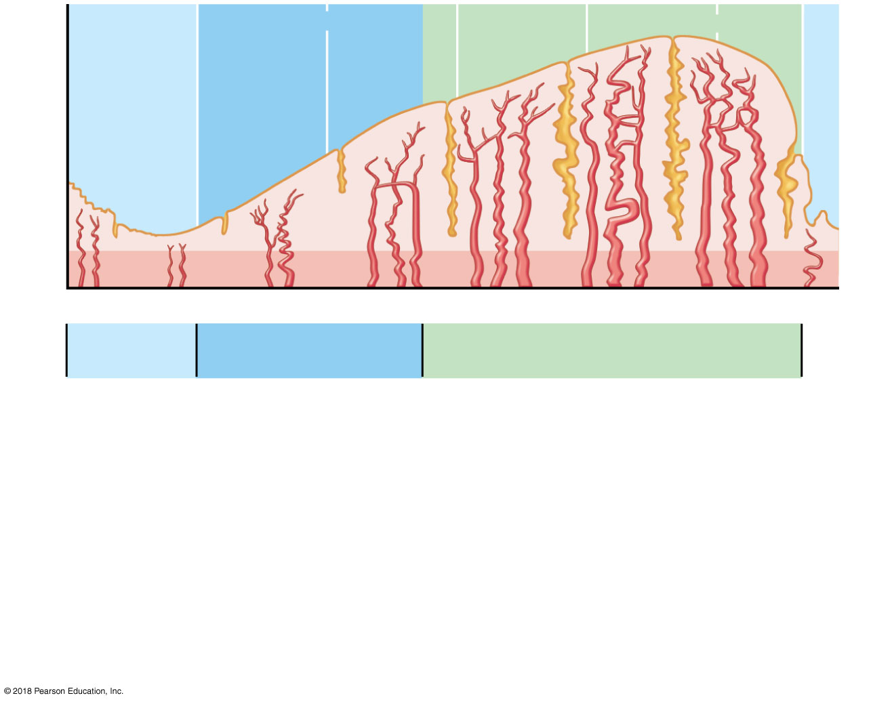
Endometrial
glands
Blood vessels
Functional layer
Menstrual
flow
Basal layer
1
5
10
15
20
25
28 Days
Menstrual
phase
Proliferative
phase
Secretory
phase
The menstrual and proliferative phases occur before ovulation and together
correspond to the follicular phase of the ovarian cycle. The secretory phase
corresponds in time to the luteal phase of the ovarian cycle.
(d) The three phases of the uterine cycle:
• Menstrual: Shedding of the functional layer of the endometrium.
• Proliferative: Rebuilding of the functional layer of the endometrium.
• Secretory: Begins immediately after ovulation. Enrichment of the blood supply and glandular secretion of nutrients prepare the endometrium to receive an embryo.
© 2018 Pearson Education, Inc.

Slide 18
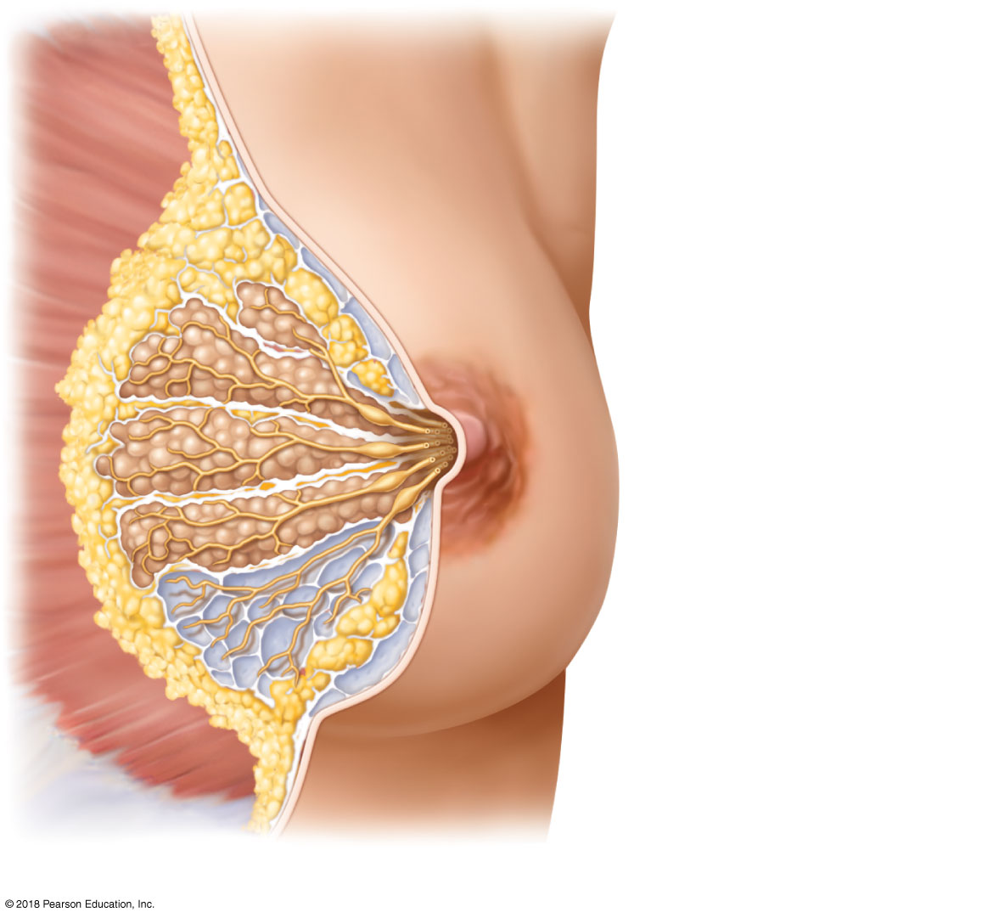
Skin (cut)
Pectoralis major muscle
Connective tissue
suspensory ligament
Adipose tissue
Lobe
Areola
Nipple
Lactiferous sinus
Lactiferous duct
Lobule containing
alveoli
(a)
© 2018 Pearson Education, Inc.

Slide 19
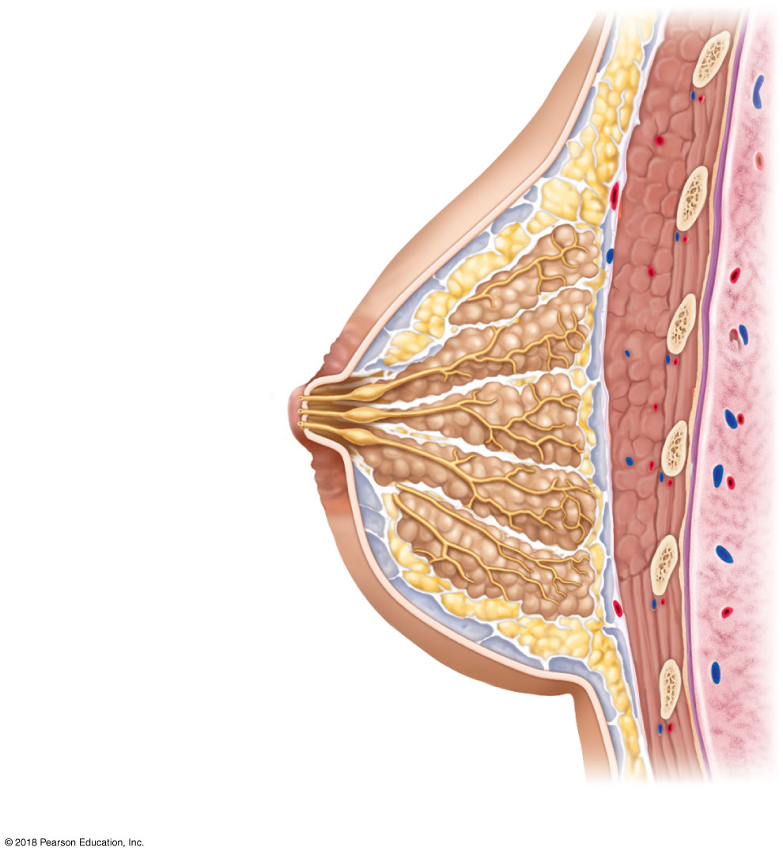
Skin (cut)
First rib
Pectoralis major muscle
Connective tissue
suspensory ligament
Adipose tissue
Lobe
Areola
Nipple
Opening of
lactiferous duct
Lactiferous sinus
Lactiferous duct
Lobule containing
alveoli
Hypodermis
(superficial fascia)
Intercostal muscles
(b)
© 2018 Pearson Education, Inc.

Slide 20
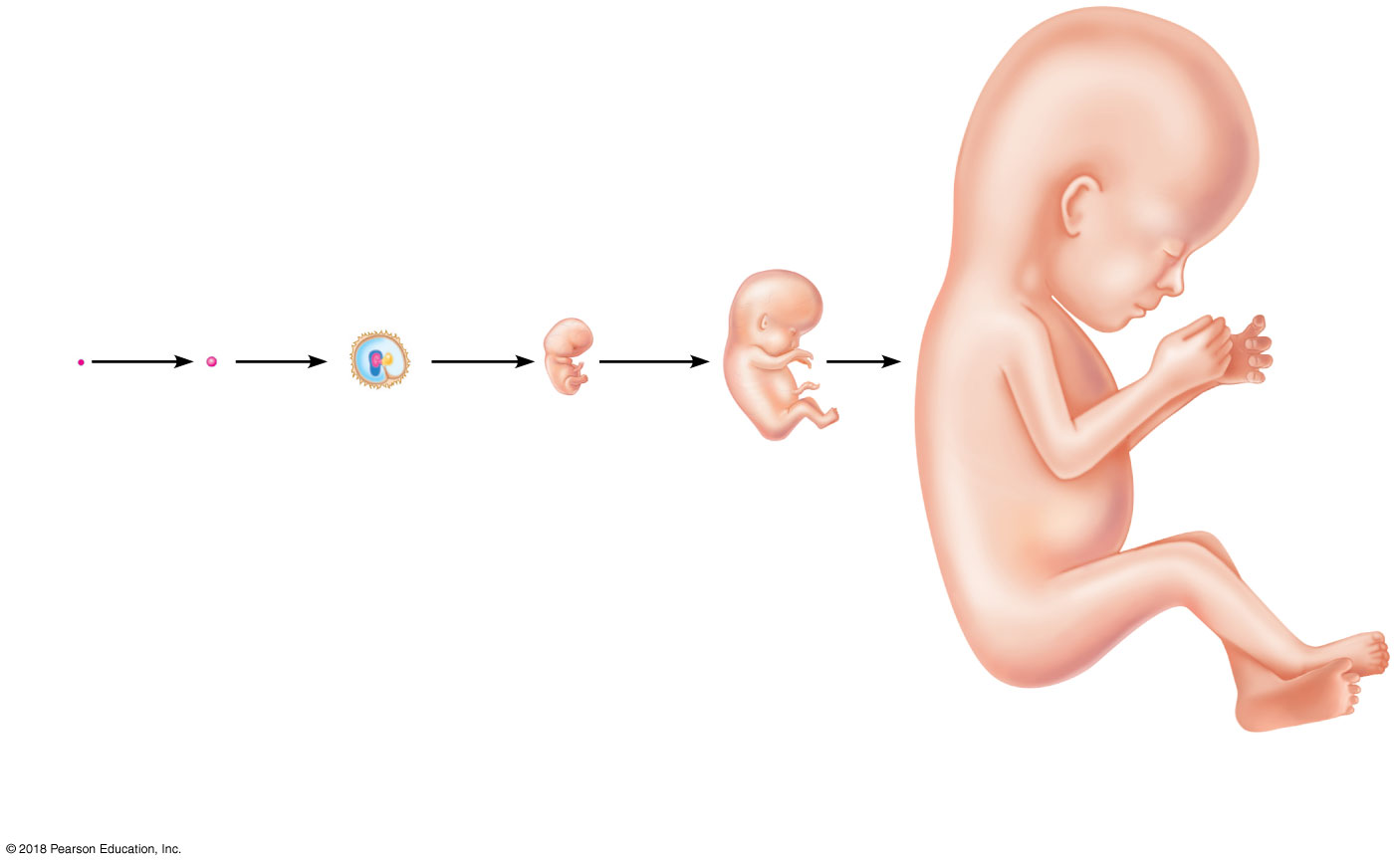
Embryo
Fertilization
1-week
conceptus
3-week
embryo
(3 mm)
5-week embryo
(10 mm)
8-week embryo
(22 mm)
12-week fetus
(90 mm)
© 2018 Pearson Education, Inc.

Slide 21
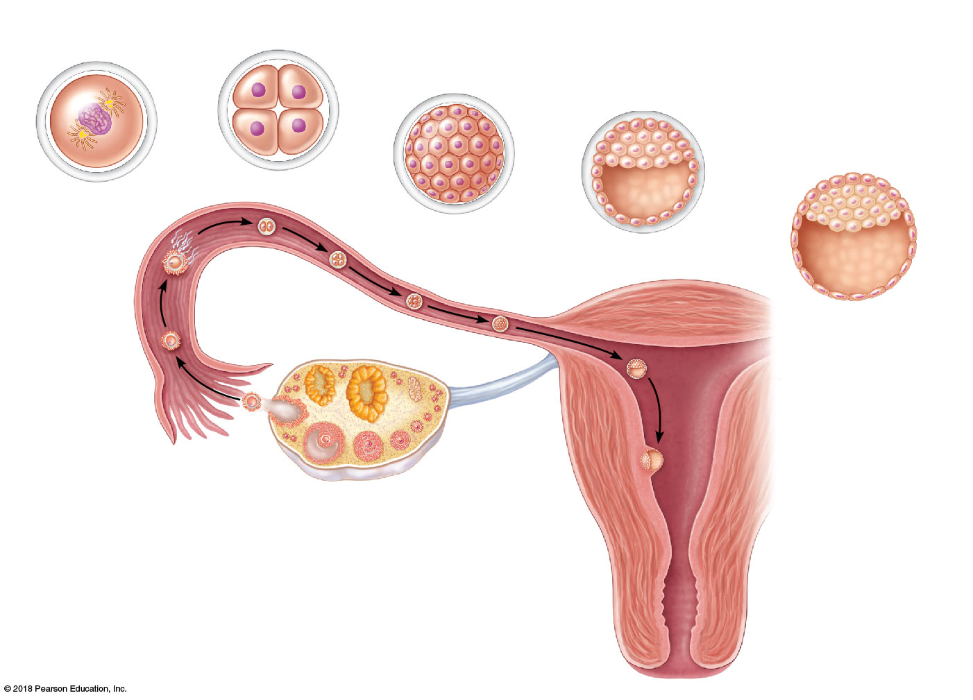
(a) Zygote (fertilized egg)
(b) 4-cell stage 2 days
(c) Morula (a solid ball of blastomeres) 3 days
(d) Early blastocyst (morula hollows out and fills with fluid) 4 days
(e) Implanting blastocyst (consists of a sphere of trophoblast cells and an eccentric cell cluster called the inner cell mass) 7 days
Zona
pellucida
Inner
cell
mass
Blastocyst
cavity
Fertilization
(sperm
meets and
enters egg)
Sperm
Uterine tube
Blastocyst
cavity
Ovary
Oocyte
(egg)
Trophoblast
Uterus
Ovulation
Endometrium
Cavity of
uterus

Slide 22
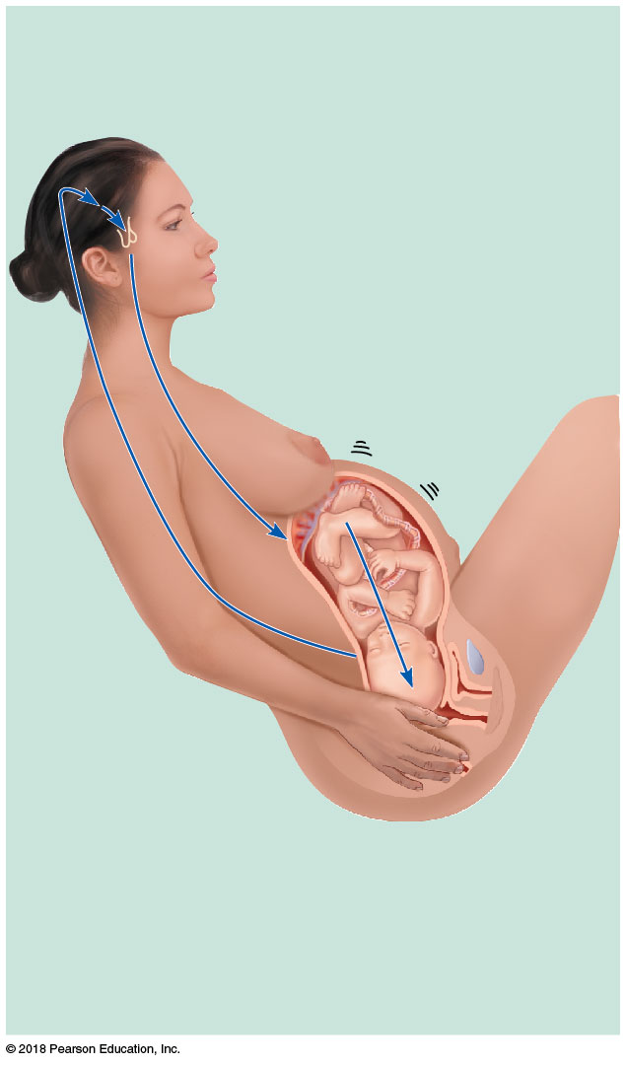
Hypothalamus sends efferent
impulses to posterior pituitary,
where oxytocin is stored
4
Posterior pituitary releases
oxytocin to blood; oxytocin
targets mother’s uterine
muscle
5
Uterus responds
by contracting more
vigorously
6
Baby moves
deeper into
mother’s birth
canal
1
Afferent
impulses to
hypothalamus
3
Pressoreceptors
in cervix of uterus
excited
2
Positive feedback
mechanism continues
to cycle until interrupted
by birth of baby

