Slide 1
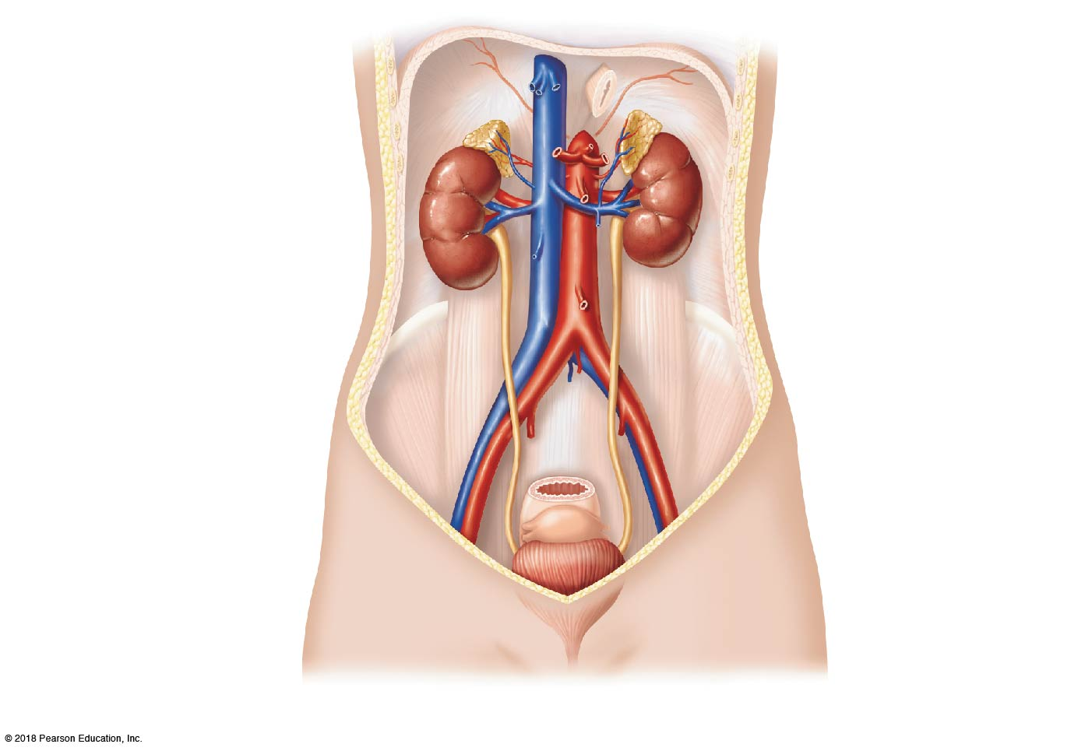
Hepatic veins (cut)
Inferior vena cava
Adrenal gland
Renal artery
Renal hilum
Aorta
Renal vein
Kidney
Iliac crest
Ureter
Rectum (cut)
Uterus (part
of female reproductive system)
Urinary bladder
Urethra
(a)

Slide 2
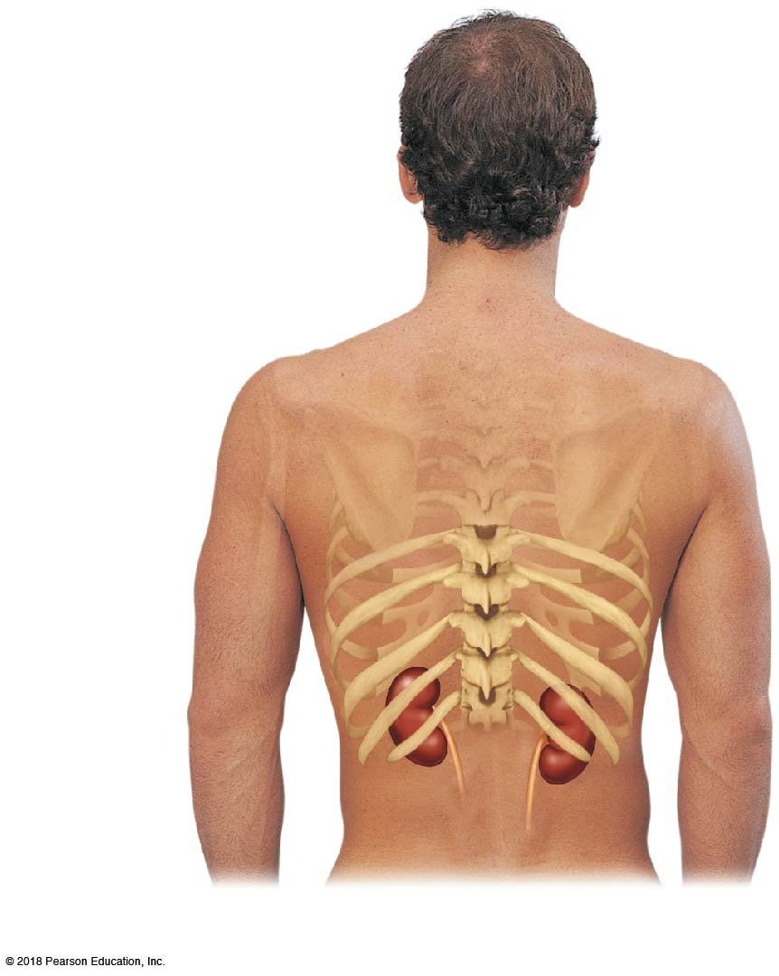
12th rib
(b)

Slide 3
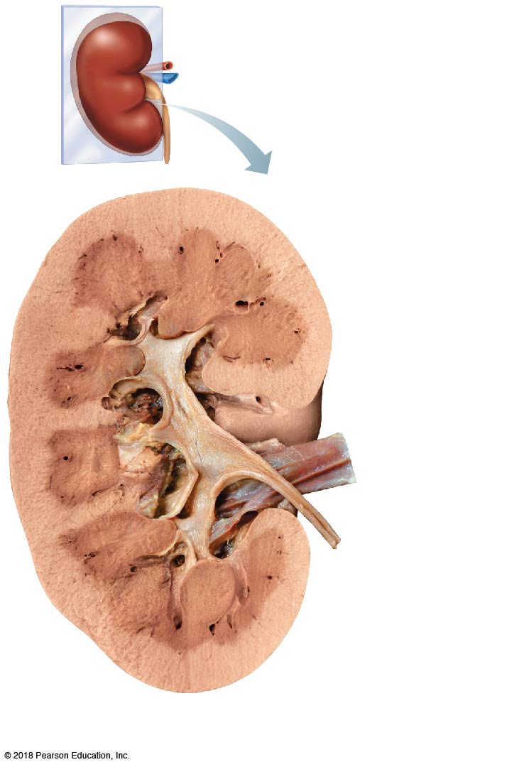
Renal cortex
Renal column
Major calyx
Minor calyx
Renal
pyramid
(a)

Slide 4
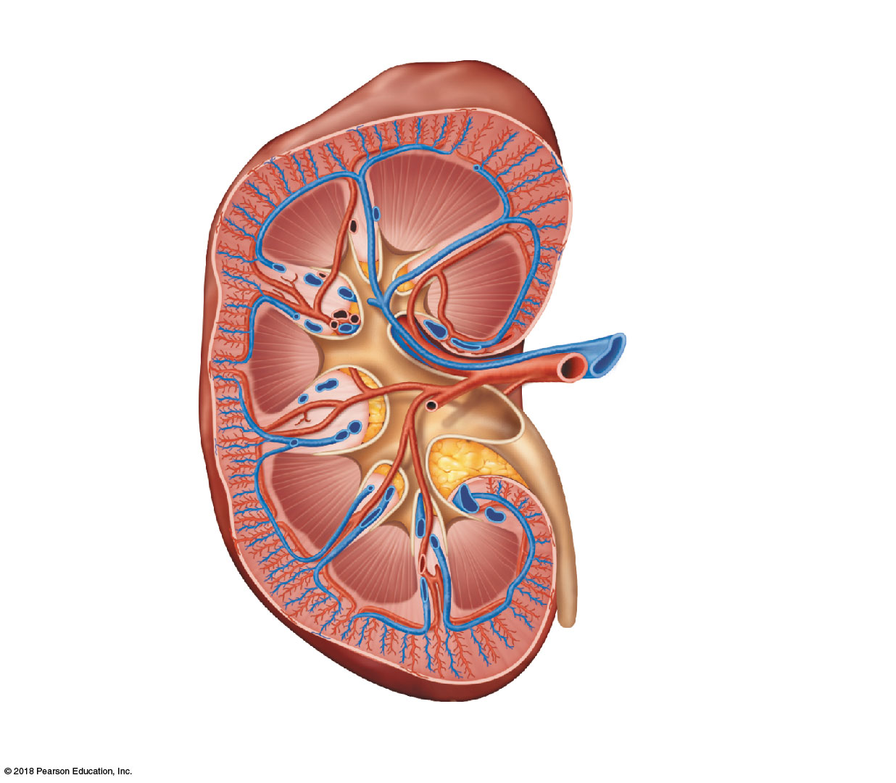
Cortical radiate vein
Cortical radiate artery
Renal cortex
Arcuate vein
Arcuate artery
Renal column
Interlobar vein
Interlobar artery
Segmental
arteries
Renal vein
Renal artery
Minor calyx
Renal pelvis
Major calyx
Renal
pyramid
Ureter
Fibrous capsule
(b)

Slide 5
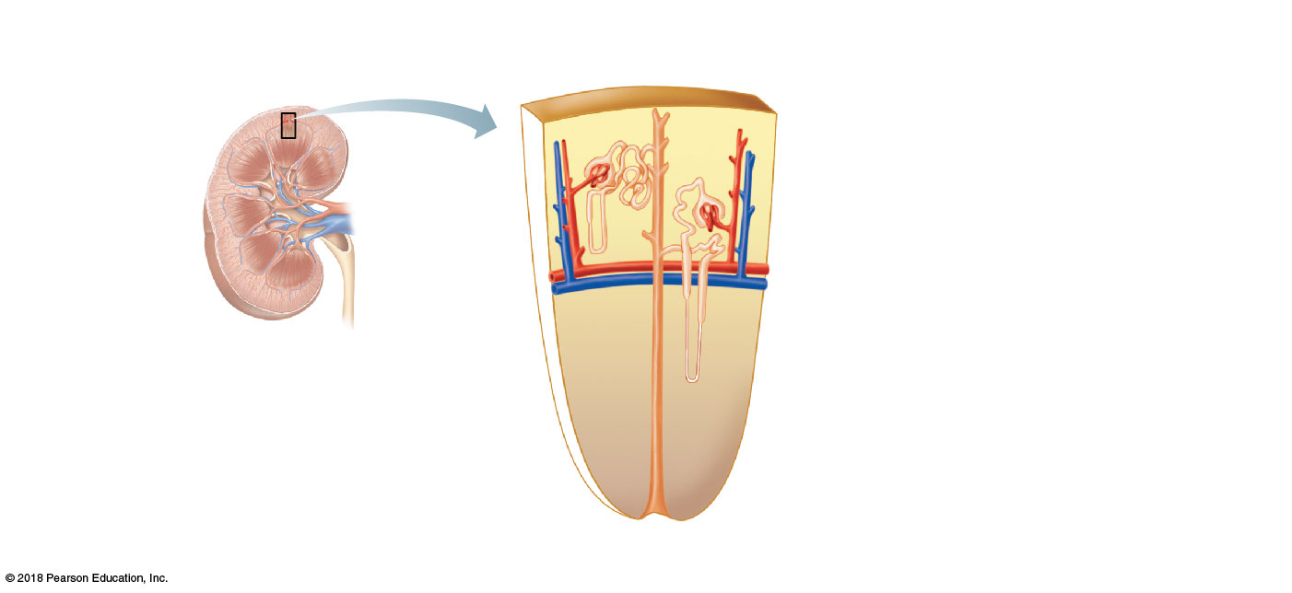
Cortical
nephron
Fibrous capsule
Renal cortex
Collecting duct
Renal medulla
Renal
cortex
Proximal
convoluted tubule
Renal pelvis
Glomerulus
Ureter
Distal
convoluted tubule
Juxtamedullary nephron
Nephron loop
Renal
medulla
(a)

Slide 6
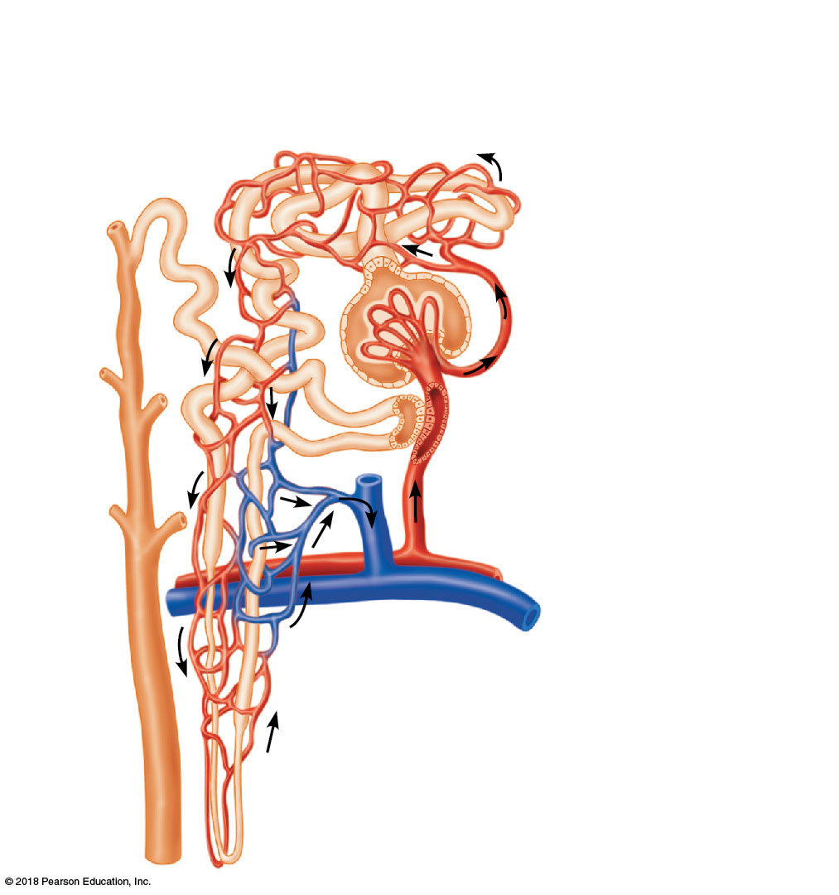
Proximal convoluted
tubule (PCT)
Peritubular
capillaries
Glomerular
capillaries
Distal convoluted tubule
(DCT)
Glomerular
(Bowman’s) capsule
Efferent arteriole
Afferent arteriole
Cells of the
juxtaglomerular
apparatus
Cortical radiate artery
Arcuate artery
Arcuate
vein
Cortical radiate
vein
Collecting duct
(b)
Nephron loop

Slide 7
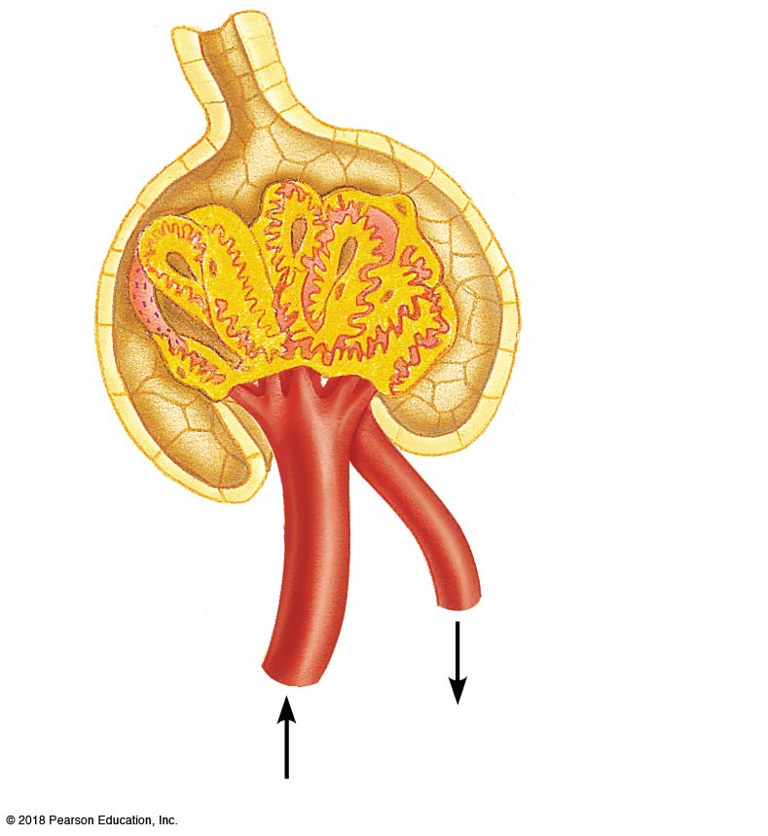
PCT
Glomerular
capsular
space
Glomerular capillary covered by podocytes
Efferent
arteriole
Afferent
arteriole
(c)

Slide 8
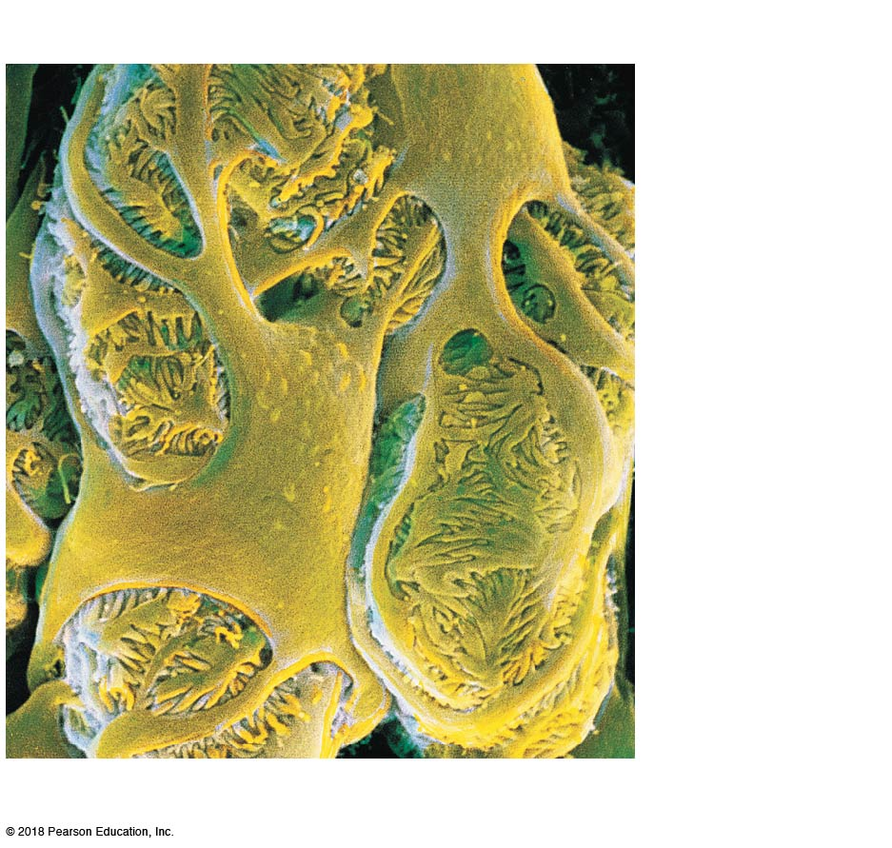
Filtration slits
Podocyte
cell body
Foot
processes
(d)

Slide 9
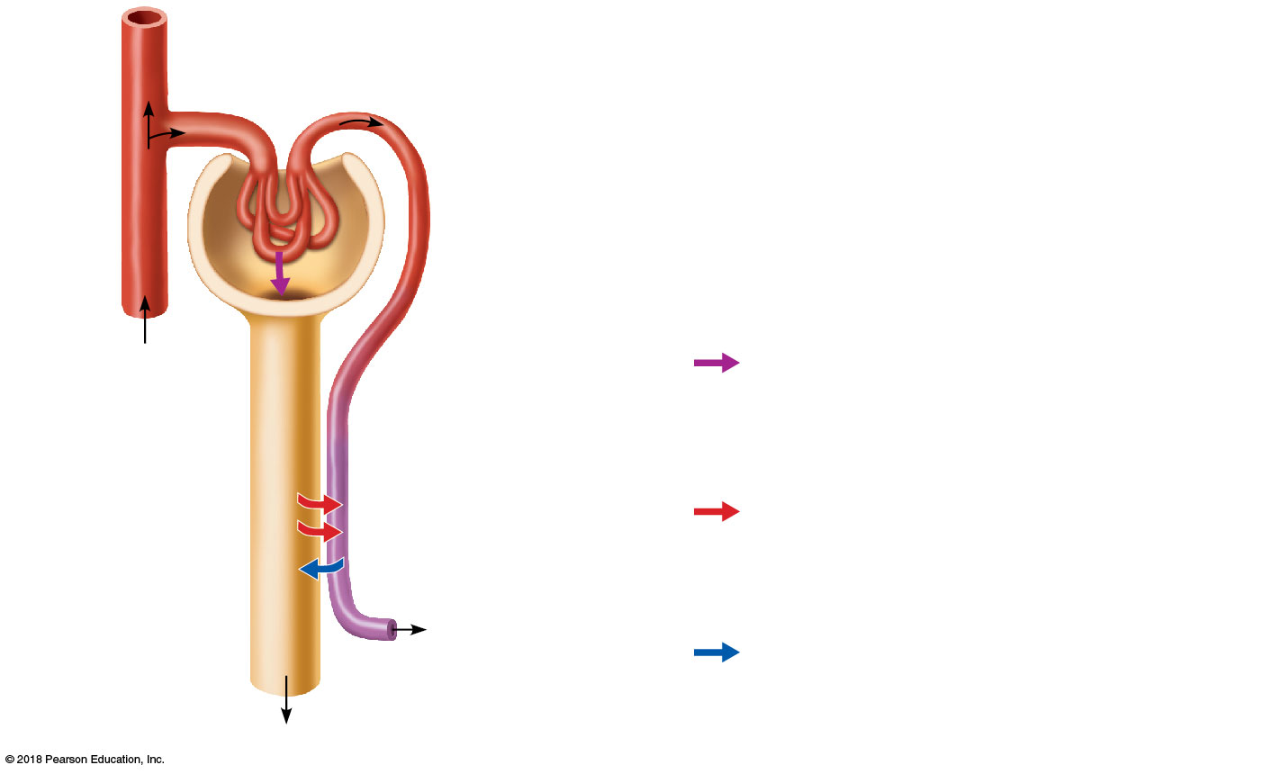
Afferent arteriole
Glomerular capillaries
Efferent arteriole
Cortical radiate artery
1
Glomerular capsule
Three major renal processes:
Rest of renal tubule containing ﬁltrate
1
Glomerular ﬁltration: Water and solutes smaller than proteins are forced through the capillary walls and pores of the glomerular capsule into the renal tubule.
1
Peritubular capillary
2
2
Tubular reabsorption: Water, glucose, amino acids, and needed ions are transported out of the ﬁltrate into the tubule cells and then enter the capillary blood.
3
To cortical radiate vein
3
Tubular secretion: H¹, K¹, creatinine, and drugs are removed from the peritubular blood and secreted by the tubule cells into the ﬁltrate.
Urine

Slide 10
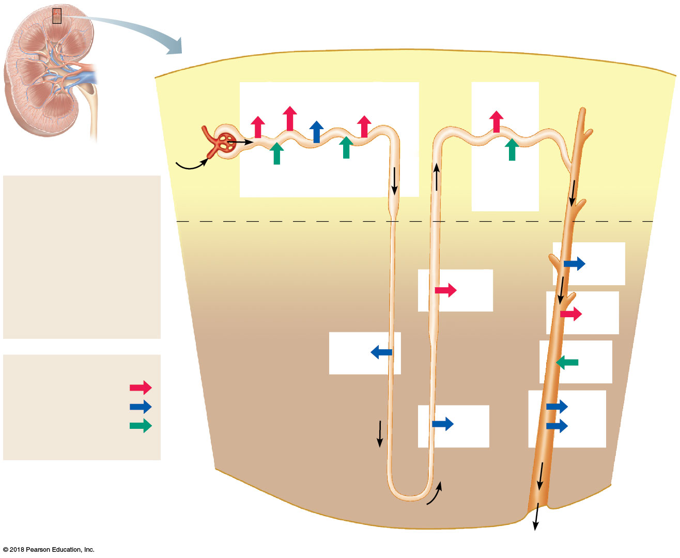
Proximal tubule
Distal tubule
Glomerular capsule
HCO₃⁻
Glucose and amino acids
NaCl
H₂O
NaCl
Blood
Some drugs and poisons
H⁺
K⁺ and some drugs
Filtrate
Collecting duct
H₂O
Salts (NaCl, etc.)
HCO₃⁻ (bicarbonate)
H⁺
Urea
Glucose; amino acids Some drugs
Cortex
Medulla
H₂O
Nephron loop
NaCl
NaCl
H₂O
Reabsorption
Active transport
K⁺
Passive transport
Urea
Secretion
(active transport)
NaCl
H₂O
Urine
(to renal pelvis)

Slide 11
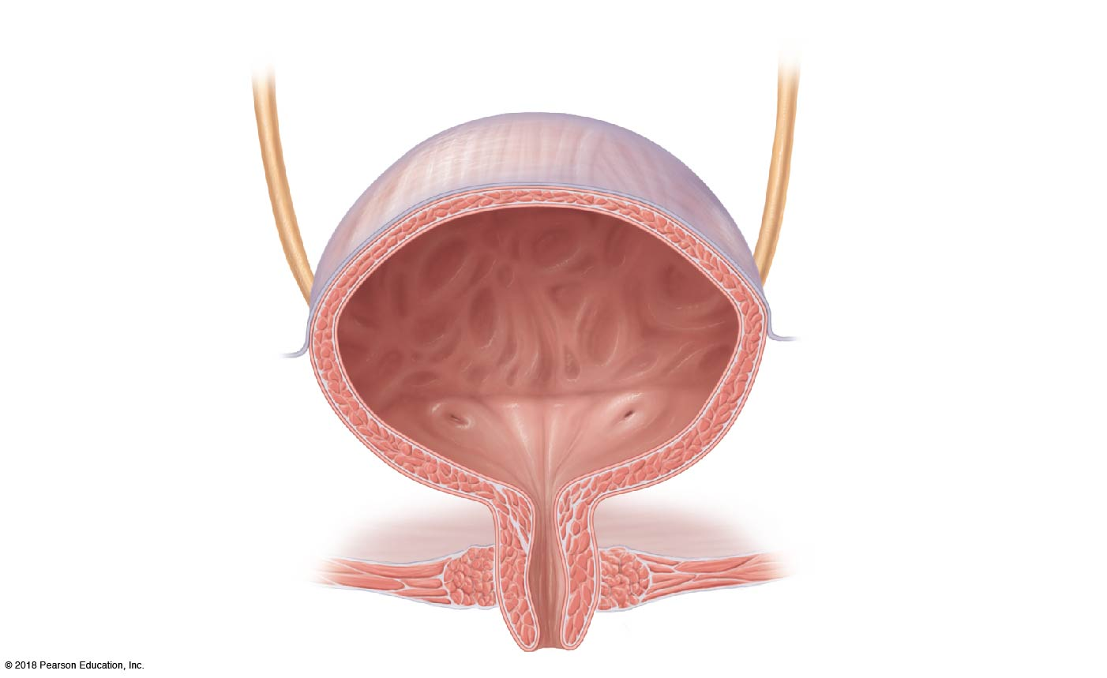
Urinary bladder
Ureter
Ureteral orifice
Internal urethral orifice
Trigone
External urethral sphincter
Internal urethral sphincter
Urogenital diaphragm
Urethra

Slide 12
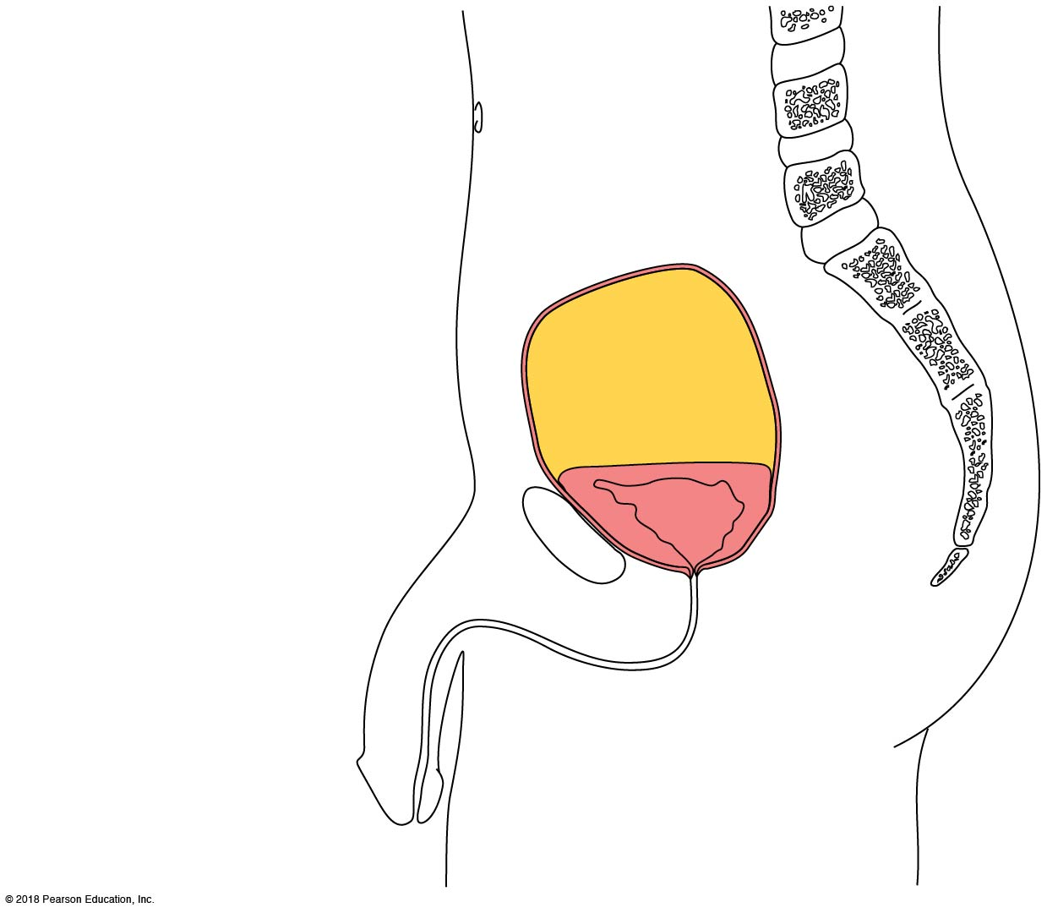
Umbilicus
Superior wall
of distended bladder
Superior wall
of empty bladder
Pubic symphysis

Slide 13
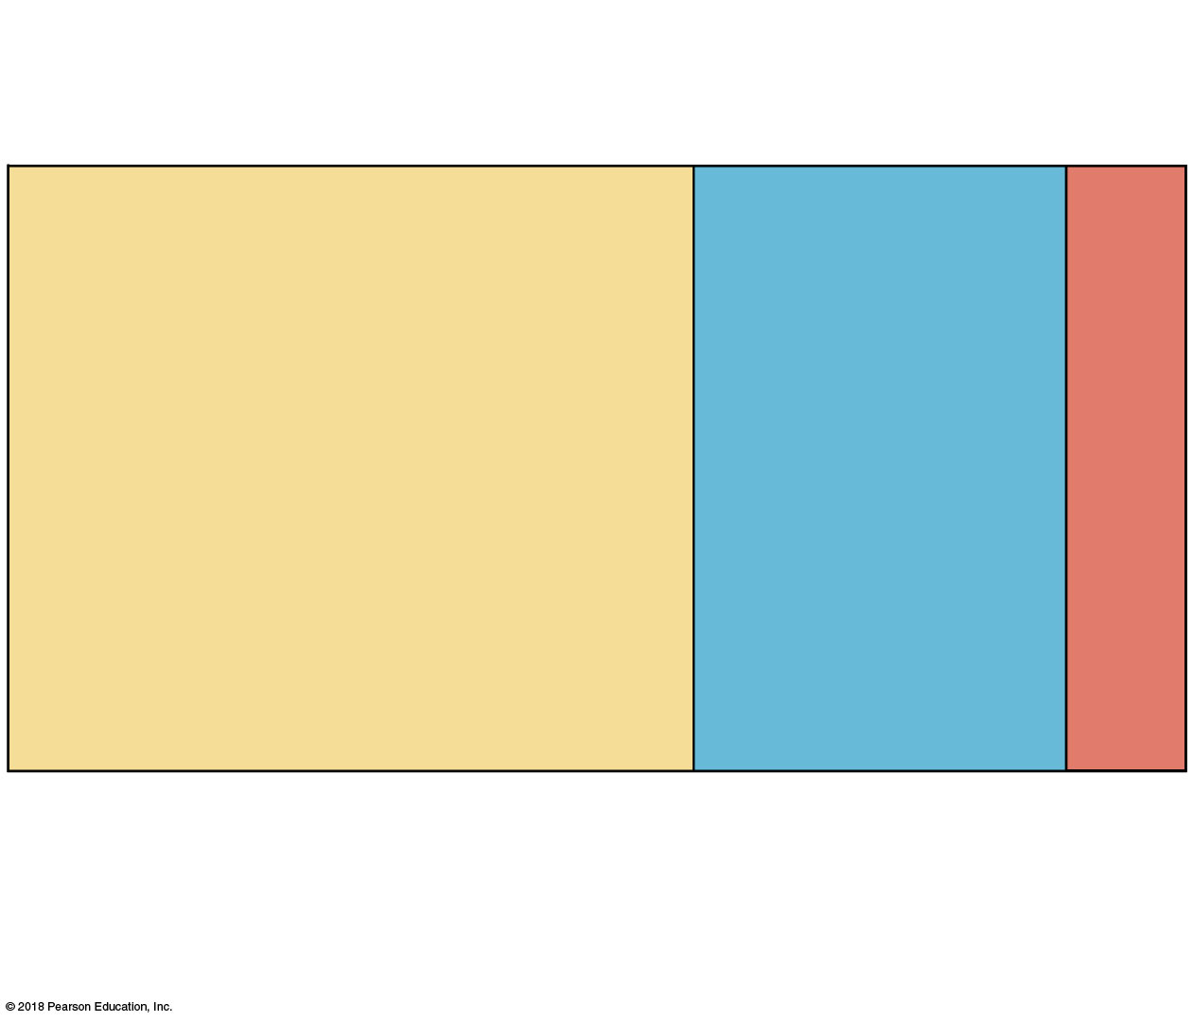
Total body water
Volume = 40 L 60% body weight
Plasma
Interstitial ﬂuid (IF)
Intracellular ﬂuid (ICF)
Volume = 25 L 40% body weight
Volume = 3 L, 20% of ECF
Volume = 12 L 80% of ECF
Extracellular ﬂuid (ECF)
Volume = 15 L 20% body weight

Slide 14
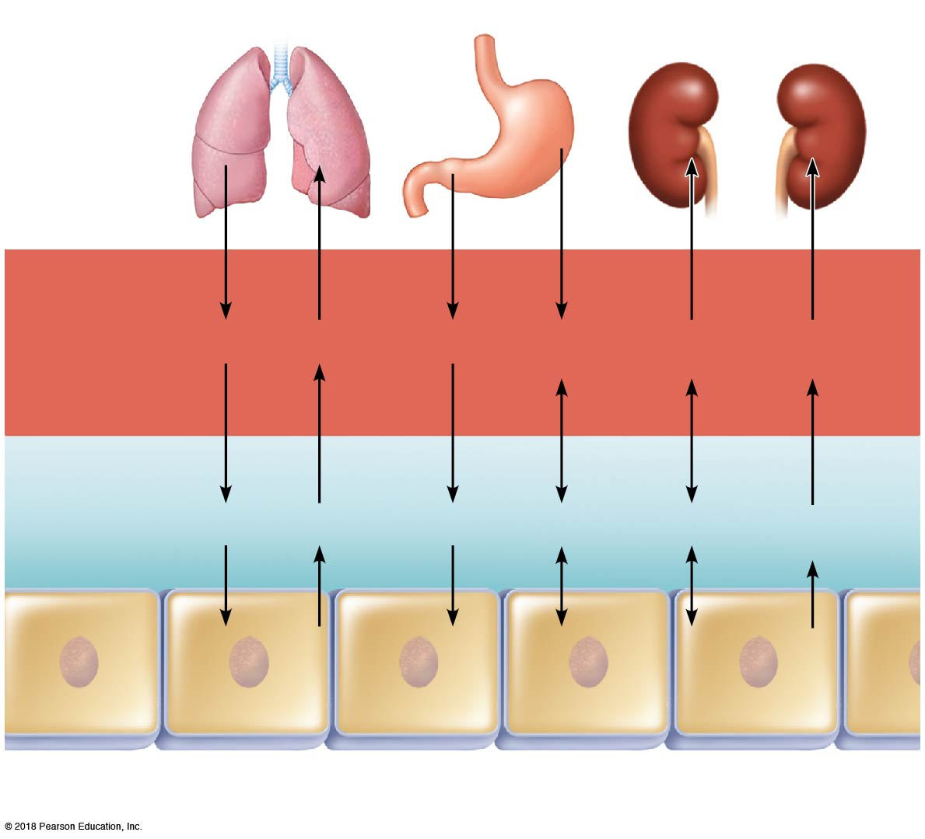
Lungs
Gastrointestinal tract
Kidneys
Blood plasma
O₂
CO₂
Nutrients
H₂O, Ions
H₂O, Ions
Nitrogenous wastes
Interstitial fluid
O₂
CO₂
Nutrients
H₂O
Ions
Nitrogenous wastes
Intracellular
fluid in tissue cells

Slide 15
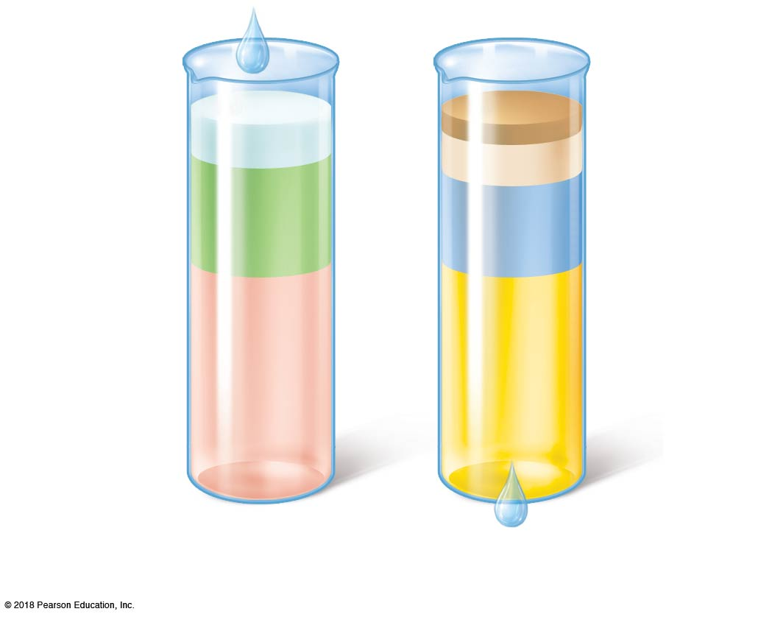
Metabolism 10%
100 ml
Feces 4%
250 ml
Sweat 8%
200 ml
Insensible losses via
skin and lungs 28%
Foods 30%
750 ml
700 ml
2500 ml
Beverages 60%
1500 ml
1500 ml
Urine 60%
Average intake per day
Average output per day

