Slide 1
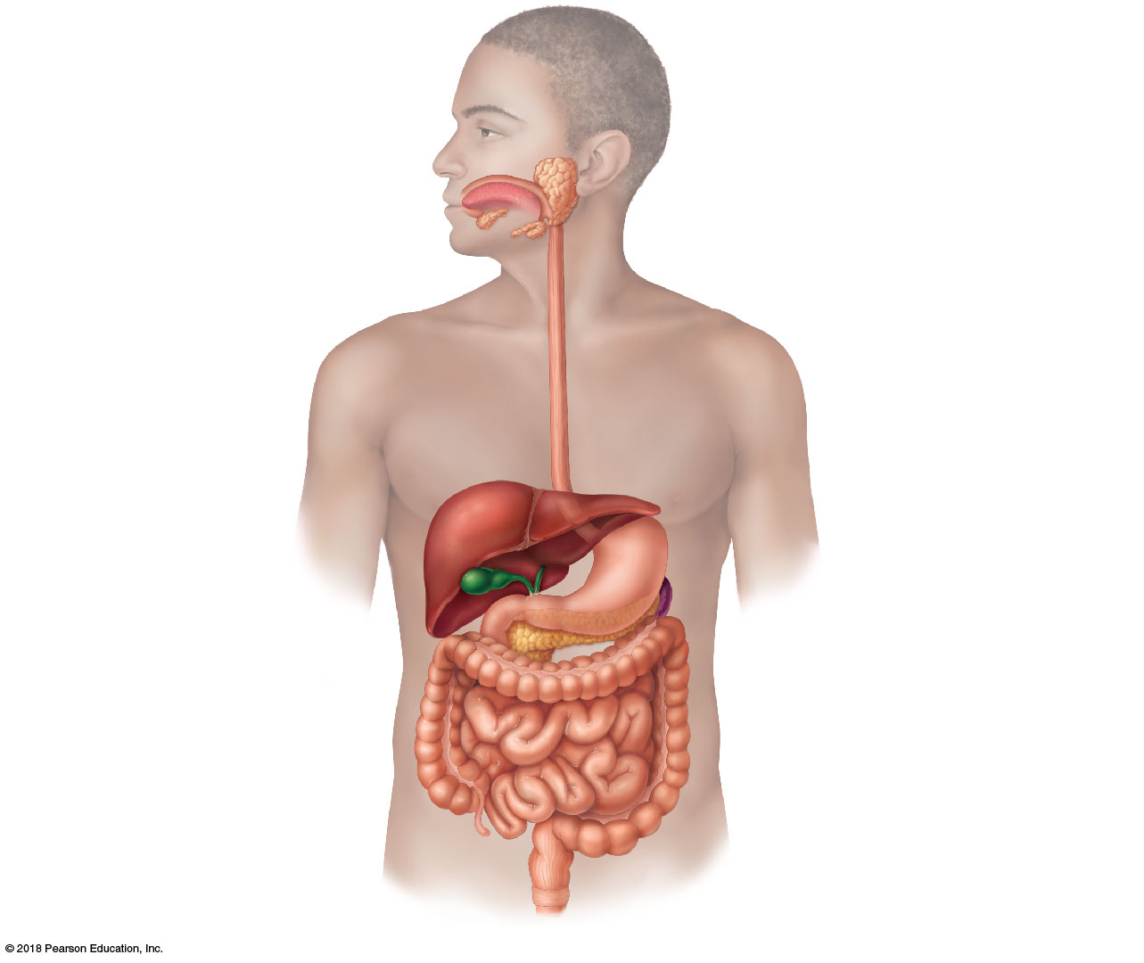
Mouth (oral cavity)
Parotid gland
Tongue
Sublingual gland
Salivary
glands
Submandibular
gland
Esophagus
Pharynx
Stomach
Pancreas
Liver
(Spleen)
Gallbladder
Transverse colon
Duodenum
Descending colon
Small
intestine
Jejunum
Ascending colon
Ileum
Cecum
Large
intestine
Sigmoid colon
Rectum
Appendix
Anus
Anal canal

Slide 2
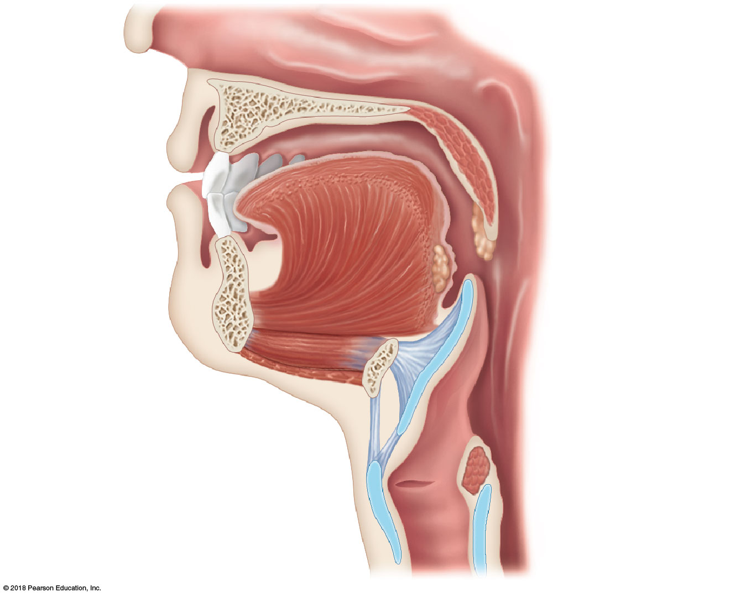
Nasopharynx
Hard
palate
Soft palate
Oral
cavity
Uvula
Lips (labia)
Palatine tonsil
Vestibule
Lingual tonsil
Oropharynx
Lingual
frenulum
Epiglottis
Tongue
Laryngopharynx
Hyoid bone
Esophagus
Trachea
(a)

Slide 3
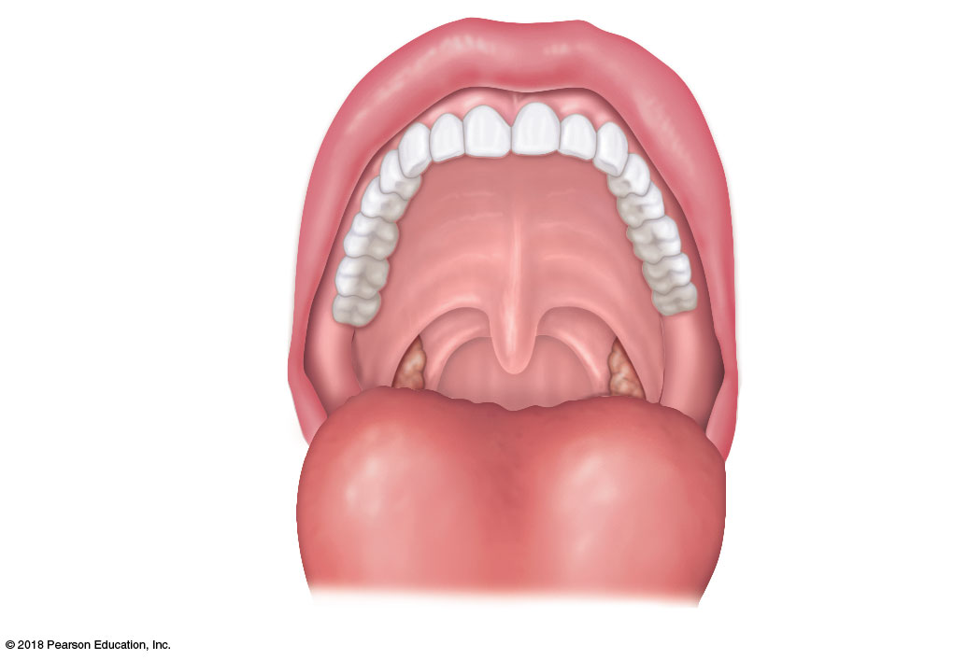
Upper lip
Gingivae
(gums)
Hard palate
Soft palate
Uvula
Palatine tonsil
Oropharynx
Tongue
(b)

Slide 4
Nasopharynx
Hard
palate
Soft palate
Oral
cavity
Uvula
Lips (labia)
Palatine tonsil
Vestibule
Lingual tonsil
Oropharynx
Lingual
frenulum
Epiglottis
Tongue
Laryngopharynx
Hyoid bone
Esophagus
Trachea
(a)

Slide 5
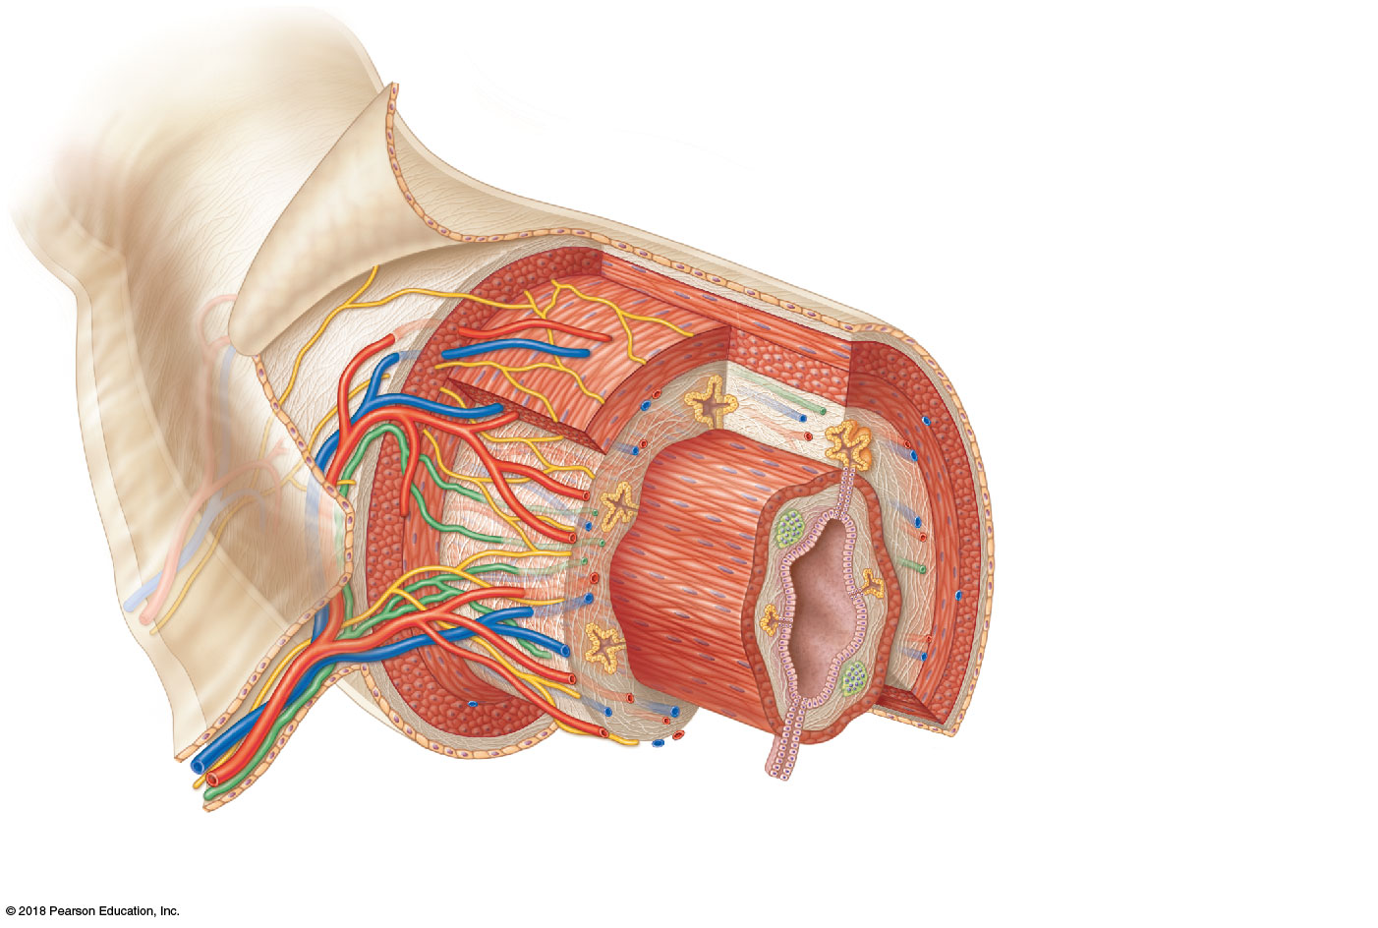
Visceral peritoneum
Intrinsic nerve plexuses
• Myenteric nerve plexus
• Submucosal nerve plexus
Submucosal glands
Mucosa
• Surface epithelium
• Lamina propria
• Muscle layer
Submucosa
Muscularis externa
• Longitudinal muscle layer
• Circular muscle layer
Serosa
(visceral peritoneum)
Nerve
Gland in
mucosa
Lumen
Artery
Mesentery
Vein
Duct of gland
outside alimentary
canal
Lymphoid tissue

Slide 6
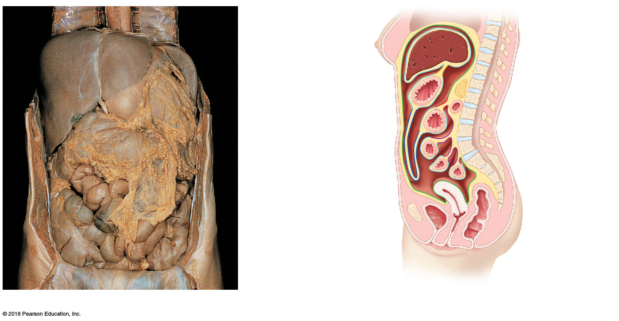
Diaphragm
Falciform ligament
Lesser
omentum
Liver
Spleen
Pancreas
Gallbladder
Stomach
Duodenum
Visceral peritoneum
Transverse
colon
Greater omentum
Mesenteries
Parietal peritoneum
Small intestine
Peritoneal
cavity
Uterus
Large intestine
Cecum
Rectum
Urinary bladder
Anus
(a)
(b)

Slide 7
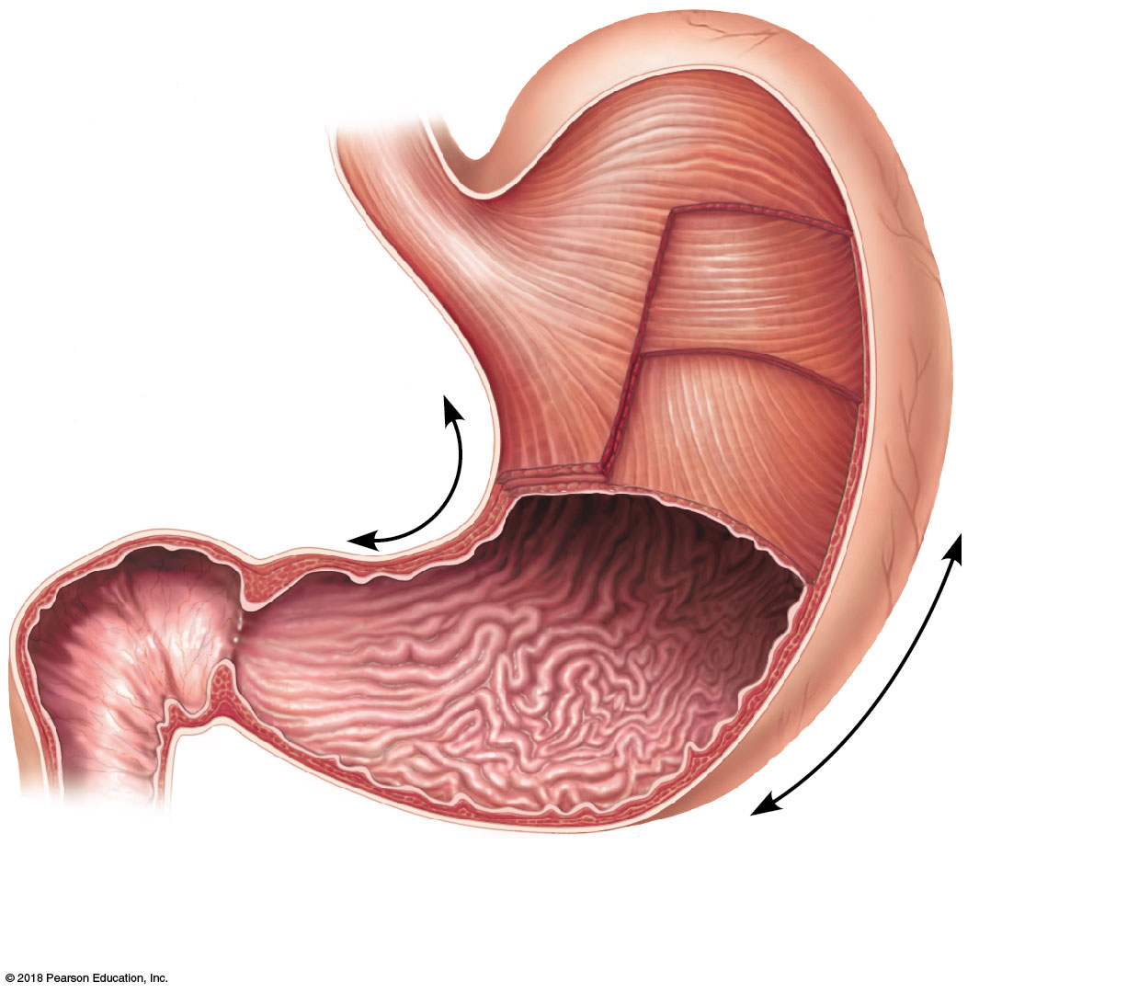
Cardia
Fundus
Esophagus
Muscularis
externa
Serosa
• Longitudinal layer
• Circular layer
• Oblique layer
Body
Lesser
curvature
Rugae
of
mucosa
Pylorus
Greater
curvature
Duodenum
Pyloric
sphincter
(valve)
Pyloric
antrum
(a)

Slide 8
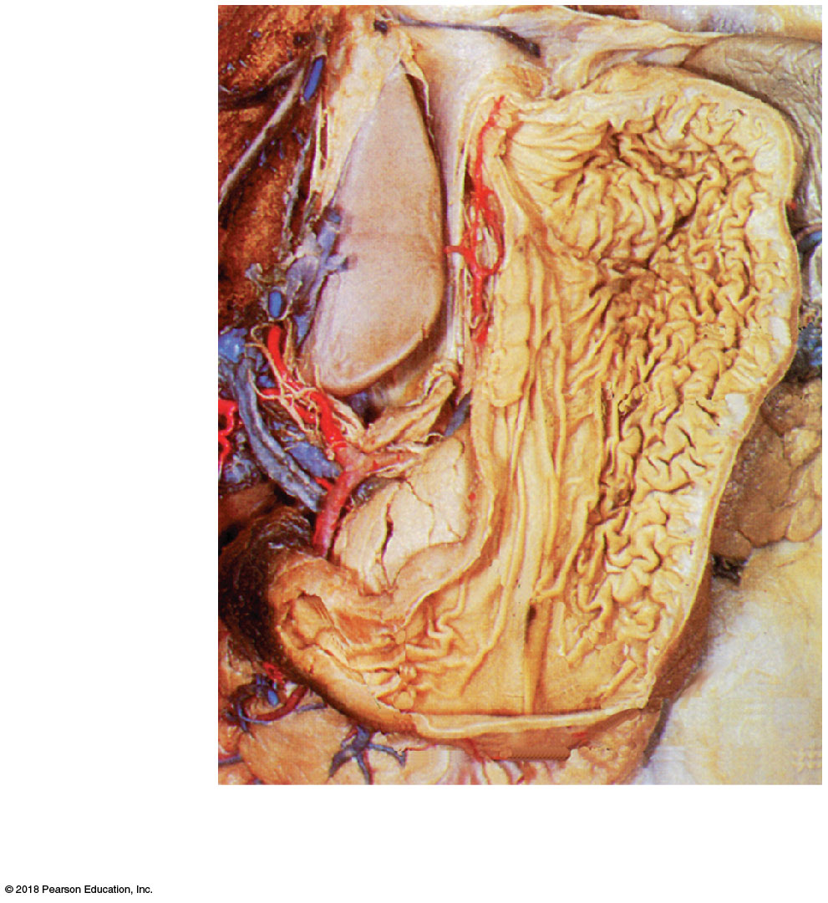
Fundus
Body
Rugae of
mucosa
Pyloric
sphincter
Pyloric
antrum
(b)

Slide 9
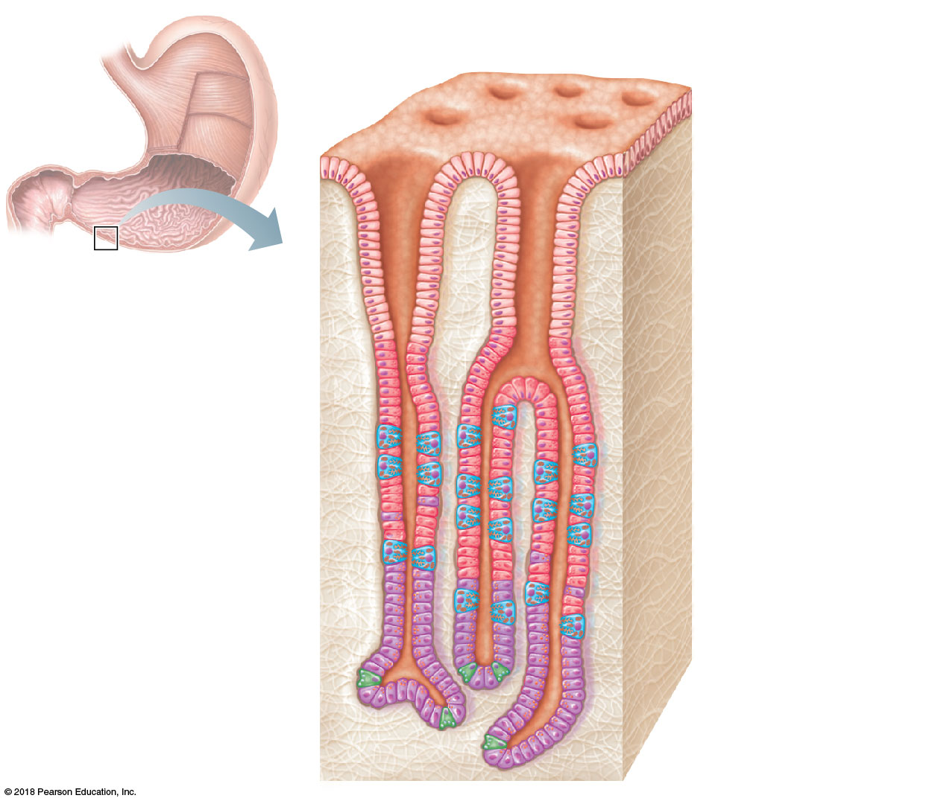
Gastric pits
Surface
epithelium
Gastric pit
Pyloric
sphincter
Mucous
neck cells
Gastric gland
Parietal cells
Gastric
glands
Chief cells
(c)

Slide 10
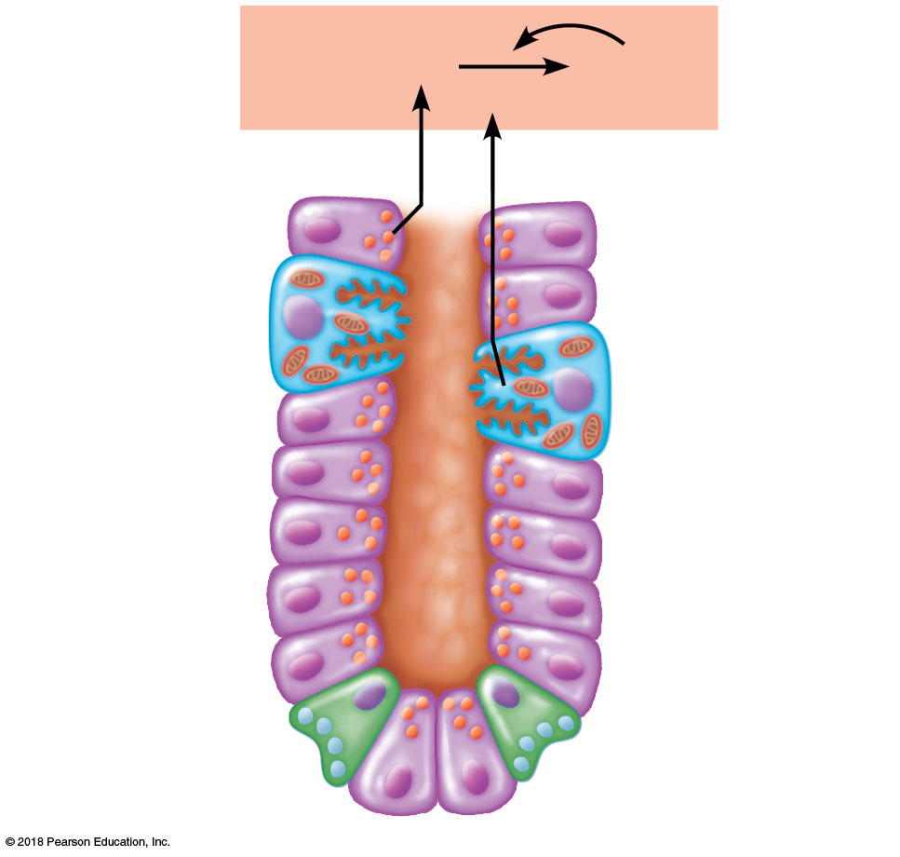
Pepsinogen
Pepsin
HCl
Parietal cells
Chief cells
Enteroendocrine
cell
(d)

Slide 11
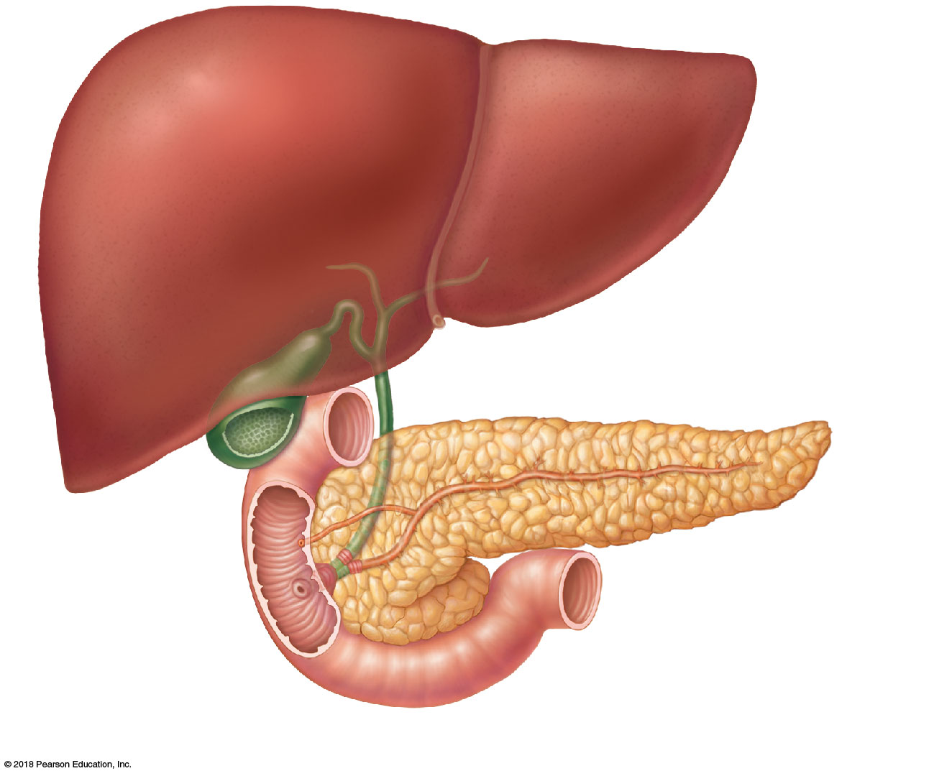
Right and left
hepatic ducts
from liver
Cystic duct
Common hepatic duct
Bile duct and sphincter
Accessory pancreatic duct
Pancreas
Gallbladder
Jejunum
Duodenal
papilla
Main pancreatic duct and sphincter
Hepatopancreatic
ampulla and sphincter
Duodenum

Slide 12
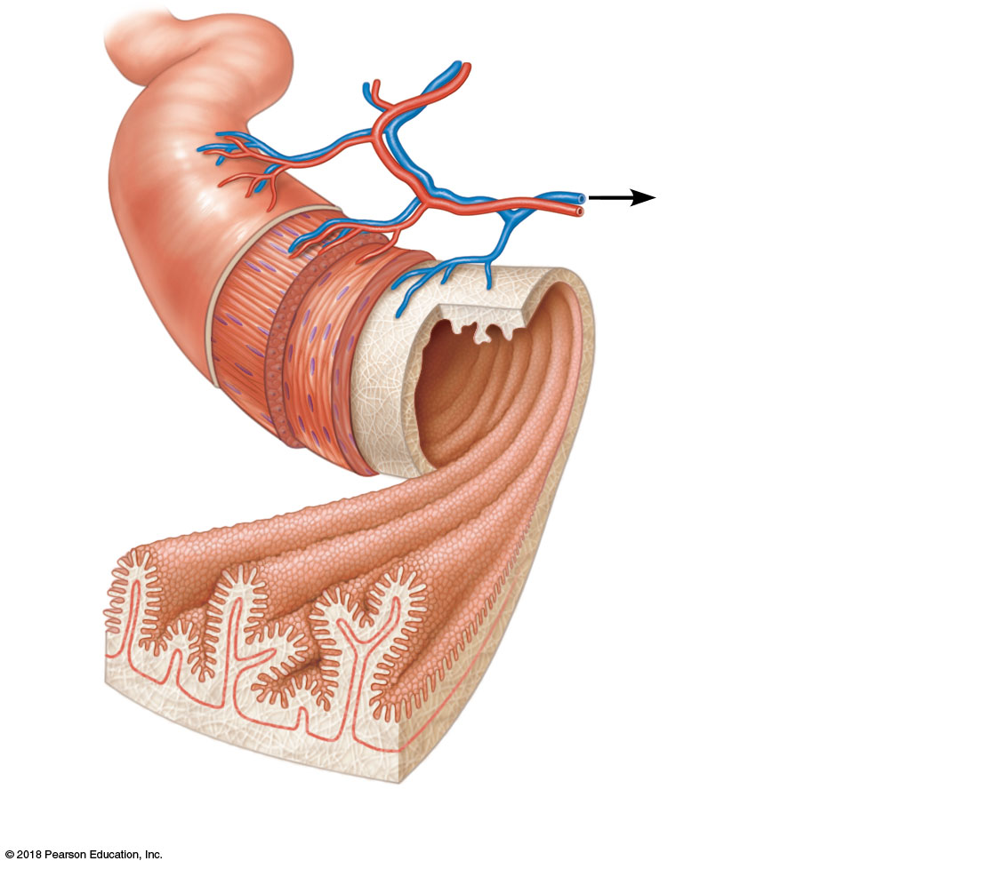
Blood vessels
serving the small
intestine
Lumen
Muscle
layers
Circular folds
(plicae circulares)
Villi
(a) Small intestine

Slide 13
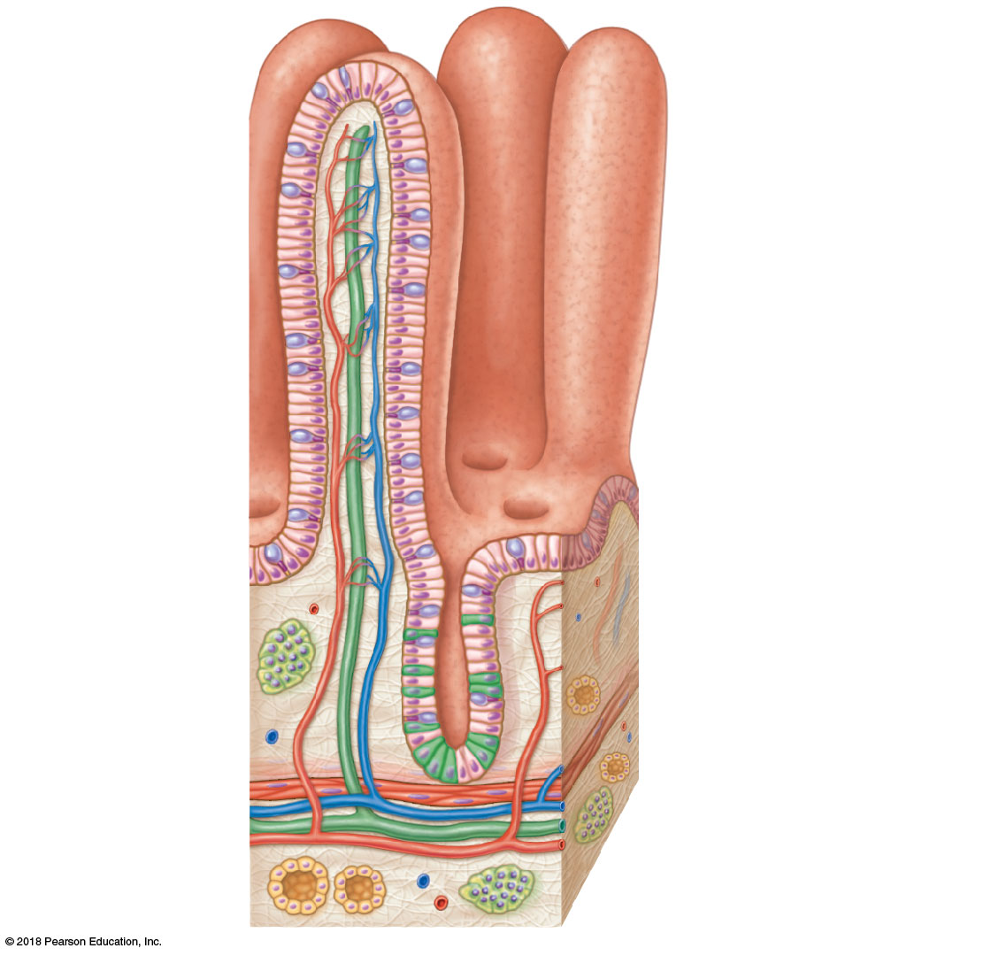
Absorptive
cells
Lacteal
Villus
Blood
capillaries
Lymphoid
tissue
Intestinal
crypt
Muscularis
mucosae
Venule
Lymphatic vessel
(b) Villi
Submucosa

Slide 14
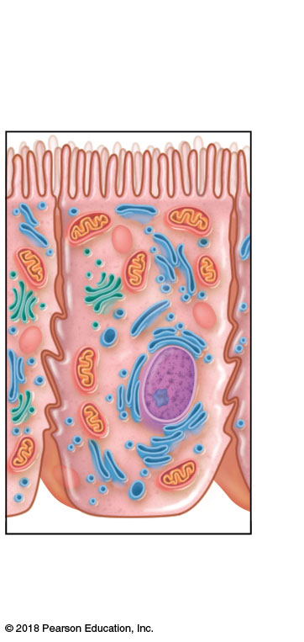
Microvilli
(brush border)
(c) Absorptive cells

Slide 15
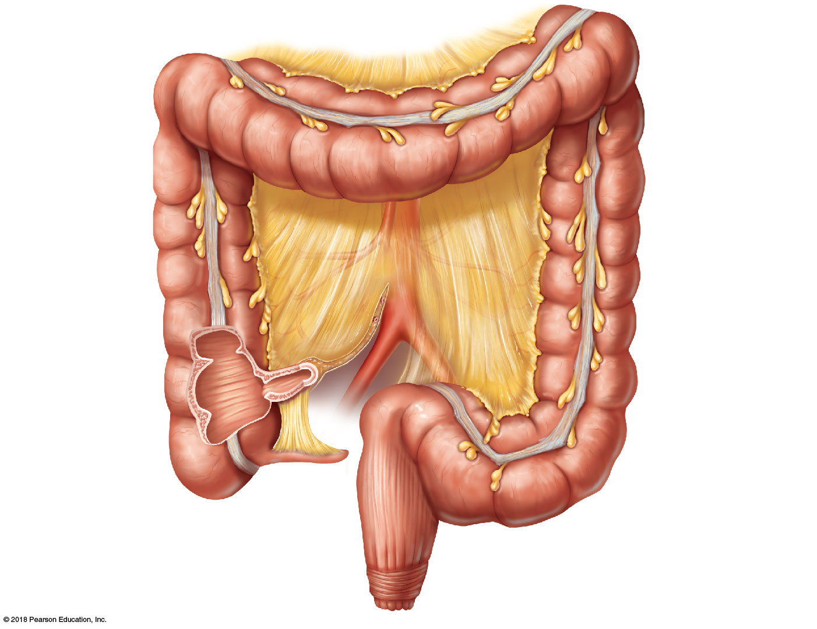
Left colic
(splenic) flexure
Transverse
mesocolon
Right colic
(hepatic) flexure
Transverse colon
Haustrum
Descending colon
Ascending colon
IIeum (cut)
Cut edge of
mesentery
IIeocecal valve
Teniae coli
Cecum
Sigmoid colon
Appendix
Rectum
Anal canal
External anal sphincter

Slide 16
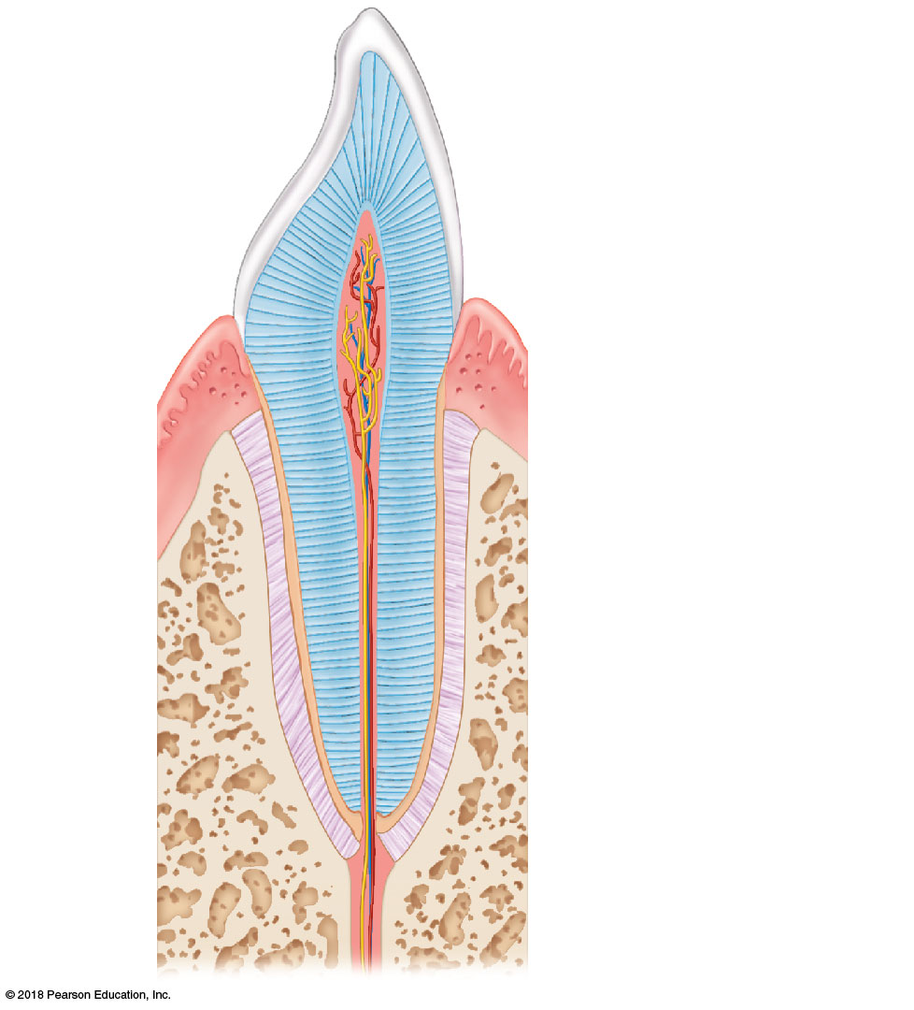
Enamel
Dentin
Crown
Pulp cavity
(contains blood
vessels and nerves)
Neck
Gum
(gingiva)
Cement
Root canal
Root
Periodontal
membrane
(ligament)
Bone

Slide 17
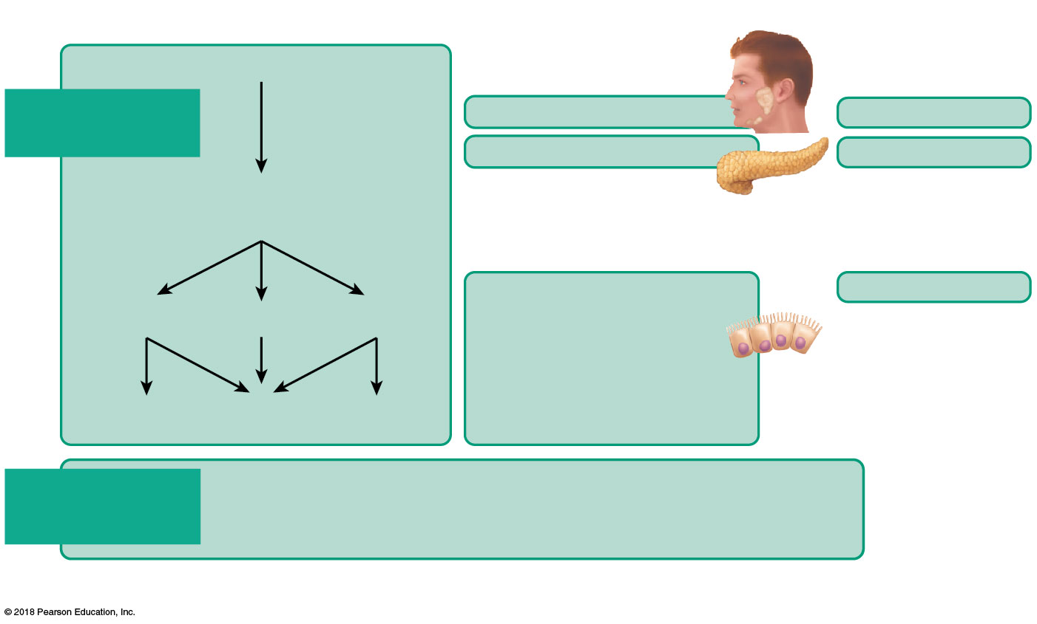
Foodstuff
Enzyme(s) and source
Site of action
Starch and disaccharides
Digestion of
carbohydrates
Salivary amylase
Mouth
Pancreatic amylase
Small intestine
Oligosaccharides*
and disaccharides
Brush border enzymes
in small intestine
(dextrinase,
glucoamylase,
lactase, maltase,
and sucrase)
Small intestine
Lactose
Maltose
Sucrose
Galactose
Glucose
Fructose
Absorption of carbohydrates
The monosaccharides glucose, galactose, and fructose
enter the capillary blood in the villi and are transported to
the liver via the hepatic portal vein.
*Oligosaccharides consist of a few linked monosaccharides.

Slide 18
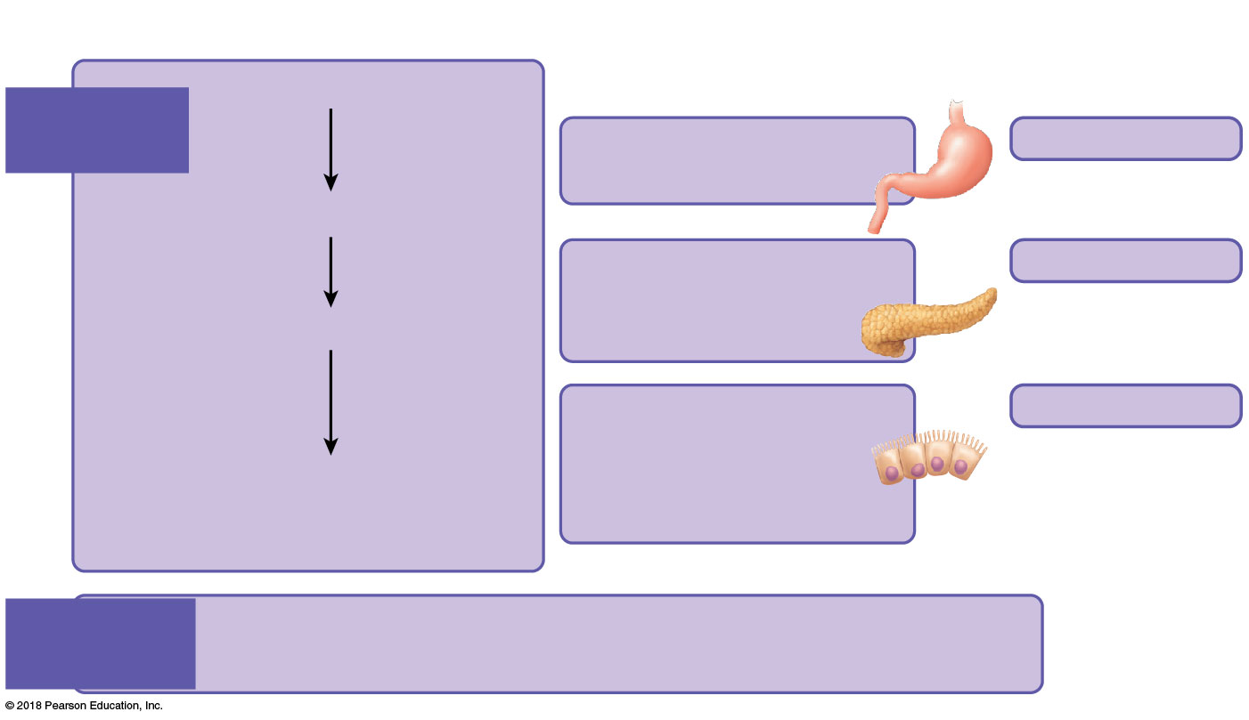
Foodstuff
Enzyme(s) and source
Site of action
Protein
Digestion
of proteins
Pepsin (stomach glands)
in the presence of HCl
Stomach
Large polypeptides
Pancreatic enzymes
(trypsin, chymotrypsin,
carboxypeptidase)
Small intestine
Small polypeptides
Brush border enzymes
(aminopeptidase,
carboxypeptidase,
and dipeptidase)
Small intestine
Amino acids
(some dipeptides
and tripeptides)
Absorption
of proteins
Amino acids enter the capillary blood in the villi and are
transported to the liver via the hepatic portal vein.

Slide 19
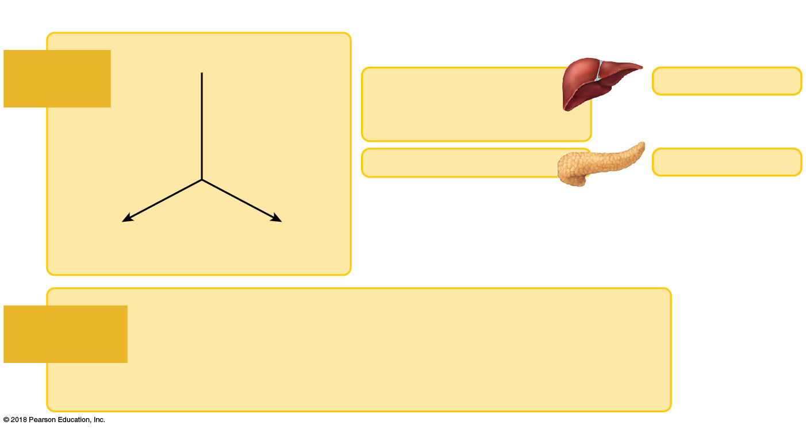
Foodstuff
Enzyme(s) and source
Site of action
Unemulsified fats
Digestion
of fats
Small intestine
Emulsified by the
detergent action
of bile salts from the liver
Pancreatic lipase
Small intestine
Monoglycerides
and fatty acids
Glycerol and
fatty acids
Fatty acids and monoglycerides enter the lacteals of the villi
and are transported to the systemic circulation via the lymph
in the thoracic duct. (Glycerol and short-chain fatty acids are
absorbed into the capillary blood in the villi and transported
to the liver via the hepatic portal vein.)
Absorption
of fats

Slide 20
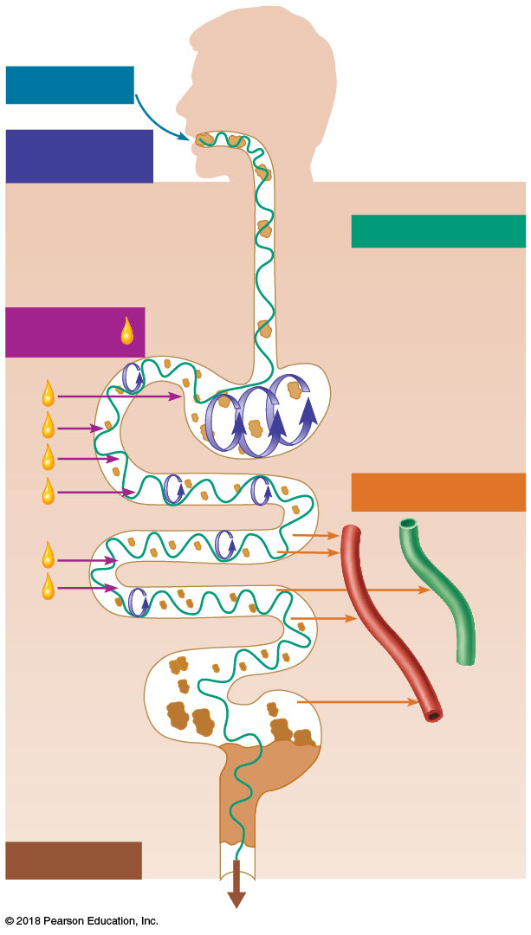
Ingestion
Food
Mechanical
breakdown
Pharynx
• Chewing (mouth)
Esophagus
• Churning (stomach)
Propulsion
• Segmentation (small intestine)
• Swallowing (oropharynx)
Digestion
• Peristalsis (esophagus, stomach, small intestine, large intestine)
Stomach
Absorption
Lymph
vessel
Small
intestine
Large
intestine
Blood
vessel
Mainly H₂O
Feces
Defecation
Anus

Slide 21
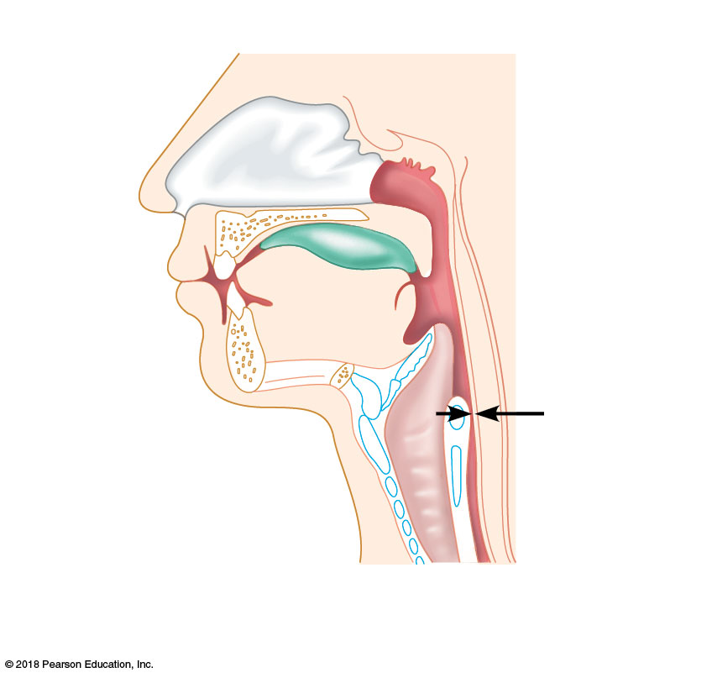
Bolus of food
Tongue
Pharynx
Epiglottis
up
Upper
esophageal
sphincter
Glottis (lumen)
of larynx
Trachea
Esophagus
1
Upper esophageal
sphincter contracted

Slide 22
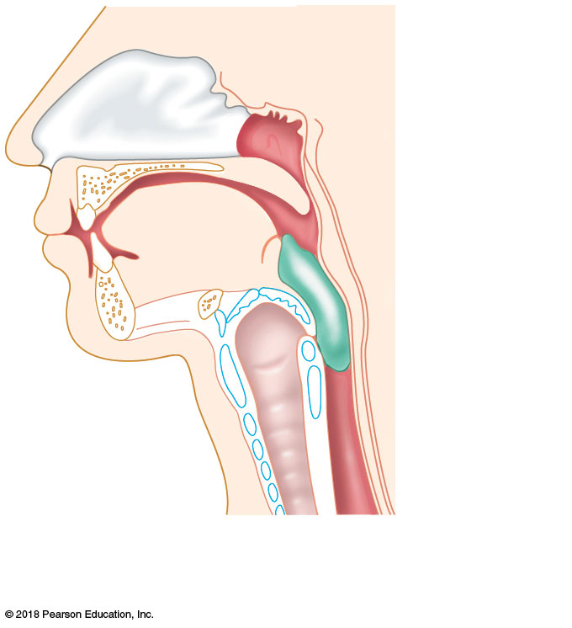
Uvula
Bolus
Epiglottis
down
Larynx up
Esophagus
2
Upper esophageal
sphincter relaxed

Slide 23
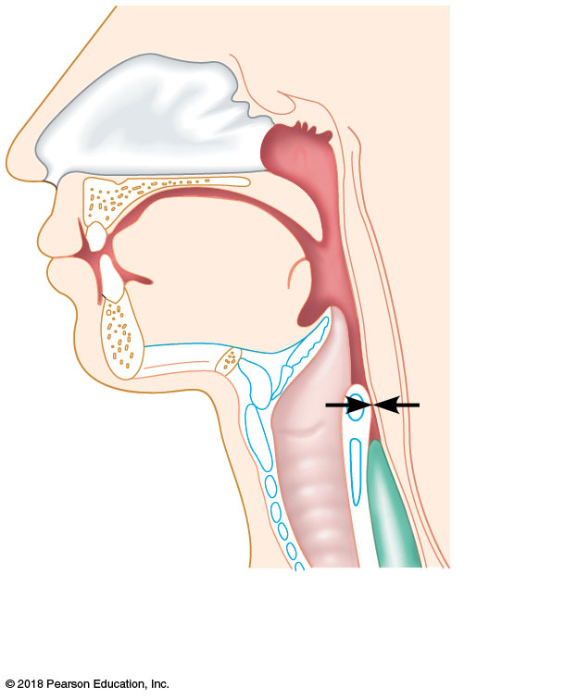
Bolus
3
Upper esophageal
sphincter contracted

Slide 24
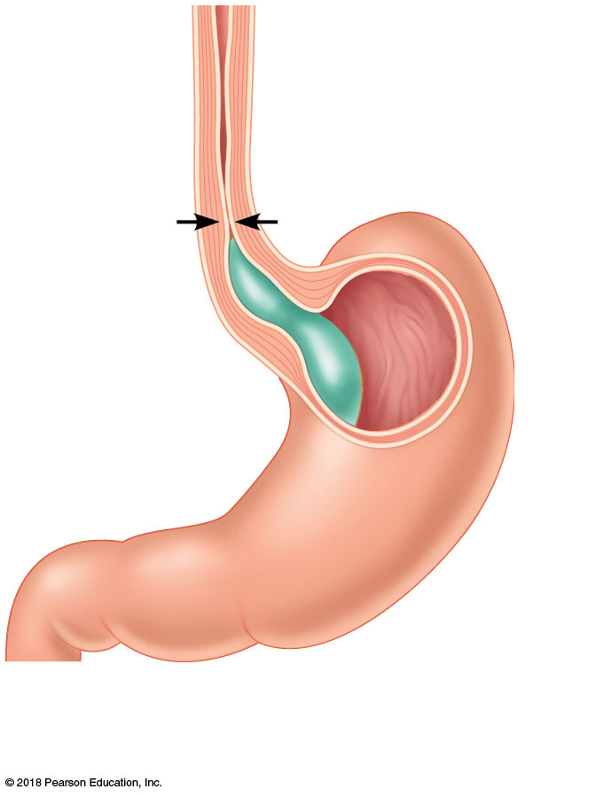
Relaxed
muscles
Cardioesophageal
sphincter open
4
Cardioesophageal
sphincter relaxed

Slide 25
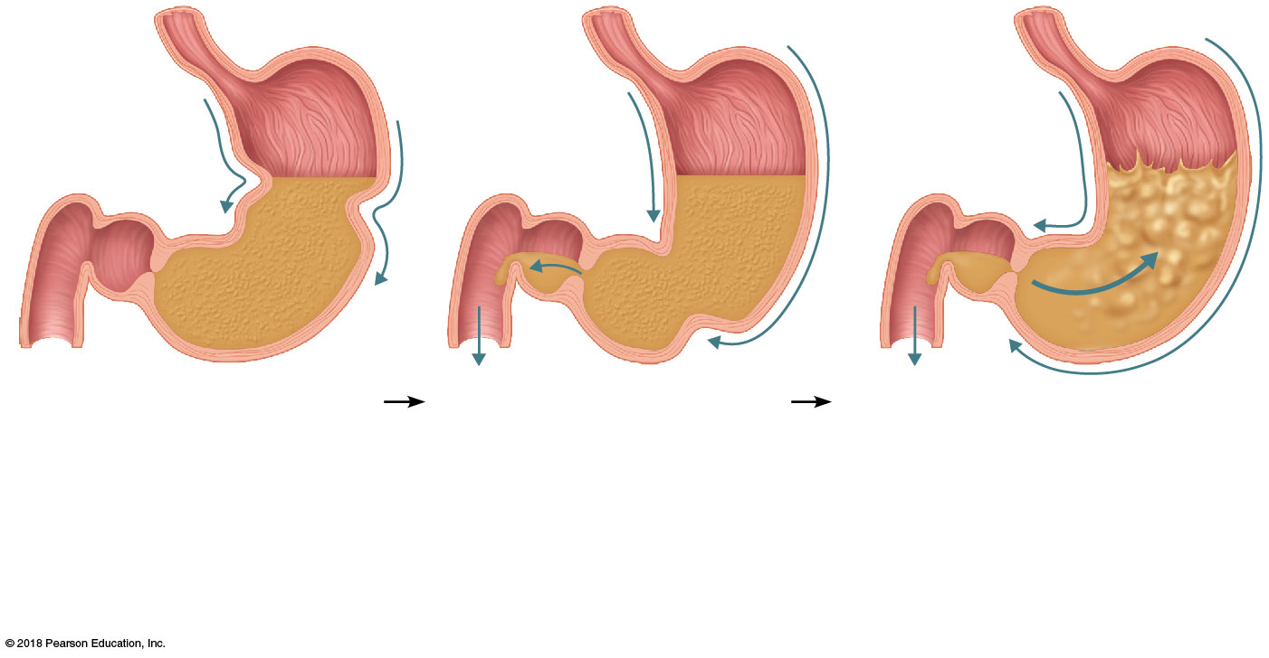
Pyloric
valve
closed
Pyloric
valve
slightly
opened
Pyloric
valve
closed
1
2
3
Propulsion: Peristaltic
waves move from the fundus
toward the pylorus.
Grinding: The most
vigorous peristalsis and
mixing action occur close
to the pylorus. The pyloric
end of the stomach acts as
a pump that delivers small
amounts of chyme into the
duodenum.
Retropulsion: The
peristaltic wave closes the
pyloric valve, forcing most of
the contents of the pylorus
backward into the stomach.

Slide 26
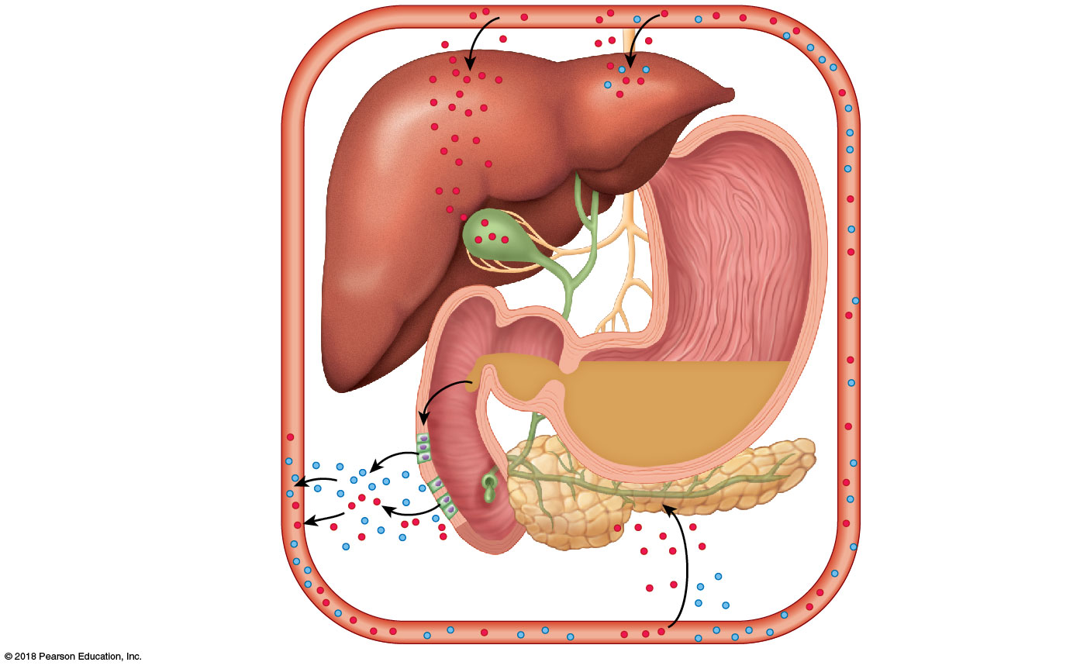
4
Secretin
causes the liver to
secrete more bile;
CCK stimulates
the gallbladder
to release stored
bile and the
hepatopancreatic
sphincter to relax
(allows bile from
both sources to
enter the
duodenum).
1
Chyme entering
duodenum causes
duodenal entero-
endocrine cells to
release cholecystokinin
(CCK) and secretin.
2
CCK (red dots) and
secretin (blue dots)
enter the bloodstream.
5
Stimulation
by vagal nerve
fibers causes
release of
pancreatic juice
and weak
contractions of
the gallbladder.
3
Upon reaching the
pancreas, CCK induces
secretion of enzyme-
rich pancreatic juice;
secretin causes
secretion of bicarbonate-
rich pancreatic juice.

Slide 27
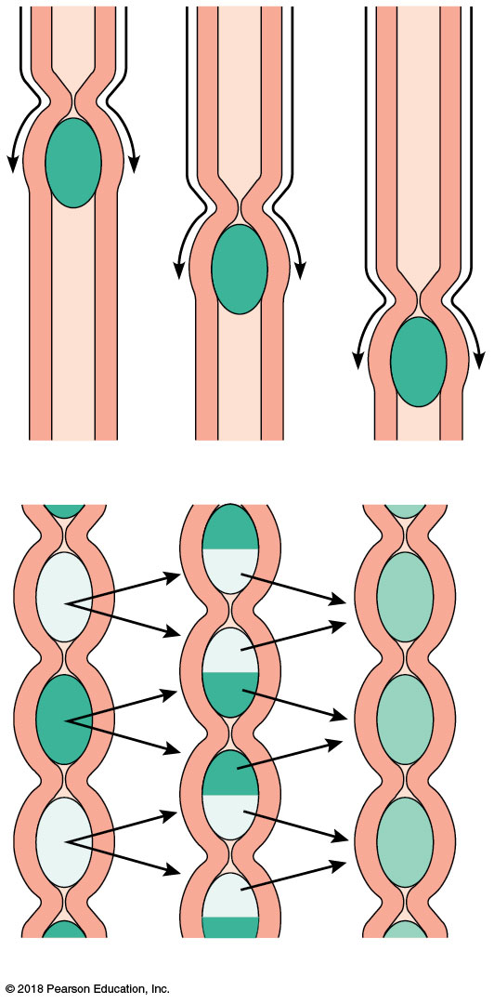
(a)
(b)

Slide 28
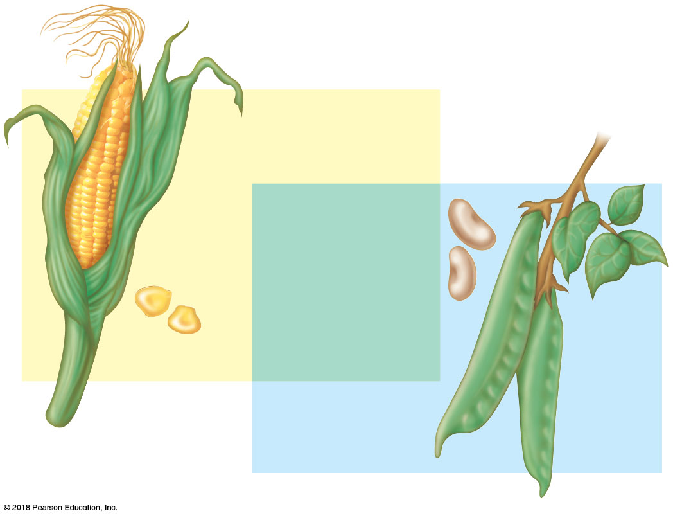
Tryptophan
Beans
and other
legumes
Methionine
Valine
Threonine
Phenylalanine
Leucine
Corn and
other grains
Isoleucine
Lysine

Slide 29
(a) Carbohydrates: polysaccharides, disaccharides; composed of simple sugars (monosaccharides)
ATP
Polysaccharides
Glycogen and fat
broken down for
ATP formation
Cellular uses
GI digestion to
simple sugars
To
capillary
Excess stored as
glycogen or fat
Broken down to glucose
and released to blood
Monosaccharides

Slide 30
(b) Fats: composed of 1 glycerol molecule and 3 fatty acids; triglycerides
Cellular
uses
ATP
Fats are the
primary fuels
in many cells
Lipid (fat)
Metabolized
by liver to
acetic acid, etc.
Fatty
acids
GI digestion
to fatty acids
and glycerol
Insulation and fat
cushions to protect
body organs
Fats build myelin
sheaths and cell
membranes
Glycerol

Slide 31
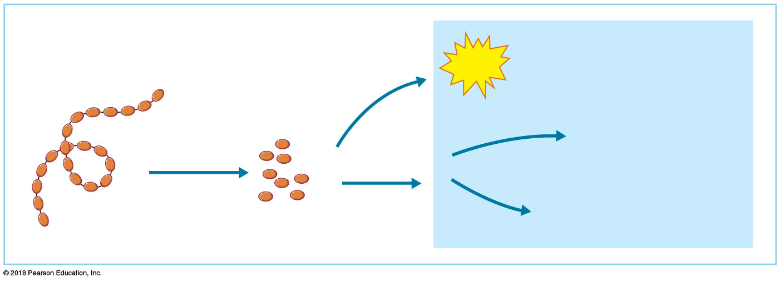
(c) Proteins: polymers of amino acids
ATP formation if inadequate
glucose and fats or if essential
amino acids are lacking
ATP
Protein
Normally
infrequent
Functional proteins
(enzymes, antibodies,
hemoglobin, etc.)
GI digestion to
amino acids
Cellular
uses
Structural proteins
(connective tissue fibers,
muscle proteins, etc.)
Amino
acids

Slide 32
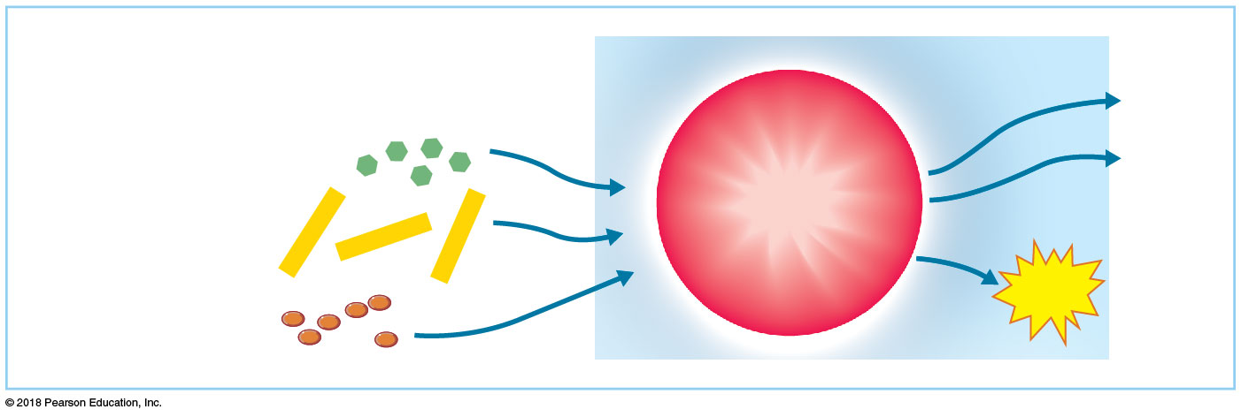
(d) ATP formation (fueling the metabolic furnace): all categories of food can be oxidized to provide energy molecules (ATP)
Carbon
dioxide
Cellular
metabolic “furnace”:
Monosaccharides
Water
Citric acid cycle
and
electron transport
chain
Fatty acids
Amino acids
(amine first removed
and combined with
CO₂ by the liver to form urea)
ATP

Slide 33
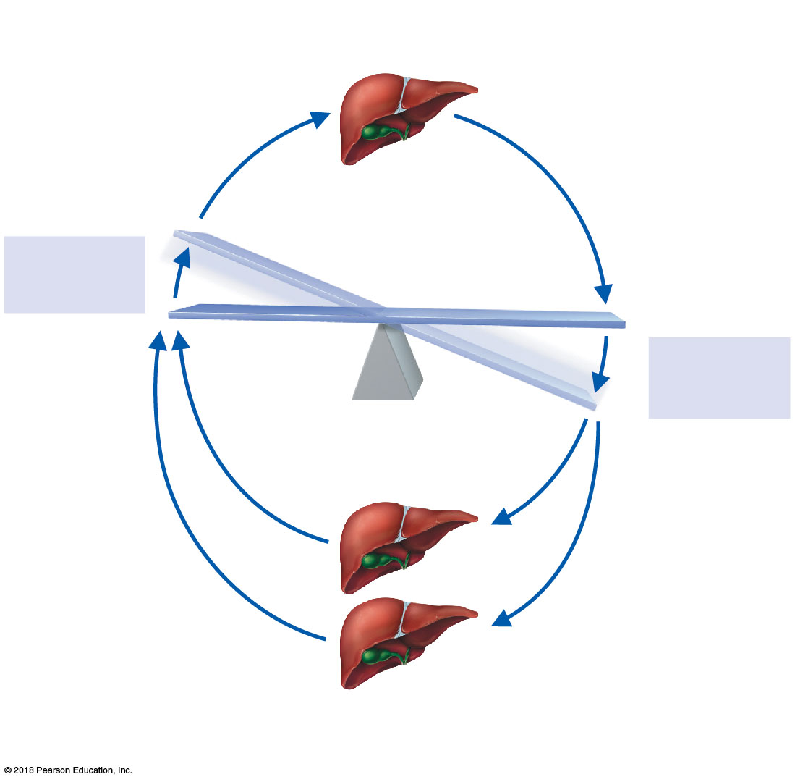
Glycogenesis:
Glucose converted to
glycogen and stored
Stimulus:
Rising blood
glucose level
IMBALANCE
HOMEOSTATIC BLOOD SUGAR
Stimulus:
Falling blood
glucose level
IMBALANCE
Glycogenolysis:
Stored glycogen
converted to glucose
Gluconeogenesis:
Amino acids and fats
converted to glucose

