Slide 1
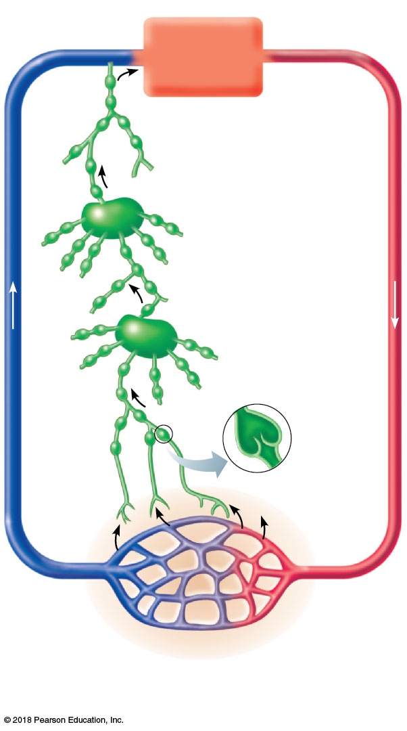
Venous
system
Arterial
system
Heart
Lymph duct
Lymph trunk
Lymph node
Lymphatic
system
Lymphatic
collecting
vessels,
with valves
Lymph
capillary
Tissue fluid
(becomes
lymph)
Blood
capillaries
Loose connective
tissue around
capillaries
© 2018 Pearson Education, Inc.

Slide 2
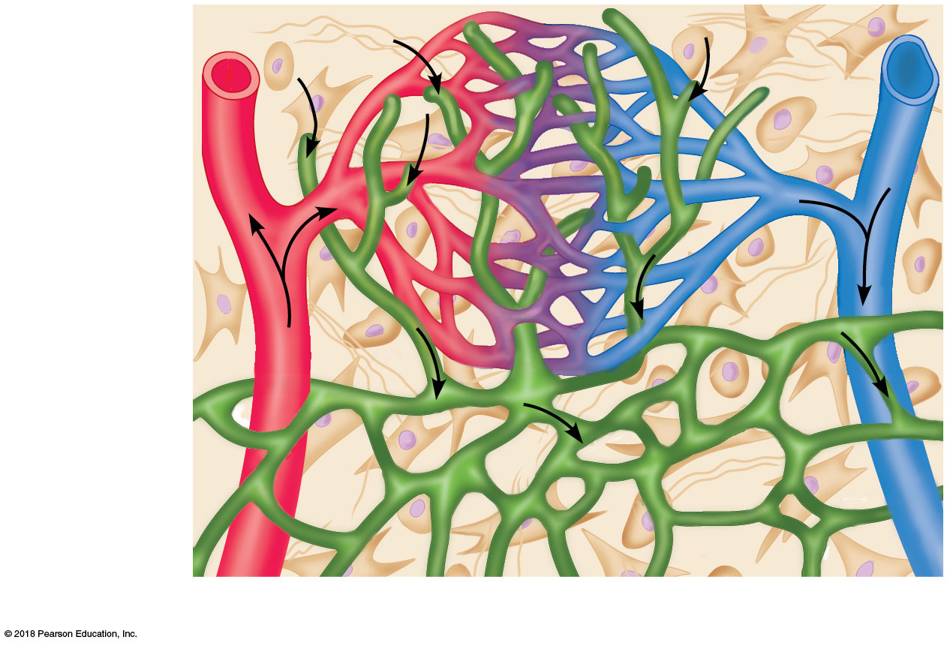
Tissue fluid
Tissue cell
Lymphatic
capillary
Blood
capillaries
(a)
Arteriole
Venule
© 2018 Pearson Education, Inc.

Slide 3
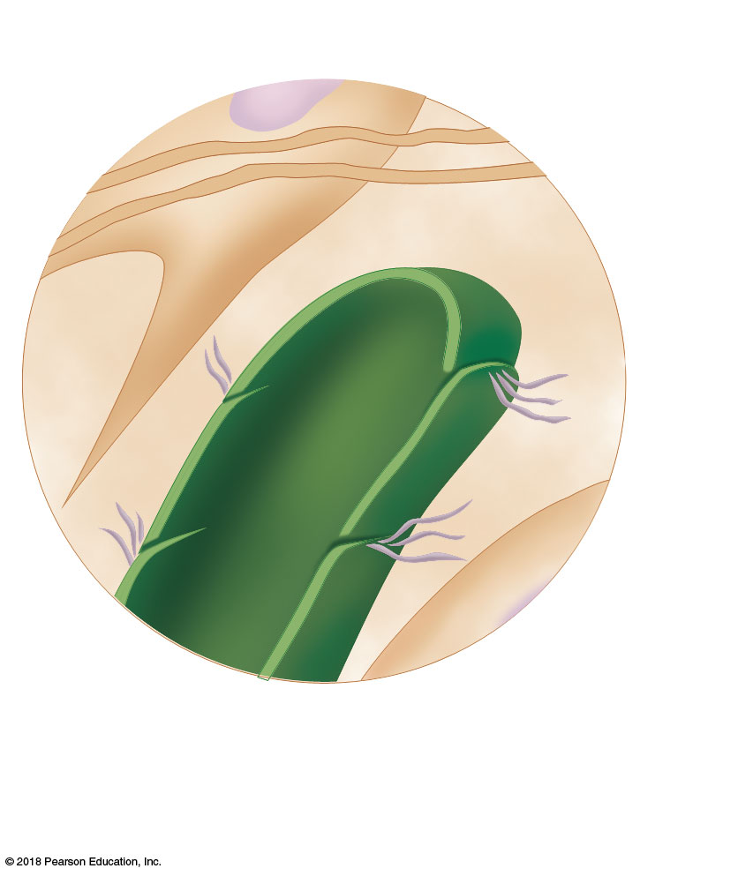
Fibroblast in loose
connective tissue
Flaplike
minivalve
Filaments
anchored to
connective
tissue
Endothelial
cell
(b)
© 2018 Pearson Education, Inc.

Slide 4
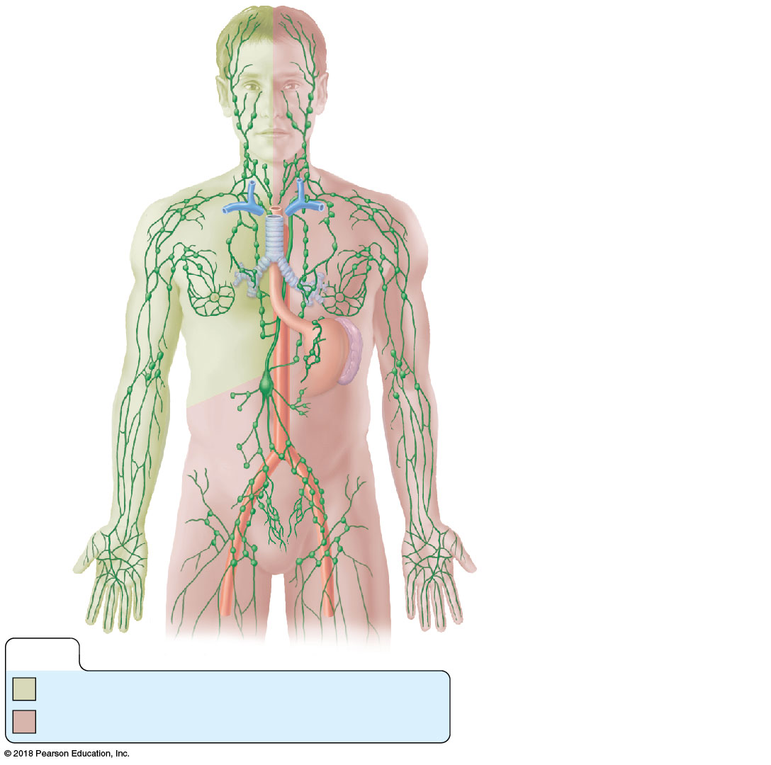
Entrance of right
lymphatic duct into right
subclavian vein
Regional
lymph nodes:
Cervical
nodes
Internal jugular vein
Thoracic duct
entry into left
subclavian vein
Axillary
nodes
Thoracic duct
Aorta
Spleen
Cisterna chyli (receives
lymph drainage from
digestive organs)
Inguinal
nodes
Lymphatics
KEY:
Drained by the right lymphatic duct
Drained by the thoracic duct
© 2018 Pearson Education, Inc.

Slide 5
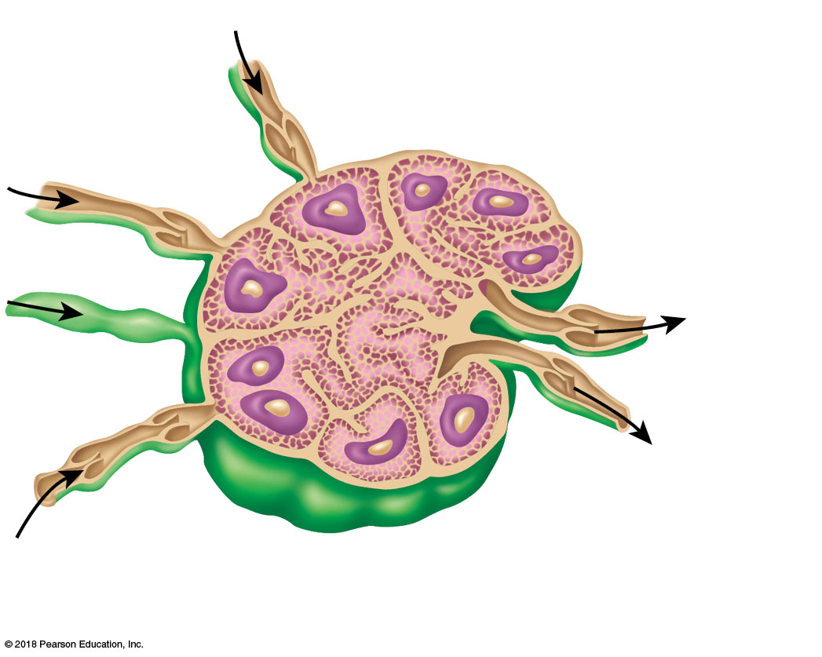
Germinal
center in
follicle
Afferent
lymphatic
vessels
Capsule
Subcapsular
sinus
Trabecula
Afferent
lymphatic
vessels
Efferent
lymphatic
vessels
Hilum
Cortex
Follicle
Medullary sinus
Medullary cord
© 2018 Pearson Education, Inc.

Slide 6
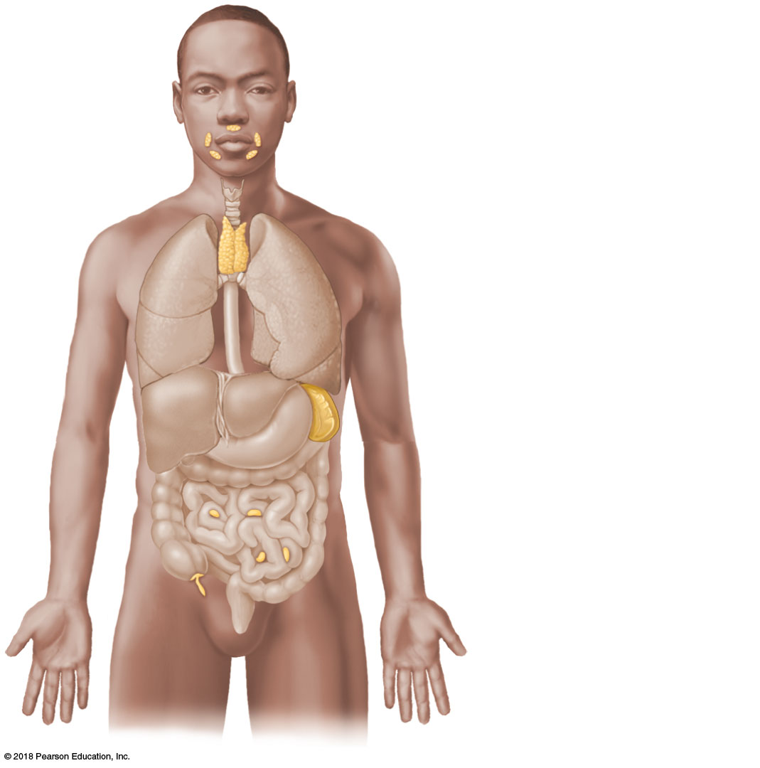
Tonsils (in
pharyngeal region)
Thymus (in thorax;
most active during
youth)
Spleen (curves
around left side of
stomach)
Peyer’s patches
(in intestine)
Appendix
© 2018 Pearson Education, Inc.

Slide 7
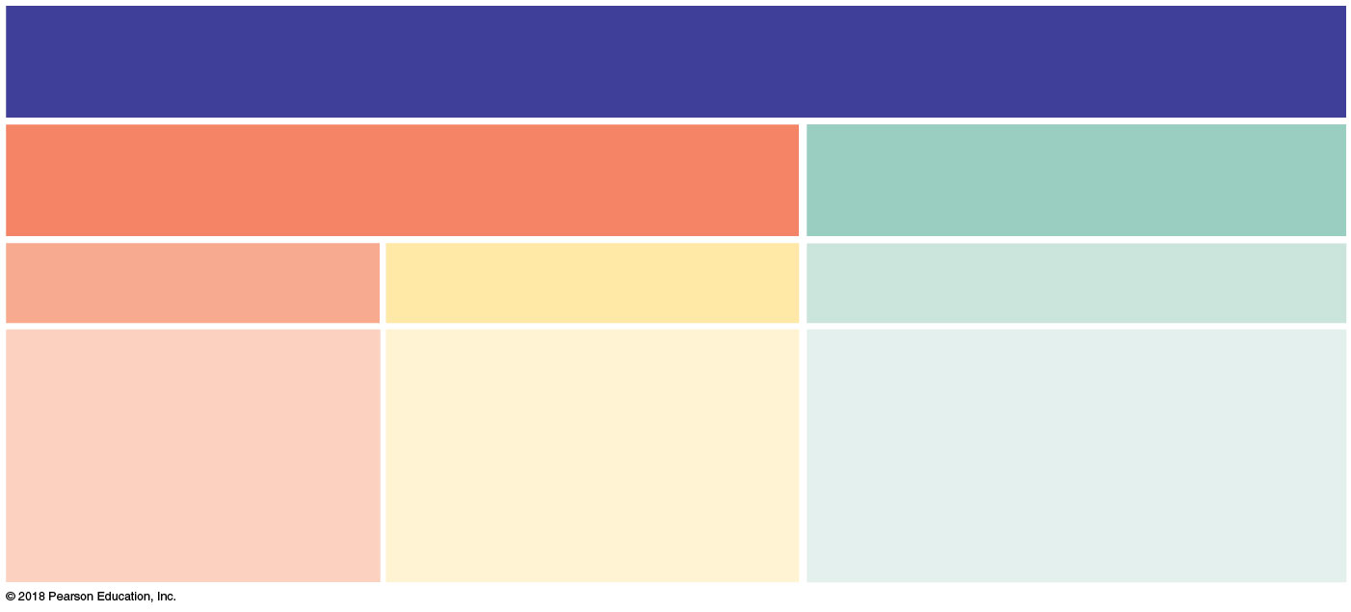
The Immune System
Innate (nonspecific) defense mechanisms
Adaptive (specific) defense
mechanisms
First line of defense
Second line of defense
Third line of defense
• Skin
• Phagocytic cells
• Lymphocytes
• Mucous membranes
• Natural killer cells
• Antibodies
• Secretions of skin and mucous membranes
• Antimicrobial proteins
• Macrophages and other antigen-presenting cells
• The inflammatory response
• Fever
© 2018 Pearson Education, Inc.

Slide 8
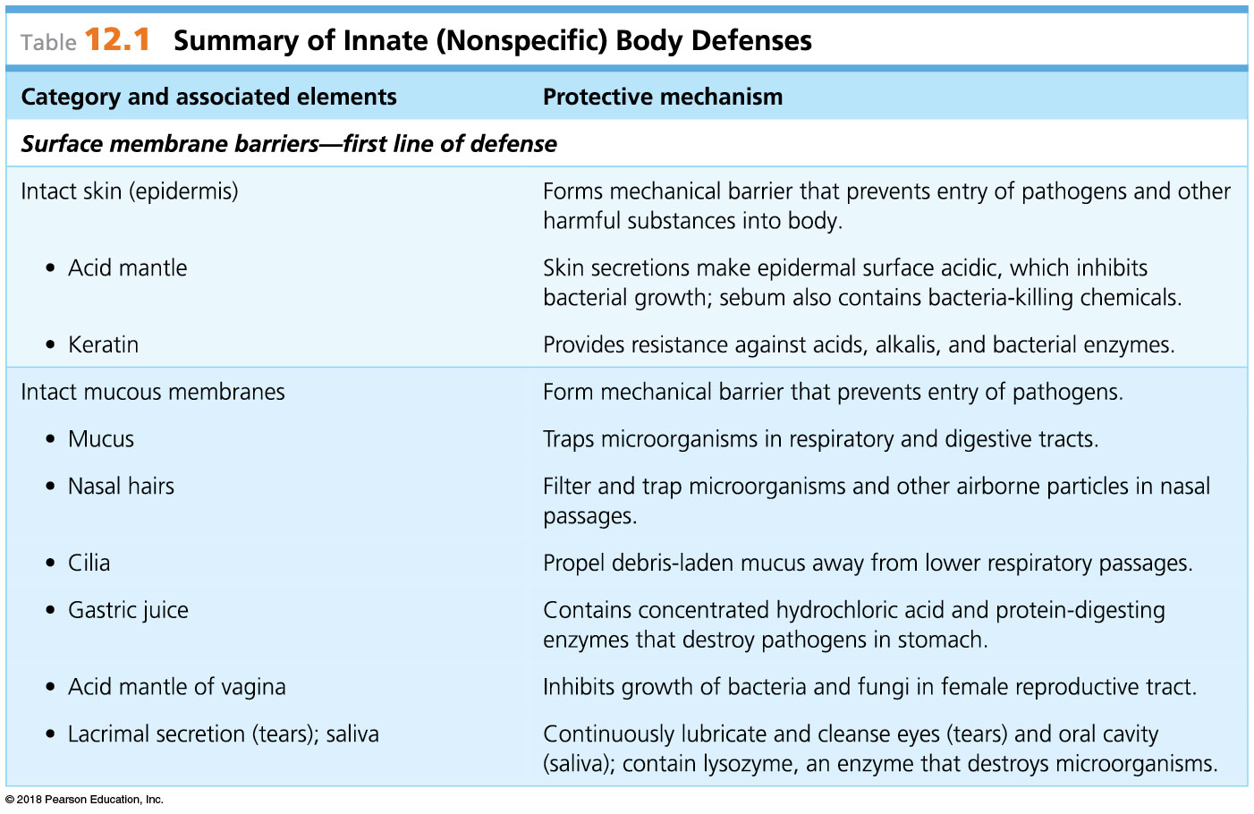
© 2018 Pearson Education, Inc.

Slide 9
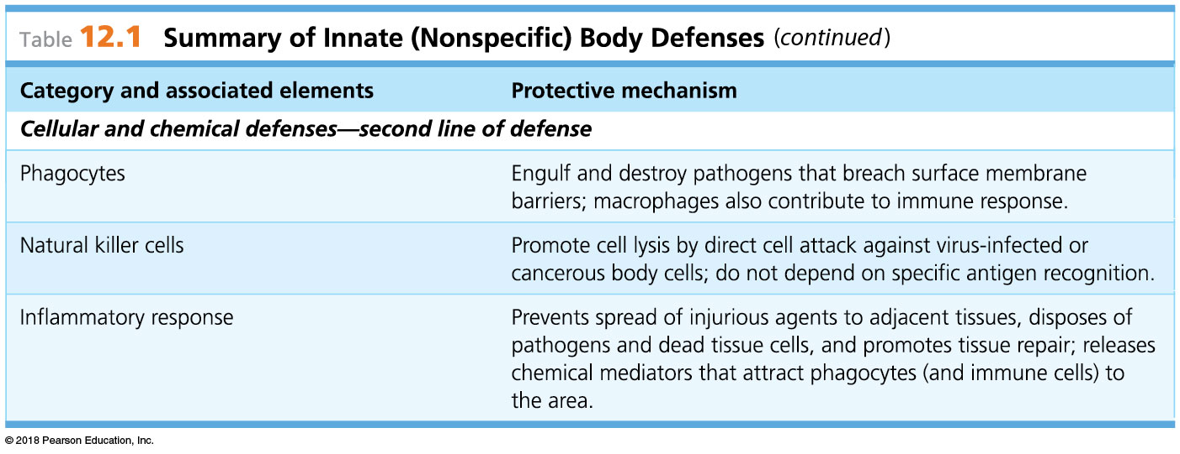
© 2018 Pearson Education, Inc.

Slide 10
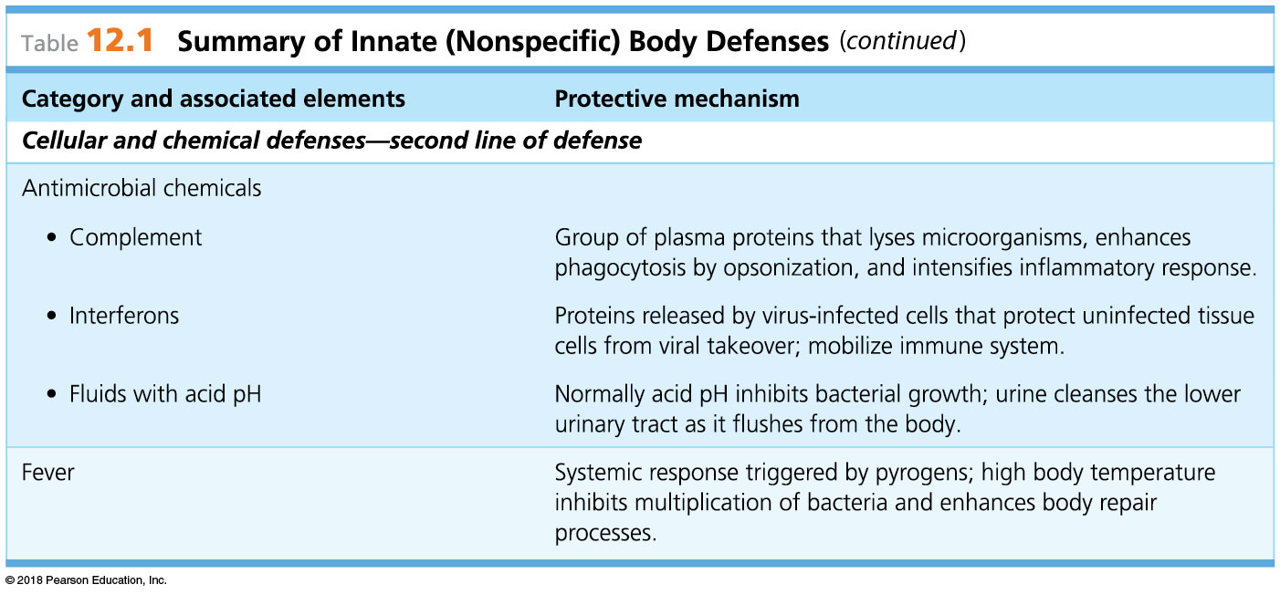
© 2018 Pearson Education, Inc.

Slide 11
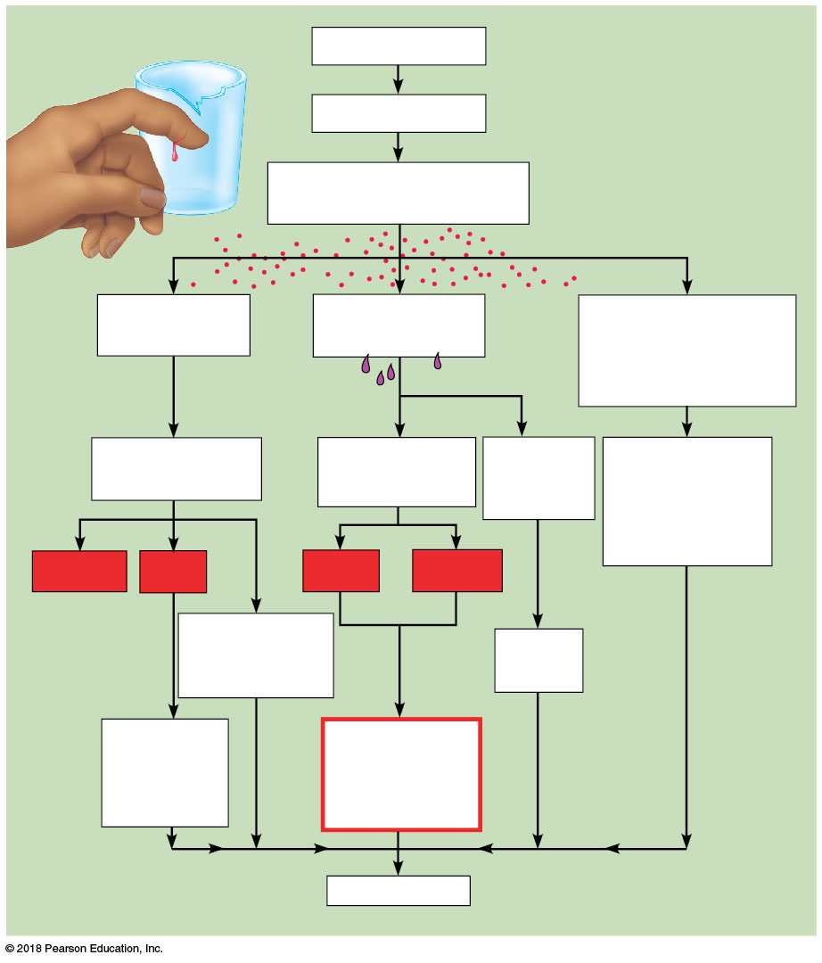
Injurious agents
Cells damaged
Release kinins, histamine,
and other chemicals
Blood vessels
dilate
Capillaries
become “leaky”
Neutrophils and then
monocytes
(and other WBCs)
enter area
Increased blood
flow into area
Edema (fluid in
tissue spaces)
Clotting
proteins
enter area
Removal of
damaged/dead
tissue cells and
pathogens
from area
Redness
Heat
Pain
Swelling
Brings more
nutrients and
oxygen to area
Fibrin
barrier
Increases
metabolic
rate of
tissue cells
Possible
temporary
limitation of
joint movement
Healing
© 2018 Pearson Education, Inc.

Slide 12
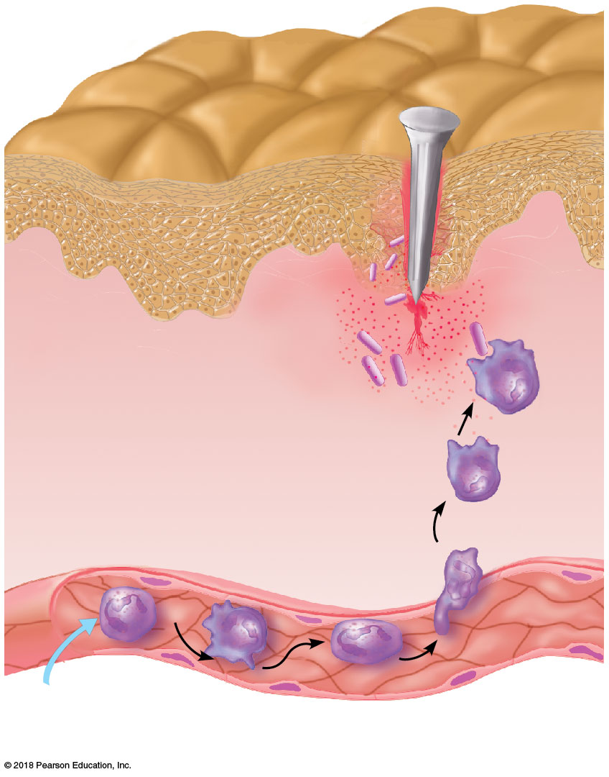
3
Positive
chemotaxis
Inflammatory
chemicals diffusing
from the inflamed
site act as chemotactic
agents
Neutrophils
1
Enter blood from bone marrow
and roll along the vessel wall
2
Diapedesis
Capillary wall
Endothelium
© 2018 Pearson Education, Inc.
Basement membrane

Slide 13
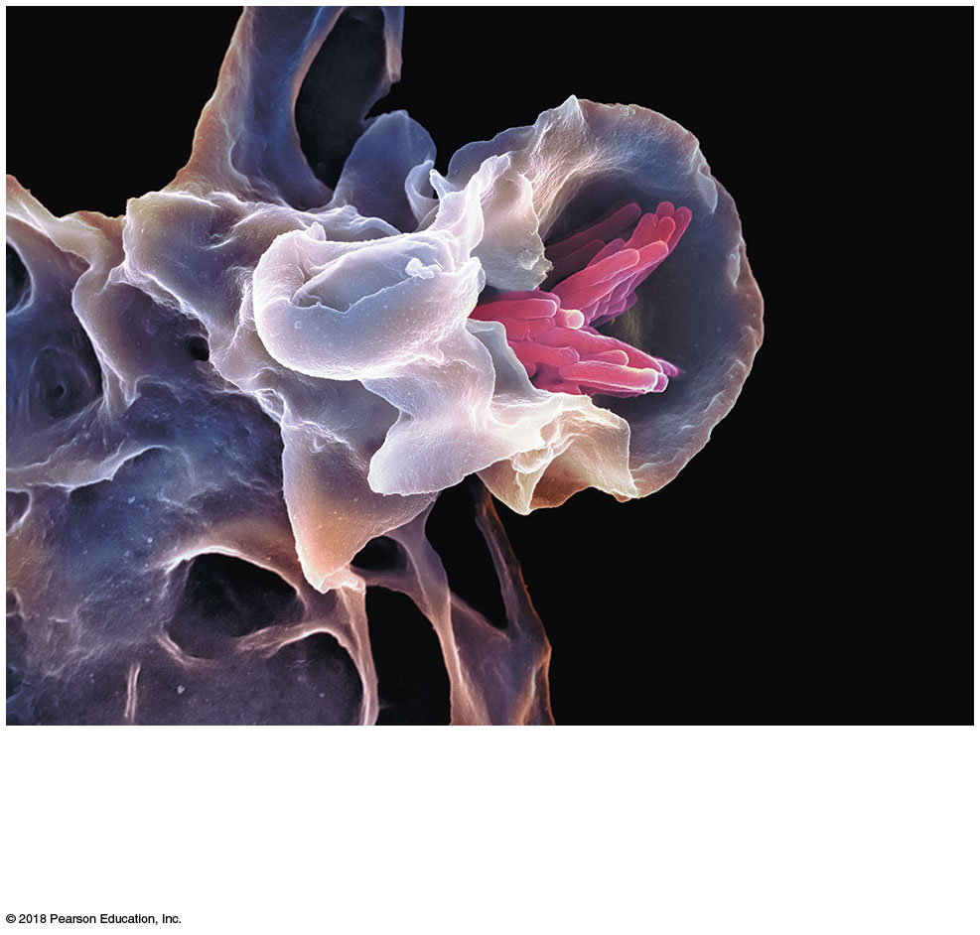
(a) A macrophage (purple) uses its cytoplasmic extensions to ingest bacillus-shaped bacteria (pink) by phagocytosis. Scanning electron micrograph.
© 2018 Pearson Education, Inc.

Slide 14
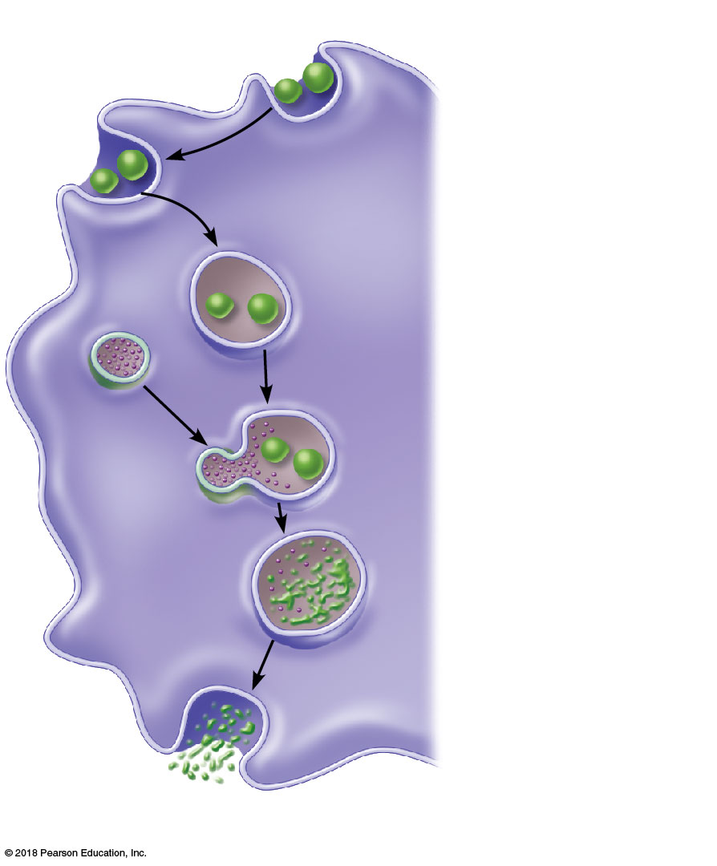
Slide 1
1
Phagocyte
adheres to
pathogens.
2
Phagocyte
engulfs the
particles, forming
a phagosome.
Phagosome
(phagocytic
vesicle)
Lysosome
3
Lysosome
fuses with the
phagocytic vesicle,
forming a
phagolysosome.
Acid
hydrolase
enzymes
4
Lysosomal
enzymes digest
the pathogens or
debris, leaving a
residual body.
5
Exocytosis of
the vesicle
removes
indigestible and
residual material.
(b) Events of phagocytosis

Slide 15
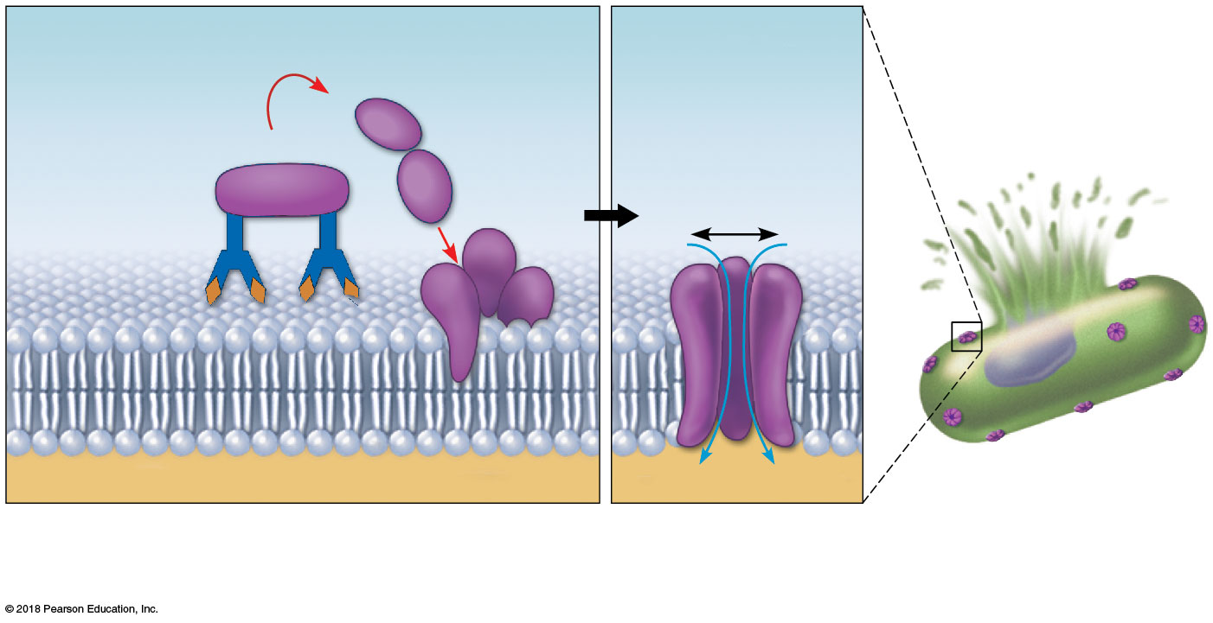
Membrane attack
complex forming
Antibodies
attached to
pathogen’s
membrane
Pore
Cytoplasm
H₂O
H₂O
1
2
3
Activated complement proteins attach to
pathogen’s membrane in step-by-step sequence,
forming a membrane attack complex (a MAC attack).
MAC pores in the
membrane allow water
to rush into the cell.
This influx of water
causes cell lysis.

Slide 16
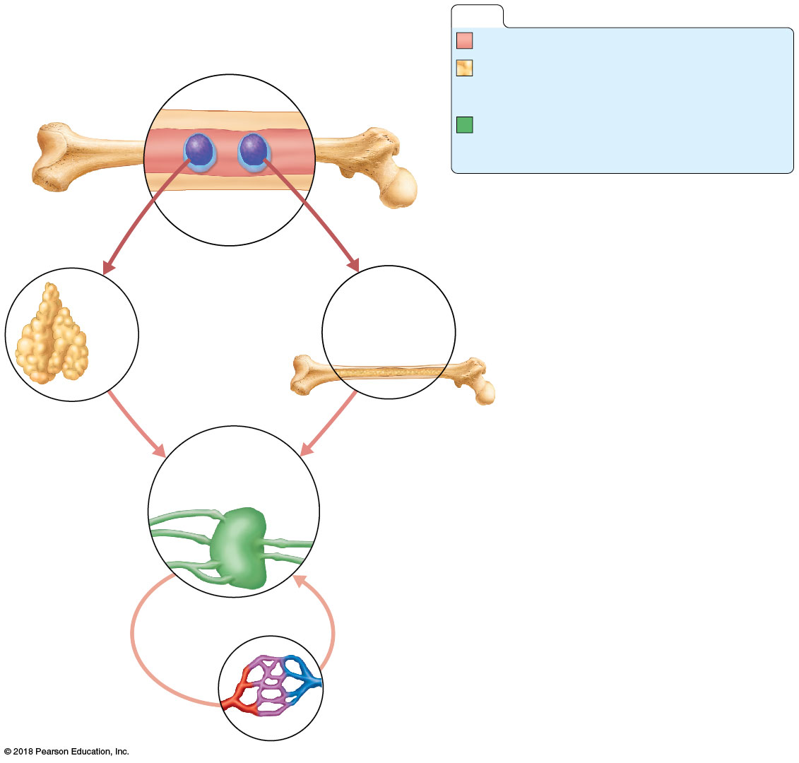
Slide 1
KEY:
Red bone marrow: site of lymphocyte origin
Primary lymphoid organs: sites of
development of immunocompetence as
Red
bone marrow
B or T cells
Secondary lymphoid organs: sites of
antigen encounter, and activation to
become effector and memory B or T cells
Immature (naive)
lymphocytes
Lymphocytes destined to become T cells
migrate (in blood) to the thymus and develop
immunocompetence there. B cells develop
immunocompetence in red bone marrow.
1
1
Thymus
Bone marrow
2
2
Immunocompetent but still naive
lymphocytes leave the thymus and bone
marrow. They “seed” the lymph nodes,
spleen, and other lymphoid tissues, where
they encounter their antigens and become
activated.
Lymph nodes,
spleen, and other
lymphoid tissues
Antigen-activated (mature)
immunocompetent lymphocytes (effector
cells and memory cells) circulate
continuously in the bloodstream and lymph
and throughout the lymphoid organs of the
body.
3
3
© 2018 Pearson Education, Inc.

Slide 17
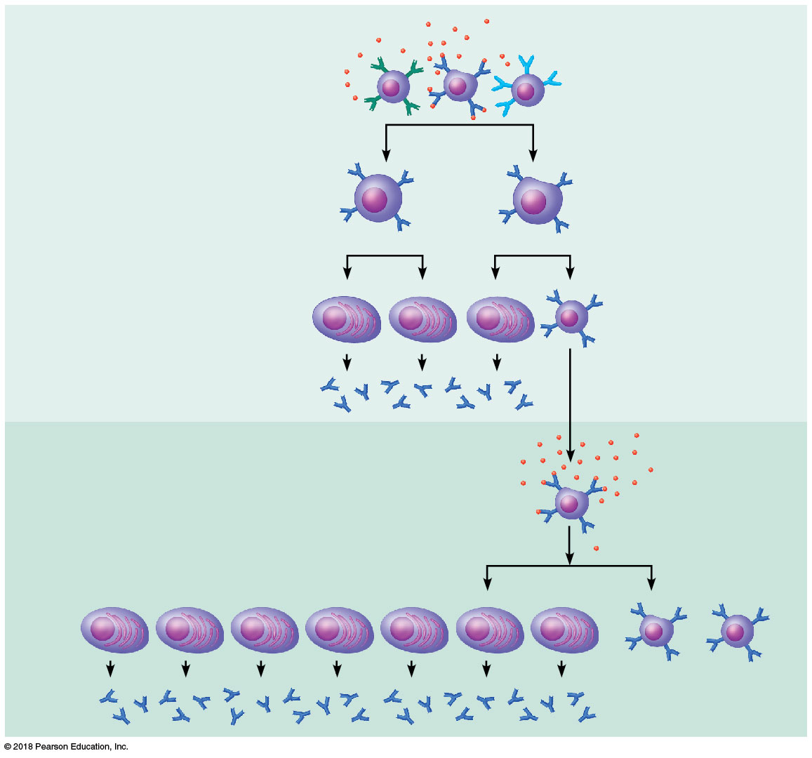
Primary response
(initial encounter
with antigen)
Free antigen
Antigen binding
to a receptor on a
specific B cell
(B cells with
non-complementary
receptors remain
inactive)
Proliferation to
form a clone
Activated B
cells
Plasma
cells
Memory
B cell
Secreted
antibody
molecules
Secondary response
(can be years later)
Subsequent
challenge
by same
antigen results
in more rapid
response
Clone of cells
identical to
ancestral cells
Plasma
cells
Secreted
antibody
molecules
Memory
B cells
© 2018 Pearson Education, Inc.

Slide 18
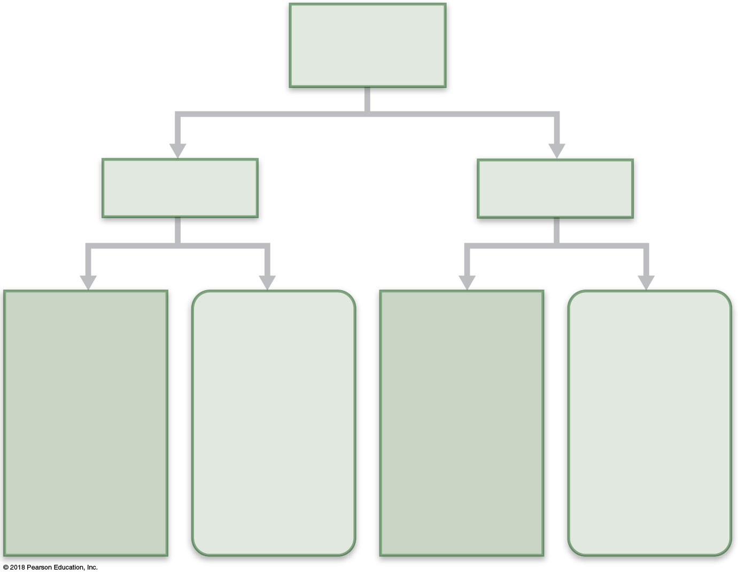
Humoral
immunity
Active
Passive
Naturally
acquired
Artificially
acquired
Naturally
acquired
Artificially
acquired
Infection;
contact with
pathogen
Vaccine;
dead or
attenuated
pathogens
Antibodies
passed from
mother to
fetus via
placenta; or
to infant in
her milk
Injection of
donated
antibodies
(gamma
globulin)
© 2018 Pearson Education, Inc.

Slide 19
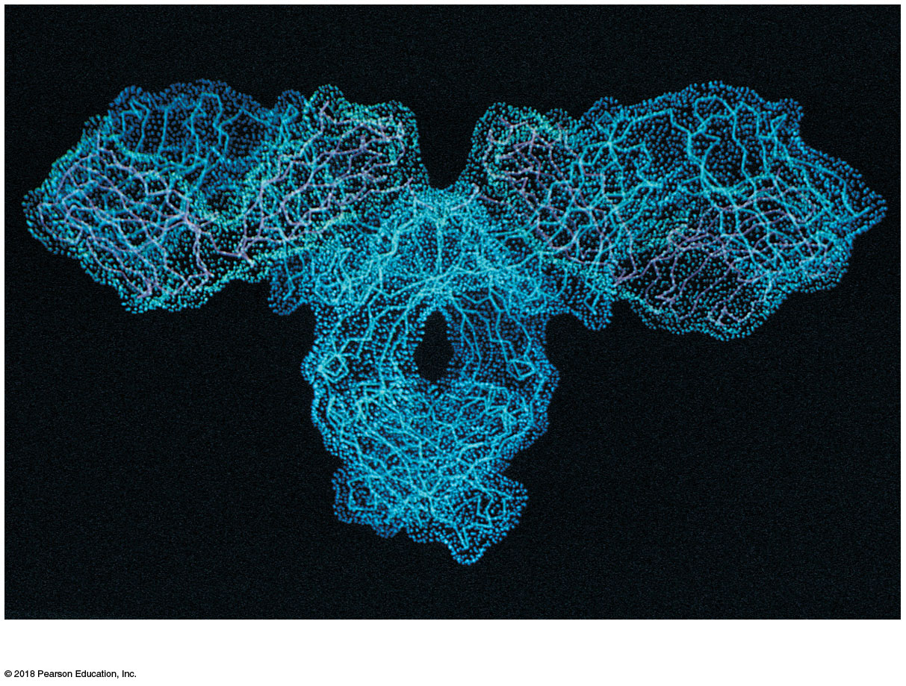
(a)
© 2018 Pearson Education, Inc.

Slide 20
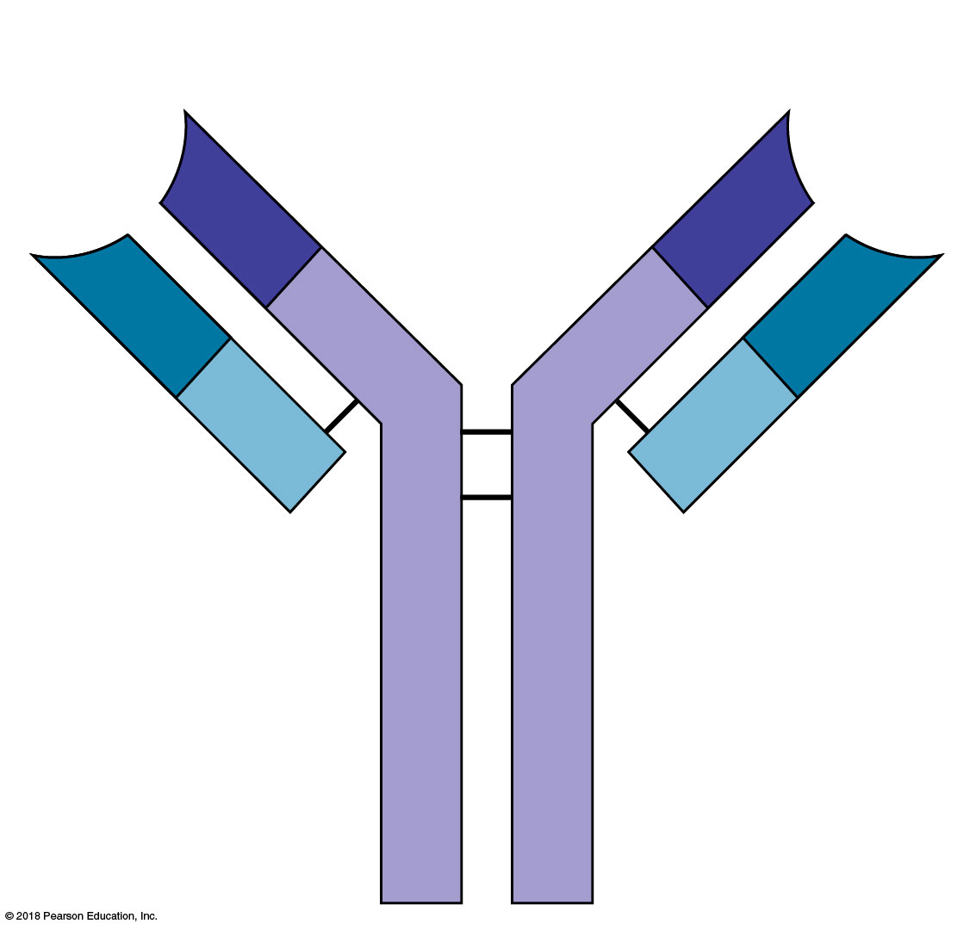
Antigen-binding
sites
V
V
V
V
C
C
Light
chain
Disulfide
bonds
Heavy
chain
C
C
(b)
© 2018 Pearson Education, Inc.

Slide 21
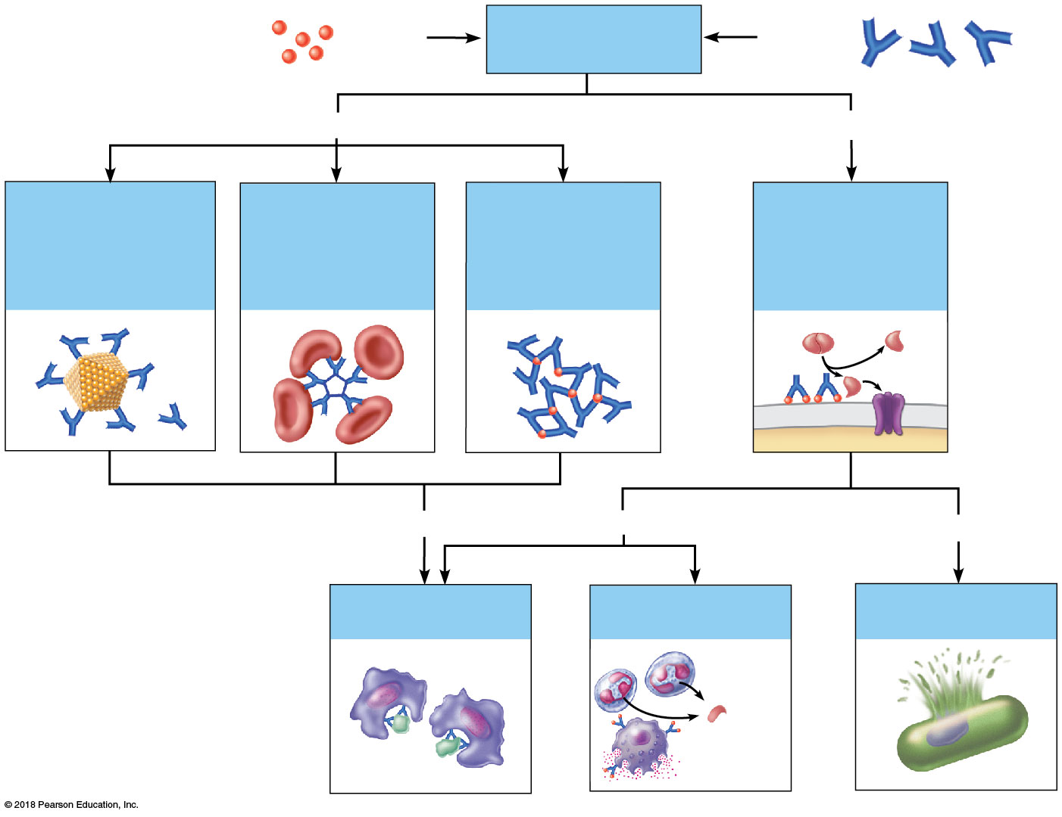
Antigen
Antigen-antibody
complex
Antibody
Inactivates by
Fixes and activates
Neutralization
(masks dangerous
parts of bacterial
exotoxins; viruses)
Agglutination
(cell-bound
antigens)
Precipitation
(soluble
antigens)
Complement
Enhances
Enhances
Leads to
Phagocytosis
Inflammation
Cell lysis
Chemo-
taxis
Histamine
release
© 2018 Pearson Education, Inc.

