Slide 1
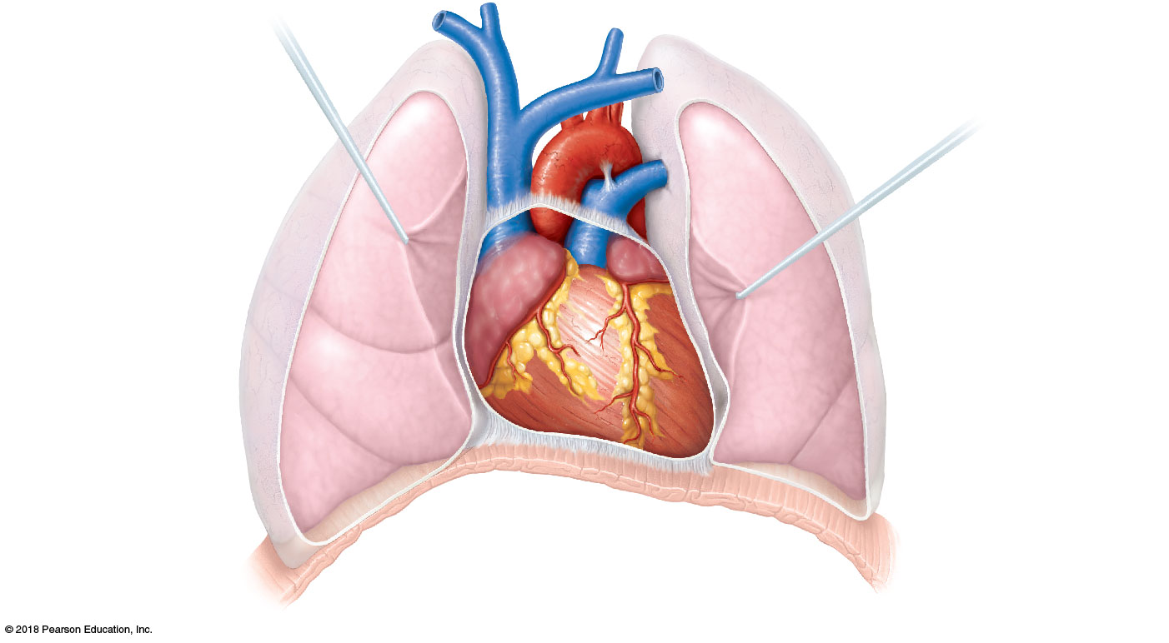
Superior
vena cava
Aorta
Parietal
pleura (cut)
Pulmonary
trunk
Left lung
Pericardium
(cut)
Apex of
heart
Diaphragm
(a)

Slide 2
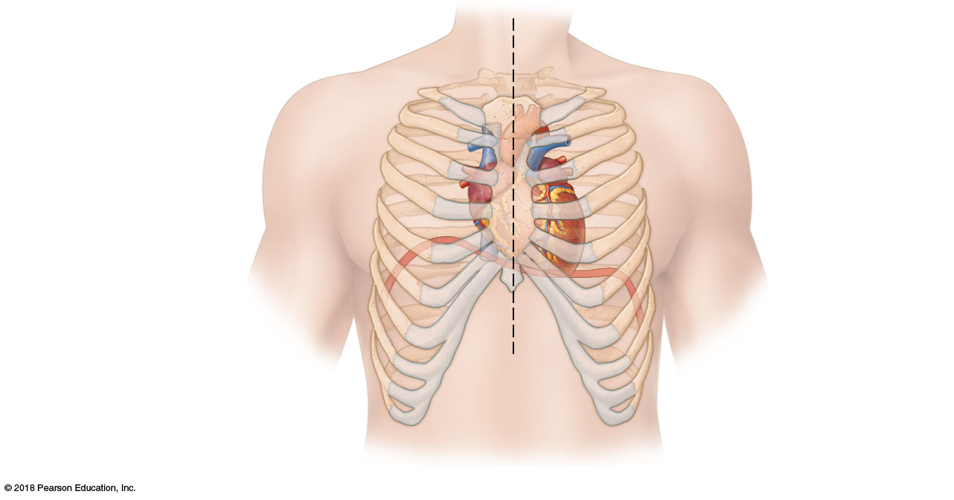
Midsternal line
2nd rib
Sternum
Diaphragm
Point of
maximal
intensity
(PMI)
(b)

Slide 3
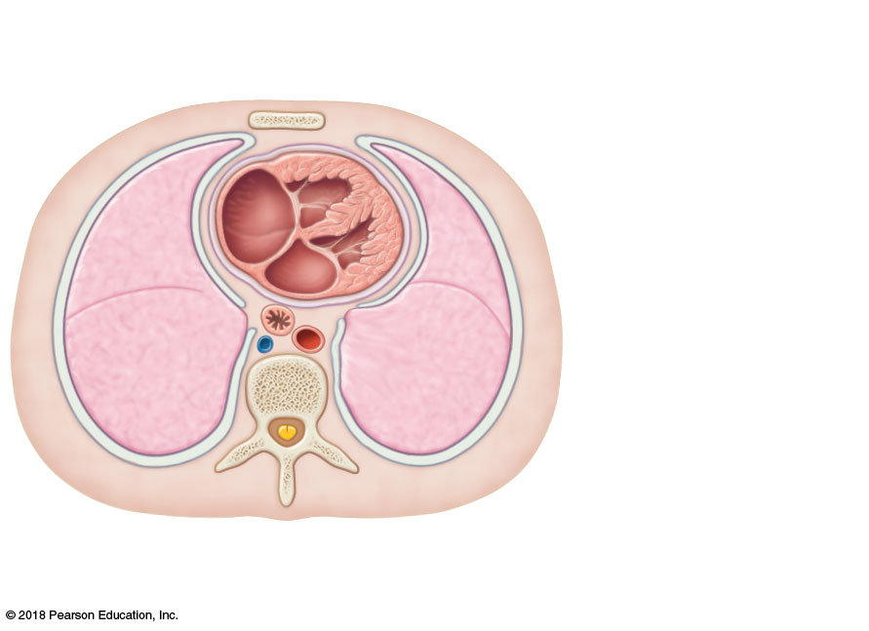
Mediastinum
Heart
Right lung
(c)
Posterior

Slide 4
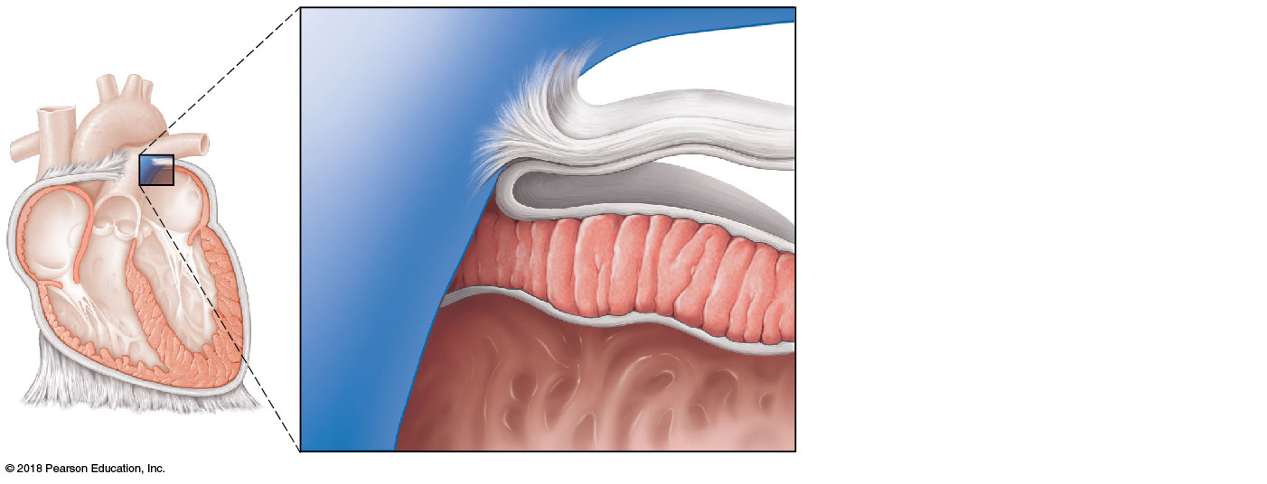
Pulmonary
trunk
Fibrous
pericardium
Parietal layer of
serous pericardium
Pericardium
Pericardial cavity
Visceral layer of
serous pericardium
Epicardium
Myocardium
Heart wall
Endocardium
Heart chamber

Slide 5
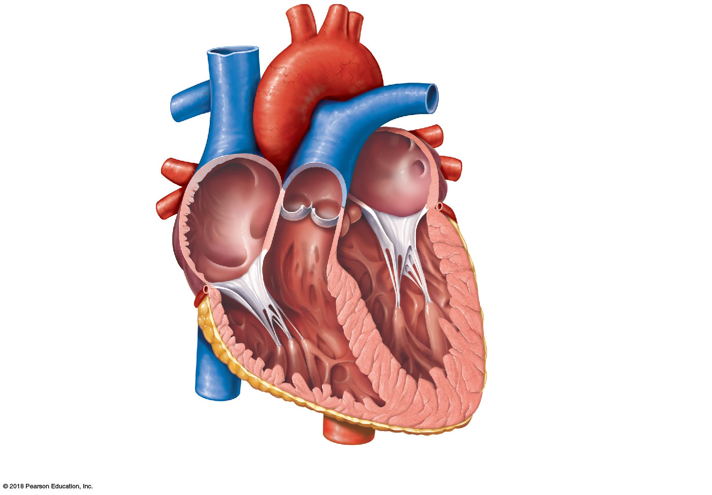
Superior vena cava
Aorta
Left pulmonary artery
Right pulmonary artery
Left atrium
Right atrium
Left pulmonary veins
Right pulmonary
veins
Pulmonary semilunar valve
Fossa ovalis
Left atrioventricular valve
(bicuspid valve)
Aortic semilunar valve
Right atrioventricular
valve (tricuspid valve)
Left ventricle
Right ventricle
Chordae tendineae
Interventricular septum
Inferior vena cava
Myocardium
Visceral pericardium
(epicardium)
(b) Frontal section showing interior chambers and valves

Slide 6
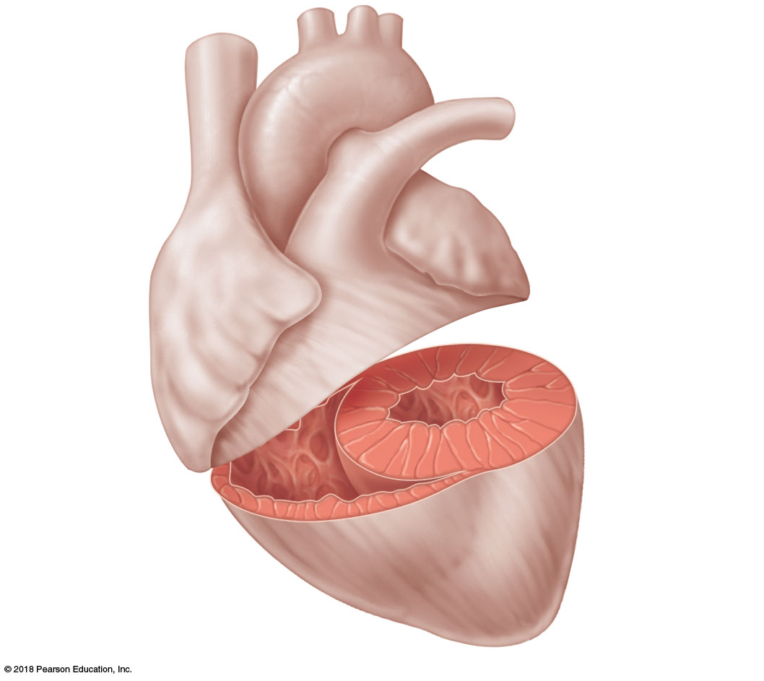
Left
ventricle
Right
ventricle
Muscular
interventricular
septum

Slide 7
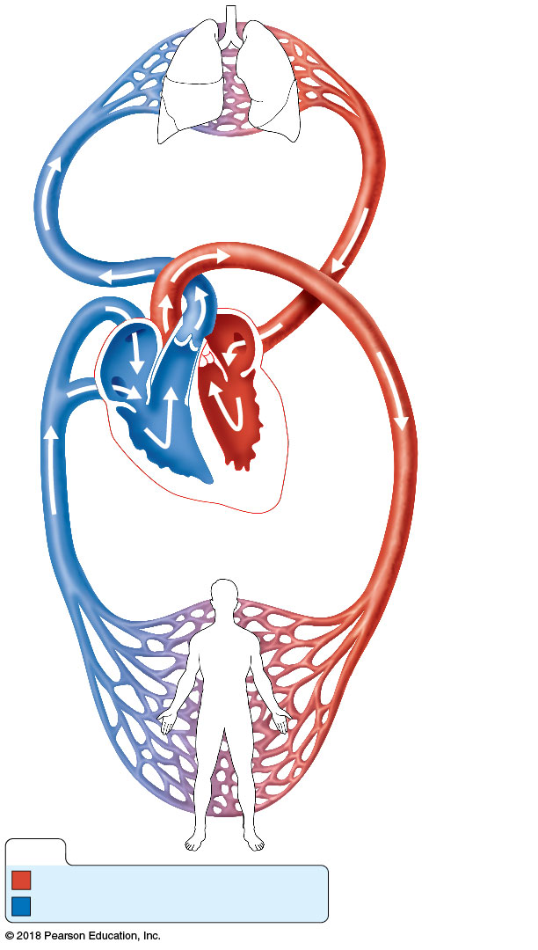
Capillary beds
of lungs where
gas exchange
occurs
Pulmonary Circuit
Pulmonary
arteries
Pulmonary
veins
Venae
cavae
Aorta and
branches
Left
atrium
Left
ventricle
Right
atrium
Heart
Right
ventricle
Systemic Circuit
Capillary
beds of all body
tissues where gas
exchange occurs
KEY:
Oxygen-rich, CO₂-poor blood
Oxygen-poor, CO₂-rich blood

Slide 8
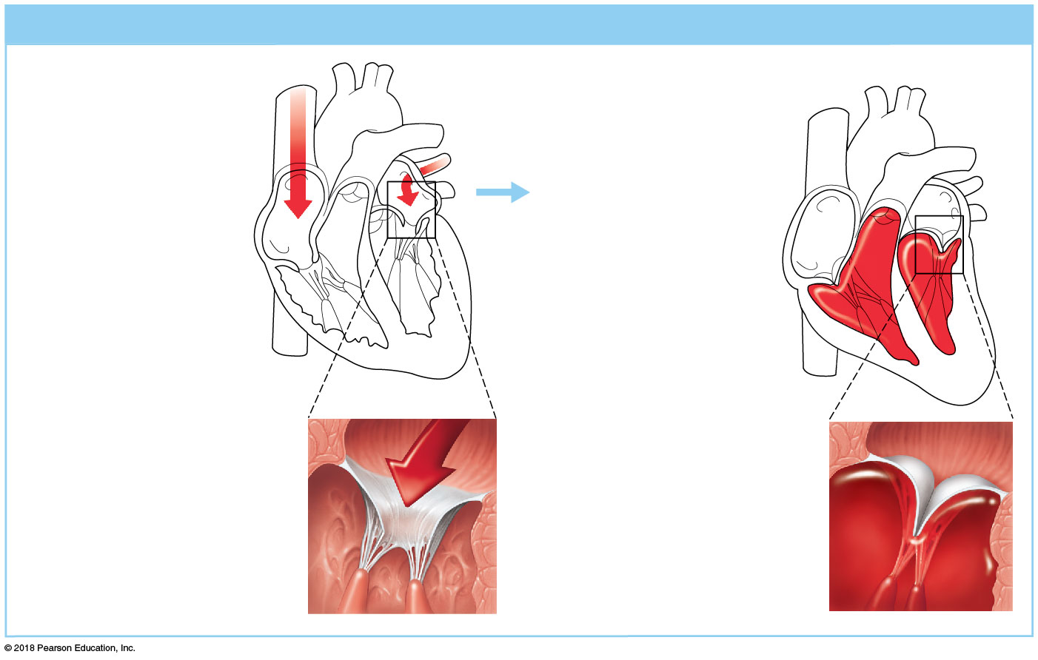
(a) Operation of the AV valves
1
Blood returning
to the atria puts
pressure against
AV valves; the AV
valves are forced
open.
4
Ventricles contract,
forcing blood against
AV valve cusps.
5
AV valves close.
2
6
As the ventricles
fill, AV valve cusps
hang limply into
ventricles.
Chordae tendineae
tighten, preventing
valve cusps from
everting into atria.
Atria contract,
forcing additional
blood into ventricles.
3
Ventricles
AV valves open;
atrial pressure
greater than
ventricular pressure
AV valves closed;
atrial pressure
less than
ventricular pressure

Slide 9
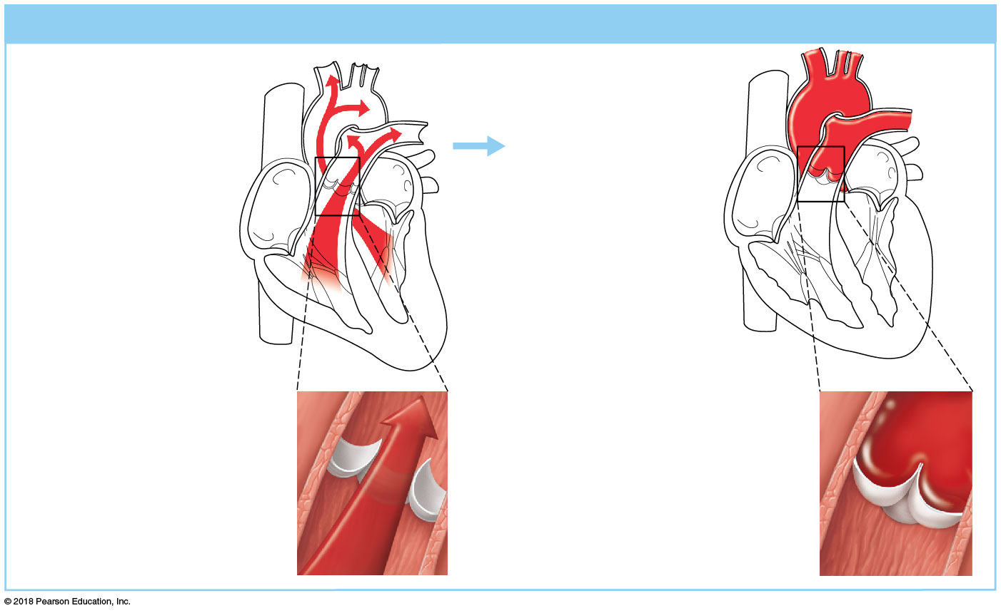
(b) Operation of the semilunar valves
Pulmonary
trunk
Aorta
As ventricles
contract and
intraventricular
pressure rises, blood
is pushed up against
semilunar valves,
forcing them open.
As ventricles relax
and intraventricular
pressure falls, blood
flows back from
arteries, filling the
cusps of semilunar
valves and forcing
them to close.
1
2
Semilunar valves open
Semilunar valves closed

Slide 10
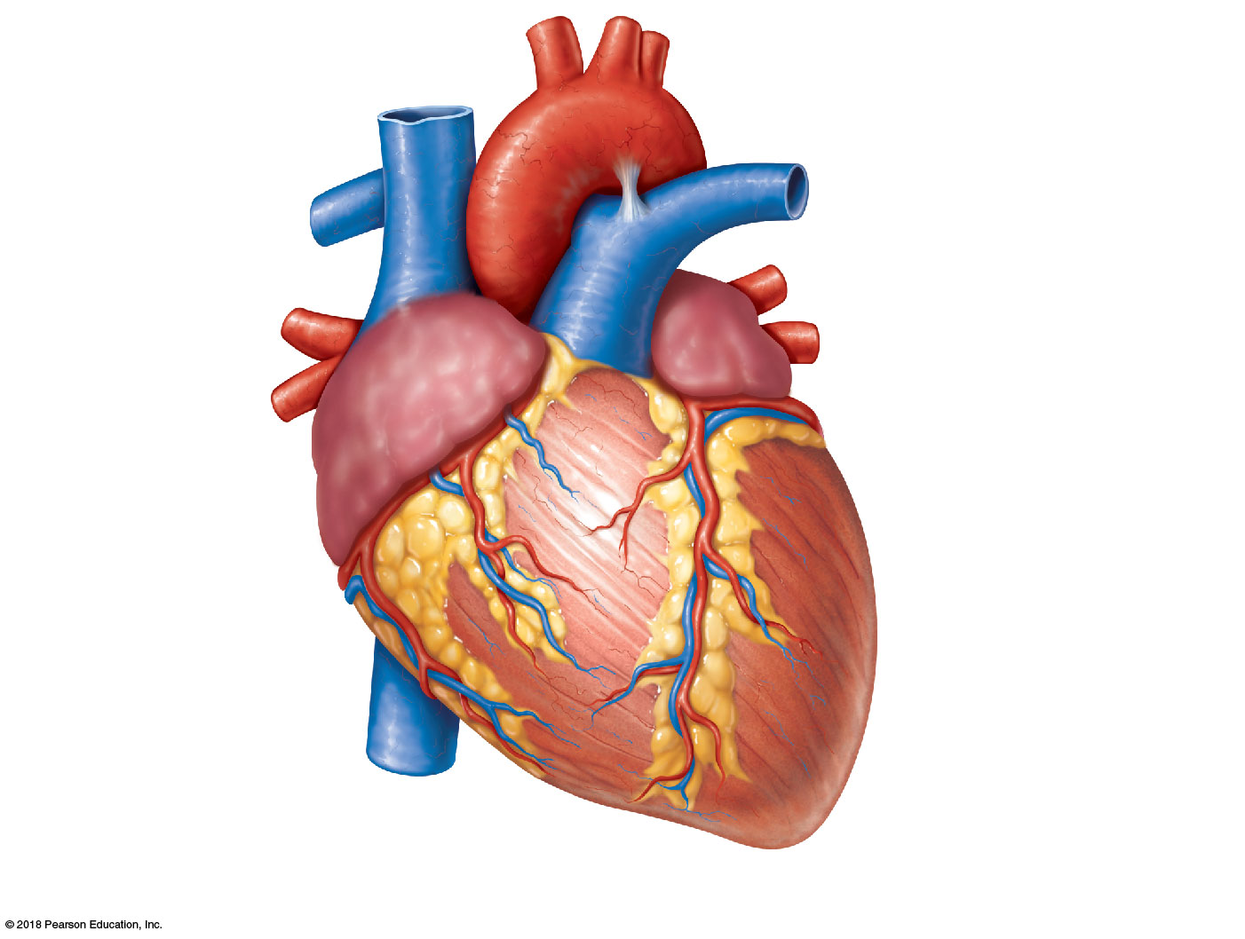
Brachiocephalic trunk
Left common carotid artery
Superior vena cava
Left subclavian artery
Right pulmonary artery
Aortic arch
Ligamentum arteriosum
Ascending aorta
Left pulmonary artery
Pulmonary trunk
Left pulmonary veins
Right pulmonary
veins
Left atrium
Right atrium
Circumflex artery
Right coronary artery
in coronary sulcus (right
atrioventricular groove)
Left coronary artery in
coronary sulcus (left
atrioventricular groove)
Anterior cardiac vein
Left ventricle
Right ventricle
Great cardiac vein
Marginal artery
Anterior interventricular
artery (in anterior
interventricular sulcus)
Small cardiac vein
Inferior vena cava
Apex
(a) Anterior view of heart showing major vessels

Slide 11
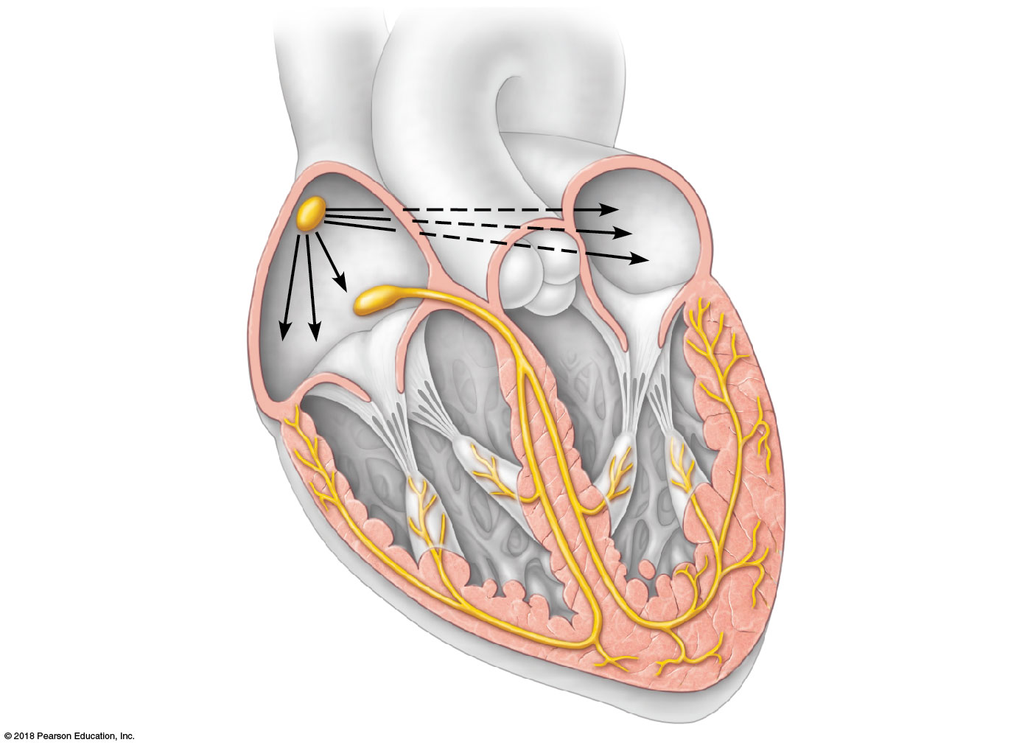
Superior
vena cava
Sinoatrial (SA)
node (pacemaker)
Left atrium
Atrioventricular
(AV) node
Right atrium
Atrioventricular
(AV) bundle
(bundle of His)
Bundle branches
Purkinje fibers
Purkinje fibers
Interventricular
septum

Slide 12
Left atrium
Right atrium
Left ventricle
Right ventricle
1
2
3
4
5
Atrial diastole
(ventricular filling)
Atrial
systole
Isovolumetric
contraction
Ventricular
systole (ejection
phase)
Isovolumetric
relaxation

Slide 13
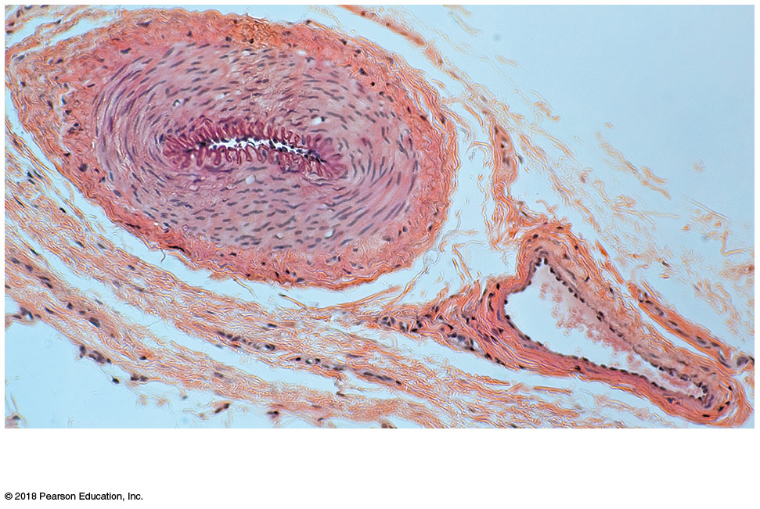
(a)
Artery
Vein

Slide 14
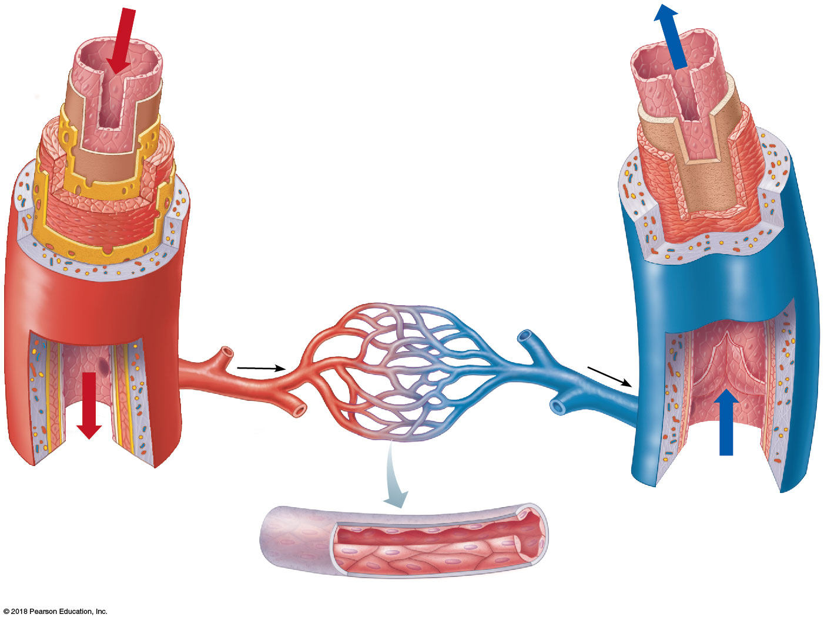
Tunica intima
Artery
• Endothelium
Vein
• Loose connective tissue
Internal elastic lamina
Tunica media
• Smooth muscle
• Elastic fibers
External elastic lamina
Tunica externa
• Collagen fibers
Valve
Venule
Arteriole
Capillary
bed
Lumen
Lumen
Basement membrane
Endothelial cells
(b)
Capillary

Slide 15
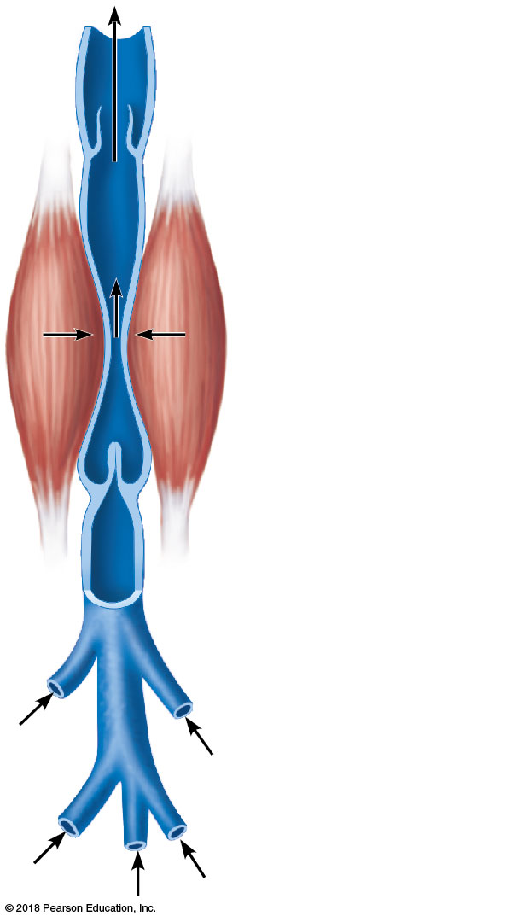
Valve (open)
Contracted
skeletal
muscle
Valve (closed)
Vein
Direction of
blood flow

Slide 16
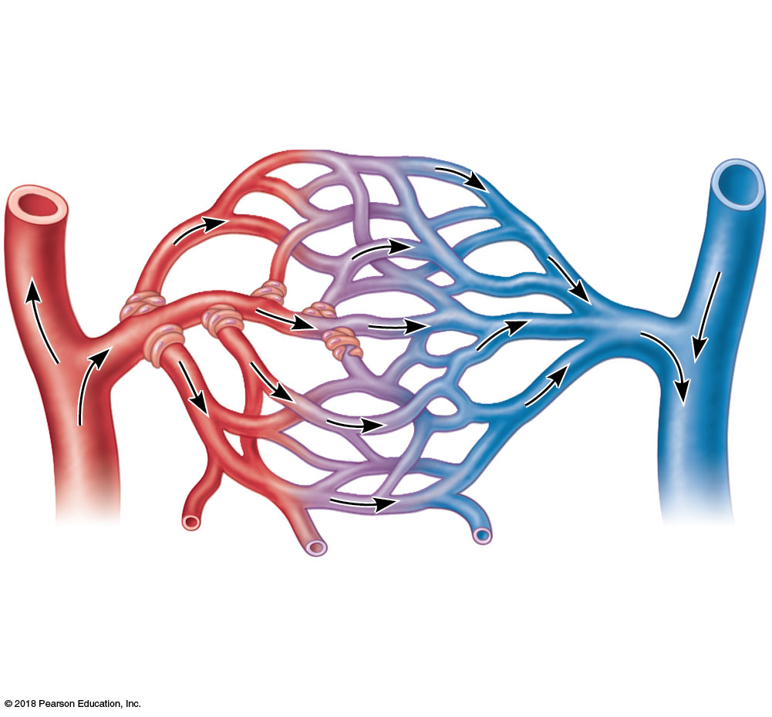
Vascular shunt
Precapillary sphincters
True
capillaries
Terminal arteriole
Postcapillary
venule
(a) Sphincters open; blood flows through true capillaries.

Slide 17
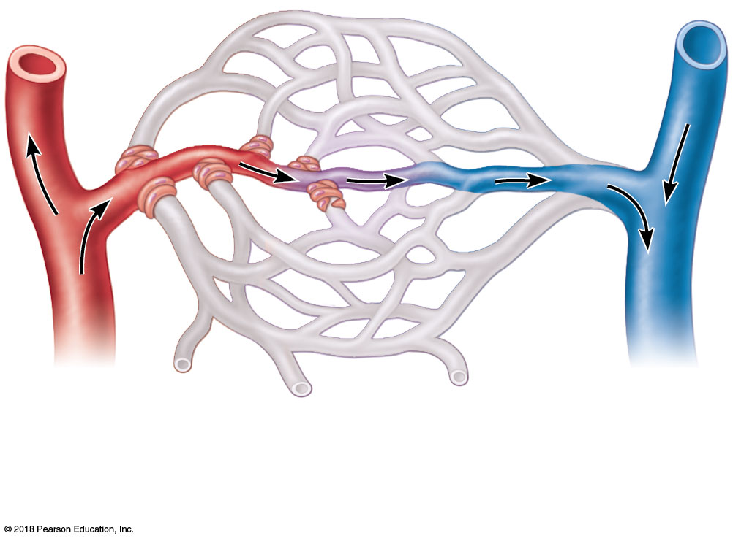
Terminal arteriole
Postcapillary
venule
(b) Sphincters closed; blood flows through vascular shunt.

Slide 18
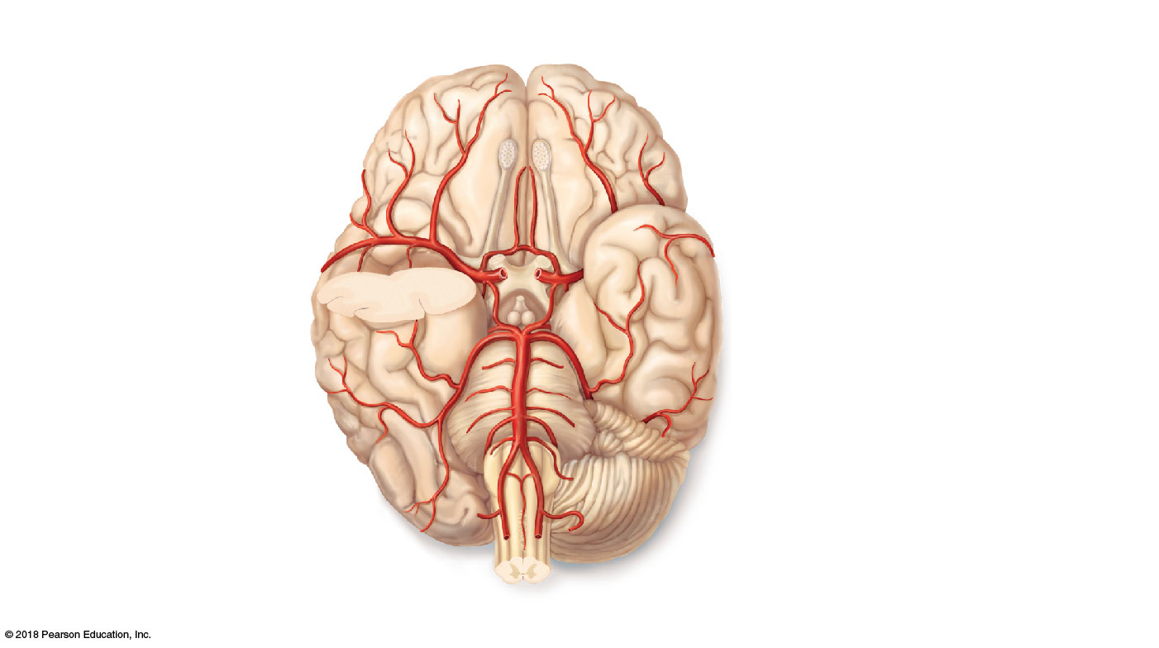
Anterior
Cerebral arterial circle
(circle of Willis)
Frontal lobe
Optic chiasma
• Anterior communicating artery
Middle cerebral
artery
• Anterior cerebral artery
Internal carotid
artery
• Posterior communicating artery
Mammillary body
• Posterior cerebral artery
Temporal lobe
Basilar artery
Pons
Vertebral artery
Occipital lobe
Cerebellum
(a)
Posterior

Slide 19
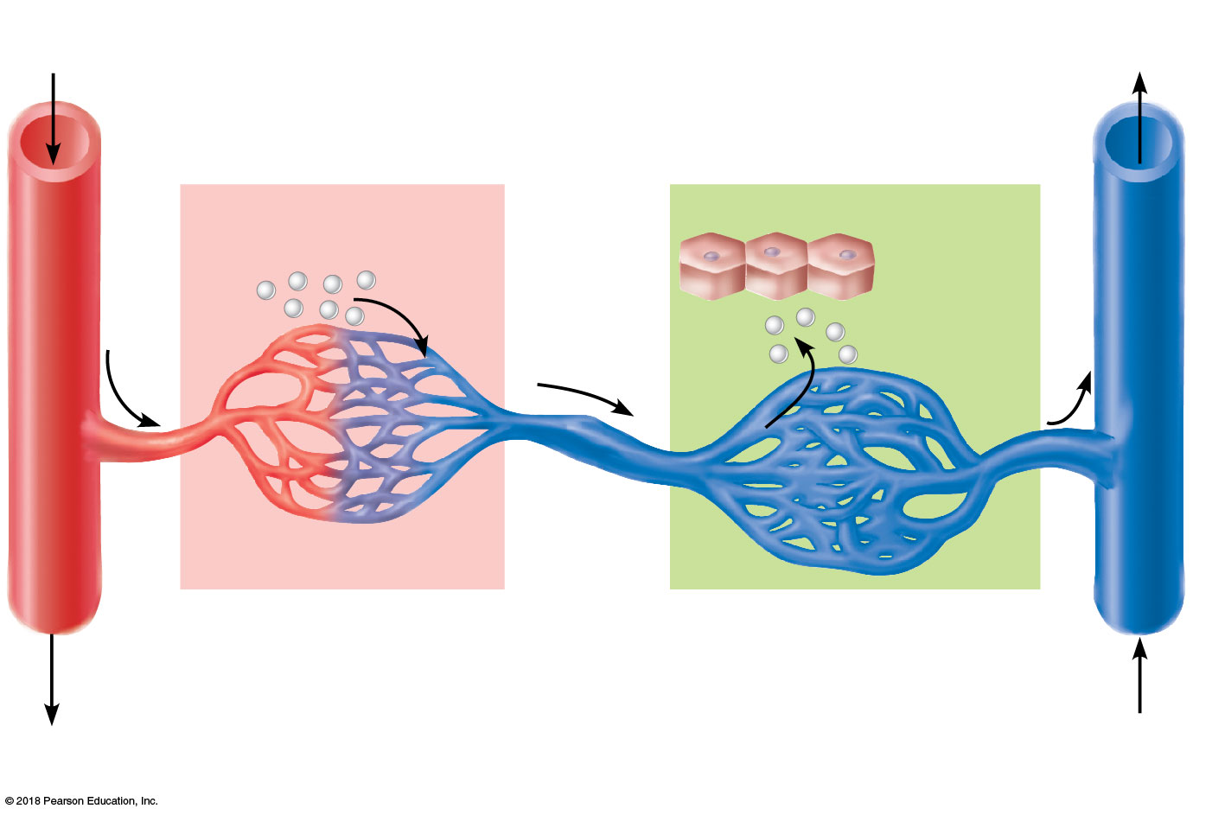
Arterial
blood
Venous
blood
Inferior
vena cava
Stomach and intestine
Liver
Nutrients and
toxins absorbed
Liver cells (hepatocytes)
Nutrients
and toxins
leave
Hepatic
portal vein
First capillary bed
Second capillary bed
(liver sinusoids)
Hepatic
vein
Hepatic portal system

Slide 20
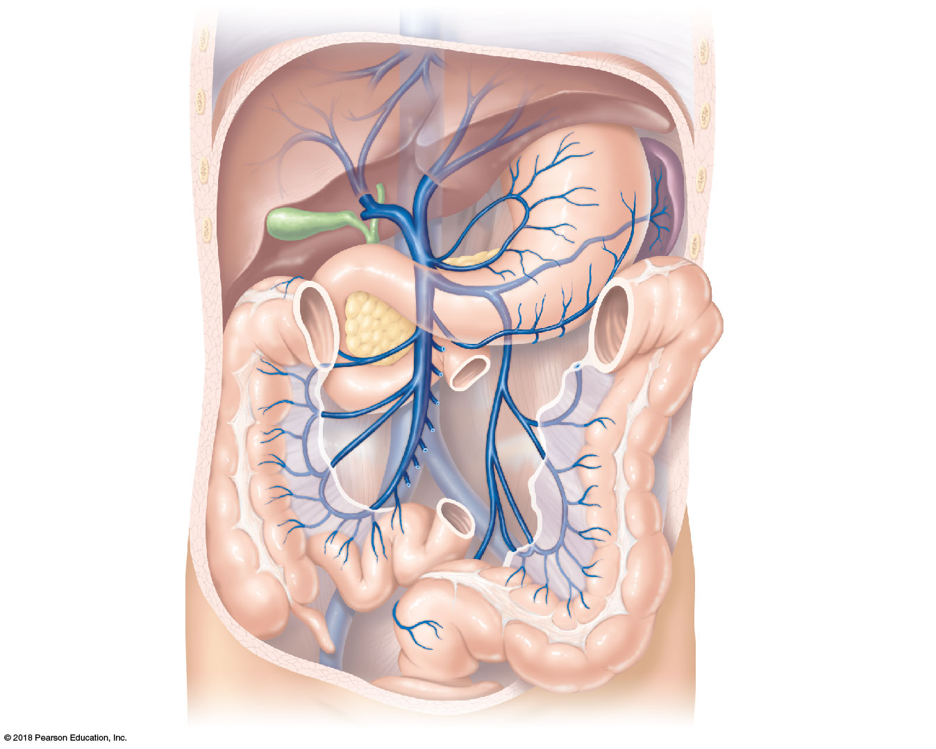
Inferior vena cava
(not part of hepatic
portal system)
Gastric veins
Liver
Spleen
Stomach
Hepatic portal vein
Splenic vein
Pancreas
Inferior
mesenteric vein
Superior
mesenteric vein
Small intestine
Large intestine

Slide 21
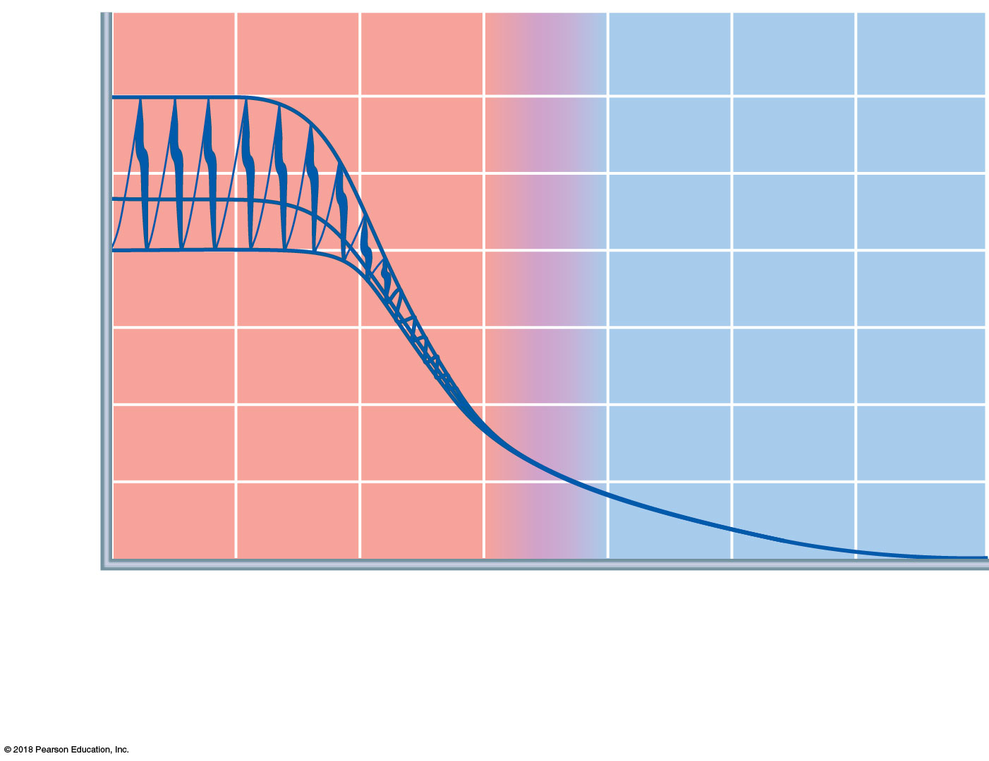
Blood pressure (mm Hg)
120
Systolic pressure
100
80
60
Diastolic
pressure
40
20
0
Aorta
Arteries
Venules
Veins
Arterioles
Capillaries
Venae cavae

Slide 22
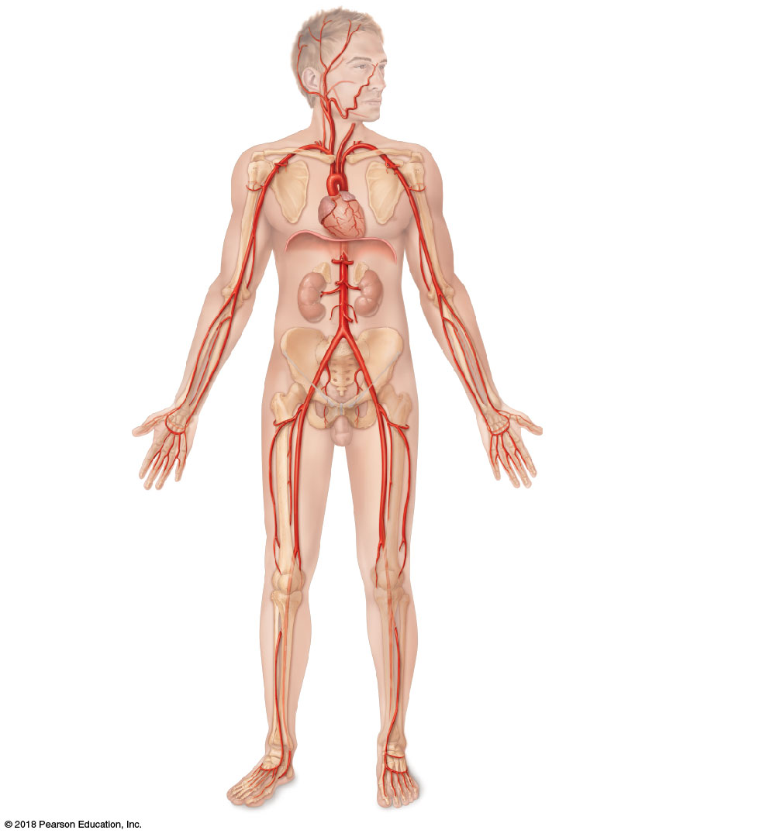
Arteries of the head and trunk
Internal carotid artery
External carotid artery
Common carotid arteries
Arteries that supply the upper limb
Vertebral artery
Subclavian artery
Subclavian artery
Brachiocephalic trunk
Axillary artery
Aortic arch
Ascending aorta
Coronary artery
Thoracic aorta
Brachial artery
(above diaphragm)
Celiac trunk
Abdominal aorta
Radial artery
Superior mesenteric
artery
Ulnar artery
Renal artery
Gonadal artery
Deep palmar arch
Superficial palmar arch
Digital arteries
Inferior mesenteric artery
Arteries that supply the lower limb
Common iliac artery
External iliac artery
Femoral artery
Popliteal artery
Internal iliac artery
Anterior tibial artery
Posterior tibial artery
Dorsalis pedis artery
Arcuate artery

Slide 23
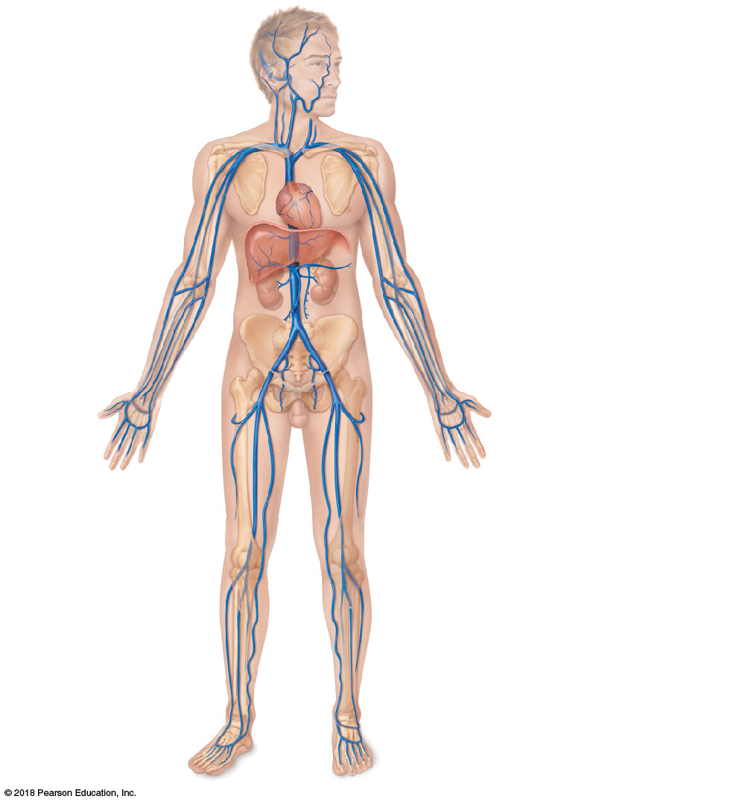
Veins of the head and trunk
Dural venous sinuses
External jugular vein
Vertebral vein
Veins that drain the upper limb
Internal jugular vein
Subclavian vein
Right and left
brachiocephalic veins
Axillary vein
Superior vena cava
Cephalic vein
Brachial vein
Great cardiac vein
Basilic vein
Hepatic veins
Splenic vein
Hepatic portal vein
Median cubital vein
Renal vein
Superior
mesenteric vein
Ulnar vein
Radial vein
Inferior
mesenteric vein
Digital veins
Veins that drain the lower limb
Inferior vena cava
External iliac vein
Femoral vein
Common iliac vein
Great saphenous vein
Internal iliac vein
Popliteal vein
Posterior tibial vein
Anterior tibial vein
Small saphenous vein
Dorsal venous arch
Dorsal metatarsal veins

