Slide 1
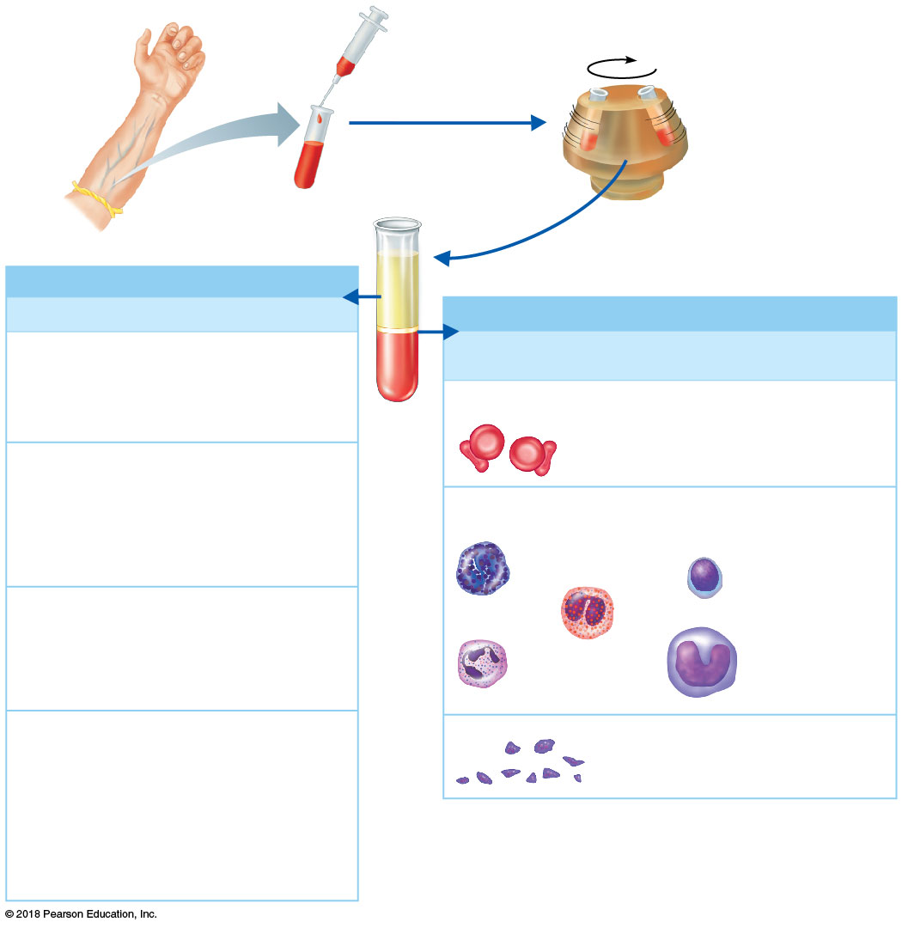
Plasma 55%
Constituent
Major Functions
Formed elements (cells) 45%
Water
90% of plasma
volume; solvent
for carrying other
substances;
absorbs heat
Cell Type
Number
(per mm³ of blood)
Functions
Erythrocytes
(red blood cells)
4–6 million
Transport oxygen
and help transport
carbon dioxide
Salts (electrolytes)
Osmotic balance,
pH buffering,
regulation of
membrane
permeability
Sodium
Potassium
Leukocytes
(white blood cells)
Calcium
4,800–10,800
Defense and
immunity
Magnesium
Chloride
Bicarbonate
Lymphocyte
Plasma proteins
Osmotic balance,
pH buffering
Basophil
Albumin
Fibrinogen
Clotting of blood
Eosinophil
Globulins
Defense (antibodies)
and lipid transport
Monocyte
Neutrophil
Substances transported by blood
Platelets
Nutrients (glucose, fatty acids, amino
acids, vitamins)
250,000–400,000
Blood clotting
Waste products of metabolism
(urea, uric acid)
Respiratory gases (O₂ and CO₂)
Hormones (steroids and thyroid hormone
are carried by plasma proteins)
© 2018 Pearson Education, Inc.

Slide 2
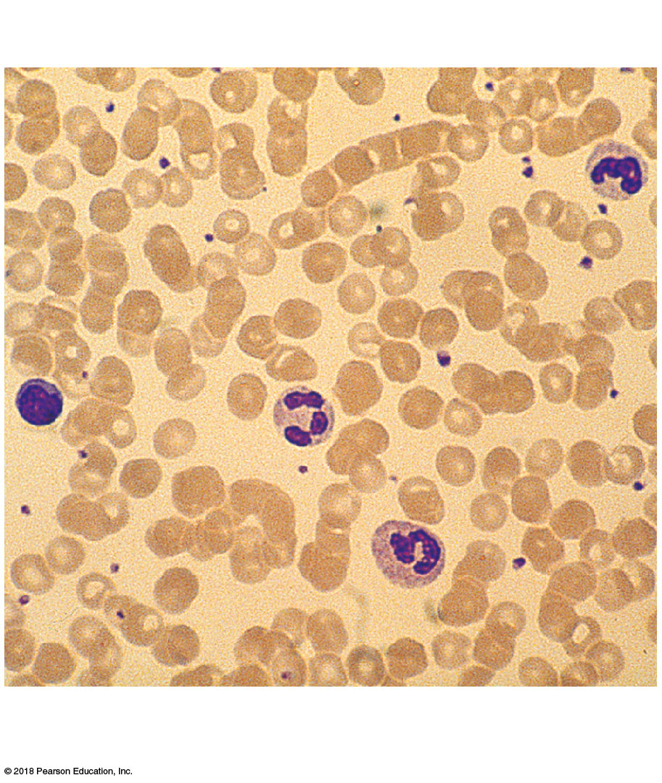
Lymphocyte
Platelets
Erythrocytes
Neutrophils
© 2018 Pearson Education, Inc.

Slide 3
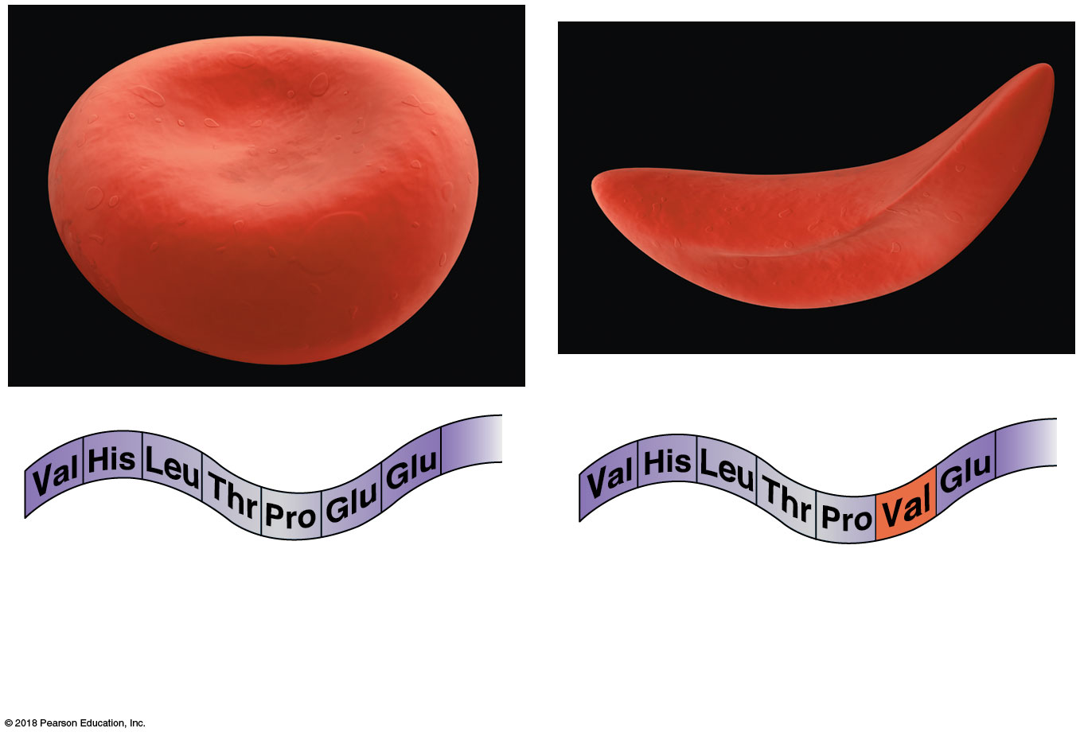
2
3
7...146
2
3
7...146
1
4
1
6
4
6
5
5
(a) Normal RBC and part of the amino acid sequence of its hemoglobin
(b) Sickled RBC and part of its hemoglobin sequence

Slide 4
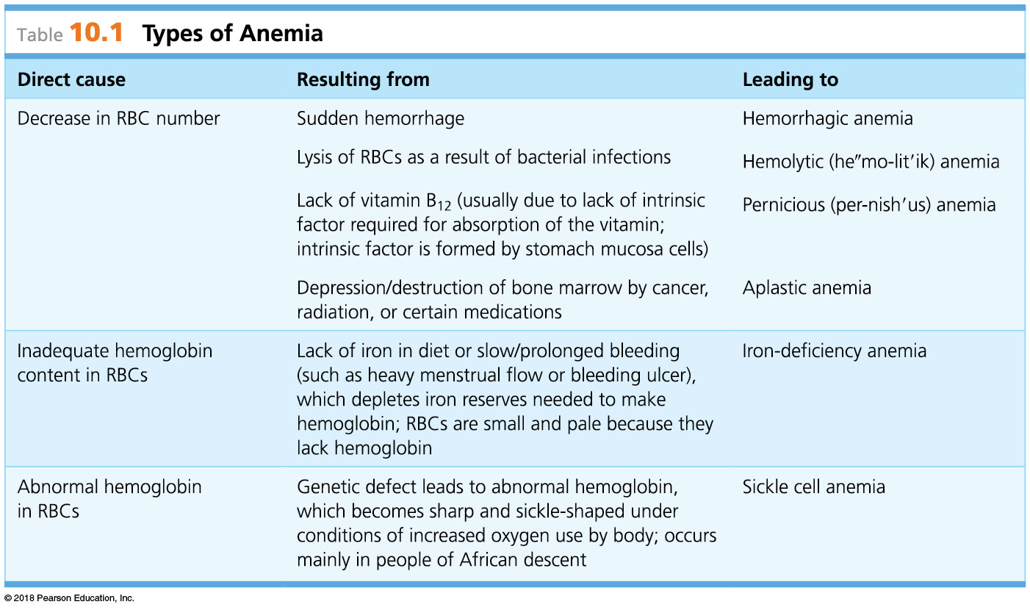
© 2018 Pearson Education, Inc.

Slide 5
© 2018 Pearson Education, Inc.

Slide 6
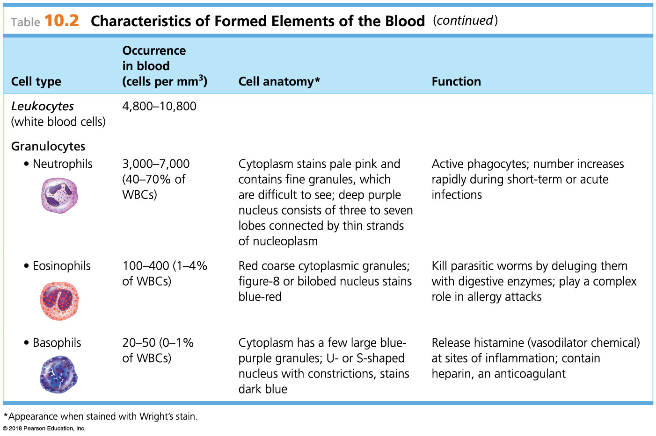
© 2018 Pearson Education, Inc.

Slide 7
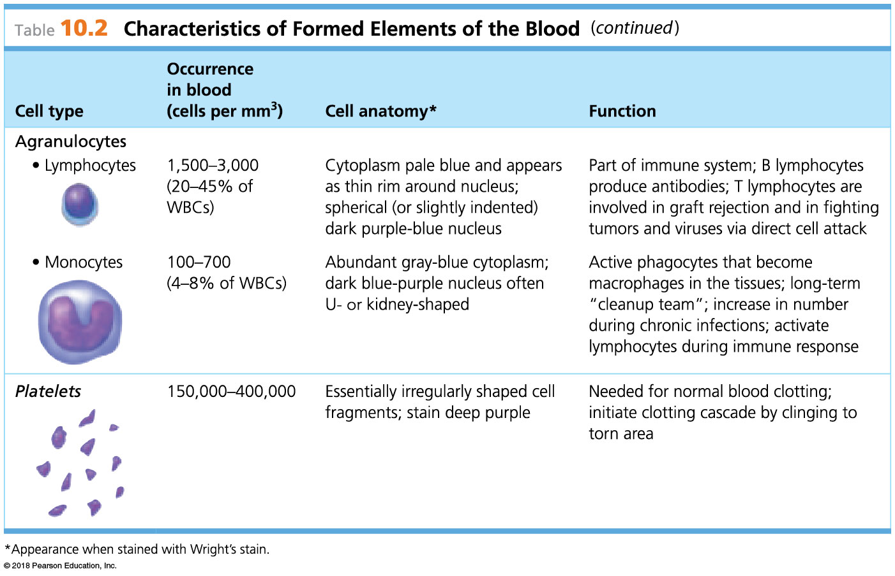
© 2018 Pearson Education, Inc.

Slide 8
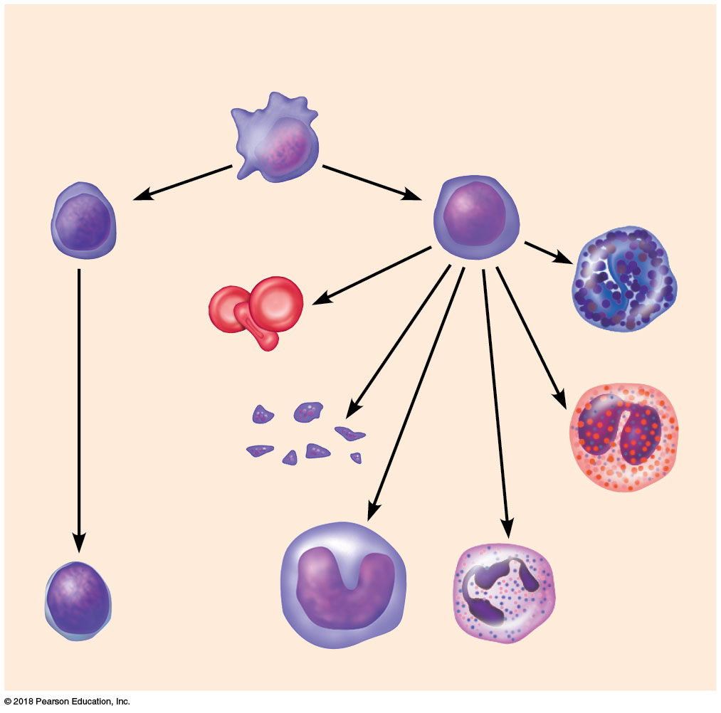
Hemocytoblast
stem cells
Lymphoid
stem cells
Myeloid
stem cells
Secondary stem cells
Basophils
Erythrocytes
Platelets
Eosinophils
Lymphocytes
Monocytes
Neutrophils
© 2018 Pearson Education, Inc.

Slide 9
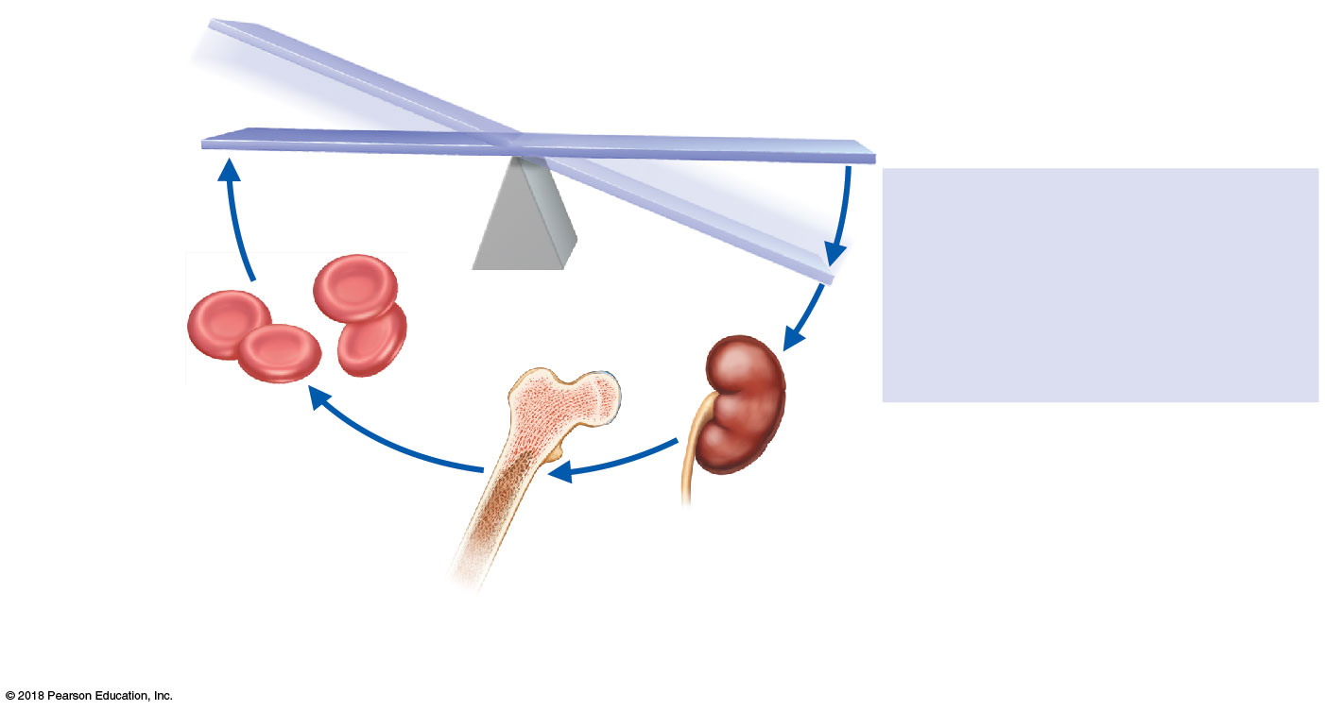
IMBALANCE
Homeostasis: Normal blood oxygen levels
1
Stimulus
5
Low blood O₂–carrying ability
due to
O₂–carrying
ability of blood
increases.
IMBALANCE
• Decreased RBC count
• Decreased amount of hemoglobin
• Decreased availability of O₂
4
Enhanced
erythropoiesis
increases RBC
count.
2
Kidneys (and liver,
to a smaller extent)
release erythropoietin.
3
Erythropoietin
stimulates red bone
marrow.

Slide 10
1
Step Vascular spasms occur.
• Smooth muscle contracts, causing vasoconstriction.

Slide 11
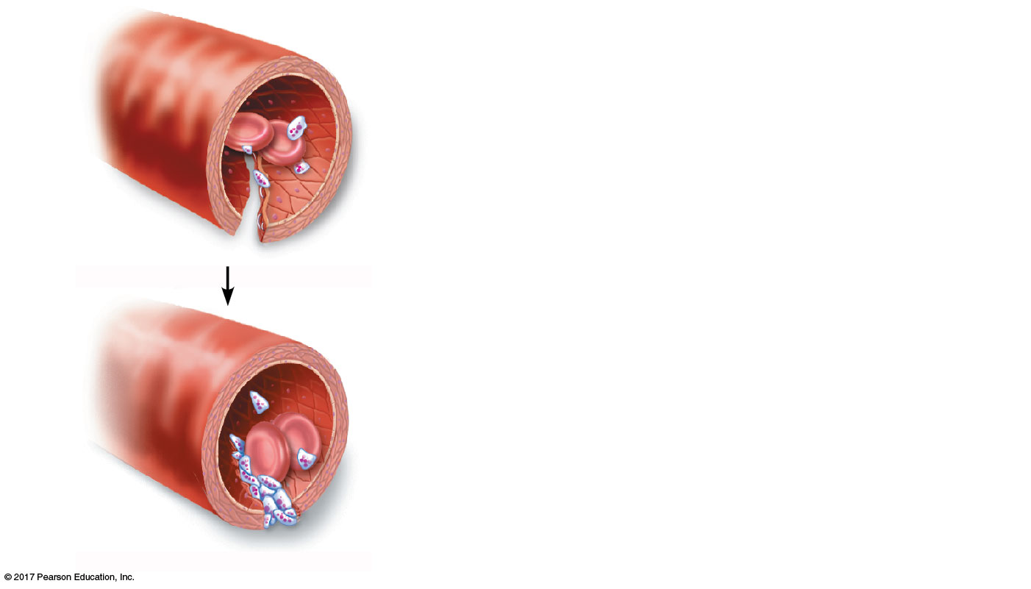
2
Step Platelet plug forms.
• Injury to lining of vessel exposes collagen fibers; platelets adhere.
Collagen
fibers
• Platelets release chemicals that make nearby platelets sticky; platelet plug forms.
Platelets

Slide 12
Step Coagulation events occur.
3
• Clotting factors present in plasma and released by injured tissue cells interact with Ca²⁺ to form thrombin, the enzyme that catalyzes joining of fibrinogen molecules in plasma to fibrin.
Fibrin
• Fibrin forms a mesh that traps red blood cells and platelets, forming the clot.

Slide 13
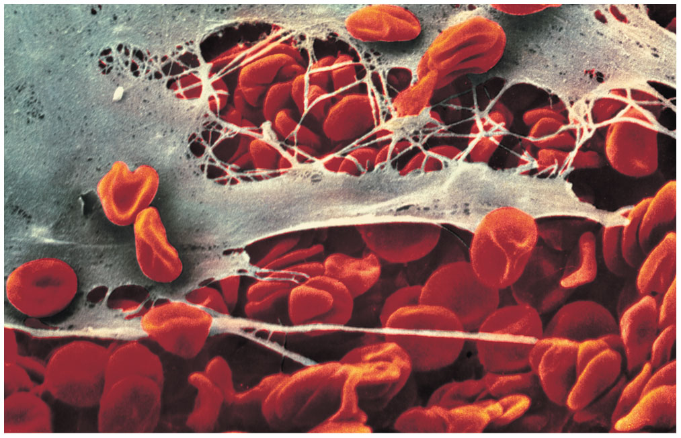
© 2018 Pearson Education, Inc.

Slide 14
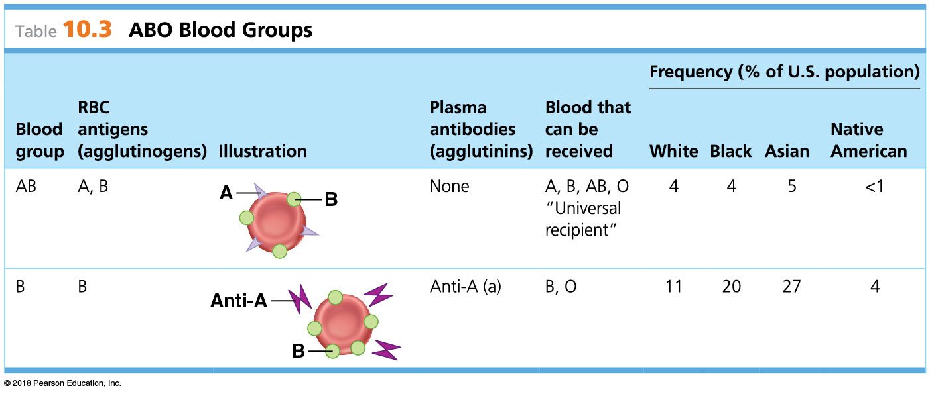
© 2018 Pearson Education, Inc.

Slide 15
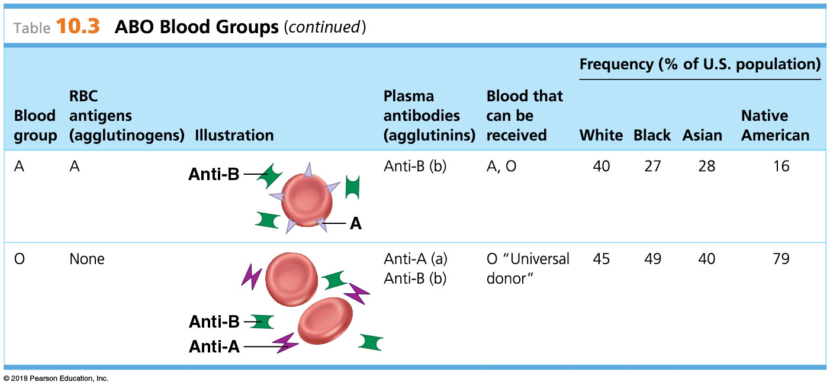
© 2018 Pearson Education, Inc.

Slide 16
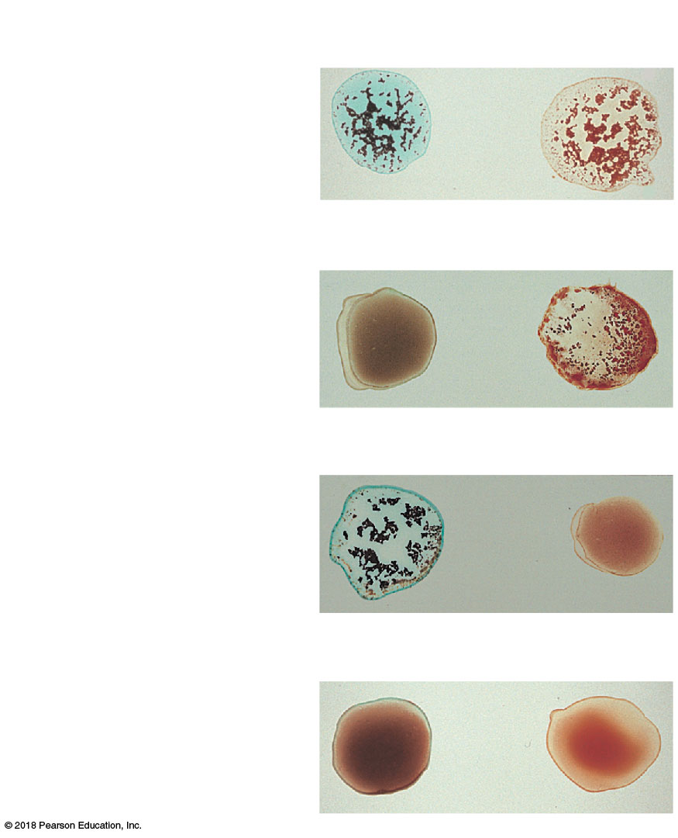
Blood being tested
Serum
Anti-A
Anti-B
Type AB
(contains antigens A and B;
agglutinates with both sera)
Agglutinated
RBCs
Type B
(contains antigen B;
agglutinates with
anti-B serum)
Type A
(contains antigen A;
agglutinates with
anti-A serum)
Type O
(contains no antigens;
does not agglutinate with
either serum)
© 2018 Pearson Education, Inc.

