Slide 1
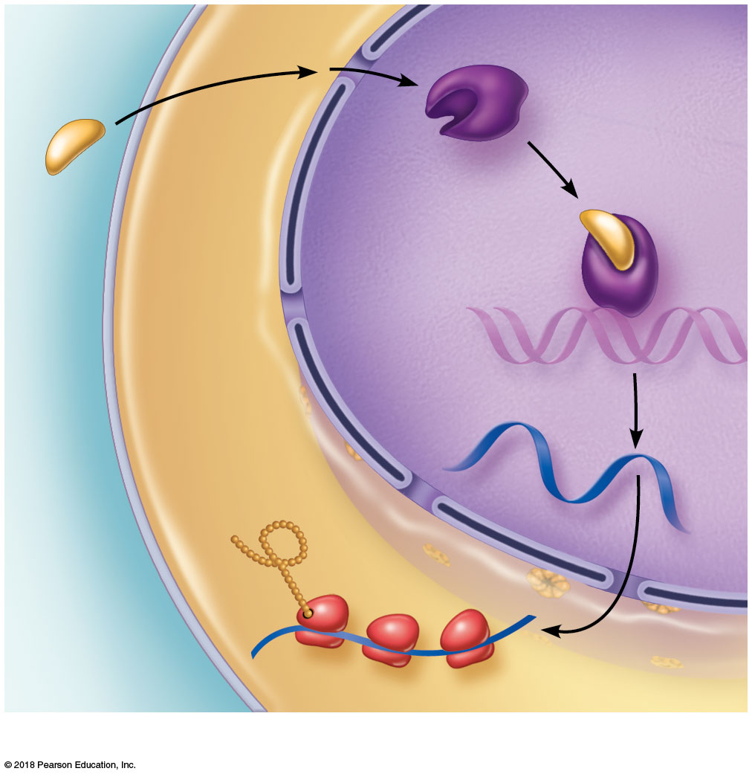
Steroid hormone
Cytoplasm
Nucleus
Receptor protein
1
2
3
Hormone-receptor complex
4
DNA
mRNA
5
New protein
Plasma membrane of target cell
6
(a) Direct gene activation

Slide 2
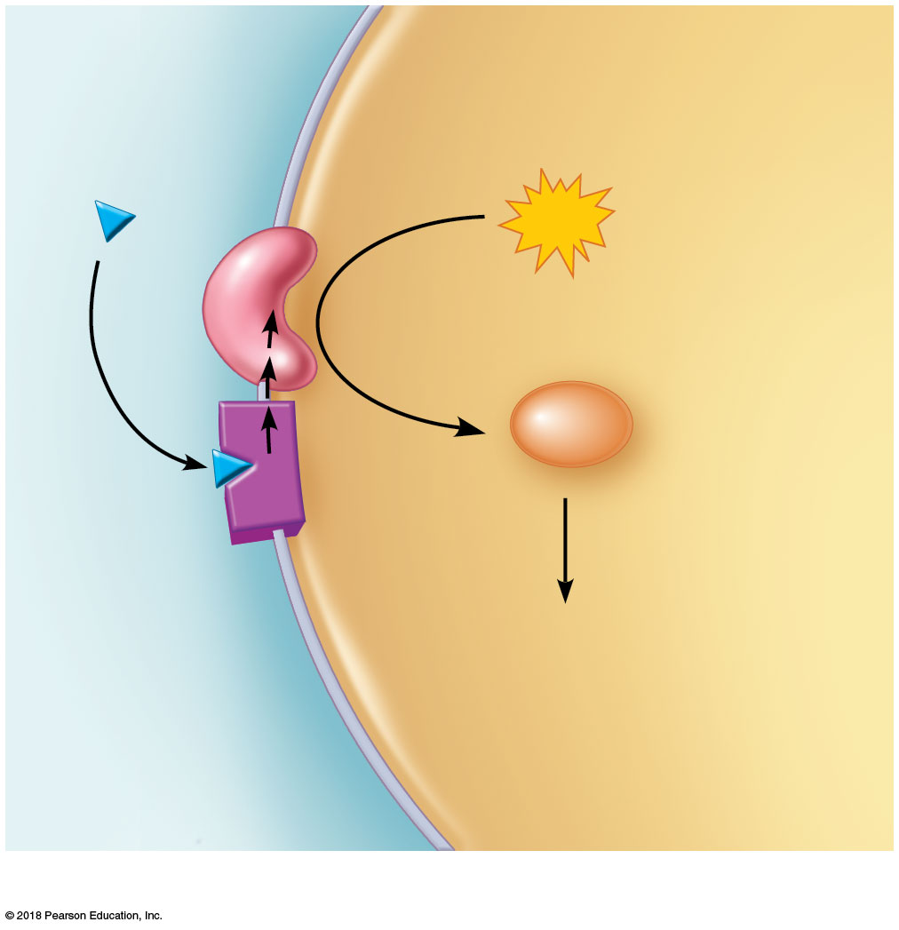
Cytoplasm
Hormone (first messenger)
Enzyme
ATP
1
2
3
cAMP
Second messenger
Receptor protein
4
Effect on cellular function, such as glycogen breakdown
Plasma membrane of target cell
(b) Second-messenger system

Slide 3
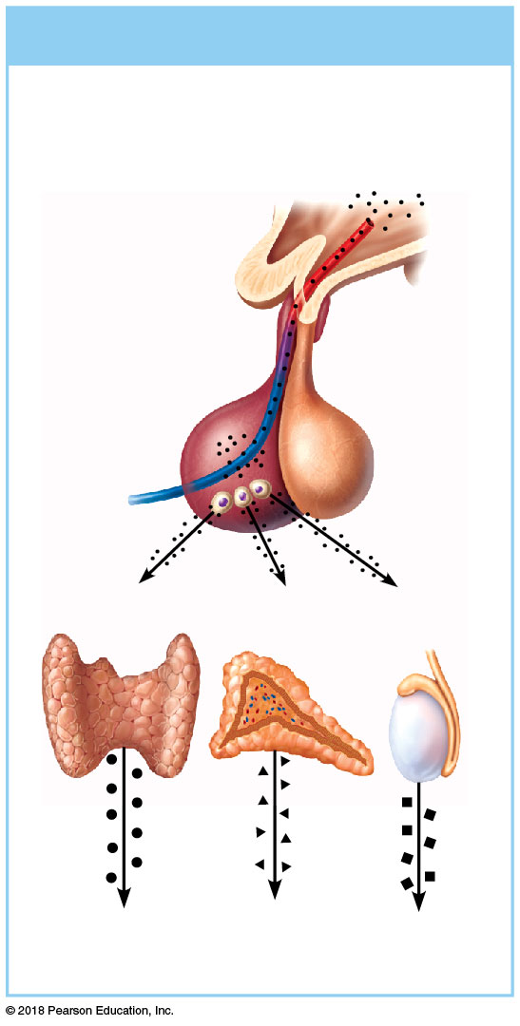
(a) Hormonal stimulus
The hypothalamus secretes hormones that…
1
Hypothalamus
…stimulate
the anterior
pituitary
gland to
secrete hormones that…
2
Anterior pituitary gland
Thyroid
gland
Adrenal
cortex
Gonad
(testis)
…stimulate other endocrine glands to secrete hormones
3

Slide 4
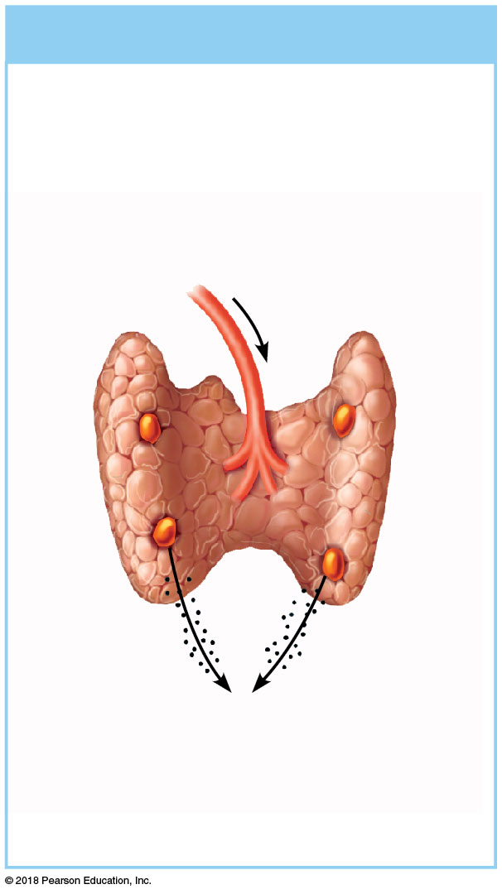
(b) Humoral stimulus
Capillary blood contains low concentration of Ca²⁺, which stimulates…
1
Capillary (low Ca²⁺ in blood)
Thyroid gland (posterior view)
Parathyroid glands
Parathyroid glands
PTH
…secretion of parathyroid hormone (PTH) by parathyroid glands
2

Slide 5
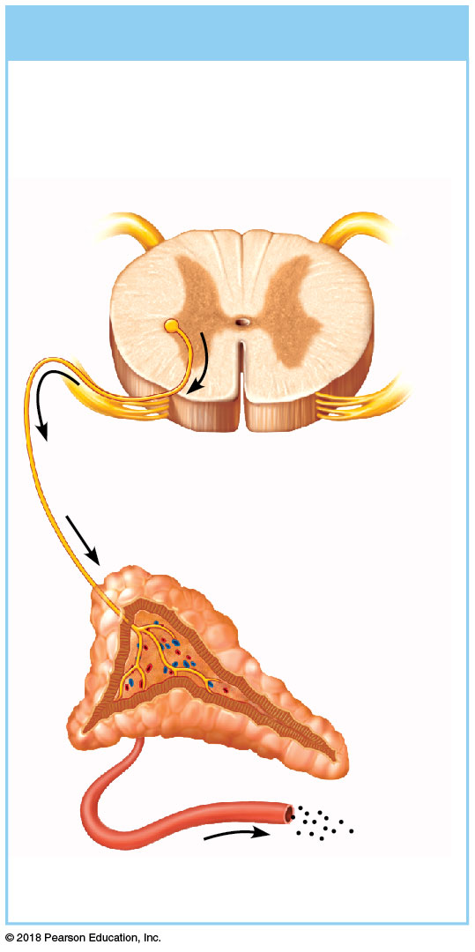
(c) Neural stimulus
Preganglionic sympathetic fiber stimulates adrenal medulla cells…
1
CNS (spinal cord)
Preganglionic sympathetic fibers
Medulla of adrenal gland
Capillary
…to secrete catecholamines (epinephrine and norepinephrine)
2

Slide 6
Pineal gland
Hypothalamus
Pituitary gland
Thyroid gland
Parathyroid glands
Thymus
Adrenal glands
Pancreas
Ovary (female)
Testis (male)

Slide 7
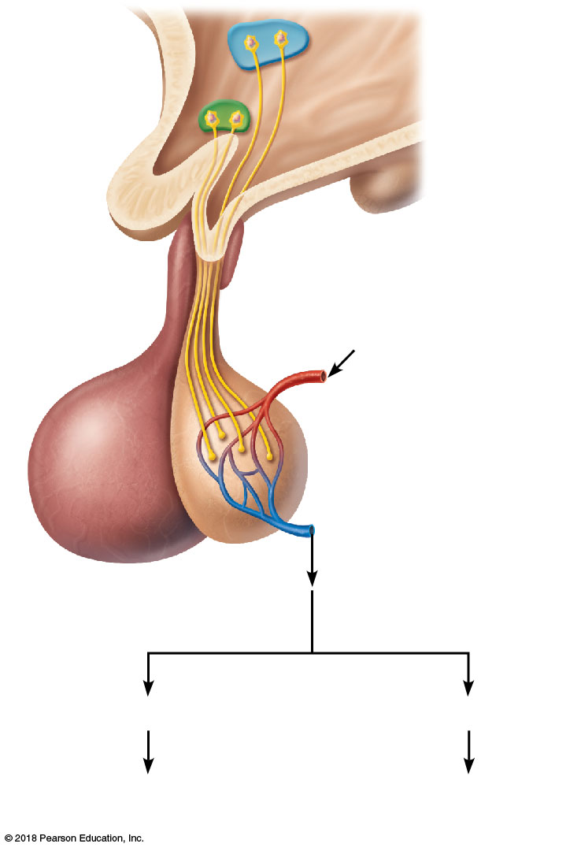
Hypothalamic neurosecretory cells
Optic chiasma
Hypothalamus
Axon
terminals
Arterial blood supply
Posterior lobe
Capillary bed
Venous drainage
Anterior lobe
of the pituitary
ADH
Oxytocin
Kidney tubules
Mammary glands Uterine muscles

Slide 8
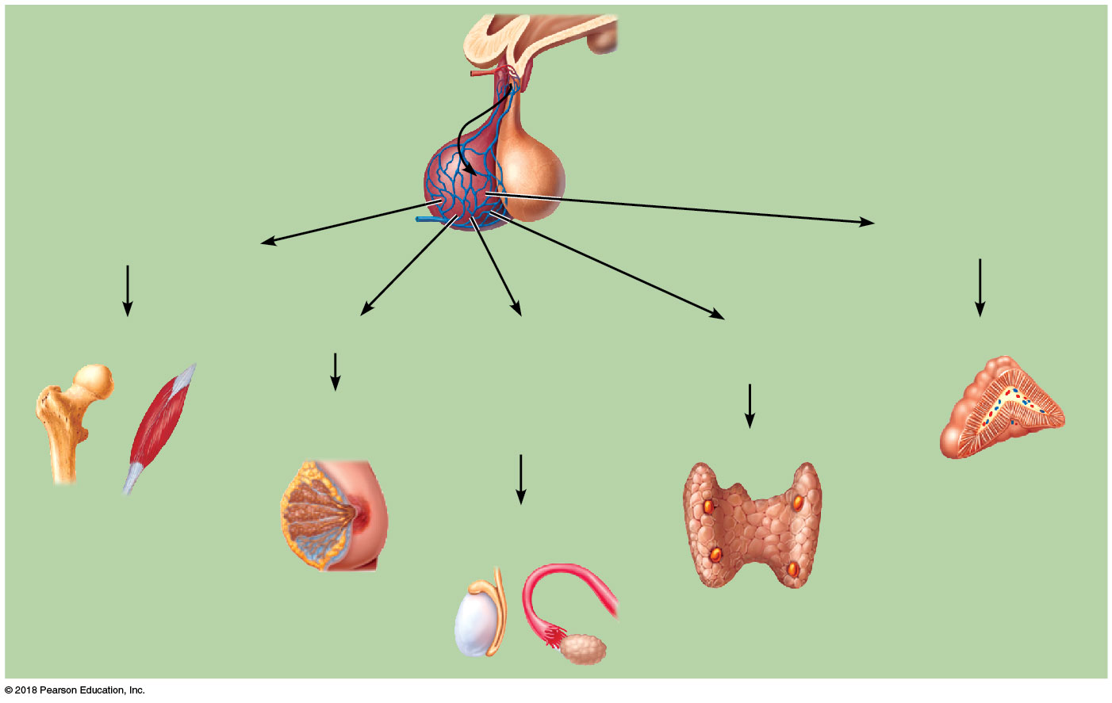
Releasing hormones secreted into portal circulation
Hypothalamus
Anterior pituitary
Posterior pituitary
Hypophyseal
portal system
Adrenocorticotropic
hormone (ACTH)
Growth hormone (GH)
Bones and muscles
Prolactin (PRL)
Follicle-stimulating hormone (FSH)
and luteinizing
hormone (LH)
Thyrotropic
hormone (TH)
Adrenal cortex
Mammary glands
Thyroid
Testes or ovaries

Slide 9
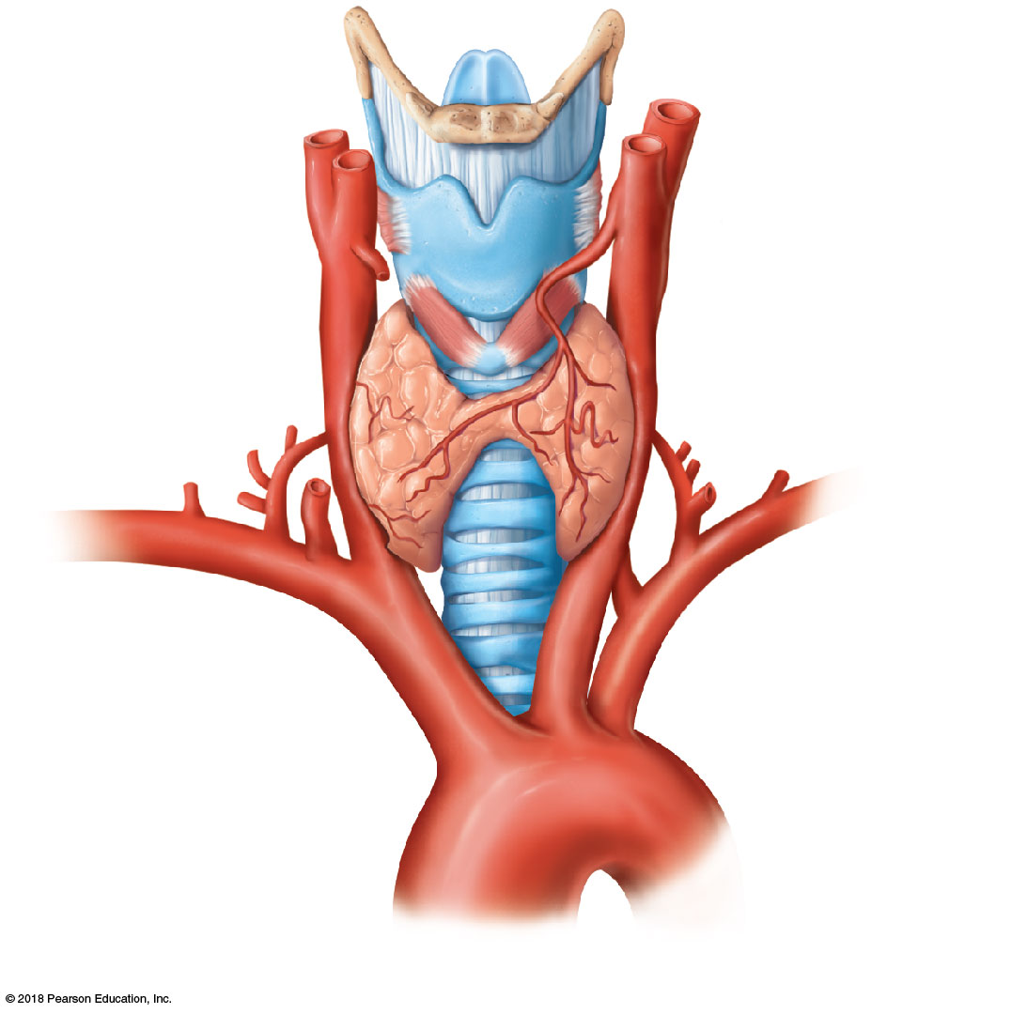
Thyroid cartilage
Epiglottis
Common carotid
artery
Isthmus of
thyroid gland
Trachea
Left subclavian artery
Brachiocephalic
artery
Left lobe of
thyroid gland
Aorta
(a) Gross anatomy of the thyroid gland, anterior view

Slide 10
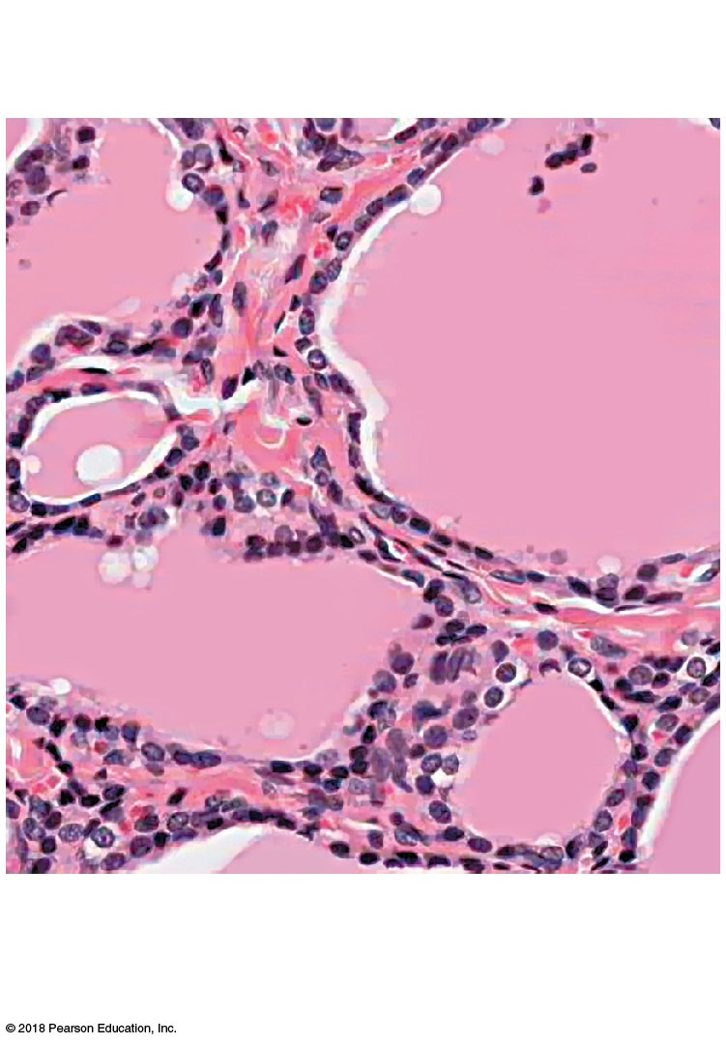
Colloid-filled
follicles
Follicle cells
Parafollicular cells
(b) Photomicrograph of thyroid gland
follicles (380x)

Slide 11
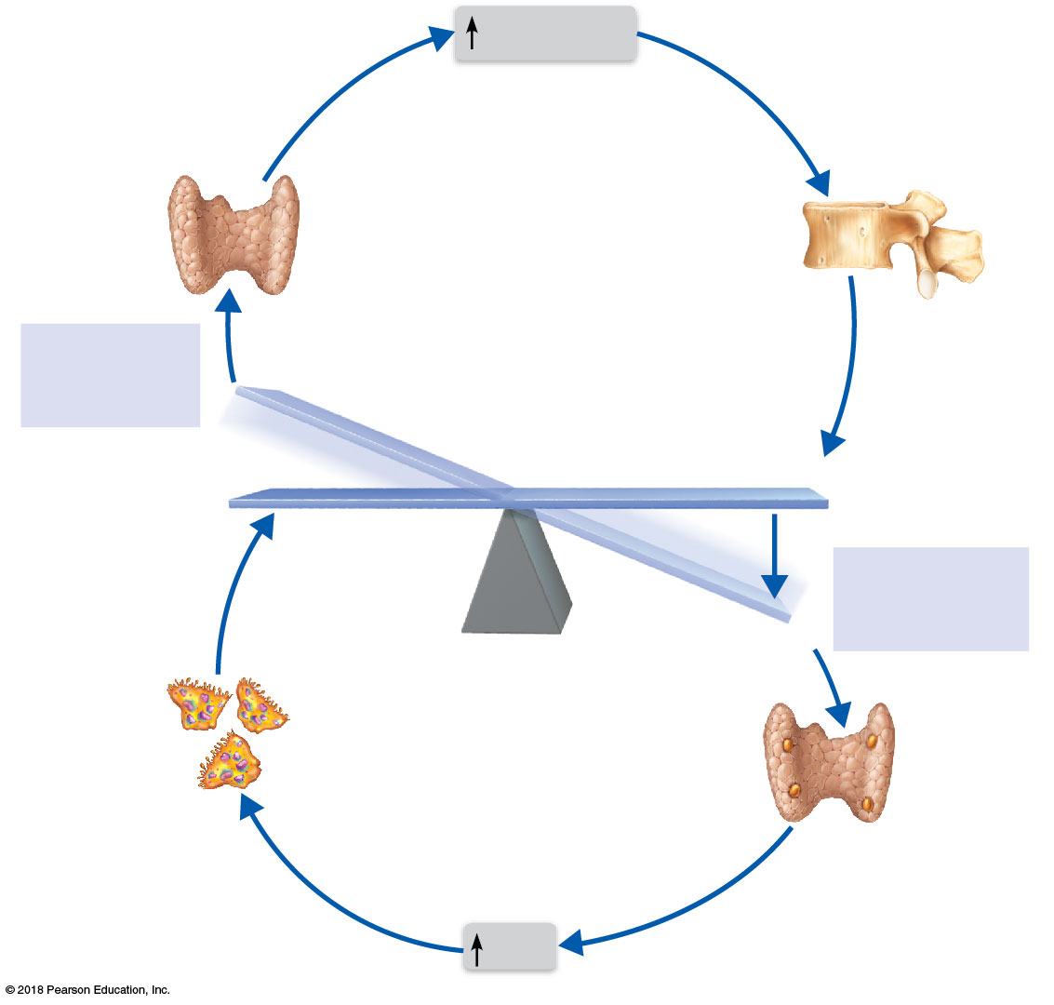
Calcitonin
Calcitonin
stimulates
calcium salt
deposit in bone.
Thyroid gland
releases calcitonin.
Stimulus
Rising blood
Ca²⁺ levels
IMBALANCE
Calcium homeostasis of blood:
9–11 mg/100 ml
BALANCE
BALANCE
Stimulus
Falling blood
Ca²⁺ levels
IMBALANCE
Thyroid
gland
Osteoclasts
degrade bone
matrix and release
Ca²⁺ into blood.
Parathyroid
glands
Parathyroid
glands release
parathyroid
hormone (PTH).
PTH

Slide 12
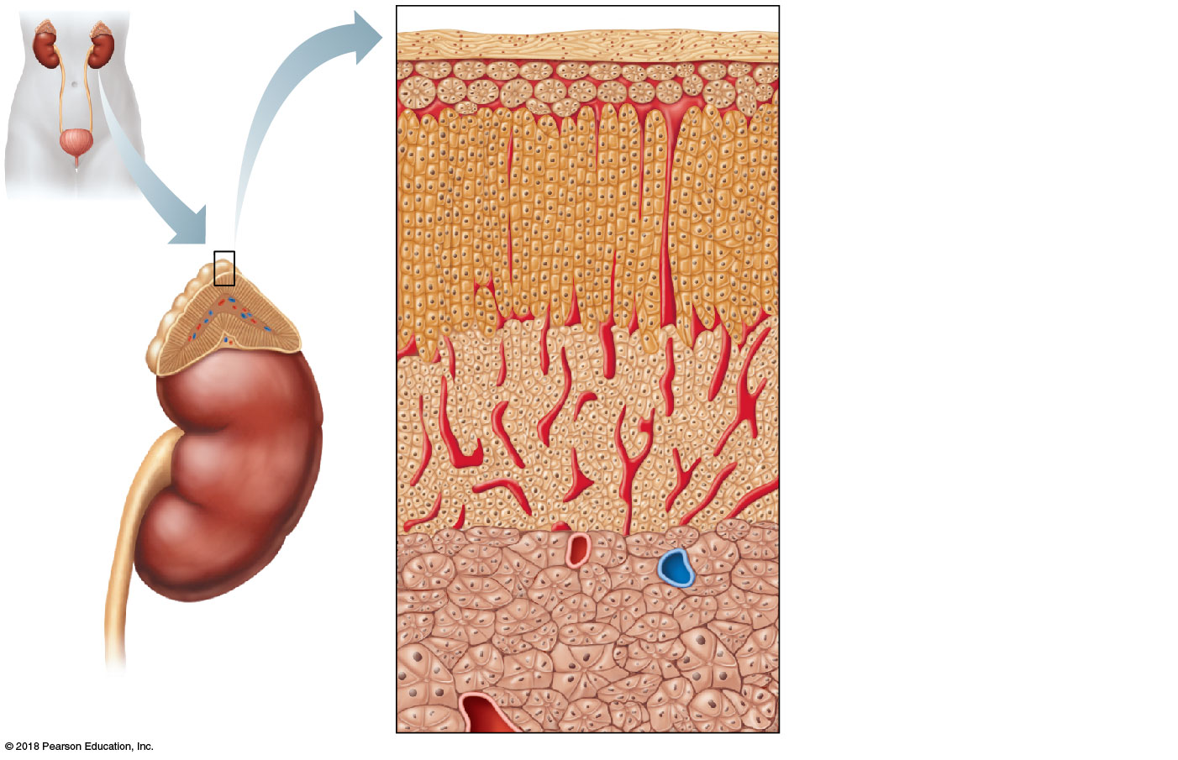
Adrenal gland
Capsule
Mineralocorticoid- secreting area
Kidney
Glucocorticoid- secreting area
Cortex
Adrenal gland
Adrenal cortex
Medulla
Cortex
Sex hormone- secreting area
Kidney
Medulla
Adrenal
medulla

Slide 13
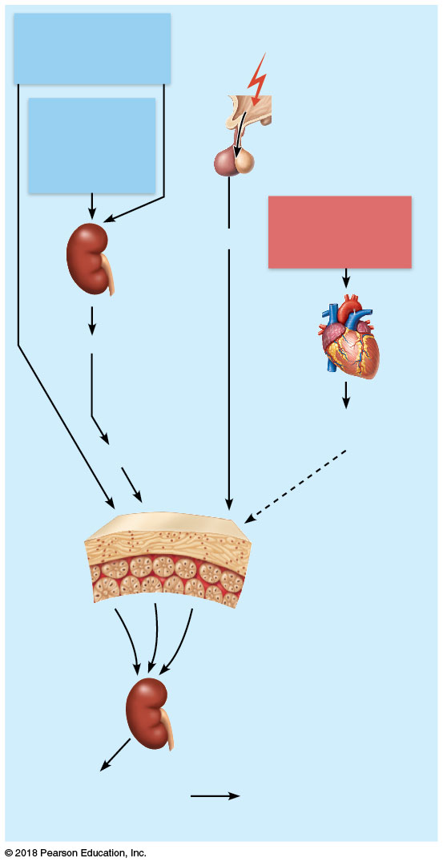
Decreased Na⁺ or
increased K⁺ in
blood
Stress
Hypothalamus
Decreased
blood volume and/or blood pressure
Corticotropin- releasing hormone
Anterior pituitary
Increased
blood pressure
or blood volume
Kidney
ACTH
Renin
Heart
Indirect stimulating effect via angiotensin
Atrial natriuretic peptide (ANP)
Angiotensin II
Direct stimulating effect
Inhibitory effect
Mineralocorticoid- producing part of adrenal cortex
Enhanced secretion
of aldosterone targets
kidney tubules
Increased absorption
of Na⁺ and water;
increased K⁺ excretion
Increased blood volume and
blood pressure

Slide 14
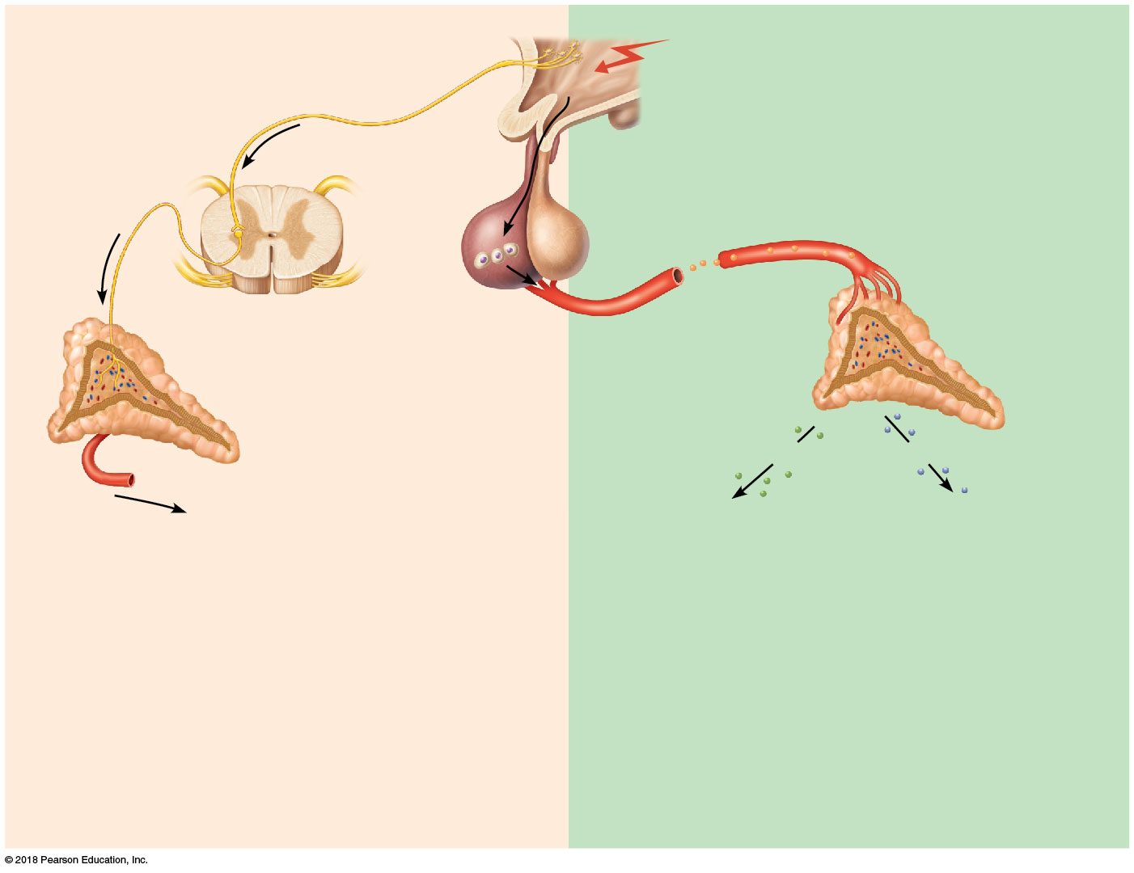
Short term
Stress
More prolonged
Hypothalamus
Releasing hormones
Nerve impulses
Spinal cord
Corticotropic cells of anterior pituitary
ACTH
Adrenal cortex
Preganglionic sympathetic
fibers
Adrenal
medulla
Mineralocorticoids
Glucocorticoids
Short-term stress response
Long-term stress response
Catecholamines (epinephrine and norepinephrine)
Increased heart rate
Increased blood pressure
Liver converts glycogen to glucose and releases glucose to blood
Dilation of bronchioles
Changes in blood flow patterns, leading to increased alertness and decreased digestive and kidney activity
Increased metabolic rate
Retention of sodium and water by kidneys
Increased blood volume and blood pressure
Proteins and fats converted to glucose or broken down for energy
Increased blood sugar
Suppression of immune system

Slide 15
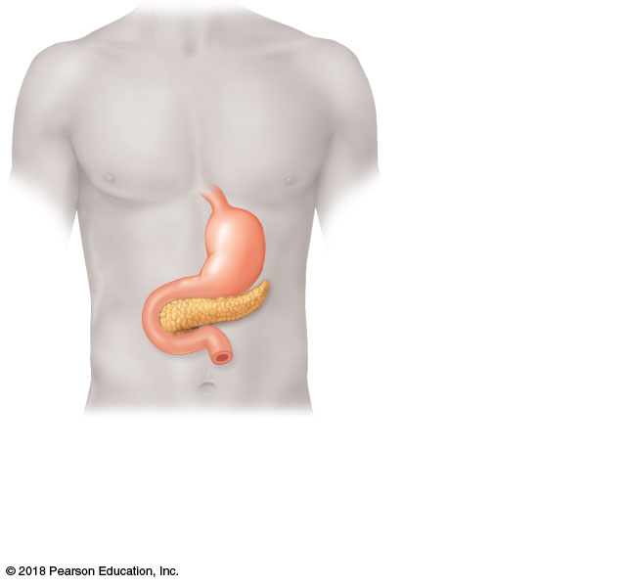
Stomach
Pancreas
(a)

Slide 16
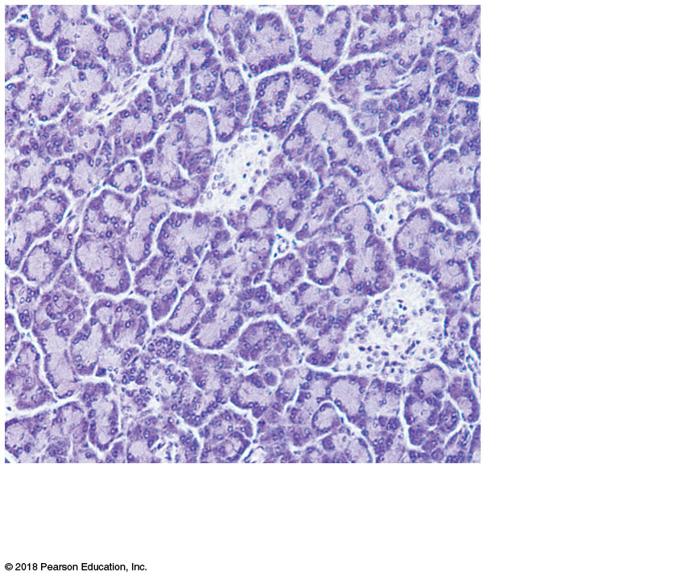
Exocrine cells of pancreas
Pancreatic
islets
(b)

Slide 17
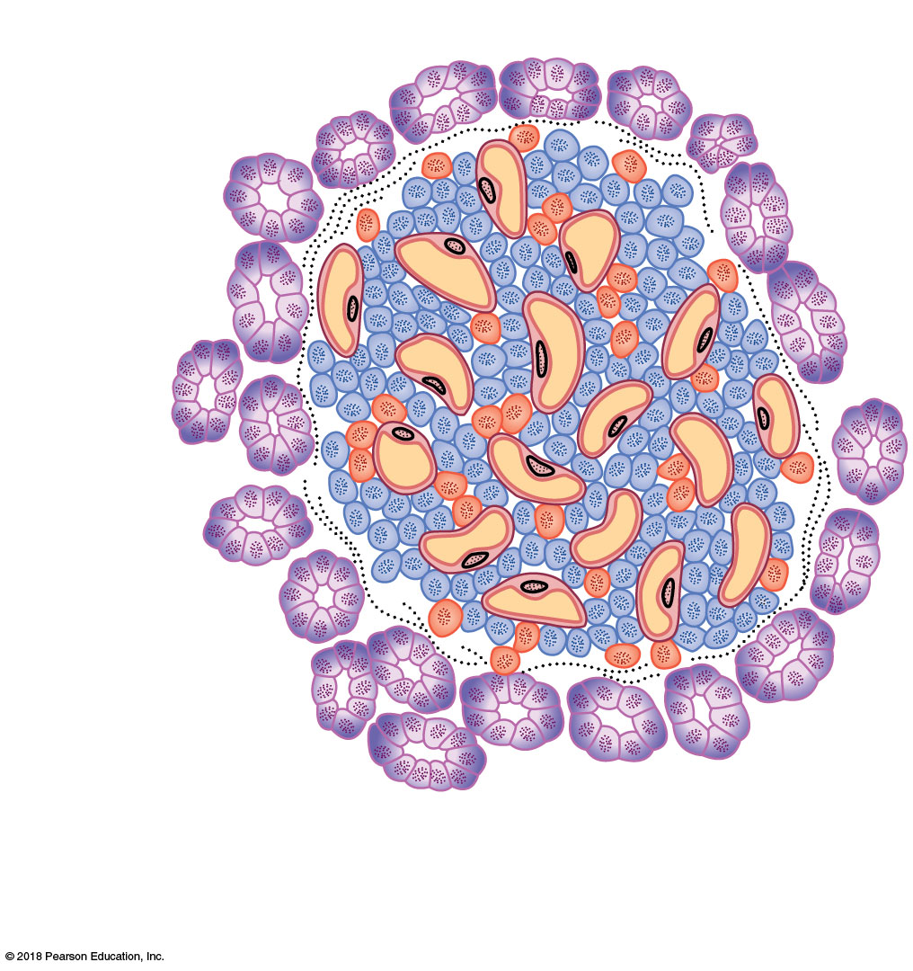
Exocrine cells of pancreas
Alpha (α) cells
Capillaries
Cord of beta (β) cells secreting
insulin into capillaries
(c)

Slide 18
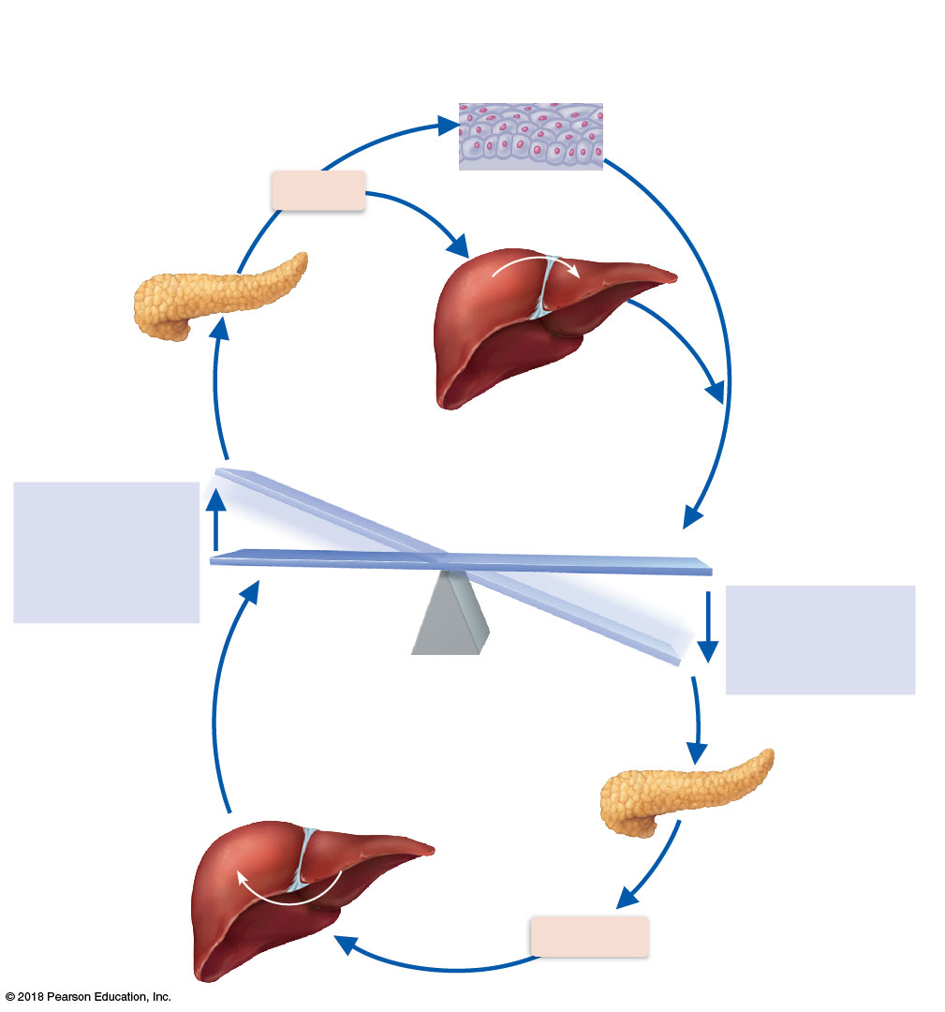
Uptake of glucose from blood is enhanced in most body cells.
Insulin-secreting cells
of the pancreas activated; release insulin into
the blood.
Insulin
Tissue cells
Pancreas
Glucose
Glycogen
Blood glucose
falls to homeostatic set point; stimulus for insulin release diminishes.
Elevated blood sugar level
Liver takes up glucose and stores as glycogen.
Stimulus
Blood glucose level (e.g., after eating four jelly doughnuts)
IMBALANCE
BALANCE: Normal blood glucose _{level}
(about 90 mg/100 ml)
Stimulus
Blood glucose level (e.g., after skipping a meal)
Blood glucose rises
to homeostatic
set point; stimulus
for glucagon
release diminishes.
IMBALANCE
Low blood sugar level
Glucose
Glycogen
Glucagon-releasing cells of pancreas activated; release glucagon into blood.
Liver breaks down glycogen stores and releases glucose to the blood.
Liver
Glucagon

Slide 19
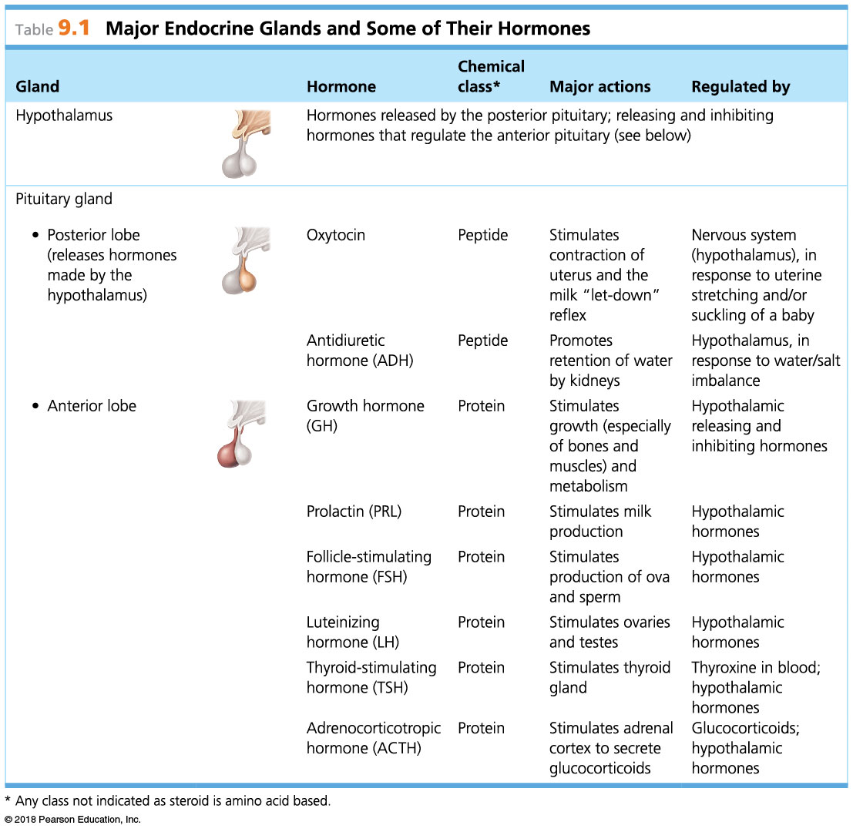

Slide 20
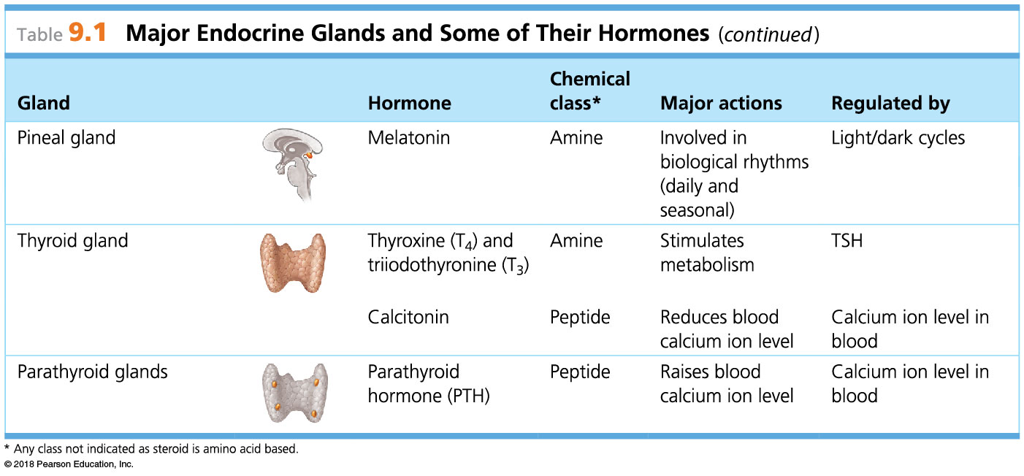

Slide 21
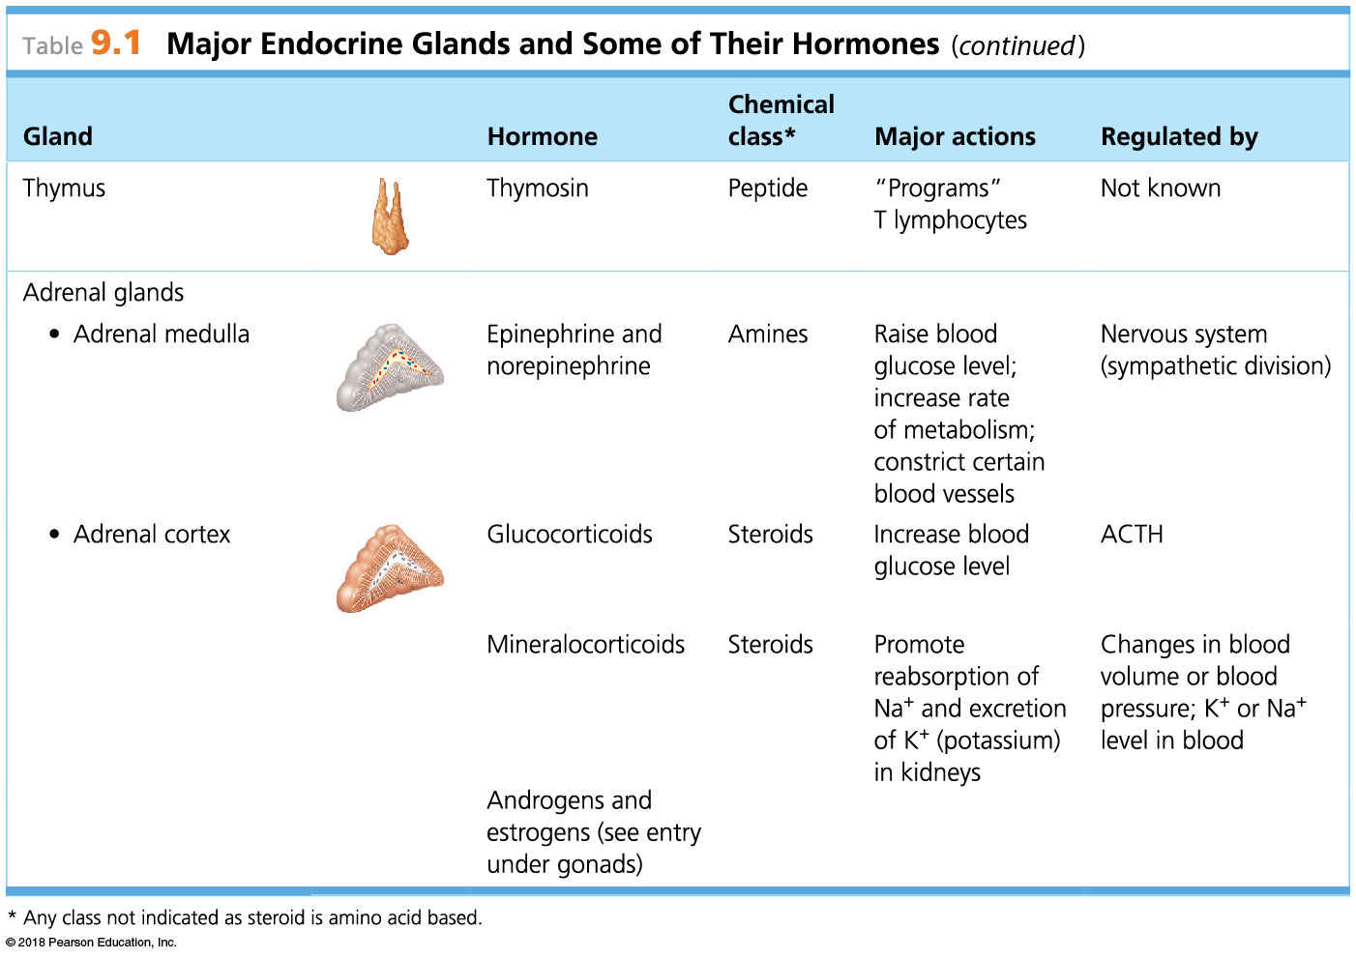

Slide 22
