Slide 1
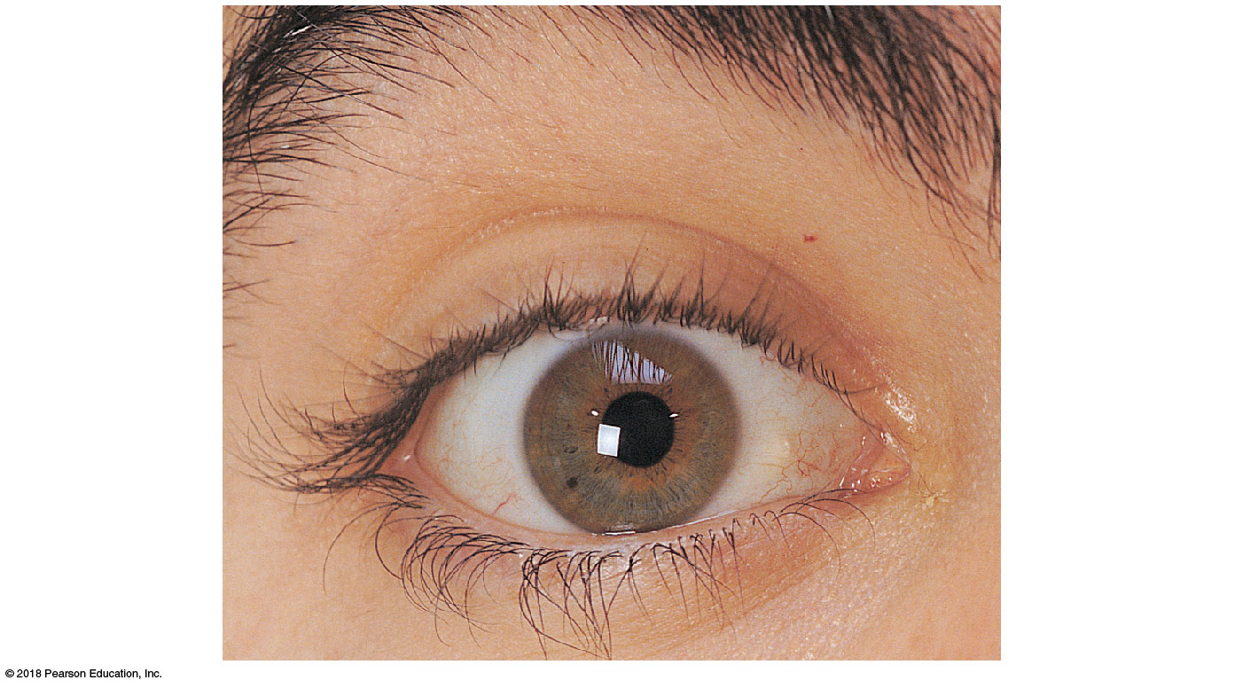
Site where
conjunctiva
merges with
cornea
Eyebrow
Eyelid
Eyelashes
Palpebral
fissure
Pupil
Lacrimal
caruncle
Lateral
commissure
(canthus)
Medial
commissure
(canthus)
Iris
Sclera
(covered by
conjunctiva)
Eyelid
© 2018 Pearson Education, Inc.

Slide 2
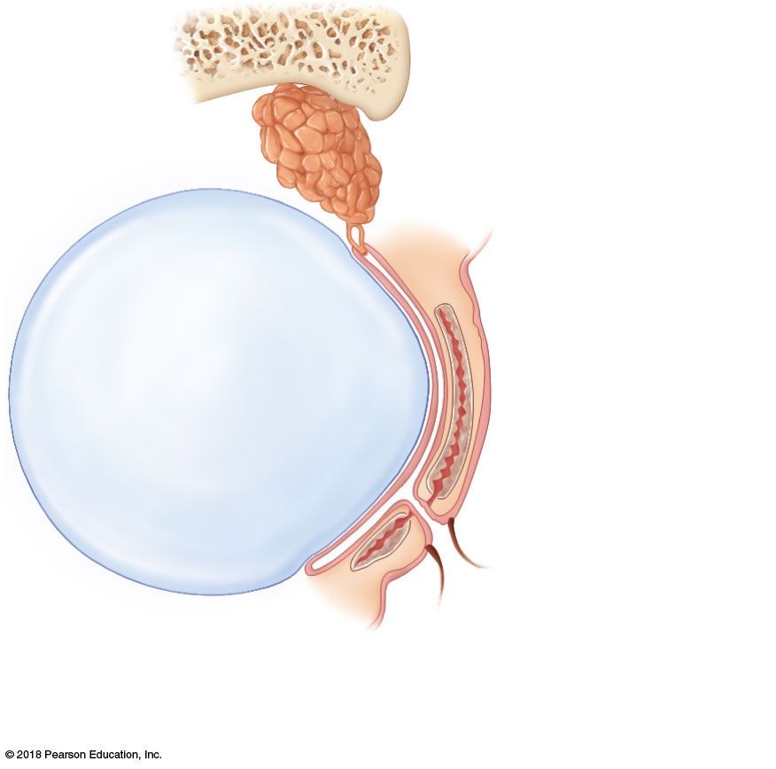
Lacrimal
gland
Excretory duct
of lacrimal gland
Conjunctiva
Anterior
aspect
Eyelid
Eyelashes
Tarsal
glands
(a)
Eyelid
© 2018 Pearson Education, Inc.

Slide 3
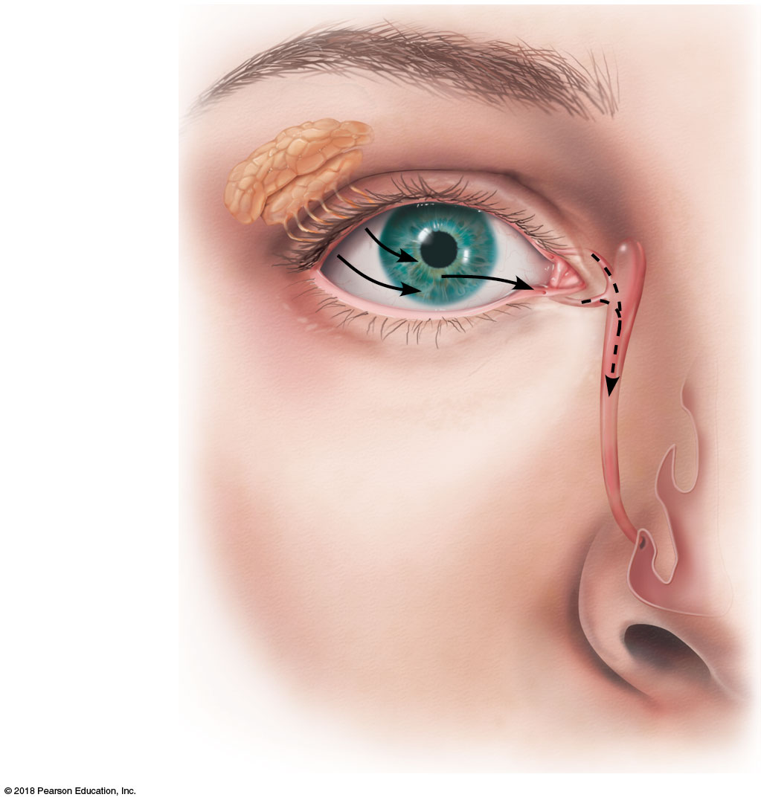
Lacrimal
gland
Lacrimal sac
Excretory ducts
of lacrimal gland
Lacrimal canaliculus
Nasolacrimal duct
Inferior meatus
of nasal cavity
Nostril
(b)
© 2018 Pearson Education, Inc.

Slide 4
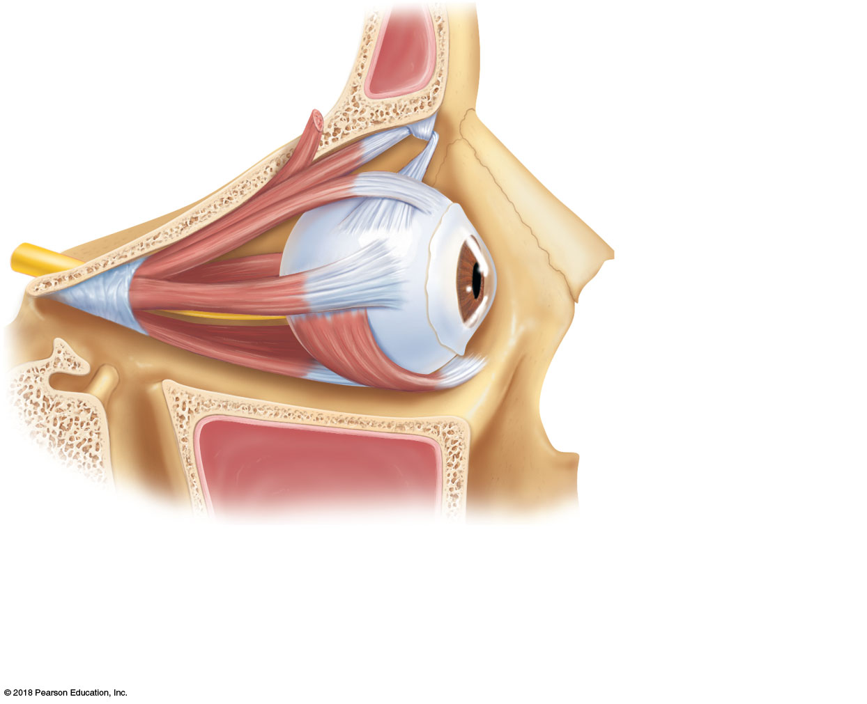
Superior
oblique muscle
Superior
oblique tendon
Superior
rectus muscle
Conjunctiva
Lateral rectus
muscle
Optic
nerve
Inferior
rectus
muscle
Inferior
oblique
muscle
(a)
© 2018 Pearson Education, Inc.

Slide 5
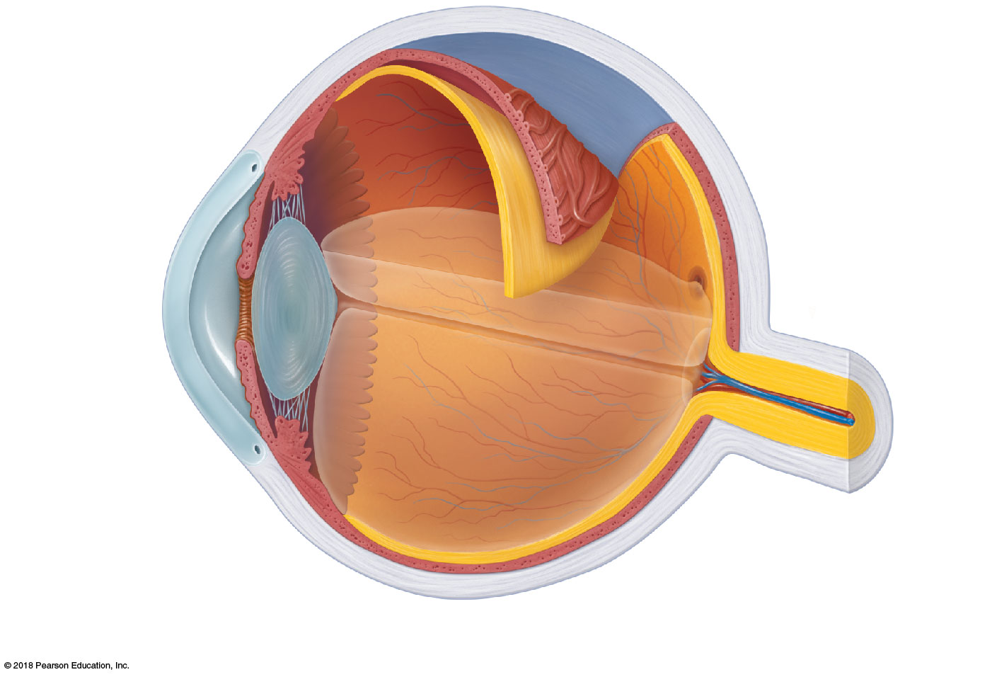
Sclera
Ciliary body
Choroid
Ciliary zonule
Retina
Cornea
Iris
Fovea centralis
Pupil
Optic nerve
Aqueous
humor
(in anterior
segment)
Lens
Scleral venous sinus
(canal of Schlemm)
Central artery
and vein of
the retina
Vitreous humor
(in posterior segment)
Optic disc
(blind spot)
(a)
© 2018 Pearson Education, Inc.

Slide 6
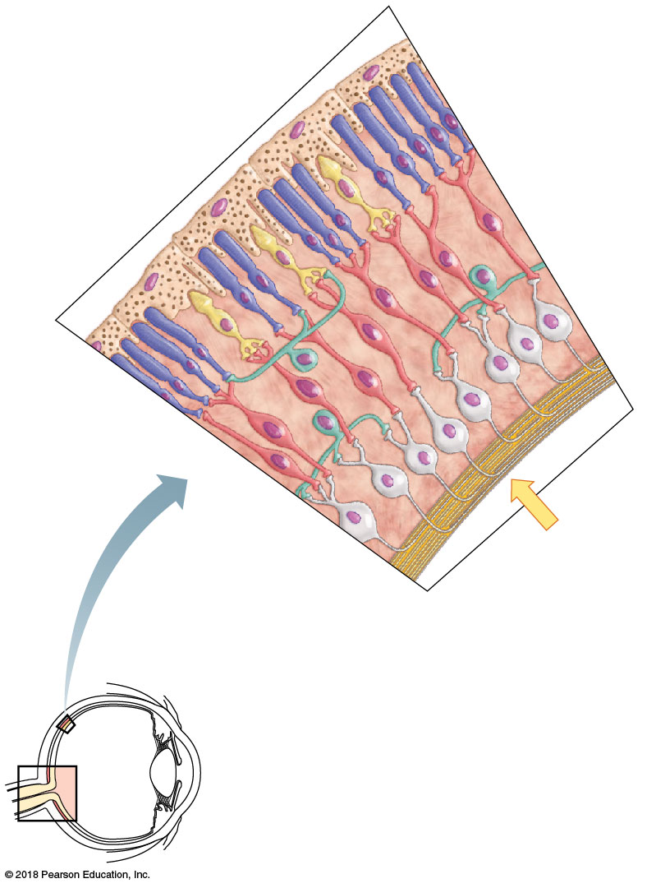
Pigmented
layer of retina
Rod
Cone
Bipolar
cells
Ganglion
cells
Pathway
of light
(a)
© 2018 Pearson Education, Inc.

Slide 7
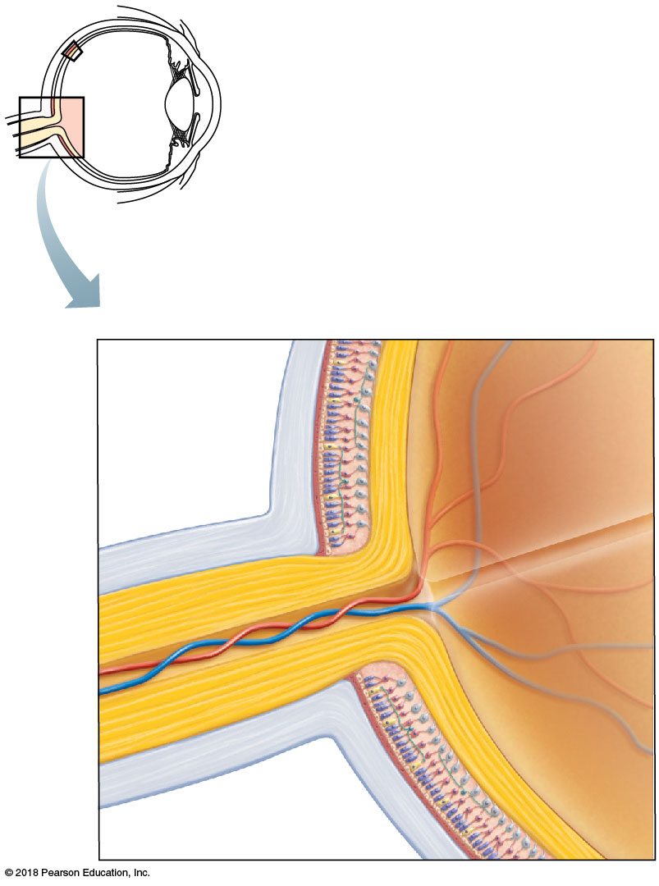
Pigmented
layer of
retina
Neural layer
of retina
Central
artery
and vein
of retina
Optic disc
Sclera
Optic
nerve
(b)
Choroid
© 2018 Pearson Education, Inc.

Slide 8
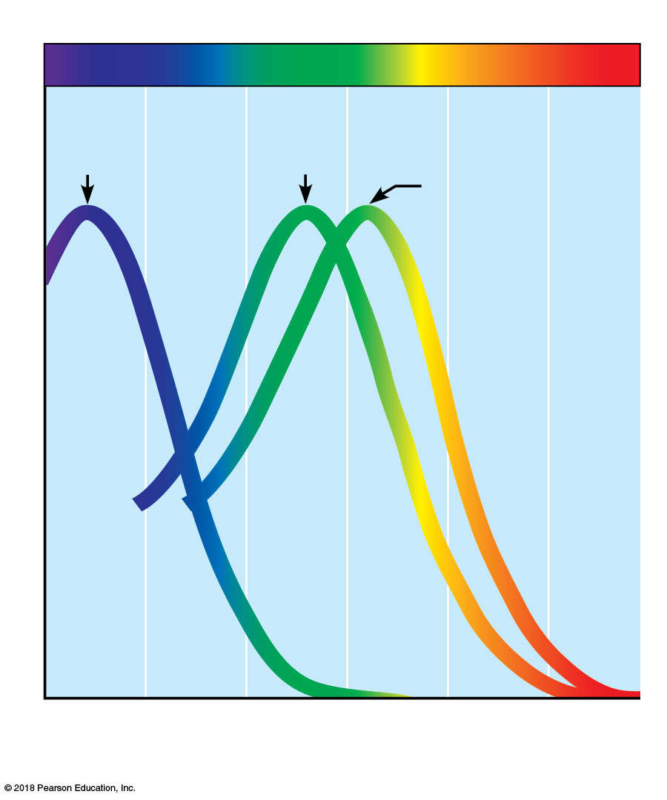
Visible light
420 nm
(blue cones)
530 nm
(green cones)
Light absorption by cone populations
560 nm
(red cones)
400
450
500
550
600
650
700
Wavelength (nanometers)
© 2018 Pearson Education, Inc.

Slide 9
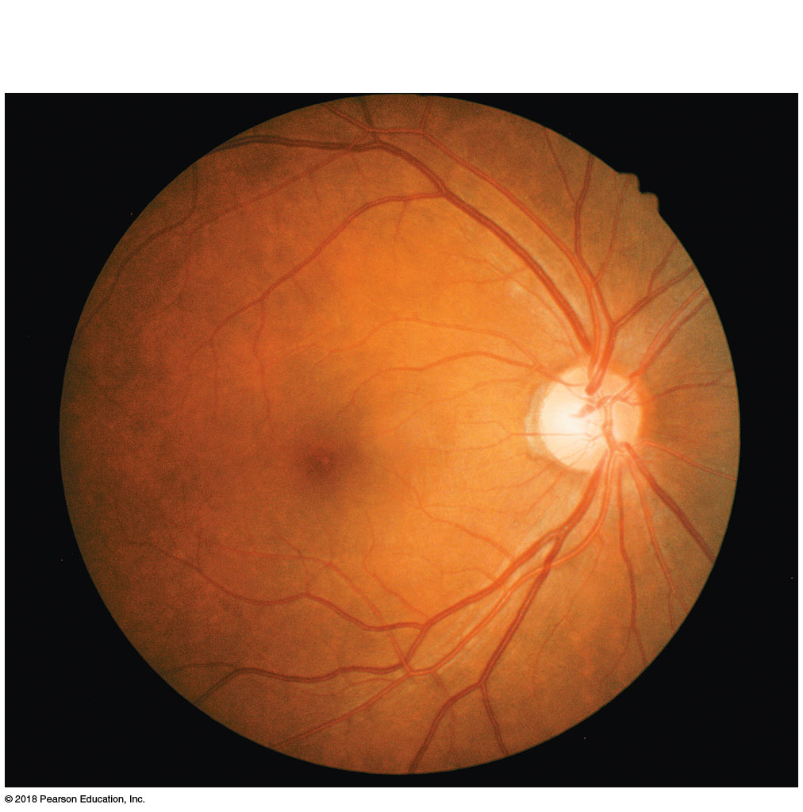
Fovea
centralis
Macula
Blood
vessels
Optic disc
Retina
Lateral
Medial
© 2018 Pearson Education, Inc.

Slide 10
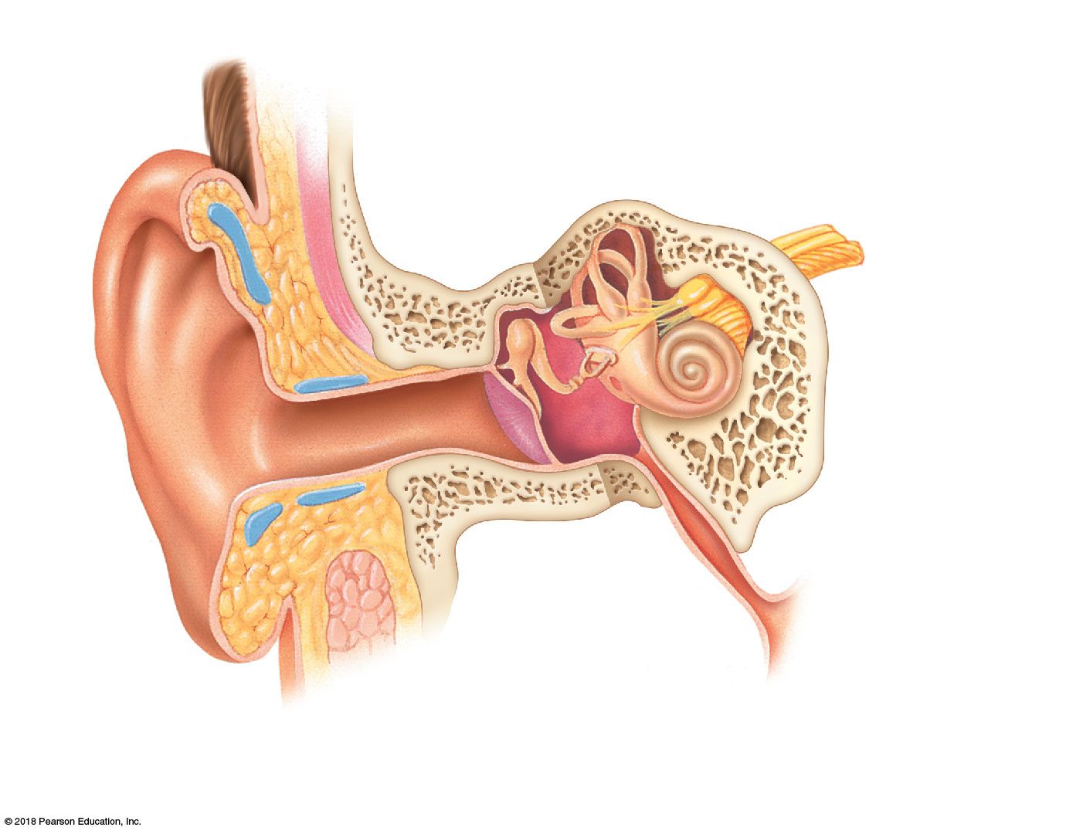
External (outer) ear
Middle ear
Internal (inner) ear
Vestibulocochlear
nerve
Auricle
(pinna)
Semicircular
canals
Oval window
Cochlea
Vestibule
Round window
Pharyngotympanic
(auditory) tube
Tympanic
membrane
(eardrum)
Hammer
(malleus)
Anvil
(incus)
Stirrup
(stapes)
External acoustic
meatus
(auditory canal)
Auditory ossicles
© 2018 Pearson Education, Inc.

Slide 11
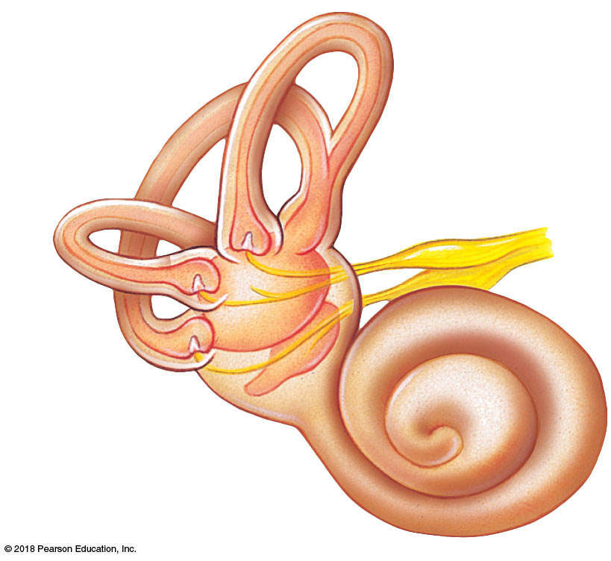
Semicircular
canals
Ampulla
Vestibular
nerve
Vestibule
(a)
© 2018 Pearson Education, Inc.

Slide 12
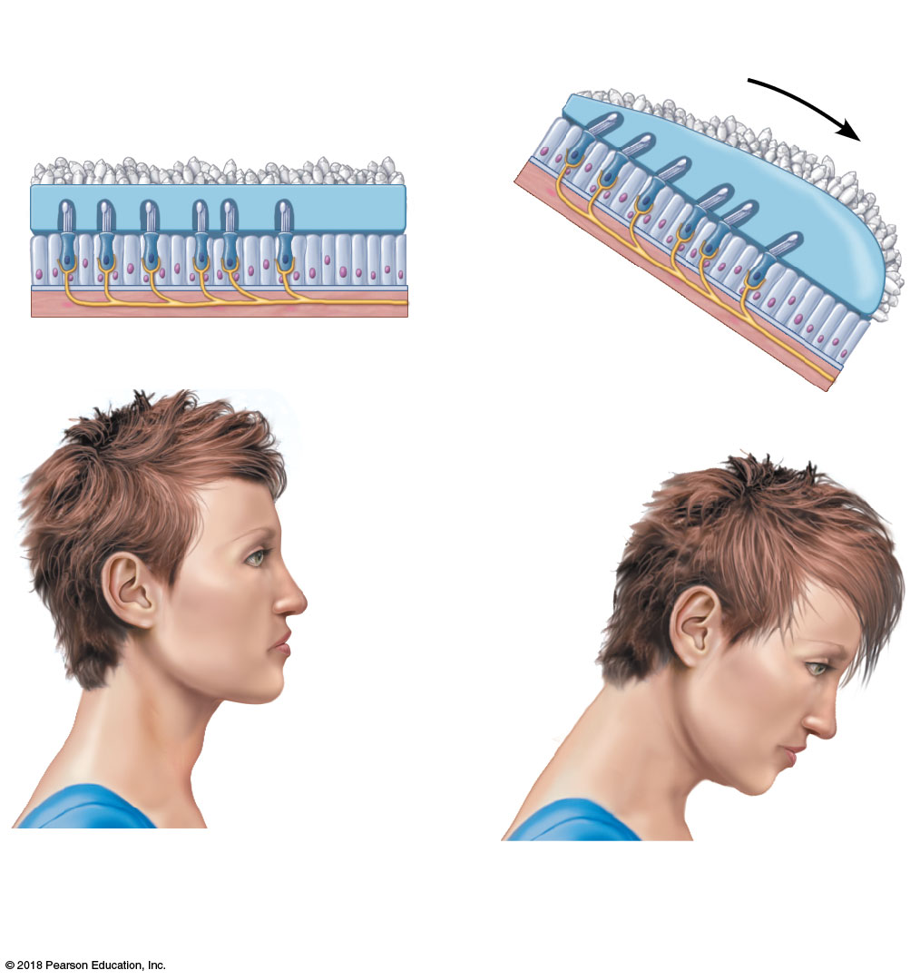
Force of
gravity
Otolithic
membrane
Otoliths
Hair cell
Head upright
Head tilted
(b)
© 2018 Pearson Education, Inc.

Slide 13
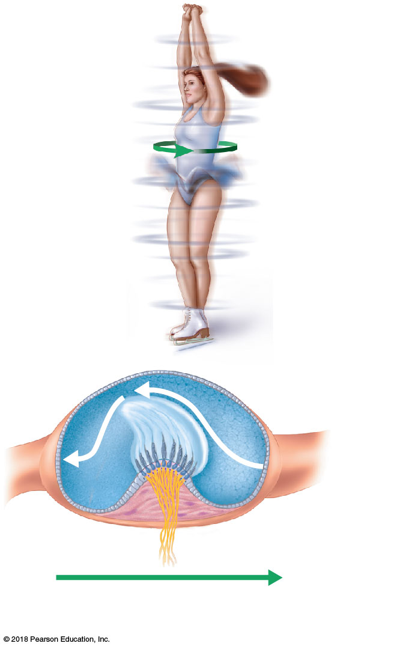
Flow of
endolymph
Cupula
Nerve
fibers
Direction of body
movement
(c)
© 2018 Pearson Education, Inc.

Slide 14
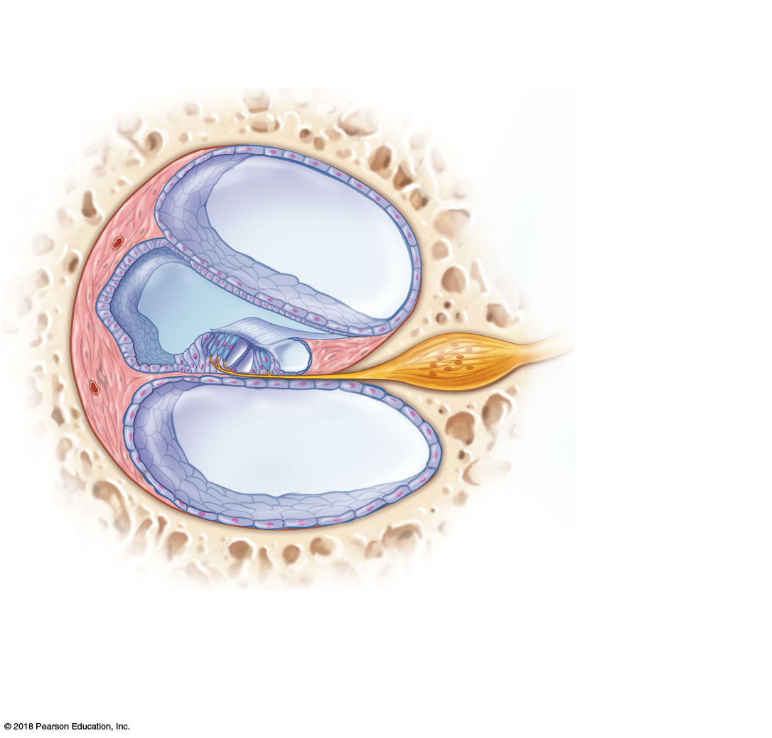
Temporal
bone
Perilymph in scala vestibuli
Spiral
organ of
Corti
Vestibular
membrane
Afferent fibers
of the cochlear
nerve
Temporal
bone
Cochlear
duct (contains
endolymph)
Perilymph in
scala tympani
(a)
© 2018 Pearson Education, Inc.

Slide 15
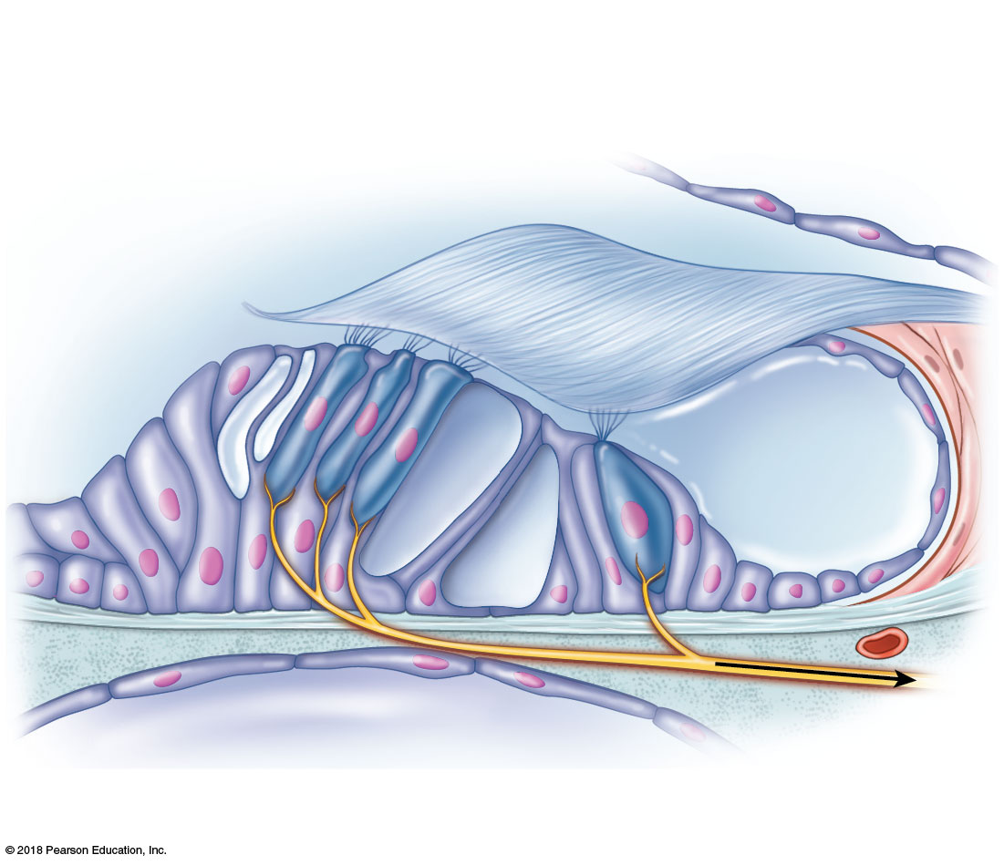
Vestibular
membrane
Hair (receptor)
cells of spiral
organ of Corti
Tectorial
membrane
Fibers of
the cochlear
nerve
Basilar
membrane
Supporting
cells
(b)
© 2018 Pearson Education, Inc.

Slide 16
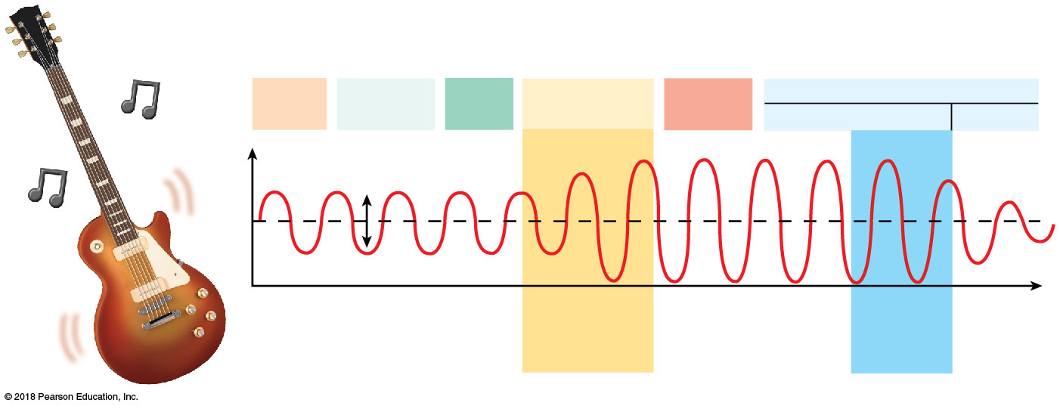
EXTERNAL EAR
MIDDLE EAR
INTERNAL EAR
Pinna
Auditory
canal
Ear-
drum
Hammer,
anvil, stirrup
Oval
window
Fluids in cochlear canals
Upper and middle
lower
Pressure
Spiral organ
of Corti
stimulated
Time
One
vibration
Amplitude
Amplification
in middle ear
© 2018 Pearson Education, Inc.

Slide 17
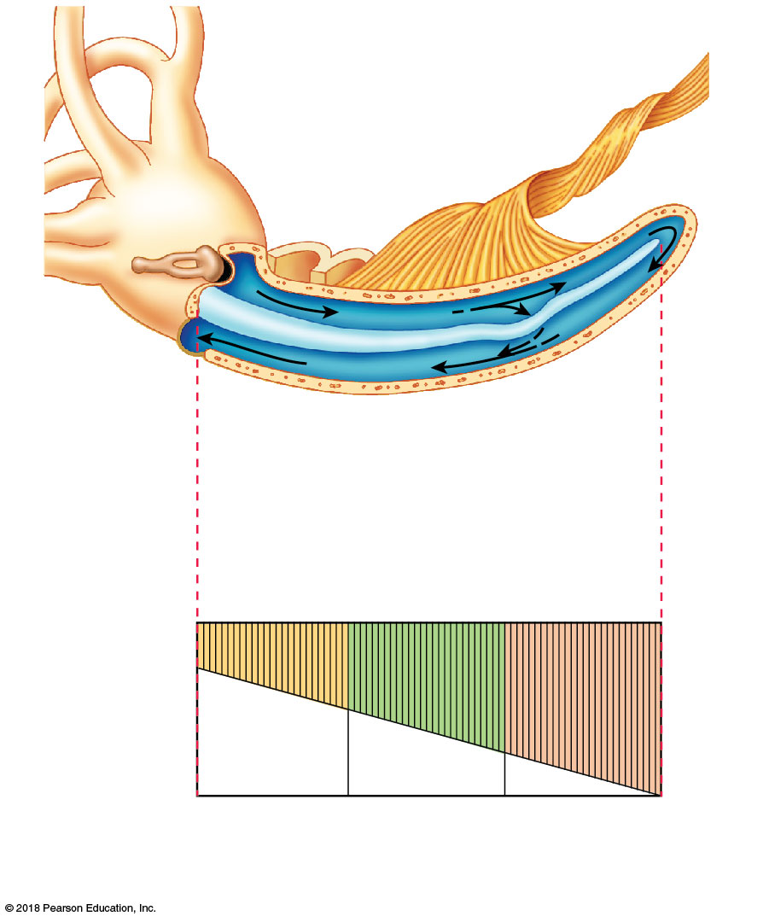
Stapes
Fibers of
sensory
neurons
Scala
vestibuli
Oval
window
Perilymph
Round
window
Scala
tympani
Basilar
membrane
Cochlear
duct
(a)
Fibers of basilar membrane
Apex
(long,
floppy
fibers)
Base (short,
stiff fibers)
20,000
2,000
200
20
(High notes)
(Low notes)
(b)
Frequency (Hz)
© 2018 Pearson Education, Inc.

Slide 18
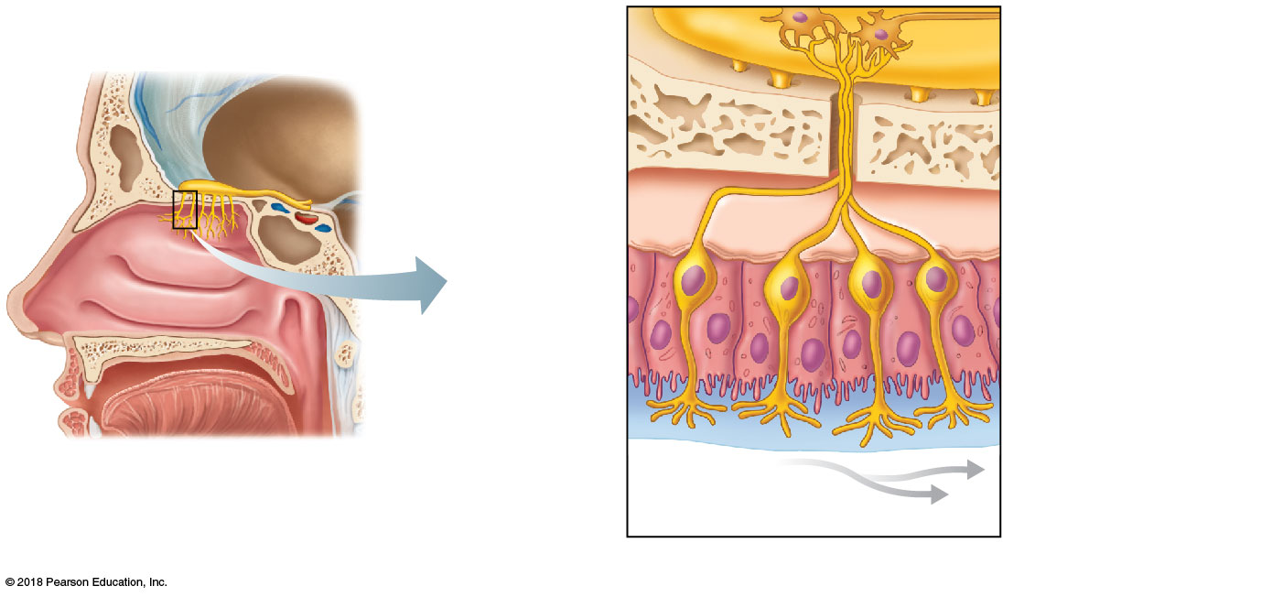
Olfactory bulb
Cribriform plate
of ethmoid bone
Olfactory tract
Olfactory filaments of
the olfactory nerve
Supporting cell
Olfactory
mucosa
Olfactory receptor
cell
Mucus layer
Olfactory hairs
(cilia)
(a)
Route of inhaled air
containing odor molecules
(b)
© 2018 Pearson Education, Inc.

Slide 19
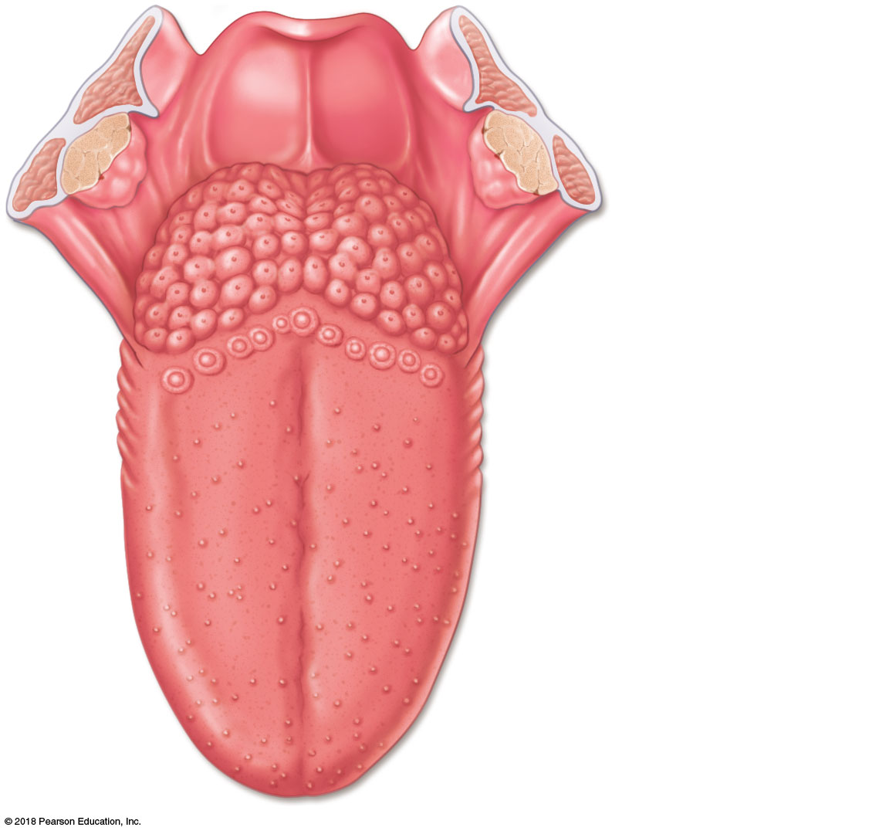
Epiglottis
Palatine tonsil
Lingual tonsil
Foliate
papillae
Fungiform
papillae
(a)
© 2018 Pearson Education, Inc.

Slide 20
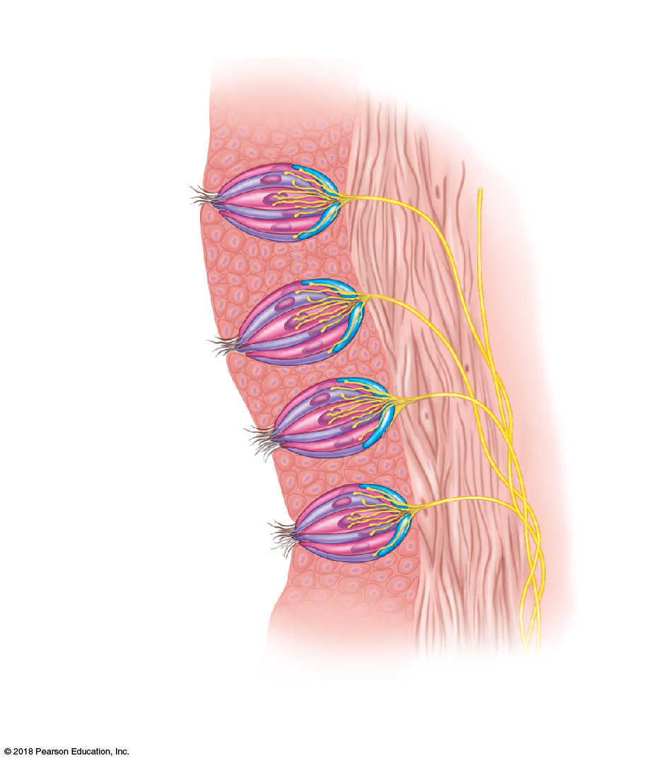
Epithelium of tongue
Taste bud
Connective
tissue
Surface of
the tongue
Gustatory
(taste) cell
Basal
cell
Sensory
nerve
fiber
Gustatory hairs
(microvilli) emerging
from a taste pore
(c)
© 2018 Pearson Education, Inc.

