Slide 1
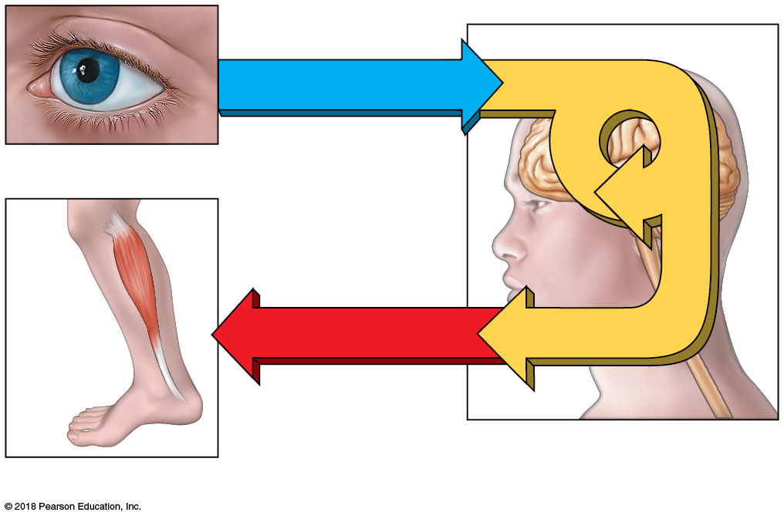
Sensory input
Integration
Integration
Sensory receptor
Motor output
Brain and spinal cord
Effector
© 2018 Pearson Education, Inc.

Slide 2
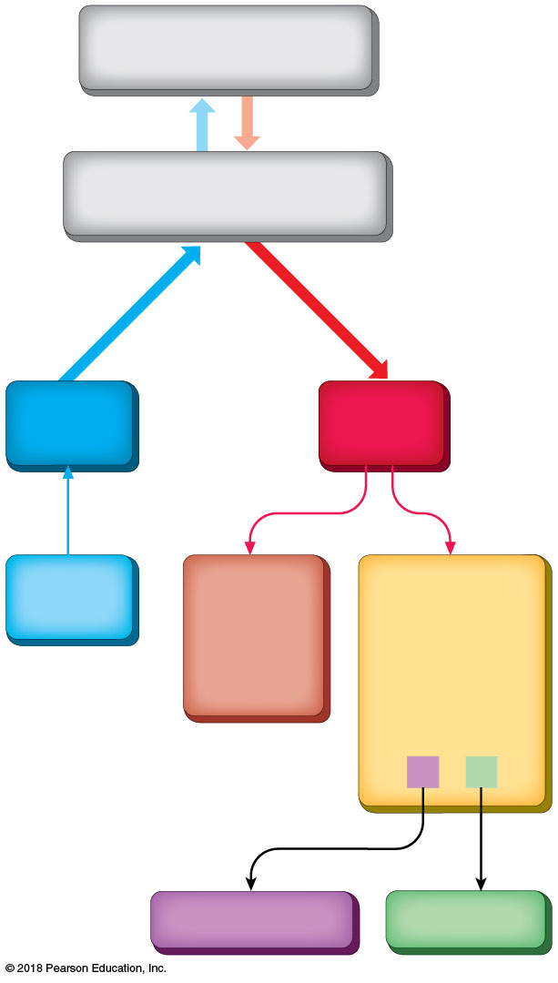
Central Nervous System
(brain and spinal cord)
Peripheral Nervous System
(cranial and spinal nerves)
Sensory
(afferent)
Motor
(efferent)
Sense
organs
Somatic
(voluntary)
Autonomic
(involuntary)
Skeletal
muscles
Cardiac and
smooth muscle,
glands
Parasympathetic
Sympathetic
© 2018 Pearson Education, Inc.

Slide 3
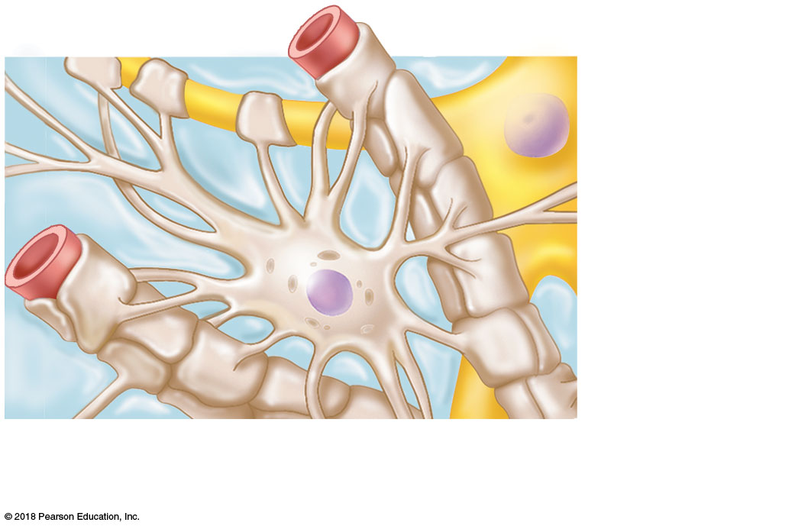
Capillary
Neuron
Astrocyte
(a) Astrocytes are the most abundant and versatile neuroglia.
© 2018 Pearson Education, Inc.

Slide 4
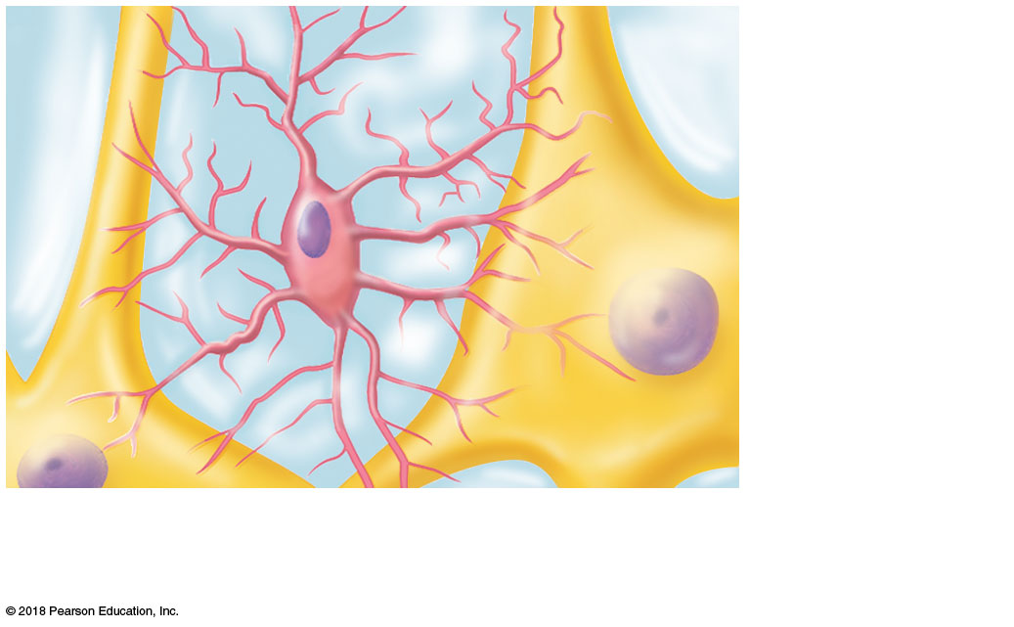
Neuron
Microglial
cell
(b) Microglial cells are phagocytes that defend CNS cells.
© 2018 Pearson Education, Inc.

Slide 5
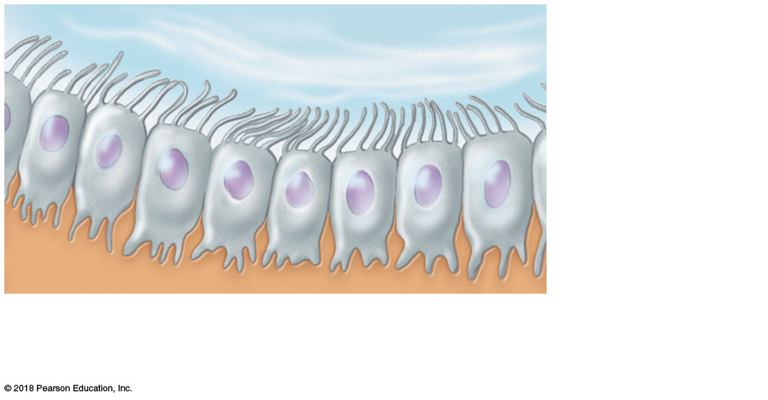
Fluid-filled cavity
Ependymal
cells
Brain or
spinal cord
tissue
(c) Ependymal cells line cerebrospinal fluid–filled cavities.
© 2018 Pearson Education, Inc.

Slide 6
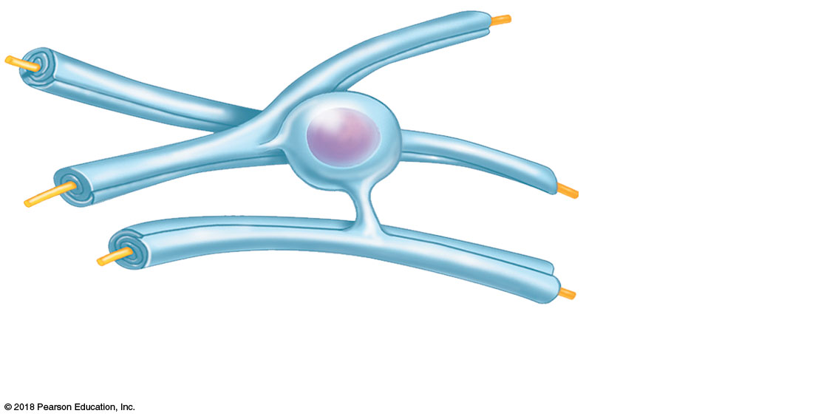
Myelin sheath
Process of
oligodendrocyte
Nerve
fibers
(d) Oligodendrocytes have processes that form myelin sheaths around CNS nerve fibers.
© 2018 Pearson Education, Inc.

Slide 7
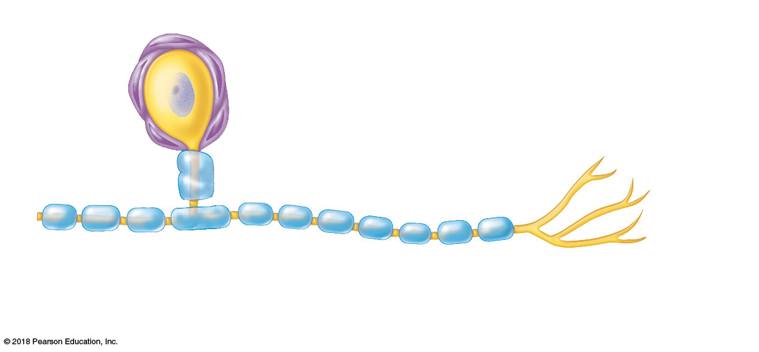
Satellite
cells
Cell body of neuron
Schwann cells
(forming myelin sheath)
Nerve fiber
(e) Satellite cells and Schwann cells (which form myelin) surround neurons in the PNS.
© 2018 Pearson Education, Inc.

Slide 8
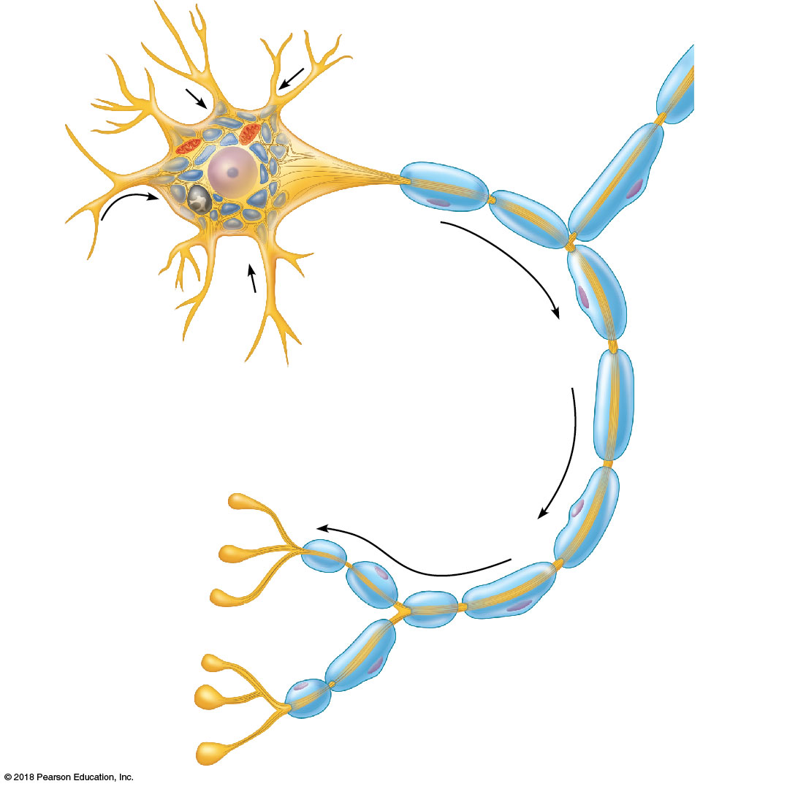
Dendrite
Cell
body
Mitochondrion
Nissl substance
Axon
hillock
Axon
Neurofibrils
Collateral
branch
Nucleus
Nucleolus
One
Schwann
cell
Axon
terminal
Node of
Ranvier
Schwann cells,
forming the myelin
sheath on axon
(a)
© 2018 Pearson Education, Inc.

Slide 9
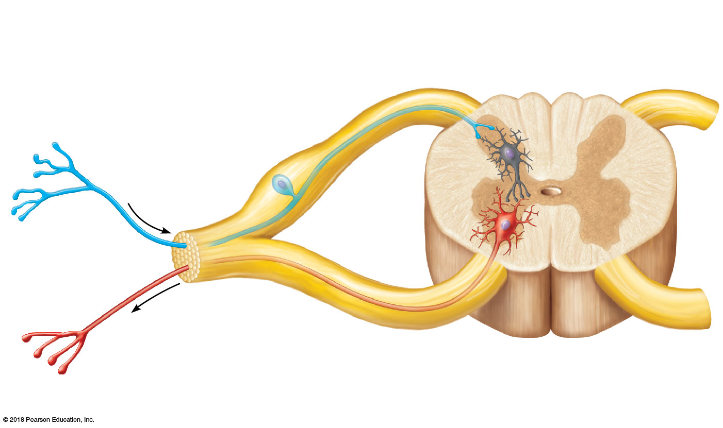
Central process (axon)
Sensory
neuron
Cell
body
Spinal cord
(central nervous system)
Ganglion
Dendrites
Peripheral
process (axon)
Afferent
transmission
Interneuron
(association
neuron)
Receptors
Peripheral
nervous
system
Efferent transmission
Motor neuron
To effectors
(muscles and glands)
© 2018 Pearson Education, Inc.

Slide 10
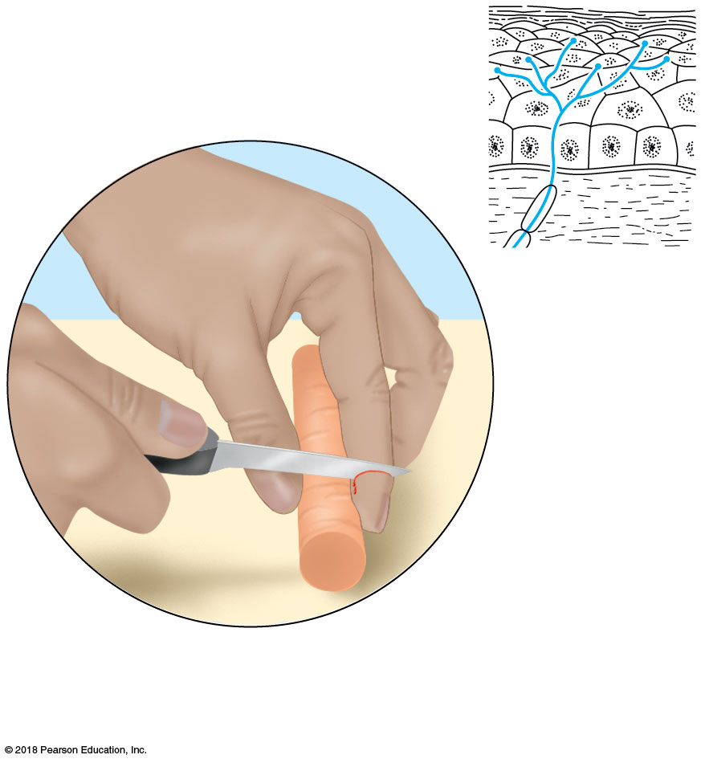
(a) Free nerve endings (pain and temperature receptors)
© 2018 Pearson Education, Inc.

Slide 11
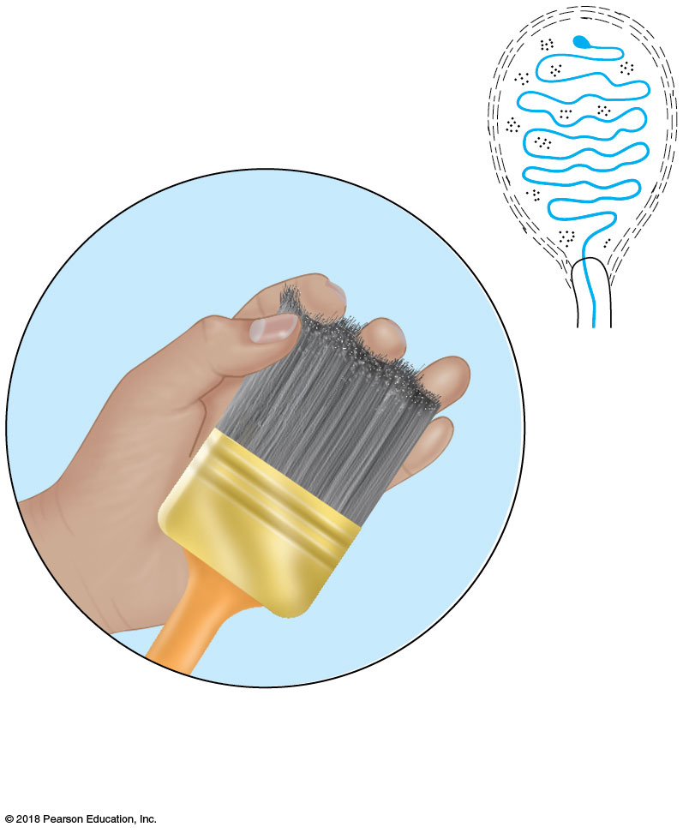
(b) Meissner’s corpuscle (touch receptor)
© 2018 Pearson Education, Inc.

Slide 12
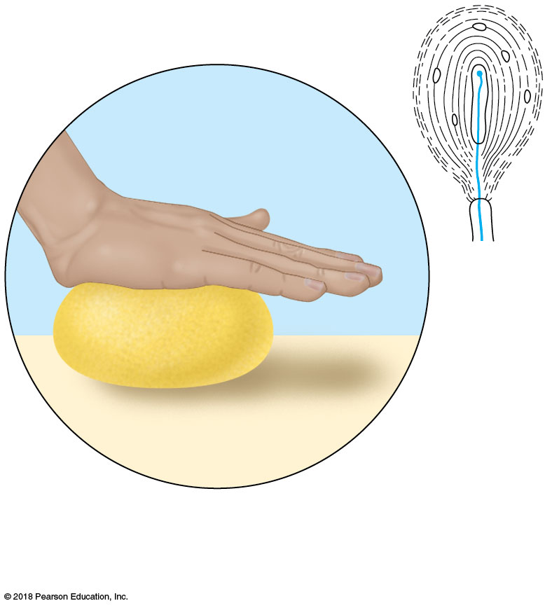
(c) Lamellar corpuscle (deep pressure receptor)
© 2018 Pearson Education, Inc.

Slide 13
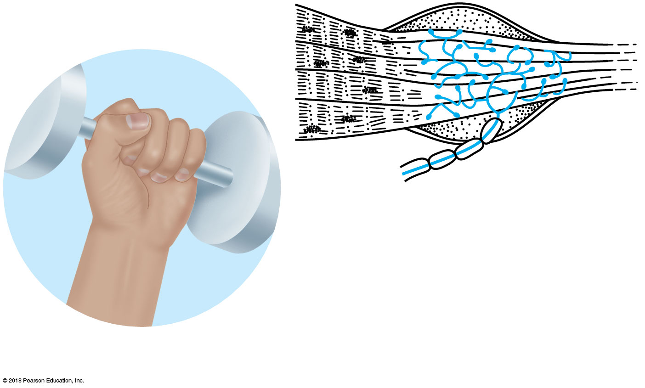
(d) Golgi tendon organ (proprioceptor)
© 2018 Pearson Education, Inc.

Slide 14
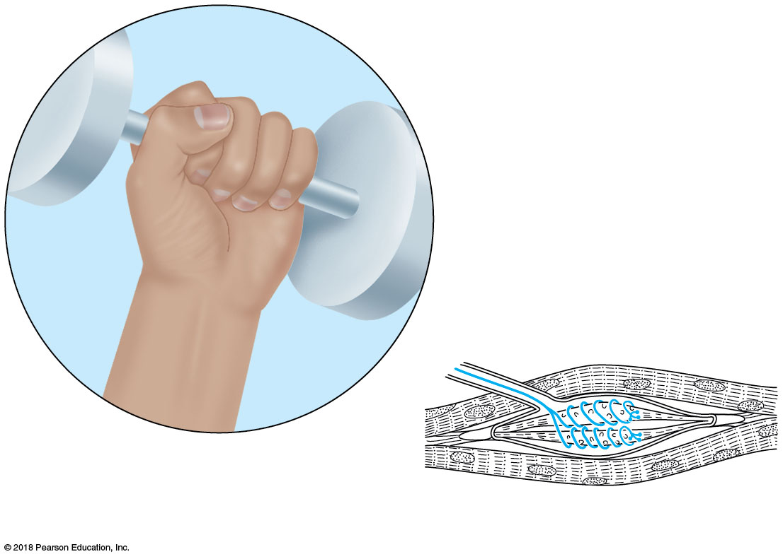
(e) Muscle spindle (proprioceptor)
© 2018 Pearson Education, Inc.

Slide 15
Slide 2
[Na⁺ ]
1
Resting membrane is polarized. In the resting state, the
external face of the membrane is slightly positive; its internal
face is slightly negative. The chief extracellular ion is sodium
(Na⁺), whereas the chief intracellular ion is potassium (K⁺). The
membrane is relatively impermeable to both ions.
[K⁺]

Slide 16
Slide 3
Na⁺
Stimulus initiates local depolarization. A stimulus
changes the permeability of a local “patch” of the membrane,
and sodium ions diffuse rapidly into the cell. This changes the
polarity of the membrane (the inside becomes more positive;
the outside becomes more negative) at that site.
2
Na⁺

Slide 17
Slide 4
Na⁺
Depolarization and generation of an action potential.
If the stimulus is strong enough, depolarization causes
membrane polarity to be completely reversed, and an action
potential is initiated.
3
Na⁺

Slide 18
Slide 5
4
Propagation of the action potential. Depolarization of the
first membrane patch causes permeability changes in the
adjacent membrane, and the events described in step are
repeated. Thus, the action potential propagates rapidly along the
entire length of the membrane.
2

Slide 19
Slide 6
K⁺
Repolarization. Potassium ions diffuse out of the cell as
the membrane permeability changes again, restoring the
negative charge on the inside of the membrane and the
positive charge on the outside surface. Repolarization occurs
in the same direction as depolarization.
5
K⁺

Slide 20
Slide 7
Cell
exterior
Na⁺ – K⁺
pump
6
Initial ionic conditions restored. The ionic conditions
of the resting state are restored later by the activity of the
sodium-potassium pump. Three sodium ions are ejected for
every two potassium ions carried back into the cell.
K⁺ Diffusion
Plasma
membrane
Na⁺ Diffusion
Cell
interior

Slide 21
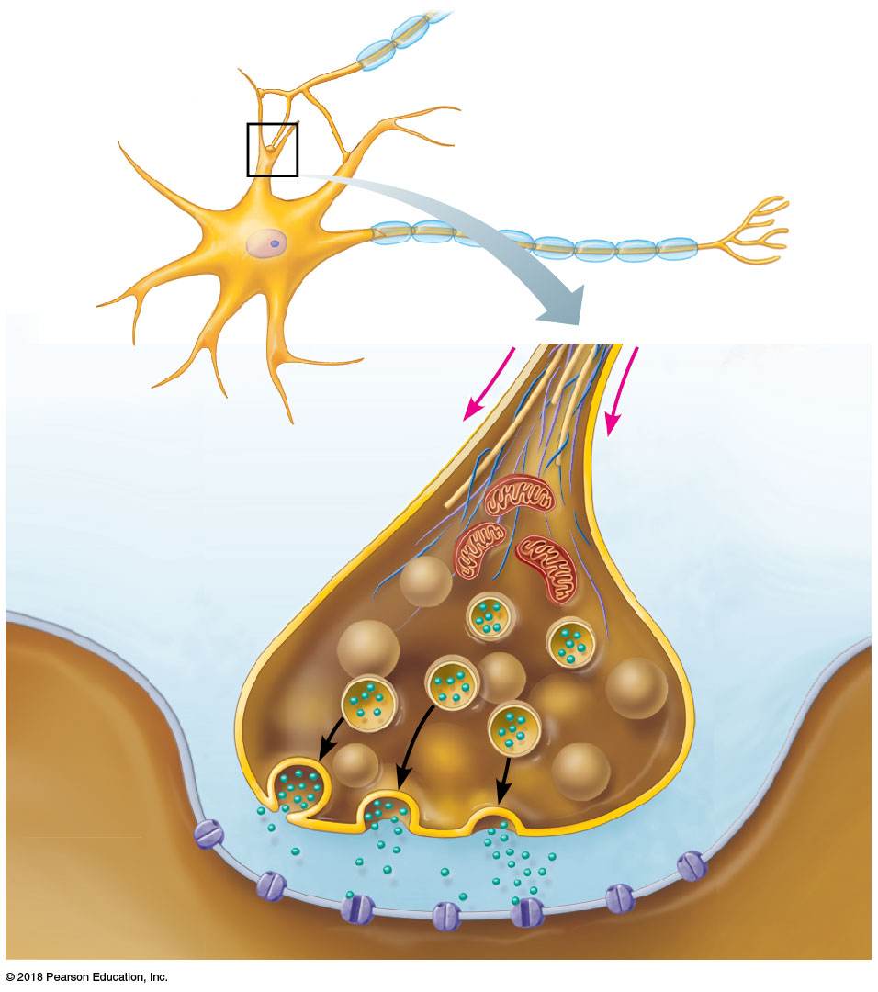
Slide 2
Axon of
transmitting
neuron
Receiving
neuron
1
Action
potential
arrives.
Dendrite
Vesicles
Axon terminal
Synaptic
cleft

Slide 22
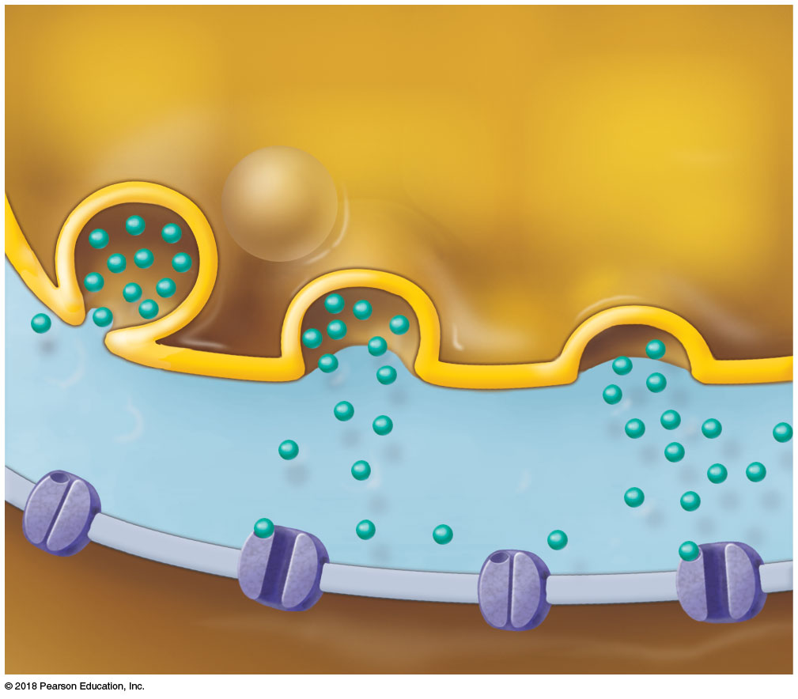
Slide 5
2
Transmitting neuron
Vesicle fuses with
plasma
membrane.
4
Neurotrans-
mitter binds
to receptor
on receiving
neuron’s
membrane.
Neurotrans-
mitter is
released into
synaptic cleft.
3
Synaptic
cleft
Ion
channels
Neurotransmitter
molecules
Receiving neuron
Receiving neuron

Slide 23
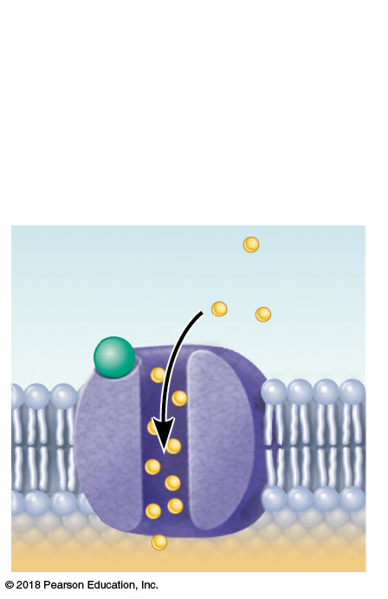
Slide 6
5
Ion channel opens.
Neurotransmitter
Receptor
Na⁺
Receiving neuron

Slide 24
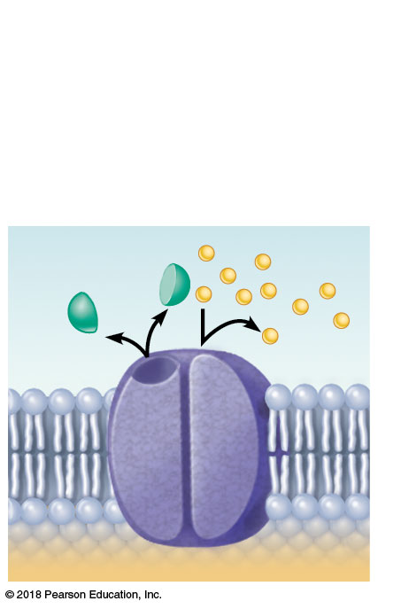
Slide 7
6
Ion channel closes.
Neurotransmitter is
broken down and
released.
Na⁺
Receiving neuron

Slide 25
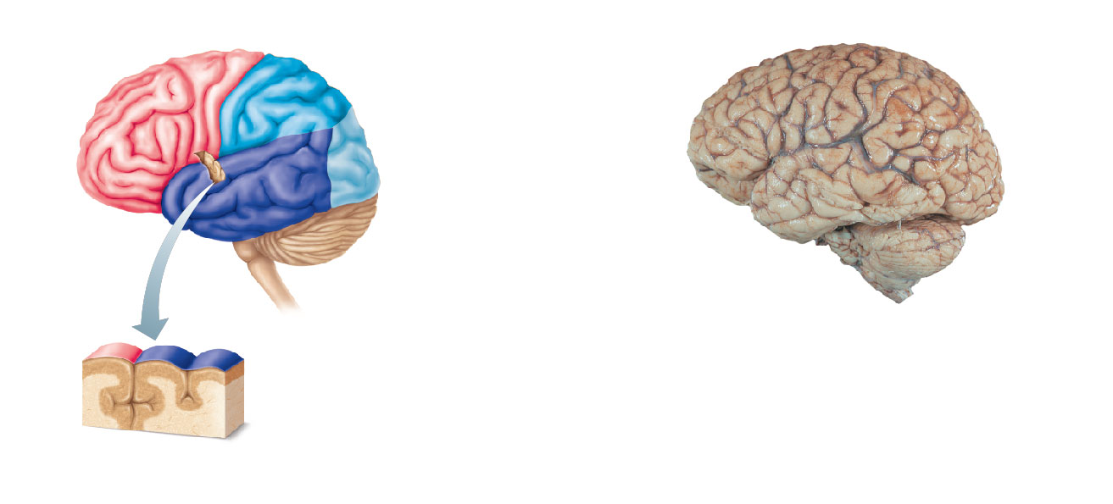
Precentral gyrus
Central sulcus
Parietal lobe
Postcentral gyrus
Frontal lobe
Parietal lobe
Left cerebral
hemisphere
Parieto-occipital
sulcus (deep)
Lateral sulcus
Frontal
lobe
Occipital lobe
Temporal lobe
Temporal
lobe
Occipital
lobe
Cerebellum
Pons
Superior
Cerebral cortex
(gray matter)
Medulla
oblongata
Inferior
Brain
stem
Cerebellum
Gyrus
Spinal
cord
(b)
Sulcus
Cerebral
white
matter
Fissure
(a deep sulcus)
(a)
© 2018 Pearson Education, Inc.

Slide 26
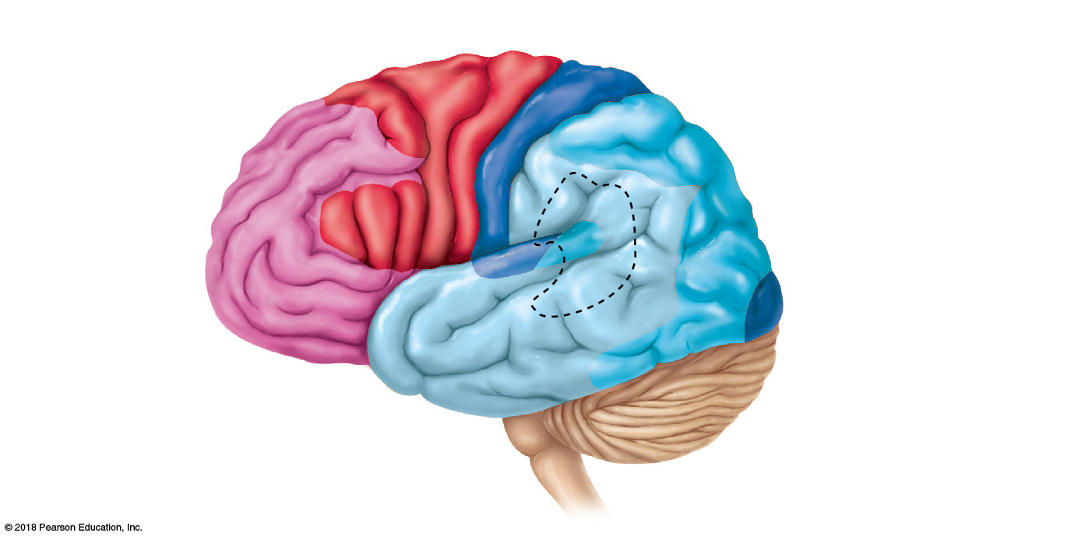
Central sulcus
Primary motor area
Primary somatic sensory
area
Premotor area
Anterior
association area
Gustatory area (taste)
• Working memory and judgment
Speech/language
(outlined by dashes)
• Problem solving
Posterior association
area
• Language comprehension
Broca’s area
(motor speech)
Visual area
Olfactory
area
Auditory area
(c)
© 2018 Pearson Education, Inc.

Slide 27
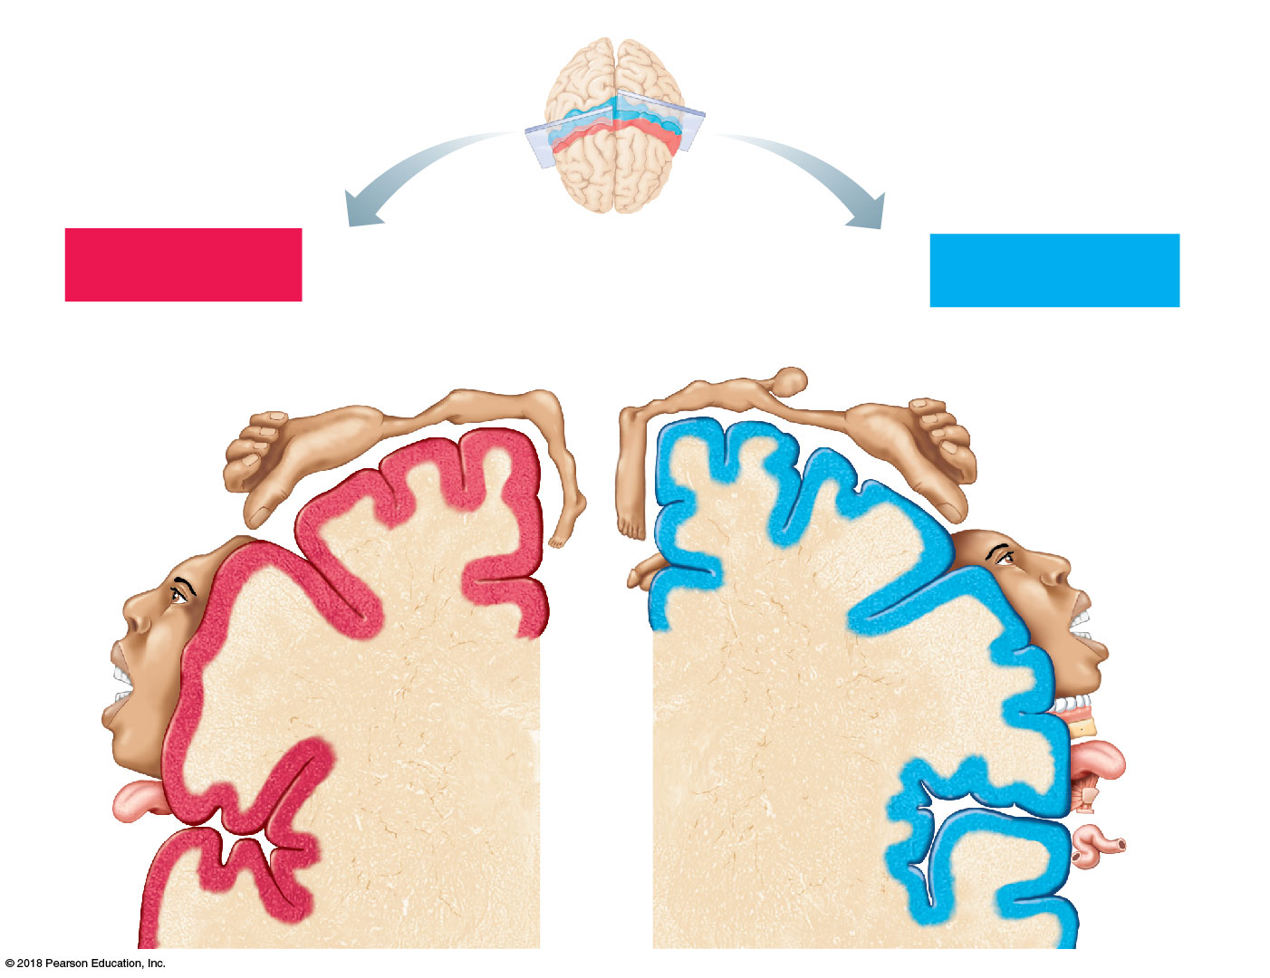
Posterior
Motor
Sensory
Motor map in
precentral gyrus
Anterior
Sensory map in
postcentral gyrus
Shoulder
Head
Trunk
Neck
Arm
Forearm
Arm
Trunk
Leg
Hip
Elbow
Wrist
Hip
Knee
Hand
Elbow
Hand
Fingers
Fingers
Knee
Thumb
Thumb
Neck
Foot
Eye
Brow
Nose
Eye
Toes
Face
Face
Genitals
Lips
Lips
Teeth
Gums
Jaw
Jaw
Tongue
Tongue
Primary motor
cortex
(precentral gyrus)
Primary somatic
sensory cortex
(postcentral gyrus)
Pharynx
Swallowing
Intra-
abdominal
© 2018 Pearson Education, Inc.

Slide 28
Posterior
Motor
Sensory
Motor map in
precentral gyrus
Anterior
Sensory map in
postcentral gyrus
Shoulder
Head
Trunk
Neck
Arm
Forearm
Arm
Trunk
Leg
Hip
Elbow
Wrist
Hip
Knee
Hand
Elbow
Hand
Fingers
Fingers
Knee
Thumb
Thumb
Neck
Foot
Eye
Brow
Nose
Eye
Toes
Face
Face
Genitals
Lips
Lips
Teeth
Gums
Jaw
Jaw
Tongue
Tongue
Primary motor
cortex
(precentral gyrus)
Primary somatic
sensory cortex
(postcentral gyrus)
Pharynx
Swallowing
Intra-
abdominal
© 2018 Pearson Education, Inc.

Slide 29
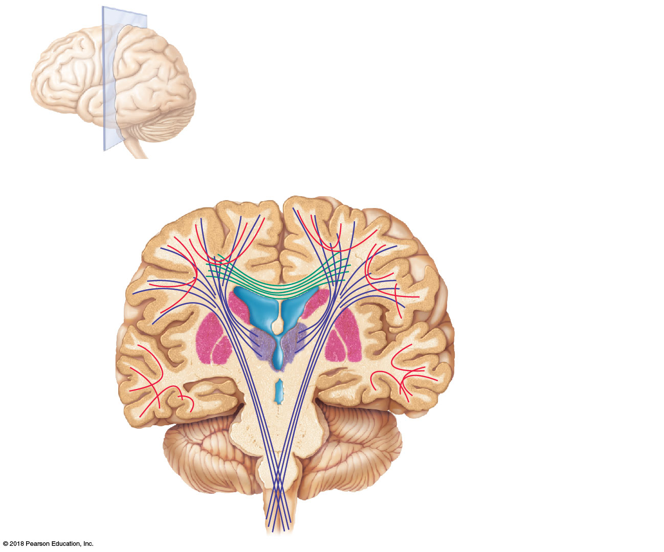
Longitudinal fissure
Association fibers
Superior
Lateral
ventricle
Commissural fibers
(corpus callosum)
Corona
radiata
Basal nuclei
Fornix
Internal
capsule
Thalamus
Third
ventricle
Pons
Projection
fibers
Medulla oblongata
© 2018 Pearson Education, Inc.

Slide 30
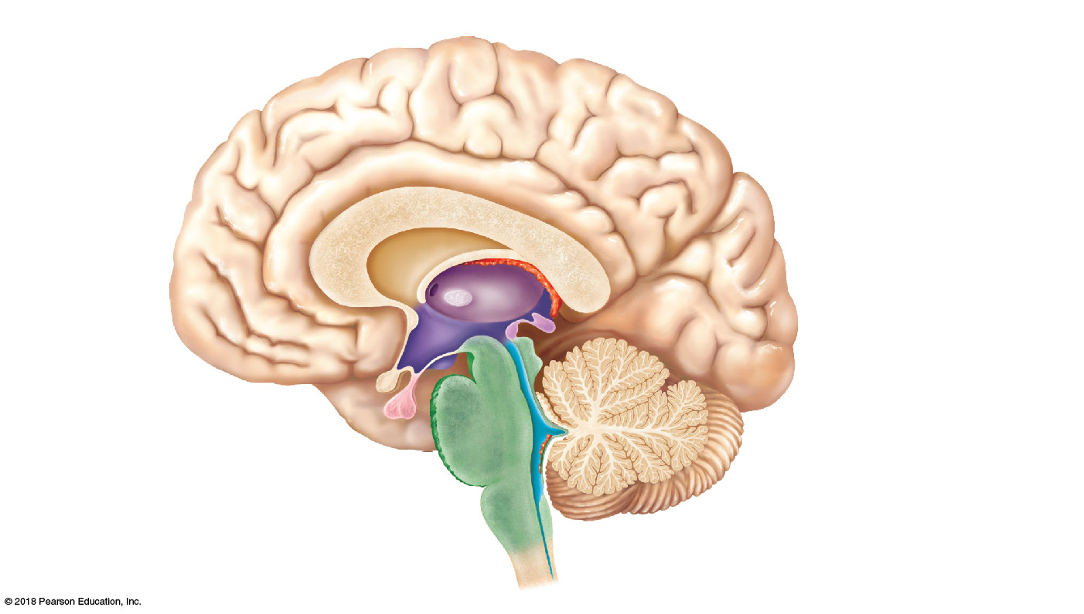
Cerebral hemisphere
Third ventricle
Corpus callosum
Choroid plexus of third
ventricle
Occipital lobe of
cerebral hemisphere
Thalamus
(encloses third ventricle)
Anterior
commissure
Pineal gland
(part of epithalamus)
Hypothalamus
Corpora
quadrigemina
Optic chiasma
Cerebral
aqueduct
Midbrain
Pituitary gland
Cerebral
peduncle
Mammillary body
Fourth ventricle
Pons
Choroid plexus
(part of epithalamus)
Medulla oblongata
Spinal cord
Cerebellum
(a)
© 2018 Pearson Education, Inc.

Slide 31
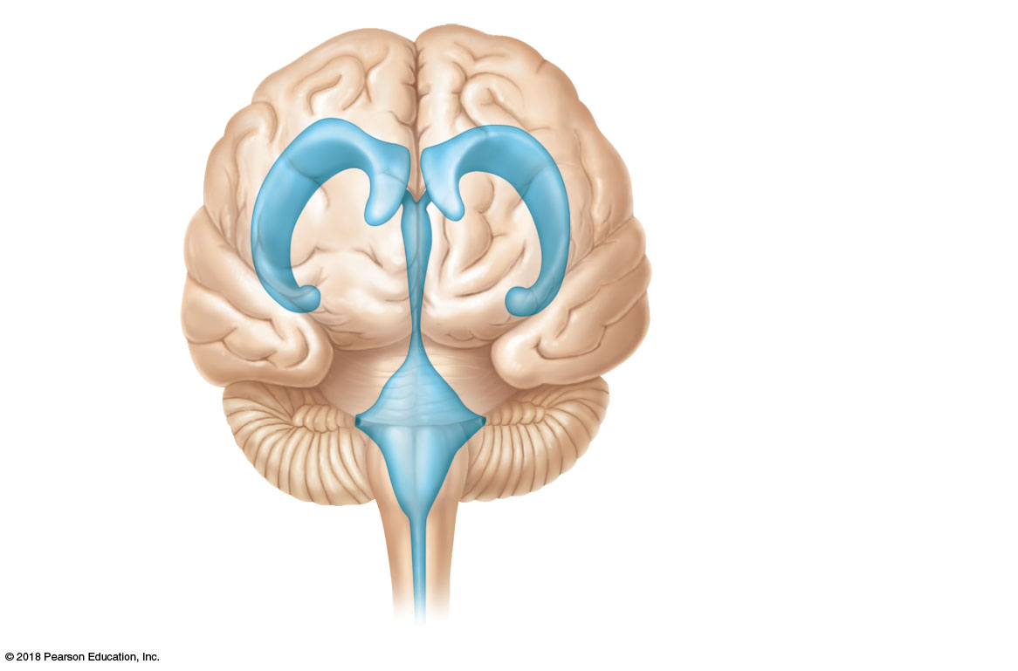
Lateral ventricle
Anterior horn
Septum
pellucidum
Interventricular
foramen
Inferior
horn
Third ventricle
Lateral
aperture
Cerebral aqueduct
Fourth ventricle
Central canal
(a) Anterior view
© 2018 Pearson Education, Inc.

Slide 32
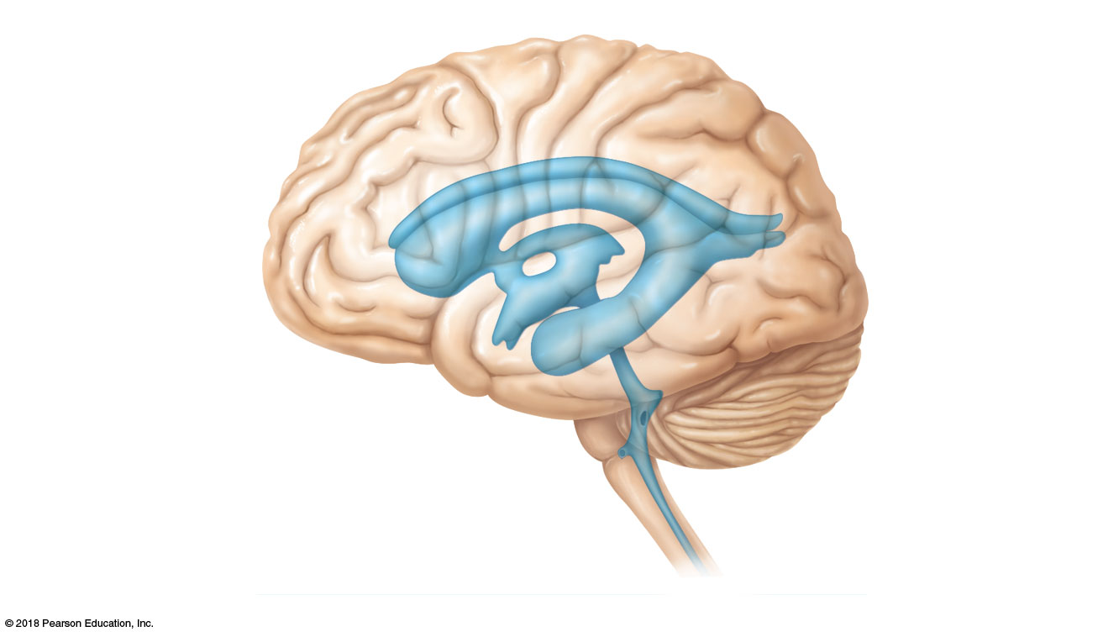
Lateral ventricle
Anterior horn
Posterior
horn
Interventricular
foramen
Third ventricle
Inferior horn
Cerebral aqueduct
Median
aperture
Fourth ventricle
Lateral
aperture
Central canal
(b) Left lateral view
© 2018 Pearson Education, Inc.

Slide 33
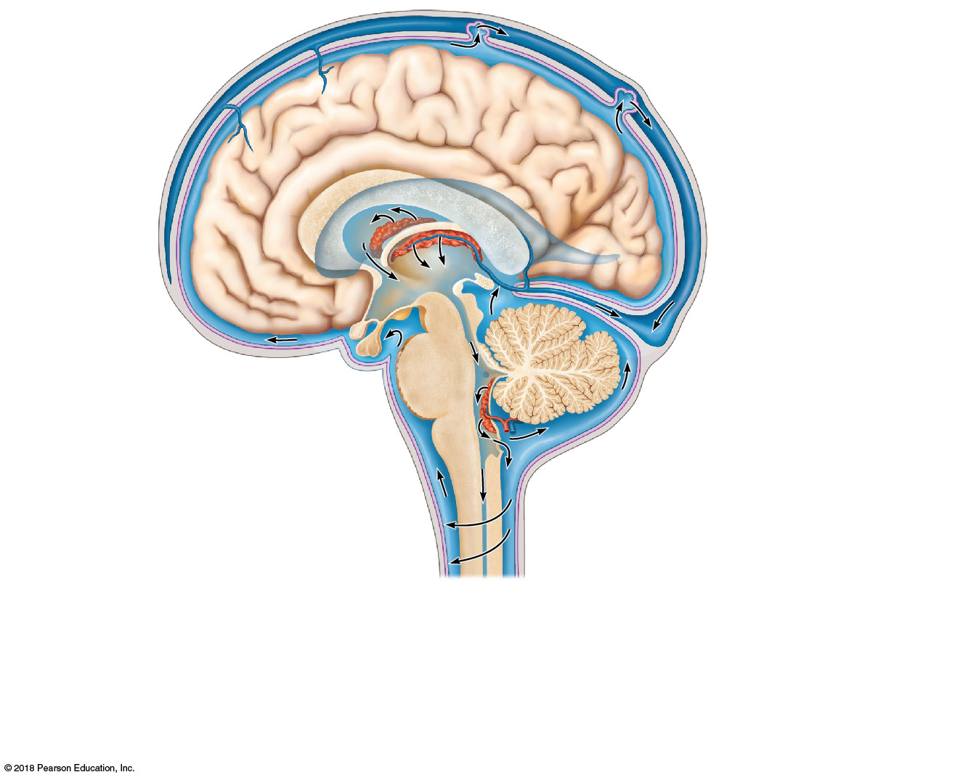
4
Superior
sagittal sinus
Arachnoid granulation
Choroid plexuses
of lateral and
third ventricles
Subarachnoid space
Arachnoid mater
Meningeal dura mater
Corpus callosum
Periosteal dura mater
Interventricular
foramen
1
Right lateral ventricle
(deep to cut)
Third ventricle
3
Choroid plexus
of fourth ventricle
Cerebral aqueduct
Lateral aperture
CSF is produced by the
choroid plexus of each
ventricle.
Fourth ventricle
1
2
Median aperture
CSF flows through the ventricles
and into the subarachnoid space via
the median and lateral apertures.
Some CSF flows through the central
canal of the spinal cord.
2
Central canal
of spinal cord
CSF flows through the
subarachnoid space.
3
CSF is absorbed into the dural
venous sinuses via the arachnoid
granulations.
4
(c) CSF circulation
© 2018 Pearson Education, Inc.

Slide 34
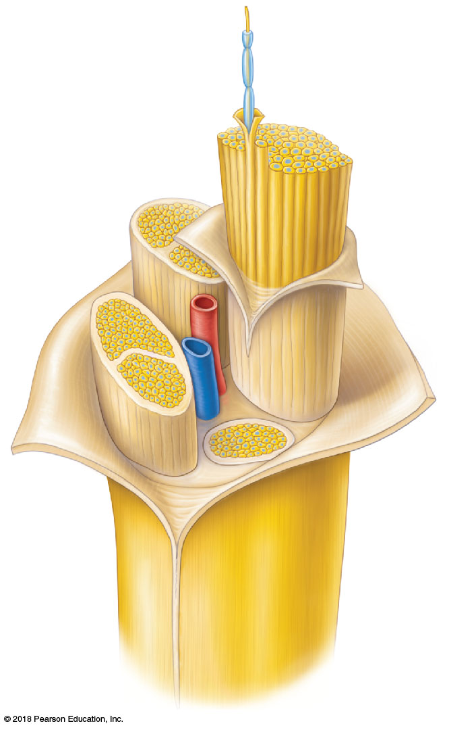
Axon
Myelin sheath
Endoneurium
Perineurium
Epineurium
Fascicle
Blood
vessels
© 2018 Pearson Education, Inc.

Slide 35
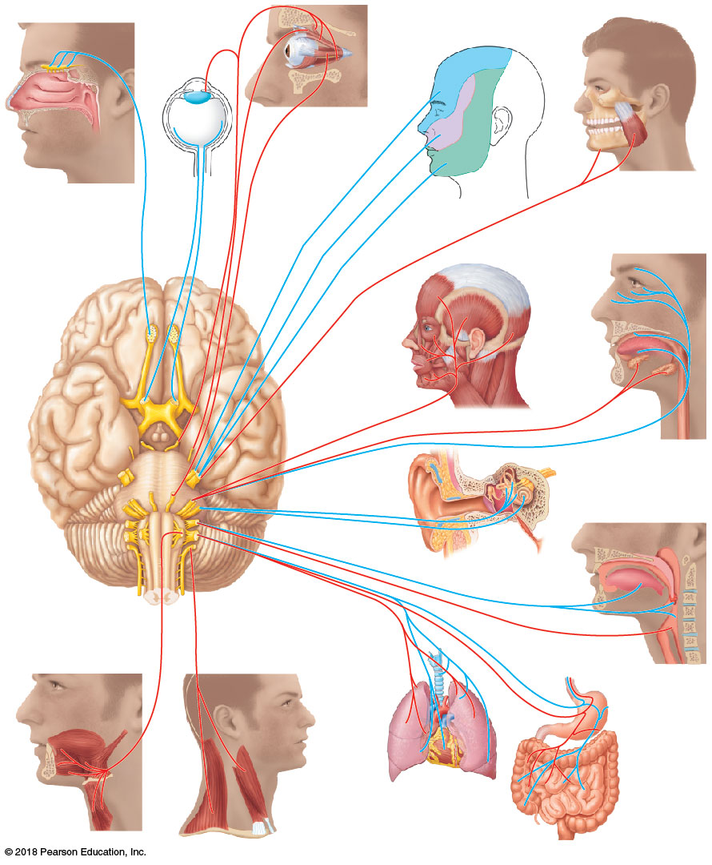
III Oculomotor
IV Trochlear
I Olfactory
VI Abducens
II Optic
V Trigeminal
V Trigeminal
VII Facial
Vestibular
branch
Cochlear
branch
VIII Vestibulocochlear
X Vagus
XII Hypoglossal
XI Accessory
IX Glossopharyngeal
© 2018 Pearson Education, Inc.

Slide 36
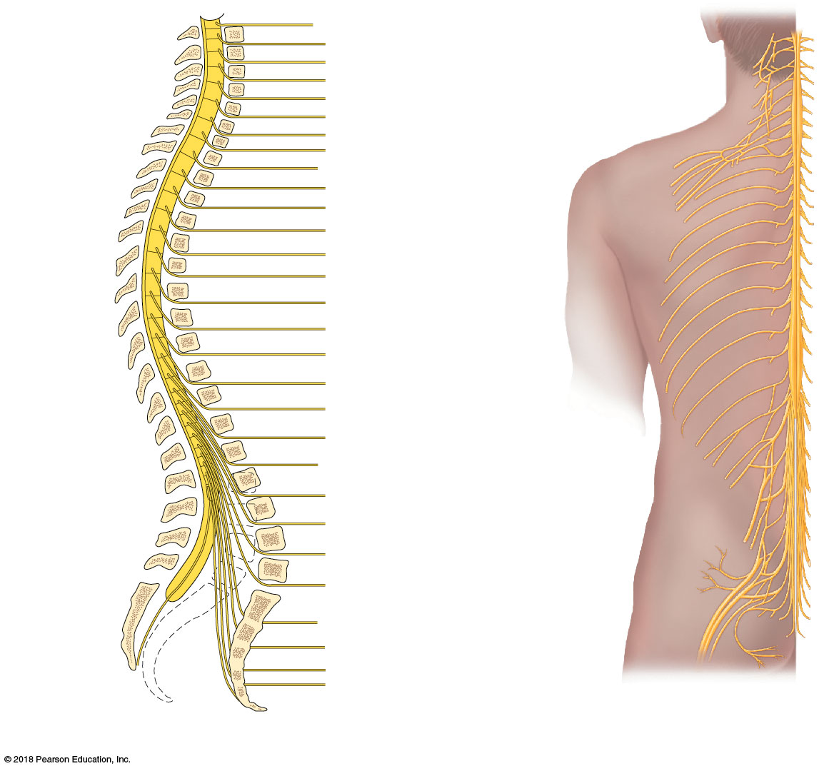
C₁
2
3
Ventral rami form
cervical plexus
(C₁ – C₅)
Cervical
nerves
4
5
6
7
Ventral rami form
brachial plexus
(C₅ – C₈; T₁)
8*
T₁
2
3
4
Thoracic
nerves
5
6
7
8
No plexus
formed
(intercostal
nerves)
(T₂ – T₁₂)
9
10
Lumbar
nerves
11
12
Sacral
nerves
L₁
2
3
Ventral rami form
lumbar plexus
(L₁ – L₄)
4
5
S₁
Ventral rami form
sacral plexus
(L₄ – L₅; S₁ – S₄)
2
3
(a)
4
*Note that the cervical nerve C₈ emerges inferior to the C₇ vertebra, while the other seven cervical nerves
emerge superior to the vertebrae for which they are named.
© 2018 Pearson Education, Inc.

Slide 37
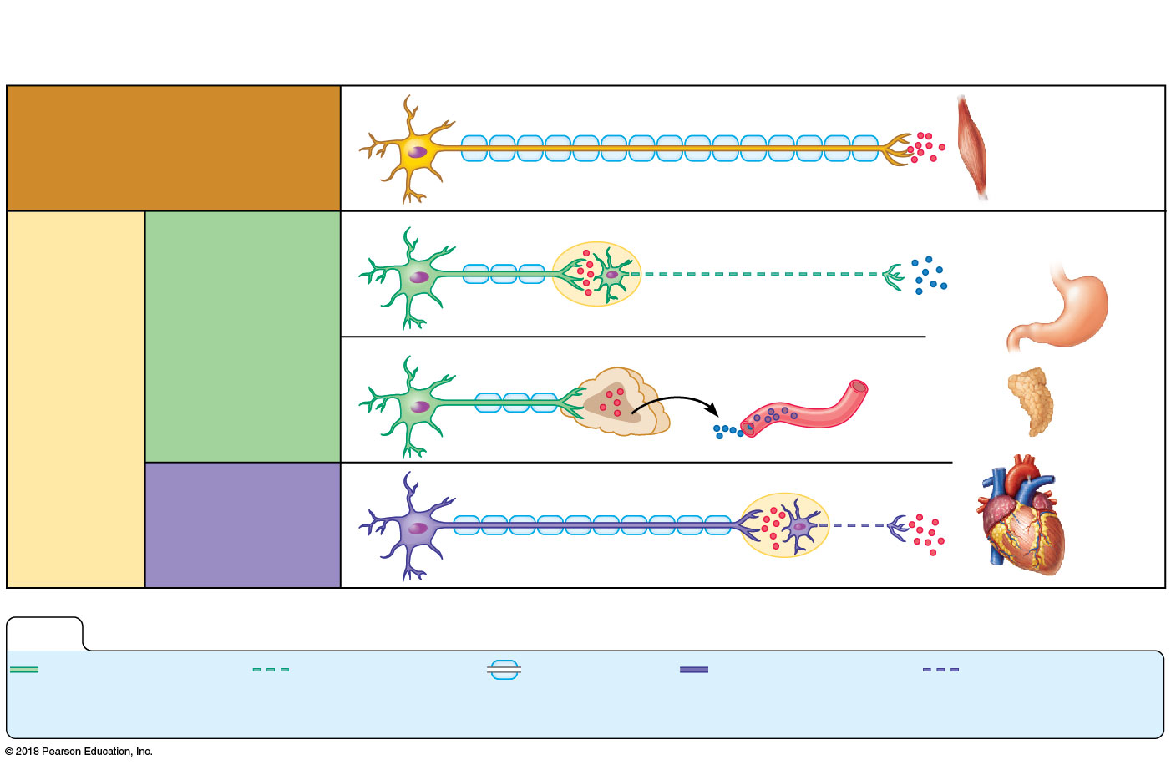
Central
nervous system
Peripheral nervous system
Effector organs
Acetylcholine
Somatic nervous system
Skeletal muscle
Acetylcholine
Norepinephrine
Smooth muscle
(e.g., in stomach)
Sympathetic
division
Ganglion
Acetylcholine
Epinephrine and
norepinephrine
Autonomic
nervous
system
Blood
vessel
Glands
Adrenal medulla
Acetylcholine
Parasympathetic
division
Cardiac
muscle
Ganglion
KEY:
Preganglionic
axons
(sympathetic)
Postganglionic
axons
(sympathetic)
Myelination
Preganglionic
axons
(parasympathetic)
Postganglionic
axons
(parasympathetic)
© 2018 Pearson Education, Inc.

