Slide 1
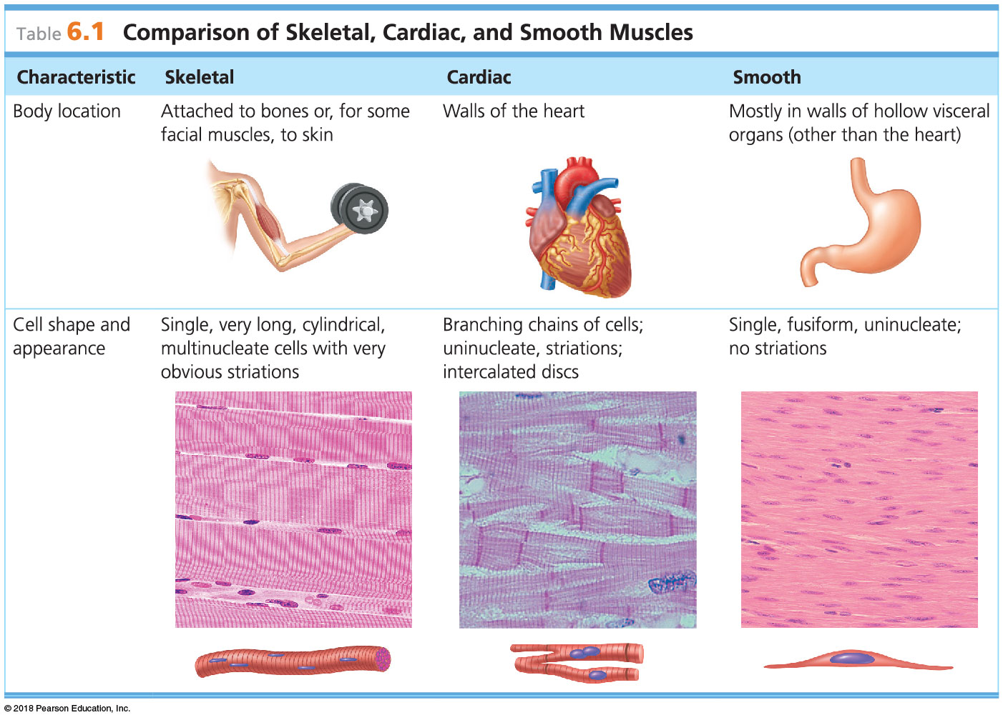
© 2018 Pearson Education, Inc.

Slide 2
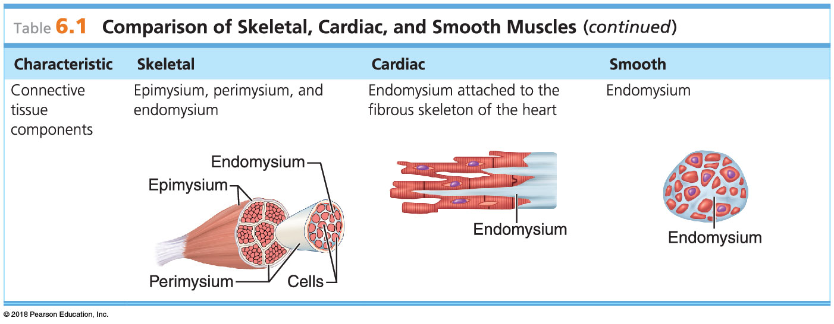
© 2018 Pearson Education, Inc.

Slide 3
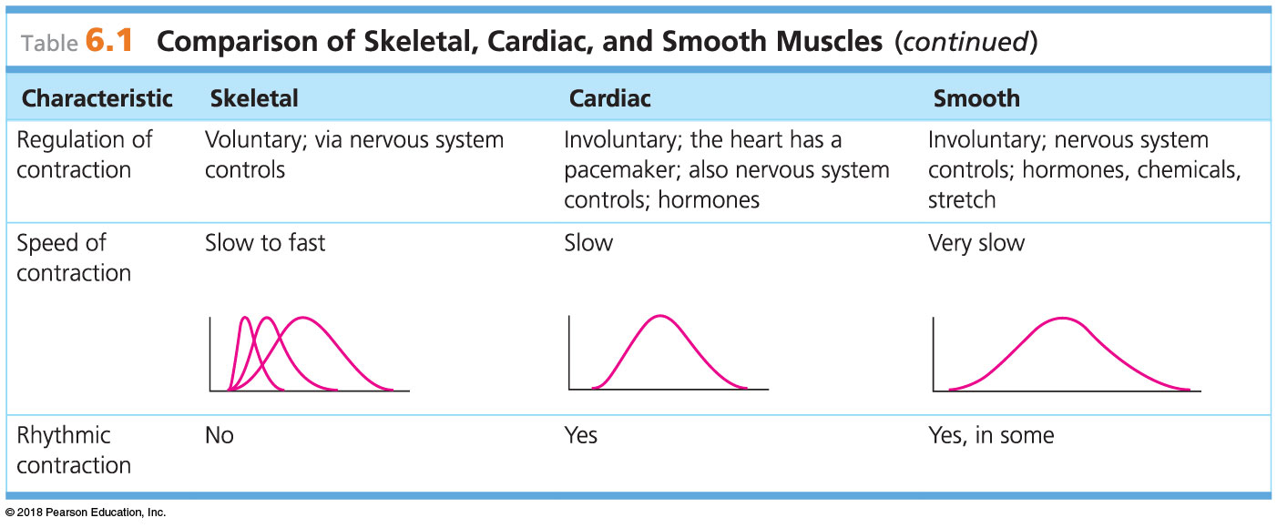
© 2018 Pearson Education, Inc.

Slide 4
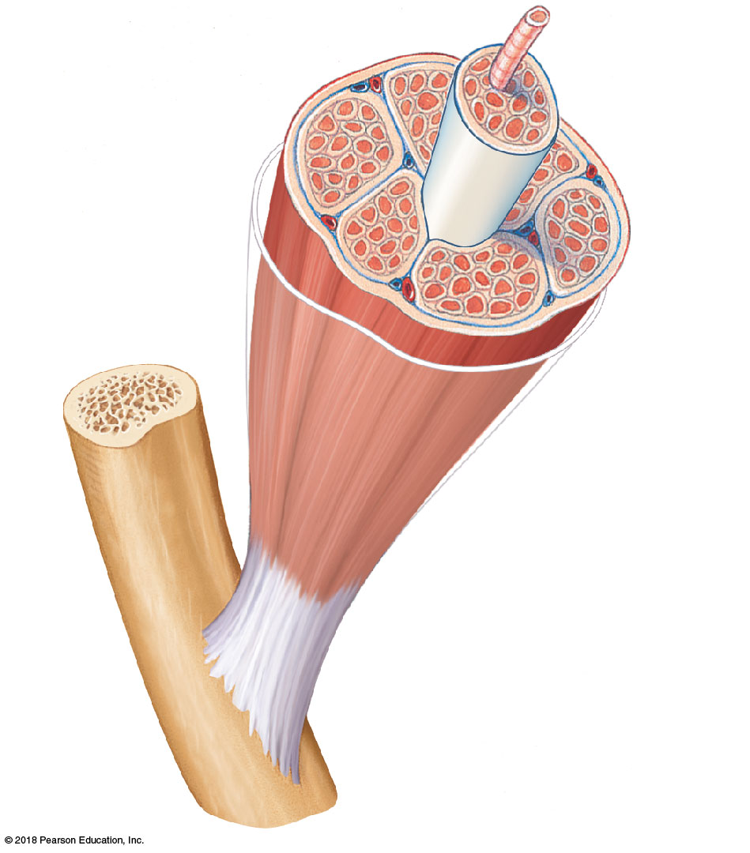
Muscle ﬁber (cell)
Blood vessel
Perimysium
Epimysium
(wraps entire muscle)
Fascicle (wrapped by perimysium)
Endomysium (between ﬁbers)
Tendon
Bone
© 2018 Pearson Education, Inc.

Slide 5
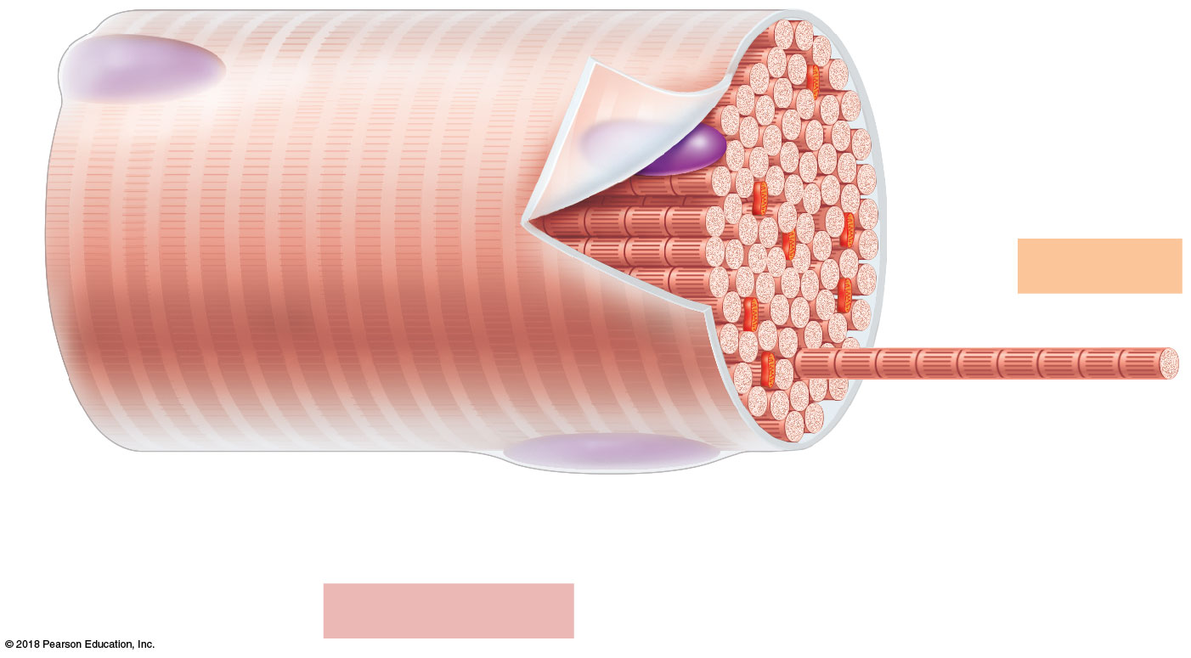
Sarcolemma
Myofibril
Dark
(A) band
Light
(I) band
Nucleus
(a) Segment of a muscle fiber (cell)
© 2018 Pearson Education, Inc.

Slide 6
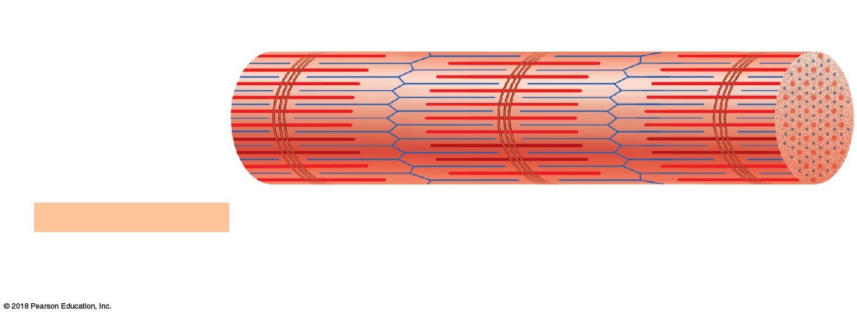
Z disc
H zone
Z disc
Thin (actin) myofilament
Thick (myosin)
myofilament
(b) Myofibril or fibril (complex organelle composed of bundles of myofilaments)
I band
A band
I band
M line
© 2018 Pearson Education, Inc.

Slide 7
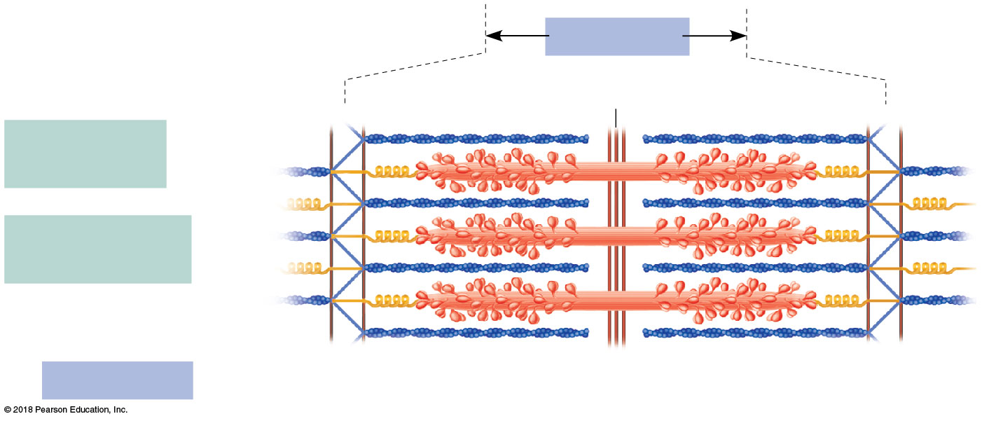
Sarcomere
M line
Z disc
Z disc
Thin (actin) myofilament
Thick (myosin) myofilament
(c) Sarcomere (segment of a myofibril)
© 2018 Pearson Education, Inc.

Slide 8
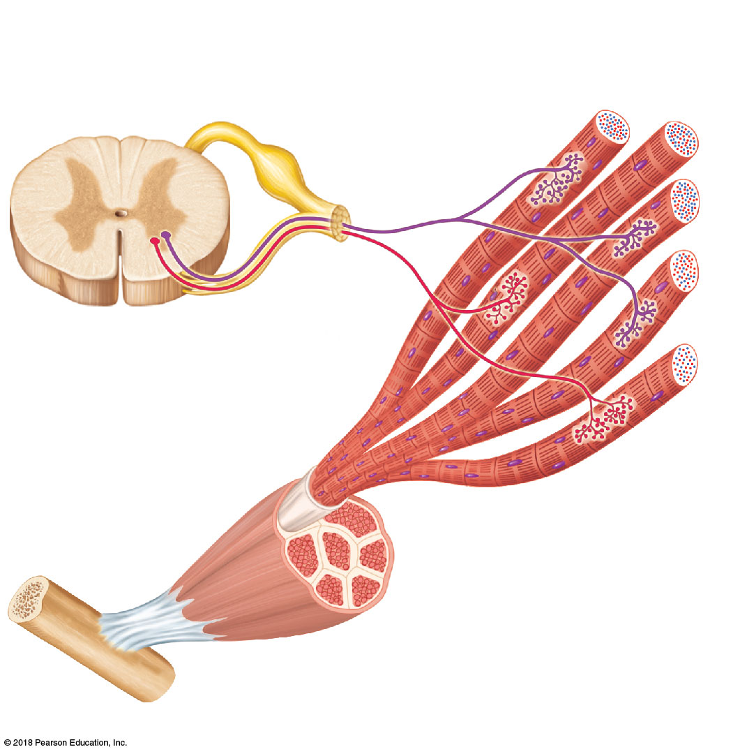
Axon terminals at neuromuscular junctions
Spinal cord
Motor unit 1
Motor
unit 2
Nerve
Axon of motor neuron
Motor neuron cell bodies
Muscle
Muscle fibers
(a)
© 2018 Pearson Education, Inc.

Slide 9
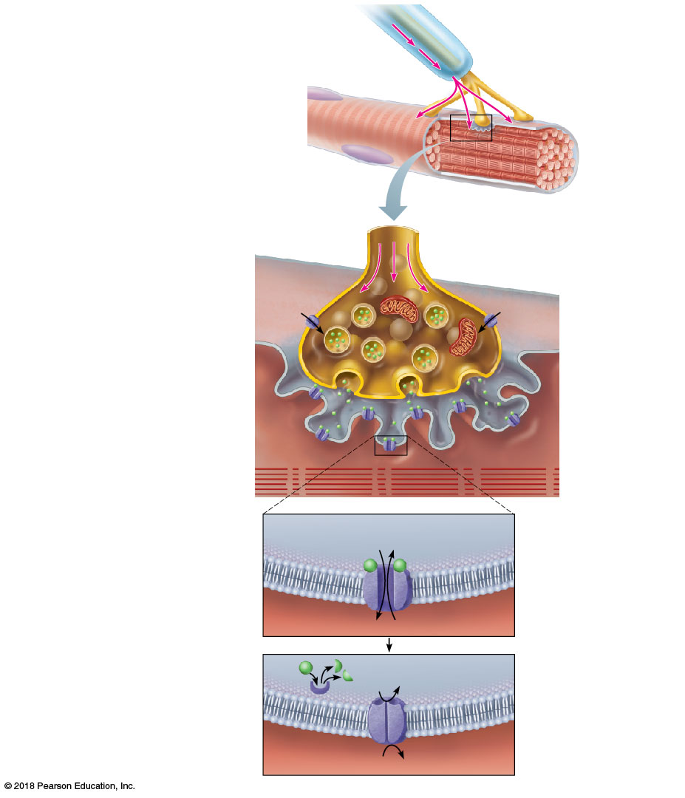
Slide 1
Nerve impulse Nucleus
Myelinated axon of motor neuron
Axon terminal of neuromuscular junction
Sarcolemma of the muscle fiber
1
Synaptic vesicle containing ACh
Nerve impulse reaches axon terminal of motor neuron.
Axon terminal of motor neuron
Mitochondrion
Calcium (Ca²⁺) channels open, and Ca²⁺ enters the axon terminal.
Ca²⁺
2
Ca²⁺
Synaptic
cleft
Sarcolemma
Fusing synaptic
vesicle
Sarcoplasm
of muscle fiber
3
Ca²⁺ entry causes some synaptic vesicles to release their contents (the neurotransmitter acetylcholine) by exocytosis.
ACh
ACh receptor
Folds of
sarcolemma
Acetylcholine diffuses across the synaptic cleft and binds to receptors in the sarcolemma.
4
5
Na⁺
K⁺
Ion channel in sarcolemma opens; ions pass.
ACh binds and opens channels that allow simultaneous passage of Na⁺ into the muscle fiber and K⁺ out of the muscle fiber. More Na⁺ ions enter than K⁺ ions leave, producing a local change in the electrical conditions of the membrane (depolarization). This eventually leads to an action potential.
ACh
Degraded ACh Na⁺
Ion channel closes; ions cannot pass.
The enzyme acetylcholinesterase breaks down ACh in the synaptic cleft, ending the process.
6
Acetylcholinesterase
K⁺

Slide 10
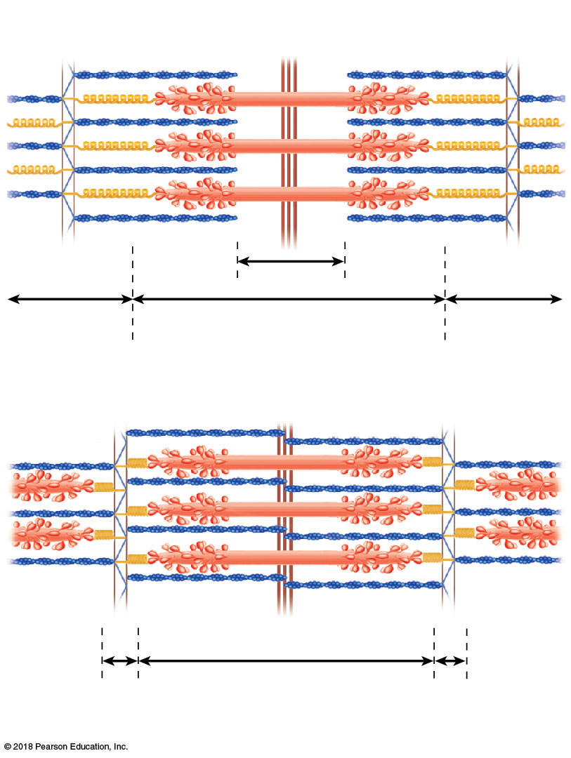
Myosin
Actin
Z
H
Z
I
A
I
(a) Relaxed sarcomere
Z
Z
I
A
I
(b) Fully contracted sarcomere
© 2018 Pearson Education, Inc.

Slide 11
Regulatory proteins
In a relaxed muscle fiber, the regulatory proteins forming part of the actin myofilaments prevent myosin binding (see a). When an action potential (AP) sweeps along its sarcolemma and a muscle fiber is excited, calcium ions (Ca²⁺) are released from intracellular storage areas (the sacs of the sarcoplasmic reticulum).
Myosin myofilament
Actin myofilament
(a)
© 2018 Pearson Education, Inc.

Slide 12
Myosin-binding site
Ca²⁺
The flood of calcium acts as the final trigger for contraction, because as calcium binds to the regulatory proteins on the actin filaments, the proteins undergo a change in both their shape and their position on the thin filaments. This action exposes myosin-binding sites on the actin, to which the myosin heads can attach (see b), and the myosin heads immediately begin seeking out binding sites.
Upper part of thick filament only
(b)
© 2018 Pearson Education, Inc.

Slide 13
The free myosin heads are “cocked,” much like an
oar ready to be pulled on for rowing. Myosin attachment to actin causes the myosin heads to snap (pivot) toward the center of the sarcomere in a rowing motion. When this happens, the thin filaments are slightly pulled toward the center of the sarcomere
(see c). ATP provides the energy needed to release and recock each myosin head so that it is ready to attach to a binding site farther along the thin filament.
(c)
© 2018 Pearson Education, Inc.

Slide 14
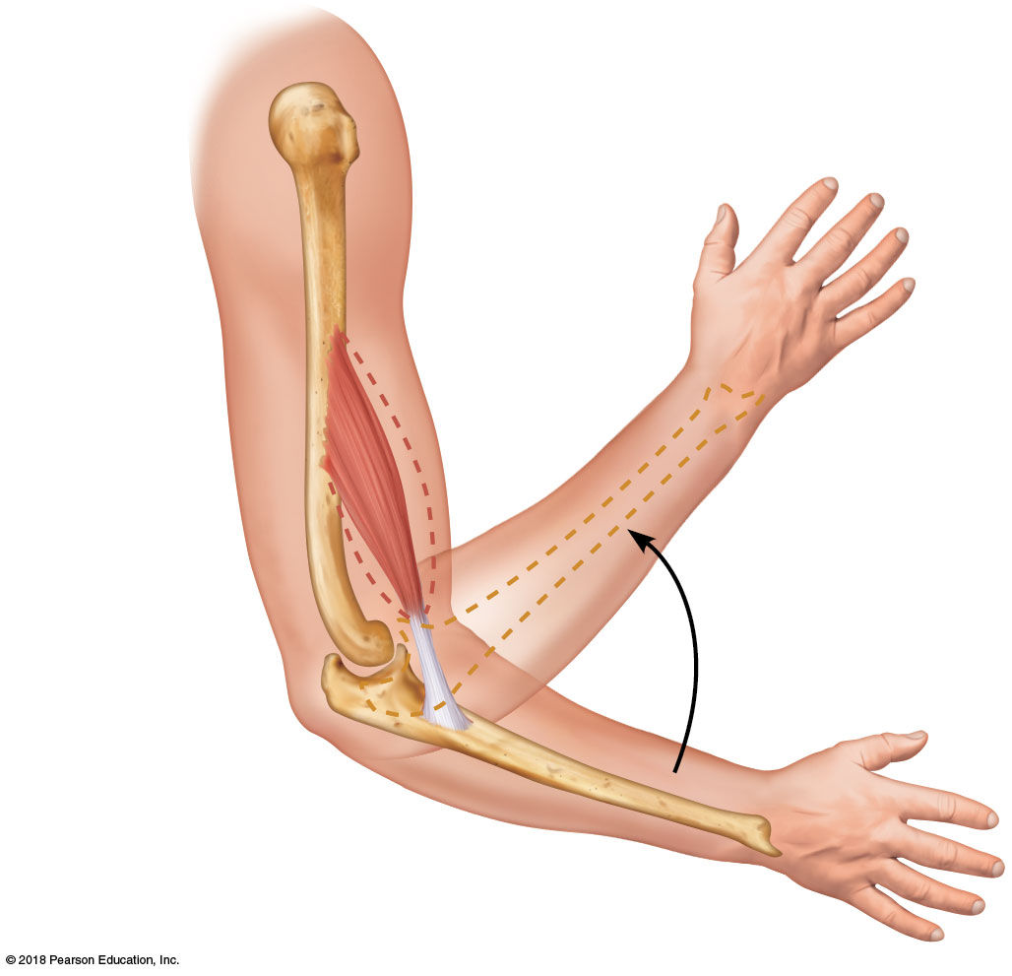
Muscle contracting
Origin
Brachialis
Tendon
Insertion
© 2018 Pearson Education, Inc.

Slide 15
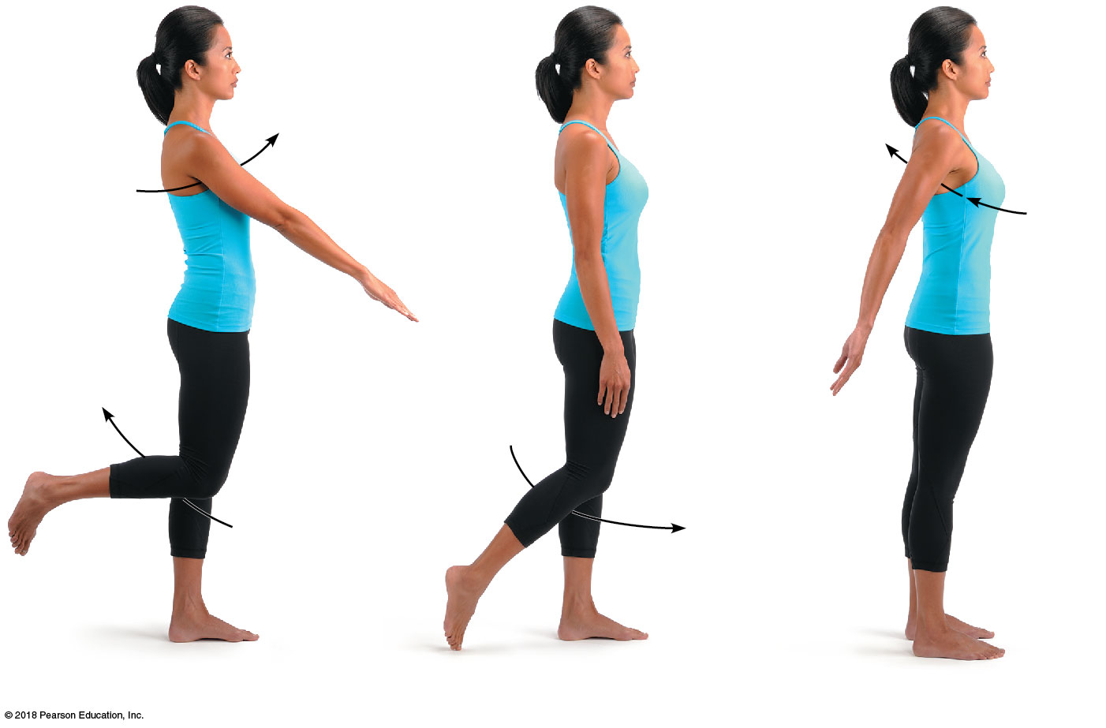
Flexion
Hyperextension
Extension
Flexion
Extension
(a) Flexion, extension, and hyperextension of the shoulder and knee
© 2018 Pearson Education, Inc.

Slide 16
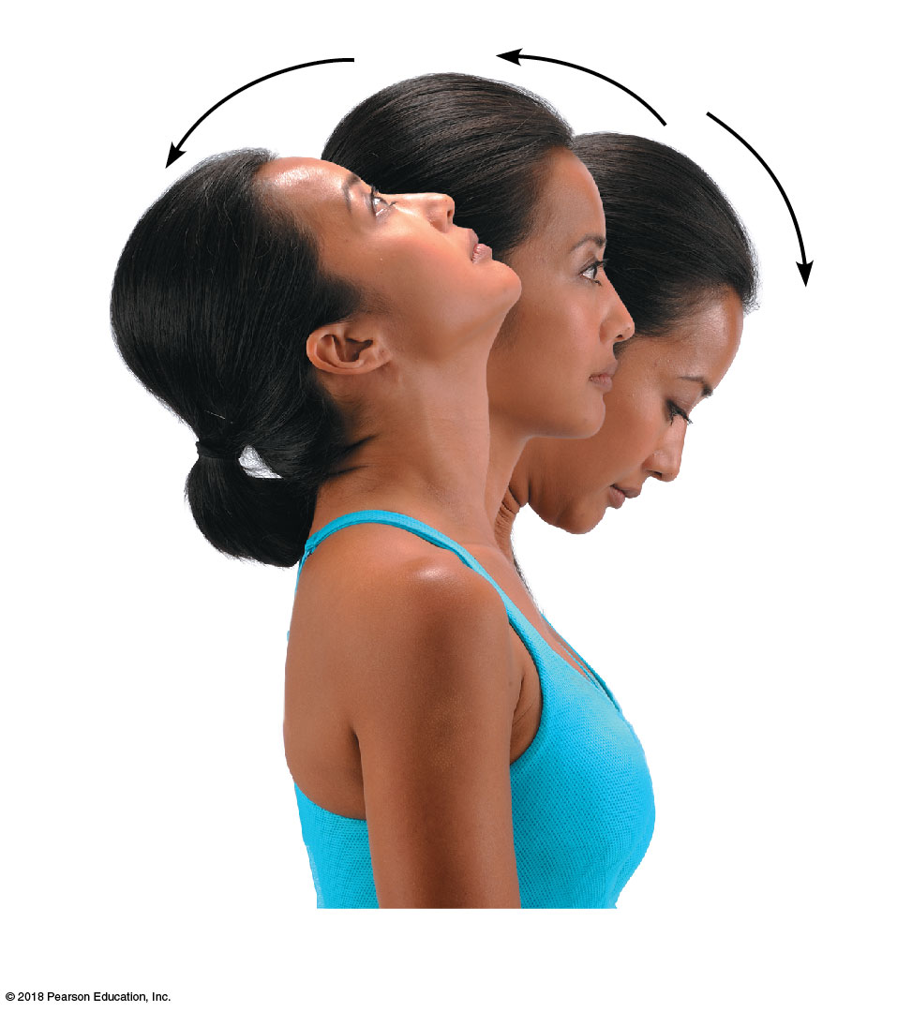
Hyperextension
Extension
Flexion
(b) Flexion, extension, and hyperextension
© 2018 Pearson Education, Inc.

Slide 17
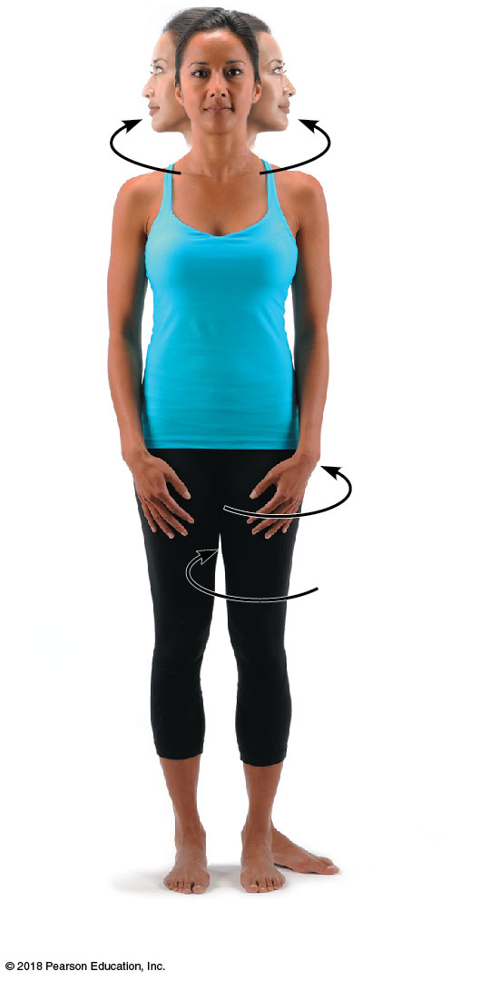
Rotation
Lateral
rotation
Medial rotation
(c) Rotation
© 2018 Pearson Education, Inc.

Slide 18
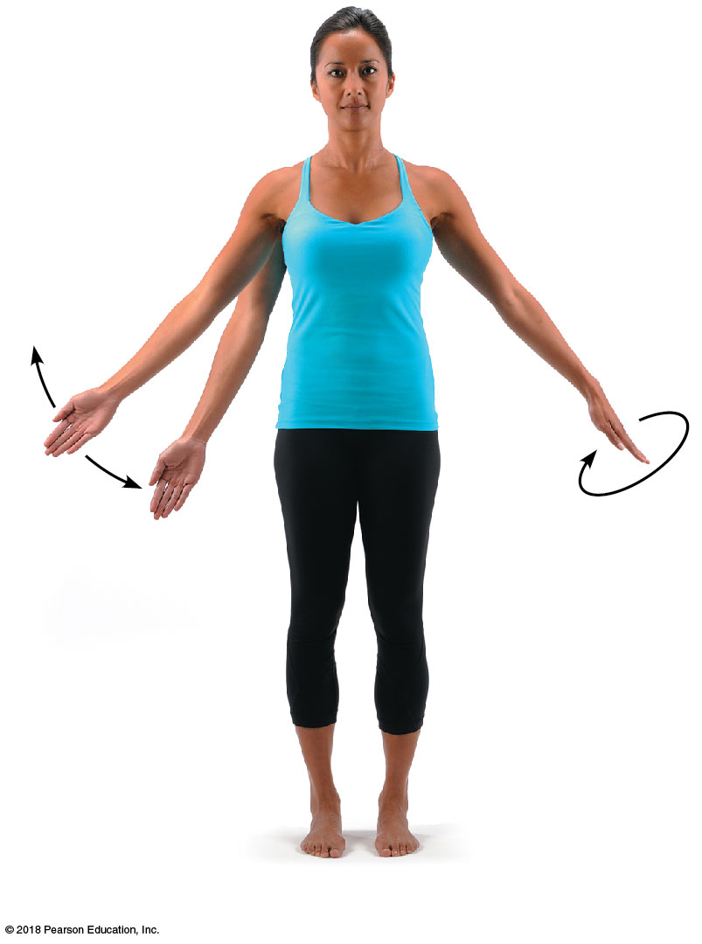
Abduction
Adduction
Circumduction
(d) Abduction, adduction, and circumduction
© 2018 Pearson Education, Inc.

Slide 19
Abduction
Adduction
Circumduction
(d) Abduction, adduction, and circumduction
© 2018 Pearson Education, Inc.

Slide 20
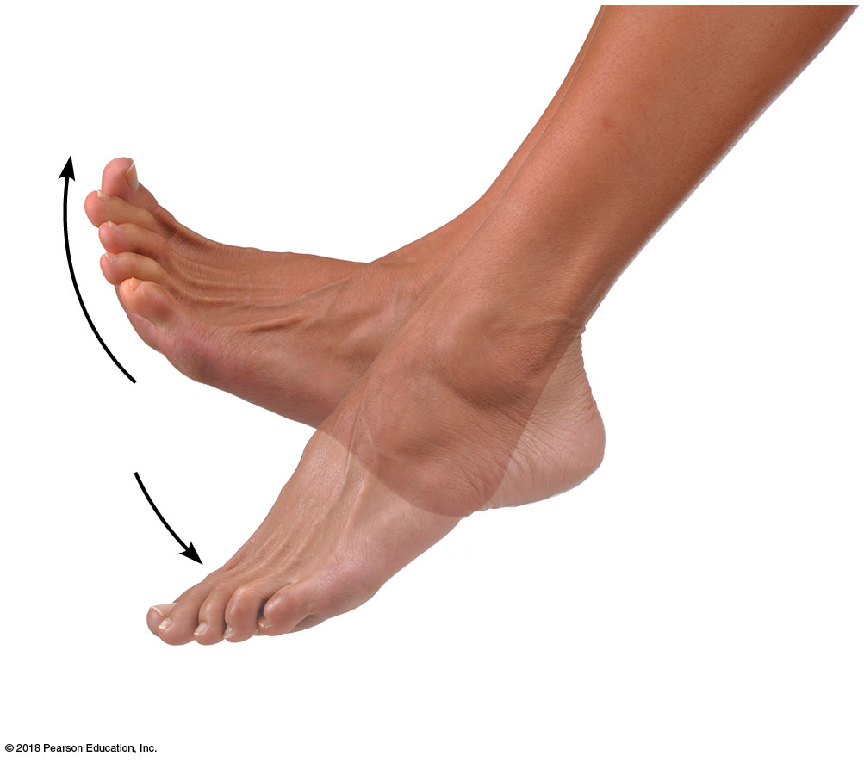
Dorsiﬂexion
Plantar flexion
(e) Dorsiﬂexion and plantar ﬂexion
© 2018 Pearson Education, Inc.

Slide 21
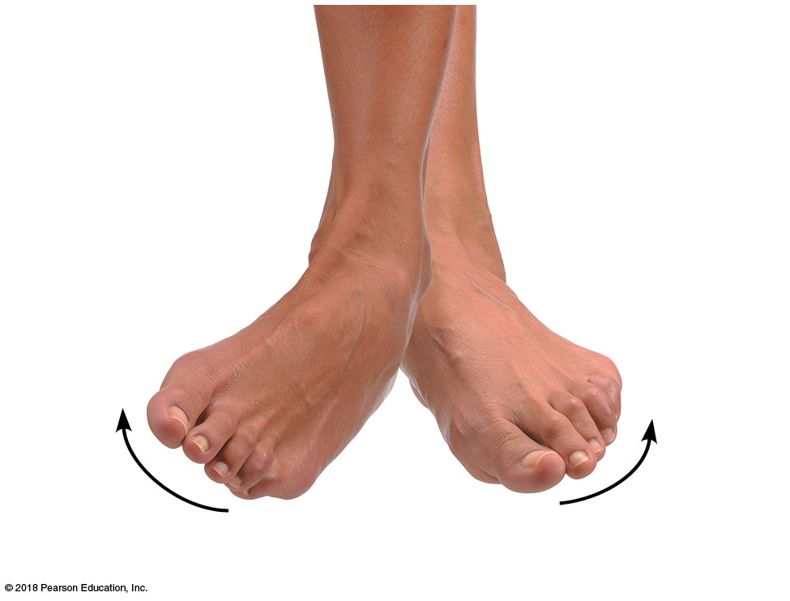
Inversion
Eversion
(f) Inversion and eversion
© 2018 Pearson Education, Inc.

Slide 22
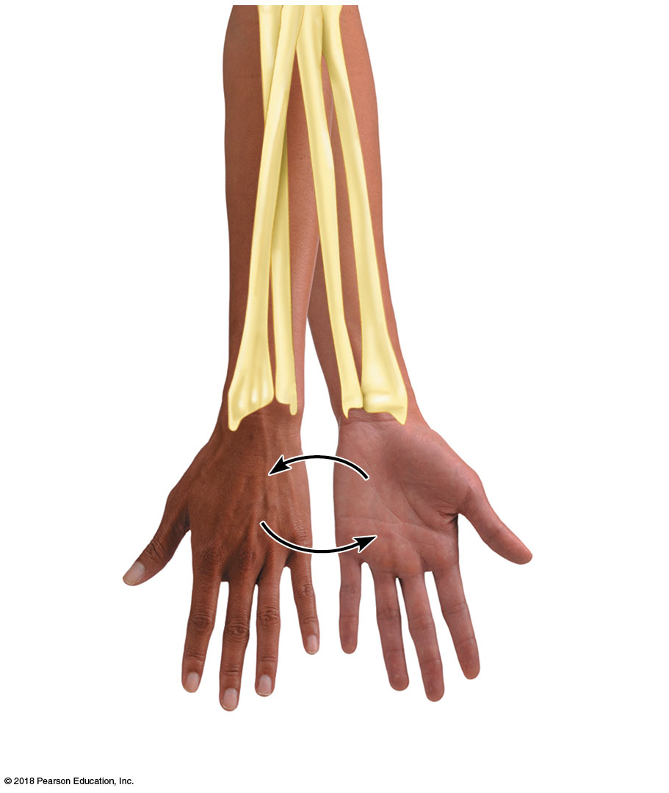
Pronation
(radius rotates
over ulna)
Supination
(radius and ulna
are parallel)
P
P
s
s
(g) Supination (S) and pronation (P)
© 2018 Pearson Education, Inc.

Slide 23
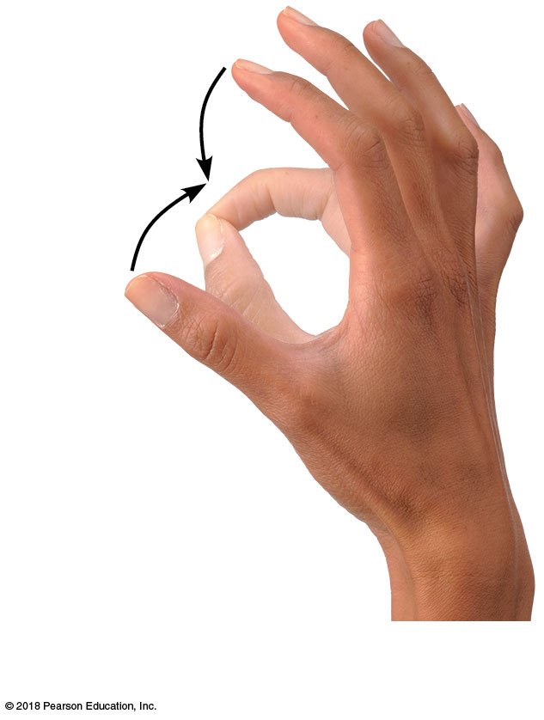
Opposition
(h) Opposition
© 2018 Pearson Education, Inc.

Slide 24
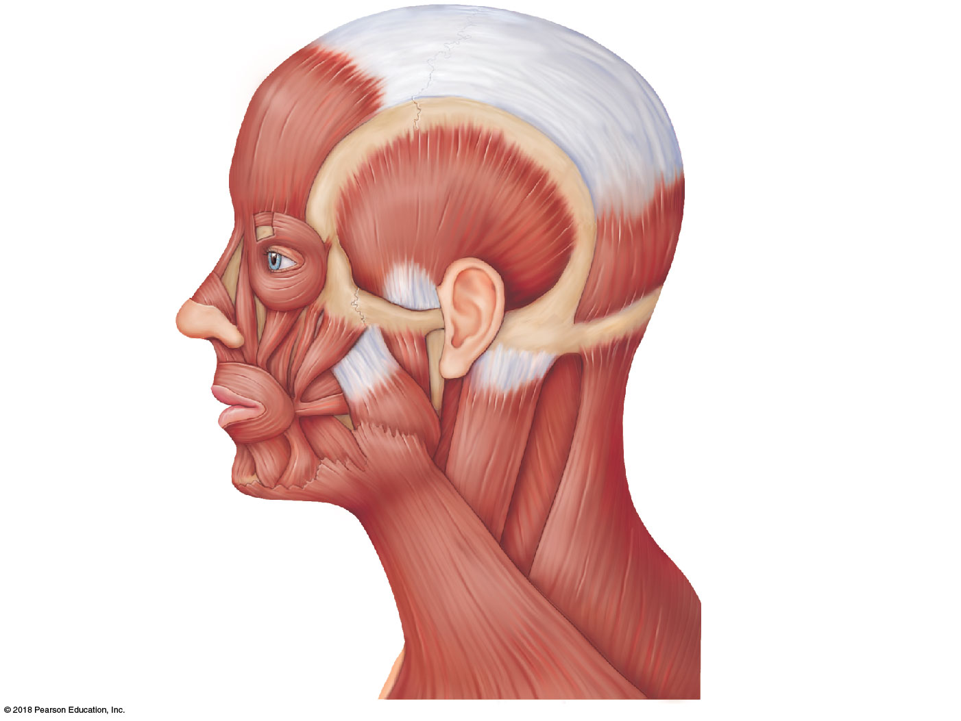
Frontalis
Cranial aponeurosis
Temporalis
Orbicularis oculi
Occipitalis
Zygomaticus
Buccinator
Masseter
Orbicularis oris
Sternocleidomastoid
Trapezius
Platysma
© 2018 Pearson Education, Inc.

Slide 25
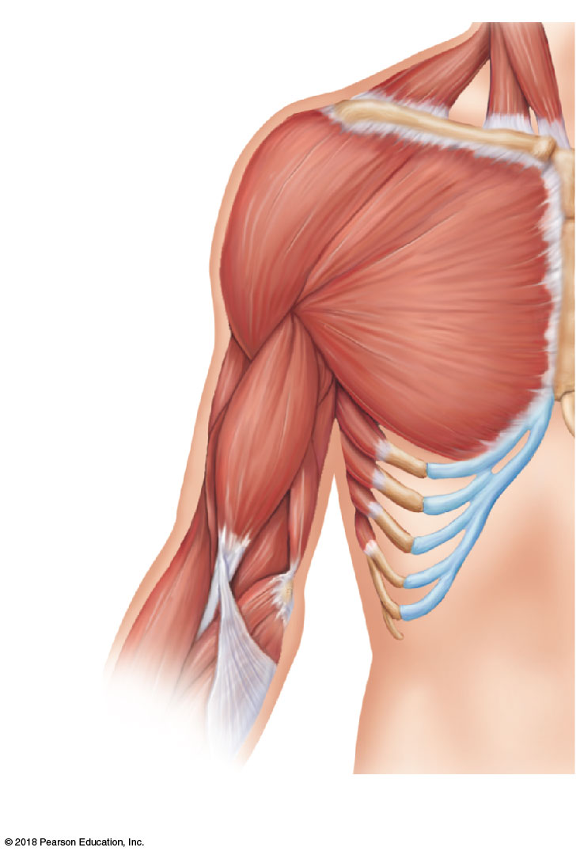
Clavicle
Deltoid
Sternum
Pectoralis major
Biceps brachii
Brachialis
Brachio- radialis
(a)
© 2018 Pearson Education, Inc.

Slide 26
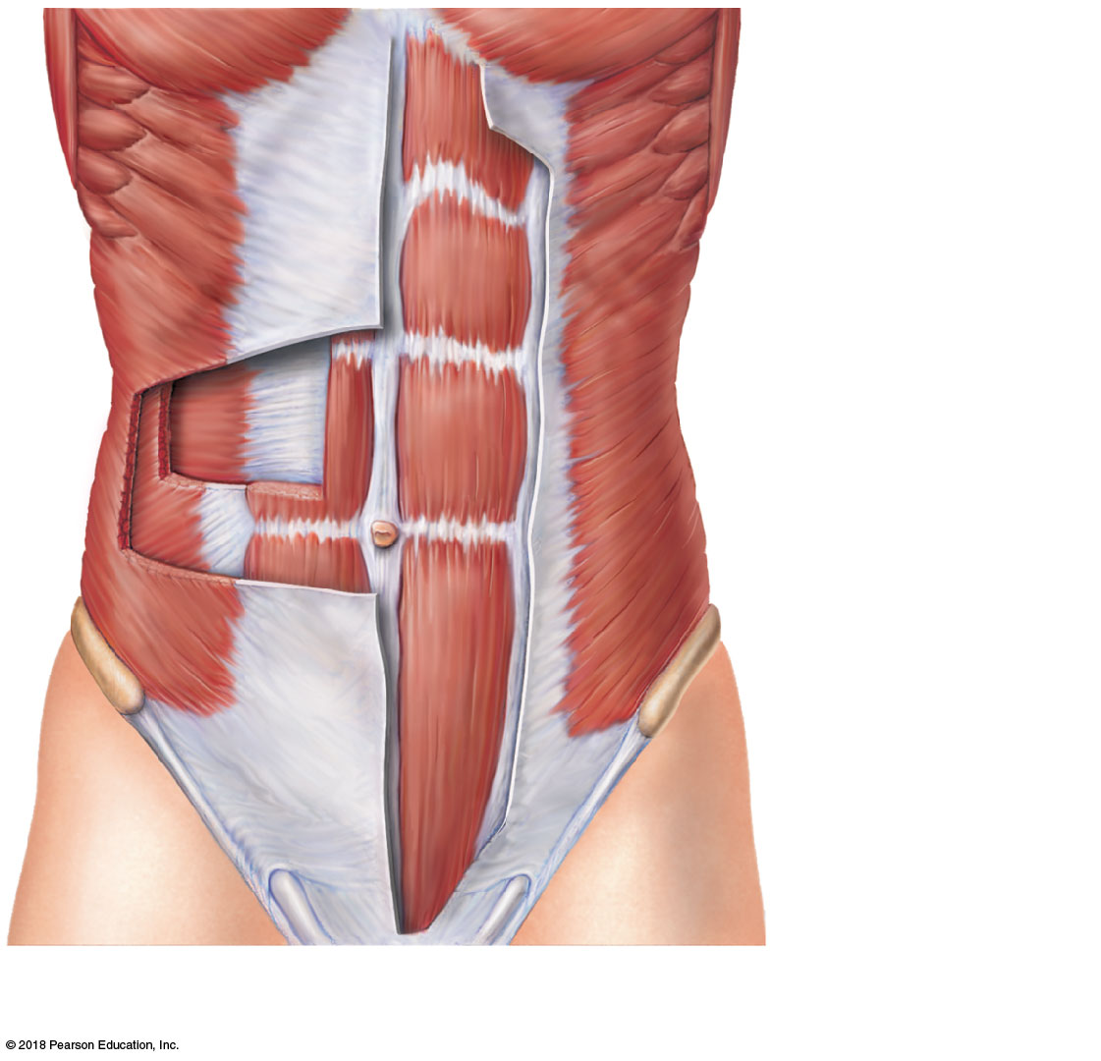
Pectoralis major
Rectus
abdominis
Transversus abdominis
Internal
oblique
External oblique
Aponeurosis
(b)
© 2018 Pearson Education, Inc.

Slide 27
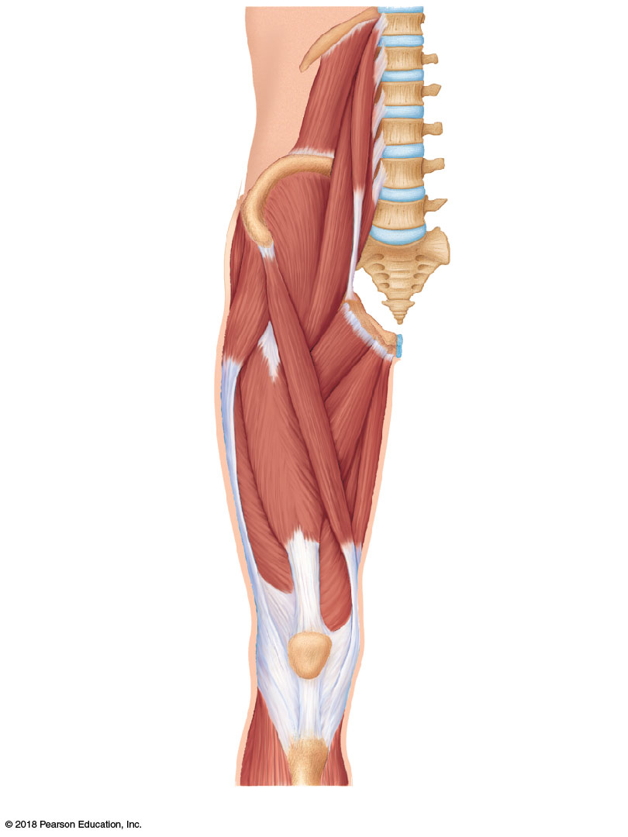
12th
thoracic vertebra
12th rib
Iliac crest
Iliopsoas
Psoas major
Iliacus
5th
lumbar vertebra
Anterior superior iliac spine
Sartorius
Adductor group
Quadriceps*
Rectus femoris
Vastus lateralis
Vastus medialis
Patella
Patellar ligament
© 2018 Pearson Education, Inc.
(c)

Slide 28
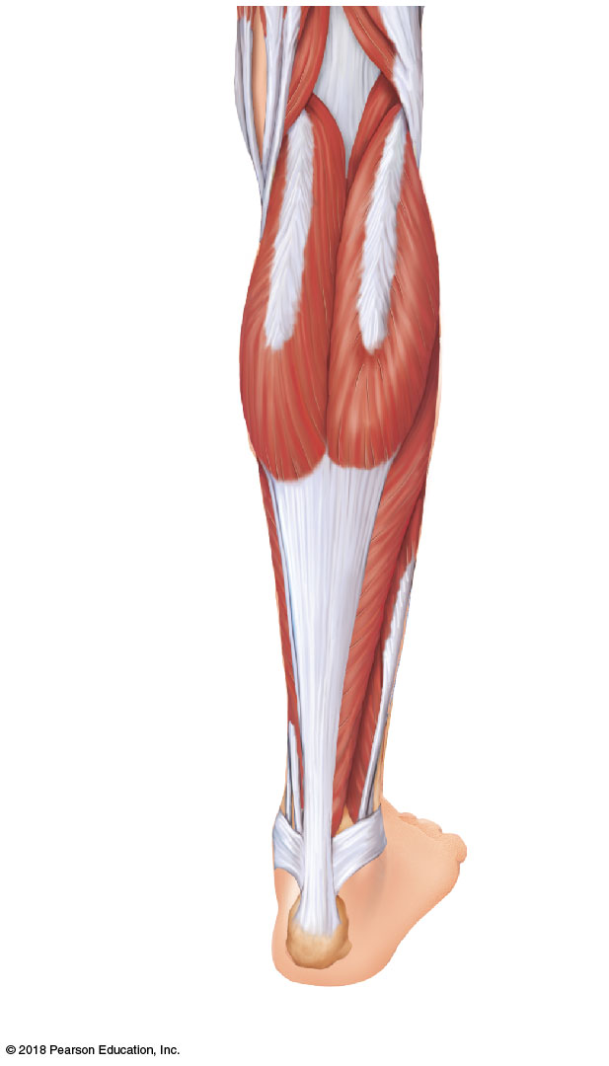
Gastrocnemius
Soleus
Calcaneal (Achilles) tendon
Medial malleolus
Lateral
malleolus
(b)
© 2018 Pearson Education, Inc.

Slide 29
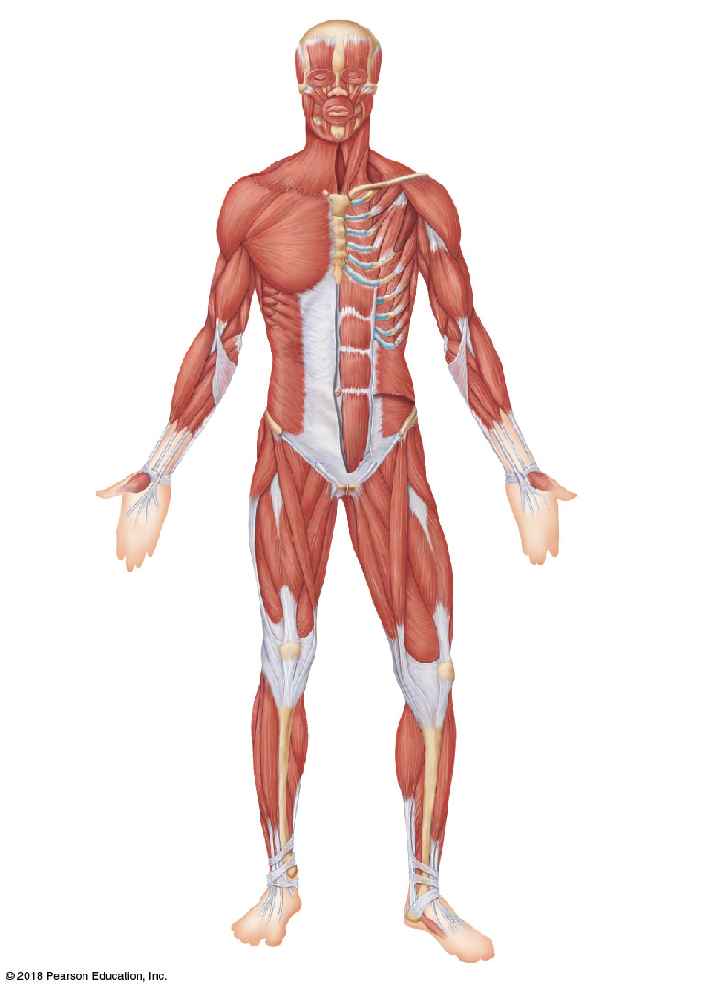
Facial
Facial
Frontalis
Temporalis
Orbicularis oculi
Masseter
Zygomaticus
Orbicularis oris
Shoulder
Neck
Trapezius
Platysma
Sternocleidomastoid
Deltoid
Thorax
Pectoralis minor
Arm
Pectoralis major
Serratus anterior
Triceps brachii
Biceps brachii
Intercostals
Brachialis
Abdomen
Forearm
Rectus abdominis
Brachioradialis
External oblique
Flexor carpi radialis
Internal oblique
Transversus abdominis
Pelvis/thigh
Iliopsoas
Thigh
Sartorius
Thigh (Quadriceps)
Adductor muscles
Rectus femoris
Vastus lateralis
Vastus medialis
Vastus intermedius (not shown, deep to rectus femoris)
Leg
Fibularis longus
Leg
Extensor digitorum longus
Gastrocnemius
Tibialis anterior
Soleus
© 2018 Pearson Education, Inc.

Slide 30
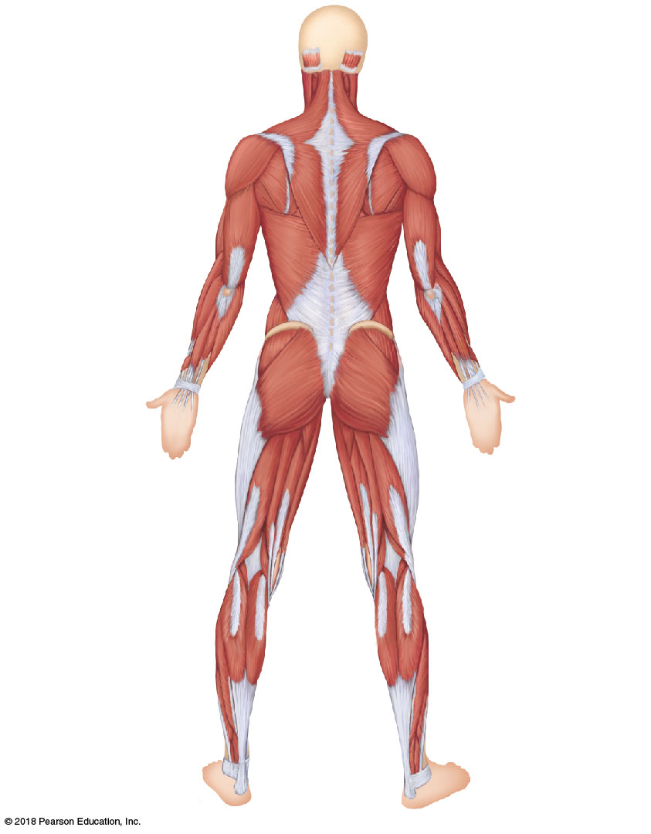
Neck
Occipitalis
Sternocleidomastoid
Trapezius
Shoulder/Back
Arm
Triceps brachii
Deltoid
Brachialis
Latissimus dorsi
Forearm
Brachioradialis
Extensor carpi radialis longus
Flexor carpi ulnaris
Hip
Gluteus medius
Extensor carpi ulnaris
Extensor digitorum
Gluteus maximus
Iliotibial tract
Thigh
Adductor muscle
Hamstrings:
Biceps femoris
Semitendinosus
Semimembranosus
Leg
Gastrocnemius
Soleus
Fibularis longus
Calcaneal (Achilles) tendon
© 2018 Pearson Education, Inc.

