Slide 1
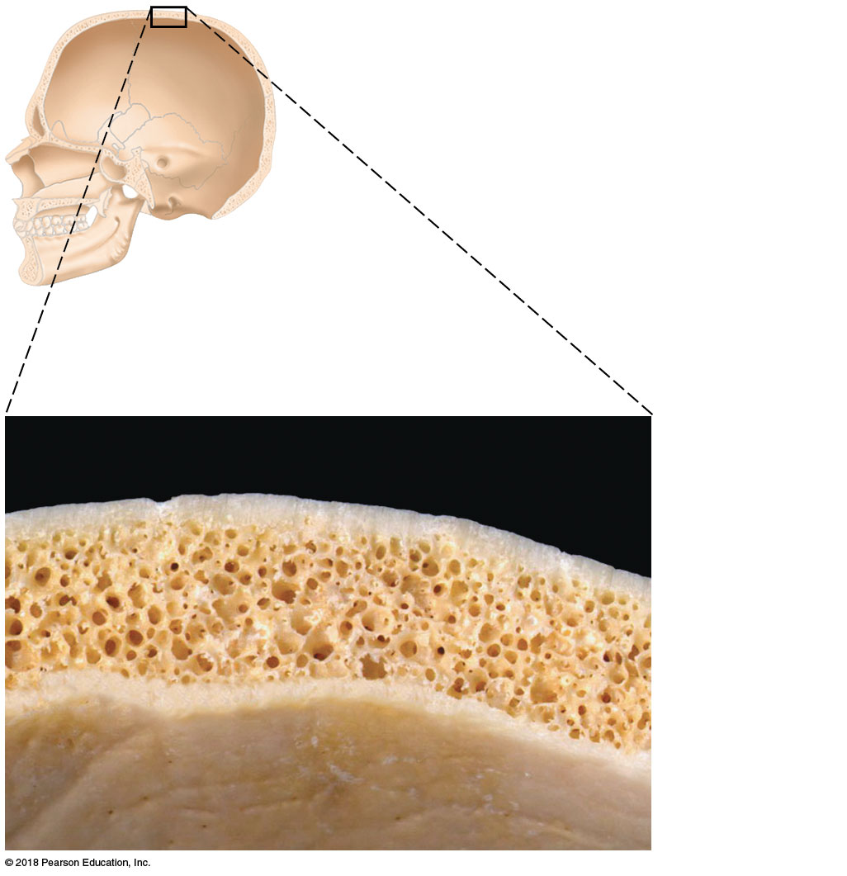
Spongy
bone
Compact
bone
© 2018 Pearson Education, Inc.

Slide 2
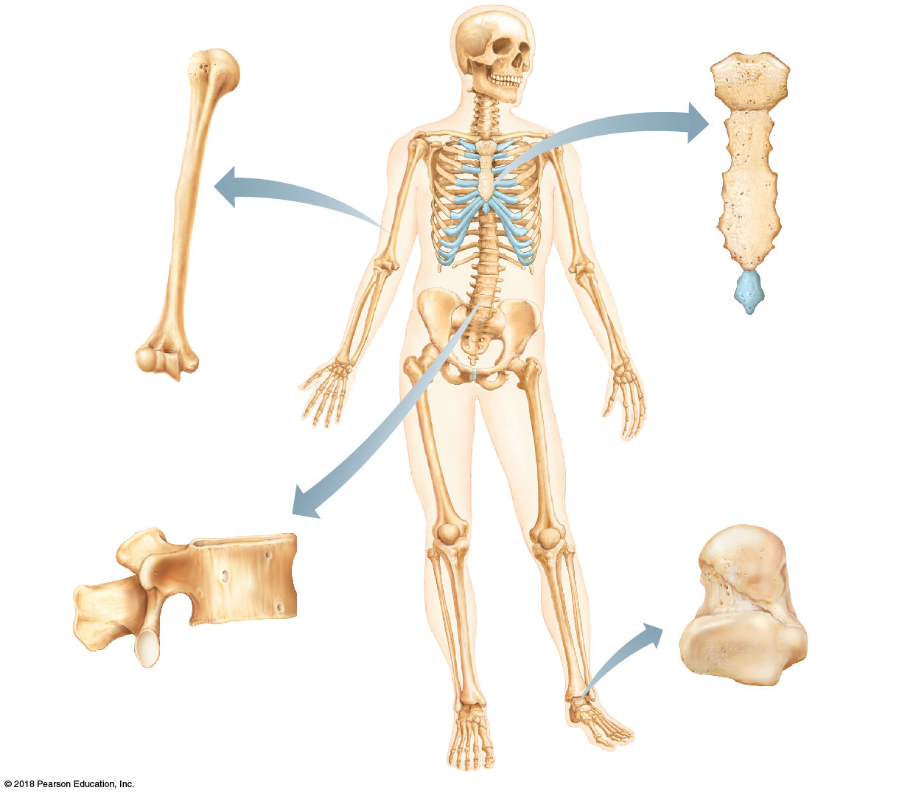
(b) Flat bone (sternum)
(a) Long bone (humerus)
(d) Irregular bone (vertebra), right lateral view
(c) Short bone (talus)
© 2018 Pearson Education, Inc.

Slide 3
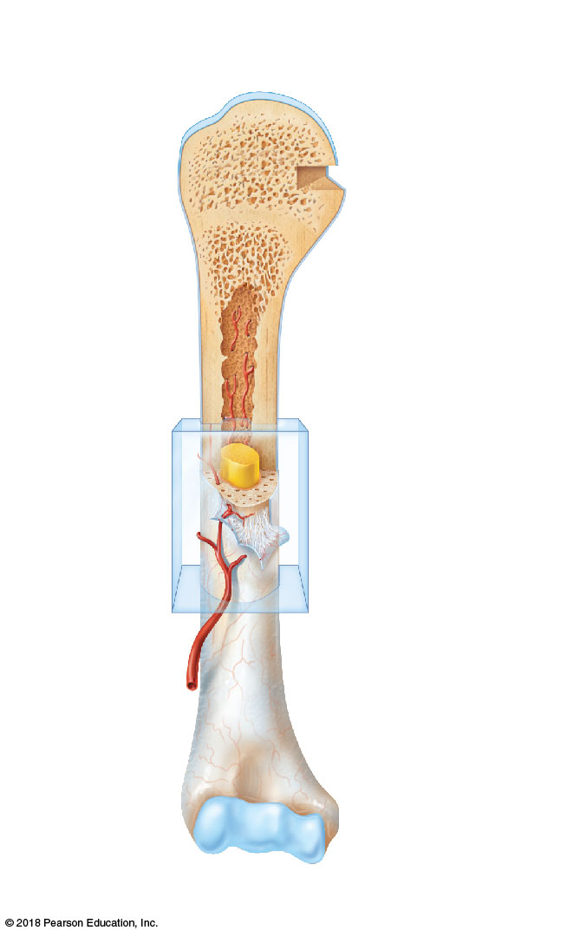
Articular
cartilage
Proximal
epiphysis
Spongy bone
Epiphyseal
line
Periosteum
Compact bone
Medullary
cavity (lined
by endosteum)
Diaphysis
Distal
epiphysis
(a)
© 2018 Pearson Education, Inc.

Slide 4
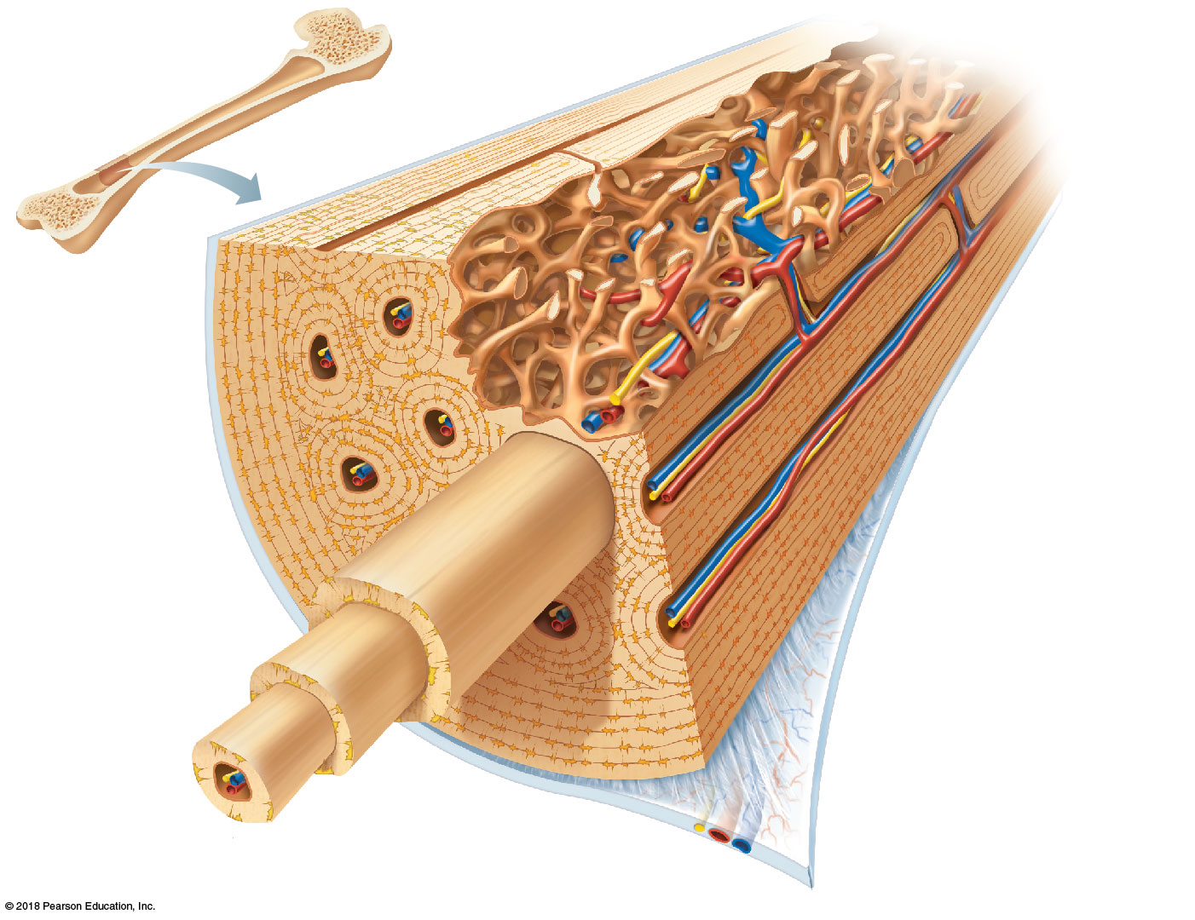
Trabeculae of
spongy bone
Osteon
(Haversian
system)
Perforating
(Volkmann’s)
canal
Blood vessel continues
into medullary cavity
containing marrow
Blood vessel
Lamellae
Compact bone
Central (Haversian) canal
Perforating (Sharpey’s)
fibers
Periosteum
Periosteal
blood vessel
(a)
© 2018 Pearson Education, Inc.

Slide 5
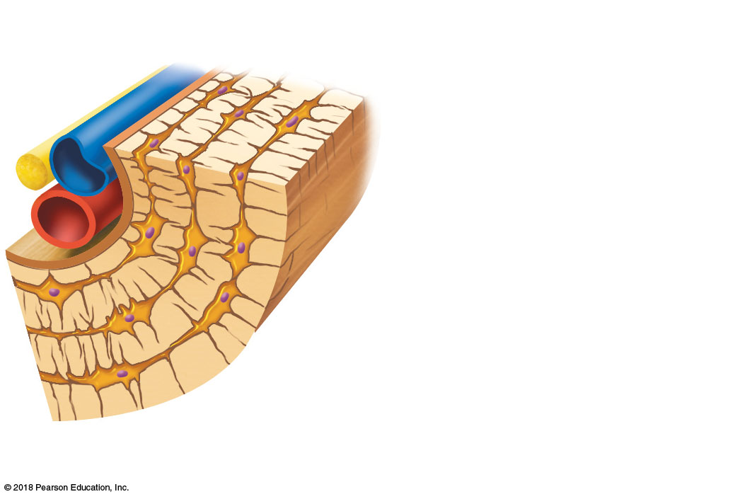
Lamella
Osteocyte
Canaliculus
Lacuna
Central
(Haversian) canal
Bone matrix
(b)
© 2018 Pearson Education, Inc.

Slide 6
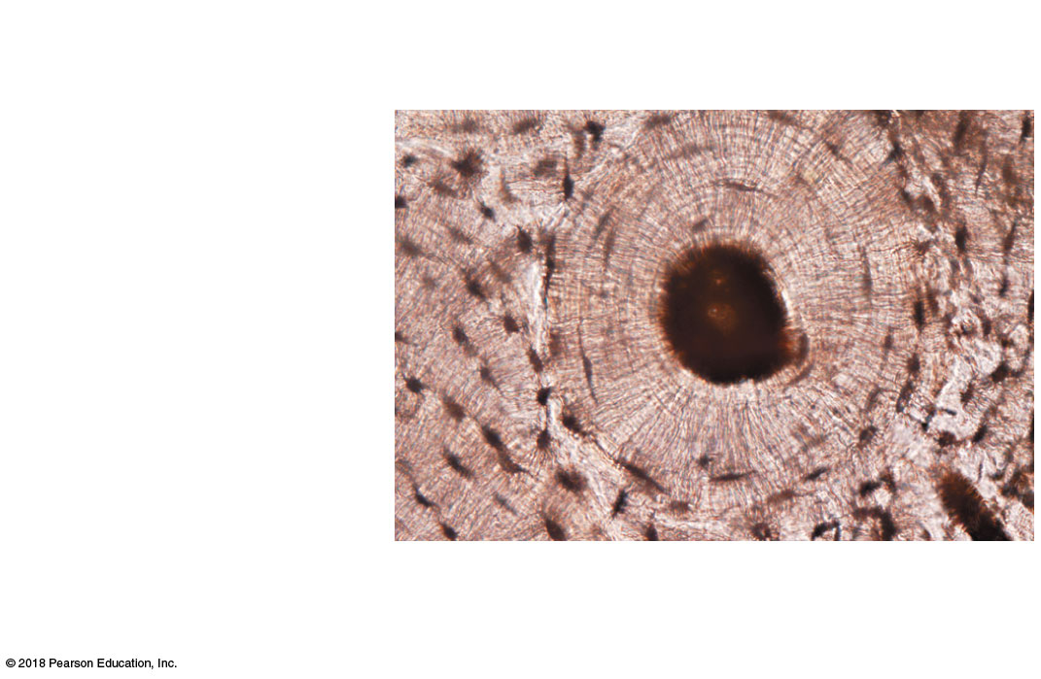
Osteon
Interstitial
lamellae
Lacuna
Central
(Haversian) canal
(c)
© 2018 Pearson Education, Inc.

Slide 7
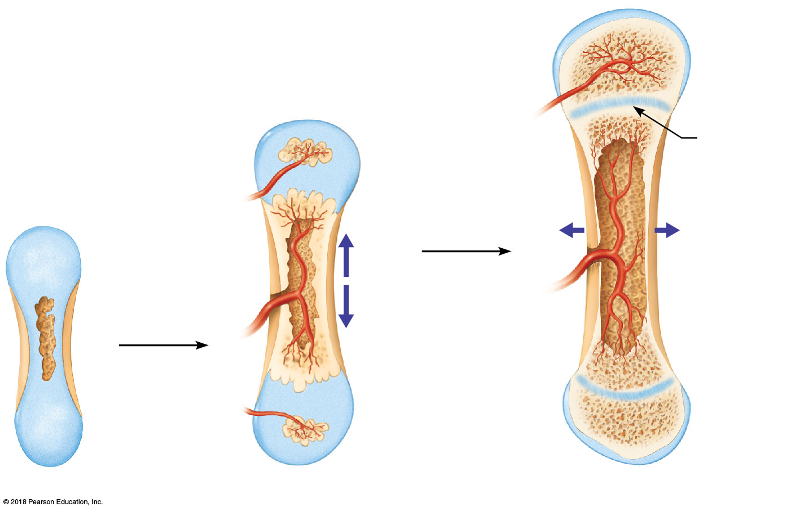
Articular
cartilage
Hyaline
cartilage
Spongy
bone
New center of
bone growth
New bone
forming
Epiphyseal
plate
cartilage
Growth
in bone
width
Medullary
cavity
Bone starting
to replace
cartilage
Invading
blood
vessels
Growth
in bone
length
New bone
forming
Bone collar
Hyaline
cartilage
model
Epiphyseal
plate cartilage
In an embryo
In a fetus
In a child
© 2018 Pearson Education, Inc.

Slide 8
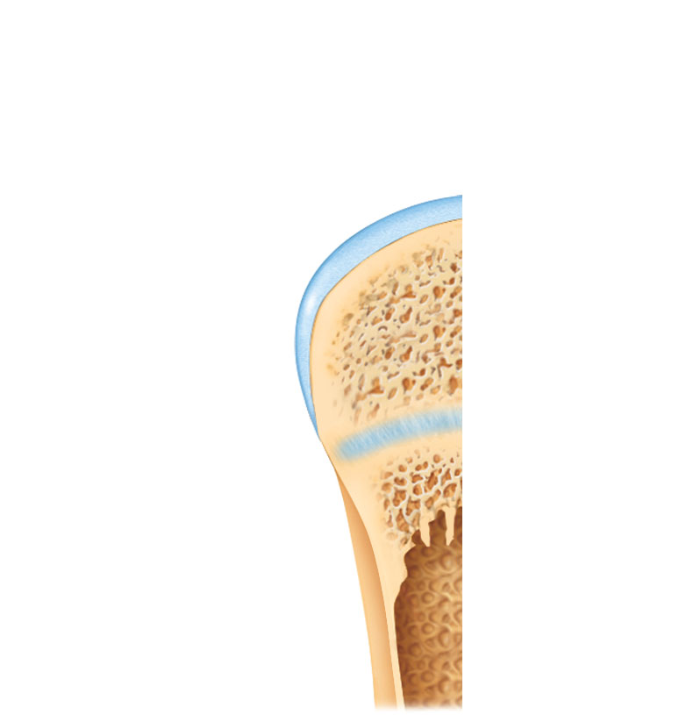
Bone growth
Bone grows in
length because:
1
Articular cartilage
Cartilage
grows here.
Epiphyseal plate
2
Cartilage
is replaced
by bone here.
Cartilage
grows here.
3

Slide 9
Bone remodeling
Growing shaft is
remodeled as:
Articular cartilage
Epiphyseal plate
Bone is
resorbed by
osteoclasts here.
1
Bone is added
(appositional growth)
by osteoblasts here.
2
Bone is resorbed
by osteoclasts here.
3

Slide 10
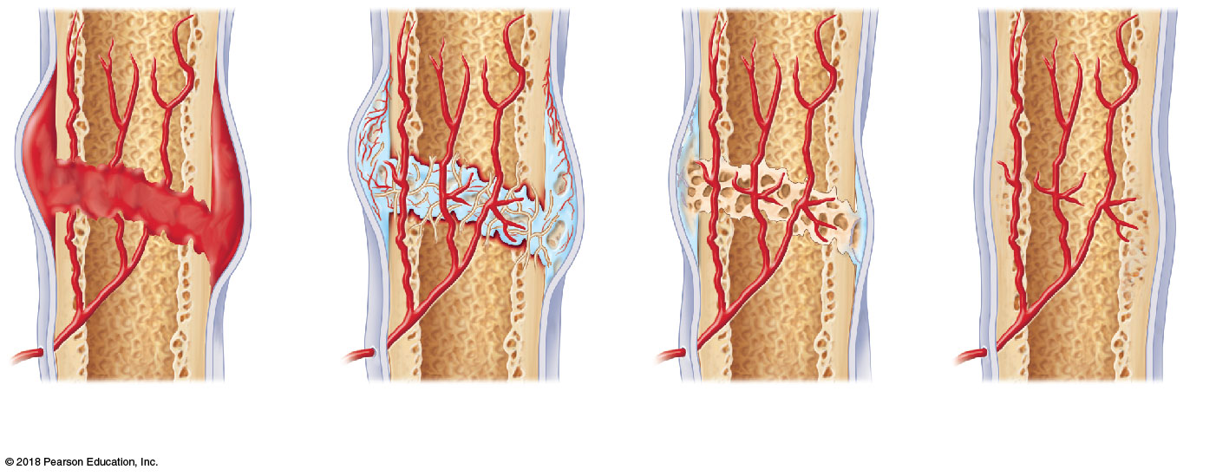
Hematoma
External
callus
Bony
callus of
spongy
bone
New
blood
vessels
Internal
callus
(fibrous
tissue and
cartilage)
Healed
fracture
Spongy
bone
trabecula
1
Fibrocartilage
callus forms.
Hematoma
forms.
2
Bony callus
forms.
3
4
Bone remodeling
occurs.
© 2018 Pearson Education, Inc.

Slide 11
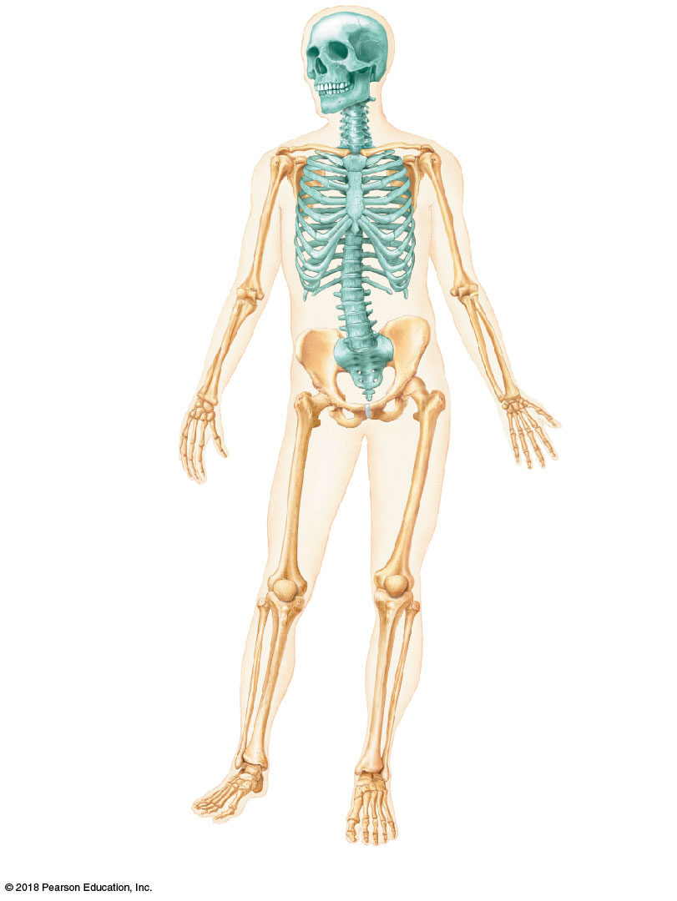
Cranium
Skull
Facial bones
Clavicle
Thoracic cage
(ribs and
sternum)
Scapula
Sternum
Rib
Humerus
Vertebral
column
Vertebra
Radius
Sacrum
Ulna
Carpals
Phalanges
Metacarpals
Femur
Patella
Tibia
Fibula
Tarsals
Metatarsals
Phalanges
© 2018 Pearson Education, Inc.
(a) Anterior view

Slide 12
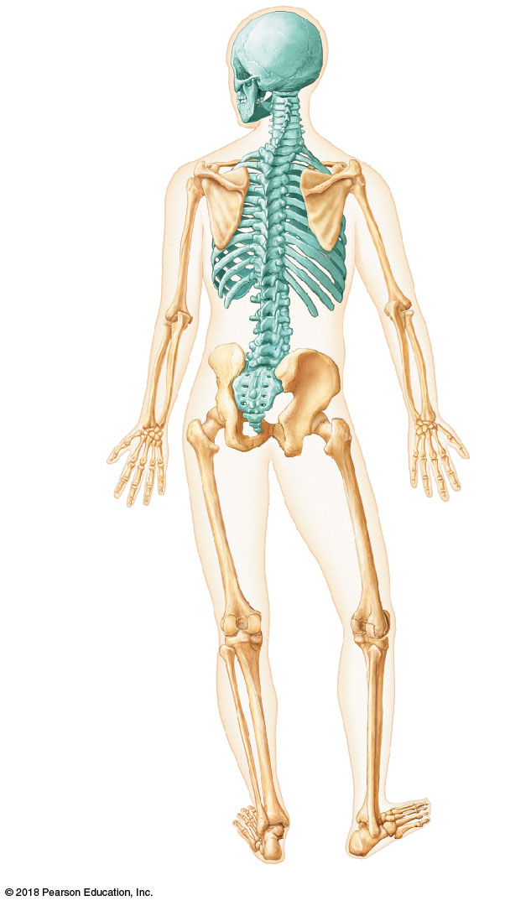
Cranium
Bones of
pectoral
girdle
Clavicle
Scapula
Sternum
Upper
limb
Rib
Humerus
Vertebra
Radius
Bones of
pelvic
girdle
Ulna
Carpals
Phalanges
Metacarpals
Femur
Lower
limb
Tibia
Fibula
© 2018 Pearson Education, Inc.
(b) Posterior view

Slide 13
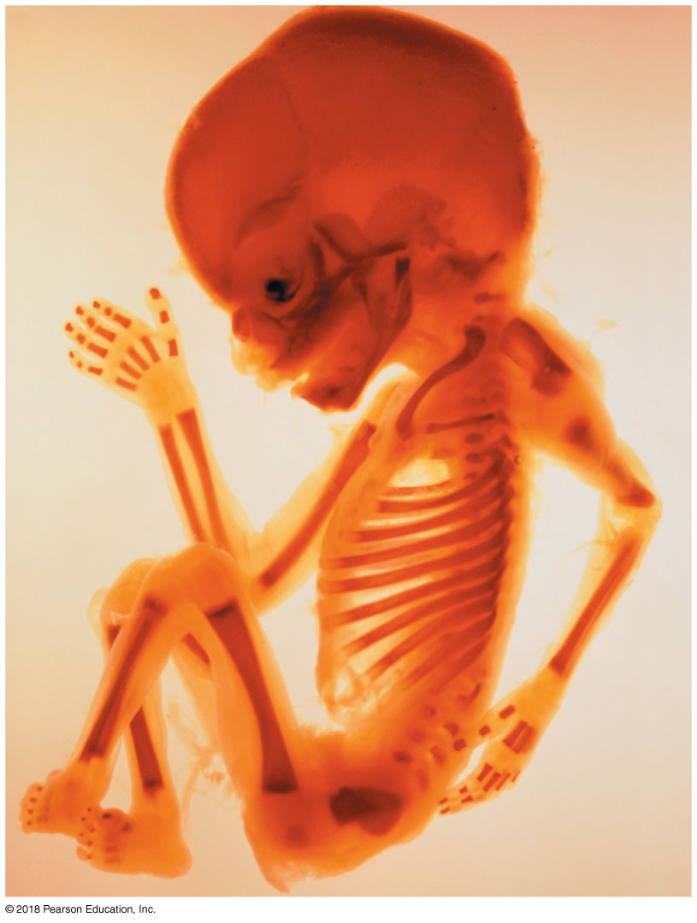
Parietal
bone
Frontal
bone
of skull
Occipital
bone
Mandible
Clavicle
Scapula
Radius
Ulna
Humerus
Femur
Tibia
Ribs
Vertebra
Hip bone
© 2018 Pearson Education, Inc.

Slide 14
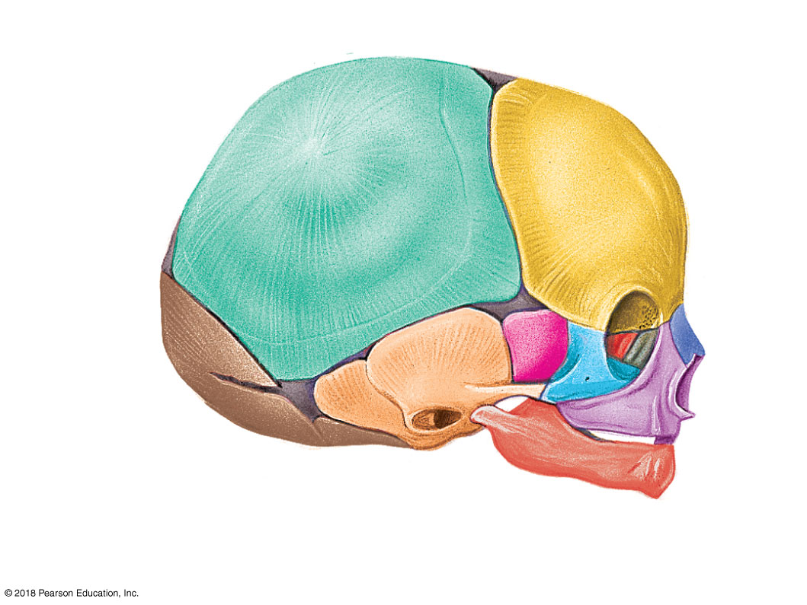
Anterior fontanel
Sphenoidal
fontanel
Parietal bone
Frontal
bone
Posterior
fontanel
Occipital
bone
Mastoid
fontanel
Temporal bone
(b)
© 2018 Pearson Education, Inc.

Slide 15
Anterior
fontanel
Frontal bone
Parietal
bone
Posterior fontanel
Occipital
bone
(a)
© 2018 Pearson Education, Inc.

Slide 16
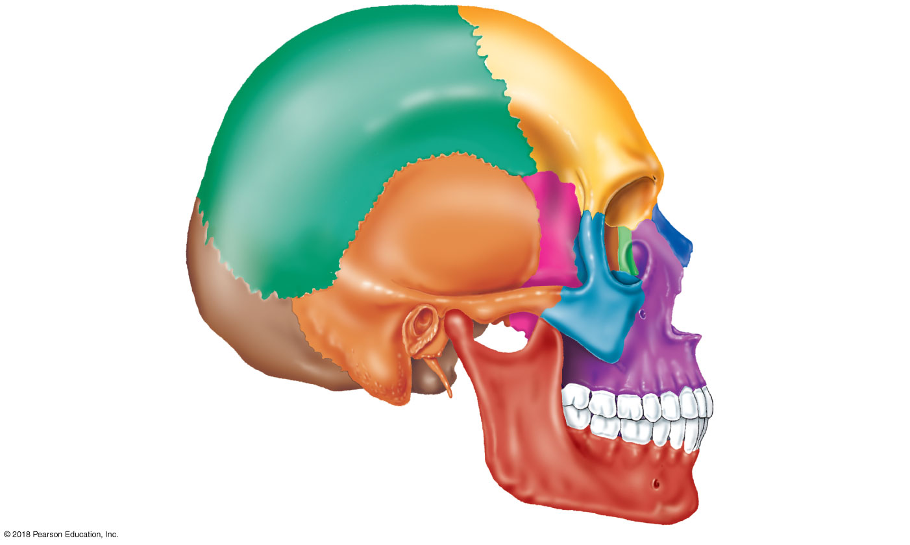
Coronal suture
Frontal bone
Parietal bone
Sphenoid bone
Temporal bone
Ethmoid bone
Lambdoid
suture
Lacrimal bone
Squamous suture
Occipital bone
Nasal bone
Zygomatic process
Zygomatic bone
Maxilla
External acoustic meatus
Mastoid process
Alveolar processes
Styloid process
Mandible (body)
Mental foramen
Mandibular ramus
© 2018 Pearson Education, Inc.

Slide 17
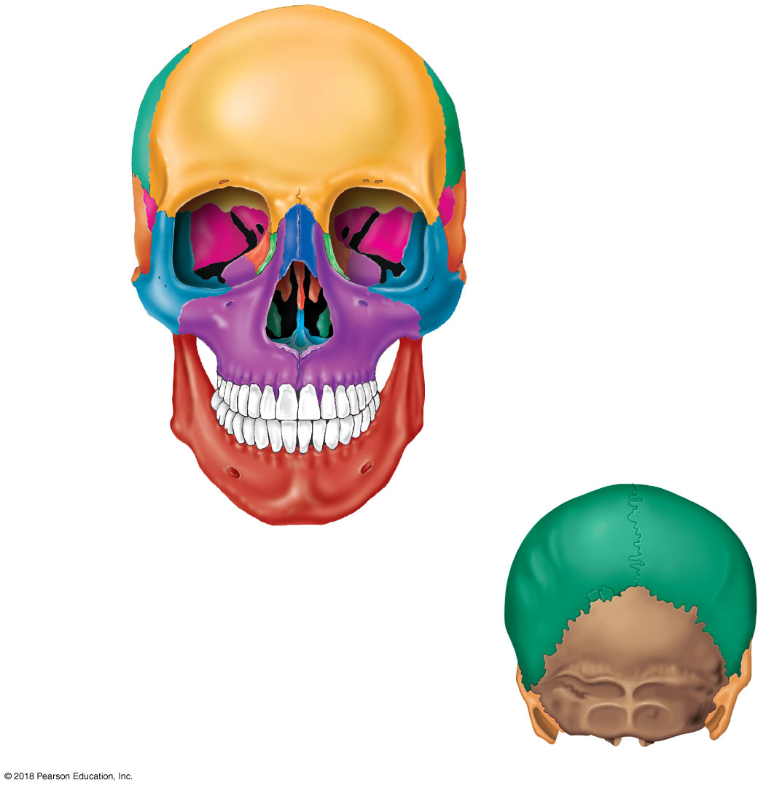
Coronal suture
Frontal bone
Parietal bone
Nasal bone
Superior orbital fissure
Sphenoid bone
Ethmoid bone
Optic canal
Lacrimal bone
Temporal bone
Zygomatic bone
Infraorbital foramen
Middle nasal concha
of ethmoid bone
Maxilla
Inferior nasal concha
Vomer
Mandible
Mental foramen
Alveolar processes
Sagittal suture
Anterior view
Parietal bone
Lambdoid suture
Occipital bone
Mastoid process
of temporal bone
© 2018 Pearson Education, Inc.
Posterior view

Slide 18
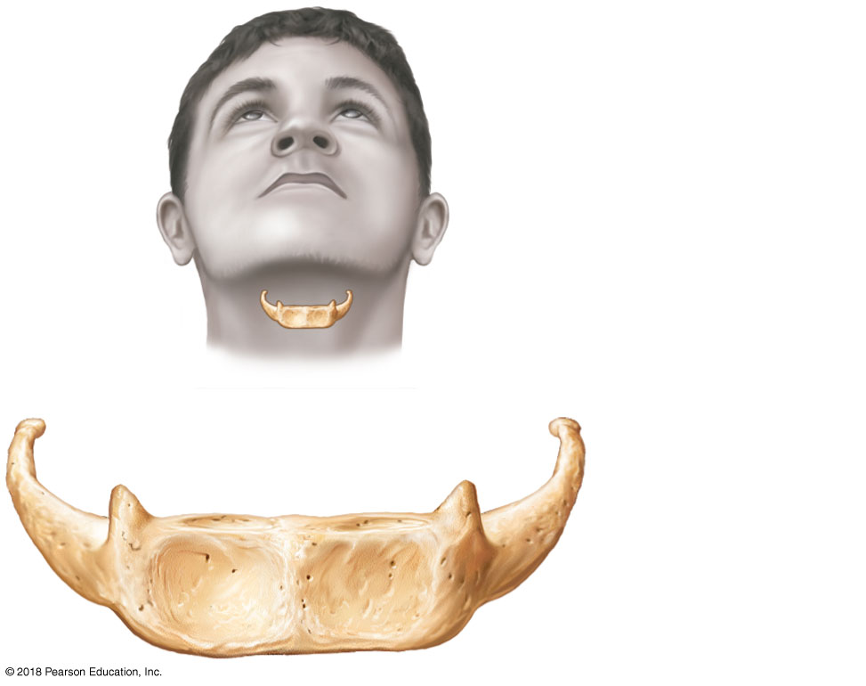
Greater horn
Lesser horn
Body
© 2018 Pearson Education, Inc.

Slide 19
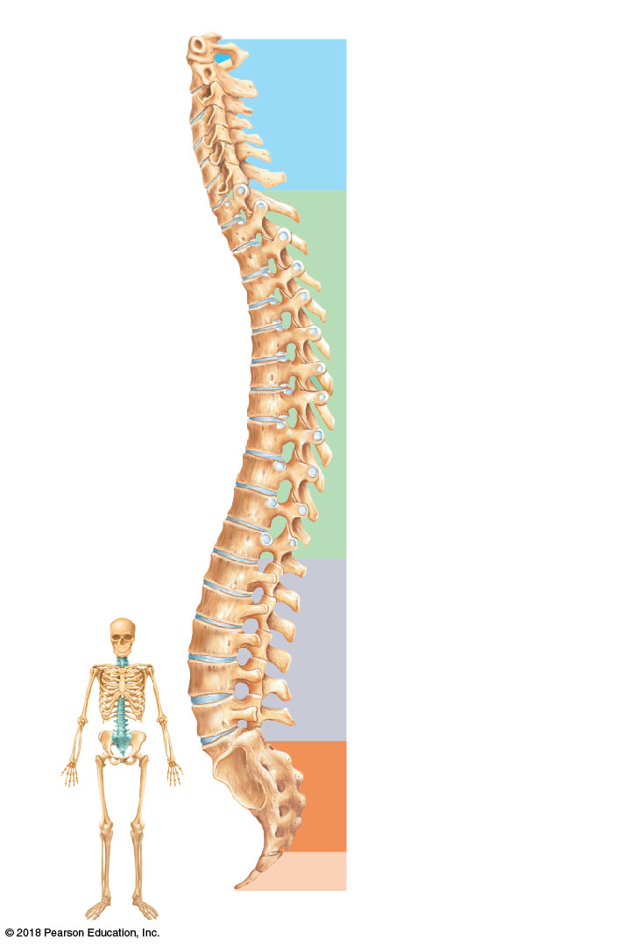
Anterior
Posterior
1st cervical
vertebra (atlas)
Cervical curvature
(concave) 7 vertebrae,
C₁ – C₇
2nd cervical
vertebra (axis)
1st thoracic
vertebra
Transverse
process
Spinous
process
Thoracic curvature
(convex) 12 vertebrae,
T₁ – T₁₂
Intervertebral
disc
Intervertebral
foramen
1st lumbar
vertebra
Lumbar curvature
(concave) 5 vertebrae,
L ₁ – L ₅
Sacral curvature
(convex) 5 fused
vertebrae
Coccyx 4 fused
vertebrae
© 2018 Pearson Education, Inc.

Slide 20
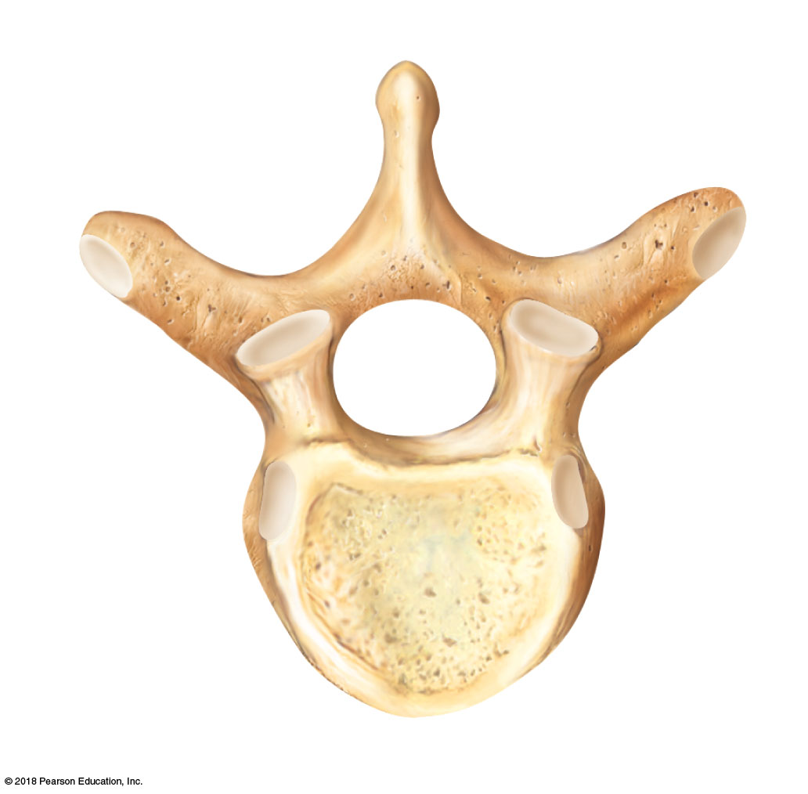
Posterior
Lamina
Vertebral
arch
Transverse
process
Spinous
process
Superior
articular
process
and
facet
Pedicle
Vertebral
foramen
Body
Anterior
© 2018 Pearson Education, Inc.

Slide 21
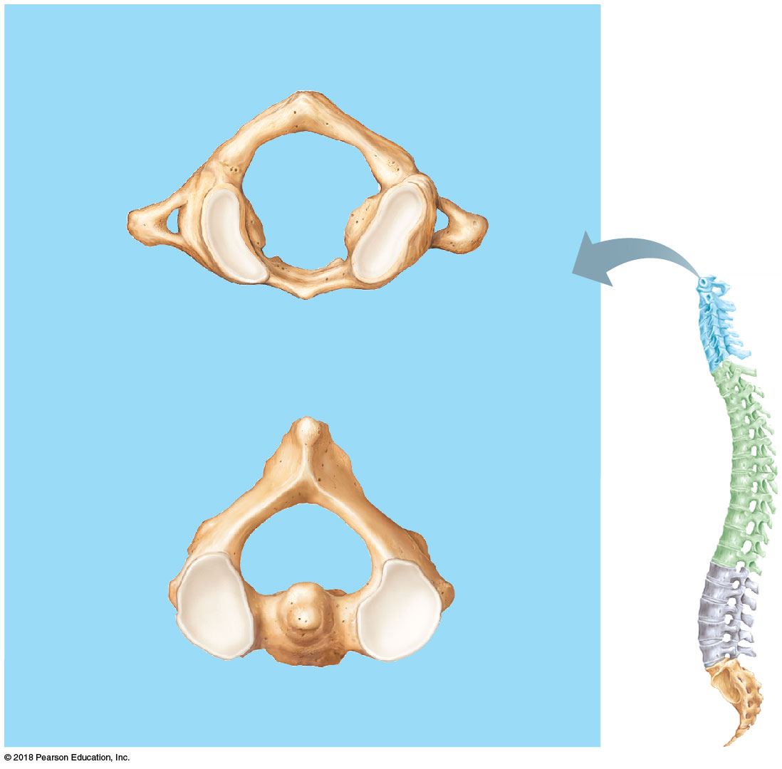
(a) ATLAS AND AXIS
Transverse
process
Posterior
arch
Anterior
arch
Superior view of atlas (C₁)
Spinous
process
Transverse
process
Facet on
superior
articular
process
Dens
Body
Superior view of axis (C₂)
© 2018 Pearson Education, Inc.

Slide 22
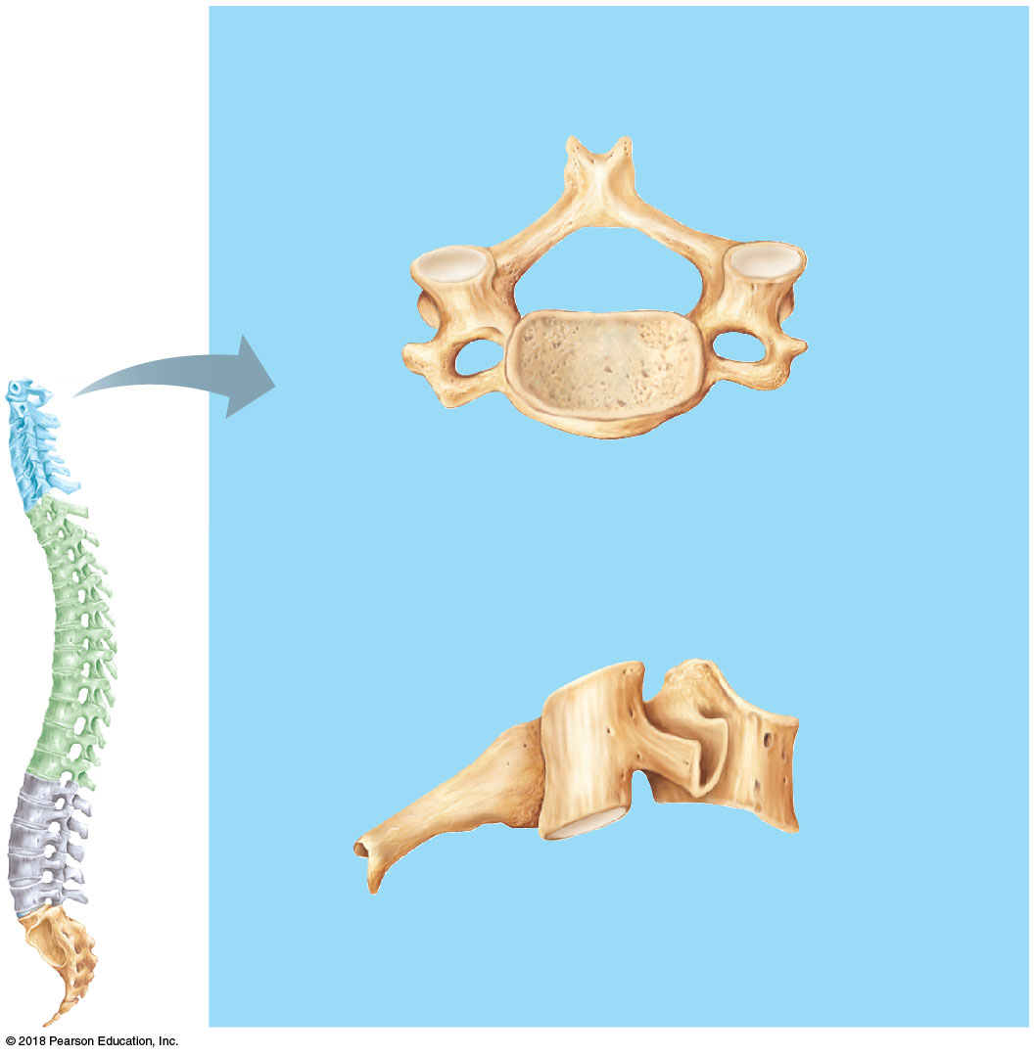
(b) TYPICAL CERVICAL VERTEBRAE
Facet on superior
articular process
Spinous
process
Vertebral
foramen
Transverse
process
Transverse
foramen
Superior view
Superior
articular
process
Body
Spinous
process
Transverse
process
Facet on inferior
articular process
Right lateral view
© 2018 Pearson Education, Inc.

Slide 23
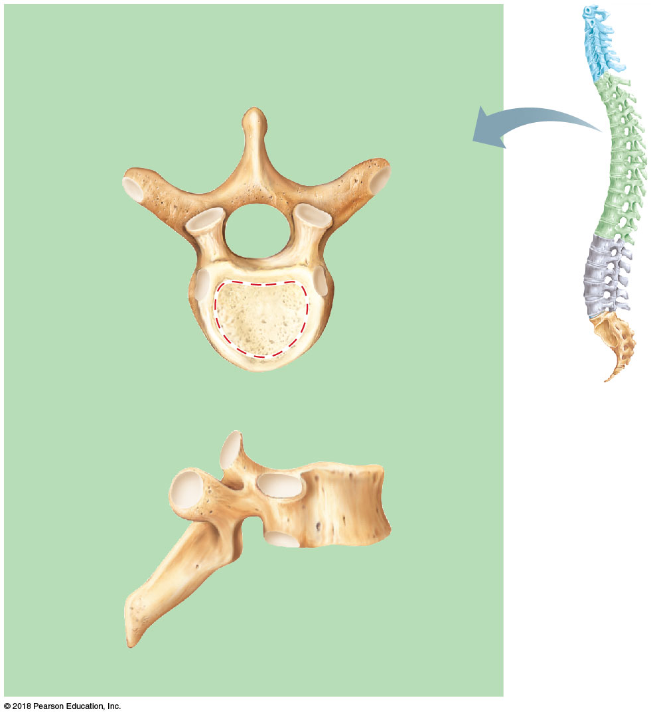
(c) THORACIC VERTEBRAE
Spinous process
Transverse
process
Vertebral
foramen
Facet
for rib
Facet on
superior
articular
process
Body
Superior view
Facet on superior
articular
process
Body
Facet on
transverse
process
Costal facet for rib
Spinous
process
Right lateral view
© 2018 Pearson Education, Inc.

Slide 24
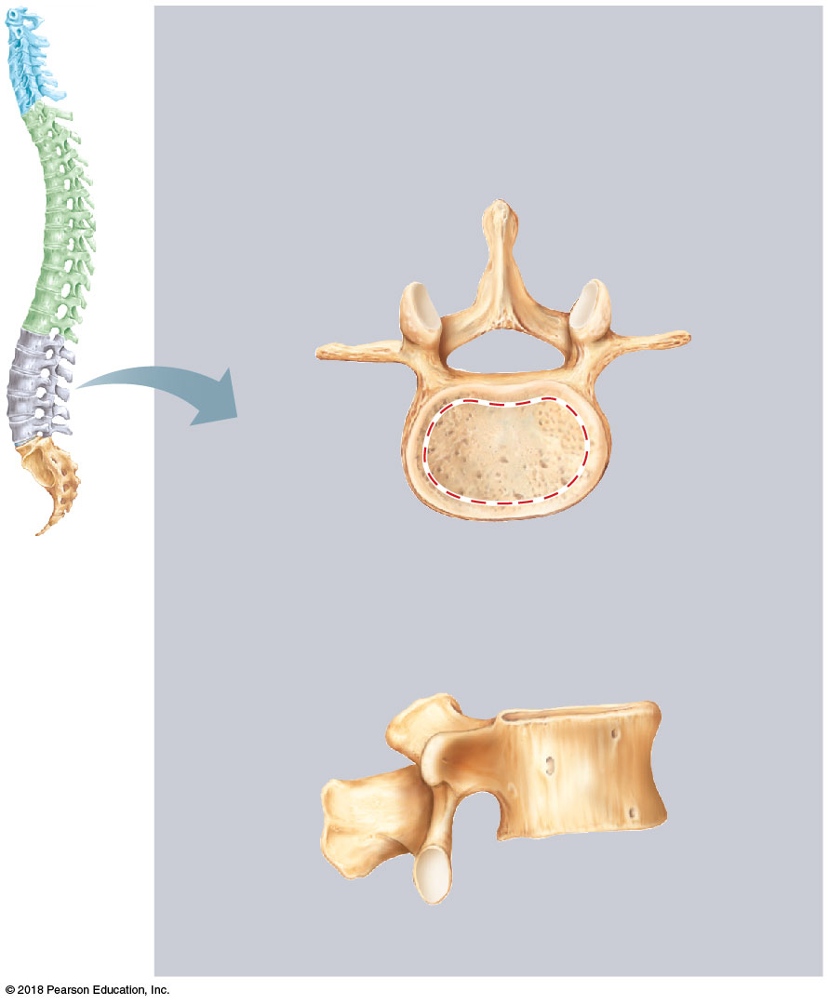
(d) LUMBAR VERTEBRAE
Spinous process
Vertebral
foramen
Transverse
process
Facet on
superior
articular
process
Body
Superior view
Superior
articular
process
Body
Spinous
process
Facet on inferior
articular process
Right lateral view
© 2018 Pearson Education, Inc.

Slide 25
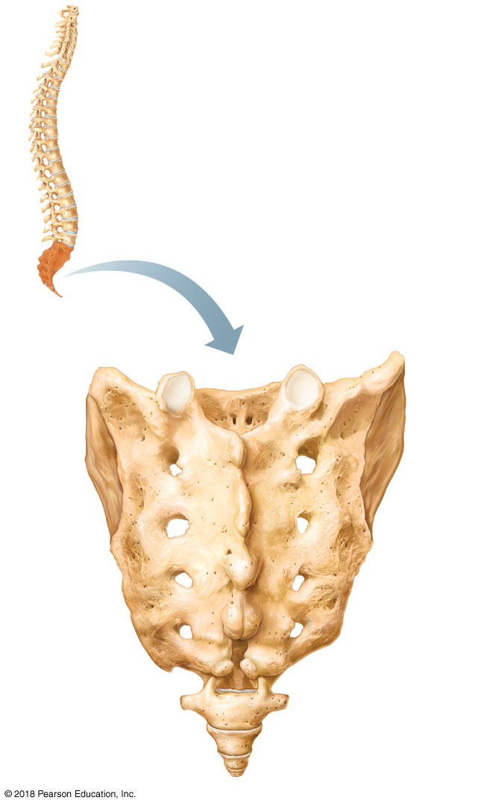
Superior
articular
process
Auricular
surface
Ala
Sacral
canal
Body
Sacrum
Median
sacral
crest
Posterior
sacral
foramina
Coccyx
Sacral
hiatus
© 2018 Pearson Education, Inc.

Slide 26
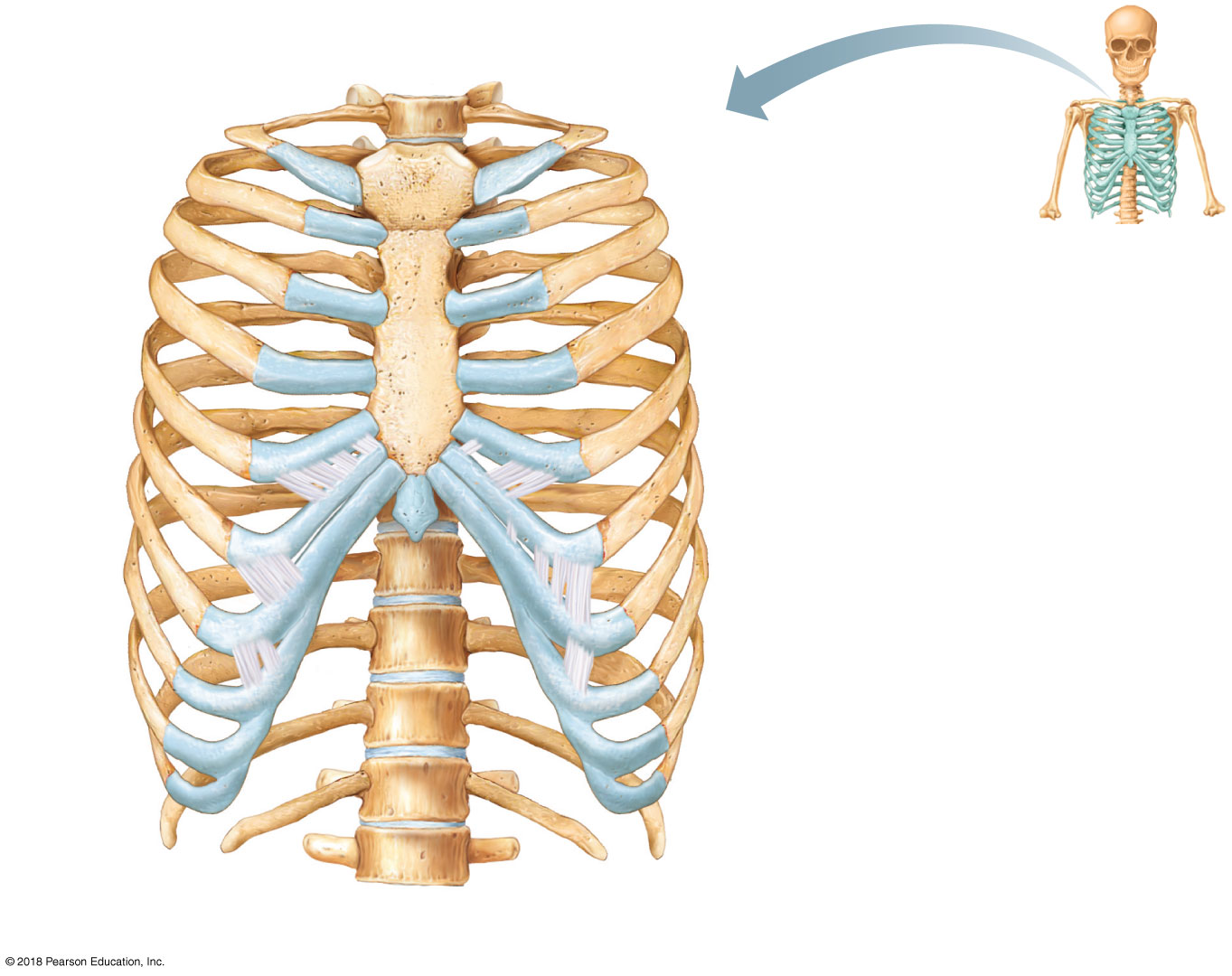
T₁ vertebra
Jugular notch
Clavicular notch
Manubrium
Sternal angle
Body
Xiphisternal
joint
Sternum
True
ribs
(1–7)
Xiphoid
process
False
ribs
(8–12)
Intercostal
spaces
L₁
vertebra
Floating
ribs (11, 12)
Costal cartilage
(a)
© 2018 Pearson Education, Inc.

Slide 27
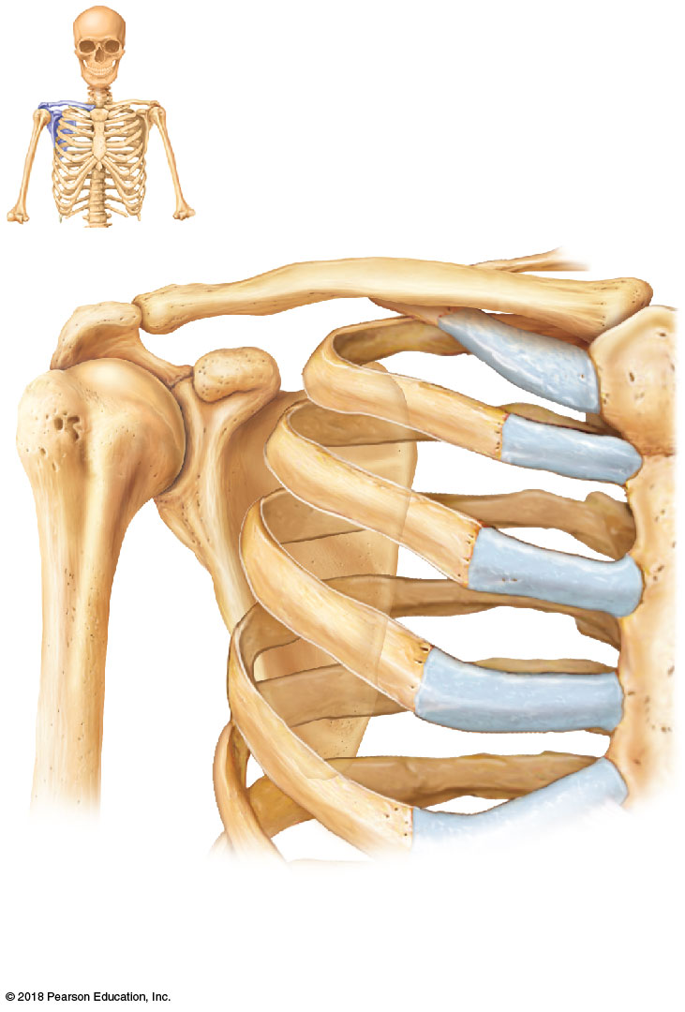
Acromio-
clavicular
joint
Clavicle
Scapula
Articulated right shoulder (pectoral) girdle showing the relationship to bones of the thorax and sternum
© 2018 Pearson Education, Inc.

Slide 28
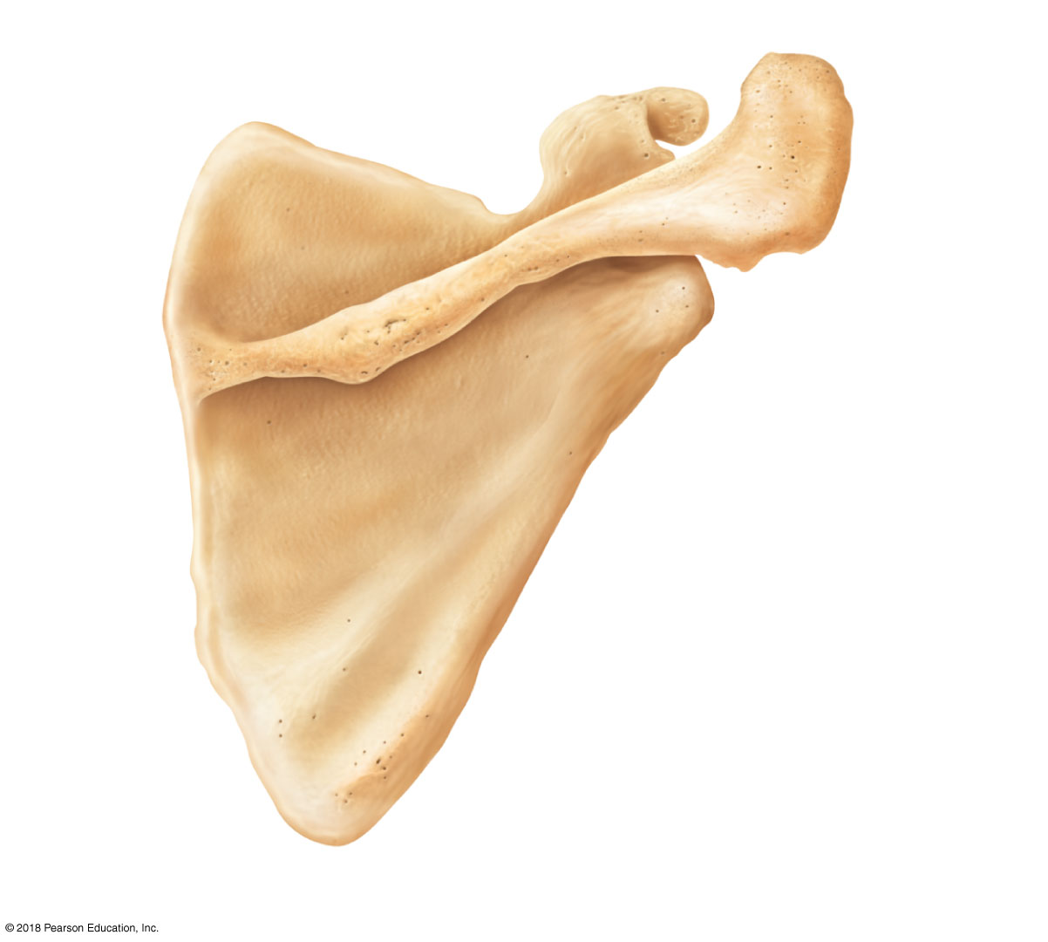
Coracoid process
Suprascapular notch
Superior
angle
Acromion
Glenoid cavity
at lateral angle
Spine
Medial
border
Lateral border
(c) Right scapula, posterior aspect
© 2018 Pearson Education, Inc.

Slide 29
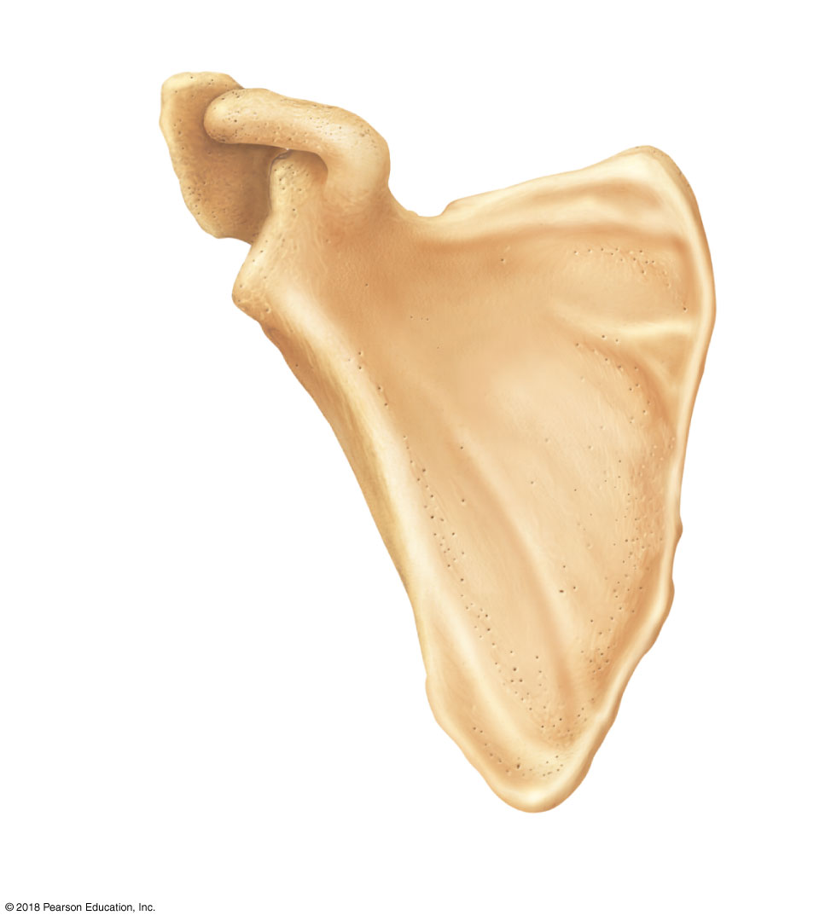
Acromion
Suprascapular notch
Coracoid
process
Superior border
Superior
angle
Glenoid
cavity
Lateral
angle
Lateral
(axillary)
border
Medial
(vertebral)
border
Inferior angle
(d) Right scapula, anterior aspect
© 2018 Pearson Education, Inc.

Slide 30
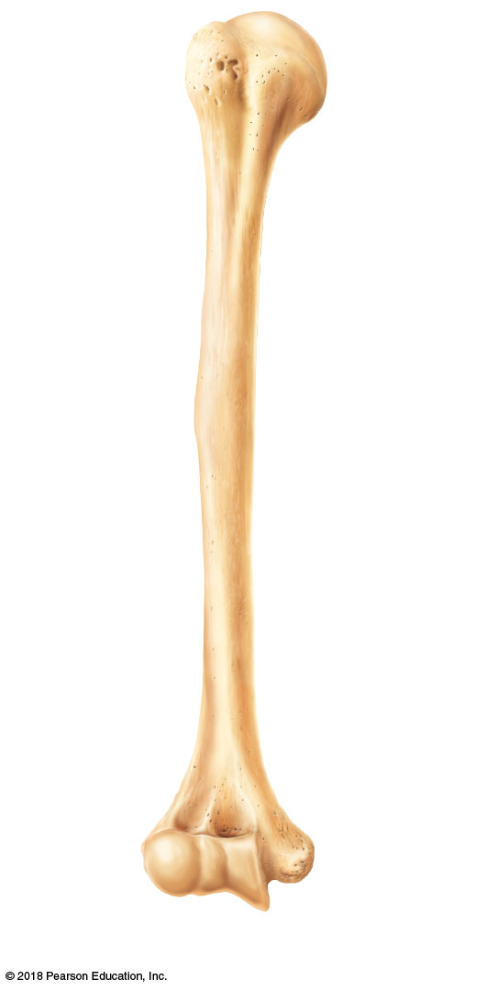
Greater
tubercle
Head of
humerus
Lesser
tubercle
Anatomical
neck
Intertubercular
sulcus
Deltoid
tuberosity
Radial
fossa
Medial
epicondyle
Coronoid
fossa
Capitulum
Trochlea
(a)
© 2018 Pearson Education, Inc.

Slide 31
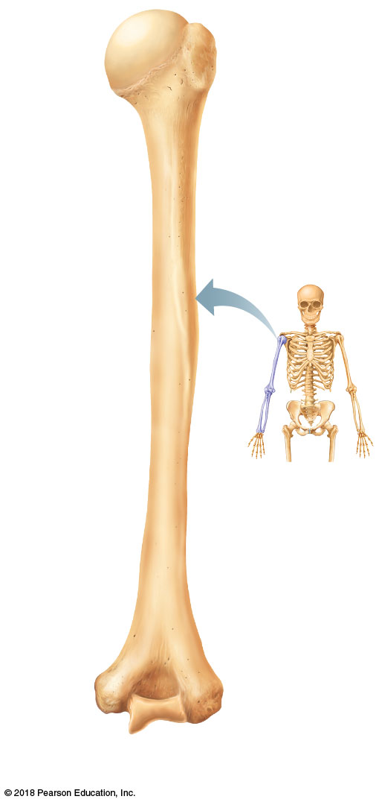
Head of
humerus
Anatomical
neck
Surgical
neck
Radial
groove
Deltoid
tuberosity
Medial
epicondyle
Olecranon
fossa
Lateral
epicondyle
Trochlea
(b)
© 2018 Pearson Education, Inc.

Slide 32
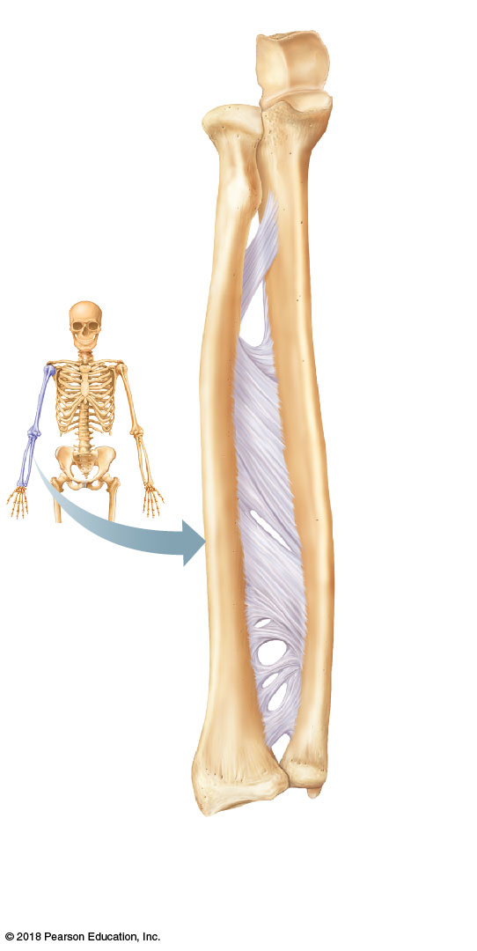
Trochlear
notch
Olecranon
Head
Coronoid
process
Neck
Radial
tuberosity
Proximal
radioulnar
joint
Radius
Ulna
Inter-
osseous
membrane
Radial
styloid
process
Ulnar
styloid
process
Distal
radioulnar
joint
© 2018 Pearson Education, Inc.
(c)

Slide 33
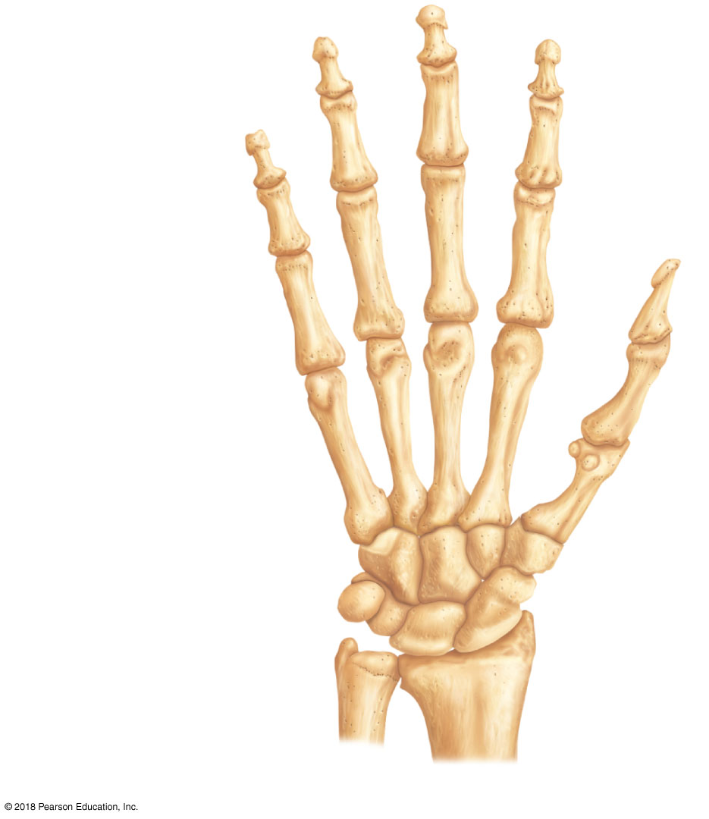
Distal
Middle
Phalanges
(fingers)
Proximal
4
3
2
Metacarpals
(palm)
5
1
Hamate
Trapezium
Carpals
(wrist)
Pisiform
Trapezoid
Triquetrum
Scaphoid
Lunate
Capitate
Ulna
Radius
© 2018 Pearson Education, Inc.

Slide 34
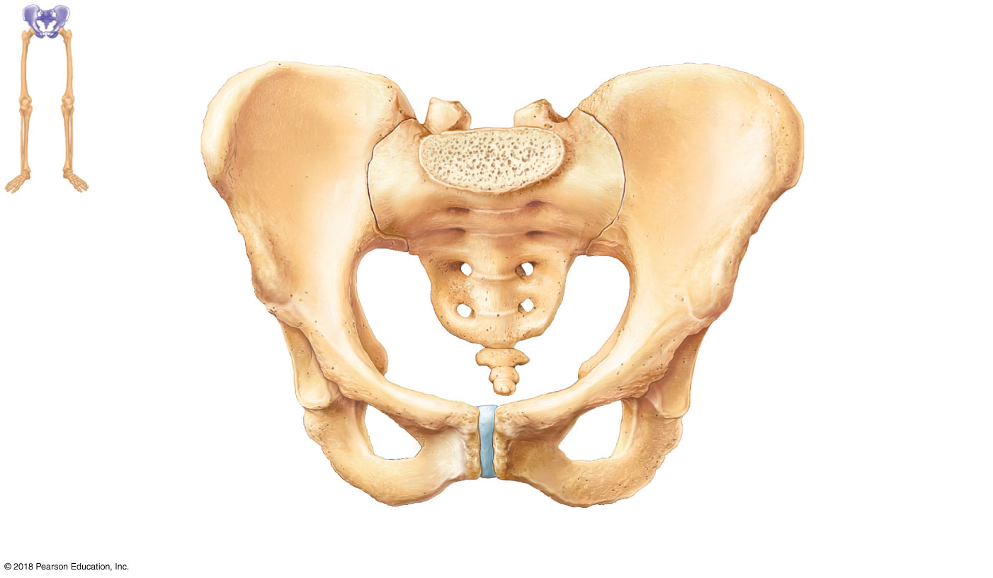
Iliac crest
Sacroiliac
joint
llium
Coxal bone
(or hip bone)
Sacrum
Pelvic brim
Pubis
Coccyx
Ischial spine
Acetabulum
Ischium
Pubic symphysis
Pubic arch
(a)
© 2018 Pearson Education, Inc.

Slide 35
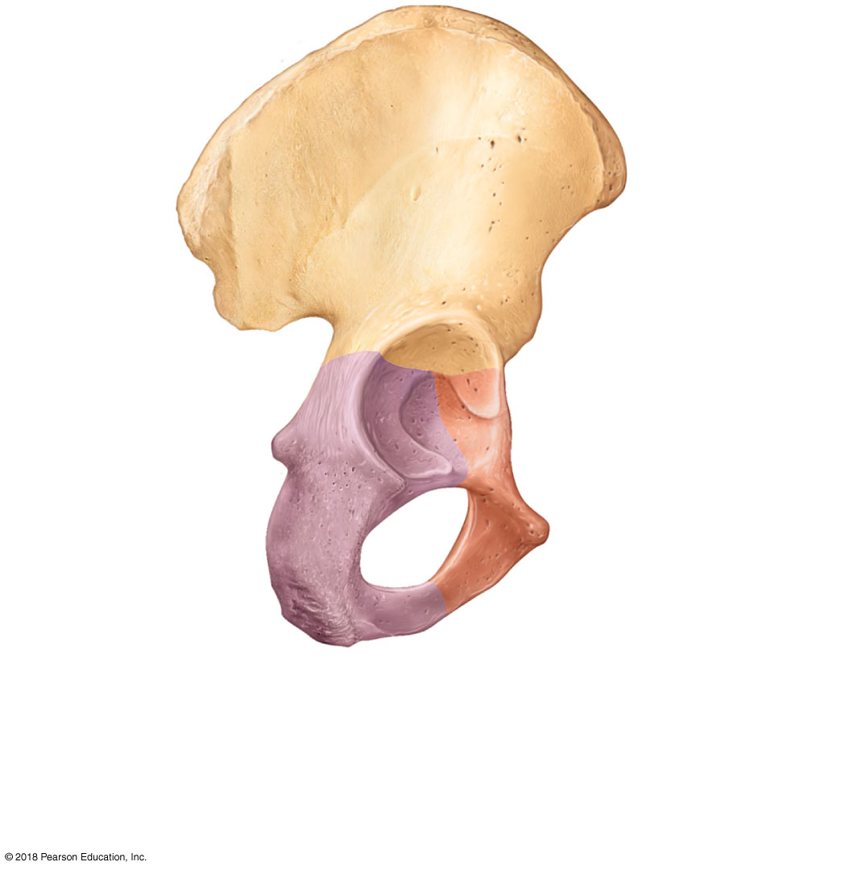
Ilium
Ala
Posterior
superior
iIiac
spine
Iliac crest
Anterior superior
iliac spine
Posterior
inferior
iIiac spine
Anterior inferior
iliac spine
Greater sciatic
notch
Acetabulum
Ischial body
Body of pubis
Ischial spine
Pubis
Ischial
tuberosity
Inferior pubic
ramus
Ischium
Obturator
foramen
Ischial ramus
(b)
© 2018 Pearson Education, Inc.

Slide 36
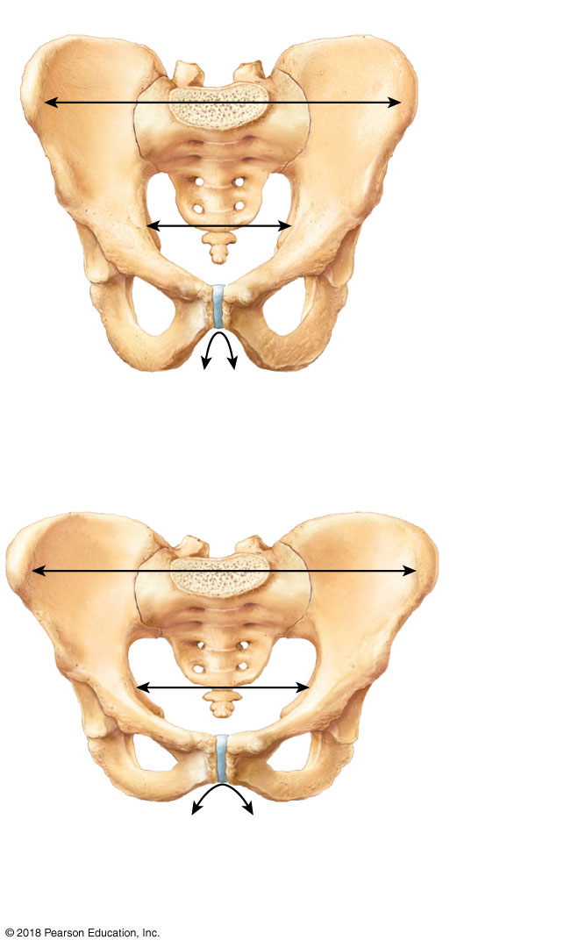
False pelvis
Inlet of
true
pelvis
Pelvic brim
Pubic arch
(less than 90º)
False pelvis
Inlet of
true
pelvis
Pelvic brim
Pubic arch
(more than 90º)
(c)
© 2018 Pearson Education, Inc.

Slide 37
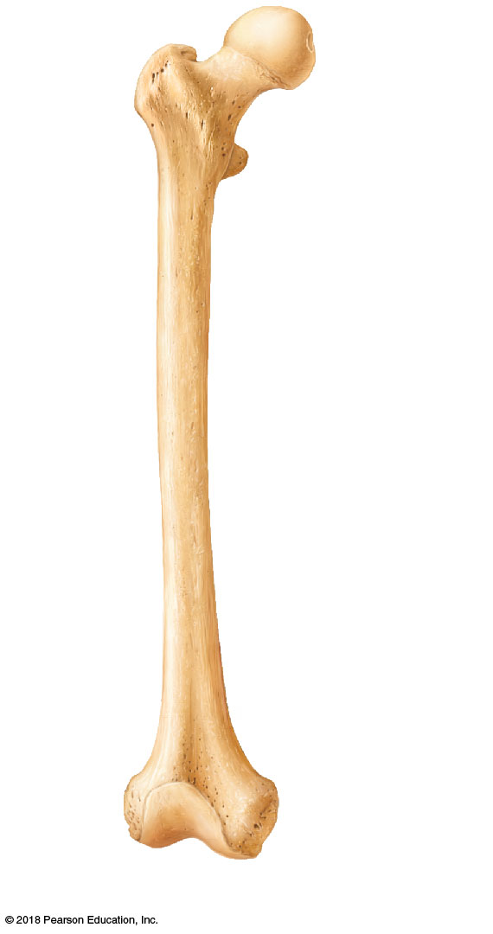
Surgical
neck
Head
Inter-
trochanteric
line
Lesser trochanter
Lateral
epicondyle
Medial
epicondyle
Patellar
surface
(a)
© 2018 Pearson Education, Inc.

Slide 38
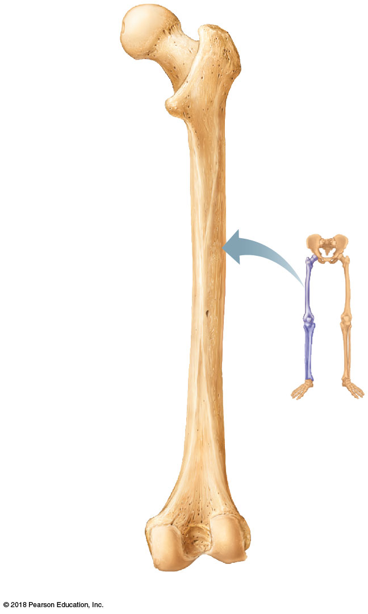
Greater
trochanter
Head
Inter-
trochanteric
crest
Lesser trochanter
Gluteal tuberosity
Intercondylar
fossa
Medial
condyle
Lateral
condyle
(b)
© 2018 Pearson Education, Inc.

Slide 39
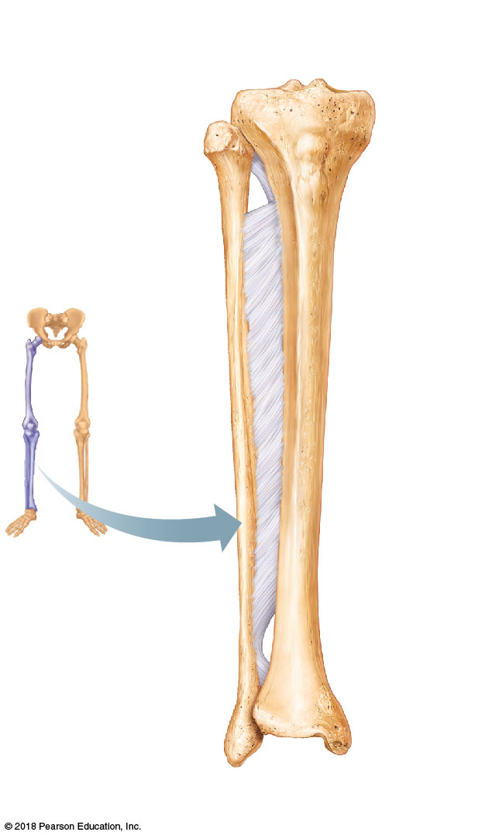
Intercondylar
eminence
Lateral
condyle
Medial
condyle
Head
Tibial
tuberosity
Proximal
tibiofibular
joint
Interosseous
membrane
Anterior
border
Fibula
Tibia
Distal
tibiofibular
joint
Lateral
malleolus
Medial
malleolus
(c)
© 2018 Pearson Education, Inc.

Slide 40
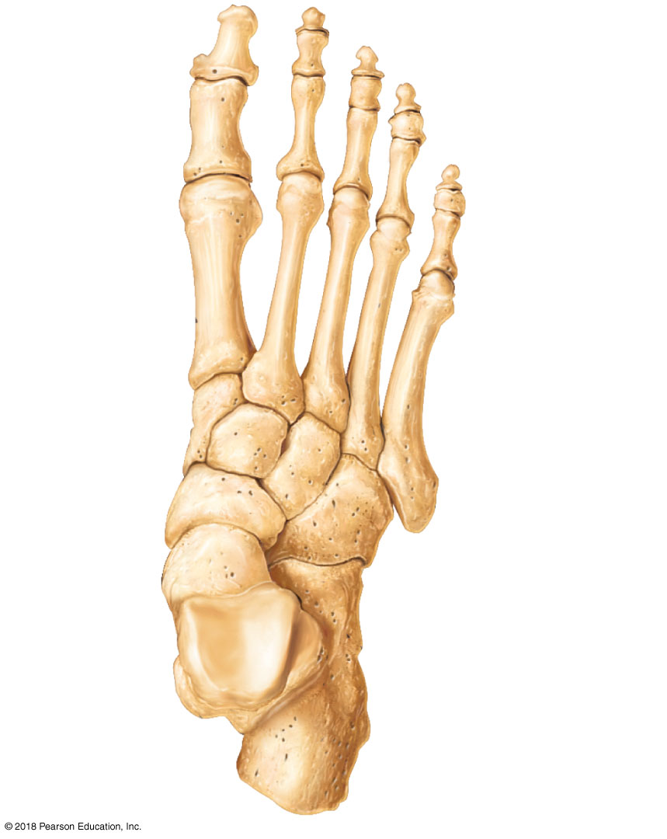
Phalanges:
Distal
Middle
Proximal
Tarsals:
Medial
cuneiform
Metatarsals
Intermediate
cuneiform
Tarsals:
Lateral
cuneiform
Navicular
Cuboid
Talus
Calcaneus
© 2018 Pearson Education, Inc.

