Slide 1
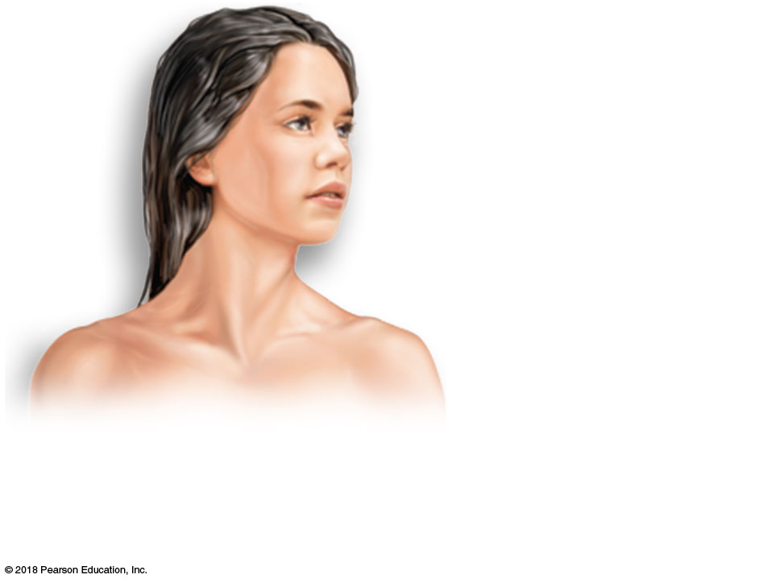
Cutaneous
membrane
(skin)
(a)
Cutaneous membrane (the skin)
covers the body surface.
© 2018 Pearson Education, Inc.

Slide 2
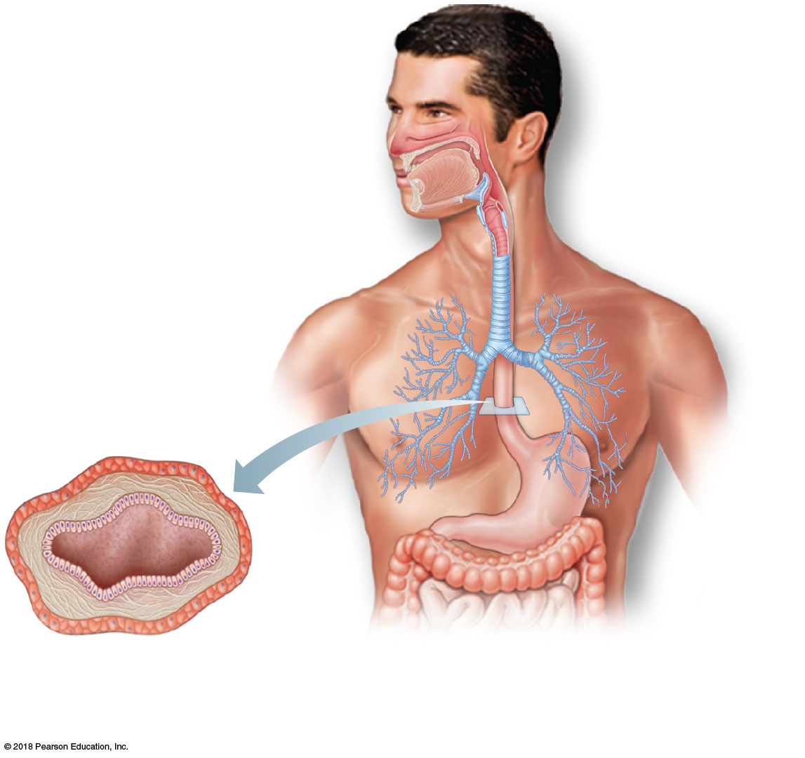
Mucosa
(b)
Mucous membranes line body cavities open to the exterior.
© 2018 Pearson Education, Inc.

Slide 3
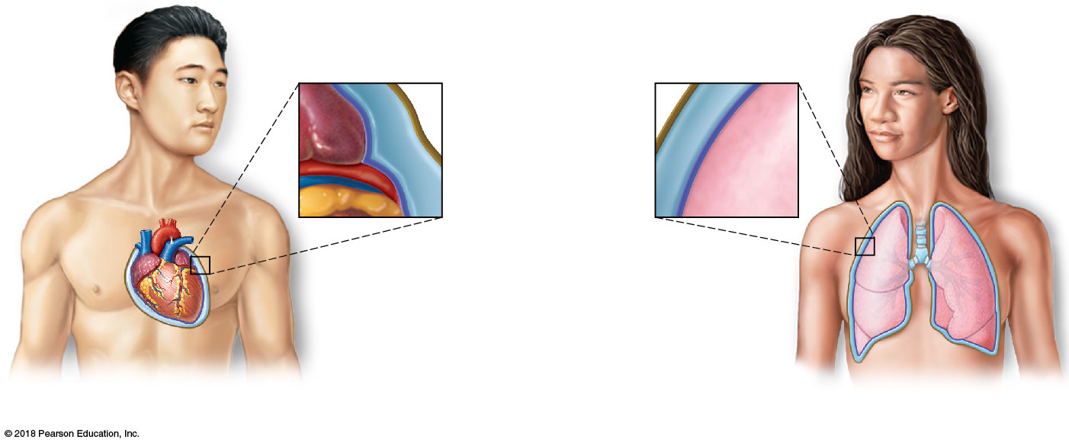
Parietal layer
Serous fluid
Visceral layer
(c)
Serous membranes line body cavities closed to exterior.
© 2018 Pearson Education, Inc.

Slide 4
Outer balloon wall
(comparable to parietal serosa)
Air (comparable to serous cavity)
Inner balloon wall
(comparable to visceral serosa)
(d)
A fist thrust into a limp balloon demonstrates the relationship between the parietal and visceral serous membrane layers.
© 2018 Pearson Education, Inc.

Slide 5
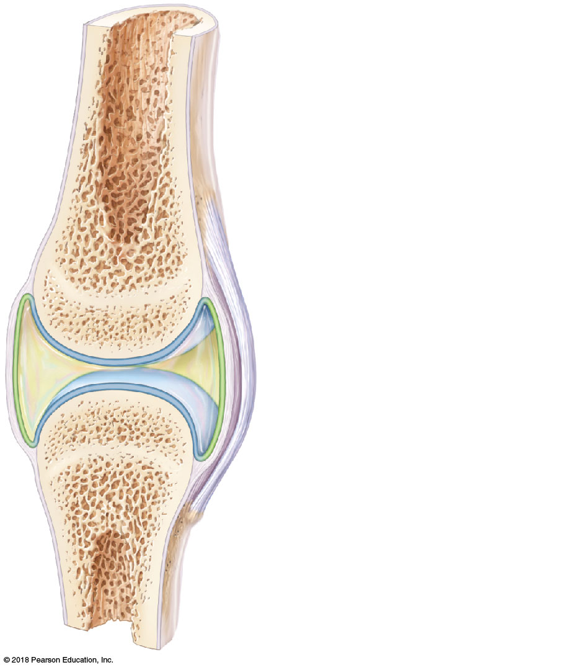
Ligament
Joint cavity (contains synovial fluid)
Articular (hyaline) cartilage
© 2018 Pearson Education, Inc.

Slide 6
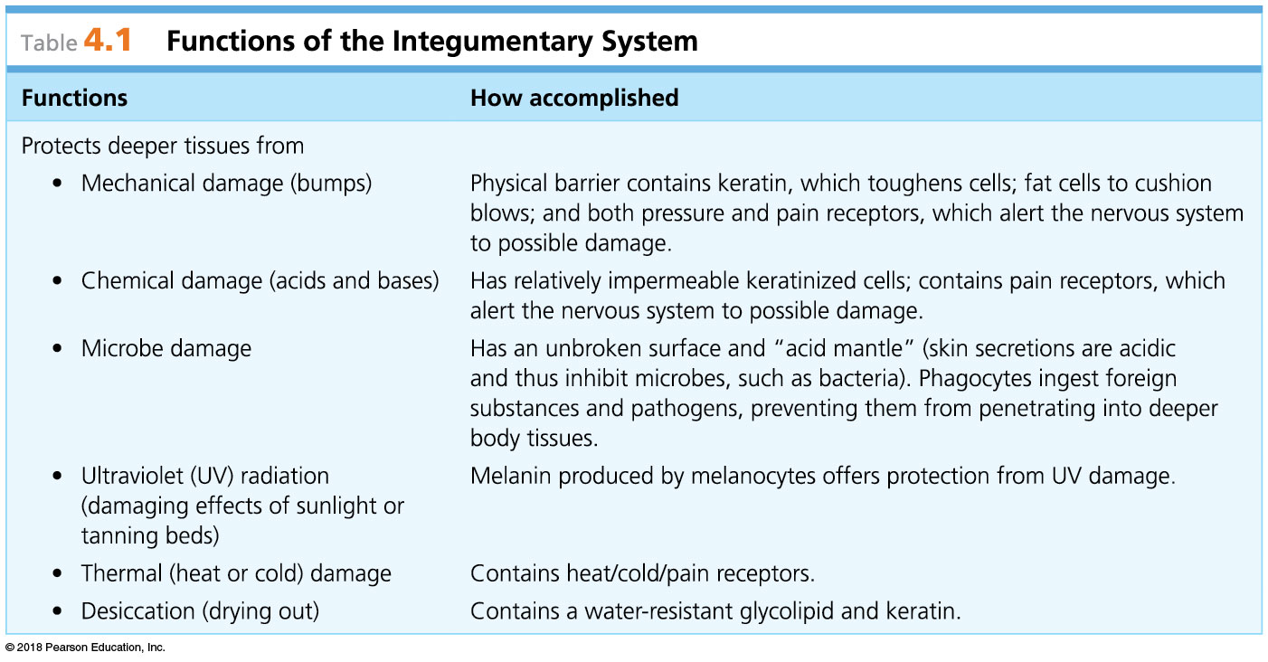
© 2018 Pearson Education, Inc.

Slide 7
© 2018 Pearson Education, Inc.

Slide 8
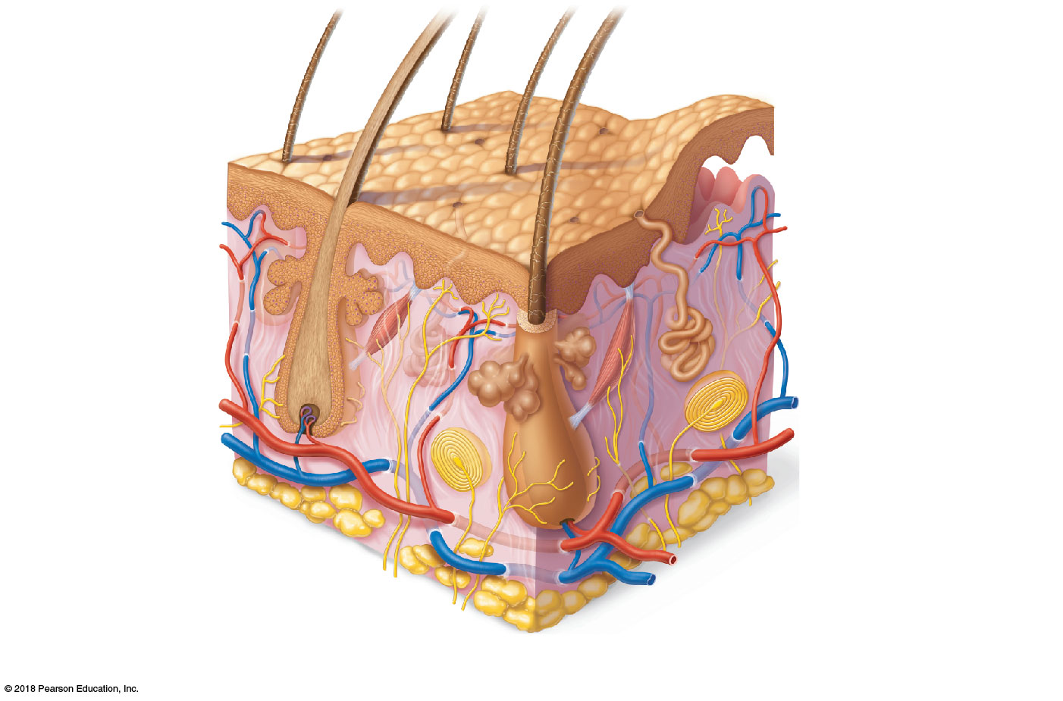
Hair shaft
Dermal papillae
Epidermis
Papillary
layer
Pore
Appendages of skin
• Eccrine sweat gland
Dermis
• Arrector pili muscle
Reticular
layer
• Sebaceous (oil) gland
• Hair follicle
• Hair root (inside follicle)
Hypodermis
(subcutaneous
tissue)
Nervous structures
Cutaneous vascular plexus
• Sensory nerve fiber
• Lamellar corpuscle
Adipose tissue
• Hair follicle receptor
(root hair plexus)
© 2018 Pearson Education, Inc.

Slide 9
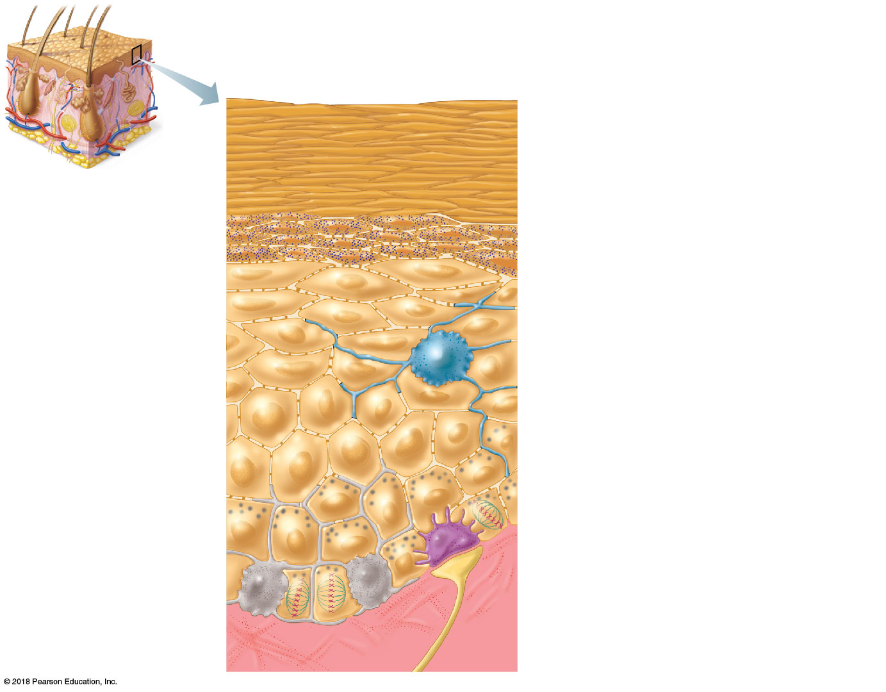
Stratum corneum. Cells are dead, flat
membranous sacs filled with keratin.
Glycolipids in extracellular space make
skin water resistant.
Stratum granulosum. Cells are flattened, organelles are deteriorating; cytoplasm full of granules.
Keratinocytes
Desmosomes
Stratum spinosum. Cells contain thick
bundles of intermediate filaments made
of pre-keratin.
Epidermal
dendritic cell
Stratum basale. Stem cells are actively
dividing; some newly formed cells
become part of the more superficial
layers.
Melanin granules
Melanocyte
Sensory
nerve
ending
Dermis
Merkel
cell
© 2018 Pearson Education, Inc.

Slide 10
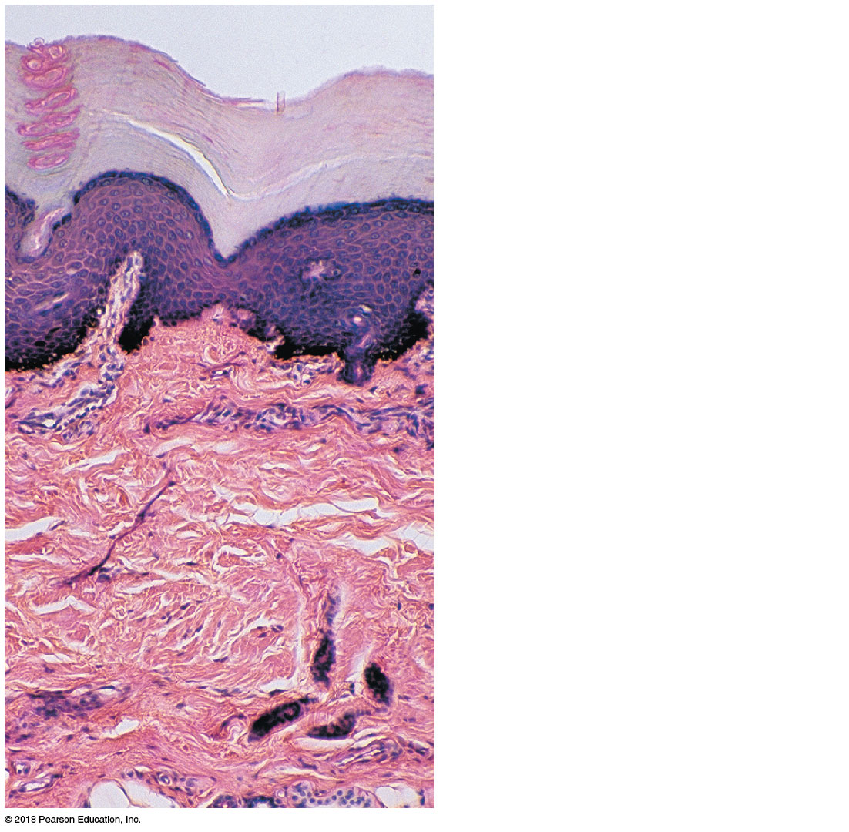
Epidermis
Papillary
layer
Dermis
Reticular
layer
© 2018 Pearson Education, Inc.

Slide 11
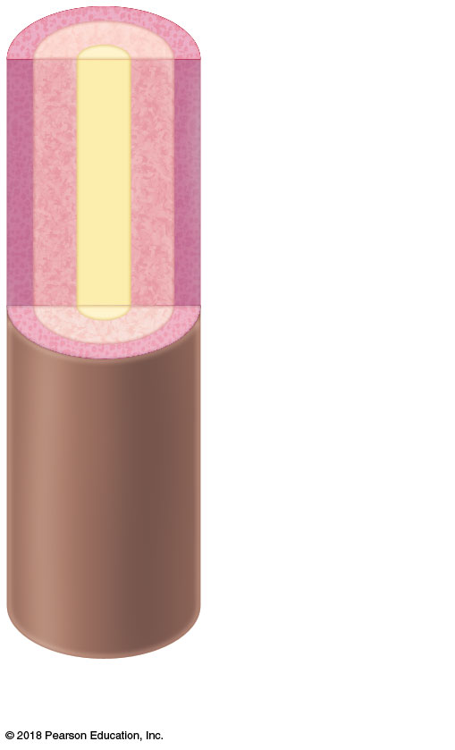
Cuticle
Cortex
Medulla
(b) Hair
© 2018 Pearson Education, Inc.

Slide 12
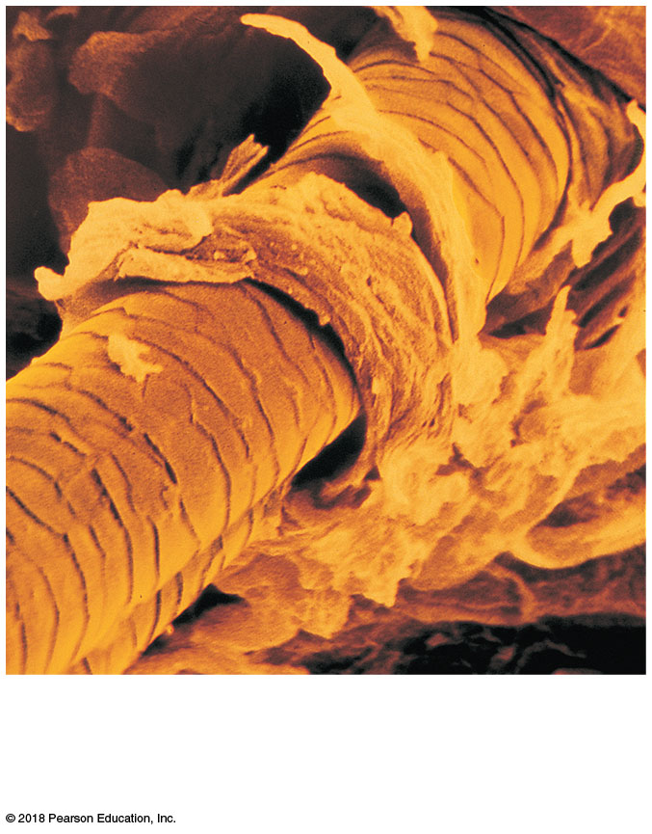
(c) Scanning electron micrograph of hair shaft emerging from follicle (435×)
© 2018 Pearson Education, Inc.

Slide 13
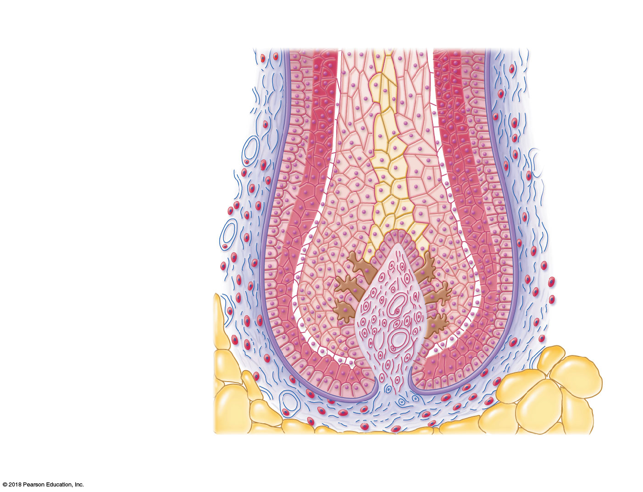
Hair root
Fibrous
sheath (dermal
connective
tissue)
Cuticle
Hair follicle
Cortex
Epithelial
root sheath
Medulla
Hair matrix (growth
zone) in hair bulb
Melanocyte
Hair papilla
containing
blood vessels
Subcutaneous
adipose tissue
(d) Cross section of hair bulb
© 2018 Pearson Education, Inc.

Slide 14
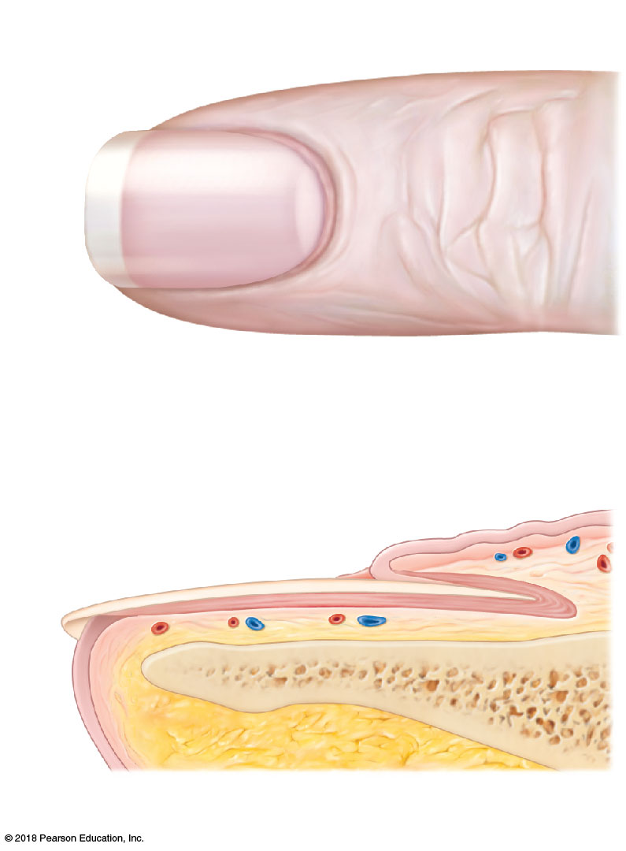
Lunule
Lateral nail fold
(a)
Free edge of nail
Body of nail
Cuticle
Root of nail
Proximal nail fold
Nail matrix
(b)
Nail bed
Bone of fingertip
© 2018 Pearson Education, Inc.

