Slide 1
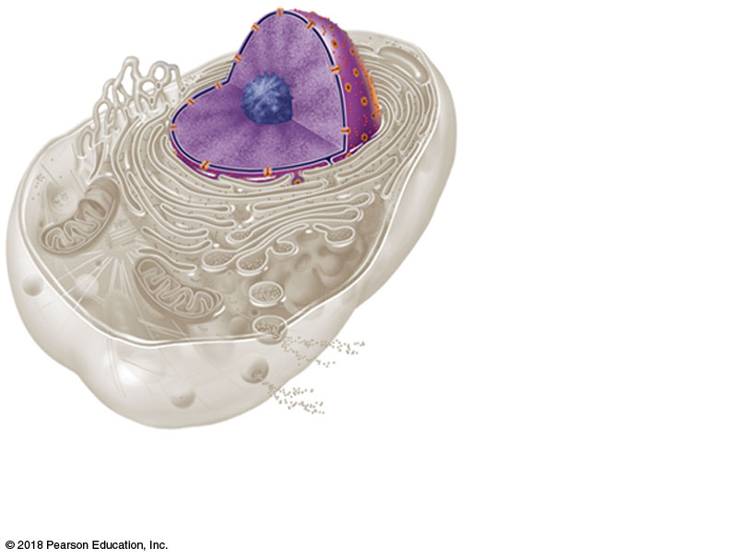
Nucleus
Cytoplasm
Plasma
membrane
(a) Generalized animal cell

Slide 2
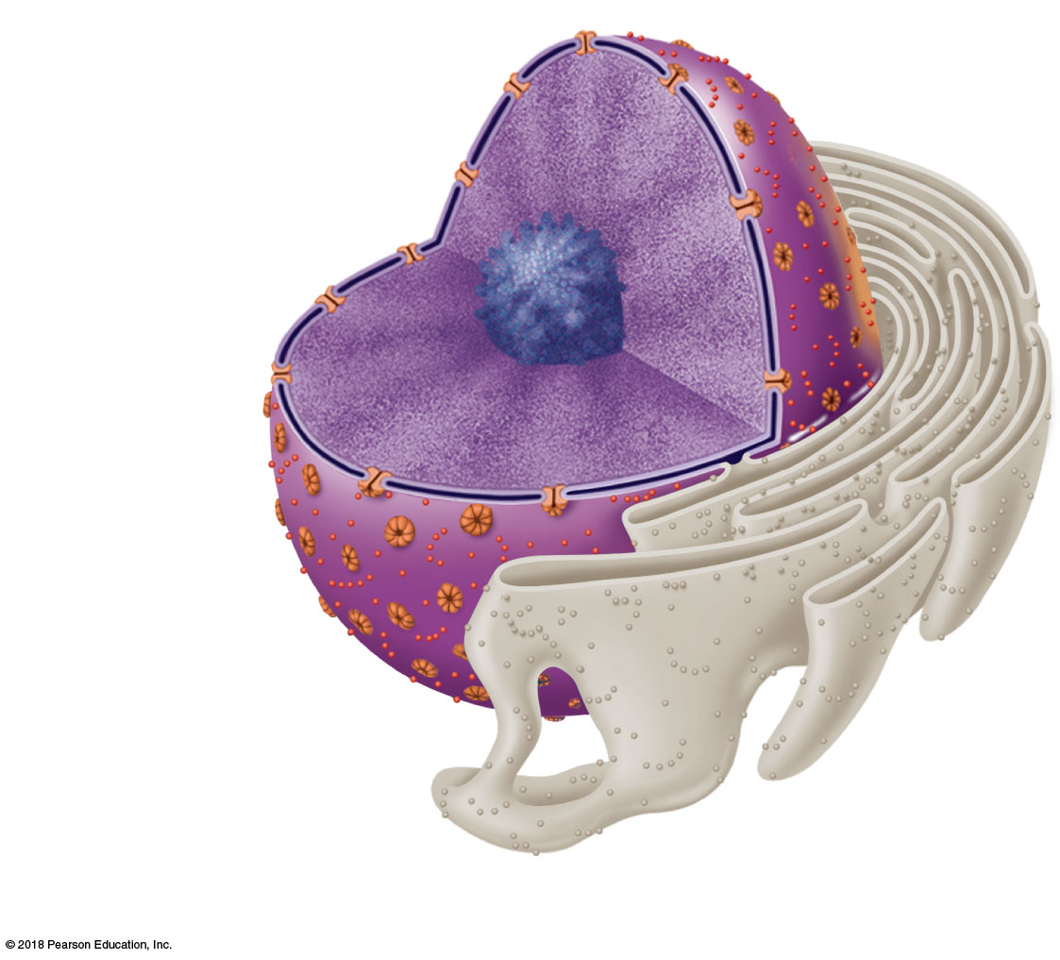
Nuclear envelope
Chromatin
Nucleus
Nucleolus
Nuclear
pores
(b) Nucleus

Slide 3
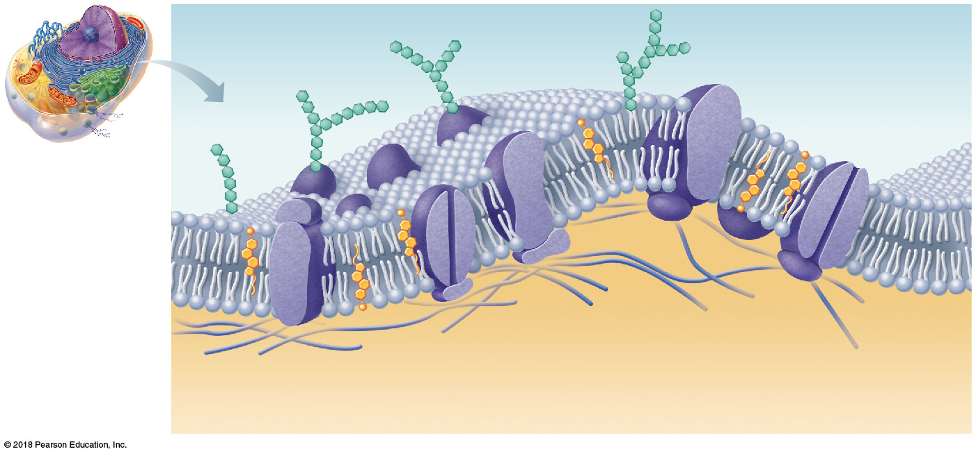
Extracellular fluid
(watery environment)
Glycoprotein
Glycolipid
Cholesterol
Sugar group
Polar heads of
phospholipid
molecules
Bimolecular
lipid layer
containing
proteins
Channel
Nonpolar tails of
phospholipid
molecules
Proteins
Filaments of
cytoskeleton
Cytoplasm
(watery environment)

Slide 4
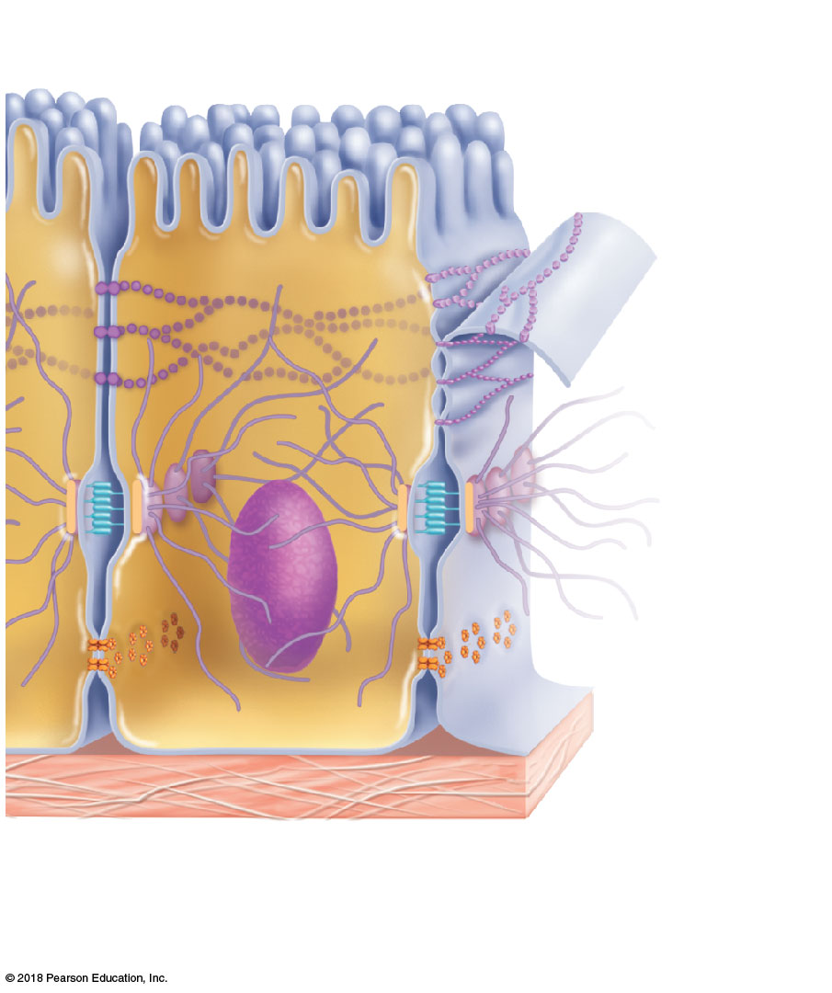
Microvilli
Tight
(impermeable)
junction
Desmosome
(anchoring
junction)
Plasma
membranes of
adjacent cells
Connexon
Underlying
basement
membrane
Extracellular
space between
cells
Gap
(communicating)
junction

Slide 5
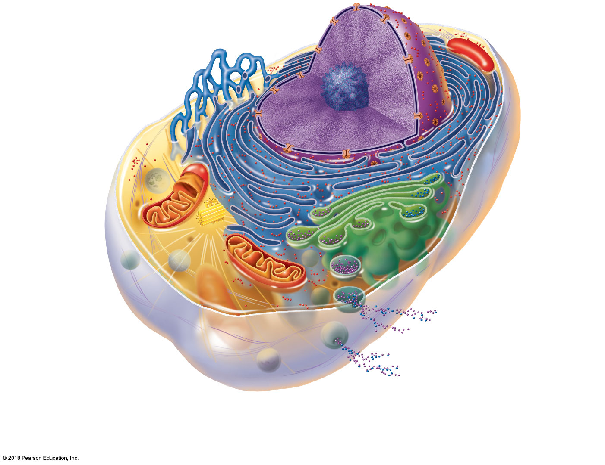
Chromatin
Nuclear envelope
Nucleolus
Nucleus
Smooth endoplasmic
reticulum
Plasma
membrane
Cytosol
Lysosome
Mitochondrion
Rough
endoplasmic
reticulum
Centrioles
Ribosomes
Golgi apparatus
Secretion being released
from cell by exocytosis
Microtubule
Peroxisome
Intermediate
filaments

Slide 6
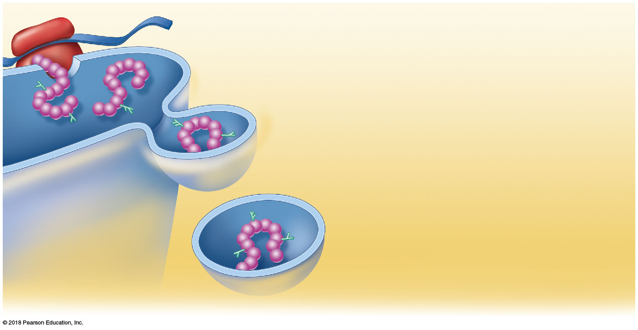
Ribosome
mRNA
As the protein is synthesized on the ribosome,
it migrates into the rough ER tunnel system.
1
Rough ER
1
2
3
2
In the tunnel, the protein folds into its
functional shape. Short sugar chains may be
attached to the protein (forming a glycoprotein).
Protein
3
The protein is packaged in a tiny
membranous sac called a transport vesicle.
Transport
vesicle buds off
4
The transport vesicle buds from the rough ER
and travels to the Golgi apparatus for further
processing.
4
Protein inside
transport vesicle

Slide 7
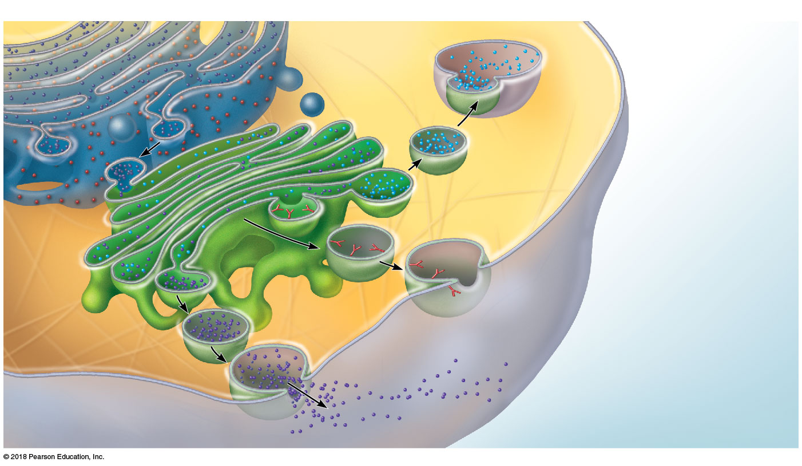
Rough ER
Tunnels
Proteins in tunnels
Membrane
Lysosome fuses with
ingested substances.
Transport
vesicle
Golgi vesicle containing
digestive enzymes
becomes a lysosome.
Pathway 3
Golgi
apparatus
Pathway 2
Golgi vesicle containing
membrane components
fuses with the plasma
membrane and is
incorporated into it.
Pathway 1
Secretory vesicles
Proteins
Golgi vesicle containing
proteins to be secreted
becomes a secretory
vesicle.
Secretion by
exocytosis
Plasma membrane
Extracellular fluid

Slide 8
(a) Microfilaments
(b) Intermediate filaments
(c) Microtubules
Tubulin subunits
Actin subunit
Fibrous subunits
7 nm
10 nm
25 nm
Microfilaments form the blue
batlike network.
Intermediate filaments form
the purple network surrounding
the pink nucleus.
Microtubules appear as gold
networks surrounding the cells’
pink nuclei.

Slide 9
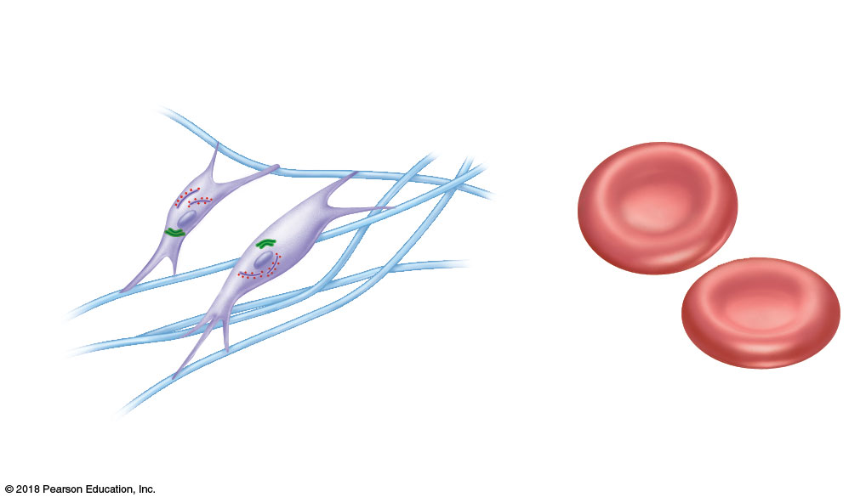
Fibroblasts
Rough ER and
Golgi apparatus
No organelles
Secreted
fibers
Nucleus
Erythrocytes
(a) Cells that connect body parts

Slide 10
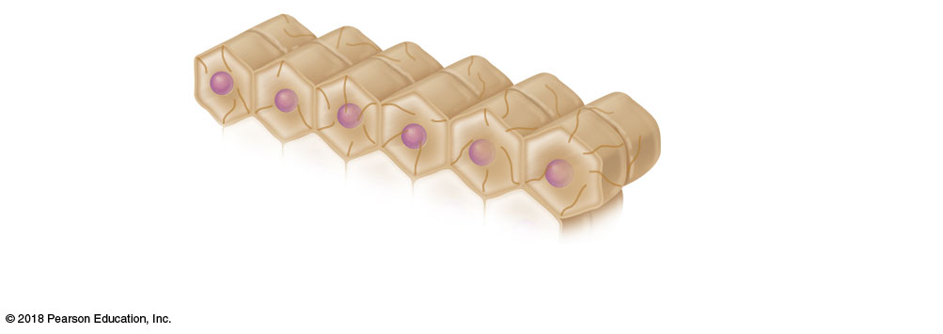
Epithelial
cells
Nucleus
Intermediate
filaments
(b) Cells that cover and line body organs

Slide 11
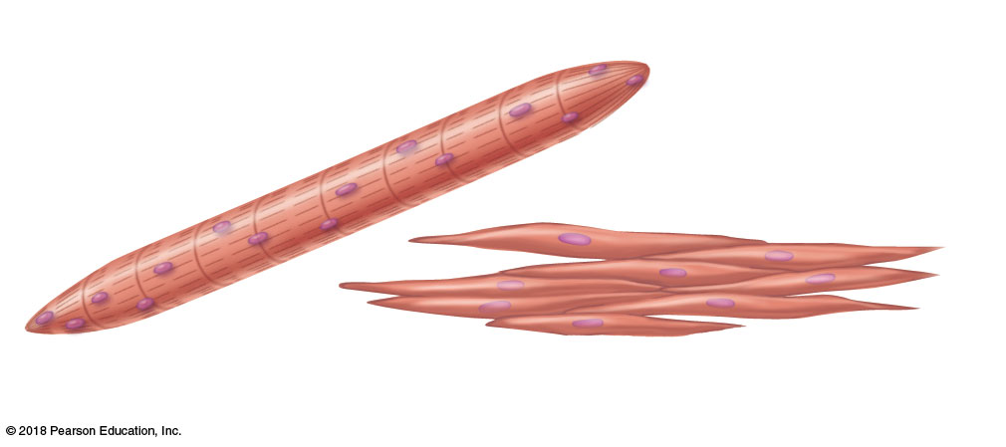
Skeletal
muscle cell
Nuclei
Contractile
filaments
Smooth
muscle cells
(c) Cells that move organs and body parts

Slide 12
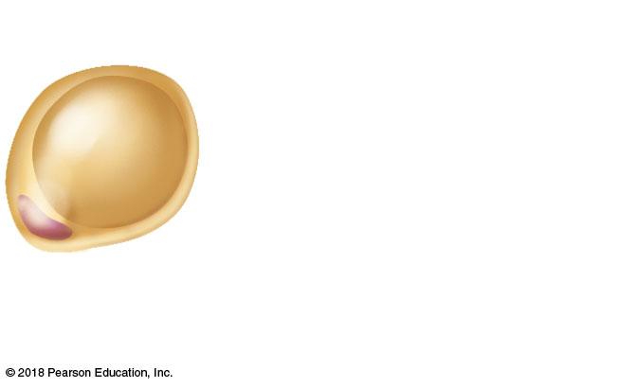
Fat cell
Lipid droplet
Nucleus
(d) Cell that stores nutrients

Slide 13
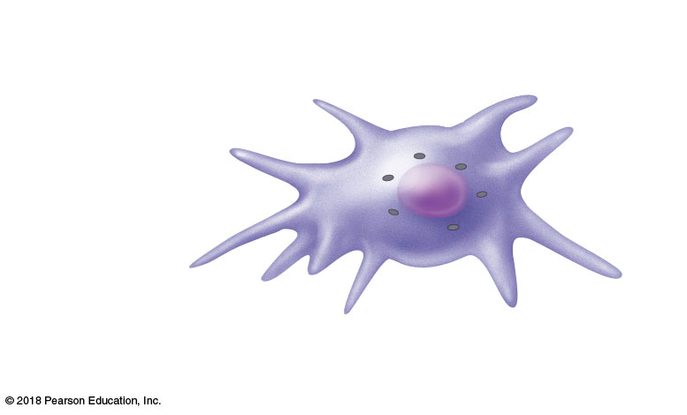
Lysosomes
Macrophage
Pseudopods
(e) Cell that fights disease

Slide 14
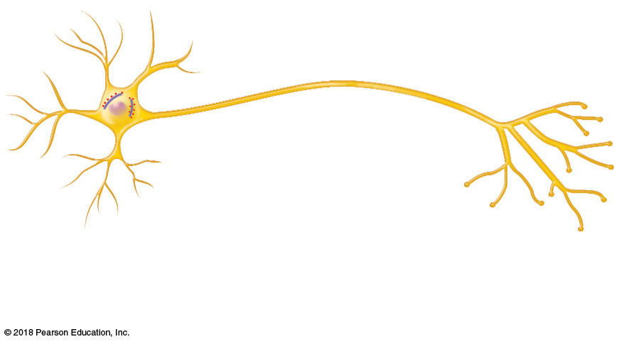
Processes
Rough ER
Nerve cell
Nucleus
(f) Cell that gathers information and controls body functions

Slide 15
Nucleus
Flagellum
Sperm
(g) Cell of reproduction

Slide 16
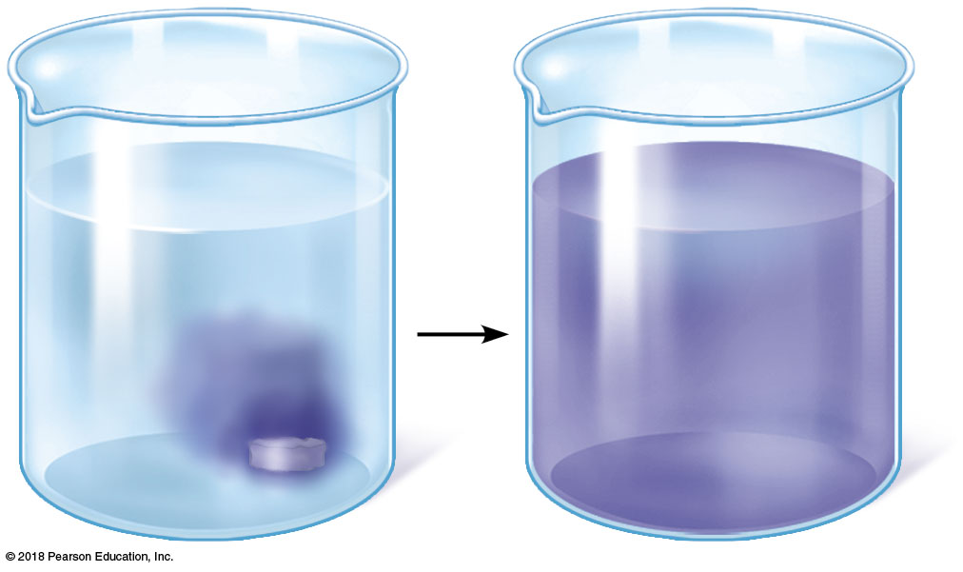

Slide 17
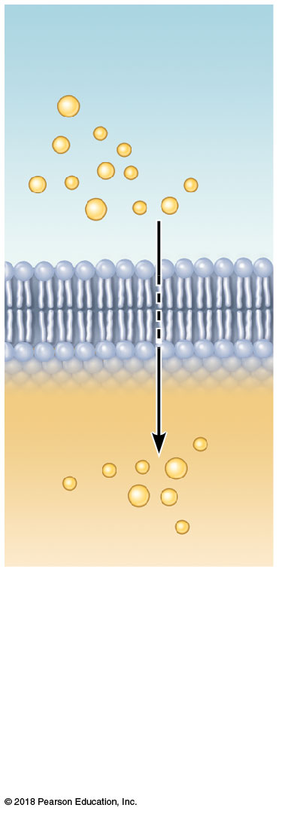
Extracellular fluid
Lipid-
soluble
solutes
Cytoplasm
(a) Simple diffusion of lipid-soluble solutes directly through the phospholipid bilayer

Slide 18
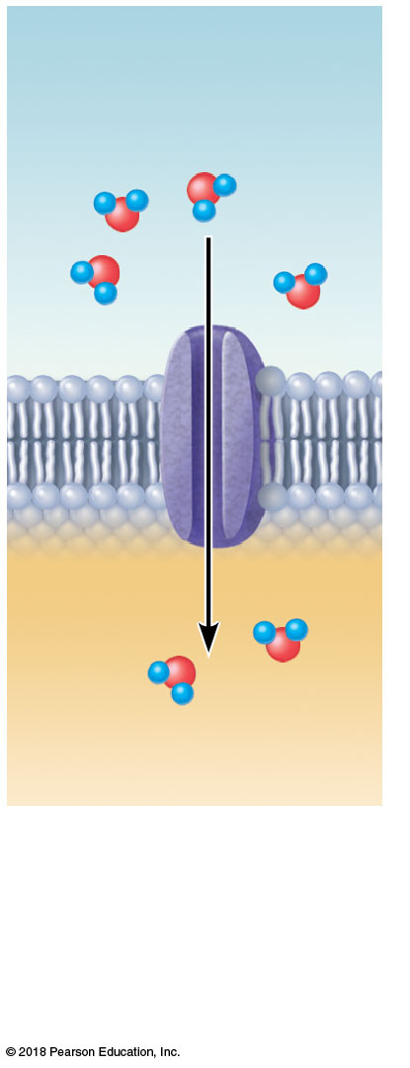
Water
molecules
(b) Osmosis, diffusion of water through a specific channel protein (aquaporin)

Slide 19
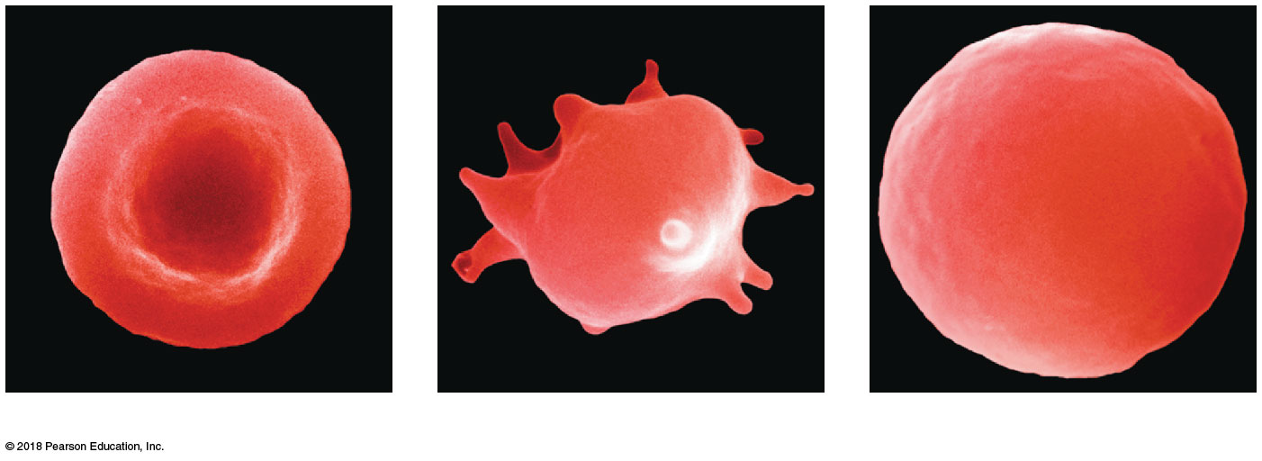
(a) RBC in isotonic solution
(b) RBC in hypertonic solution
(c) RBC in hypotonic solution

Slide 20
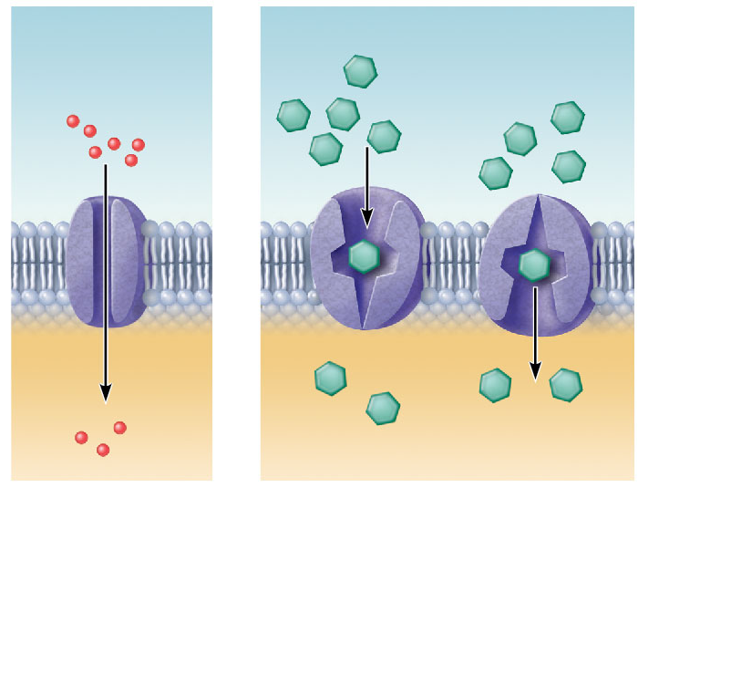
Small lipid-
insoluble
solutes
Lipid-
insoluble
solutes
Lipid
bilayer
(c) Facilitated diffusion through a channel protein; mostly ions, selected on basis of size and charge
(d) Facilitated diffusion via protein carrier specific for one chemical; binding of substrate causes shape change in transport protein

Slide 21
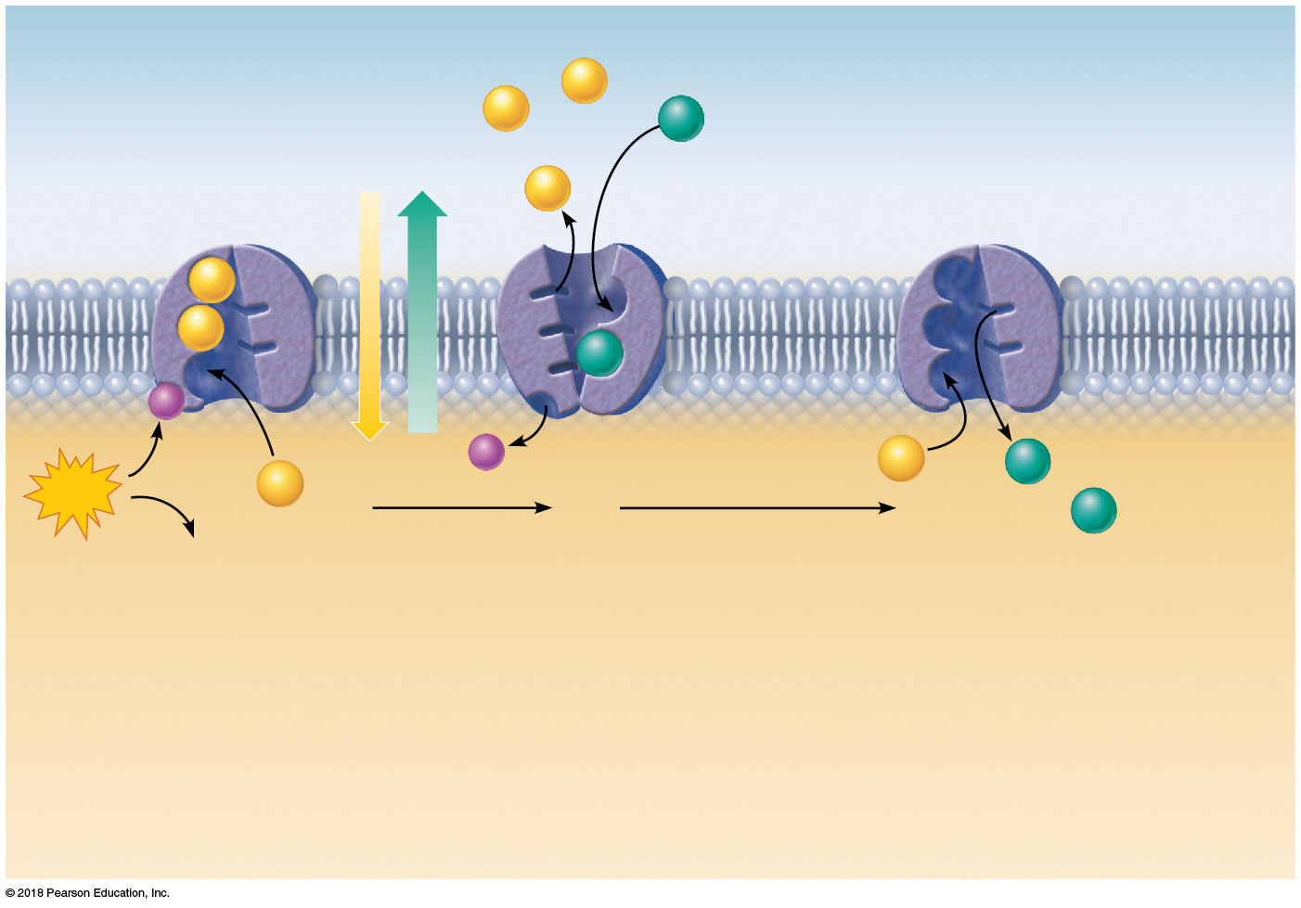
Slide 1
Extracellular fluid
Na⁺
Na⁺
K⁺
Na⁺-K⁺ pump
Na⁺
Na⁺
Na⁺
K⁺
P_{i}
P_{i}
Na⁺
K⁺
ATP
Na⁺
1
2
3
K⁺
ADP
2
Binding of cytoplasmic Na⁺
to the pump protein stimulates
phosphorylation by ATP, which
causes the pump protein to
change its shape.
The shape change expels
Na⁺ to the outside. Extracellular
K⁺ binds, causing release of the
inorganic phosphate group.
3
1
Loss of phosphate restores
the original shape of the pump
protein. K⁺ is released to the
cytoplasm, and Na⁺ sites are
ready to bind Na⁺ again; the
cycle repeats.
Cytoplasm

Slide 22
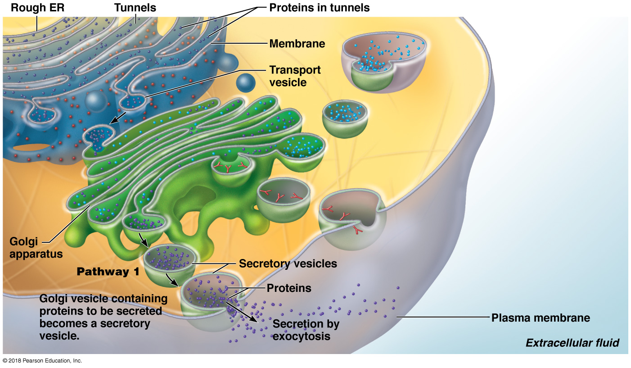

Slide 23
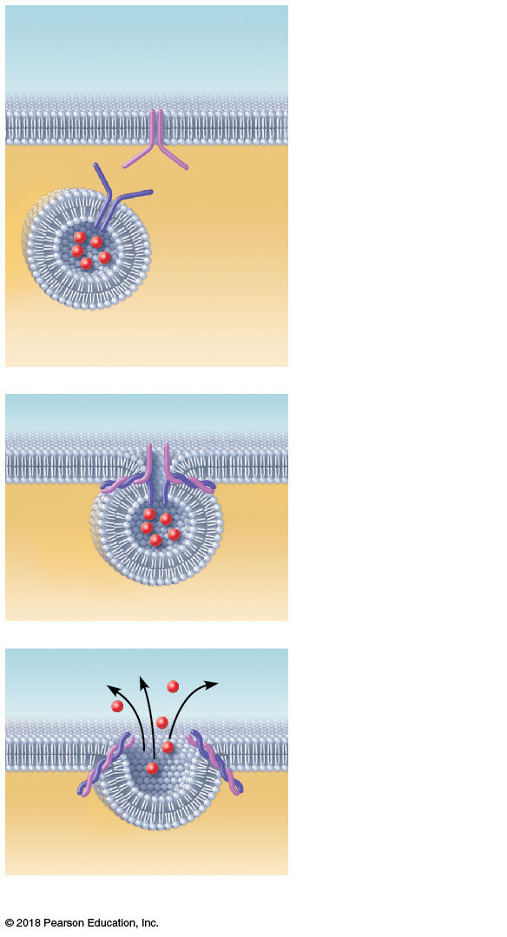
Extracellular
fluid
Plasma
membrane
docking
protein
1
The membrane-
bound vesicle
migrates to the
plasma membrane.
Vesicle
docking
protein
Molecule
to be
secreted
Secretory
vesicle
Cytoplasm
Fusion pore formed
2
There, docking
proteins on the
vesicle and plasma
membrane bind, the
vesicle and
membrane fuse, and
a pore opens up.
Fused
docking
proteins
3
Vesicle contents
are released to the
cell exterior.
(a) The process of exocytosis

Slide 24
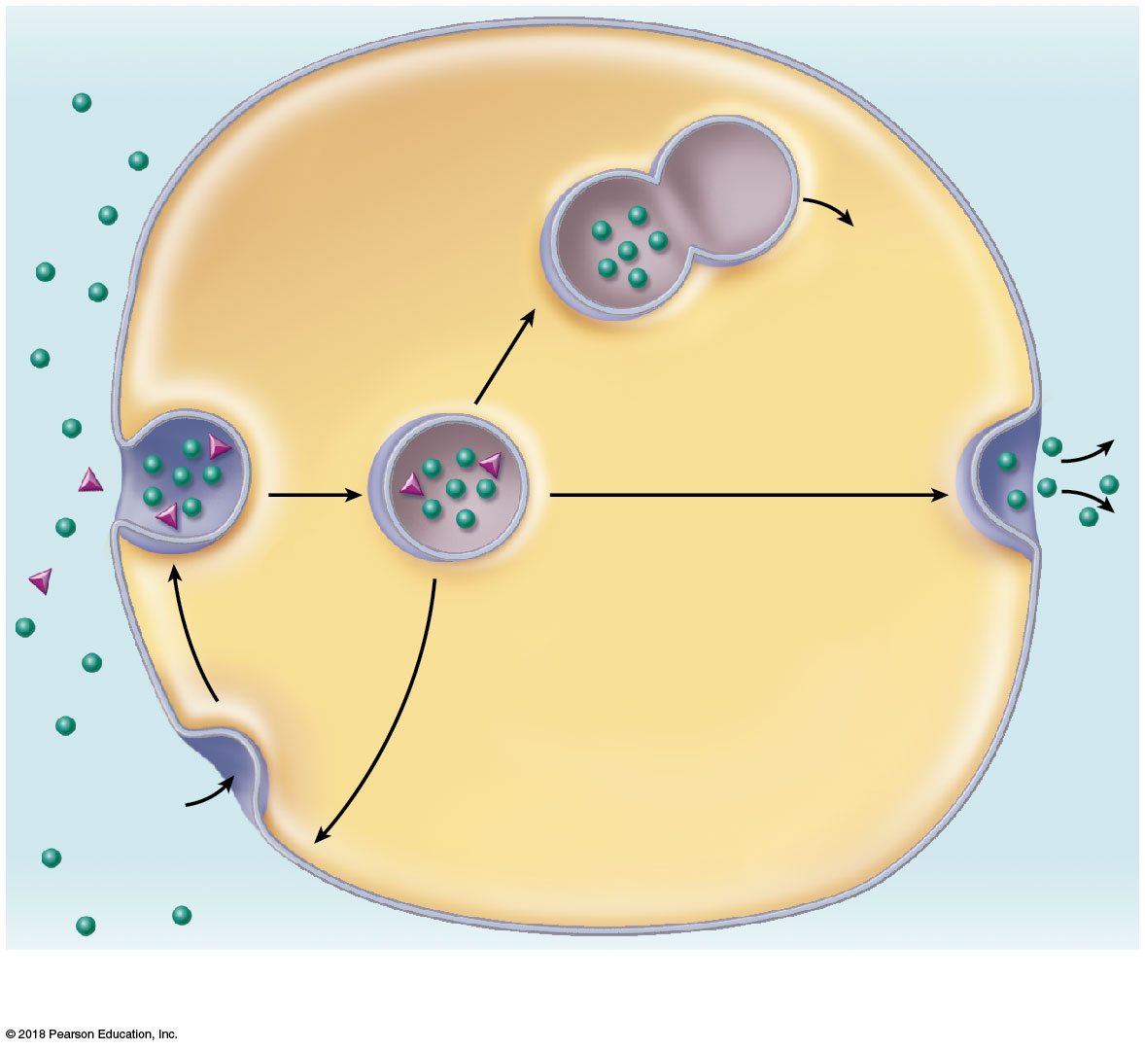
Extracellular
fluid
Cytoplasm
Plasma
membrane
Vesicle
Lysosome
1
Vesicle
forms and fuses
with lysosome
for digestion.
Release of
contents to
cytosol
2A
Transport to plasma
membrane and exocytosis
of vesicle contents
2
Detached vesicle
Ingested
substance
2B
3
Membranes and receptors
(if present) recycled to
plasma membrane
Pit
(a) Endocytosis (pinocytosis)

Slide 25
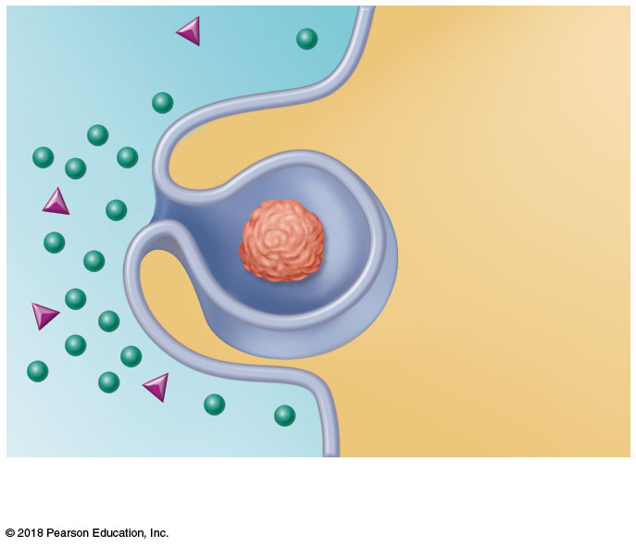
Cytoplasm
Extracellular
fluid
Bacterium
or other
particle
Pseudopod
(b) Phagocytosis

Slide 26
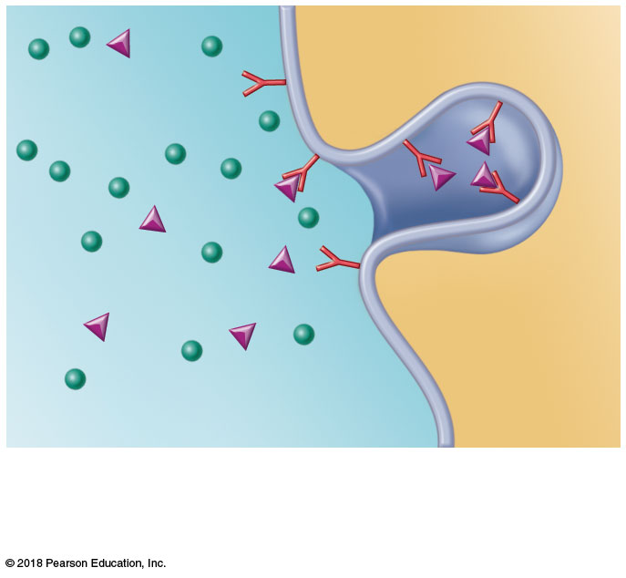
Membrane
receptor
Target molecule
(c) Receptor-mediated endocytosis

Slide 27
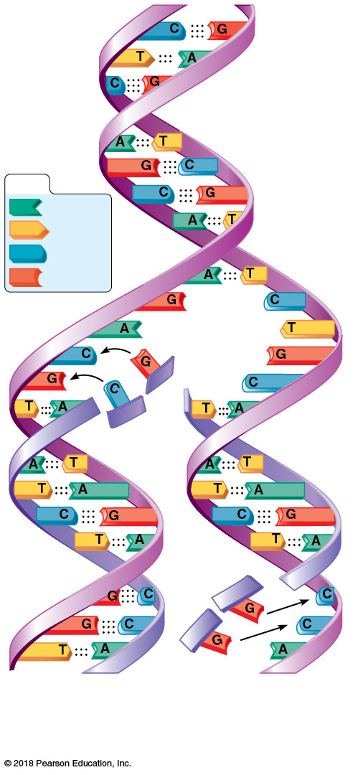
KEY:
Adenine
Thymine
Cytosine
Guanine
Old
(template)
strand
Newly
synthesized
strand
New
strand
forming
Old (template)
strand
DNA of one sister chromatid

Slide 28
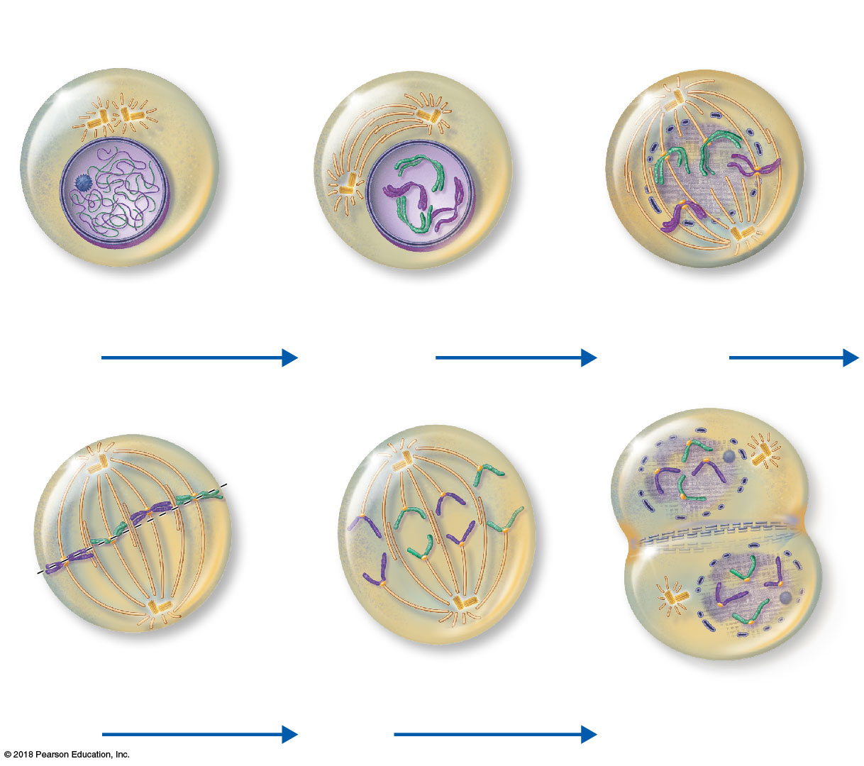
Centrioles
Chromatin
Centrioles
Spindle
microtubules
Centromere
Forming
mitotic
spindle
Centromere
Plasma
membrane
Nuclear
envelope
Chromosome,
consisting of two
sister chromatids
Fragments of
nuclear envelope
Nucleolus
Interphase
Early prophase
Late prophase
Metaphase
plate
Nucleolus
forming
Cleavage
furrow
Nuclear
envelope
forming
Mitotic
spindle
Sister
chromatids
Daughter
chromosomes
Metaphase
Anaphase
Telophase and cytokinesis

Slide 29
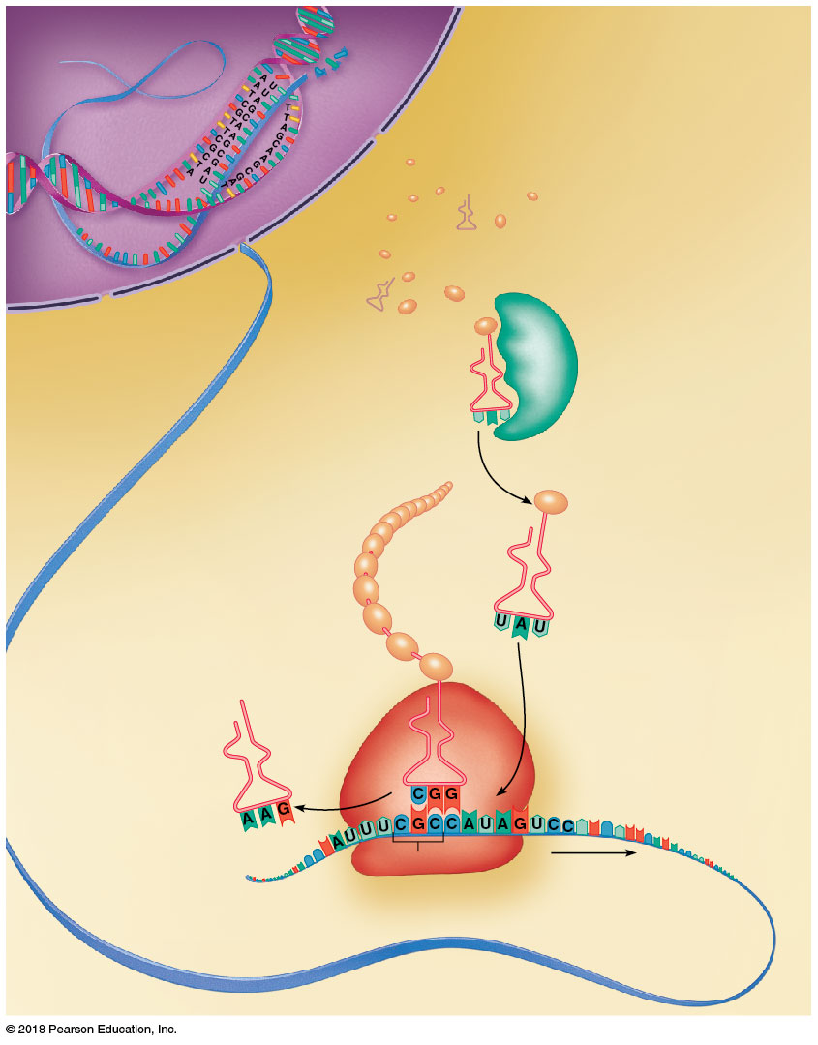
Slide 1
Nucleus
(site of transcription)
DNA
gene
Cytoplasm
(site of translation)
mRNA specifying
one polypeptide is
made from a gene on
the DNA template by an
enzyme (not shown).
1
mRNA leaves nucleus
and attaches to ribosome,
and translation begins.
Amino
2
mRNA
acids
Nuclear pore
Nuclear membrane
Correct amino
acid attached to
each type of
tRNA by an
enzyme
Synthetase
enzyme
3
IIe
Incoming tRNA
recognizes a complementary
mRNA codon calling for its
amino acid by temporarily
binding its anticodon to the
codon.
Growing
polypeptide
chain
Met
4
Gly
As the ribosome moves
along the mRNA, a new amino
acid is added to the growing
protein chain.
Ser
tRNA “head”
bearing anticodon
Phe
Peptide bond
Ala
Released tRNA
reenters the cytoplasmic
pool, ready to be recharged
with a new amino acid.
5
Large ribosomal subunit
Codon
Direction of ribosome
reading; ribosome
moves the mRNA strand
along sequentially
as each codon is read.
Portion of
mRNA already
translated
Small ribosomal subunit

Slide 30
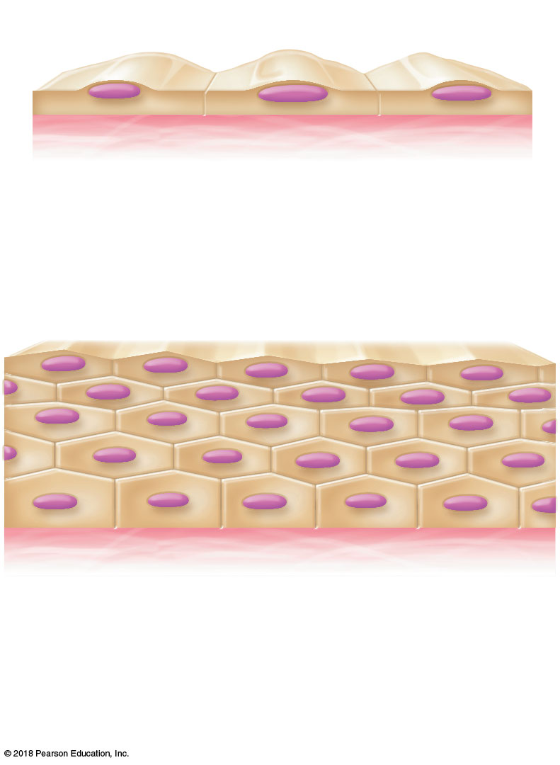
Apical surface
Basal
surface
Simple
Apical surface
Basal
surface
Stratified
(a) Classification based on number of cell layers

Slide 31
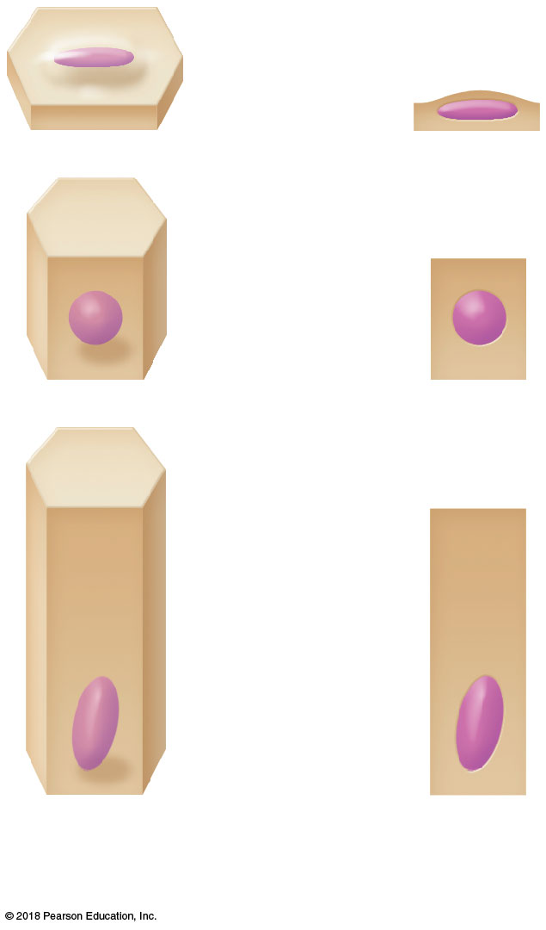
Squamous
Cuboidal
Columnar
(b) Classification based on cell shape

Slide 32
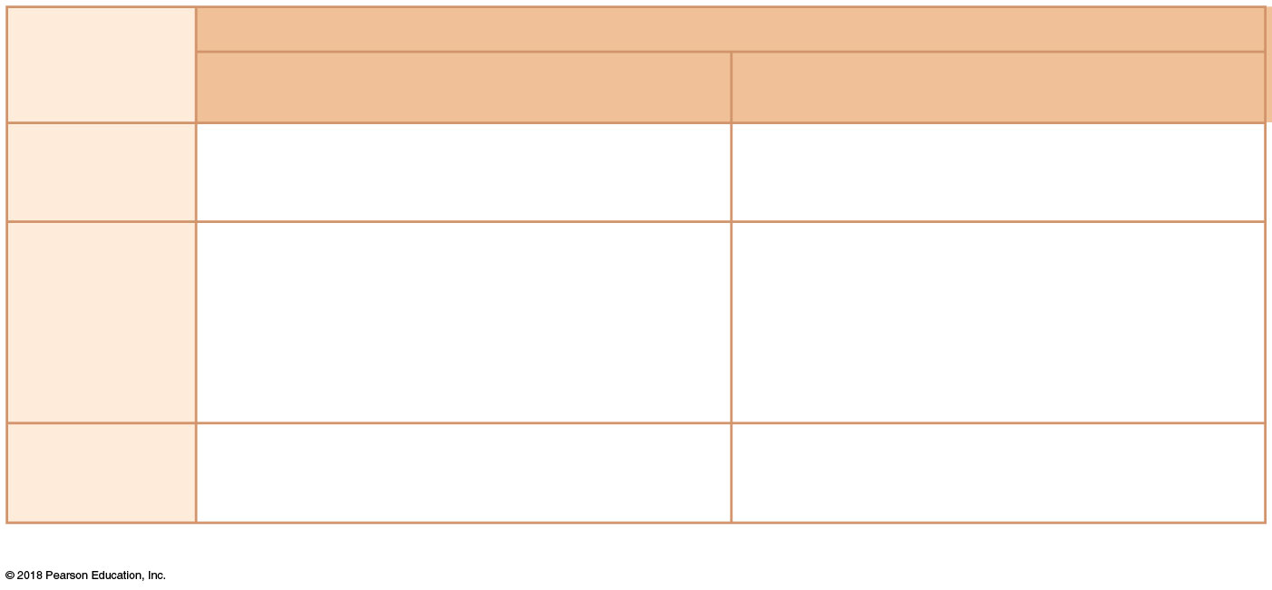
Number of layers
Cell shape
One layer: simple epithelial tissues
More than one layer: stratified epithelial tissues
Squamous
Diffusion and filtration Secretion in serous membranes
Protection
Cuboidal
Secretion and absorption; ciliated types
propel mucus or reproductive cells
Protection; these tissue types are rare in humans
Columnar
Secretion and absorption; ciliated types
propel mucus or reproductive cells
Transitional
No simple transitional epithelium exists
Protection; stretching to accommodate distension of urinary structures
(c) Function of epithelial tissue related to tissue type

Slide 33
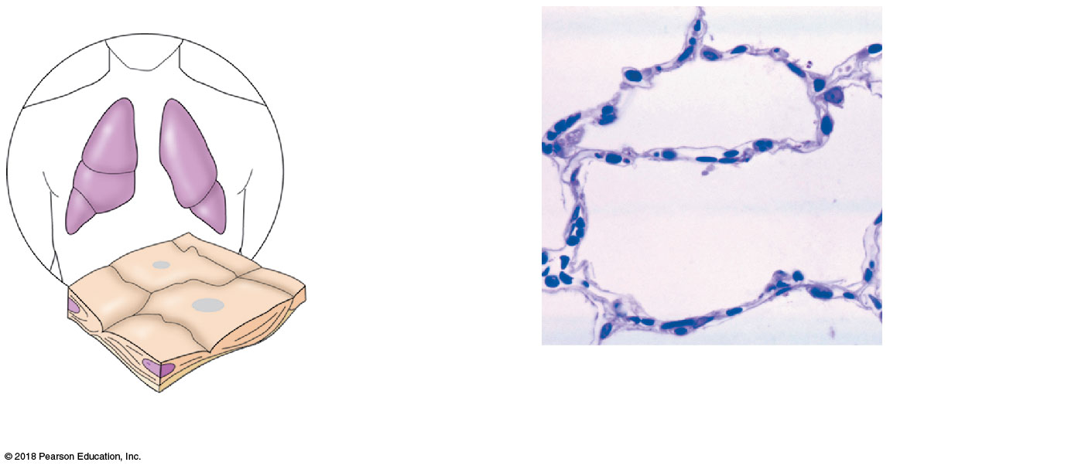
Air sacs of
lungs
Nucleus of
squamous
epithelial cell
Nuclei of
squamous
epithelial
cells
Basement
membrane
Photomicrograph: Simple squamous
epithelium forming part of the alveolar
(air sac) walls (275×).
(a) Diagram: Simple squamous

Slide 34
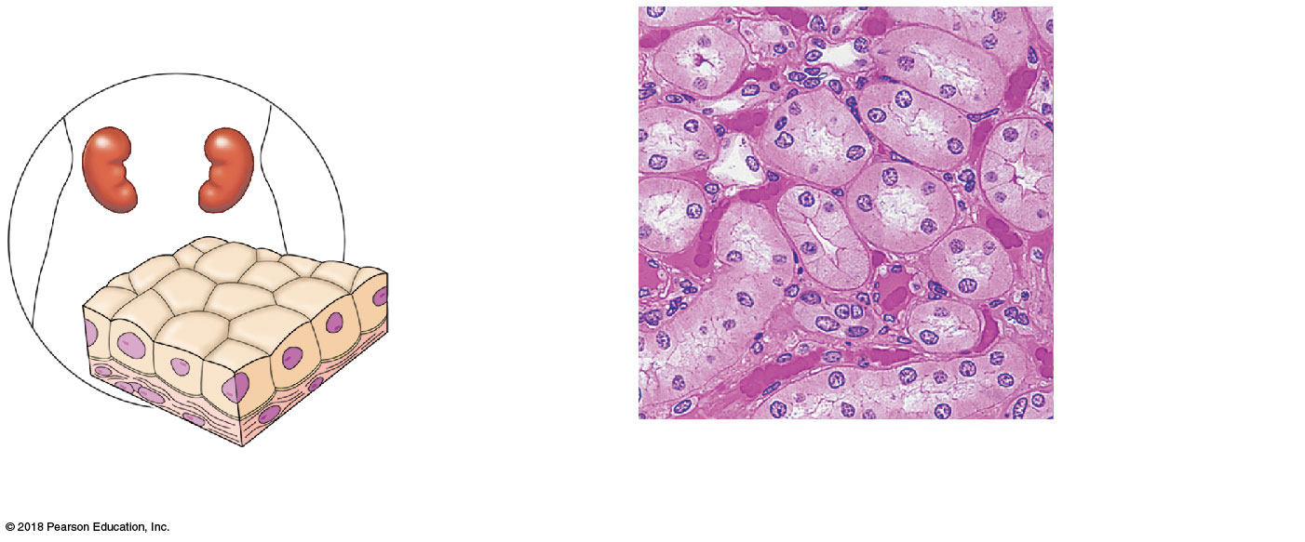
Nucleus of
simple
cuboidal
epithelial
cell
Simple
cuboidal
epithelial
cells
Basement
membrane
Basement
membrane
Connective
tissue
Photomicrograph: Simple cuboidal
epithelium in kidney tubules (250×).
(b) Diagram: Simple cuboidal

Slide 35
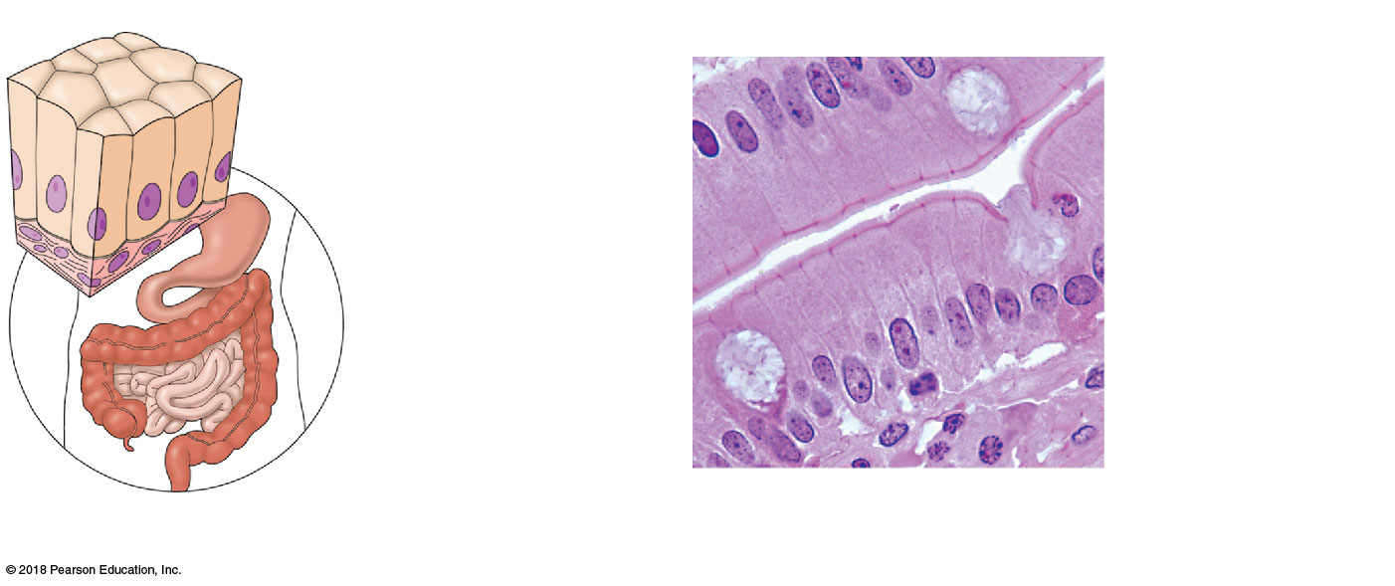
Nuclei of simple
columnar epithelial cells
tend to line up
Mucus of a
goblet cell
Simple columnar
epithelial cell
Basement
membrane
Basement
membrane
Photomicrograph: Simple columnar
epithelium of the small intestine (575×).
(c) Diagram: Simple columnar

Slide 36
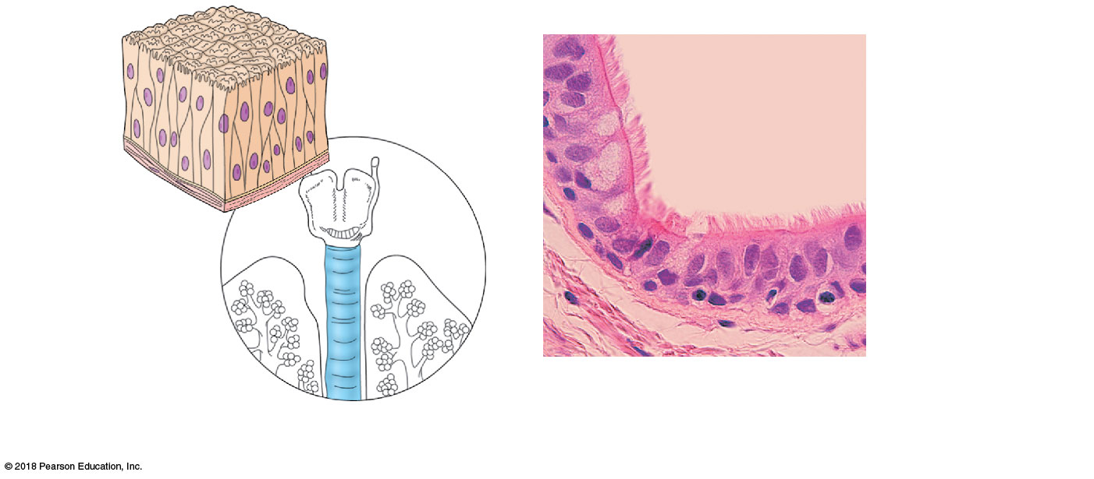
Pseudo-
stratified
epithelial
layer
Cilia
Pseudostratified
epithelial layer
Basement
membrane
Basement
membrane
Nuclei of
pseudostratified
cells do not line up
Connective tissue
Photomicrograph: Pseudostratified
ciliated columnar epithelium lining
the human trachea (560×).
(d) Diagram: Pseudostratified (ciliated)
columnar

Slide 37
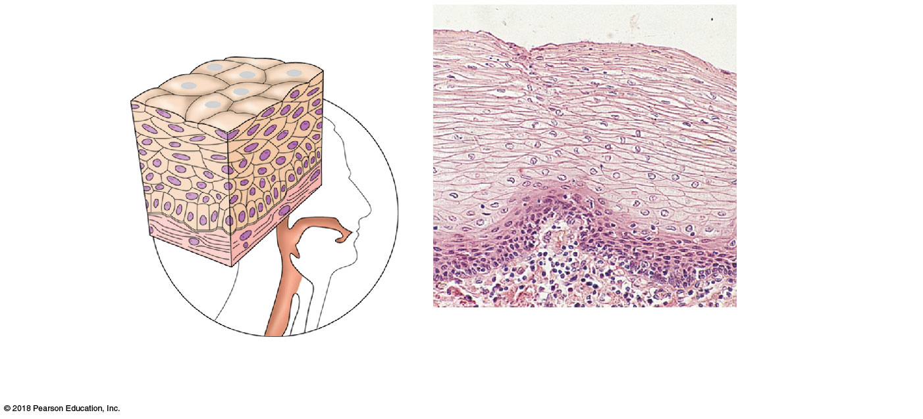
Nuclei
Stratified
squamous
epithelium
Stratified
squamous
epithelium
Basement
membrane
Basement
membrane
Connective
tissue
Photomicrograph: Stratified
squamous epithelium lining of
the esophagus (140×).
(e) Diagram: Stratified squamous

Slide 38
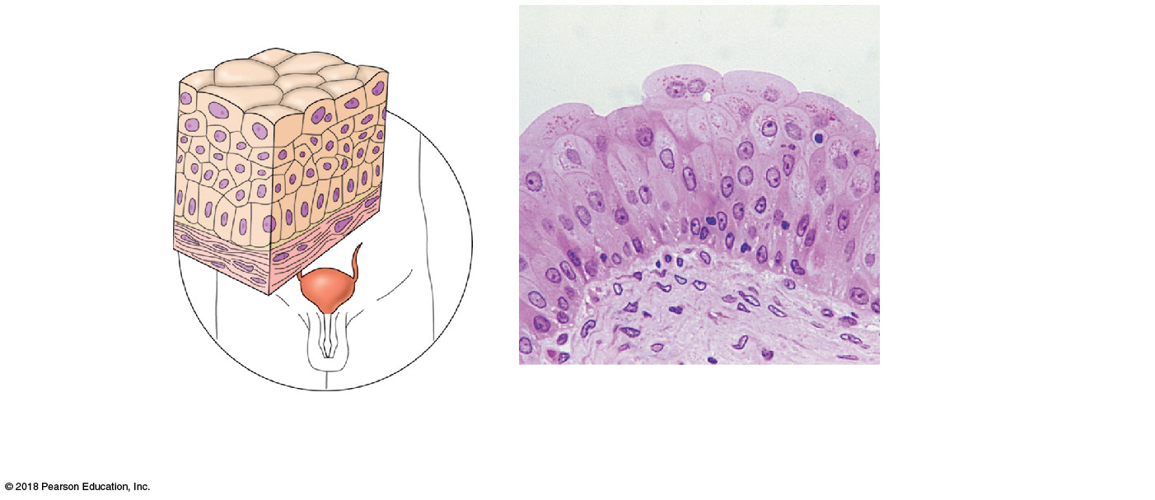
Basement
membrane
Transi-
tional
epithelium
Transitional
epithelium
Basement
membrane
Connective
tissue
Photomicrograph: Transitional epithelium lining of
the bladder, relaxed state (270×); surface rounded cells
flatten and elongate when the bladder fills with urine.
(f) Diagram: Transitional

Slide 39
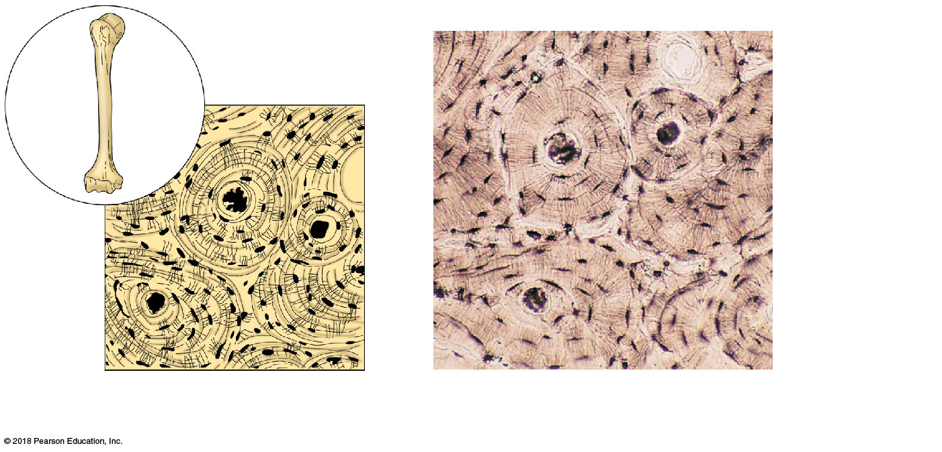
Osteocytes
(bone cells)
in lacunae
Central canal
Lacunae
(a) Diagram: Bone
Photomicrograph: Cross-sectional view
of bone (165×).

Slide 40
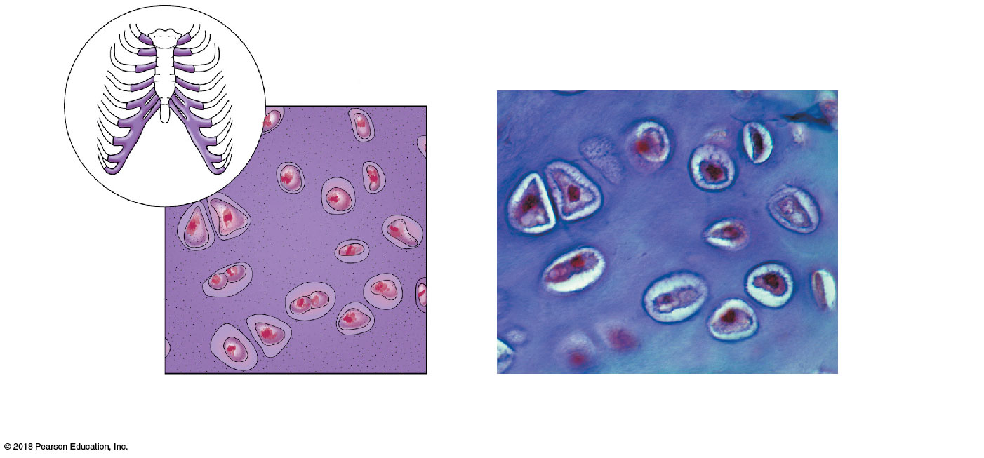
Chondrocyte
(cartilage cell)
Chondrocyte
in lacuna
Lacunae
Matrix
(b) Diagram: Hyaline cartilage
Photomicrograph: Hyaline cartilage
from the trachea (400×).

Slide 41
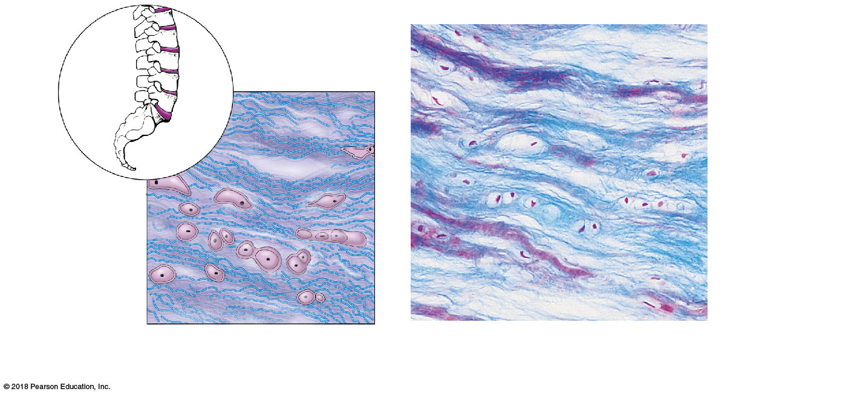
Chondrocytes
in lacunae
Chondro-
cytes in
lacunae
Collagen fiber
Collagen
fibers
(c) Diagram: Fibrocartilage
Photomicrograph: Fibrocartilage of an
intervertebral disc (150×).

Slide 42
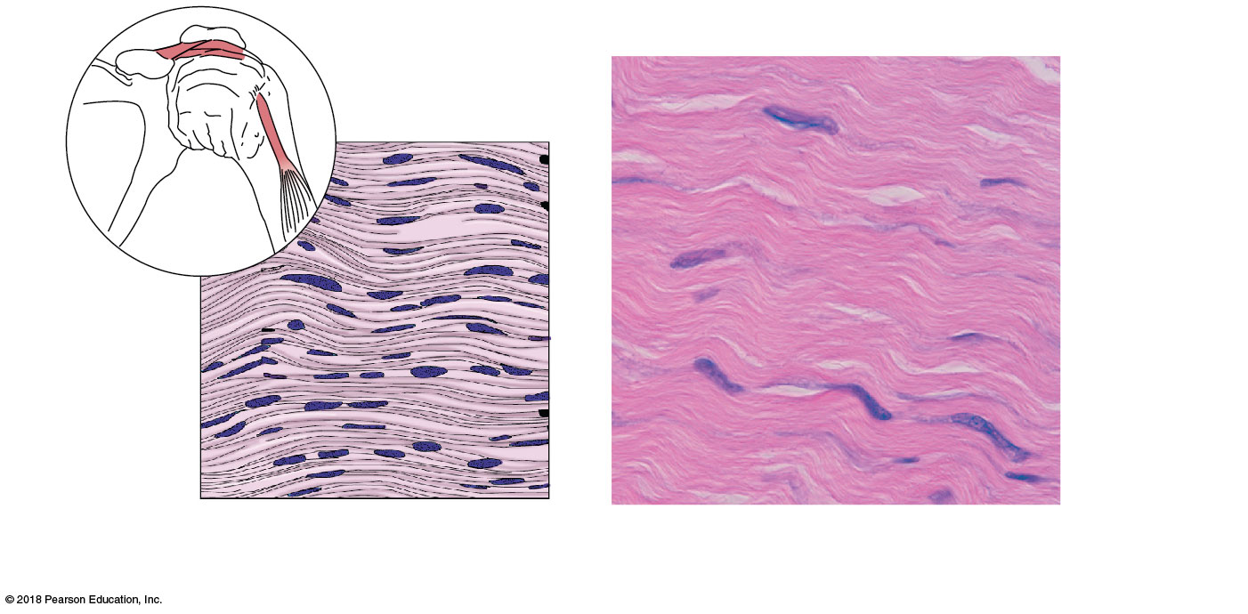
Ligament
Tendon
Collagen
fibers
Collagen
fibers
Nuclei of
fibroblasts
Nuclei of
fibroblasts
(d) Diagram: Dense fibrous
Photomicrograph: Dense fibrous connective
tissue from a tendon (475×).

Slide 43
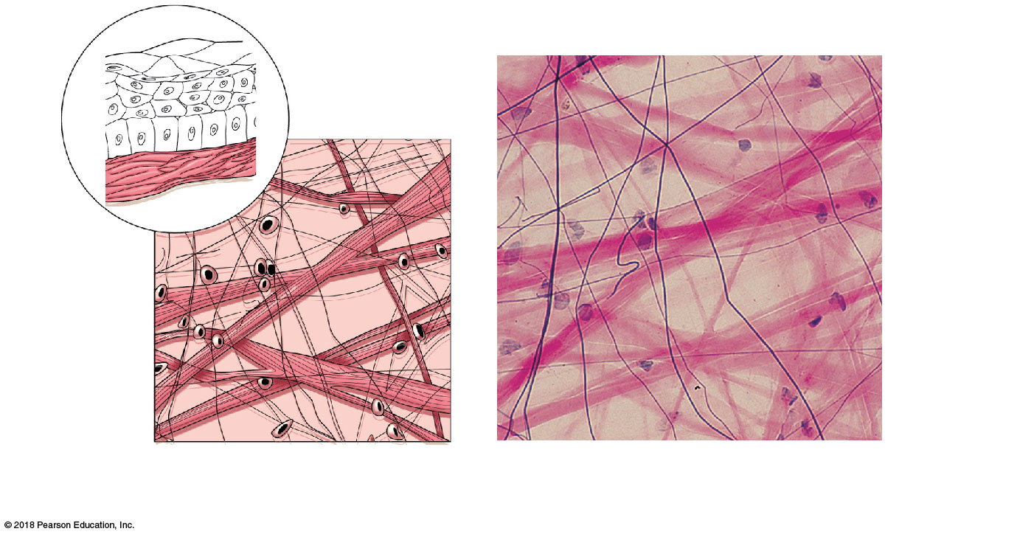
Mucosal
epithelium
Lamina
propria
Elastic
fibers
Collagen
fibers
Elastic
fibers of
matrix
Fibroblast
nuclei
Nuclei of
fibroblasts
Collagen
fibers
(e) Diagram: Areolar
Photomicrograph: Areolar connective tissue, a
soft packaging tissue of the body (270×).

Slide 44
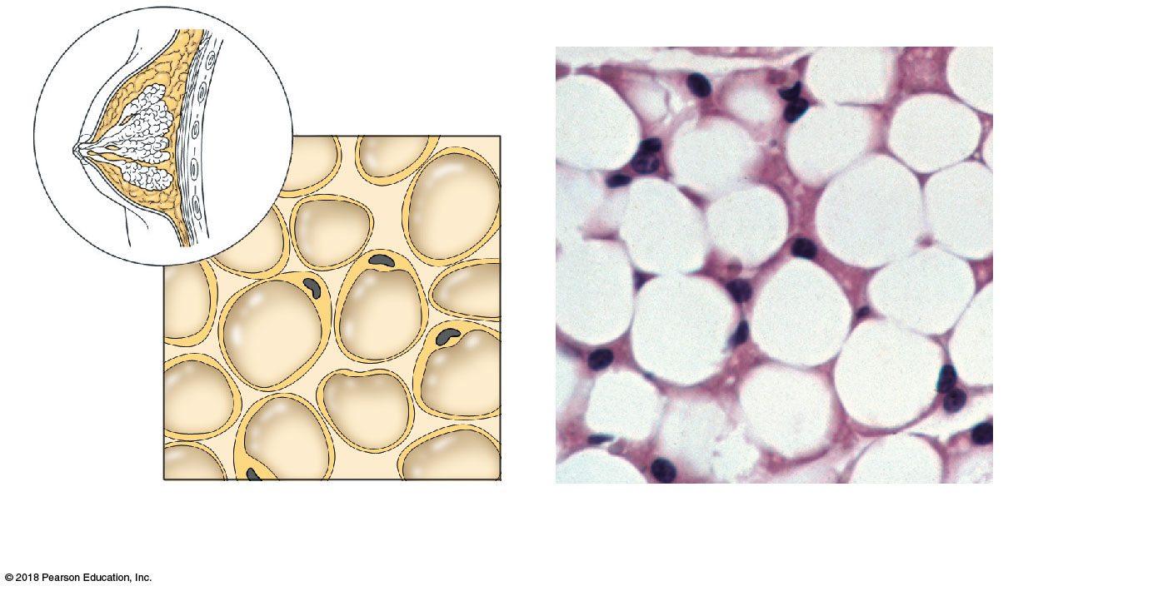
Nuclei of
fat cells
Vacuole
containing
fat droplet
Nuclei of
fat cells
Vacuole
containing
fat droplet
(f) Diagram: Adipose
Photomicrograph: Adipose tissue from the
subcutaneous layer beneath the skin (570×).

Slide 45
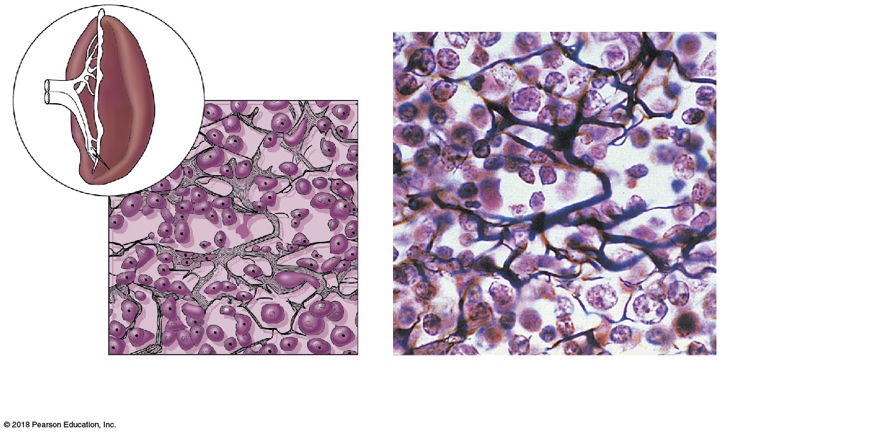
Spleen
White blood cell
(lymphocyte)
Reticular
cell
Reticular fibers
Blood
cell
Reticular
fibers
(g) Diagram: Reticular
Photomicrograph: Dark-staining network
of reticular connective tissue (400×).

Slide 46
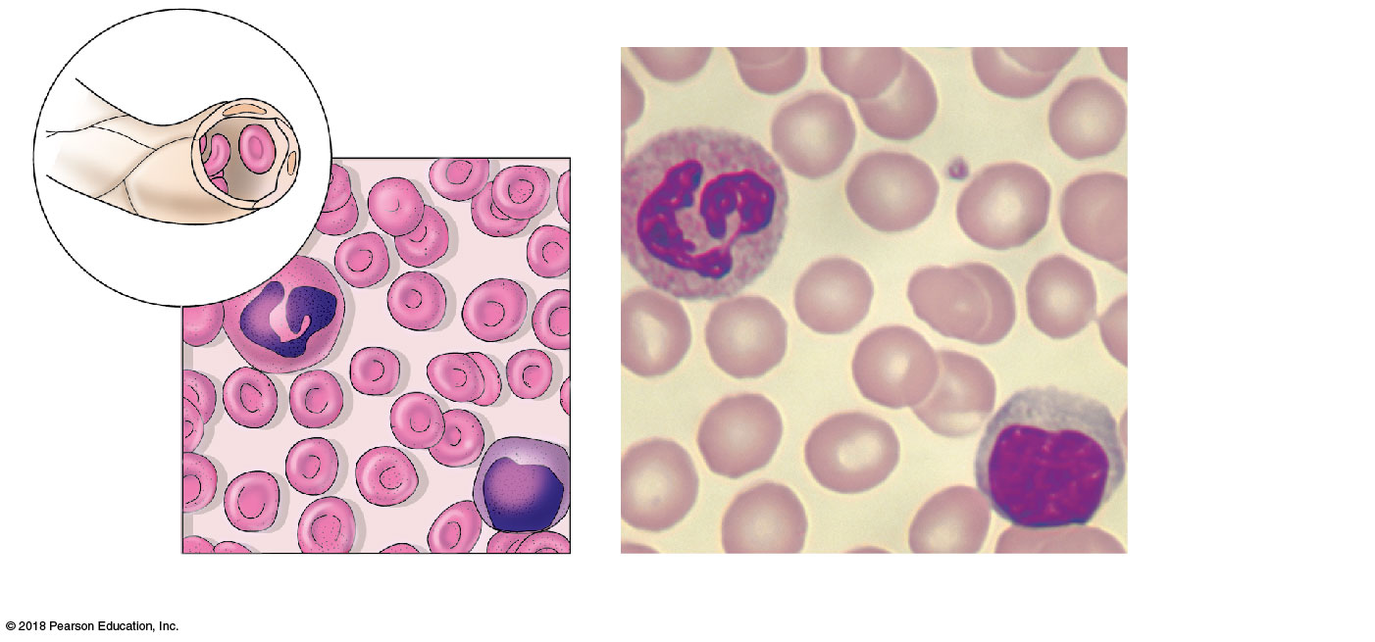
Blood cells
in capillary
Plasma (fluid
matrix)
Neutrophil
(white blood
cell)
White
blood cell
Red blood
cells
Monocyte
(white blood
cell)
Red
blood cells
(h) Diagram: Blood
Photomicrograph: Smear of human blood (1290×)

Slide 47
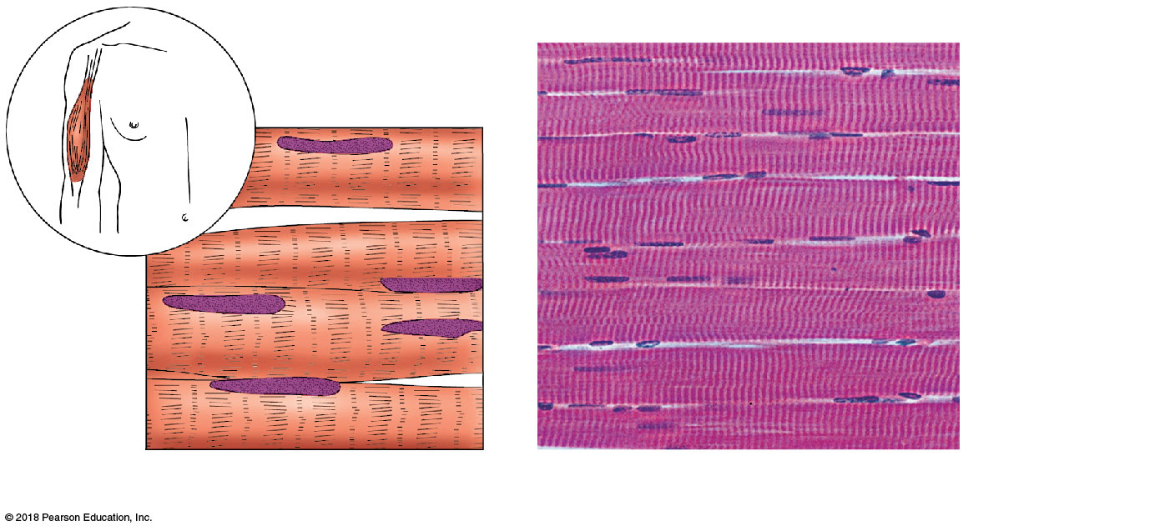
Striations
Multiple nuclei
per fiber
Part of muscle
fiber
(a) Diagram: Skeletal muscle
Photomicrograph: Skeletal muscle (195×).

Slide 48
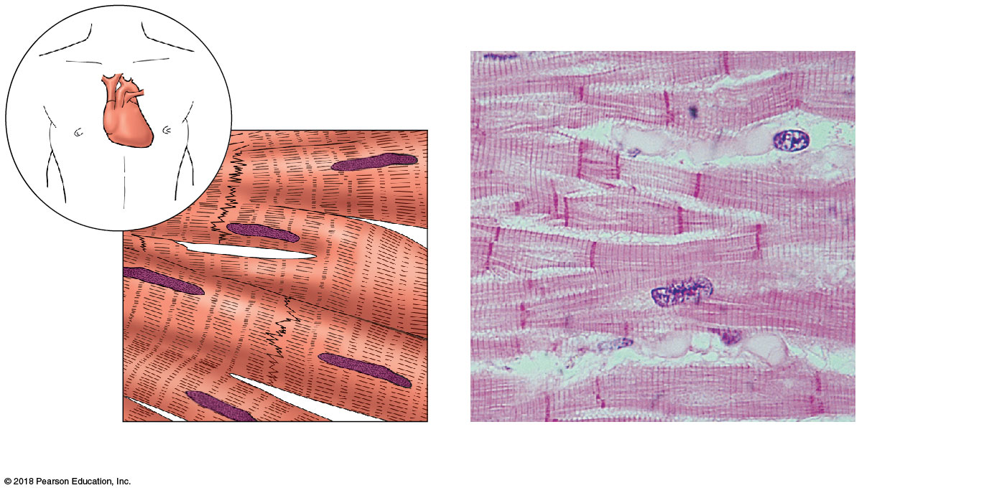
Intercalated
discs
Nucleus
(b) Diagram: Cardiac muscle
Photomicrograph: Cardiac muscle (475×).

Slide 49
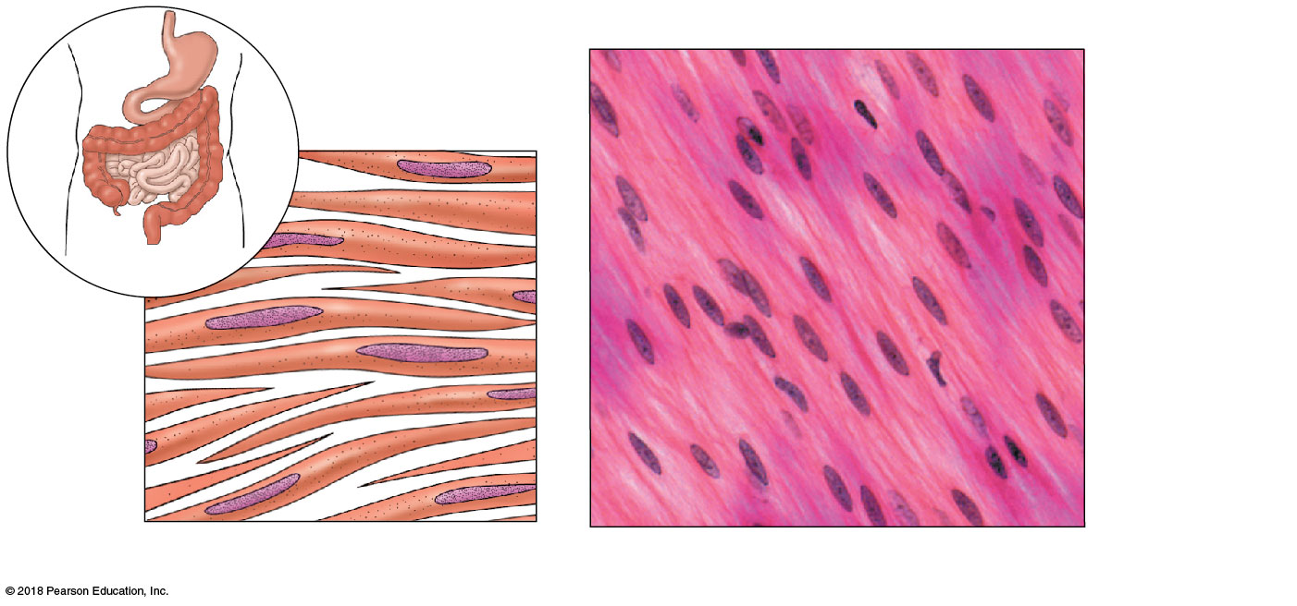
Nuclei
Smooth
muscle cell
(c) Diagram: Smooth muscle
Photomicrograph: Sheet of smooth muscle (360×).

Slide 50
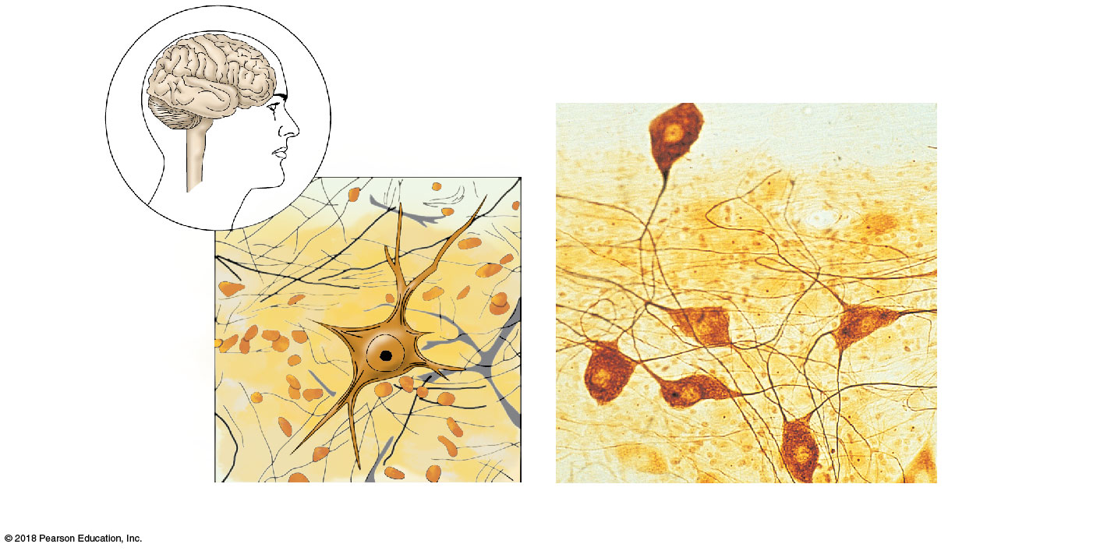
Brain
Nuclei of
neuroglia
(supporting
cells)
Spinal
cord
Nuclei of
neuroglia
(supporting
cells)
Cell body
of neuron
Cell body
of neuron
Neuron
processes
Neuron
processes
Diagram: Nervous tissue
Photomicrograph: Neurons (320×)

Slide 51
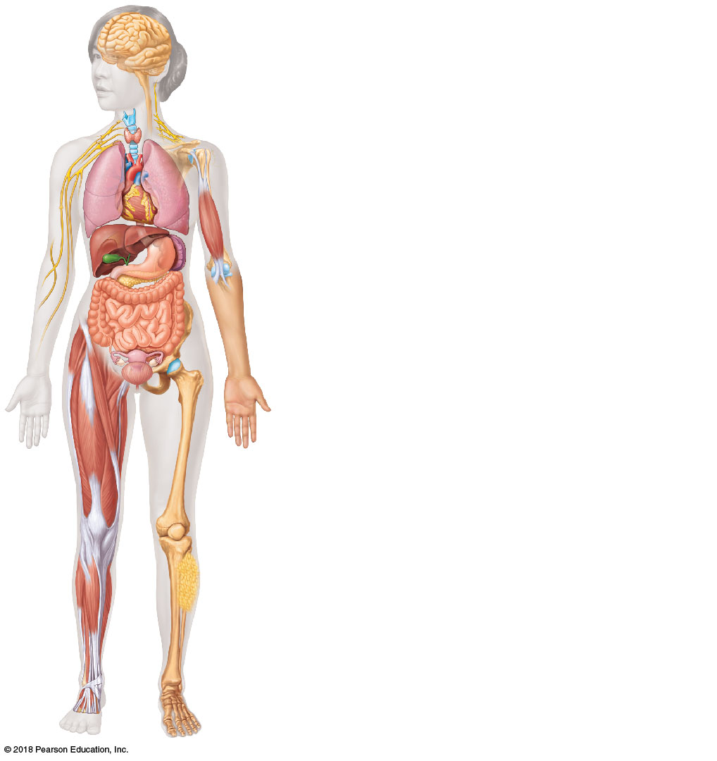
Nervous tissue: Internal communication and control
Hallmarks: irritable, conductive
• Brain, spinal cord, and nerves
Muscle tissue: Contracts to cause movement
Hallmarks: irritable, contractile
• Muscles attached to bones (skeletal)
• Muscles of heart wall (cardiac)
• Muscles of walls of hollow organs (smooth)
Epithelial tissue: Forms boundaries between different
environments, protects, secretes, absorbs, filters
Hallmarks: one free (apical) surface, avascular
• Lining of GI tract and other hollow organs
• Skin surface (epidermis)
Connective tissue: Supports, protects, binds
other tissues together
Hallmarks: extracellular matrix, varying vascularity
• Cartilage
• Bones
• Tendons
• Fat and other soft padding tissue

