Slide 1
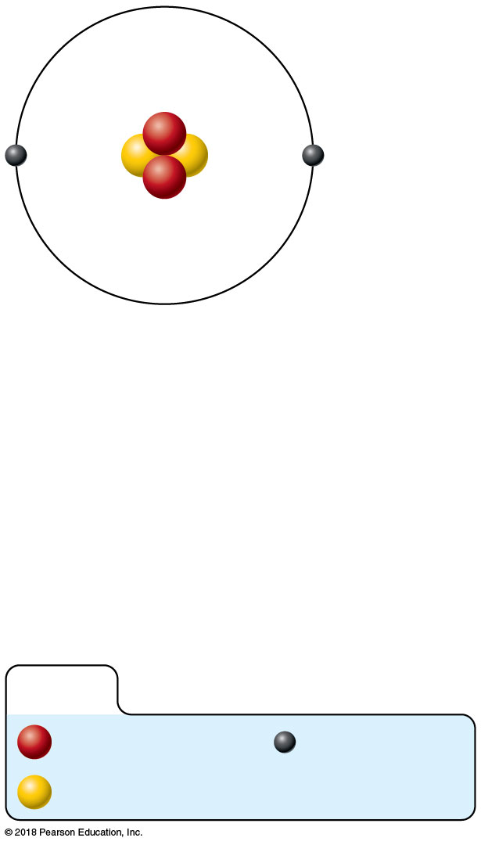
Nucleus
Helium atom
2 protons (p⁺)
2 neutrons (n⁰)
2 electrons (e⁻)
(a) Planetary model
KEY:
Proton
Electron
Neutron
© 2018 Pearson Education, Inc.

Slide 2
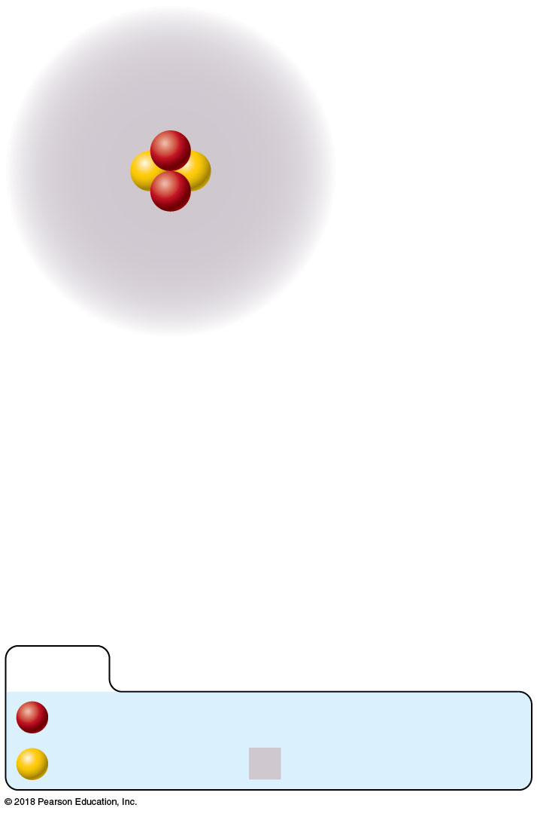
Nucleus
Helium atom
2 protons (p⁺)
2 neutrons (n⁰)
2 electrons (e⁻)
(b) Orbital model
KEY:
Proton
Neutron
Electron cloud
© 2018 Pearson Education, Inc.

Slide 3
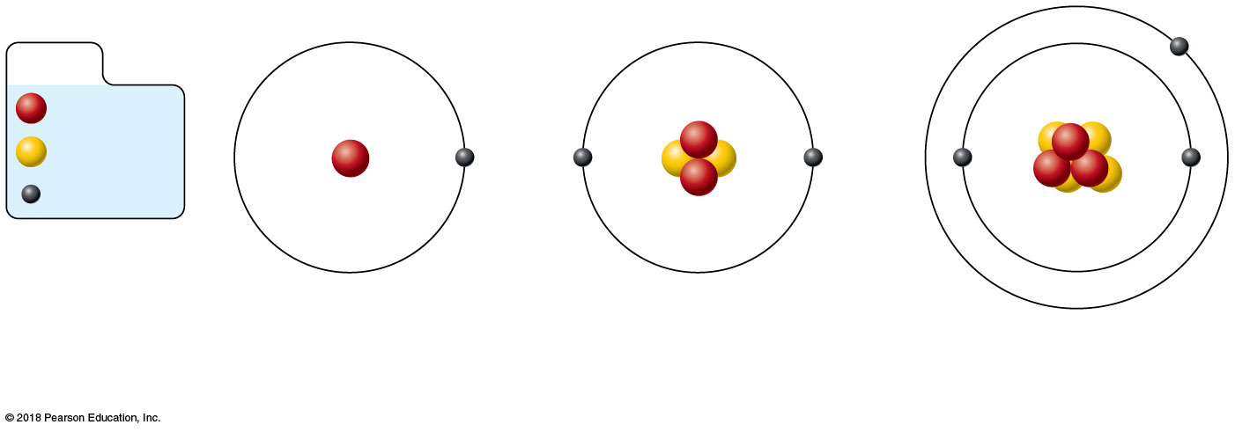
KEY:
Proton
Neutron
Electron
(a) Hydrogen (H)
(b) Helium (He)
(c) Lithium (Li)
(1p⁺; 0n⁰; 1e⁻)
(2p⁺; 2n⁰; 2e⁻)
(3p⁺; 4n⁰; 3e⁻)
© 2018 Pearson Education, Inc.

Slide 4
KEY:
Proton
Neutron
Electron
Hydrogen (¹H)
Deuterium (²H)
Tritium (³H)
(1p⁺; 0n⁰; 1e⁻)
(1p⁺; 1n⁰; 1e⁻)
(1p⁺; 2n⁰; 1e⁻)
© 2018 Pearson Education, Inc.

Slide 5
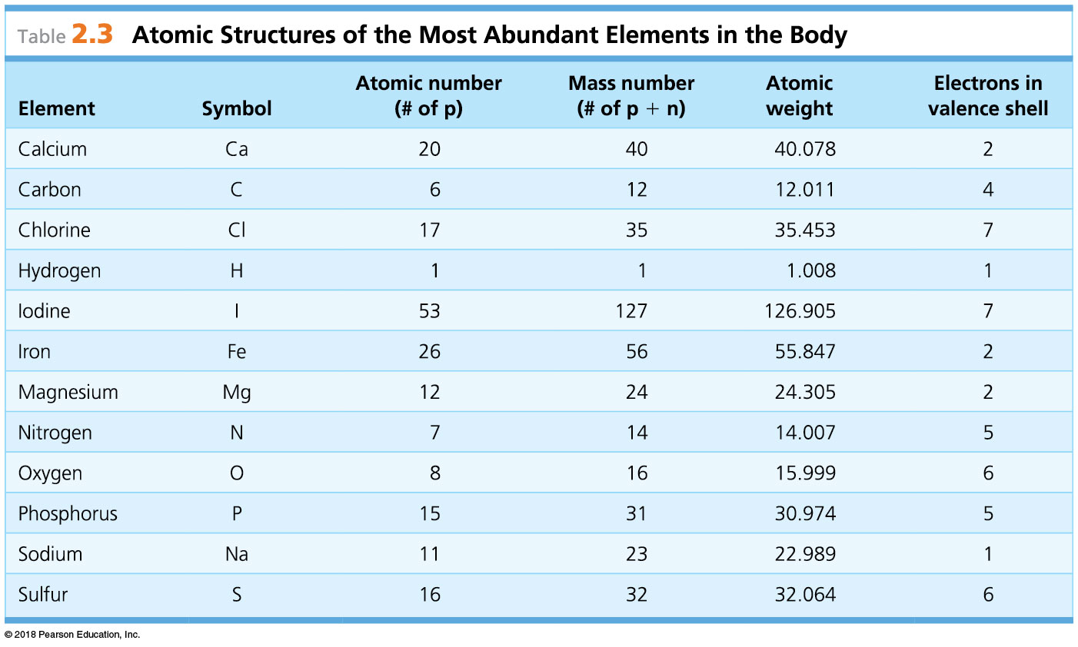
© 2018 Pearson Education, Inc.

Slide 6
Sodium (silvery metal)
Chlorine (poisonous gas)
Sodium chloride (table salt)
© 2018 Pearson Education, Inc.

Slide 7
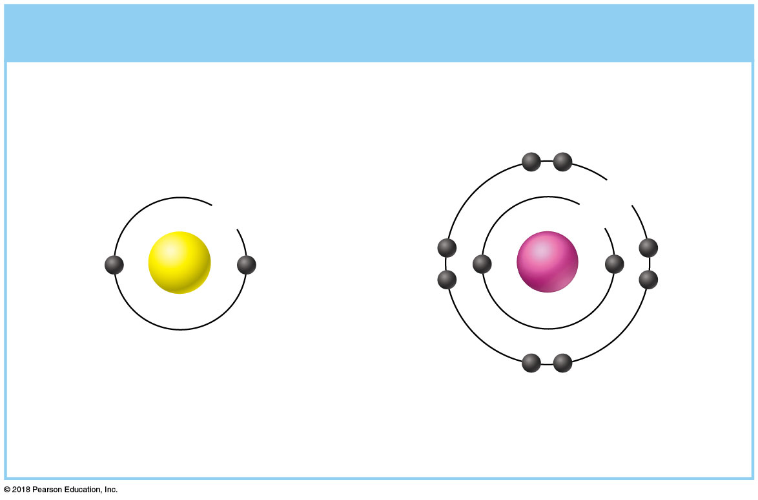
(a) Chemically inert elements
Outermost energy level (valence shell) complete
8e
2e
2e
He
Ne
Helium (He)
Neon (Ne)
(2p⁺; 2n⁰; 2e⁻)
(10p⁺; 10n⁰; 10e⁻)
© 2018 Pearson Education, Inc.

Slide 8
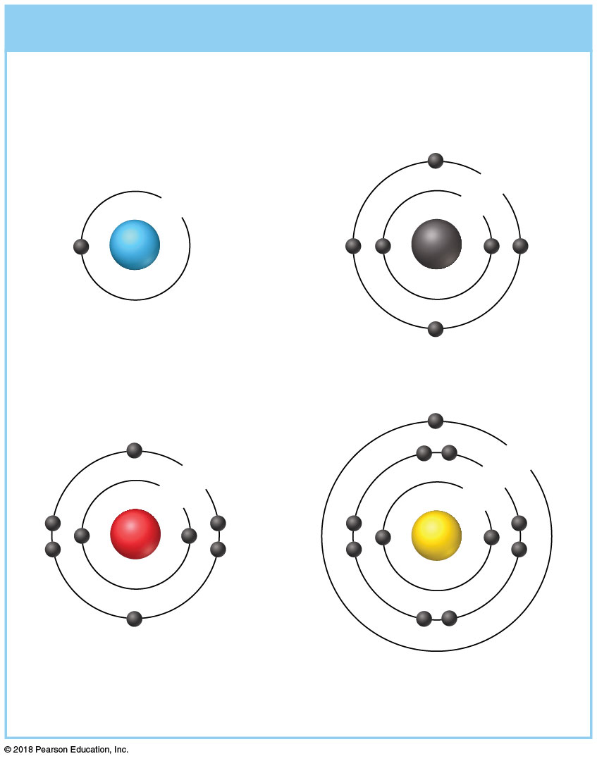
(b) Chemically reactive elements
Outermost energy level
(valence shell) incomplete
4e
1e
2e
H
C
Hydrogen (H)
Carbon (C)
(1p⁺; 0n⁰; 1e⁻)
(6p⁺; 6n⁰; 6e⁻)
1e
6e
8e
2e
2e
O
Na
Oxygen (O)
(8p⁺; 8n⁰; 8e⁻)
Sodium (Na)
(11p⁺; 12n⁰; 11e⁻)
© 2018 Pearson Education, Inc.

Slide 9
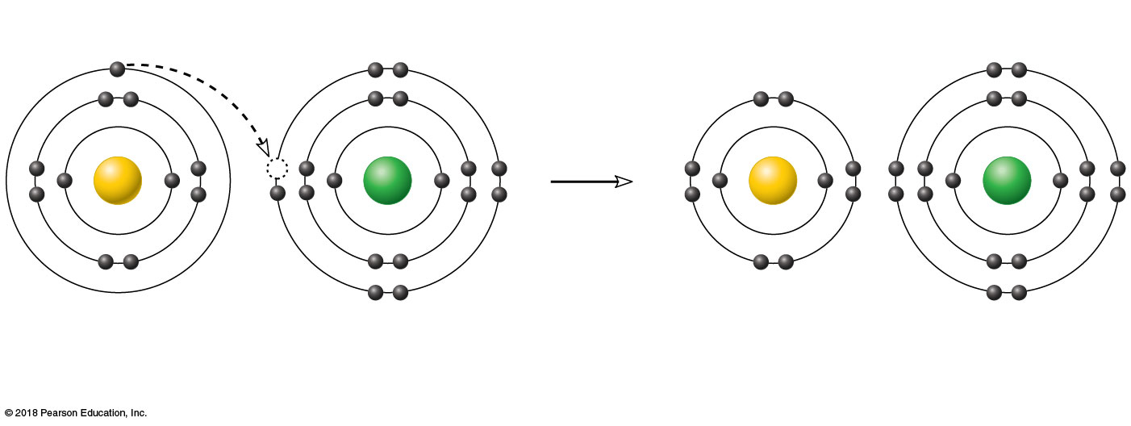
+
−
Na
Cl
Na
Cl
Sodium atom (Na)
Chlorine atom (Cl)
Sodium ion (Na⁺)
Chloride ion (Cl⁻)
(11p⁺; 12n⁰; 11e⁻)
(17p⁺; 18n⁰; 17e⁻)
Sodium chloride (NaCl)
© 2018 Pearson Education, Inc.

Slide 10
Reacting atoms
Resulting molecules
H
H
H
H
or
Hydrogen
atom
Hydrogen
atom
Molecule of
hydrogen gas (H₂)
(a) Formation of a single covalent bond
© 2018 Pearson Education, Inc.

Slide 11
Reacting atoms
Resulting molecules
O
O
O
O
or
Oxygen atom
Oxygen atom
Molecule of oxygen gas (O₂)
(b) Formation of a double covalent bond
© 2018 Pearson Education, Inc.

Slide 12
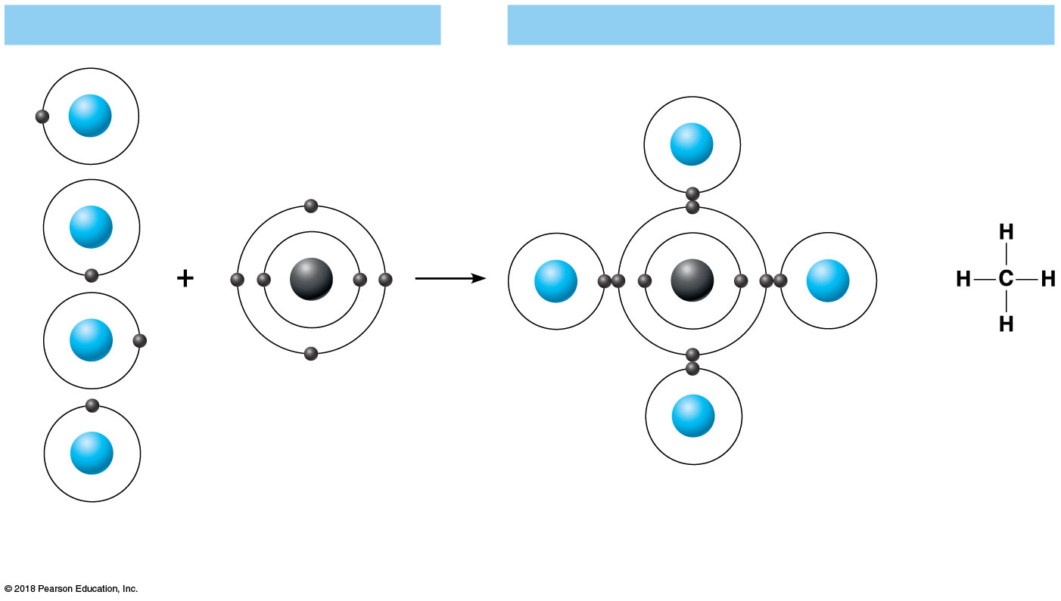
Reacting atoms
Resulting molecules
H
H
H
C
H
C
H
or
H
H
H
Hydrogen atoms
Carbon atom
Molecule of methane gas (CH₄)
(c) Formation of four single covalent bonds
© 2018 Pearson Education, Inc.

Slide 13
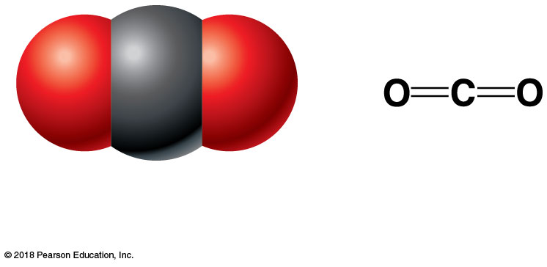
(a) Carbon dioxide (CO₂)
© 2018 Pearson Education, Inc.

Slide 14
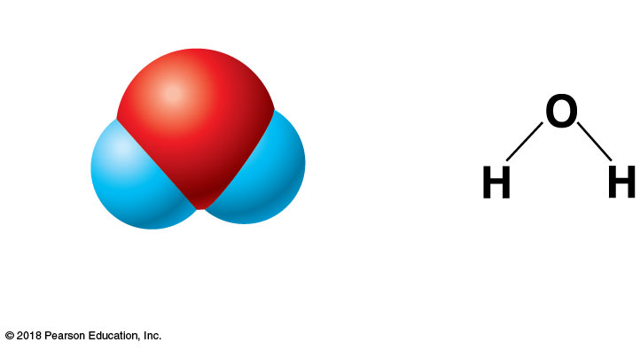
δ⁻
δ⁺
δ⁺
(b) Water (H₂O)
© 2018 Pearson Education, Inc.

Slide 15
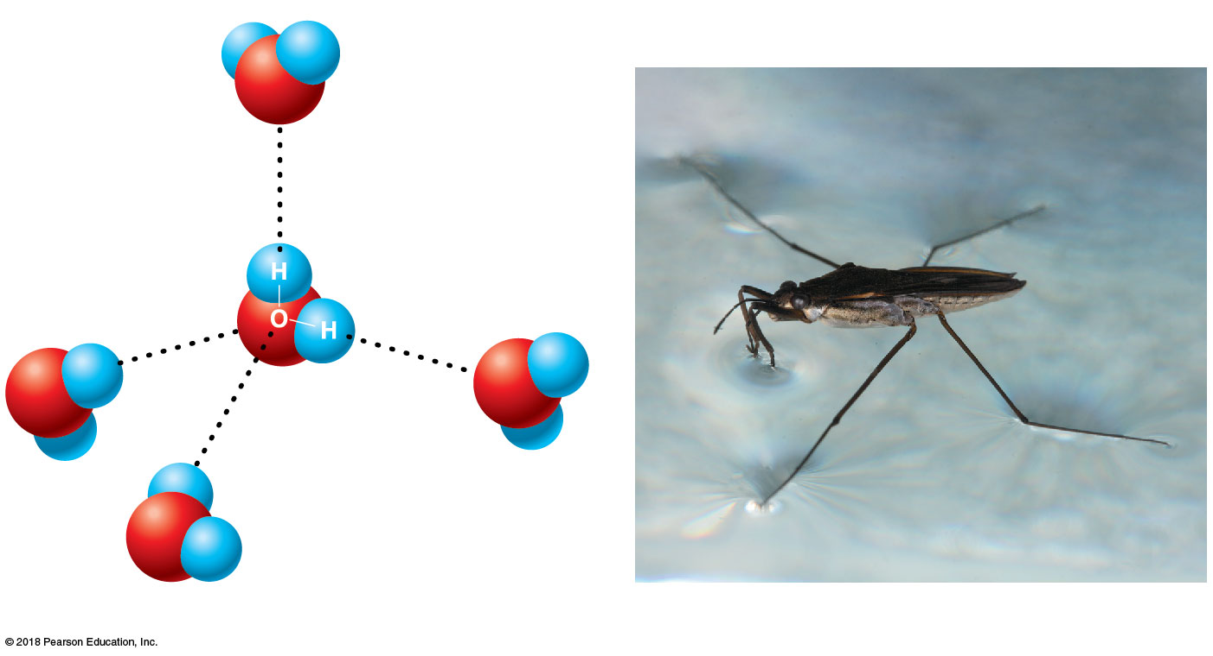
δ⁺
H
H
O
δ⁻
Hydrogen bonds
δ⁺
δ⁺
δ⁻
δ⁻
δ⁻
H
O
H
O
δ⁺
δ⁺
H
H
H
δ⁺
O
H
δ⁻
(a)
(b)
© 2018 Pearson Education, Inc.

Slide 16
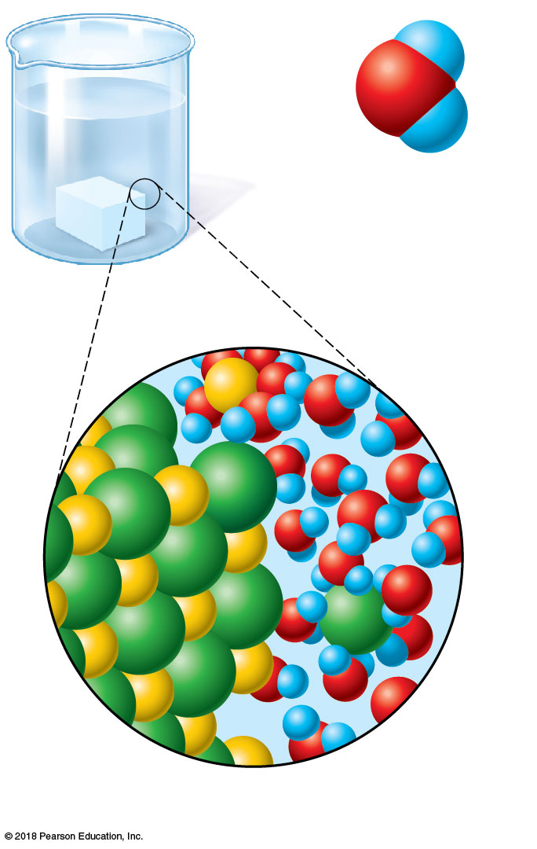
δ⁺
H
δ⁻
O
H
δ⁺
Water molecule
Na⁺
Na⁺
Cl⁻
Cl⁻
Salt
crystal
Ions in
solution
© 2018 Pearson Education, Inc.

Slide 17
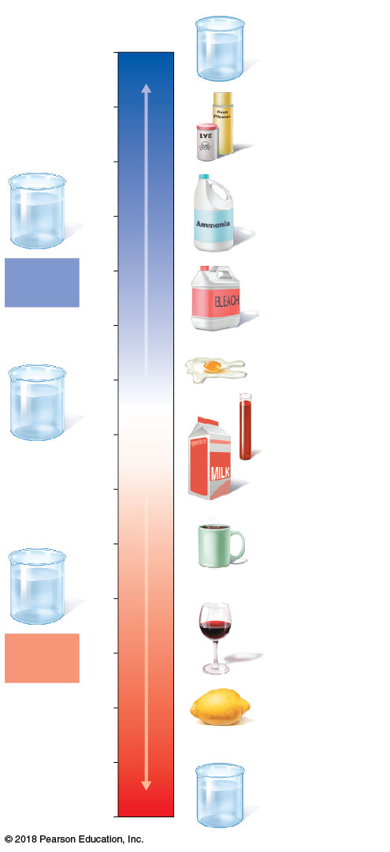
pH
Examples
14
Sodium
hydroxide
(pH 14)
13
Oven cleaner,
lye
(pH 13.5)
Increasingly basic
12
OH⁻
OH⁻
Household
ammonia
(pH 10.5−11.5)
OH⁻
H⁺
11
OH⁻
H⁺
OH⁻
OH⁻
Basic
solution
10
Household
bleach
(pH 9.5)
9
8
Egg white
H⁺
OH⁻
Neutral
[H⁺]=[OH–]
(pH 8)
OH⁻
H⁺
Blood
H⁺
H⁺
OH⁻
OH⁻
7
(pH 7.4)
Neutral
solution
Milk
6
(pH 6.3−6.6)
5
Increasingly acidic
Black coffee
H⁺
(pH 5)
H⁺
OH⁻
H⁺
H⁺
4
OH⁻
H⁺
H⁺
Acidic
solution
3
Wine
(pH 2.5−3.5)
2
Lemon juice;
gastric juice
(pH 2)
1
0
Hydrochloric
acid (pH 0)
© 2018 Pearson Education, Inc.

Slide 18
(a) Dehydration synthesis
Monomers are joined by removal of OH from one monomer
and removal of H from the other at the site of bond formation.
H₂O
Monomer 1
Monomer 2
Monomers linked by covalent bond
© 2018 Pearson Education, Inc.

Slide 19
(b) Hydrolysis
Monomers are released by the addition of a water molecule,
adding OH to one monomer and H to the other.
H₂O
Monomer 1
Monomer 2
Monomers linked by covalent bond
© 2018 Pearson Education, Inc.

Slide 20
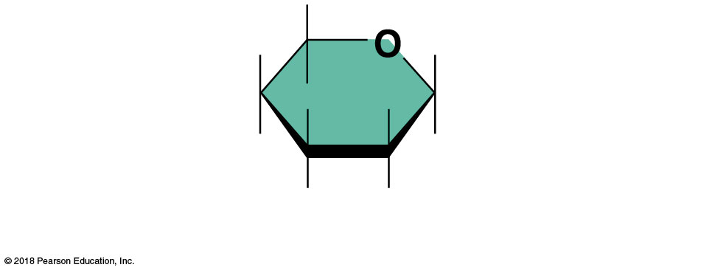
(a) Simple sugar (monosaccharide)
© 2018 Pearson Education, Inc.

Slide 21
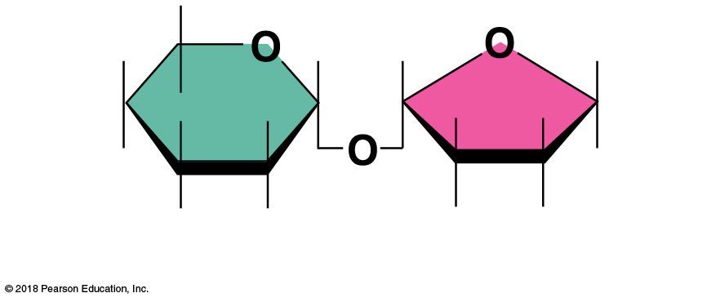
(b) Double sugar (disaccharide)
© 2018 Pearson Education, Inc.

Slide 22
Dehydration
synthesis
H₂O
Hydrolysis
Glucose
Fructose
Sucrose
Water
(c) Dehydration synthesis and hydrolysis of a molecule of sucrose
© 2018 Pearson Education, Inc.

Slide 23
(d) Starch (polysaccharide)
© 2018 Pearson Education, Inc.

Slide 24
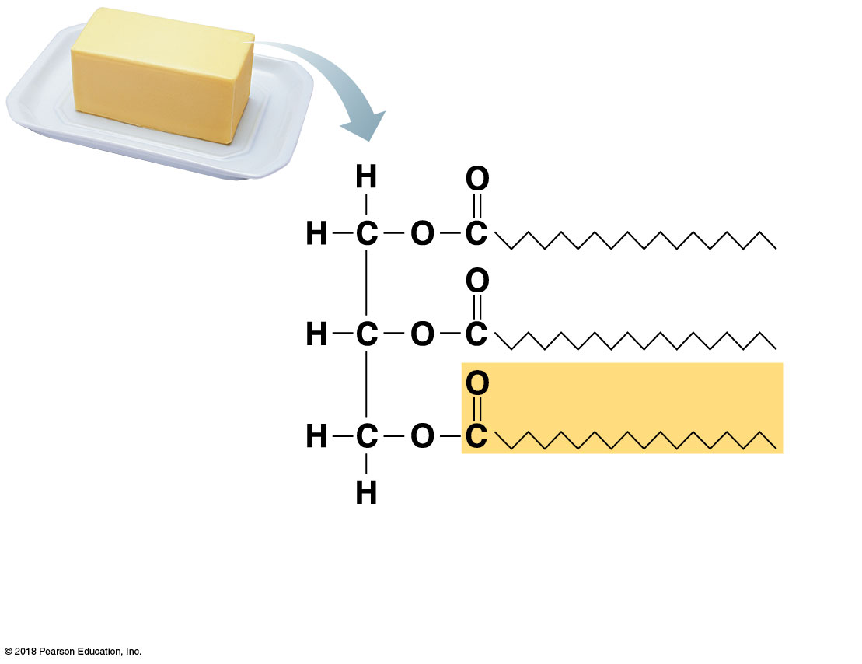
Structural formula of a
saturated fat molecule
(a) Saturated fat. At room temperature, the molecules of a saturated fat such as this butter are packed closely together, forming a solid.
© 2018 Pearson Education, Inc.

Slide 25
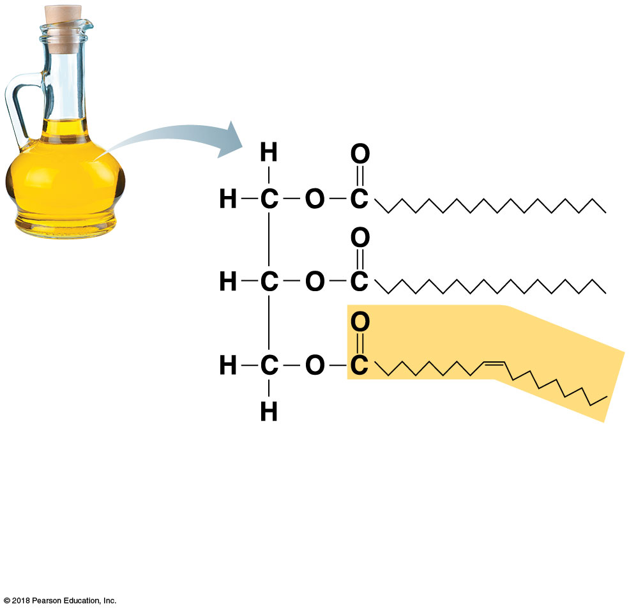
Structural formula of an
unsaturated fat molecule
(b) Unsaturated fat. At room temperature, the molecules of an unsaturated fat such as this olive oil cannot pack together closely enough to solidify because of the kinks in some of their fatty acid chains.
© 2018 Pearson Education, Inc.

Slide 26
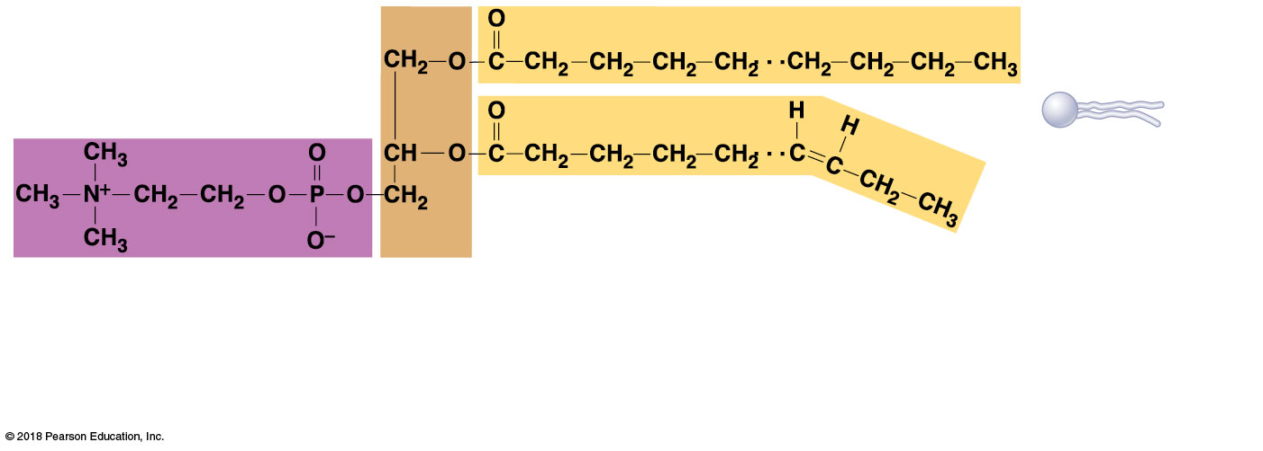
Polar “head”
Nonpolar “tail”
(schematic
phospholipid)
Phosphorus-containing
group (polar head)
Glycerol
backbone
2 fatty acid chains
(nonpolar tail)
(b) Typical structure of a phospholipid molecule (phosphatidylcholine). Two fatty acid chains and a phosphorous-containing group are attached to a glycerol backbone.
© 2018 Pearson Education, Inc.

Slide 27
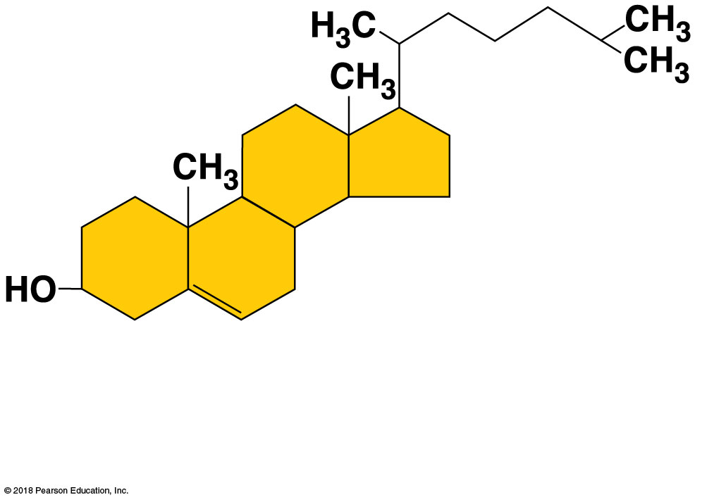
(c) Cholesterol. Simplified structure of cholesterol, a steroid, formed by four interlocking carbon rings.
© 2018 Pearson Education, Inc.

Slide 28
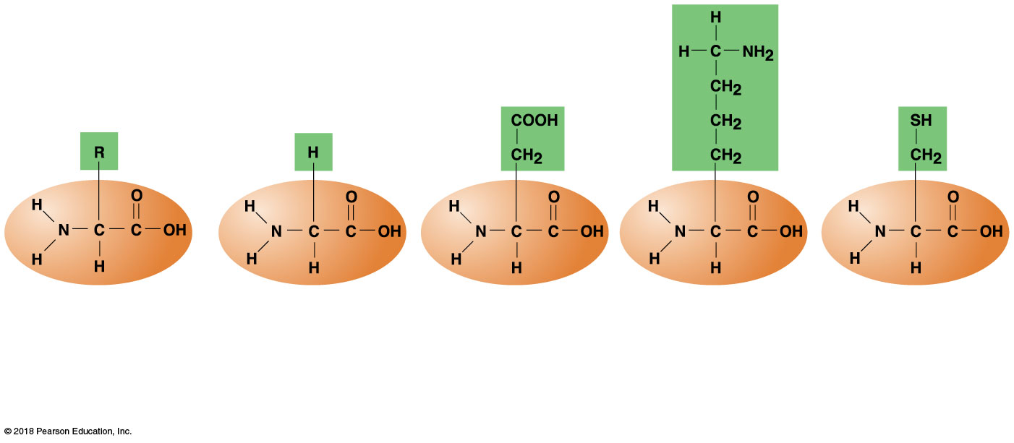
Amine
(basic)
group
Acid
group
(a) Generalized structure of all amino acids.
(b) Glycine is the simplest amino acid.
(c) Aspartic acid (an acidic amino acid) has an acid group (—COOH) in the R group.
(d) Lysine (a basic amino acid) has an amine group (—NH₂) in the R group.
(e) Cysteine (a basic amino acid) has a sulfhydryl (—SH) group in the R group.
© 2018 Pearson Education, Inc.

Slide 29
Leu
Ala
Ala
Glu
Ala
Cys
Ala
Met
Aps
Lys
Arg
His
Gly
Leu
Amino
acids
(a) Primary structure. A protein’s primary structure is the unique sequence of amino acids in the polypeptide chain.
© 2018 Pearson Education, Inc.

Slide 30
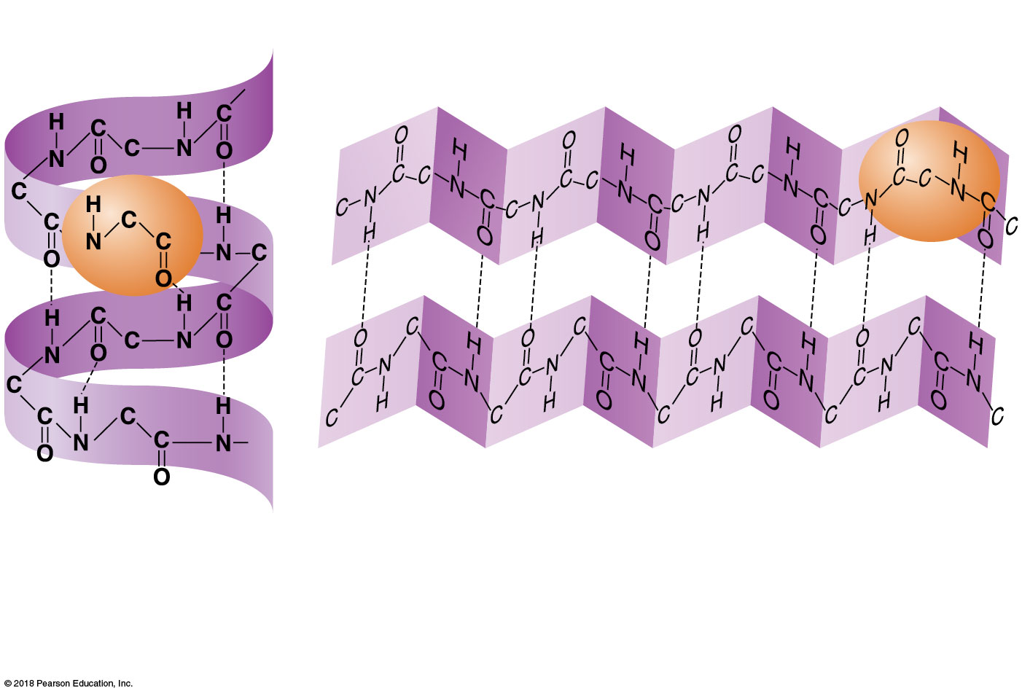
Hydrogen bonds
β-pleated sheet
Alpha-
helix
(b) Secondary structure. Two types of secondary structure are the alpha-helix and beta-pleated sheet. Secondary structure is reinforced by hydrogen bonds, represented by dashed lines in this figure.
© 2018 Pearson Education, Inc.

Slide 31
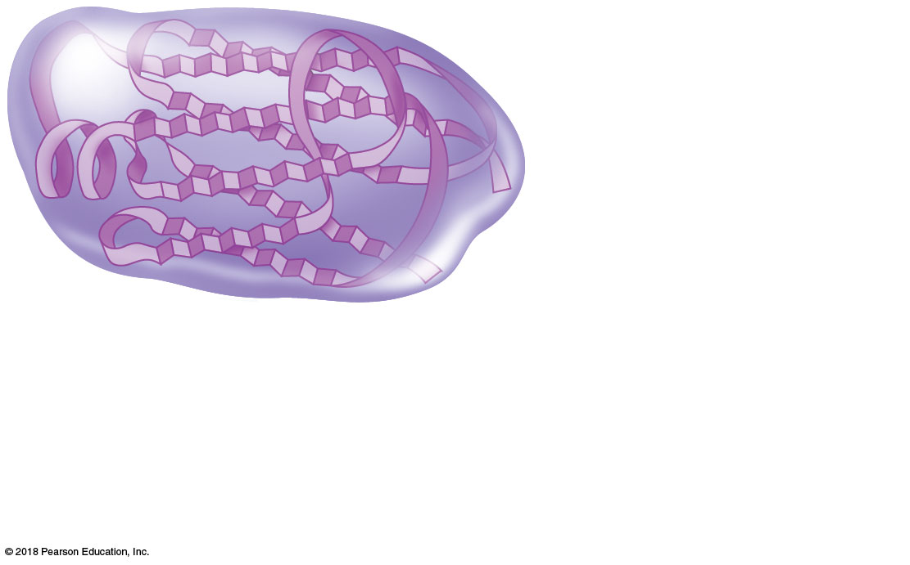
Protein (if > 50
amino acids) or
polypeptide (if < 50
amino acids)
(c) Tertiary structure. The overall three-dimensional shape of the polypeptide or protein is called tertiary structure. It is reinforced by chemical bonds between the R-groups of amino acids in different regions of the protein chain.
© 2018 Pearson Education, Inc.

Slide 32
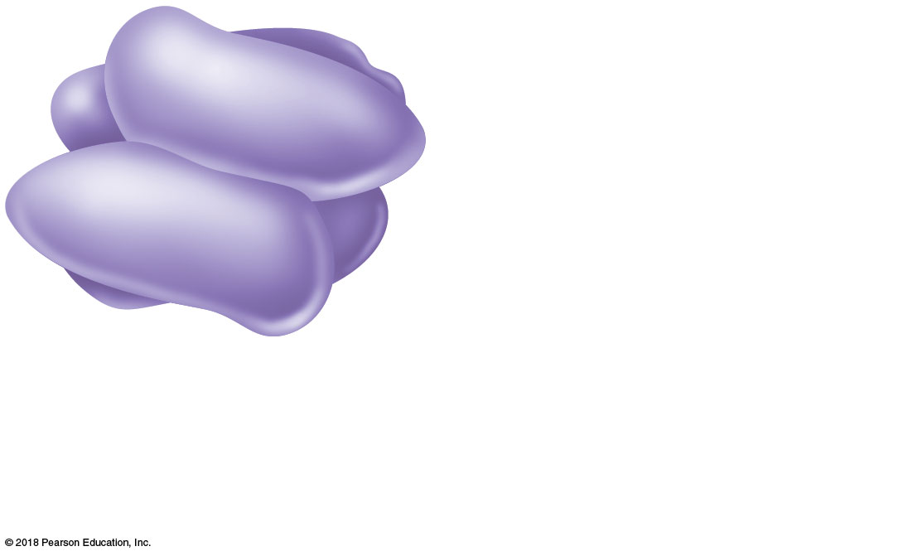
Complex protein
with four polypeptide
subunits, each with
tertiary structure
(d) Quaternary structure. Some proteins consist of two or more polypeptide chains. For example, four polypeptides construct the protein hemoglobin, a blood protein.
© 2018 Pearson Education, Inc.

Slide 33
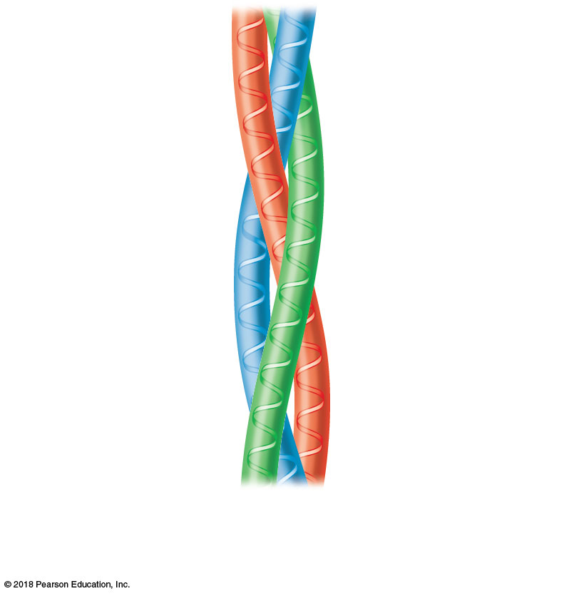
(a) Triple helix of collagen (a fibrous or structural protein).
© 2018 Pearson Education, Inc.

Slide 34
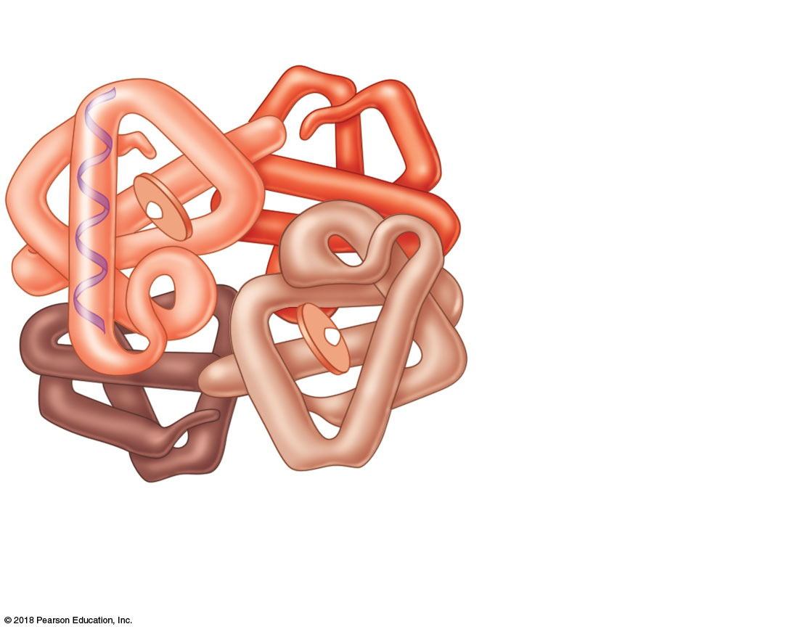
Heme group
Globin
protein
(b) Hemoglobin molecule composed of the protein globin and attached heme groups. (Globin is a globular, or functional, protein.)
© 2018 Pearson Education, Inc.

Slide 35
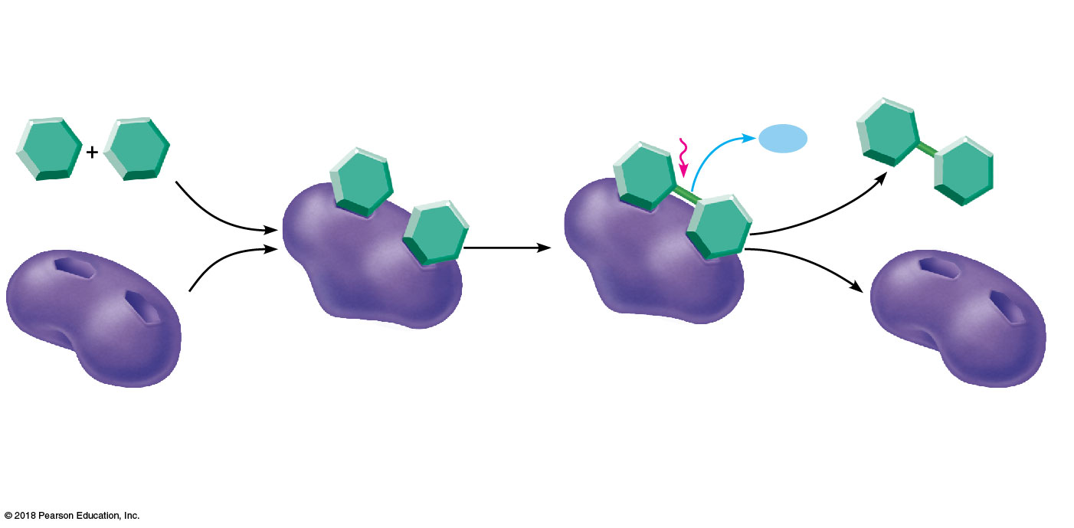
Energy is
absorbed;
bond is
formed by
dehydration
synthesis.
Product (P)
e.g., disaccharide
Substrates (S)
e.g., simple sugars
Water is
released.
H₂O
Active site
Enzyme-substrate
complex (E-S)
1
2
Enzyme (E)
Substrates bind at active
site, temporarily forming an
enzyme-substrate complex.
The E-S complex
undergoes structural
changes that form the
product.
Enzyme (E)
3
The enzyme
releases the product
of the reaction.
© 2018 Pearson Education, Inc.

Slide 36
Pentose
sugar:
Deoxyribose
Nitrogen-
containing base:
Adenine (A)
Phosphate
group
(b) Adenine nucleotide (Diagrammatic representation)
(a) Adenine nucleotide (Chemical structure)
© 2018 Pearson Education, Inc.

Slide 37
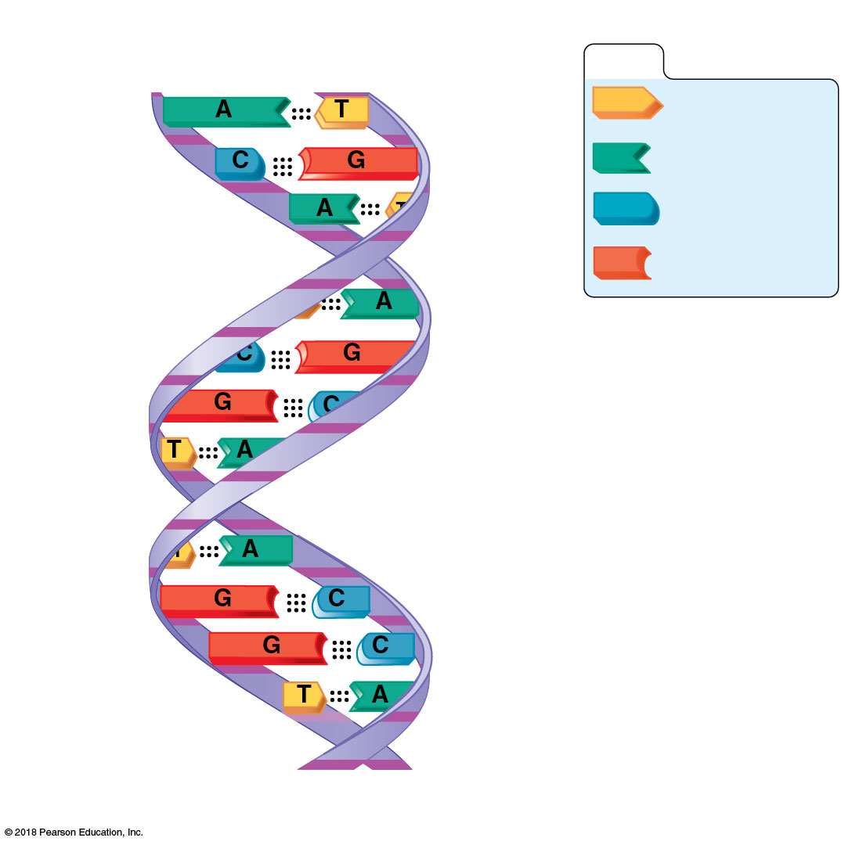
Hydrogen bonds
KEY:
Thymine (T)
Adenine (A)
Cytosine (C)
Deoxyribose
sugar
Guanine (G)
Phosphate
Sugar-phosphate
backbone
(d) Diagram of a DNA molecule
© 2018 Pearson Education, Inc.

Slide 38
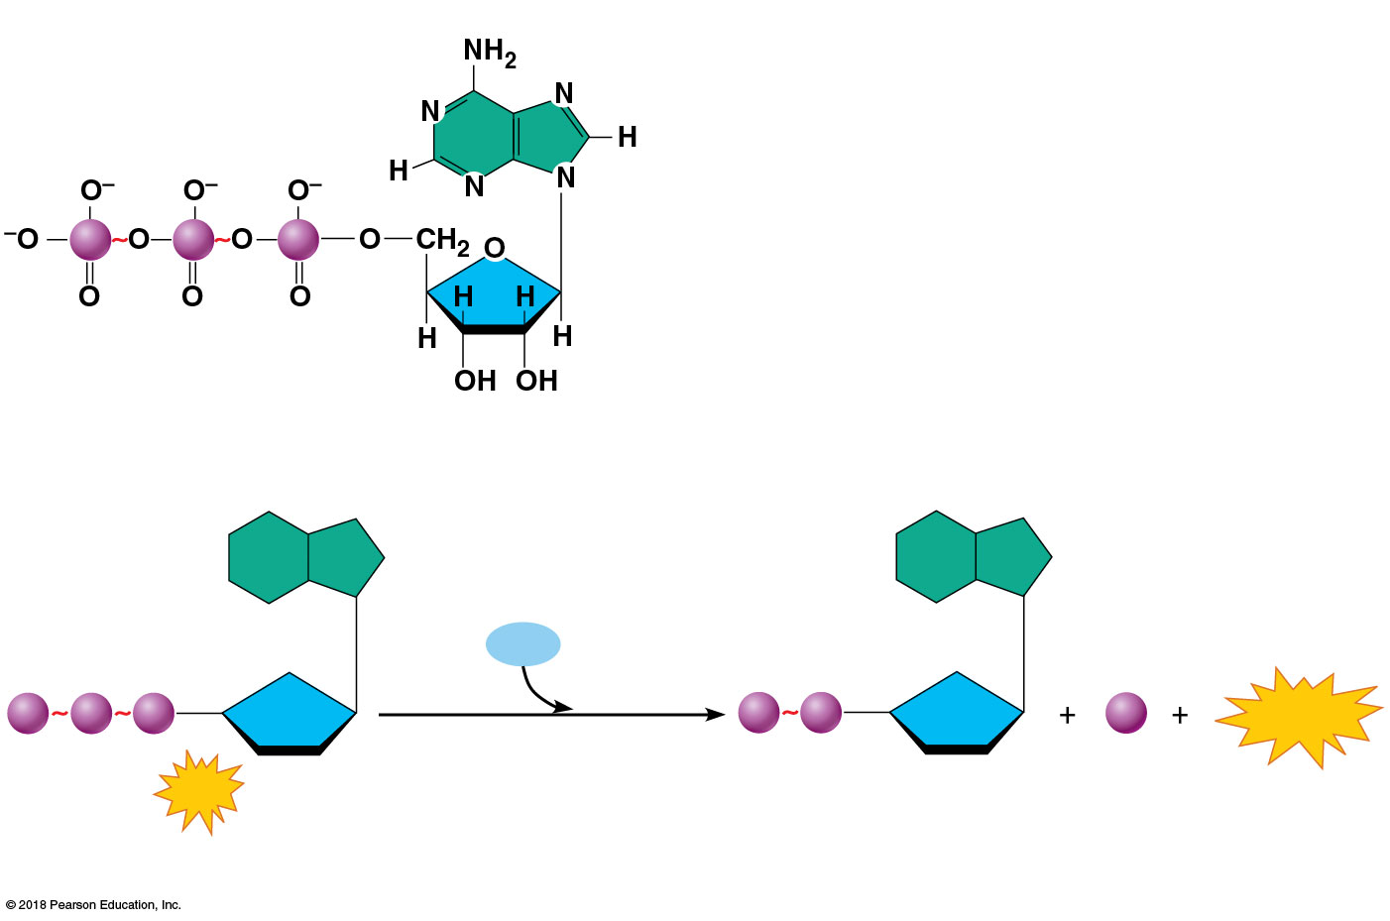
Adenine base
High-energy
phosphate
bonds
P
P
P
Ribose
sugar
Phosphate groups
(a) Adenosine triphosphate (ATP)
H₂O
P
P
P
P
P
P_{i}
Energy
Hydrolysis
ATP
Adenosine diphosphate
(ADP)
(b) Hydrolysis of ATP
© 2018 Pearson Education, Inc.

Slide 39
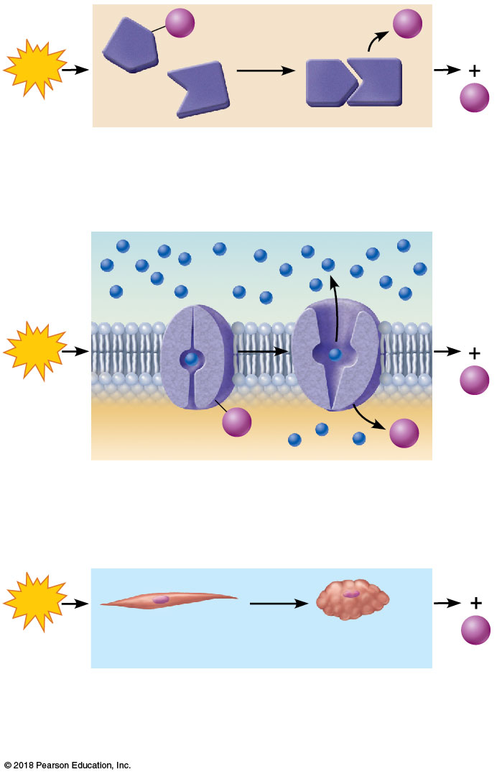
P
P_{i}
A
ADP
ATP
A
B
+
B
P_{i}
(a) Chemical work. ATP provides the energy needed to drive energy-absorbing chemical reactions.
Solute
ATP
ADP
+
P_{i}
Membrane
protein
P
P_{i}
(b) Transport work. ATP drives the transport of certain solutes (amino acids, for example) across cell membranes.
ADP
ATP
+
Relaxed
muscle cell
Contracted
muscle cell
P_{i}
(c) Mechanical work. ATP activates contractile proteins in muscle cells so that the cells can shorten and perform mechanical work.
© 2018 Pearson Education, Inc.

