Slide 1
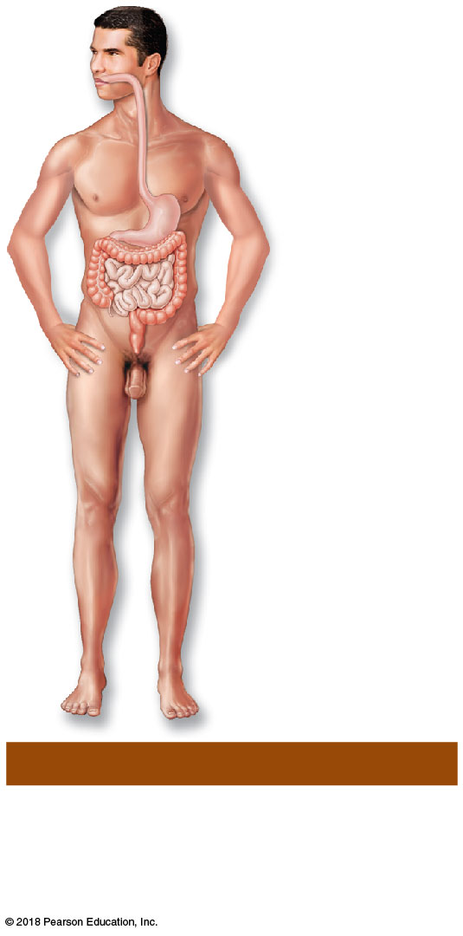
Oral cavity
Esophagus
Stomach
Small
intestine
Large
intestine
Rectum
(i) Digestive System
Breaks food down into absorbable
nutrients that enter the blood for
distribution to body cells; indigestible
foodstuffs are eliminated as feces.
© 2018 Pearson Education, Inc.

Slide 2
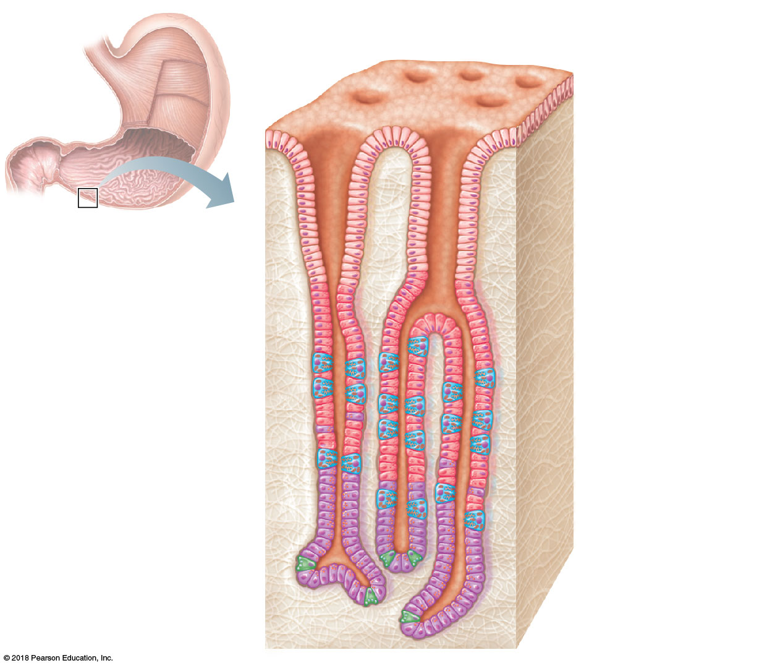
Gastric pits
Surface
epithelium
Gastric pit
Pyloric
sphincter
Mucous
neck cells
Gastric gland
Parietal cells
Gastric
glands
Chief cells
(c)

Slide 3
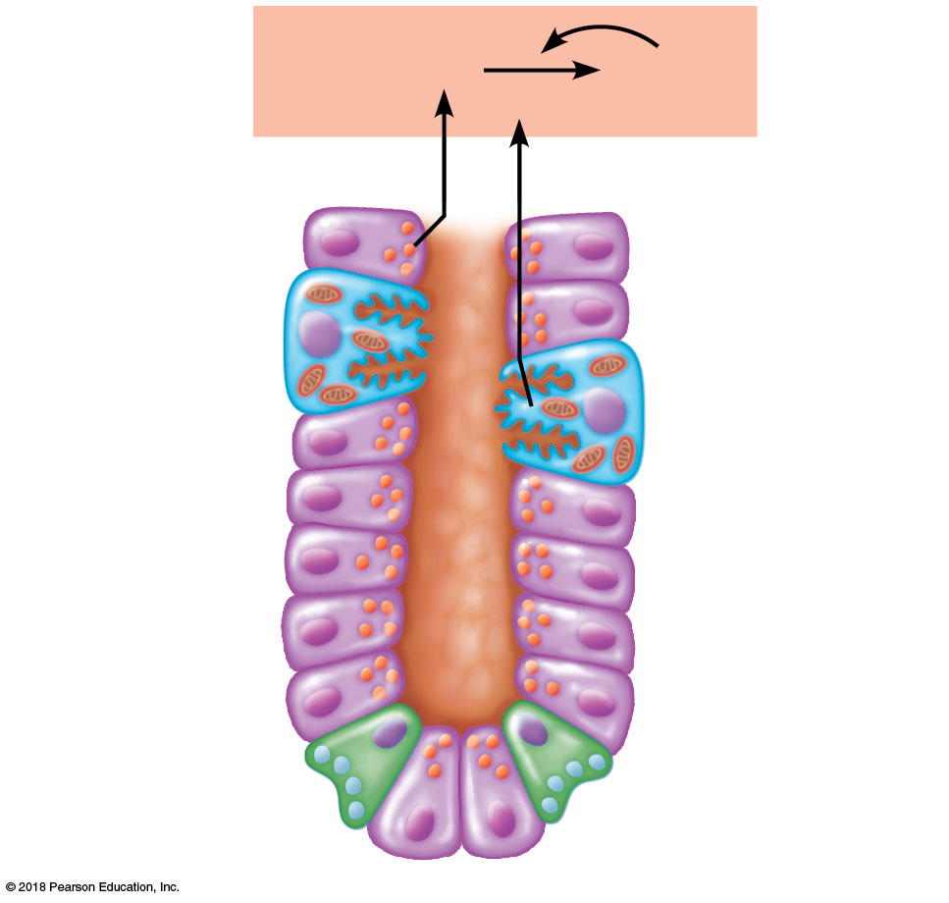
Pepsinogen
Pepsin
HCl
Parietal cells
Chief cells
Enteroendocrine
cell
(d)

Slide 4
Smooth muscle cell
Atoms
1
Chemical level
Molecules
Atoms combine to
form molecules.
2
Cellular level
Cells are made up of molecules.
Smooth
muscle
tissue
3
Tissue level
Blood
vessels
Tissues consist of
similar types of cells.
Heart
Epithelial
tissue
Smooth
muscle
tissue
Blood
vessel
(organ)
Cardio–
vascular
system
Connective
tissue
4
Organ level
5
Organ system level
Organs are made up of different types of tissues.
6
Organismal level
Organ systems consist of
different organs that work
together closely.
Human organisms are
made up of many organ
systems.
© 2018 Pearson Education, Inc.

Slide 5
Hair
Skin
Fingernails
(a) Integumentary System
Forms the external body covering;
protects deeper tissue from injury;
synthesizes vitamin D; location of
sensory receptors (pain, pressure,
etc.) and sweat and oil glands.
© 2018 Pearson Education, Inc.

Slide 6
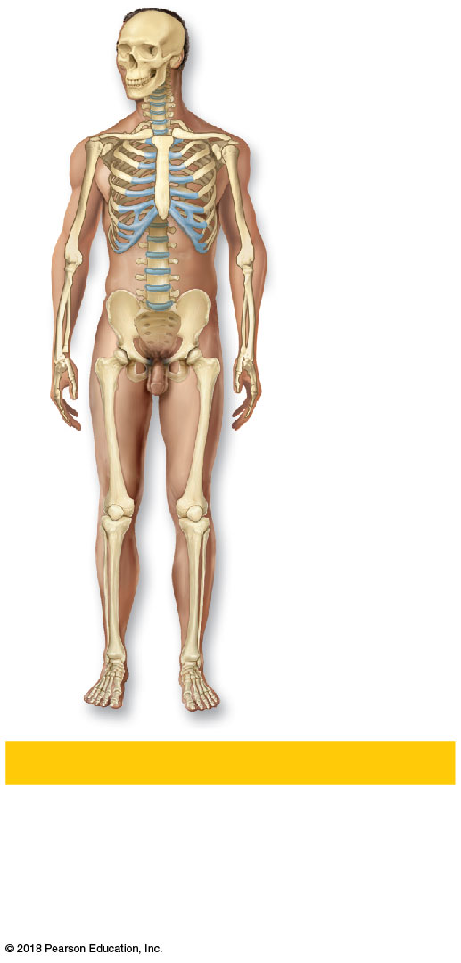
Cartilages
Joint
Bones
(b) Skeletal System
Protects and supports body organs; provides a framework the muscles use to cause movement; blood cells are formed within bones; stores minerals.
© 2018 Pearson Education, Inc.

Slide 7
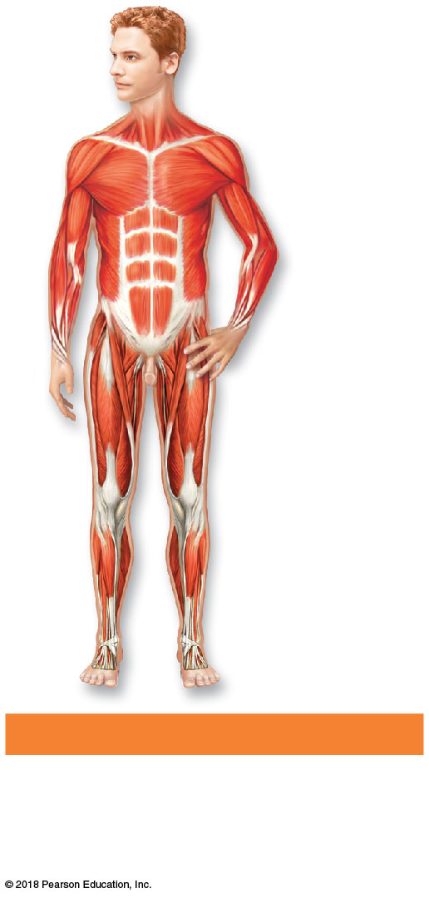
Skeletal
muscles
(c) Muscular System
Allows manipulation of the
environment, locomotion, and facial expression; maintains posture; produces heat.
© 2018 Pearson Education, Inc.

Slide 8
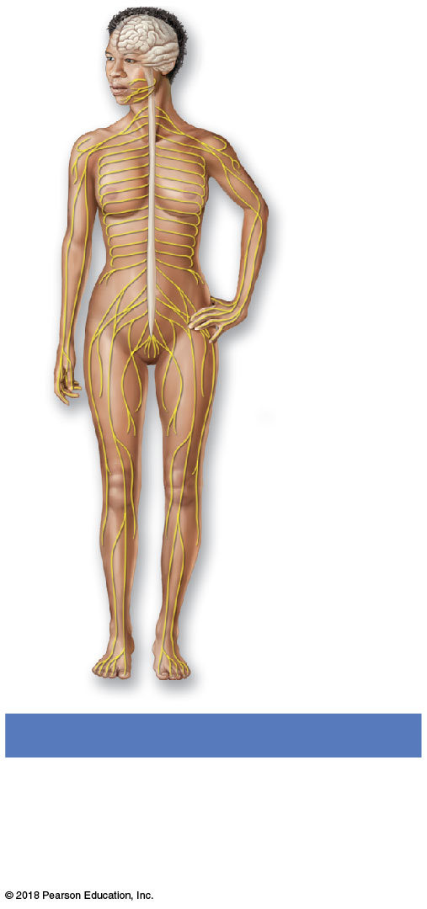
Brain
Sensory
receptor
Spinal
cord
Nerves
(d) Nervous System
Fast-acting control system of the
body; responds to internal and
external changes by activating
appropriate muscles and glands.
© 2018 Pearson Education, Inc.

Slide 9
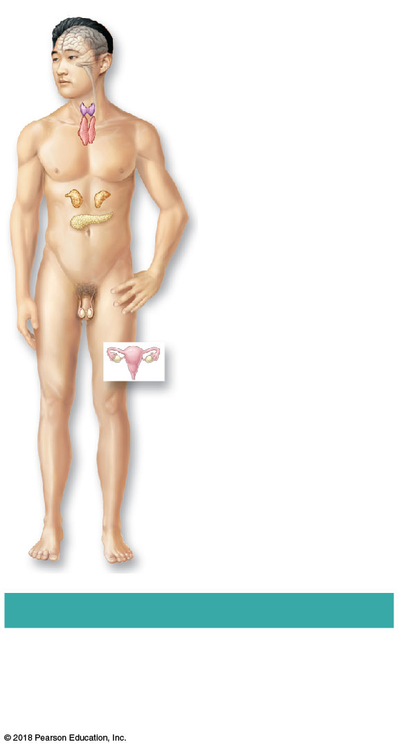
Pineal gland
Pituitary gland
Thyroid gland
(parathyroid glands
on posterior aspect)
Thymus gland
Adrenal glands
Pancreas
Testis (male)
Ovary (female)
(e) Endocrine System
Glands secrete hormones that
regulate processes such as growth, reproduction, and nutrient use by body cells.
© 2018 Pearson Education, Inc.

Slide 10
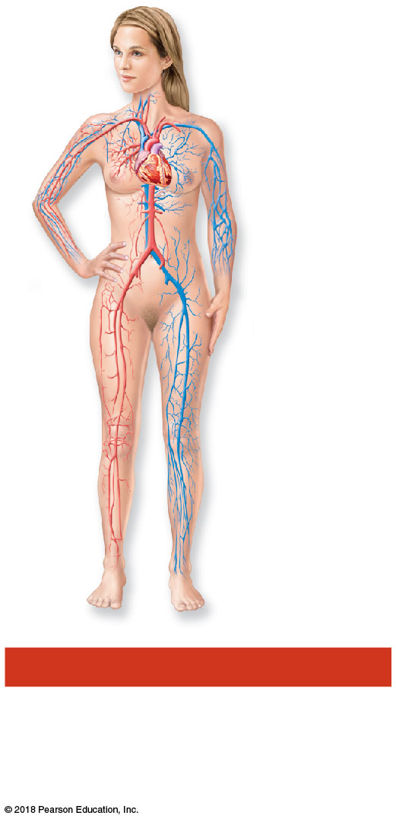
Heart
Blood
vessels
(f) Cardiovascular System
Blood vessels transport blood, which carries oxygen, nutrients, hormones, carbon dioxide, wastes, etc.; the heart pumps blood.
© 2018 Pearson Education, Inc.

Slide 11
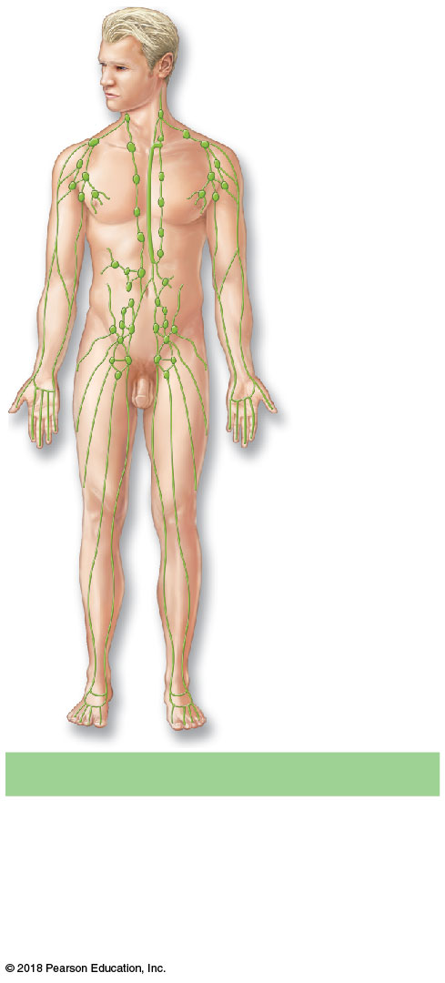
Lymph
nodes
Lymphatic
vessels
(g) Lymphatic System
Picks up fluid leaked from blood
vessels and returns it to blood;
disposes of debris in the lymphatic stream; houses white blood cells involved in immunity.
© 2018 Pearson Education, Inc.

Slide 12
Nasal
cavity
Pharynx
Larynx
Trachea
Bronchi
Lungs
(h) Respiratory System
Keeps blood constantly supplied
with oxygen and removes carbon
dioxide; the gaseous exchanges
occur through the walls of the air
sacs of the lungs.
© 2018 Pearson Education, Inc.

Slide 13
Oral cavity
Esophagus
Stomach
Small
intestine
Large
intestine
Rectum
(i) Digestive System
Breaks food down into absorbable
nutrients that enter the blood for
distribution to body cells; indigestible
foodstuffs are eliminated as feces.
© 2018 Pearson Education, Inc.

Slide 14
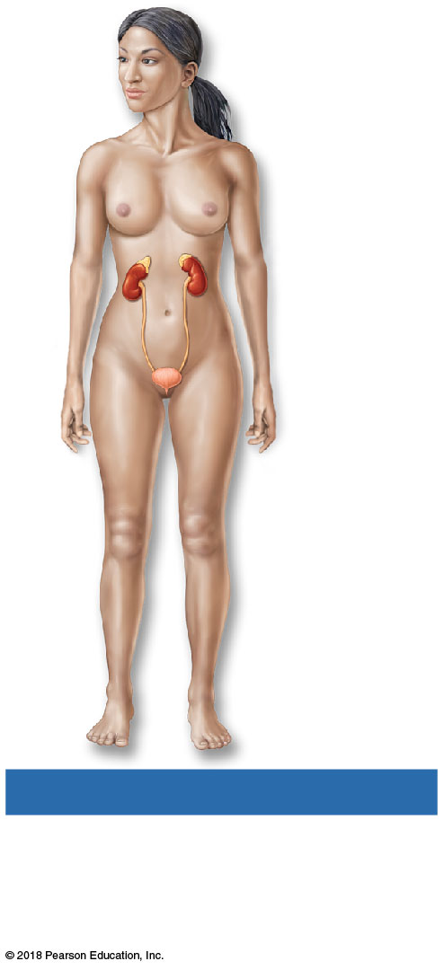
Kidney
Ureter
Urinary
bladder
Urethra
(j) Urinary System
Eliminates nitrogen-containing
wastes from the body; regulates
water, electrolyte, and acid-base
balance of the blood.
© 2018 Pearson Education, Inc.

Slide 15
Mammary
glands
(in breasts)
Prostate
gland
Seminal
vesicles
Uterine
tube
Ovary
Uterus
Penis
Testis
Scrotum
Vagina
(k) Male Reproductive System
(l) Female Reproductive System
Overall function of the reproductive system is production of offspring. Testes
produce sperm and male sex hormone; ducts and glands aid in delivery of viable
sperm to the female reproductive tract. Ovaries produce eggs and female sex
hormones; remaining structures serve as sites for fertilization and development of
the fetus. Mammary glands of female breasts produce milk to nourish the newborn.
© 2018 Pearson Education, Inc.

Slide 16
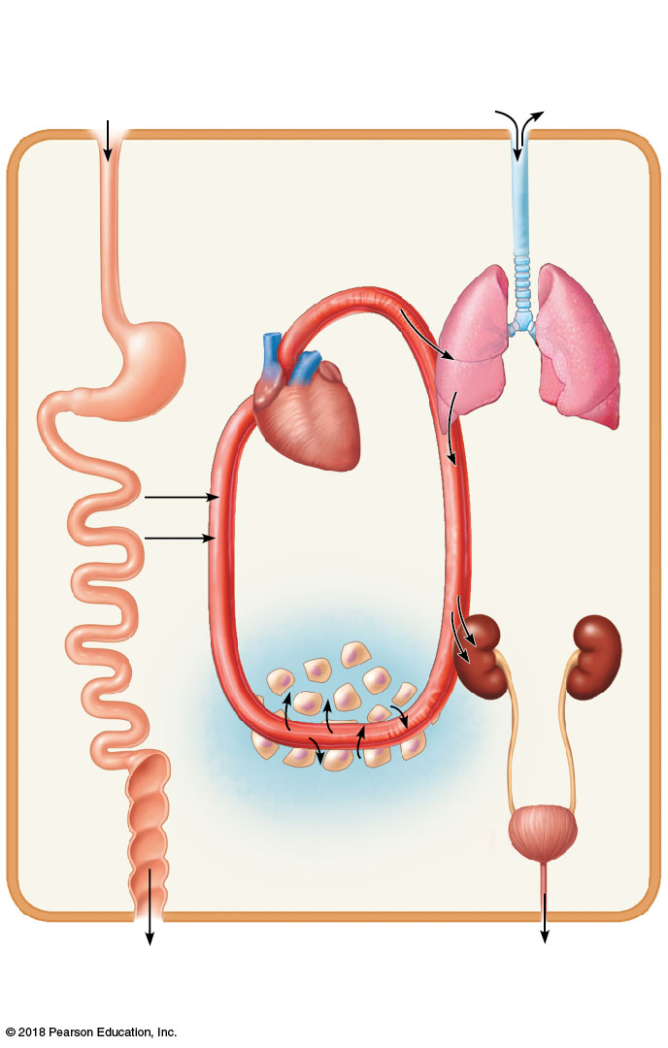
Digestive system
Takes in nutrients, digests them
(part of metabolism), and excretes
unabsorbed matter (feces)
Respiratory system
Takes in oxygen, which is
required for metabolism, and
excretes carbon dioxide
Food
O₂
CO₂
Cardiovascular system
Via the blood, distributes oxygen and nutrients to all body cells and delivers wastes and carbon dioxide to disposal organs
Blood
CO₂
O₂
Heart
Urinary system
Excretes nitrogen- containing wastes
and excess ions
Nutrients
Interstitial fluid
Nutrients and wastes pass
between blood and cells
via the interstitial fluid
Feces are
excreted
Integumentary system
Protects the body as a whole
from the external environment
by maintaining boundaries
Urine is
excreted
© 2018 Pearson Education, Inc.

Slide 17
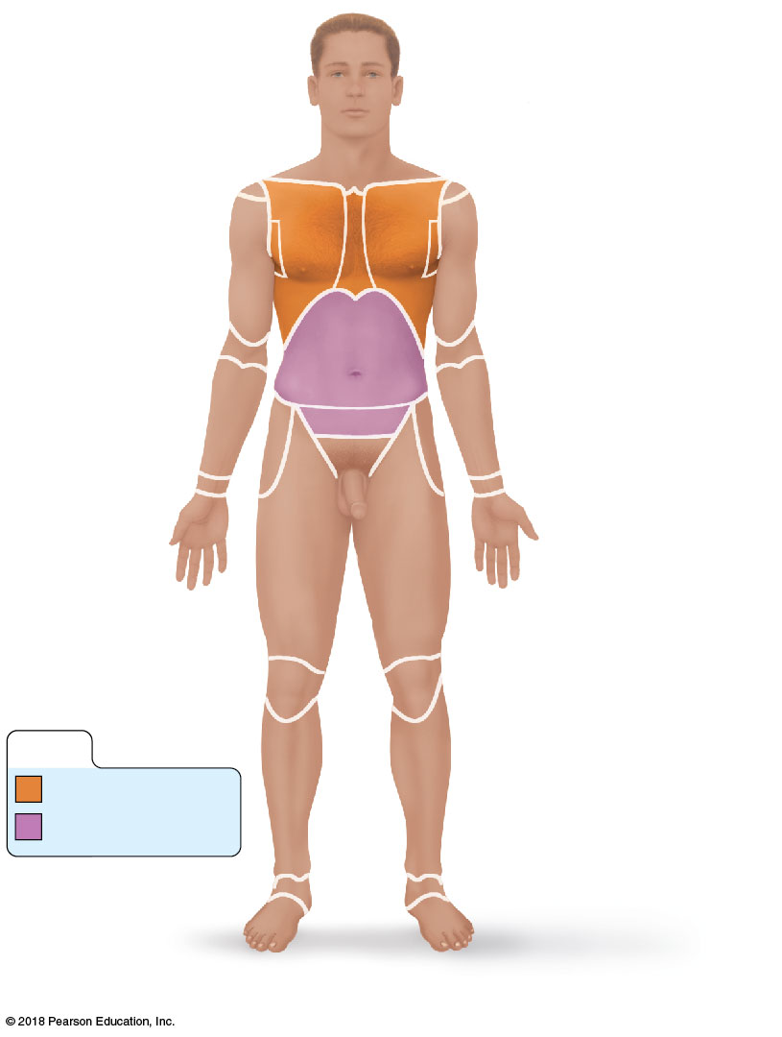
© 2018 Pearson Education, Inc.

Slide 18
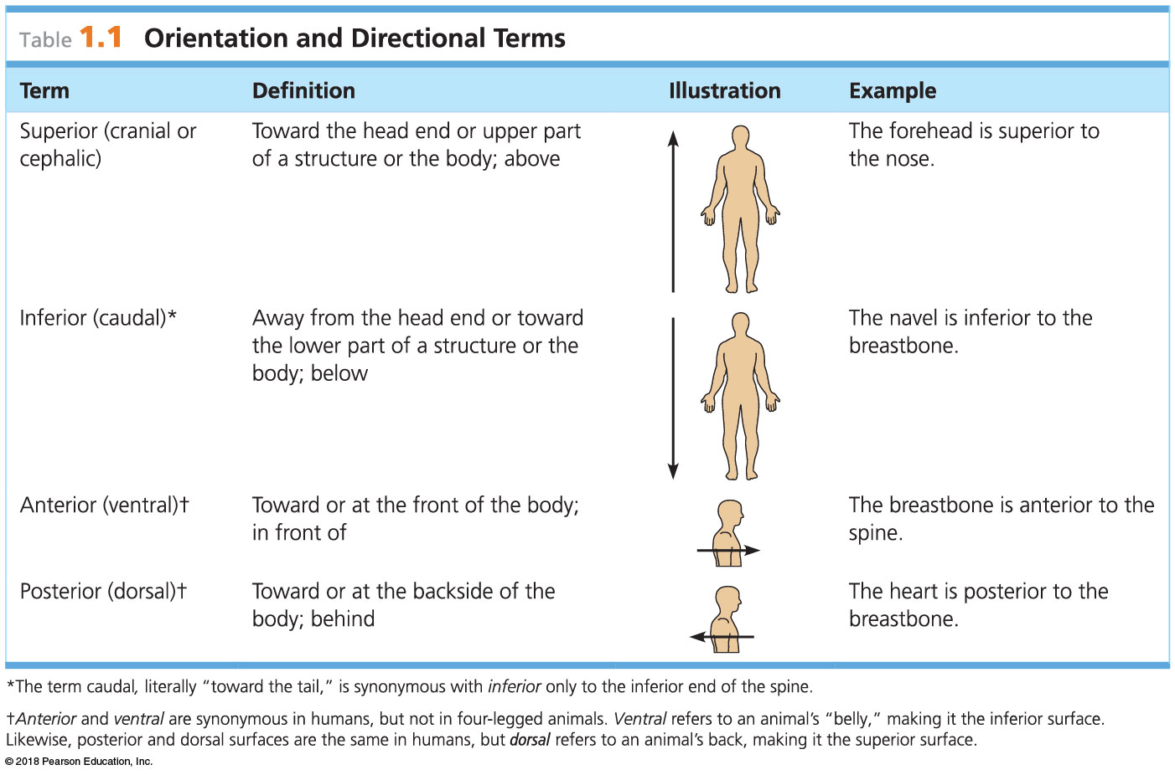
© 2018 Pearson Education, Inc.

Slide 19
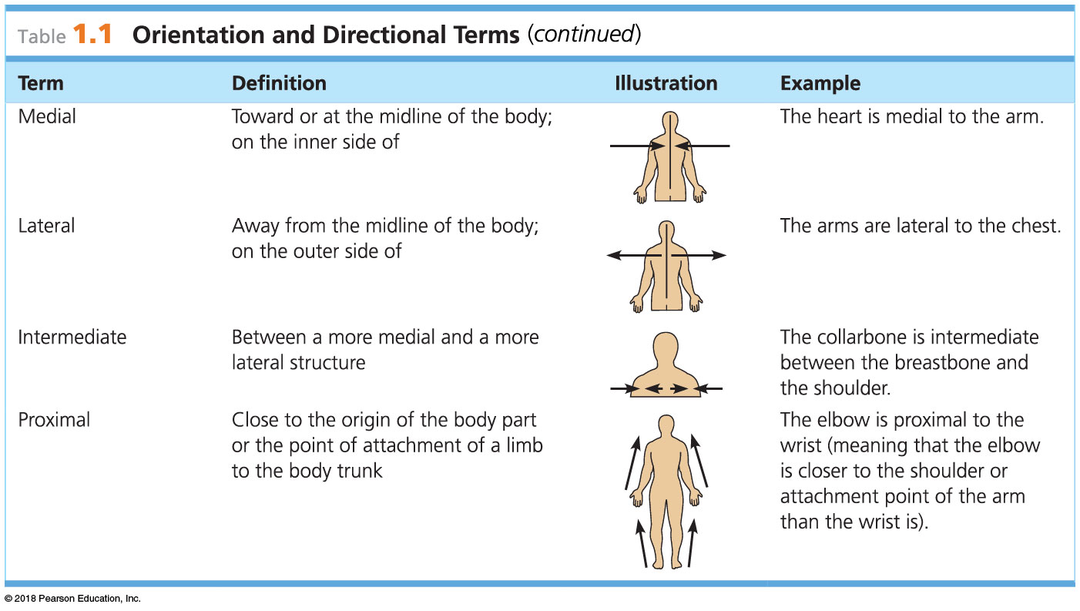
© 2018 Pearson Education, Inc.

Slide 20
© 2018 Pearson Education, Inc.

Slide 21
Cephalic
Frontal
Orbital
Upper limb
Nasal
Acromial
Buccal
Deltoid
Oral
Brachial (arm)
Mental
Antecubital
Cervical
Olecranal
Thoracic
Antebrachial
(forearm)
Sternal
Axillary
Pectoral
Carpal (wrist)
Abdominal
Manus (hand)
Umbilical
Digital
Pelvic
Inguinal
(groin)
Lower limb
Coxal (hip)
Pubic (genital)
Femoral (thigh)
Patellar
Crural (leg)
KEY:
Thorax
Abdomen
Fibular
Pedal (foot)
Tarsal (ankle)
Digital
(a) Anterior/Ventral
© 2018 Pearson Education, Inc.

Slide 22
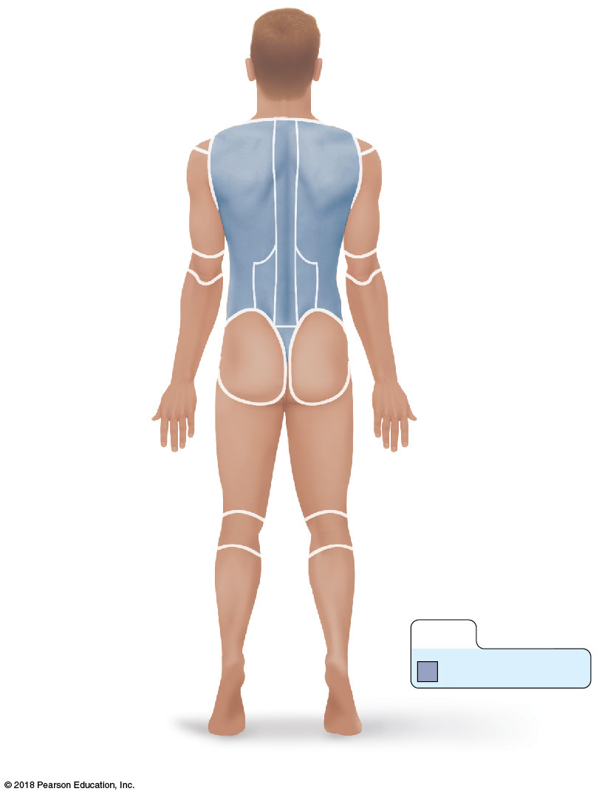
Cephalic
Upper limb
Occipital (back
of head)
Acromial
Cervical
Brachial (arm)
Olecranal
Back (dorsal)
Antebrachial
(forearm)
Scapular
Vertebral
Lumbar
Manus (hand)
Sacral
Digital
Gluteal
Lower limb
Femoral (thigh)
Popliteal
Sural (calf)
Fibular
KEY:
Pedal (foot)
Back (Dorsum)
Calcaneal
Plantar
© 2018 Pearson Education, Inc.
(b) Posterior/Dorsal

Slide 23
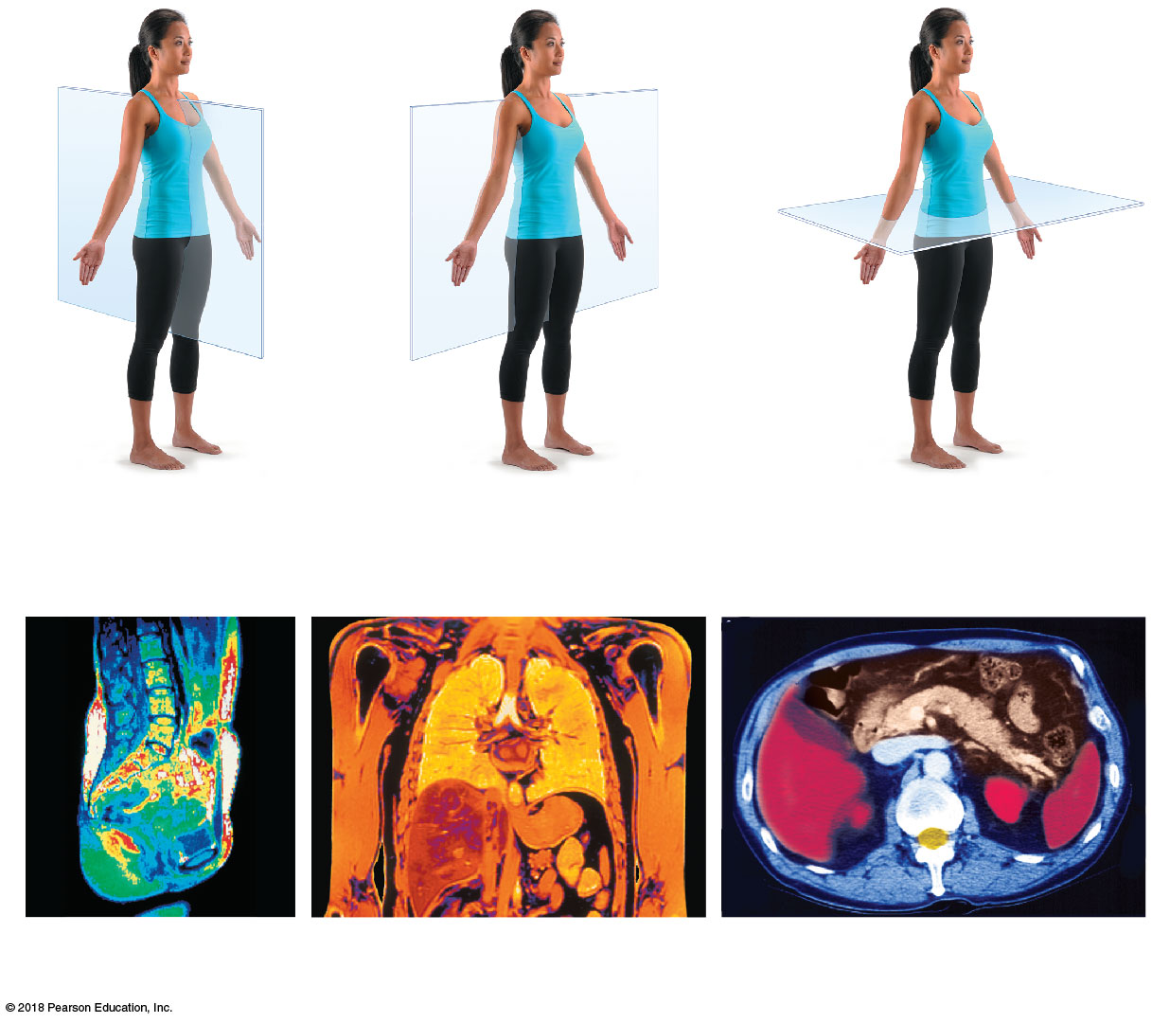
(a) Median (midsagittal)
(b) Frontal (coronal) plane
(c) Transverse plane
Vertebral
column
Right
lung
Left
lung
Heart
Liver
Aorta
Pancreas
Spleen
Rectum
Intestines
Liver
Stomach
Spleen
Subcutaneous
fat layer
Spinal
cord
© 2018 Pearson Education, Inc.

Slide 24
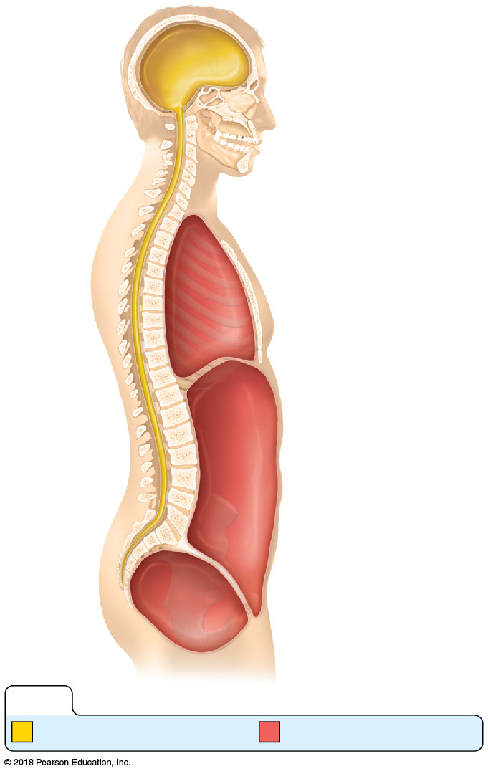
Cranial
cavity
Thoracic
cavity
Diaphragm
Abdominal
cavity
Spinal
cavity
Abdominopelvic
cavity
Pelvic
cavity
KEY:
Dorsal body cavity
Ventral body cavity
© 2018 Pearson Education, Inc.

Slide 25
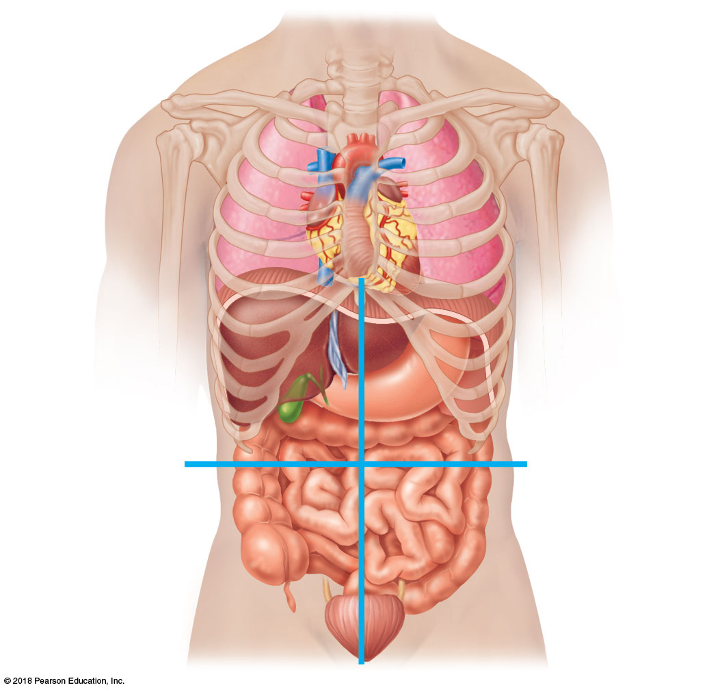
Right upper
quadrant
(RUQ)
Left upper
quadrant
(LUQ)
Right lower
quadrant
(RLQ)
Left lower
quadrant
(LLQ)
© 2018 Pearson Education, Inc.

Slide 26
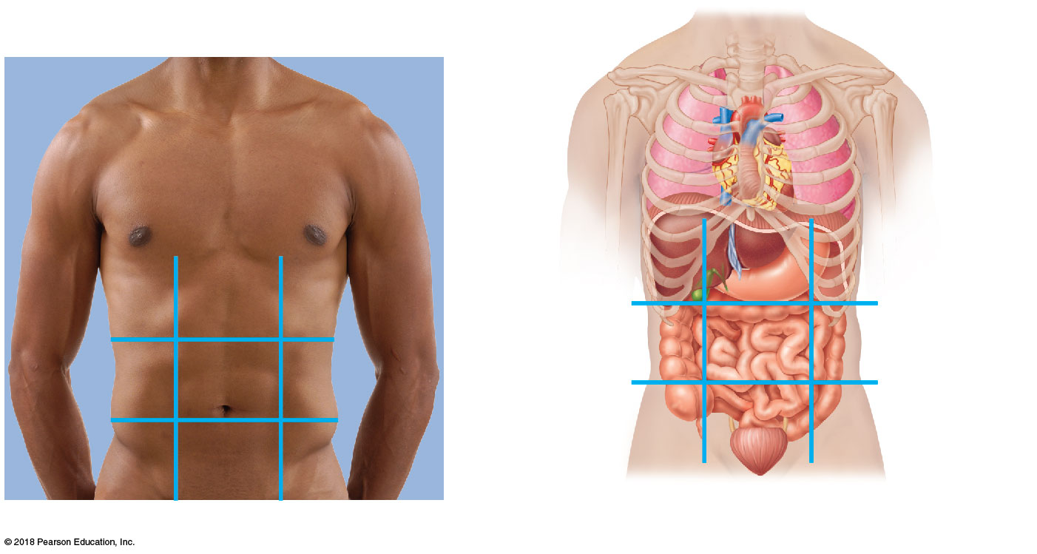
Diaphragm
Liver
Stomach
Right
hypochondriac
region
Epigastric
region
Left
hypochondriac
region
Large
intestine
Large
intestine
Right
lumbar
region
Umbilical
region
Left
lumbar
region
Small intestine
Appendix
Urinary
bladder
Right iliac
(inguinal)
region
Hypogastric
(pubic)
region
Left iliac
(inguinal)
region
(b) Anterior view of the nine regions showing the superficial organs
(a) Nine regions delineated by four planes
© 2018 Pearson Education, Inc.

Slide 27
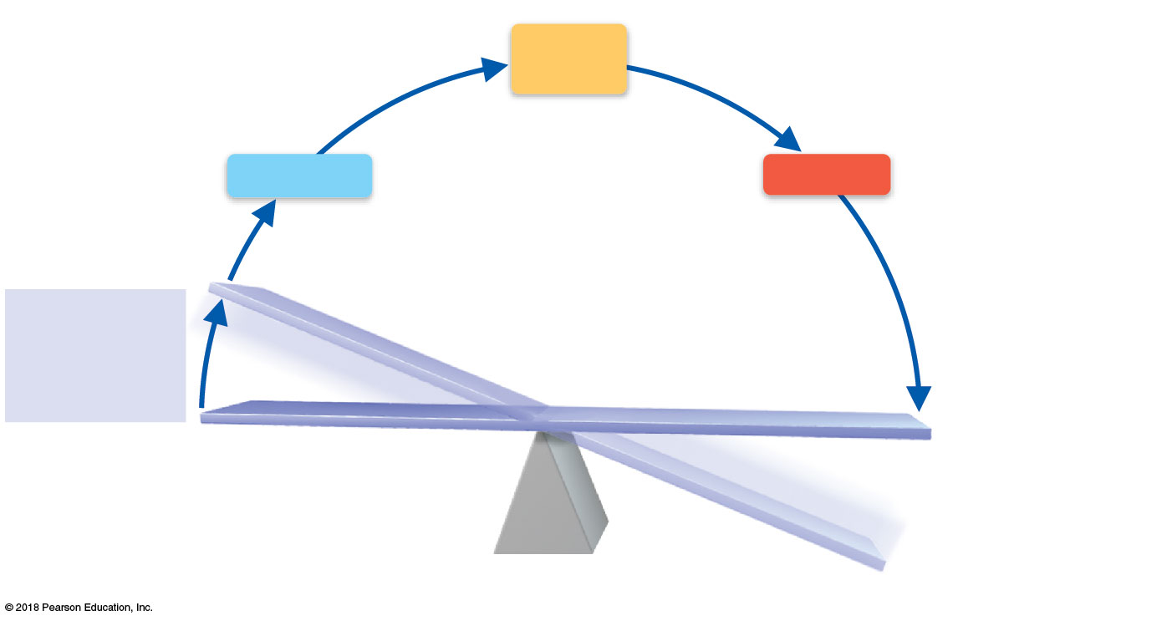
Output: Information
is sent along efferent
pathway to effector.
3
4
Input: Information
is sent along afferent
pathway to control
center.
Control
Center
Afferent
pathway
Efferent
pathway
Receptor
Effector
Receptor
detects change.
2
5
Response
of effector feeds
back to reduce
the effect of
stimulus and
returns variable
to homeostatic level.
1
IMBALANCE
Stimulus
produces
change in
variable.
VARIABLE (in homeostasis)
IMBALANCE
© 2018 Pearson Education, Inc.

