Slide 1
Proteomics
Proteomics is the study of protein structure and function.
An organism’s proteome is its entire set of proteins.
Proteomics is much more complicated than genomics.

Slide 2
Proteomics Versus Genomics
Genomics tells us what kinds of proteins a given organism has the capacity for producing, but genomics tells us almost nothing about how those proteins function or when and in which cells those proteins are produced.
Proteomics gives us a clearer picture of what roles the various proteins play in cells. Therefore, compared to genomics, proteomics allows us to better understand an organism.

Slide 3
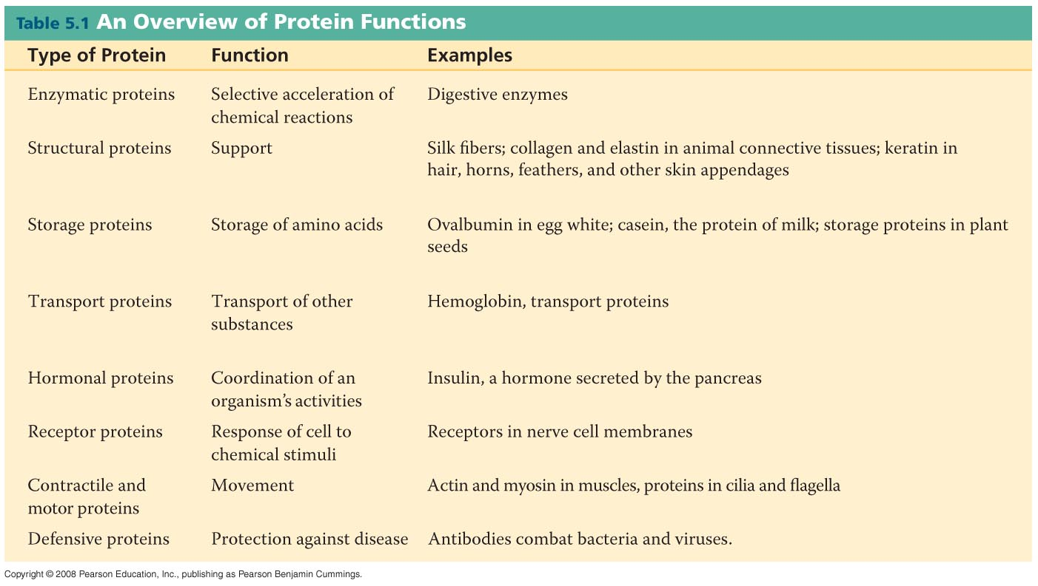

Slide 4
Four Levels of Protein Structure

Slide 5
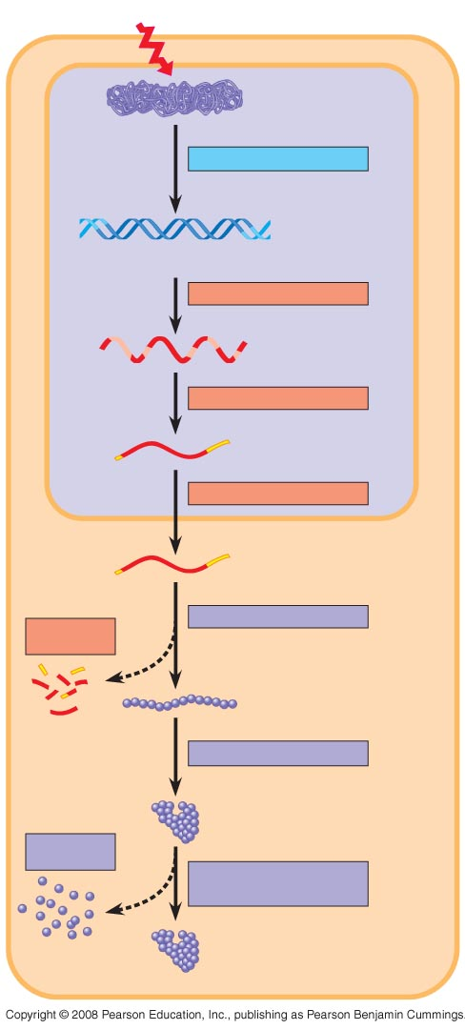
Signal
NUCLEUS
Chromatin
Chromatin modification
DNA
Gene available
for transcription
Gene
Transcription
RNA
Exon
Primary transcript
Intron
RNA processing
Tail
Cap
mRNA in nucleus
Transport to cytoplasm
CYTOPLASM
mRNA in cytoplasm
Degradation
of mRNA
Translation
Polypeptide
Protein processing
Degradation
of protein
Active protein
Transport to cellular
destination
Cellular function

Slide 6
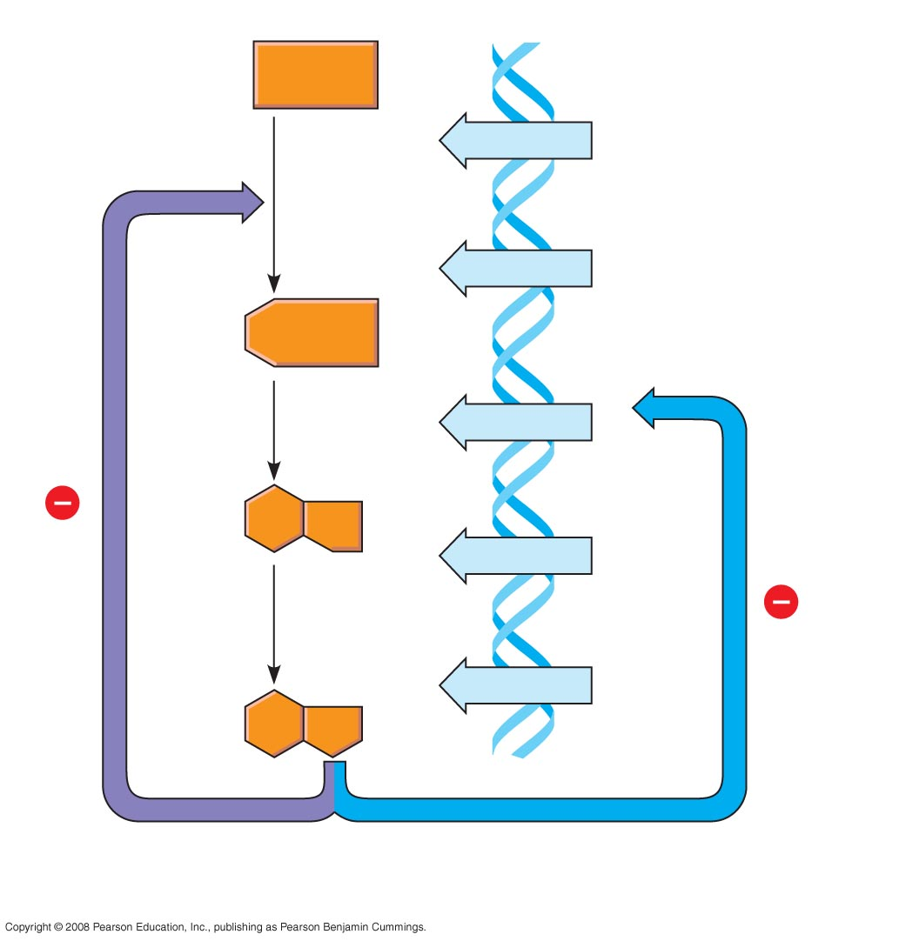
Precursor
Feedback
inhibition
trpE gene
Enzyme 1
trpD gene
Regulation
of gene
expression
Enzyme 2
trpC gene
trpB gene
Enzyme 3
trpA gene
Tryptophan
(a) Regulation of enzyme
activity
(b) Regulation of enzyme
production

Slide 7
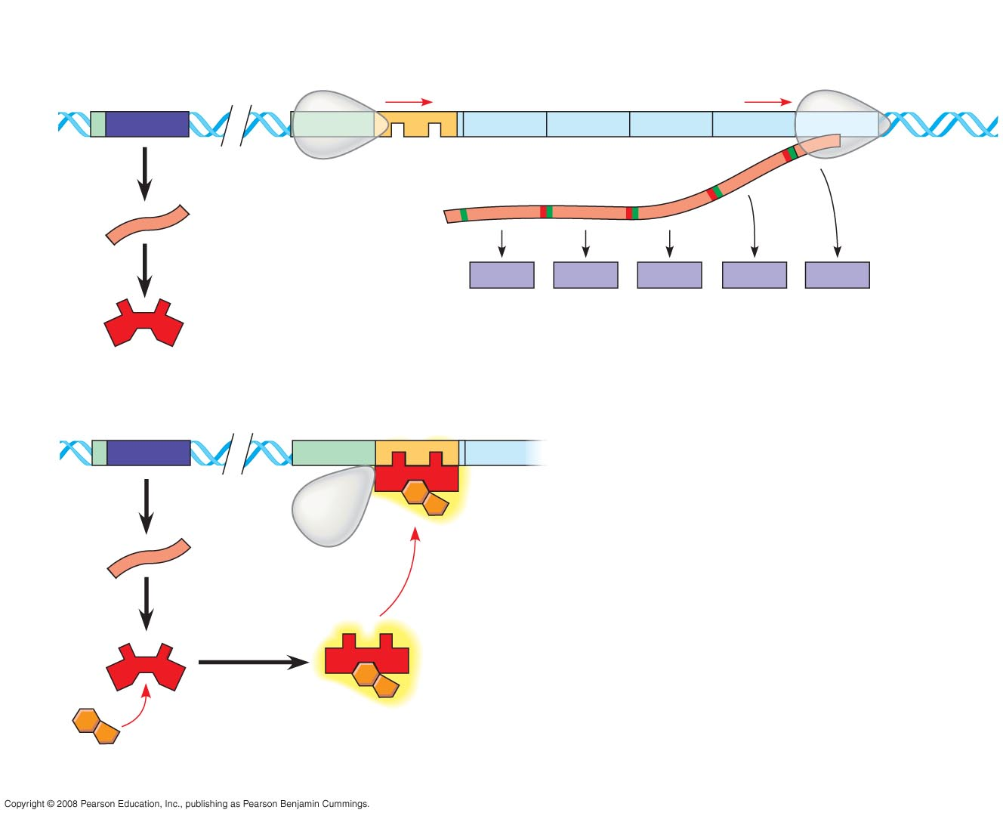
trp operon
Promoter
Promoter
Genes of operon
DNA
trpR
trpE
trpD
trpC
trpB
trpA
Regulatory
gene
Operator
3′
Start codon
Stop codon
mRNA
RNA
polymerase
mRNA 5′
5′
E
D
C
B
A
Protein
Inactive
repressor
Polypeptide subunits that make up
enzymes for tryptophan synthesis
(a) Tryptophan absent, repressor inactive, operon on
DNA
No RNA made
mRNA
Protein
Active
repressor
Tryptophan
(corepressor)
(b) Tryptophan present, repressor active, operon off

Slide 8
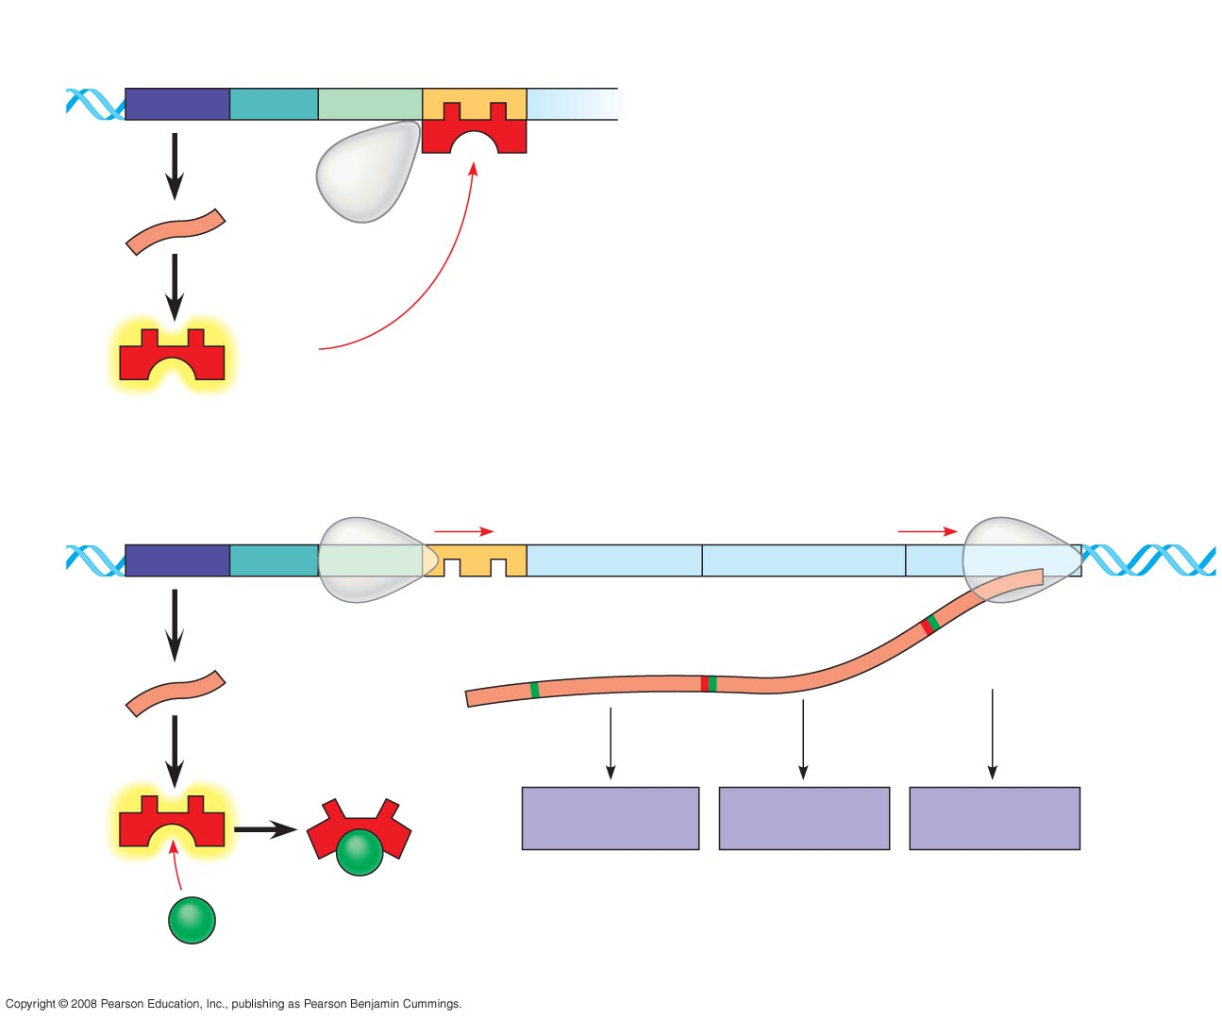
Regulatory
gene
Promoter
Operator
DNA
lacI
lacZ
No
RNA
made
3′
mRNA
RNA
polymerase
5′
Protein
Active
repressor
(a) Lactose absent, repressor active, operon off
lac operon
DNA
lacI
lacZ
lacY
lacA
RNA
polymerase
3′
mRNA
mRNA 5′
5′
Protein
β-Galactosidase
Permease
Transacetylase
Allolactose
(inducer)
Inactive
repressor
(b) Lactose present, repressor inactive, operon on

Slide 9
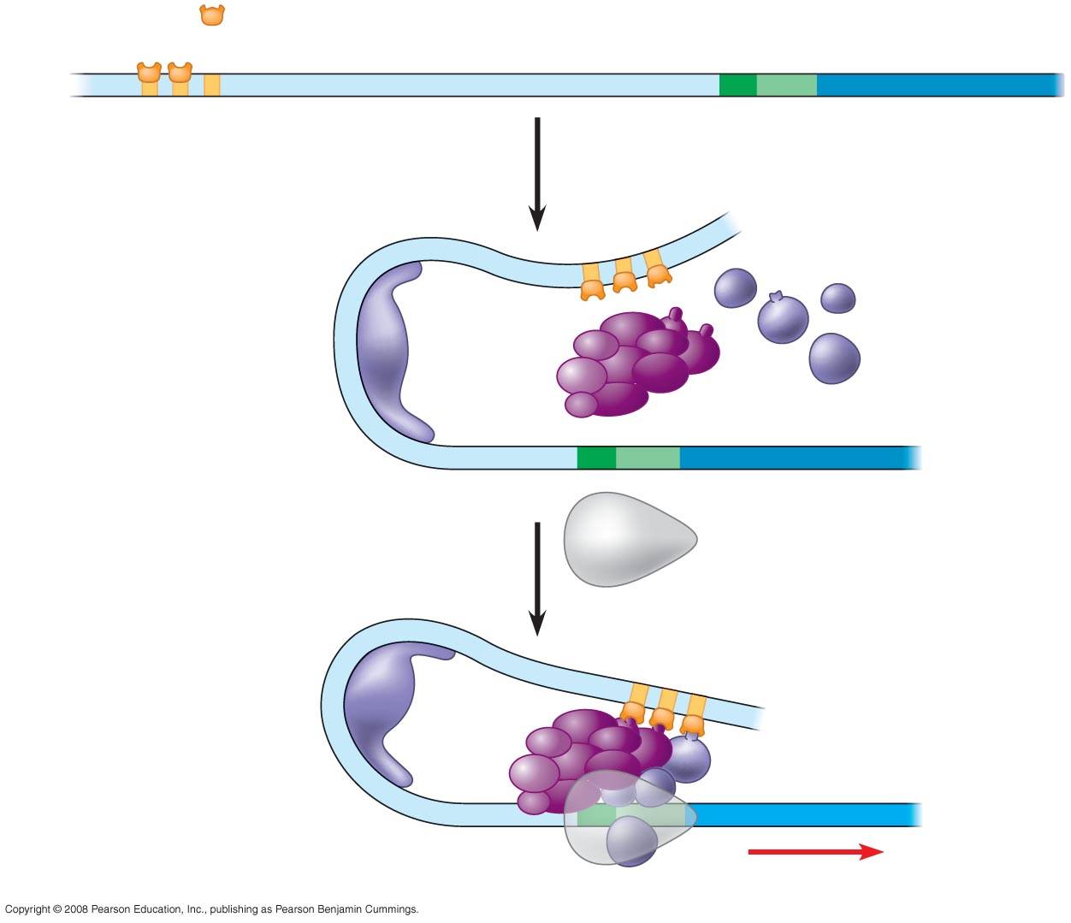
Activators
Promoter
Gene
DNA
Enhancer
Distal control
element
TATA
box
General
transcription
factors
DNA-bending
protein
Group of
mediator proteins
RNA
polymerase II
RNA
polymerase II
Transcription
initiation complex
RNA synthesis

Slide 10
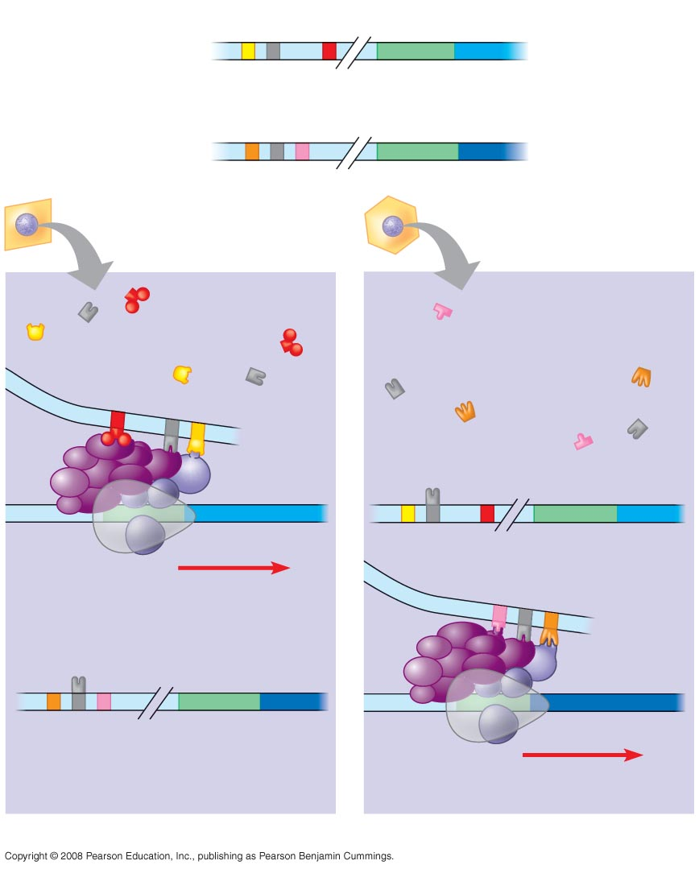
Enhancer
Promoter
Control
elements
Albumin gene
Crystallin gene
LIVER CELL
NUCLEUS
LENS CELL
NUCLEUS
Available
activators
Available
activators
Albumin gene
not expressed
Albumin gene
expressed
Crystallin gene
not expressed
Crystallin gene
expressed
(a) Liver cell
(b) Lens cell

Slide 11
Post-translational Modifications
Phosphorylation
Ubiquitination
Methylation
Acetylation
Glycosylation

Slide 12
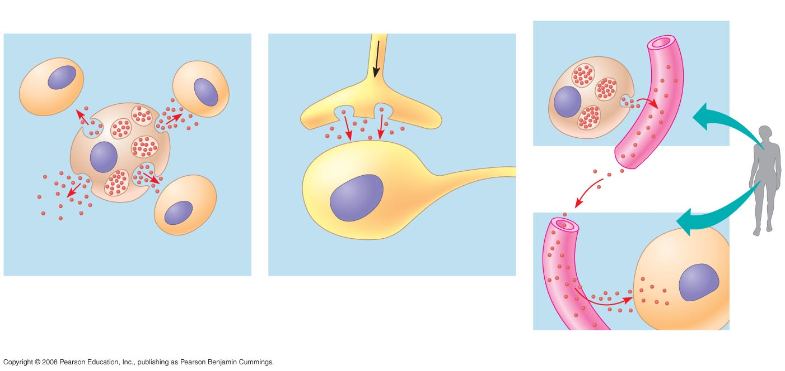
Local signaling
Long-distance signaling
Target cell
Electrical signal
along nerve cell
triggers release of
neurotransmitter
Endocrine cell
Blood
vessel
Secreting
cell
Secretory
vesicle
Neurotransmitter
diffuses across
synapse
Hormone travels
in bloodstream
to target cells
Local regulator
diffuses through
extracellular fluid
Target cell
is stimulated
Target
cell
(a) Paracrine signaling
(b) Synaptic signaling
(c) Hormonal signaling

Slide 13
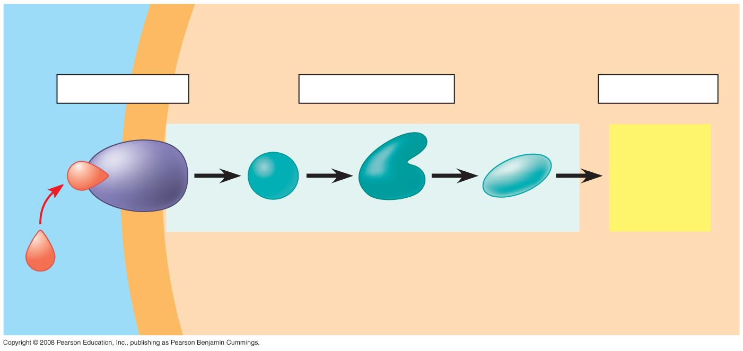
EXTRACELLULAR
FLUID
CYTOPLASM
Plasma membrane
1
Reception
2
Transduction
3
Response
Receptor
Activation
of cellular
response
Relay molecules in a signal transduction pathway
Signaling
molecule

Slide 14
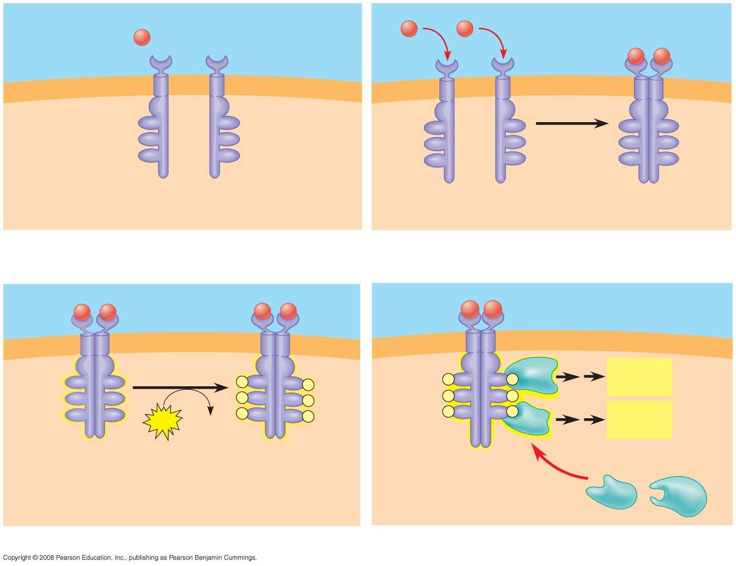
Signaling
molecule (ligand)
Ligand-binding site
Signaling
molecule
α Helix
Tyrosines
Tyr
Tyr
Tyr
Tyr
Tyr
Tyr
Tyr
Tyr
Tyr
Tyr
Tyr
Tyr
Tyr
Tyr
Tyr
Tyr
Tyr
Tyr
Receptor tyrosine
kinase proteins
Dimer
CYTOPLASM
1
2
Activated relay
proteins
Cellular
response 1
Tyr
Tyr
P
Tyr
Tyr
P
P
Tyr
Tyr
P
Tyr
Tyr
P
Tyr
Tyr
P
P
Tyr
Tyr
P
Tyr
Tyr
6
ATP
6 ADP
P
Tyr
Tyr
P
P
Tyr
Tyr
P
Cellular
response 2
Activated tyrosine
kinase regions
Fully activated receptor
tyrosine kinase
Inactive
relay proteins
3
4

