Slide 1
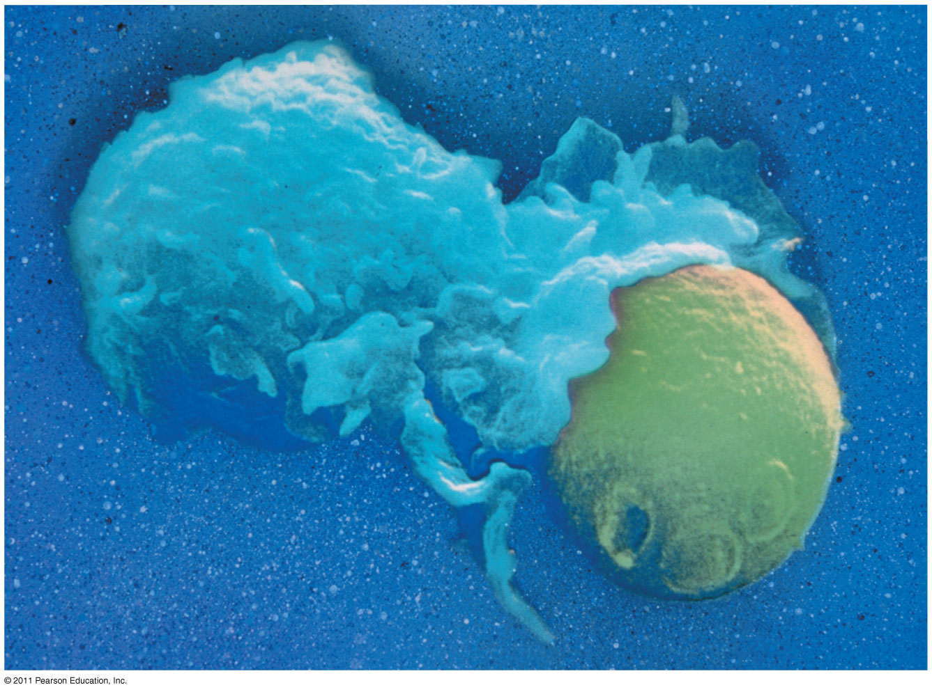
Notes:
Figure 43.1 How do an animal’s immune cells recognize foreign cells?

Slide 2
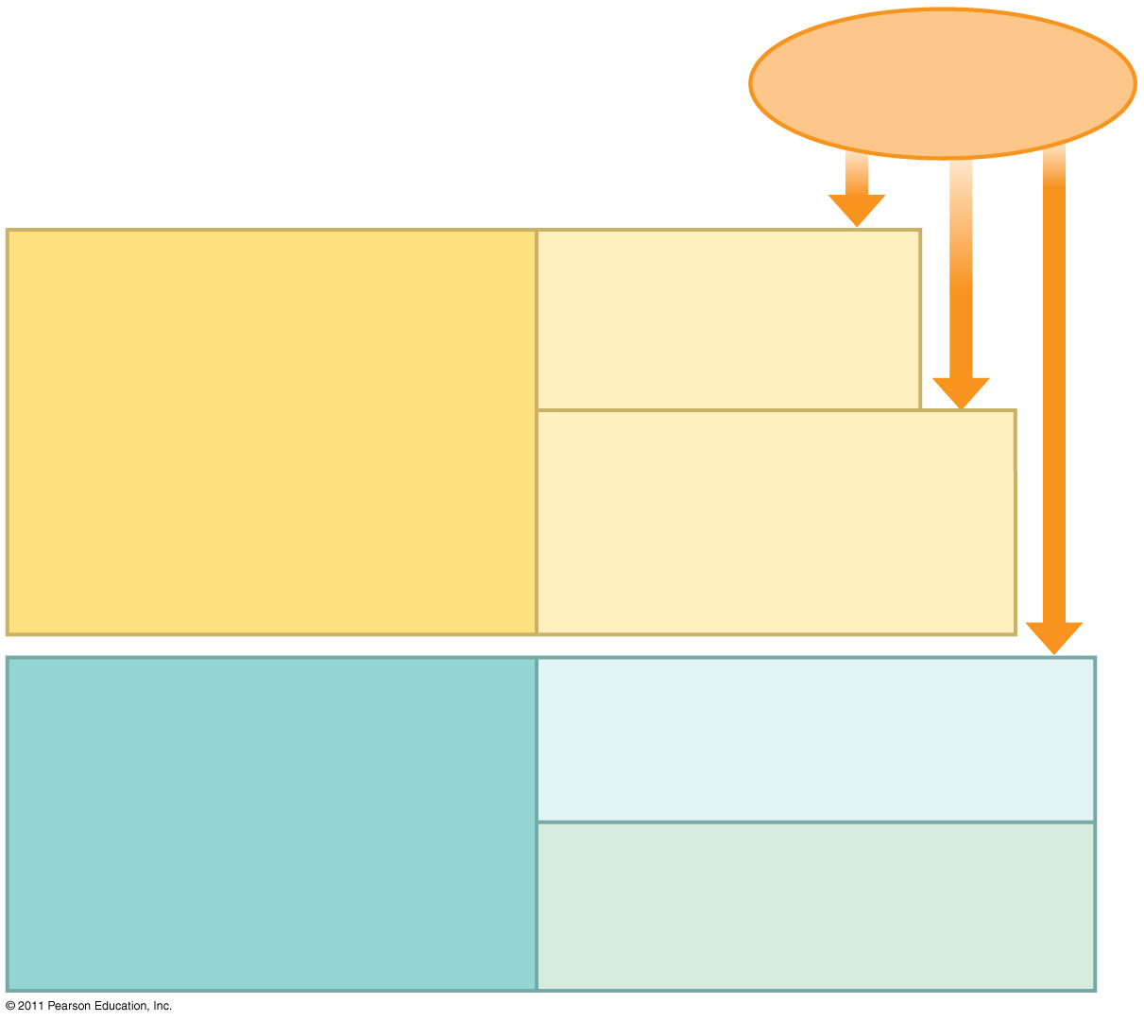
Pathogens (such as bacteria, fungi, and viruses)
INNATE IMMUNITY (all animals)
Barrier defenses:
Skin Mucous membranes Secretions
•
Recognition of traits shared by broad ranges of pathogens, using a small set of receptors
Internal defenses:
Phagocytic cells Natural killer cells Antimicrobial proteins Inflammatory response
• Rapid response
ADAPTIVE IMMUNITY (vertebrates only)
Humoral response:
Antibodies defend against infection in body fluids.
•
Recognition of traits specific to particular pathogens, using a vast array of receptors
Cell-mediated response:
Cytotoxic cells defend against infection in body cells.
• Slower response
Notes:
Figure 43.2 Overview of animal immunity.

Slide 3
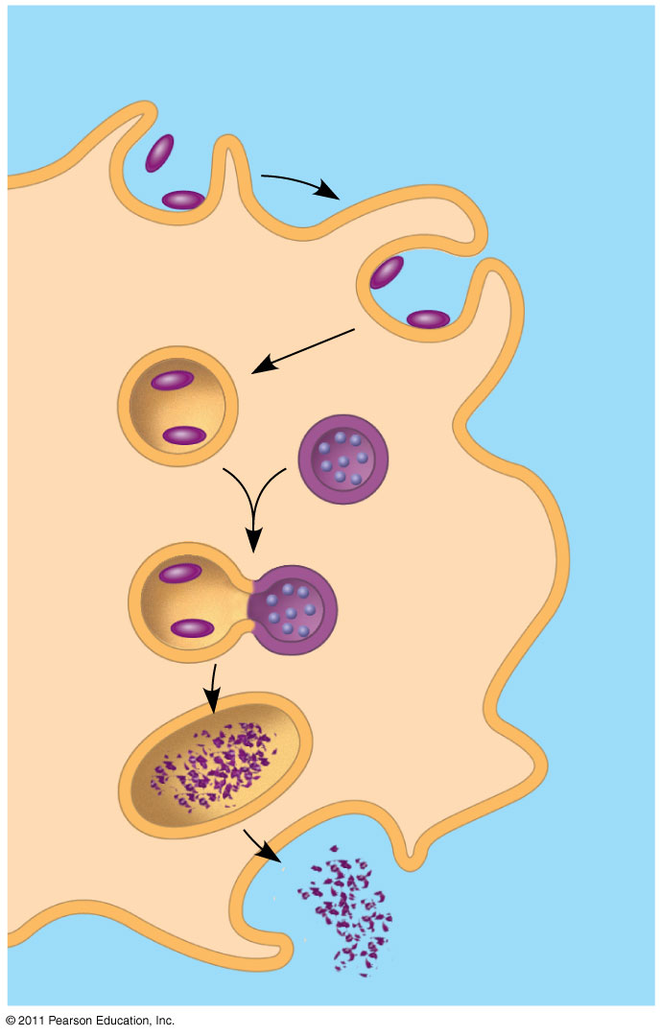
Pathogen
PHAGOCYTIC CELL
Vacuole
Lysosome containing enzymes
Notes:
Figure 43.3 Phagocytosis.

Slide 4
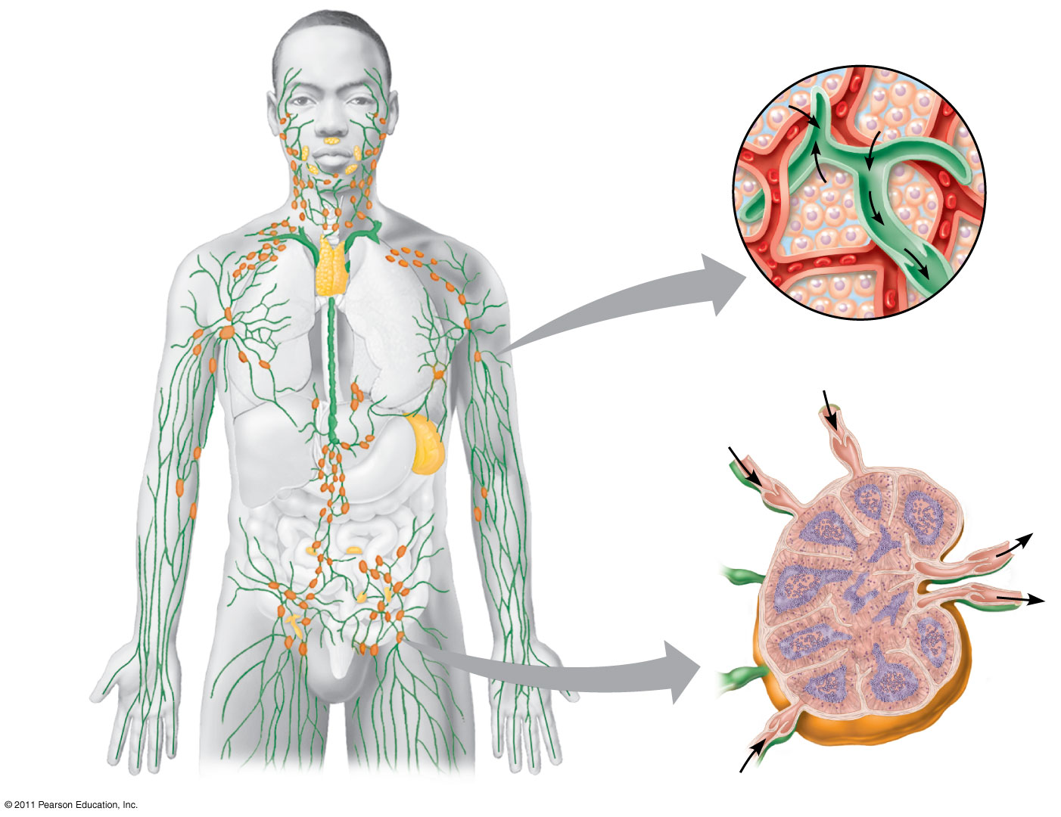
Interstitial fluid
Blood capillary
Adenoid
Tonsils
Lymphatic vessels
Thymus
Tissue cells
Lymphatic vessel
Peyer’s patches (small intestine)
Lymphatic vessel
Spleen
Lymph nodes
Appendix (cecum)
Lymph node
Masses of defensive cells
Notes:
Figure 43.7 The human lymphatic system.

Slide 5
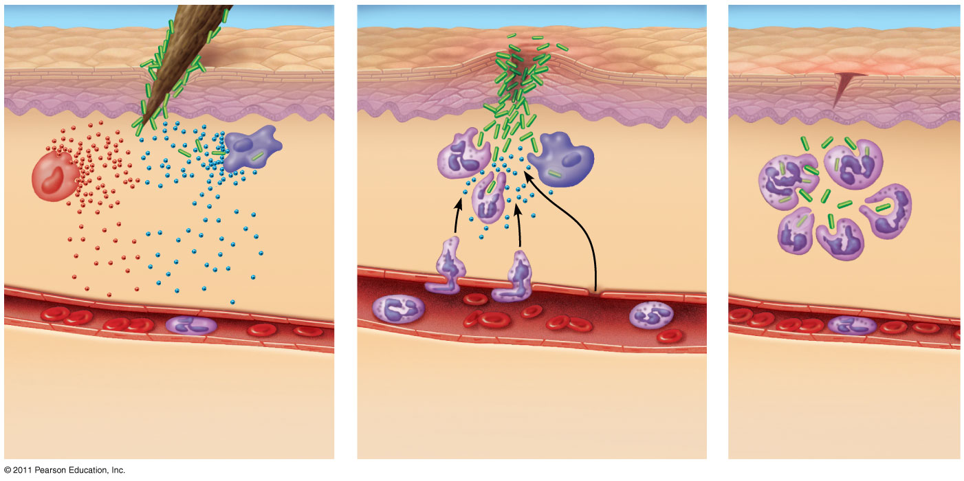
Pathogen
Splinter
Signaling molecules
Macro- phage
Movement of fluid
Mast cell
Capillary
Phagocytosis
Red blood cells
Neutrophil
Notes:
Figure 43.8 Major events in a local inflammatory response.

Slide 6
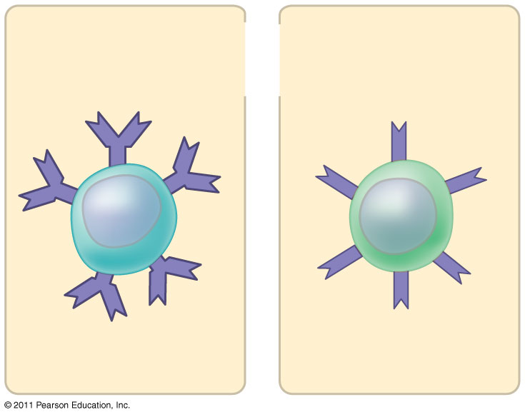
Antigen receptors
Mature B cell
Mature T cell
Notes:
Figure 43.UN01 In-text figure, p. 935

Slide 7
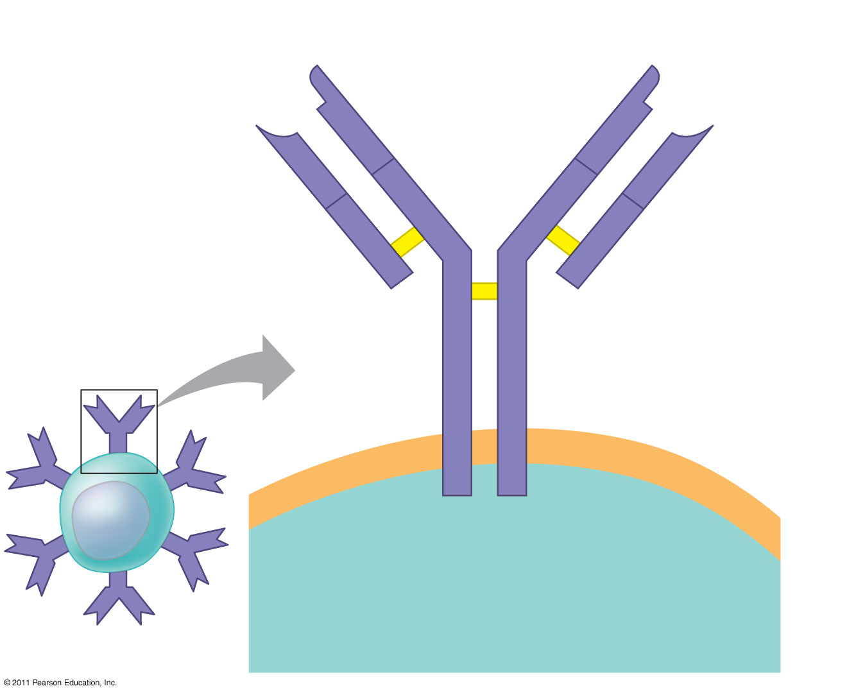
Antigen- binding site
Antigen- binding site
V
Disulfide bridge
V
V
V
Variable regions
C
C
B cell antigen receptor
Constant regions
C
C
Light chain
Transmembrane region
Heavy chains
Plasma membrane
B cell
Cytoplasm of B cell
Notes:
Figure 43.9 The structure of a B cell antigen receptor.

Slide 8
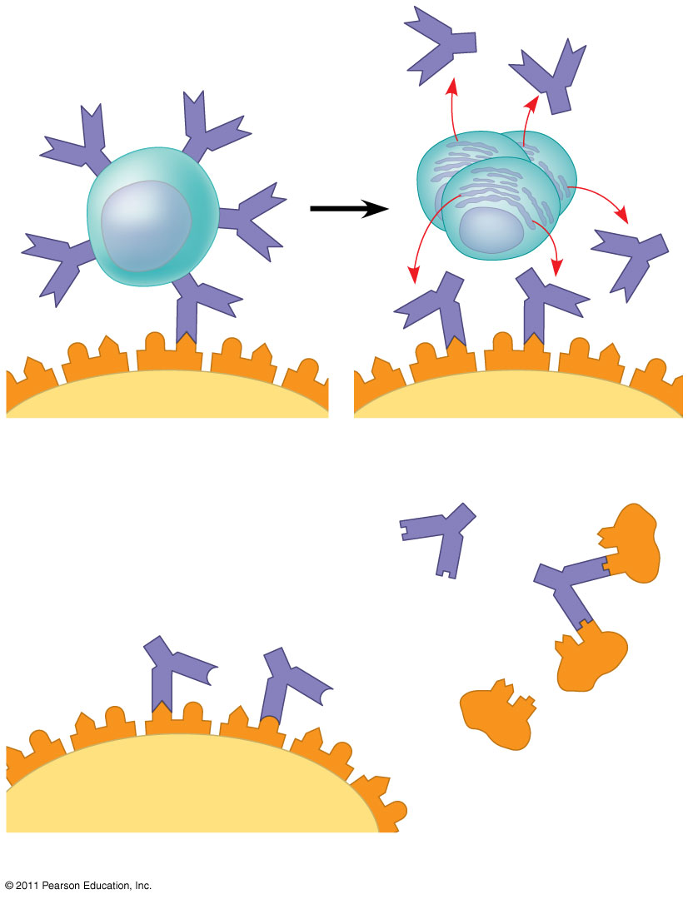
Antigen receptor
Antibody
B cell
Antigen
Epitope
Pathogen
(a) B cell antigen receptors and antibodies
Antibody C
Antibody A
Antibody B
Antigen
(b) Antigen receptor specificity
Notes:
Figure 43.10 Antigen recognition by B cells and antibodies.

Slide 9
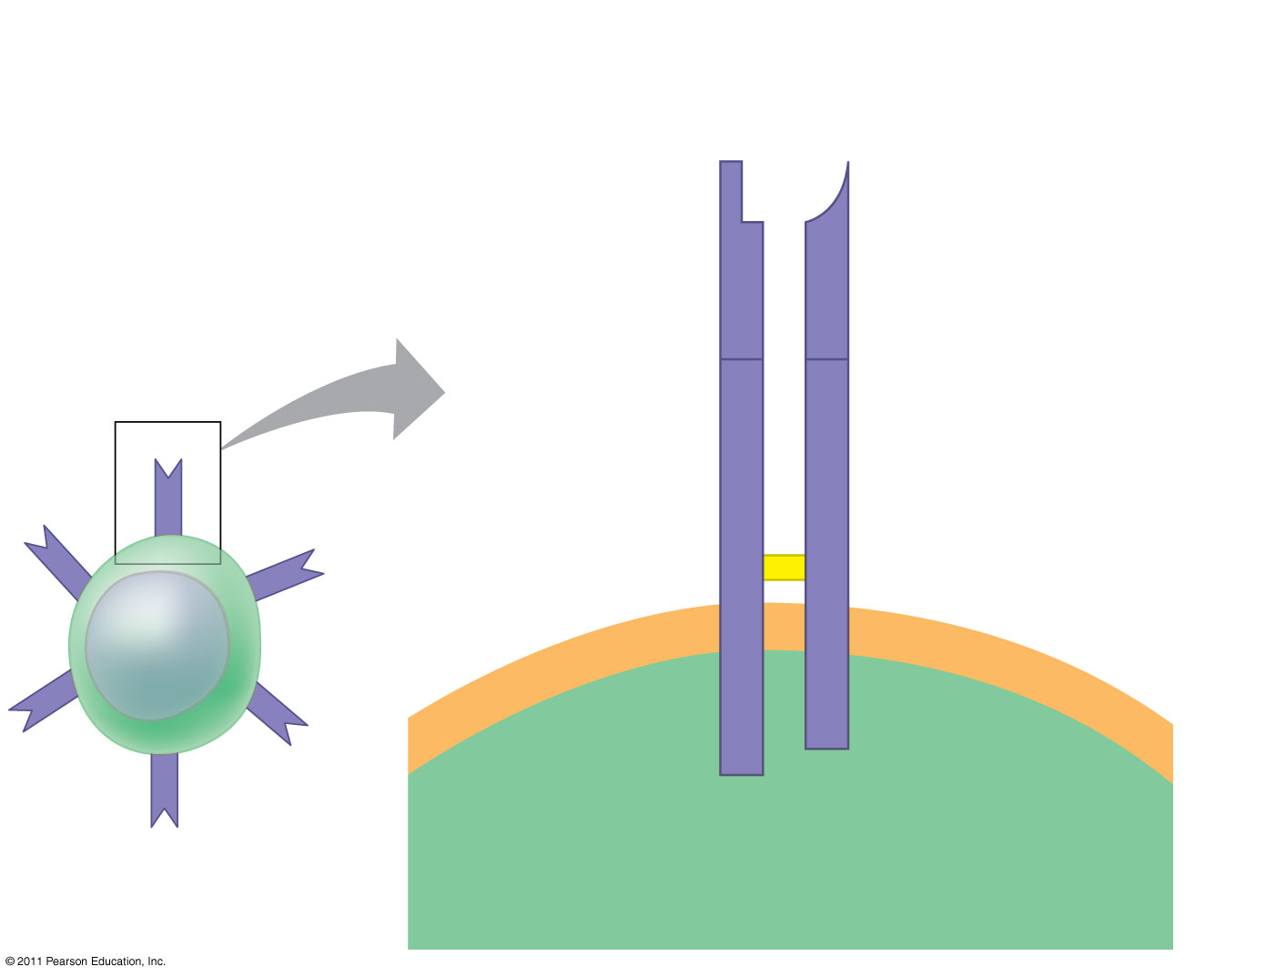
Antigen- binding site
T cell antigen receptor
Variable regions
V
V
C
C
Constant regions
Disulfide bridge
Transmembrane region
α chain
β chain
Plasma membrane
T cell
Cytoplasm of T cell
Notes:
Figure 43.11 The structure of a T cell antigen receptor.

Slide 10
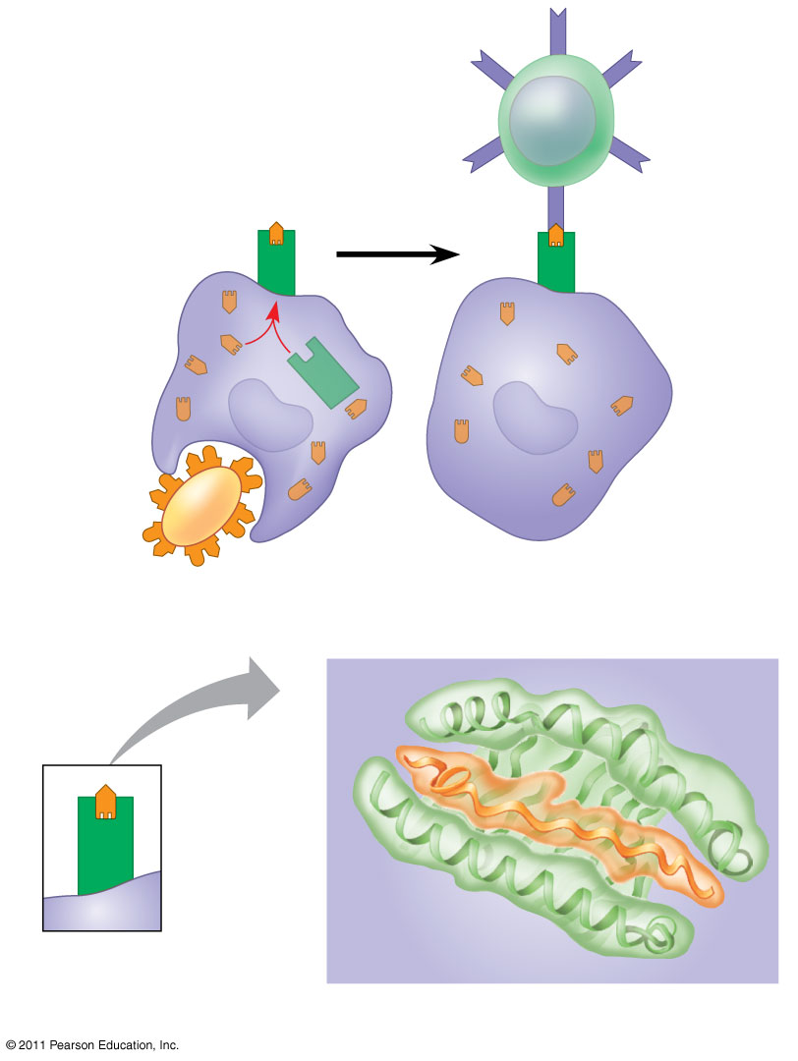
Displayed antigen fragment
T cell
MHC molecule
T cell antigen receptor
Antigen fragment
Pathogen
Host cell
(a) Antigen recognition by a T cell
Top view
Antigen fragment
MHC molecule
Host cell
(b) A closer look at antigen presentation
Notes:
Figure 43.12 Antigen recognition by T cells.

Slide 11
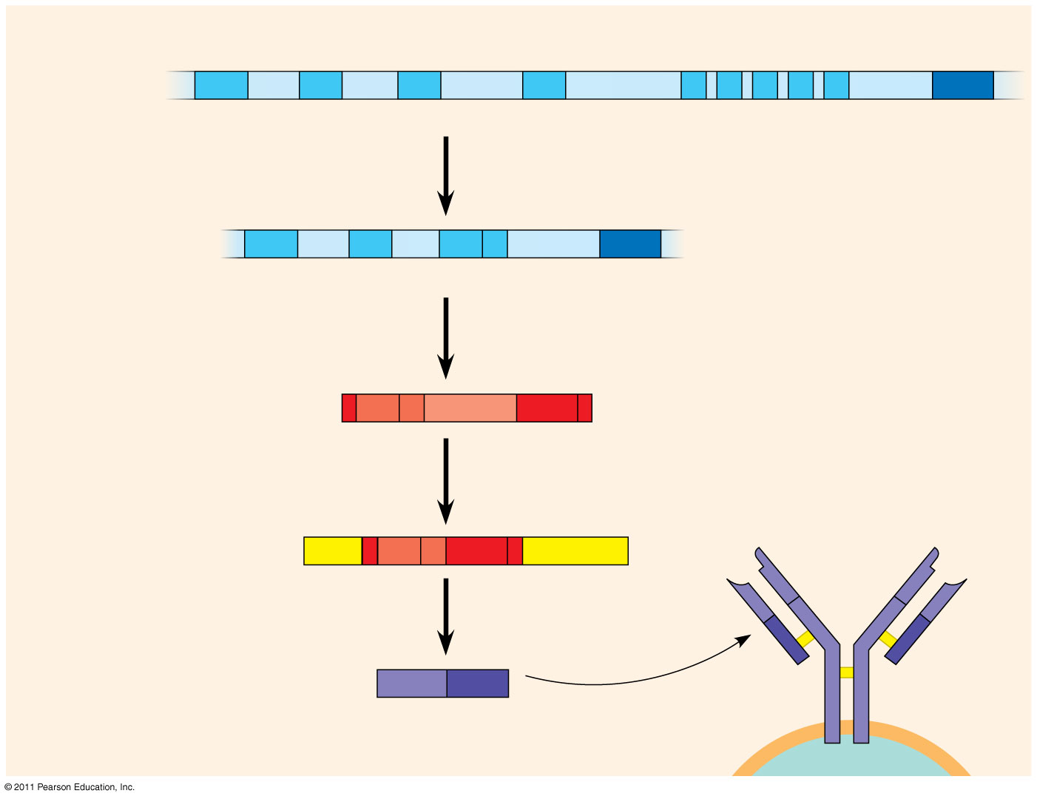
DNA of undifferentiated B cell
V₃₇
V₃₈
V₃₉
V₄₀
J₁
J₂
J₃
J₄
J₅
Intron
C
1
Recombination deletes DNA between randomly selected V segment and J segment
DNA of differentiated B cell
V₃₇
V₃₈
V₃₉
J₅
Intron
C
Functional gene
2
Transcription
pre-mRNA
V₃₉
J₅
Intron
C
3
RNA processing
mRNA
Cap
V₃₉
J₅
C
Poly-A tail
V
V
4
Translation
V
V
C
C
Light-chain polypeptide
V
C
C
C
Antigen receptor
Variable region
Constant region
B cell
Notes:
Figure 43.13 Immunoglobulin (antibody) gene rearrangement.

Slide 12
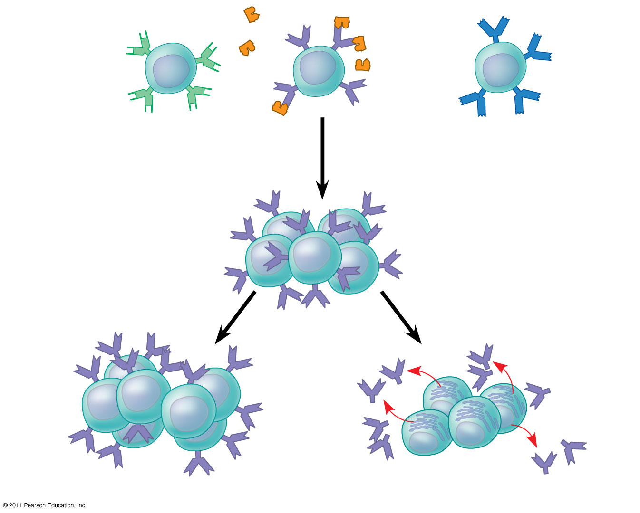
B cells that differ in antigen specificity
Antigen
Antigen receptor
Antibody
Memory cells
Plasma cells
Notes:
Figure 43.14 Clonal selection.

Slide 13
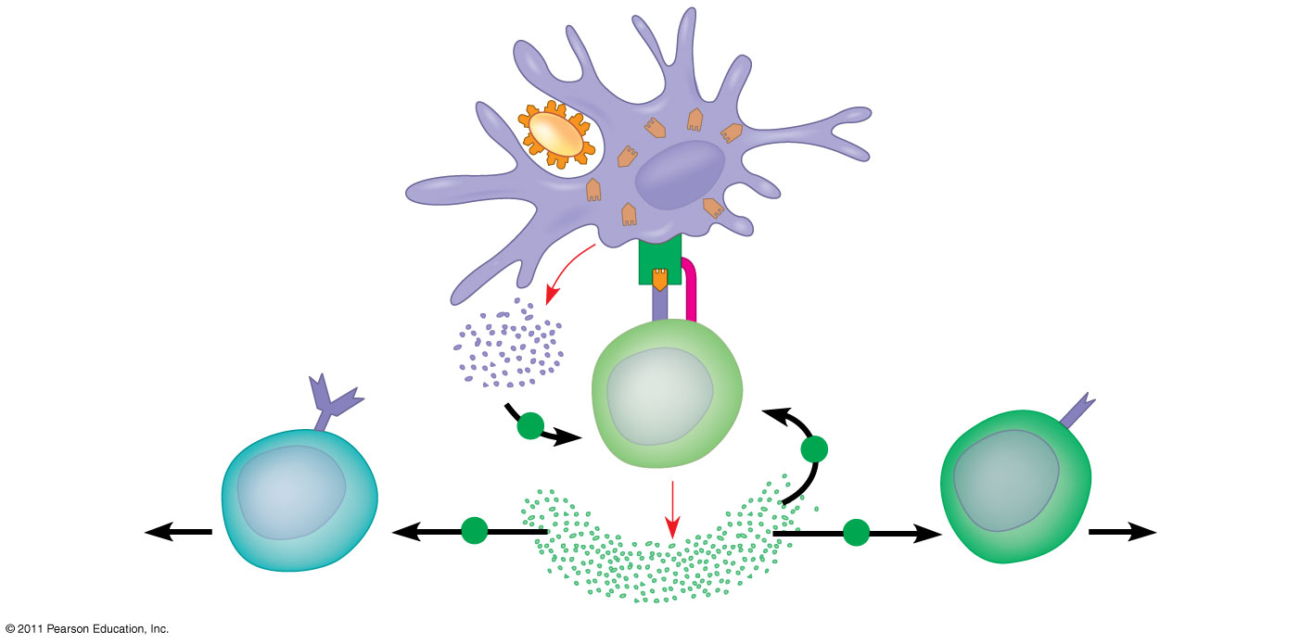
Antigen- presenting cell
Antigen fragment
Pathogen
Class II MHC molecule
1
Accessory protein
Antigen receptor
Helper T cell
+
Cytokines
+
Humoral immunity
2
Cell- mediated immunity
+
+
B cell
3
Cytotoxic T cell
Notes:
Figure 43.16 The central role of helper T cells in humoral and cell-mediated immune responses.

Slide 14
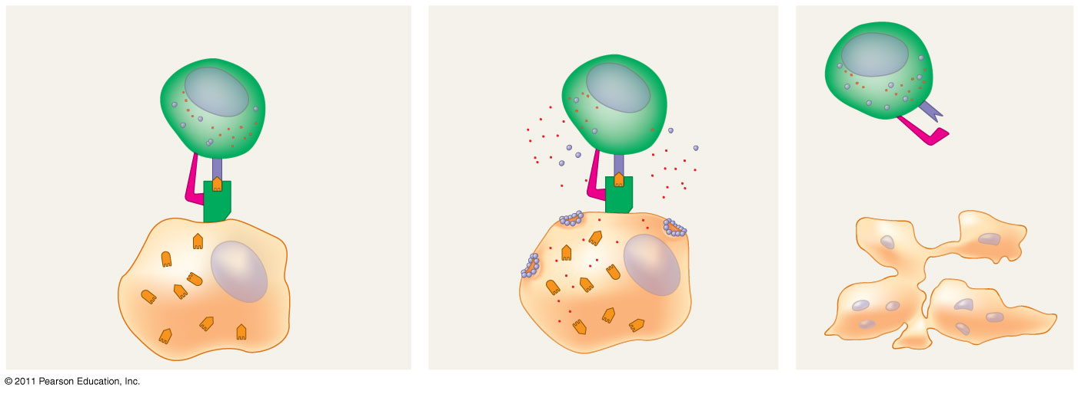
Cytotoxic T cell
Released cytotoxic T cell
Accessory protein
Antigen receptor
Dying infected cell
Class I MHC molecule
Perforin
Gran- zymes
Pore
Infected cell
Antigen fragment
1
2
3
Notes:
Figure 43.17 The killing action of cytotoxic T cells on an infected host cell.

Slide 15
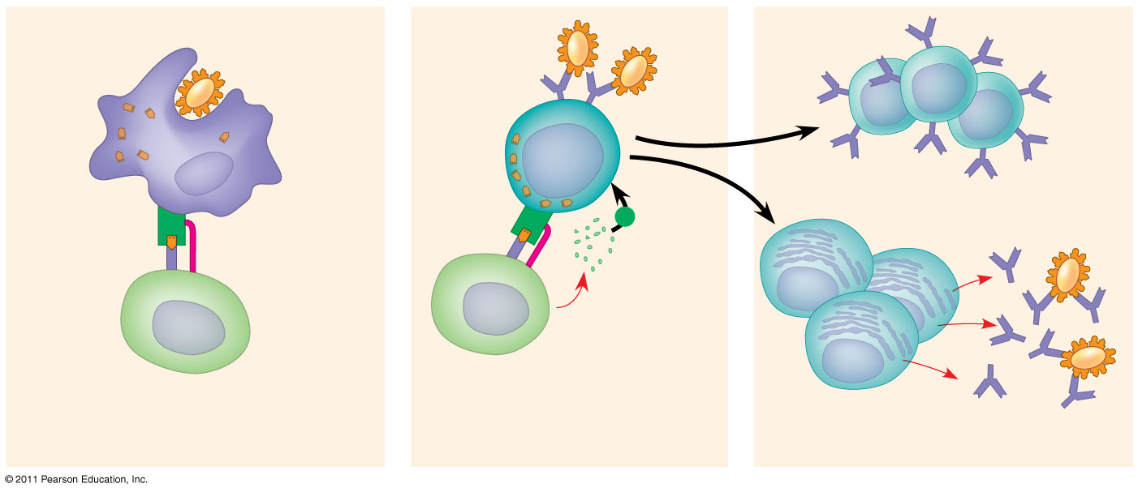
Antigen-presenting cell
Pathogen
Antigen fragment
B cell
Class II MHC molecule
Memory B cells
+
Accessory protein
Antigen receptor
Cytokines
Activated helper T cell
Plasma cells
Helper T cell
Secreted antibodies
1
2
3
Notes:
Figure 43.18 Activation of a B cell in the humoral immune response.

Slide 16
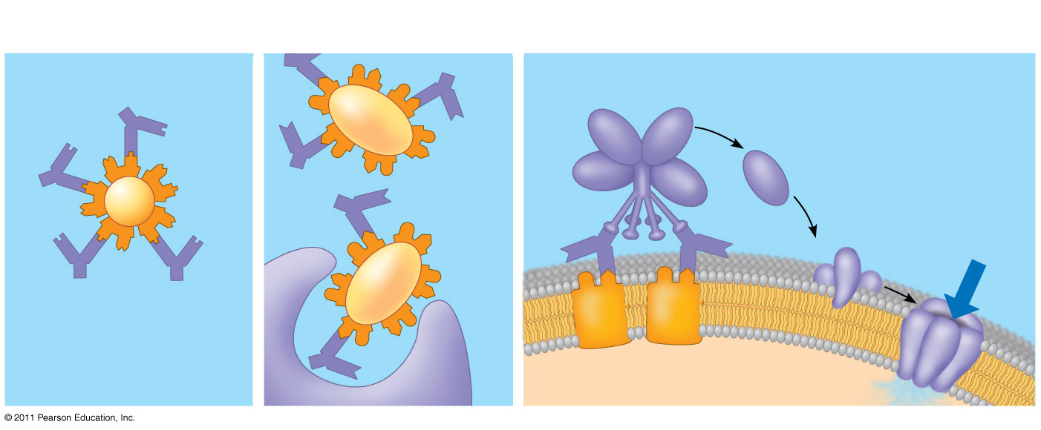
Activation of complement system and pore formation
Neutralization
Opsonization
Complement proteins
Antibody
Formation of membrane attack complex
Virus
Bacterium
Flow of water and ions
Pore
Foreign cell
Antigen
Macrophage
Notes:
Figure 43.19 Antibody-mediated mechanisms of antigen disposal.

Slide 17
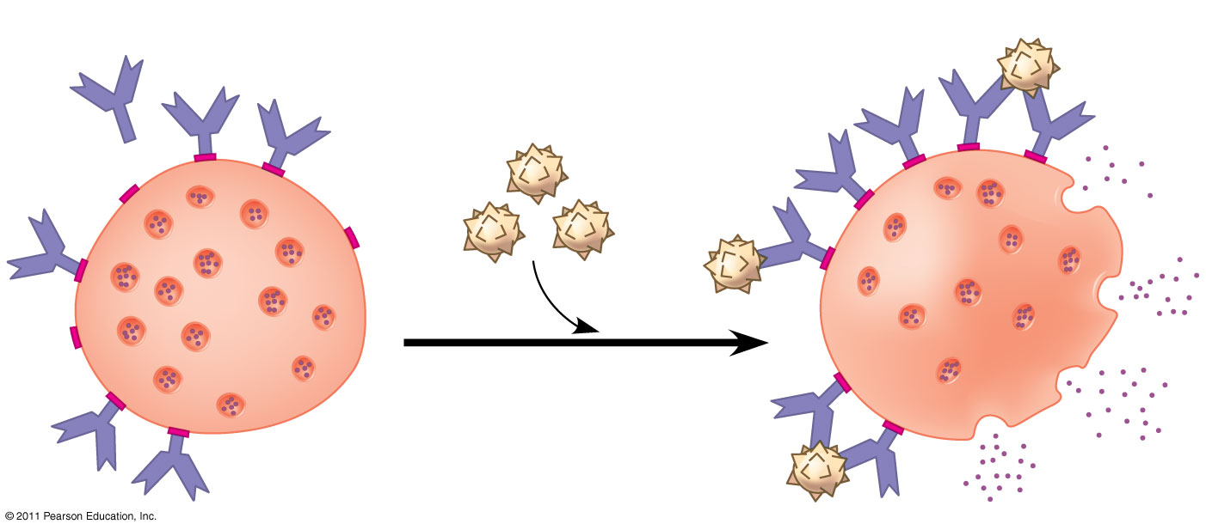
Histamine
IgE
Allergen
Granule
Mast cell
Notes:
Figure 43.22 Mast cells, IgE, and the allergic response.

