Slide 1
Genetically Modified (GM) Foods
GM foods can be either transgenic or cisgenic.
The transgene codes for a protein that is somehow advantageous to the plant.
Pest resistance
Tolerance to herbicides
Delayed ripening of fruit
Improved yield
Increased or improved nutrient content

Slide 2
Creating a GM Crop
A potentially useful gene must be identified.
A popular source is a gene from the bacterium, Bacillus thuringiensis (Bt).
The Bt transgene codes for delta-endotoxin.
Delta-endotoxin kills various pests that would otherwise destroy plants by boring into them.
The potential transgene must be located within the host’s genome.
The potential transgene must be isolated.
The coding portion of the transgene might be just hundreds or thousands of base pairs, but could contain tens of thousands of base pairs in introns.

Slide 3
Creating a GM Crop (cont.)
The transgene is modified for the recipient by removing introns.
A promoter is added, allowing polymerase to initiate transcription.
The most commonly used promoter is CaMV 35S from the cauliflower mosaic virus.
35S is used, because it has evolved to “work” (cause transcription) in all types of cells within a plant.
A terminator is added, serving as a signal to end transcription.
The most commonly used terminator is the nopaline synthase (NOS) terminator from Agrobacterium tumefaciens.
The transgene is engineered to be constitutively transcribed.

Slide 4
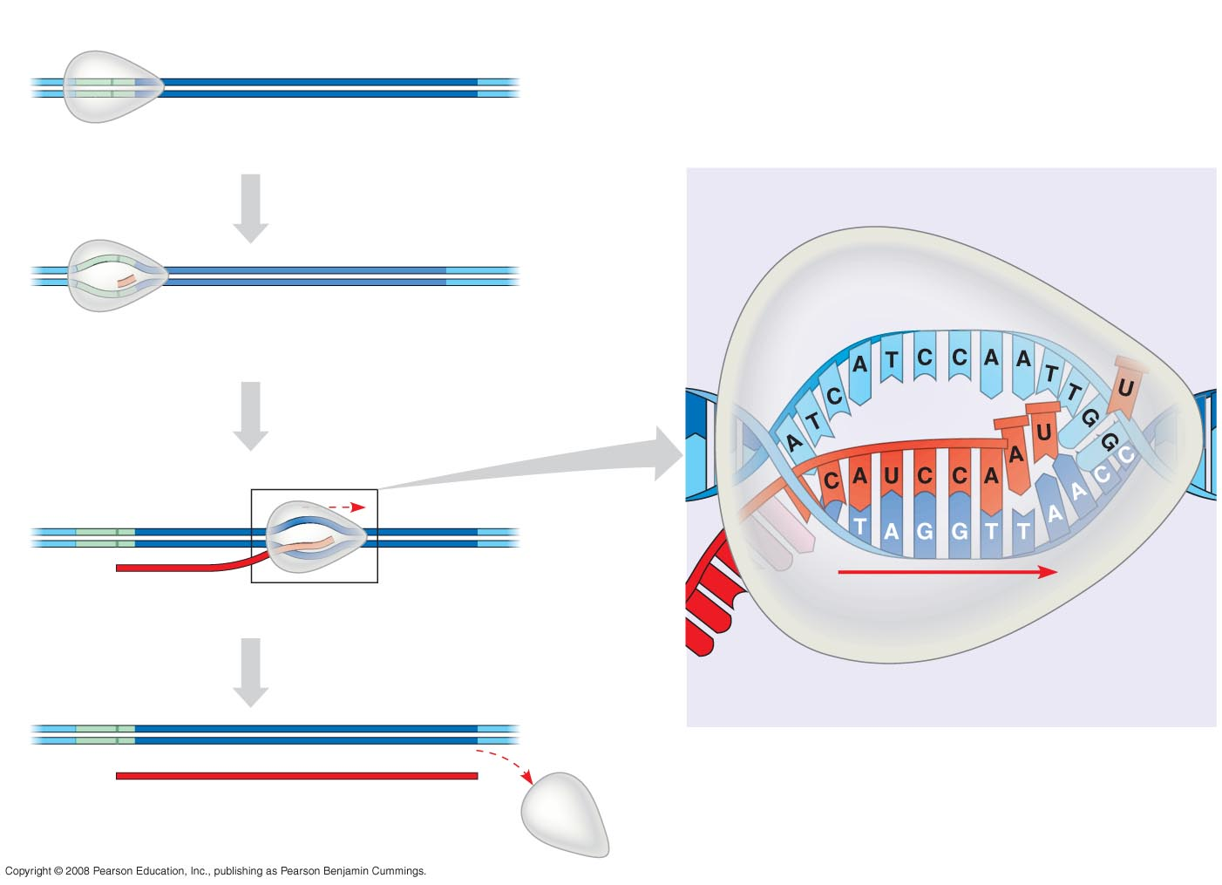
Promoter
Gene
Terminator
5′
3′
3′
DNA
5′
Start point
RNA polymerase
1
Initiation
Elongation
Nontemplate
strand of DNA
5′
3′
RNA nucleotides
3′
5′
RNA
polymerase
RNA
transcript
Template strand
of DNA
Unwound
DNA
2
Elongation
3′
3′ end
Rewound
DNA
5′
5′
3′
3′
3′
5′
5′
RNA
transcript
5′
Direction of
transcription
(“downstream”)
Template
strand of DNA
3
Termination
Newly made
RNA
5′
3′
3′
5′
5′
Completed RNA transcript
3′

Slide 5
Creating a GM Crop (cont.)
A sample of cells is removed from the “parent” plant.
Sampled cells are grown into a callus.
The transgene is inserted into cells of the callus by one of several methods.
Electroporation
Gene gun
Agrobacterium tumefaciens
A marker is transferred along with the transgene.
Antibiotic resistance
Visual marker (e.g., GFP)
Transgenic cells must be identified and isolated from the callus.

Slide 6
Creating a GM Crop (cont.)
Isolated transgenic cells are hormonally induced to grow into complete plants.
The transgenic plant is back-crossed with the highest-yielding field crop.
Bringing a GM crop to market can take a decade or more.

Slide 7
Experimental Procedure
Follow instructions very carefully.
Take careful steps to prevent contamination.
InstaGene matrix is a suspension of negatively charged beads that bind to cations, preventing them from helping enzymes degrade the DNA.
The beads are removed by centrifugation, and the supernatant contains the DNA.
Master Mix contains nucleotides, buffer, polymerase, primers, and dye.

