Slide 1
Genetically Modified Organisms
GMO’s are organisms in which the DNA has been intentionally modified by techniques of genetic engineering.
This is distinct from genetic modification that is accomplished via conventional breeding methods (selective breeding of plants and animals).
GMO’s are produced for various reasons, the most controversial of which is GMO’s as food.
Genetically modified organisms can be produced by transgenesis or cisgenesis.
Both transgenesis and cisgenesis are examples of horizontal gene transfer.

Slide 2
Vertical Gene Transfer
versus
Horizontal Gene Transfer
Both of these can occur naturally, and both can be exploited for genetic modification.

Slide 3
Mechanisms for Horizontal Gene Transfer
Conjugation
Transfer between bacteria connected by pilus
Transduction
Transfer from a bacteriophage to a bacterium
Transformation
Uptake of genetic material from environment
Gene Transfer Agents
Virus-like agents produced in alphaproteobacteria, including Agrobacteria

Slide 4
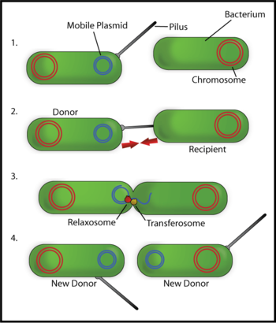
Conjugation

Slide 5
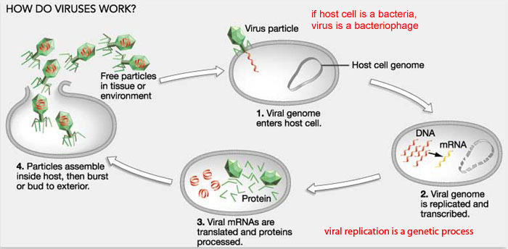
Transduction

Slide 6
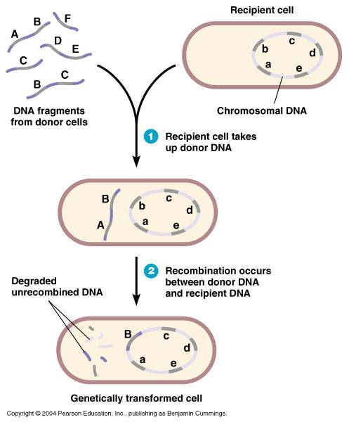
Transformation

Slide 7
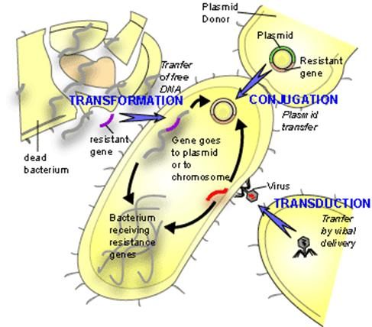

Slide 8
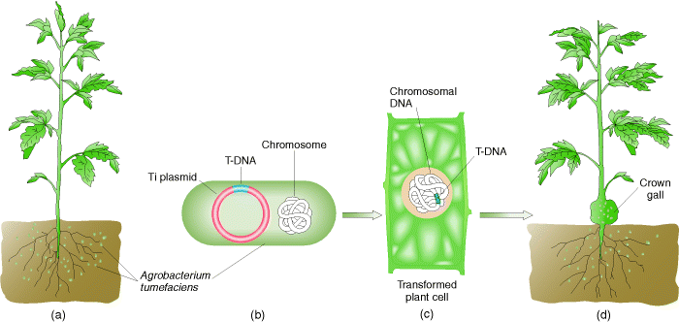
Gene Transfer Agent (Agrobacterium)

Slide 9
