Slide 1
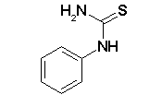
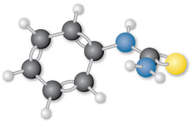
PTC: Phenylthiocarbamide
C₇H₈N₂S

Slide 2
PTC Tasting
PTC stands for phenylthiocarbamide.
In 1931 a Dupont chemist, Arthur Fox, accidentally released some PTC powder into the air.
His colleague complained about the taste, but Fox noticed no taste.
They both directly tasted the powder.
The ability to taste PTC (and related compounds) is genetic.
PTC tasting became one of the earliest genetic tests.
The taste of PTC is bitter.
PTC does not occur in nature, but many related compounds do, and any of them creates the sensation of bitterness.

Slide 3
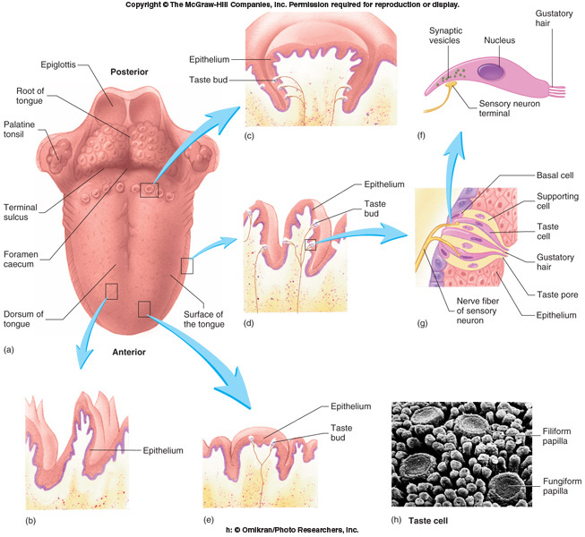

Slide 4
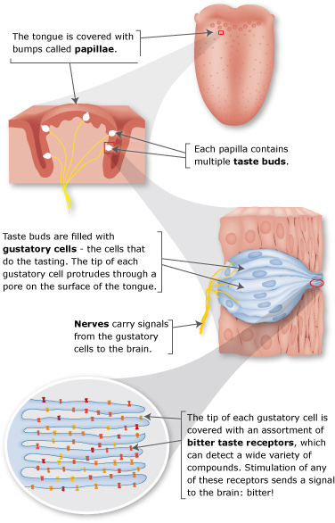

Slide 5
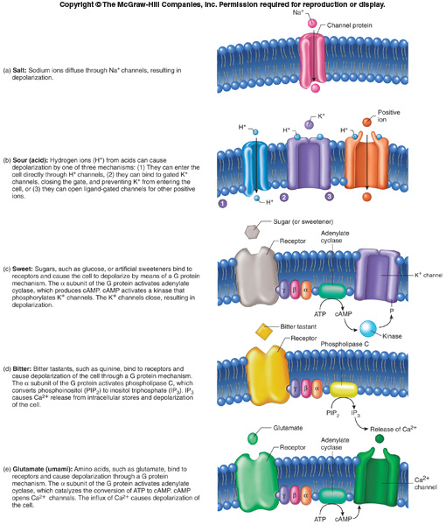

Slide 6
