Slide 1
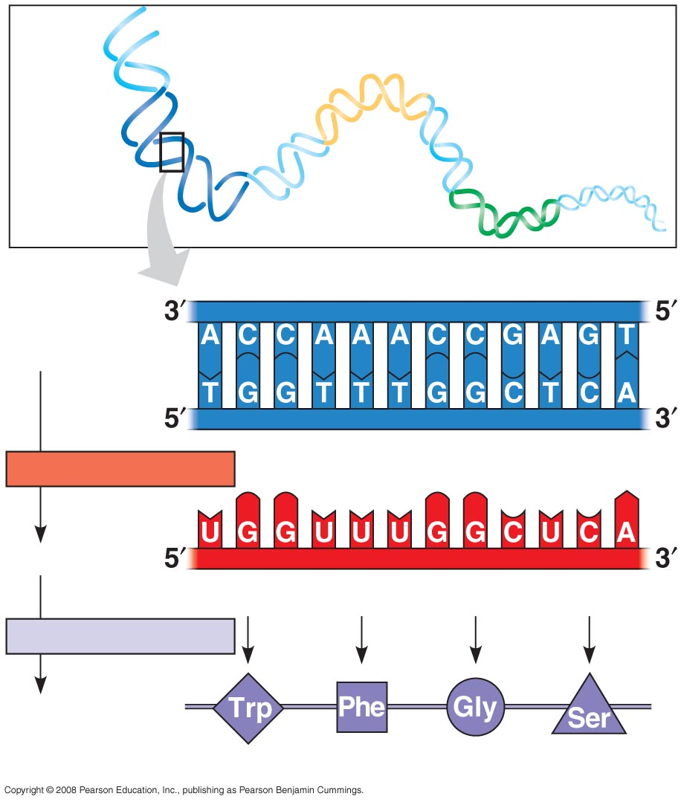
Gene 2
DNA
molecule
Gene 1
Gene 3
DNA
template
strand
TRANSCRIPTION
mRNA
Codon
TRANSLATION
Protein
Amino acid

Slide 2
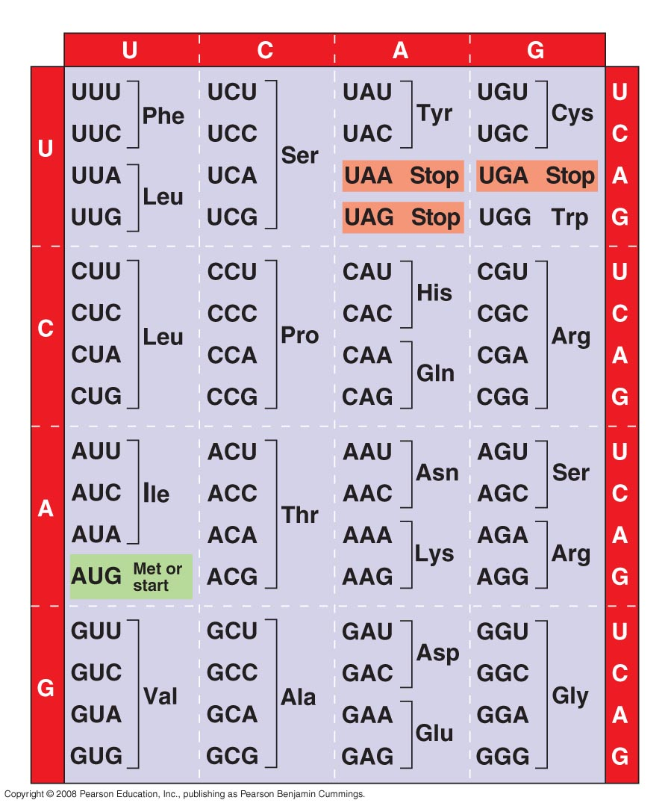
Second mRNA base
First mRNA base (5′ end of codon)
Third mRNA base (3′ end of codon)

Slide 3
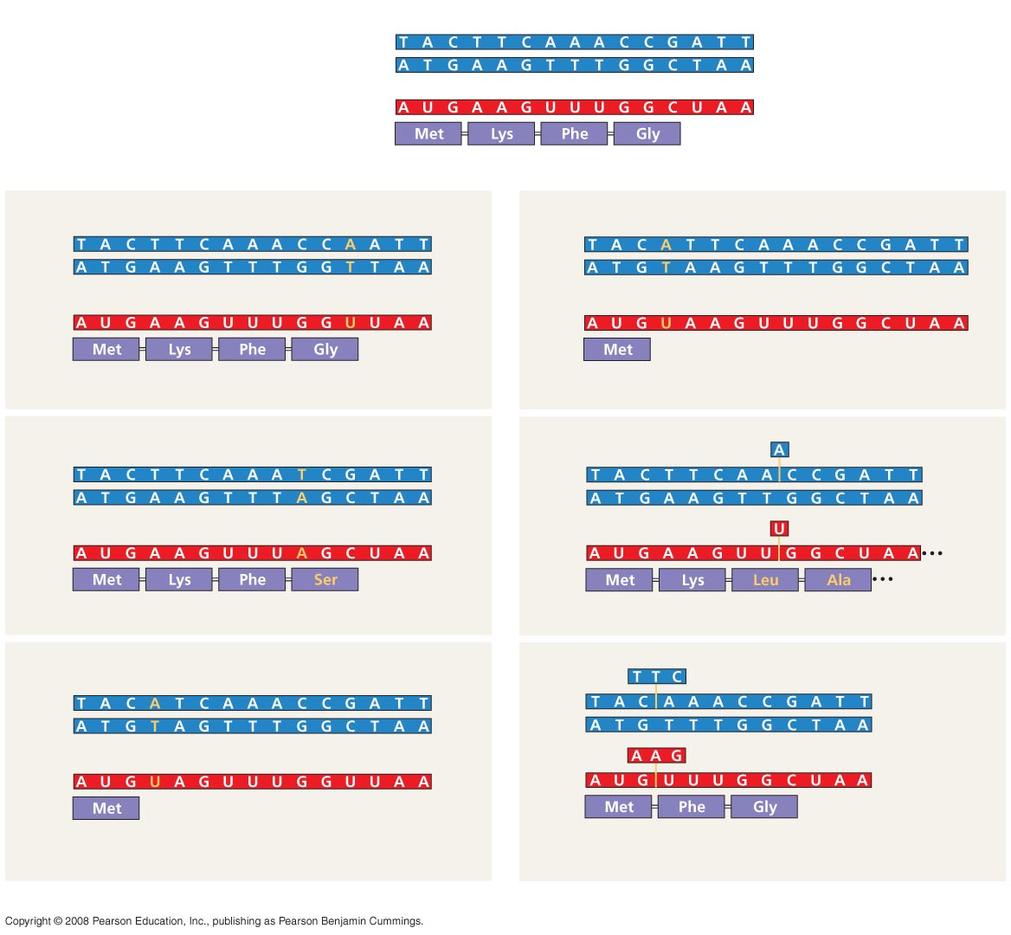
Wild-type
DNA template strand
3′
5′
5′
3′
mRNA
5′
3′
Protein
Stop
Amino end
Carboxyl end
A instead of G
Extra A
3′
5′
3′
5′
5′
3′
5′
3′
U instead of C
Extra U
5′
3′
5′
3′
Stop
Stop
Silent (no effect on amino acid sequence)
Frameshift causing immediate nonsense (1 base-pair insertion)
T instead of C
missing
3′
5′
3′
5′
5′
3′
5′
3′
A instead of G
missing
5′
3′
5′
3′
Stop
Missense
Frameshift causing extensive missense (1 base-pair deletion)
A instead of T
missing
3′
5′
3′
5′
5′
3′
5′
3′
U instead of A
missing
5′
3′
5′
3′
Stop
Stop
Nonsense
No frameshift, but one amino acid missing (3 base-pair deletion)
(a) Base-pair substitution
(b) Base-pair insertion or deletion

Slide 4
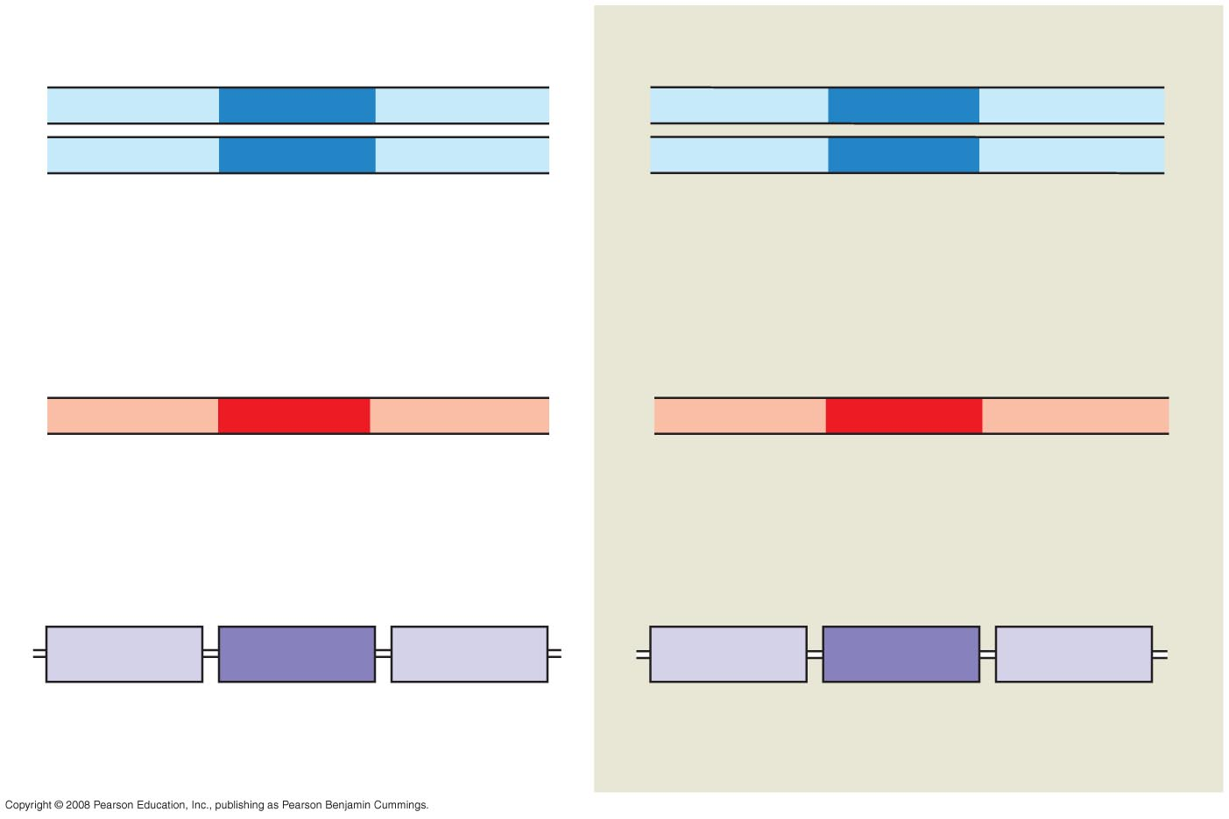
Wild-type hemoglobin DNA
Mutant hemoglobin DNA
3′
C
T
T
5′
3′
C
A
T
5′
5′
G
A
A
3′
5′
G
T
A
3′
mRNA
mRNA
5′
G
A
A
3′
5′
G
U
A
3′
Normal hemoglobin
Sickle-cell hemoglobin
Glu
Val

Slide 5
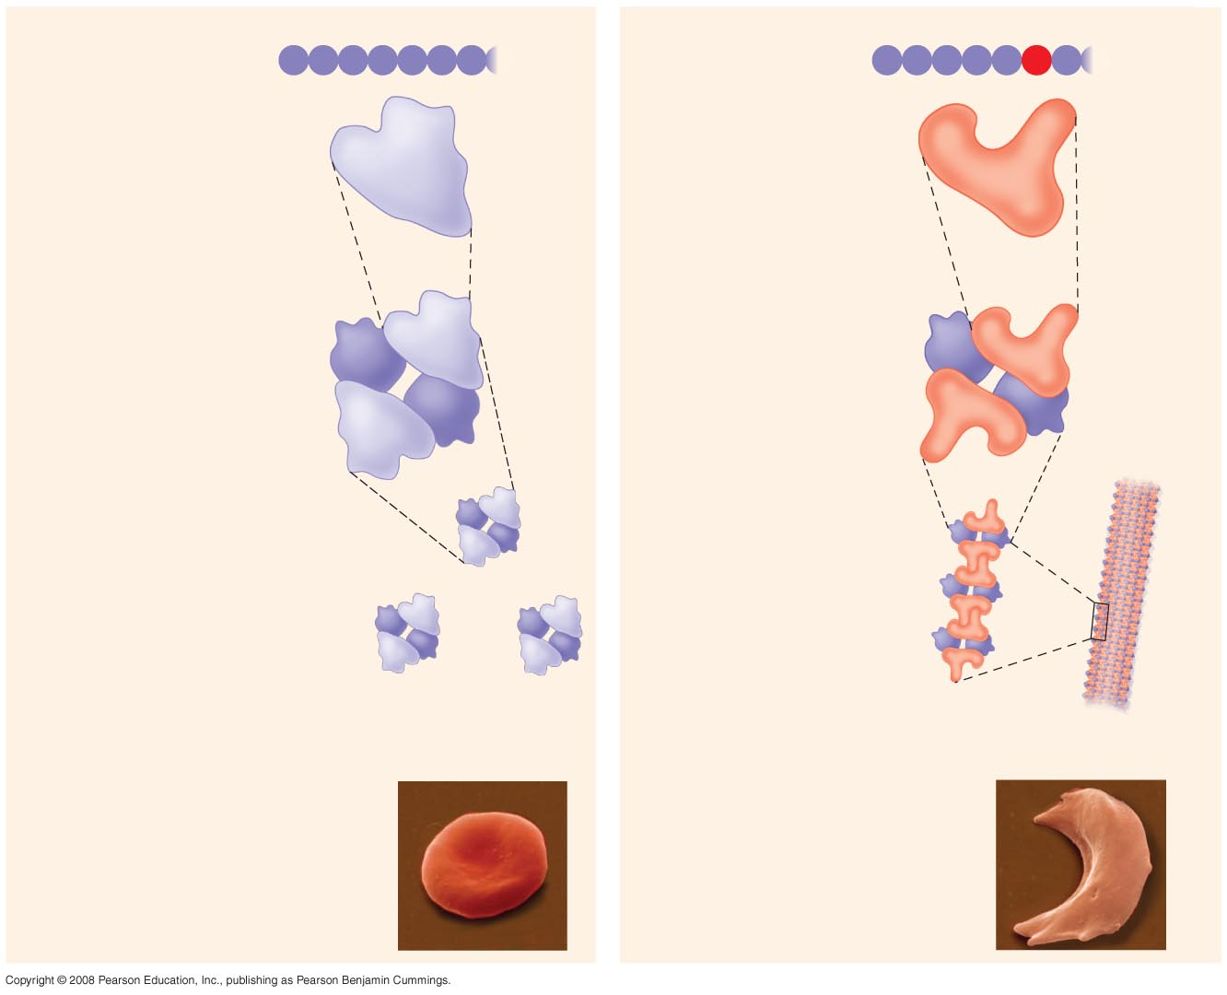
Normal hemoglobin
Primary
structure
Sickle-cell hemoglobin
Primary
structure
Val
His
Leu
Thr
Pro
Glu
Glu
Val
His
Leu
Thr
Pro
Val
Glu
1
2
3
4
5
6
7
1
2
3
4
5
6
7
Secondary
and tertiary
structures
Secondary
and tertiary
structures
Exposed
hydrophobic
region
β subunit
β subunit
α
β
α
Quaternary
structure
Normal
hemoglobin
(top view)
Quaternary
structure
Sickle-cell
hemoglobin
β
β
α
β
α
Function
Molecules do
not associate
with one
another; each
carries oxygen.
Function
Molecules
interact with
one another and
crystallize into
a fiber; capacity
to carry oxygen
is greatly reduced.
10 µm
10 µm
Red blood
cell shape
Normal red blood
cells are full of
individual
hemoglobin
moledules, each
carrying oxygen.
Red blood
cell shape
Fibers of abnormal
hemoglobin deform
red blood cell into
sickle shape.

