Slide 1
Gel Electrophoresis
Gel is made from agarose
Agarose is a polysaccharide found in seaweed
TAE is a buffer
TAE is also used to conduct electricity
Wells are made to accept samples
Charged sample particles migrate through the gel
Dye is added for viewing samples

Slide 2
Factors Affecting Mobility
Concentration of agarose in gel
Size of particles
Conformation of particles
Charge of particles
Voltage applied
Time

Slide 3
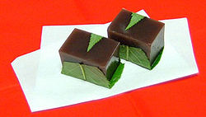
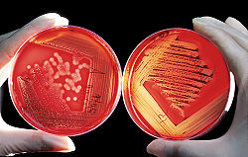
Agar Containing Agarose

Slide 4
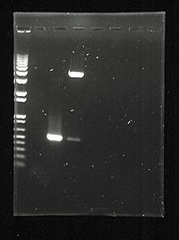
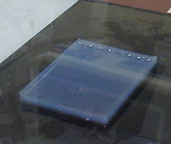
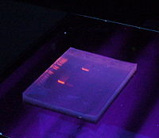
Agarose Gels

Slide 5
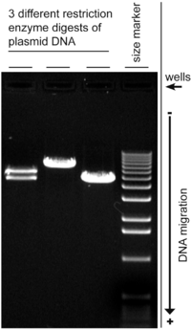
Comparison to a DNA Ladder

