Slide 1
Restriction Enzymes
Discovered in bacteria
Allow bacteria to protect themselves from viri
Specialized proteins (enzymes) that act as nucleases
Break bonds between nucleotides (building blocks of nucleic acids, including DNA)
Recognize specific, short sequences of nucleotides in DNA
Cleave DNA at the recognition sites

Slide 2
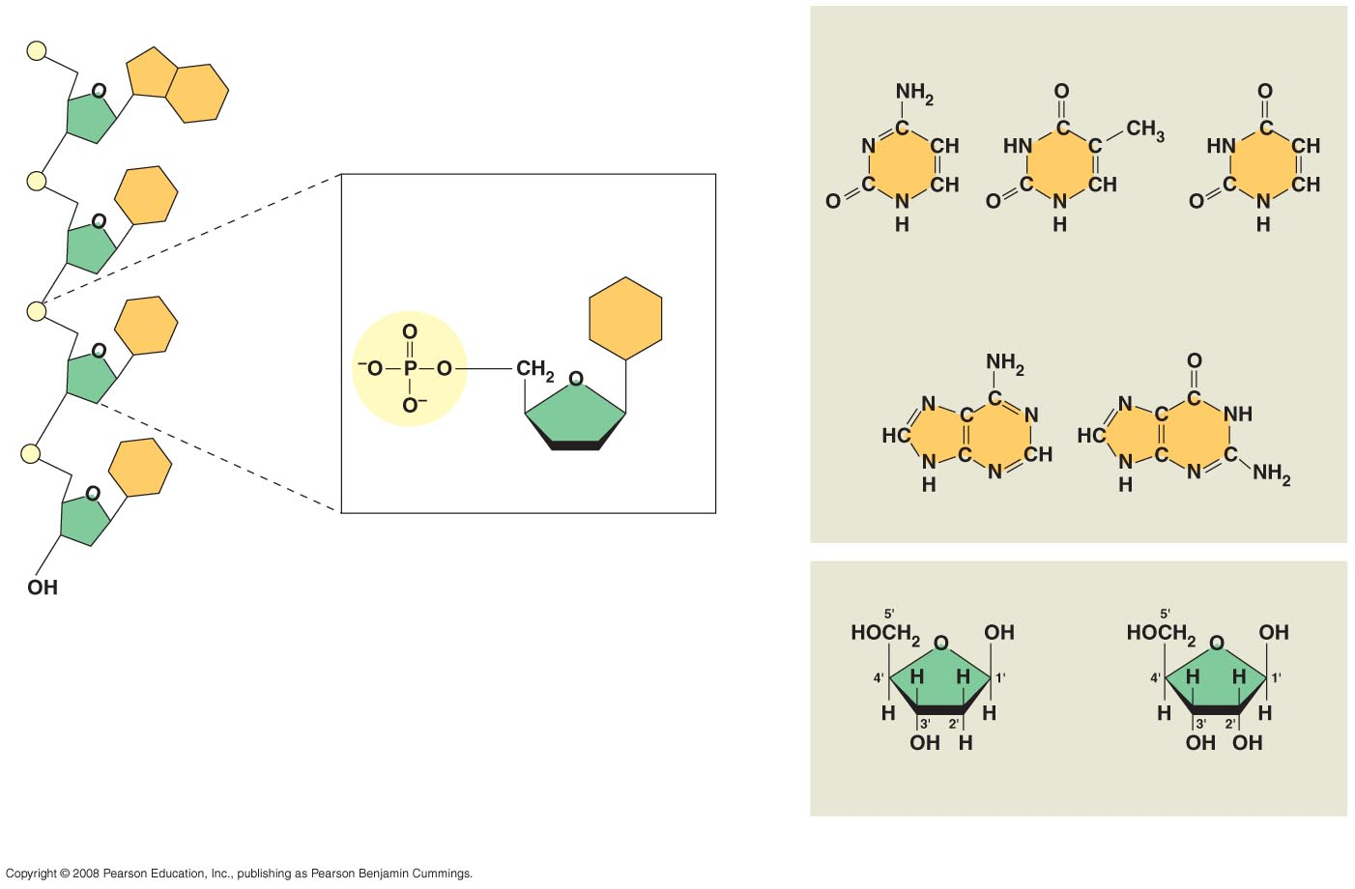
5′ end
Nitrogenous bases
Pyrimidines
5′C
3′C
Nucleoside
Nitrogenous
base
Cytosine (C)
Thymine (T, in DNA)
Uracil (U, in RNA)
Purines
Phosphate
group
5′C
Sugar
(pentose)
Adenine (A)
Guanine (G)
3′C
(b) Nucleotide
Sugars
3′ end
(a) Polynucleotide, or nucleic acid
Deoxyribose (in DNA)
Ribose (in RNA)
(c) Nucleoside components: sugars

Slide 3
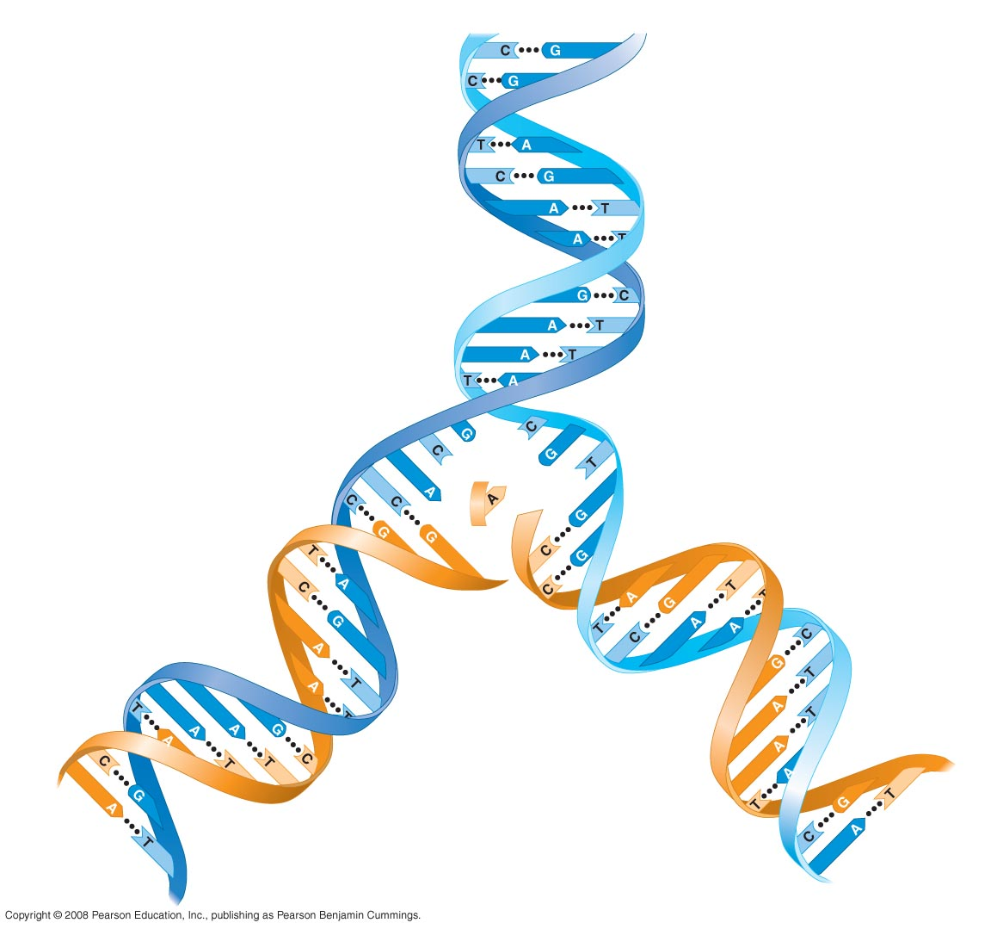
5' end
3' end
Sugar-phosphate
backbones
Base pair (joined by
hydrogen bonding)
Old strands
Nucleotide
about to be
added to a
new strand
3' end
5' end
New
strands
3' end
5' end
5' end
3' end

Slide 4
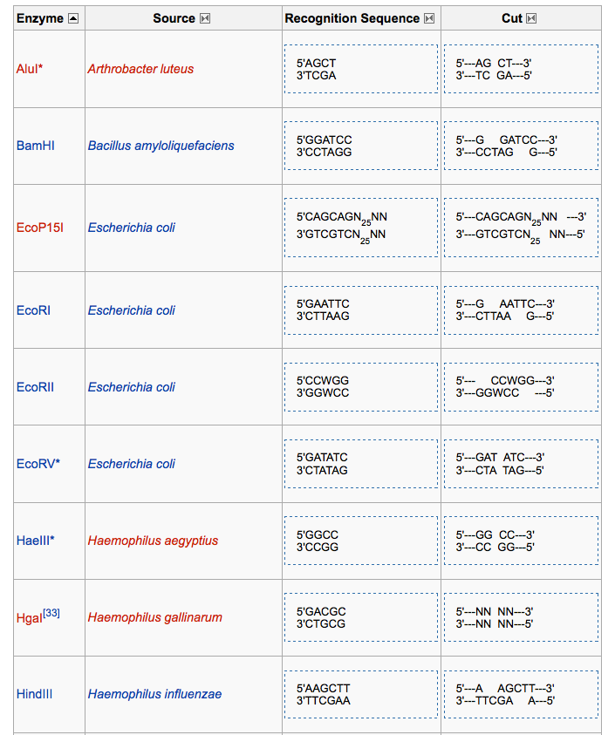

Slide 5
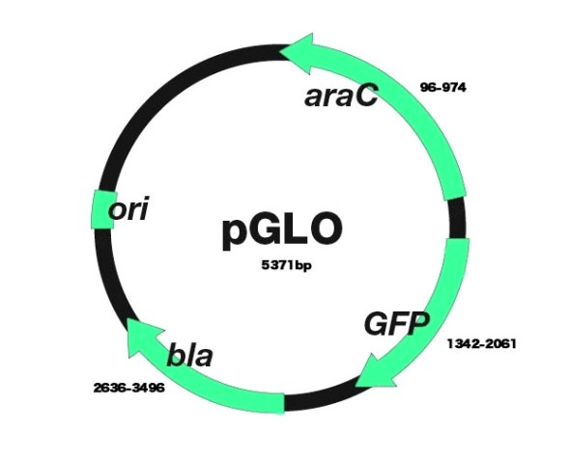

Slide 6
