Slide 1
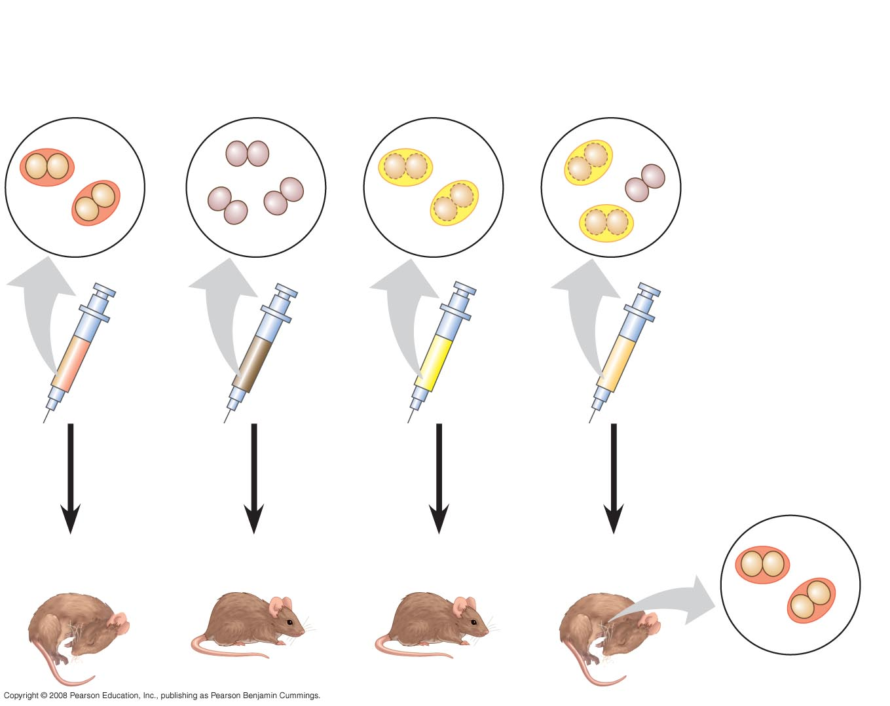
EXPERIMENT
Mixture of heat-killed S cells and living R cells
Living S cells (control)
Living R cells (control)
Heat-killed S cells (control)
RESULTS
Mouse dies
Mouse healthy
Mouse healthy
Mouse dies
Living S cells

Slide 2
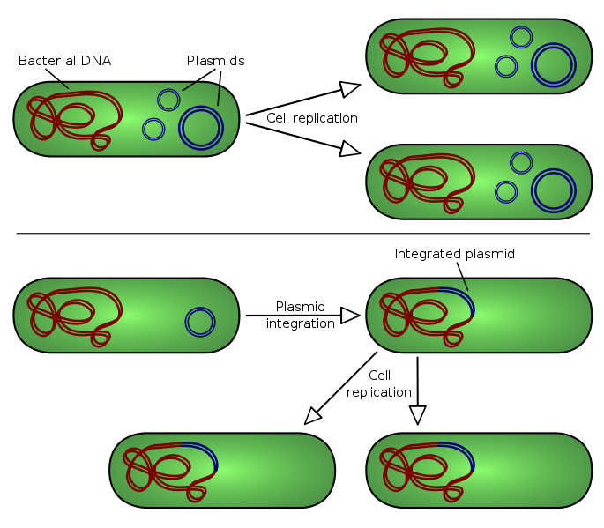

Slide 3
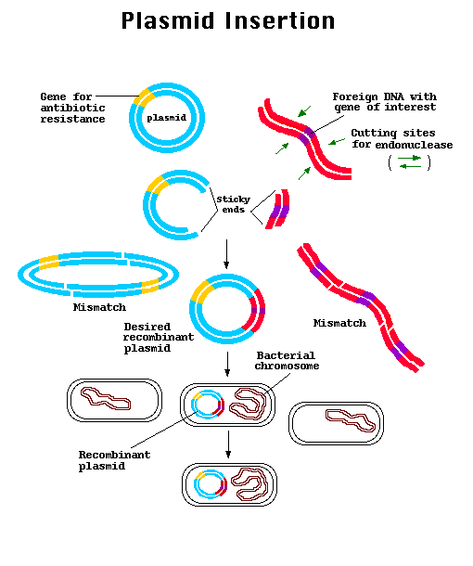

Slide 4
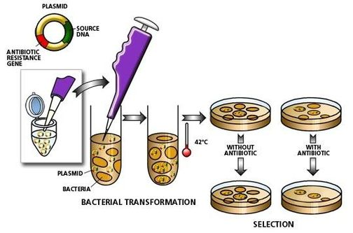

Slide 5
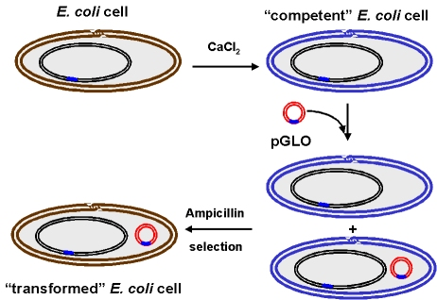

Slide 6
