Slide 1
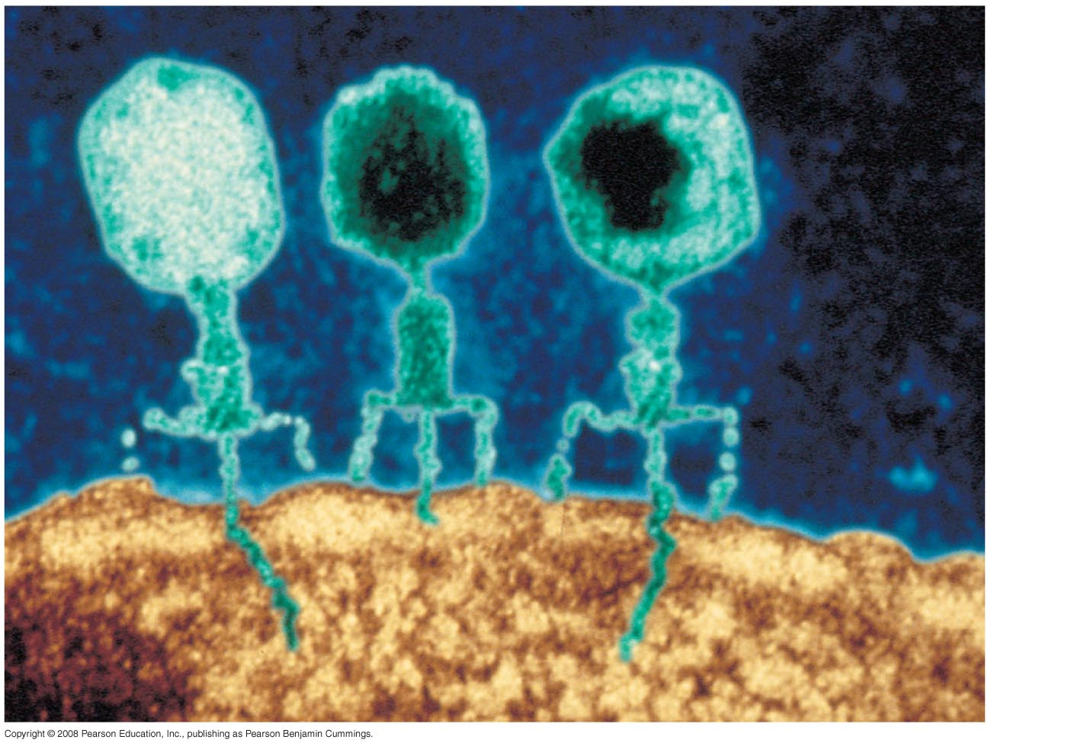
Phage head
Tail sheath
Tail fiber
DNA
100 nm
Bacterial
cell

Slide 2
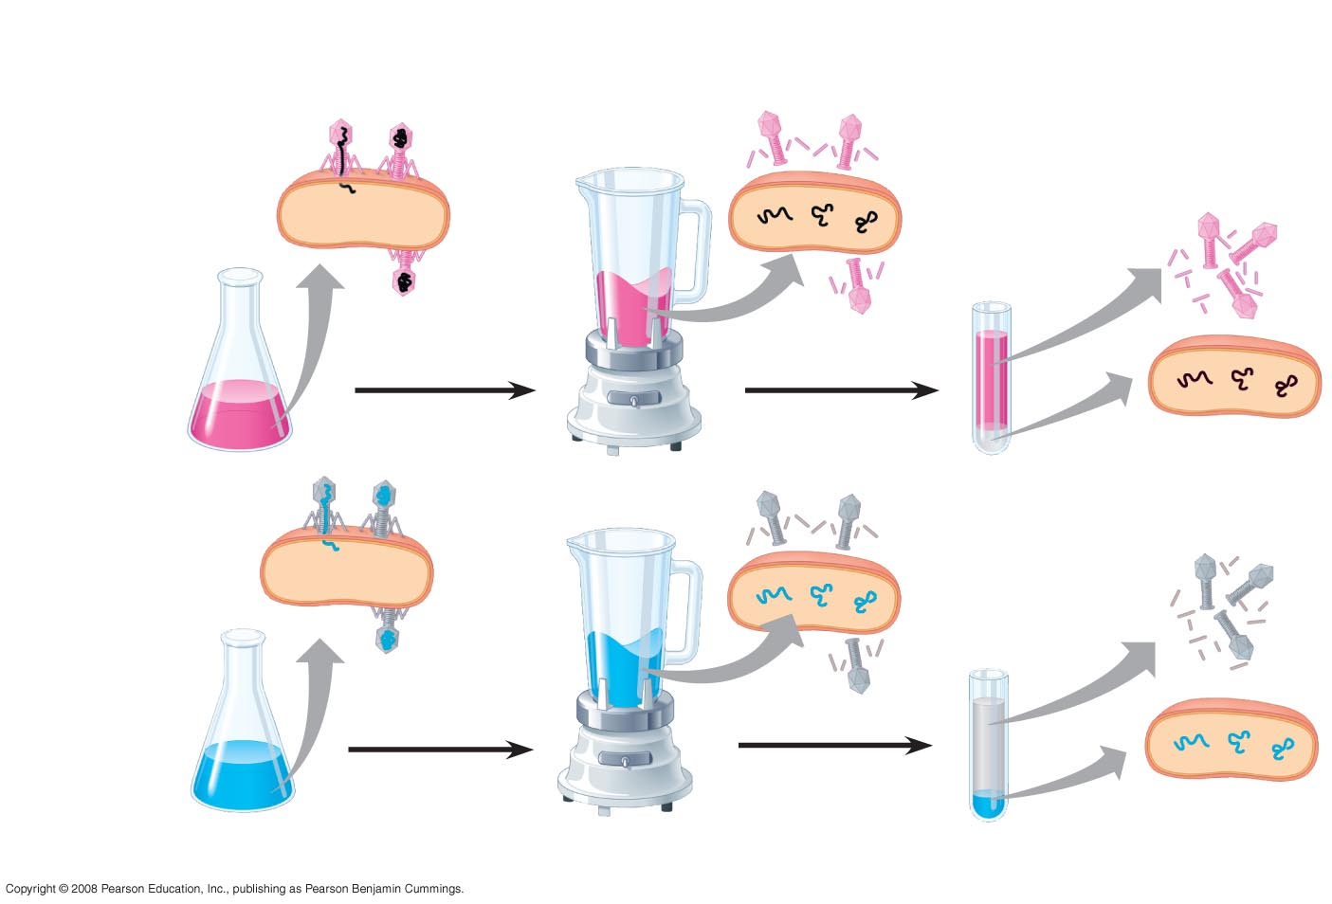
EXPERIMENT
Empty protein shell
Radioactivity (phage protein) in liquid
Phage
Radioactive protein
Bacterial cell
Batch 1: radioactive sulfur (³⁵S)
DNA
Phage DNA
Centrifuge
Radioactive DNA
Pellet (bacterial cells and contents)
Batch 2: radioactive phosphorus (³²P)
Centrifuge
Radioactivity (phage DNA) in pellet
Pellet

Slide 3
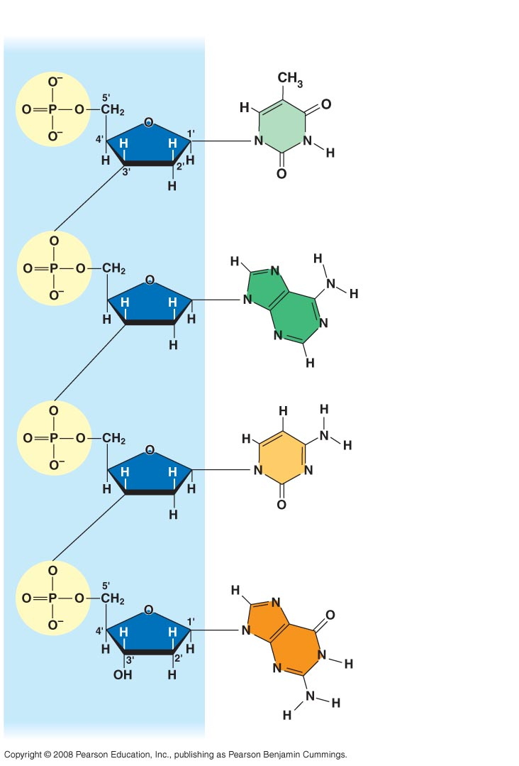
Sugar–phosphate backbone 5′ end
Nitrogenous bases
Thymine (T)
Adenine (A)
Cytosine (C)
Phosphate
DNA nucleotide
Sugar (deoxyribose) 3′ end
Guanine (G)

Slide 4
(a) Rosalind Franklin
(b) Franklin’s X-ray diffraction photograph of DNA

Slide 5
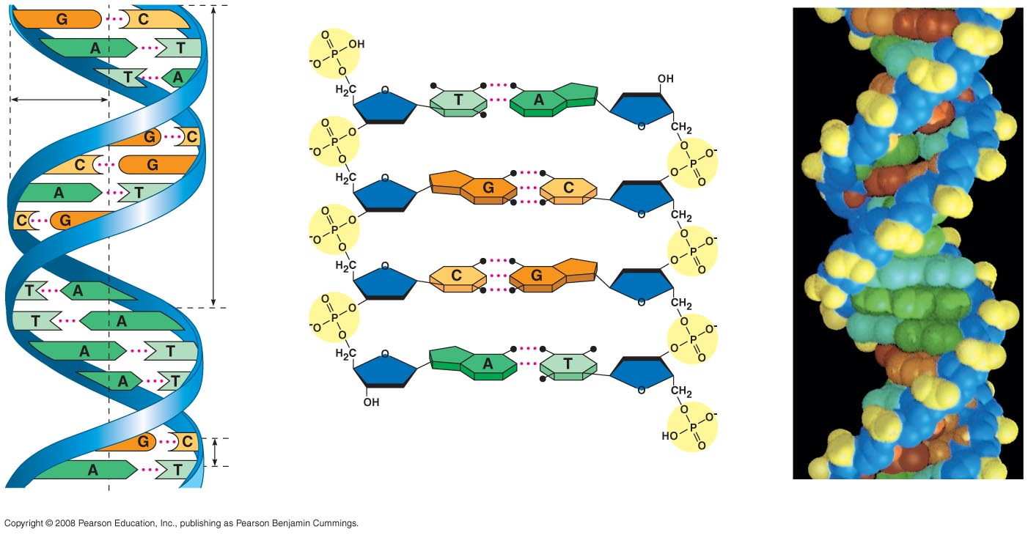
5′ end
Hydrogen bond
3′ end
1 nm
3.4 nm
3′ end
0.34 nm
5′ end
(a) Key features of DNA structure
(b) Partial chemical structure
(c) Space-filling model

Slide 6
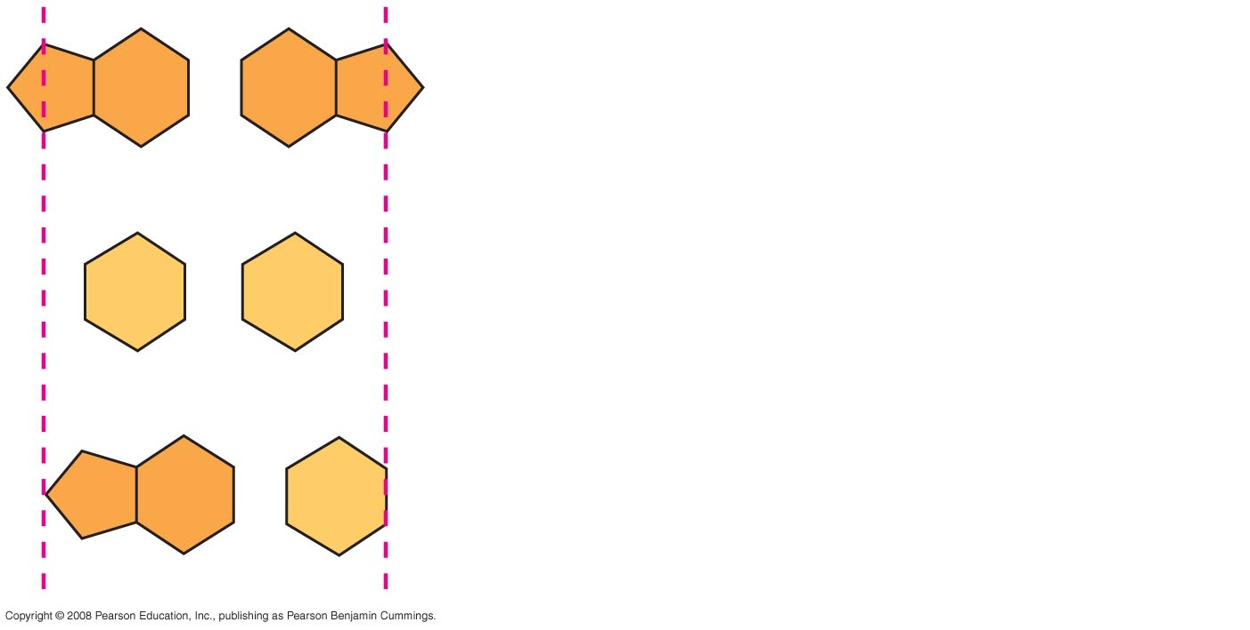
Purine + purine: too wide
Pyrimidine + pyrimidine: too narrow
Purine + pyrimidine: width consistent with X-ray data

Slide 7
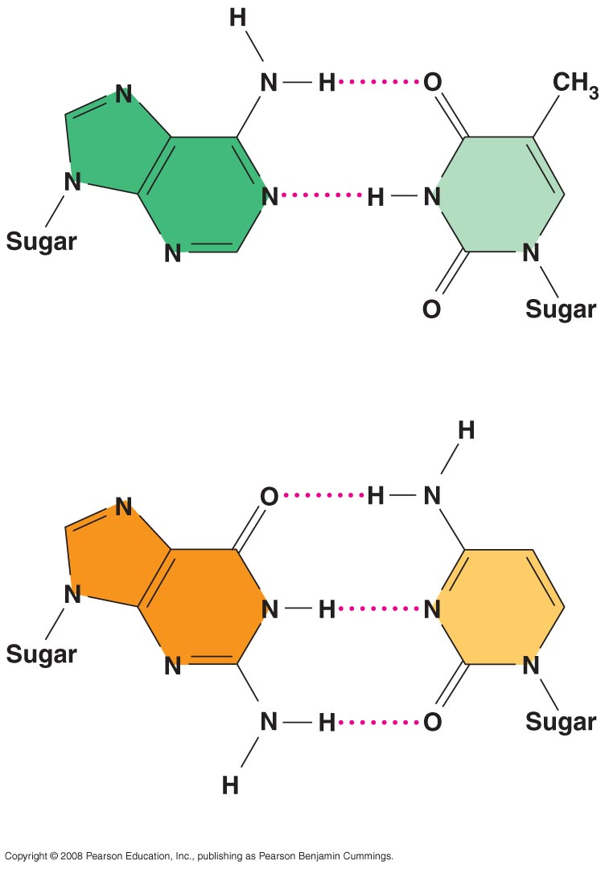
Adenine (A)
Thymine (T)
Guanine (G)
Cytosine (C)

Slide 8
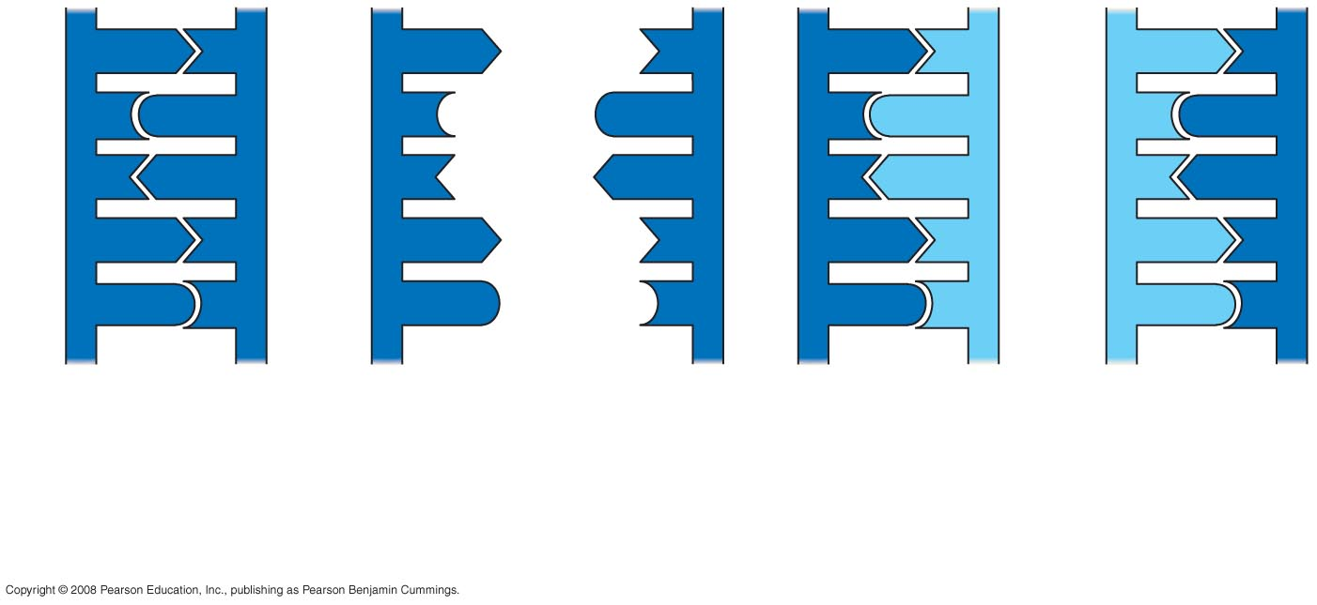
A
T
A
T
A
T
A
T
C
G
C
G
C
G
C
G
T
A
T
A
T
A
T
A
A
T
A
T
A
T
A
T
G
C
G
C
G
C
G
C
(a) Parent molecule
(b) Separation of strands
(c) “Daughter” DNA molecules, each consisting of one parental strand and one new strand

Slide 9
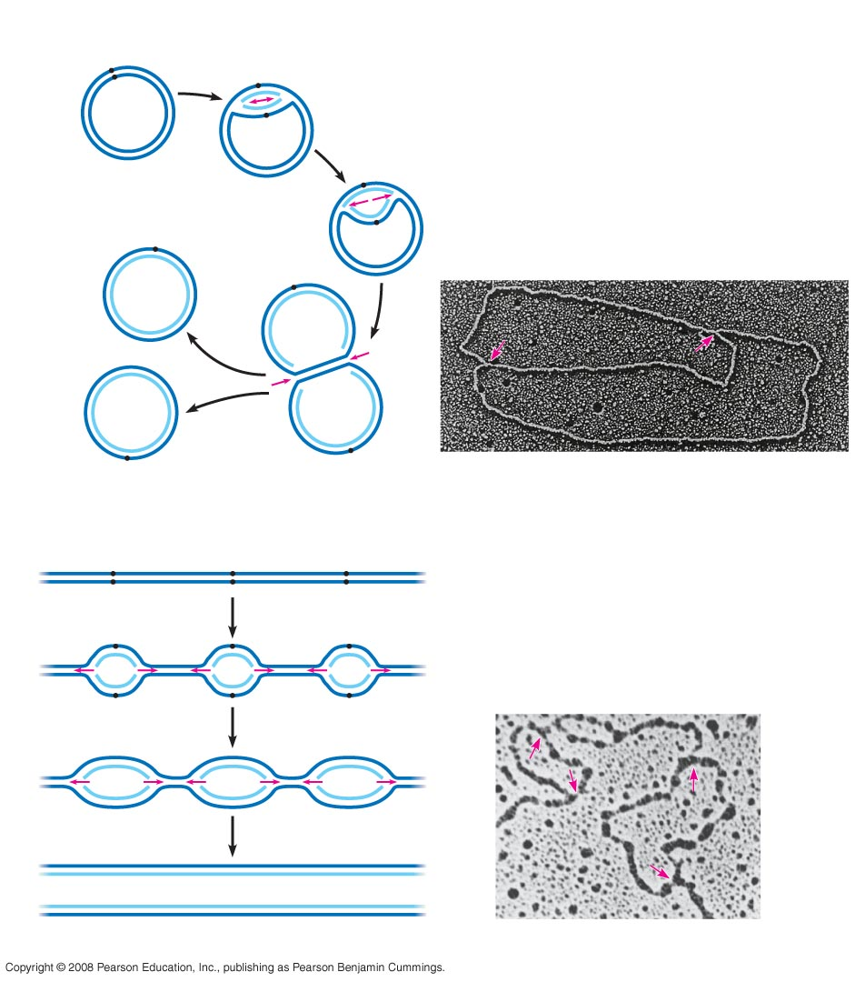
Origin of replication
Parental (template) strand
Daughter (new) strand
Double-
stranded
DNA molecule
Replication fork
Replication bubble
0.5 µm
Two daughter DNA molecules
(a) Origins of replication in E. coli
Origin of replication
Double-stranded DNA molecule
Parental (template) strand
Daughter (new) strand
0.25 µm
Replication fork
Bubble
Two daughter DNA molecules
(b) Origins of replication in eukaryotes

Slide 10
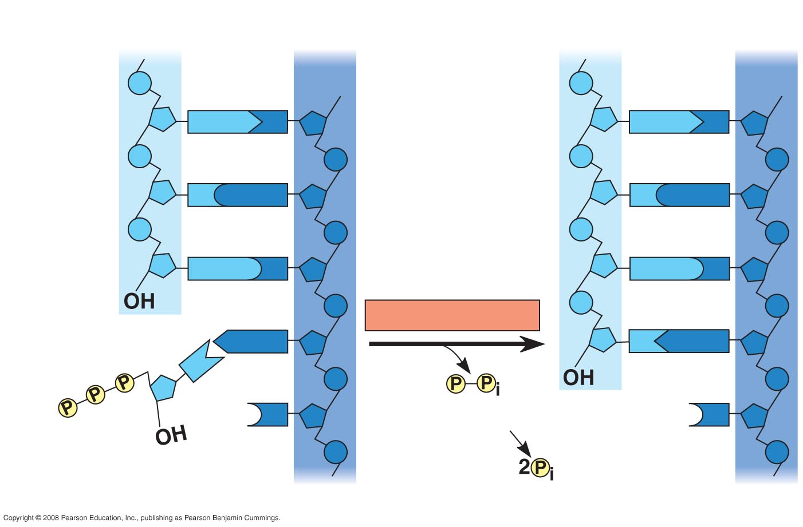
New strand 5′ end
Template strand 3′ end
5′ end
3′ end
Sugar
A
T
A
T
Phosphate
Base
C
G
C
G
G
C
G
C
DNA polymerase
3′ end
A
T
A
T
C
Pyrophosphate
3′ end
C
Nucleoside triphosphate
5′ end
5′ end

Slide 11
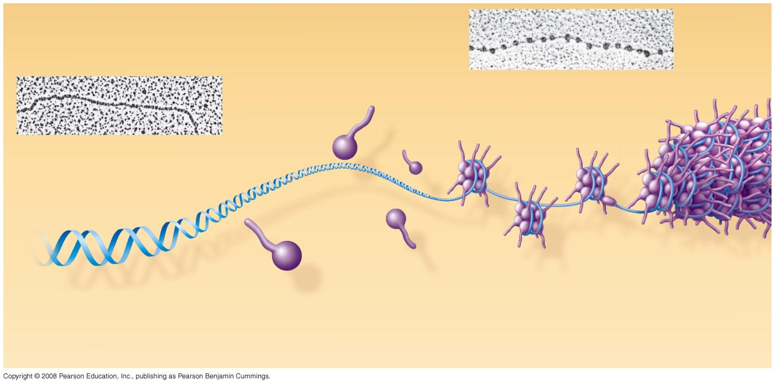
Nucleosome
(10 nm in diameter)
DNA double helix (2 nm in diameter)
H1
Histone tail
Histones
DNA, the double helix
Histones
Nucleosomes, or “beads on a string” (10-nm fiber)

Slide 12
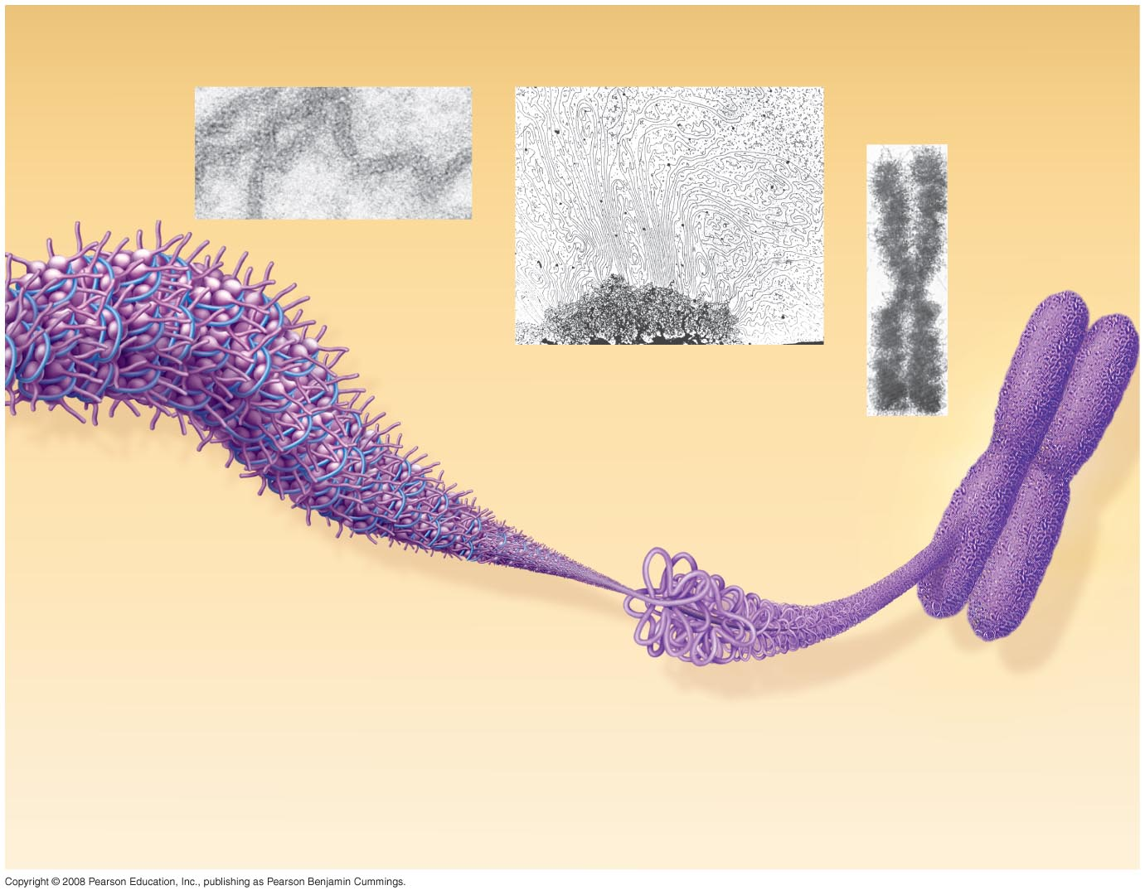
Chromatid
(700 nm)
30-nm fiber
Loops
Scaffold
300-nm fiber
Replicated chromosome (1,400 nm)
30-nm fiber
Looped domains (300-nm fiber)
Metaphase chromosome

