Slide 1
Biological Macromolecules
Much larger than other particles found in cells
Made up of smaller subunits
Found in all cells
Great diversity of functions

Slide 2
Four Classes of Biological Macromolecules
Lipids
Polysaccharides
Proteins
Nucleic Acids

Slide 3
Lipids
Hydrophobic or amphipathic
Important for:
energy storage
membrane structure
signaling
cushioning
insulation
Include:
fats
phospholipids
cholesterol and phytosterol
some hormones
others

Slide 4
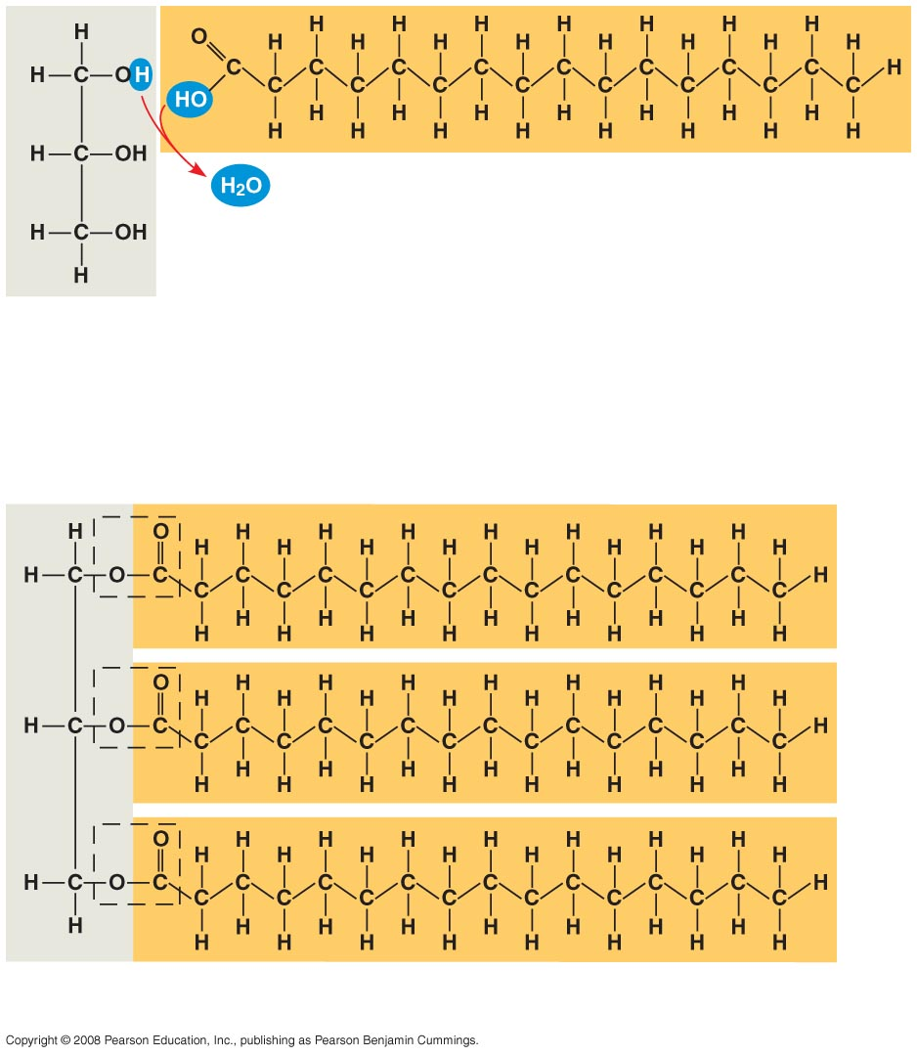
Fatty acid
(palmitic acid)
Glycerol
(a) Dehydration reaction in the synthesis of a fat
Ester linkage
(b) Fat molecule (triacylglycerol)

Slide 5
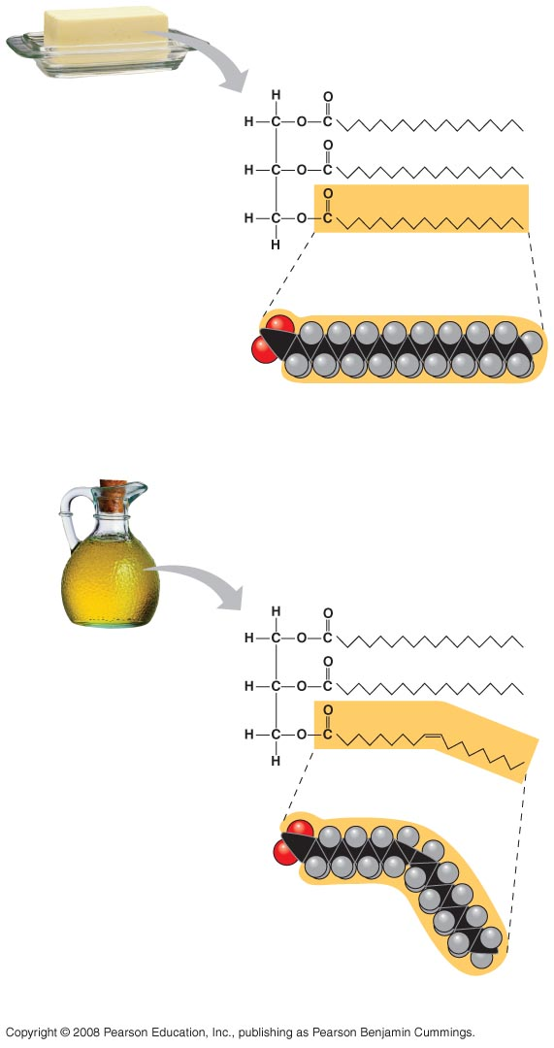
Structural
formula of a
saturated fat
molecule
Stearic acid, a
saturated fatty
acid
(a) Saturated fat
Structural formula
of an unsaturated
fat molecule
Oleic acid, an
unsaturated
fatty acid
cis double
bond causes
bending
(b) Unsaturated fat

Slide 6
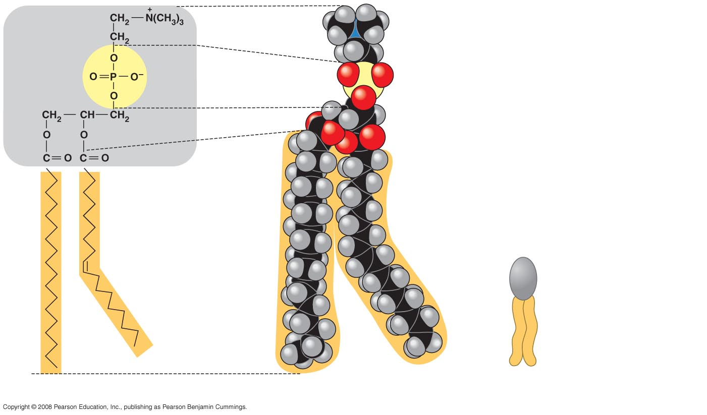
Choline
Hydrophilic head
Phosphate
Glycerol
Fatty acids
Hydrophobic tails
Hydrophilic
head
Hydrophobic
tails
(a)
Structural formula
(b)
Space-filling model
(c)
Phospholipid symbol

Slide 7
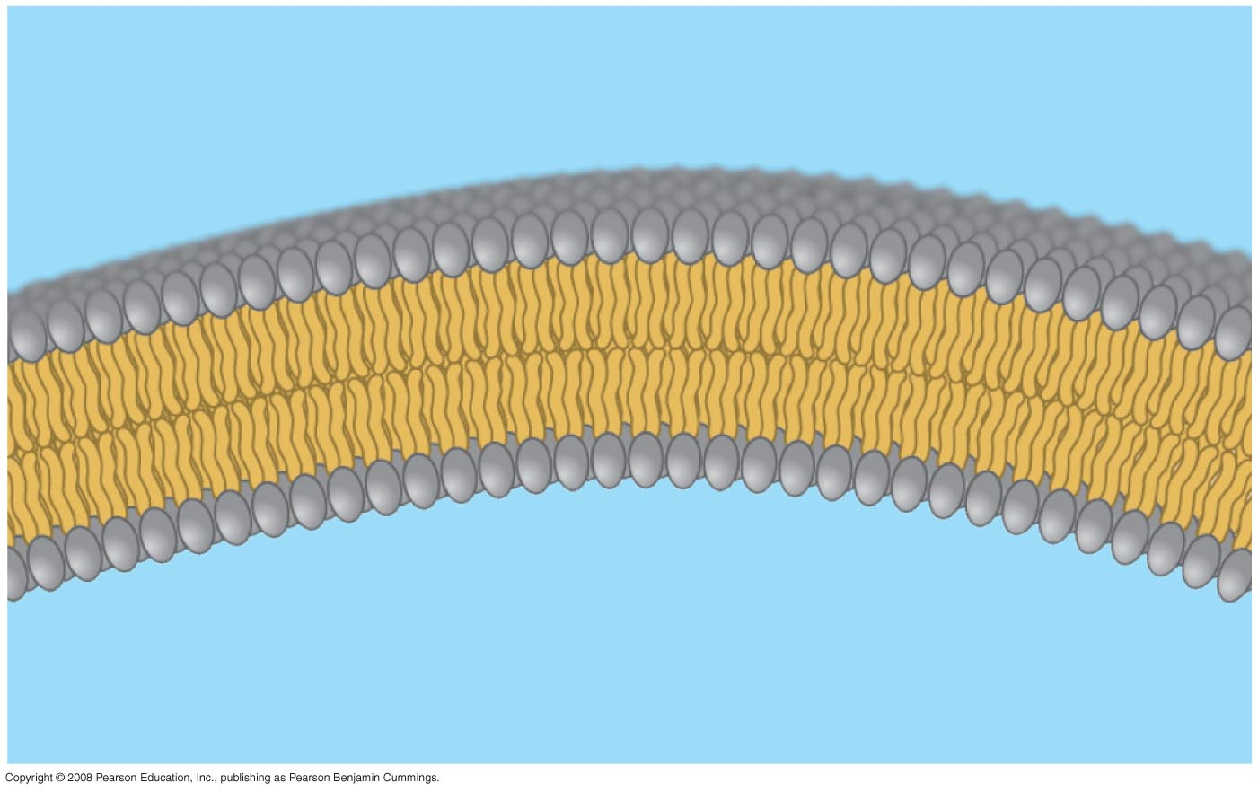
Hydrophilic
head
WATER
Hydrophobic
tail
WATER

Slide 8
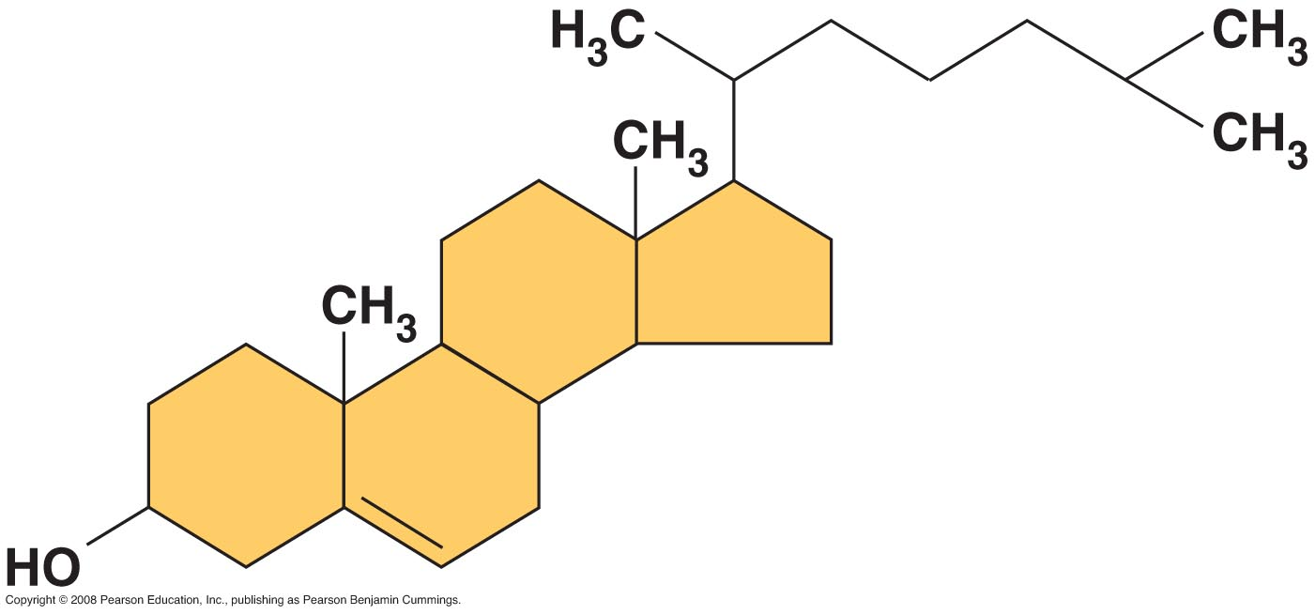

Slide 9
Polysaccharides
Complex sugars
Polymers of monosaccharides (simple sugars)
Polysaccharides and monosaccharides are carbohydrates
Important for:
structure
storage of energy
cell identity marking

Slide 10
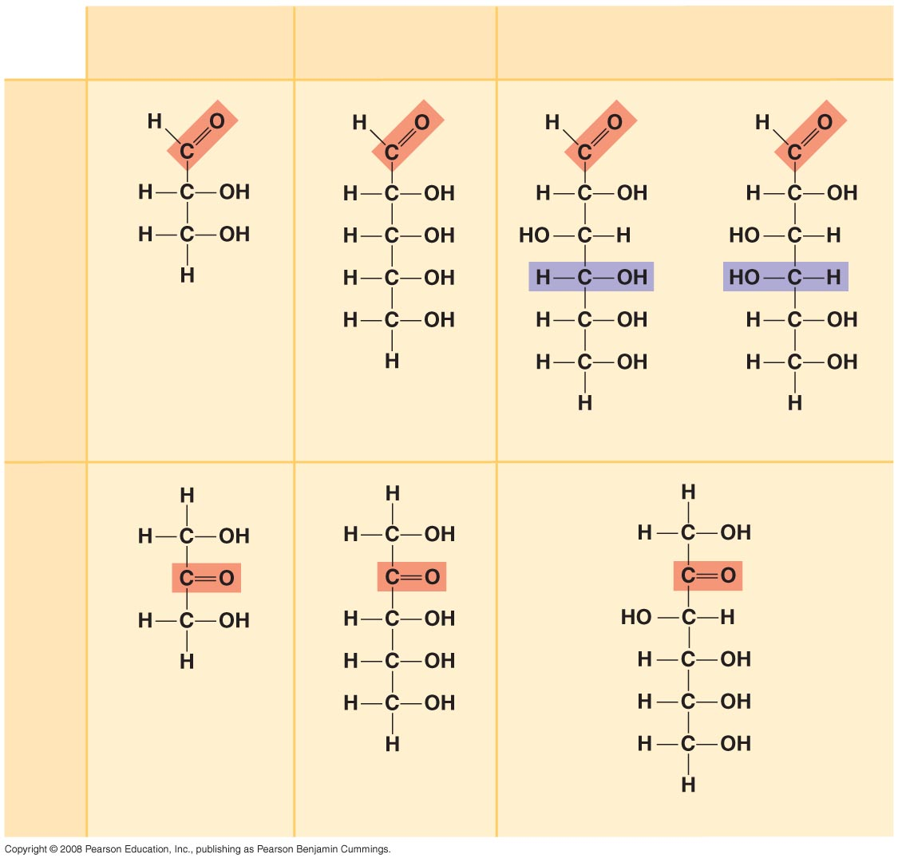
Trioses (C₃H₆O₃)
Pentoses (C₅H₁₀O₅)
Hexoses (C₆H₁₂O₆)
Aldoses
Glyceraldehyde
Ribose
Glucose
Galactose
Ketoses
Dihydroxyacetone
Ribulose
Fructose

Slide 11
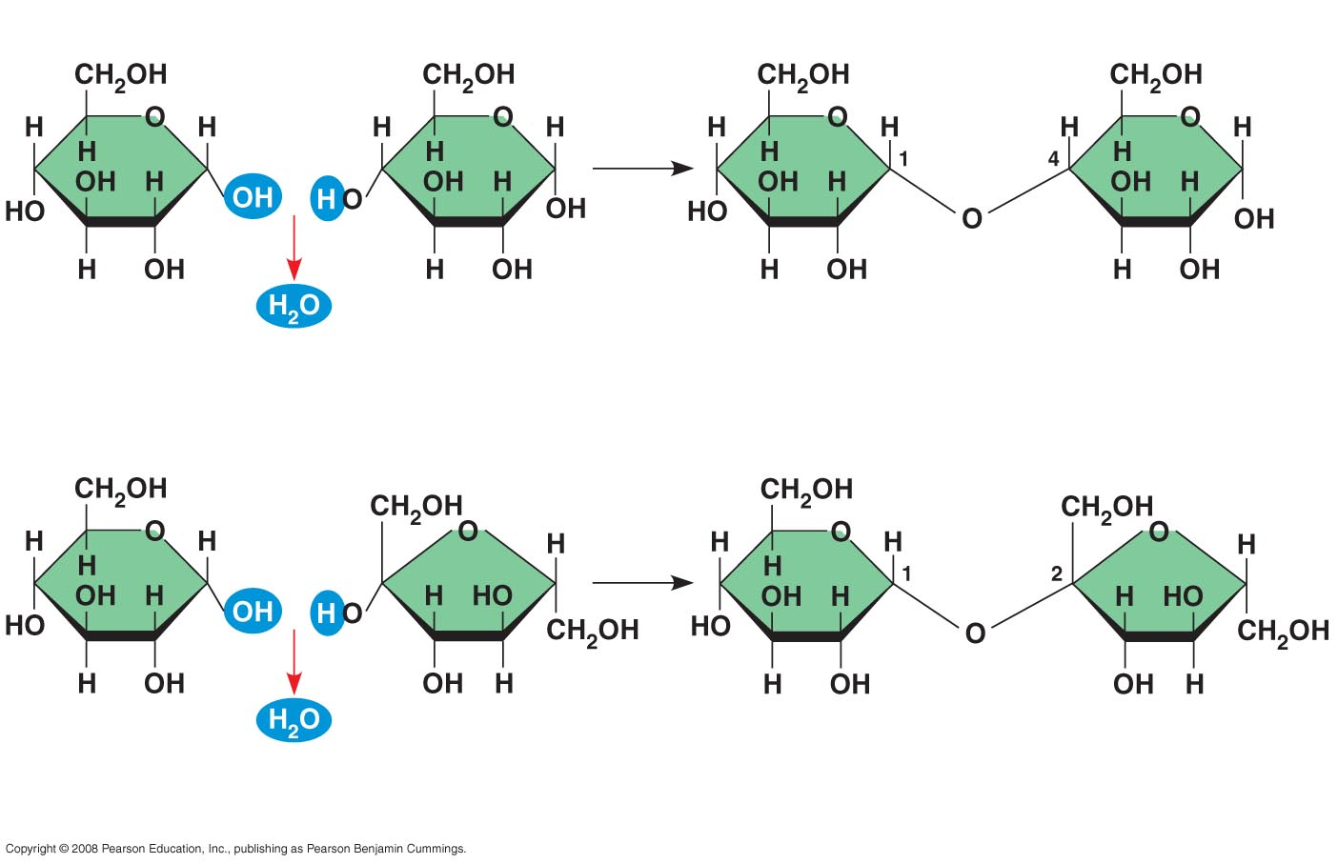
1–4
glycosidic
linkage
Glucose
Glucose
Maltose
(a) Dehydration reaction in the synthesis of maltose
1–2
glycosidic
linkage
Glucose
Fructose
Sucrose
(b) Dehydration reaction in the synthesis of sucrose

Slide 12
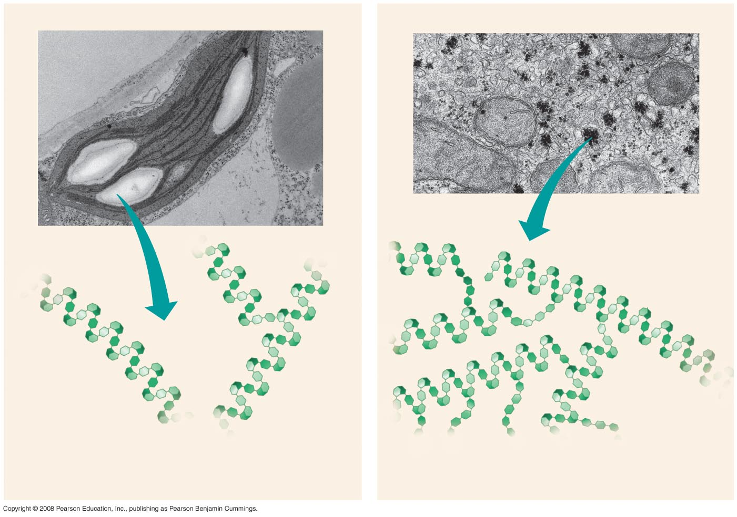
Chloroplast
Starch
Mitochondria
Glycogen granules
0.5 µm
1 µm
Amylose
Glycogen
Amylopectin
(a) Starch: a plant polysaccharide
(b) Glycogen: an animal polysaccharide

Slide 13
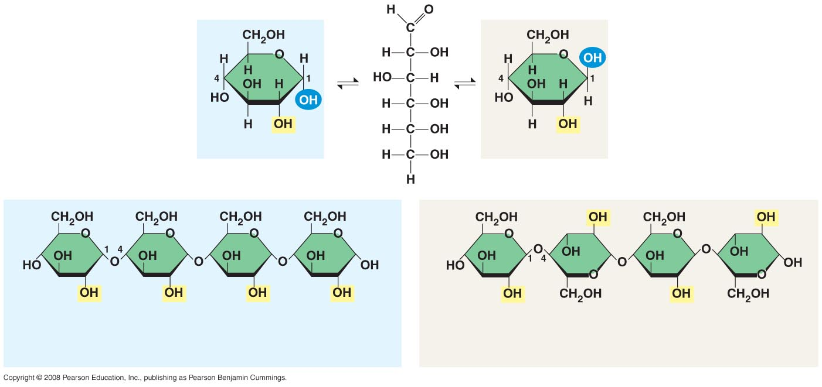
(a) α and β glucose
ring structures
α Glucose
β Glucose
(b) Starch: 1–4 linkage of α glucose monomers
(b) Cellulose: 1–4 linkage of β glucose monomers

Slide 14
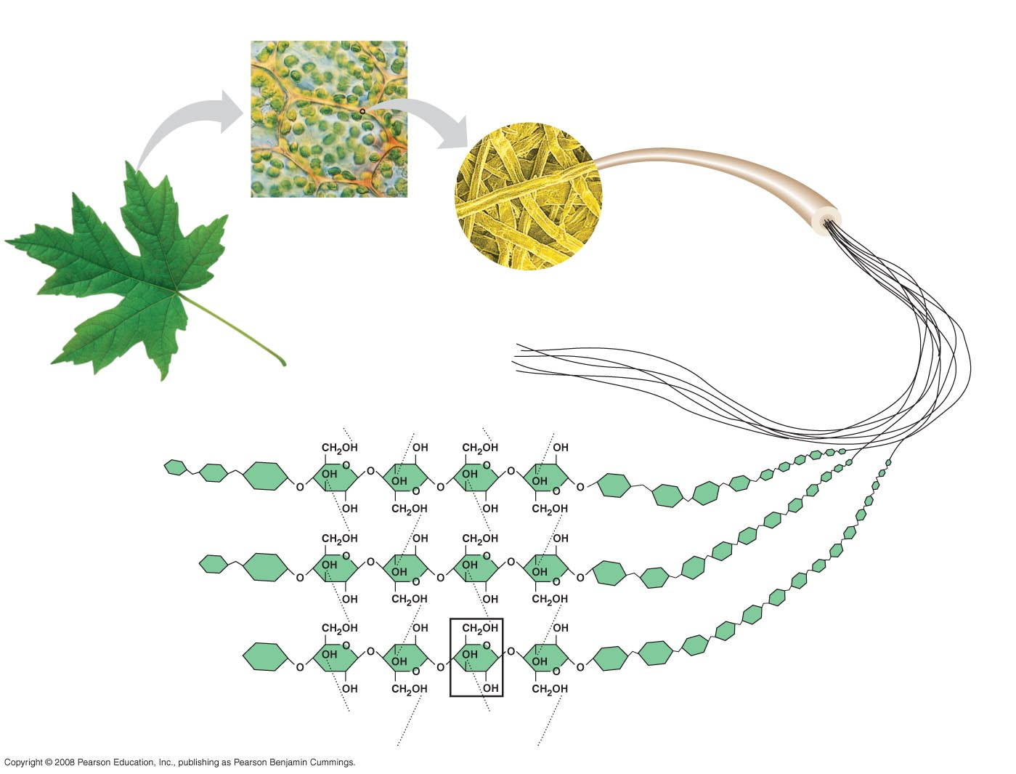
Cell walls
Cellulose
microfibrils
in a plant
cell wall
Microfibril
10 µm
0.5 µm
Cellulose
molecules
Glucose
monomer

Slide 15
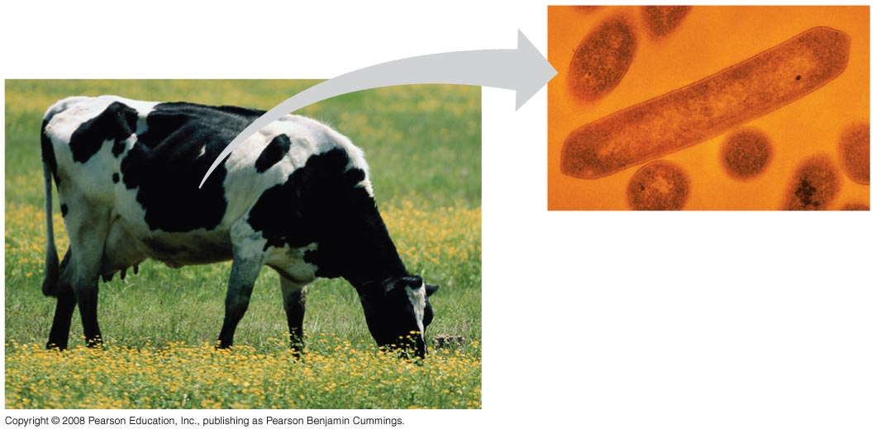

Slide 16
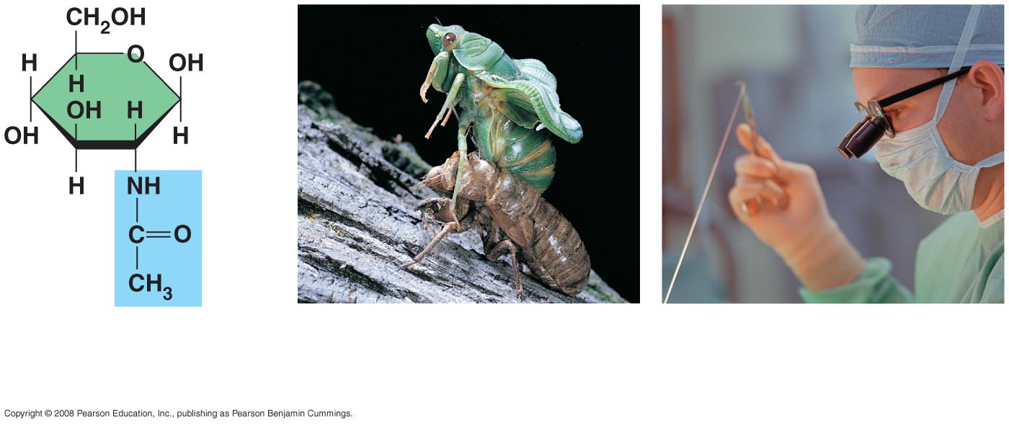
(a)
The structure
of the chitin
monomer.
(b)
Chitin forms the
exoskeleton of
arthropods.
(c)
Chitin is used to make
a strong and flexible
surgical thread.

Slide 17
Proteins
Polymers of amino acids
Highly complex shape
Function is based on shape
Huge variety of functions

Slide 18
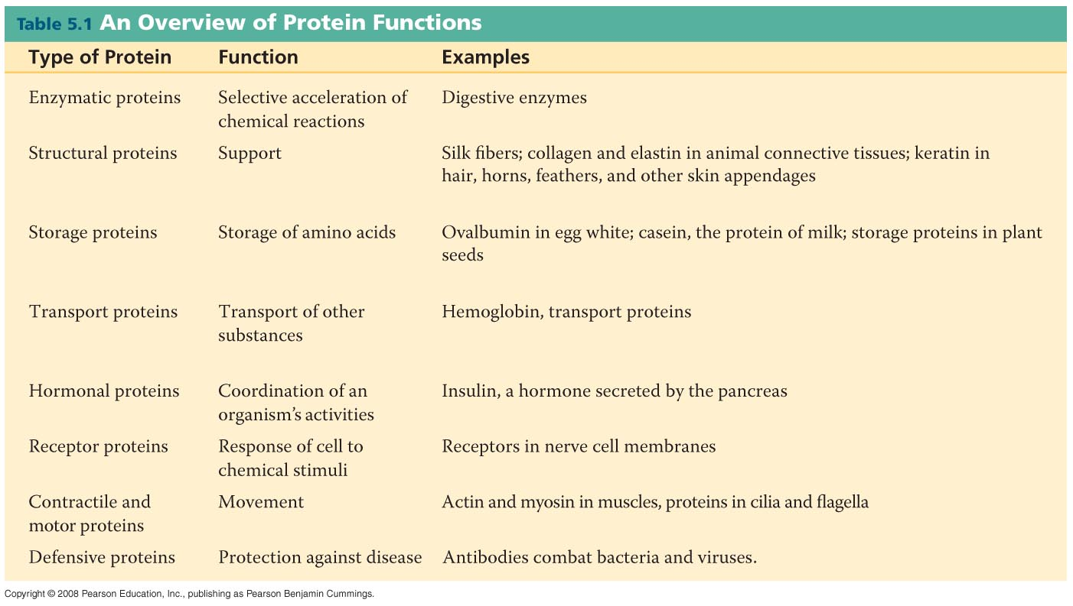

Slide 19
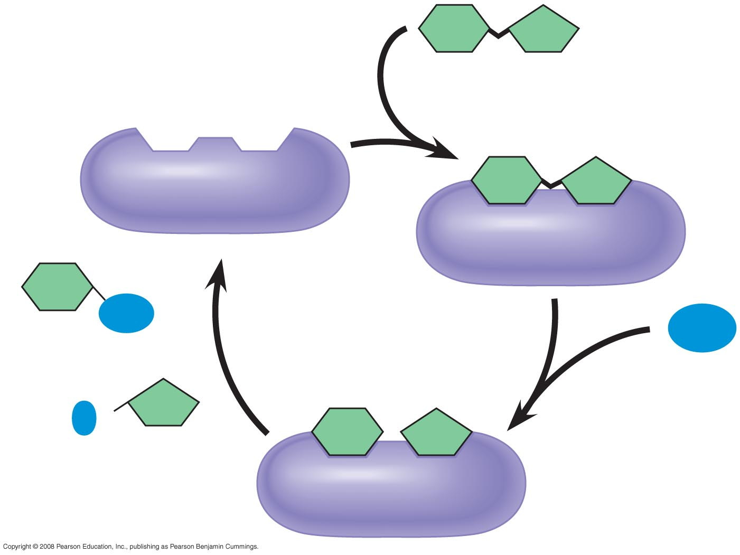
Substrate
(sucrose)
Glucose
Enzyme
(sucrase)
OH
H₂O
Fructose
H
O

Slide 20
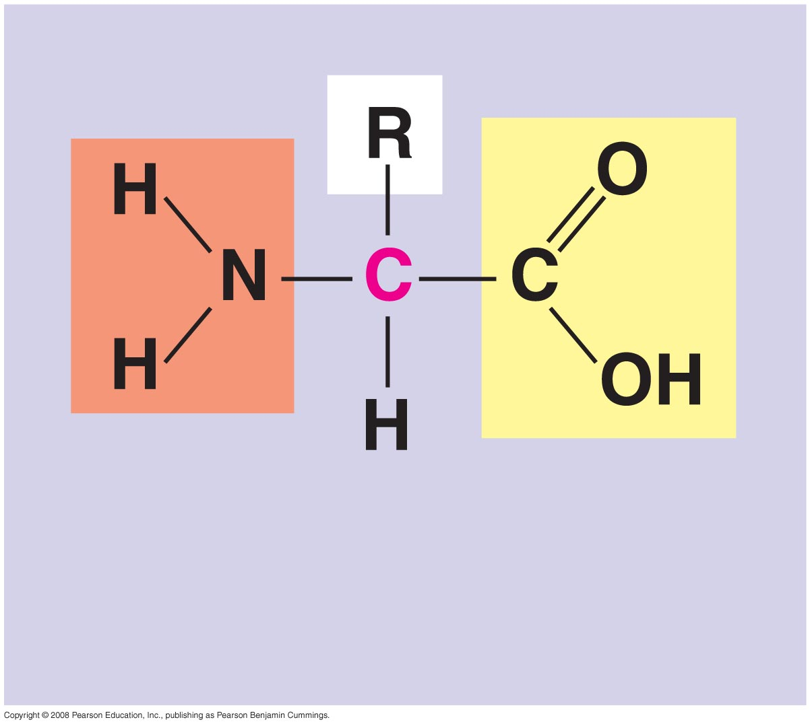
α carbon
Amino
group
Carboxyl
group

Slide 21
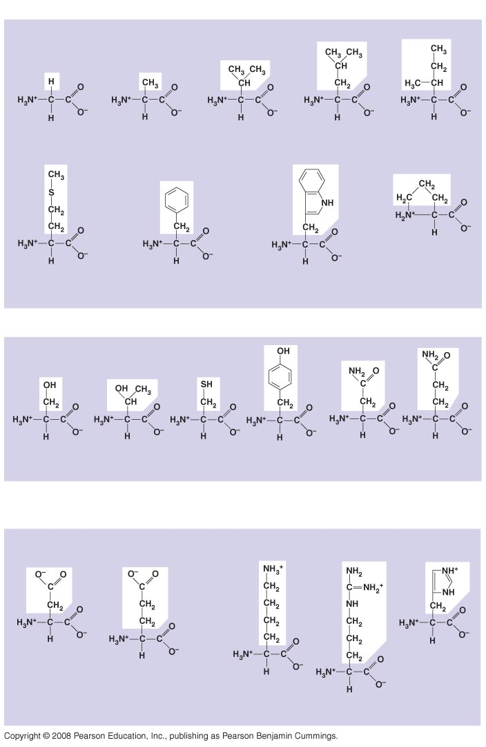
Nonpolar
Glycine
(Gly or G)
Alanine
(Ala or A)
Valine
(Val or V)
Leucine
(Leu or L)
Isoleucine
(Ile or I)
Methionine
(Met or M)
Phenylalanine
(Phe or F)
Trypotphan
(Trp or W)
Proline
(Pro or P)
Polar
Serine
(Ser or S)
Threonine
(Thr or T)
Cysteine
(Cys or C)
Tyrosine
(Tyr or Y)
Asparagine
(Asn or N)
Glutamine
(Gln or Q)
Electrically
charged
Acidic
Basic
Aspartic acid
(Asp or D)
Glutamic acid
(Glu or E)
Lysine
(Lys or K)
Arginine
(Arg or R)
Histidine
(His or H)

Slide 22
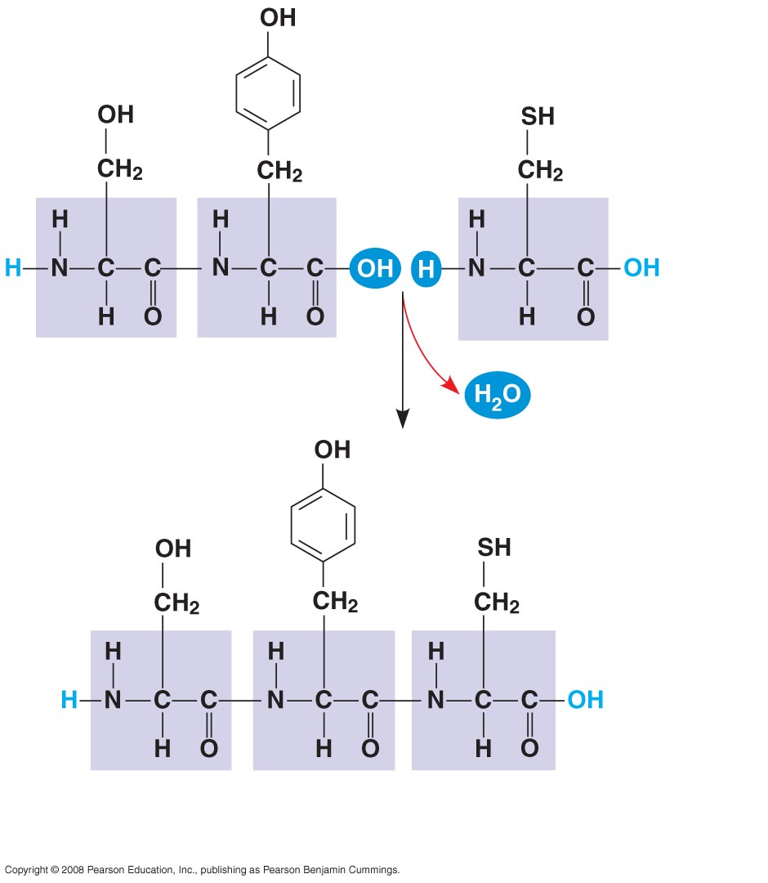
Peptide
bond
(a)
Side chains
Peptide
bond
Backbone
Amino end
(N-terminus)
Carboxyl end
(C-terminus)
(b)

Slide 23
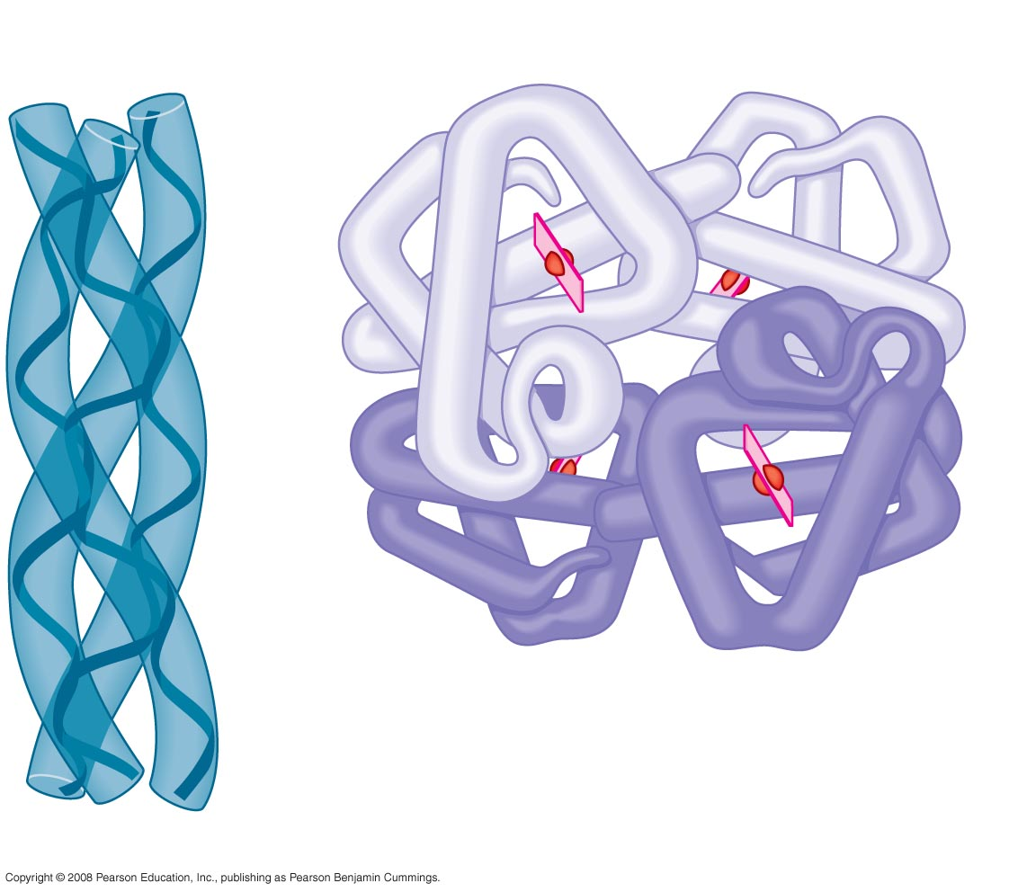
Polypeptide
chain
β Chains
Iron
Heme
α Chains
Hemoglobin
Collagen

Slide 24
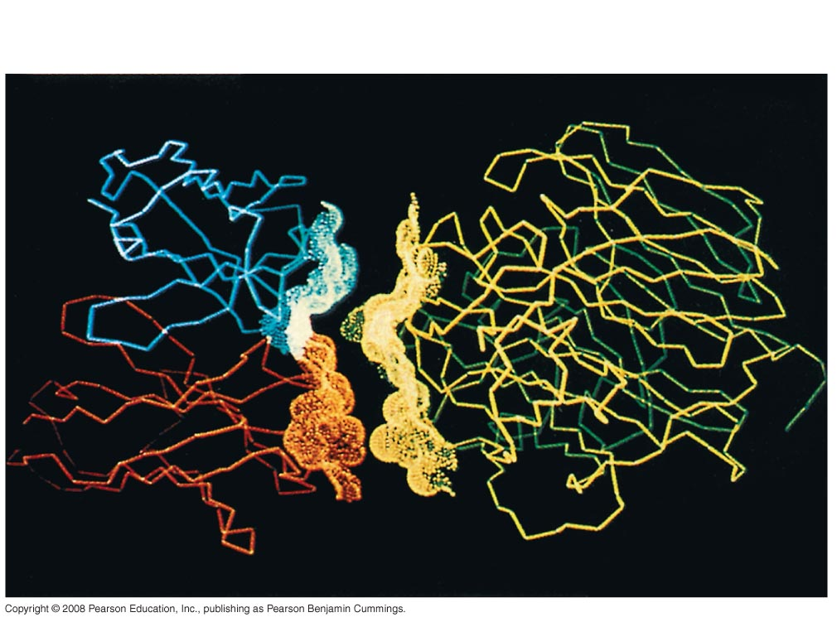
Antibody protein
Protein from flu virus

Slide 25
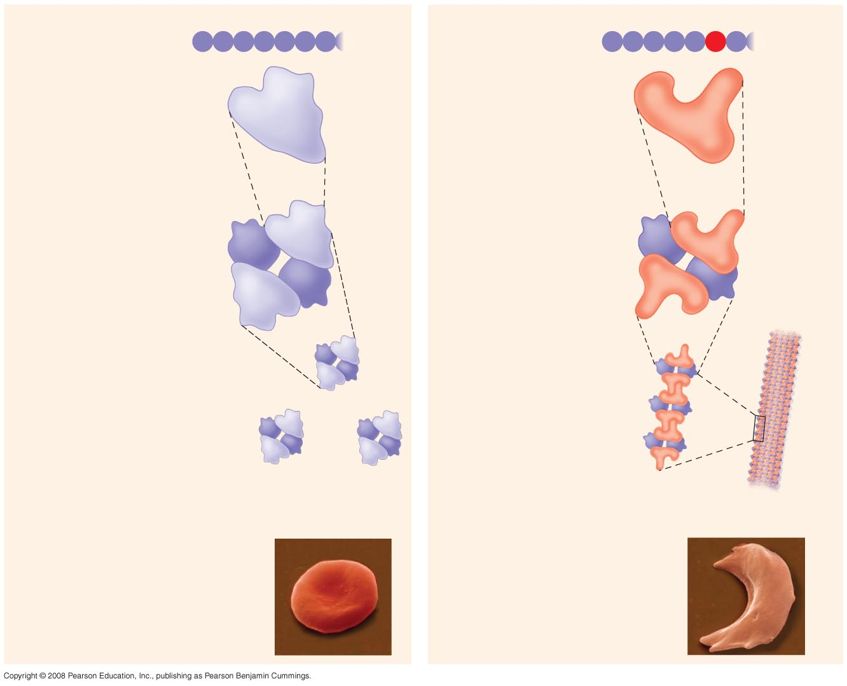
Normal hemoglobin
Primary
structure
Sickle-cell hemoglobin
Primary
structure
Val
His
Leu
Thr
Pro
Glu
Glu
Val
His
Leu
Thr
Pro
Val
Glu
1
2
3
4
5
6
7
1
2
3
4
5
6
7
Secondary
and tertiary
structures
Secondary
and tertiary
structures
Exposed
hydrophobic
region
β subunit
β subunit
α
β
α
Quaternary
structure
Normal
hemoglobin
(top view)
Quaternary
structure
Sickle-cell
hemoglobin
β
β
α
β
α
Function
Molecules do
not associate
with one
another; each
carries oxygen.
Function
Molecules
interact with
one another and
crystallize into
a fiber; capacity
to carry oxygen
is greatly reduced.
10 µm
10 µm
Red blood
cell shape
Normal red blood
cells are full of
individual
hemoglobin
moledules, each
carrying oxygen.
Red blood
cell shape
Fibers of abnormal
hemoglobin deform
red blood cell into
sickle shape.

Slide 26
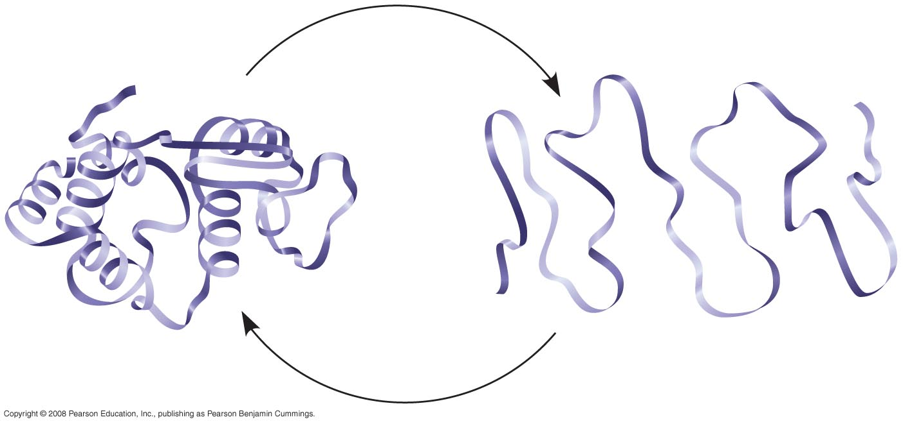
Denaturation
Normal protein
Renaturation
Denatured protein

Slide 27
Nucleic Acids
Polymers of nucleotides
also called polynucleotides
Store and convey information
Instruction manual of the cell
Include:
DNA (deoxyribonucleic acid)
RNA (ribonucleic acid)
Important for:
reproduction of cells
production of proteins

Slide 28
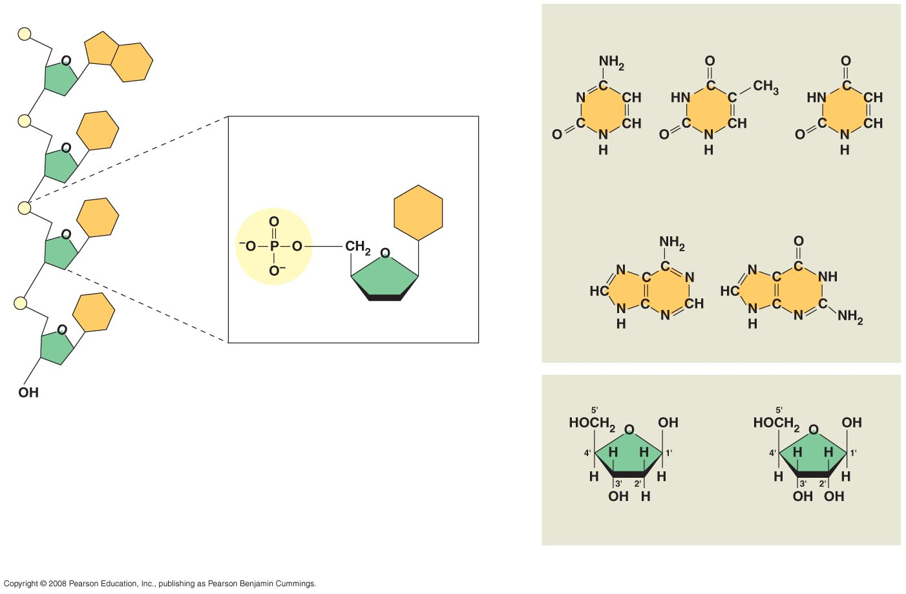
5′ end
Nitrogenous bases
Pyrimidines
5′C
3′C
Nucleoside
Nitrogenous
base
Cytosine (C)
Thymine (T, in DNA)
Uracil (U, in RNA)
Purines
Phosphate
group
5′C
Sugar
(pentose)
Adenine (A)
Guanine (G)
3′C
(b) Nucleotide
Sugars
3′ end
(a) Polynucleotide, or nucleic acid
Deoxyribose (in DNA)
Ribose (in RNA)
(c) Nucleoside components: sugars

Slide 29
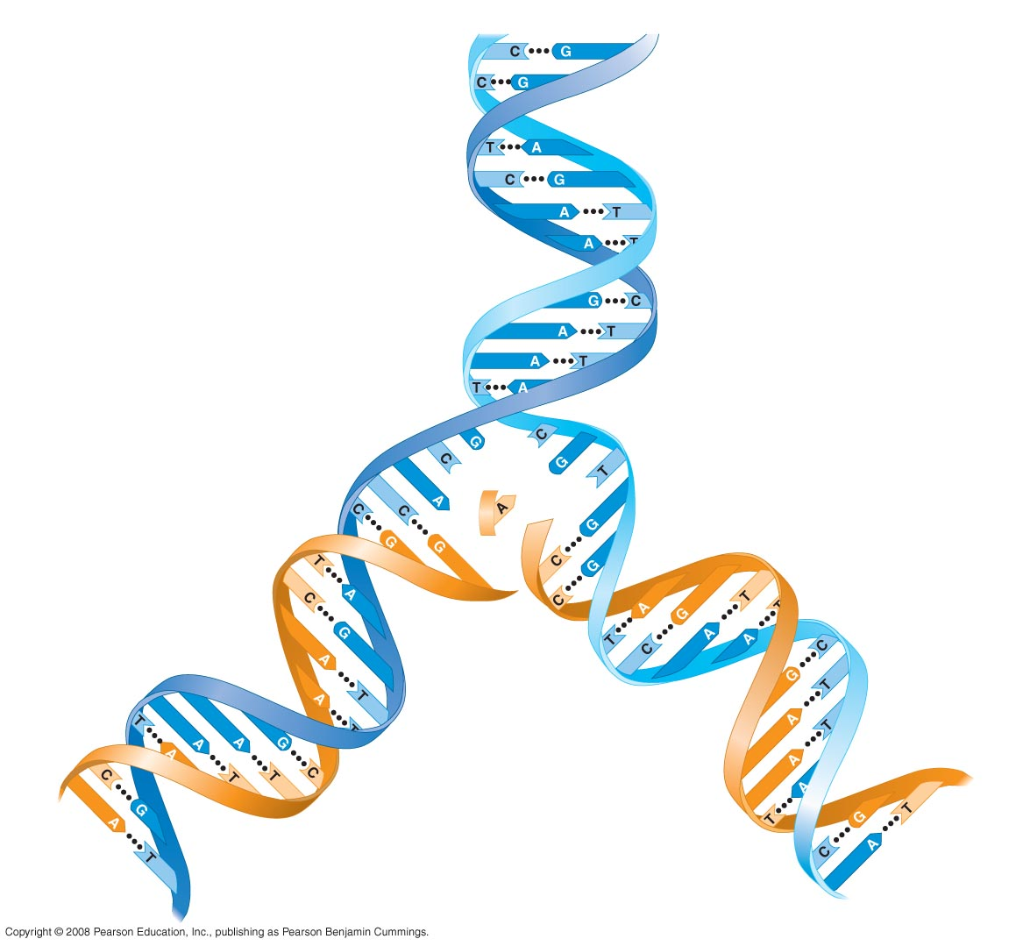
5' end
3' end
Sugar-phosphate
backbones
Base pair (joined by
hydrogen bonding)
Old strands
Nucleotide
about to be
added to a
new strand
3' end
5' end
New
strands
3' end
5' end
5' end
3' end

Slide 30
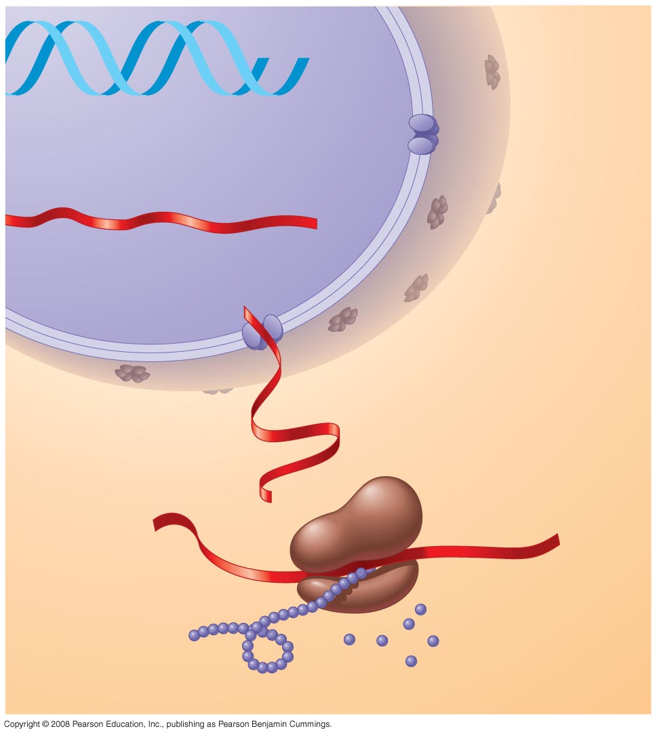
DNA
1
Synthesis of
mRNA in the
nucleus
mRNA
NUCLEUS
CYTOPLASM
mRNA
2
Movement of
mRNA into cytoplasm
via nuclear pore
Ribosome
3
Synthesis
of protein
Amino
acids
Polypeptide

Slide 31
