Slide 1
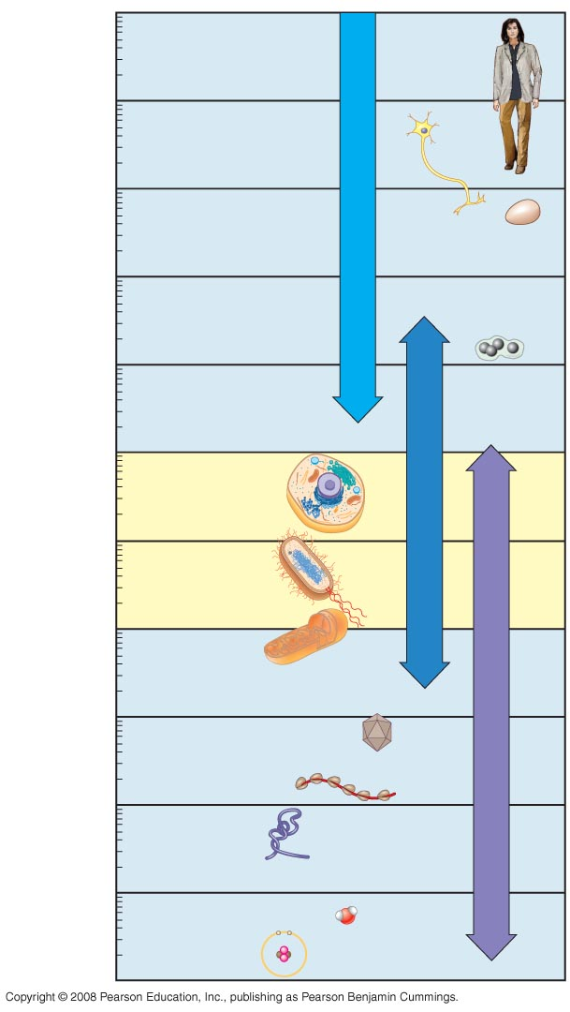
10 m
1 m
Human height
Length of some nerve and muscle cells
0.1 m
Chicken egg
Unaided eye
1 cm
1 mm
Frog egg
100 µm
Most plant and animal cells
Light microscope
10 µm
Nucleus
Most bacteria
1 µm
Mitochondrion
100 nm
Smallest bacteria
Electron microscope
Viruses
10 nm
Ribosomes
Proteins
1 nm
Lipids
Small molecules
0.1 nm
Atoms

Slide 2
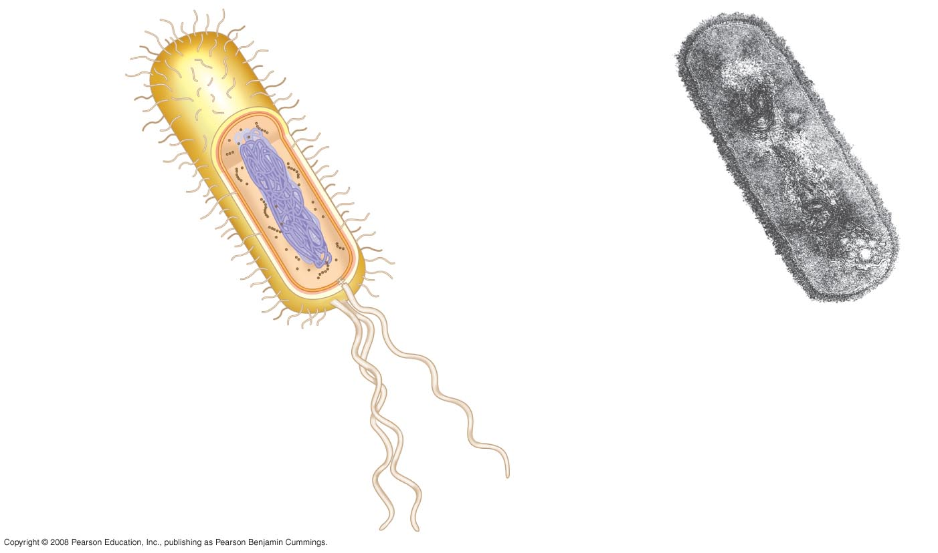
Fimbriae
Nucleoid
Ribosomes
Plasma membrane
Bacterial
chromosome
Cell wall
Capsule
0.5 µm
(a)
A typical rod-shaped bacterium
Flagella
(b)
A thin section through the bacterium Bacillus coagulans (TEM)

Slide 3
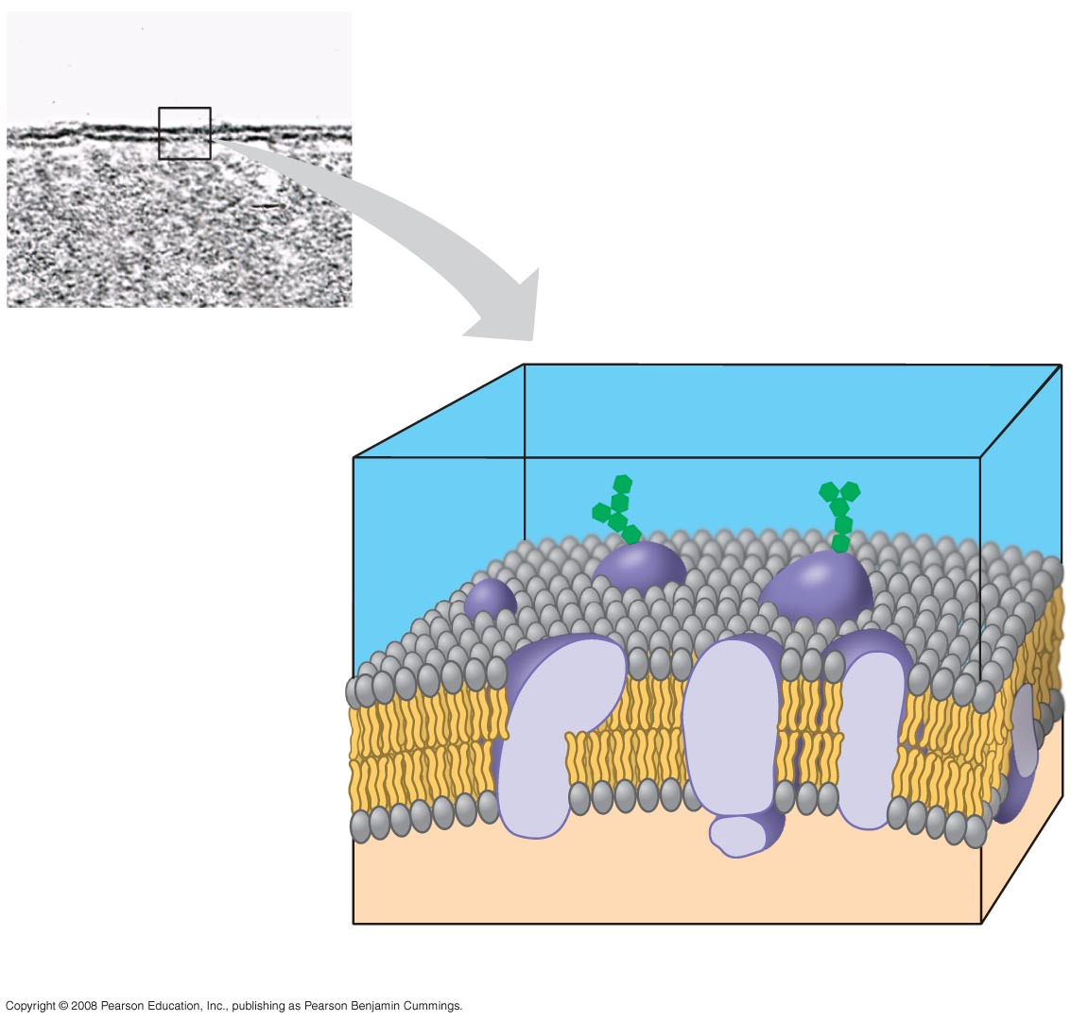
(a)
TEM of a plasma
membrane
Outside of cell
Inside of
cell
0.1 µm
Carbohydrate side chain
Hydrophilic
region
Hydrophobic
region
Hydrophilic
region
Phospholipid
Proteins
(b) Structure of the plasma membrane

Slide 4
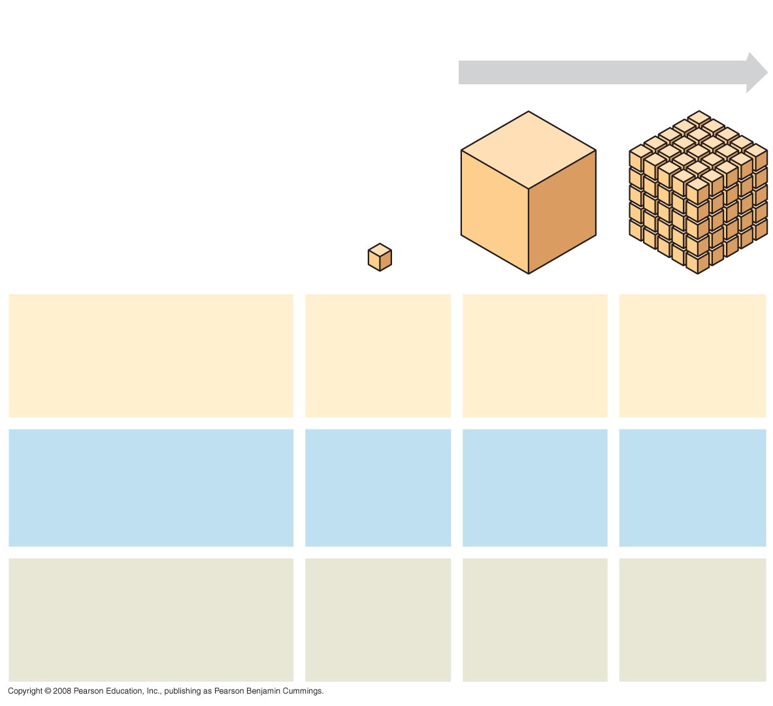
Surface area increases while
total volume remains constant
5
1
1
Total surface area
[Sum of the surface areas
(height × width) of all boxes
sides × number of boxes]
6
150
750
Total volume
[height × width × length ×
number of boxes]
1
125
125
Surface-to-volume
(S-to-V) ratio
[surface area ÷ volume]
6
1.2
6

Slide 5
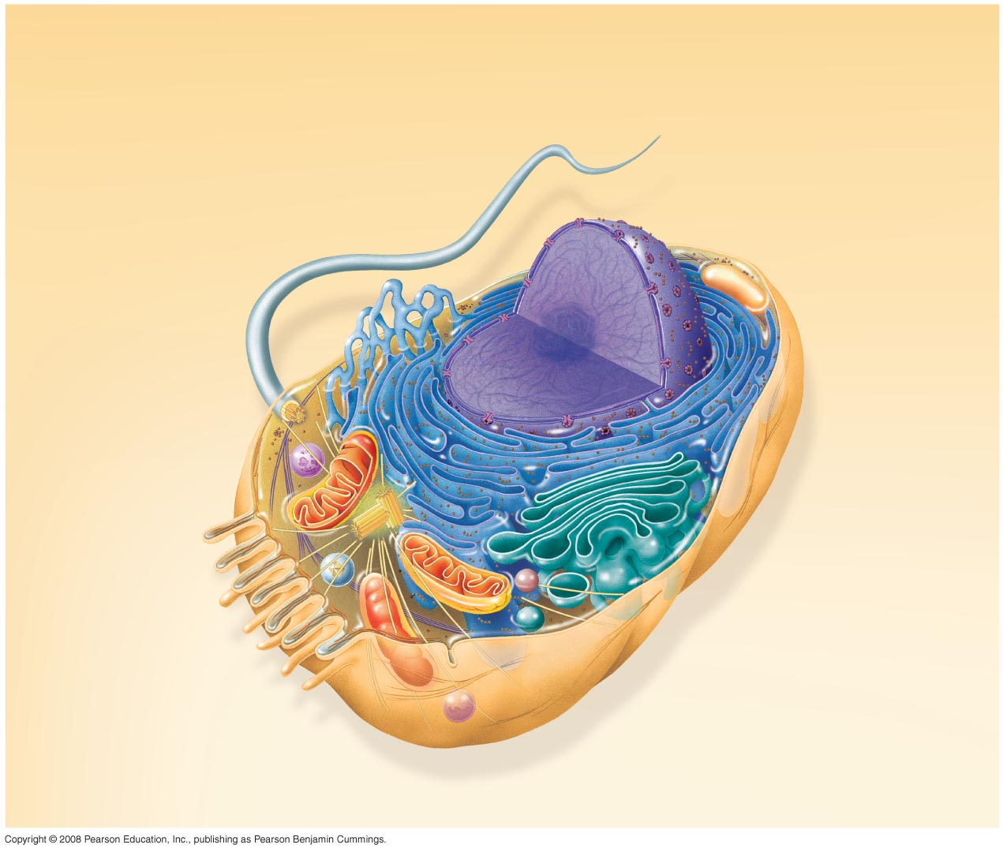
Nuclear
envelope
ENDOPLASMIC RETICULUM (ER)
NUCLEUS
Nucleolus
Rough ER
Smooth ER
Flagellum
Chromatin
Centrosome
Plasma membrane
CYTOSKELETON:
Microfilaments
Intermediate
filaments
Microtubules
Ribosomes
Microvilli
Golgi
apparatus
Peroxisome
Mitochondrion
Lysosome

Slide 6
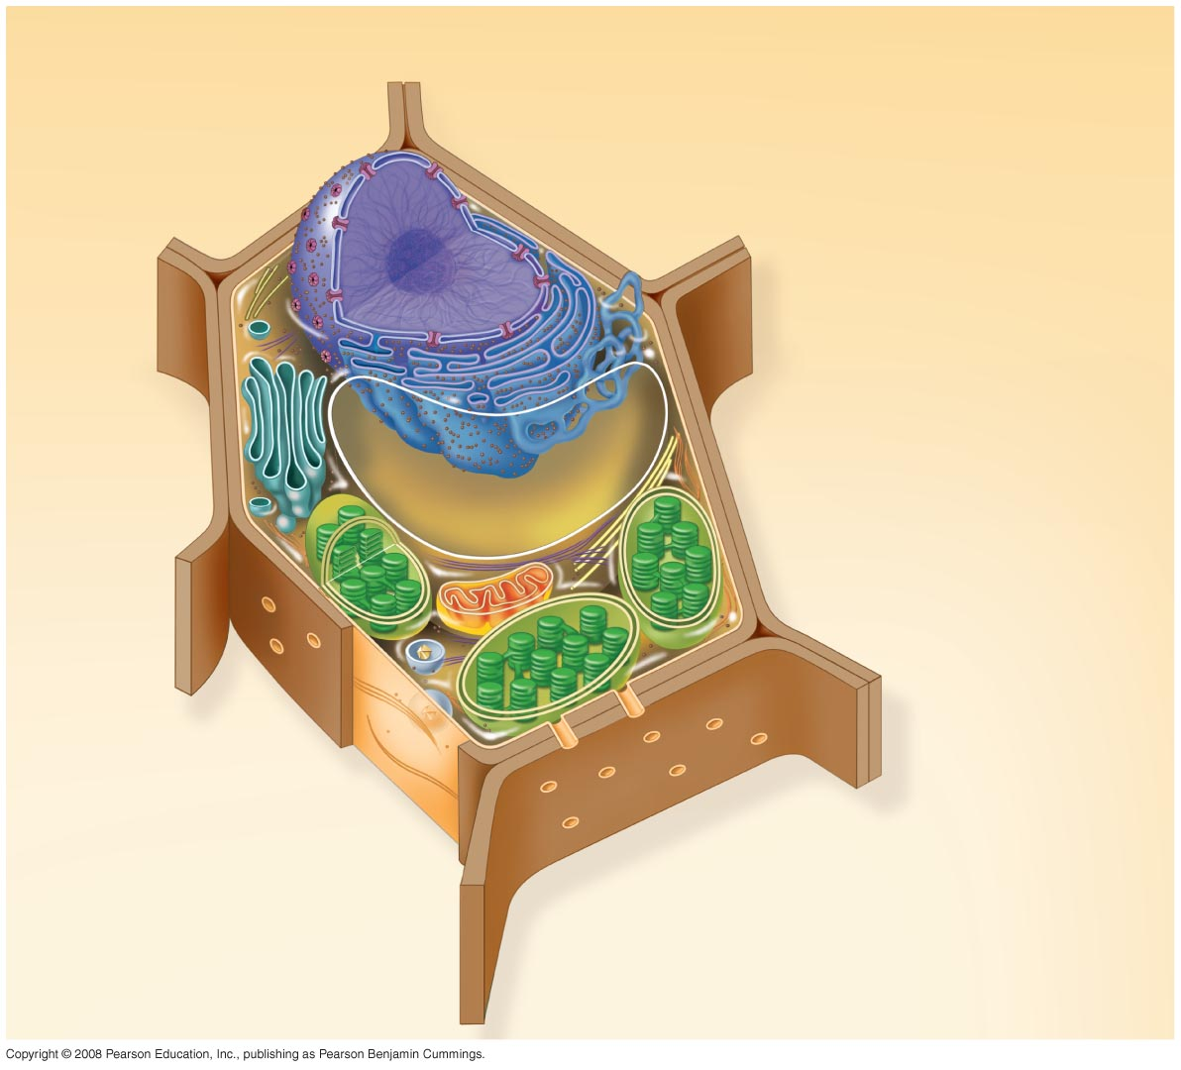
Nuclear envelope
Rough endoplasmic reticulum
NUCLEUS
Nucleolus
Chromatin
Smooth endoplasmic reticulum
Ribosomes
Golgi
apparatus
Central vacuole
Microfilaments
Intermediate filaments
CYTO-
SKELETON
Microtubules
Mitochondrion
Peroxisome
Plasma membrane
Chloroplast
Cell wall
Plasmodesmata
Wall of adjacent cell

Slide 7
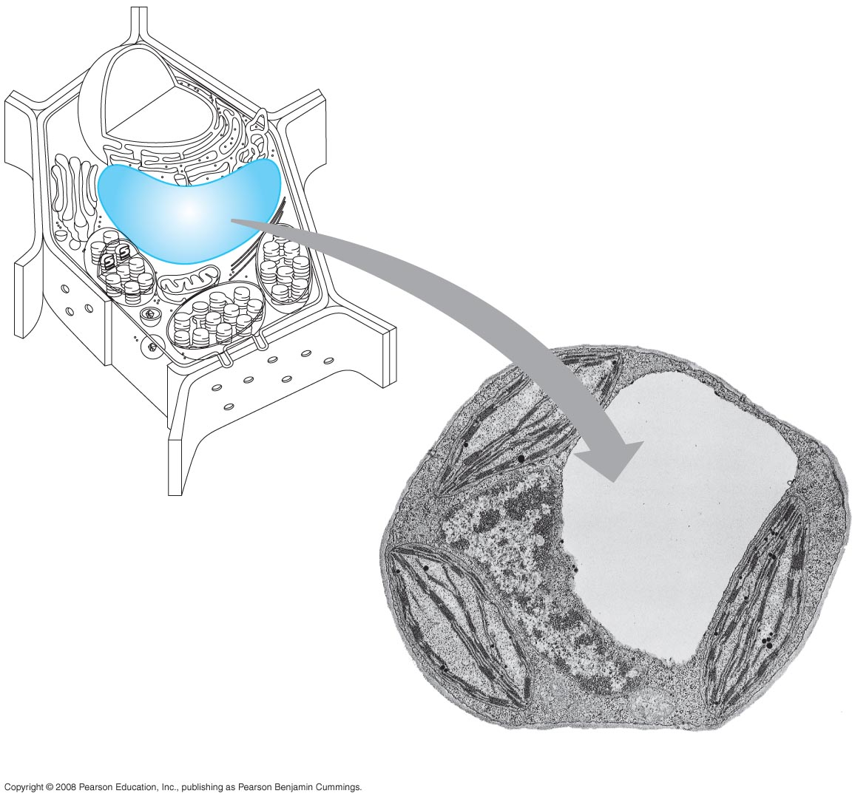
Central vacuole
Cytosol
Nucleus
Central vacuole
Cell wall
Chloroplast
5 µm

Slide 8
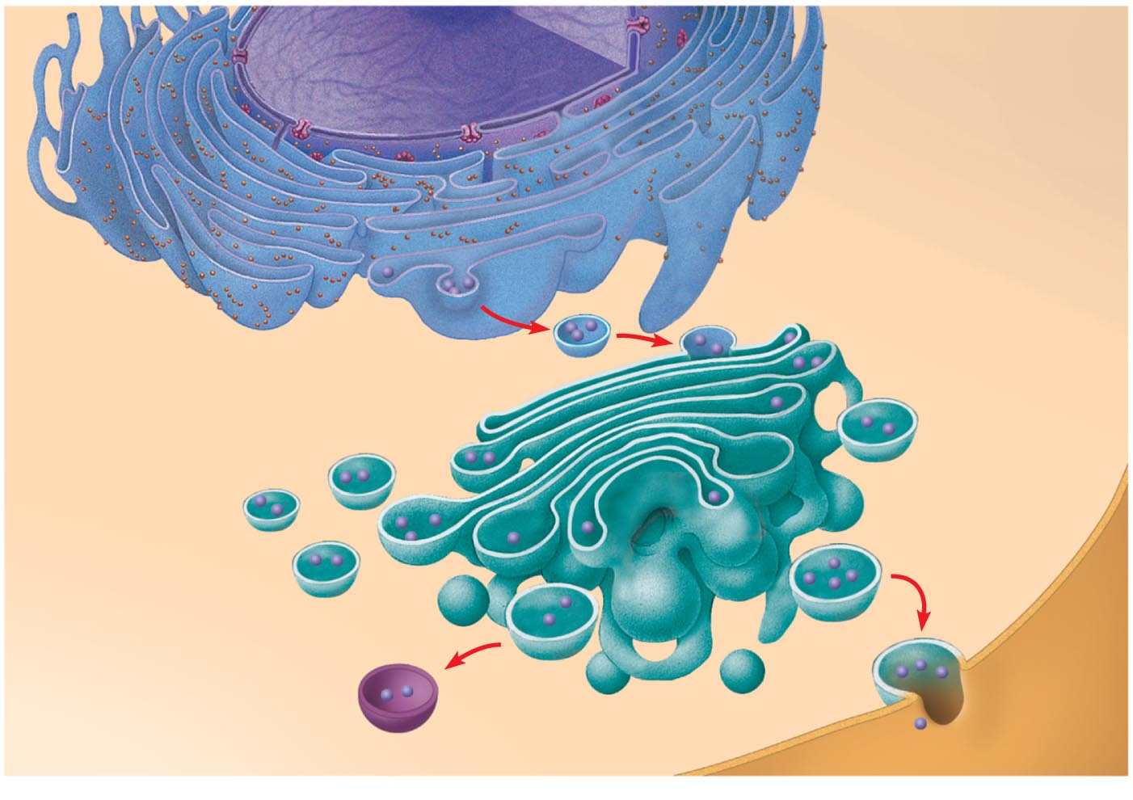
Nucleus
Rough ER
Smooth ER
cis Golgi
Plasma membrane
trans Golgi

Slide 9
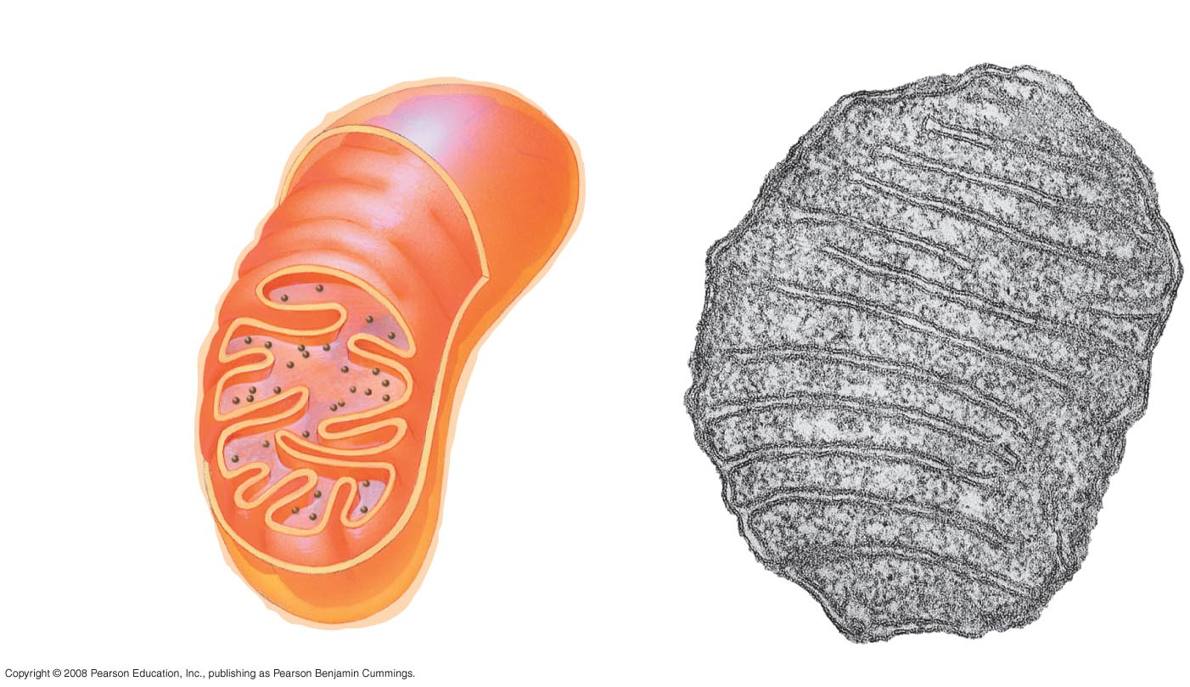
Intermembrane space
Outer membrane
Free ribosomes
in the mitochondrial matrix
Inner membrane
Cristae
Matrix
0.1 µm

Slide 10
Ribosomes
Stroma
Inner and outer membranes
Granum
Thylakoid
1 µm

Slide 11
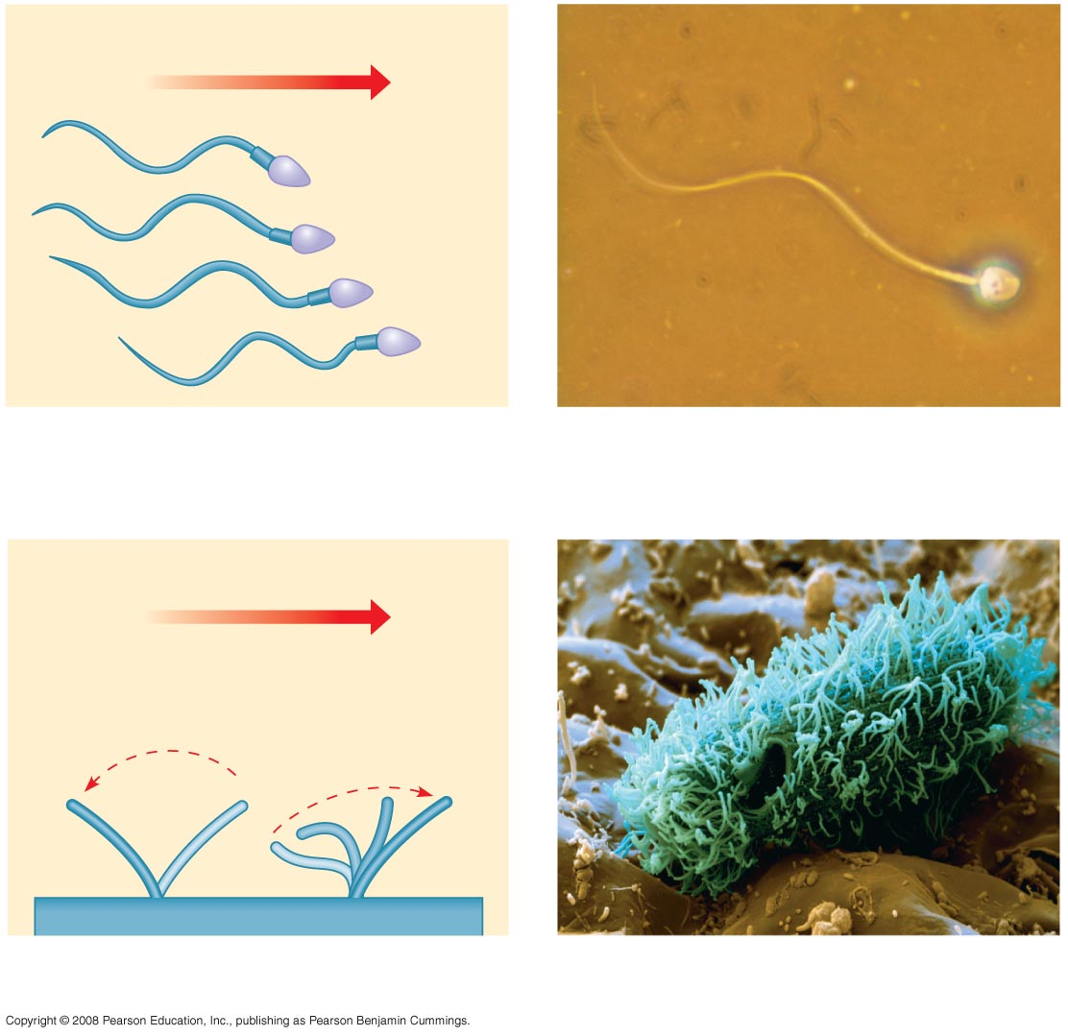
Direction of swimming
(a) Motion of flagella
5 µm
Direction of organism’s movement
Power stroke
Recovery stroke
(b) Motion of cilia
15 µm

