Slide 1
BIO107 Introduction to Biotechnology Dr. Ty C.M. Hoffman bio107hoffman@gmail.com

Slide 2
Science Versus Religion Religion is based on faith in the absence of evidence. Science is based on evidence that leads to belief.

Slide 3
What is Chemistry? What is Biology? What is Biotechnology?

Slide 4
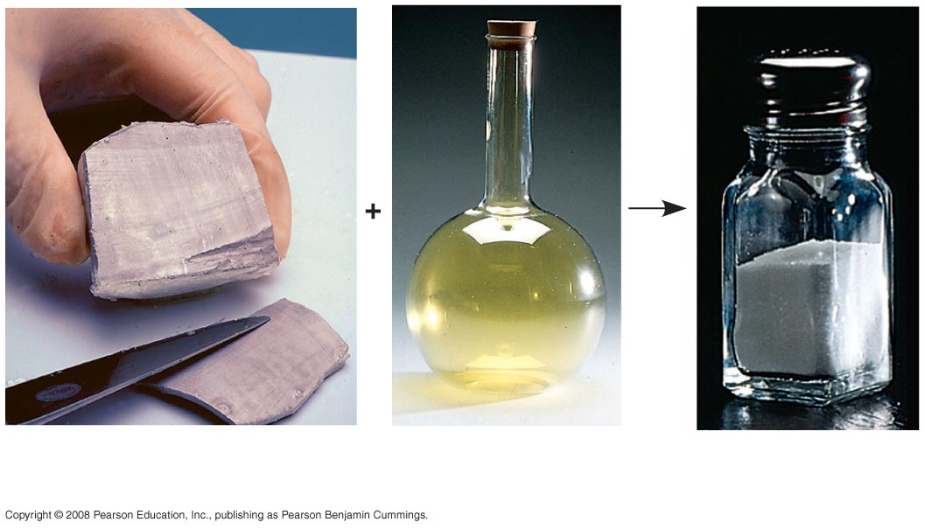
Sodium
Chlorine
Sodium
chloride

Slide 5
Nucleus
Protons (+ charge)
determine element
Electrons (– charge) form negative cloud
and determine
chemical behavior
Neutrons (no charge)
determine isotope
Atom

Slide 6
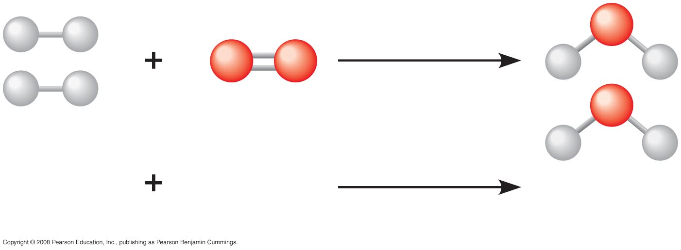
2 H₂
O₂
2 H₂O
Reactants
Reaction
Products

Slide 7
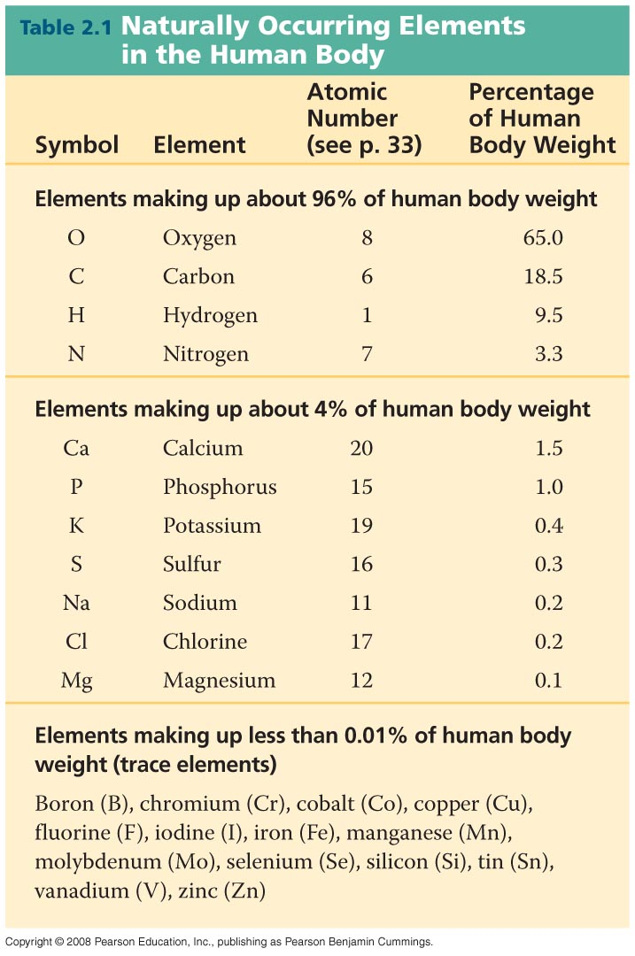

Slide 8
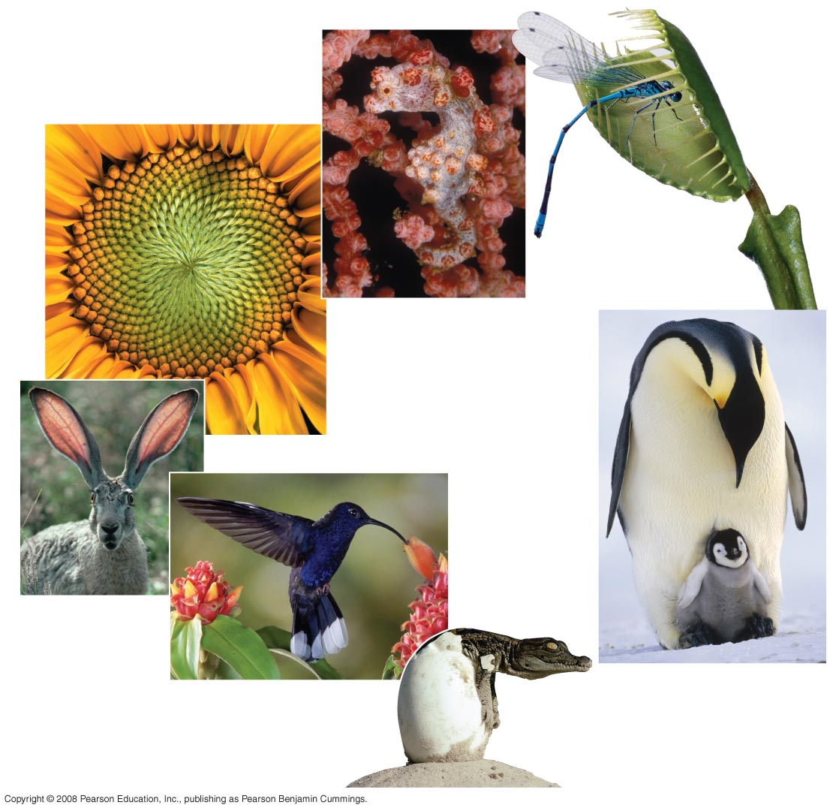
Order
Response
to the
environment
Evolutionary adaptation
Regulation
Reproduction
Energy
processing
Growth and
development

Slide 9
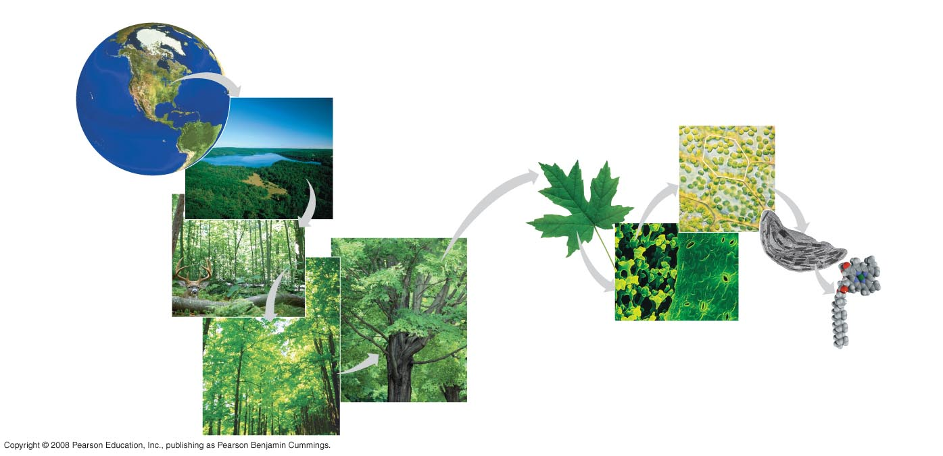
The biosphere
Cells
Organs and organ systems
10 µm
Cell
Ecosystems
Organelles
Communities
1 µm
Atoms
Tissues
50 µm
Populations
Molecules
Organisms

Slide 10
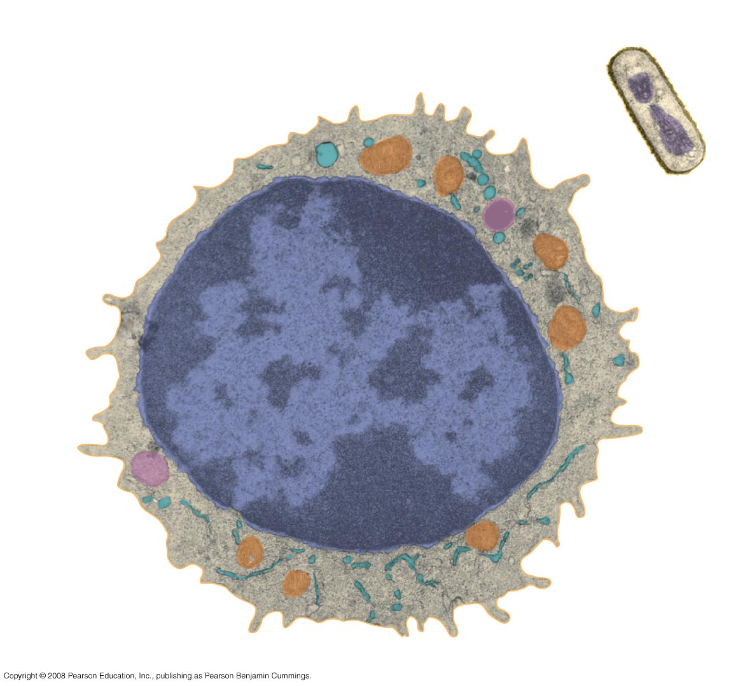
Prokaryotic cell
Eukaryotic cell
DNA
(no nucleus)
Membrane
Membrane
Cytoplasm
Organelles
Nucleus (contains DNA)
1 µm

Slide 11
Nucleus
DNA
Nucleotide
Cell
(a) DNA double helix
(b) Single strand of DNA

Slide 12
Classes of Biological Macromolecules
Lipids
Polysaccharides
Proteins
Nucleic Acids

Slide 13
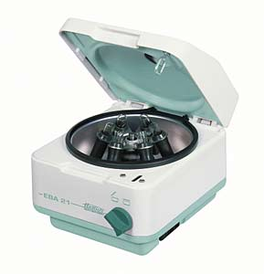
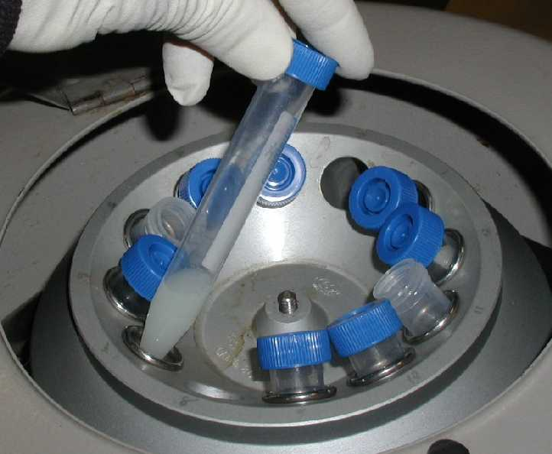
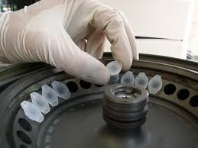
Tools of Biotechnology: Centrifuge

Slide 14
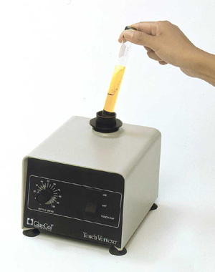
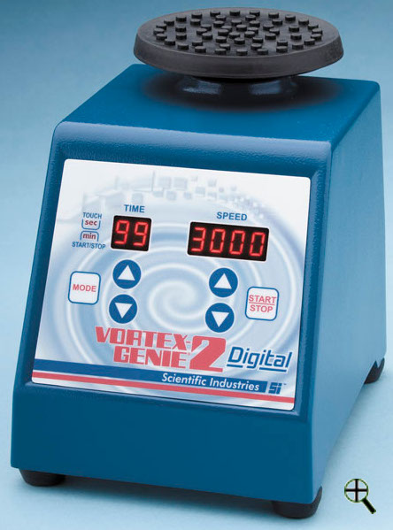
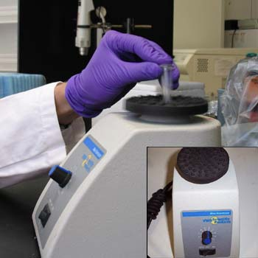
Tools of Biotechnology: Vortexer

Slide 15
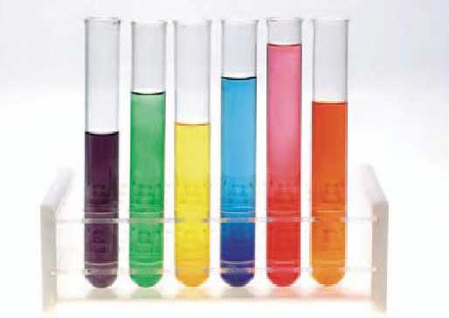
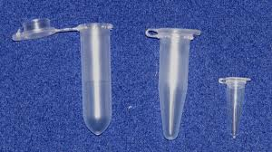
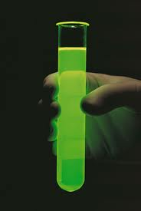
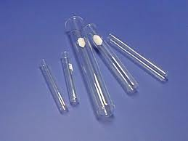
Tools of Biotechnology: Tubes

Slide 16
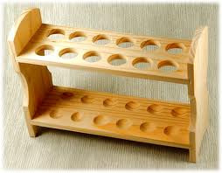
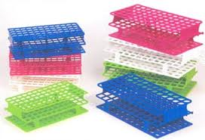
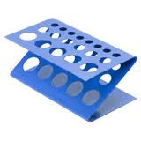
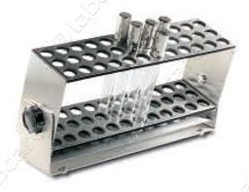
Tools of Biotechnology: Racks

Slide 17
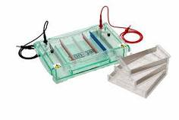
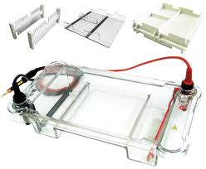
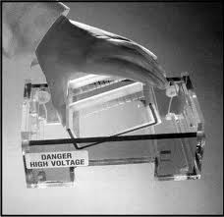
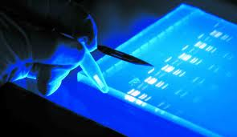
Tools of Biotechnology: Gel Trays

Slide 18
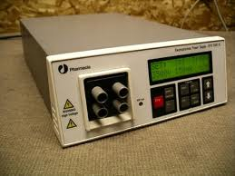
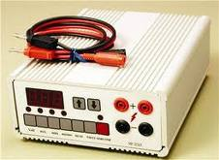
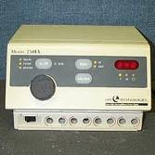
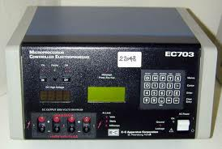
Tools of Biotechnology: Power Supplies

Slide 19
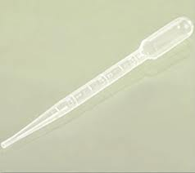
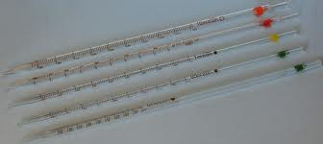
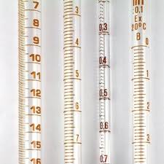
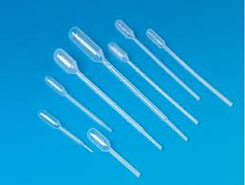
Tools of Biotechnology: Pipettes

Slide 20
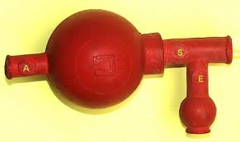
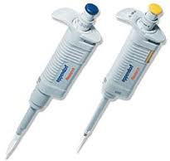
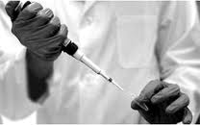
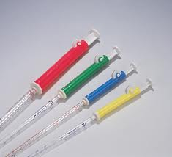
Tools of Biotechnology: Pipettors

Slide 21
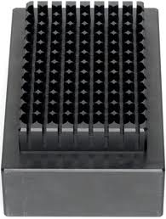
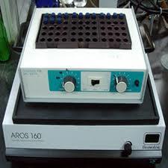
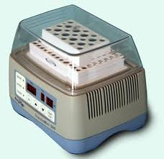
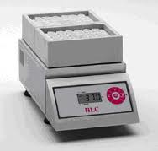
Tools of Biotechnology: Heat Blocks

