Slide 1
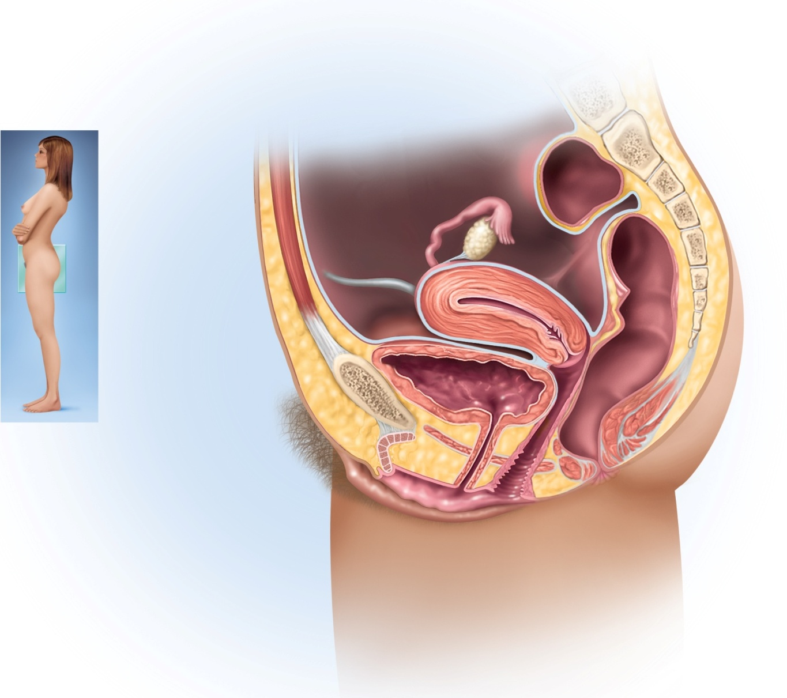
Fig. 28.1
Copyright © McGraw-Hill Education. Permission required for reproduction or display.
Uterine tube
Fimbriae
Ovary
Vesicouterine
pouch
Round ligament
Uterus
Rectouterine
pouch
Peritoneum
Posterior fornix
Urinary bladder
Cervix of uterus
Pubic symphysis
Anterior fornix
Mons pubis
Urethra
Rectum
Clitoris
Anus
Prepuce
Vaginal rugae
Labium minus
Vaginal orifice
Labium majus

Slide 2
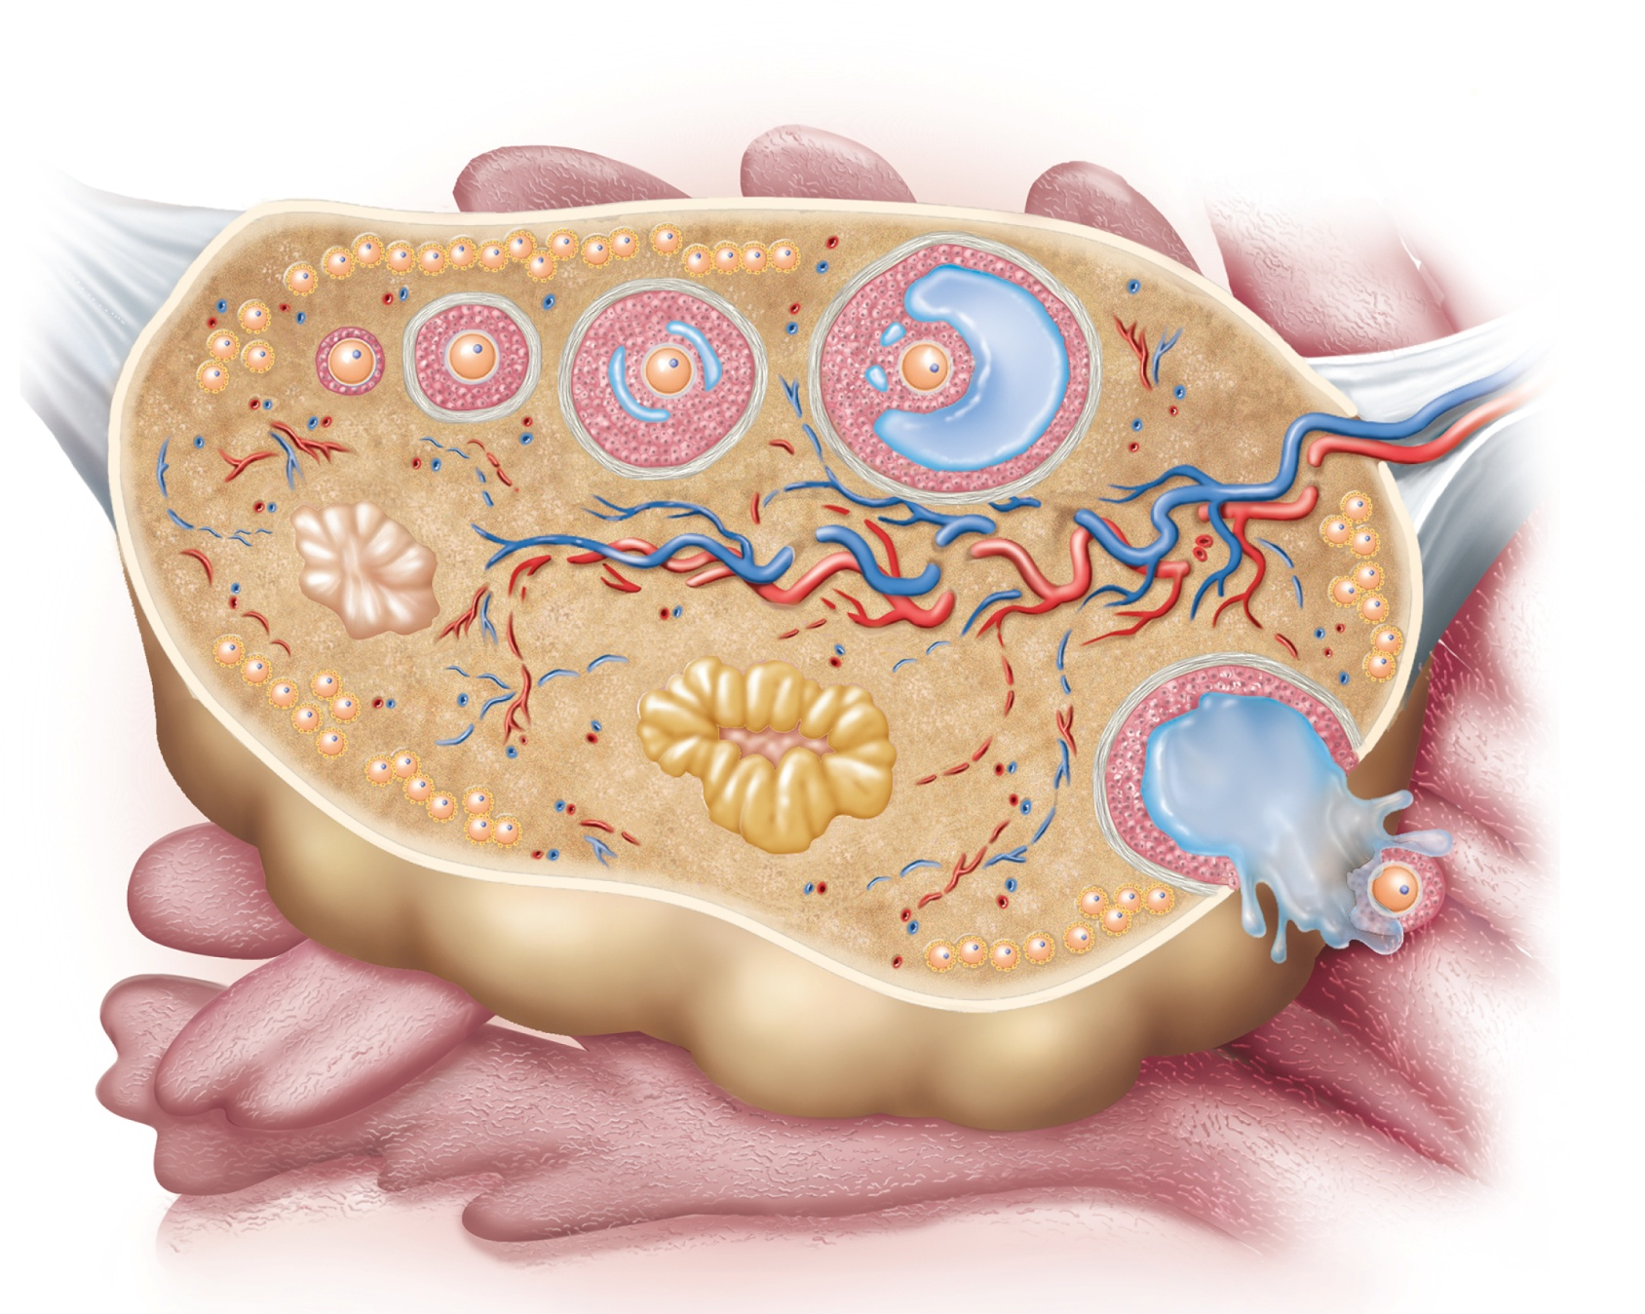
Fig. 28.2
Copyright © McGraw-Hill Education. Permission required for reproduction or display.
Primordial
follicles
Secondary
follicle
Tertiary
follicle
Mature
follicle
Oocyte
Suspensory ligament
and blood vessels
Primary
follicle
Ovarian
ligament
Medulla
Cortex
Tunica
albuginea
Corpus
albicans
Corpus
luteum
Fimbriae
of uterine
tube
Ovulated
oocyte

Slide 3
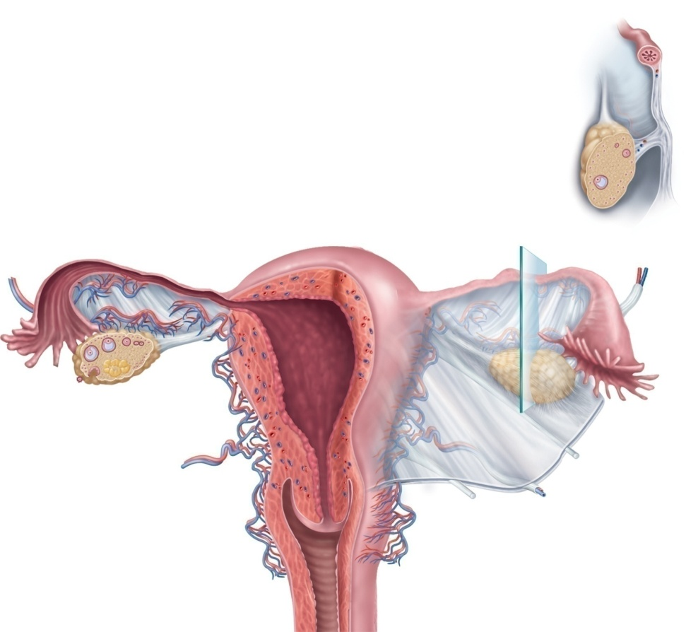

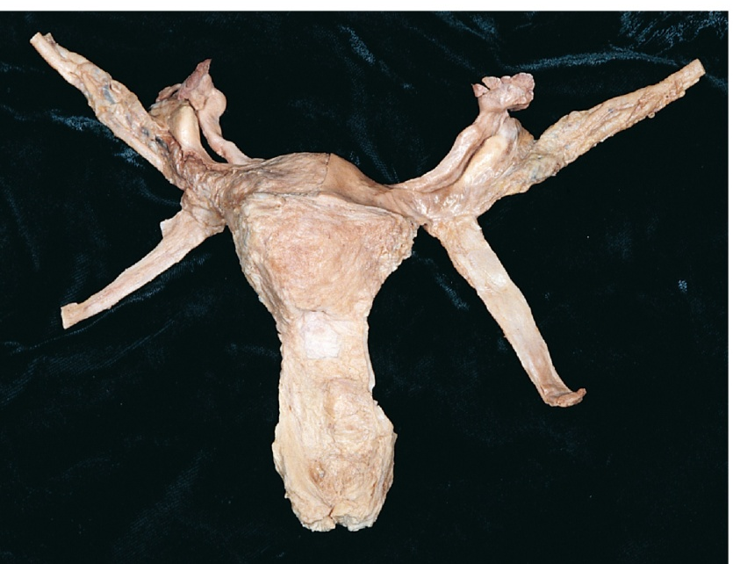
Fig. 28.3
Copyright © McGraw-Hill Education. Permission required for reproduction or display.
Uterine tube
Mesovarium
Broad ligament:
Ovary
Mesosalpinx
Mesometrium
Mesosalpinx
(b)
Infundibulum
Ampulla
Isthmus
Fundus
Body
Ovarian
ligament
Uterine
tube
Ovarian artery
Ovarian vein
Suspensory
ligament
Fimbriae
Perimetrium
Ovary
Myometrium
Mesometrium
Endometrium
Round
ligament
Internal os
Cervical canal
Broad
ligament
Lateral fornix
Cervix
Cardinal
ligament
External os
Vagina
Uterosacral
ligament
(a)
Suspensory ligament
Uterine tube :
Fimbriae
Infundibulum
Ampulla
Ovary
Ovarian ligament
Round ligament
Uterus:
Fundus
Body
Cervix
Vagina
(c)
c: ©McGraw-Hill Education/Rebecca Gray/Don Kincaid, dissections

Slide 4

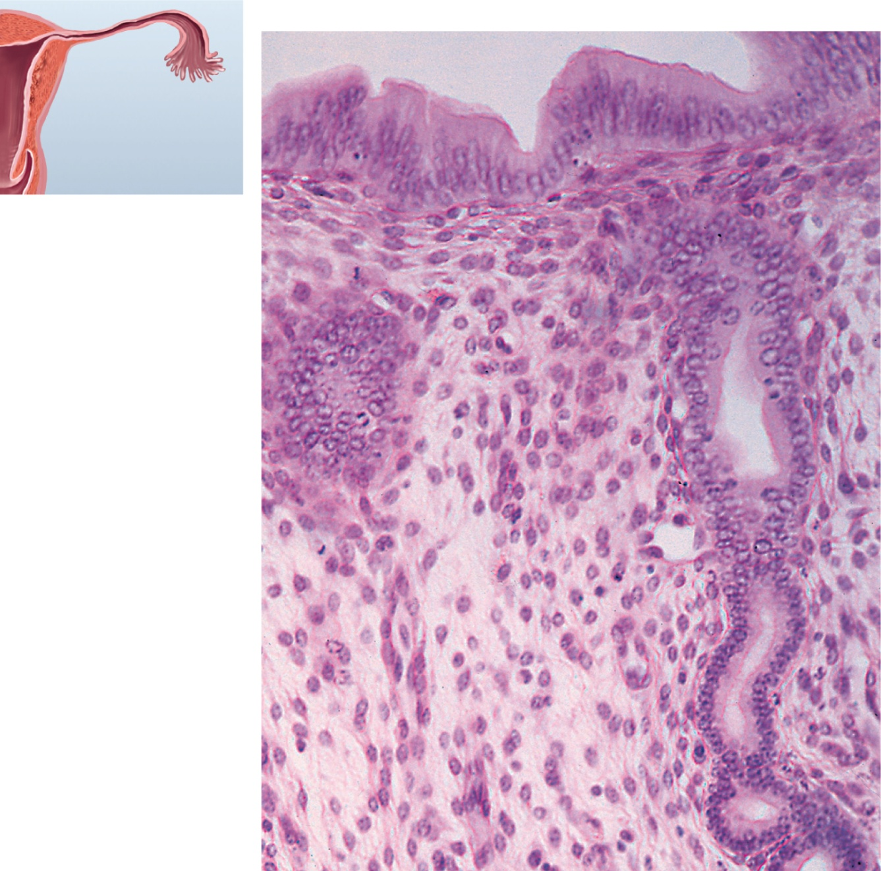
Fig. 28.6
Copyright © McGraw-Hill Education. Permission required for reproduction or display.
Surface epithelium
Endometrial gland
Lamina propria
0.1 mm
©Ed Reschke

Slide 5
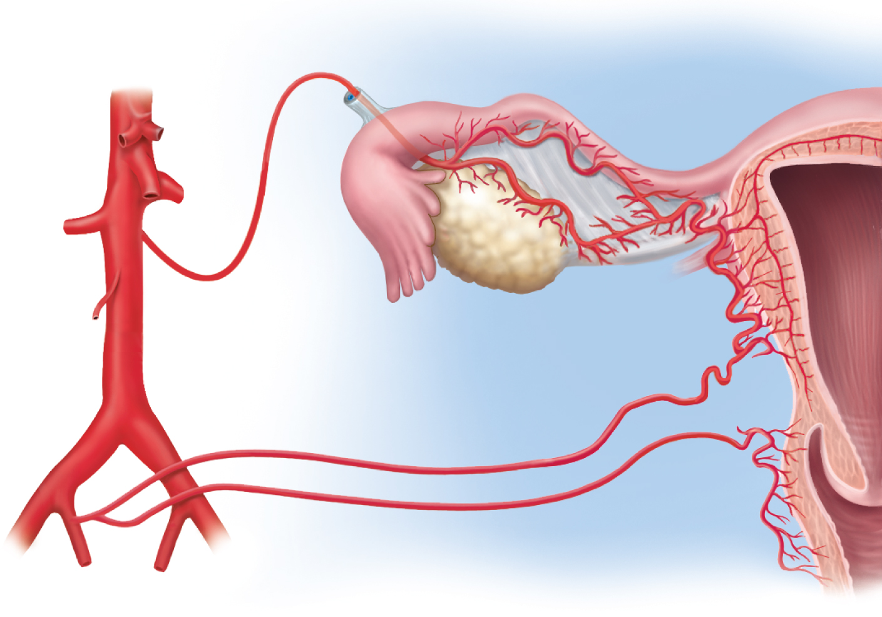
Fig. 28.7
Copyright © McGraw-Hill Education. Permission required for reproduction or display.
Suspensory
ligament
Ovarian branch
of uterine artery
Arcuate artery
Aorta
Mesosalpinx
Uterine
artery
Common
iliac artery
Ovarian
artery
Ovary
Vaginal
artery
Internal iliac artery
Spiral arteries

Slide 6
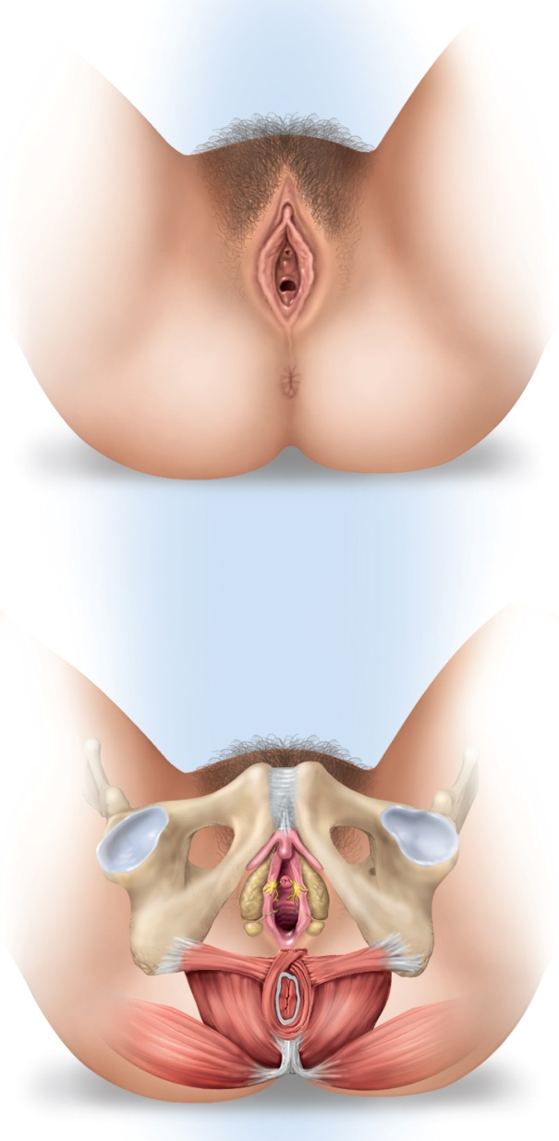
Fig. 28.8
Copyright © McGraw-Hill Education. Permission required for reproduction or display.
Mons pubis
Prepuce
Labium majus
Clitoris
Labium minus
Urethral
orifice
Vaginal orifice
Hymen
Vestibule
(a)
Perineal raphe
Anus
Clitoris
Glans
Pubic symphysis
Crus
Ramus of
pubis
Urethral
orifice
Vestibular
bulb
Paraurethral
gland
Vaginal
orifice
Greater
vestibular
gland
Ischial
tuberosity
Anus
(b)

Slide 7
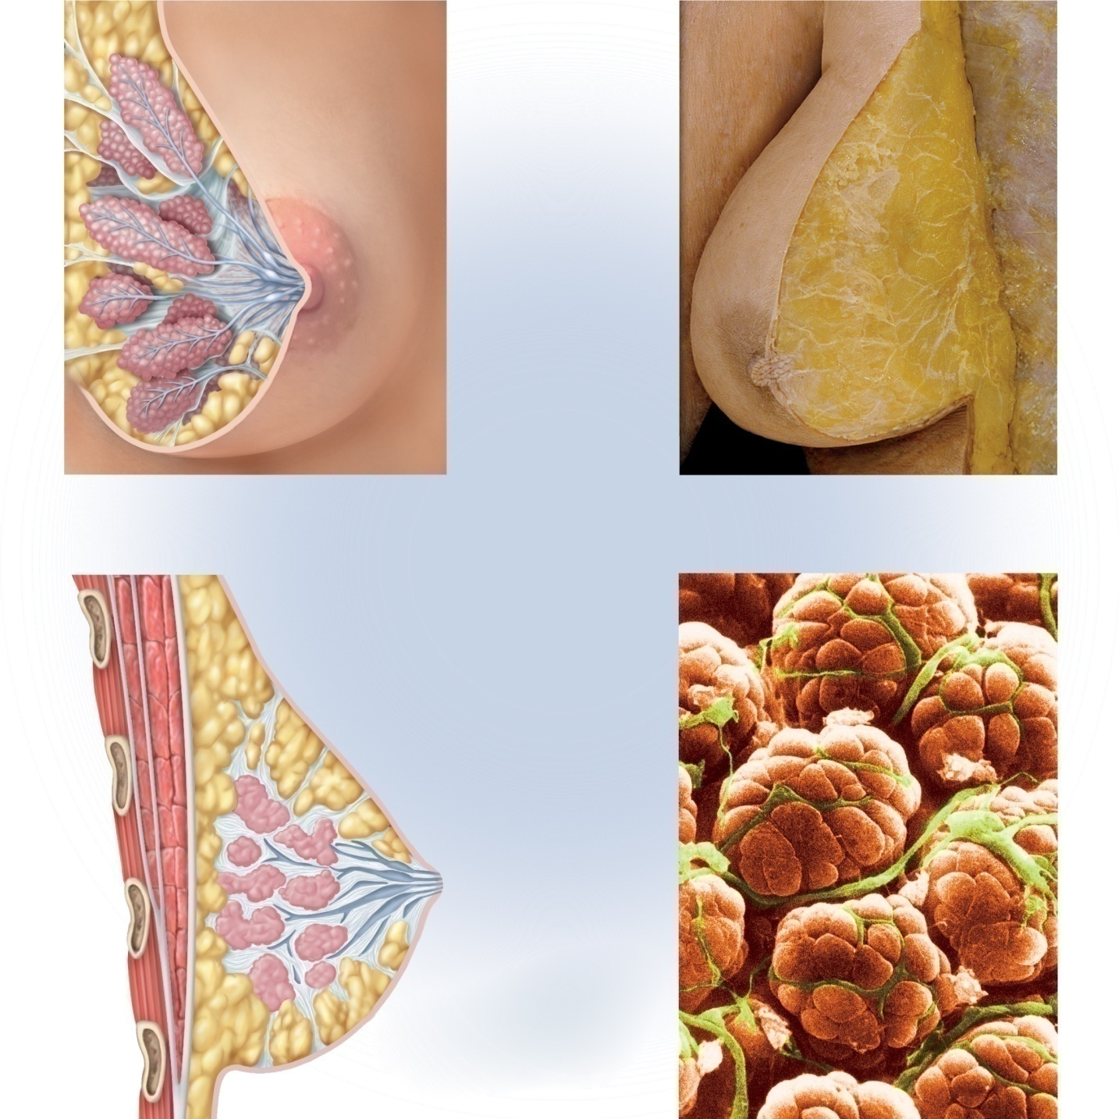

Fig. 28.9
Copyright © McGraw-Hill Education. Permission required for reproduction or display.
Adipose tissue
Suspensory ligaments
Lobe
Lobules
Areolar glands
Areola
Nipple
Lactiferous sinus
Lactiferous ducts
(a) Anterior view
(b) Breast of cadaver
Rib
Intercostal muscles
Pectoralis minor
Pectoralis major
Secretory cells
Fascia
Suspensory ligament
Lobules
Lobe
Adipose tissue
Nipple
Lactiferous sinus
Lactiferous duct
Myoepithelial cells
(c) Sagittal section
(d) Mammary acinus
b: From Anatomy & Physiology Revealed, © The McGraw-Hill Companies, Inc./The University of Toledo, photography and dissection; d: © Dr. Donald Fawcett/Science Source

Slide 8
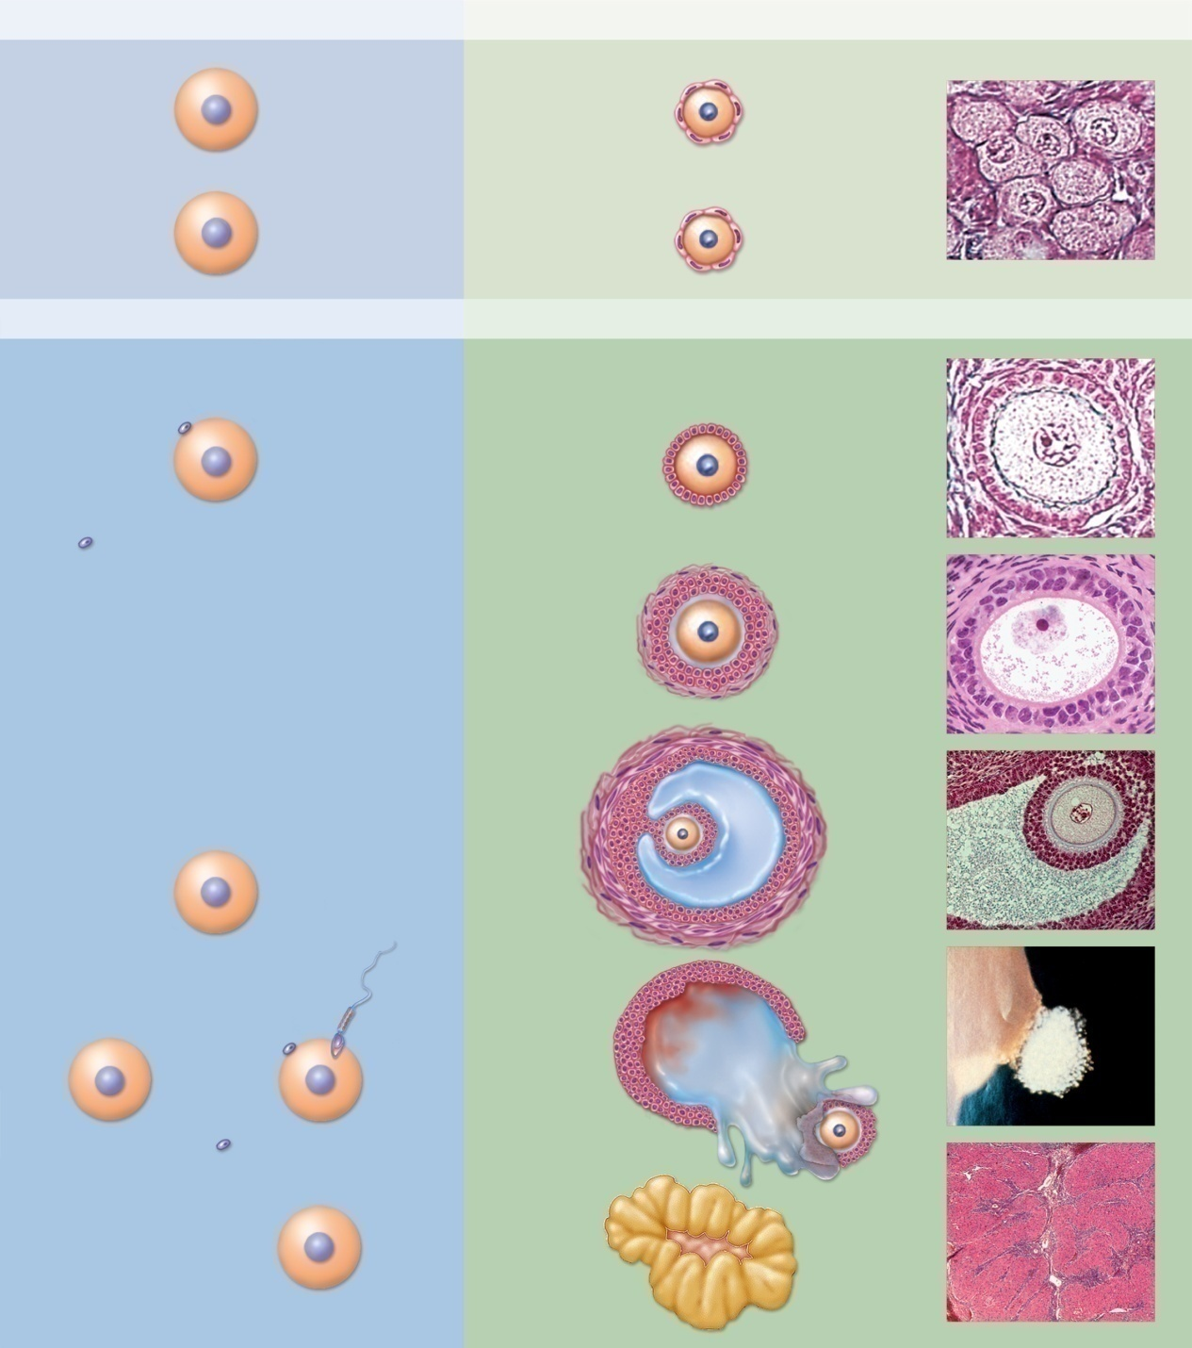
Fig. 28.11
Copyright © McGraw-Hill Education. Permission required for reproduction or display.
Development of egg (oogenesis)
Development of follicle (folliculogenesis)
Before birth
Mitosis
2n
Multiplication
of oogonia
Oocyte
Primordial follicle
Nucleus
Follicular
cells
2n
Primary oocyte
No change
Adolescence to menopause
Meiosis I
n
Secondary oocyte
Granulosa cells
Primary follicle
n
First polar
body (dies)
Secondary follicle
Granulosa cells
Zona pellucida
Theca folliculi
Antrum
Tertiary follicle
Cumulus
oophorus
n
Secondary oocyte
(ovulated)
Theca
interna
Theca
externa
If not fertilized
If fertilized
Ovulation of
mature
(graafian)
follicle
Bleeding into
antrum
n
n
n
Ovulated
oocyte
Dies
n
Meiosis II
Follicular fluid
Second polar
body (dies)
Corpus luteum
2n
Zygote
Embryo
(Primordial & Primary follicle): © Ed Reschke; (Secondary follicle): © McGraw- Hill Education/Al Telser; (Tertiary follicle): © Ed Reschke/Photolibrary/ Getty Images;
(graafian follicle): © Landrum B. Shettles, MD; ( Corpus luteum): © McGraw-Hill Education/Al Telser

Slide 9
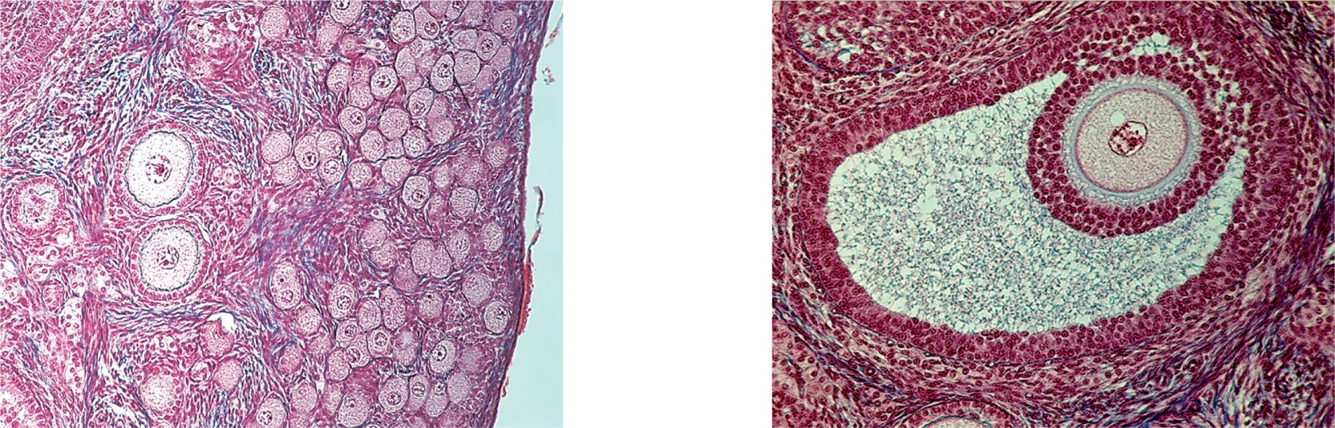
Fig. 28.12
Copyright © McGraw-Hill Education. Permission required for reproduction or display.
Tunica albuginea
of ovary
Primordial follicles
Oocyte and
nucleus
Follicular cells
Zona pellucida
Cumulus oophorus
Granulosa cells
Primary follicles
Oocytes
Theca folliculi
Antrum
(a)
50 µm
(b)
100 µm
a: © Ed Reschke; b: © Ed Reschke/Photolibrary/Getty Images

Slide 10
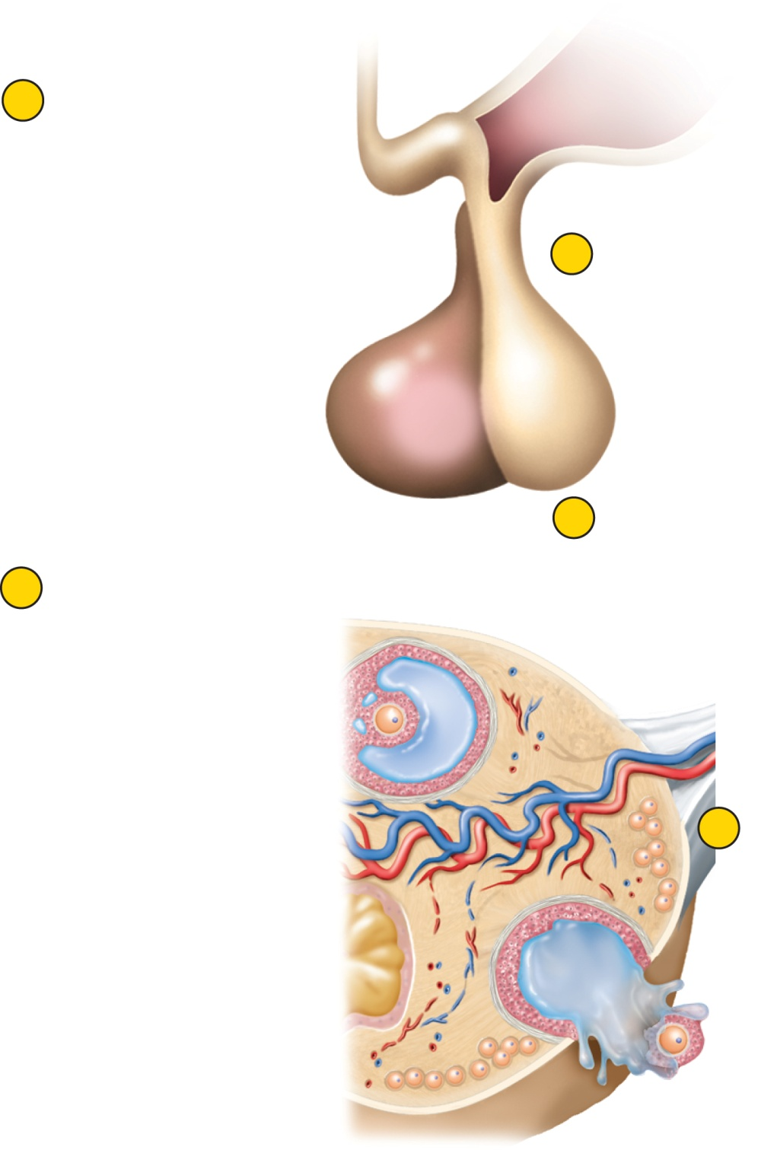
Fig. 28.13
Copyright © McGraw-Hill Education. Permission required for reproduction or display.
Hypothalamus
2
Estradiol stimulates
hypothalamus and
anterior pituitary
GnRH
Anterior
pituitary
3
Hypothalamus secretes GnRH
LH
FSH
4
GnRH and estradiol
stimulate pituitary
to secrete LH and FSH
1
Maturing follicle secretes
estradiol
5
Oocyte completes
meiosis I; follicle
rapidly enlarges and
then ovulates
Ovulated
secondary
oocyte

Slide 11
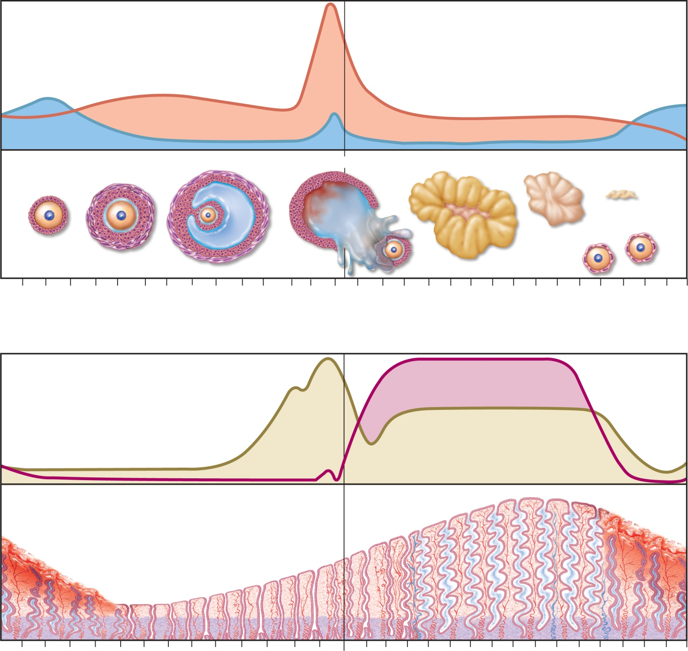
Fig. 28.14
Copyright © McGraw-Hill Education. Permission required for reproduction or display.
(a) Ovarian cycle
LH
Gonadotropin secretion
FSH
Developing follicles
Tertiary
Ovulation
Corpus luteum
Involution
Corpus
albicans
Primary
Secondary
Ovarian events
New primordial
follicles
Days
1
3
5
7
9
11
13
15
17
19
21
23
25
27
1
Follicular phase
Luteal phase
(b) Menstrual cycle
Progesterone
Ovarian hormone secretion
Estradiol
Menstrual
fluid
Thickness of endometrium
Days
1
3
5
7
9
11
13
15
17
19
21
23
25
27
1
Menstrual phase
Proliferative phase
Secretory phase
Premenstrual
phase

Slide 12
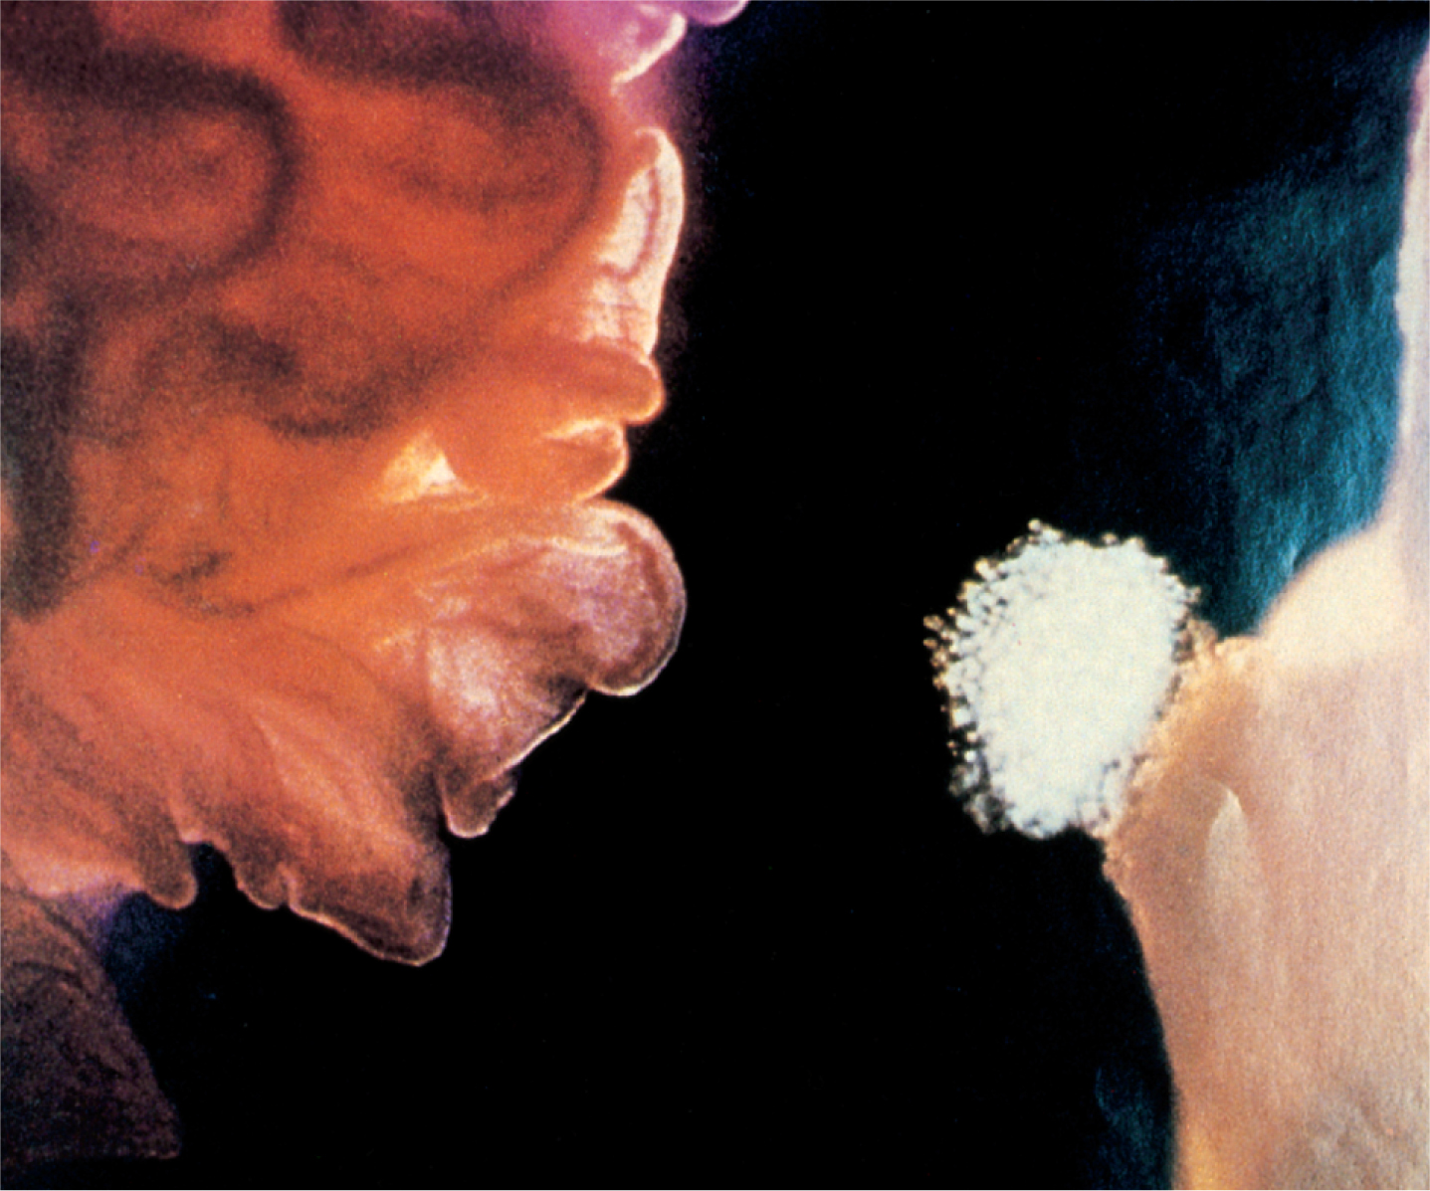
Fig. 28.15
Copyright © McGraw-Hill Education. Permission required for reproduction or display.
Infundibulum of
uterine tube
Fimbriae
Cumulus
oophorus
Oocyte
Stigma
Ovary
0.1 mm
© Landrum B. Shettles, MD
Notes:
12

Slide 13
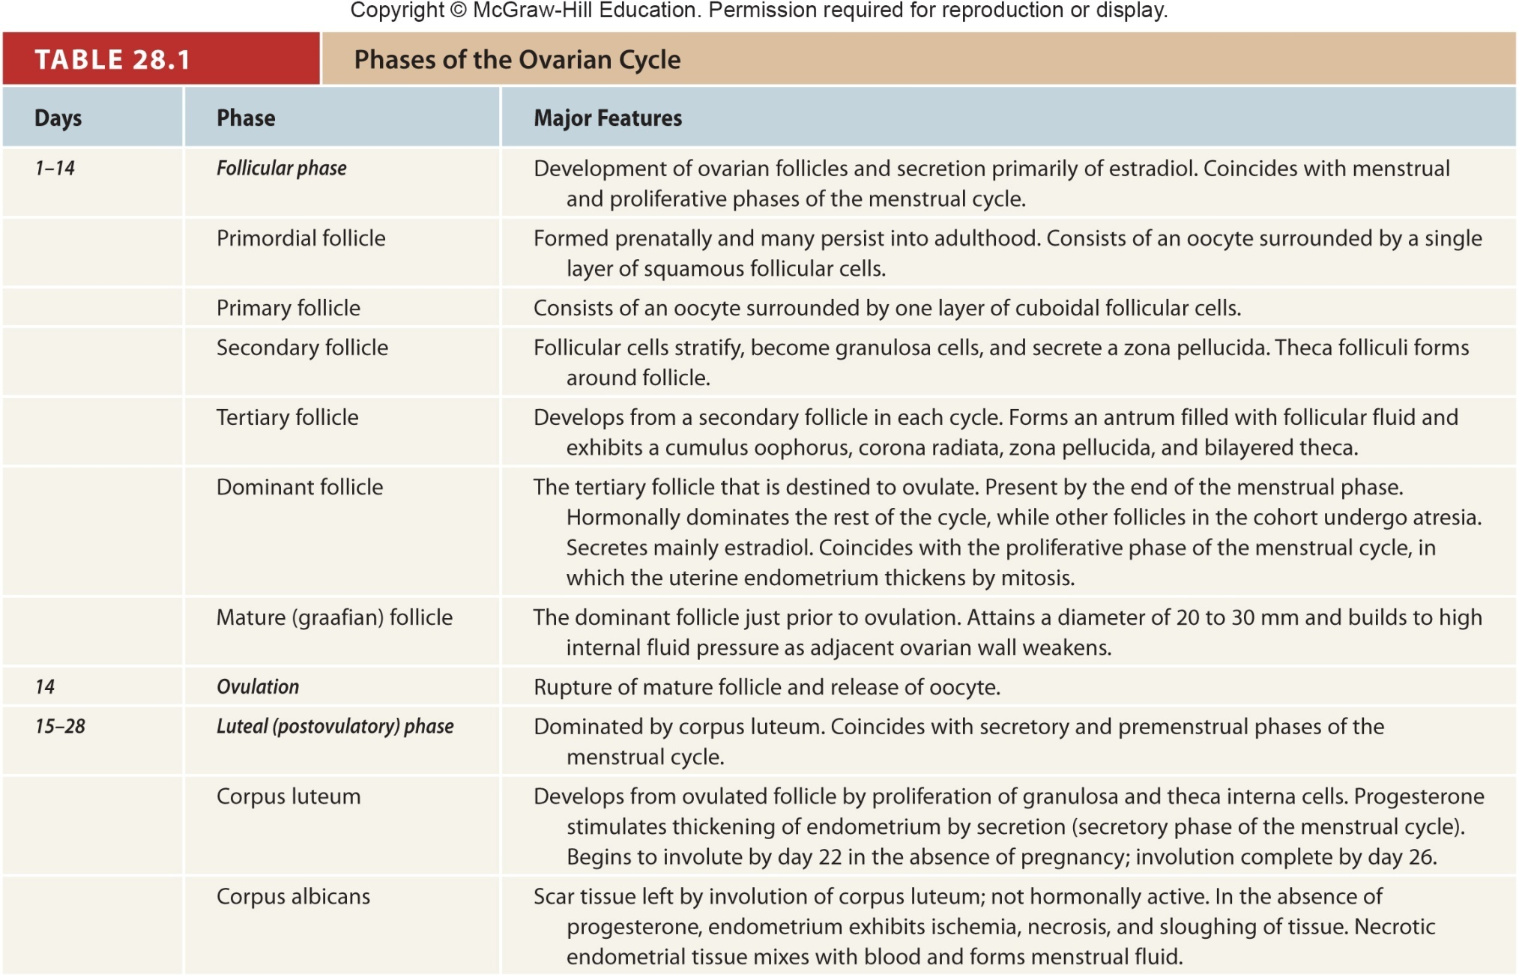
Table 28.1
Notes:
13

Slide 14
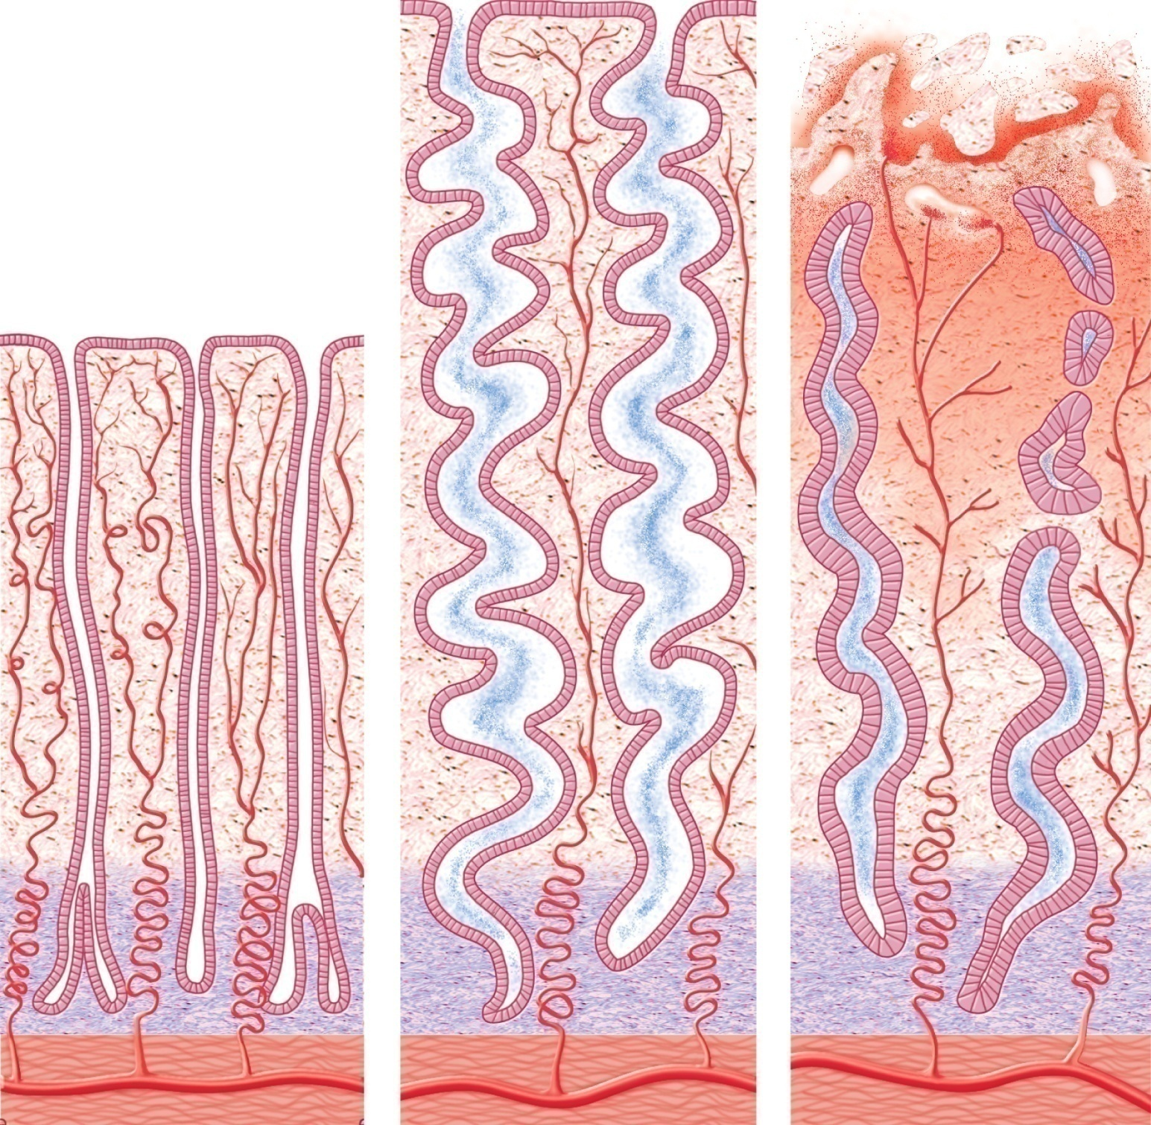
Fig. 28.16
Copyright © McGraw-Hill Education. Permission required for reproduction or display.
Secretion
Endometrial
gland
Functional
layer
Spiral artery
Basal layer
Myometrium
(a) Proliferative phase
(b) Secretory phase
(c) Menstrual phase

Slide 15
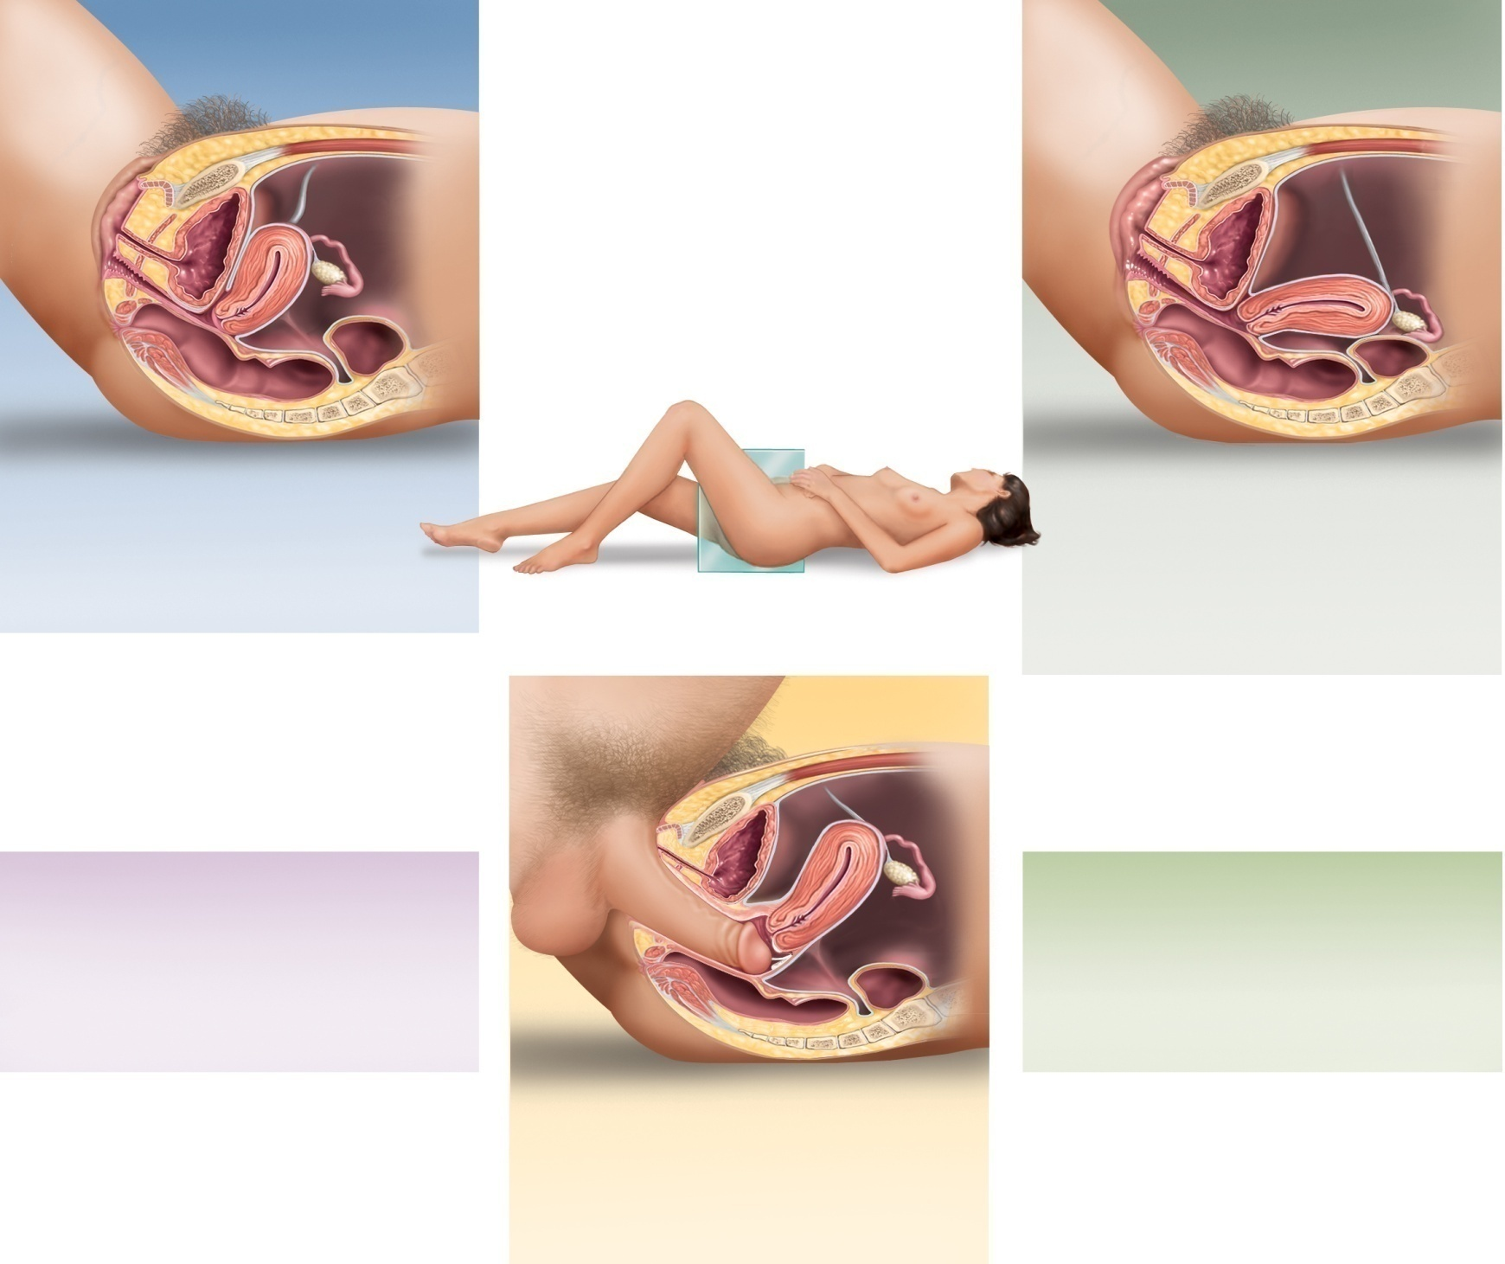

Fig. 28.17
Copyright © McGraw-Hill Education. Permission required for reproduction or display.
Labia minora
Urinary bladder
Uterus
Unstimulated
Excitement
Uterus tilts forward over urinary
bladder; vagina relatively narrow;
labia minora retracted
Uterus stands more superiorly; inner end of
vagina dilates; labia minora become
vasocongested, may extend beyond labia
majora; labia minora and vaginal mucosa
become red to violet due to hyperemia;
vaginal transudate moistens vagina and vestibule
Resolution
Plateau
Uterus returns to original position; orgasmic
platform relaxes; inner end of vagina
constricts and returns to original dimensions
Uterus is tented (erected) and cervix is
withdrawn from vagina; orgasmic platform
(lower one-third) of vagina constricts penis;
clitoris is engorged and its glans is withdrawn
beneath prepuce; labia are bright red or violet
Orgasm
Orgasmic platform contracts rhythmically;
cervix may dip into pool of semen;
uterus exhibits peristaltic contractions;
anal and urinary sphincters constrict

Slide 16
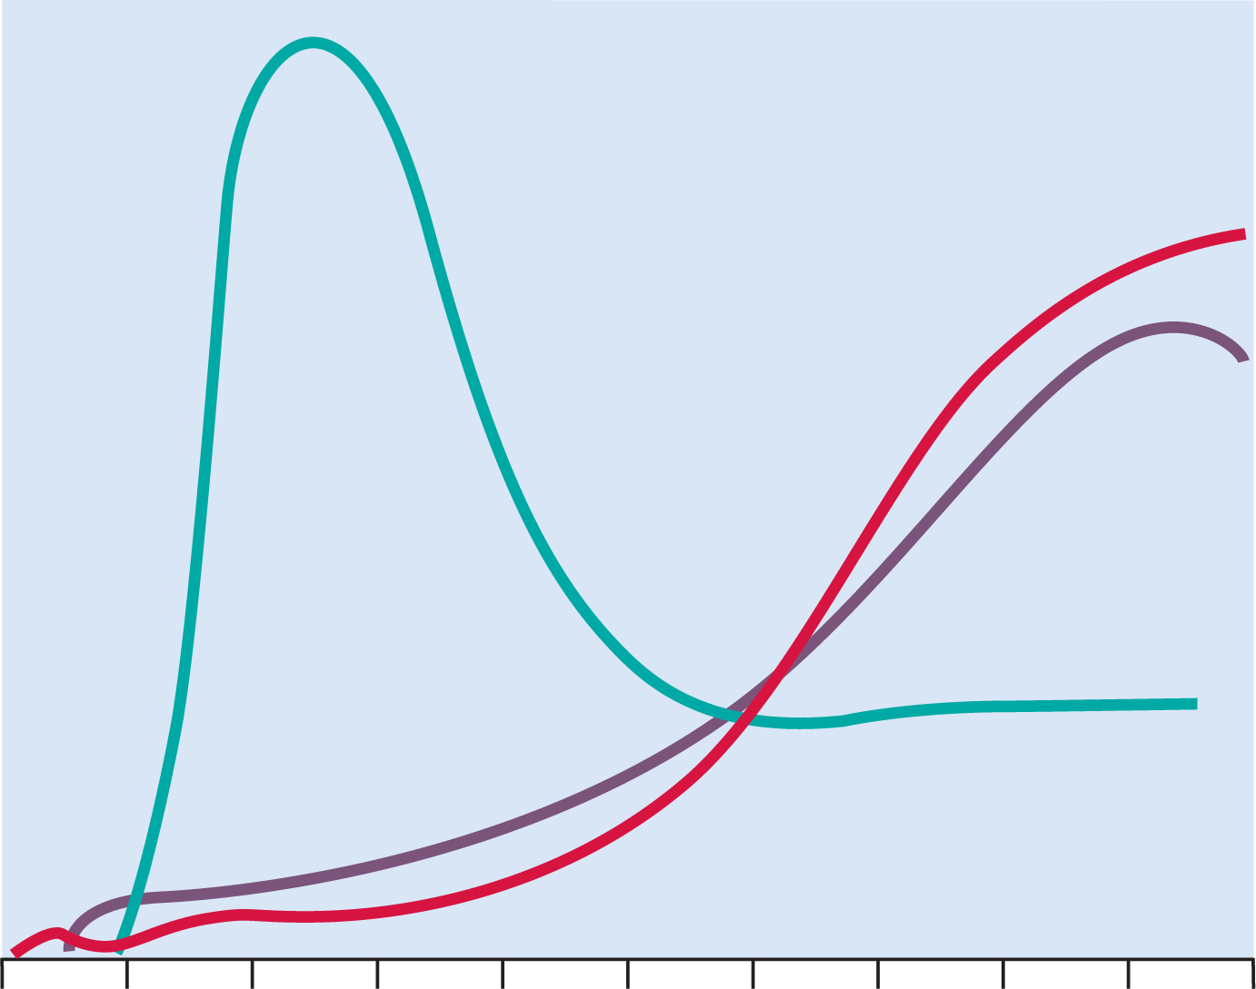
Fig. 28.18
Copyright © McGraw-Hill Education. Permission required for reproduction or display.
Human
chorionic
gonadotropin
Relative hormone levels
Estradiol
Progesterone
Ovulation
Parturition
0
4
8
12
16
20
24
28
32
36
40
Weeks after beginning of last menstrual period
Notes:
16

Slide 17
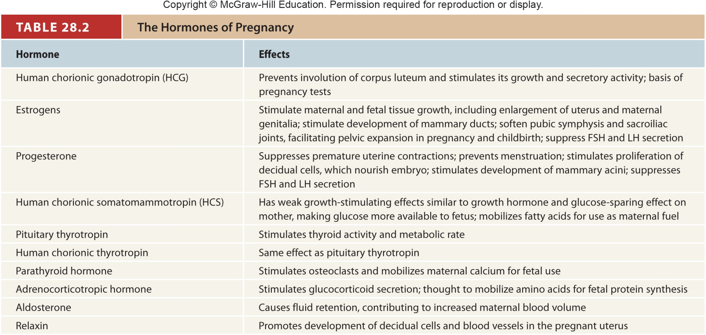
Table 28.2
Notes:
17

Slide 18
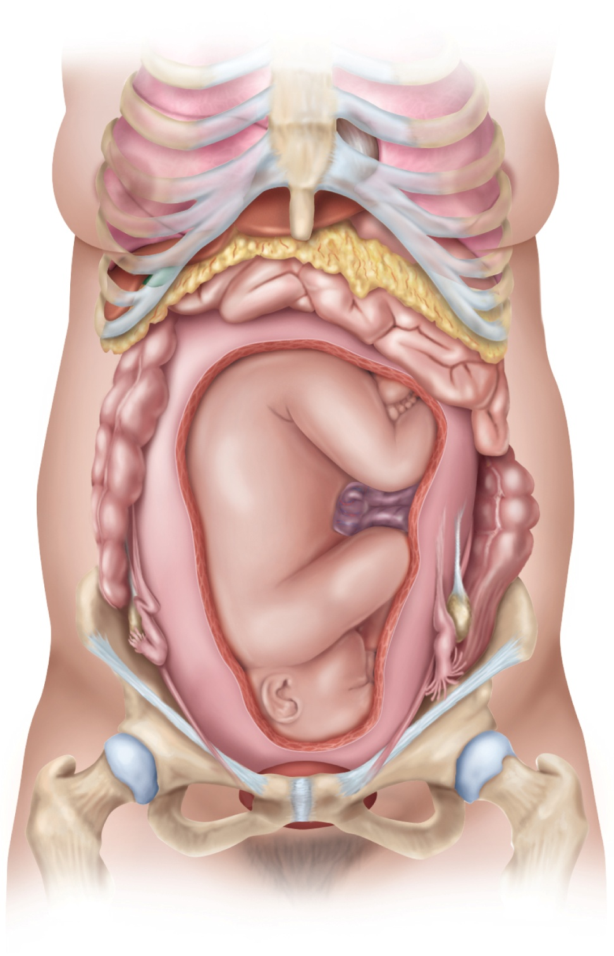
Fig. 28.19
Copyright © McGraw-Hill Education. Permission required for reproduction or display.
Lung
Xiphoid process
Pericardium
Breast
Liver
Stomach
Gallbladder
Greater omentum
Small intestine
Ascending colon
Descending colon
Uterus
Umbilical cord
Ilium
Ovary
Ovary
Inguinal ligament
Uterine tube
Round ligament of uterus
Urinary bladder
Pubic symphysis
Notes:
18

Slide 19
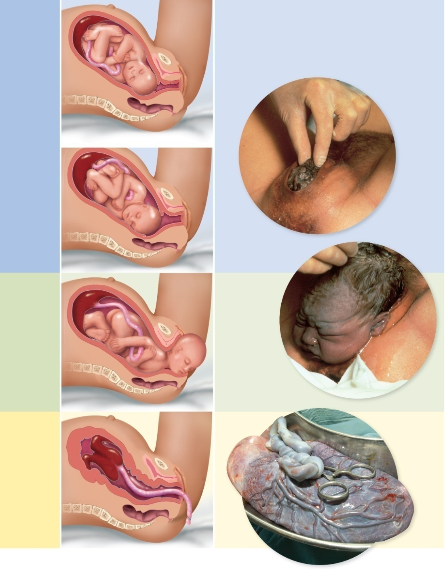
Fig. 28.20
Copyright © McGraw-Hill Education. Permission required for reproduction or display.
Early dilation
stage
Placenta
Uterus
Umbilical
cord
Cervix
Vagina
Late dilation
stage
Pubic
symphysis
Crowning
Expulsion
stage
Expulsion
stage
Placental
stage
Uterus
Placenta
(detaching)
Umbilical
cord
Afterbirth
(Crowning, Expulsion stage): © D. Van Rossum/Science Source; (Afterbirth): © Medicimage/ Visuals Unlimited, Inc.
Notes:
19

Slide 20
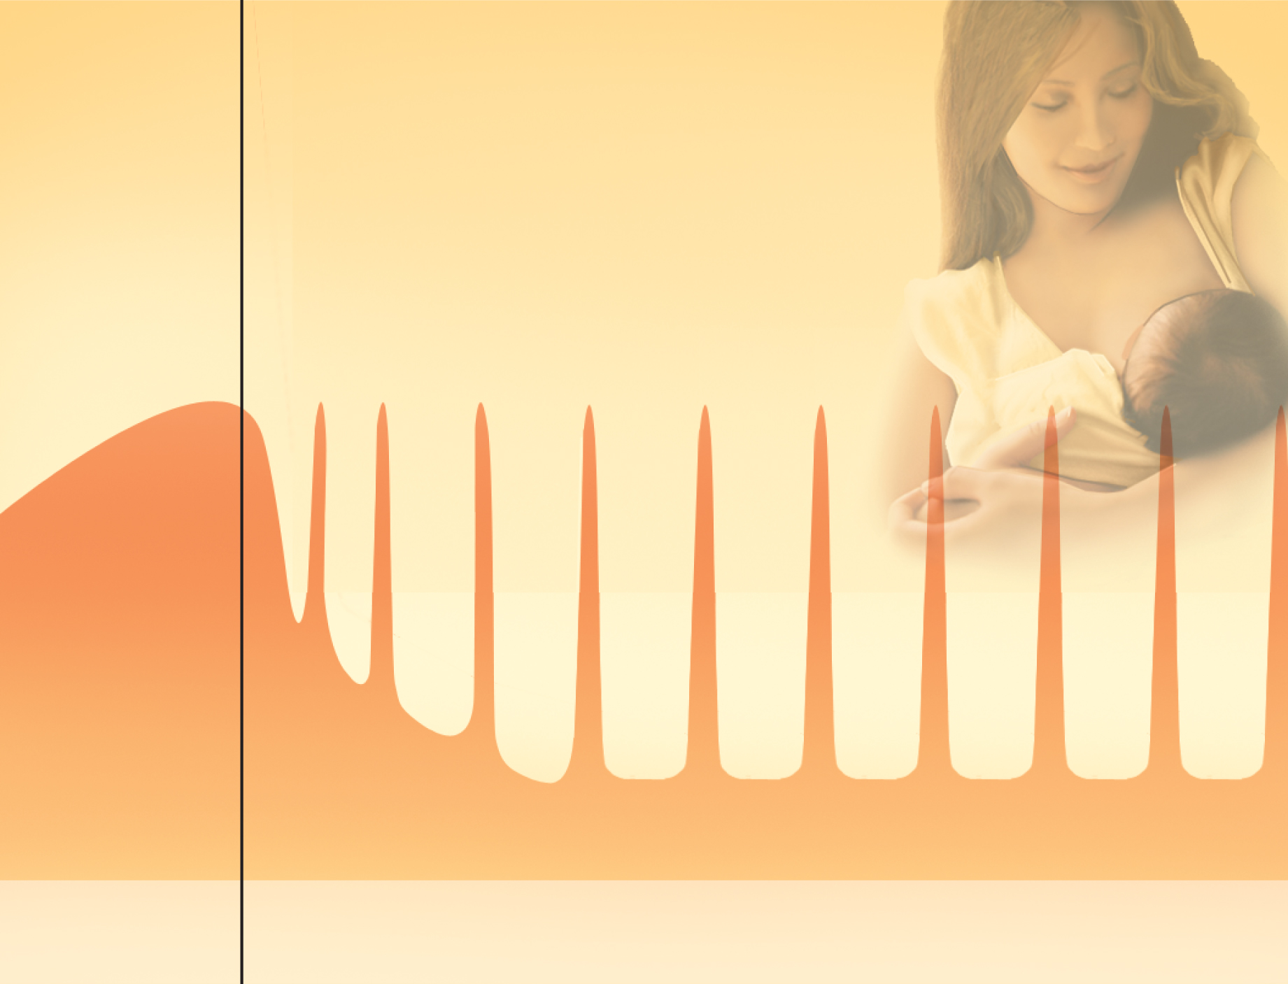
Fig. 28.21
Copyright © McGraw-Hill Education. Permission required for reproduction or display.
Prolactin surges
Feedings
Pregnancy
Lactation

