Slide 1
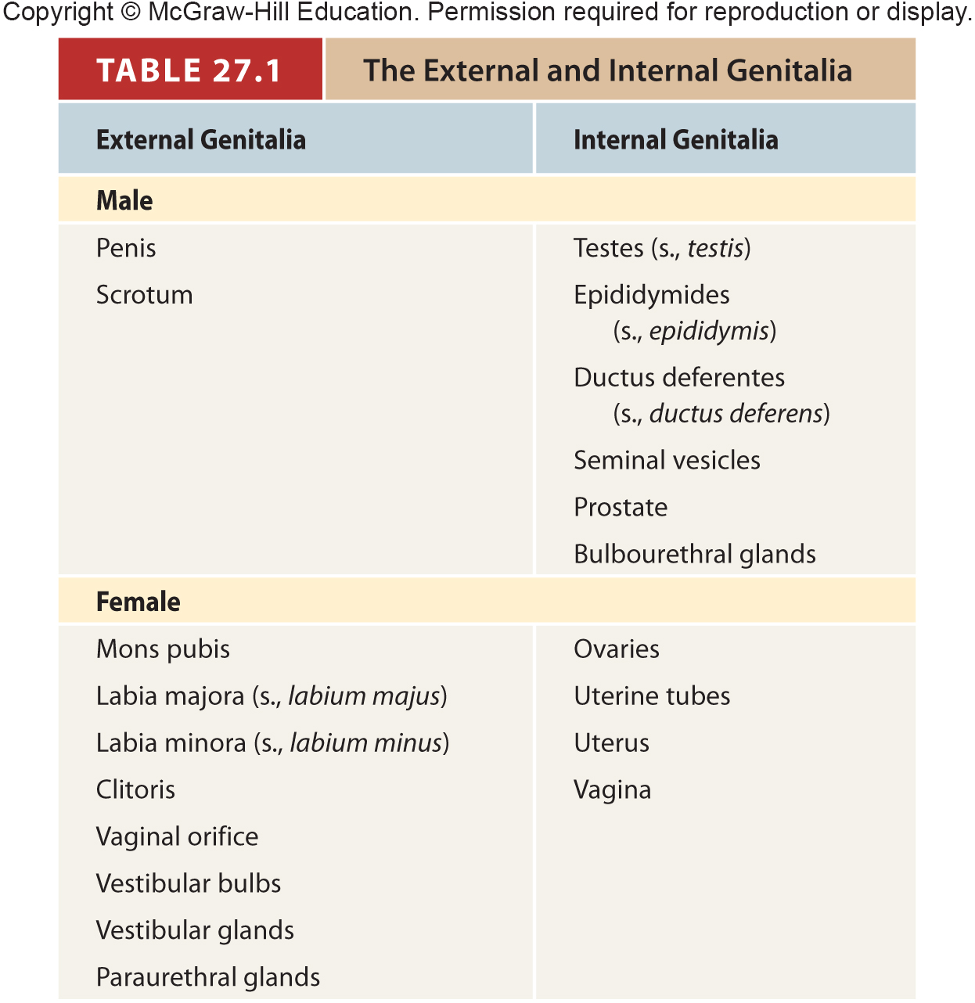
Table 27.1
Notes:
1

Slide 2
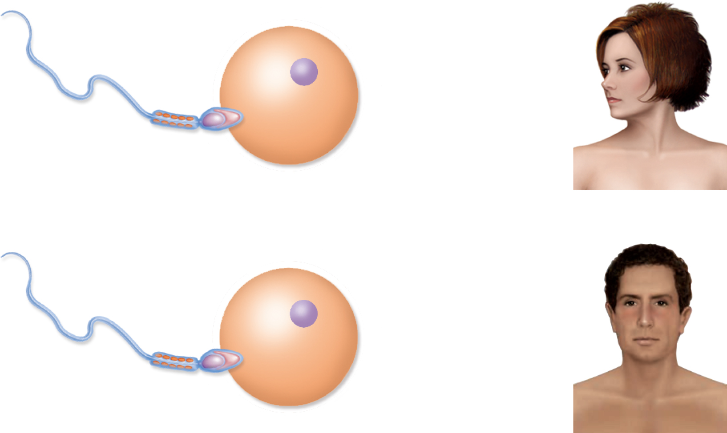
Fig. 27.2
Copyright © McGraw-Hill Education. Permission required for reproduction or display.
X
X
XX = female
Sperm
Egg
Y
X
XY = male
Notes:
2

Slide 3
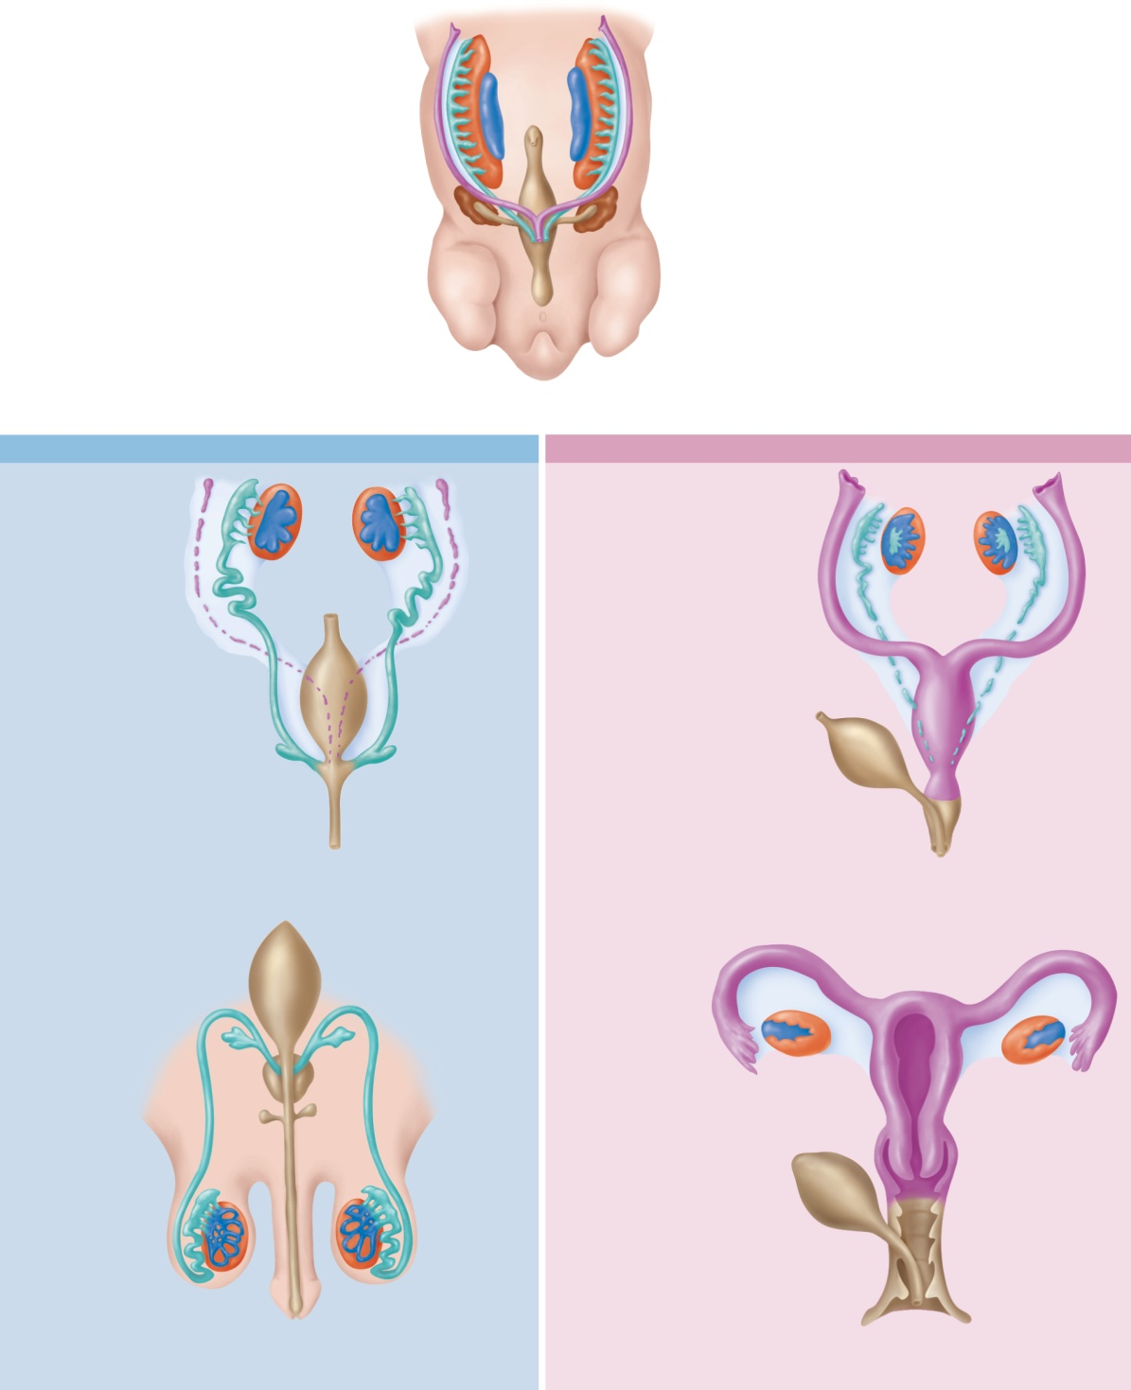


Fig. 27.3
Copyright © McGraw-Hill Education. Permission required for reproduction or display.
Mesonephros
Mesonephric duct
Gonadal ridge
Paramesonephric
(müllerian) duct
Kidney
Cloaca
5- to 6-week embryo;
sexually indifferent stage
Male
Female
Testes
Ovaries
Efferent ductules
Paramesonephric
duct forming the
uterine tube
Epididymis
Paramesonephric
duct (degenerating)
Mesonephric duct
(degenerating)
Mesonephric duct
forming the
ductus deferens
Fused paramesonephric
ducts forming
the uterus
Urinary bladder
Urinary bladder
(moved aside)
Seminal vesicle
Urogenital sinus
forming the urethra
Urogenital sinus
forming the urethra
and lower vagina
7 to 8 weeks
8 to 9 weeks
Urinary
bladder
Uterine
tube
Seminal
vesicle
Ovary
Prostate gland
Uterus
Bulbourethal
gland
Ductus deferens
Urinary bladder
(moved aside)
Epididymis
Vagina
Testis
Urethra
Urethra
Hymen
Penis
Vestibule
At birth
At birth
Notes:
3

Slide 4
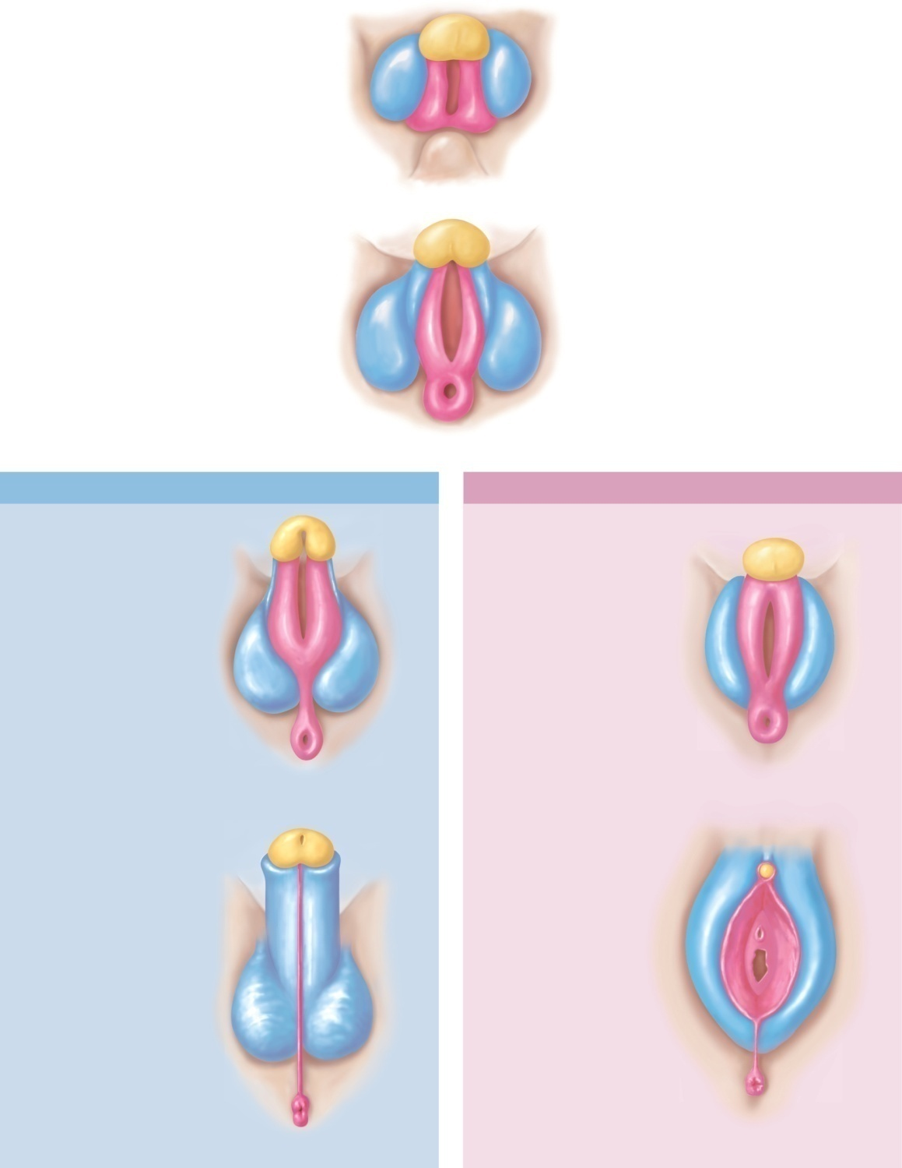


Fig. 27.4
Copyright © McGraw-Hill Education. Permission required for reproduction or display.
Genital tubercle
Urogenital fold
Labioscrotal fold
Tail
6 weeks
8 weeks
Male
Female
Phallus:
Developing glans
of penis
Developing glans
of clitoris
Urethral groove
Labia minora
Urethral groove
Labia majora
Anus
Anus
10 weeks
10 weeks
Urethral orifice
Glans of penis
Prepuce
Prepuce
Glans of clitoris
Urethral orifice
Scrotum
Vaginal orifice
Perineal raphe
Perineal raphe
Anus
Anus
12 weeks
12 weeks
Notes:
4

Slide 5
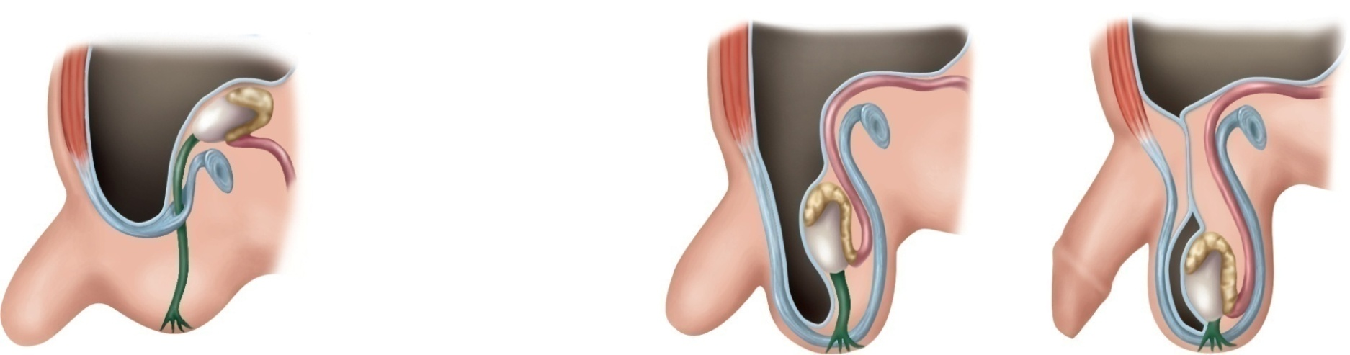
Fig. 27.5
Copyright © McGraw-Hill Education. Permission required for reproduction or display.
3-month fetus
8-month fetus
1-month-old infant
Parietal
peritoneum
Muscular wall
of abdomen
Closed proximal
portion of
vaginal process
Epididymis
Testis
Inguinal canal
Ductus deferens
Spermatic cord
Pubic symphysis
Vaginal process
Tunica vaginalis
Vaginal process
Gubernaculum
Scrotum
Scrotal swelling
Penis
Gubernaculum
Notes:
5

Slide 6
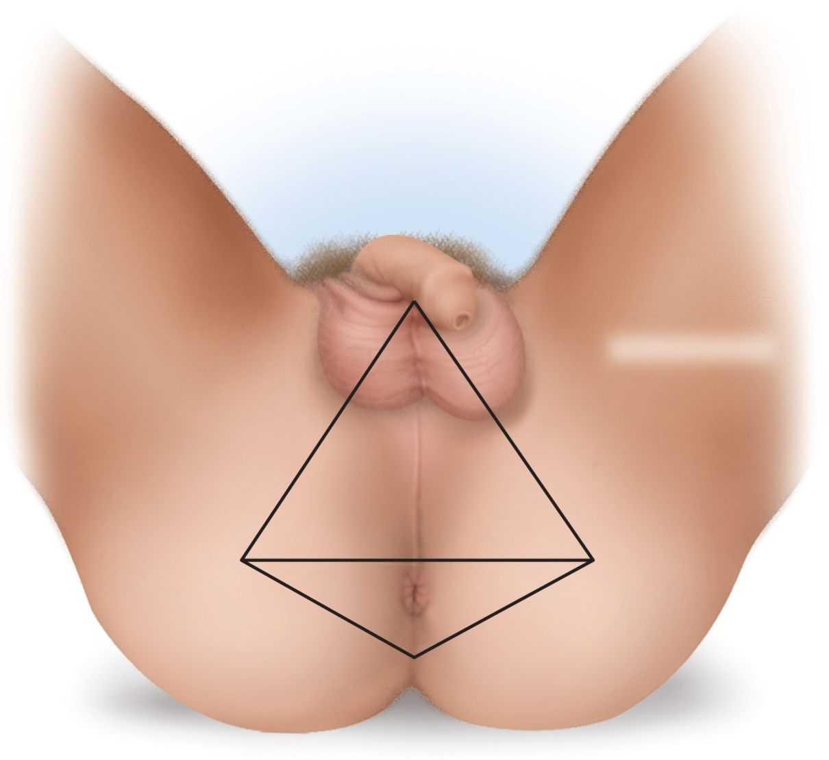
Fig. 27.6
Copyright © McGraw-Hill Education. Permission required for reproduction or display.
Location of pubic
symphysis
Perineal raphe
Urogenital triangle
Location of
coccyx
Location of ischial
tuberosity
Anal triangle
Anus
Notes:
6

Slide 7
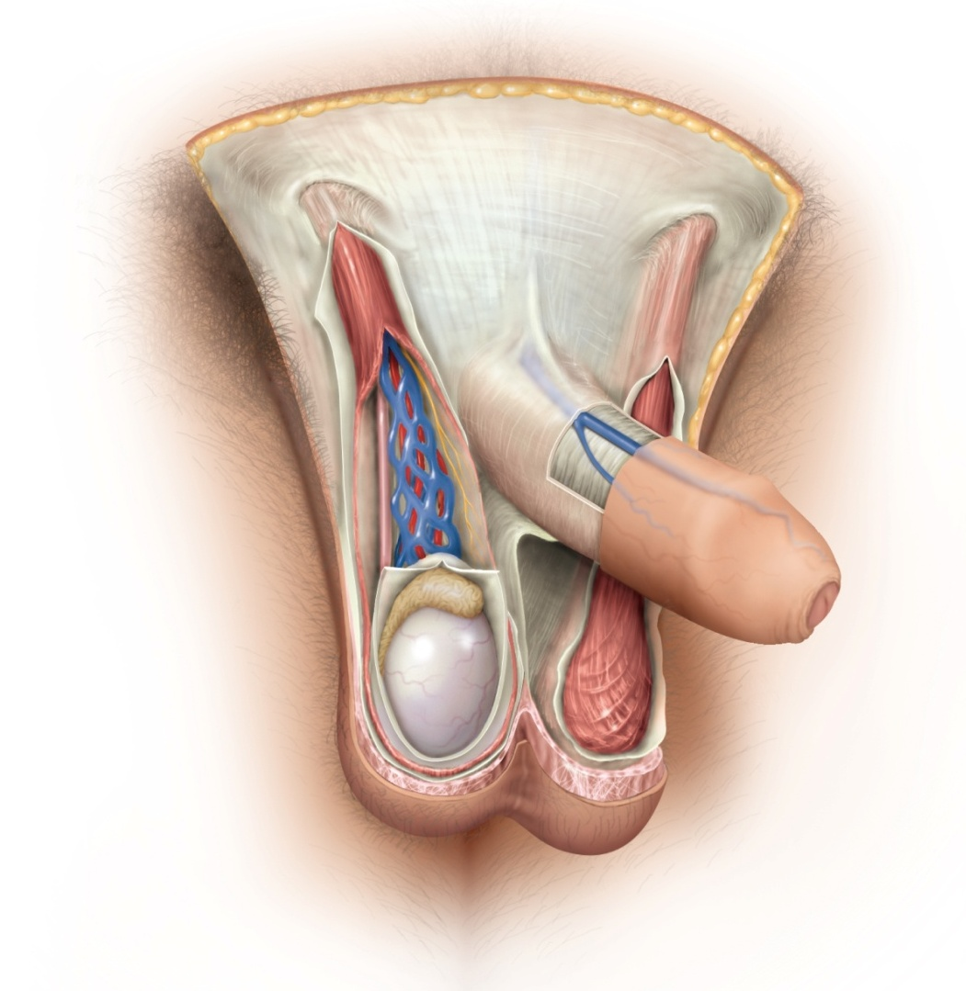
Fig. 27.7
Copyright © McGraw-Hill Education. Permission required for reproduction or display.
External inguinal ring
Spermatic cord:
Cremaster muscle
Testicular artery
Fascia of spermatic cord
Ductus deferens
Superficial fascia of penis
Deep fascia of penis
Pampiniform plexus
Prepuce (foreskin)
Epididymis
Glans
Tunica vaginalis
Median septum of scrotum
Testis
Cremaster muscle
Dartos muscle
Scrotal skin
Notes:
7

Slide 8
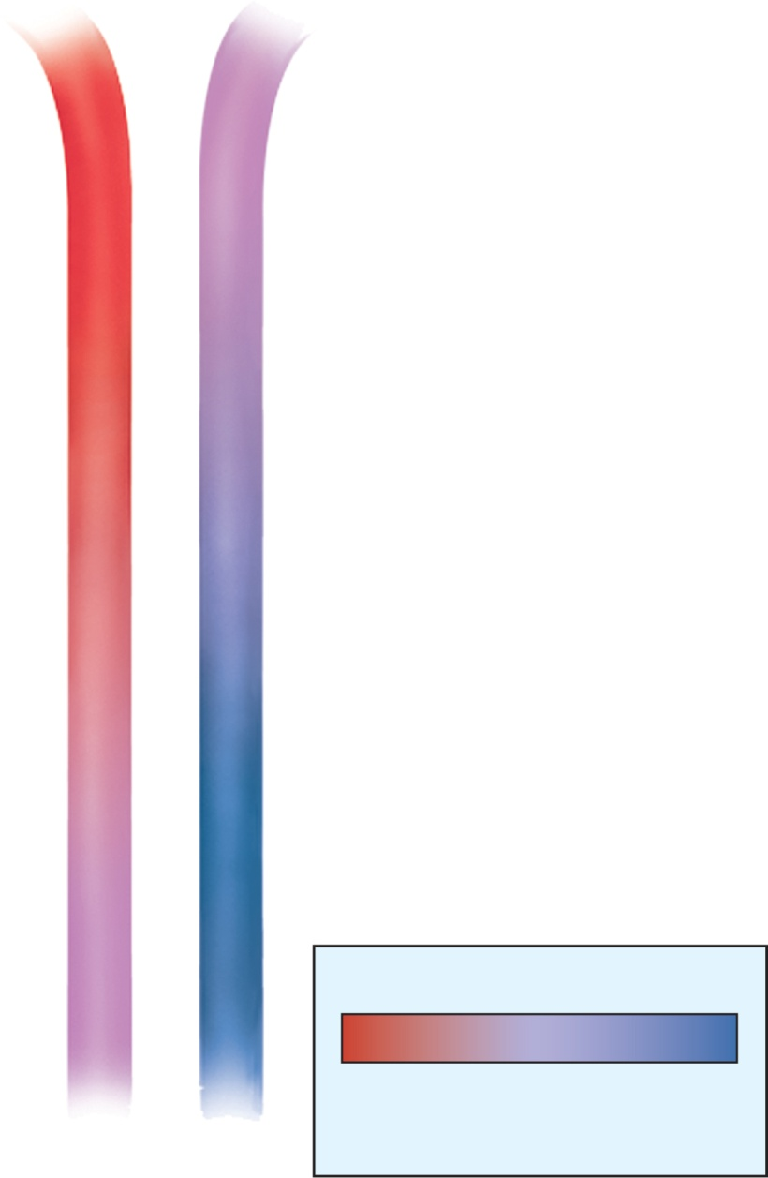
Fig. 27.8
Copyright © McGraw-Hill Education. Permission required for reproduction or display.
Pelvic cavity
37°C
Testicular artery
Pampiniform plexus
Blood flow
Blood flow
Heat transfer
Arterial blood cools
as it descends
Venous blood carries
away heat as it ascends
Key
35°C
Warmest
blood
Coolest
blood
Testis
Notes:
8

Slide 9
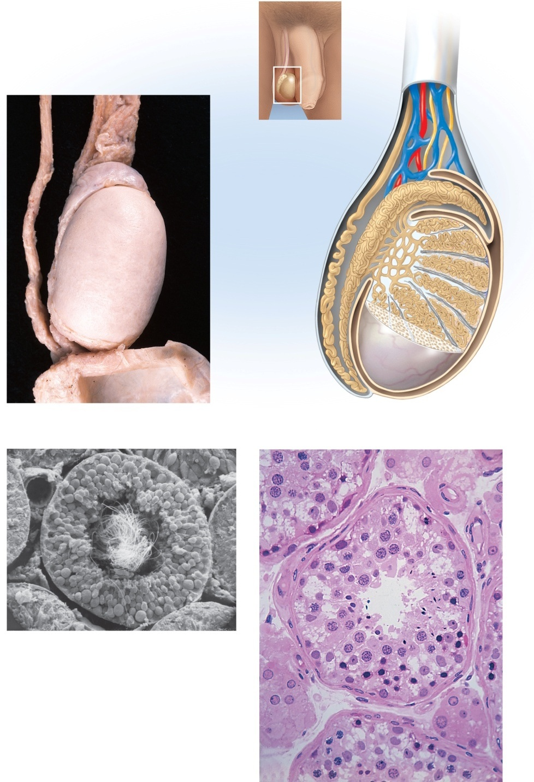
Fig. 27.9
Copyright © McGraw-Hill Education. Permission required for reproduction or display.
Spermatic cord
Spermatic
cord
Ductus deferens
Blood vessels
and nerves
Head of
epididymis
Head of
epididymis
Ductus
deferens
Efferent
ductule
Seminiferous
tubule
Rete testis
Septum
Testis, covered
by tunica
albuginea
Body of
epididymis
Lobule
Tunica
vaginalis
Tail of epididymis
Scrotum
(folded down)
Tunica
albuginea
Tail of
epididymis
(a)
2 cm
(b)
Interstitial cells
Blood vessel
Blood vessel
Germ cells
Sustentacular cell
Seminiferous
tubule
Tails of
spermatozoa
Spermatids
Sustentacular
cell nuclei
Tubule lumen
Germ cells
(c)
Connective tissue
wall of tubule
Interstitial cells
(d)
50 µm
a: ©McGraw-Hill Education/Dennis Strete; c: ©Dr. Kessel & Dr. Kardon/Tissues and Organs/Visuals Unlimited, Inc.; d: ©Ed Reschke
Notes:
9

Slide 10
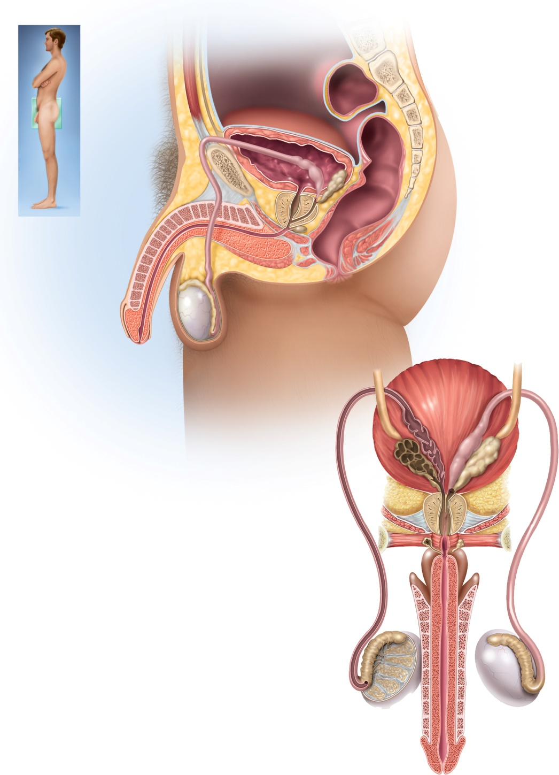
Fig. 27.10
Copyright © McGraw-Hill Education. Permission required for reproduction or display.
Urinary
bladder
Pubic
symphysis
Rectum
Ampulla of ductus deferens
Root of
penis
Seminal vesicle
Ejaculatory duct
Ductus (vas) deferens
Prostate gland
Shaft of penis
Bulbourethral
gland
Corpus cavernosum
Bulbospongiosus
muscle
Corpus spongiosum
Urethra
Epididymis
Glans of penis
Prepuce
Testis
Scrotum
Ureter
Urinary
bladder
(a) Sagittal section
Ampulla
Seminal
vesicle
Prostate
gland
Ejaculatory
duct
Prostatic
urethra
Bulbourethral
gland
Membranous
urethra
Bulb
Crus
Ductus deferens
Corpus
spongiosum
Corpus
cavernosum
Efferent
ductules
Testis
Epididymis
Spongy (penile)
urethra
Glans of penis
(b) Posterior view
Penis
Notes:
10

Slide 11
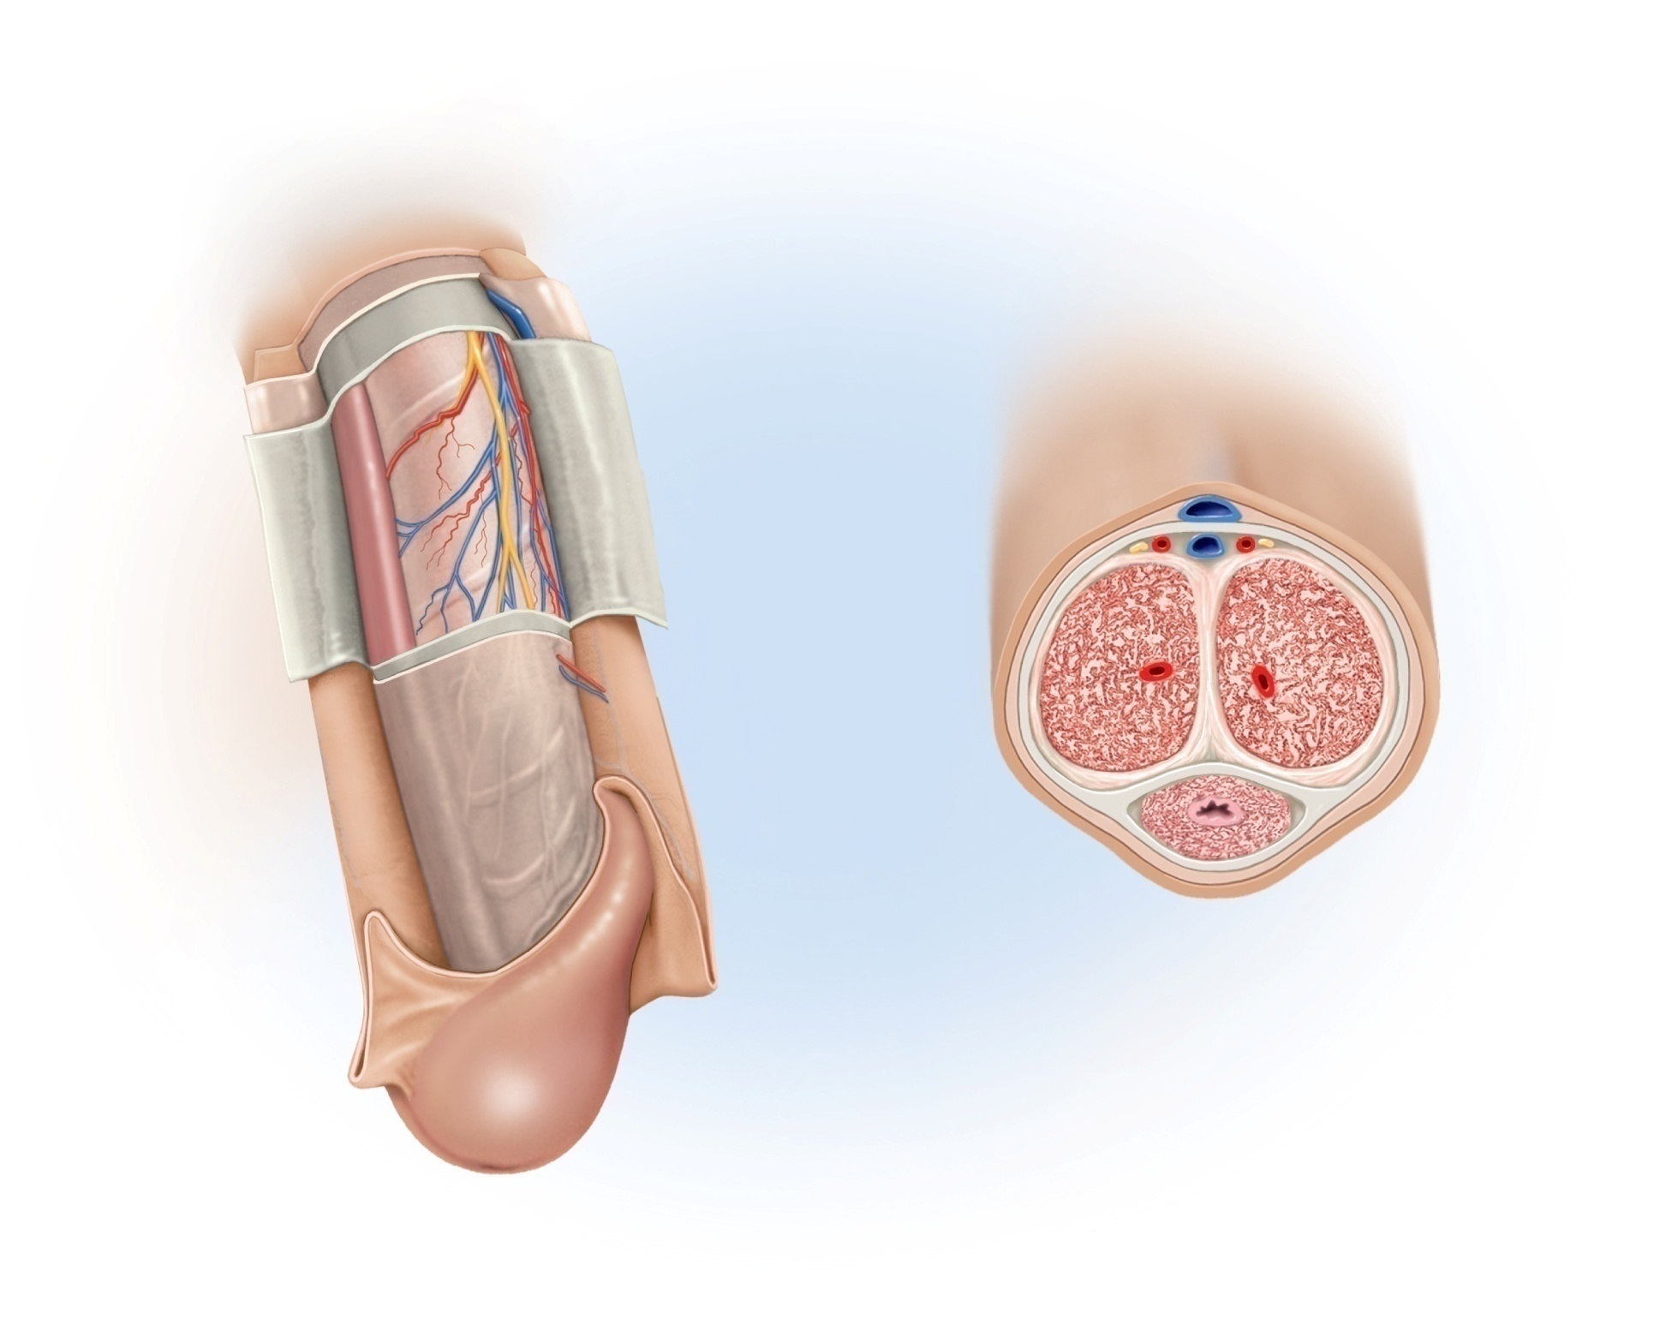
Fig. 27.11
Copyright © McGraw-Hill Education. Permission required for reproduction or display.
Dorsal vein
Dorsal
Dorsal artery
Dorsal nerve
Corpus spongiosum
Corpus cavernosum
Deep artery
Deep fascia
Tunica
albuginea
Superficial fascia
Skin
Lacunae
Urethra
Median septum
Corpus spongiosum
Prepuce
(b)
Ventral
Glans of penis
(a)
External urethral orifice
Notes:
11

Slide 12
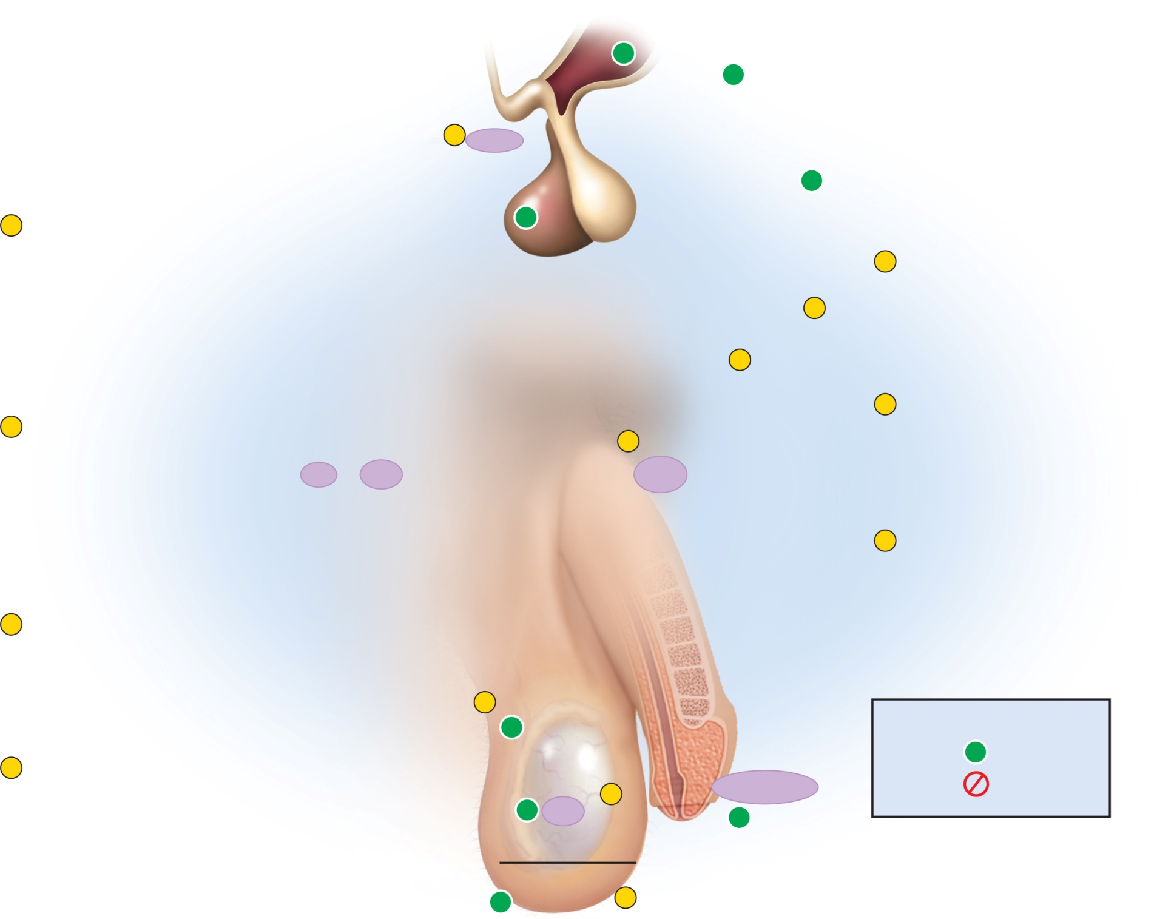
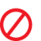
Fig. 27.12
Copyright © McGraw-Hill Education. Permission required for reproduction or display.
+
Hypothalamus
Libido
+
Secondary
sex organs
1
GnRH
Secondary sex
characteristics
+
GnRH from hypothalamus stimulates the
anterior pituitary to secrete FSH and LH.
+
1
Pituitary gland
5
Testosterone also stimulates the
libido and the development of
secondary sex organs and
characteristics.
5
6
6
Testosterone has negative
feedback effects that reduce GnRH
secretion and pituitary sensitivity
to GnRH.
2
FSH stimulates sustentacular
cells to secrete androgen-binding
protein (ABP).
7
LH
FSH
Inhibin
7
Sustentacular cells also secrete
inhibin, which selectively inhibits
FSH secretion and thus reduces
sperm production without reducing
testosterone secretion.
3
LH stimulates interstitial cells to
secrete testosterone (androgen).
2
+
Key
Testis
Sustentacular
cells
+
Stimulation
4
In the presence of ABP,
testosterone stimulates
spermatogenesis.
Inhibition
+
4
Testosterone
ABP
+
Spermatogenesis
+
Interstitial
cells
3
Notes:
12

Slide 13
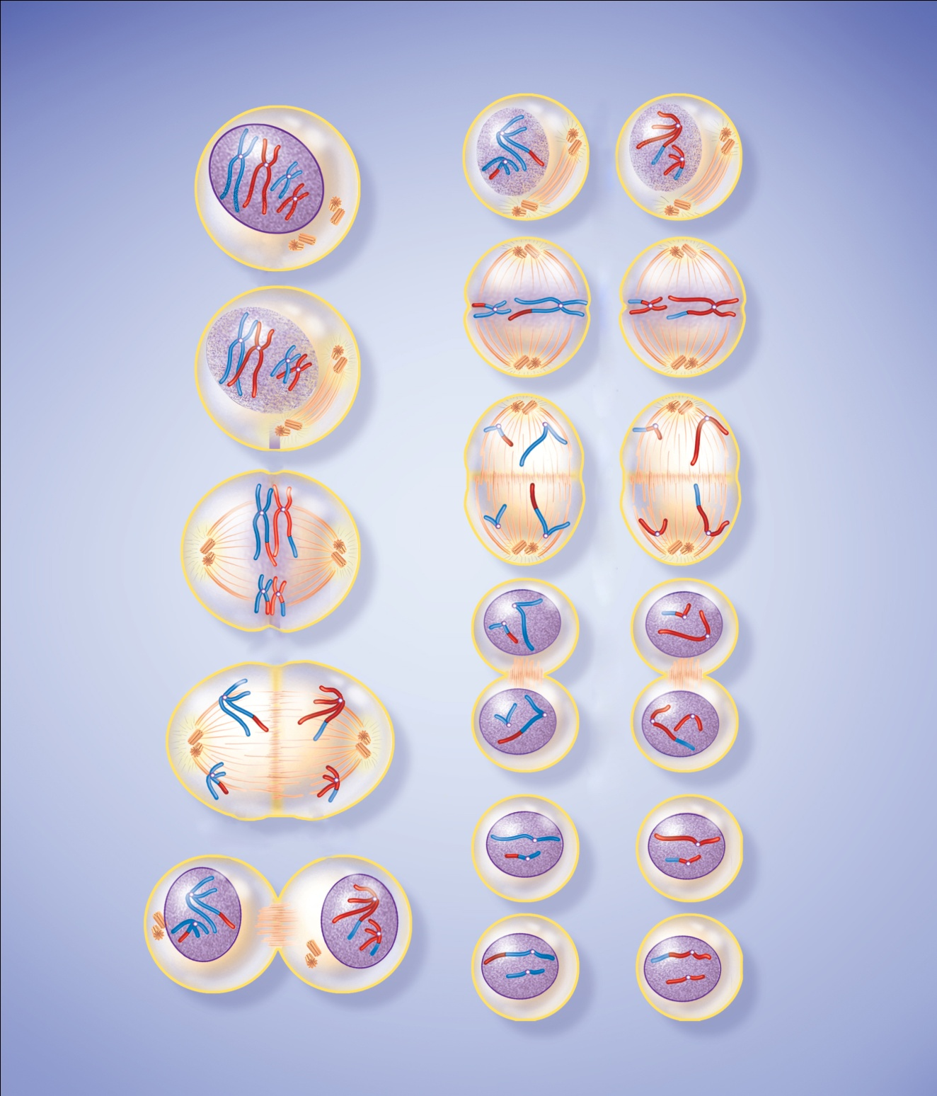







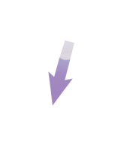

Fig. 27.13
Copyright © McGraw-Hill Education. Permission required for reproduction or display.
Meiosis I (first division)
Meiosis II (second division)
Early prophase I
Chromatin condenses to
form visible chromosomes;
each chromosome has 2
chromatids joined by a
centromere.
Chromosome
Prophase II
Nuclear envelopes
disintegrate again;
chromosomes still
consist of 2 chromatids.
New spindle forms.
Nucleus
Centromere
Centrioles
Mid- to late prophase I
Homologous chromosomes
form pairs called tetrads.
Chromatids often break
and exchange segments
(crossing-over). Centrioles
produce spindle fibers.
Nuclear envelope
disintegrates.
Metaphase II
Chromosomes align on
equatorial plane.
Tetrad
Crossing-over
Spindle
fibers
Anaphase II
Centromeres divide;
sister chromatids
migrate to opposite
poles of cell. Each
chromatid now constitutes
a single-stranded
chromosome.
Metaphase I
Tetrads align on
equatorial plane of
cell with centromeres
attached to spindle
fibers.
Centromere
Chromatid
Equatorial
plane
Telophase II
New nuclear envelopes
form around chromosomes;
chromosomes uncoil and
become less visible;
cytoplasm divides.
Anaphase I
Homologous
chromosomes
separate and
migrate to opposite
poles of the cell.
Telophase I
New nuclear
envelopes
form around
chromosomes;
cell undergoes
cytoplasmic
division
(cytokinesis).
Each cell is
now haploid.
Final product is 4
haploid cells with
single-stranded
chromosomes.
Cleavage furrow
Notes:
13

Slide 14
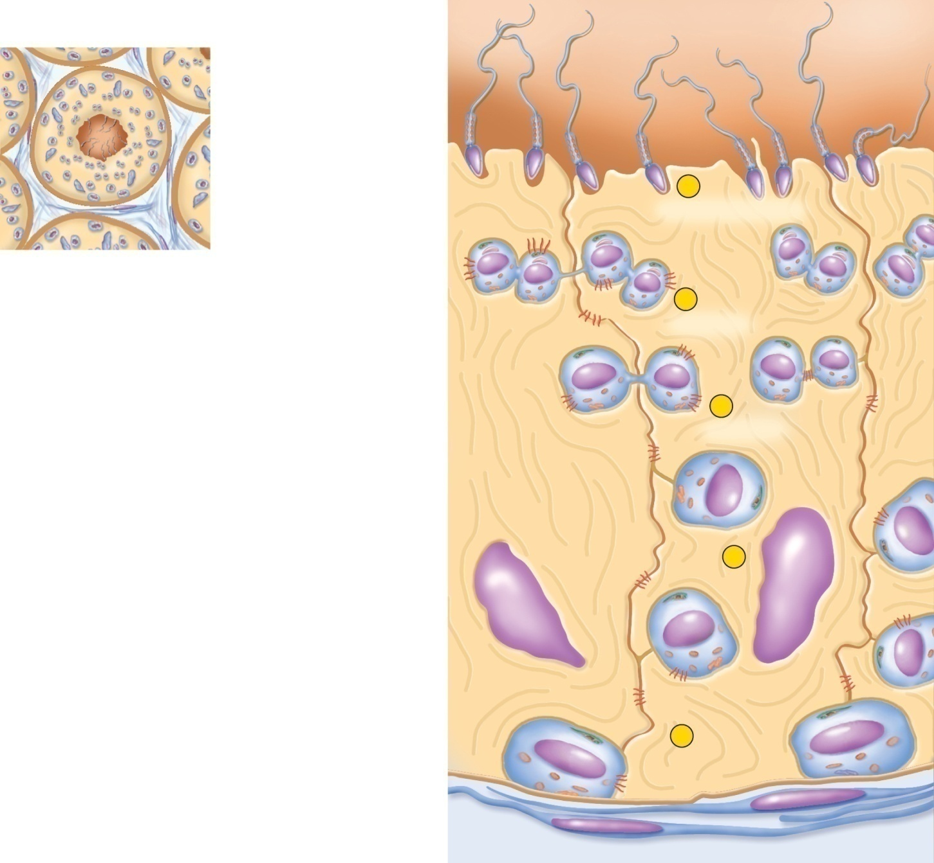

Fig. 27.14
Copyright © McGraw-Hill Education. Permission required for reproduction or display.
Cross section of
seminiferous tubules
Lumen of
seminiferous tubule
Sperm
5
Spermiogenesis
Spermatid
n
n
n
n
4
Meiosis II
Secondary spermatocyte
n
n
3
Blood–testis barrier
Meiosis I
Primary
spermatocyte
2n
Sustentacular cell
2
Type B spermatogonium
2n
Tight junction
Type A spermatogonium
1
2n
Basement membrane
of seminiferous tubule
Notes:
14

Slide 15
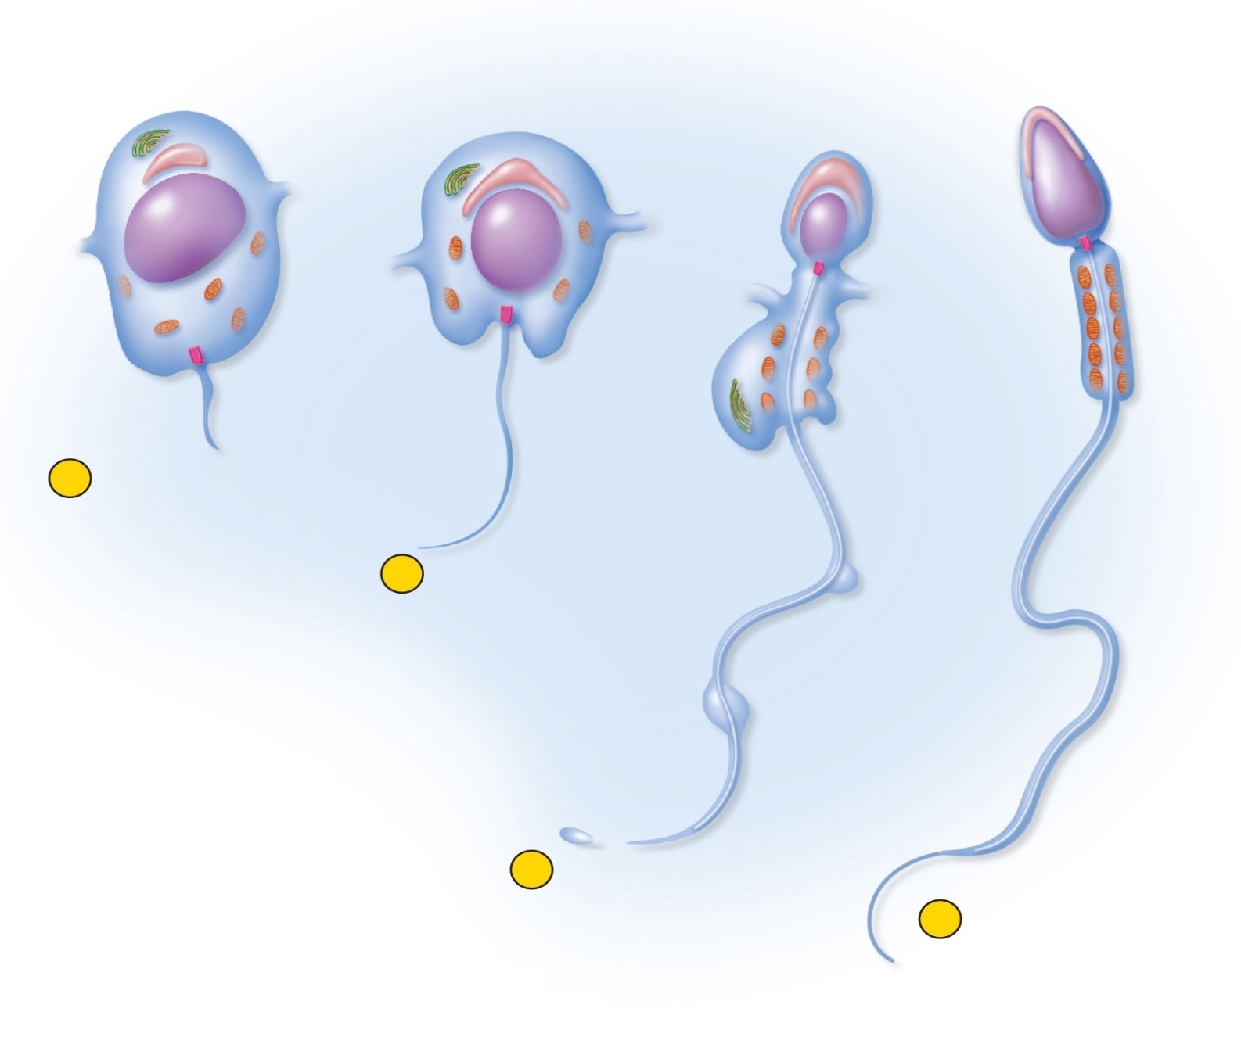
Fig. 27.15
Copyright © McGraw-Hill Education. Permission required for reproduction or display.
Golgi complex
Bridge to
adjacent
spermatid
Acrosome
Acrosomal
vesicle
Nucleus
Head
Axoneme
Mitochondria
Basal
body
Midpiece
of tail
Flagellum
Excess
cytoplasm
1
Appearance of
acrosomal vesicle
and flagellum in
spermatid
2
Growth of
acrosome
and flagellum
3
Shedding of
excess
cytoplasm
4
Mature sperm
Notes:
15

Slide 16
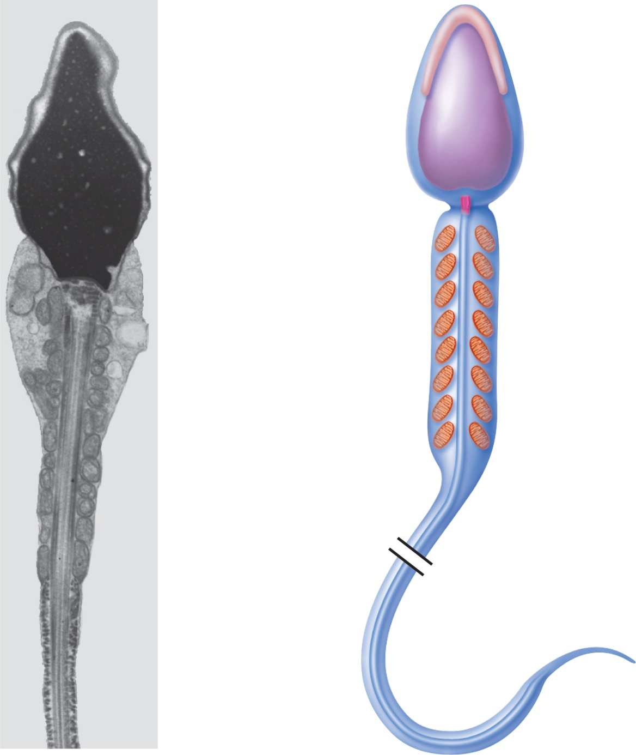
Fig. 27.16
Copyright © McGraw-Hill Education. Permission required for reproduction or display.
Acrosome
Head
Nucleus
Basal body
Mitochondrion
Midpiece
of tail
Axoneme
Principal
piece of
tail
Endpiece
of tail
2 µm
(a)
(b)
a: ©David Phillips/Visuals Unlimited
Notes:
16

Slide 17
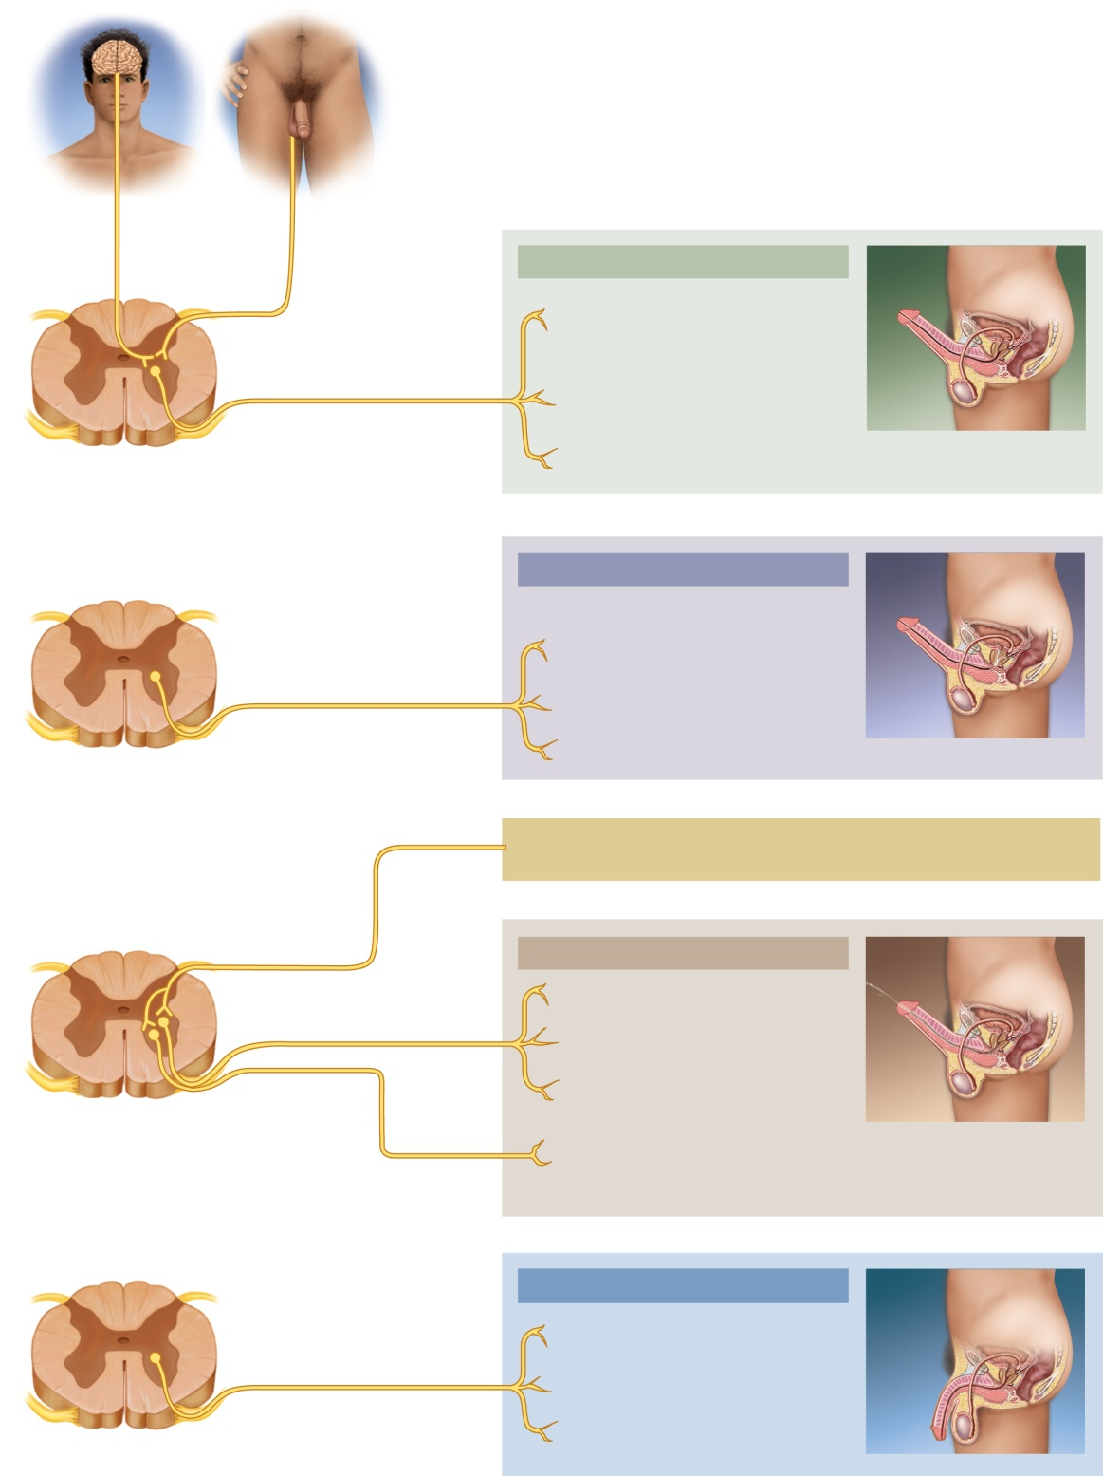
Fig. 27.17
Copyright © McGraw-Hill Education. Permission required for reproduction or display.
Stimulation
of genital
region,
especially
glans
Visual,
mental,
and other
stimuli
Internal
pudendal
nerve
Excitement
Deep artery of penis dilates; erectile
tissues engorge with blood; penis
becomes erect
Pelvic nerve
Trabecular muscle of erectile tissues
relaxes; allows engorgement of
erectile tissues; penis becomes erect
Efferent
parasympathetic
signals
Bulbourethral gland secretes
bulbourethral fluid
Spinal cord (sacral)
Orgasm — emission stage
Ductus deferens exhibits peristalsis;
sperm are moved into ampulla; ampulla
contracts; sperm are moved into urethra
Prostate secretes components of the
seminal fluid
Efferent
sympathetic
signals
Seminal vesicles secrete components of
the seminal fluid
Spinal cord (L1–L2)
Semen in urethra
Afferent
signals
Orgasm — expulsion stage
Efferent
sympathetic
signals
Prostate releases additional secretion
Seminal vesicles release additional
secretion
Efferent
somatic
signals
Internal urethral sphincter contracts;
urine is retained in bladder
Spinal cord (L1–S4)
Bulbocavernosus muscle contracts, and
rhythmically compresses bulb and root of
penis; semen is expelled (ejaculation
occurs)
Resolution
Internal pudendal artery constricts;
reduces blood flow into penis
Efferent
sympathetic
signals
Trabecular muscles contract;
squeeze blood from erectile tissues
Spinal cord (L1–L2)
Penis becomes flaccid (detumescent)
Notes:
17

Slide 18
Fig. 27.18
Copyright © McGraw-Hill Education. Permission required for reproduction or display.
Sexual
stimulation
Inactive
guanylate
cyclase
Nitric oxide
GTP
Active
guanylate
cyclase
Vasodilation
and erection
cGMP
Phosphodiesterase
inhibitors
Degraded
by PDE5
Loss of
erection
Notes:
18

