Slide 1
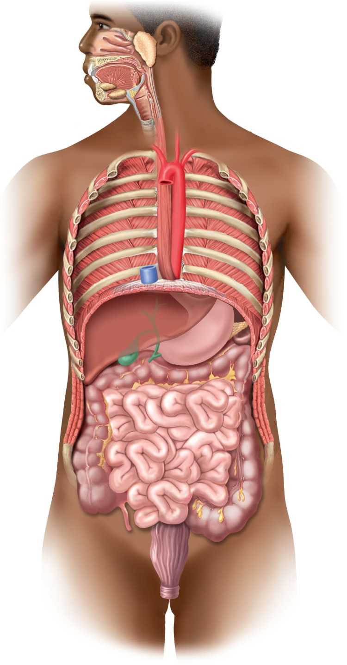
Fig. 25.1
Copyright © McGraw-Hill Education. Permission required for reproduction or display.
Oral cavity
Tongue
Parotid
gland
Teeth
Sublingual gland
Pharynx
Submandibular
gland
Esophagus
Diaphragm
Liver
Stomach
Pancreas
Gallbladder
Transverse
colon
Bile duct
Ascending
colon
Descending
colon
Small intestine
Cecum
Appendix
Sigmoid
colon
Rectum
Anal canal
Anus

Slide 2
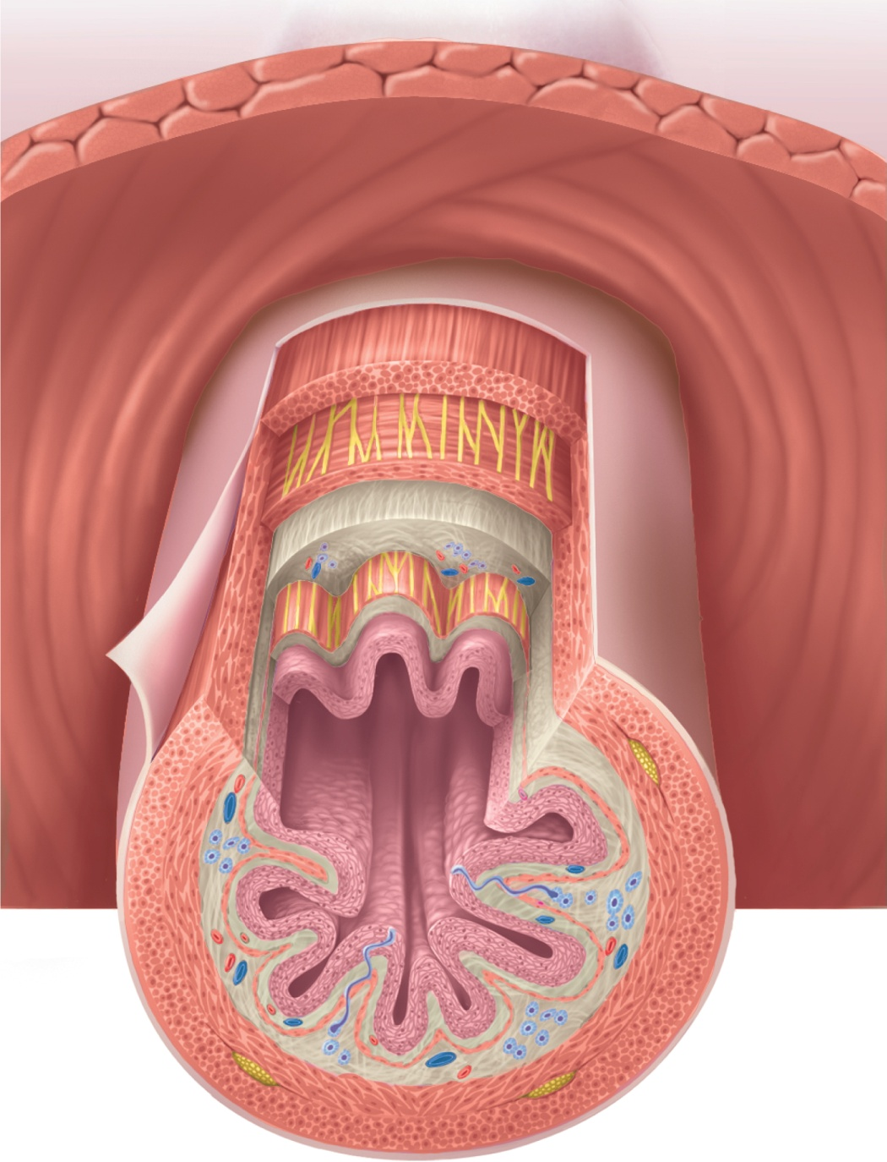
Fig. 25.2
Copyright © McGraw-Hill Education. Permission required for reproduction or display.
Diaphragm
Esophageal hiatus
Enteric nervous system:
Mucosa:
Myenteric plexus
Stratified squamous
epithelium
Lamina propria
Submucosal plexus
Muscularis mucosae
Parasympathetic ganglion of
myenteric plexus
Submucosa:
Esophageal gland
Lumen
Muscularis externa:
Inner circular layer
Outer longitudinal layer
Serosa
Blood vessels

Slide 3
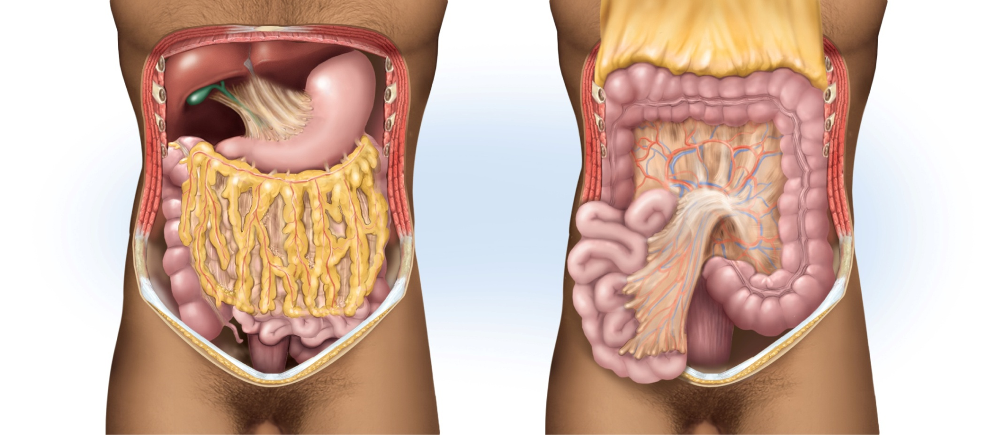
Fig. 25.3
Copyright © McGraw-Hill Education. Permission required for reproduction or display.
Greater
omentum
(retracted)
Liver
Gallbladder
Stomach
Transverse
colon
Lesser
omentum
Mesocolon
Greater
omentum
Descending
colon
Ascending
colon
Mesentery
Jejunum
Sigmoid
colon
Small
intestine
(a)
(b)

Slide 4
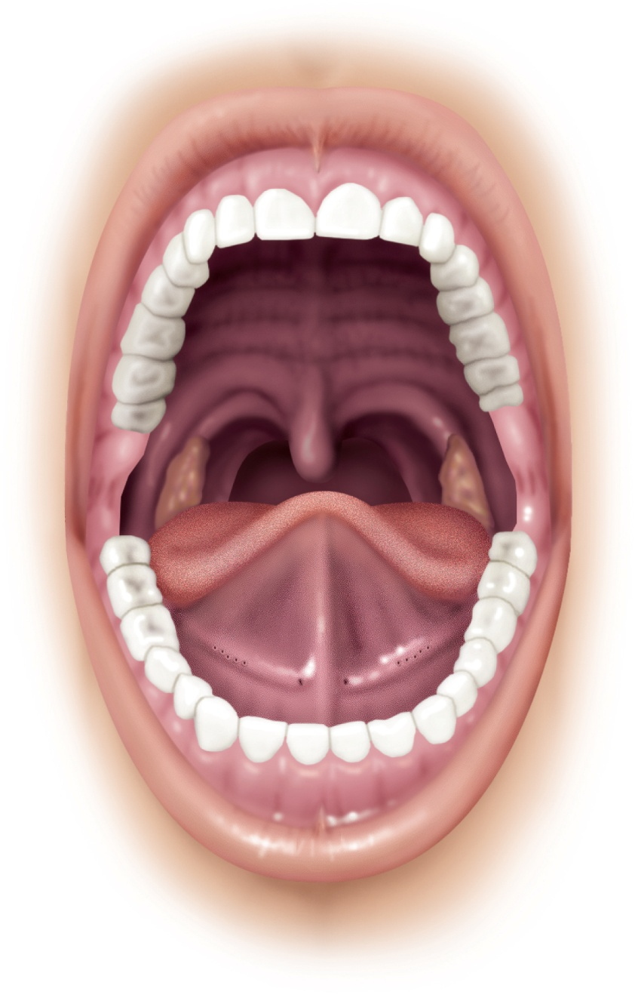
Fig. 25.4
Copyright © McGraw-Hill Education. Permission required for reproduction or display.
Upper lip
Vestibule
Superior
labial
frenulum
Palatoglossal
arch
Palatopharyngeal
arch
Hard palate
and palatine
rugae
Palatine tonsil
Soft palate
Tongue
Uvula
Lingual frenulum
Salivary duct
orifices:
Sublingual
Submandibular
Inferior labial
frenulum
Lower lip

Slide 5
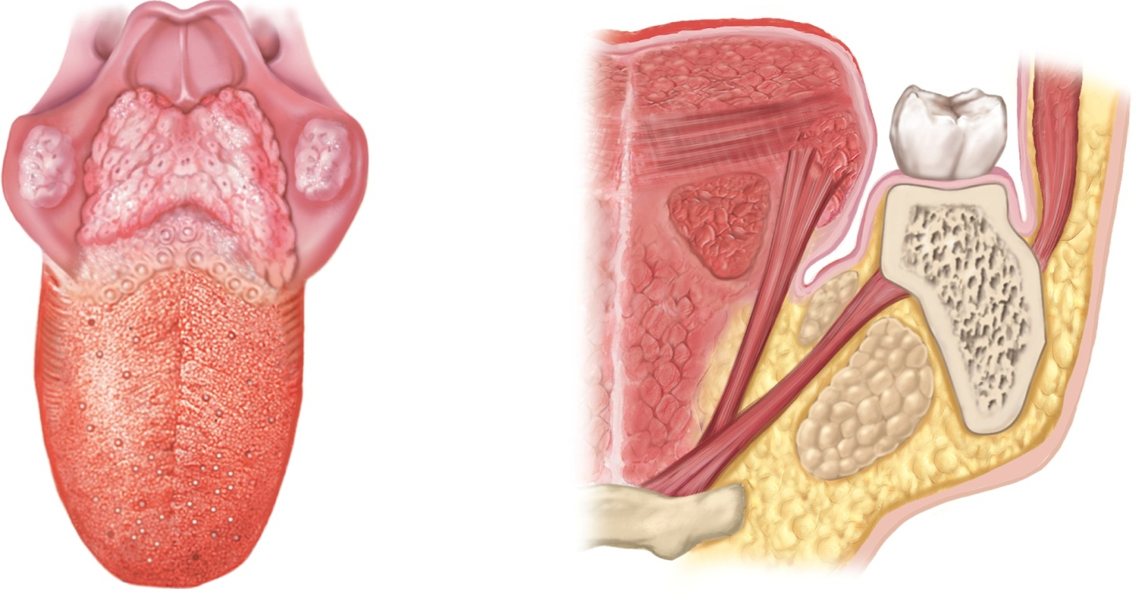
Fig. 25.5
Copyright © McGraw-Hill Education. Permission required for reproduction or display.
Epiglottis
Intrinsic muscles of
the tongue
Root
Lingual
tonsils
Buccinator m.
Palatine
tonsil
1st molar
Styloglossus m.
Terminal
sulcus
Vallate
papillae
Hyoglossus m.
Genioglossus m.
Foliate
papillae
Mandible
Sublingual gland
Body
Submandibular gland
Fungiform
papillae
Mylohyoid m.
Hyoid bone
(a) Superior view
(b) Frontal section, anterior view

Slide 6
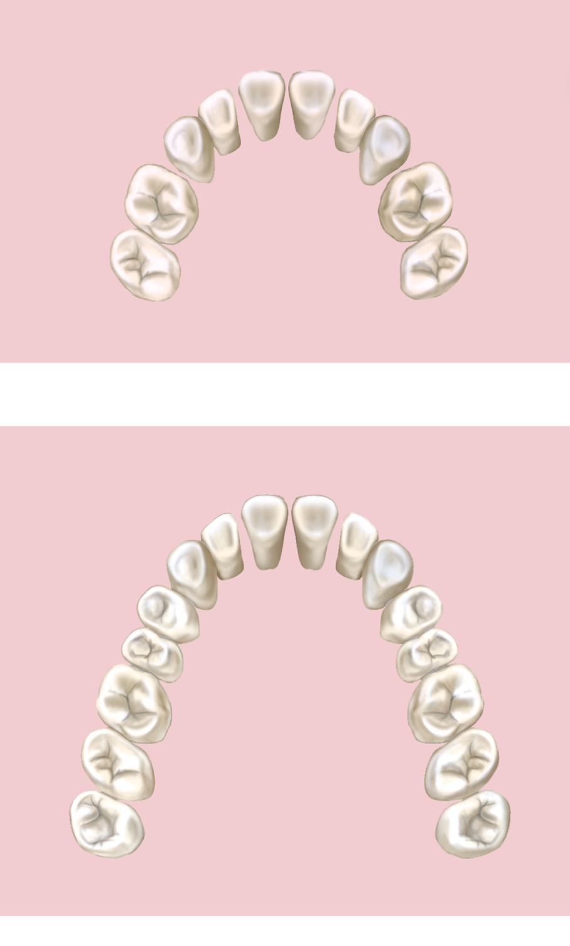
Fig. 25.6
Copyright © McGraw-Hill Education. Permission required for reproduction or display.
Names of teeth
Age at eruption
(months)
Central incisor
6–9
Lateral incisor
7–11
Canine
16–20
1st molar
12–16
2nd molar
20–26
(a) Deciduous (baby) teeth
Names of teeth
Age at eruption
(years)
Central incisor
6–8
Lateral incisor
7–9
Canine
9–12
1st premolar
10–12
2nd premolar
10–12
1st molar
6–7
2nd molar
11–13
3rd molar
(wisdom tooth)
17–25
(b) Permanent teeth
Notes:
6

Slide 7
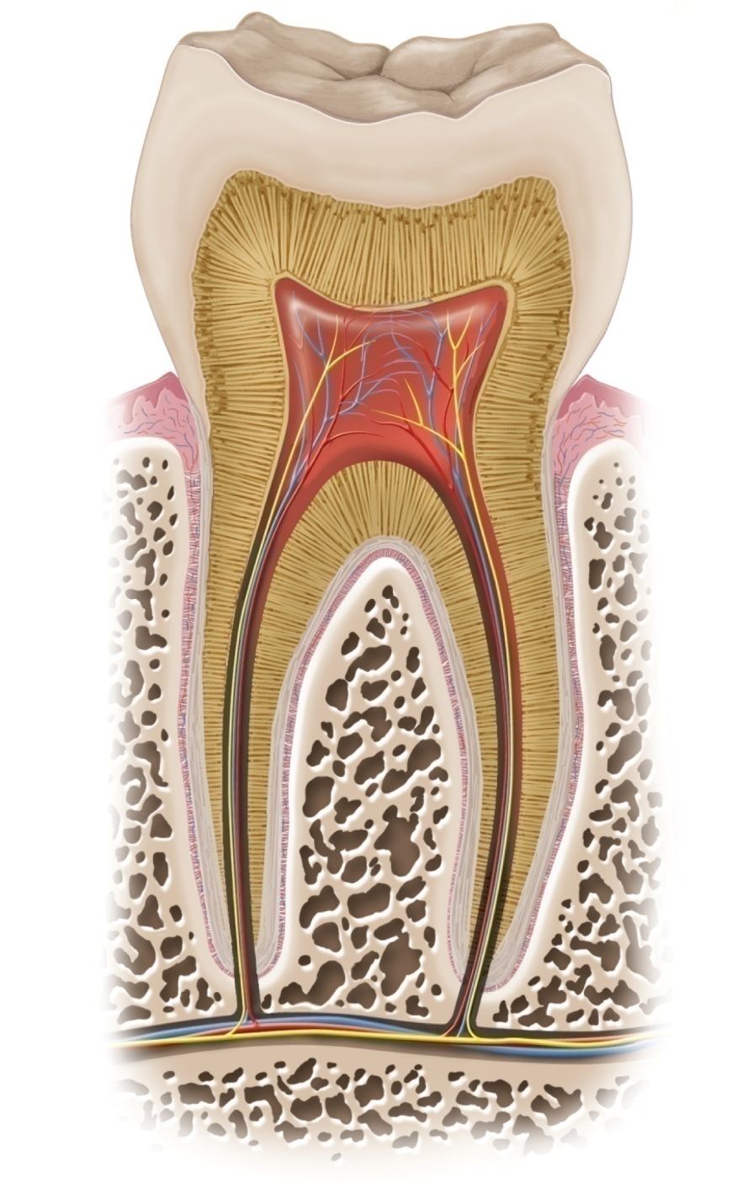
Fig. 25.7
Copyright © McGraw-Hill Education. Permission required for reproduction or display.
Enamel
Dentin
Crown
Pulp in pulp cavity
Gingival sulcus
Gingiva
Neck
Alveolar bone
Periodontal
ligament
Root canal
Cementum
Root
Apical
foramen
Artery,
nerve, vein
Notes:
7

Slide 8
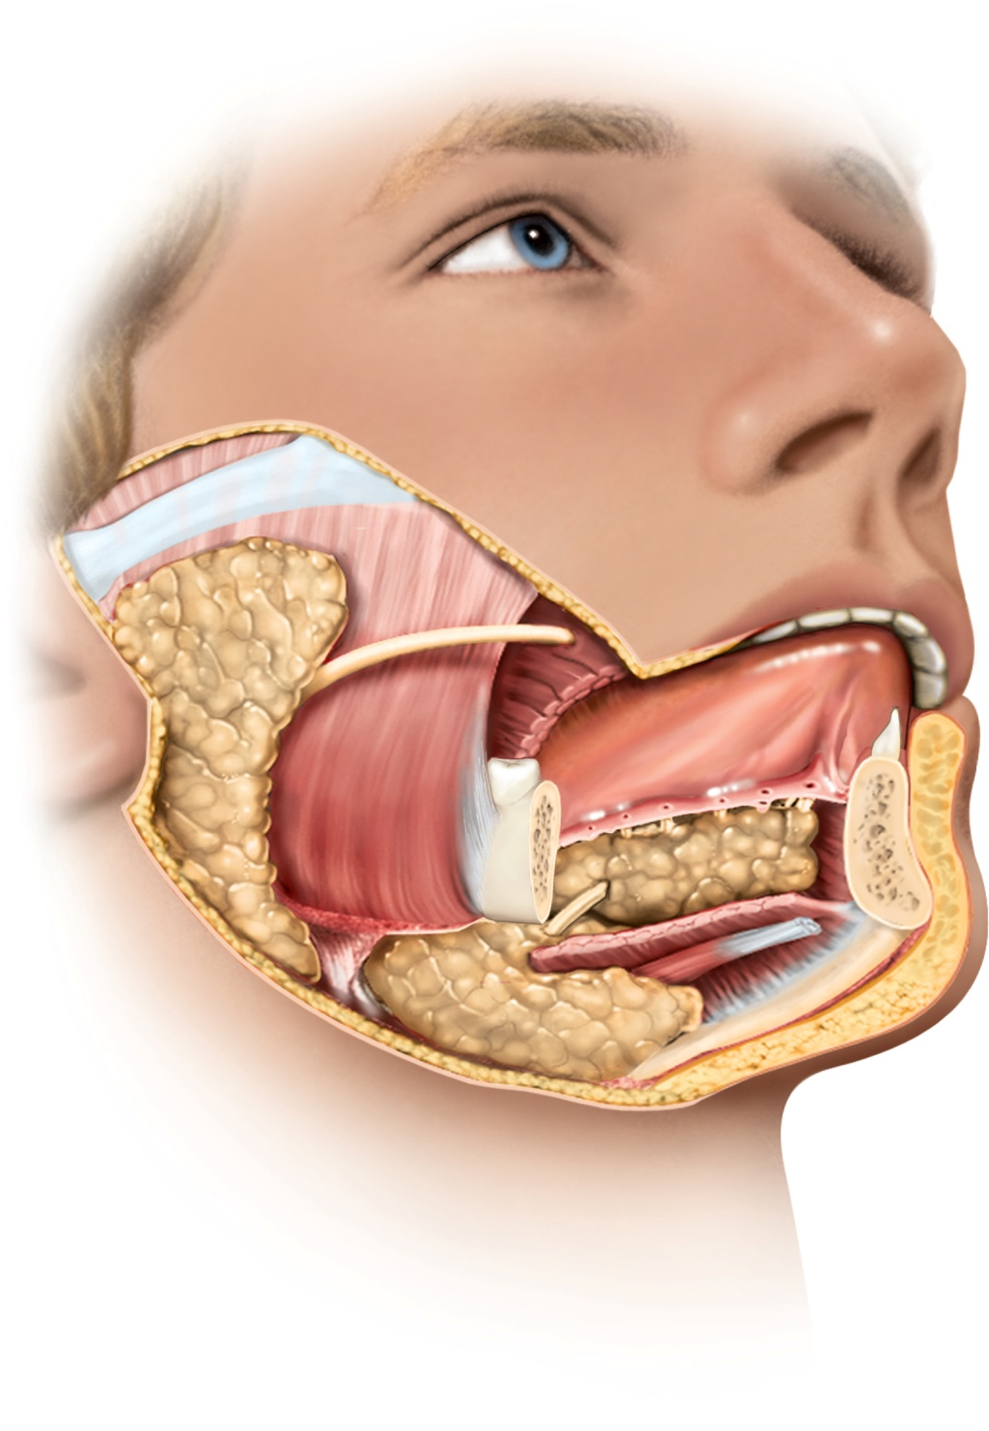
Fig. 25.9
Copyright © McGraw-Hill Education. Permission required for reproduction or display.
Parotid
gland
Parotid duct
Tongue
Sublingual
ducts
Masseter
muscle
Submandibular
duct
Submandibular
gland
Lingual
frenulum
Sublingual
gland
Opening of
submandibular
duct
Mandible
Notes:
8

Slide 9
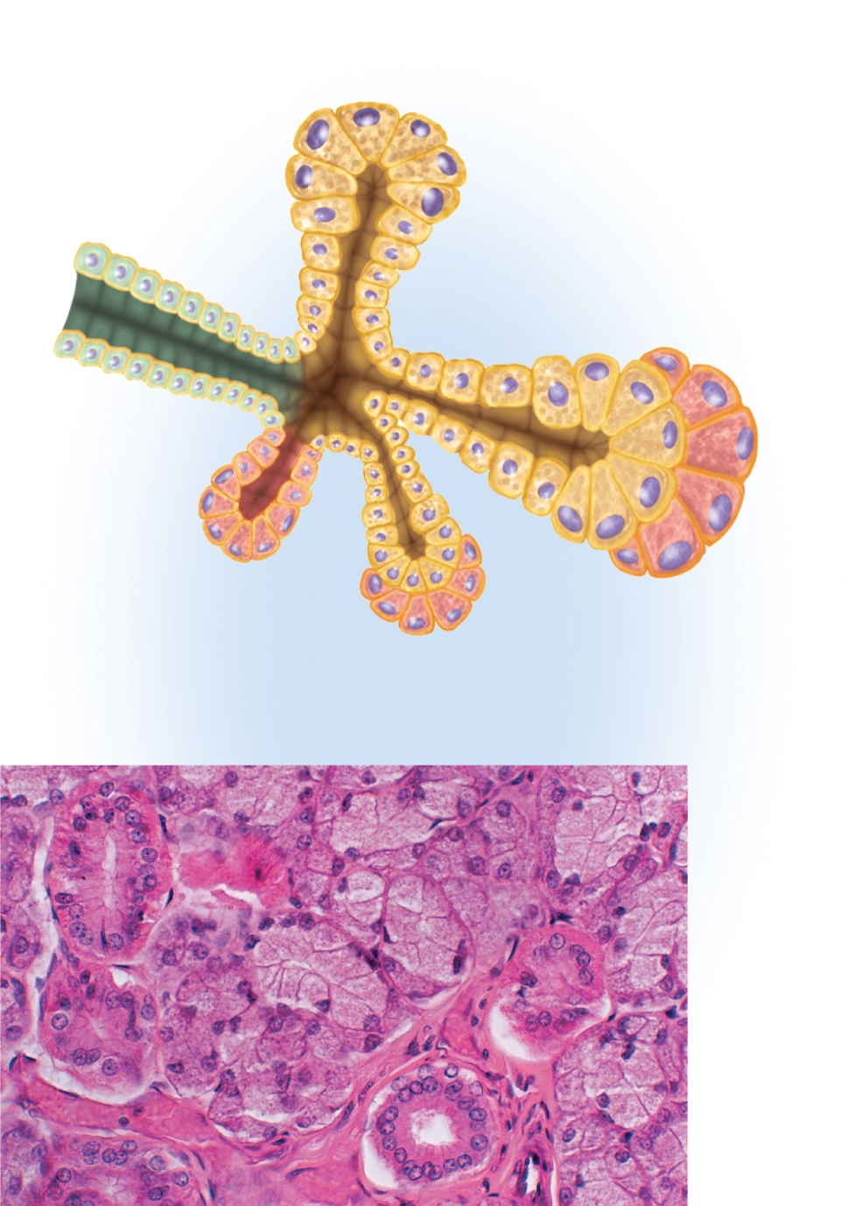
Fig. 25.10
Copyright © McGraw-Hill Education. Permission required for reproduction or display.
Mucous acinus
Mucous cells
Serous cells
Salivary duct
Serous
demilune
on mixed
acinus
Serous
acinus
Mixed acinus
(a)
Mucous
cells
Serous
demilune
Stroma
Duct
(b)
b: ©McGraw Hill Education/Dennis Strete
Notes:
9

Slide 10
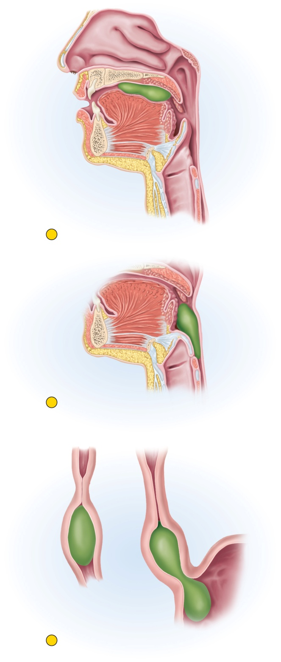
Fig. 25.11
Copyright © McGraw-Hill Education. Permission required for reproduction or display.
1
Oral phase. The tongue forms a food bolus and
pushes it into the laryngopharynx.
2
Pharyngeal phase. The palate, tongue, vocal
cords, and epiglottis block the oral and nasal
cavities and airway while pharyngeal constrictors
push the bolus into the esophagus.
Esophagus
Stomach
3
Esophageal phase. Peristalsis drives the bolus downward, and relaxation of the lower
esophageal sphincter admits it into the stomach.

Slide 11
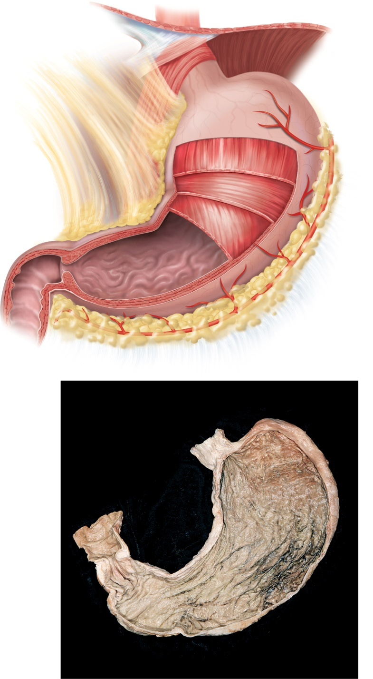
Fig. 25.12
Copyright © McGraw-Hill Education. Permission required for reproduction or display.
Diaphragm
Lesser omentum
Fundic region
Cardiac region
Lesser curvature
Body
Pyloric region:
Longitudinal
muscle
Antrum
Pyloric canal
Circular muscle
Pylorus
Pyloric
sphincter
Oblique muscle
Gastric rugae
Greater curvature
Duodenum
Greater omentum
(a)
Esophagus
Fundic region
Lesser curvature
Cardiac orifice
Cadiac region
Duodenum
Body
Pyloric region:
Gastric rugae
Pylorus
Pyloric
sphincter
Pyloric
canal
Antrum
Greater curvature
(b)
b: ©McGraw-Hill Education/Rebecca Gray/Don Kincaid, dissections

Slide 12
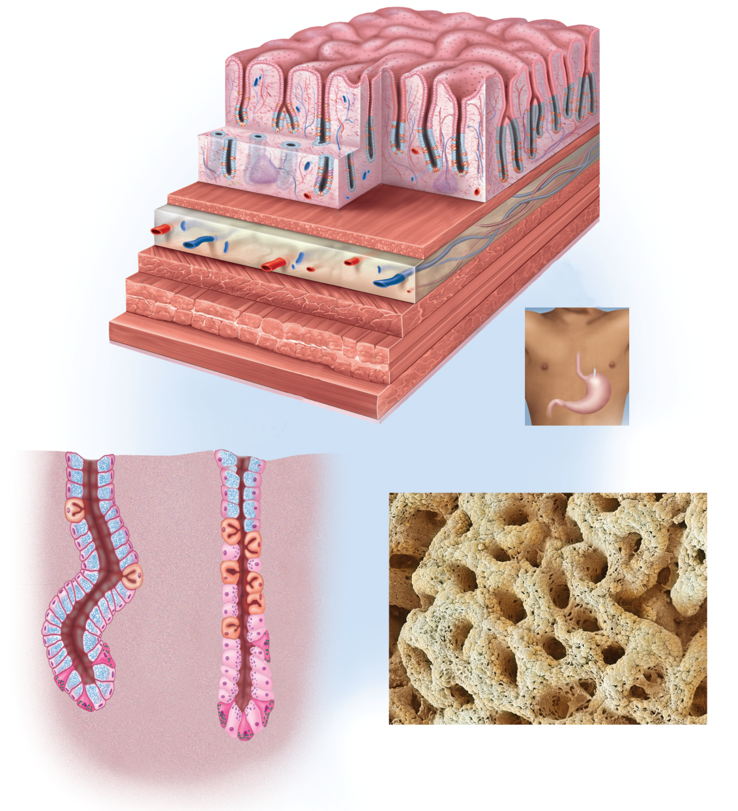
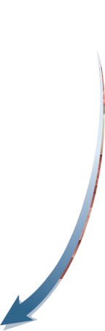

Fig. 25.13
Copyright © McGraw-Hill Education. Permission required for reproduction or display.
Lumen of stomach
Epithelium
Gastric pit
Mucosa
Gastric gland
Lamina propria
Submucosa
Lymphatic nodule
Muscularis mucosae
Muscularis
externa
Artery
Serosa
Vein
Oblique layer of muscle
Circular layer of muscle
Longitudinal layer
of muscle
(a) Stomach wall
Mucous neck cell
Parietal cell
Mucous cell
Chief cell
G cell
(b) Pyloric gland
(c) Gastric gland
(d) Gastric pit
d: ©Steve Gschmeissner/Science Source

Slide 13
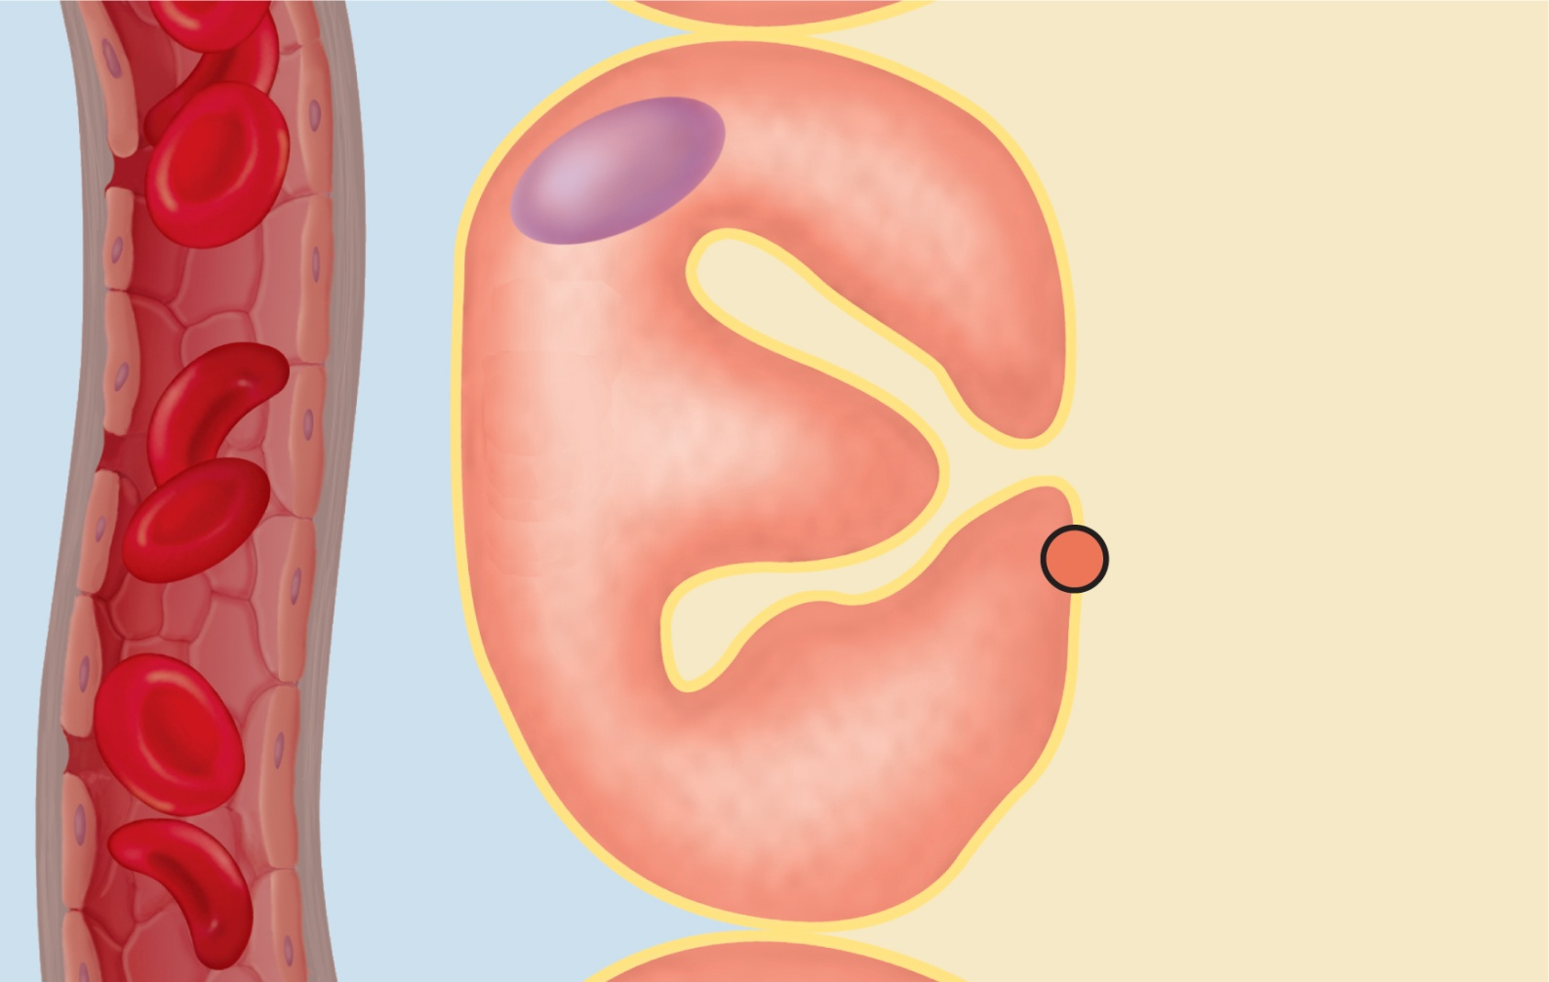
Fig. 25.14
Copyright © McGraw-Hill Education. Permission required for reproduction or display.
Blood
Parietal cell
Lumen of gastric gland
Alkaline
tide
Cl–
Cl–
Stomach
acid
K⁺
HCO₃–
HCO₃–
H⁺
H⁺–K⁺ ATPase
CO₂
CO₂ + H₂O
H₂CO₃

Slide 14
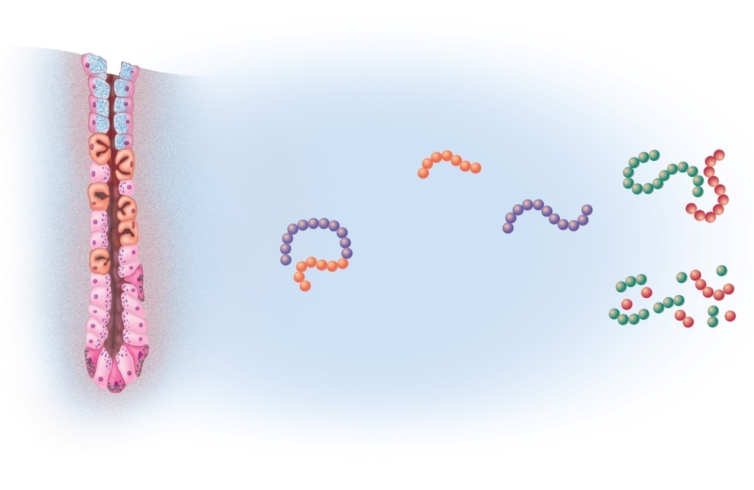
Fig. 25.15
Copyright © McGraw-Hill Education. Permission required for reproduction or display.
Parietal cell
Removed
peptide
Dietary
proteins
HCl
Pepsin
(active enzyme)
Chief cell
Pepsinogen
(zymogen)
Partially digested
protein
Gastric gland

Slide 15
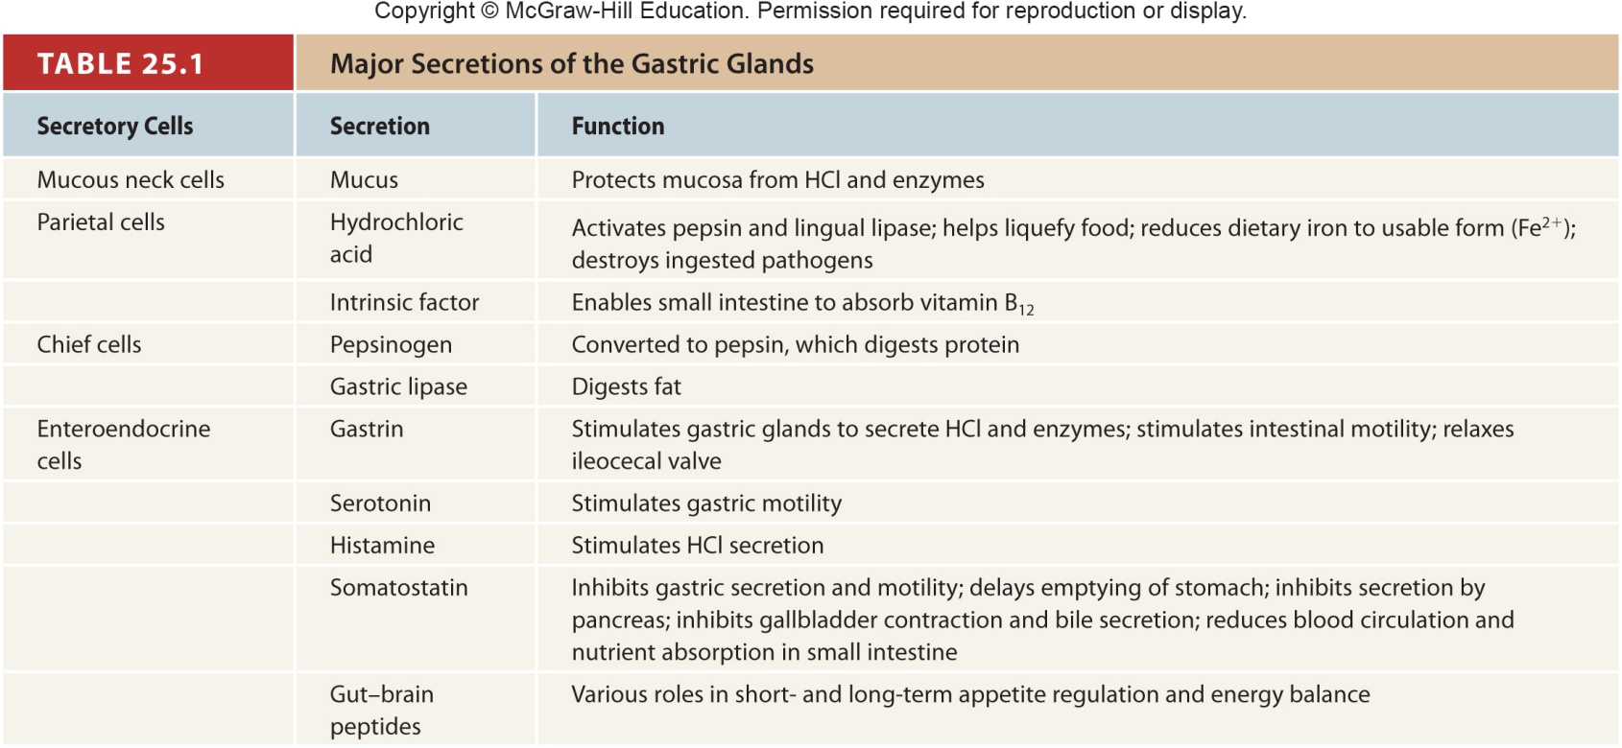
Table 25.1

Slide 16
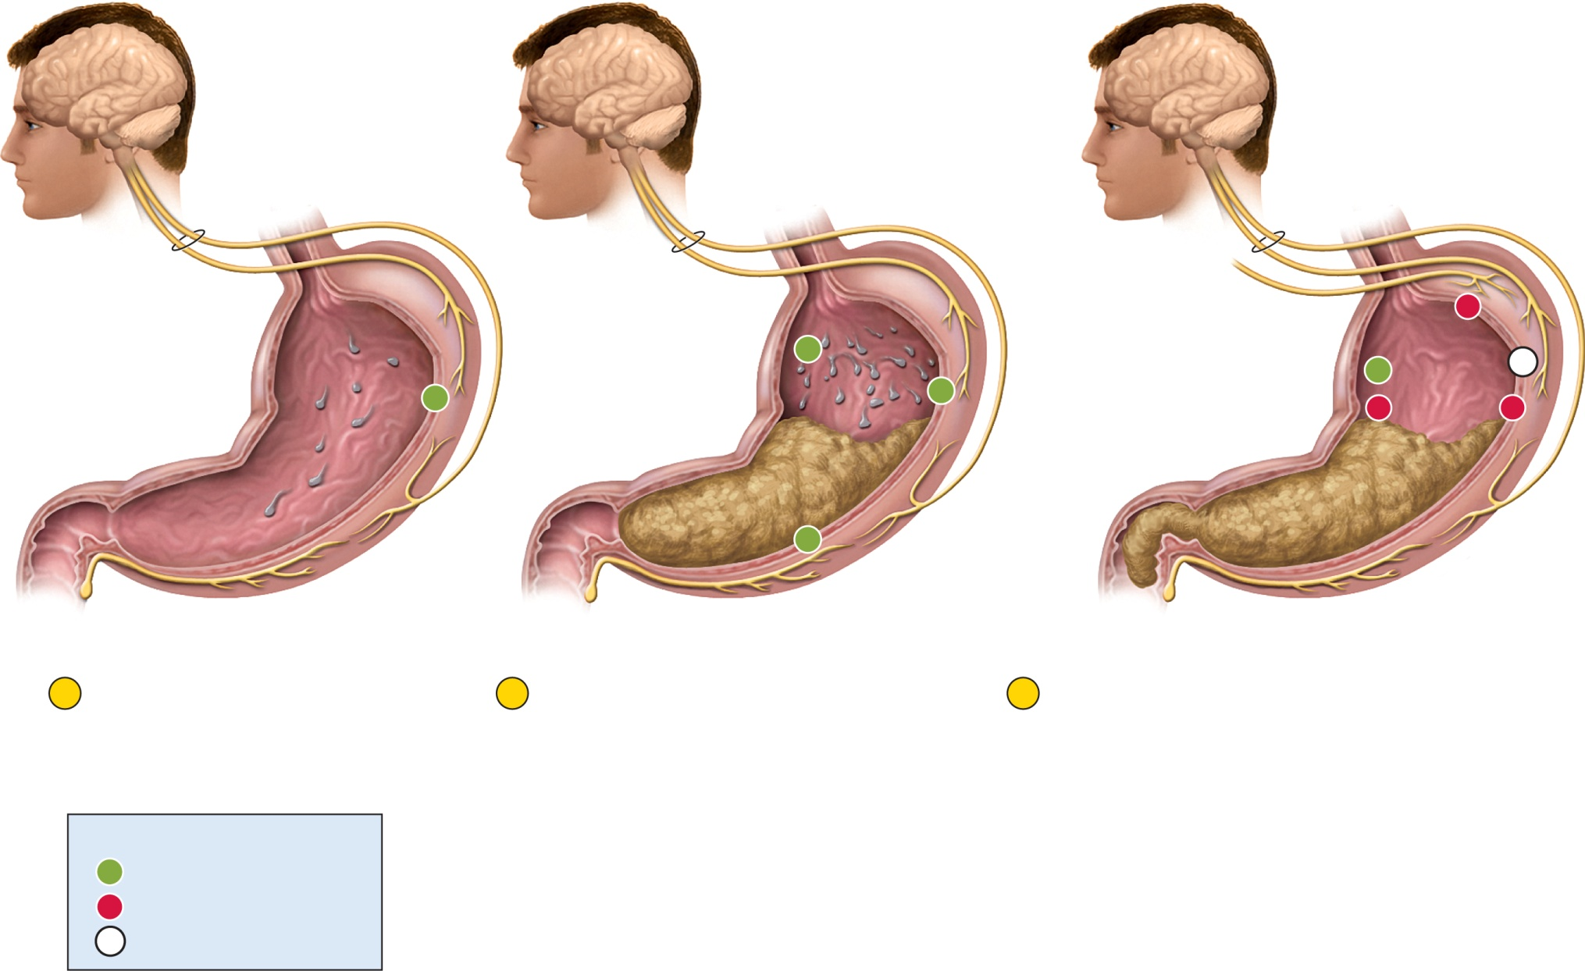
Fig. 25.17
Copyright © McGraw-Hill Education. Permission required for reproduction or display.
Sensory and
mental input
Long (vagovagal) reflex:
Sensory fibers
Motor fibers
Vagus nerve
Vagus nerve
Vagus nerve
Sympathetic nerve
–
+
Intestinal gastrin
+
0
+
Histamine
+
Secretin
and CCK
–
–
Gastrin
+
Short
(myenteric)
reflex
Enterogastric
reflex
1
Cephalic phase
Vagus nerve stimulates
gastric secretion even
before food is swallowed.
2
Gastric phase
Food stretches the stomach and
activates myenteric and vagovagal
reflexes. These reflexes stimulate
gastric secretion. Histamine and
gastrin also stimulate acid and
enzyme secretion.
3
Intestinal phase
Intestinal gastrin briefly stimulates the stomach,
but then secretin, CCK, and the enterogastric
reflex inhibit gastric secretion and motility while
the duodenum processes the chyme already in
it. Sympathetic nerve fibers suppress gastric
activity, while vagal (parasympathetic)
stimulation of the stomach is now inhibited.
Key
+
Stimulation
–
Inhibition
0
Reduced or no effect

Slide 17
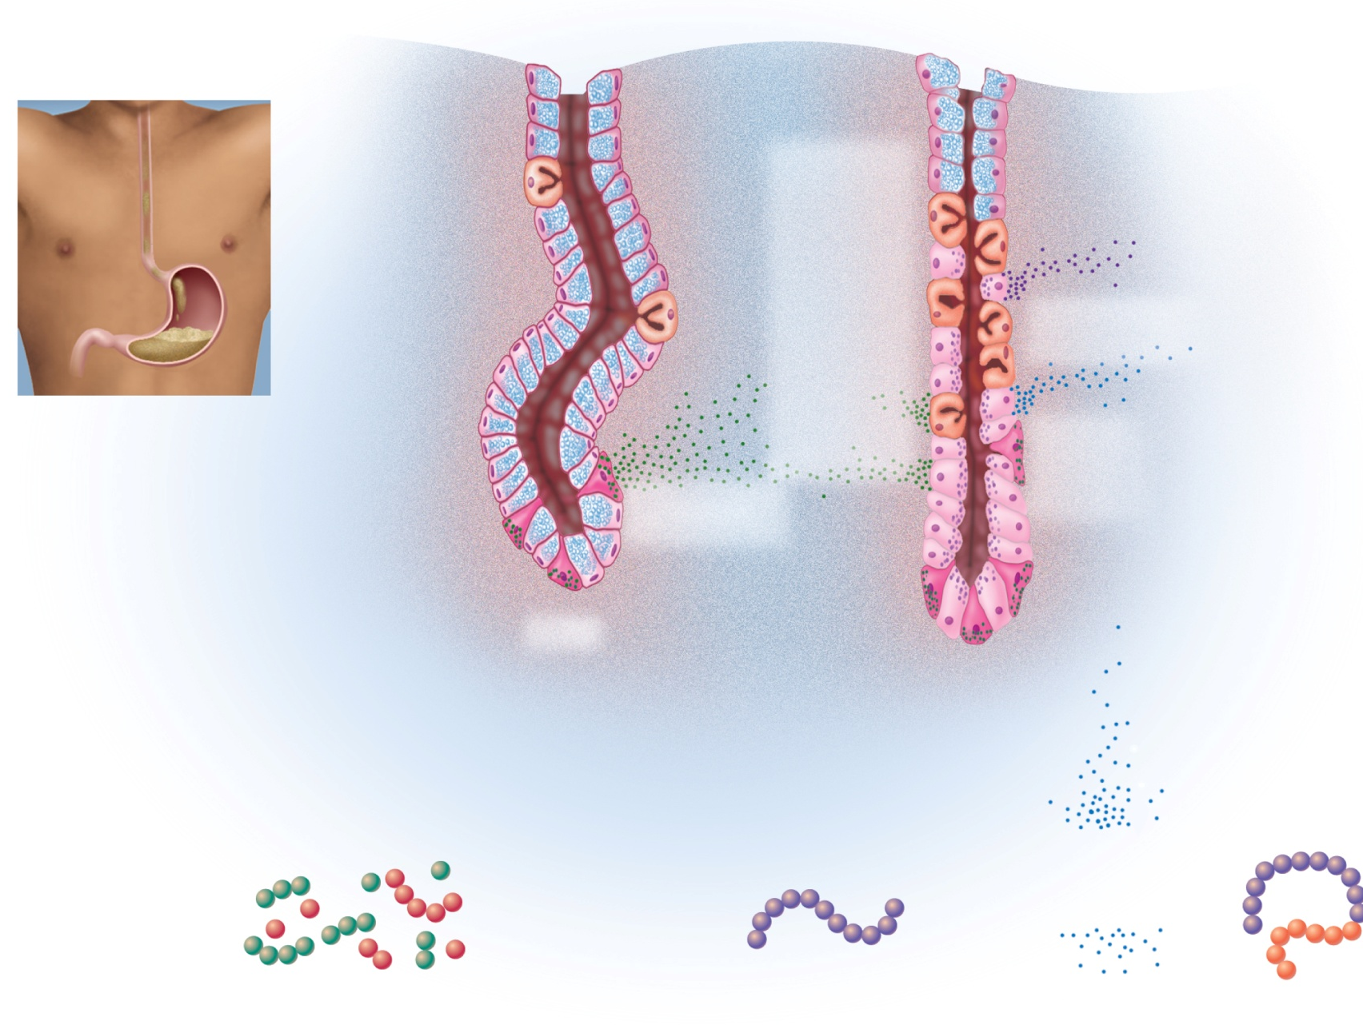
Fig. 25.18
Copyright © McGraw-Hill Education. Permission required for reproduction or display.
Pyloric gland
Gastric gland
Mucous cell
Parietal cell
Chief cell
Gastrin
stimulates
chief cells
and
parietal
cells
Chief cells secrete
pepsinogen
Ingested food
buffers
stomach acid
Parietal
cells
secrete
HCI
Elevated pH
stimulates
G cells
G cells secrete
gastrin
G cell
Oligopeptides
and amino
acids buffer
stomach acid
Oligopeptides
directly
stimulate
G cells
Pepsin digests
dietary protein
HCI converts
pepsinogen
to pepsin
Partially digested protein
Pepsin (active enzyme)
HCI
Pepsinogen
(zymogen)

Slide 18
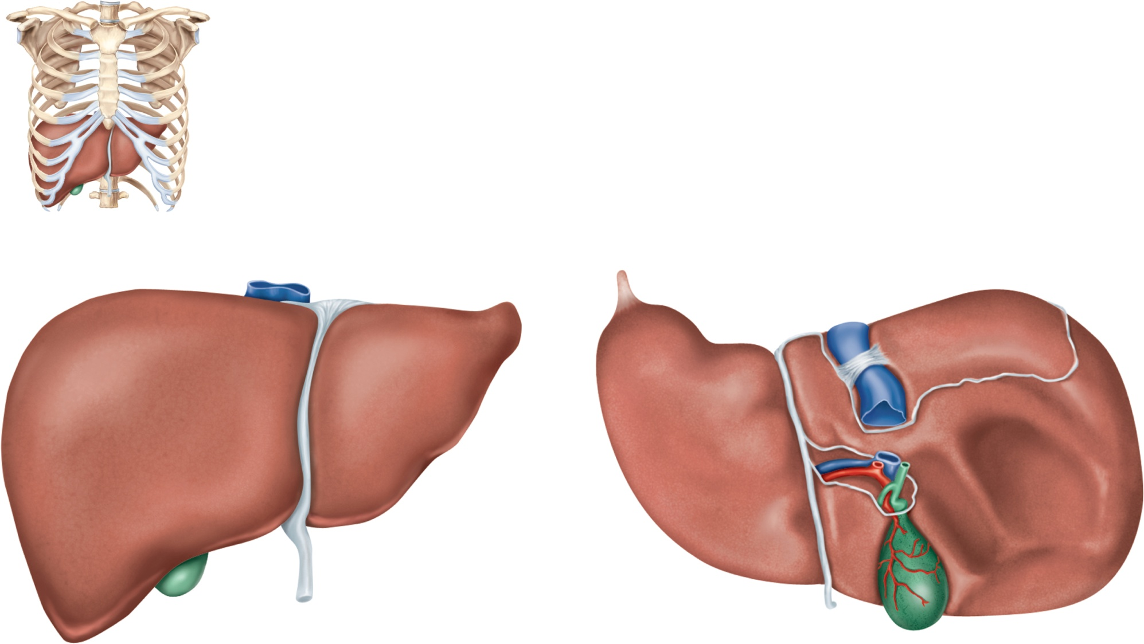
Fig. 25.19
Copyright © McGraw-Hill Education. Permission required for reproduction or display.
Sternum
5th rib
Liver
(a) Location
Inferior vena cava
Caudate lobe
Posterior
Bare area
Right lobe
Left lobe
Falciform
ligament
Round ligament
Porta hepatis:
Hepatic portal vein
Hepatic artery proper
Bile duct
Anterior
Quadrate lobe
Gallbladder
Right lobe
(b) Anterior view
(c) Inferior view

Slide 19
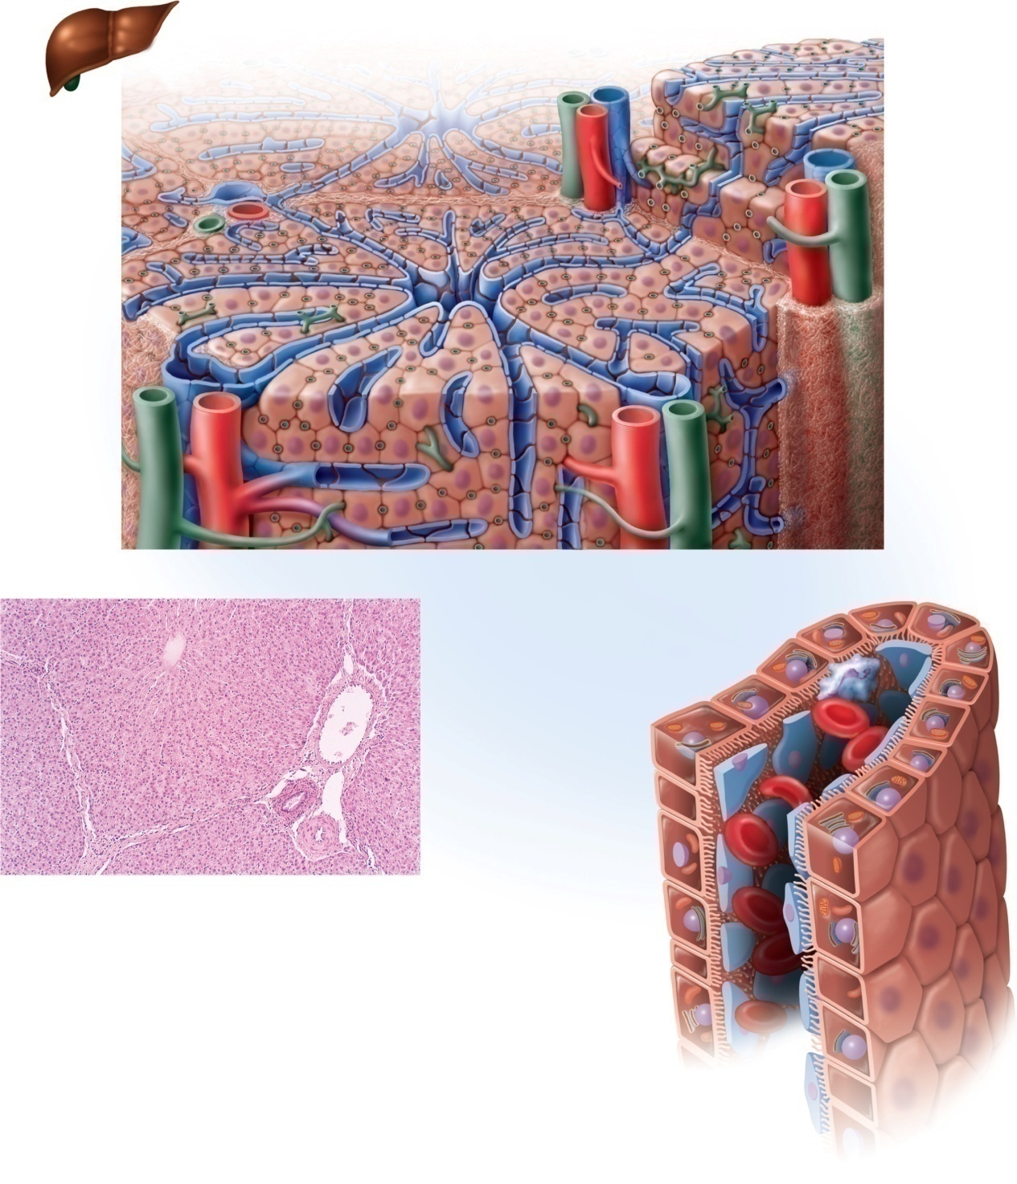
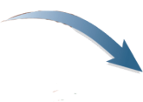
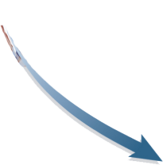


Fig. 25.20
Copyright © McGraw-Hill Education. Permission required for reproduction or display.
Hepatocytes
Bile
canaliculi
Stroma
Central vein
Hepatic triad:
Hepatic
sinusoid
Branch of
hepatic
portal vein
Branch of
hepatic artery
proper
Stroma
Bile ductule
(a)
Stroma
Central vein
Hepatic
macrophage
Hepatic
lobule
Branch of
hepatic
portal vein
Hepatocyte
Bile ductule
Lymphatic
vessel
Branch
of hepatic
artery proper
Erythrocytes
in sinusoid
(b)
0.5 mm
Endothelial
cells
Fenestration
Sinusoid
Blood flow
(c)
b: ©McGraw-Hill Education/Dennis Strete

Slide 20
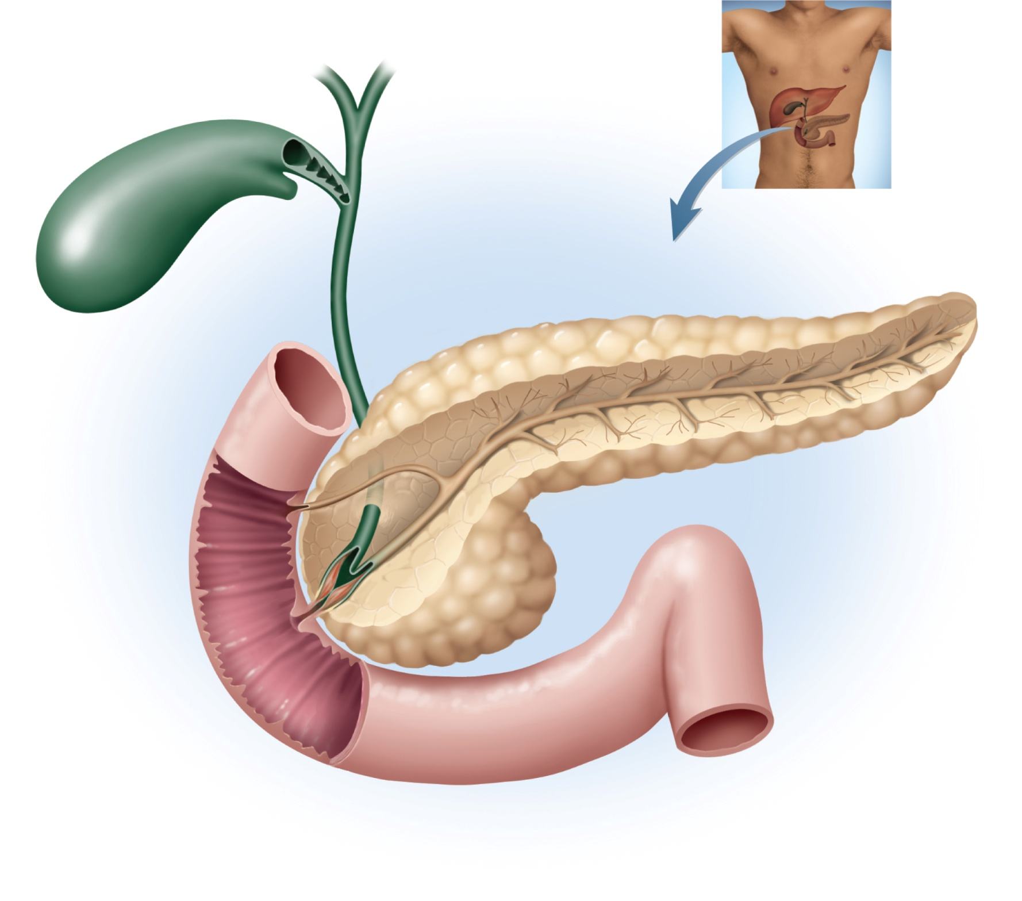
Fig. 25.21
Copyright © McGraw-Hill Education. Permission required for reproduction or display.
Gallbladder:
Hepatic ducts
Neck
Body
Head
Common hepatic duct
Cystic duct
Bile duct
Accessory
pancreatic duct
Pancreatic duct
Duodenum
Minor duodenal
papilla
Pancreas:
Tail
Circular folds
Body
Head
Hepatopancreatic
sphincter
Duodenojejunal
flexure
Major duodenal
papilla
Hepatopancreatic
ampulla
Jejunum

Slide 21
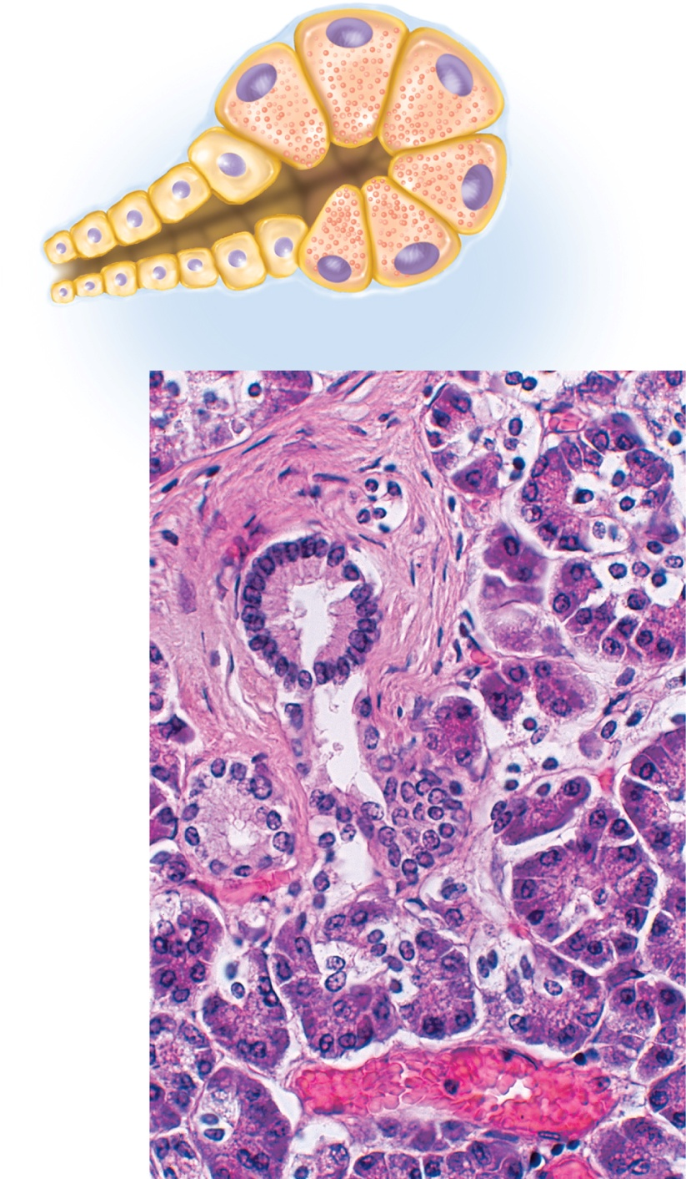
Fig. 25.22
Copyright © McGraw-Hill Education. Permission required for reproduction or display.
Acinar cells
Zymogen
granules
(a)
Stroma
Ducts
Exocrine
acinar cells
Vein
(b)
50 μm
b: ©McGraw-Hill Education/Dennis Strete

Slide 22
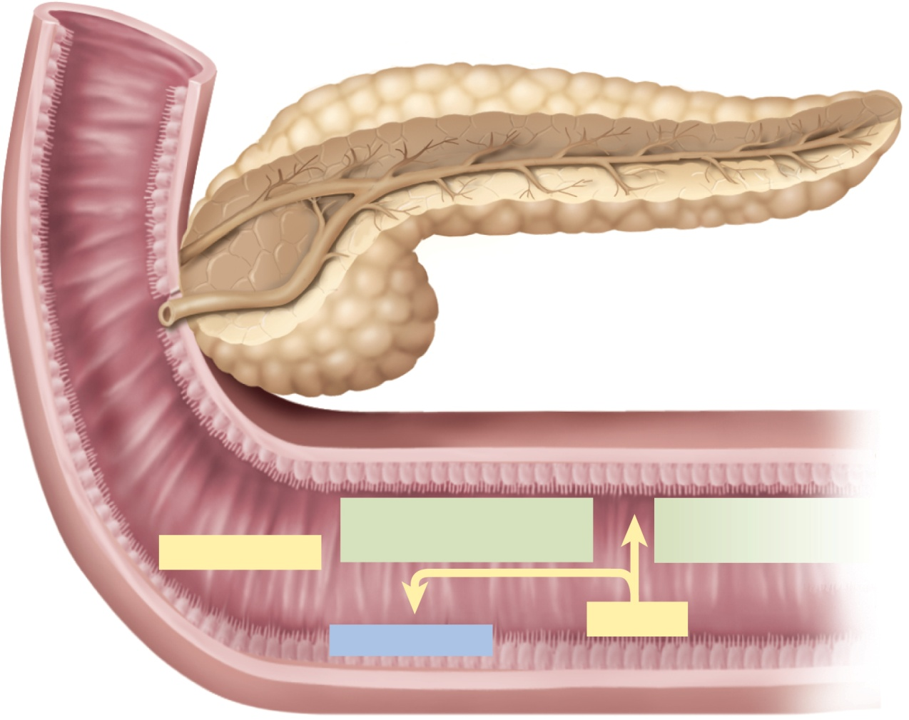
Fig. 25.23
Copyright © McGraw-Hill Education. Permission required for reproduction or display.
Chymotrypsinogen
Procarboxypeptidase
Chymotrypsin
Carboxypeptidase
Trypsinogen
Trypsin
Enterokinase

Slide 23
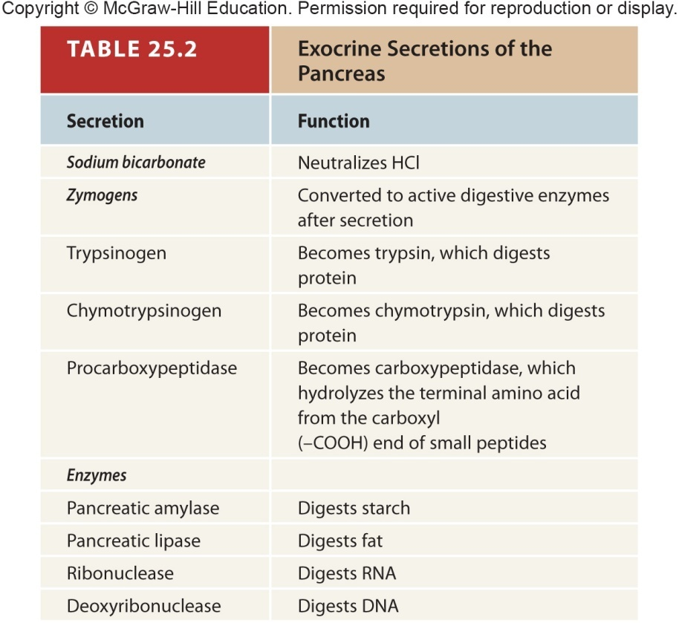
Table 25.2

Slide 24
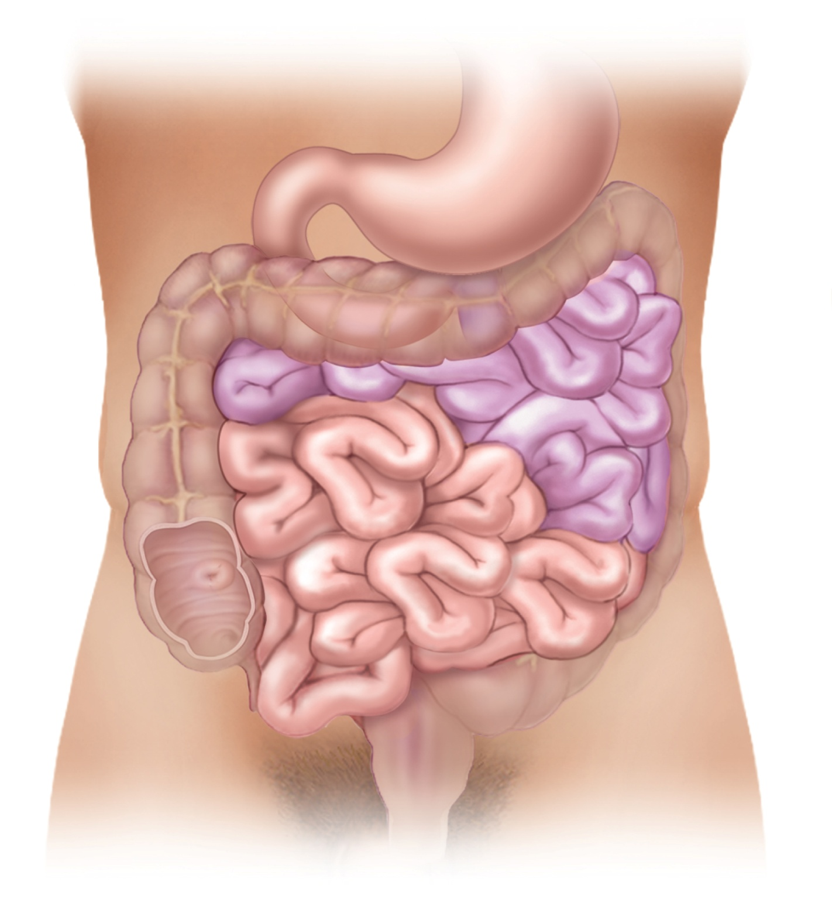
Fig. 25.24
Copyright © McGraw-Hill Education. Permission required for reproduction or display.
Duodenum
Large intestine
Jejunum
Ileum
Ileocecal valve

Slide 25
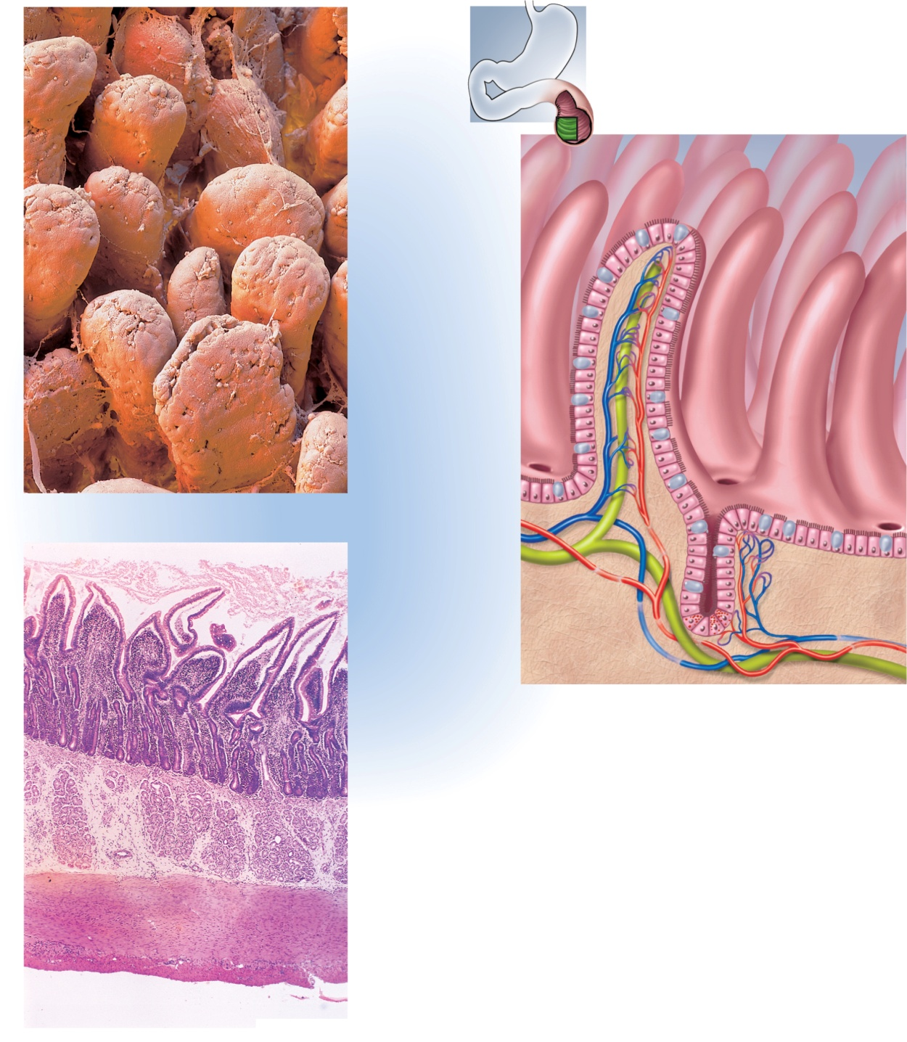

Fig. 25.25
Copyright © McGraw-Hill Education. Permission required for reproduction or display.
Villi
Absorptive cell
Brush border
of microvilli
Capillary network
Goblet cell
Lacteal
Intestinal crypts
(a)
Venule
Arteriole
Lymphaticvessel
Paneth cell
Villi
(c)
Intestinal
crypts
Muscularis
mucosae
Duodenal
glands
Muscularis
externa
Serosa
(b)
0.5 mm
a: ©Meckes/Ottawa/Science Source; b: © McGraw-Hill Education/Dennis Strete

Slide 26
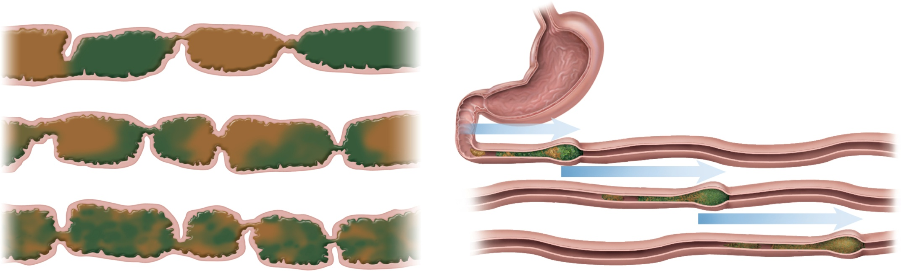
Fig. 25.26
Copyright © McGraw-Hill Education. Permission required for reproduction or display.
(a) Segmentation
(b) Peristalsis

Slide 27
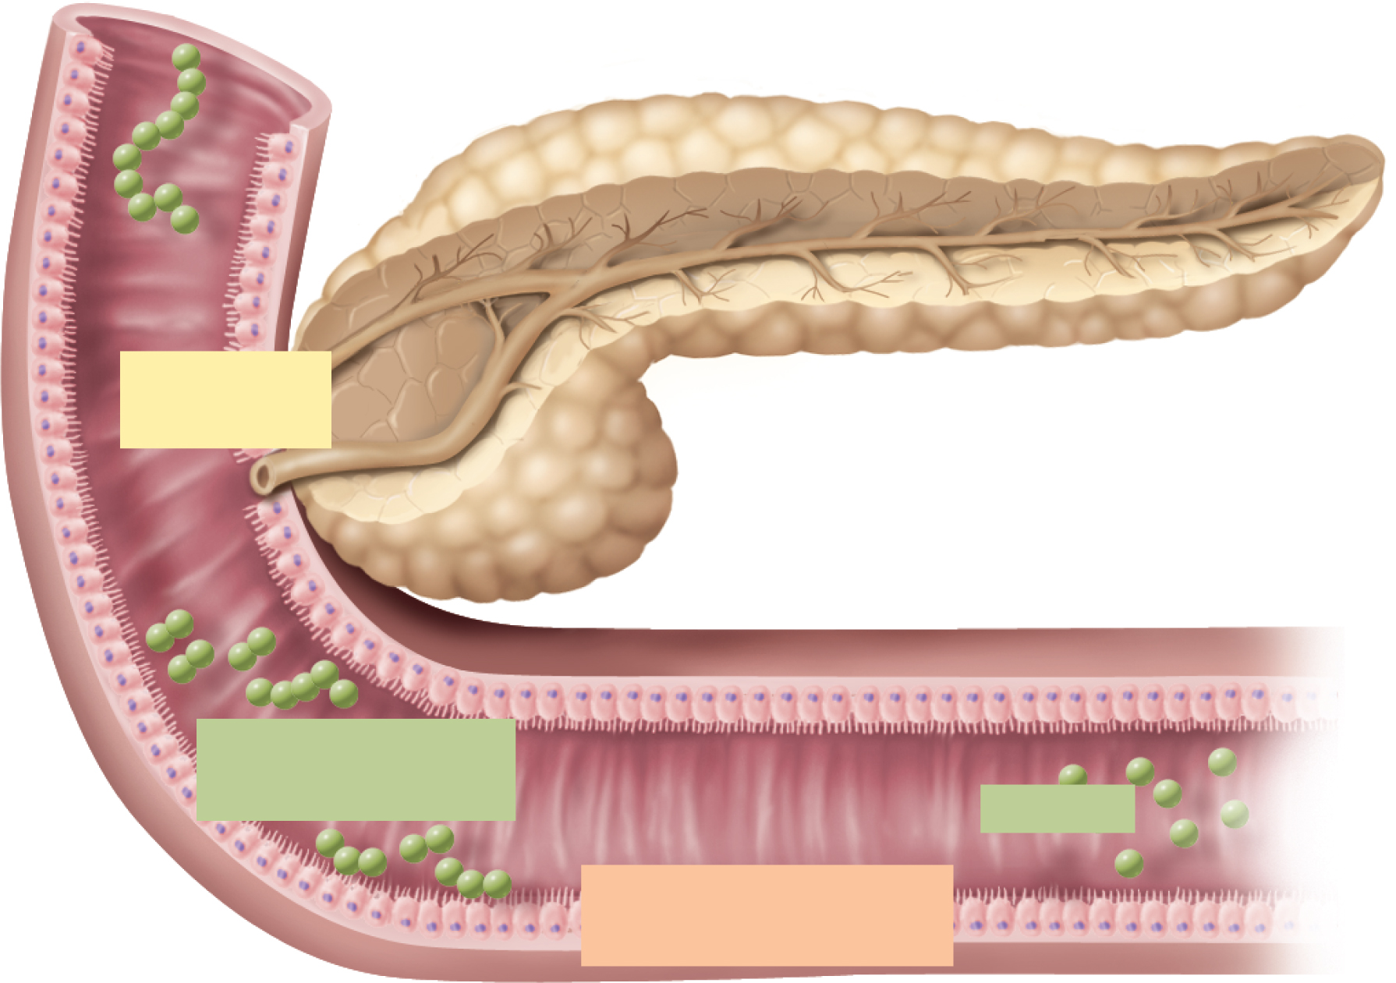


Fig. 25.27
Copyright © McGraw-Hill Education. Permission required for reproduction or display.
Starch
Pancreatic
amylase
Maltose and
oligosaccharides
Glucose
Contact digestion
Maltase, dextrinase,
and glucoamylase
Absorption

Slide 28
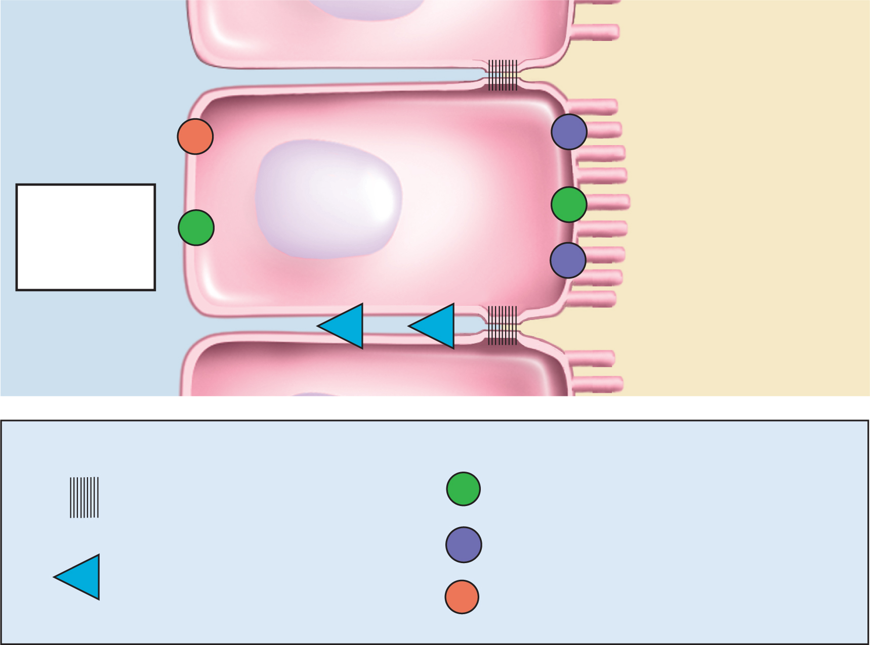
Fig. 25.28
Copyright © McGraw-Hill Education. Permission required for reproduction or display.
Epithelial cell of
small intestine
Core of villus
Lumen of small intestine
Tight junction
Na⁺
Na⁺
K⁺
Glucose
Glucose
Fructose
Fructose
Fructose
Galactose
Galactose
Na⁺
H₂O, glucose
Key
Leakage through
tight junction
Facilitated diffusion
Symports (SGLT)
Solvent
drag
Antiport

Slide 29
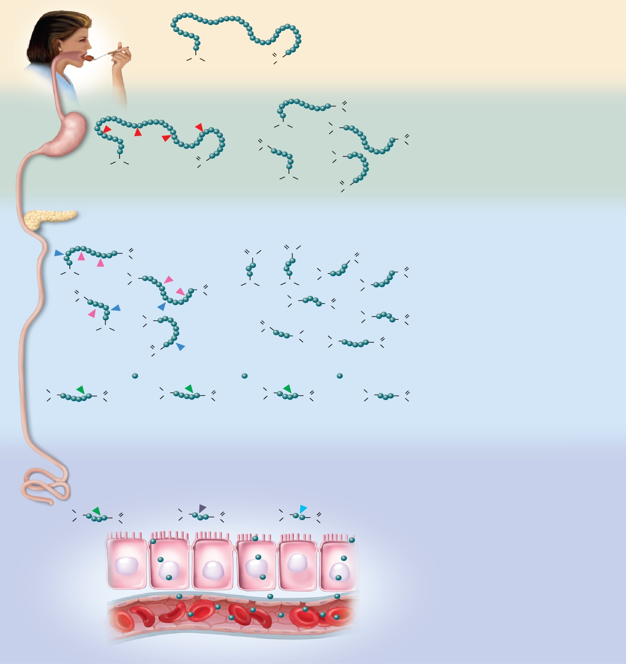
Fig. 25.29
Copyright © McGraw-Hill Education. Permission required for reproduction or display.
Mouth
Protein
O
No chemical digestion occurs.
H
N
H
HO
C
Polypeptides
Protein
C
O
Stomach
N
H
OH
O
H
H
H
N
C
O
Pepsin ( ) hydrolyzes certain
peptide bonds, breaking protein down
into smaller polypeptides.
O
HO
C
H
N
OH
H
N
H
HO
C
H
H
N
H
O
C
HO
Small intestine
Actions of pancreatic enzymes
C
O
O
C
OH
O
C
OH
O
H
OH
H
C
OH
O
H
N
H
N
O
H
N
H
N
H
N
H
N
C
OH
Trypsin ( ) and chymotrypsin ( )
hydrolyze other peptide bonds, breaking
polypeptides down into smaller
oligopeptides.
O
C
H
C
OH
H
H
N
H
O
H
HO
H
H
C
OH
H
N
O
H
N
H
H
N
O
C
H
H
C
OH
O
HO
N
H
H
N
C
O
Polypeptides
HO
C
H
OH
Oligopeptides
H
N
C
O
H
N
C
O
H
N
C
O
H
N
C
O
Carboxypeptidase ( ) removes one
amino acid at a time from the carboxyl
(–COOH) end of an oligopeptide.
H
OH
H
OH
H
OH
H
OH
Small intestine
Actions of brush border enzymes (contact digestion)
Carboxypeptidase
Aminopeptidase
Dipeptidase
H
N
C
O
H
N
C
O
H
N
C
O
H
OH
H
OH
H
OH
Carboxypeptidase ( ) of the brush
border continues to remove amino acids
from the carboxyl (–COOH) end.
Aminopeptidase ( ) of the brush border
removes one amino acid at a time from
the amino (–NH₂) end.
Blood capillary
of intestinal villus
Dipeptidase ( ) splits dipeptides ( )
into separate amino acids ( ).

Slide 30
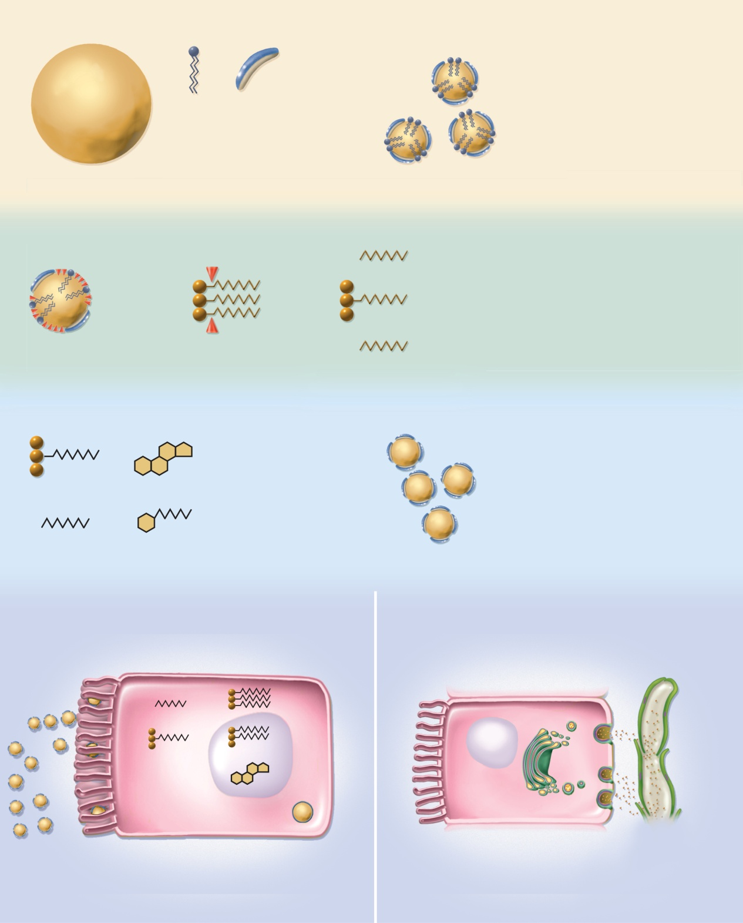
Fig. 25.30
Copyright © McGraw-Hill Education. Permission required for reproduction or display.
Emulsification
Hydrophilic region
Lecithin
Hydrophobic region
Bile acid
Fat globule is broken up and coated by
lecithin and bile acids.
Fat globule
Emulsification
droplets
Fat hydrolysis
Pancreatic lipase
Pancreatic lipase
Free fatty acid
Lecithin
Emulsification droplets are acted upon by
pancreatic lipase, which hydrolyzes the
first and third fatty acids from triglycerides,
usually leaving the middle fatty acid.
Bile acid
Monoglyceride
Dietary lipid
Triglyceride
Free fatty acid
Lipid uptake by micelles
Bile acid
Micelles in the bile pass to the small
intestine and pick up several types of
dietary and semidigested lipids.
Monoglycerides
Cholesterol
Lipid core
Fatty acids
Fat-soluble vitamins
Micelles
Chylomicron formation
Chylomicron exocytosis and lymphatic uptake
Absorptive cell
Chylomicrons
in secretory
vesicles
Brush border
Lacteal
Fatty acids
Triglycerides
Monoglycerides
Phospholipids
Chylomicrons
in lymph
Micelles
Cholesterol
Protein shell
Chylomicron
Intestinal cells absorb lipids from micelles, resynthesize triglycerides, and package triglycerides, cholesterol, and phospholipids into protein-coated chylomicrons.
Golgi complex packages chylomicrons into secretory vesicles;
chylomicrons are released from basal cell membrane by exocytosis
and enter the lacteal (lymphatic capillary) of the villus.

Slide 31
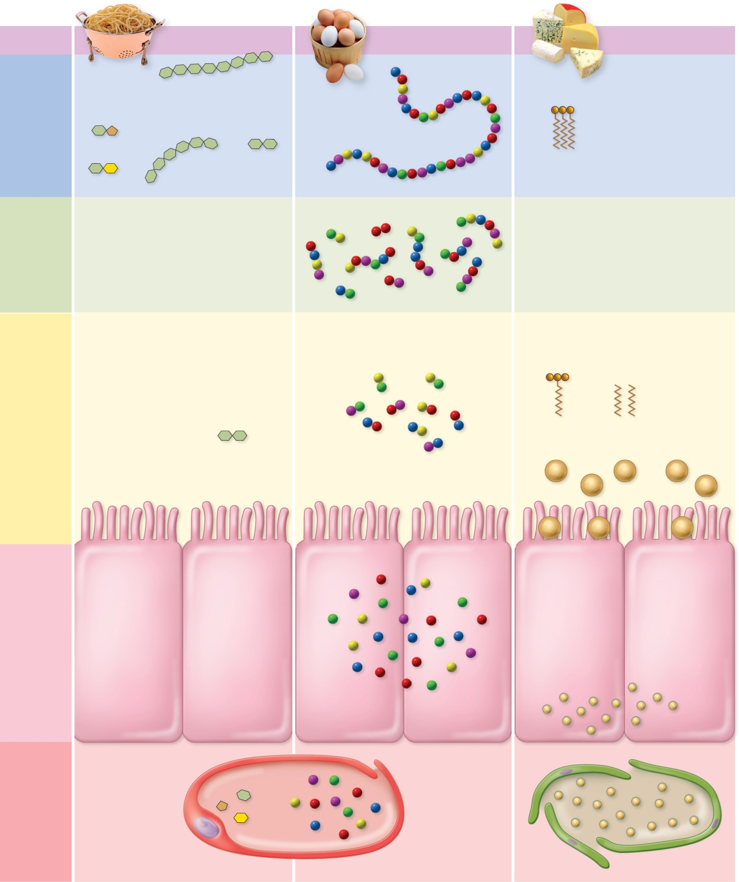
Fig. 25.31
Copyright © McGraw-Hill Education. Permission required for reproduction or display.
Site
(a) Carbohydrates
(b) Proteins
(c) Fats
Starch
Salivary
amylase
Mouth
Cholesterol
Phospholipids
Fat-soluble vitamins
Sucrose
Protein
Maltose
Fat
Lactose
Oligosaccharides
Pepsin
Stomach
Lingual
lipase
Small peptides
Pancreatic
amylase
Trypsin
Chymotrypsin
Carboxypeptidase
Pancreatic
lipase
Small
intestine
(lumen)
Monoglyceride
Free fatty
acids
Maltose
Dipeptides
Micelles
Sucrose
Lactase
Maltase
Dipeptidase
Aminopeptidase
Monoglycerides
Free
fatty
acids
Cholesterol
Phospholipids
Fat-soluble vitamins
Small
intestine
(epithelium)
Fructose
Galactose
Glucose
Triglycerides
Free amino acids
Chylomicrons
Circulation
Blood capillary
Lacteal

Slide 32
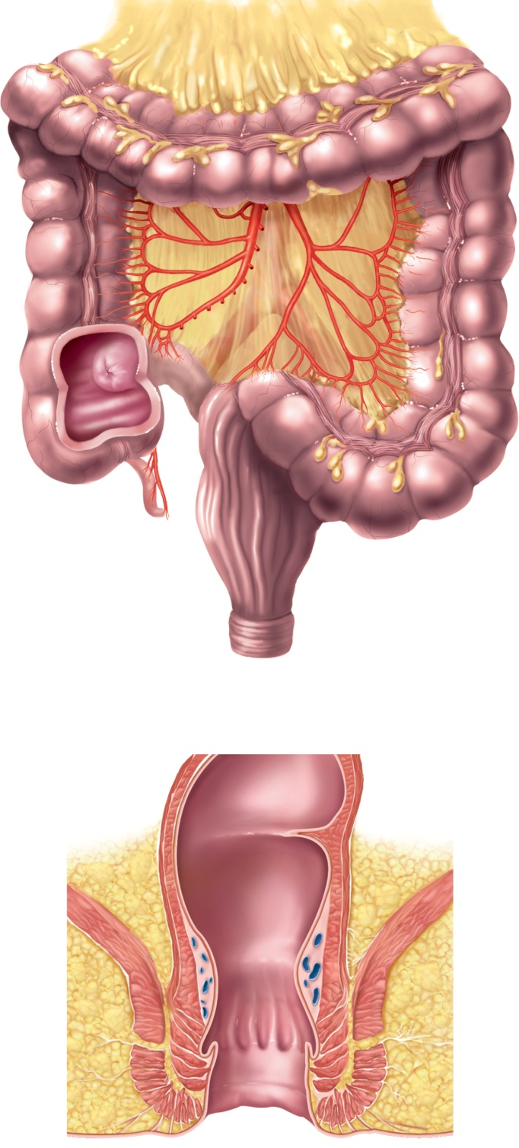
Fig. 25.32
Copyright © McGraw-Hill Education. Permission required for reproduction or display.
Right colic
flexure
Greater
omentum
(retracted)
Left colic
flexure
Transverse
colon
Superior
mesenteric
artery
Taeniae coli
Haustrum
Mesocolon
Ascending
colon
Descending
colon
Ileocecal
valve
Omental
appendages
Ileum
Cecum
Appendix
Sigmoid
colon
Rectum
Anal canal
External anal
sphincter
(a) Gross anatomy
Rectum
Rectal valve
Anal canal
Levator ani
muscle
Hemorrhoidal
veins
Internal anal
sphincter
External anal
sphincter
Anus
Anal columns
Anal sinuses
(b) Anal canal

Slide 33
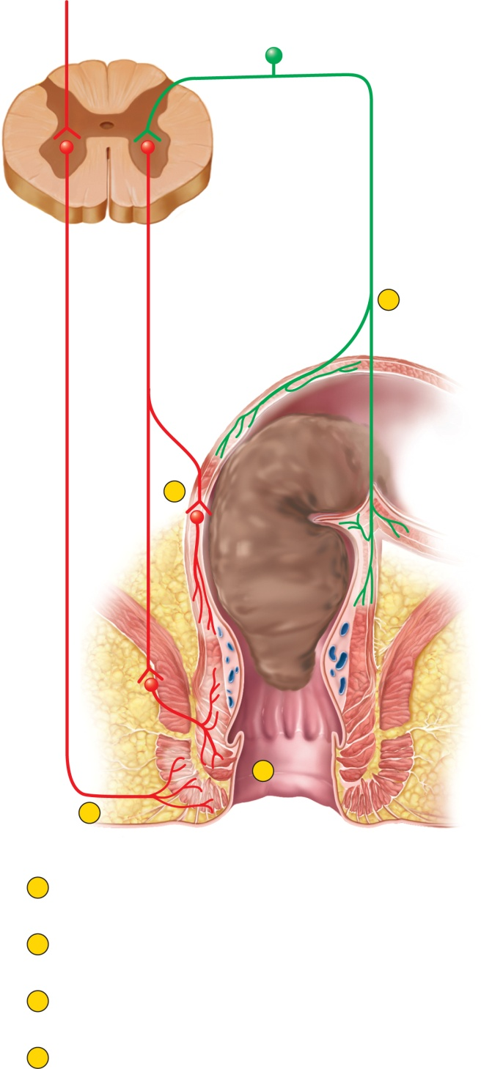
Fig. 25.33
Copyright © McGraw-Hill Education. Permission required for reproduction or display.
Impulses from
cerebral cortex
Sensory
fibers
Parasympathetic
motor fibers
Stretch
receptors
1
Voluntary
motor
fibers
Sigmoid
colon
2
Stretch
receptors
Rectum
Anal canal
Internal anal
sphincter
3
External anal
sphincter
4
1
Feces stretch the rectum and stimulate stretch
receptors, which transmit signals to the spinal cord.
2
A spinal reflex stimulates contraction of the rectum.
3
The spinal reflex also relaxes the internal anal sphincter.
4
Impulses from the brain prevent untimely defecation
by keeping the external anal sphincter contracted.
Defecation occurs only if this sphincter also relaxes.

