Slide 1
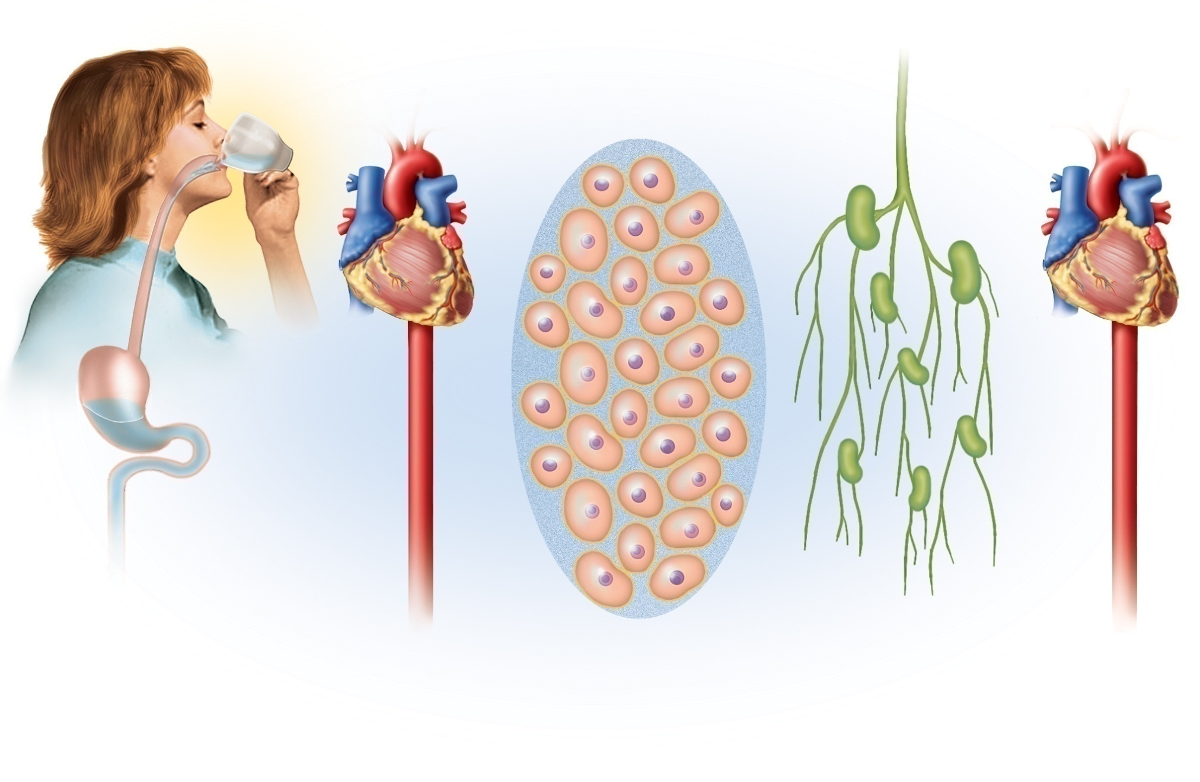
















Fig. 24.1
Copyright © McGraw-Hill Education. Permission required for reproduction or display.
Intracellular
fluid
Digestive tract
Bloodstream
Tissue fluid
Lymph
Bloodstream

Slide 2


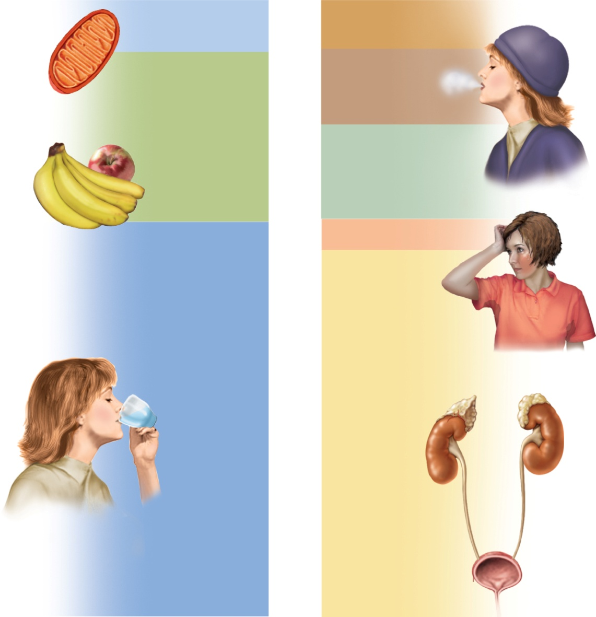
Fig. 24.2
Copyright © McGraw-Hill Education. Permission required for reproduction or display.
Gains
2,500 mL/day
Losses
2,500 mL/day
Metabolic water
200 mL
Feces
200 mL
Expired air
300 mL
Food
700 mL
Cutaneous
transpiration
400 mL
Sweat 100 mL
Drink
1,600 mL
Urine
1,500 mL
Notes:
2

Slide 3
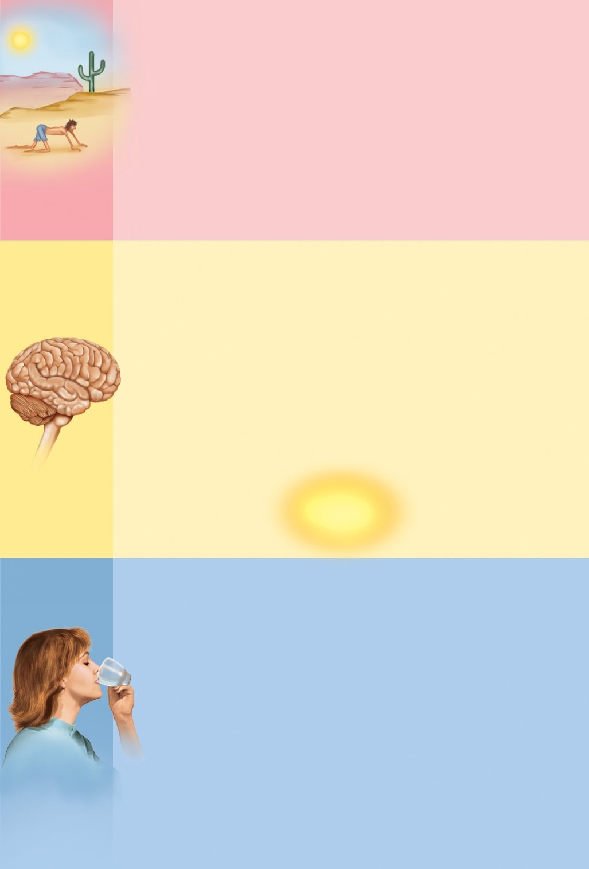


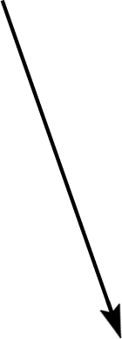
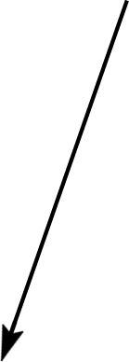


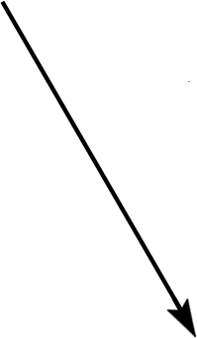
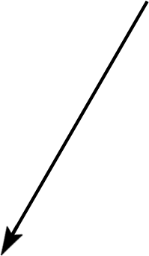
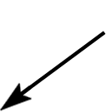

Fig. 24.3
Copyright © McGraw-Hill Education. Permission required for reproduction or display.
Dehydration
Increased
blood osmolarity
Reduced
blood pressure
Renin
Dehydration
Angiotensin II
Stimulates
hypothalamic
osmoreceptors
Stimulates
hypothalamic
osmoreceptors
Reduced
salivation
Dry mouth
?
Thirst
Sense of
thirst
Ingestion
of water
Cools and
moistens mouth
Distends
stomach
and intestines
Short-term
inhibition
of thirst
Long-term
inhibition
of thirst
Rehydrates
blood
Rehydration
Notes:
3

Slide 4
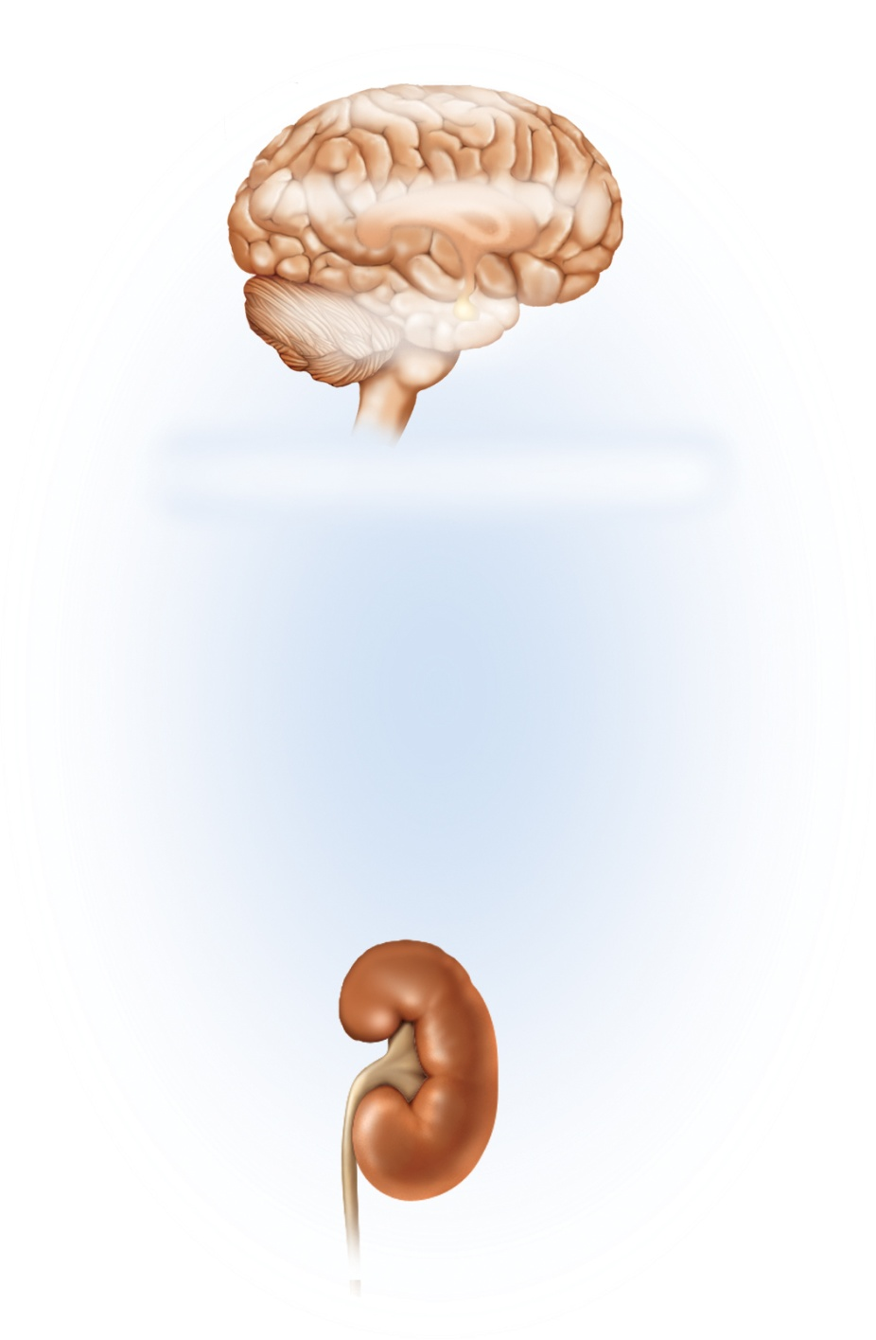


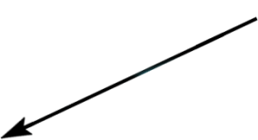
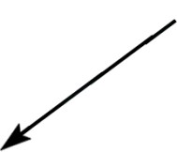
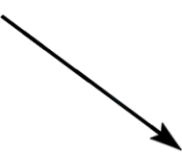
Fig. 24.4
Copyright © McGraw-Hill Education. Permission required for reproduction or display.
Dehydration
H₂O
H₂O
Na⁺
Na⁺
Elevates blood osmolarity
Negative
feedback
loop
Stimulates hypothalamic
osmoreceptors
Negative
feedback
loop
Stimulates posterior pituitary
to release antidiuretic hormone (ADH)
Water
ingestion
Stimulates distal convoluted
tubule and collecting duct
Thirst
Increases water reabsorption
Reduces urine
volume
Increases ratio
of Na⁺: H₂O
in urine
Notes:
4

Slide 5
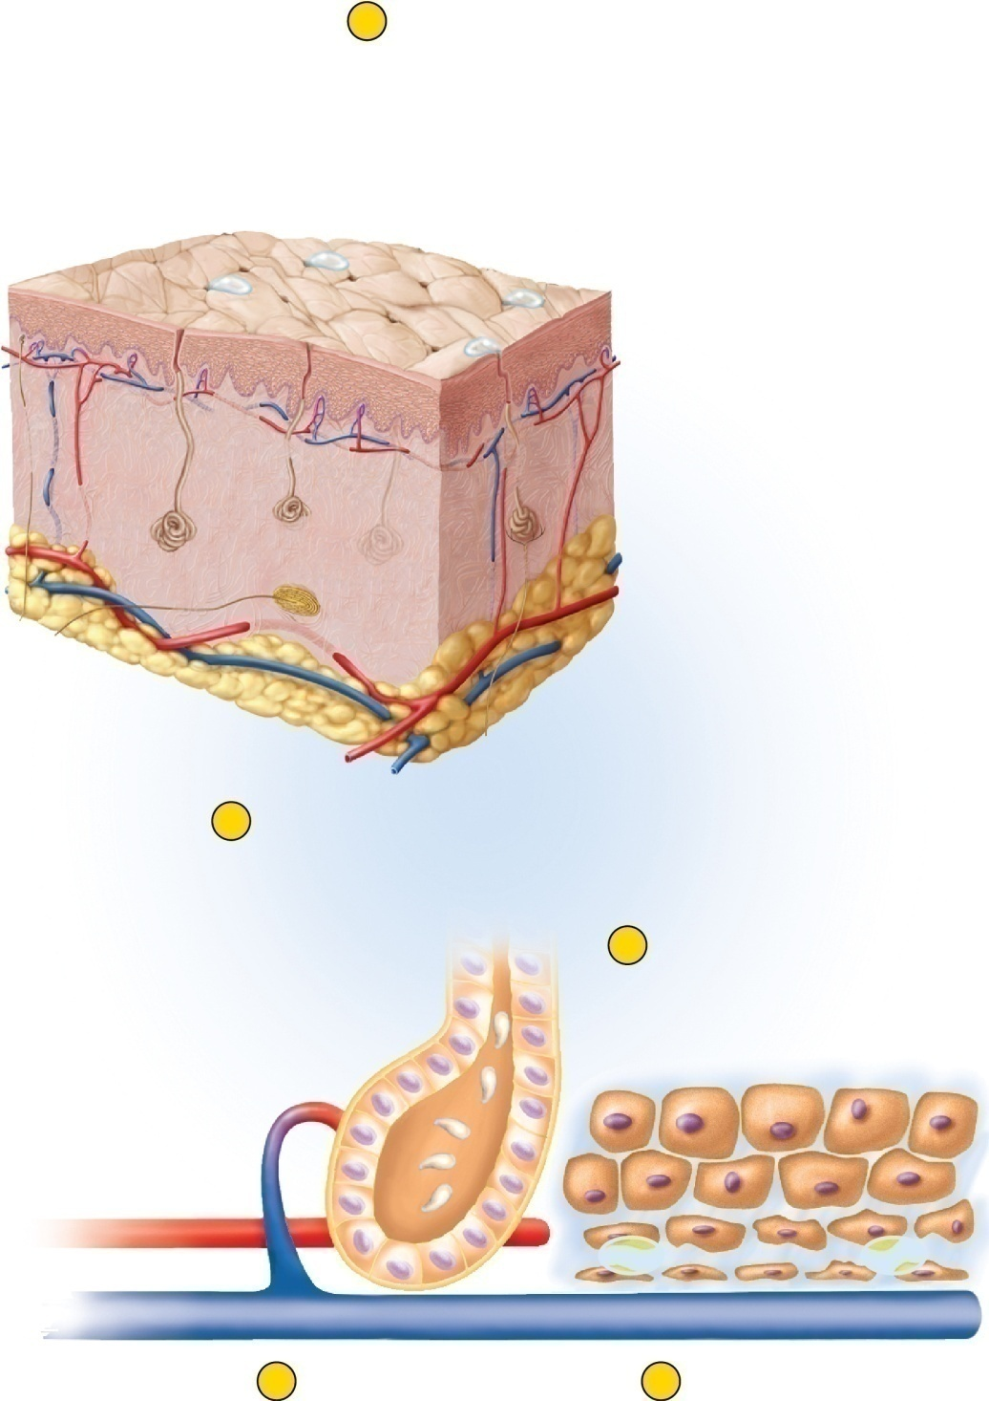

Fig. 24.5
Copyright © McGraw-Hill Education. Permission required for reproduction or display.
1
Water loss
(sweating)
H₂O
H₂O
H₂O
Skin
Sweat pores
Sweat gland
2
Sweat glands
produce perspiration
by capillary
filtration.
5
Intracellular fluid
diffuses out of
cells to replace
lost tissue fluid.
Secretory cells
of sweat gland
H₂O
H₂O
H₂O
H₂O
3
Blood volume
and pressure drop;
osmolarity rises.
4
Blood absorbs tissue
fluid to replace loss.
Notes:
5

Slide 6
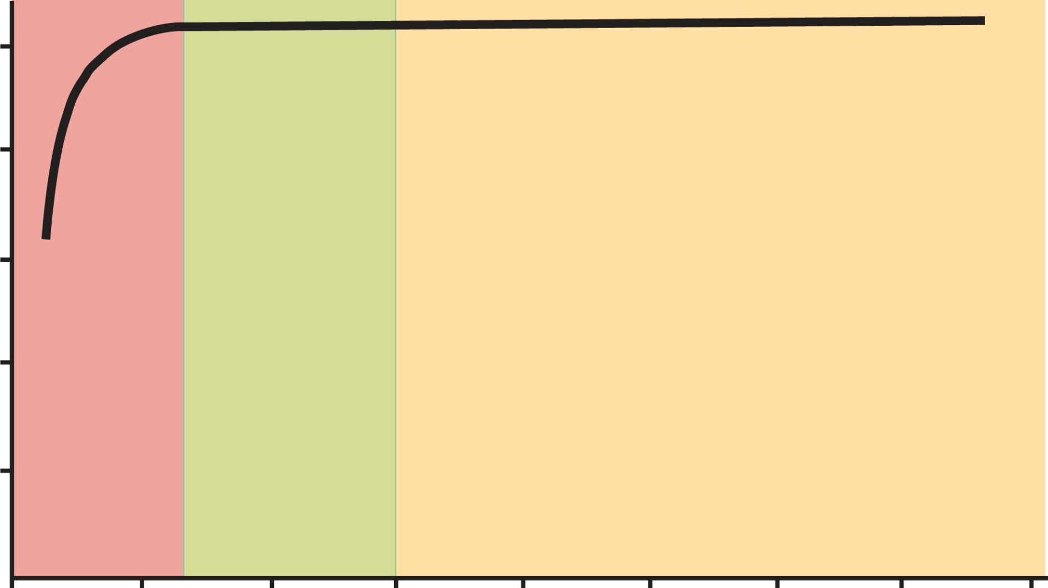
Fig. 24.6
Copyright © McGraw-Hill Education. Permission required for reproduction or display.
5
4
Hypovolemia
Death
3
Blood volume (L)
2
1
Danger
Normal
Water diuresis
0
0
1
2
3
4
5
6
7
8
Fluid intake (L/day)
Notes:
6

Slide 7
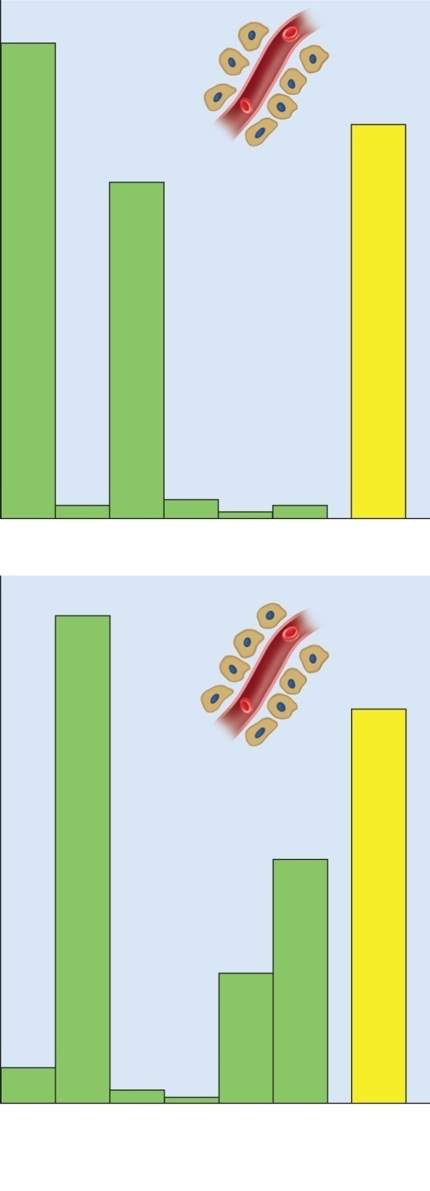


Fig. 24.7
Copyright © McGraw-Hill Education. Permission required for reproduction or display.
145
300
103
4
5
2
4
(a) Blood plasma
150
300
75
40
12
4
< 1
Na⁺
K⁺
Cl–
Ca²⁺
Mg²⁺
P_{i}
Osmolarity
(mOsm/L)
(mEq/L)
(b) Intracellular fluid
Notes:
7

Slide 8
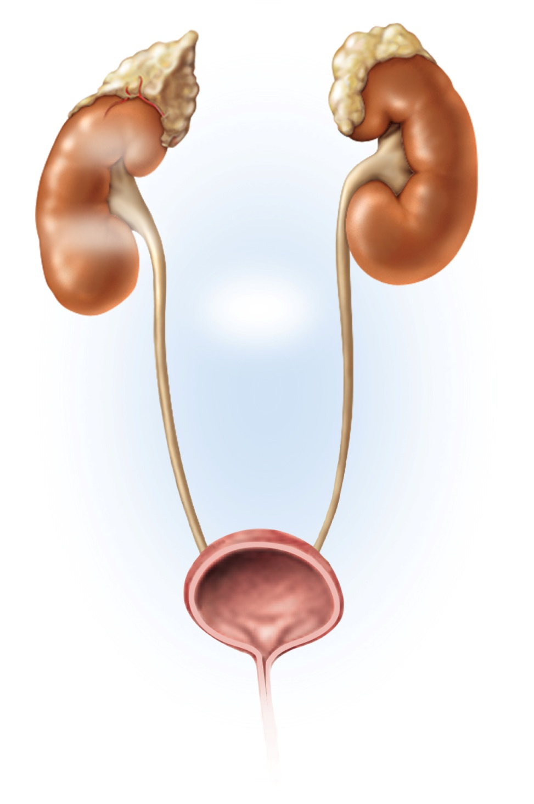
Fig. 24.8
Copyright © McGraw-Hill Education. Permission required for reproduction or display.
Hypotension
Hyponatremia
Hyperkalemia
H₂O
Na⁺
K⁺
K⁺
Renin
Angiotensin
Stimulates
adrenal cortex
to secrete
aldosterone
Negative
feedback
loop
Stimulates renal
tubules
Increases Na⁺
reabsorption
Increases K⁺
secretion
Less Na⁺
and H₂O in urine
More K⁺
in urine
Supports existing
fluid volume and
Na⁺ concentration
pending oral intake
Notes:
8

Slide 9
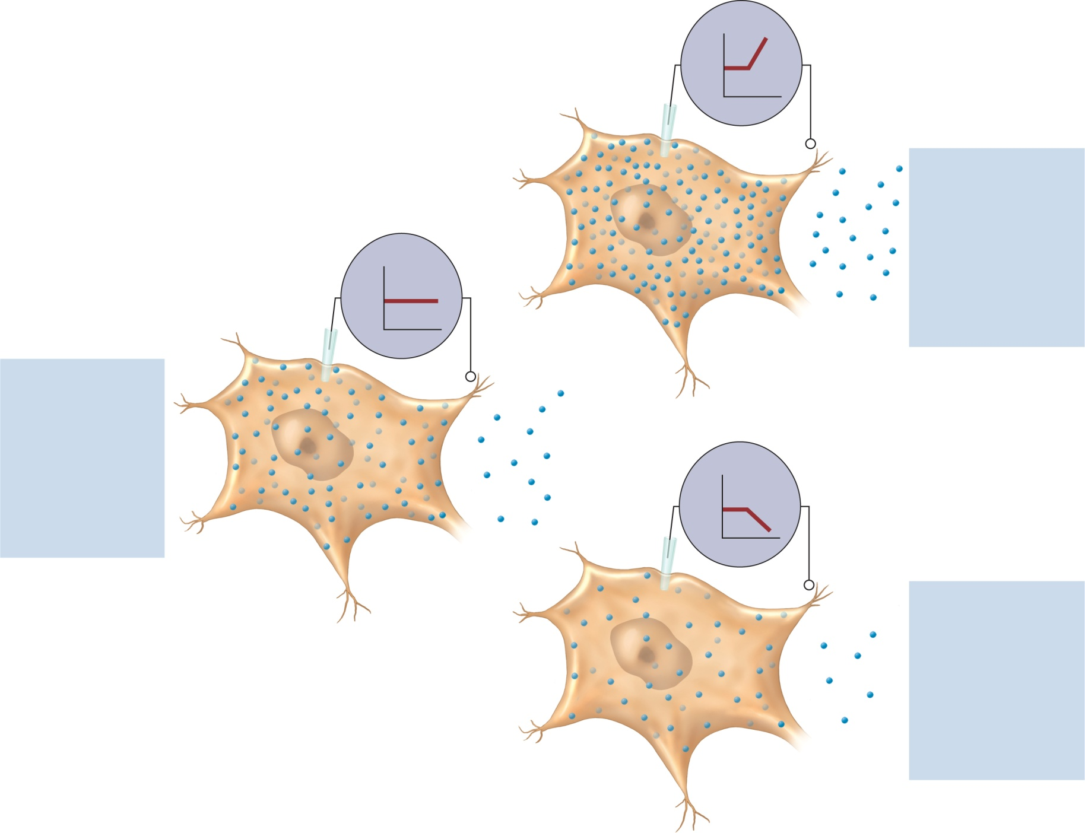
Fig. 24.9
Copyright © McGraw-Hill Education. Permission required for reproduction or display.
+
mV
–
Elevated extracellular
K⁺ concentration
Less diffusion of K⁺
out of cell
+
Elevated RMP (cells
partially depolarized)
mV
RMP
K⁺
–
Cells more excitable
K⁺ concentrations
in equilibrium
(b) Hyperkalemia
Equal diffusion into
and out of cell
Normal resting
membrane
potential (RMP)
+
mV
–
Reduced extracellular
K⁺ concentration
(a) Normokalemia
Greater diffusion of
K⁺ out of cell
Reduced RMP (cells
hyperpolarized)
Cells less excitable
(c) Hypokalemia
Notes:
9

Slide 10
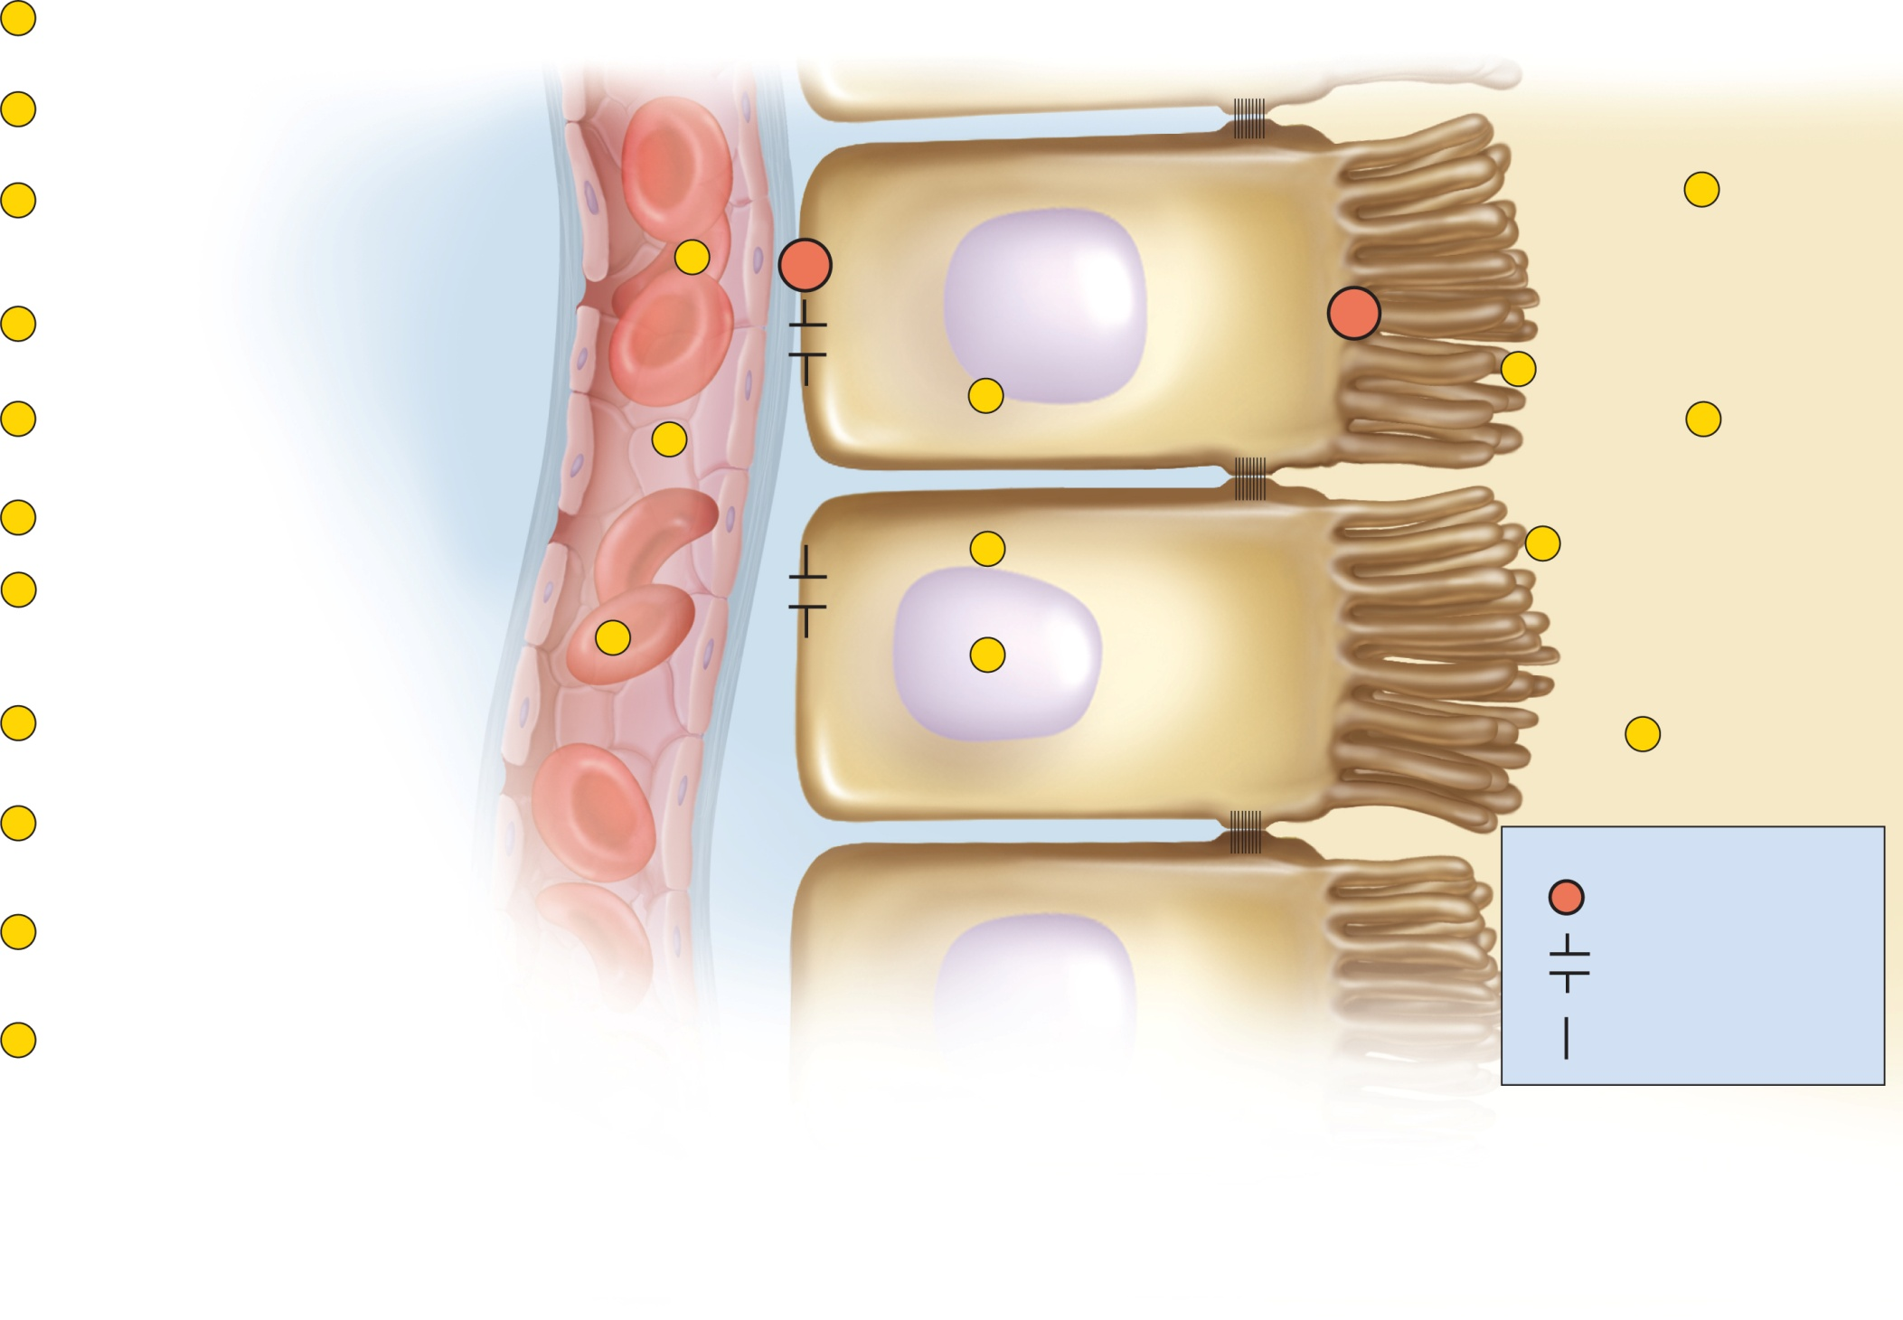
Fig. 24.10
Copyright © McGraw-Hill Education. Permission required for reproduction or display.
1
H⁺ in blood reacts with HCO₃– to
form H₂CO₃.
Blood of
peritubular capillary
Renal tubule cells
(proximal convoluted tubule)
Tubular fluid
2
H₂CO₃ decomposes into H₂O and
CO₂, which enter the tubule cell.
Glomerular
filtrate
3
Tubule cells acquire CO₂ from
blood, tubular fluid, and their own
aerobic respiration.
7
K⁺
NaHCO₃
8
Na⁺
Na⁺
Na⁺
HCO₃–
4
Carbonic anhydrase (CAH) combines
H₂O and CO₂ to re-form H₂CO₃.
HCO₃–
HCO₃–
+
H⁺
H⁺
5
6
5
H₂CO₃ ionizes to form HCO₃– (which
returns to the blood) and H⁺.
H⁺
9
1
H₂CO₃
H₂CO₃
6
Na⁺–H⁺ antiport exchanges H⁺ for Na⁺.
H₂CO₃
4
CAH
10
CAH
7
NaHCO₃ from glomerular filtrate
decomposes into Na⁺ and HCO₃–.
Na⁺ is pumped into tubule cell.
H₂O
H₂O
H₂O
2
3
+
CO₂
CO₂
CO₂
8
Na⁺ is removed by Na⁺–K⁺
pump at the base of the cell.
11
Urine
9
HCO₃– reacts with H⁺ from tubule
cell to form H₂CO₃.
Key
Antiport
10
CAH on brush border decomposes
H₂CO₃ to H₂O and CO₂ again.
Aerobic respiration
Diffusion through a
membrane channel
11
CO₂ enters the tubular cell and H₂O passes in the
urine (carrying the H⁺ that was originally in the blood).
Diffusion through the
membrane lipid
Notes:
10

Slide 11
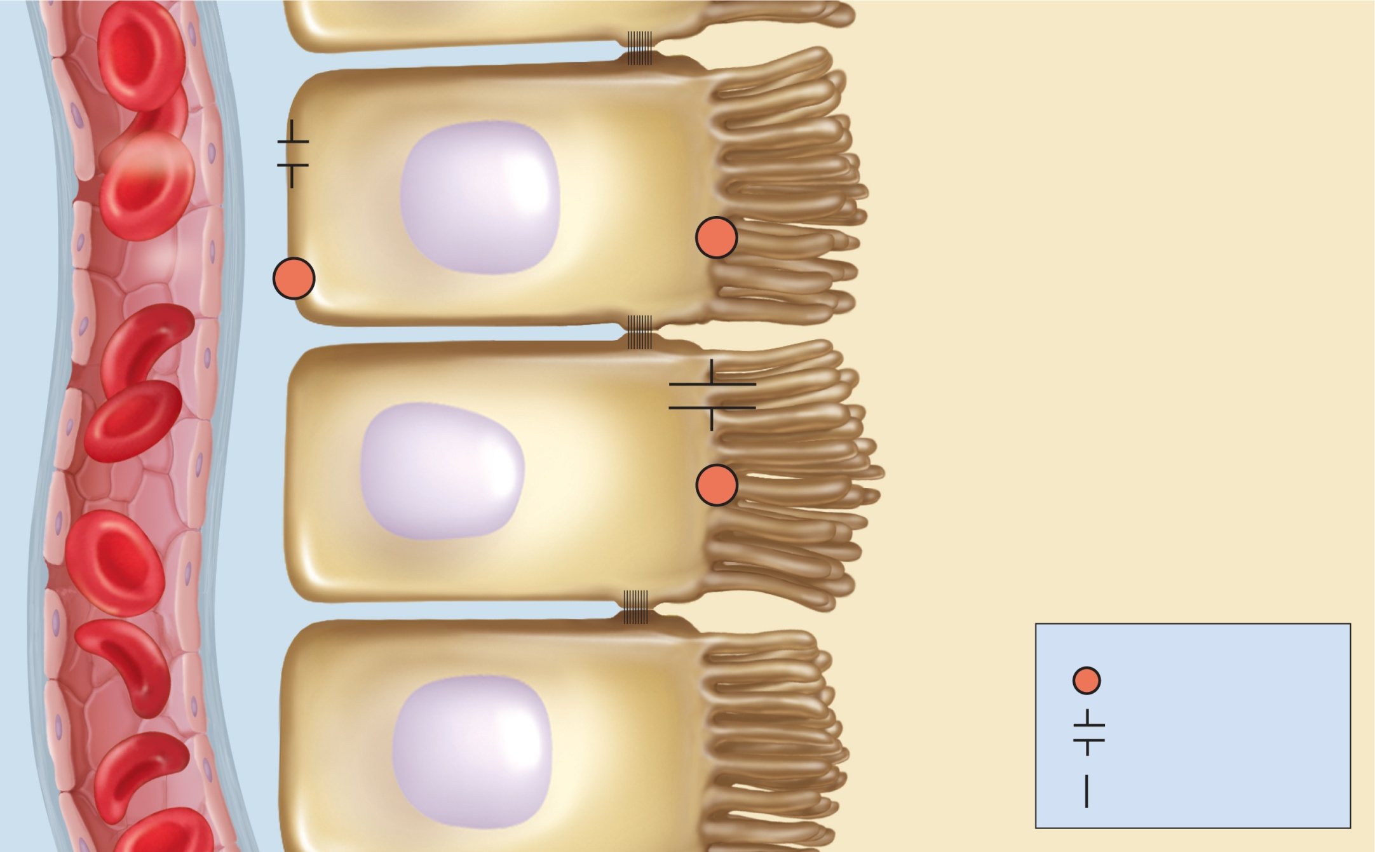
Fig. 24.11
Blood of
peritubular
capillary
Copyright © McGraw-Hill Education. Permission required for reproduction or display.
Renal tubule cells
(proximal convoluted tubule)
Tubular fluid
H₂CO₃
Glomerular filtrate
HCO₃–
HCO₃–
+
H⁺
H⁺ + Na₂HPO₄
Na⁺
Na⁺ + NaH₂PO₄
K⁺
Amino acid
catabolism
NH₃
HCO₃–
+
H⁺
H⁺ + NH₃ + Cl–
Na⁺
NH₄Cl
H₂CO₃
Urine
Ke
y
Antiport
Diffusion through a
membrane channel
Diffusion through the
membrane lipid
Notes:
11

Slide 12
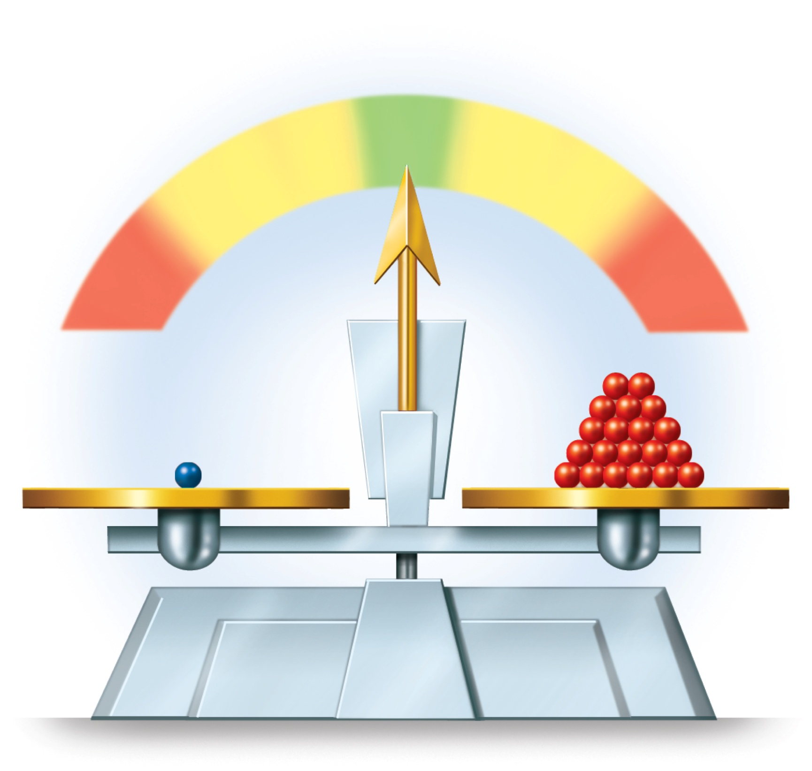
Fig. 24.12
Copyright © McGraw-Hill Education. Permission required for reproduction or display.
pH
Normal
Acidosis
7.35
7.45
Alkalosis
6.8
8.0
Death
Death
H₂CO₃
HCO₃–
Notes:
12

Slide 13
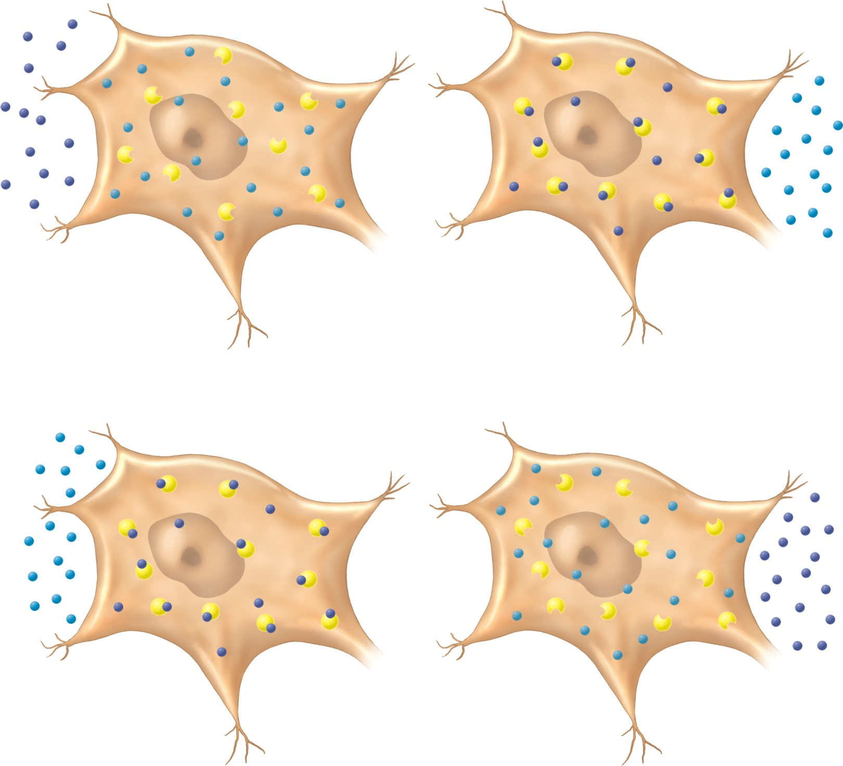
Fig. 24.13
Copyright © McGraw-Hill Education. Permission required for reproduction or display.
H+
K+
Protein
(a) Acidosis
leading to
Hyperkalemia
K+
H+
Protein
(b) Alkalosis
leading to
Hypokalemia
Notes:
13

Slide 14
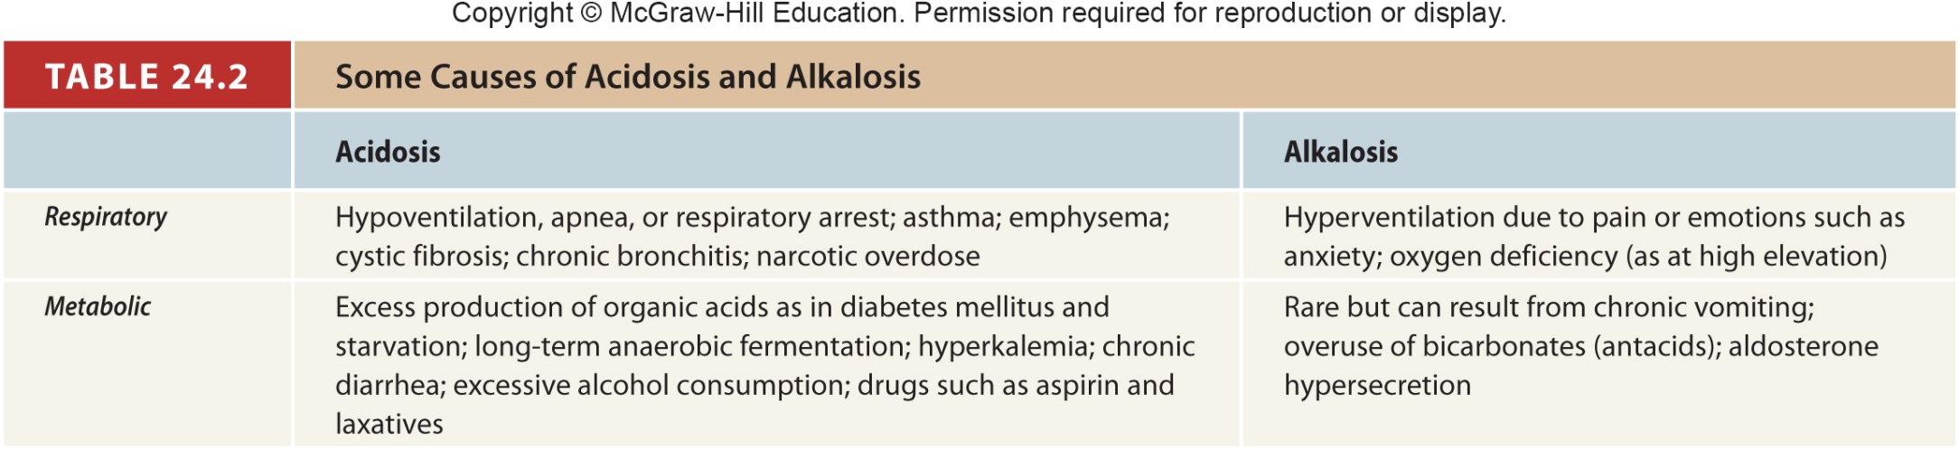
Table 24.2
Notes:
14

