Slide 1
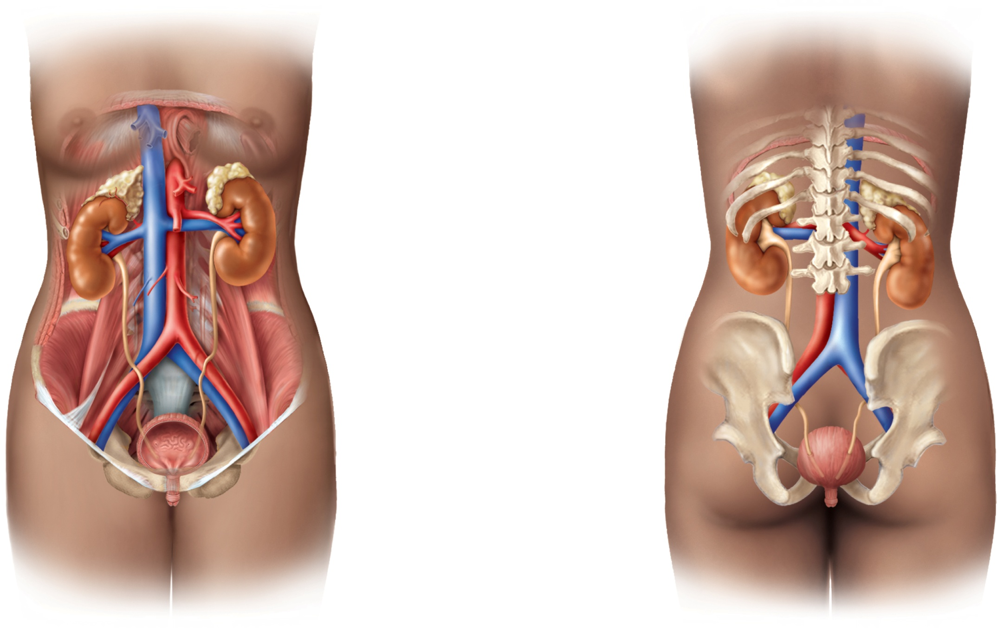
Fig. 23.1
Copyright © McGraw-Hill Education. Permission required for reproduction or display.
Diaphragm
11th and 12th ribs
Adrenal gland
Renal artery
Renal vein
Kidney
Vertebra L2
Aorta
Inferior vena cava
Ureter
Urinary bladder
Urethra
(a) Anterior view
(b) Posterior view

Slide 2
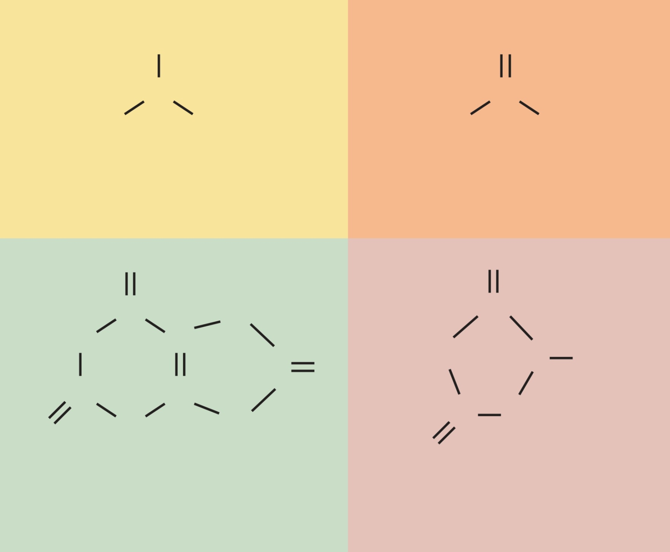
Fig. 23.2
Copyright © McGraw-Hill Education. Permission required for reproduction or display.
H
O
N
C
H
H
H₂N
NH₂
Ammonia
Urea
O
NH
H
N
C
C
HN
C
C
O
HN
N
CH₃
C
C
N
H
N
H
C
CH₂
O
O
Uric acid
Creatinine
Notes:
2

Slide 3
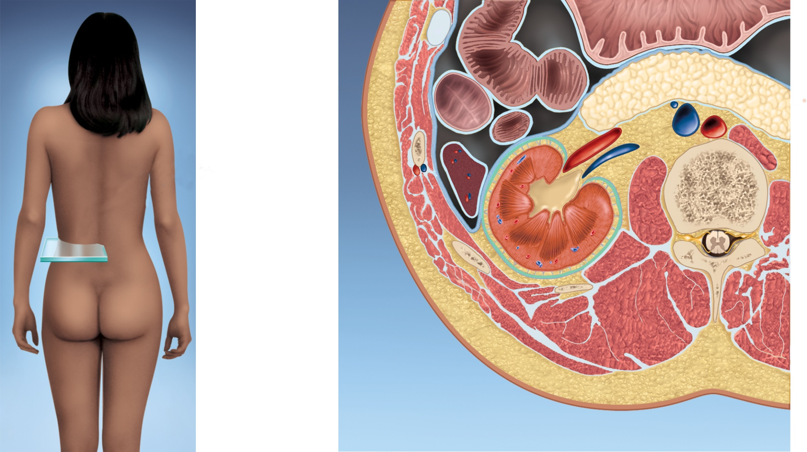
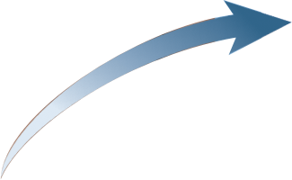
Fig. 23.3
Copyright © McGraw-Hill Education. Permission required for reproduction or display.
Anterior
Small intestine
Stomach
Colon
Pancreas
Renal artery
and vein
Inferior vena cava
Aorta
Peritoneum
L1
Spleen
Ureter
Kidney
Hilum
Fibrous capsule
Perirenal
fat capsule
Renal fascia
Lumbar muscles
Posterior
Notes:
3

Slide 4
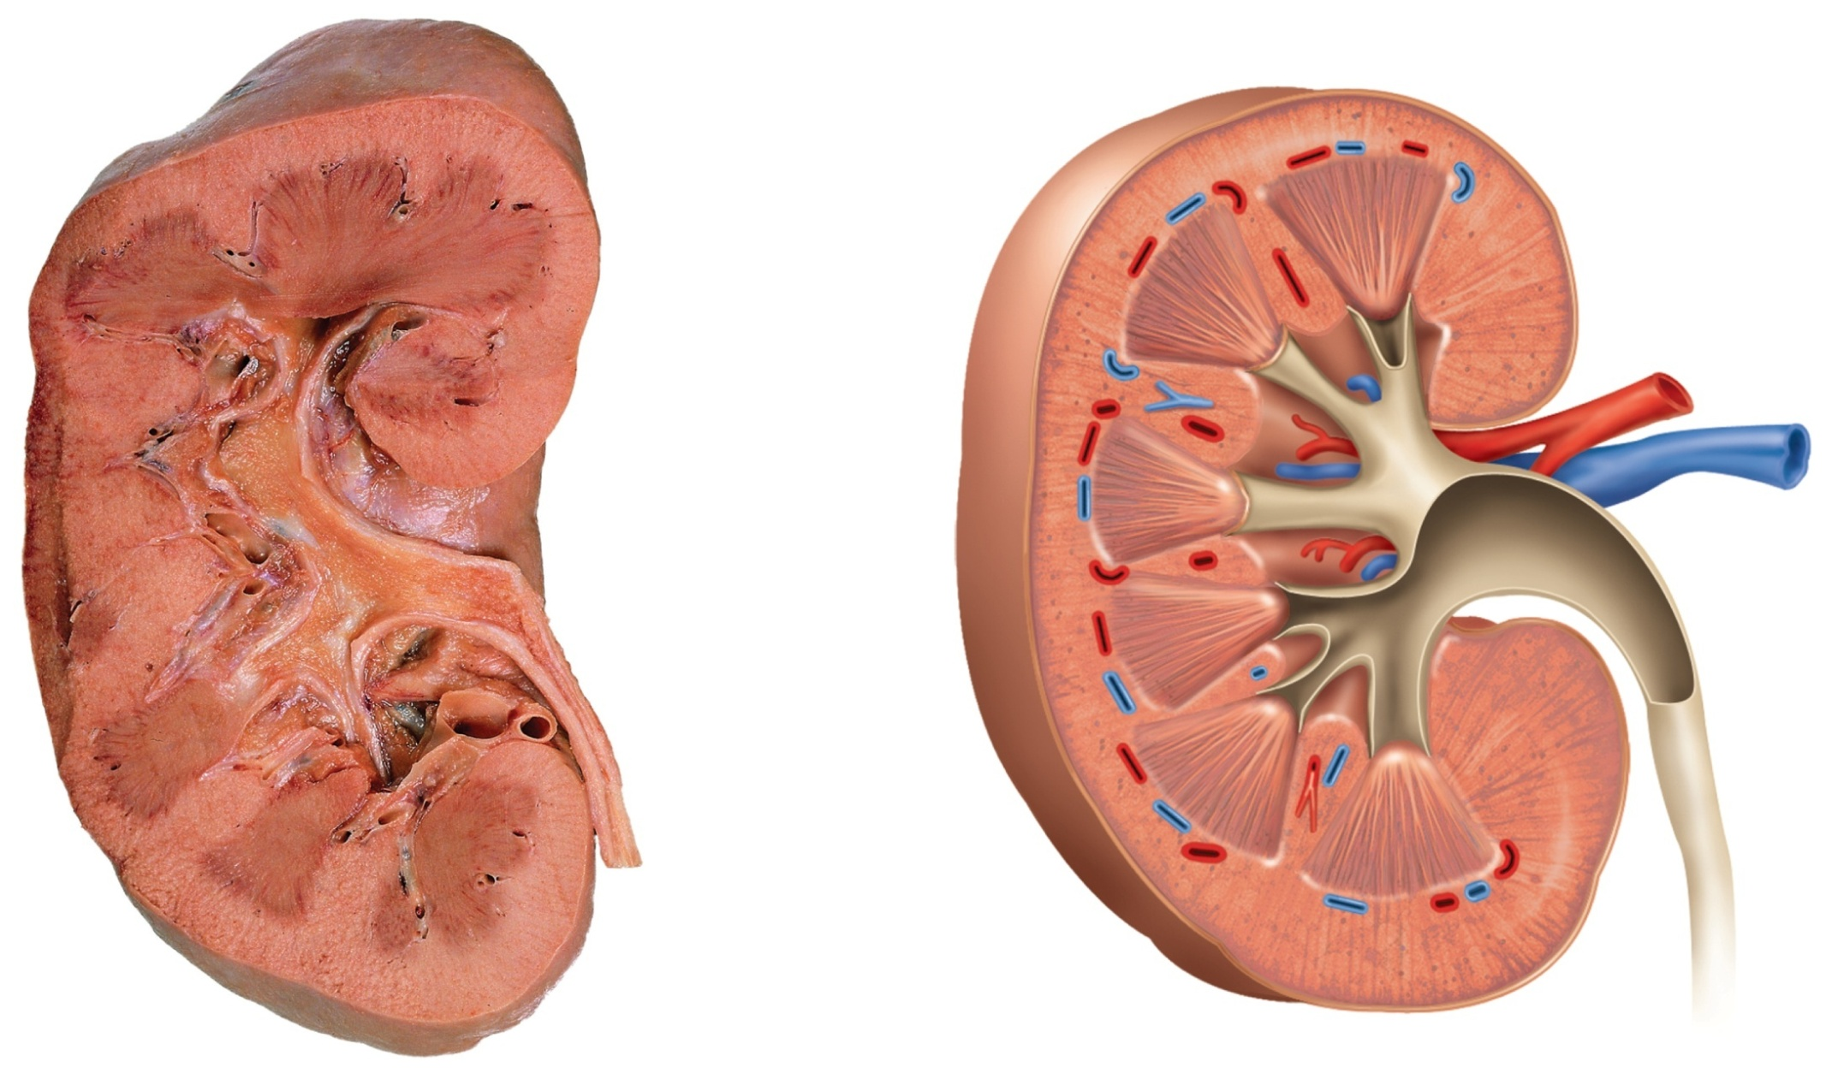
Fig. 23.4
Copyright © McGraw-Hill Education. Permission required for reproduction or display.
Fibrous capsule
Renal cortex
Renal medulla
Renal papilla
Renal sinus
Adipose tissue
in renal sinus
Renal pelvis
Major calyx
Minor calyx
Renal column
Renal pyramid
Ureter
Renal blood
vessels
(a)
(b)
a: ©Ralph Hutchings/Visuals Unlimited
Notes:
4

Slide 5
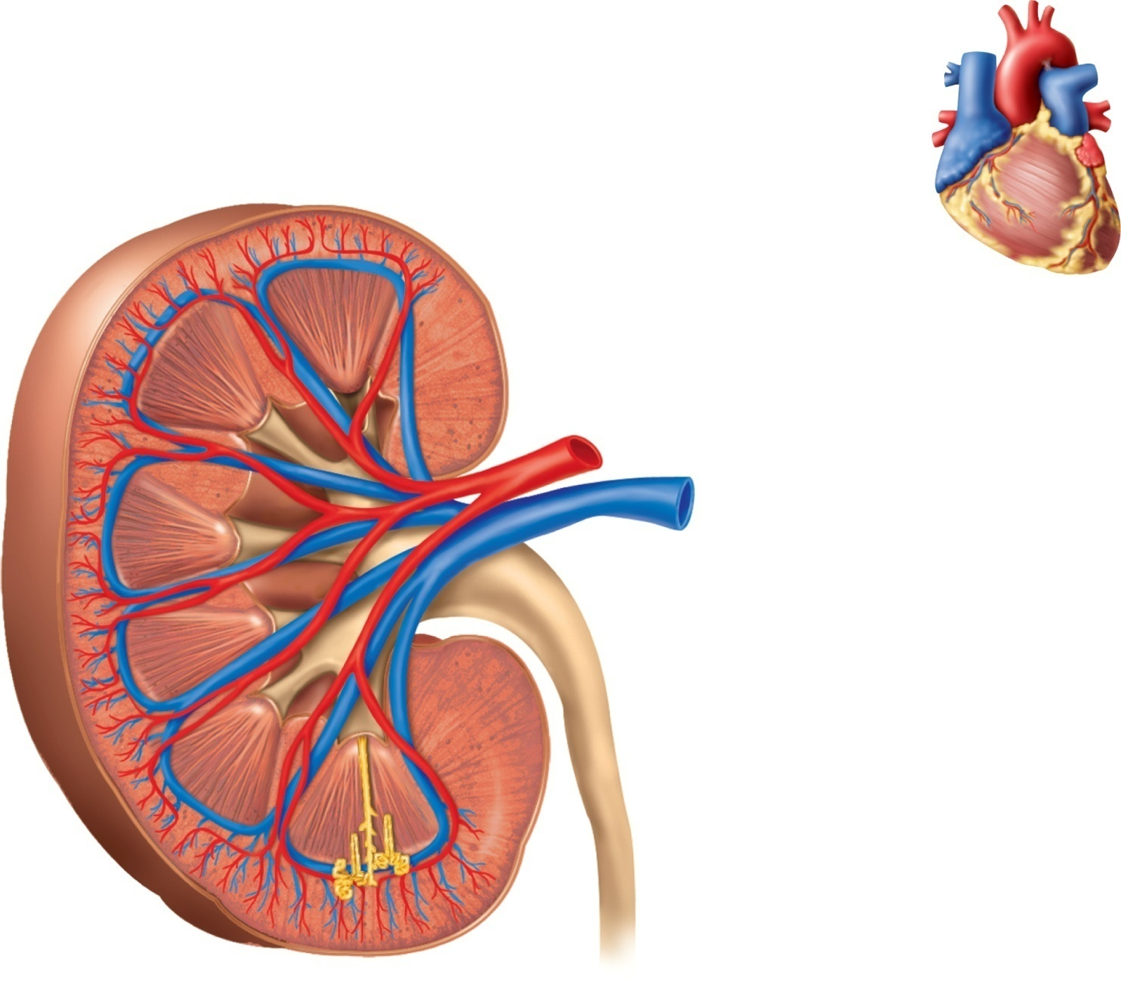
Fig. 23.5
Copyright © McGraw-Hill Education. Permission required for reproduction or display.
Cortical radiate
artery and vein
Interlobar
artery and vein
Aorta
Inferior vena cava
Segmental
artery
Renal a.
Renal v.
Renal
medulla
Segmental a.
Renal
artery
and
vein
Interlobar a.
Interlobar v.
Renal
cortex
Arcuate a.
Arcuate v.
Cortical radiate a.
Cortical radiate v.
Arcuate
artery
and vein
Afferent arteriole
Peritubular capillaries
Vasa recta
Glomerulus
Efferent arteriole
(a)
(b)
Notes:
5

Slide 6
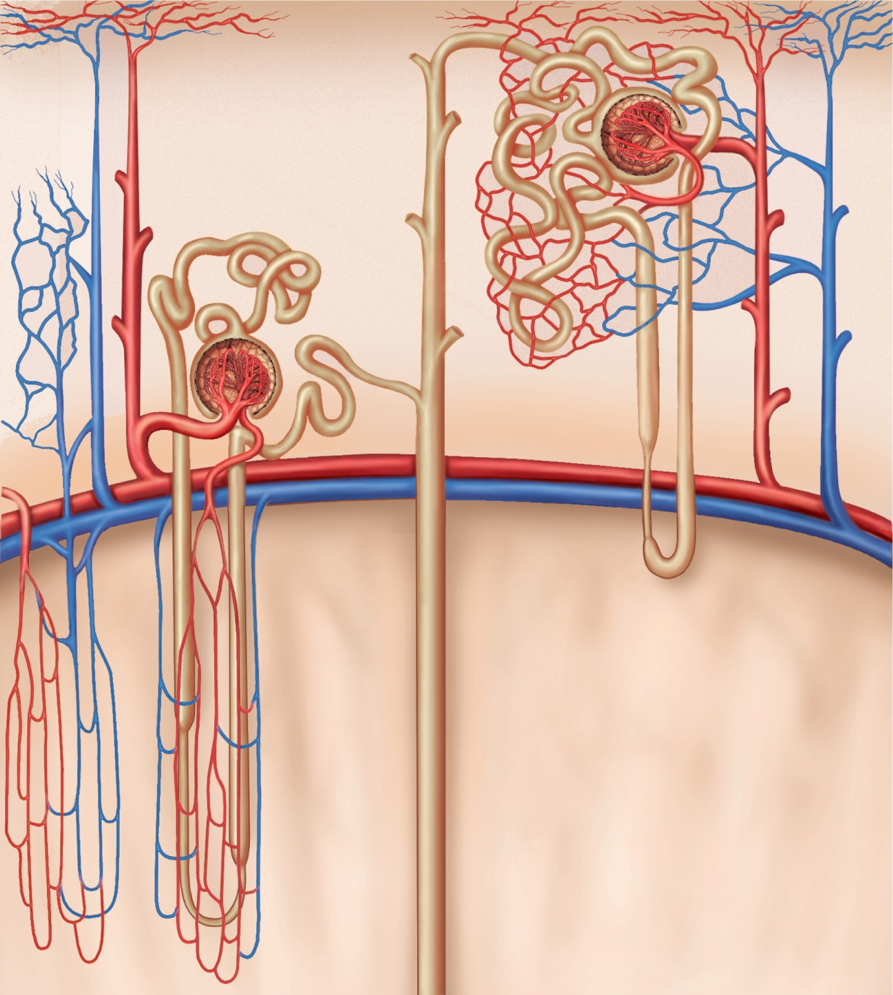
Fig. 23.6
Copyright © McGraw-Hill Education. Permission required for reproduction or display.
Cortical nephron
Afferent arteriole
Juxtamedullary nephron
Glomerulus
Efferent arteriole
C
o
r
t
e
x
PCT
DCT
Cortical radiate
artery
Peritubular
capillaries
Cortical radiate
vein
Corticomedullary
junction
Arcuate artery
Arcuate vein
Vasa recta
M
e
d
u
l
l
a
Collecting duct
Nephron loop
Notes:
6

Slide 7
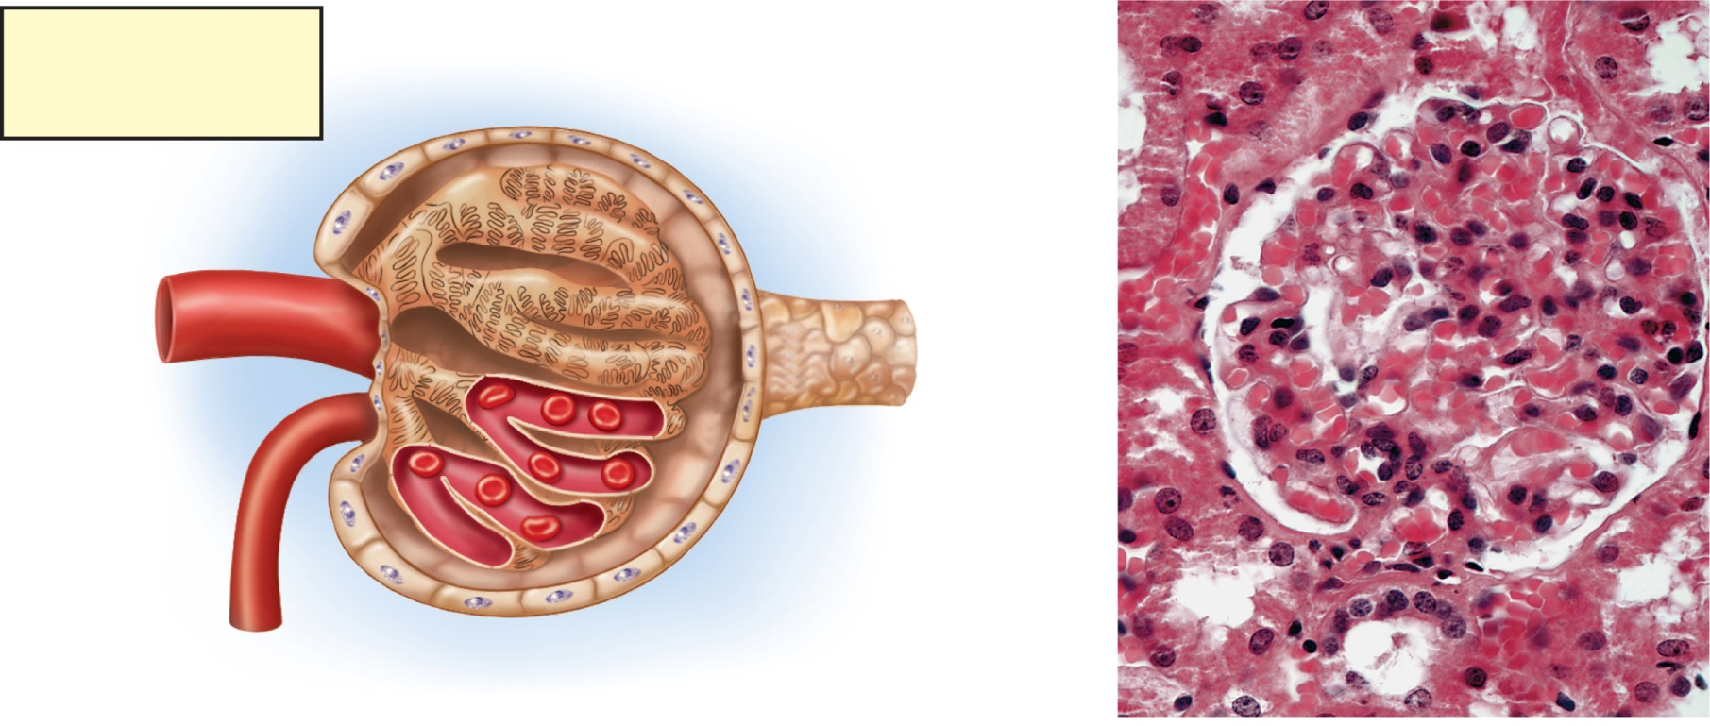
Fig. 23.7
Copyright © McGraw-Hill Education. Permission required for reproduction or display.
Key
Glomerular capsule:
Flow of blood
Parietal layer
Flow of filtrate
Capsular
space
Proximal convoluted
tubule
Podocytes of
visceral layer
Afferent
arteriole
Peritubular
capillary
Glomerulus
Blood
flow
Glomerular
capillaries
Proximal
convoluted
tubule
Glomerular capsule:
Visceral layer
Efferent
arteriole
Capsular space
Glomerular
capillaries
(podocytes
and capillary
wall
removed)
Parietal layer
Afferent arteriole
Macula densa
Blood flow
Nephron loop
(a)
(b)
100 µm
b: © McGraw-Hill Education/Al Telser
Notes:
7

Slide 8
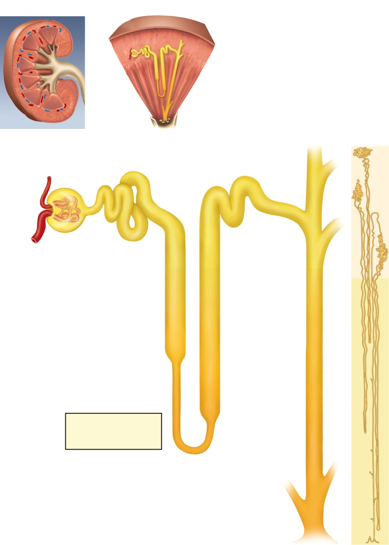
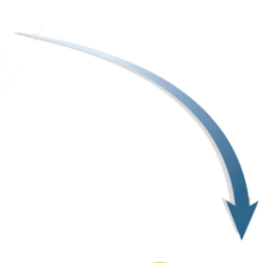
Fig. 23.8
Copyright © McGraw-Hill Education. Permission required for reproduction or display.
Renal capsule
Renal
cortex
Nephron
Collecting duct
Renal
medulla
Minor
calyx
(a)
Renal
papilla
Renal corpuscle:
Cortical nephron
Glomerular capsule
Glomerulus
Efferent
arteriole
Convoluted tubules
(PCT and DCT)
Afferent
arteriole
Juxtamedullary
nephron
Proximal
convoluted
tubule (PCT)
Distal
convoluted
tubule (DCT)
Cortex
Medulla
Nephron loop:
Descending limb
Collecting
duct (CD)
Ascending limb
Thick segment
Thin segment
Key
Nephron
loops
Flow of blood
Flow of tubular fluid
(b)
Collecting
duct
Papillary
duct
(c)
Notes:
8

Slide 9
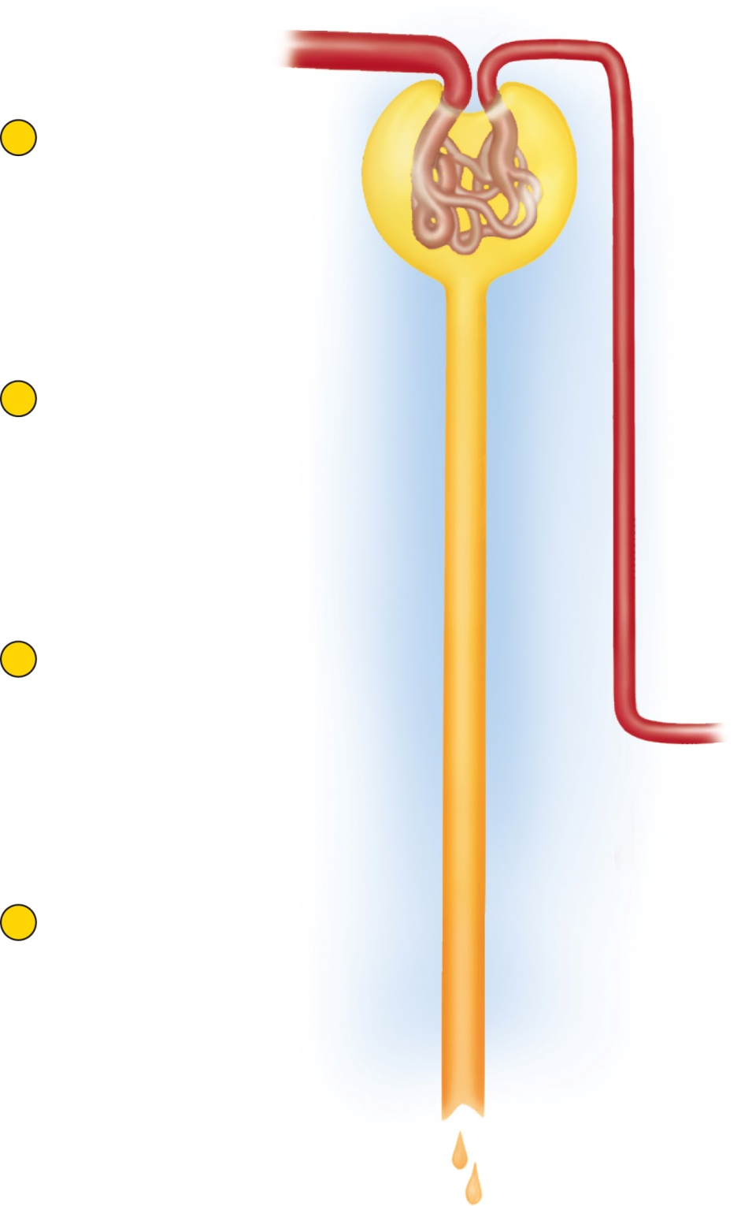
Fig. 23.9
Copyright © McGraw-Hill Education. Permission required for reproduction or display.
Blood flow
1
Glomerular filtration
Creates a plasmalike
filtrate of the blood
Renal corpuscle
Flow of filtrate
2
Tubular reabsorption
Removes useful solutes
from the filtrate, returns
them to the blood
Peritubular
capillaries
3
Tubular secretion
Removes additional
wastes from the blood,
adds them to the filtrate
Renal tubule
4
Water conservation
Removes water from the
urine and returns it to
blood; concentrates
wastes
H₂O
H₂O
H₂O
Urine
Notes:
9

Slide 10
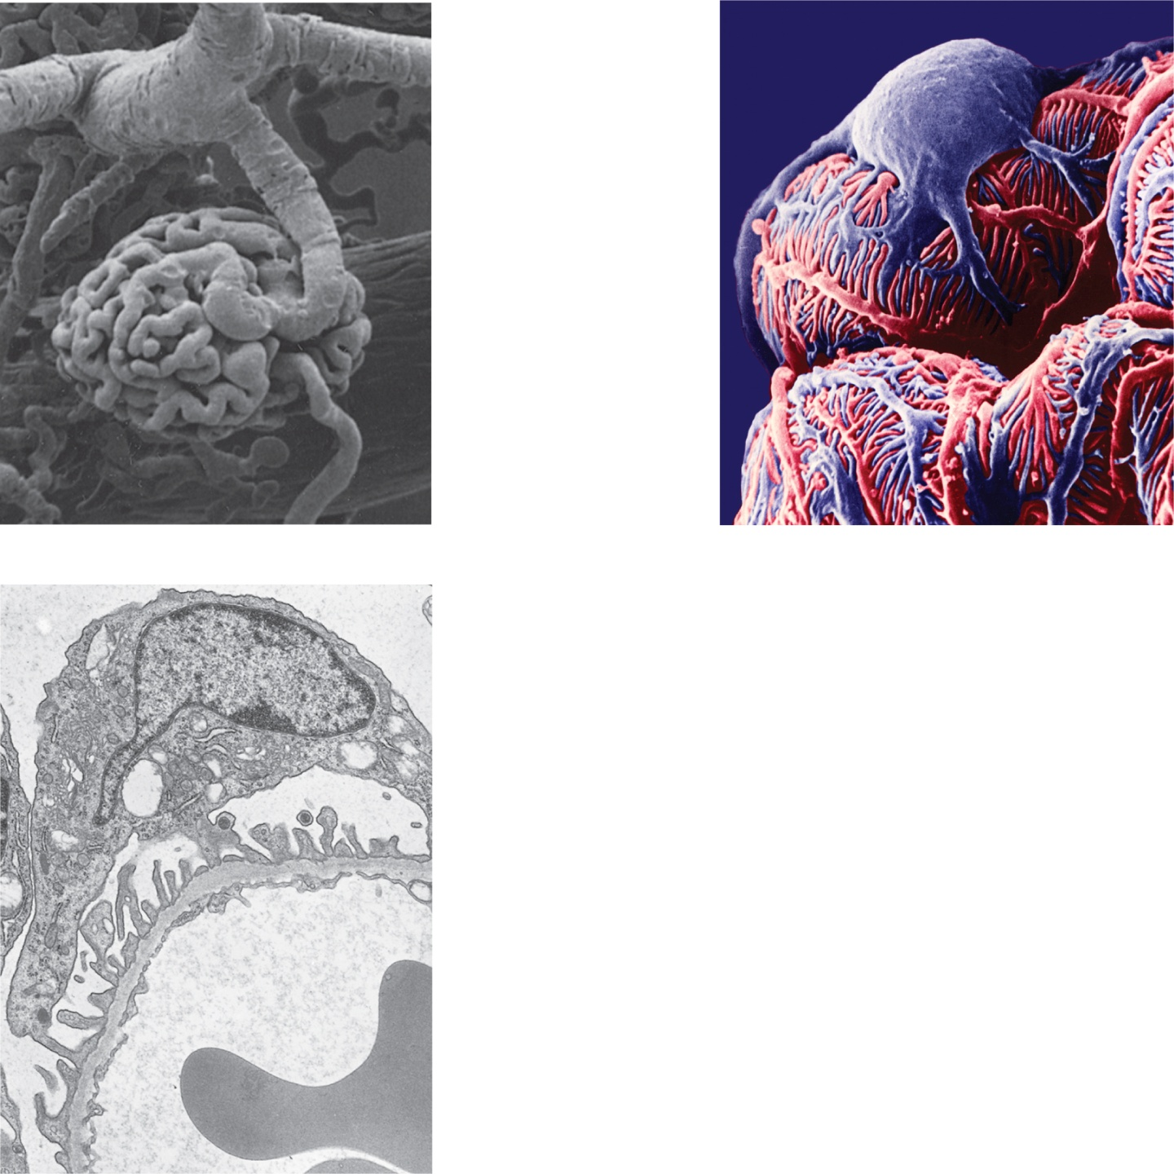
Fig. 23.10
Copyright © McGraw-Hill Education. Permission required for reproduction or display.
Podocyte
cell body
Cortical
radiate artery
Afferent
arteriole
Glomerulus
Foot processes
(separated by
narrow
filtration slits)
Efferent
arteriole
(a)
100 µm
(b)
5 µm
Capsular space
Podocyte
Foot processes
Filtration slits
Basement membrane
Filtration pore
Endothelial cell
Blood plasma
Erythrocyte
(c)
0.5 µm
a: © Dr. Richard Kessel & Dr. Randy Kardon/Visuals Unlimited, Inc.; b:© Dr. Donald Fawcett/Visuals Unlimited, Inc.; c: © Barry F. King/Biological Photo Service
Notes:
10

Slide 11
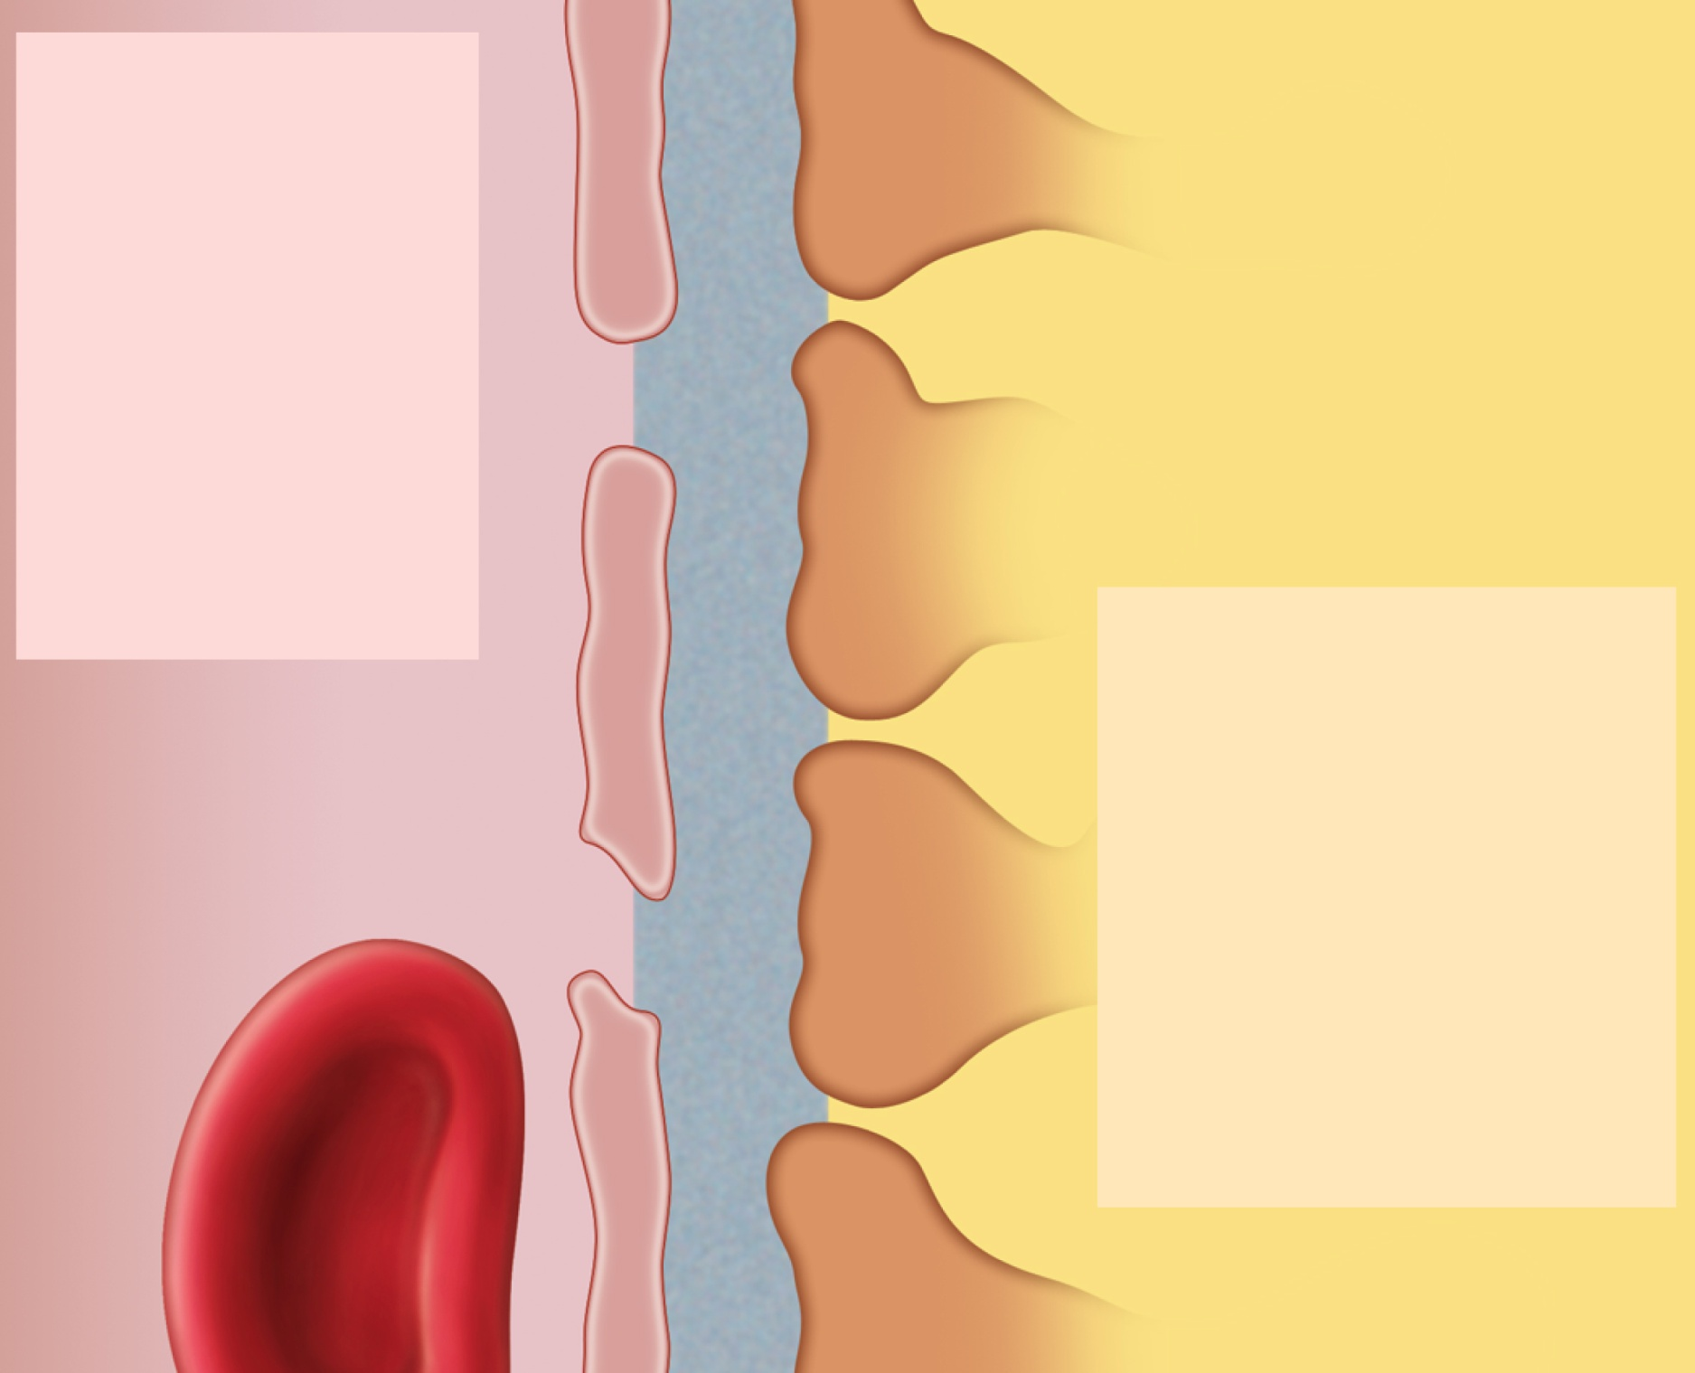
Fig. 23.11
Copyright © McGraw-Hill Education. Permission required for reproduction or display.
Turned back:
Blood cells
Plasma proteins
Large anions
Protein-bound
minerals and
hormones
Most molecules
> 8 nm in
diameter
Endothelial cell of
glomerular capillary
Basement membrane
Filtration slit
Filtration pore
Foot process of
podocyte
Passed through filter:
Water
Electrolytes
Glucose
Amino acids
Fatty acids
Vitamins
Urea
Uric acid
Creatinine
Bloodstream
Capsular space
Notes:
11

Slide 12
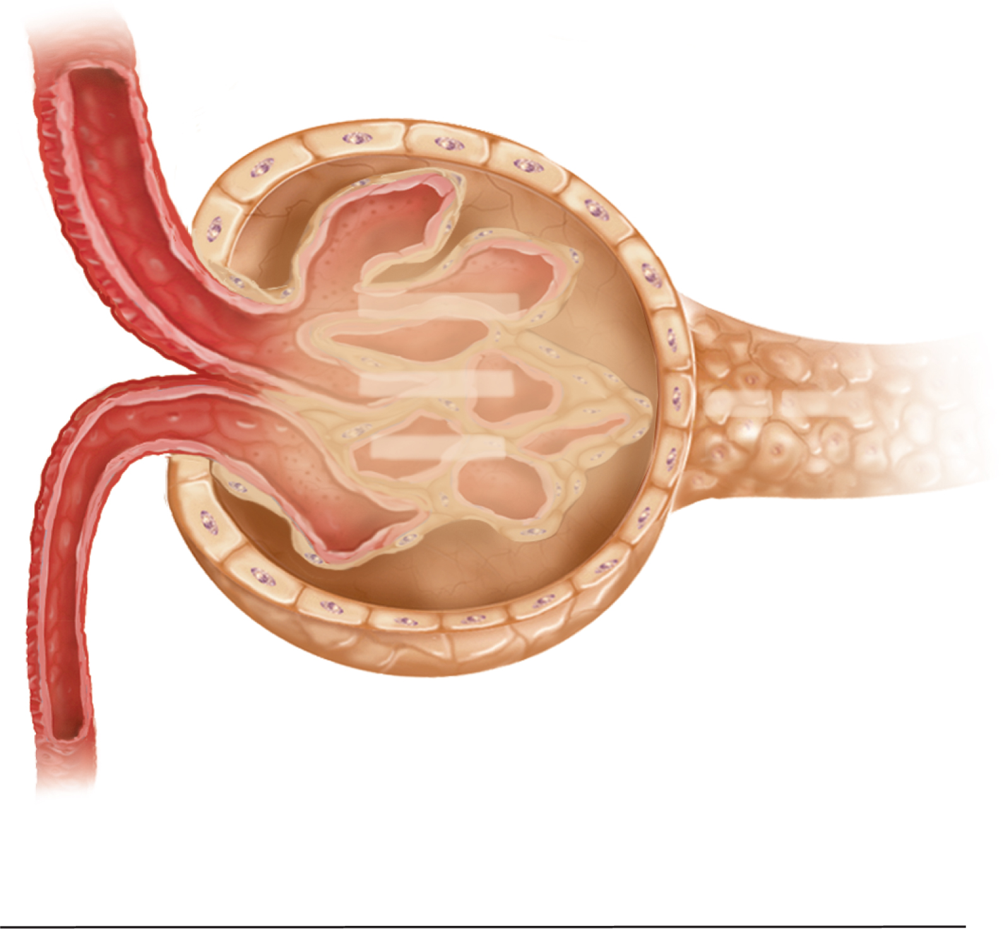
Fig. 23.12
Copyright © McGraw-Hill Education. Permission required for reproduction or display.
BHP 60 out
COP 32 in
NFP 10 out
CP 18 in
Blood hydrostatic pressure (BHP)
60 mm Hg_{out}
Colloid osmotic pressure (COP)
–32 mm Hg_{in}
Capsular pressure (CP)
–18 mm Hg_{in}
Net filtration pressure (NFP)
10 mm Hg_{out}
Notes:
12

Slide 13
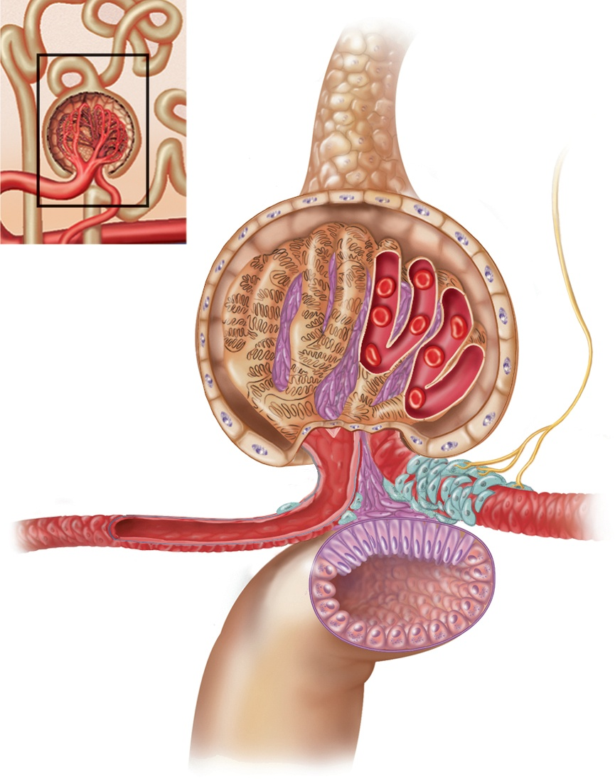
Fig. 23.13
Copyright © McGraw-Hill Education. Permission required for reproduction or display.
Sympathetic
nerve fiber
Podocytes
Mesangial cells
Granular
cells
Efferent arteriole
Afferent arteriole
Smooth muscle
cells
Macula densa
Nephron
loop
Notes:
13

Slide 14
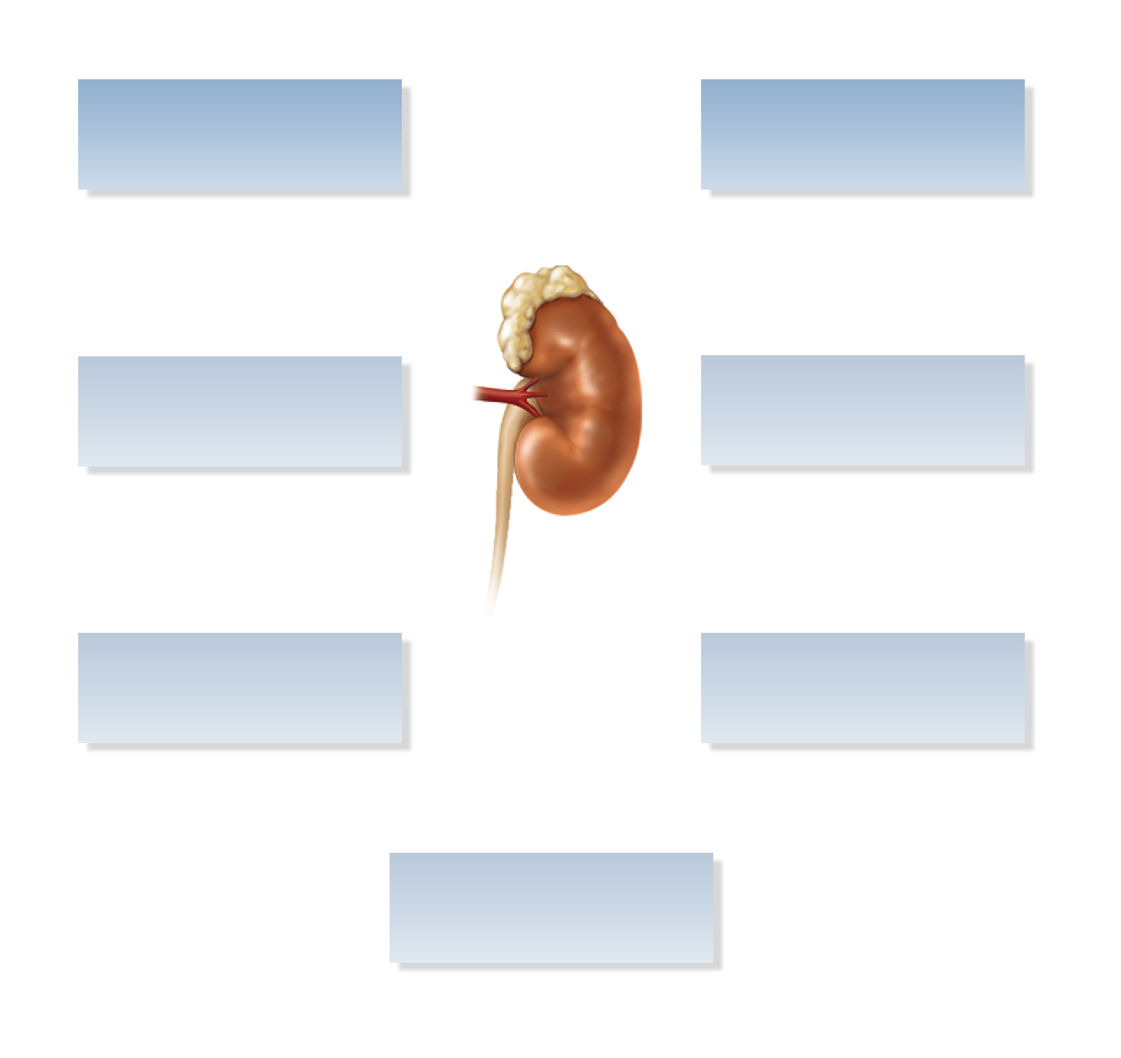
Fig. 23.14
Copyright © McGraw-Hill Education. Permission required for reproduction or display.
High GFR
Reduced GFR
Increased NaCl
load in nephron loop
Afferent arteriole
constricts
Macula densa
secretes ATP
Adenosine stimulates
granular cells
Mesangial cells
metabolize ATP
to adenosine
Notes:
14

Slide 15
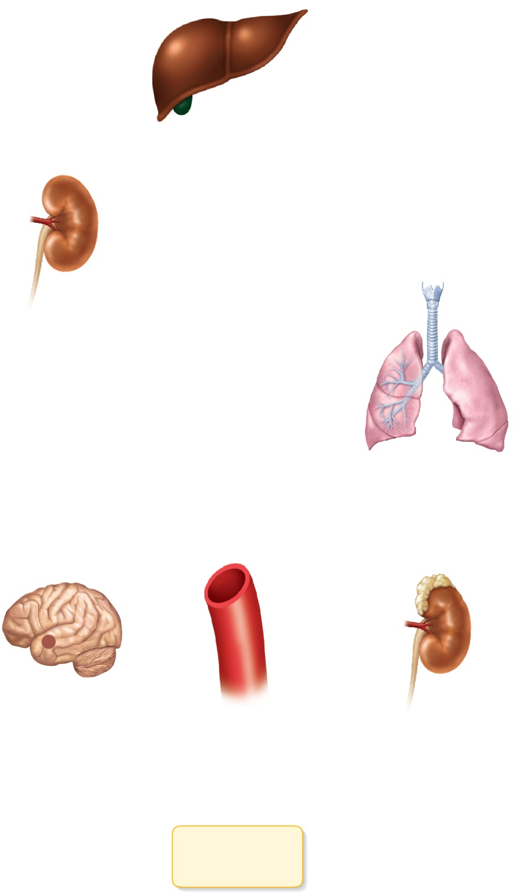
Fig. 23.15
Copyright © McGraw-Hill Education. Permission required for reproduction or display.
Drop in blood
pressure
Liver
Angiotensinogen
(453 amino acids long)
Renin
Kidney
Angiotensin I
(10 amino acids long)
Angiotensin-
converting
enzyme (ACE)
Angiotensin II
(8 amino acids long)
Lungs
Hypothalamus
Cardiovascular
system
Adrenal
cortex
Aldosterone
Kidney
Vasoconstriction
Thirst and
drinking
Sodium and
water retention
Elevated blood
pressure
Notes:
15

Slide 16
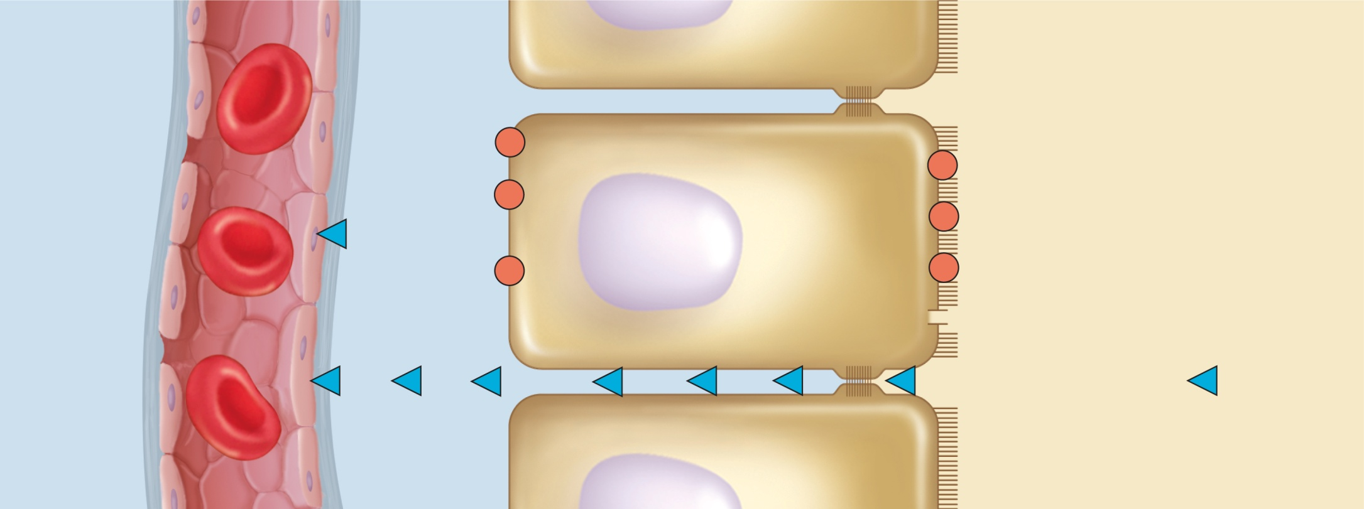
Fig. 23.16
Copyright © McGraw-Hill Education. Permission required for reproduction or display.
Peritubular
capillary
Tissue
fluid
Tubule epithelial cells
Tubular fluid
Glucose
Sodium–glucose
transporter
(SGLT) (symport)
ATP
Na⁺
Na⁺
Na⁺ –K⁺ pump
Glucose
K⁺
Na⁺
Na⁺–H⁺ antiport
ADP + P_{i}
H⁺
K⁺
Cl–
Cl––anion antiport
Cl–
Anions
K⁺ –Cl–
symport
H₂O
Aquaporin
Tight junction
Solvent drag
Transcellular route
Brush
border
H₂O, urea, uric acid,
Na⁺, K⁺, Cl–, Mg²⁺,Ca²⁺, P_{i}
Paracellular route
Notes:
16

Slide 17
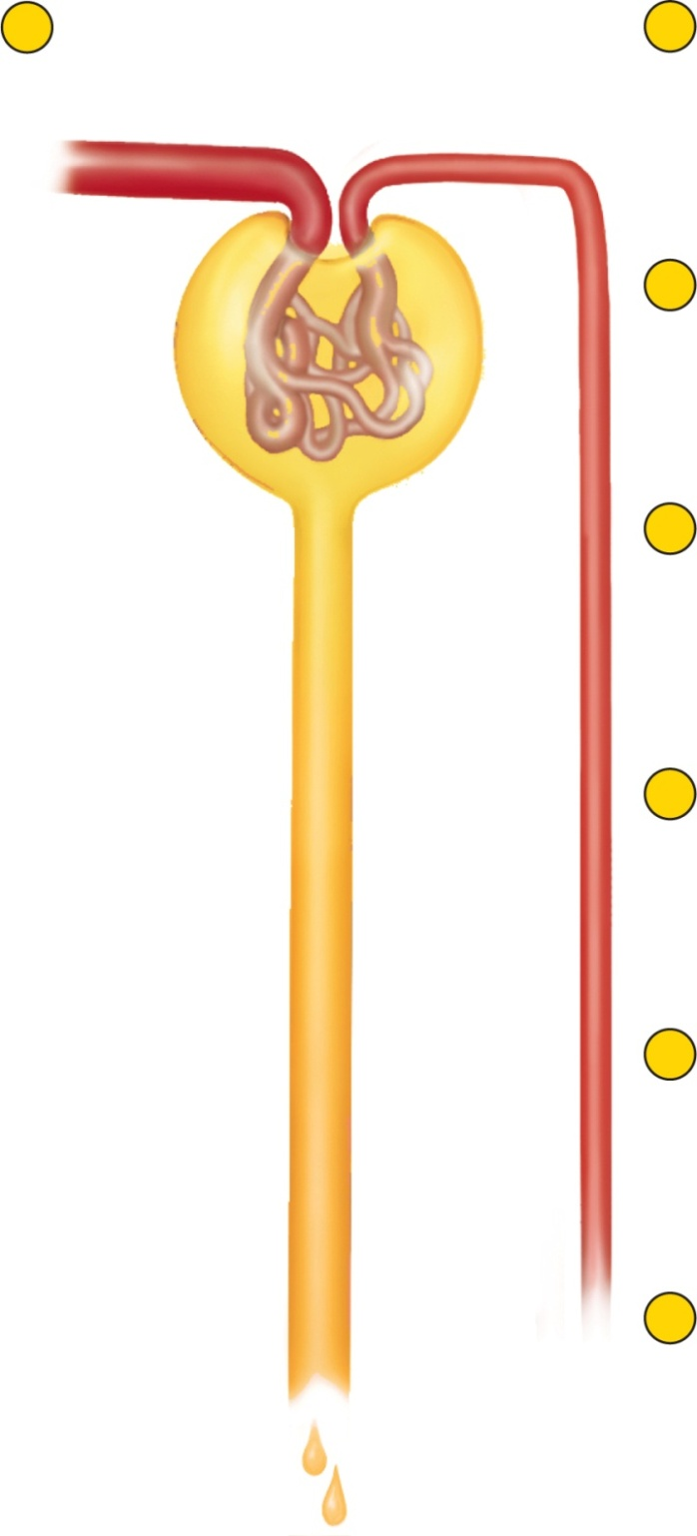
Fig. 23.17
Copyright © McGraw-Hill Education. Permission required for reproduction or display.
1
Angiotensin II
secreted
2
Constricts afferent and
especially efferent arterioles
3
Maintains or increases
glomerular blood pressure
and glomerular filtration
and
4
Reduces blood pressure
in peritubular capillary
H₂O
5
Reduces resistance to
tubular reabsorption
6
Tubular reabsorption
increases
7
Urine volume is less
but concentration is high
Notes:
17

Slide 18
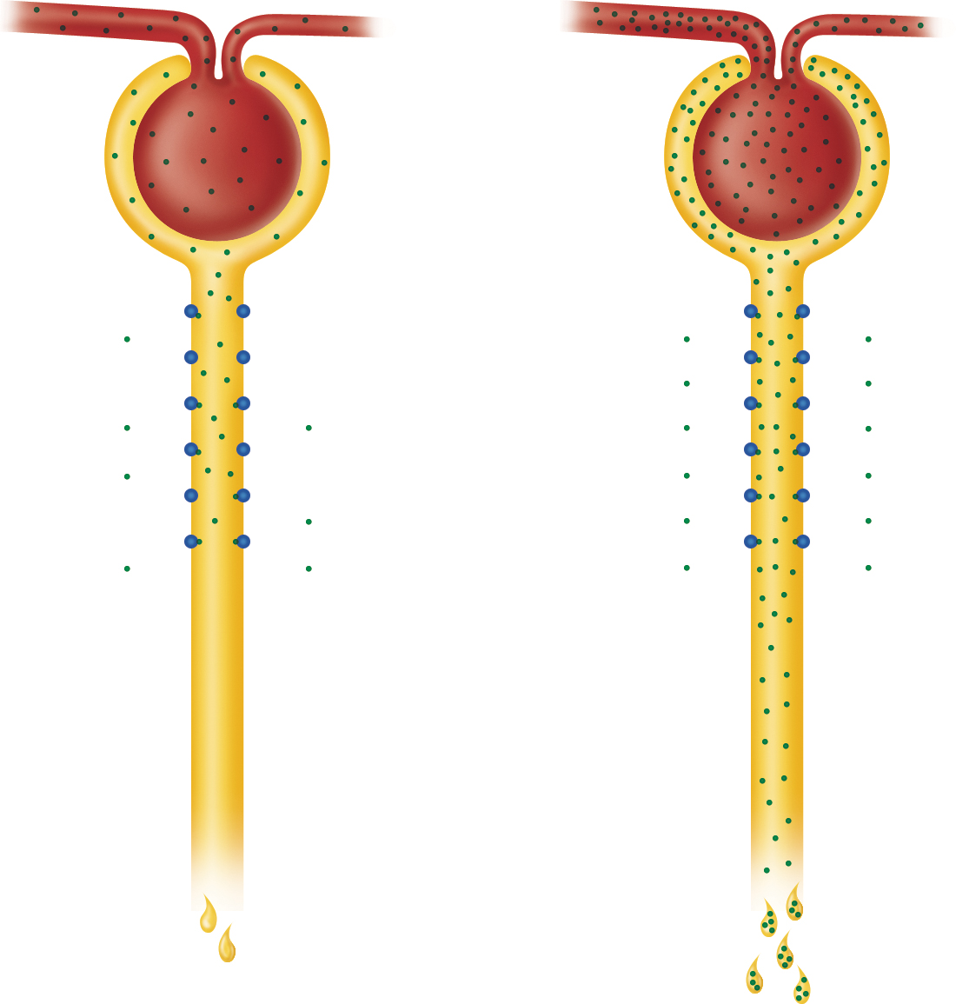
Fig. 23.18
Copyright © McGraw-Hill Education. Permission required for reproduction or display.
Normoglycemia
Hyperglycemia
Glomerular
filtration
Glucose-
transport
protein
Glucose reabsorption
(a)
Normal
urine volume,
glucose-free
(b)
Increased
urine volume,
with glycosuria
Notes:
18

Slide 19
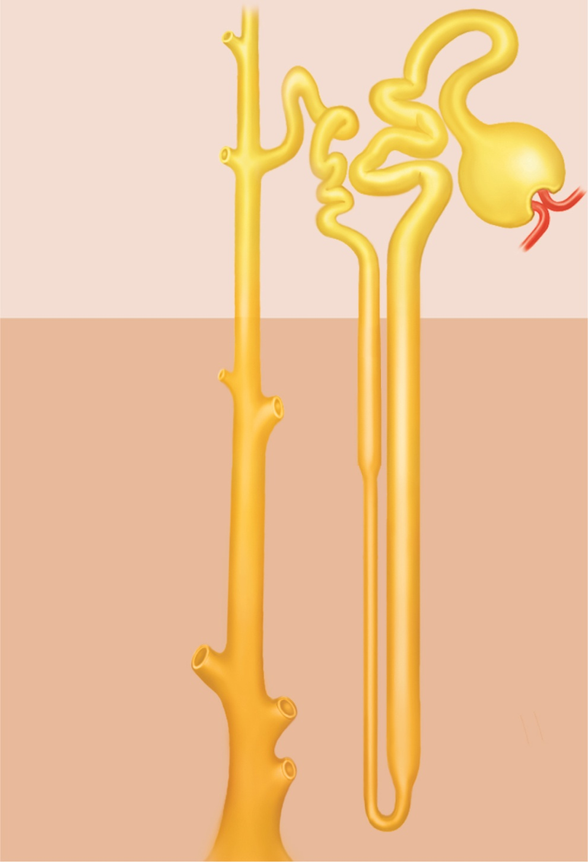
Fig. 23.19
Copyright © McGraw-Hill Education. Permission required for reproduction or display.
Tubular fluid
(300 mOsm/L)
300
Cortex
Medulla
600
H₂O
Osmolarity of tissue fluid (mOsm/L)
H₂O
Collecting
duct
900
H₂O
H₂O
Nephron
loop
1,200
H₂O
Urine
(up to 1,200 mOsm/L)
Notes:
19

Slide 20
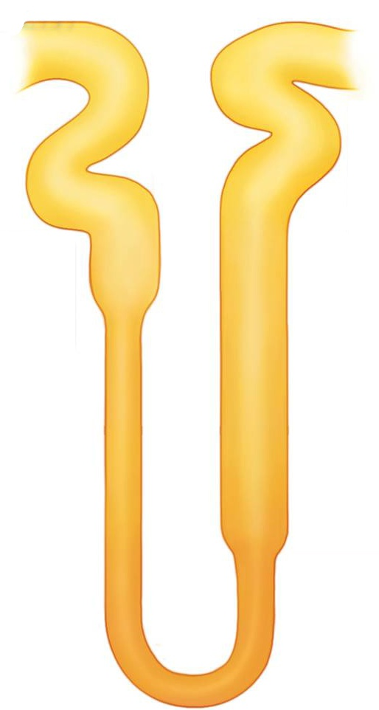
Fig. 23.20
Copyright © McGraw-Hill Education. Permission required for reproduction or display.
1
More salt is continually
added by the PCT.
300
100
5
The more salt that
is pumped out of the
ascending limb, the
saltier the ECF is in
the renal medulla.
400
200
2
The higher the osmolarity
of the ECF, the more water
leaves the descending limb
by osmosis.
Na+
Na+
K+
K+
Cl–
Cl–
H₂O
H₂O
600
Na+
400
Na+
K+
K+
Cl–
Cl–
H₂O
Na+
H₂O
K+
Na+
Cl–
K+
700
Cl–
3
The more water that leaves
the descending limb, the
saltier the fluid is that
remains in the tubule.
900
H₂O
4
The saltier the fluid in the
ascending limb, the more
salt the tubule pumps into
the ECF.
1,200
Notes:
20

Slide 21
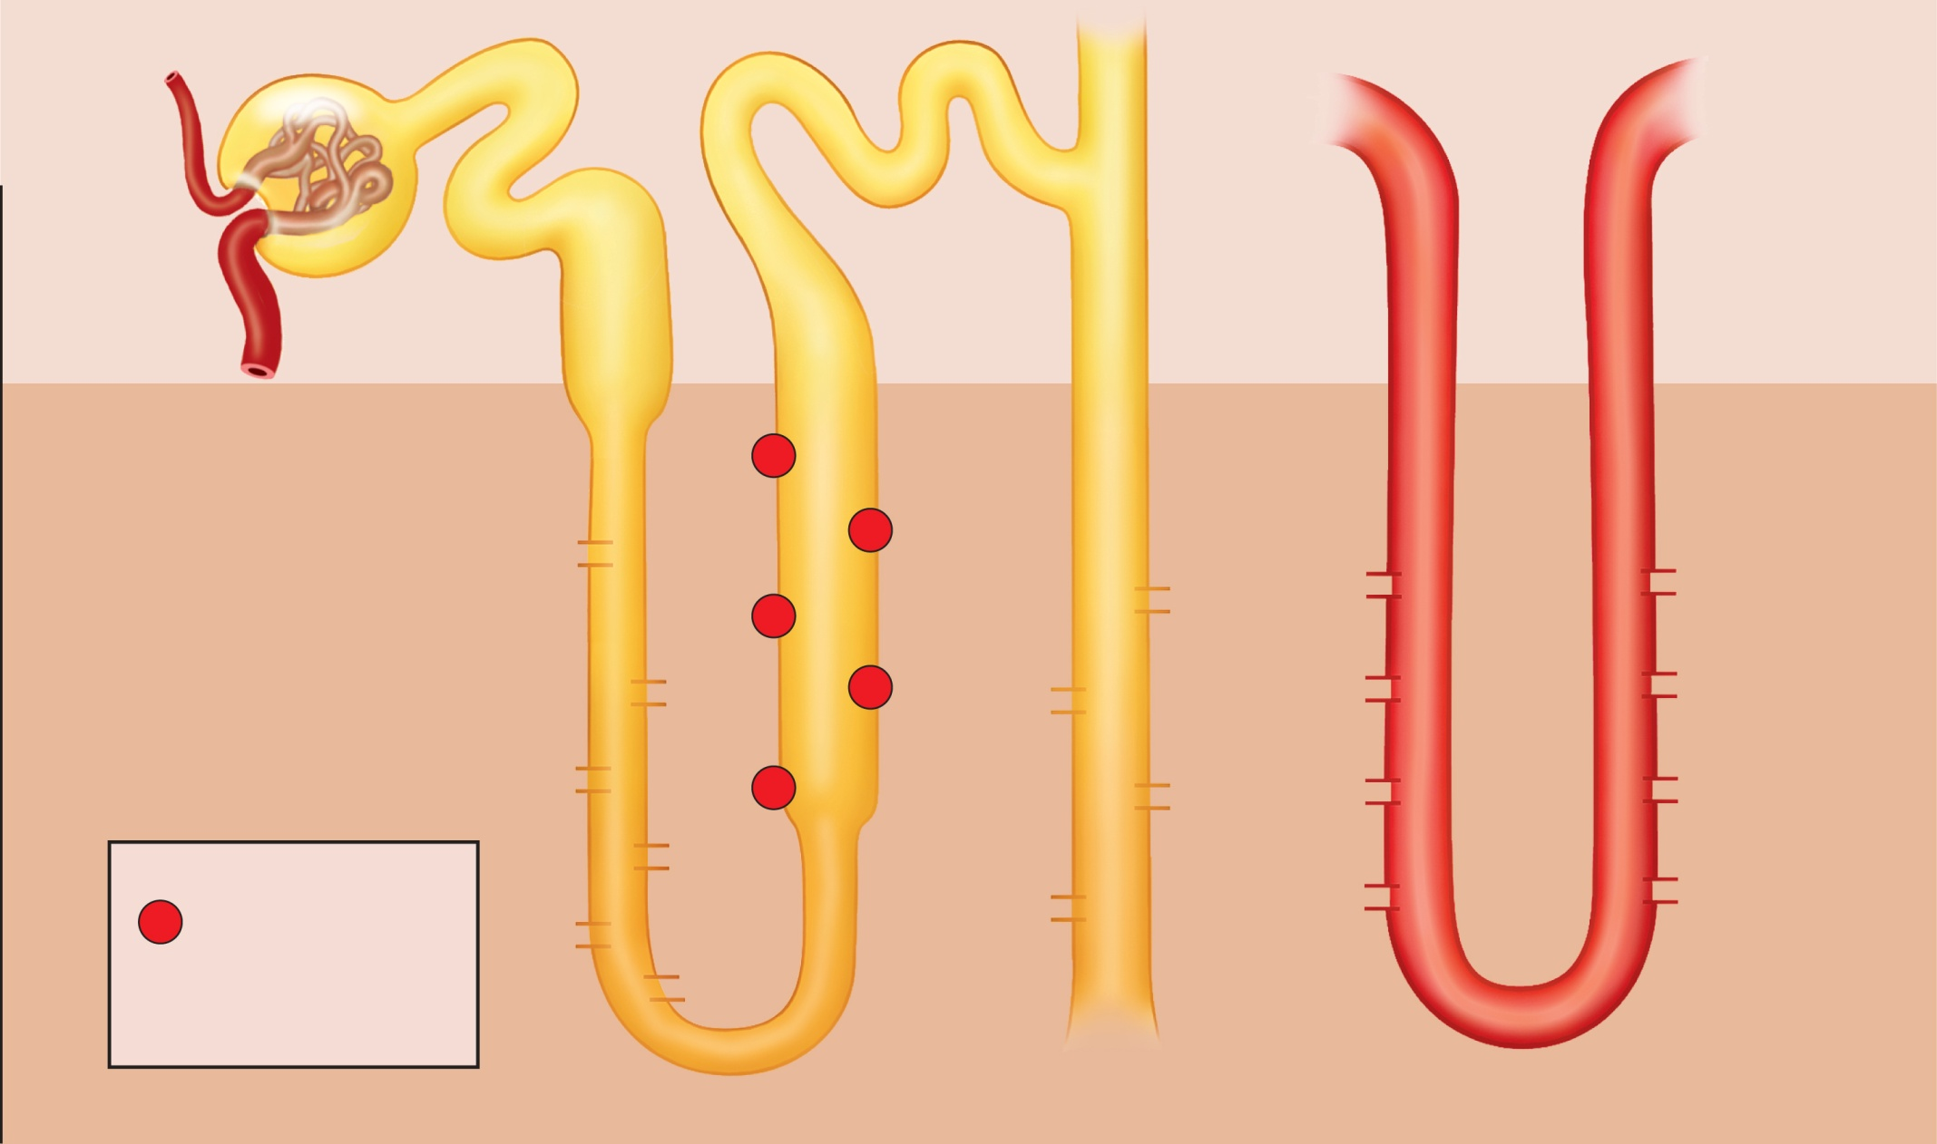
Fig. 23.21
Copyright © McGraw-Hill Education. Permission required for reproduction or display.
Osmolarity of
ECF
(mOsm/L)
300
300
100
300
300
300
100
300
Cortex
200
400
Medulla
400
Na⁺
400
K⁺
Cl–
200
Na⁺
K⁺
400
Urea
Na⁺
Cl–
500
600
K⁺
Urea
H₂O
H₂O
600
Cl–
400
Na⁺
600
H₂O
K⁺
NaCl
NaCl
Na⁺
Cl–
Urea
H₂O
K⁺
700
600
900
Cl–
400
Urea
H₂O
H₂O
Urea
900
Key
700
900
NaCl
Active transport
900
Urea
NaCl
Urea
Diffusion through
a membrane channel
H₂O
1,200
1,200
1,200
1,200
Nephron loop
Collecting duct
Vasa recta
Notes:
21

Slide 22
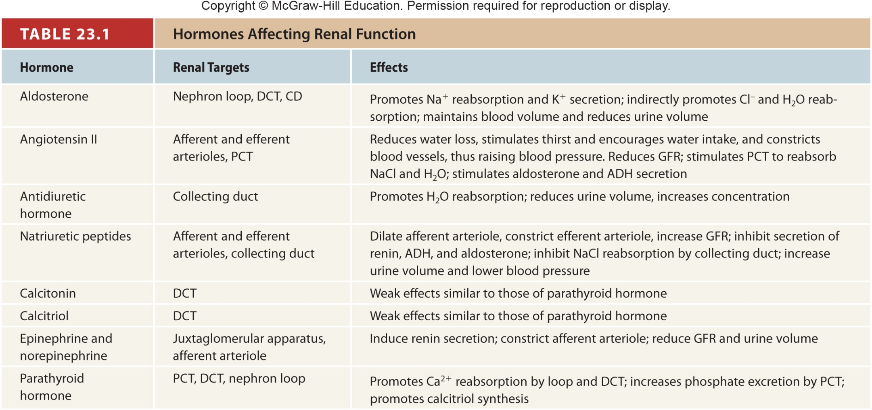
Table 23.1
Notes:
22

Slide 23
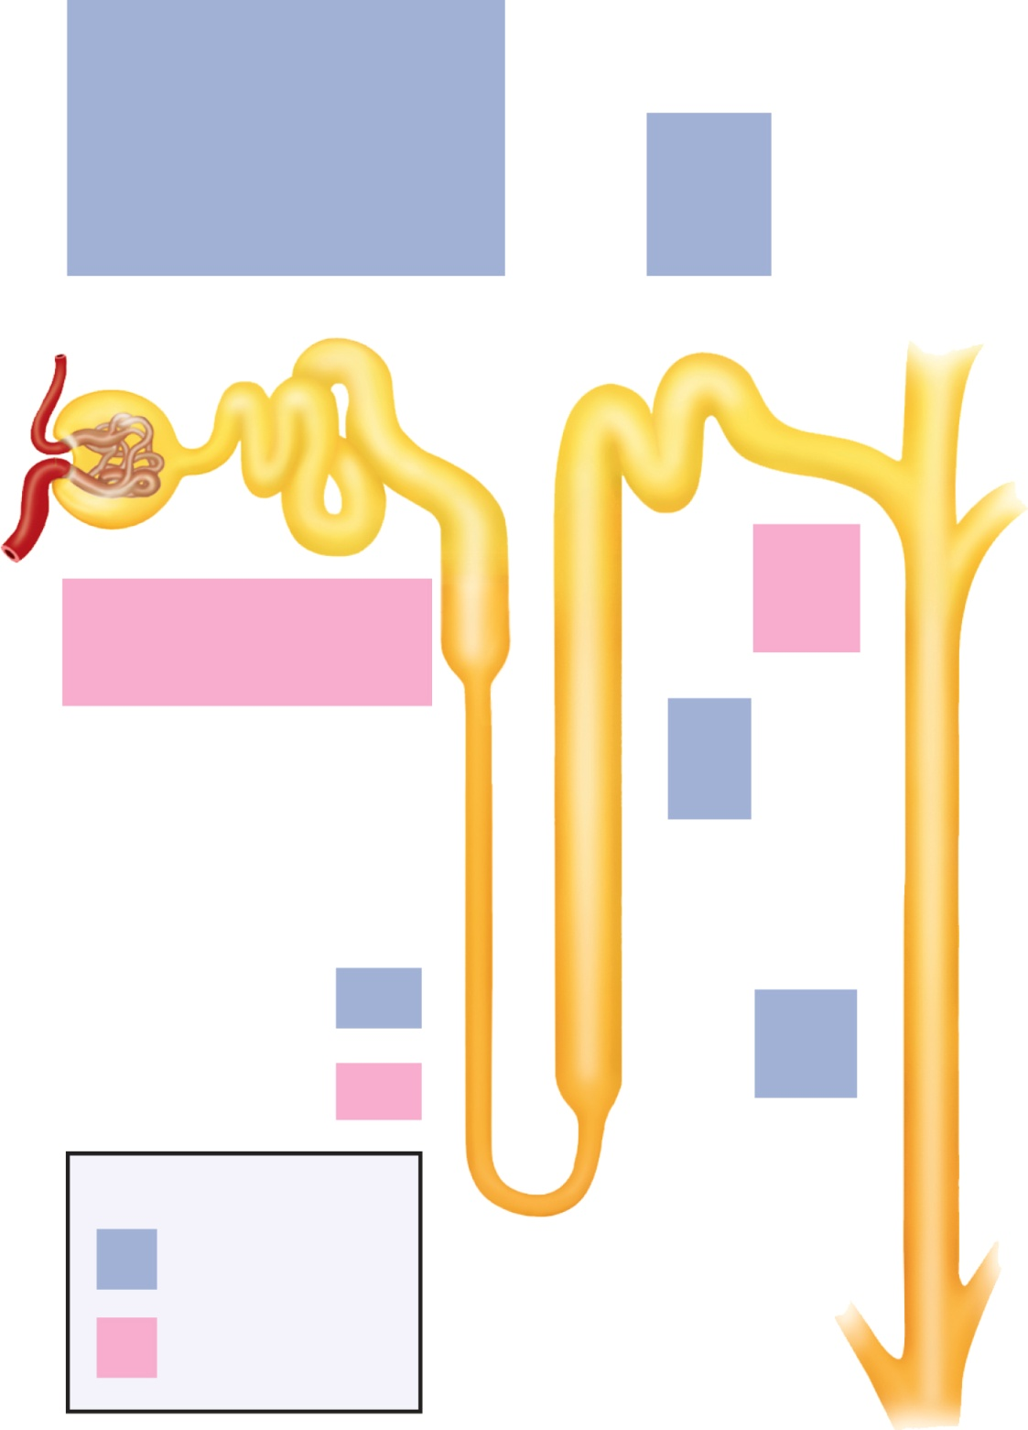
Fig. 23.22
Copyright © McGraw-Hill Education. Permission required for reproduction or display.
Glucose
Na⁺
Amino acids
K⁺
Protein
Ca²⁺
Vitamins
Mg²⁺
Na⁺
Lactate
Cl–
Cl–
Urea
HCO₃–
HCO₃–
Uric acid
H₂O
H₂O
PCT
DCT
H⁺
Urea
Uric acid
Creatinine
H⁺
NH₄⁺
Some drugs
K⁺
NH₄⁺
Na⁺
Nephron loop:
K⁺
Cl–
Descending limb
Ascending limb
Collecting
duct
H₂O
H₂O
Urea
Urea
Key
Tubular
reabsorption
Tubular
secretion
Notes:
23

Slide 24
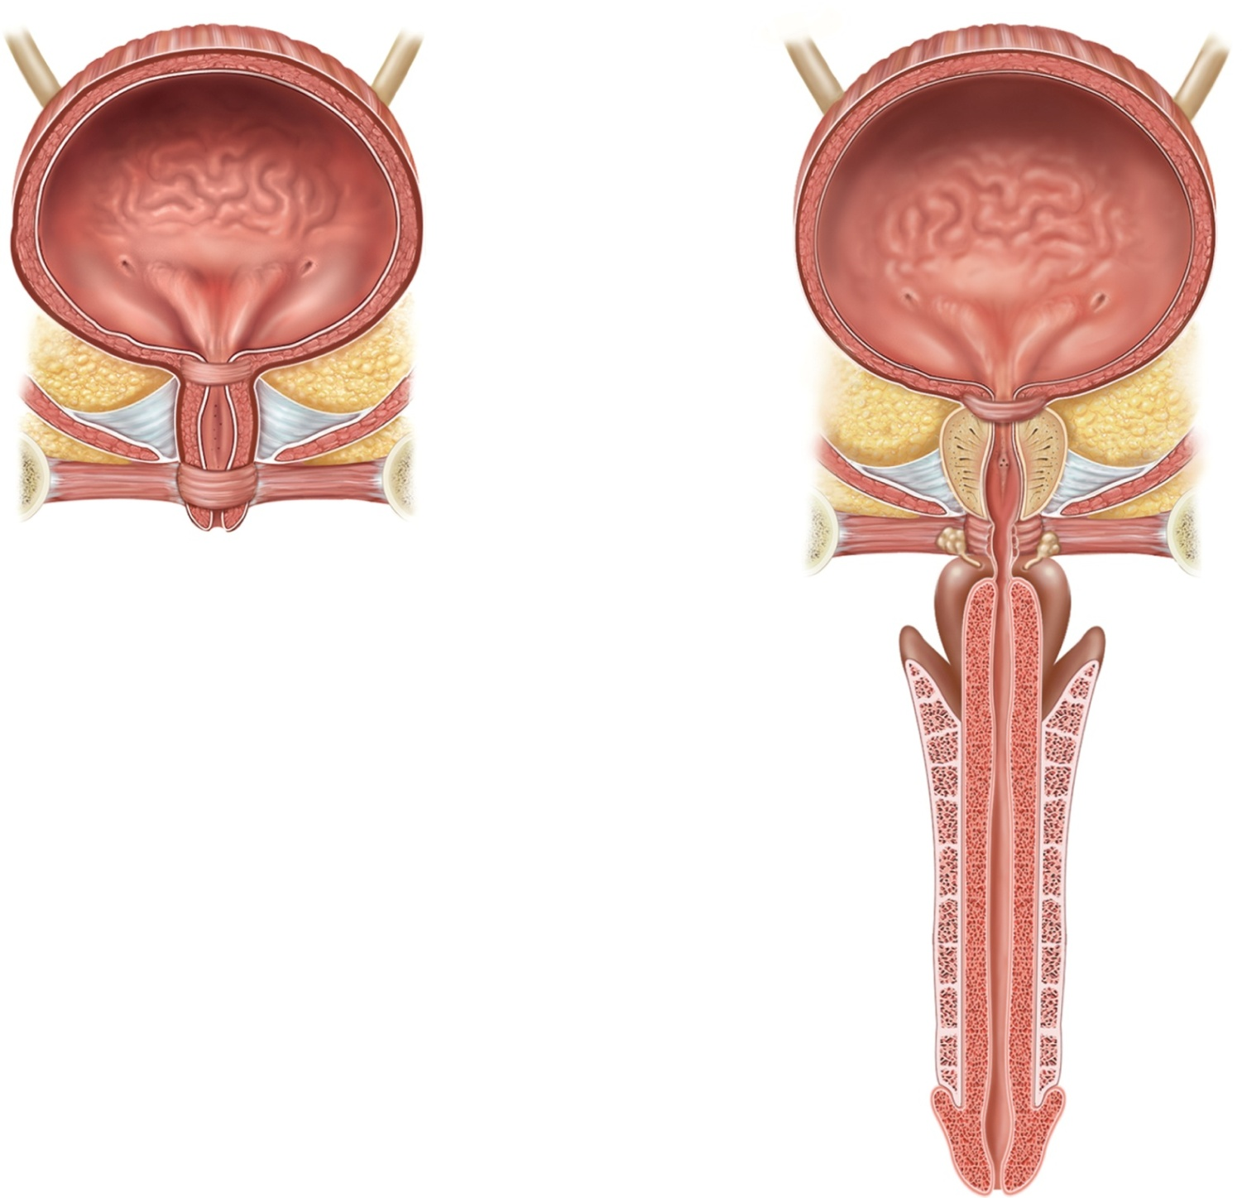
Fig. 23.23
Copyright © McGraw-Hill Education. Permission required for reproduction or display.
Ureter
Ureter
Detrusor
muscle
Rugae
Ureteral
openings
Detrusor
muscle
Ureteral
openings
Trigone
Internal urethral
sphincter
Trigone
Urethra
Internal urethral
sphincter
Prostate gland
Urogenital
diaphragm
Prostatic urethra
External urethral
orifice
External urethral
sphincter
Membranous
urethra
Urogenital
diaphragm
(a) Female
Bulbourethral
gland
External urethral
sphincter
Spongy (penile)
urethra
Penis
External urethral orifice
(b) Male
Notes:
24

Slide 25
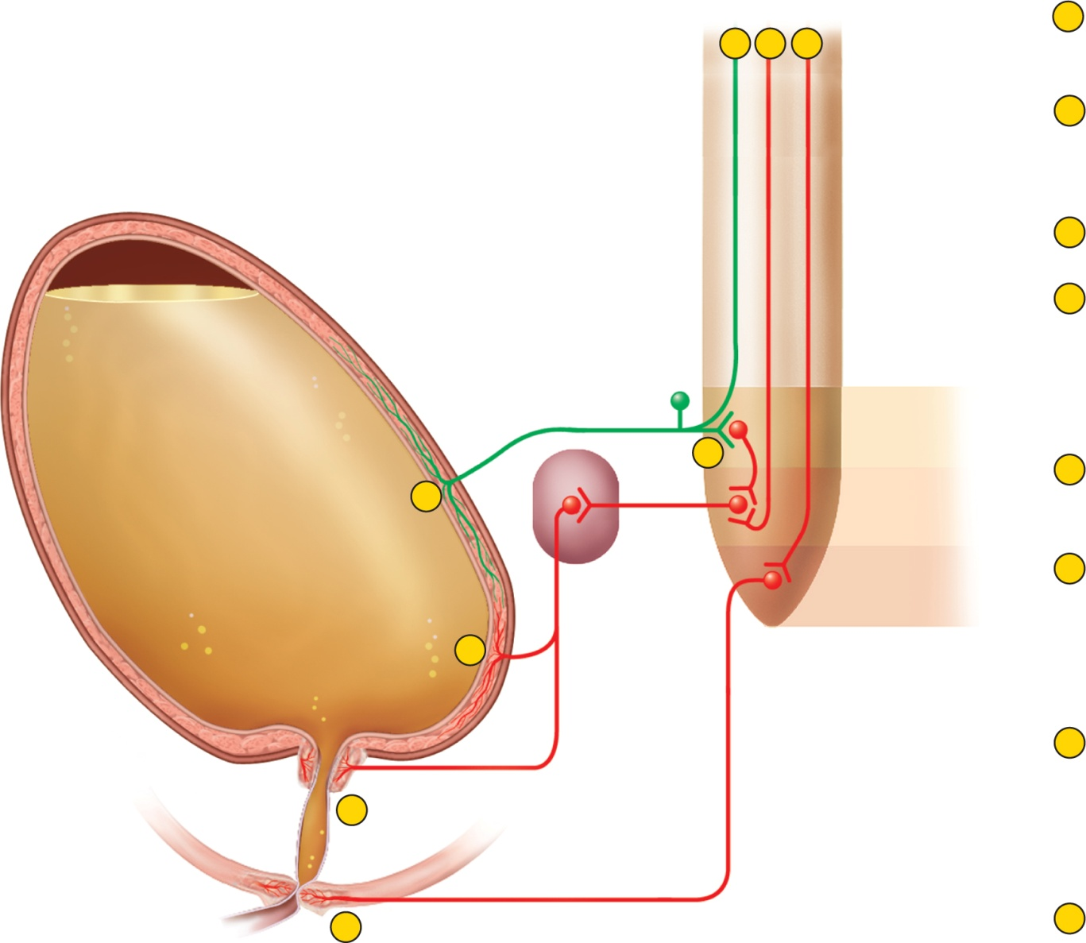
Fig. 23.24
Copyright © McGraw-Hill Education. Permission required for reproduction or display.
From pons
Involuntary micturition reflex
To pons
and cerebrum
From
cerebral cortex
1
Stretch receptors detect filling of
bladder, transmit afferent
signals to spinal cord.
5
6
7
2
Signals return to bladder from
spinal cord segments S2 and S3
via parasympathetic fibers in
pelvic nerve.
Pelvic nerve
3
Efferent signals excite
detrusor muscle.
Sensory
fiber
Motor
fiber
Full
urinary bladder
4
Efferent signals relax internal
urethral sphincter. Urine is
involuntarily voided if not
inhibited by brain.
Sacral segments
of spinal cord
S2
Voluntary control
2
5
For voluntary control, micturition
center in pons receives signals
from stretch receptors.
1
S3
Para-
sympathetic
ganglion in
bladder wall
S4
6
If it is timely to urinate, pons returns signals to
spinal interneurons that
excite detrusor and relax internal urethral sphincter. Urine is voided.
3
Stretch receptors
7
If it is untimely to urinate,
signals from cerebrum excite
spinal interneurons that
keep external urethral
sphincter contracted. Urine
is retained in bladder.
Motor fibers to
detrusor muscle
4
Internal urethral
sphincter (involuntary)
Urethra
External urethral
sphincter (voluntary)
8
Somatic motor fiber
of pudendal nerve
8
If it is timely to urinate, signals
from cerebrum inhibit sacral
neurons that keep external
sphincter closed. External urethral
sphincter relaxes and urine is
voided.
Notes:
25

