Slide 1
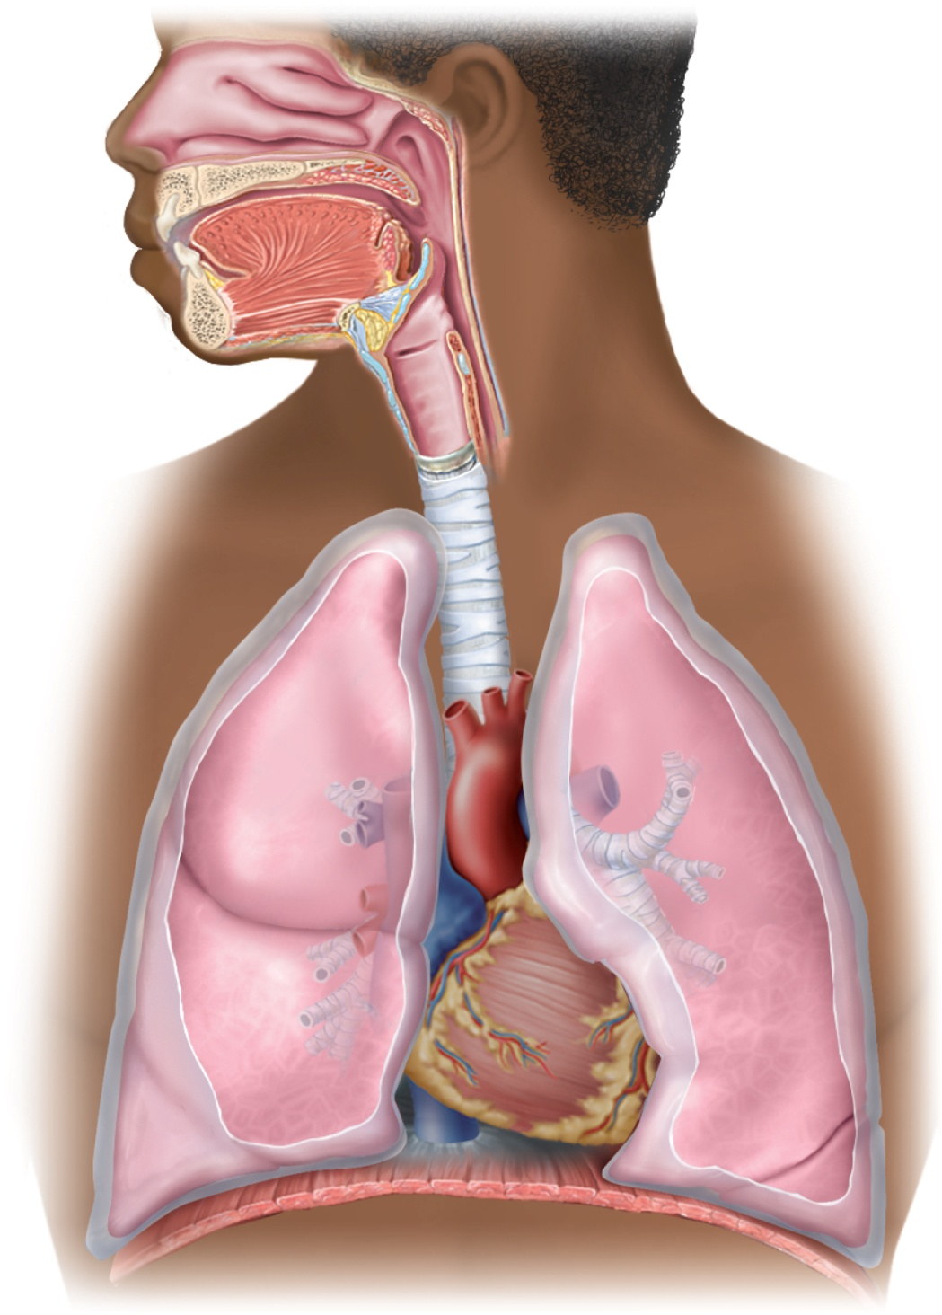
Fig. 22.1
Copyright © McGraw-Hill Education. Permission required for reproduction or display.
Nasal
cavity
Hard
palate
Posterior
nasal
aperture
Nostril
Soft palate
Epiglottis
Pharynx
Larynx
Esophagus
Trachea
Left lung
Left main
bronchus
Lobar
bronchus
Right lung
Segmental
bronchus
Pleural
cavity
Pleura
(cut)
Diaphragm

Slide 2
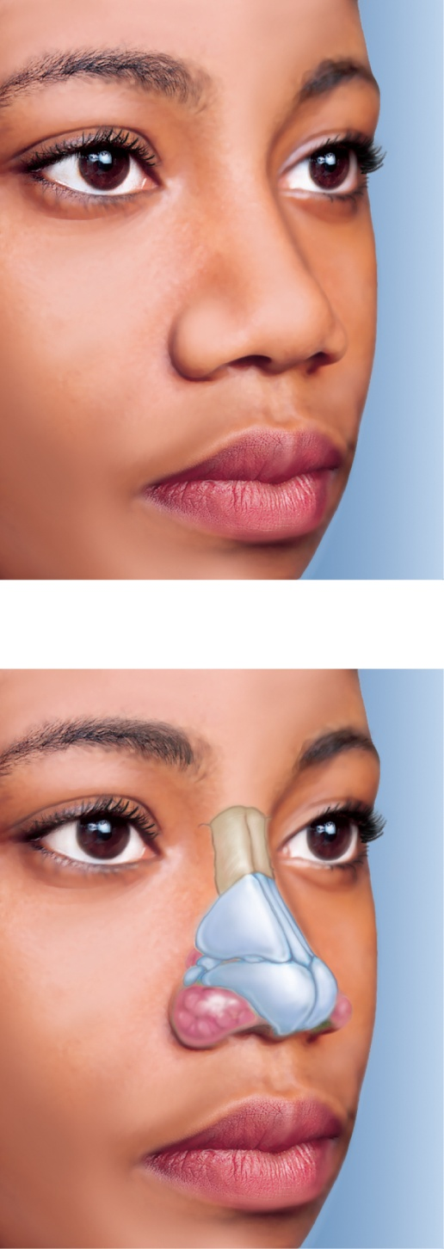
Fig. 22.2
Copyright © McGraw-Hill Education. Permission required for reproduction or display.
Root
Bridge
Dorsum nasi
Nasofacial angle
Apex
Ala nasi
Naris (nostril)
Nasal septum
Philtrum
Alar nasal sulcus
(a)
Nasal bone
Lateral cartilage
Septal nasal
cartilage
Minor alar
cartilages
Major alar
cartilages
Dense connective
tissue
(b)
a-b: ©McGraw-Hill Education/Joe DeGrandis
Notes:
2

Slide 3
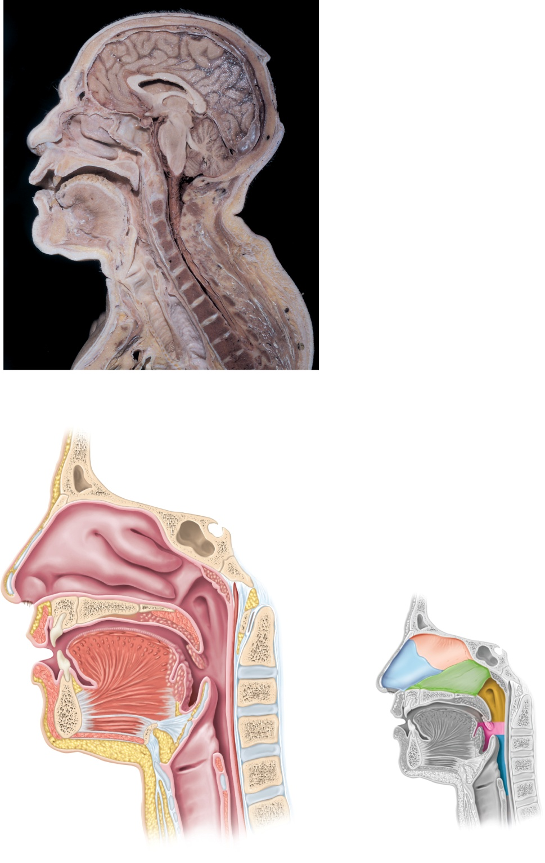
Fig. 22.3
Copyright © McGraw-Hill Education. Permission required for reproduction or display.
Frontal sinus
Cribriform plate
Nasal conchae:
Auditory tube
Superior
Sites of respiratory control nuclei:
Middle
Inferior
Pons
Meatuses
Medulla oblongata
Nasopharynx
Hard palate
Uvula
Tongue
Oropharynx
Larynx:
Laryngopharynx
Epiglottis
Vestibular fold
Vocal cord
Trachea
Vertebral column
Esophagus
(a)
Frontal
sinus
Meatuses:
Superior
Nasal conchae:
Middle
Superior
Inferior
Sphenoid sinus
Middle
Posterior nasal
aperture
Vestibule
Inferior
Pharyngeal
tonsil
Guard hairs
Auditory
tube
Nasal septum:
Naris (nostril)
Perpendicular plate
Hard palate
Soft palate
Septal cartilage
Upper lip
Uvula
Vomer
Tongue
Palatine tonsil
Lower lip
Lingual tonsil
Pharynx:
Mandible
Epiglottis
Nasopharynx
Oropharynx
Vestibular fold
Laryngopharynx
Vocal cord
Larynx
Trachea
(b)
Esophagus
(c)
a: ©McGraw-Hill Education/Joe DeGrandis
Notes:
3

Slide 4
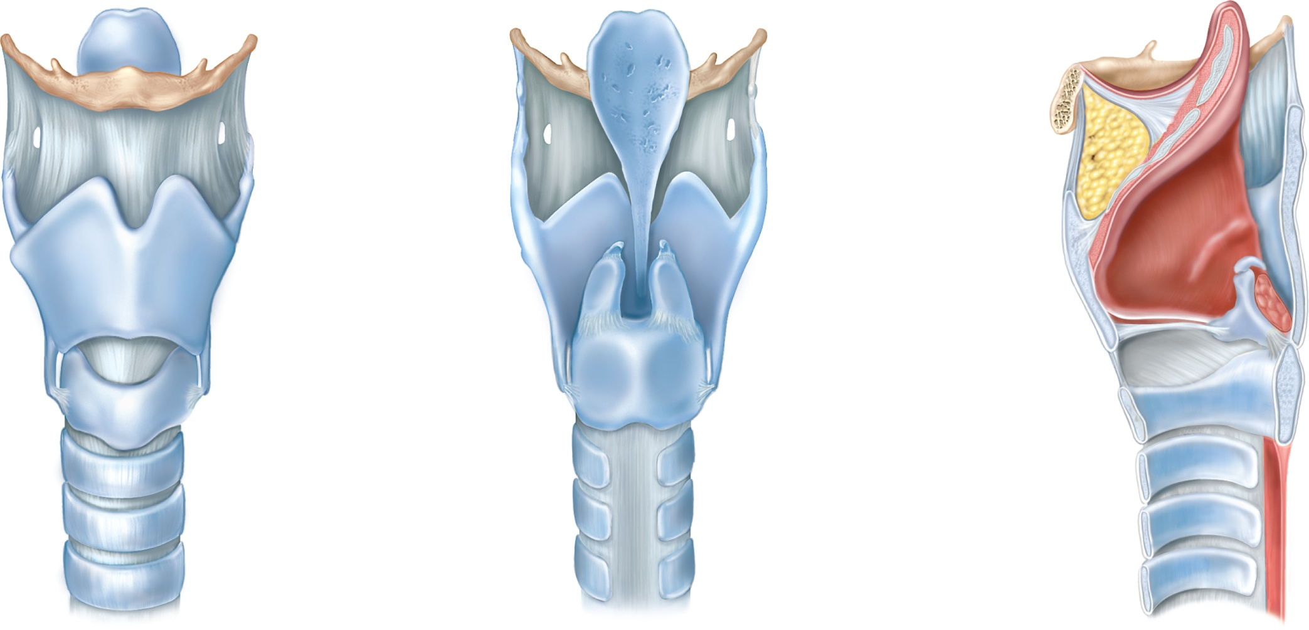
Fig. 22.4
Copyright © McGraw-Hill Education. Permission required for reproduction or display.
Epiglottic
cartilage
Epiglottis
Hyoid bone
Hyoid bone
Epiglottic cartilage
Thyrohyoid ligament
Fat pad
Thyroid cartilage
Thyroid cartilage
Laryngeal prominence
Cuneiform cartilage
Arytenoid cartilage
Corniculate cartilage
Vestibular fold
Cricoid cartilage
Vocal cord
Cricotracheal
ligament
Arytenoid cartilage
Arytenoid muscle
Trachea
Cricoid cartilage
Tracheal cartilage
(a) Anterior
(b) Posterior
(c) Median
Notes:
4

Slide 5
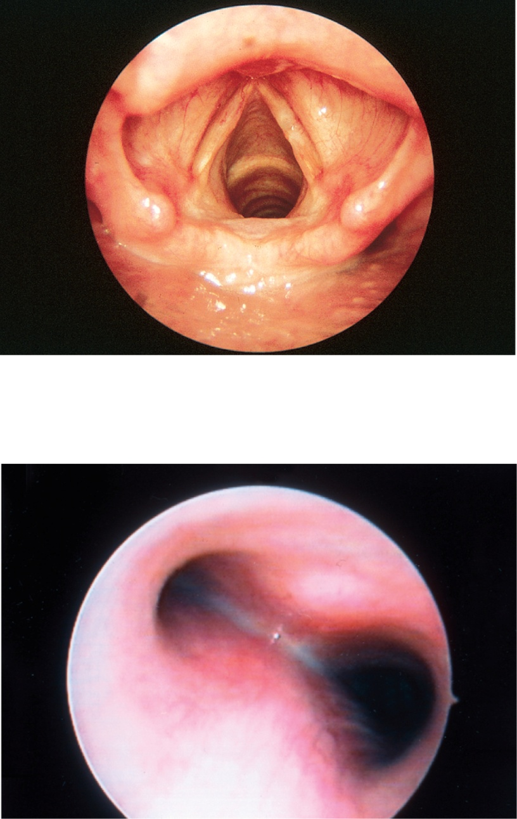
Fig. 22.5
Copyright © McGraw-Hill Education. Permission required for reproduction or display.
Anterior
Epiglottis
Glottis
Vestibular fold
Vocal cord
Trachea
Corniculate
cartilage
(a)
Posterior
Main
bronchi
Carina
Tracheal
mucosa
(b)
a: ©Phototake; b: ©J. Siebert/Custom Medical Stock Photo, Inc.
Notes:
5

Slide 6
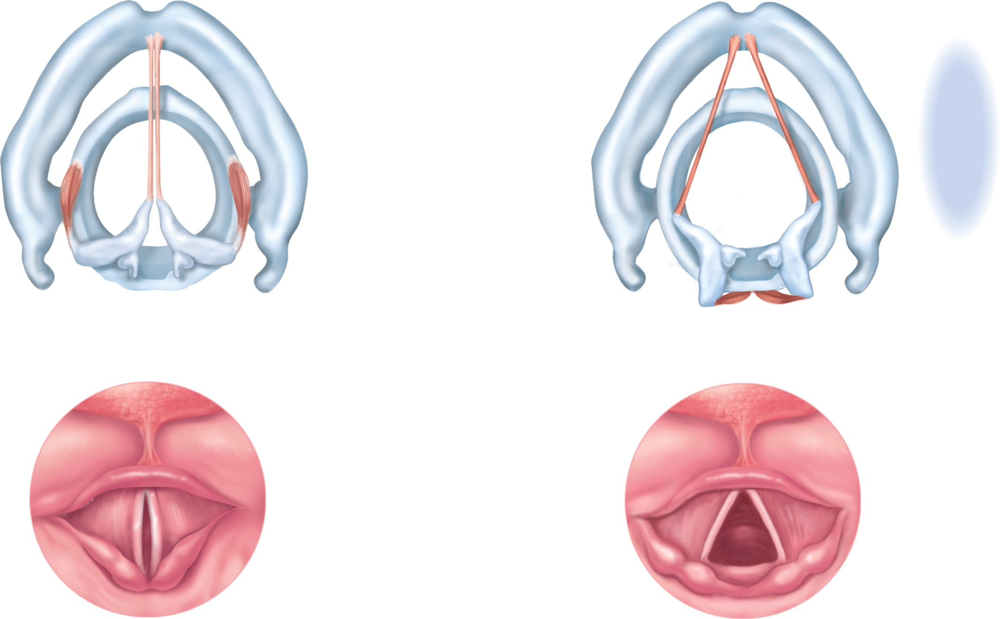
Fig. 22.6
Copyright © McGraw-Hill Education. Permission required for reproduction or display.
Adduction of vocal cords
Abduction of vocal cords
Thyroid cartilage
Cricoid cartilage
Anterior
Vocal cord
Lateral
cricoarytenoid muscle
Arytenoid cartilage
Posterior
Corniculate cartilage
Posterior
cricoarytenoid muscle
(a)
(c)
Base of tongue
Epiglottis
Vestibular fold
Vocal cord
Glottis
Corniculate
cartilage
(b)
(d)
Notes:
6

Slide 7
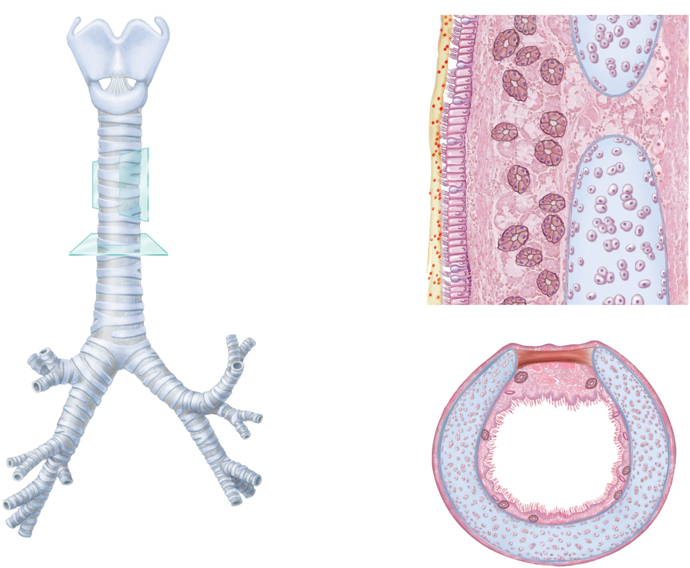


Fig. 22.7
Copyright © McGraw-Hill Education. Permission required for reproduction or display.
Mucus
Thyroid
cartilage
Mucociliary
escalator
Larynx
Cricoid
cartilage
Particles
of debris
Epithelium:
Goblet cell
Ciliated cell
Mucous gland
Trachea
Cartilage
Chondrocytes
(b)
Carina
Trachealis
muscle
Lobar
bronchi
Hyaline
cartilage ring
Main
bronchi
Lumen
Segmental
bronchi
Mucosa
Mucous gland
Perichondrium
(a)
(c)
Notes:
7

Slide 8
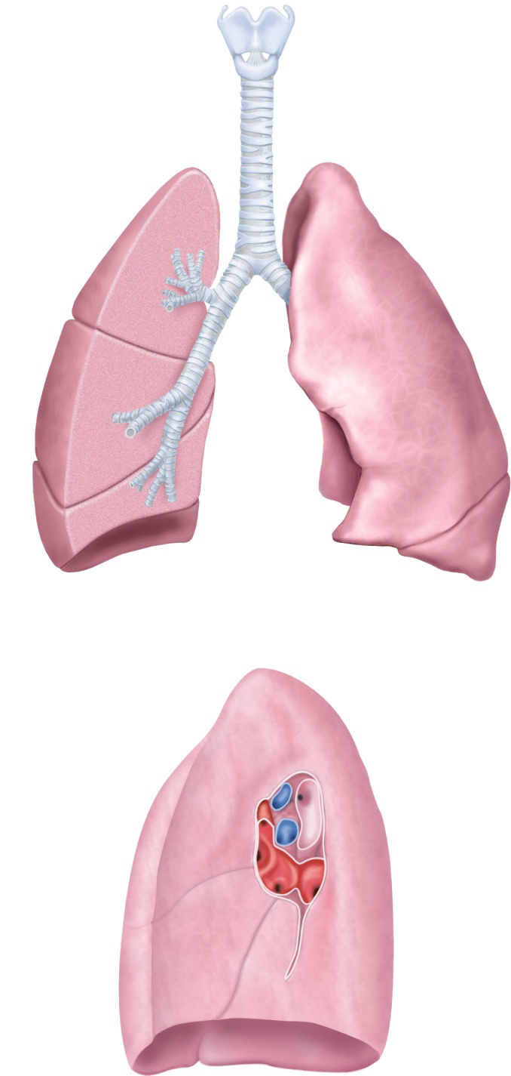
Fig. 22.9
Copyright © McGraw-Hill Education. Permission required for reproduction or display.
Larynx:
Thyroid cartilage
Cricoid cartilage
Trachea
Apex of lung
Main bronchi
Superior lobe
Superior lobar
bronchus
Horizontal fissure
Costal
surface
Middle lobar
bronchus
Superior
lobe
Middle lobe
Inferior lobar
bronchus
Cardiac
impression
Oblique fissure
Mediastinal
surfaces
Inferior lobe
Inferior lobe
Oblique
fissure
Base of lung
(a) Anterior view
Apex
Superior lobe
Pulmonary
arteries
Lobar bronchi
Pulmonary
veins
Hilum
Pulmonary
ligament
Middle lobe
Inferior lobe
Diaphragmatic
surface
(b) Mediastinal surface, right lung
Notes:
8

Slide 9
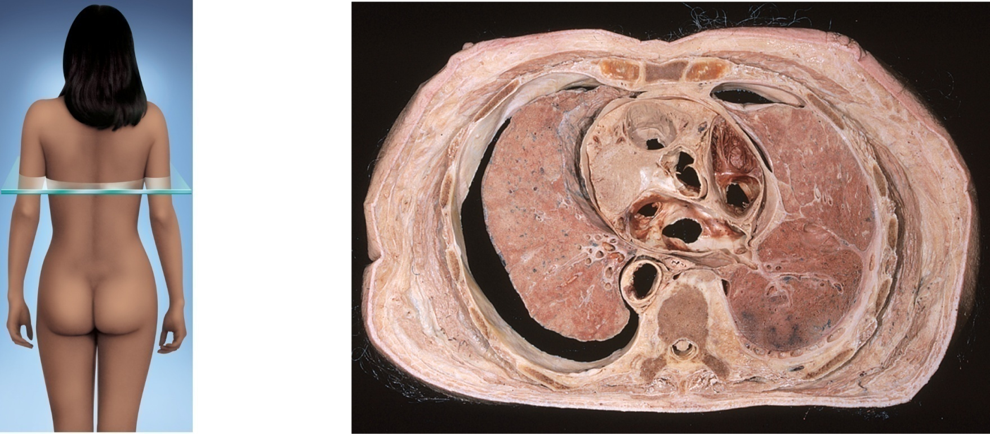
Fig. 22.10
Copyright © McGraw-Hill Education. Permission required for reproduction or display.
Anterior
Breast
Sternum
Pericardial
cavity
Ribs
Heart
Left lung
Right lung
Visceral
pleura
Aorta
Pleural cavity
Vertebra
Parietal
pleura
Spinal cord
Posterior
©Ralph Hutchings/Visuals Unlimited
Notes:
9

Slide 10
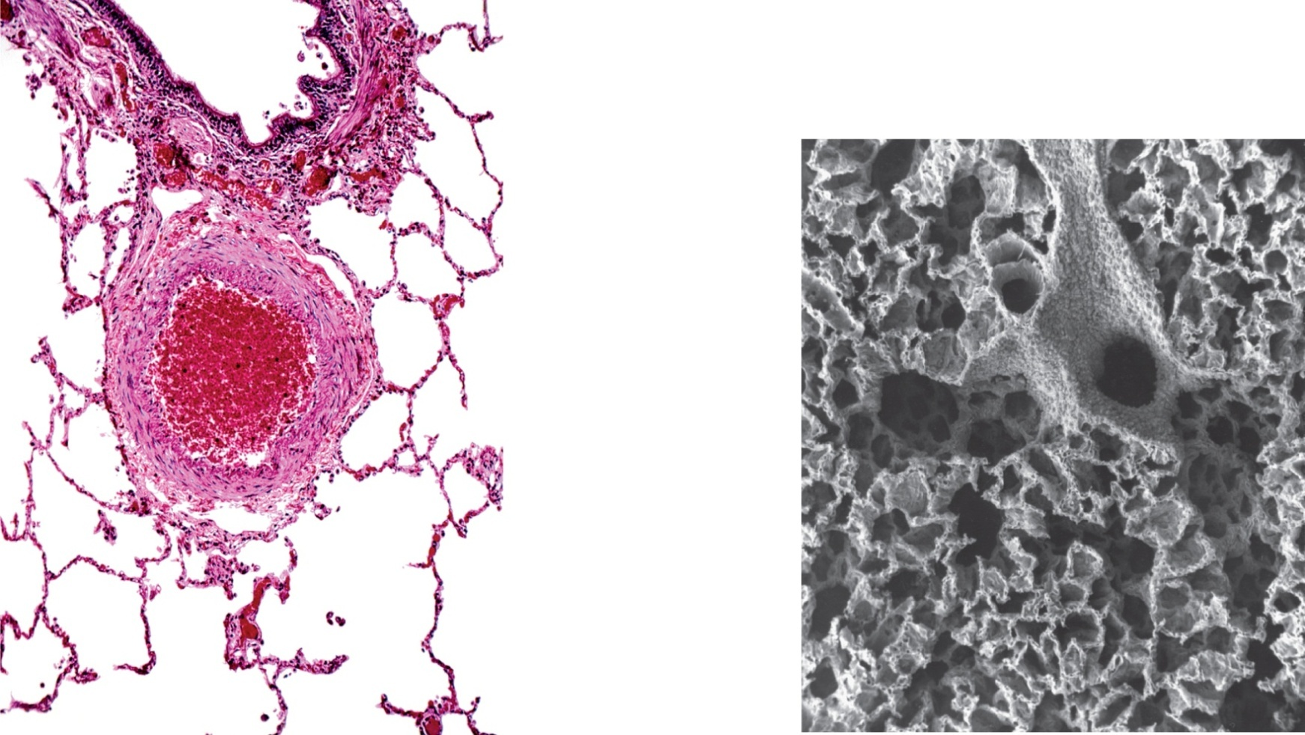
Fig. 22.11
Copyright © McGraw-Hill Education. Permission required for reproduction or display.
Bronchiole:
Epithelium
Smooth muscle
Alveoli
Terminal bronchiole
Pulmonary arteriole
Branch of
pulmonary artery
Respiratory bronchiole
Alveolar duct
Alveolar duct
Alveoli
(a)
1 mm
(b)
1 mm
a: ©Dr. Gladden Willis/Visuals Unlimited; b: ©Visuals Unlimited
Notes:
10

Slide 11
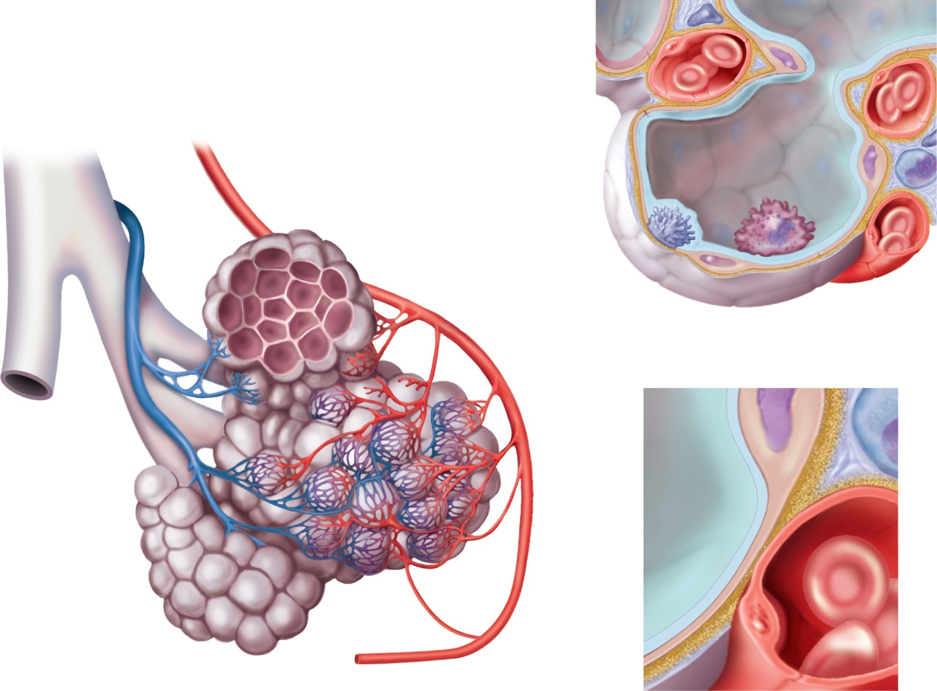


Fig. 22.12
Copyright © McGraw-Hill Education. Permission required for reproduction or display.
Respiratory membrane
Capillary endothelial cell
Bronchiole
Fluid with surfactant
Pulmonary arteriole
Pulmonary venule
Squamous alveolar cell
Lymphocyte
Alveoli
Alveolar sac
(b)
Great
alveolar
cell
Alveolar
macrophage
Capillary
networks
around
alveoli
Terminal
bronchiole
Respiratory
bronchiole
Air
Respiratory membrane:
CO₂
Squamous alveolar cell
Shared basement membrane
O₂
Capillary endothelial cell
(a)
Blood
(c)
Notes:
11

Slide 12
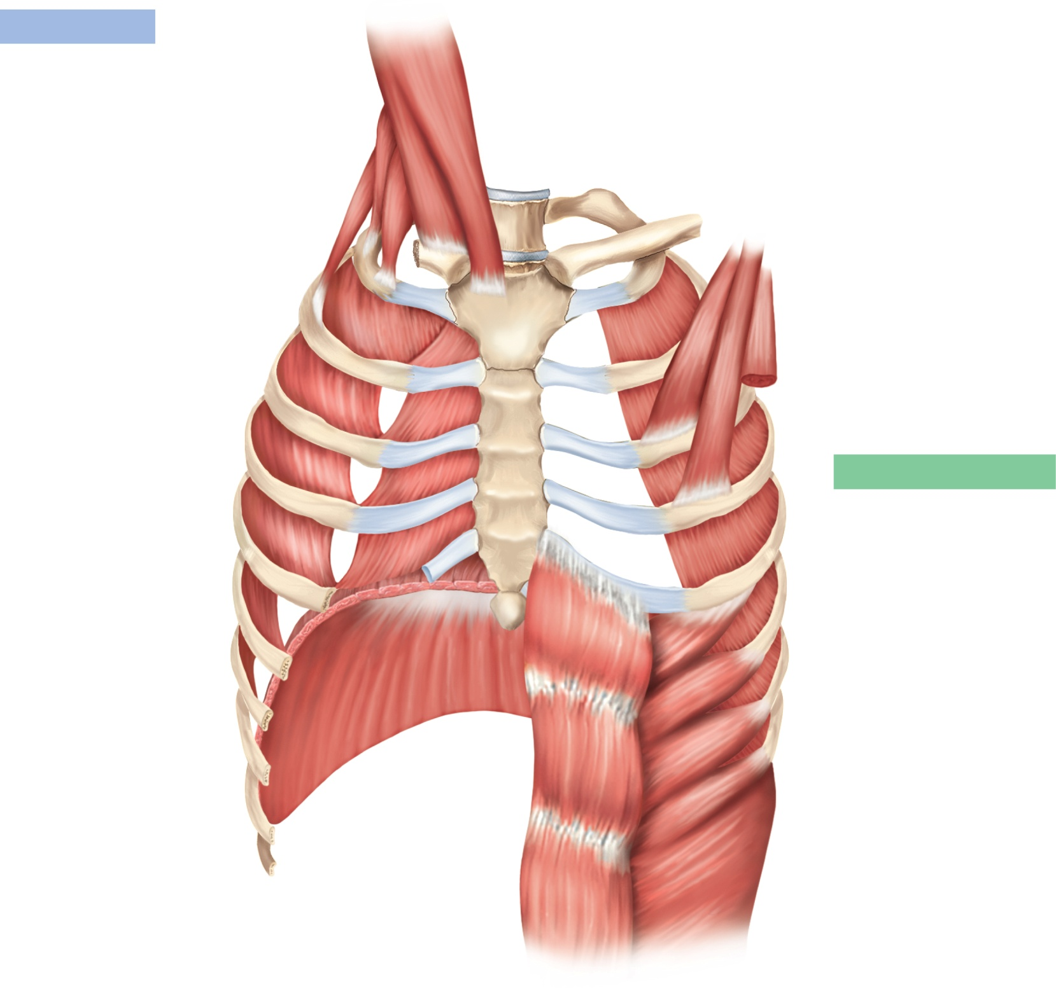
Fig. 22.13
Copyright © McGraw-Hill Education. Permission required for reproduction or display.
Inspiration
Sternocleidomastoid
(elevates sternum)
Scalenes
(fix or elevate ribs 1–2)
External intercostals
(elevate ribs 2–12,
widen thoracic cavity)
Pectoralis minor (cut)
(elevates ribs 3–5)
Forced expiration
Internal intercostals,
interosseous part
(depress ribs 1–11,
narrow thoracic cavity)
Internal intercostals,
intercartilaginous part
(aid in elevating ribs)
Diaphragm
(ascends and
reduces depth
of thoracic cavity)
Diaphragm
(descends and
increases depth
of thoracic cavity)
Rectus abdominis
(depresses lower ribs,
pushes diaphragm upward
by compressing
abdominal organs)
External abdominal oblique
(same effects as
rectus abdominis)
Notes:
12

Slide 13
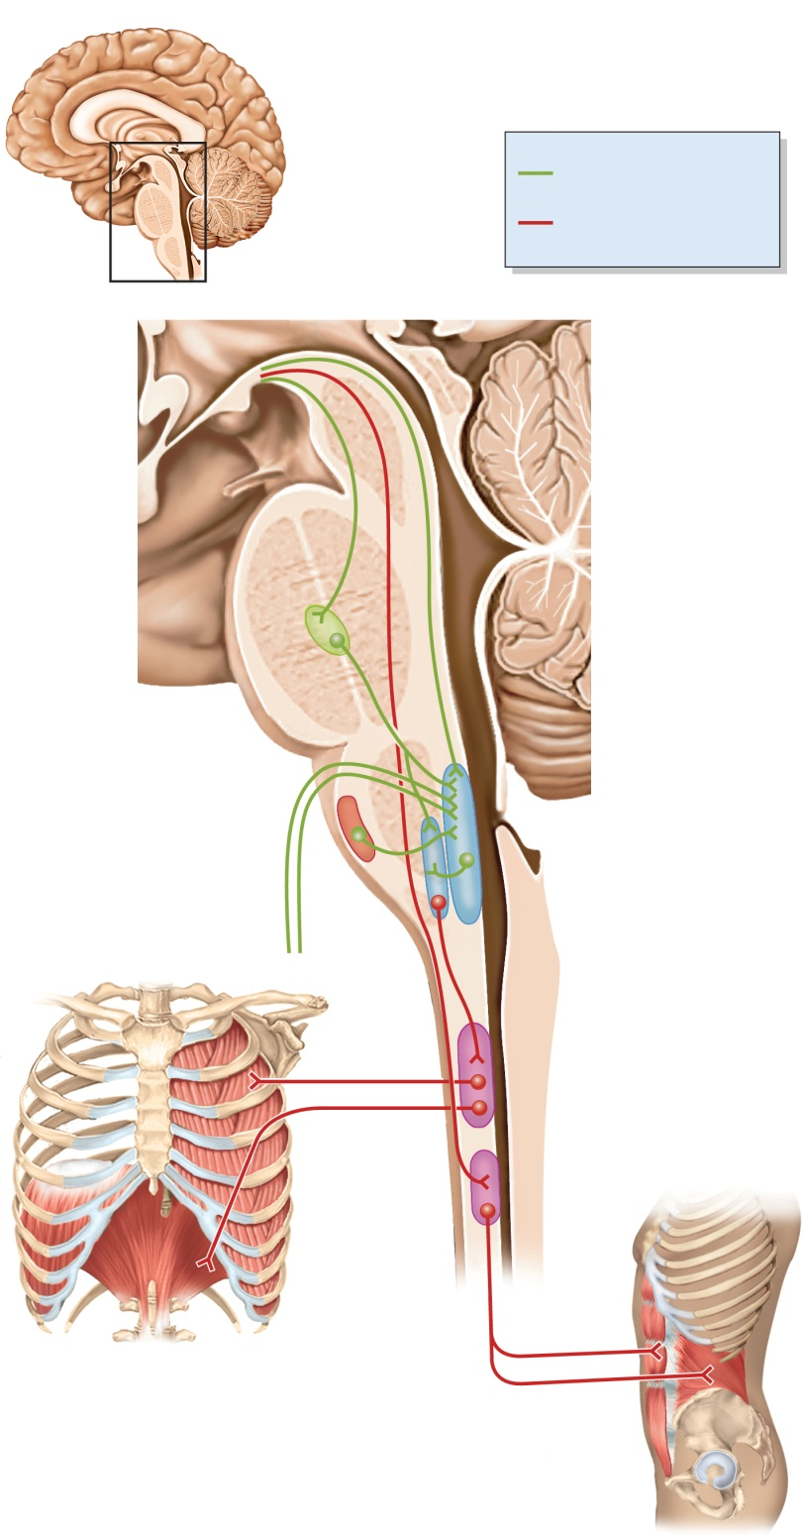

Fig. 22.14
Copyright © McGraw-Hill Education. Permission required for reproduction or display.
Key
Inputs to respiratory
centers of medulla
Outputs to spinal centers
and respiratory muscles
Output from
hypothalamus,
limbic system, and
higher brain centers
Pons
Pontine respiratory
group (PRG)
Central chemoreceptors
Dorsal respiratory
group (DRG)
Glossopharyngeal n.
Ventral respiratory
group (VRG)
Vagus n.
Medulla oblongata
Intercostal
nn.
Spinal integrating
centers
Phrenic n.
Diaphragm and intercostal muscles
Accessory muscles
of respiration
Notes:
13

Slide 14
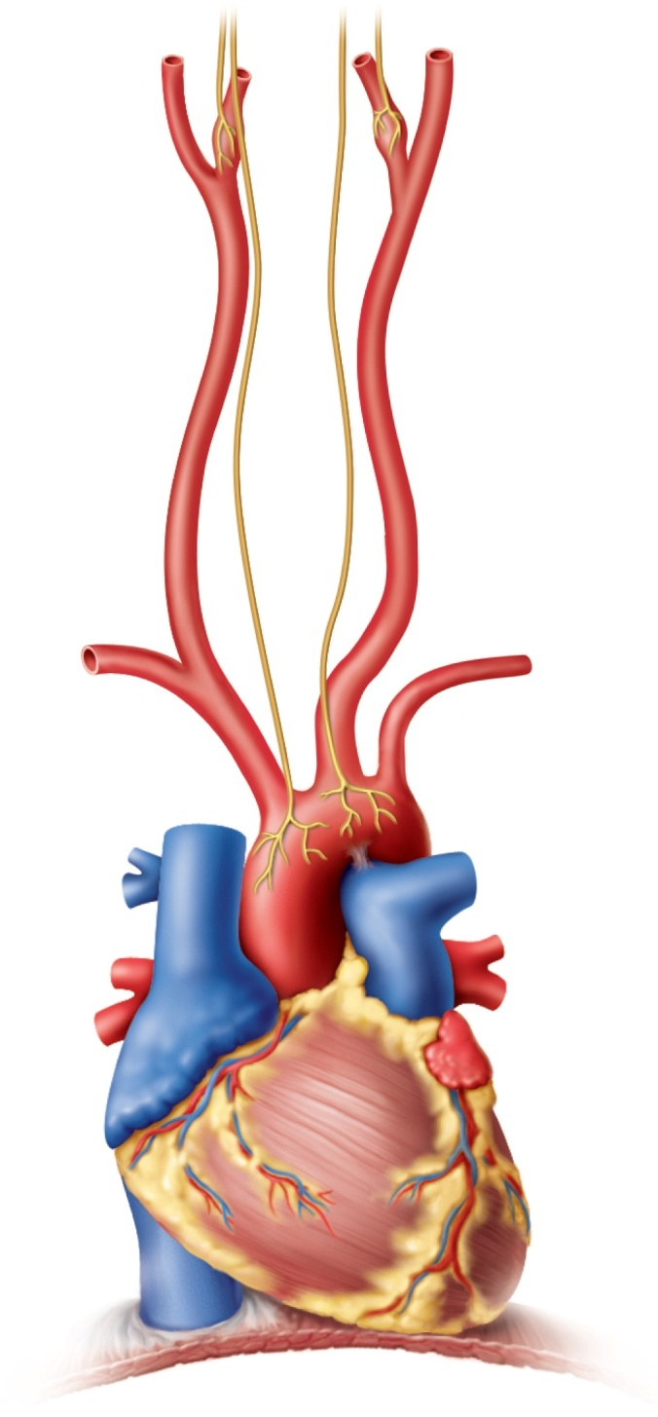
Fig. 22.15
Copyright © McGraw-Hill Education. Permission required for reproduction or display.
Sensory nerve fiber
in glossopharyngeal
nerve
Carotid body
Sensory nerve fibers
in vagus nerves
Common carotid artery
Aortic bodies
Aorta
Heart
Notes:
14

Slide 15
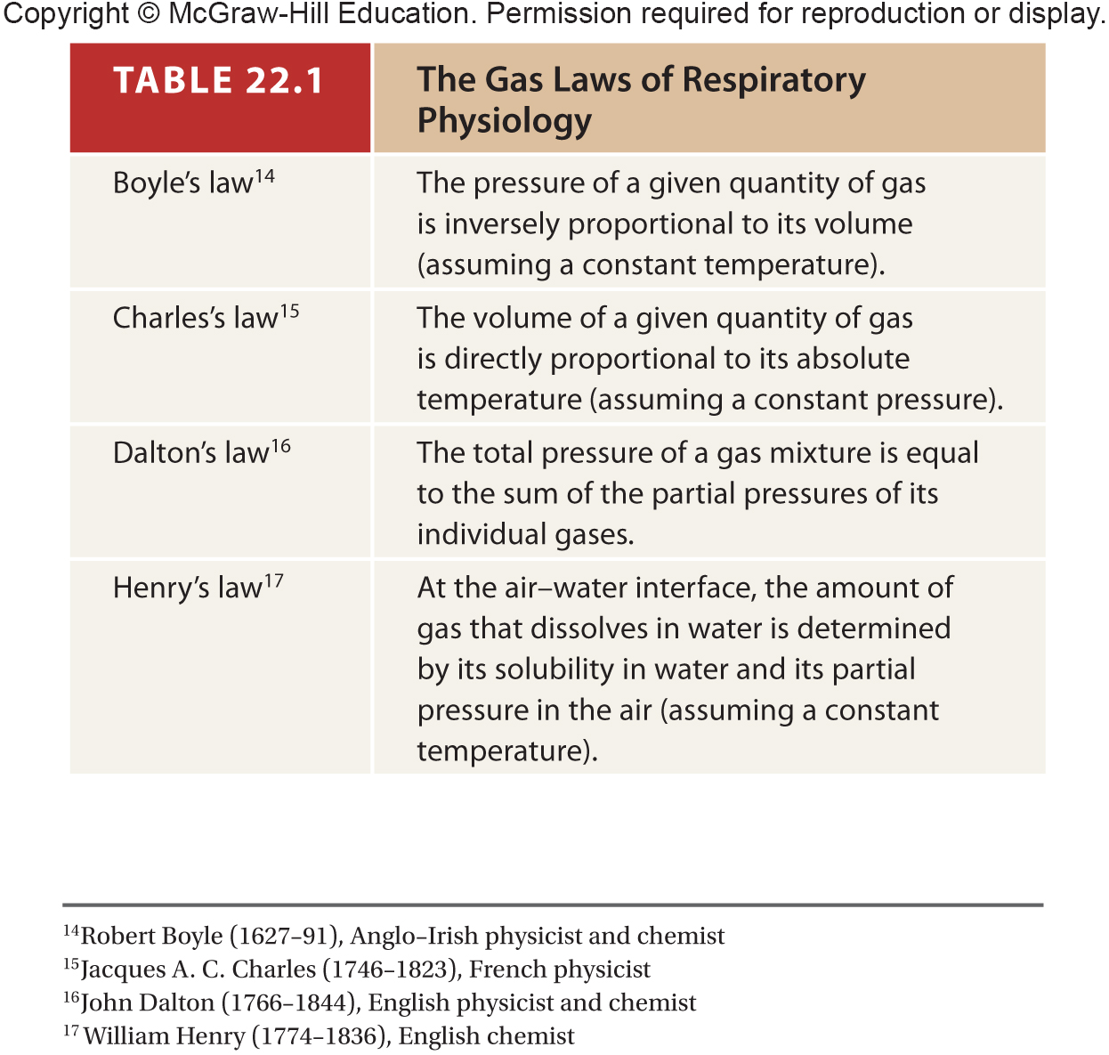
Table 22.1
Notes:
15

Slide 16
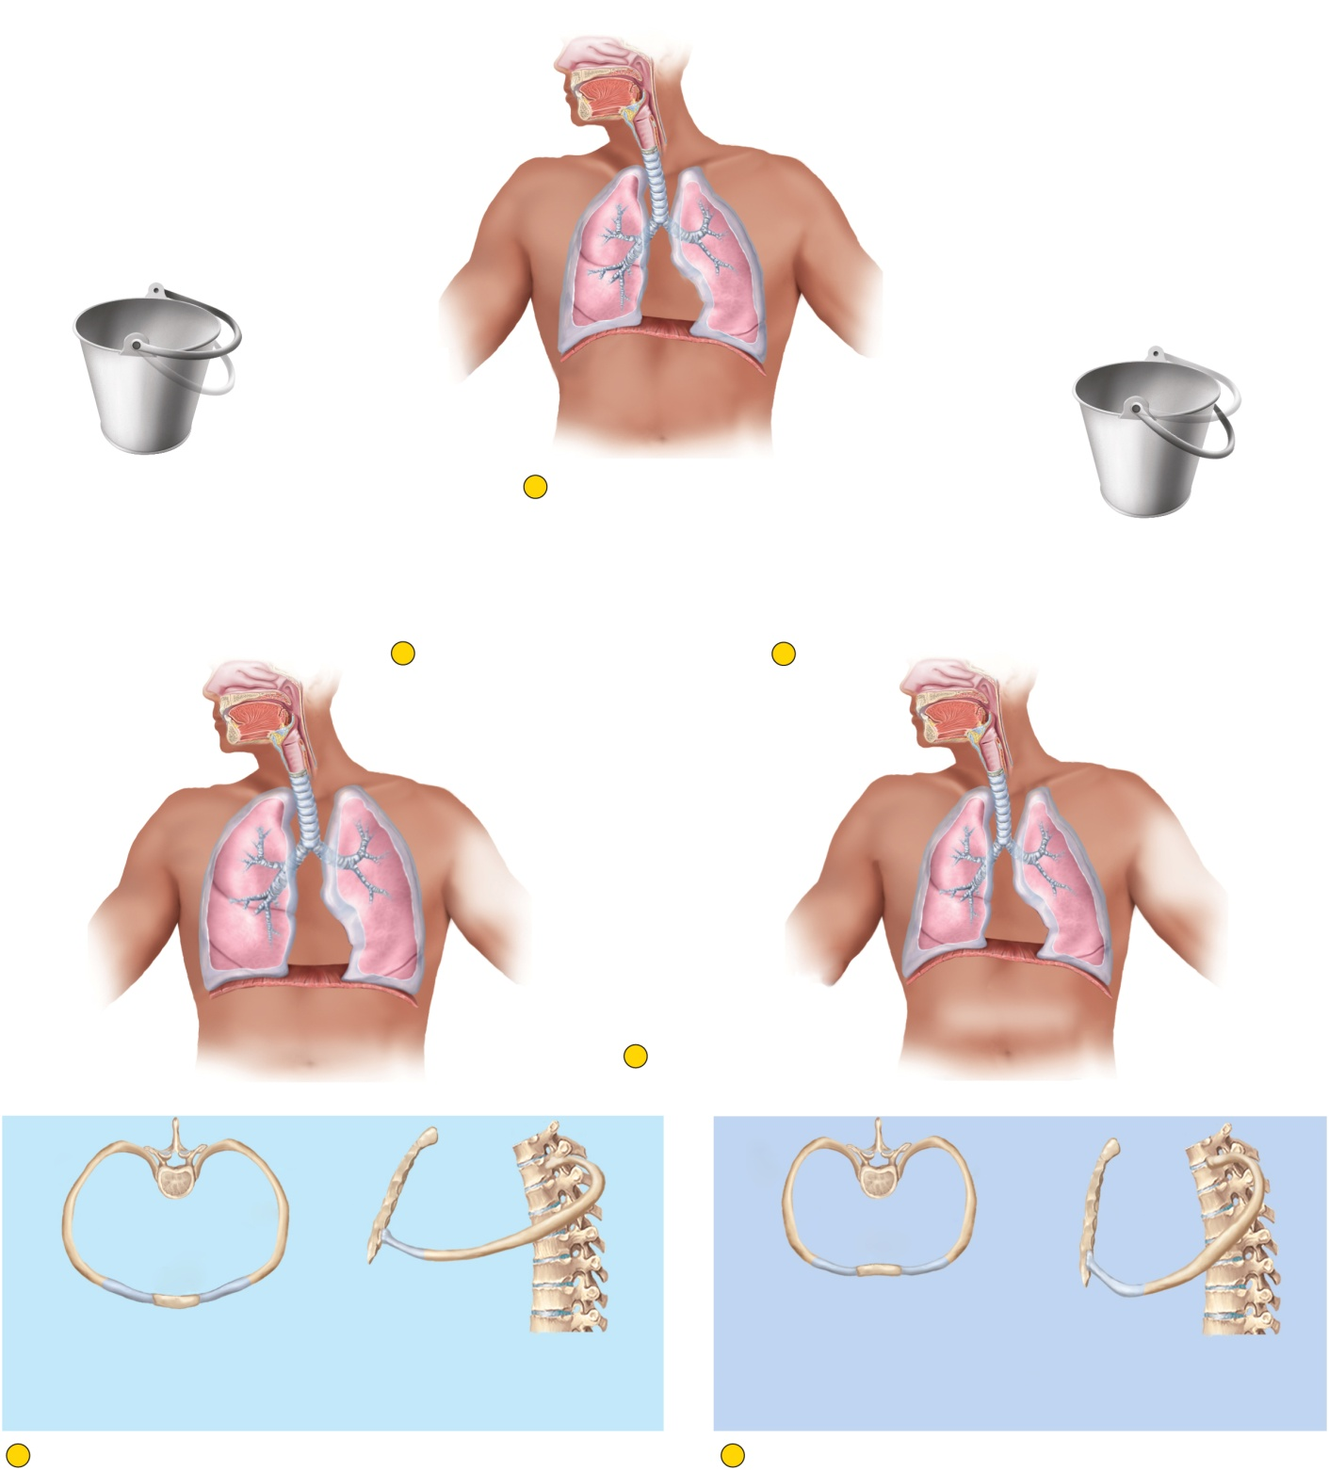







Fig. 22.16
Copyright © McGraw-Hill Education. Permission required for reproduction or display.
No airflow
Pleural cavity
Intrapulmonary pressure 0 cm H₂O
Diaphragm
Intrapleural pressure –5 cm H₂O
Ribs swing upward
like bucket handles
during inspiration.
1
At rest, atmospheric and
intrapulmonary pressures
are equal, and there is
no airflow.
Ribs swing downward
like bucket handles
during expiration.
2
Inspiration
4
Pause
Airflow
Airflow
Intrapleural
pressure –8 cm H₂O
Intrapleural
pressure –5 cm H₂O
Intrapulmonary
pressure –1 cm H₂O
Intrapulmonary
pressure +1 cm H₂O
Diaphragm rises
Diaphragm flattens
3
Expiration
Rib
Rib
Rib
Rib
Sternum
Sternum
Sternum
Sternum
Ribs elevated, thoracic
cavity expands laterally
Sternum swings up,
thoracic cavity expands
anteriorly
Ribs depressed, thoracic
cavity narrows
Sternum swings down,
thoracic cavity contracts
posteriorly
2
In inspiration, the thoracic cavity expands laterally, vertically,
and anteriorly; intrapulmonary pressure drops 1 cm H₂O below
atmospheric pressure, and air flows into the lungs.
3
In expiration, the thoracic cavity contracts in all three directions;
intrapulmonary pressure rises 1 cm H₂O above atmospheric
pressure, and air flows out of the lungs.
Notes:
16

Slide 17
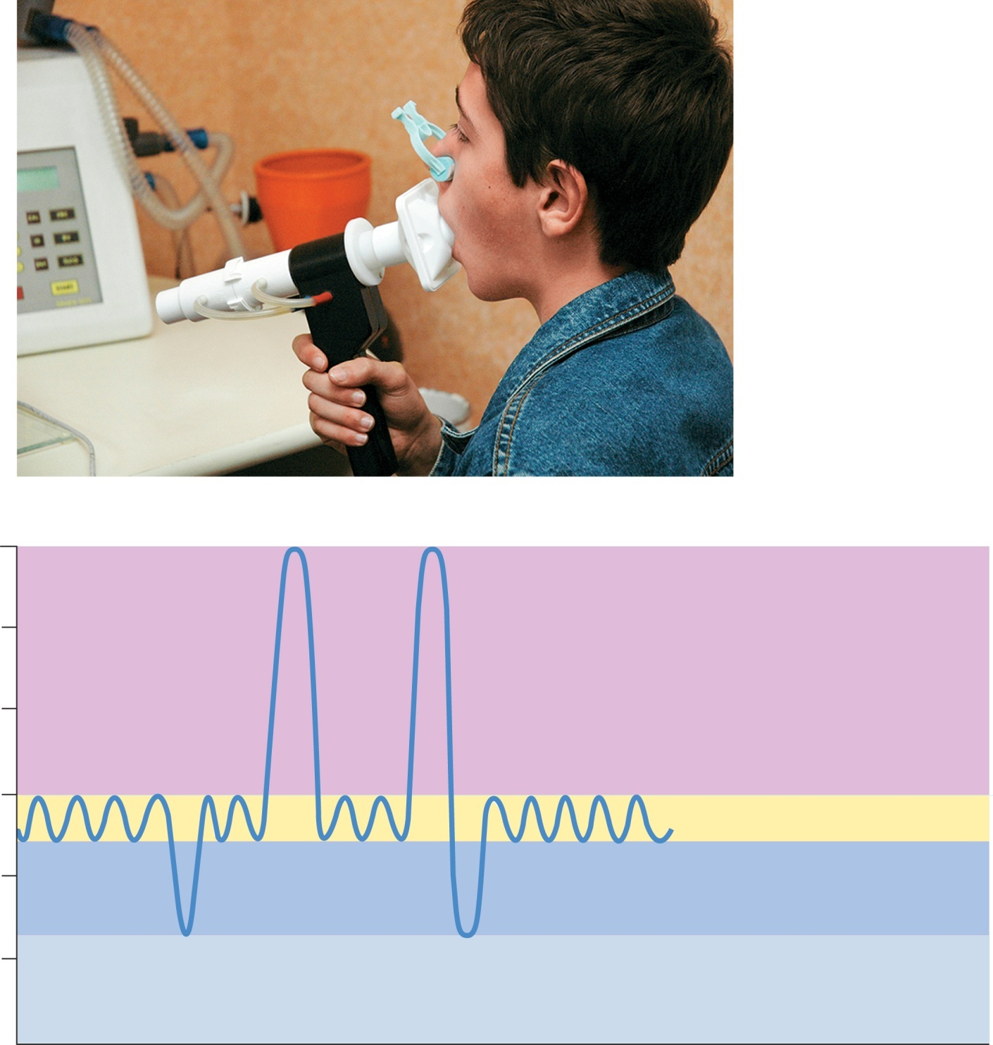
Fig. 22.17
Copyright © McGraw-Hill Education. Permission required for reproduction or display.
(a)
6,000
Maximum possible inspiration
5,000
Inspiratory
reserve volume
Vital capacity
Inspiratory
capacity
4,000
Tidal
volume
3,000
Lung volume (mL)
Total lung capacity
2,000
Expiratory
reserve volume
1,000
Maximum voluntary
expiration
Residual
volume
Functional residual
capacity
0
(b)
a: ©BSIP/Science Source
Notes:
17

Slide 18
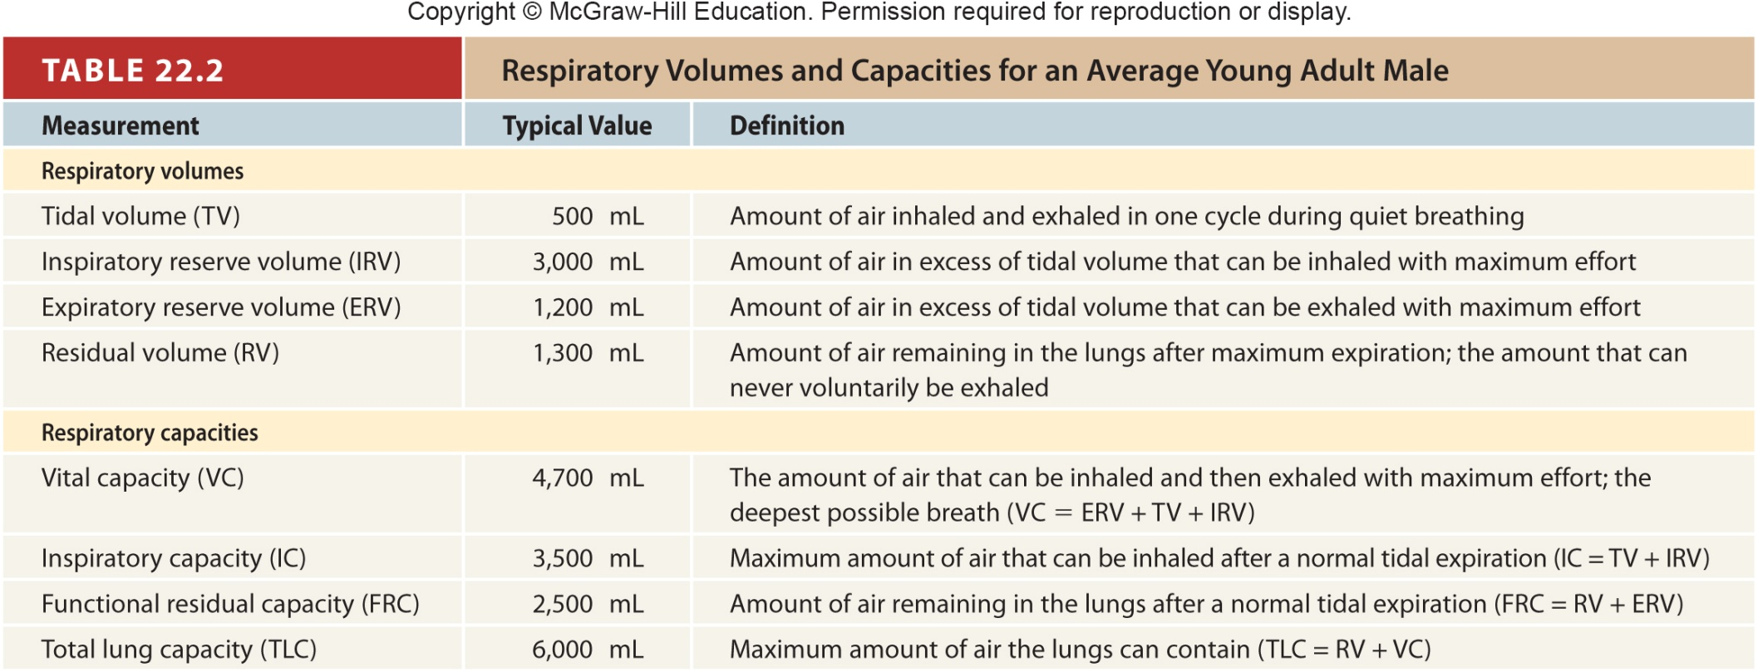
Table 22.2
Notes:
18

Slide 19
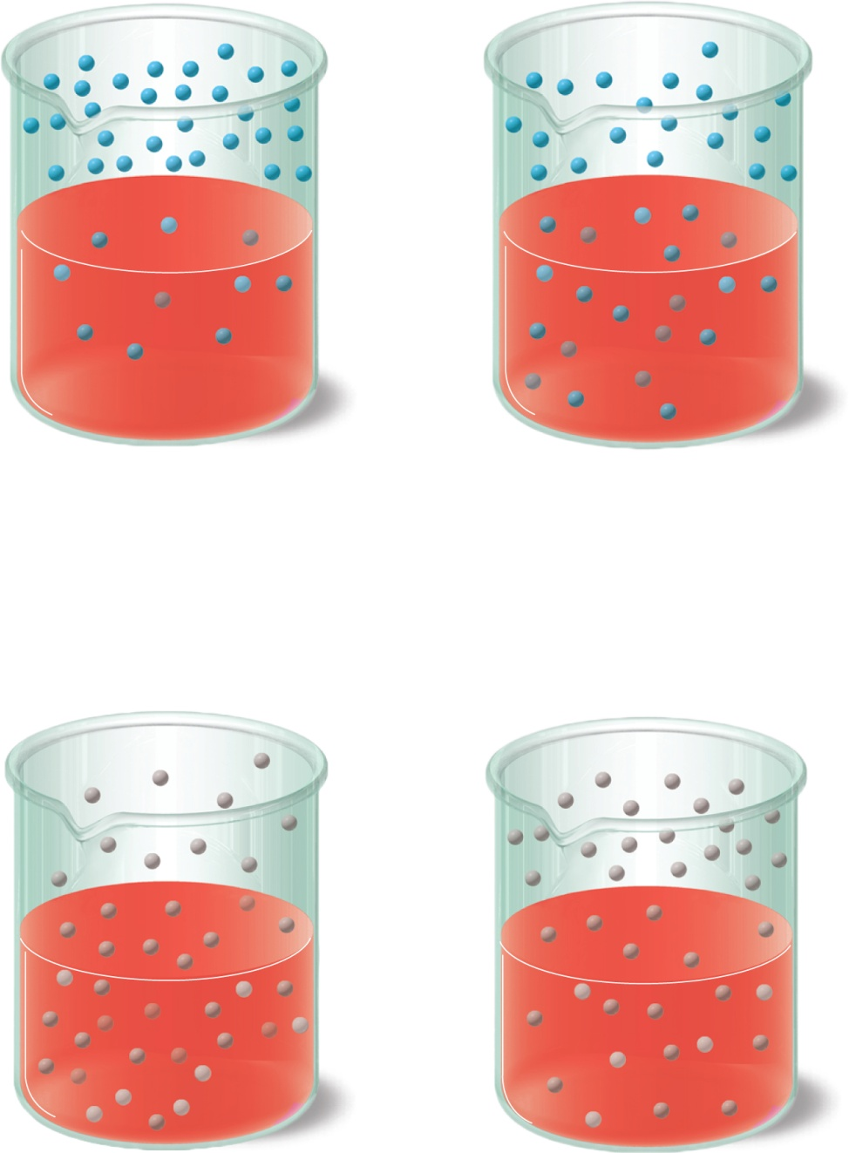
Fig. 22.18
Copyright © McGraw-Hill Education. Permission required for reproduction or display.
Air
Air
Time
Blood
Blood
Initial state
Equilibrium state
(a) Oxygen
Air
Air
Time
Blood
Blood
Initial state
Equilibrium state
(b) Carbon dioxide
Notes:
19

Slide 20
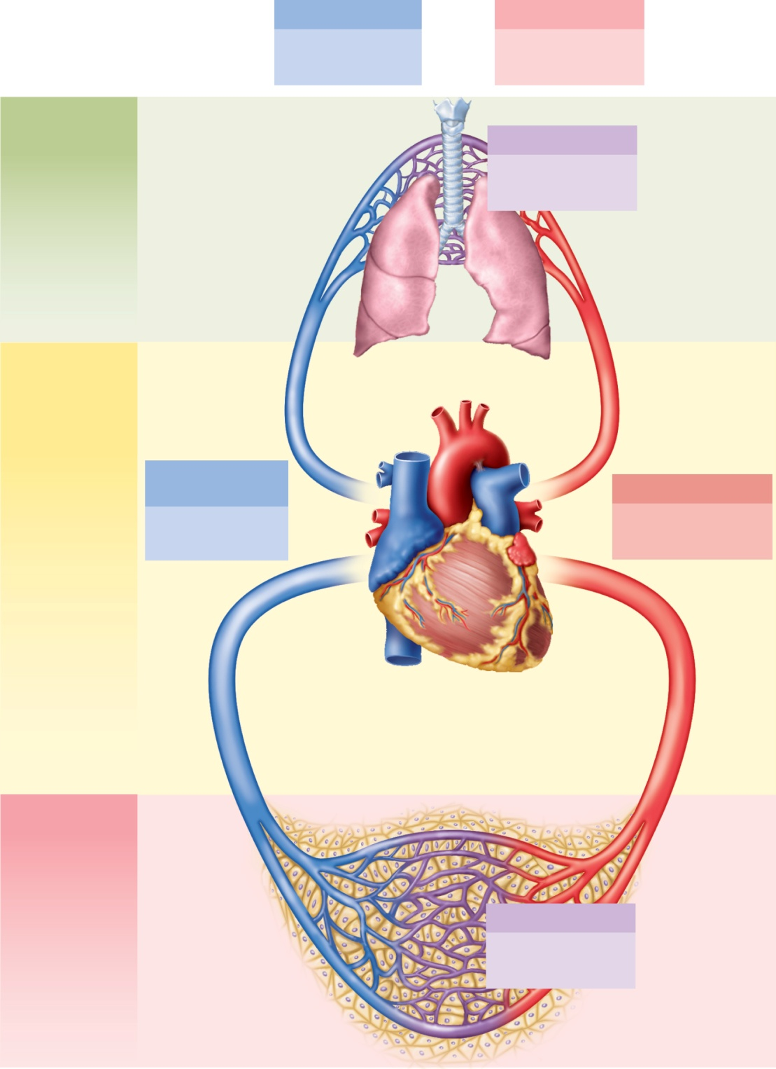
Fig. 22.19
Copyright © McGraw-Hill Education. Permission required for reproduction or display.
Expired air
Inspired air
Po₂ 116 mm Hg
Po₂ 159 mm Hg
Pco₂ 32 mm Hg
Pco₂ 0.3 mm Hg
Alveolar
gas exchange
Alveolar air
O₂ loading
Po₂ 104 mm Hg
CO₂ unloading
Pco₂ 40 mm Hg
CO2
O2
Gas transport
Pulmonary circuit
O₂ carried
from alveoli
to systemic
tissues
CO₂ carried
from systemic
tissues to
alveoli
Deoxygenated
blood
Oxygenated blood
Po₂ 40 mm Hg
Po₂ 95 mm Hg
Pco₂ 46 mm Hg
Pco₂ 40 mm Hg
Systemic circuit
Systemic
gas exchange
CO2
O2
O₂ unloading
CO₂ loading
Tissue fluid
Po₂ 40 mm Hg
Pco₂ 46 mm Hg
Notes:
20

Slide 21
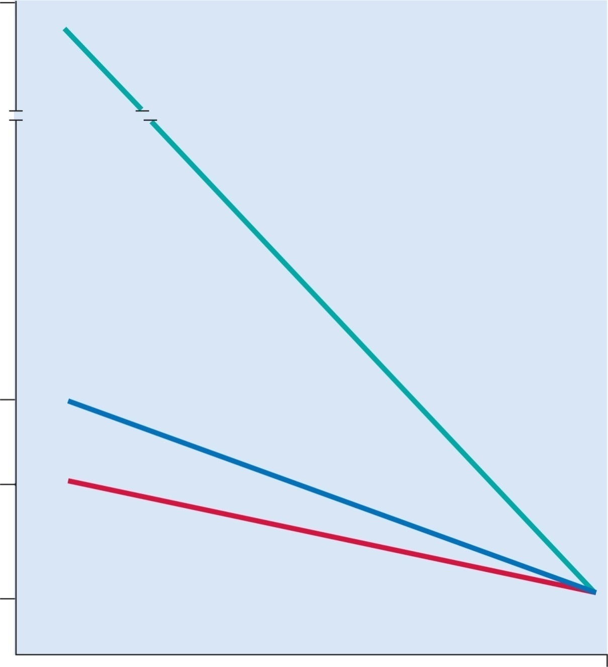
Fig. 22.20
Copyright © McGraw-Hill Education. Permission required for reproduction or display.
2,500
Air in hyperbaric chamber
(100% O₂ at 3 atm)
Ambient PO₂ (mm Hg)
Air at sea level
(1 atm)
Steep gradient, rapid O₂ diffusion
158
Normal gradient and O₂ diffusion
110
Reduced gradient, slower O₂ diffusion
Air at 3,000 m
(10,000 ft)
40
Atmosphere
Venous blood
arriving at
alveoli
Pressure gradient of O₂
Notes:
21

Slide 22
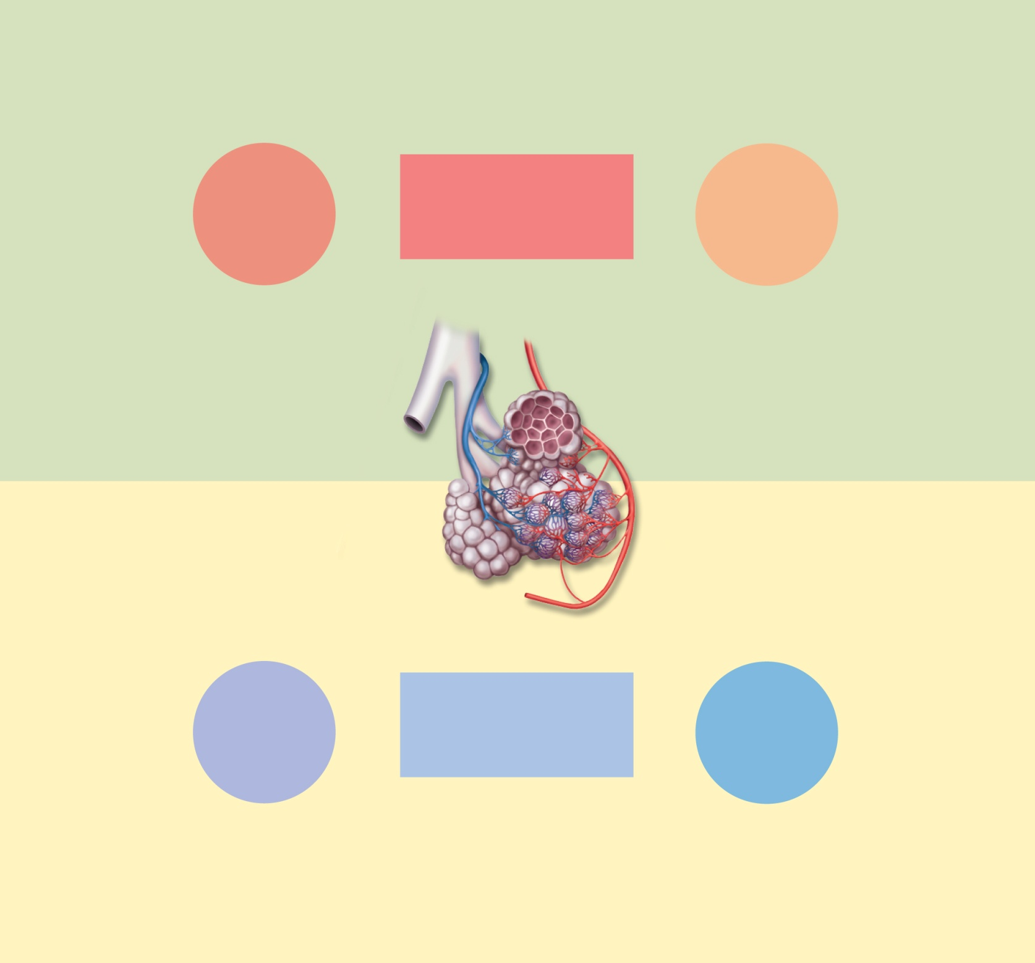
Fig. 22.22
Copyright © McGraw-Hill Education. Permission required for reproduction or display.
Reduced PO₂ in
blood vessels
Decreased
airflow
Increased
airflow
Elevated PO₂ in
blood vessels
Response
to reduced
ventilation
Result:
Blood flow
matches airflow
Response
to increased
ventilation
Vasoconstriction of
pulmonary vessels
Vasodilation of
pulmonary vessels
Decreased
blood flow
Increased
blood flow
(a) Perfusion adjusted to changes
in ventilation
Reduced PCO₂
in alveoli
Decreased
blood flow
Increased
blood flow
Elevated PCO₂
in alveoli
Response
to reduced
perfusion
Result:
Airflow matches
blood flow
Response
to increased
perfusion
Constriction of
bronchioles
Dilation of
bronchioles
Decreased
airflow
Increased
airflow
(b) Ventilation adjusted to changes in perfusion
Notes:
22

Slide 23
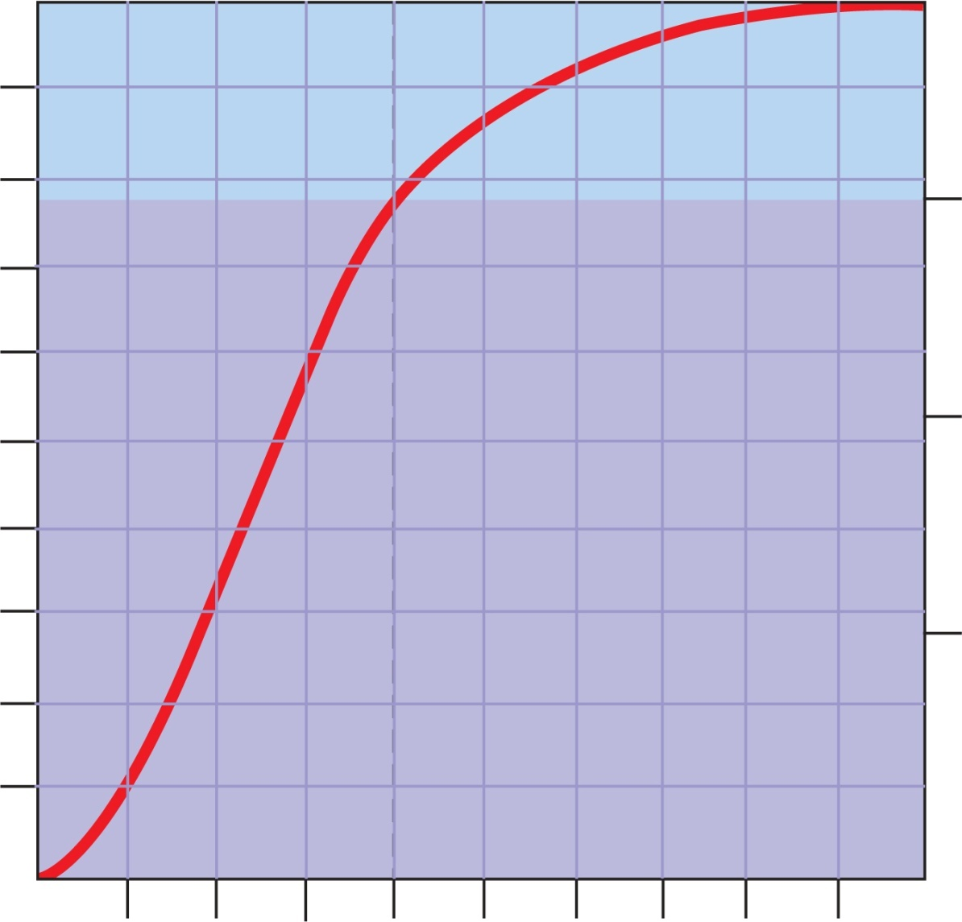
Fig. 22.23
Copyright © McGraw-Hill Education. Permission required for reproduction or display.
100
20
22%
80
15
60
Percentage O₂ saturation of hemoglobin
10
mL O₂/dL of blood
40
5
20
0
0
20
40
60
80
100
Systemic tissues
Alveoli
Partial pressure of O₂ (Po₂) in mm Hg
Notes:
23

Slide 24
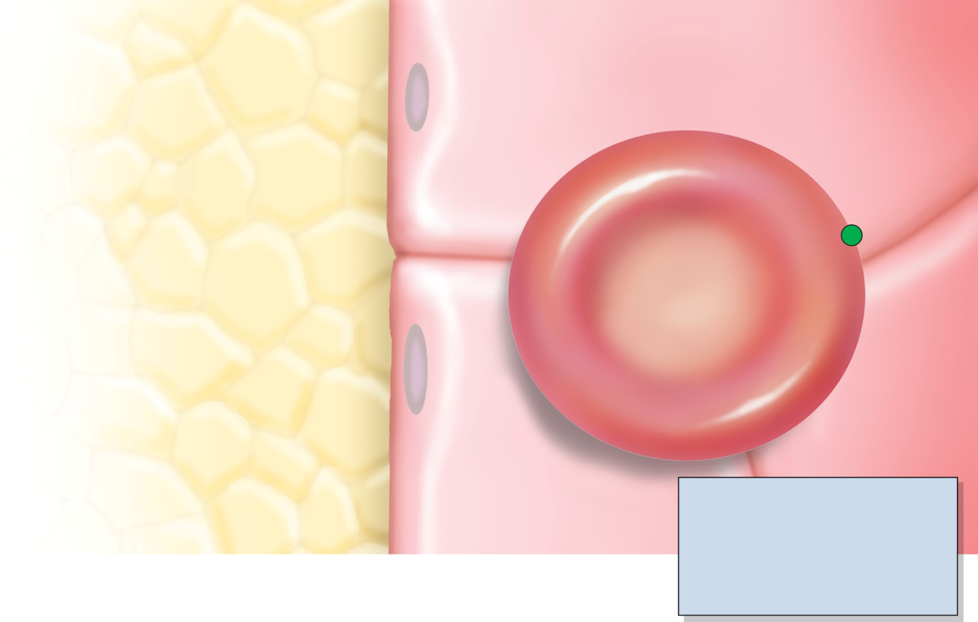
Fig. 22.24
Copyright © McGraw-Hill Education. Permission required for reproduction or display.
Respiring tissue
Capillary blood
7%
CO₂
Dissolved CO₂ gas
CO₂ + plasma protein
Carbamino compounds
23%
CO₂
CO₂ + Hb
HbCO₂
Chloride shift
Cl–
HCO₃–
Cl–
HCO₃– – Cl–
antiport
70%
CAH
CO₂
CO₂ + H₂O
H₂CO₃
HCO₃ – + H⁺
98.5%
O₂
O₂ + HHb
HbO₂ + H⁺
1.5%
Key
O₂
Dissolved O₂ gas
Hb
Hemoglobin
HbCO₂
Carbaminohemoglobin
HbO₂
Oxyhemoglobin
HHb
Deoxyhemoglobin
CAH
Carbonic anhydrase

Slide 25
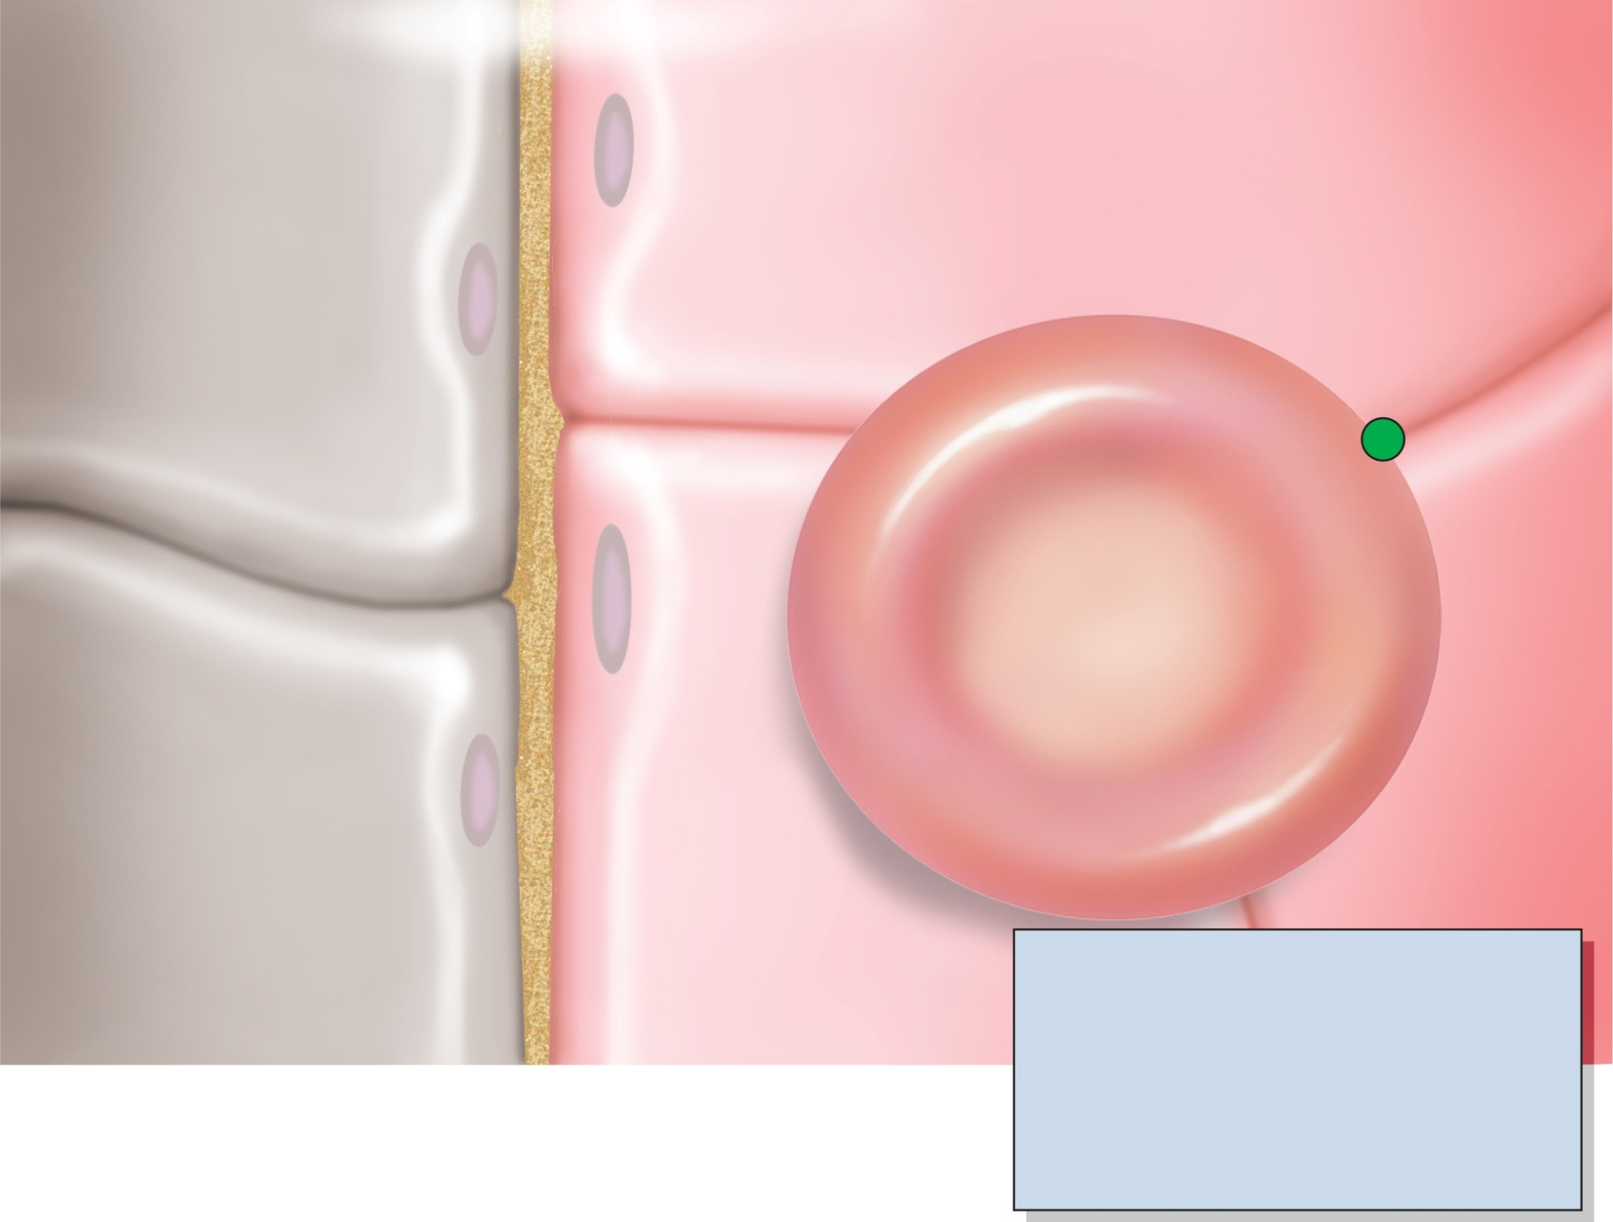
Fig. 22.25
Copyright © McGraw-Hill Education. Permission required for reproduction or display.
Alveolar air
Respiratory membrane
Capillary blood
7%
CO₂
Dissolved CO₂ gas
CO₂ + plasma protein
Carbamino compounds
Chloride shift
23%
Cl–
CO₂
CO₂ + Hb
HbCO₂
HCO₃–
HCO₃– – Cl–
antiport
70%
Cl–
CAH
H₂CO₃
HCO₃– + H⁺
CO₂
CO₂ + H₂O
98.5%
O₂
O₂ + HHb
HbO₂ + H⁺
1.5%
O₂
Dissolved O₂ gas
Key
Hb
Hemoglobin
HbCO₂
Carbaminohemoglobin
HbO₂
Oxyhemoglobin
HHb
Deoxyhemoglobin
CAH
Carbonic anhydrase

Slide 26
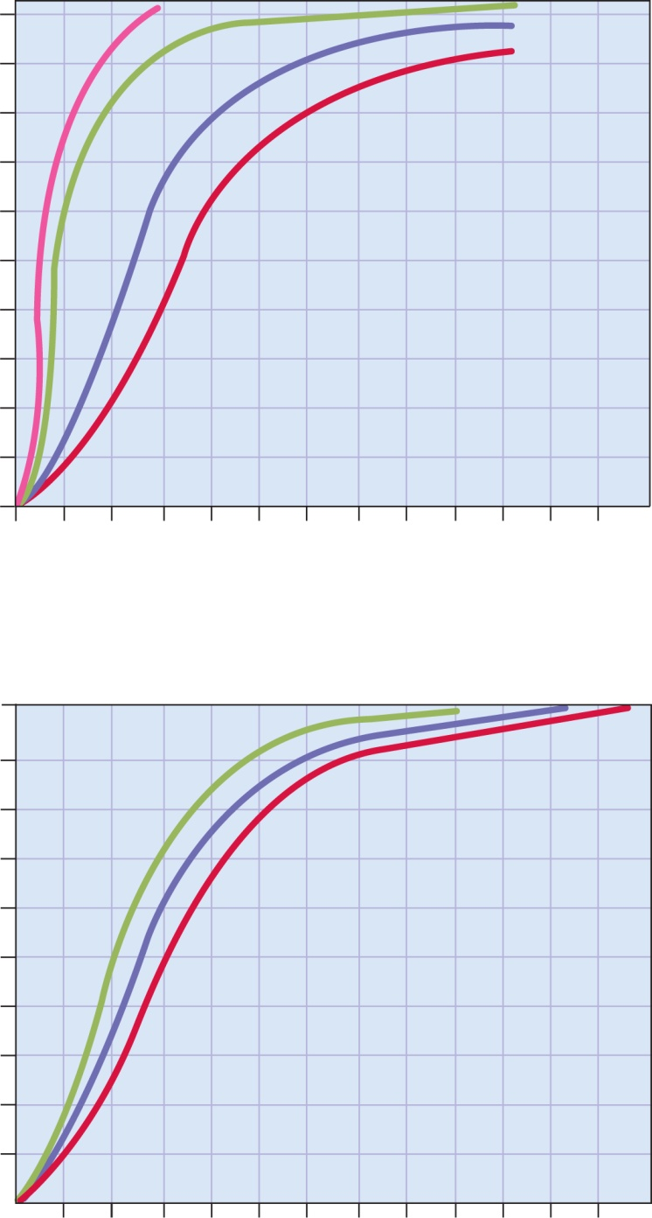
Fig. 22.26
Copyright © McGraw-Hill Education. Permission required for reproduction or display.
100
10°C
90
20°C
80
38°C
43°C
70
60
Percentage saturation of hemoglobin
Normal body
temperature
50
40
30
20
10
0
0
20
40
60
80
100
120
Po₂ (mm Hg)
(a) Effect of temperature
100
90
pH 7.60
80
pH 7.40
(normal blood pH)
70
60
pH 7.20
Percentage saturation of hemoglobin
50
40
30
20
10
0
0
20
40
60
80
100
120
Po₂ (mm Hg)
(b) Effect of pH

