Slide 1
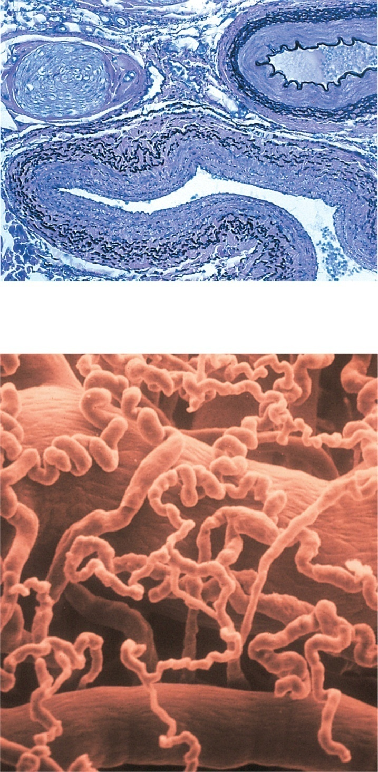
Fig. 20.1
Copyright © McGraw-Hill Education. Permission required for reproduction or display.
Capillaries
Artery:
Tunica interna
Tunica media
Tunica externa
Nerve
Vein
(a)
1 mm
Vein
Capillaries
Artery
(b)
100 µm
a: ©The McGraw-Hill Companies, Inc.; b: ©Wolf H. Fahrenbach/Visuals Unlimited

Slide 2
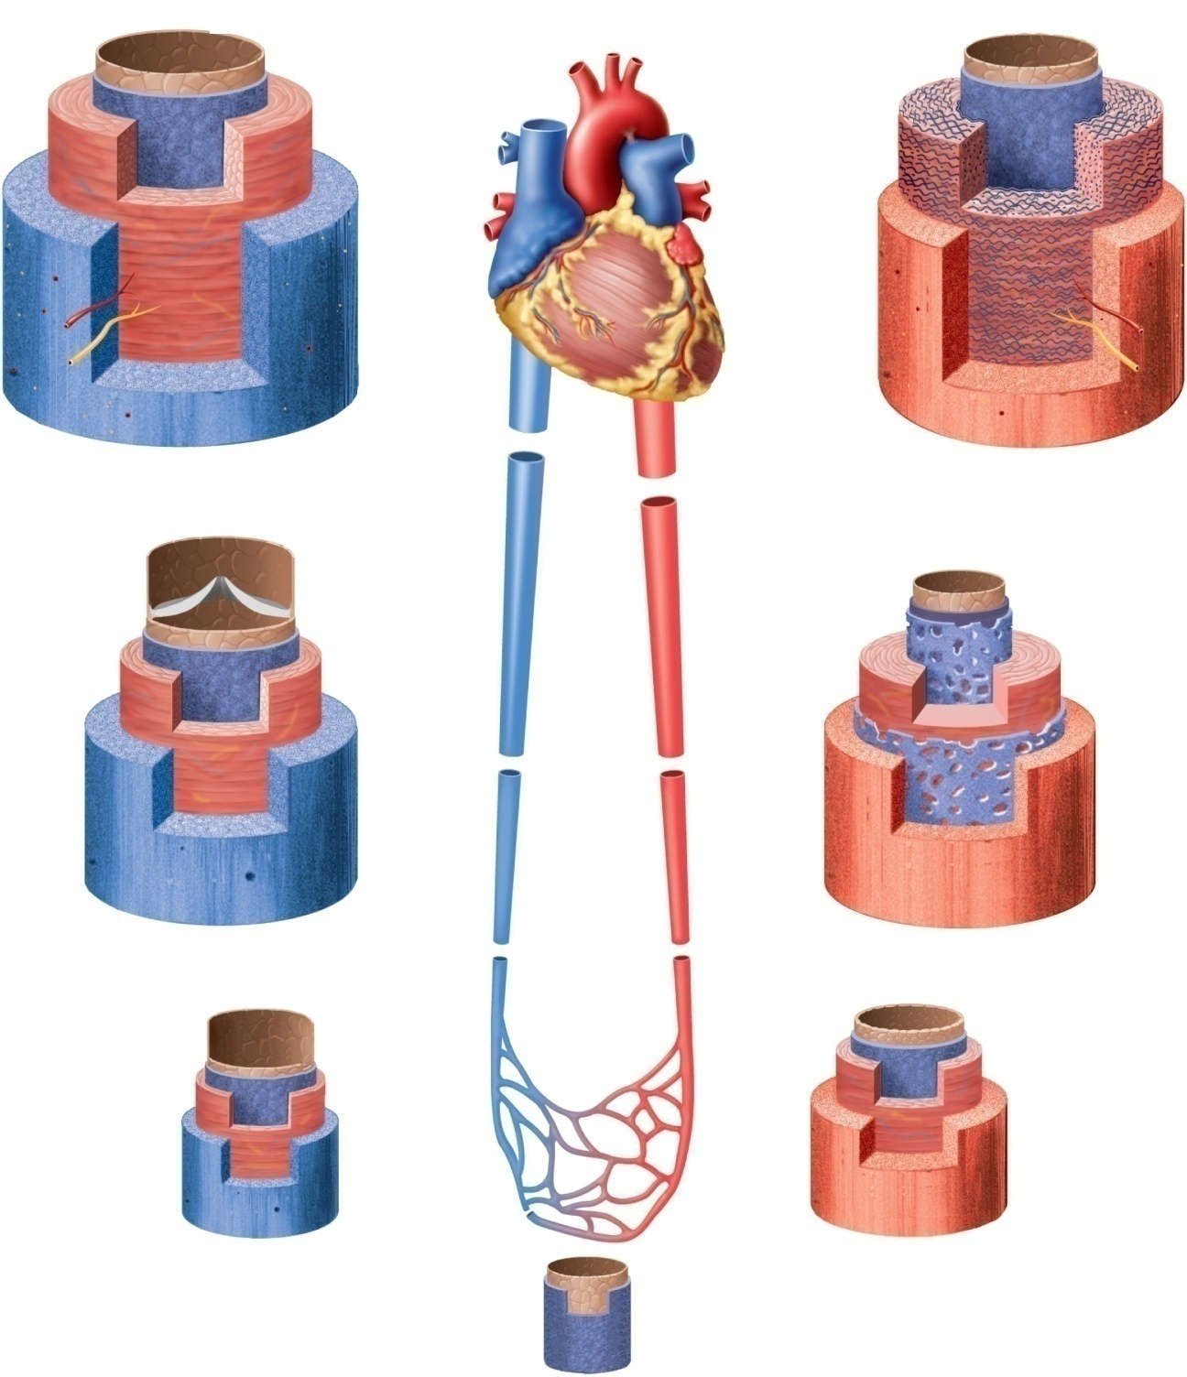
Fig. 20.2
Copyright © McGraw-Hill Education. Permission required for reproduction or display.
Lumen
Large vein
Conducting (large) artery
Lumen
Tunica interna:
Tunica interna:
Endothelium
Endothelium
Basement
membrane
Basement
membrane
Tunica media
Tunica externa
Tunica media
Tunica externa
Vasa
Vasa
vasorum
vasorum
Nerve
Nerve
Medium vein
Inferior
vena
cava
Distributing (medium) artery
Aorta
Tunica interna:
Tunica interna:
Endothelium
Endothelium
Basement
membrane
Basement
membrane
Internal elastic lamina
Valve
Tunica media
Tunica media
External elastic lamina
Tunica externa
Tunica externa
Direction
of blood
flow
Venule
Arteriole
Tunica interna:
Tunica interna:
Endothelium
Endothelium
Basement
membrane
Basement
membrane
Tunica media
Tunica media
Tunica externa
Tunica externa
Endothelium
Basement
membrane
Capillary

Slide 3
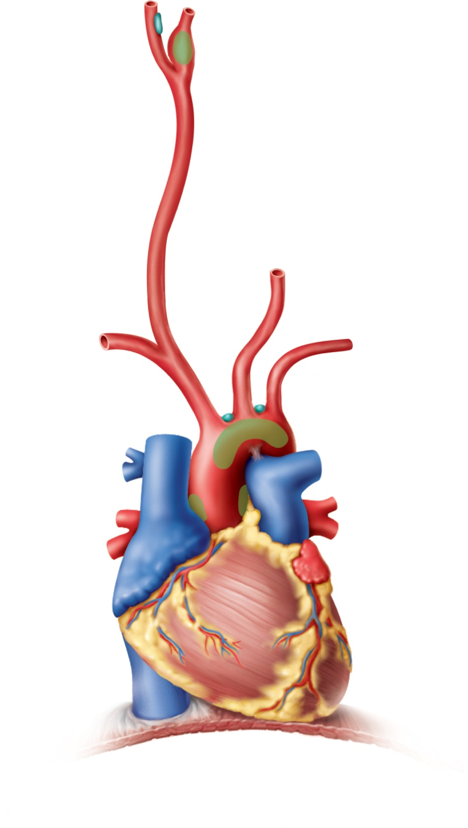
Fig. 20.3
Copyright © McGraw-Hill Education. Permission required for reproduction or display.
Carotid body
(containing
chemoreceptors)
Internal carotid artery
Carotid sinus
(containing
baroreceptors)
External carotid
artery
Right common
carotid artery
Left common
carotid artery
Aortic bodies
(containing
chemoreceptors)
Right subclavian
artery
Left subclavian
artery
Aortic arch
Baroreceptors

Slide 4
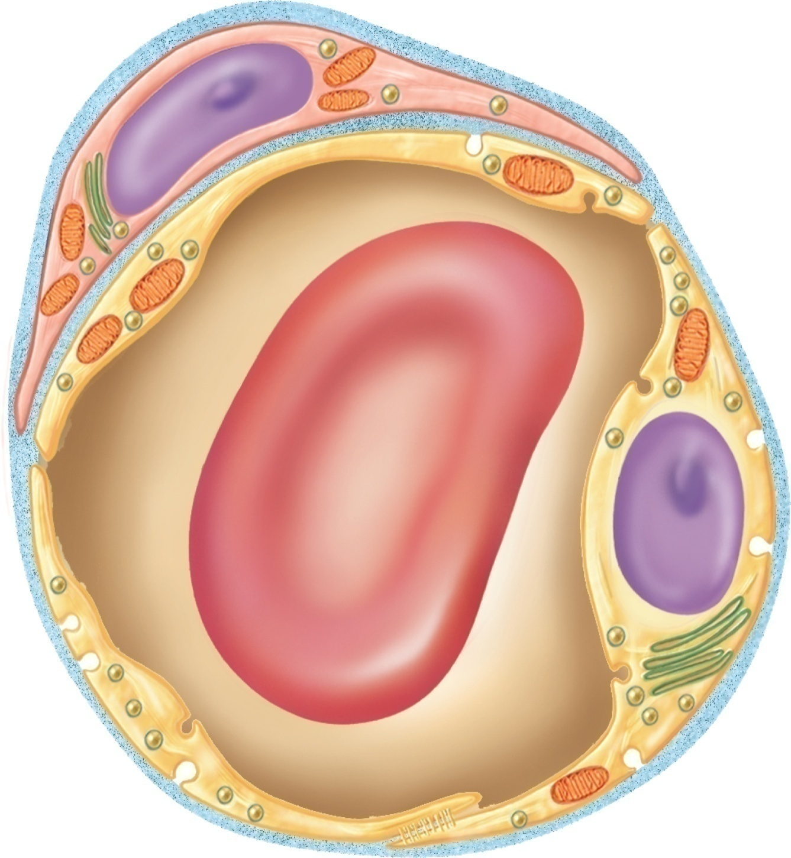
Fig. 20.4
Copyright © McGraw-Hill Education. Permission required for reproduction or display.
Pericyte
Basal
lamina
Intercellular
cleft
Pinocytotic
vesicle
Endothelial
cell
Erythrocyte
Tight
junction

Slide 5
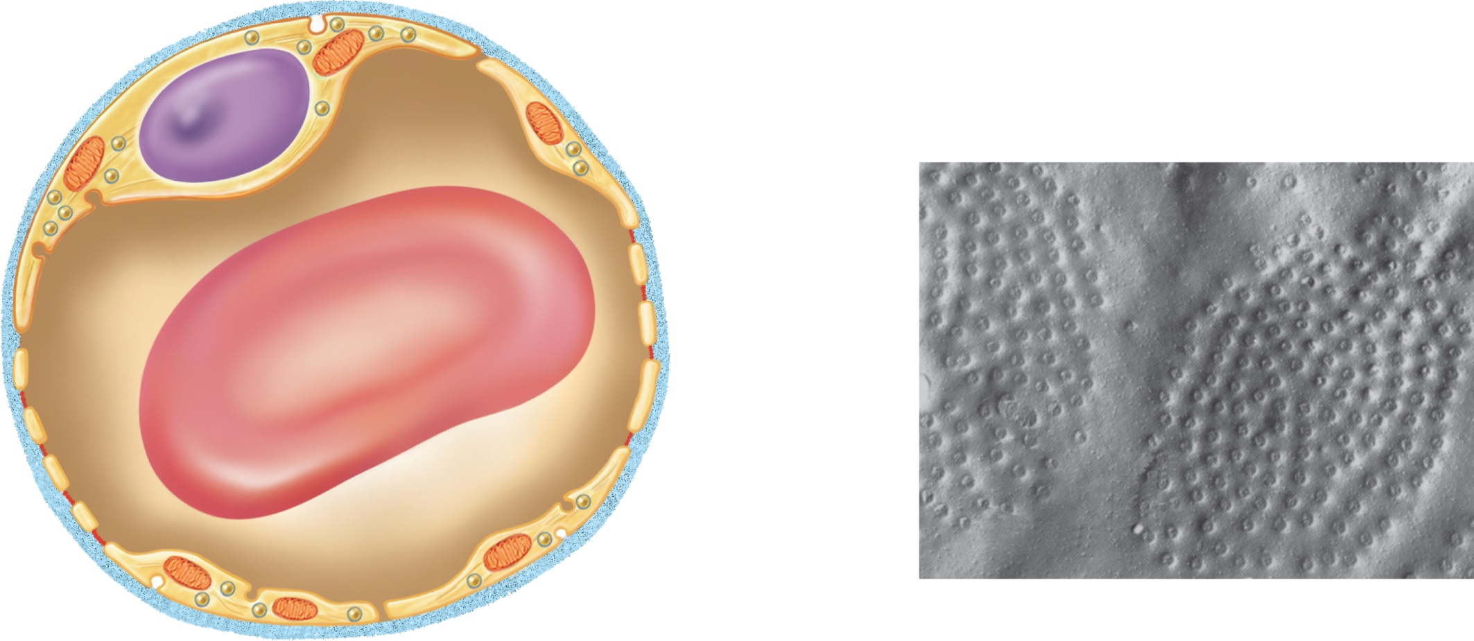
Fig. 20.5
Copyright © McGraw-Hill Education. Permission required for reproduction or display.
Endothelial
cells
Nonfenestrated
area
Erythrocyte
Filtration pores
(fenestrations)
Basal
lamina
Intercellular
cleft
(a)
(b)
400 μm
b: Courtesy of S. McNutt

Slide 6
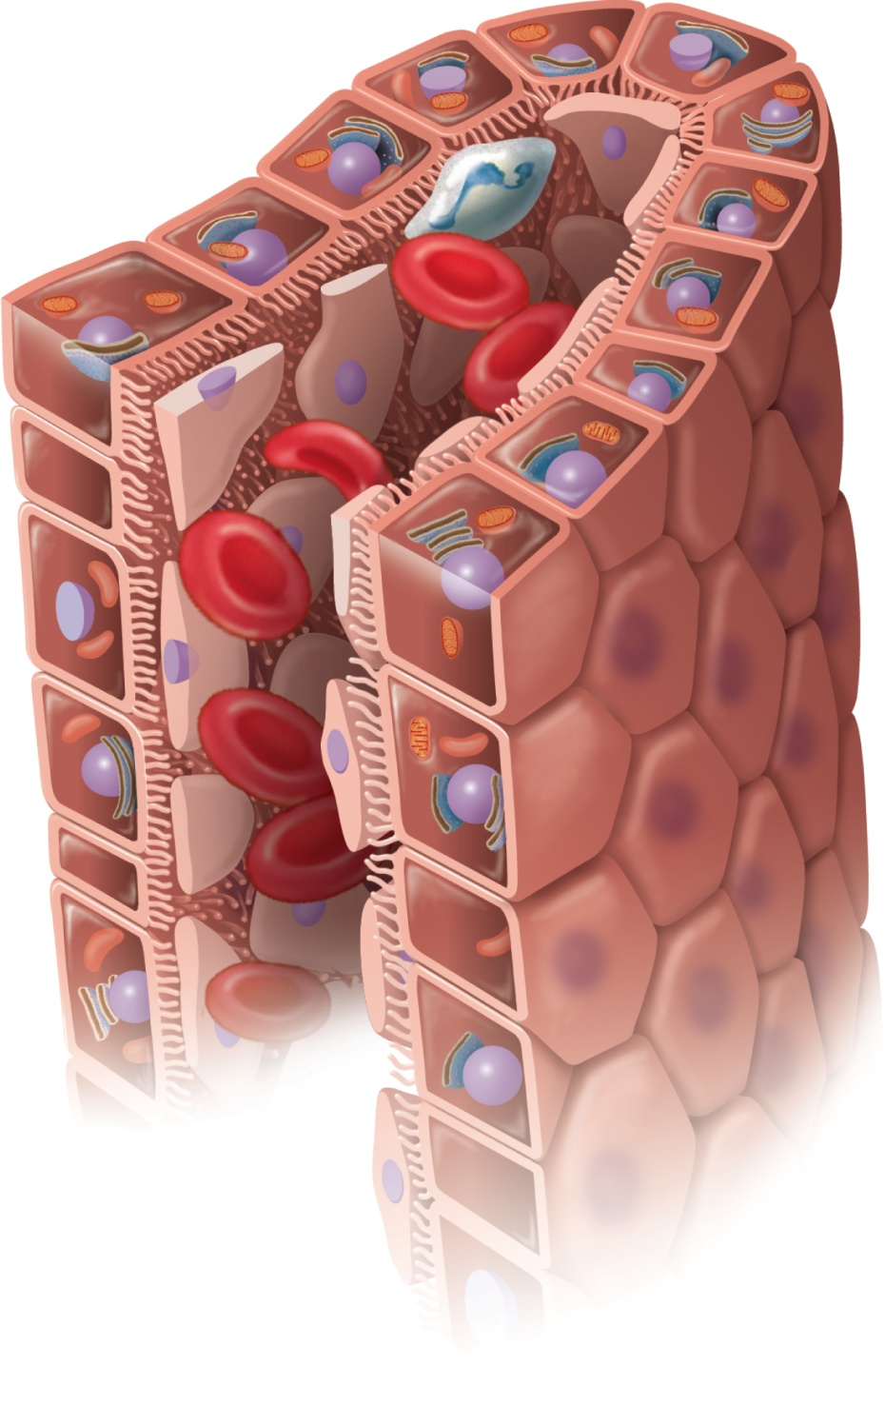
Fig. 20.6
Copyright © McGraw-Hill Education. Permission required for reproduction or display.
Macrophage
Endothelial
cells
Erythrocytes
in sinusoid
Liver cell
(hepatocyte)
Microvilli
Sinusoid

Slide 7
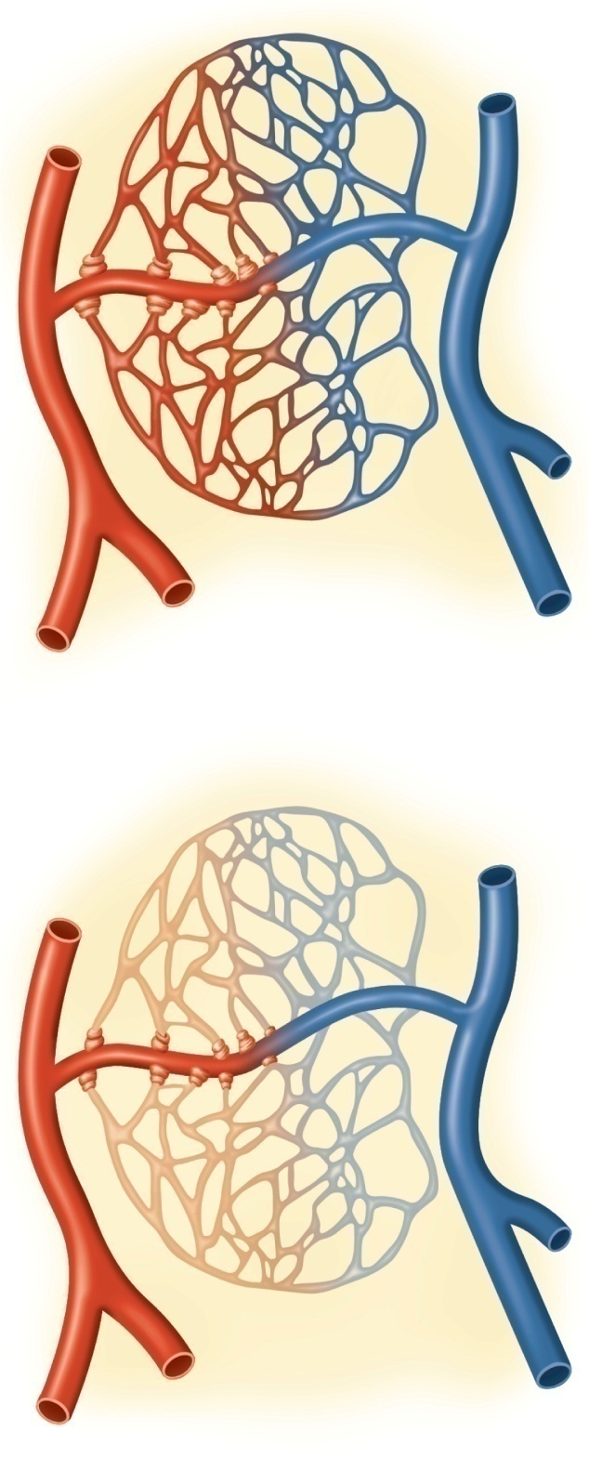
Fig. 20.7
Copyright © McGraw-Hill Education. Permission required for reproduction or display.
Precapillary
sphincters
Thoroughfare
channel
Metarteriole
Capillaries
Arteriole
Venule
(a) Sphincters open
Arteriole
Venule
(b) Sphincters closed

Slide 8
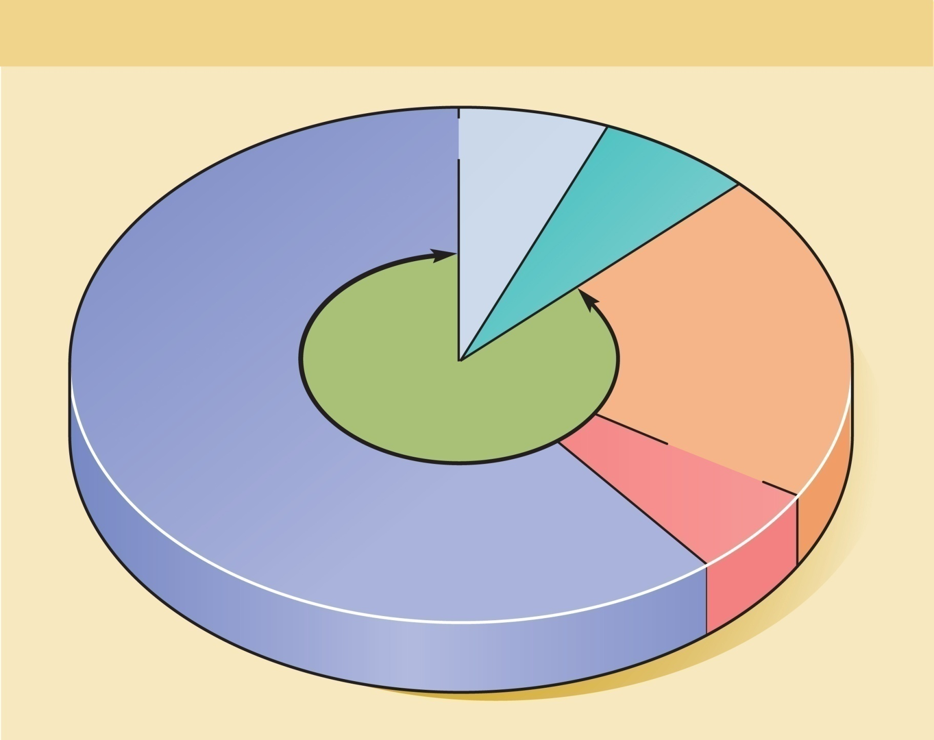
Fig. 20.8
Copyright © McGraw-Hill Education. Permission required for reproduction or display.
Distribution of Blood
Pulmonary
circuit
9%
Heart
7%
Veins
64%
Arteries
15%
Systemic
circuit
84%
Capillaries
5%

Slide 9
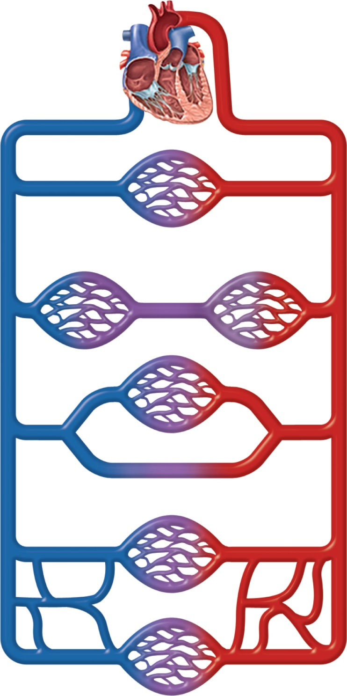
Fig. 20.9
Copyright © McGraw-Hill Education. Permission required for reproduction or display.
(a) Simplest pathway
(1 capillary bed)
(b) Portal system
(2 capillary beds)
(c) Arteriovenous
anastomosis
(shunt)
(d) Venous
anastomoses
(e) Arterial
anastomoses

Slide 10
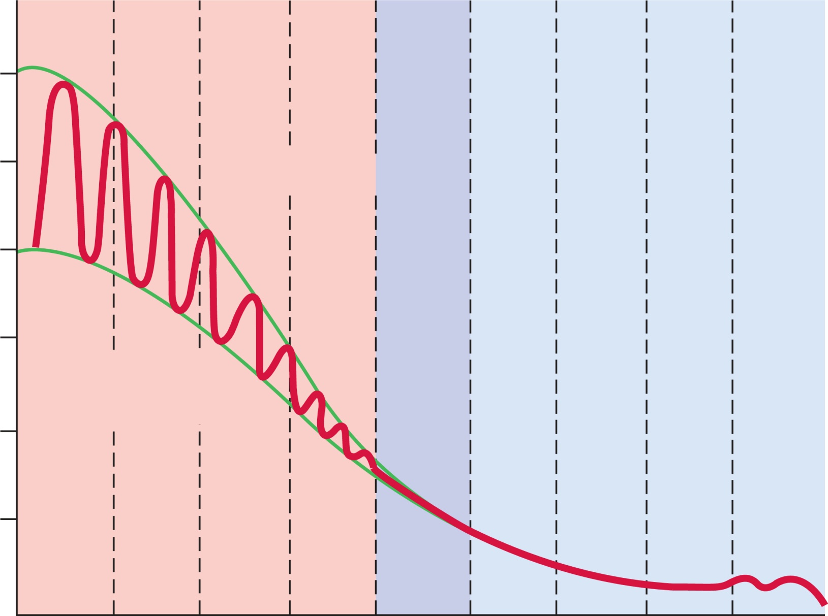
Fig. 20.10
Copyright © McGraw-Hill Education. Permission required for reproduction or display.
120
100
Systolic pressure
80
Systemic blood pressure (mm Hg)
60
Diastolic
pressure
40
20
0
Aorta
Large
arteries
Small
arteries
Venules
Small
veins
Large
veins
Venae
cavae
Arterioles
Capillaries
Increasing distance from left ventricle

Slide 11
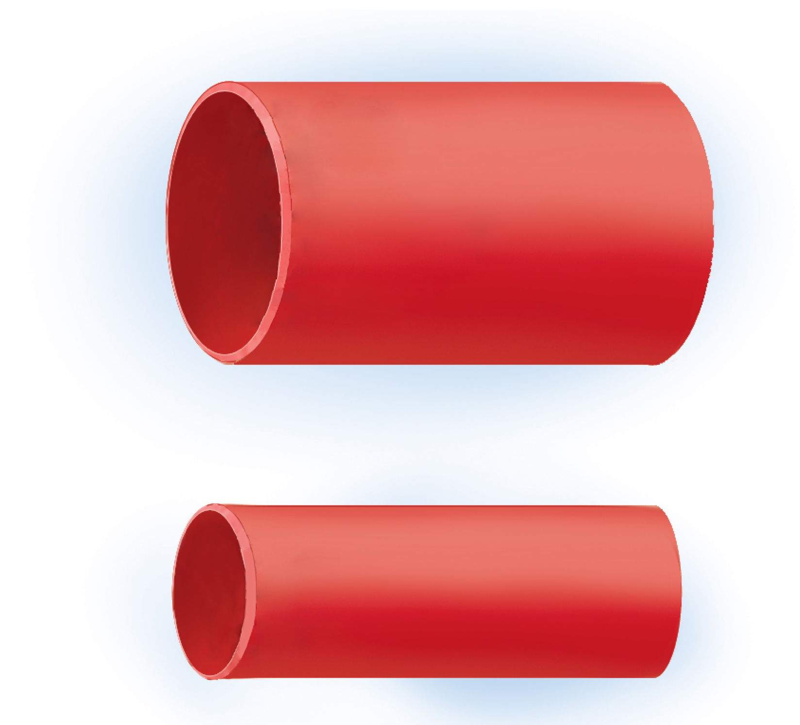
Fig. 20.11
Copyright © McGraw-Hill Education. Permission required for reproduction or display.
(a)
(b)

Slide 12
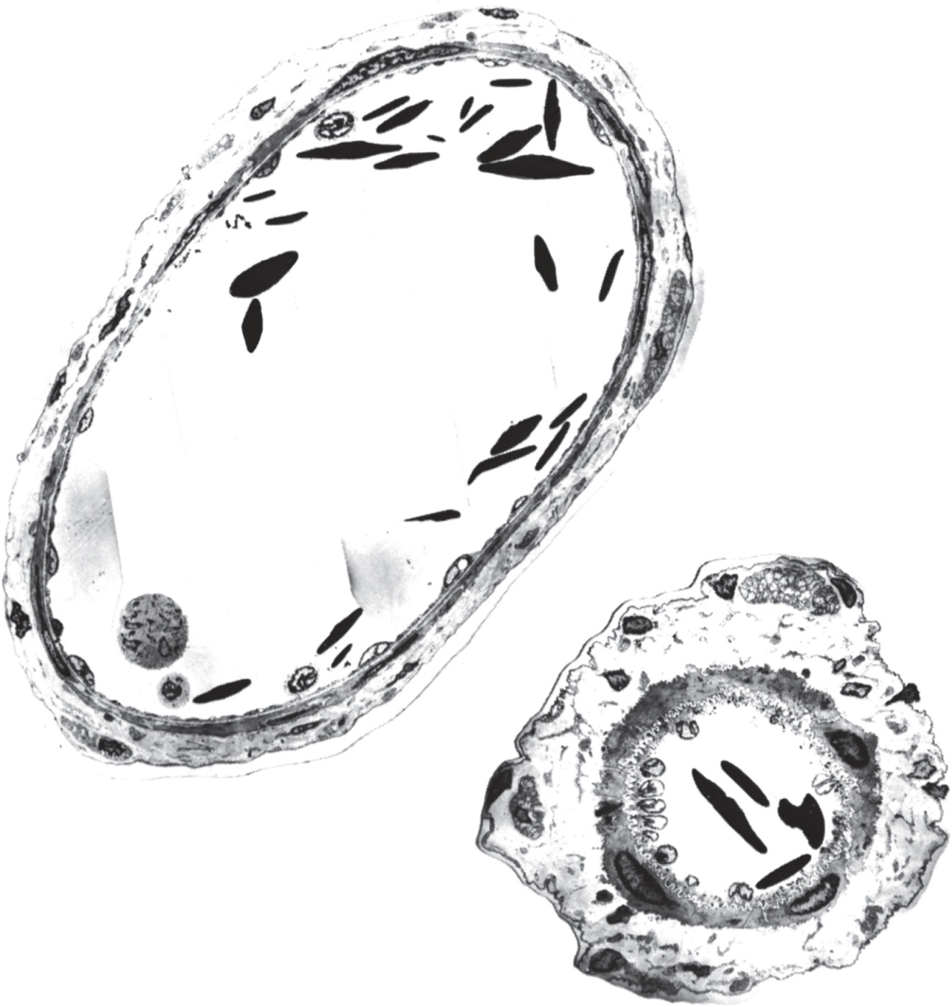
Fig. 20.12
Copyright © McGraw-Hill Education. Permission required for reproduction or display.
Externa
Media
Interna
Lumen
(a)
(b)
30 µm
a,b: Phelps, P. C. and Luft, J. H. (1969), “Electron microscopical study of relaxation and constriction in frog arterioles.” Am. J. Anat., 1969/125: 399–427.
Reproduced with permission of Wiley Inc.

Slide 13
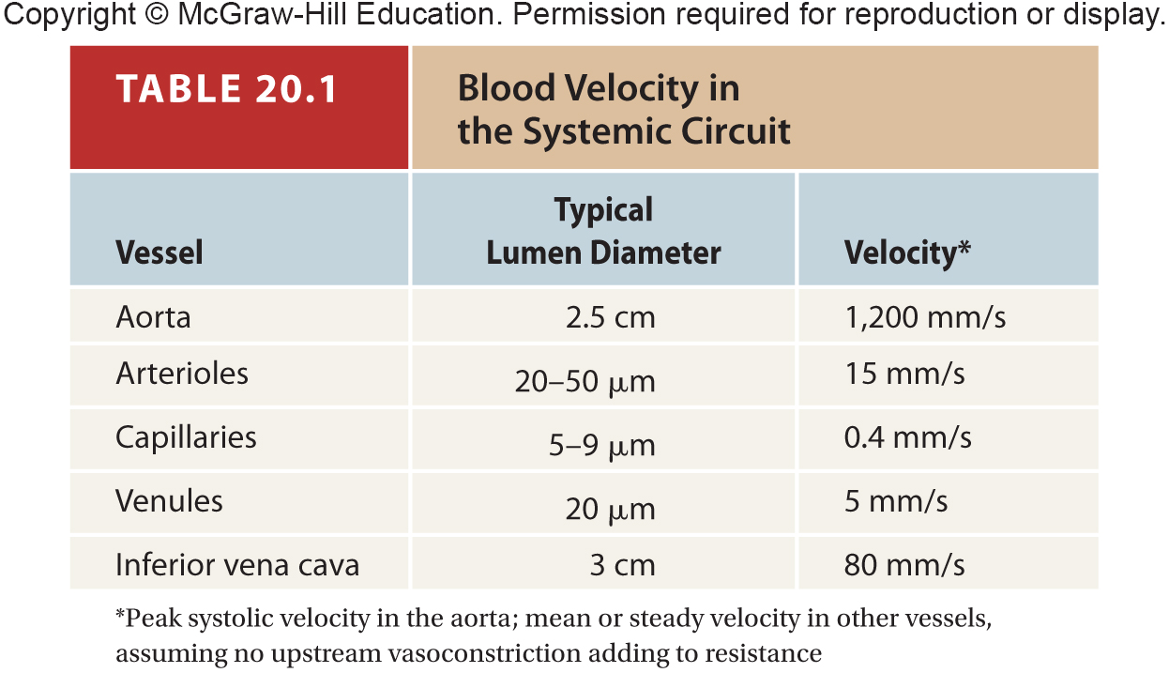
Table 20.1

Slide 14
Fig. 20.13
Copyright © McGraw-Hill Education. Permission required for reproduction or display.
Elevated
blood pressure
Reduced
blood pressure
Vasodilation
Arteries
stretched
Reduced
heart rate
Reduced
vasomotor tone
Baroreceptors
increase firing rate
Increased
vagal tone
Cardioinhibitory
neurons stimulated
Reduced
sympathetic tone
Vasomotor center
is inhibited

Slide 15
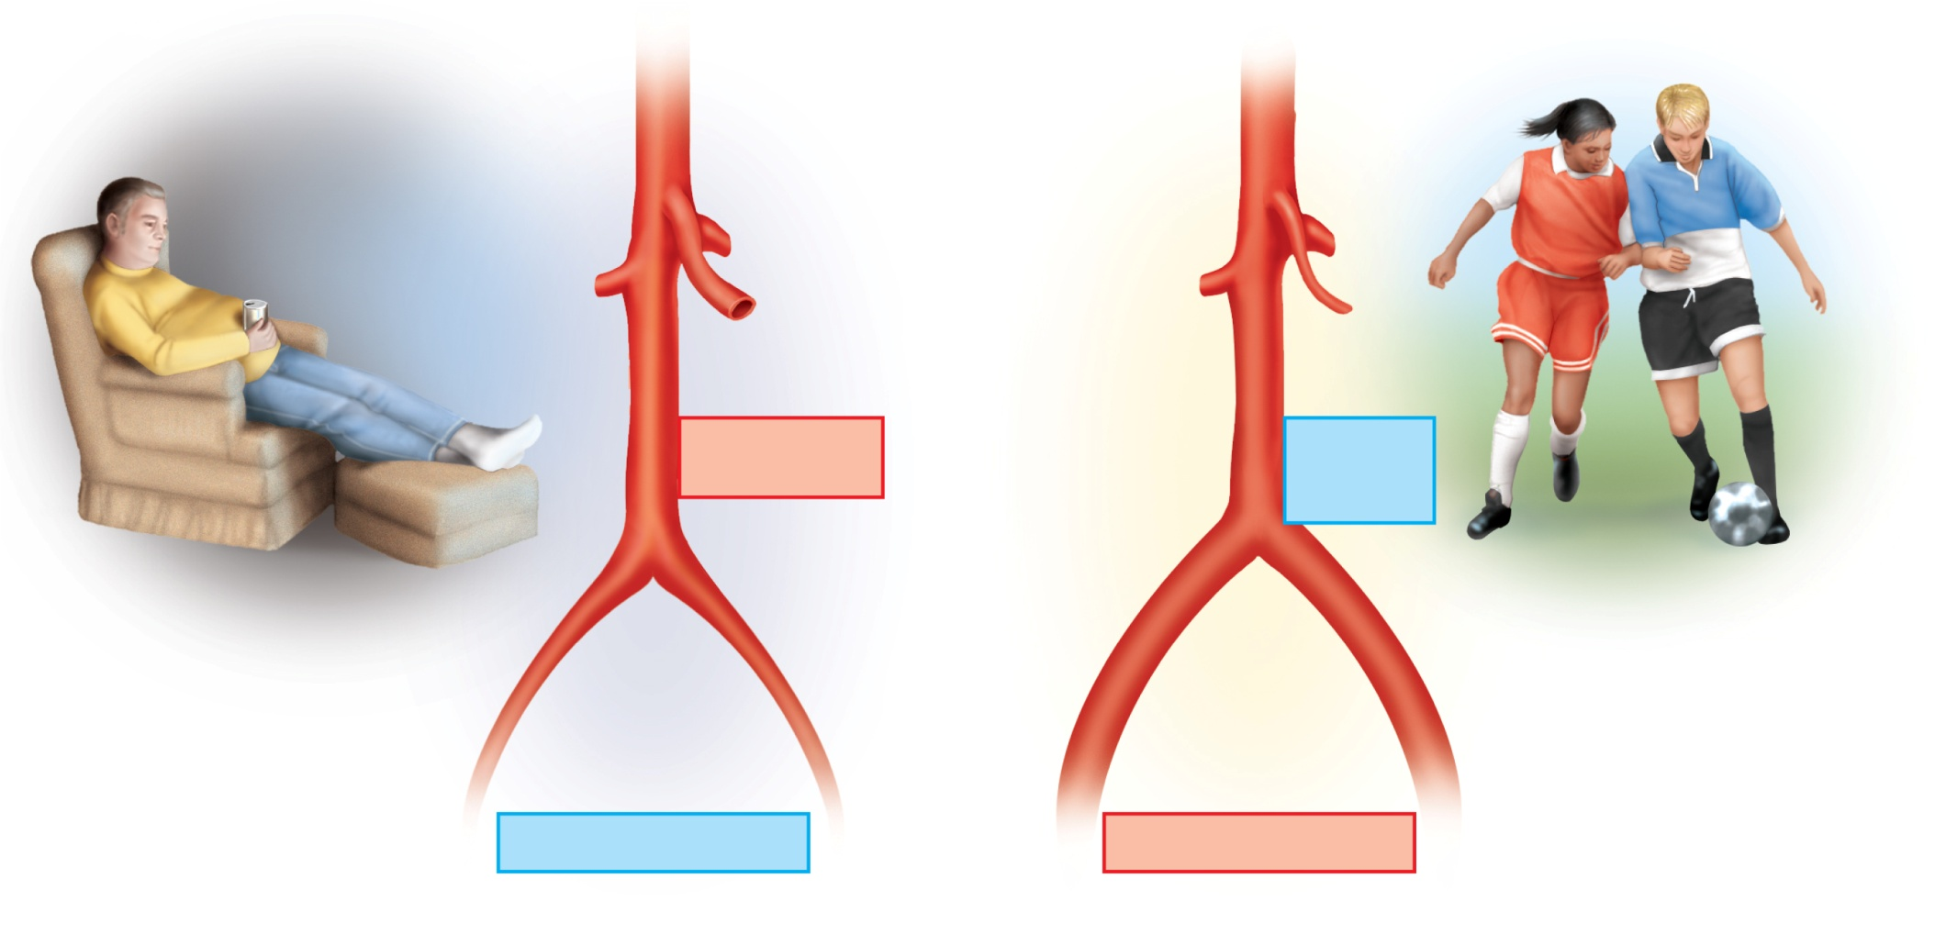
Fig. 20.14
Copyright © McGraw-Hill Education. Permission required for reproduction or display.
Aorta
Superior
mesenteric
artery
Dilated
Constricted
Increased flow
to intestines
Reduced
flow to
intestines
Common iliac
arteries
Constricted
Dilated
Reduced flow to legs
Increased flow to legs
(a)
(b)

Slide 16
Fig. 20.15
Copyright © McGraw-Hill Education. Permission required for reproduction or display.
At rest
Total cardiac output 5 L/min.
Moderate exercise
Total cardiac output 17.5 L/min.
Coronary
200 mL/min.
(4.0%)
Other
350 mL/min.
(7.0%)
Coronary
750 mL/min.
(4.3%)
Other
400 mL/min.
(2.3%)
Cutaneous
1,900 mL/min.
(10.9%)
Cutaneous
300 mL/min.
(6.0%)
Muscular
1,000 mL/min.
(20.0%)
Cerebral
750 mL/min.
(4.3%)
Cerebral
700 mL/min.
(14.0%)
Renal
600 mL/min.
(3.4%)
Digestive
1,350 mL/min.
(27.0%)
Muscular
12,500 mL/min.
(71.4%)
Renal
1,100 mL/min.
(22.0%)
Digestive
600 mL/min.
(3.4%)

Slide 17
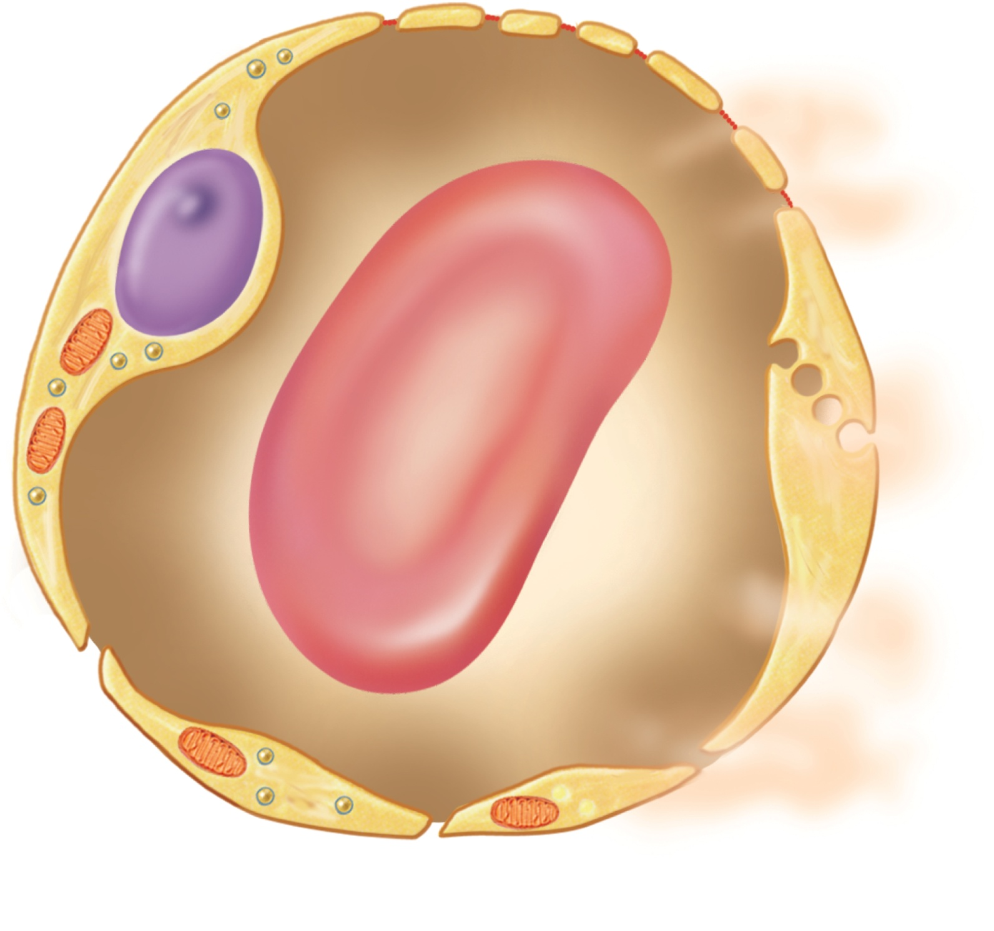
Fig. 20.16
Copyright © McGraw-Hill Education. Permission required for reproduction or display.
Filtration pores
Transcytosis
Diffusion through
endothelial cells
Intercellular
clefts

Slide 18
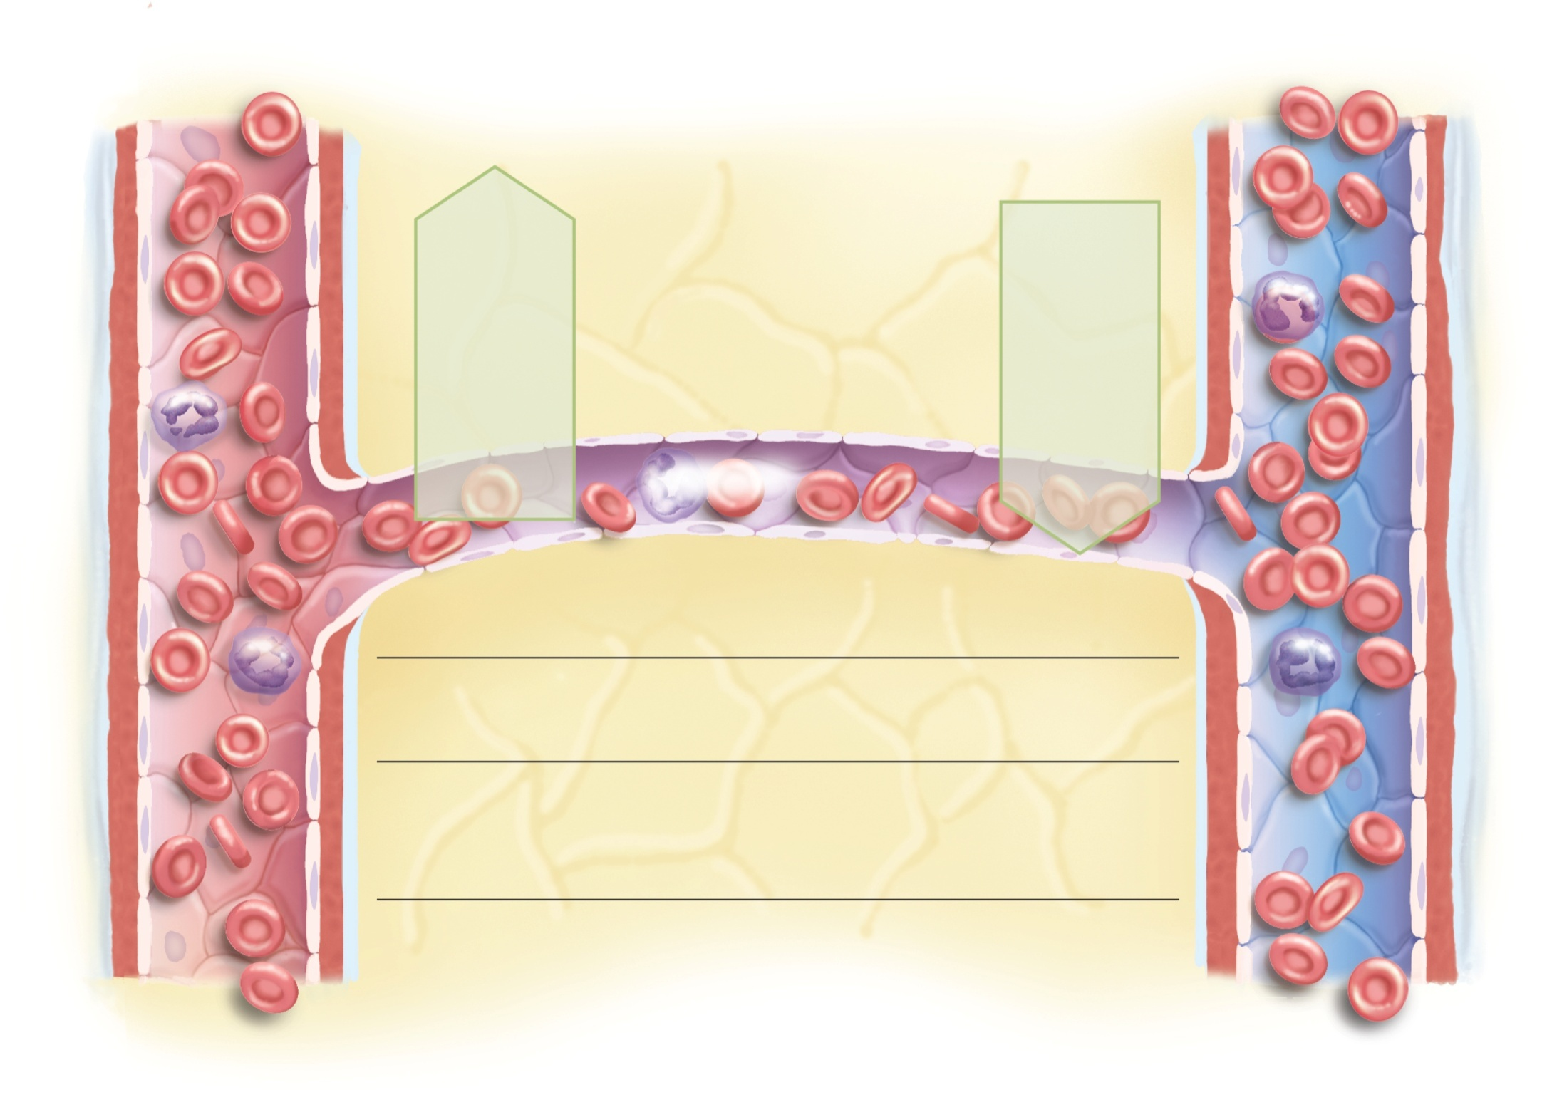
Fig. 20.17
Copyright © McGraw-Hill Education. Permission required for reproduction or display.
Arteriole
Venule
Net
filtration
pressure:
13 out
Net
reabsorption
pressure:
7 in
33 out
13 out
20 in
Capillary
20 in
Blood flow
Arterial end
Forces (mm Hg)
Venous end
Hydrostatic pressures
30 out
Blood hydrostatic pressure
10 out
+3 out
Interstitial hydrostatic pressure
+3 out
33 out
Net hydrostatic pressure
13 out
Colloid osmotic pressures (COP)
28 in
Blood
28 in
–8 out
Tissue fluid
–8 out
20 in
Oncotic pressure (net COP)
20 in
13 out
Net filtration or reabsorption pressure
7 in

Slide 19
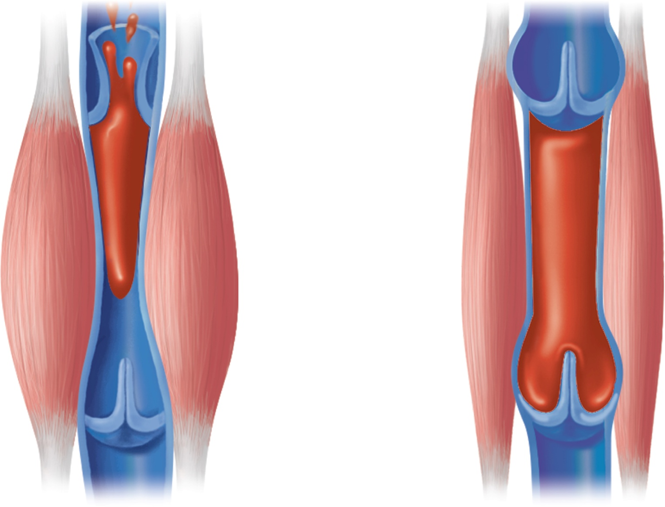
Fig. 20.19
Copyright © McGraw-Hill Education. Permission required for reproduction or display.
To heart
Valve open
Venous
blood
Valve closed
(a) Contracted skeletal muscles
(b) Relaxed skeletal muscles

