Slide 1
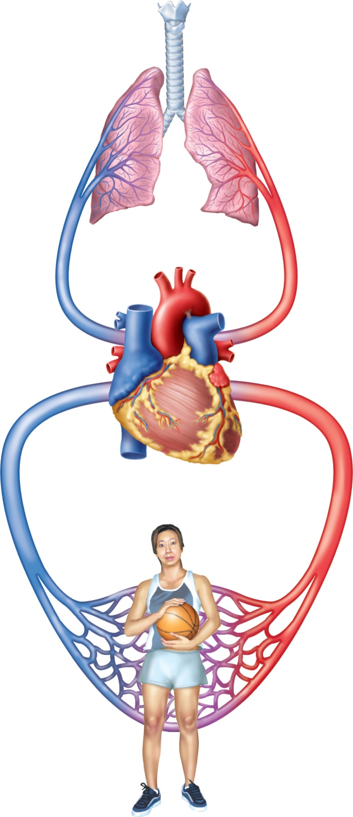
Fig. 19.1
Copyright © McGraw-Hill Education. Permission required for reproduction or display.
CO₂
O₂
Pulmonary circuit
O₂-poor,
CO₂-rich
blood
O₂-rich,
CO₂-poor
blood
Systemic circuit
CO₂
O₂

Slide 2
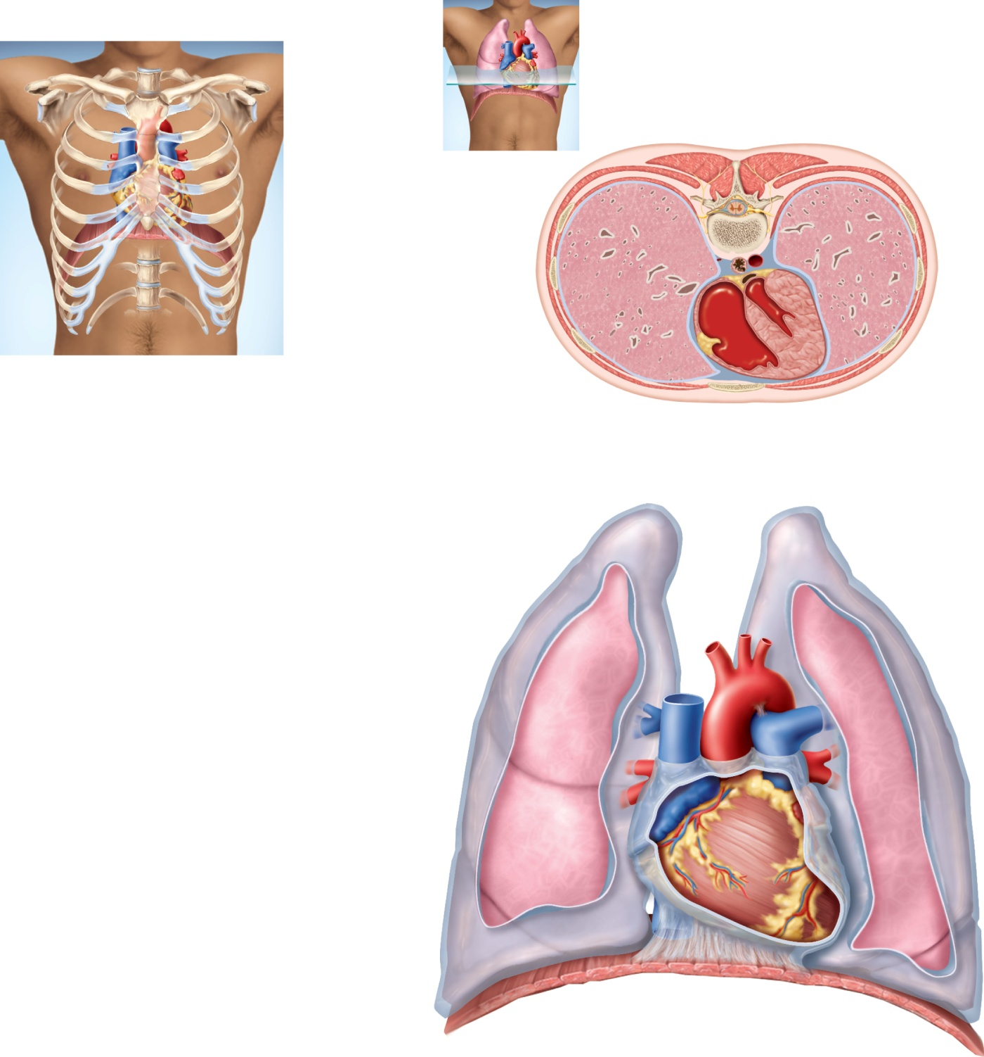
Fig. 19.2
Copyright © McGraw-Hill Education. Permission required for reproduction or display.
Sternum
Posterior
3rd rib
Lungs
Diaphragm
Thoracic
vertebra
Pericardial
cavity
Right
ventricle
Left
ventricle
(a)
Interventricular
septum
Sternum
(b)
Anterior
Aorta
Superior
vena cava
Pulmonary
trunk
Right lung
Base of
heart
Parietal
pleura (cut)
Pericardial
sac (cut)
Apex
of heart
Diaphragm
(c)
Notes:
2

Slide 3
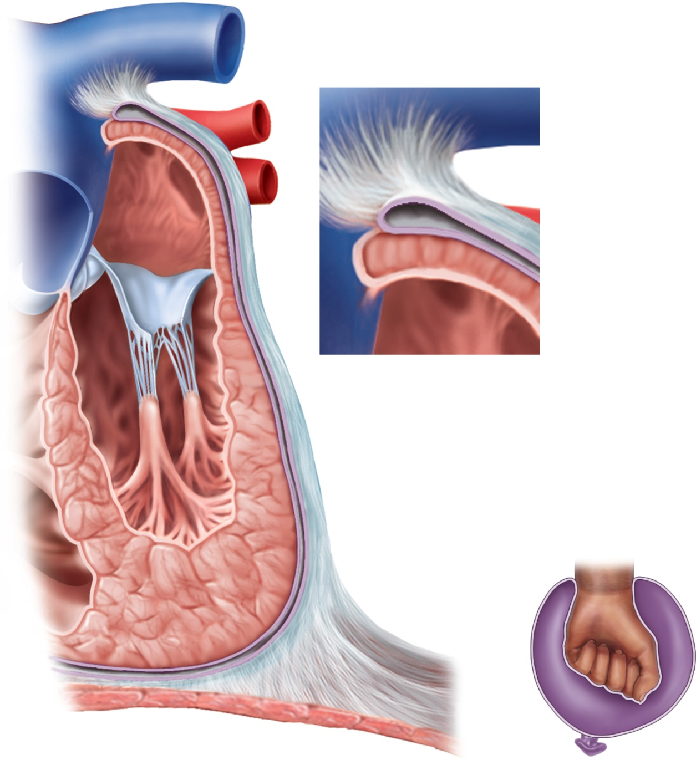

Fig. 19.3
Copyright © McGraw-Hill Education. Permission required for reproduction or display.
Pericardial
cavity
Pericardial sac:
Fibrous layer
Serous layer
Epicardium
(b)
Myocardium
Endocardium
Epicardium
Pericardial sac
(a)
(c)
Notes:
3

Slide 4
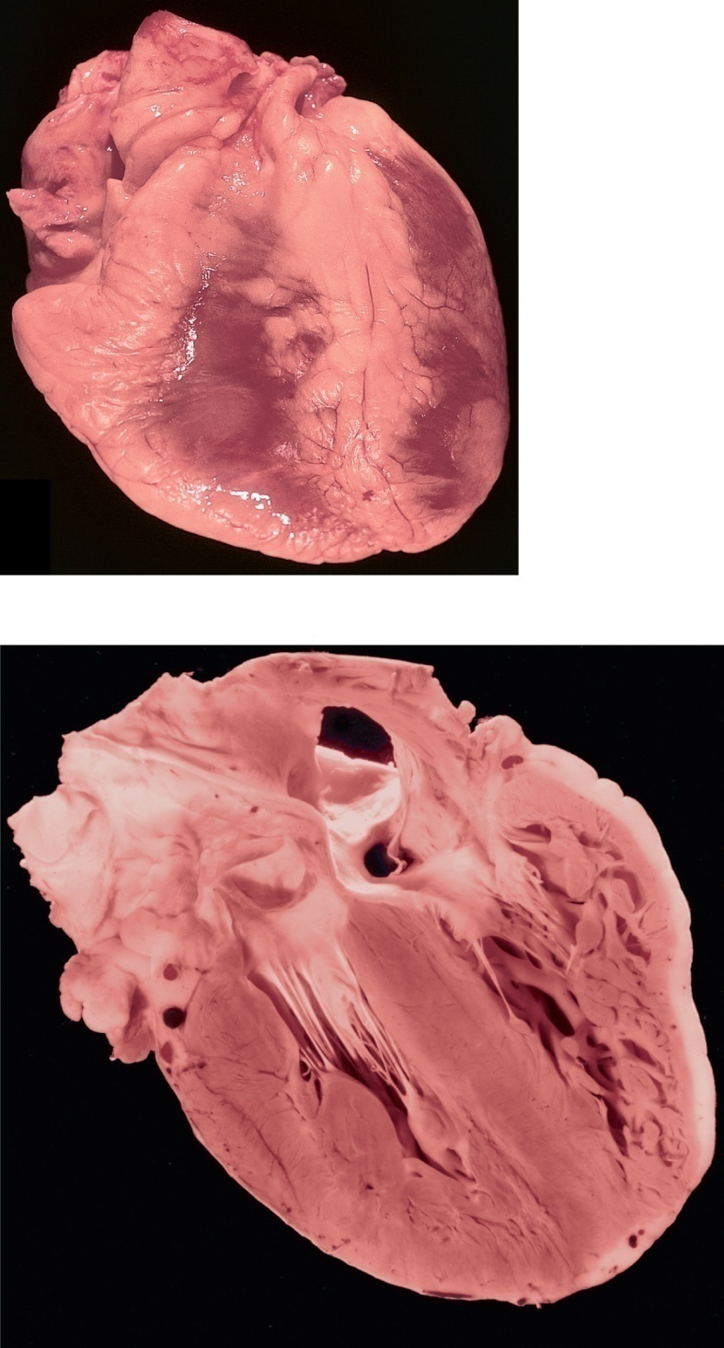
Fig. 19.4
Copyright © McGraw-Hill Education. Permission required for reproduction or display.
Fat in interventricular
sulcus
Left ventricle
Right ventricle
Anterior interventricular
artery
(a) Anterior view, external anatomy
Superior vena cava
Base of heart
Inferior vena cava
Right atrium
Interatrial septum
Left atrium
Opening of coronary sinus
Left AV valve
Right AV valve
Trabeculae carneae
Coronary blood vessels
Right ventricle
Tendinous cords
Papillary muscles
Left ventricle
Endocardium
Epicardial fat
Myocardium
Interventricular septum
Epicardium
Apex of heart
(b) Posterior view, internal anatomy
a,b: ©The McGraw-Hill Companies, Inc.
Notes:
4

Slide 5
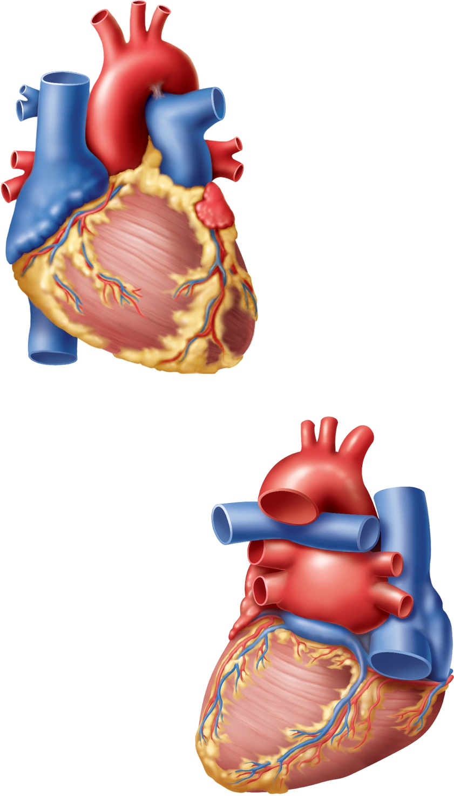
Fig. 19.5
Copyright © McGraw-Hill Education. Permission required for reproduction or display.
Aortic arch
Ligamentum
arteriosum
Superior vena cava
Ascending
aorta
Left pulmonary
artery
Branches of the
right pulmonary
artery
Pulmonary trunk
Right pulmonary
veins
Left pulmonary
veins
Left auricle
Right auricle
Right atrium
Coronary sulcus
Right ventricle
Anterior
interventricular
sulcus
Inferior vena cava
Left ventricle
(a) Anterior view
Apex of heart
Aorta
Left pulmonary
artery
Superior
vena cava
Left pulmonary
veins
Right pulmonary
artery
Right pulmonary
veins
Left atrium
Coronary sulcus
Coronary sinus
Right atrium
Inferior vena cava
Fat
Posterior
interventricular
sulcus
Left ventricle
Apex of heart
Right ventricle
(b) Posterior view
Notes:
5

Slide 6
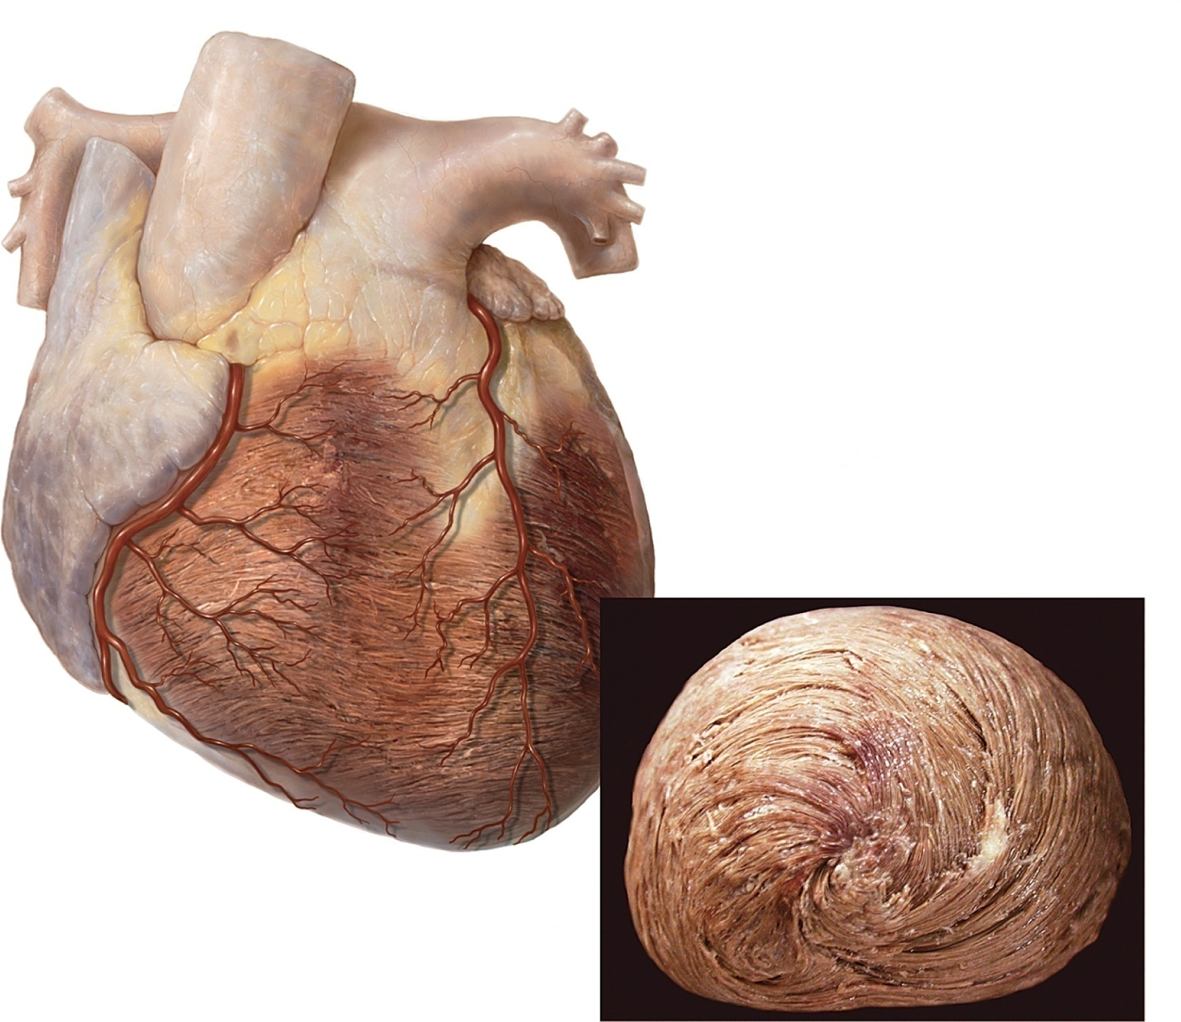
Fig. 19.6
Copyright © McGraw-Hill Education. Permission required for reproduction or display.
(a)
(b)
b: Photo and illustration by Roy Schneider, University of Toledo. Plastinated heart model for illustration courtesy of Dr. Carlos Baptista, University of Toledo
Notes:
6

Slide 7
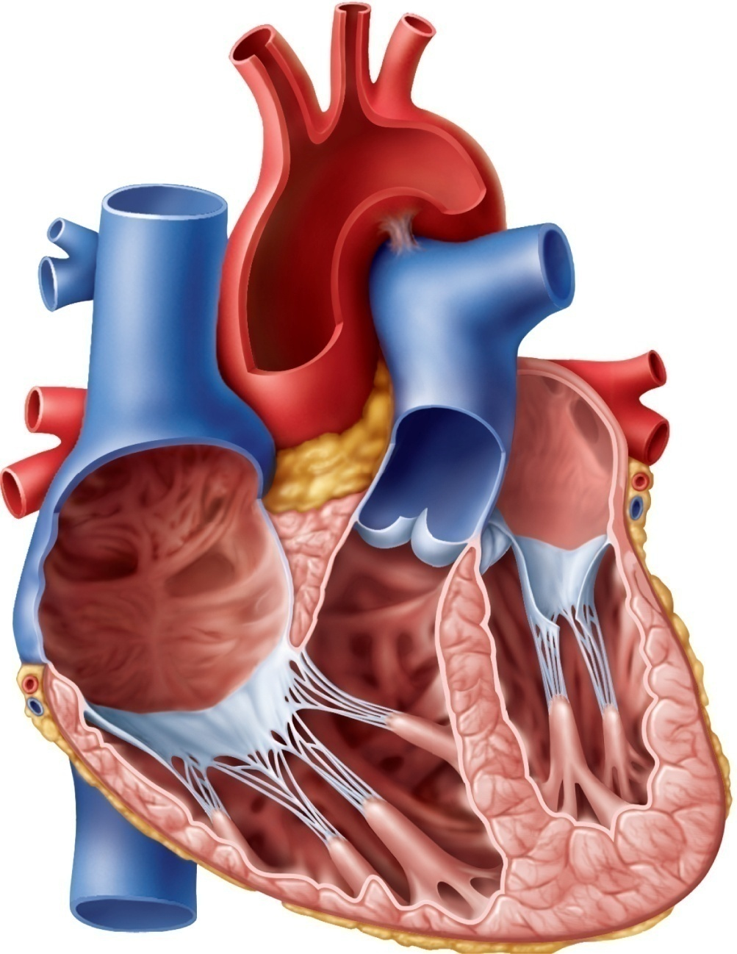
Fig. 19.7
Copyright © McGraw-Hill Education. Permission required for reproduction or display.
Aorta
Right pulmonary
artery
Left pulmonary artery
Superior vena cava
Pulmonary trunk
Right pulmonary
veins
Left pulmonary veins
Interatrial
septum
Pulmonary valve
Left atrium
Right atrium
Aortic valve
Fossa ovalis
Left AV valve
Pectinate muscles
Right AV valve
Left ventricle
Papillary muscle
Tendinous cords
Interventricular septum
Endocardium
Trabeculae carneae
Myocardium
Right ventricle
Inferior vena cava
Epicardium
Notes:
7

Slide 8
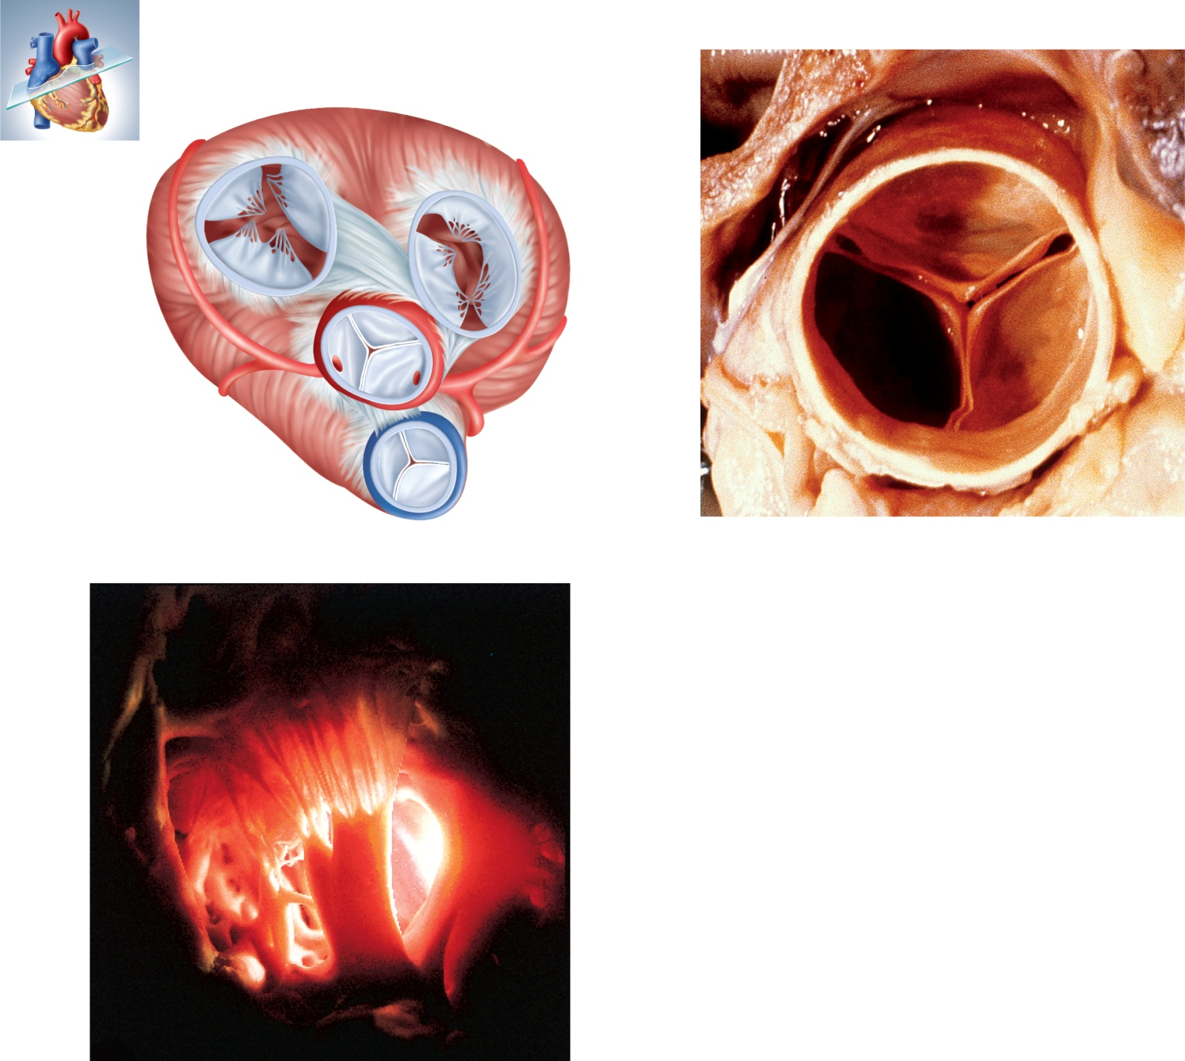
Fig. 19.8
Copyright © McGraw-Hill Education. Permission required for reproduction or display.
Left AV
(mitral) valve
Right AV
(tricuspid) valve
Fibrous
skeleton
Openings to
coronary arteries
Aortic
valve
Pulmonary
valve
(a)
(b)
Tendinous
cords
Papillary
muscle
(c)
b: ©Photo Researchers/Biophoto Associates/Getty Images; c: ©The McGraw-Hill Companies, Inc.
Notes:
8

Slide 9
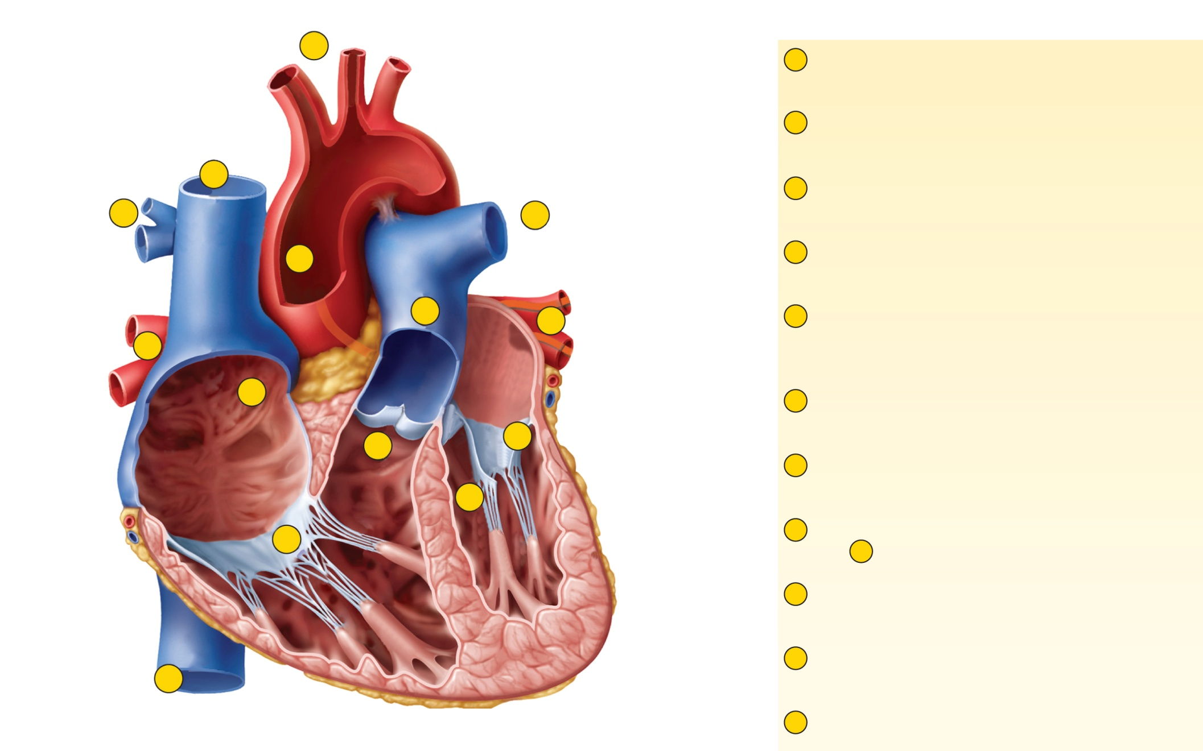




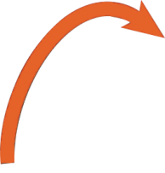
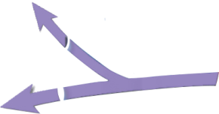



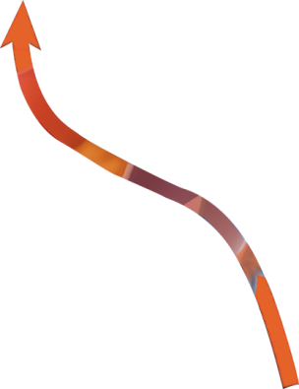
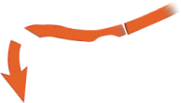





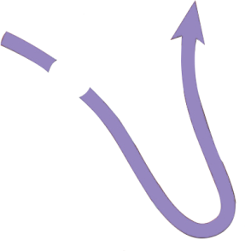


Fig. 19.9
Copyright © McGraw-Hill Education. Permission required for reproduction or display.
10
1
Blood enters right atrium from superior
and inferior venae cavae.
Aorta
2
Blood in right atrium flows through right
AV valve into right ventricle.
Left pulmonary
artery
11
3
Contraction of right ventricle forces
pulmonary valve open.
5
5
9
Pulmonary trunk
4
Blood flows through pulmonary valve
into pulmonary trunk.
Superior
vena cava
4
6
Left pulmonary
veins
5
Blood is distributed by right and left
pulmonary arteries to the lungs, where it
unloads CO₂ and loads O₂ .
Right
pulmonary
veins
6
1
Left atrium
Aortic valve
6
Blood returns from lungs via pulmonary
veins to left atrium.
3
7
Left AV valve
Right
atrium
7
Blood in left atrium flows through left AV
valve into left ventricle.
8
2
Left ventricle
8
Contraction of left ventricle (simultaneous with
step ) forces aortic valve open.
Right AV
valve
3
Right
ventricle
9
Blood flows through aortic valve into
ascending aorta.
Inferior
vena cava
10
Blood in aorta is distributed to every organ in
the body, where it unloads O₂ and loads CO₂.
11
11
Blood returns to right atrium via venae cavae.
Notes:
9

Slide 10
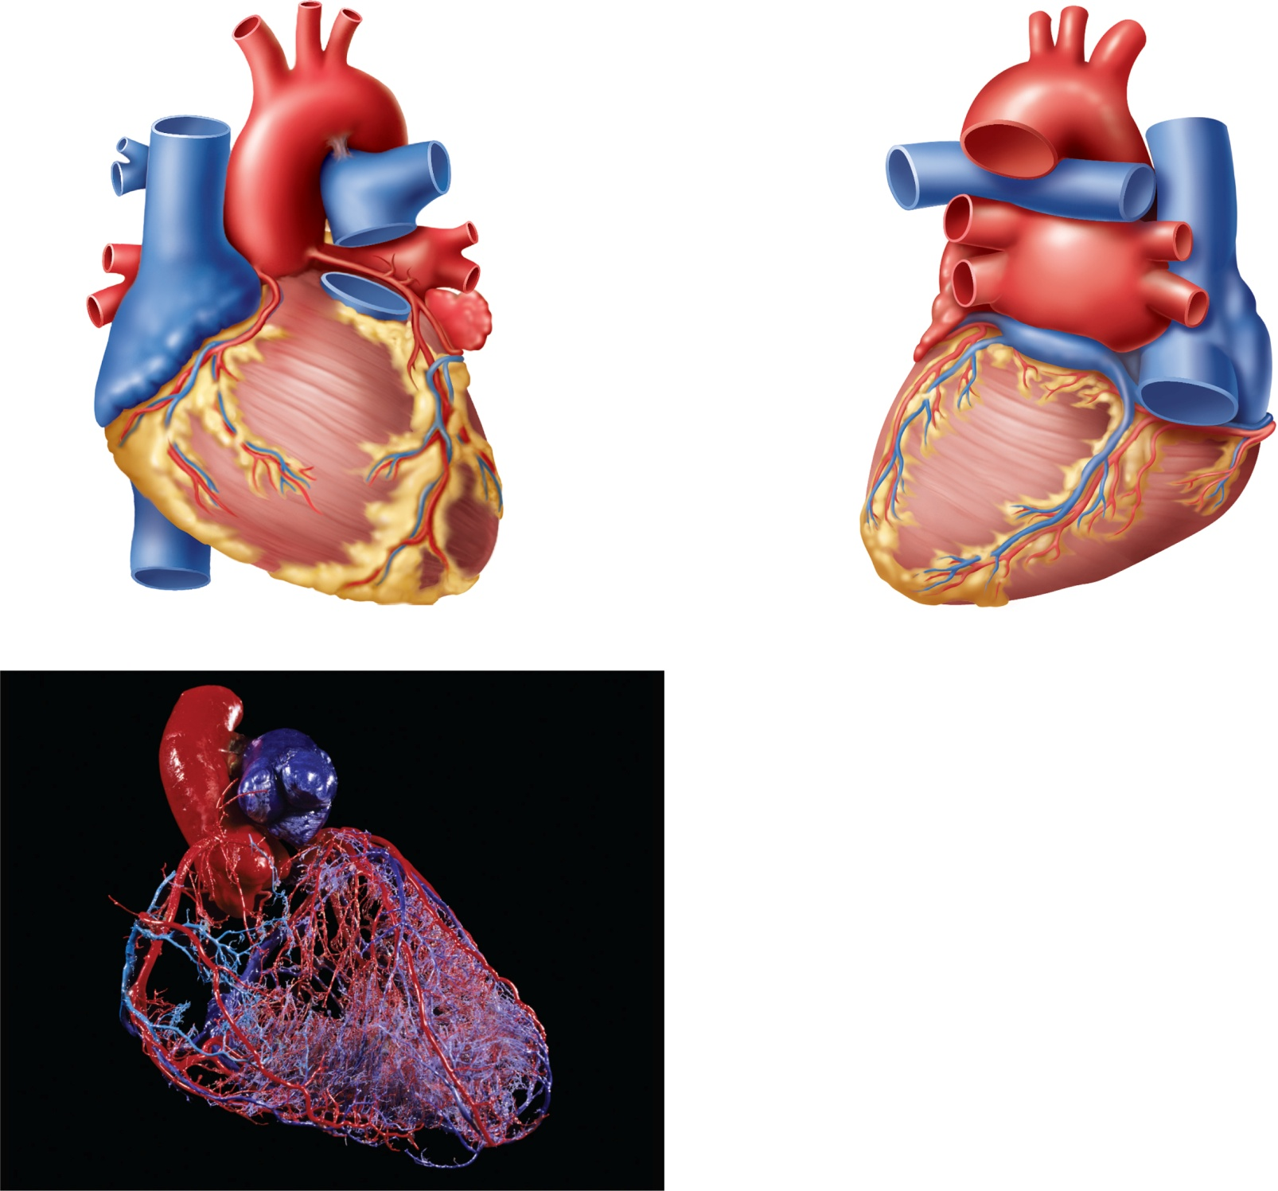
Fig. 19.10
Copyright © McGraw-Hill Education. Permission required for reproduction or display.
Left coronary
artery (LCA)
Great cardiac
vein
Left auricle
(reflected)
Circumflex
branch of
LCA
Right
coronary
artery
(RCA)
Circumflex
branch
of LCA
Coronary
sinus
Right coronary
artery (RCA)
Great cardiac
vein
Left marginal
branch of
LCA
Right marginal
branch of RCA
Right
marginal
branch
of RCA
Left marginal
vein
Posterior
interventricular
branch of RCA
Anterior
interventricular
branch of LCA
Posterior
interventricular
vein
(a) Anterior view
(b) Posterior view
(c)
c: © Visuals Unlimited
Notes:
10

Slide 11
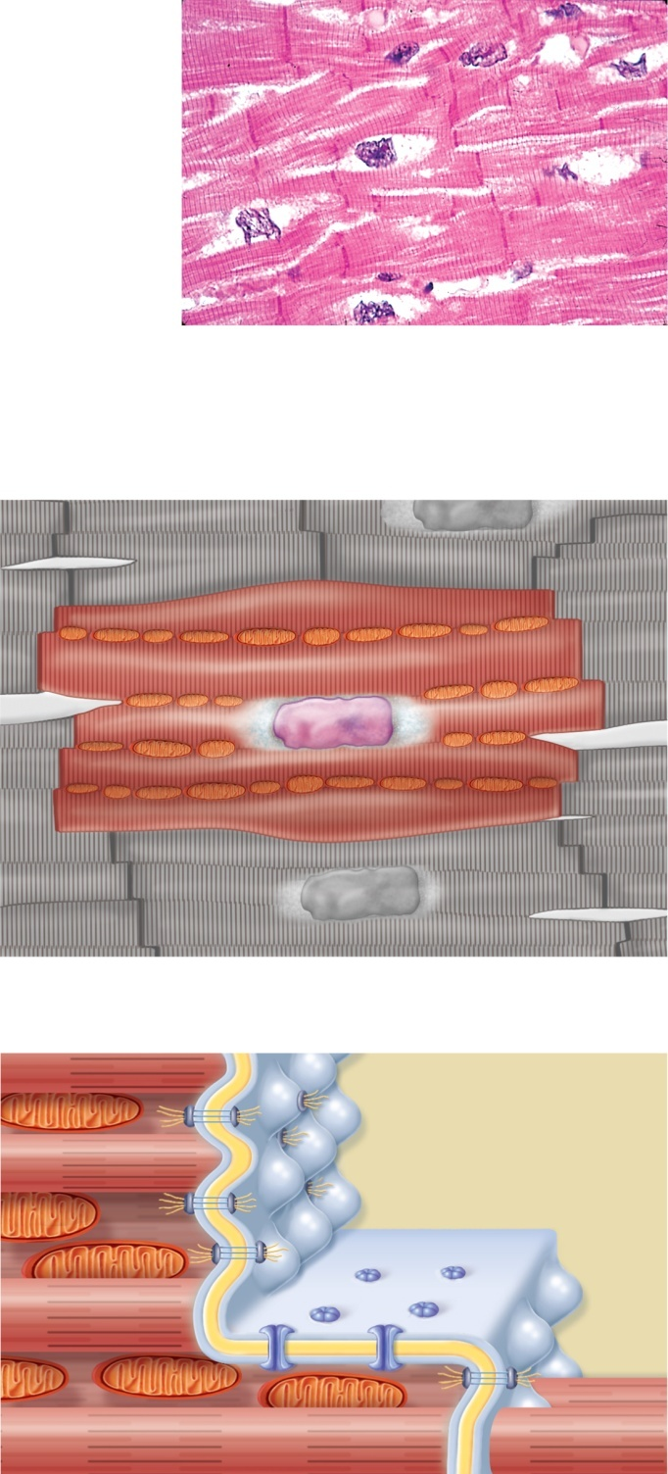

Fig. 19.11
Copyright © McGraw-Hill Education. Permission required for reproduction or display.
Striations
Nucleus
Intercalated discs
(a)
Striated myofibril
Glycogen
Nucleus
Mitochondria
Intercalated
discs
(b)
Intercellular space
Desmosomes
Gap junctions
(c)
a: ©Ed Reschke
Notes:
11

Slide 12
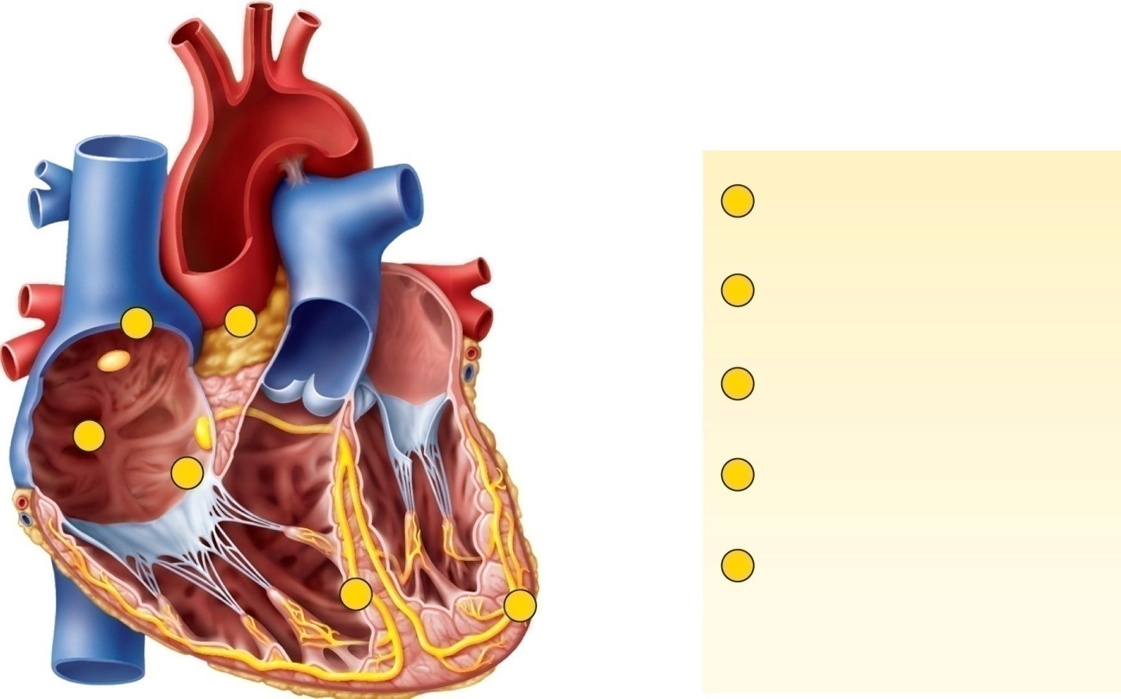










Fig. 19.12
Copyright © McGraw-Hill Education. Permission required for reproduction or display.
1
SA node fires.
2
Excitation spreads through
atrial myocardium.
Right atrium
1
2
Sinoatrial node
(pacemaker)
Left
atrium
3
AV node fires.
2
3
Purkinje
fibers
4
Excitation spreads down AV
bundle.
Atrioventricular
node
Bundle
branches
Atrioventricular
bundle
5
Purkinje fibers distribute
excitation through
ventricular myocardium.
4
5
Purkinje fibers
Notes:
12

Slide 13
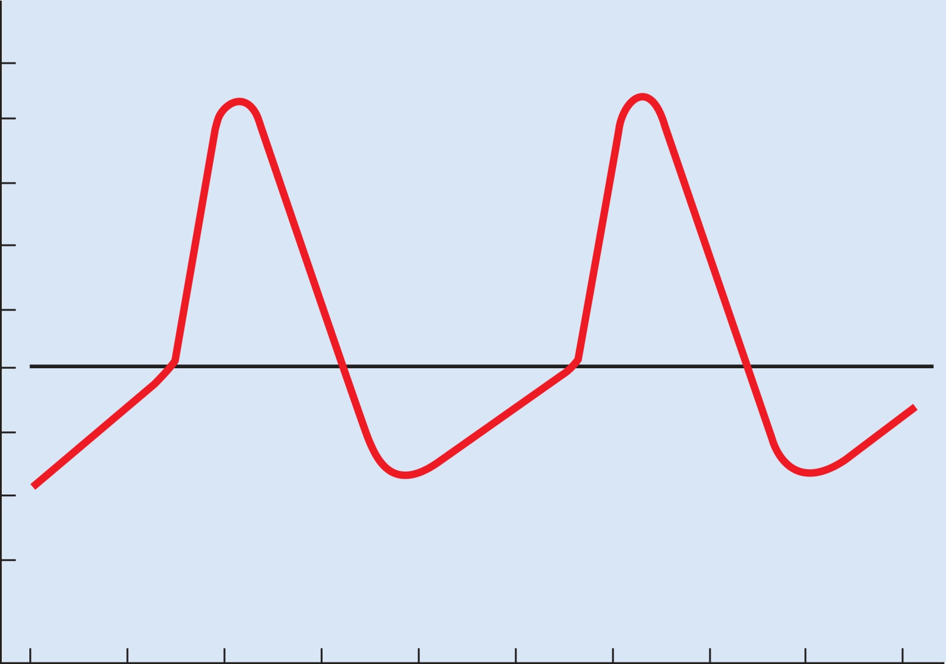
Fig. 19.13
Copyright © McGraw-Hill Education. Permission required for reproduction or display.
+10
0
–10
Ca²⁺ –Na⁺
K⁺
inflow
outflow
Action
potential
–20
–30
Threshold
Membrane potential (mV)
–40
–50
Pacemaker
potential
–60
Slow Na⁺
inflow
–70
0
.4
.8
1.2
1.6
Time (seconds)
Notes:
13

Slide 14
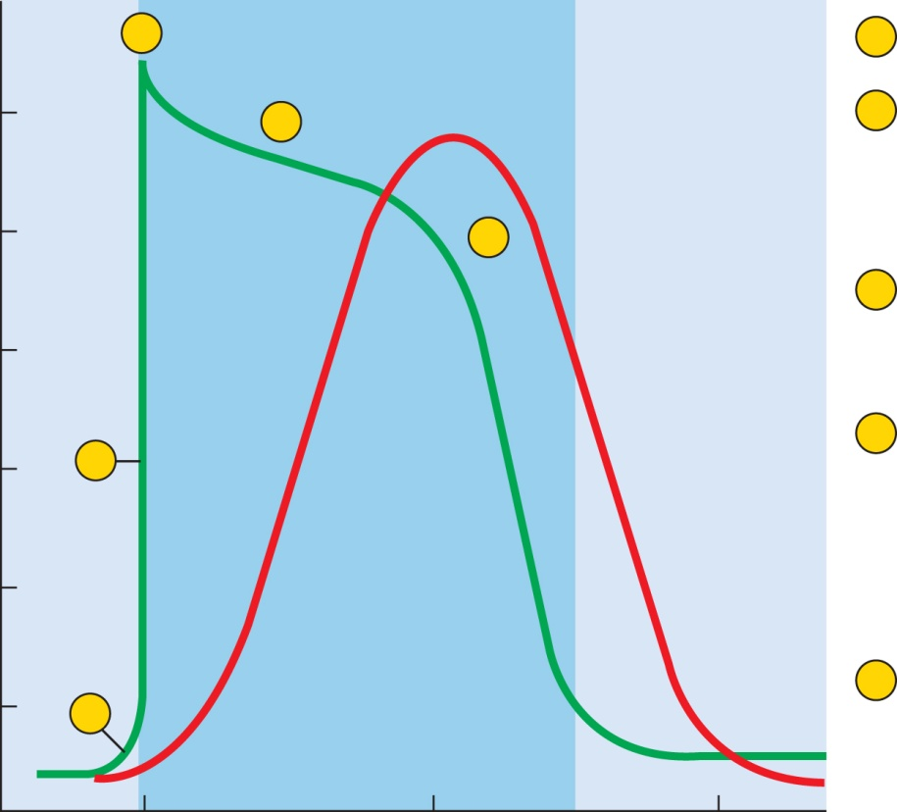
Fig. 19.14
Copyright © McGraw-Hill Education. Permission required for reproduction or display.
3
Plateau
1
Voltage-gated Na⁺ channels open.
+20
4
2
Na⁺ inflow depolarizes the membrane
and triggers the opening of still more Na⁺
channels, creating a positive feedback
cycle and a rapidly rising membrane voltage.
0
Action
potential
5
3
Na⁺ channels close when the cell
depolarizes, and the voltage peaks at
nearly +30 mV.
–20
Myocardial
relaxation
Membrane potential (mV)
2
4
Ca²⁺ entering through slow Ca²⁺
channels prolongs depolarization of
membrane, creating a plateau. Plateau falls
slightly because of some K⁺ leakage, but most
K⁺ channels remain closed until end of
plateau.
–40
Myocardial
contraction
–60
Absolute
refractory
period
–80
5
Ca²⁺ channels close and Ca²⁺ is transported
out of cell. K⁺ channels open, and rapid K⁺
outflow returns membrane to its resting
potential.
1
0
.15
.30
Time (seconds)
Notes:
14

Slide 15
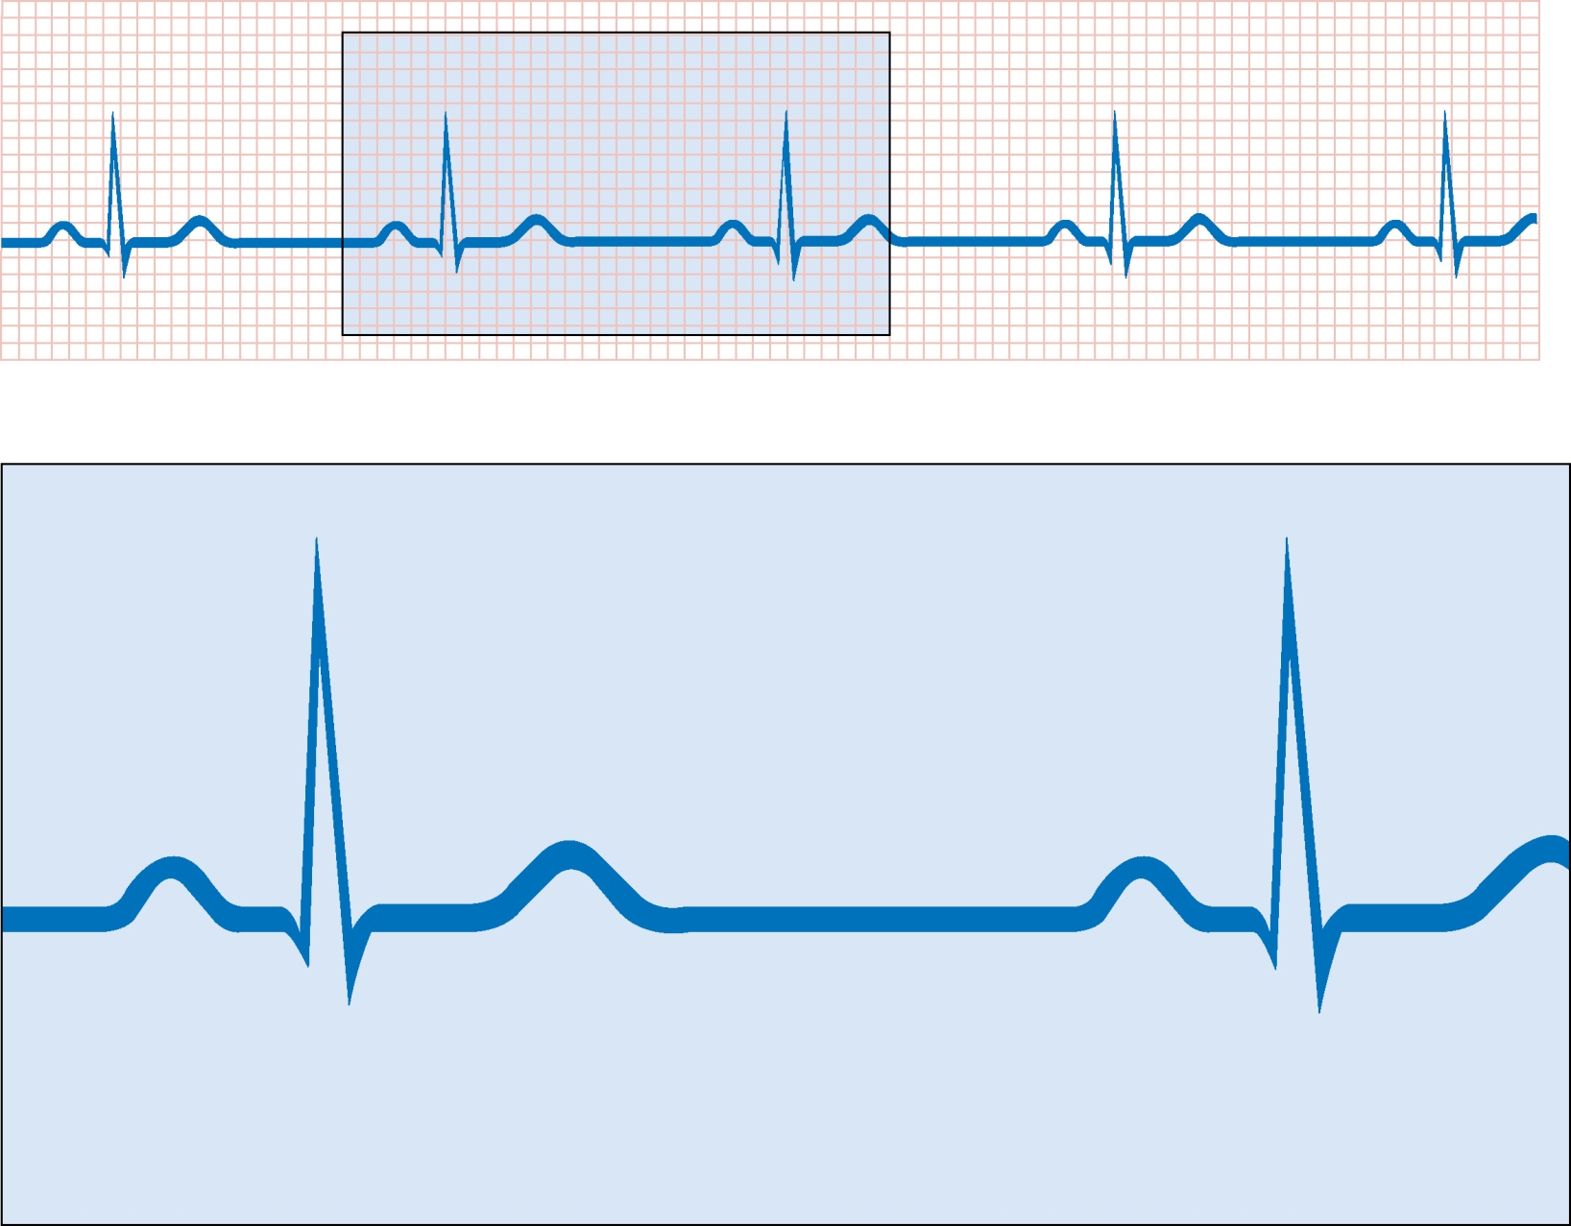

Fig. 19.15
Copyright © McGraw-Hill Education. Permission required for reproduction or display.
0.8 second
R
R
+1 –
PQ
segment
ST
segment
Millivolts
P wave
T wave
0
PR
interval
Q
S
QT
interval
QRS interval
–1
Atria
contract
Ventricles
contract
Atria
contract
Ventricles
contract
Notes:
15

Slide 16
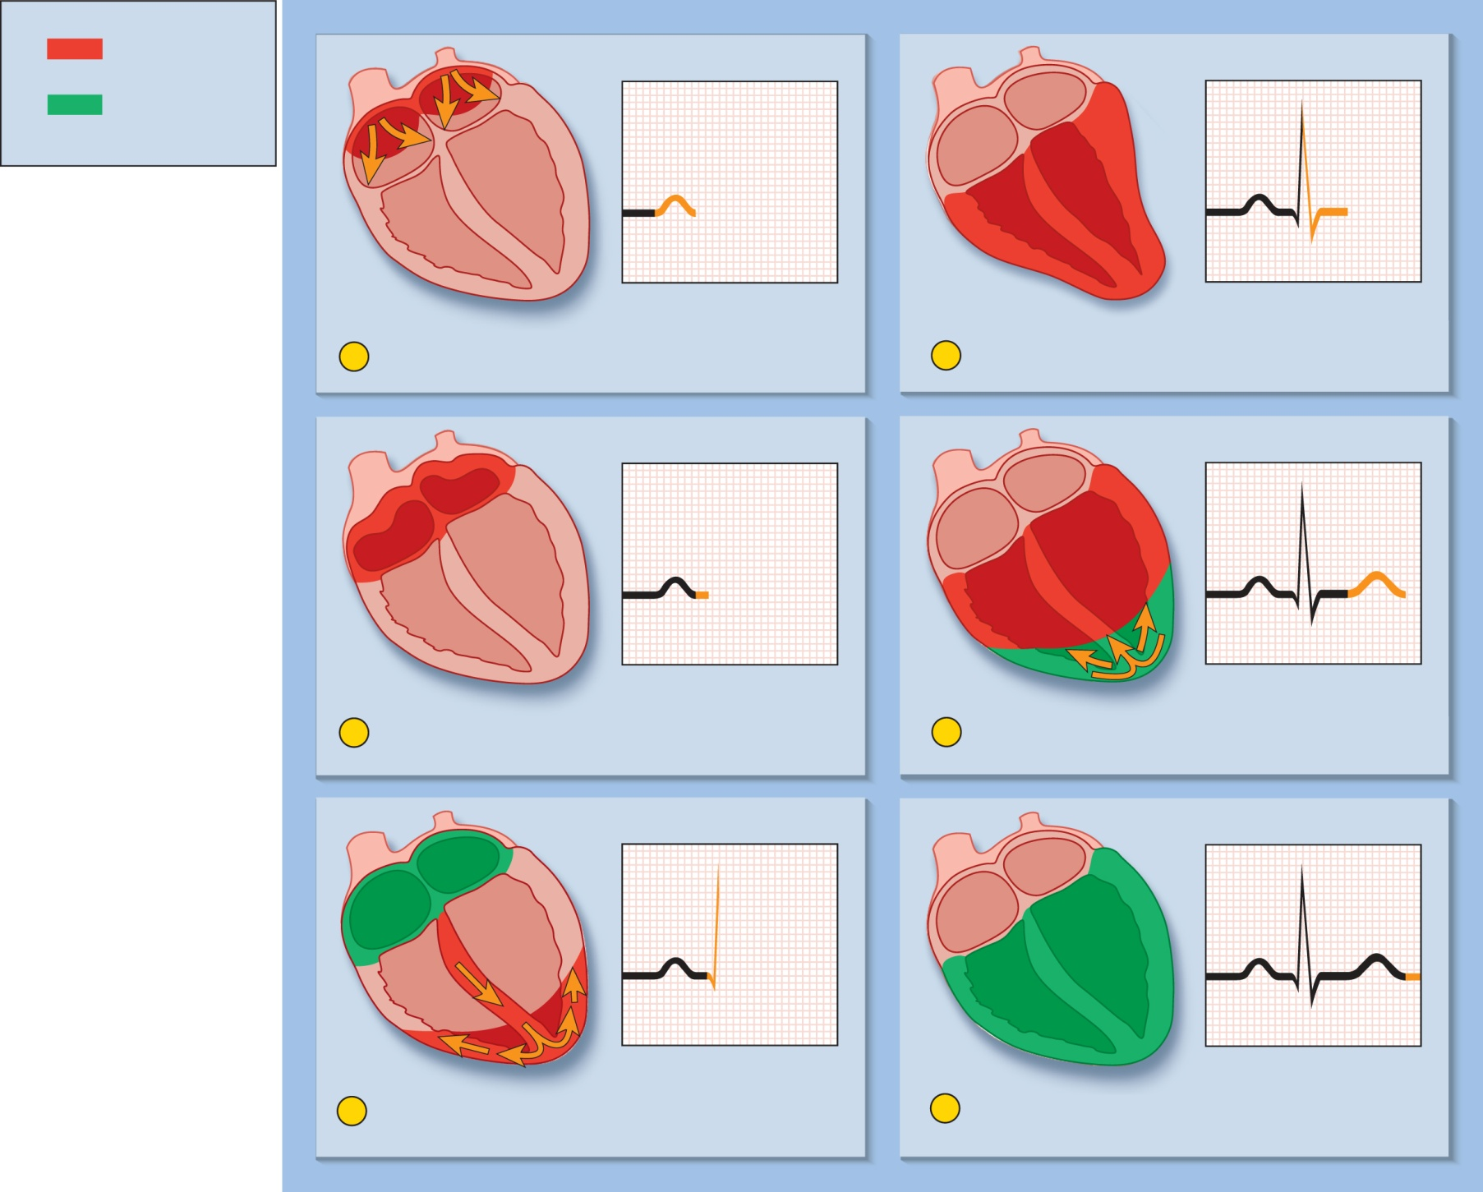
Fig. 19.16
Copyright © McGraw-Hill Education. Permission required for reproduction or display.
Key
Wave of
depolarization
Wave of
repolarization
R
P
P
Q
S
1
Atria begin depolarizing.
4
Ventricular depolarization complete.
R
P
P
T
Q
S
2
Atrial depolarization complete.
5
Ventricular repolarization begins at apex and
progresses superiorly.
R
R
P
P
T
Q
Q
S
3
Ventricular depolarization begins at apex and
progresses superiorly as atria repolarize.
6
Ventricular repolarization complete; heart is
ready for the next cycle.
Notes:
16

Slide 17
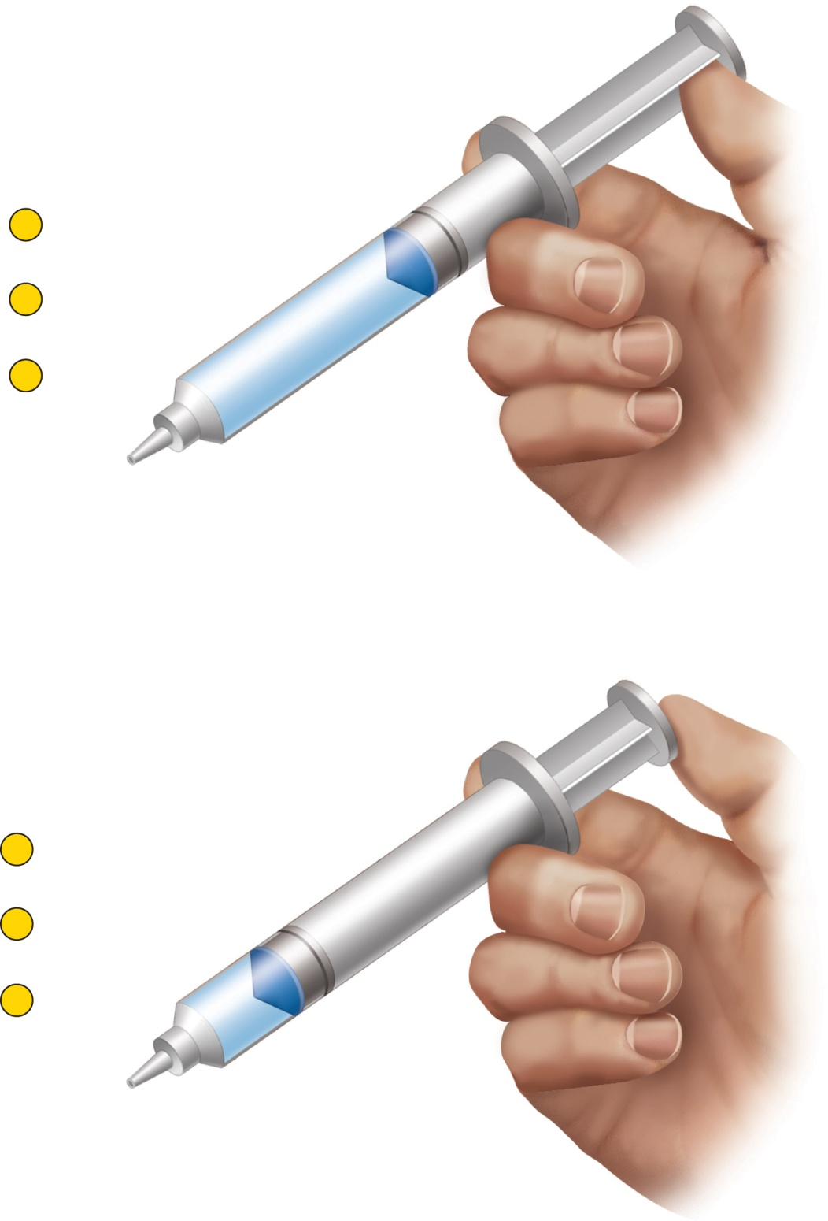
Fig. 19.18
Copyright © McGraw-Hill Education. Permission required for reproduction or display.
1
Volume
increases
2
Pressure
decreases
3
Air flows in
P₁
P₂ > P₁
P₂
Pressure gradient
(a)
1
Volume
decreases
2
Pressure
increases
3
Air flows out
P₁
P₂ < P₁
Pressure gradient
(b)
P₂
Notes:
17

Slide 18
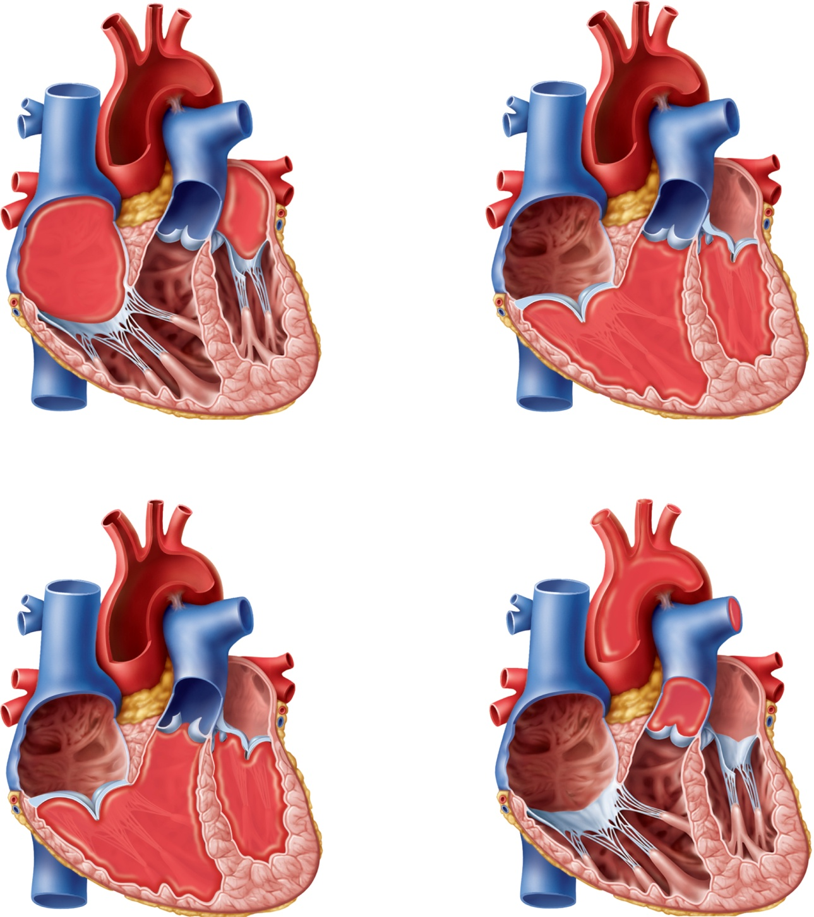








Fig. 19.19
Copyright © McGraw-Hill Education. Permission required for reproduction or display.
Atrium
Atrioventricular
valve
Ventricle
Atrioventricular valves open
Atrioventricular valves closed
(a)
Aorta
Pulmonary
artery
Semilunar
valve
Semilunar valves open
Semilunar valves closed
(b)
Notes:
18

Slide 19
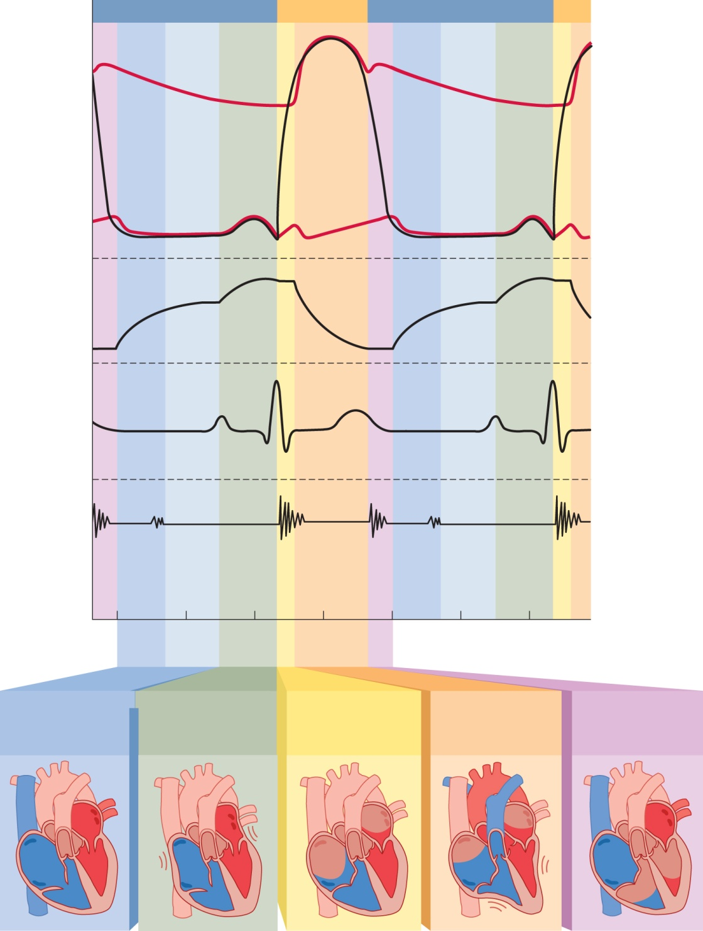
Fig. 19.20
Copyright © McGraw-Hill Education. Permission required for reproduction or display.
Diastole
Systole
Diastole
120
Aortic
pressure
100
80
Aortic
valve
opens
Aortic valve
closes
(dicrotic notch)
Pressure (mm Hg)
Left
ventricular
pressure
60
40
AV
valve
closes
AV
valve
opens
20
Left atrial
pressure
0
120
End-diastolic
volume
Ventricular
volume (mL)
90
60
End-systolic volume
R
R
P
T
P
ECG
Q
S
Q
S
Heart
sounds
S₂
S₃
S₁
S₂
S₃
S₁
Phase of
cardiac cycle
1a
1b
1c
2
3
4
1a
1b
1c
2
0
.2
.4
.6
.8
.2
.4
Time (seconds)
Ventricular filling
2
3
4
1a Rapid filling
1b Diastasis
1c Atrial systole
Isovolumetric
contraction
Ventricular
ejection
Isovolumetric
relaxation
Notes:
19

Slide 20
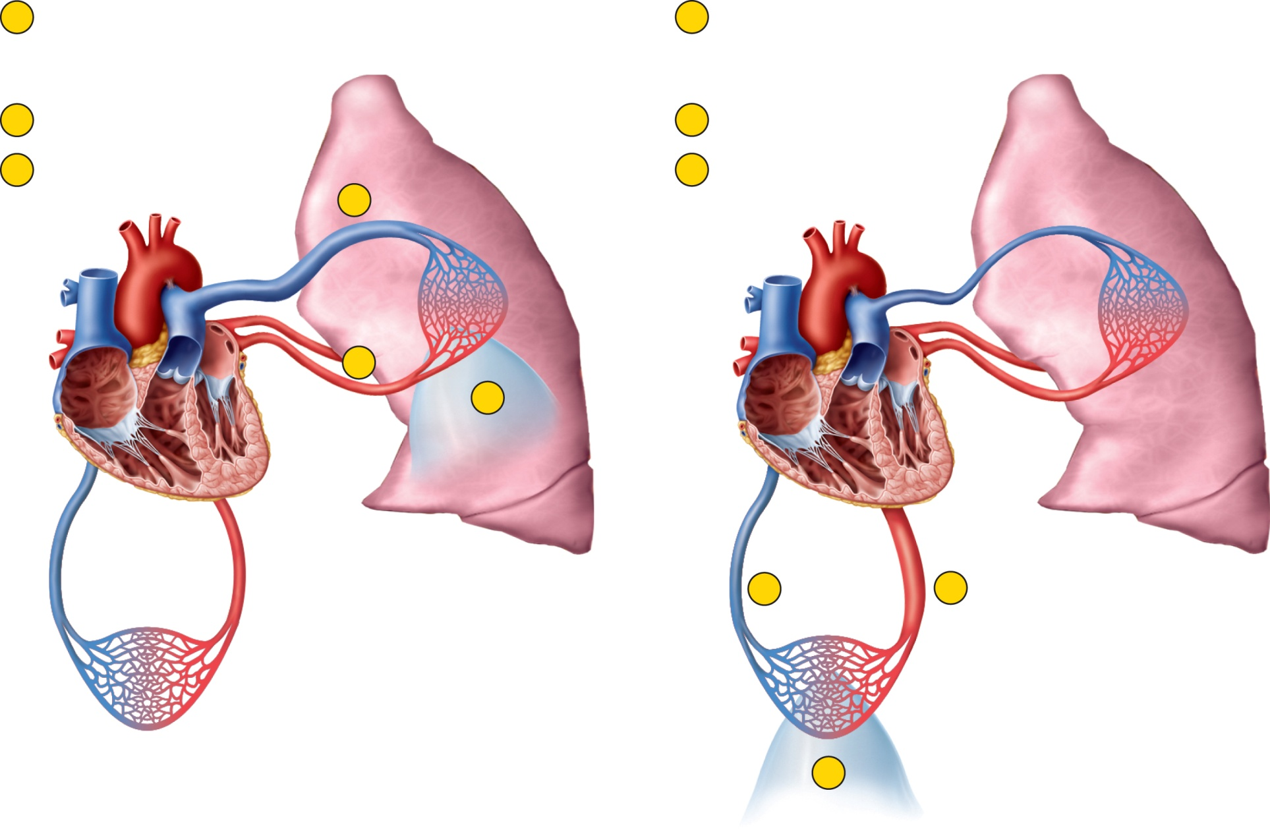




Fig. 19.21
Copyright © McGraw-Hill Education. Permission required for reproduction or display.
1
Right ventricular
output exceeds left
ventricular output.
1
Left ventricular
output exceeds right
ventricular output.
2
Pressure backs up.
2
Pressure backs up.
3
Fluid accumulates in
pulmonary tissue.
3
Fluid accumulates in
systemic tissue.
1
2
3
2
1
3
(a) Pulmonary edema
(b) Systemic edema
Notes:
20

