Slide 1
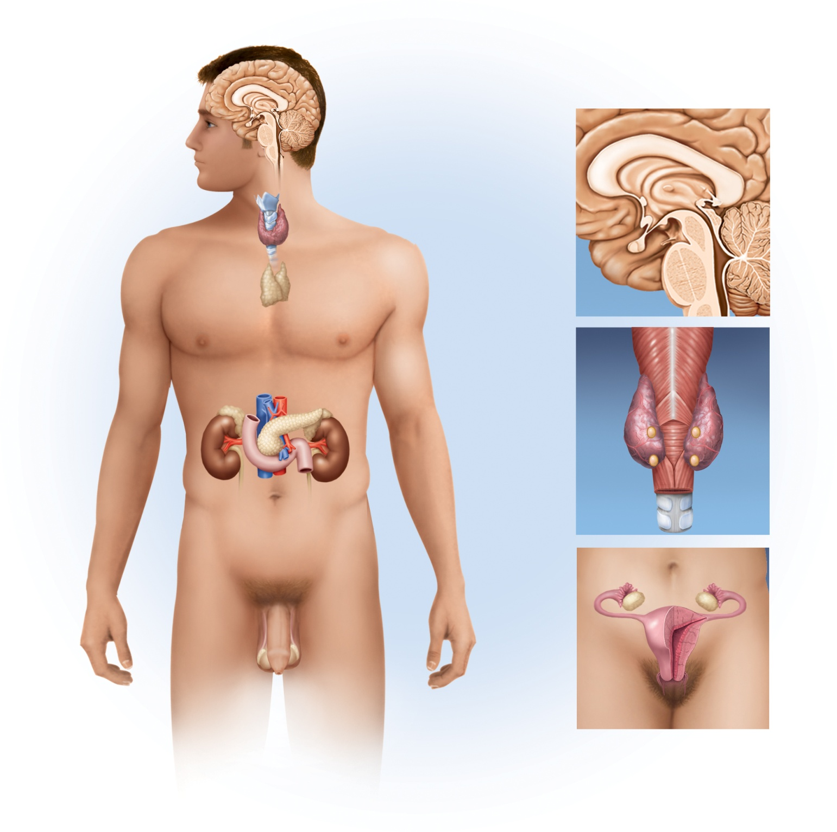

Fig. 17.1
Copyright © McGraw-Hill Education. Permission required for reproduction or display.
Pineal gland
Hypothalamus
Pituitary gland
Thyroid gland
Thymus
Adrenal gland
Pancreas
Parathyroid
glands
Posterior
view
Trachea
Gonads:
Ovary (female)
Testis (male)

Slide 2
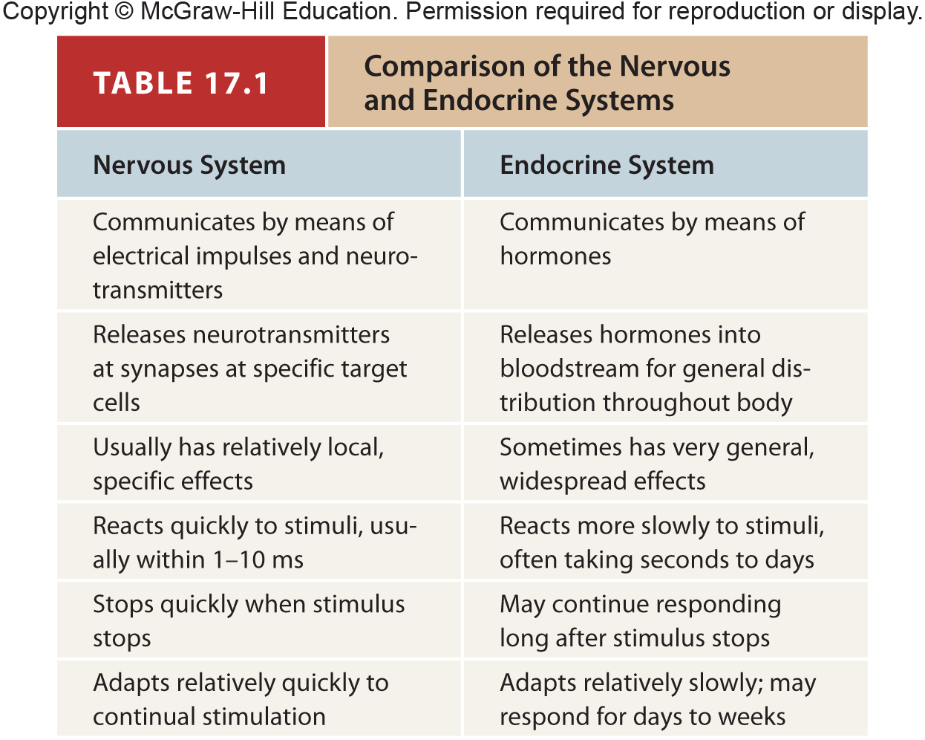
Table 17.1
Notes:
2

Slide 3
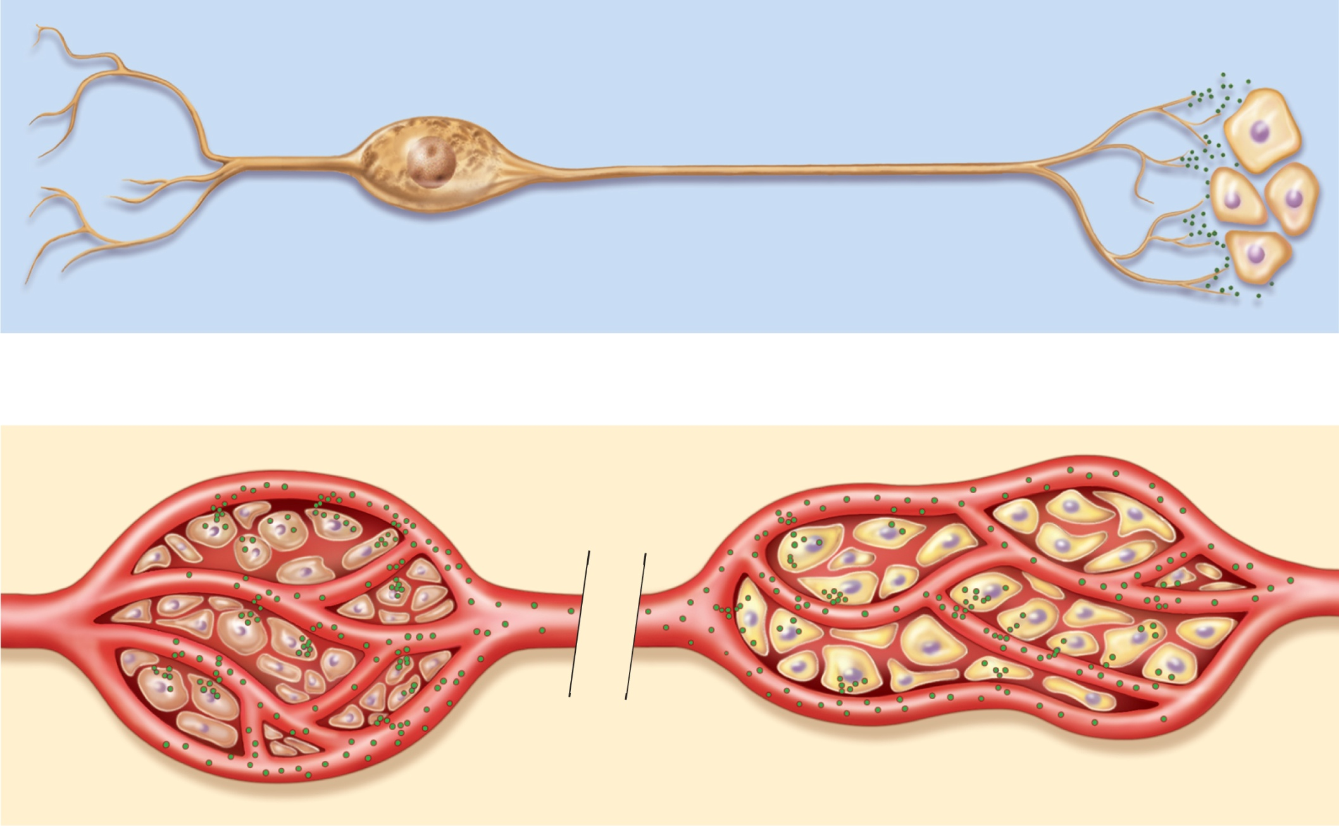
Fig. 17.2
Copyright © McGraw-Hill Education. Permission required for reproduction or display.
Neurotransmitter
Nerve impulse
Neuron
Target cells
(a) Nervous system
Endocrine
cells
Target cells
Hormone in
bloodstream
(b) Endocrine system
Notes:
3

Slide 4
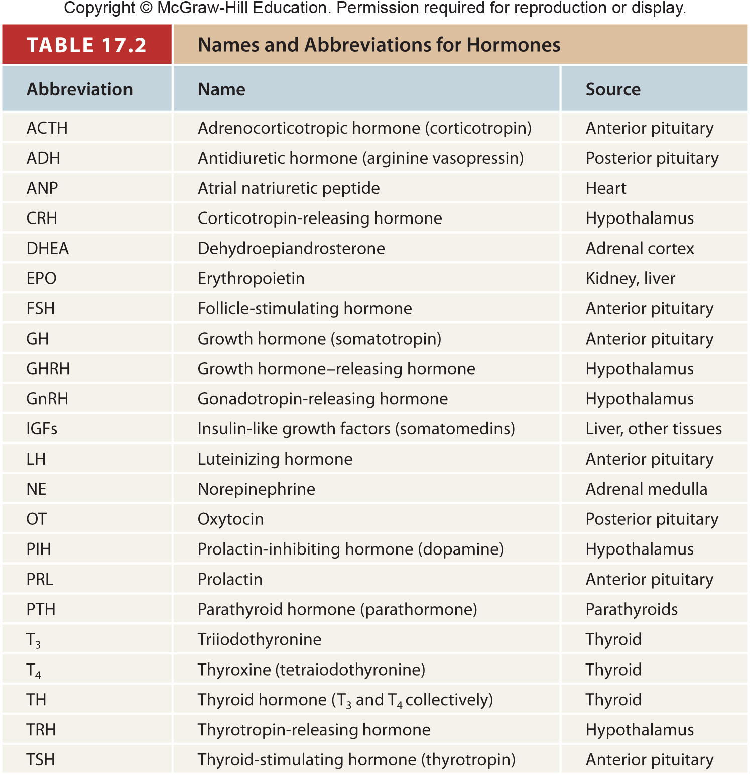
Table 17.2
Notes:
4

Slide 5
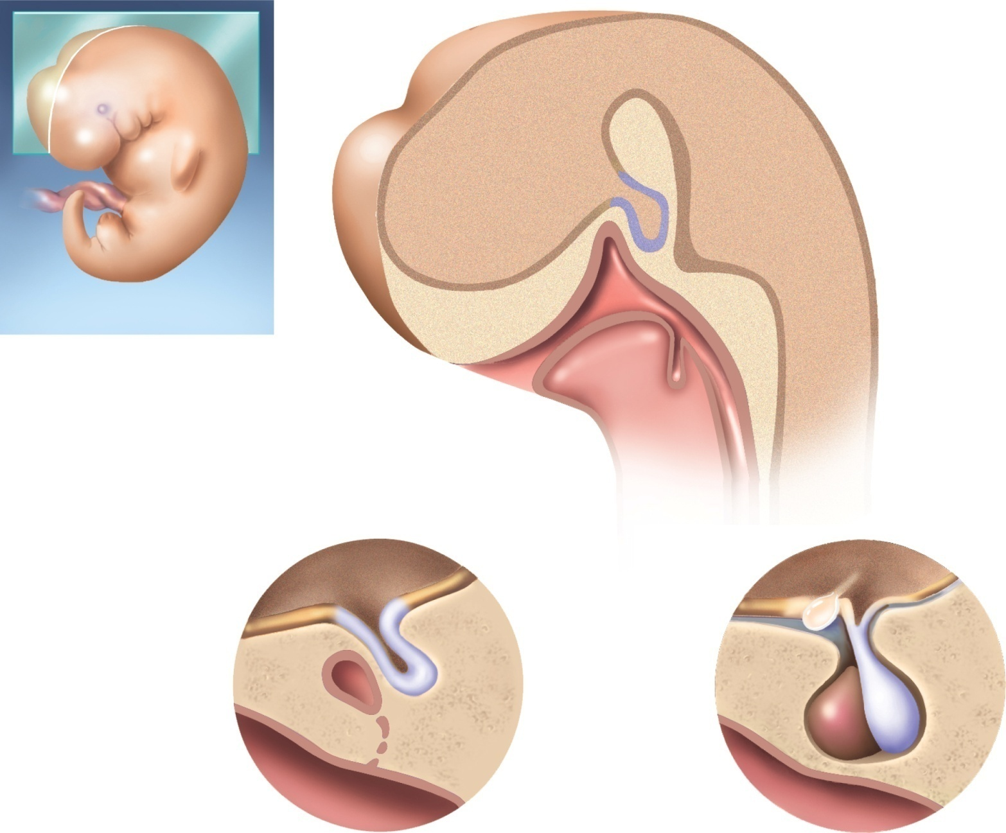


Fig. 17.3
Copyright © McGraw-Hill Education. Permission required for reproduction or display.
Telencephalon of brain
Future hypothalamus
Neurohypophyseal bud
Hypophyseal pouch
Pharynx
Tongue
Future thyroid
gland
Mouth
(a) 4 weeks
Hypothalamus
Hypothalamus
Optic chiasm
Neurohypophyseal
bud
Pituitary stalk
Posterior lobe
Hypophyseal pouch
Anterior lobe
Sphenoid bone
Pharynx
Pharynx
(b) 8 weeks
(c) 16 weeks
Notes:
5

Slide 6
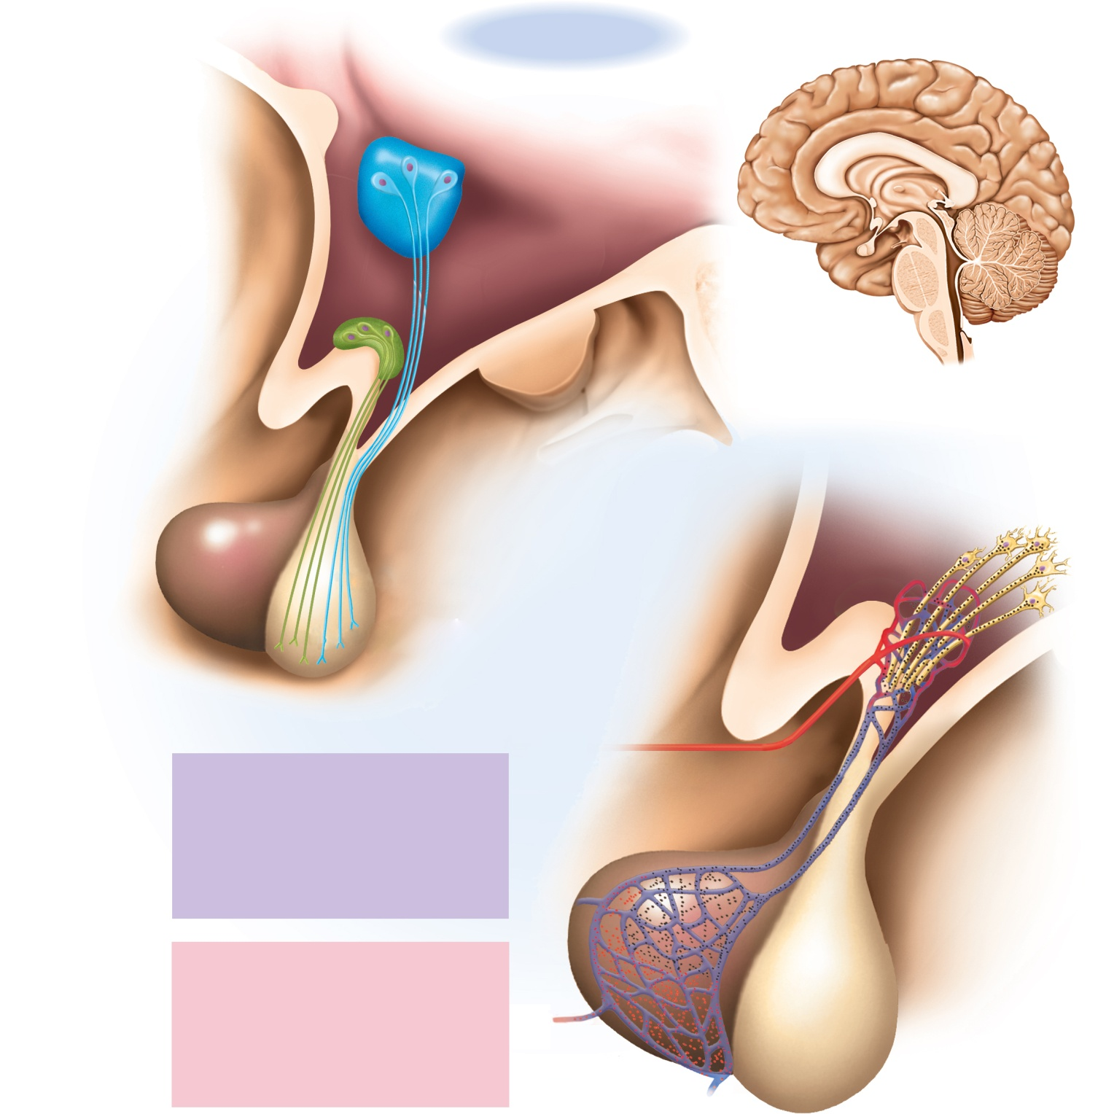





Fig. 17.4
Copyright © McGraw-Hill Education. Permission required for reproduction or display.
Anterior
Posterior
Third ventricle
of brain
Floor of
hypothalamus
Nuclei of hypothalamus:
Paraventricular nucleus
Supraoptic nucleus
Optic chiasm
Axons to
primary
capillaries
Neuron
cell body
Anterior pituitary
Posterior pituitary
Oxytocin
(a)
Antidiuretic hormone
Primary capillaries
Superior hypophyseal
artery
Hypothalamic hormones
Gonadotropin-releasing hormone
Thyrotropin-releasing hormone
Corticotropin-releasing hormone
Prolactin-inhibiting hormone
Growth hormone–releasing hormone
Somatostatin
Portal venules
Secondary
capillaries
Anterior lobe hormones
Anterior lobe
Follicle-stimulating hormone
Luteinizing hormone
Thyroid-stimulating hormone (thyrotropin)
Adrenocorticotropic hormone
Prolactin
Growth hormone
Posterior lobe
(b)
Notes:
6

Slide 7
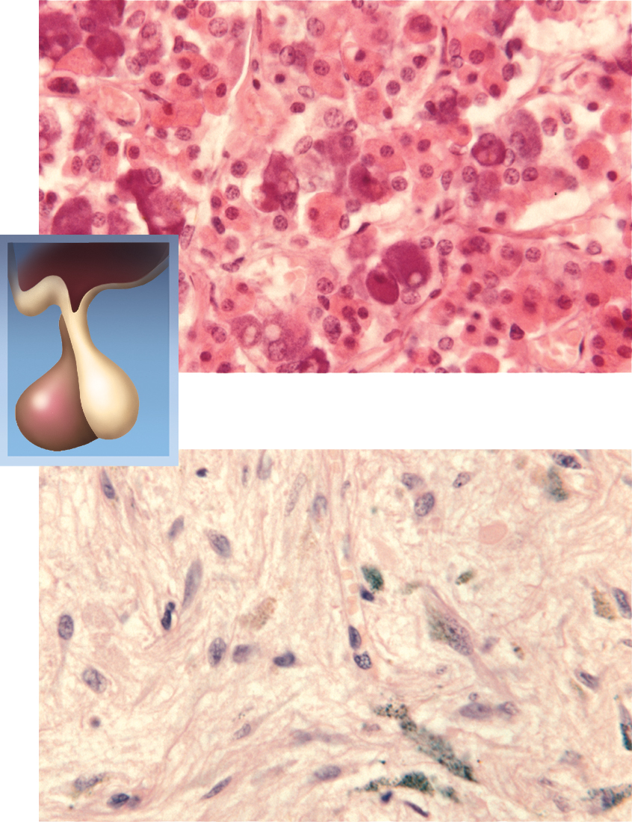


Fig. 17.5
Copyright © McGraw-Hill Education. Permission required for reproduction or display.
Chromophobe
Basophil
Acidophil
(a) Anterior pituitary
Unmyelinated
nerve fibers
Glial cells
(pituicytes)
(b) Posterior pituitary
a: ©Dr. John D. Cunningham/Visuals Unlimited; b: ©Science VU/Visuals Unlimited
Notes:
7

Slide 8
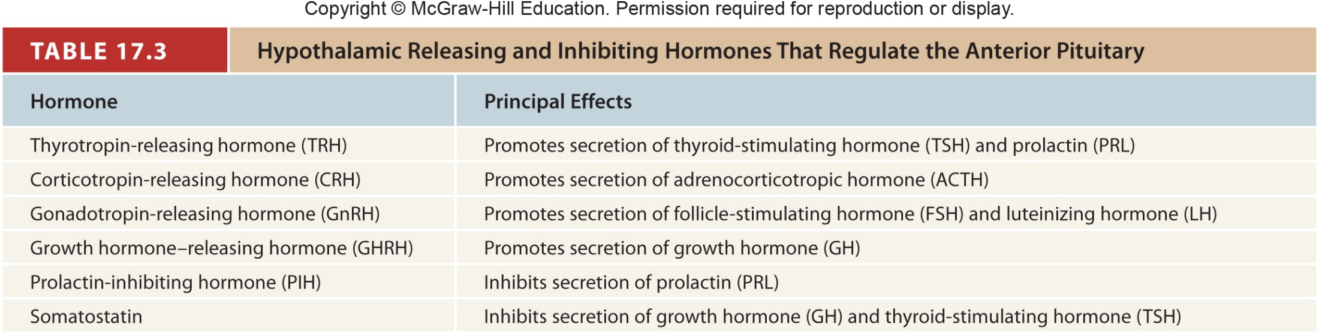
Table 17.3
Notes:
8

Slide 9
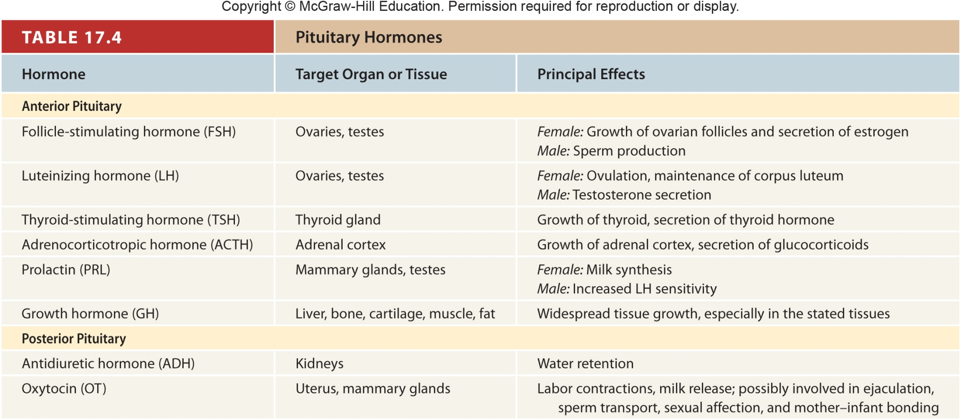
Table 17.4
Notes:
9

Slide 10
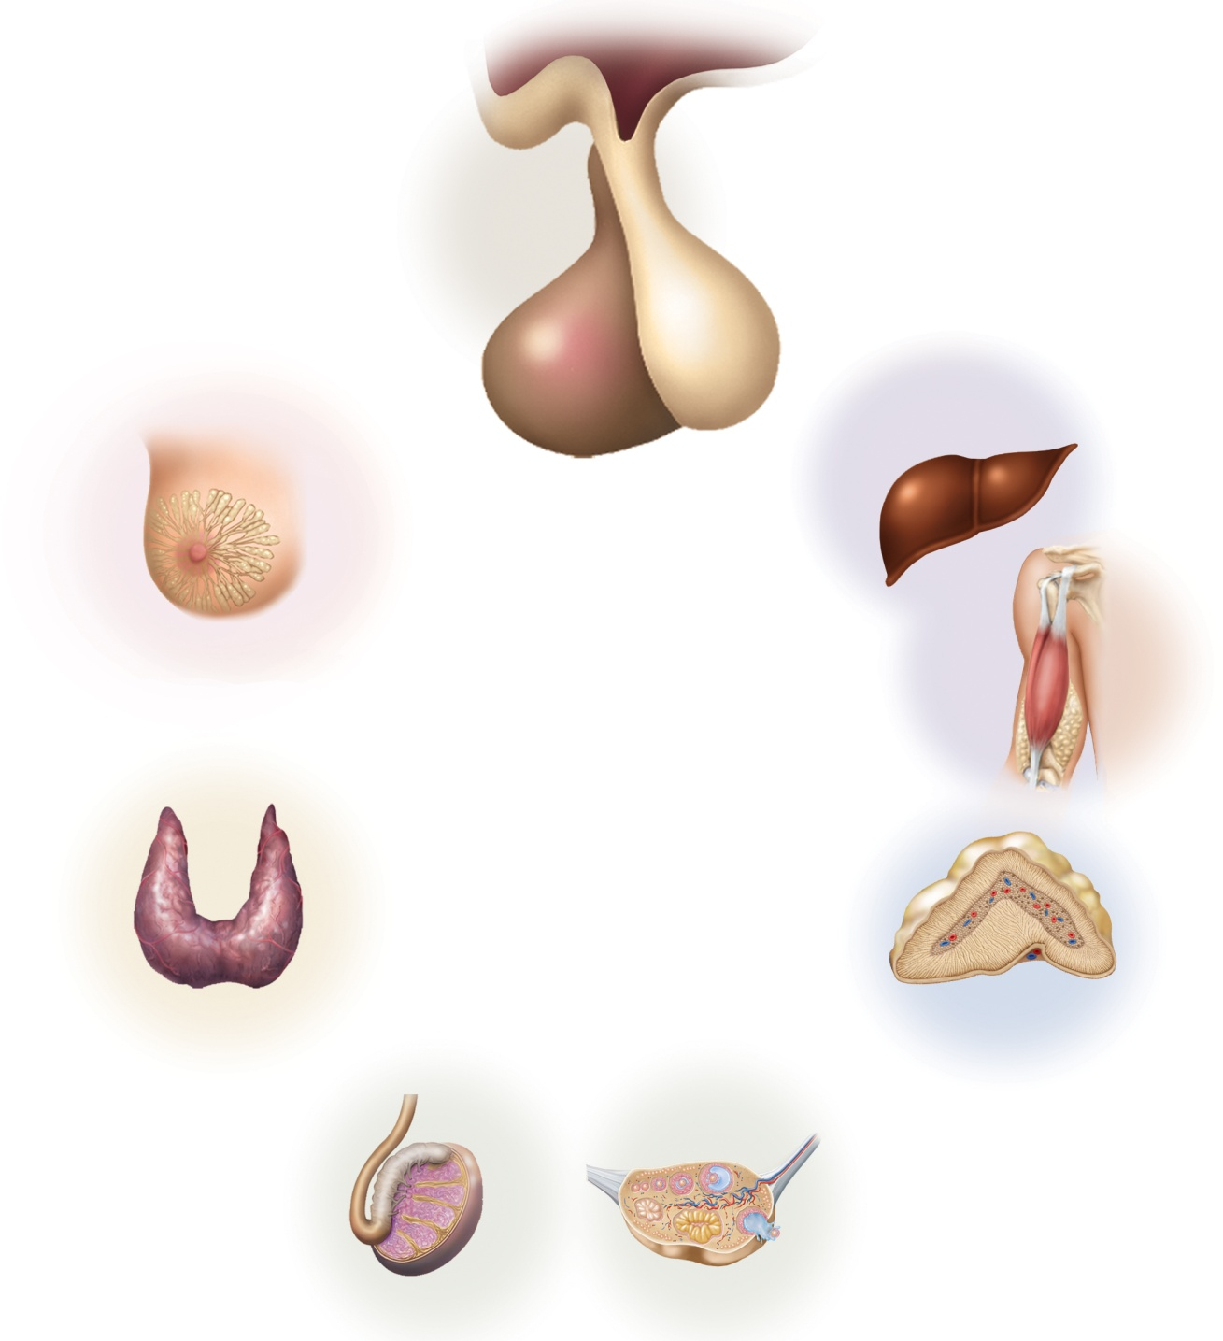

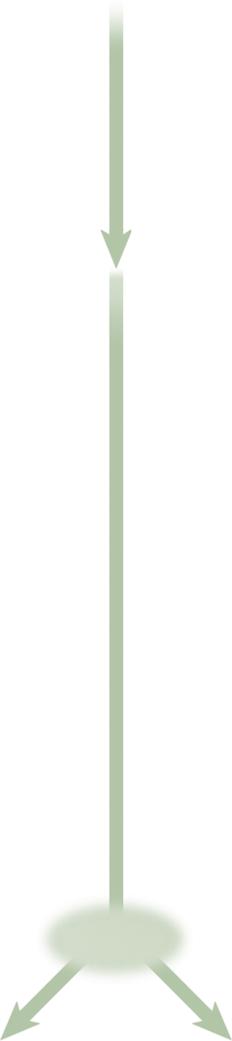
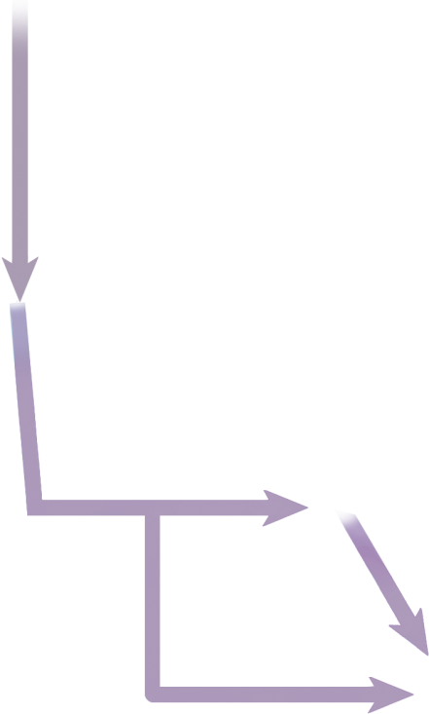
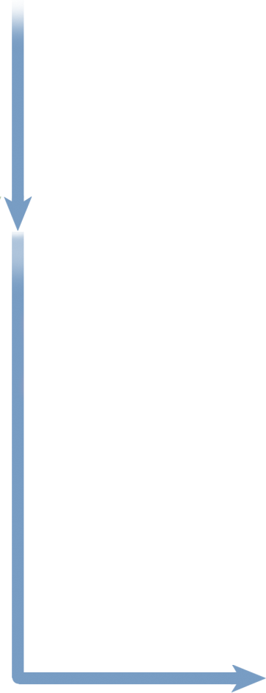

Fig. 17.6
Copyright © McGraw-Hill Education. Permission required for reproduction or display.
Hypothalamus
TRH
GnRH
CRH
GHRH
Liver
PRL
GH
IGF
Mammary
gland
Fat,
muscle,
bone
ACTH
TSH
Thyroid
Adrenal cortex
LH
FSH
Testis
Ovary
Notes:
10

Slide 11
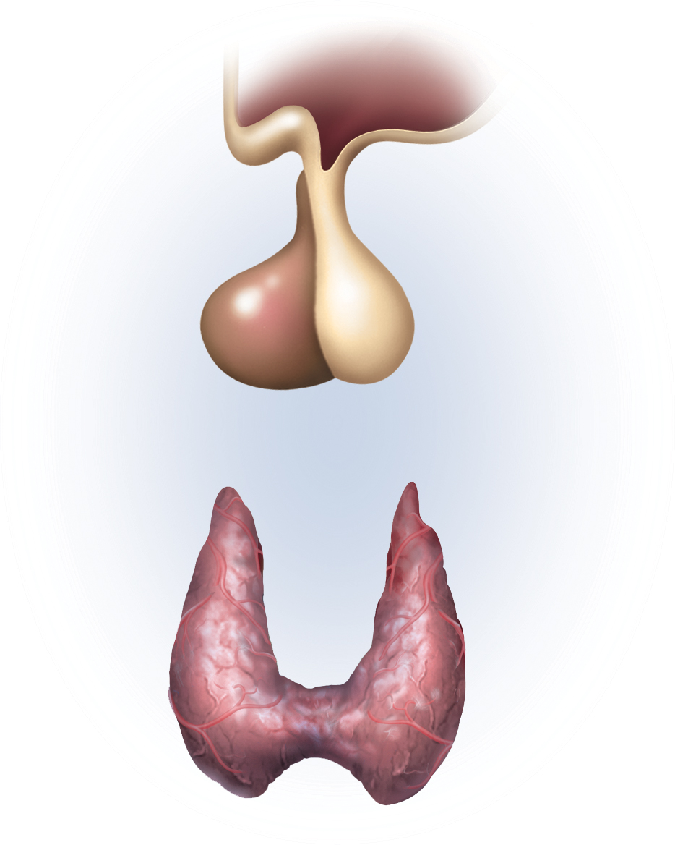

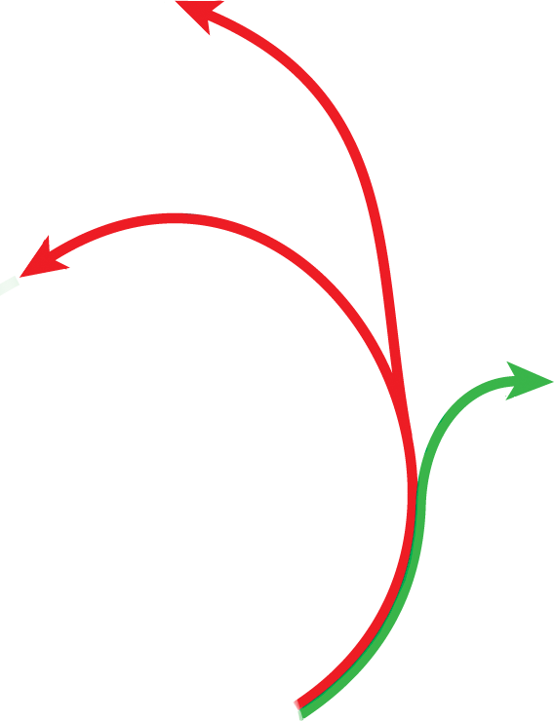

Fig. 17.7
Copyright © McGraw-Hill Education. Permission required for reproduction or display.
1
TRH
–
6
Negative feedback
inhibition
+
–
5
4
Target organs
2
+
TSH
Thyroid hormone
+
3
+
Stimulatory effect
–
Inhibitory effect
Notes:
11

Slide 12
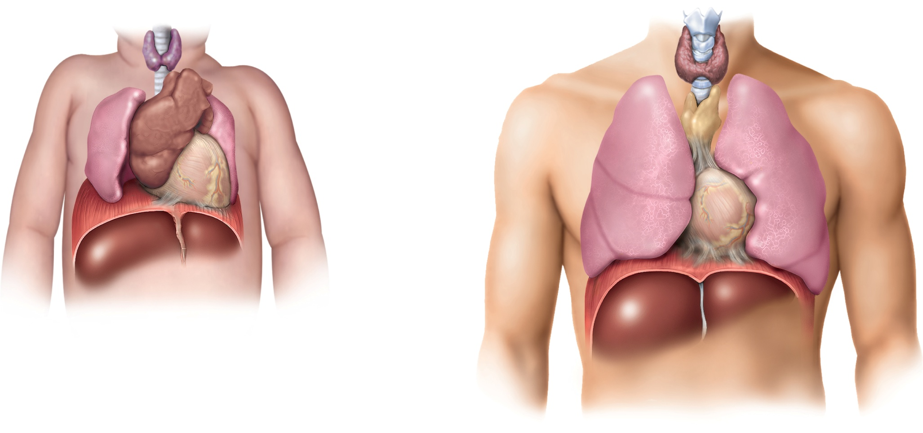
Fig. 17.8
Copyright © McGraw-Hill Education. Permission required for reproduction or display.
Thyroid
Trachea
Thymus
Lung
Heart
Diaphragm
(a) Newborn
Liver
(b) Adult
Notes:
12

Slide 13
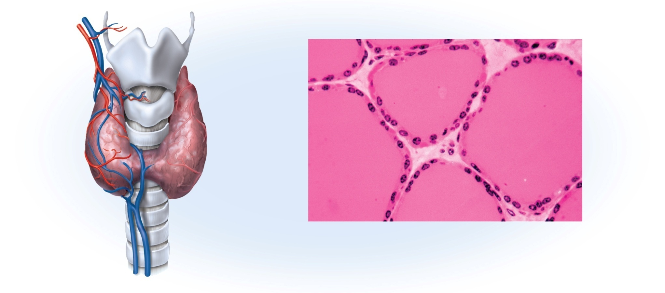
Fig. 17.9
Copyright © McGraw-Hill Education. Permission required for reproduction or display.
Superior thyroid
artery and vein
Thyroid
cartilage
Follicular
cells
Thyroid
gland
Colloid of
thyroglobulin
C (parafollicular)
cells
Isthmus
Follicle
Inferior thyroid vein
Trachea
(a)
(b)
b: ©Robert Calentine/Visuals Unlimited
Notes:
13

Slide 14
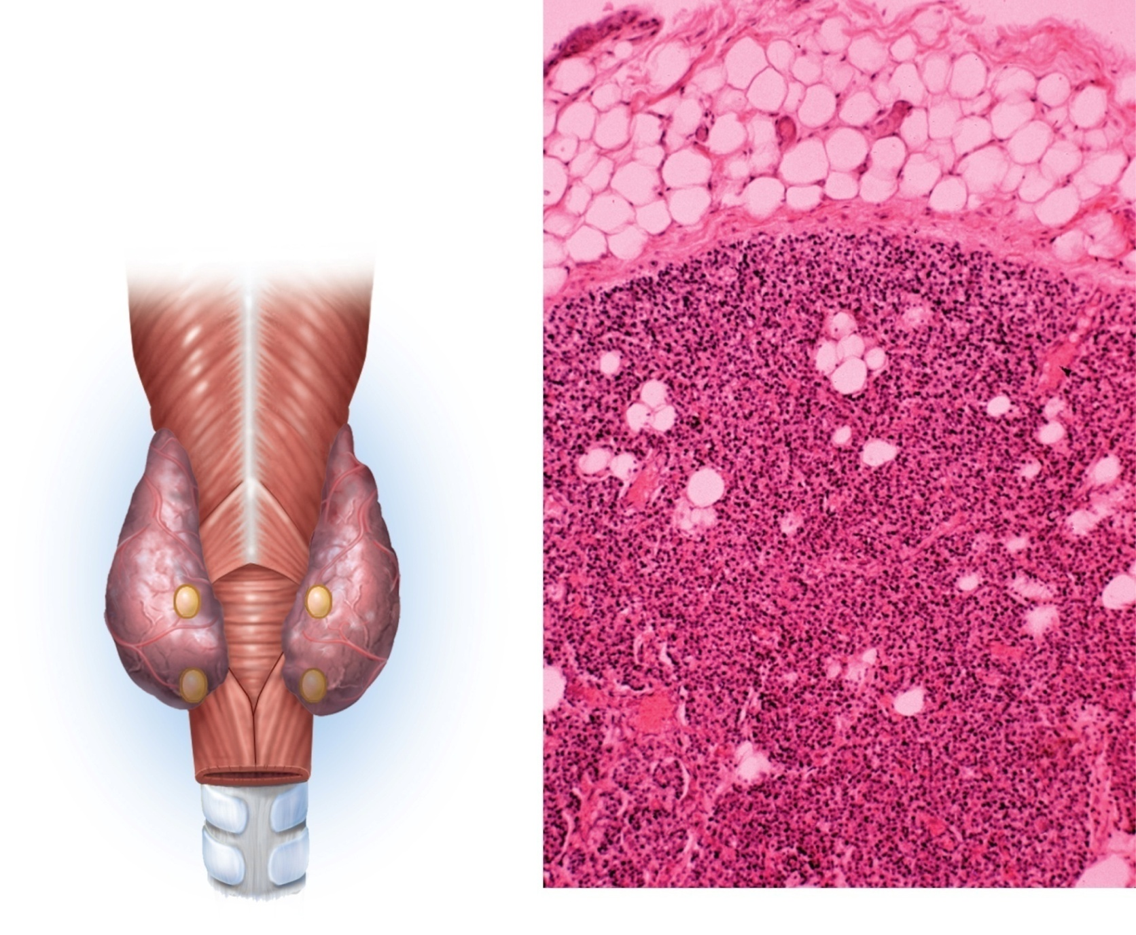
Fig. 17.10
Copyright © McGraw-Hill Education. Permission required for reproduction or display.
Adipose tissue
Parathyroid
capsule
Pharynx
(posterior view)
Parathyroid gland
cells
Thyroid gland
Parathyroid
glands
Adipocytes
Esophagus
Trachea
(a)
(b)
b: ©John Cunningham/Visuals Unlimited
Notes:
14

Slide 15
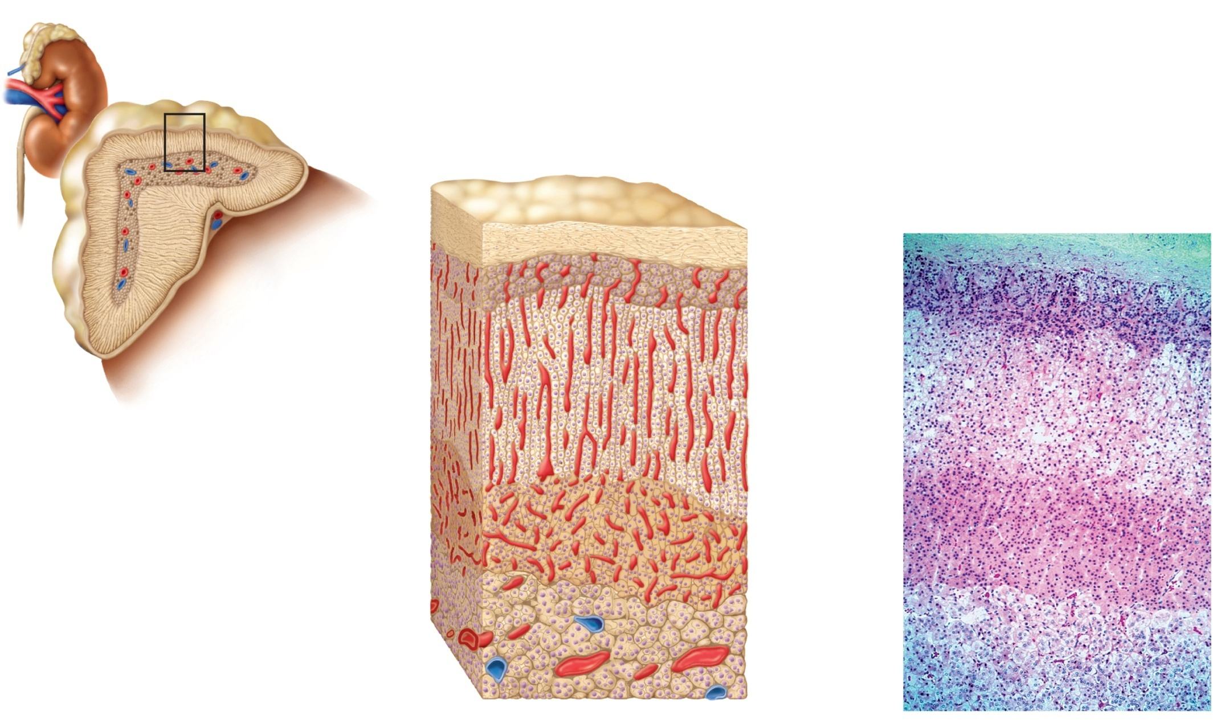


Fig. 17.11
Copyright © McGraw-Hill Education. Permission required for reproduction or display.
Adrenal gland
Suprarenal vein
Kidney
Adrenal cortex
Adrenal medulla
Connective
tissue capsule
Zona
glomerulosa
(a)
Adrenal cortex
Zona
fasciculata
Zona
reticularis
Adrenal
medulla
(b)
b: ©Victor Eroschenko
Notes:
15

Slide 16
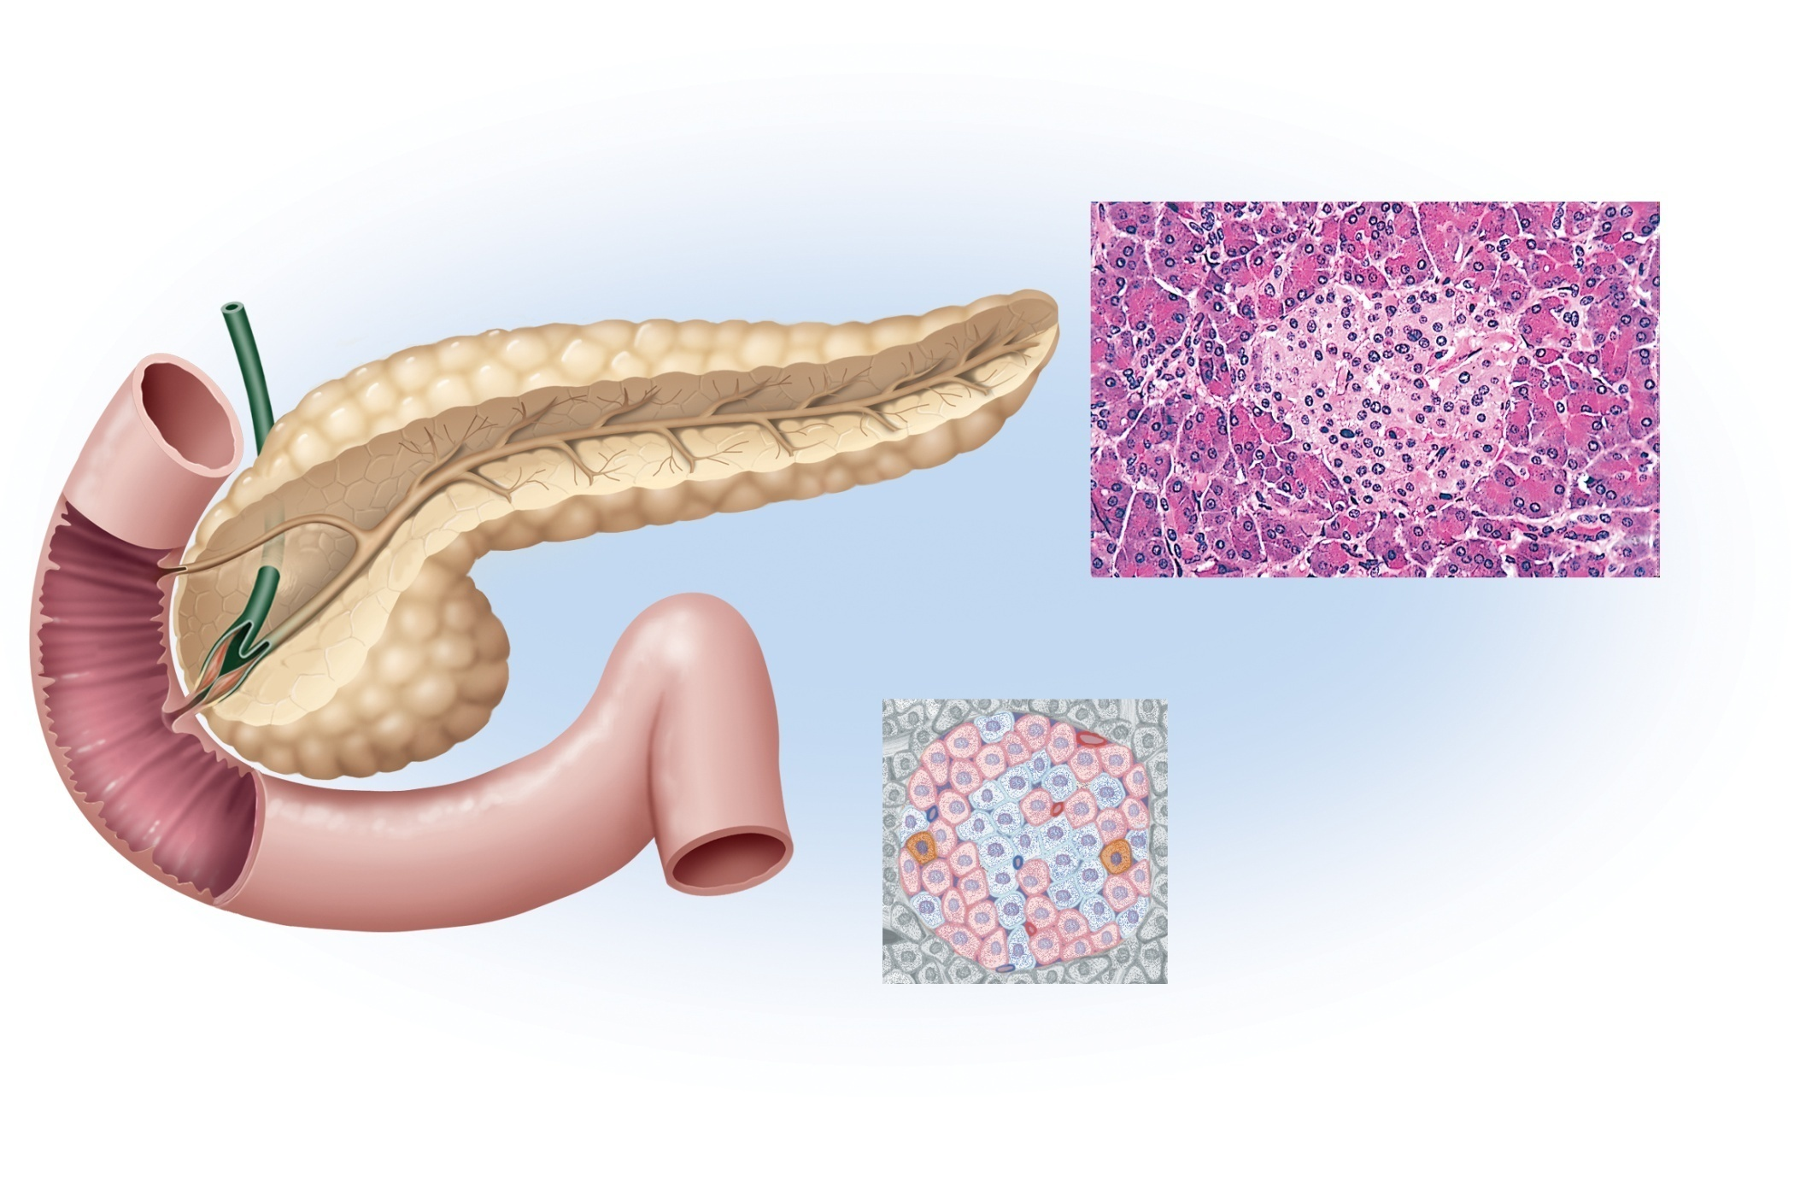

Fig. 17.12
Copyright © McGraw-Hill Education. Permission required for reproduction or display.
Tail of pancreas
Bile duct
(c)
Pancreatic islet
Exocrine acinus
Pancreatic
ducts
Duodenum
Head of
pancreas
Beta cell
Alpha cell
(a)
Delta cell
(b) Pancreatic islet
c: ©Ed Reschke
Notes:
16

Slide 17
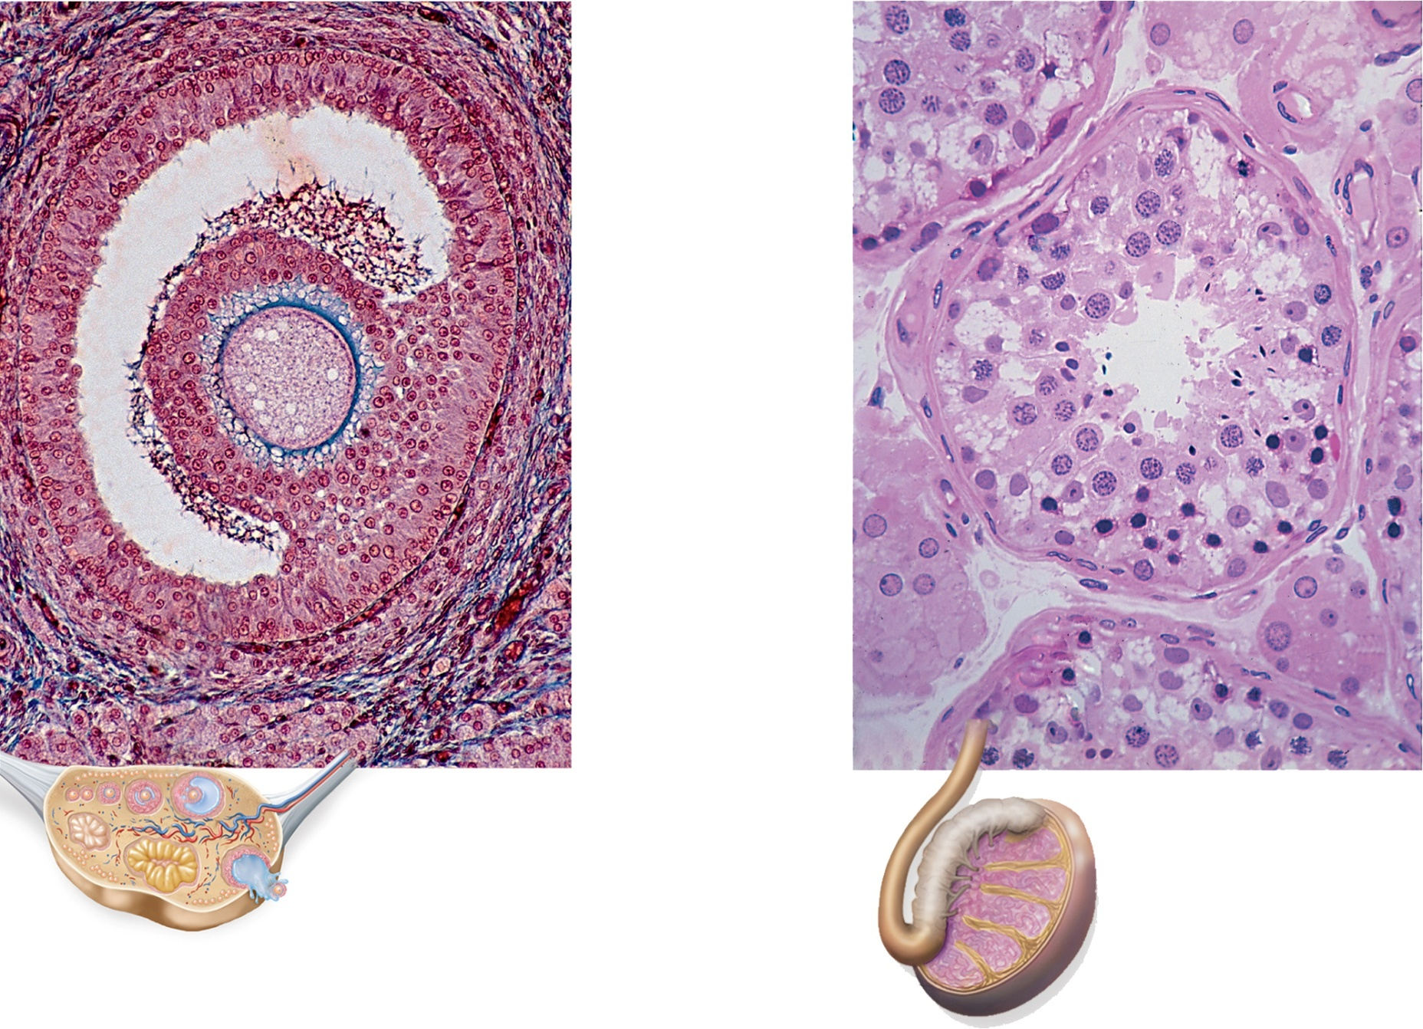


Fig. 17.13
Copyright © McGraw-Hill Education. Permission required for reproduction or display.
Blood vessels
Granulosa cells
(source of
estrogen)
Seminiferous
tubule
Germ cells
Egg cell (oocyte)
Connective tissue
wall of tubule
Sustentacular
cells
Theca
Interstitial cells
(source of
testosterone)
100 µm
Testis
50 µm
Ovary
(a)
(b)
a: ©Ed Reschke/Getty Images; b: © Ed Reschke
Notes:
17

Slide 18
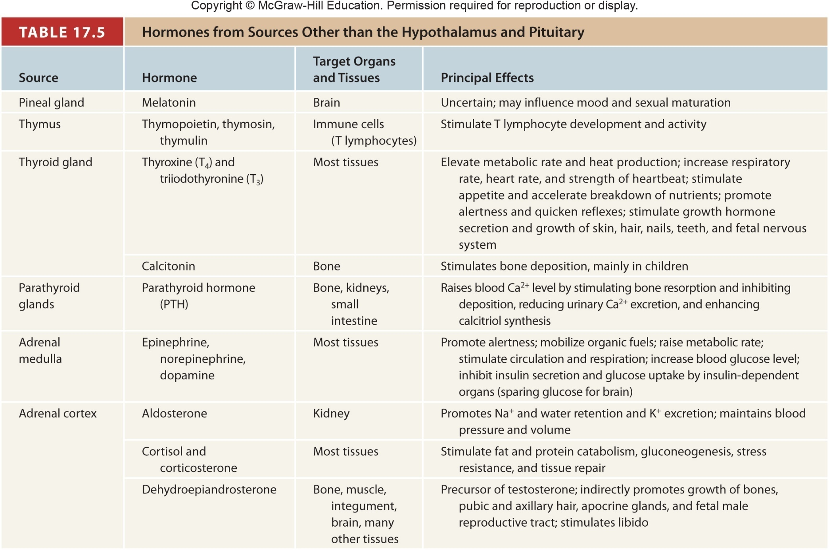
Table 17.5a
Notes:
18

Slide 19
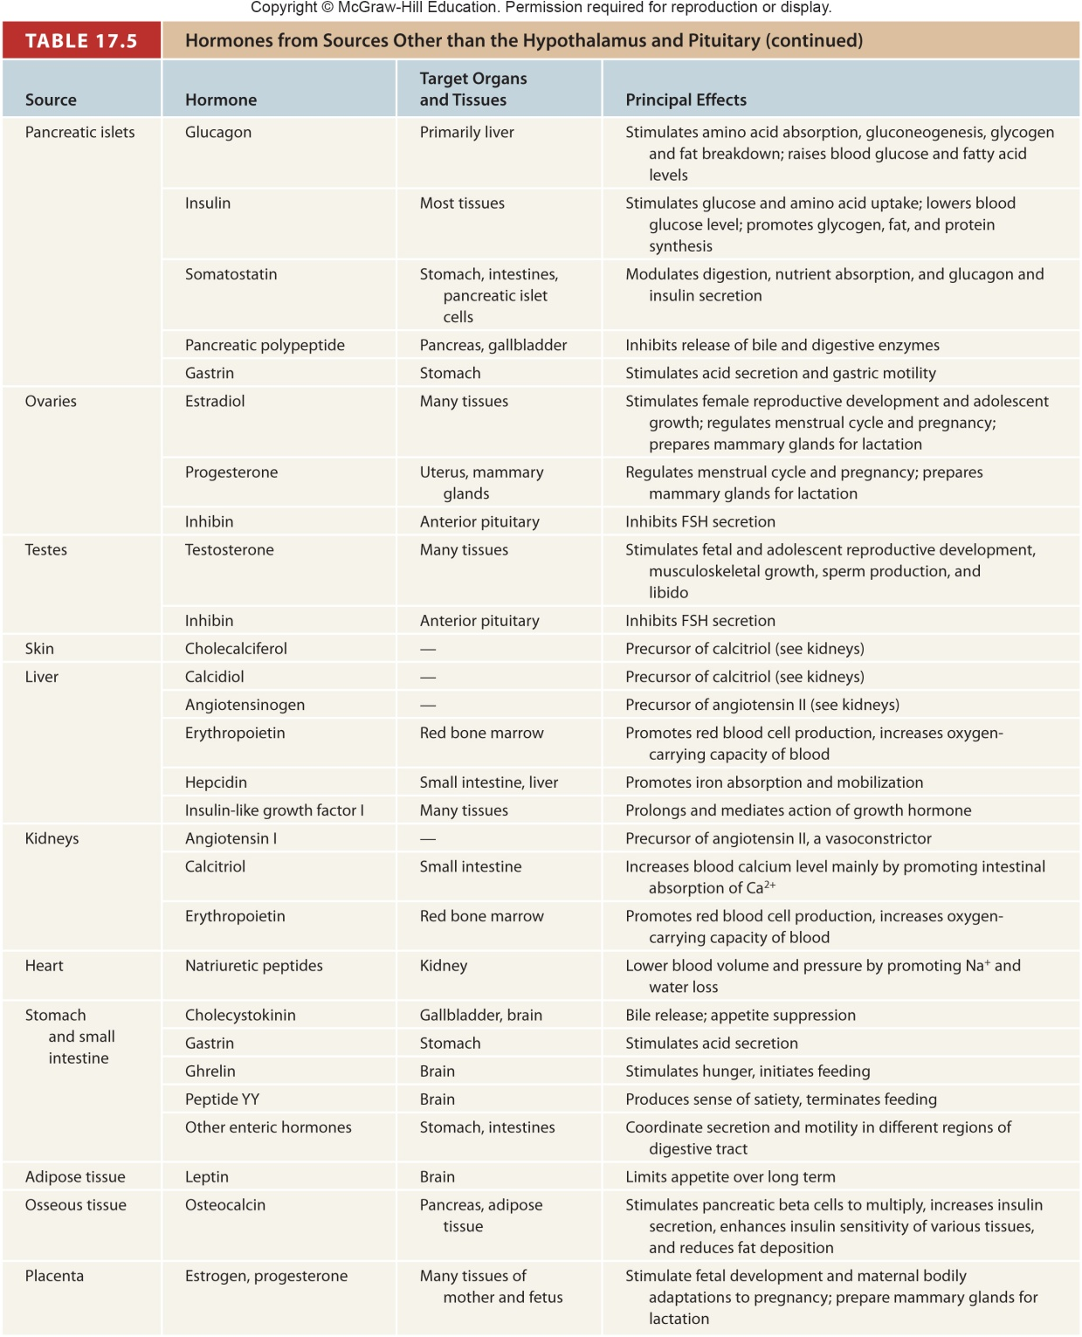
Table 17.5b
Notes:
19

Slide 20
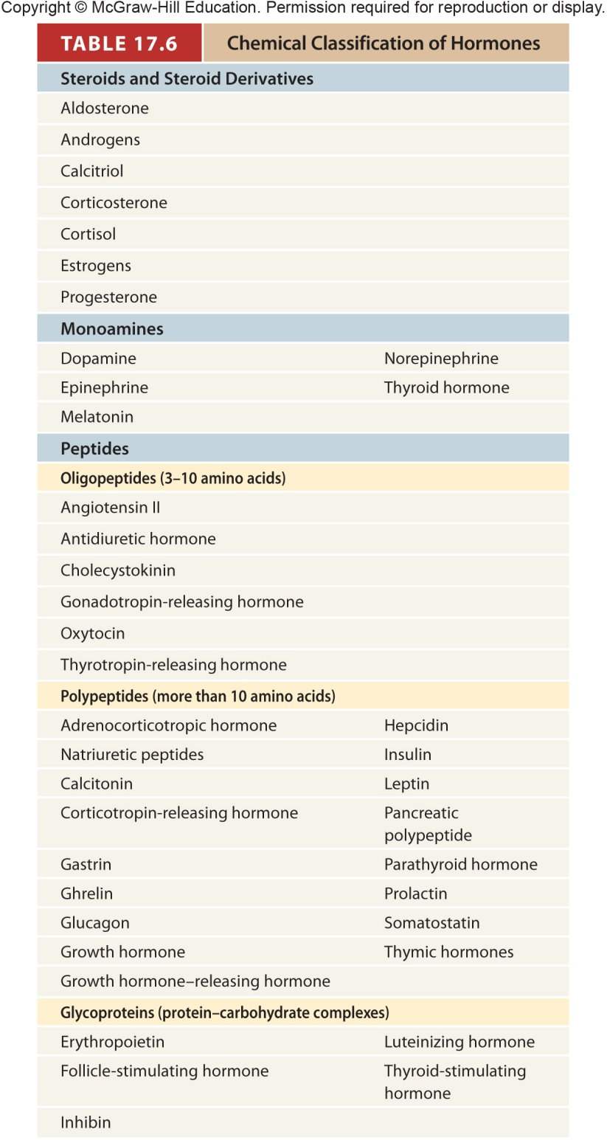
Table 17.6
Notes:
20

Slide 21
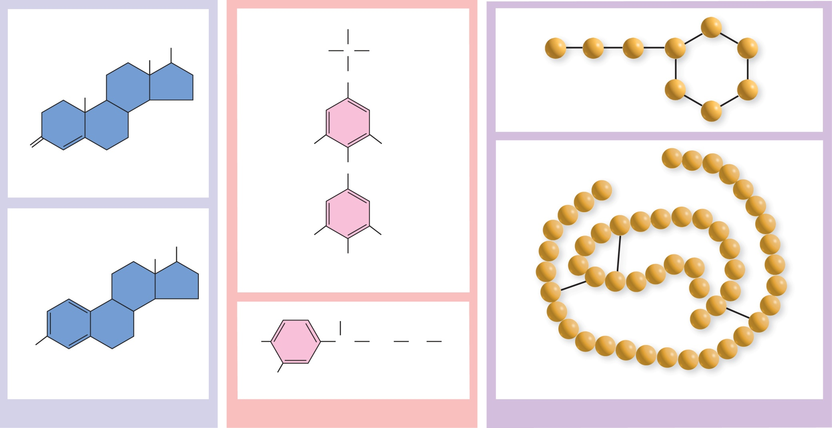
Fig. 17.14
Copyright © McGraw-Hill Education. Permission required for reproduction or display.
H
OH
H₂N
C
COOH
CH₃
CH₂
CH₃
Oxytocin
O
I
I
O
Testosterone
OH
I
I
CH₃
OH
Thyroxine
OH
HO
HO
CH
CH₂
NH
CH₂
Estradiol
HO
Epinephrine
Insulin
(a) Steroids
(b) Monoamines
(c) Peptides
Notes:
21

Slide 22
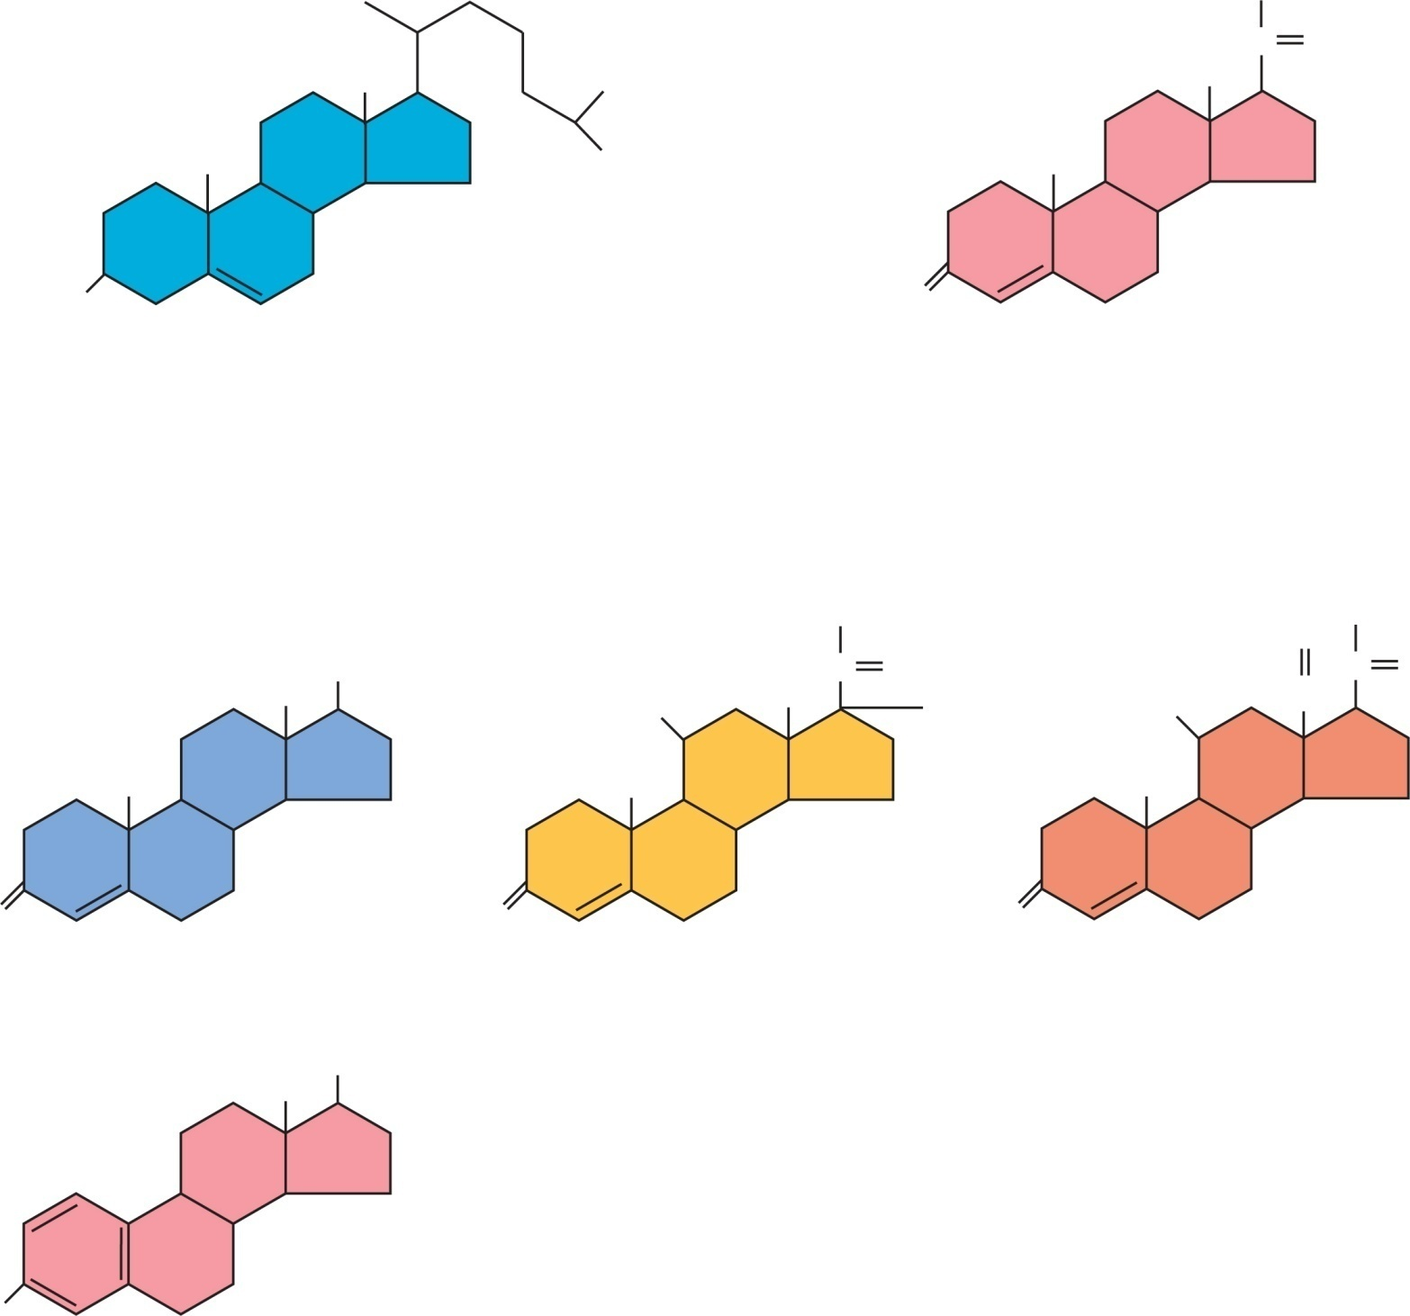
Fig. 17.15
Copyright © McGraw-Hill Education. Permission required for reproduction or display.
CH₃
C
O
CH₃
CH₃
CH₃
CH₃
CH₃
CH₃
HO
O
Cholesterol
Progesterone
CH₂OH
O
CH₂OH
CH₃
OH
C
O
C
O
HO
CH₃
OH
HO
HC
CH₃
CH₃
CH₃
O
O
O
Testosterone
Cortisol (hydrocortisone)
Aldosterone
CH₃
OH
HO
Estradiol
Notes:
22

Slide 23
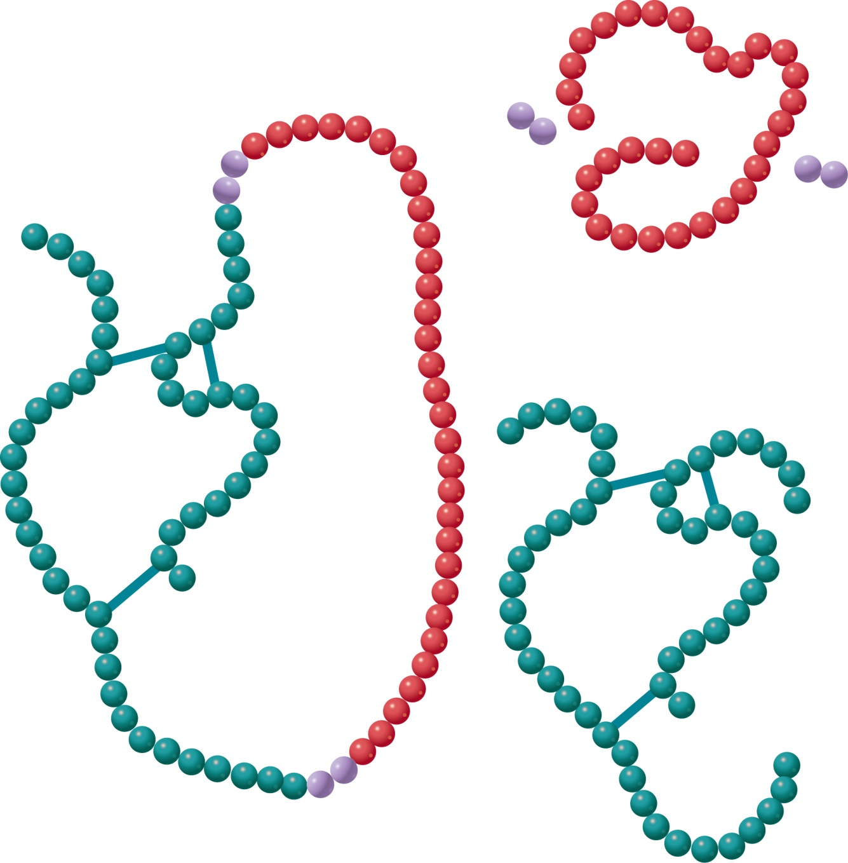
Fig. 17.16
Copyright © McGraw-Hill Education. Permission required for reproduction or display.
Connecting
peptide
Proinsulin
Insulin
Notes:
23

Slide 24
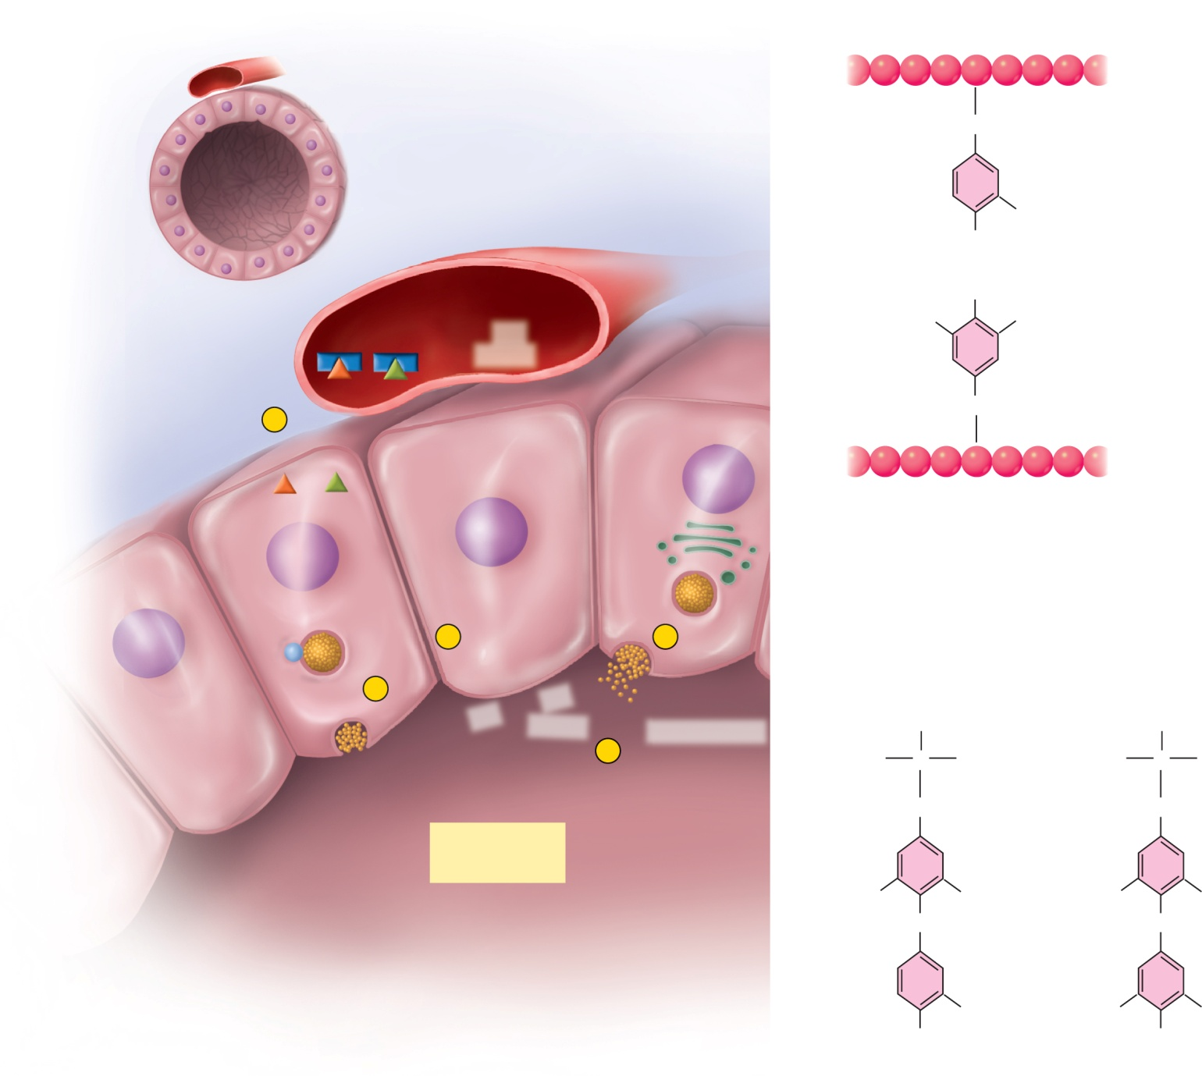

Fig. 17.17
Copyright © McGraw-Hill Education. Permission required for reproduction or display.
CH₂
MIT
I
Blood capillary
OH
Thyroid follicle
OH
Transport
proteins
I —
DIT
I
I
Iodide
5
Follicle cell
CH₂
T₃
T₄
(b)
1
2
Lysosome
4
I*
I —
Iodine
Thyroglobulin
H
H
3
H₂N
C
COOH
H₂N
C
COOH
CH₂
CH₂
Stored
thyroglobulin
I
I
I
I
O
O
I
I
I
T₃
OH
T₄
OH
(a)
(c)
Notes:
24

Slide 25
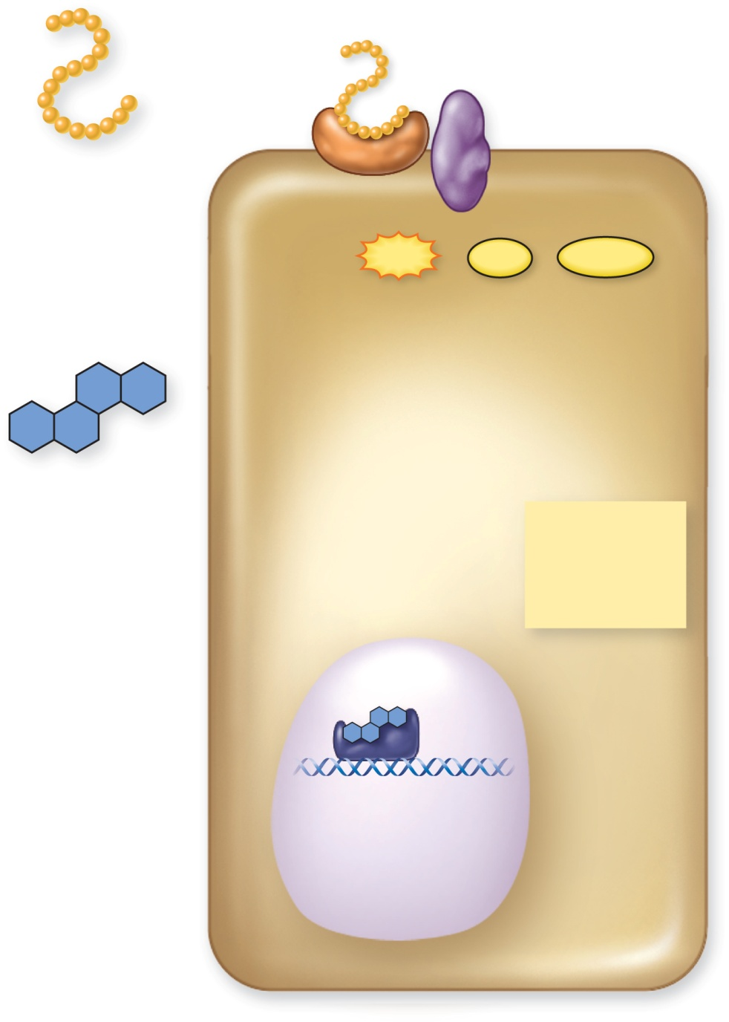
Fig. 17.18
Copyright © McGraw-Hill Education. Permission required for reproduction or display.
Hormone
receptor
Membrane
enzyme
(a) Peptide
hormone
ATP
PP_{i}
cAMP
Enzyme
activation
(b) Steroid
hormone
Various
metabolic
effects
Nucleus
Hormone
receptor
Protein
synthesis
DNA
Gene
transcription
mRNA
Notes:
25

Slide 26
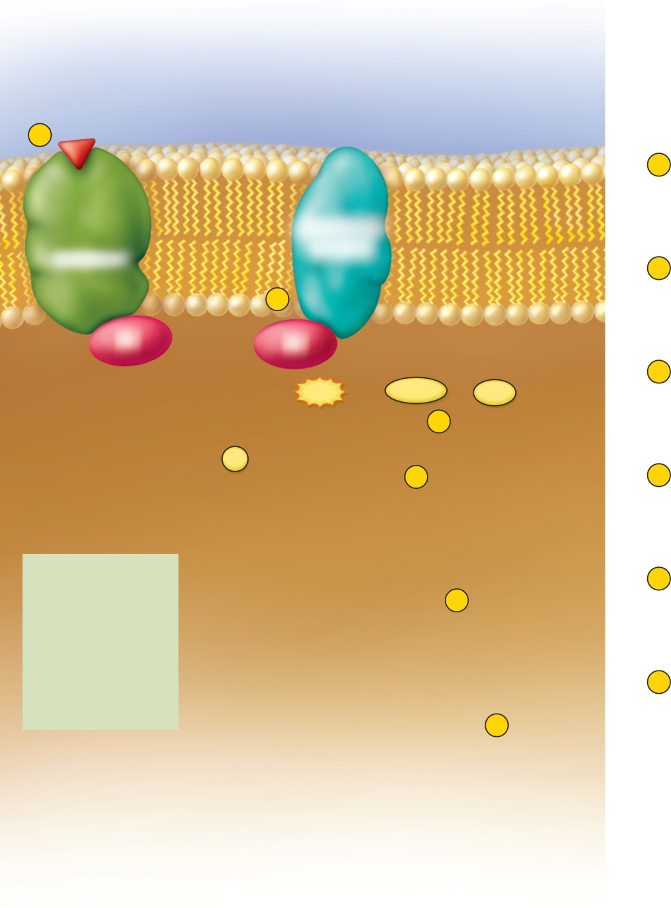
Fig. 17.19
Copyright © McGraw-Hill Education. Permission required for reproduction or display.
Hormone
1
G protein
1
Hormone–receptor binding
activates a G protein.
Adenylate
cyclase
Receptor
2
G protein activates adenylate cyclase.
2
G
G
ATP
cAMP
+
PP_{i}
3
Adenylate cyclase produces cAMP.
GTP
GDP
+
3
P_{i}
4
4
cAMP activates protein kinases.
Inactive protein
kinase
Activated protein
kinase
ACTH
5
Protein kinases phosphorylate enzymes.
This activates some enzymes and
deactivates others.
FSH
5
LH
PTH
Inactive
enzymes
Activated
enzymes
TSH
Glucagon
6
Activated enzymes catalyze metabolic
reactions with a wide range of possible
effects on the cell.
Calcitonin
Catecholamines
6
Enzyme
substrates
Enzyme
products
Various
metabolic
effects
Notes:
26

Slide 27
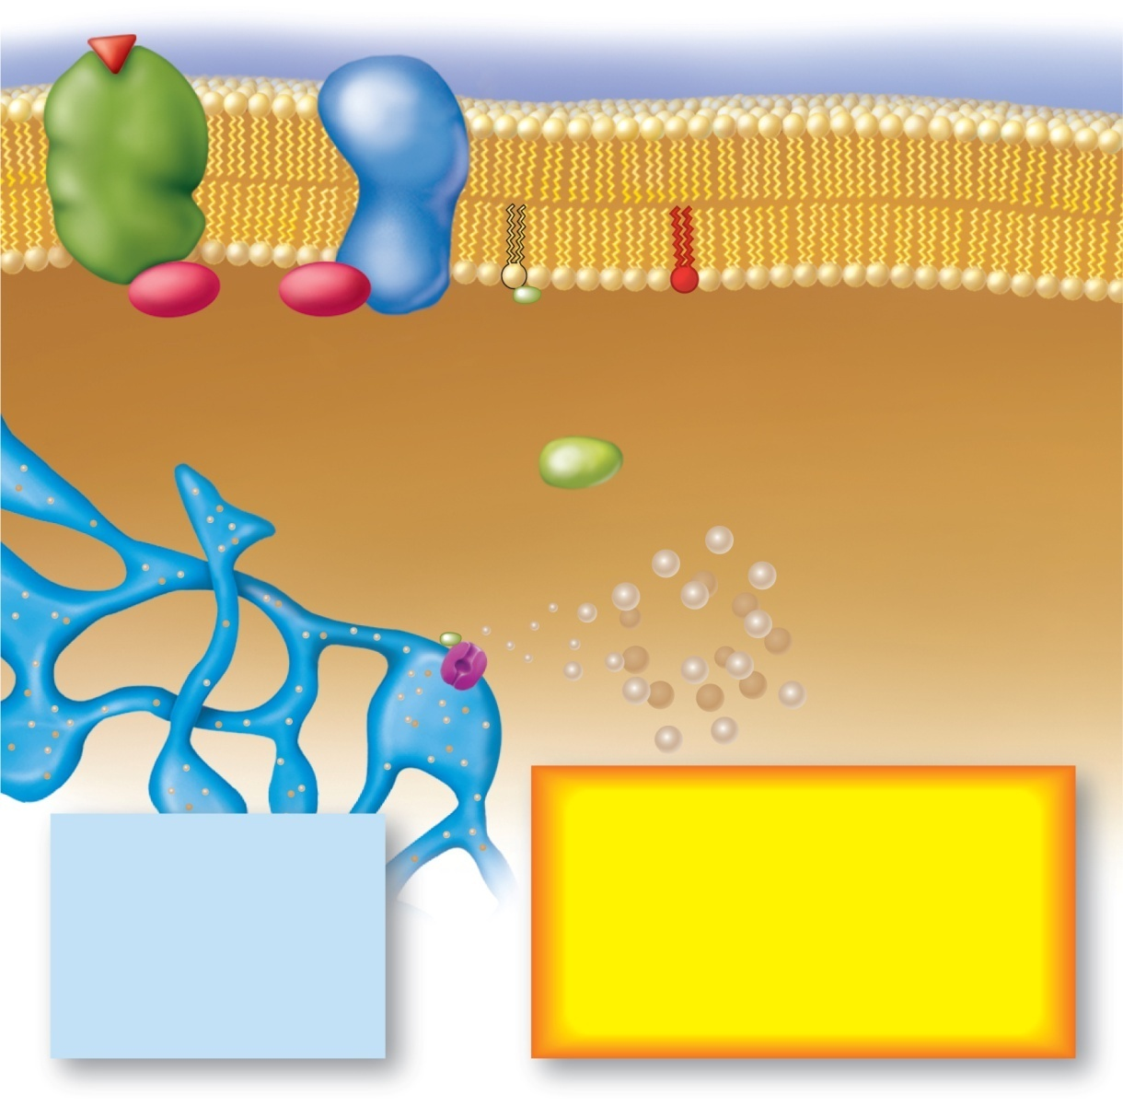
Fig. 17.20
Copyright © McGraw-Hill Education. Permission required for reproduction or display.
Hormone
Phospho-
lipase
Phospho-
lipase
Receptor
Receptor
DAG
G
G
G
G
Endoplasmic
reticulum
Protein
kinase (PK)
Activated
PK
IP₃
Calcium
reservoir
Ca²⁺
Enzyme
activation
Hormones
Various metabolic effects
Smooth muscle contraction
Protein synthesis
Secretion
Mitosis
etc.
ADH
TRH
OT
LHRH
Catecholamines
Notes:
27

Slide 28

Fig. 17.21
Copyright © McGraw-Hill Education. Permission required for reproduction or display.
Small stimulus
Hormone
cAMP and
protein kinase
Reaction cascade (time)
Activated enzymes
Metabolic product
Great effect
Notes:
28

Slide 29
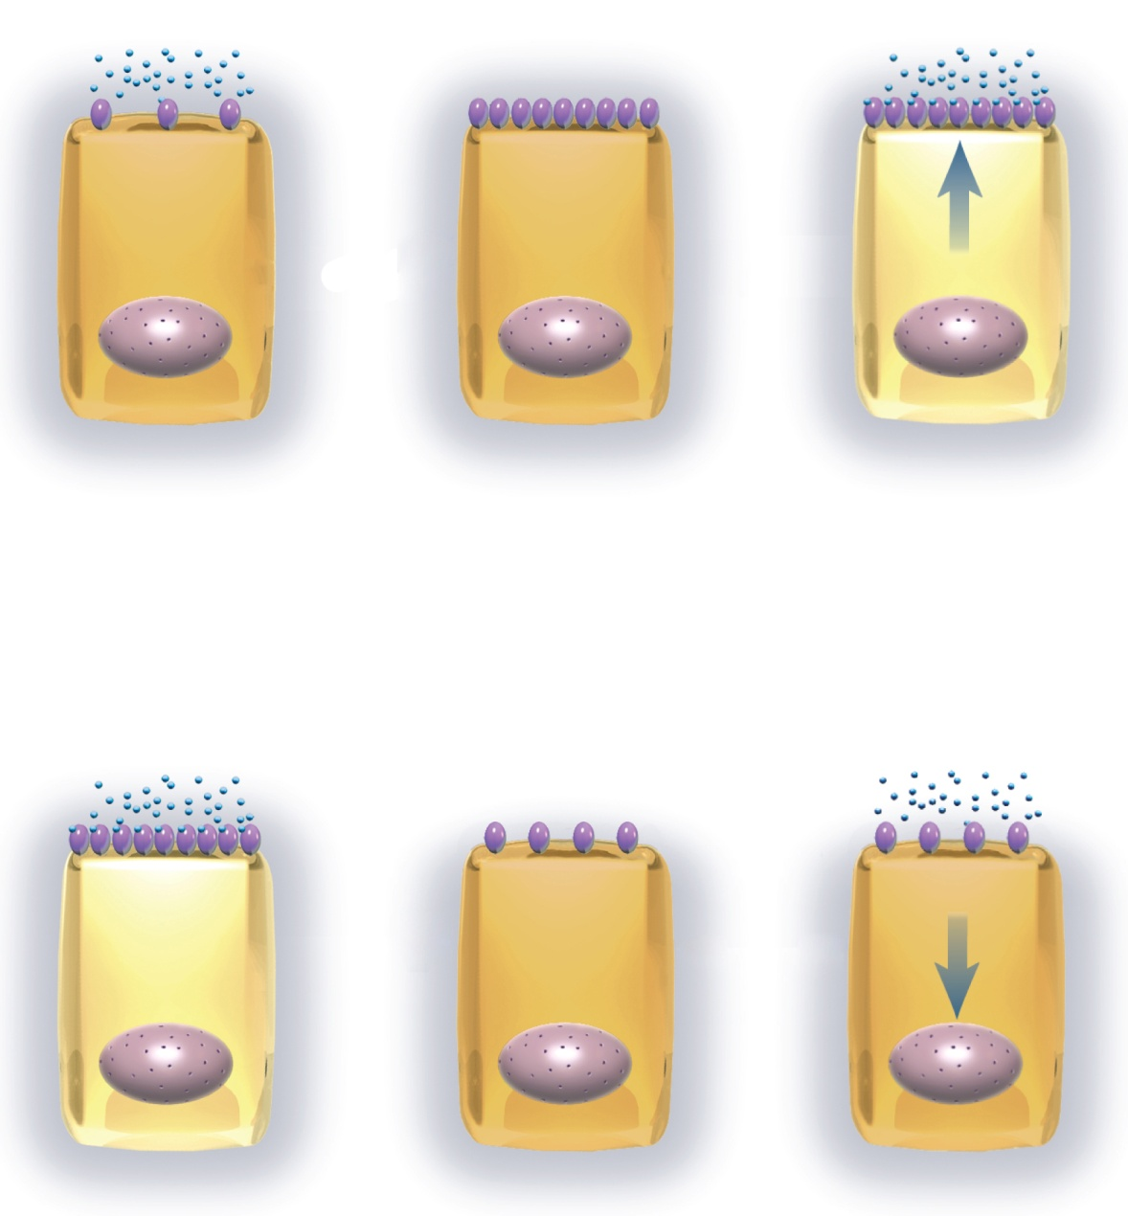
Fig. 17.22
Copyright © McGraw-Hill Education. Permission required for reproduction or display.
Hormone
Receptor
Response
Low receptor density
Weak response
Increased receptor density
Increased sensitivity
Stronger response
(a) Up-regulation
Response
High receptor density
Strong response
Reduced receptor density
Reduced sensitivity
Diminished response
(b) Down-regulation
Notes:
29

Slide 30
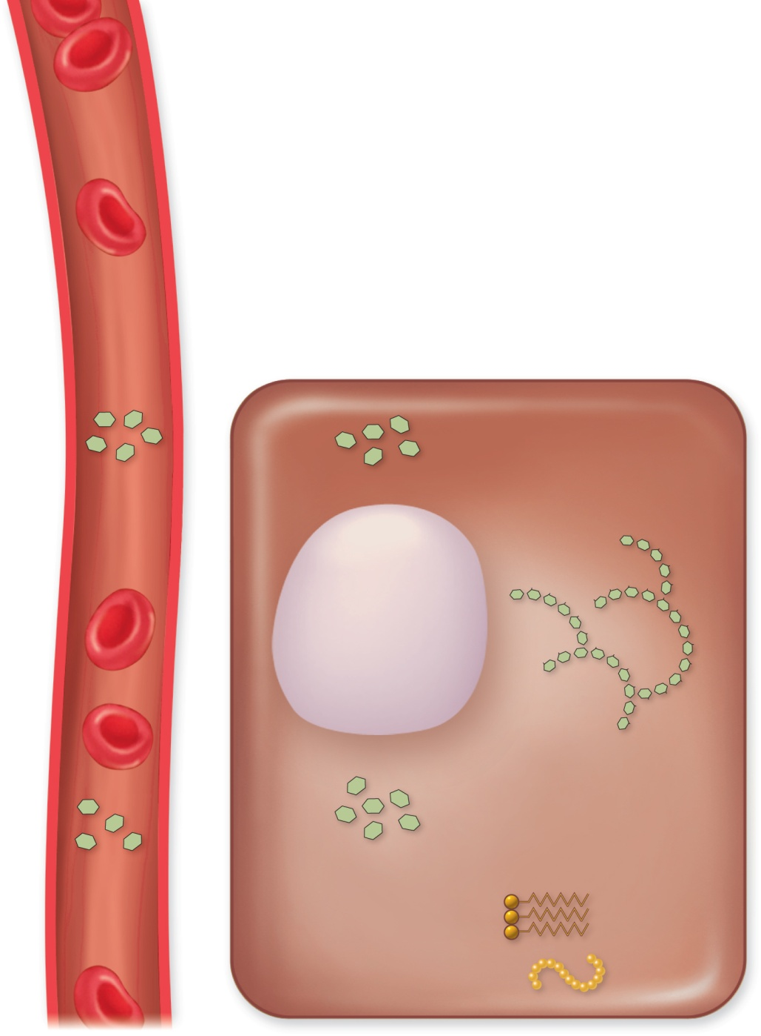
Fig. 17.23
Copyright © McGraw-Hill Education. Permission required for reproduction or display.
Blood
Blood
Liver cell
Glucose
Absorption
of blood
sugar
Glucose
Absorption
of blood
sugar
Glycogenesis
(a) Actions
of insulin
Glycogenesis
Glycogen
Glycogen
Glycogenolysis
Glycogenolysis
(b) Actions of
glucagon
Glucose
Glucose
Gluconeogenesis
Elevated
blood
sugar
Gluconeogenesis
Elevated
blood
sugar
Fat
Fat
Protein
Protein
Notes:
30

Slide 31
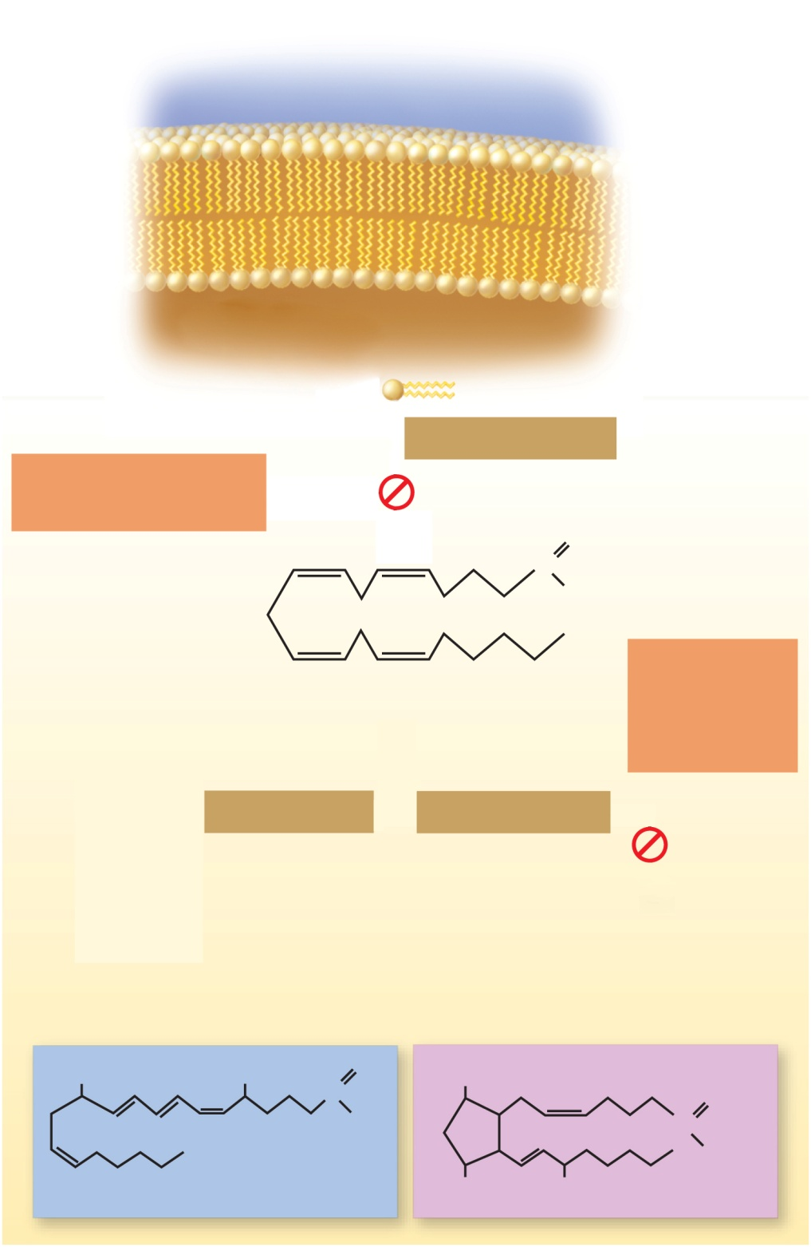

Fig. 17.24
Copyright © McGraw-Hill Education. Permission required for reproduction or display.
Phospholipids of
plasma membrane
Phospholipase A₂
Blocked by cortisol
and SAIDs
O
C
OH
Blocked by
NSAIDs such
as aspirin
and ibuprofen
Arachidonic acid
Lipoxygenase
Cyclooxygenase
Leukotrienes
Prostacyclin
Thromboxanes
Prostaglandins
OH
OH
O
OH
C
OH
O
C
OH
Leukotriene B₄
OH
OH
PGF_{2α}
Notes:
31

Slide 32
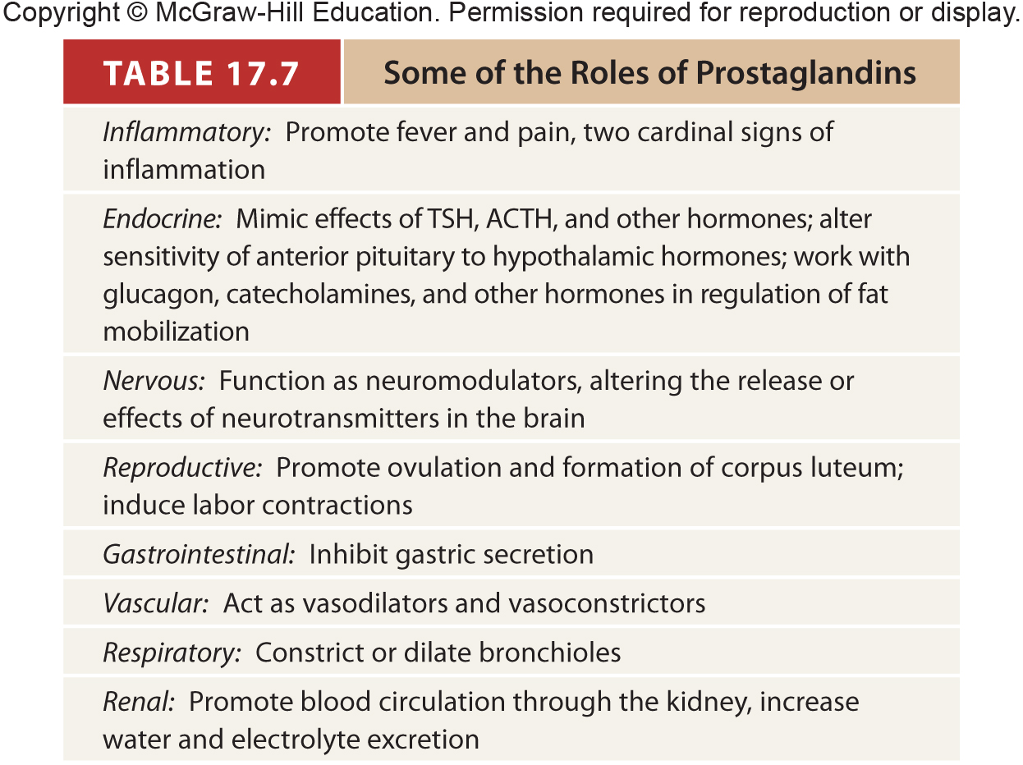
Table 17.7
Notes:
32

Slide 33
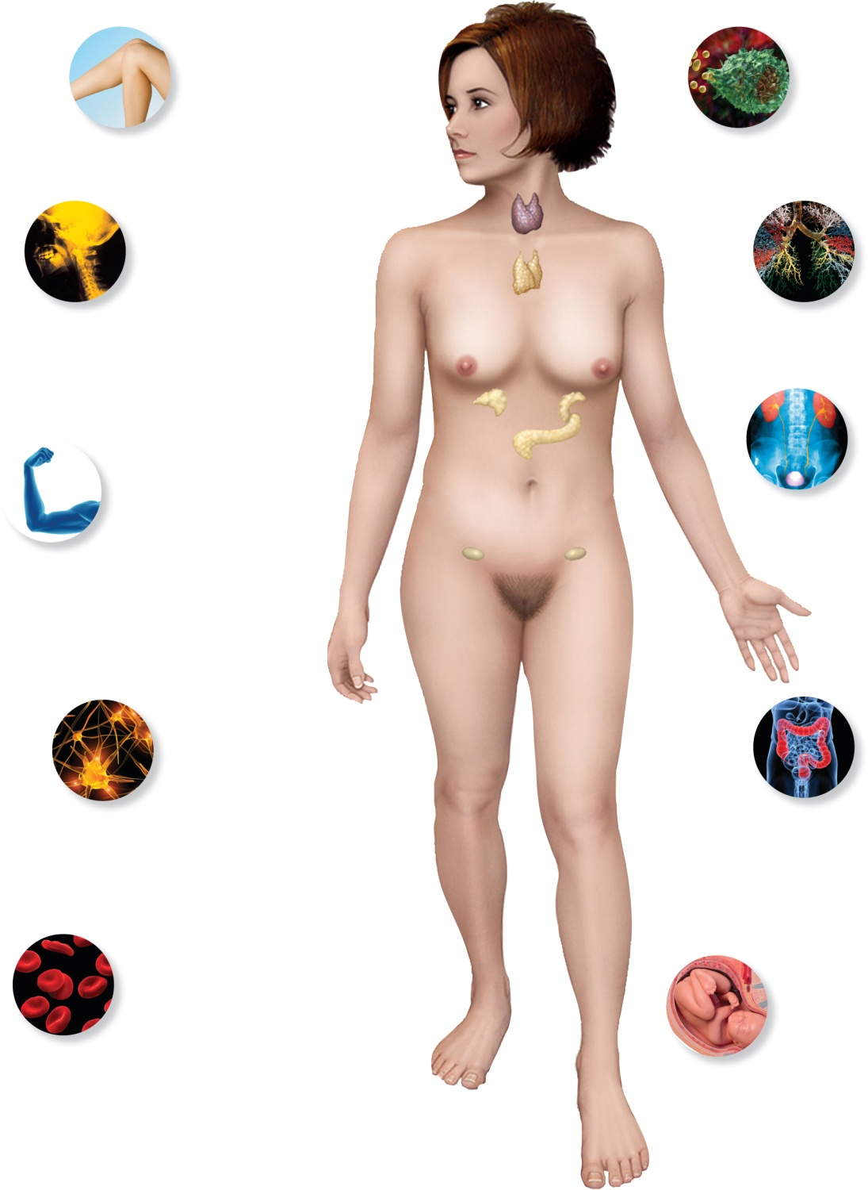
Page 668
Copyright © McGraw-Hill Education. Permission required for reproduction or display.
INTEGUMENTARY SYSTEM
Sex hormones affect skin
pigmentation, development
of body hair and apocrine
glands, and subcutaneous fat
deposition.
LYMPHATIC/IMMUNE SYSTEM
Thymic hormones activate immune cells;
glucocorticoids suppress immunity and
inflammation.
SKELETAL SYSTEM
Skeletal growth and
maintenance are regulated
by numerous hormones—
calcitonin, calcitriol,
parathyroid hormone,
growth hormone, estrogen,
testosterone, and others.
RESPIRATORY SYSTEM
Epinephrine and
norepinephrine dilate the
bronchioles and increase
pulmonary airflow.
URINARY SYSTEM
Antidiuretic hormone regulates
urine volume; calcitriol,
parathyroid hormone,
aldosterone, and natriuretic
peptides regulate electrolyte
absorption by the kidneys.
MUSCULAR SYSTEM
Growth hormone and
testosterone stimulate
muscular growth; insulin
regulates glucose
uptake by muscle, other
hormones regulate the
electrolyte balances
that are important in
muscular contraction.
NERVOUS SYSTEM
Hormones exert
negative feedback inhibition
on the hypothalamus; several
hormones affect nervous
system development, mood,
and behavior; hormones
regulate the electrolyte
balances that are important in
neuron function.
DIGESTIVE SYSTEM
Insulin and glucagon regulate
nutrient storage and metabolism;
enteric hormones control
gastrointestinal secretion and
motility; gut–brain peptides
affect appetite and regulate food
intake and body weight.
CIRCULATORY SYSTEM
Angiotensin II, aldosterone, antidiuretic
hormone, natriuretic peptides, and other
hormones regulate blood volume and
pressure; erythropoietin stimulates
RBC production; thymic hormones
stimulate WBC production;
thrombopoietin stimulates platelet
production; epinephrine, thyroid
hormone, and other hormones affect the
rate and force of the heartbeat.
REPRODUCTIVE SYSTEM
Gonadotropins and sex steroids
regulate sexual development,
spermatogenesis and oogenesis, the
ovarian and uterine cycles, sex drive,
pregnancy, fetal development, and
lactation.
Notes:
33

