Slide 1
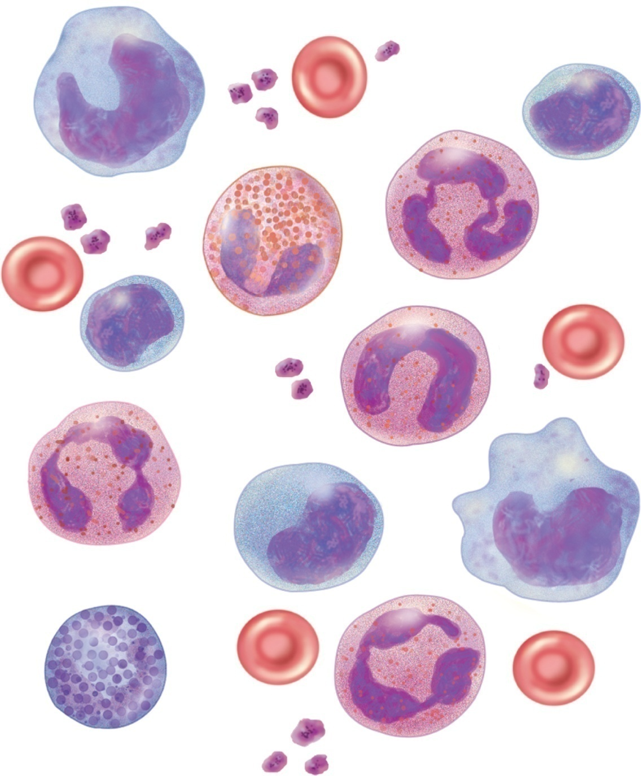
Fig. 18.1
Copyright © McGraw-Hill Education. Permission required for reproduction or display.
Monocyte
Small
lymphocyte
Neutrophil
Platelets
Eosinophil
Small
lymphocyte
Erythrocyte
Young (band)
neutrophil
Neutrophil
Monocyte
Large
lymphocyte
Neutrophil
Basophil

Slide 2
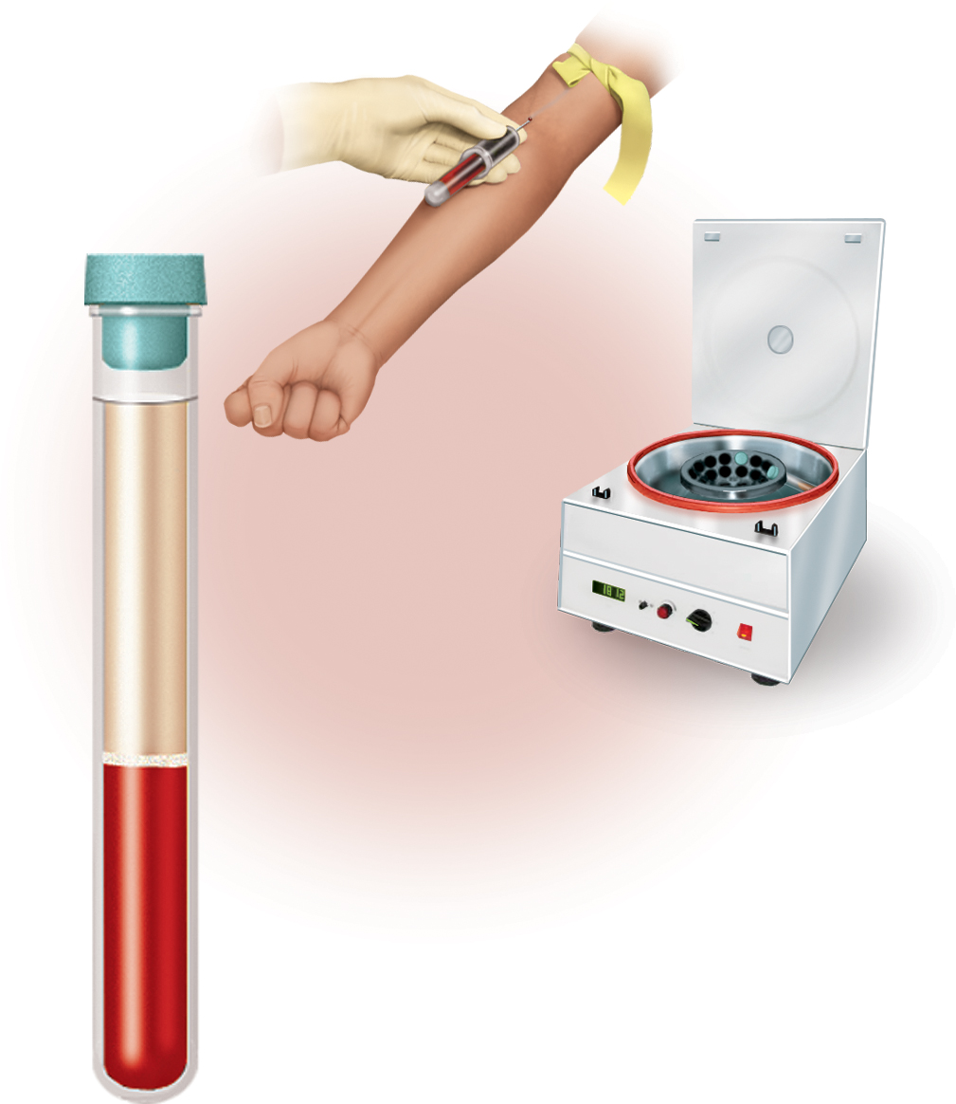


Fig. 18.2
Copyright © McGraw-Hill Education. Permission required for reproduction or display.
Withdraw
blood
Centrifuge
Plasma
(55% of whole blood)
Buffy coat: leukocytes
and platelets
(<1% of whole blood)
Erythrocytes
(45% of whole blood)
Formed
elements
Notes:
2

Slide 3
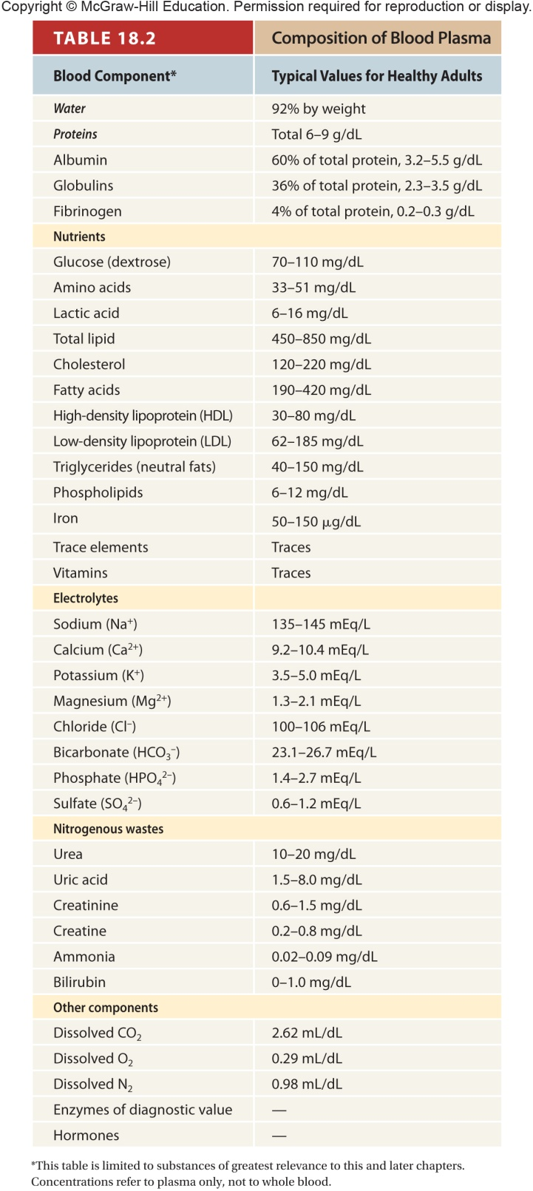
Table 18.2

Slide 4
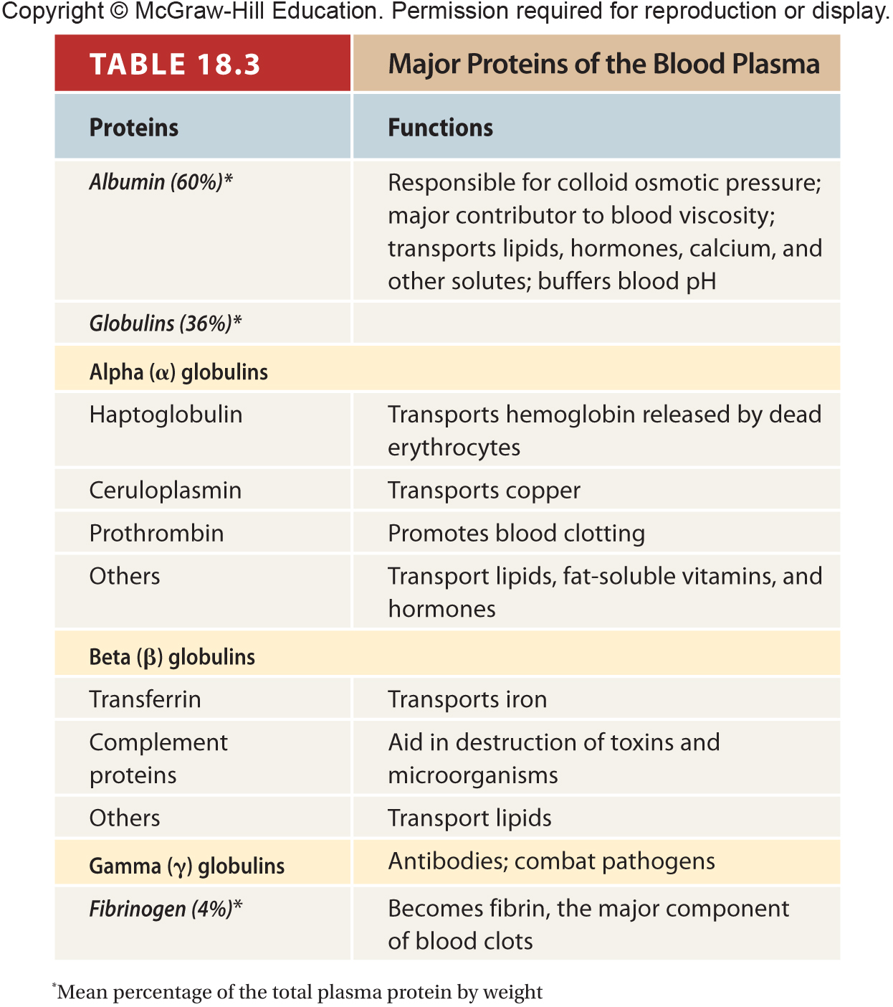
Table 18.3

Slide 5
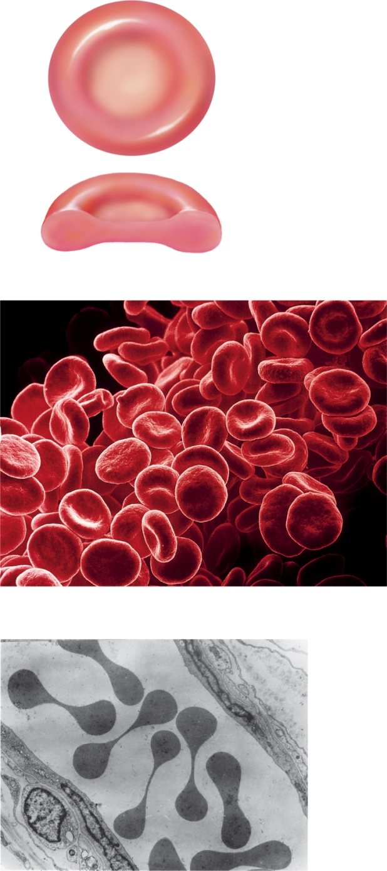
Fig. 18.4
Copyright © McGraw-Hill Education. Permission required for reproduction or display.
Surface view
7.5 µm
2.0 µm
(a)
Sectional view
(b)
Capillary
wall
Erythrocytes
(c)
7 µm
b: ©Susumu Nishinaga/Getty Images; c: ©Dr. Don W. Fawcett/Visuals Unlimited
Notes:
5

Slide 6
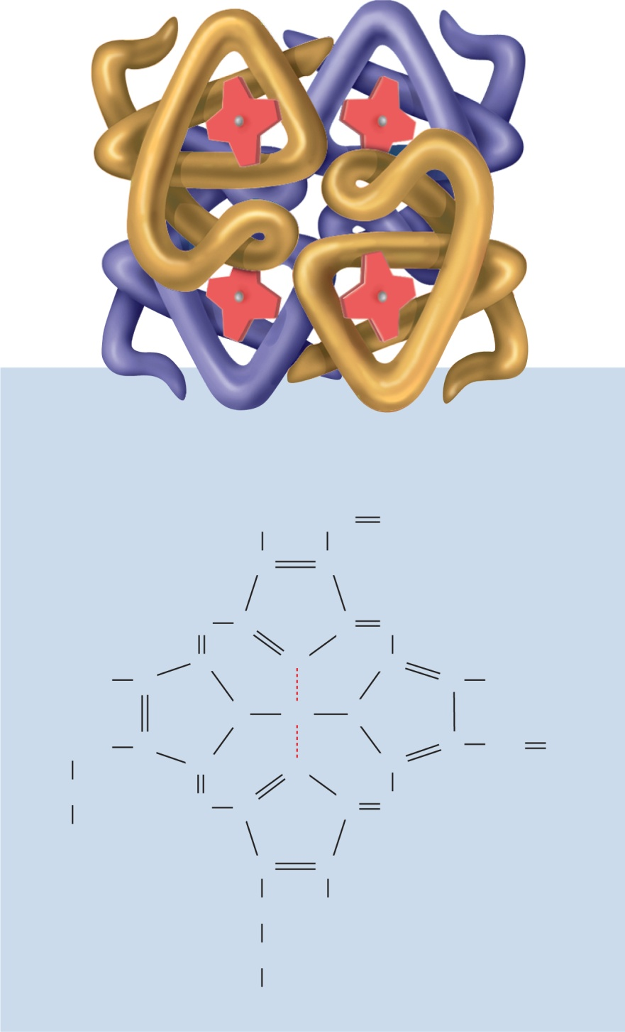

Fig. 18.5
Copyright © McGraw-Hill Education. Permission required for reproduction or display.
Beta
Alpha
Heme
groups
(a)
Alpha
Beta
CH₃
CH
CH₂
C
C
HC
C
C
CH
C
N
C
CH₃
C
C
CH₃
N
Fe
N
CH₂
C
C
C
C
CH
CH₂
CH₂
N
HC
C
C
CH
COOH
C
C
CH₂
CH₃
CH₂
COOH
(b)
Notes:
6

Slide 7
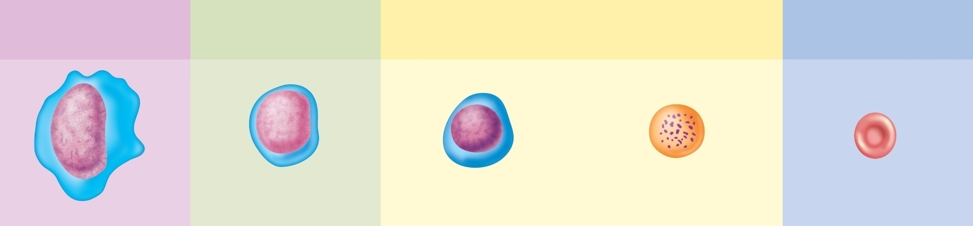
Fig. 18.6
Copyright © McGraw-Hill Education. Permission required for reproduction or display.
Hemopoietic
stem cell
Colony-forming
unit (CFU)
Precursor
cells
Mature
cell
Erythrocyte CFU
Erythroblast
Reticulocyte
Erythrocyte
Notes:
7

Slide 8
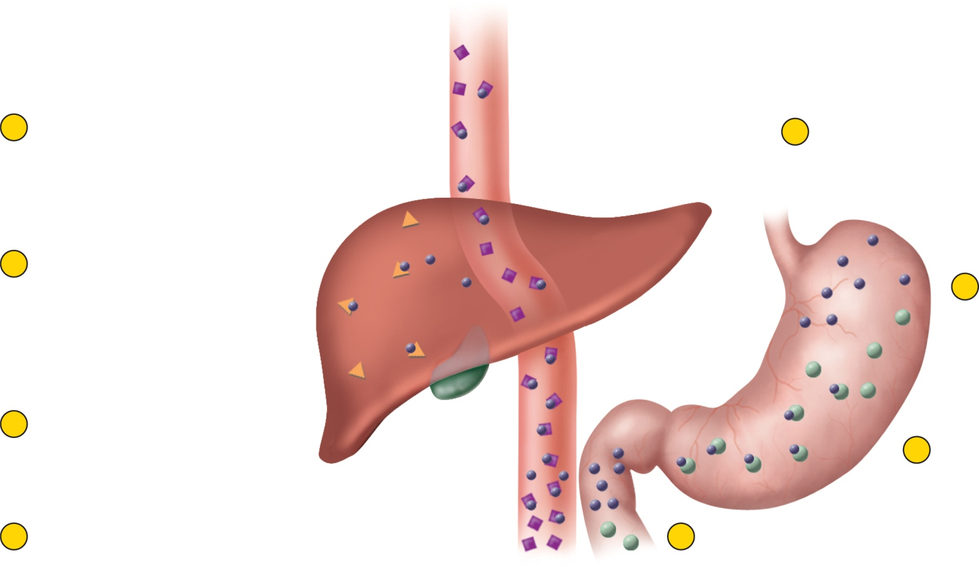
Fig. 18.7
Copyright © McGraw-Hill Education. Permission required for reproduction or display.
8
Remaining transferrin is distributed
to other organs where Fe²⁺ is used
to make hemoglobin, myoglobin, etc.
1
Mixture of Fe²⁺ and
Fe³⁺ is ingested
7
Fe²⁺ binds to
apoferritin
to be stored
as ferritin
Fe³⁺
Ferritin
2
Stomach acid
converts Fe³⁺
to Fe²⁺
Apoferritin
Fe²⁺
Gastroferritin
6
In liver, some transferrin
releases Fe²⁺ for storage
3
Fe²⁺ binds to
gastroferritin
Blood plasma
5
In blood plasma,
Fe²⁺ binds to transferrin
Transferrin
4
Gastroferritin transports
Fe²⁺ to small intestine and
releases it for absorption
Notes:
8

Slide 9
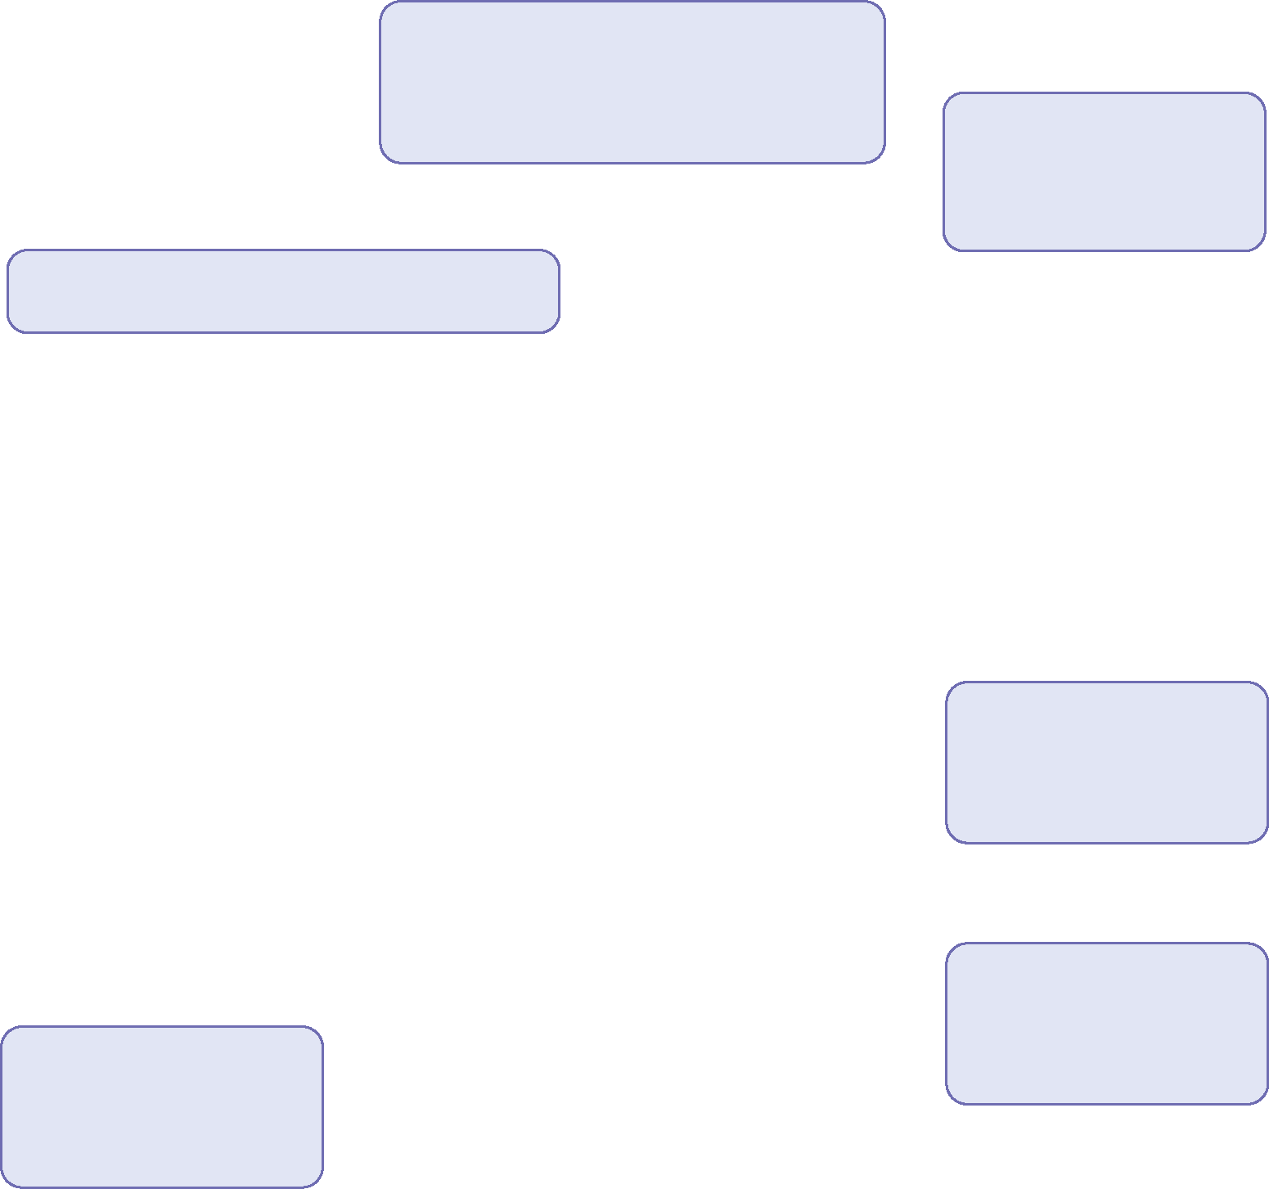




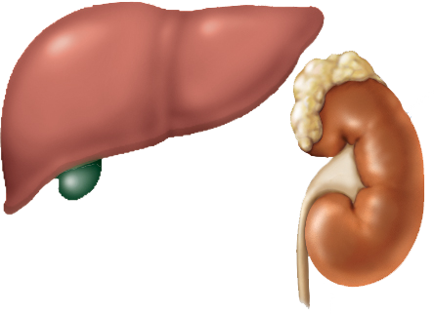
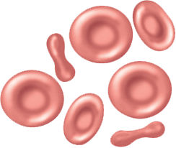



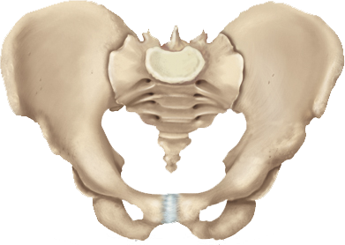
Fig. 18.8
Copyright © McGraw-Hill Education. Permission required for reproduction or display.
Hypoxemia
(inadequate O₂ transport)
Increased
O₂ transport
Sensed by liver and kidneys
Increased
RBC count
Accelerated
erythropoiesis
Secretion of
erythropoietin
Stimulation of
red bone marrow
Notes:
9

Slide 10
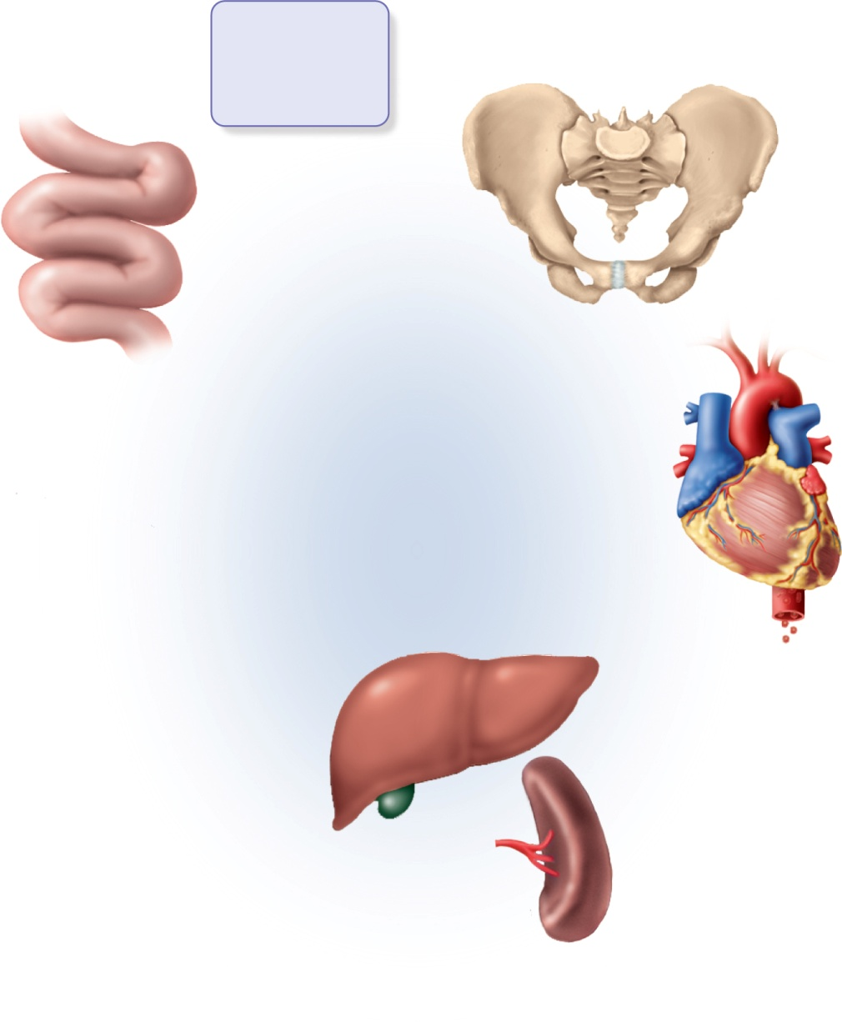





Fig. 18.9
Copyright © McGraw-Hill Education. Permission required for reproduction or display.
Amino acids
Iron
Folic acid
Vitamin B₁₂
Erythropoiesis in
red bone marrow
Nutrient
absorption
Small intestine
Erythrocytes
circulate for
120 days
Expired erythrocytes
break up in liver and spleen
Cell fragments
phagocytized
Hemoglobin
degraded
Heme
Globin
Biliverdin
Iron
Hydrolyzed to free
amino acids
Bilirubin
Storage
Reuse
Loss by
menstruation,
injury, etc.
Bile
Feces
Notes:
10

Slide 11
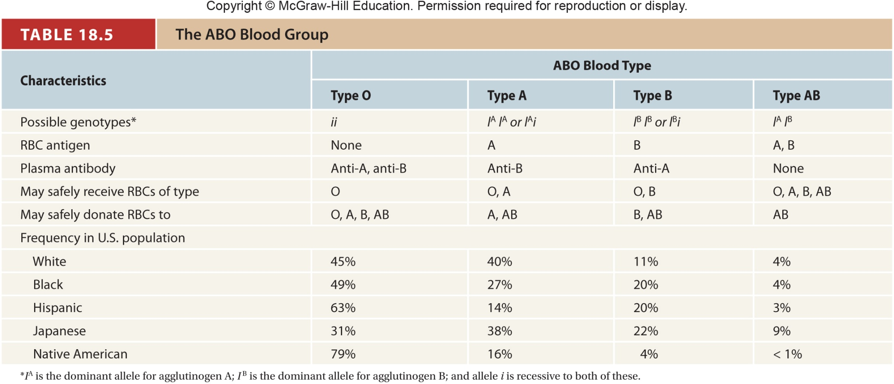
Table 18.5

Slide 12
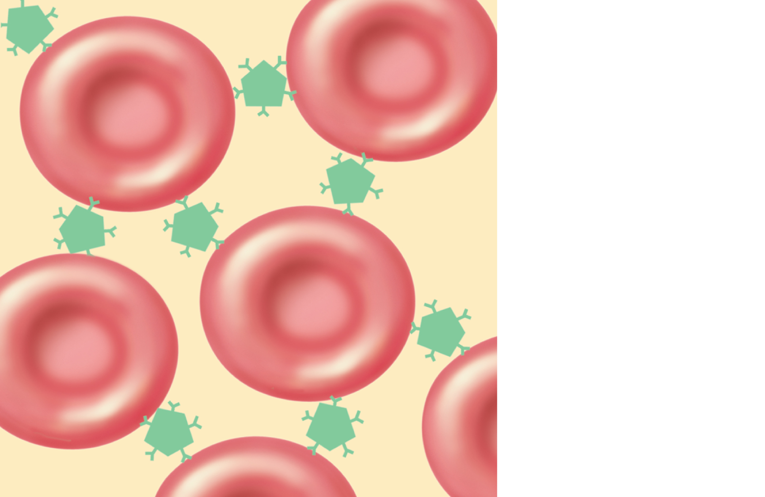
Fig. 18.13
Copyright © McGraw-Hill Education. Permission required for reproduction or display.
Antibodies
(agglutinins)
Notes:
12

Slide 13
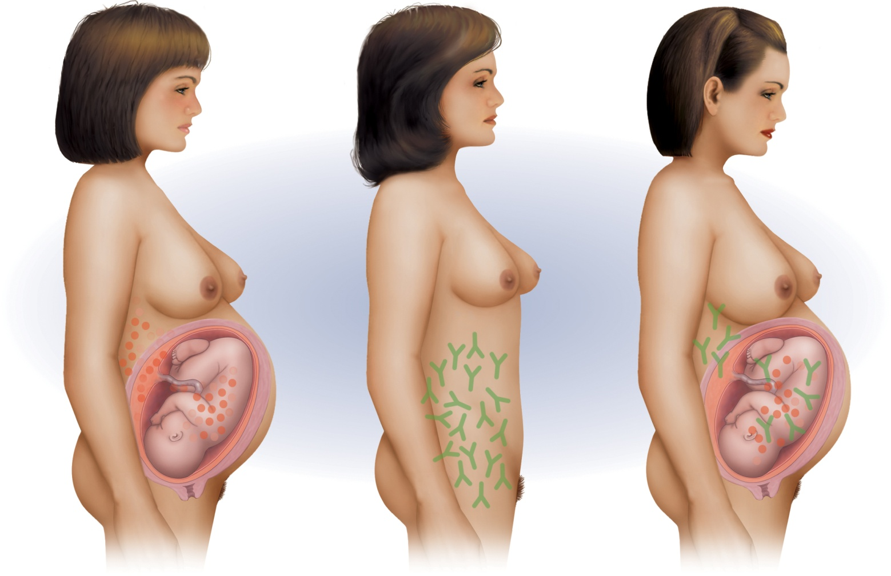


Fig. 18.16
Copyright © McGraw-Hill Education. Permission required for reproduction or display.
Rh– mother
Rh
antigen
Second
Rh+ fetus
Rh+ fetus
Uterus
Anti-D
antibody
Amniotic sac
and chorion
Placenta
(a) First pregnancy
(b) Between pregnancies
(c) Second pregnancy
Notes:
13

Slide 14
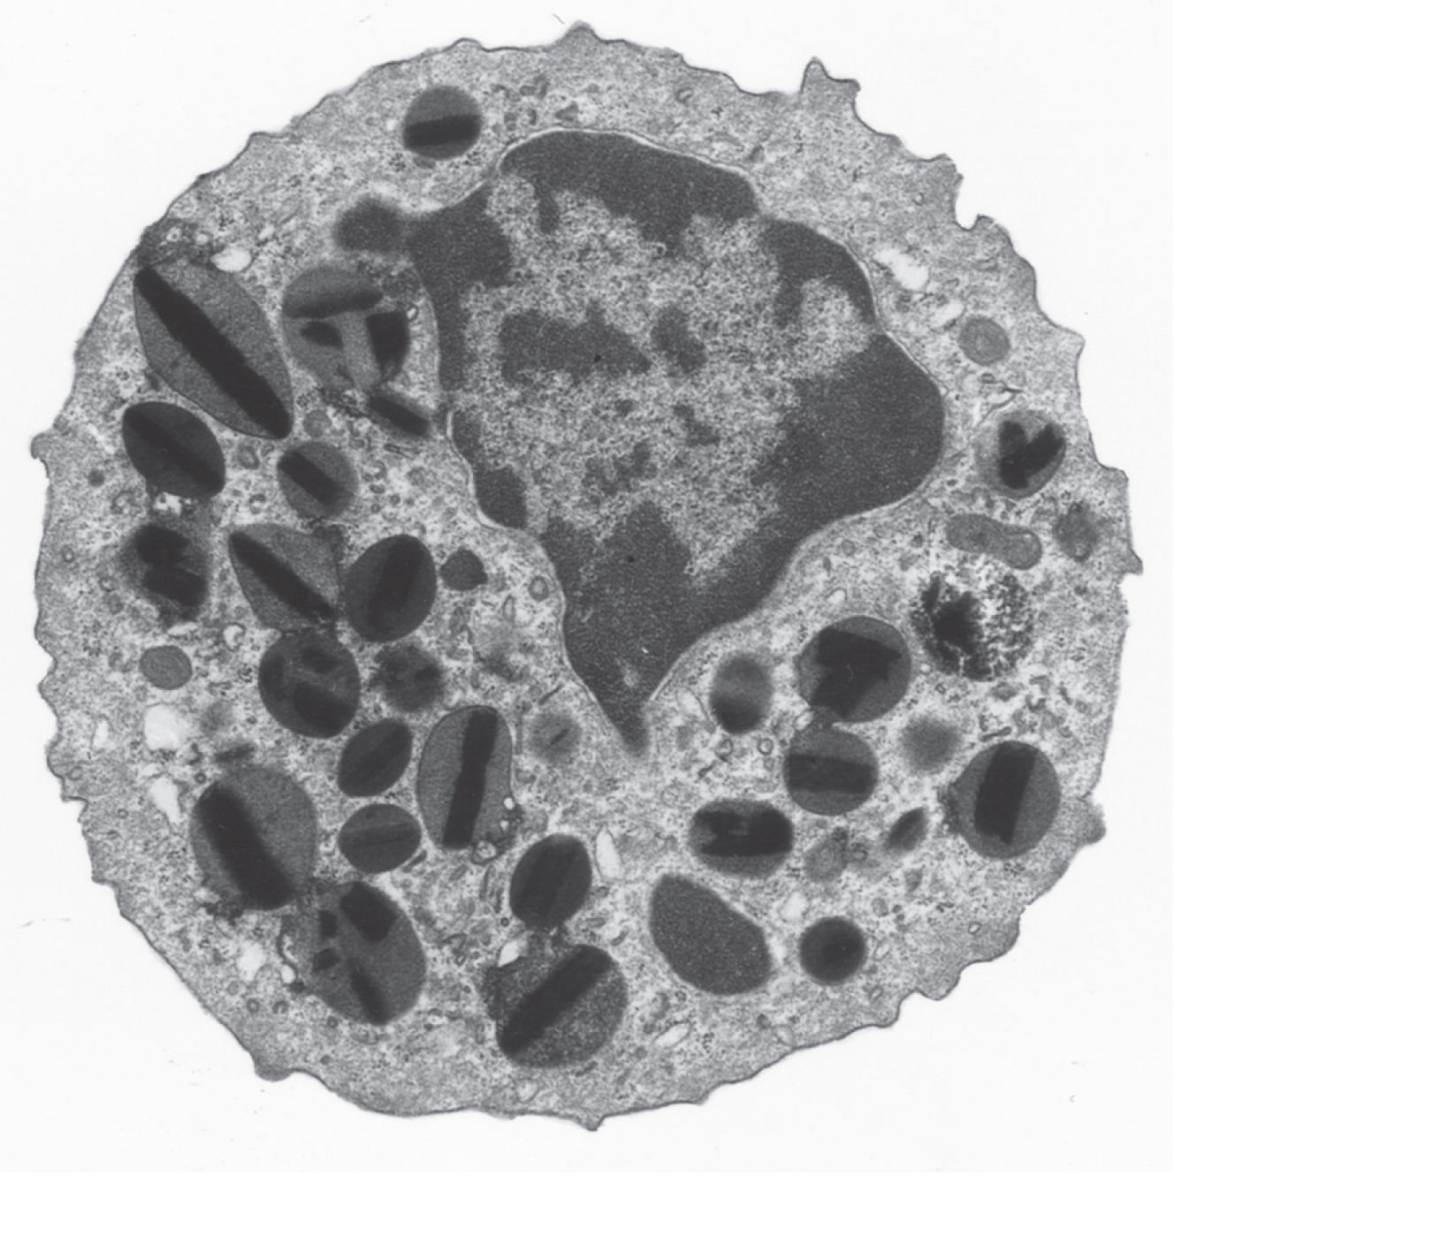
Fig. 18.17
Copyright © McGraw-Hill Education. Permission required for reproduction or display.
Nucleus
Lysosomes
5 µm
©SIU/Science Source
Notes:
14

Slide 15
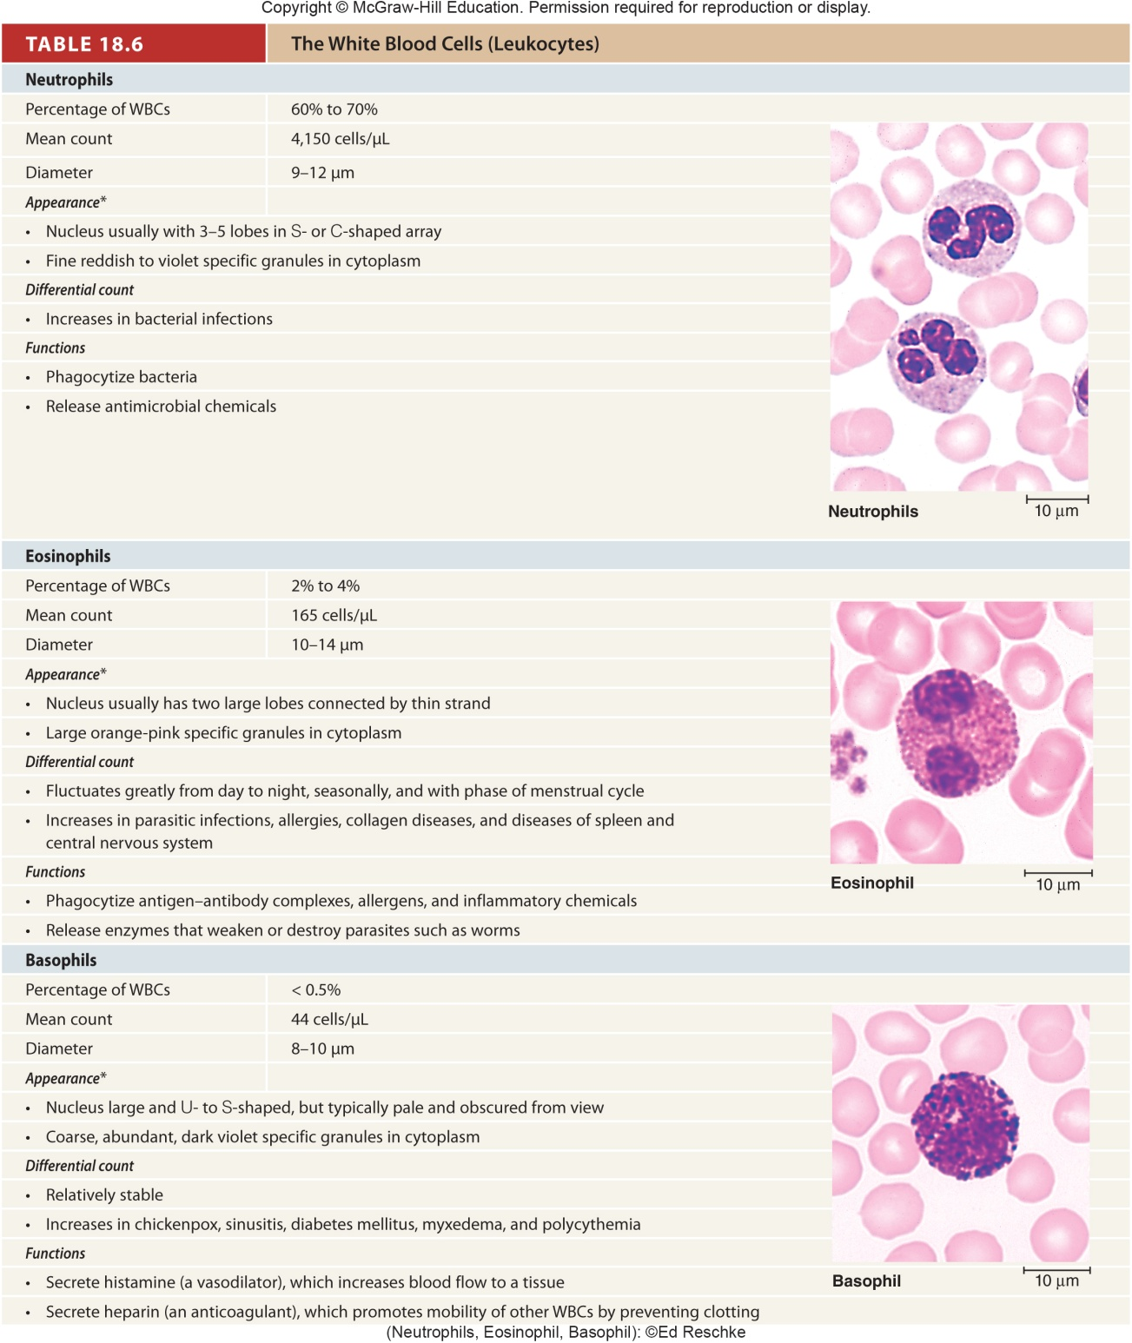
Table 18.6a
Notes:
15

Slide 16
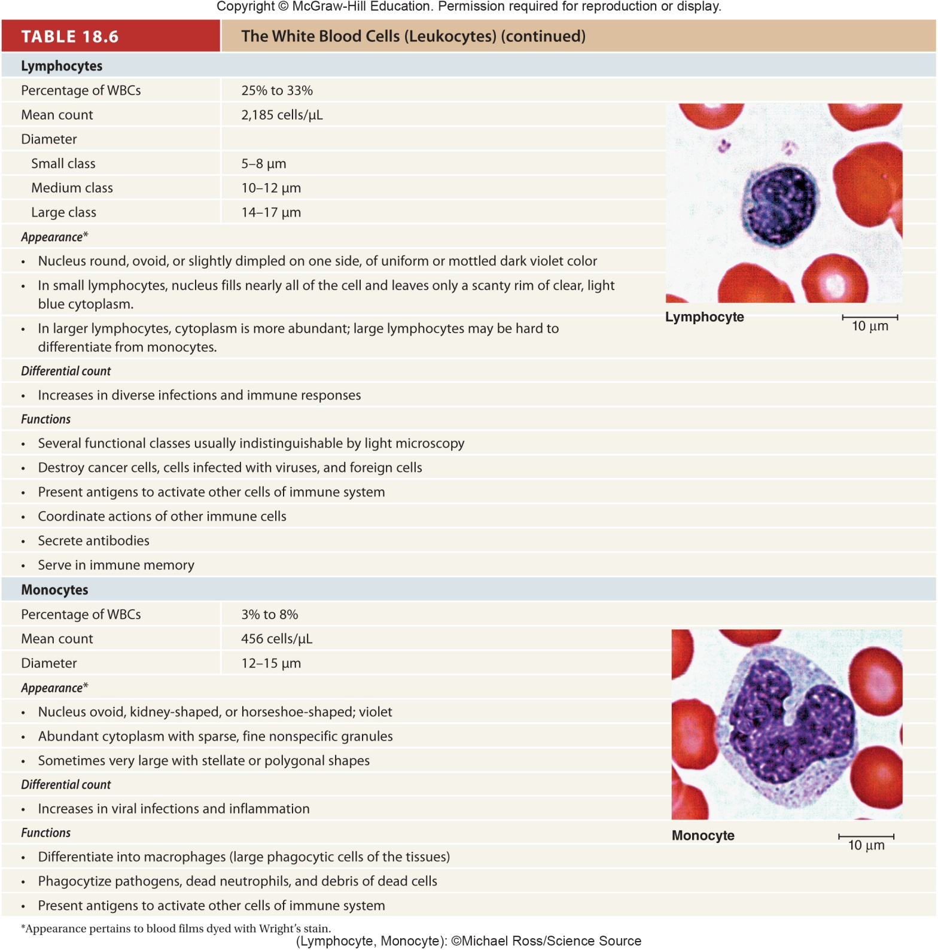
Table 18.6b
Notes:
16

Slide 17
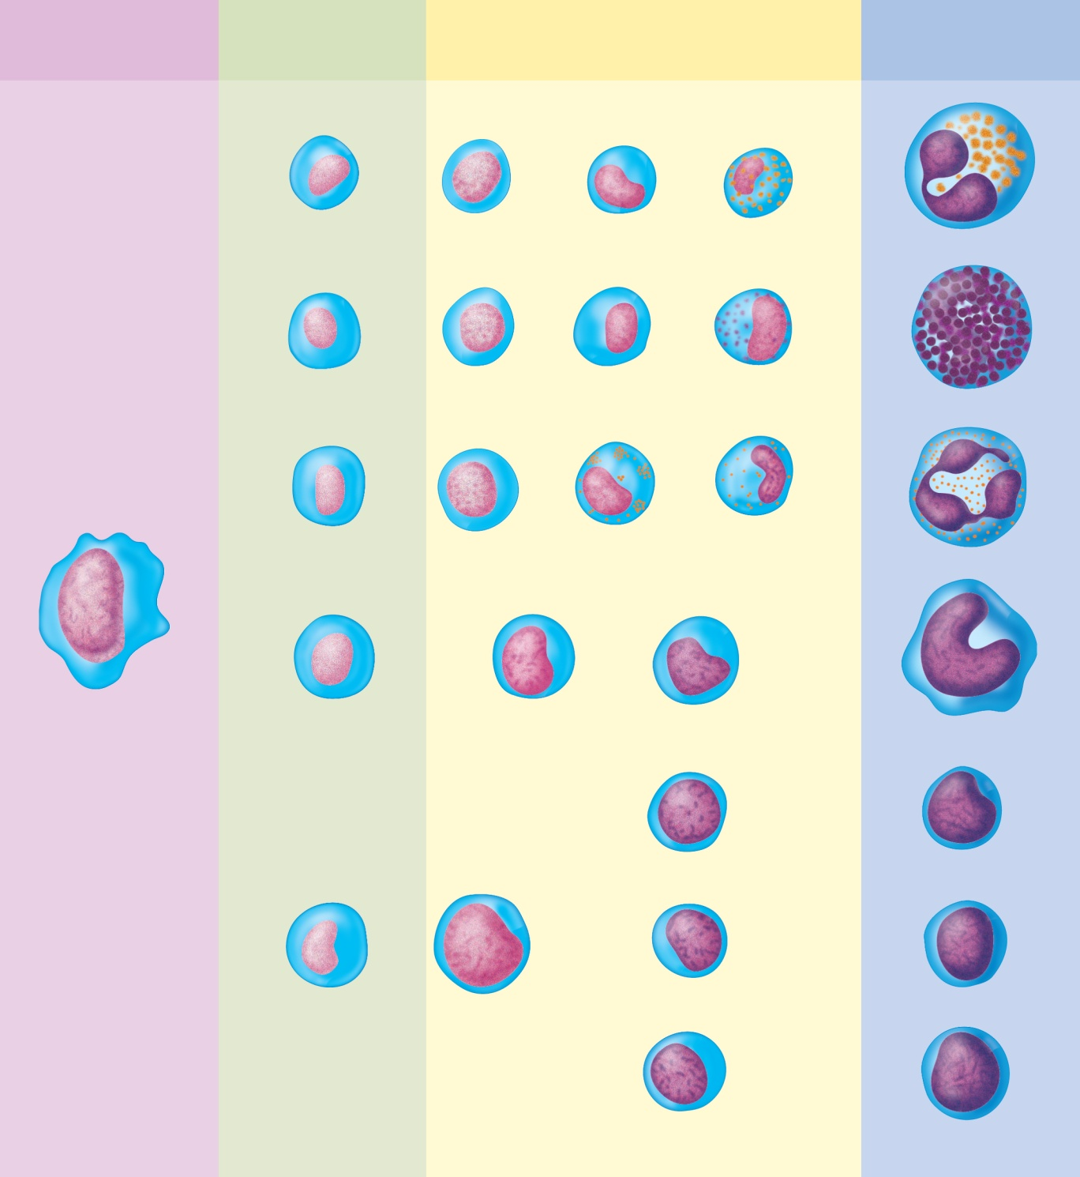
Fig. 18.18
Copyright © McGraw-Hill Education. Permission required for reproduction or display.
Hemopoietic
stem cell
Colony-forming
units (CFUs)
Precursor
cells
Mature
cells
Eosinophilic
CFU
Eosinophilic
myeloblast
Eosinophilic
promyelocyte
Eosinophilic
myelocyte
Eosinophil
Basophilic
CFU
Basophilic
myeloblast
Basophilic
promyelocyte
Basophilic
myelocyte
Basophil
Neutrophilic
CFU
Neutrophilic
myeloblast
Neutrophilic
promyelocyte
Neutrophilic
myelocyte
Neutrophil
Monocytic
CFU
Monoblast
Promonocyte
Monocyte
B prolymphocyte
B lymphocyte
Lymphocytic
CFU
Lymphoblast
T prolymphocyte
T lymphocyte
NK prolymphocyte
NK cell
Notes:
17

Slide 18
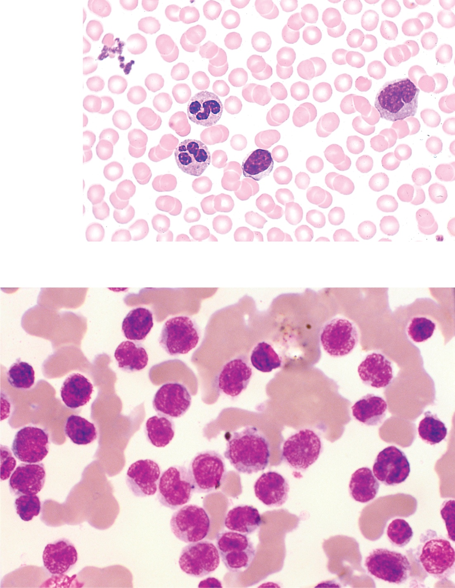
Fig. 18.19
Copyright © McGraw-Hill Education. Permission required for reproduction or display.
Platelets
Monocyte
Neutrophils
Lymphocyte
Erythrocytes
(a)
(b)
75 µm
a: ©Ed Reschke; b: ©Leonard Lessin/Photo Researchers/Getty Images
Notes:
18

Slide 19
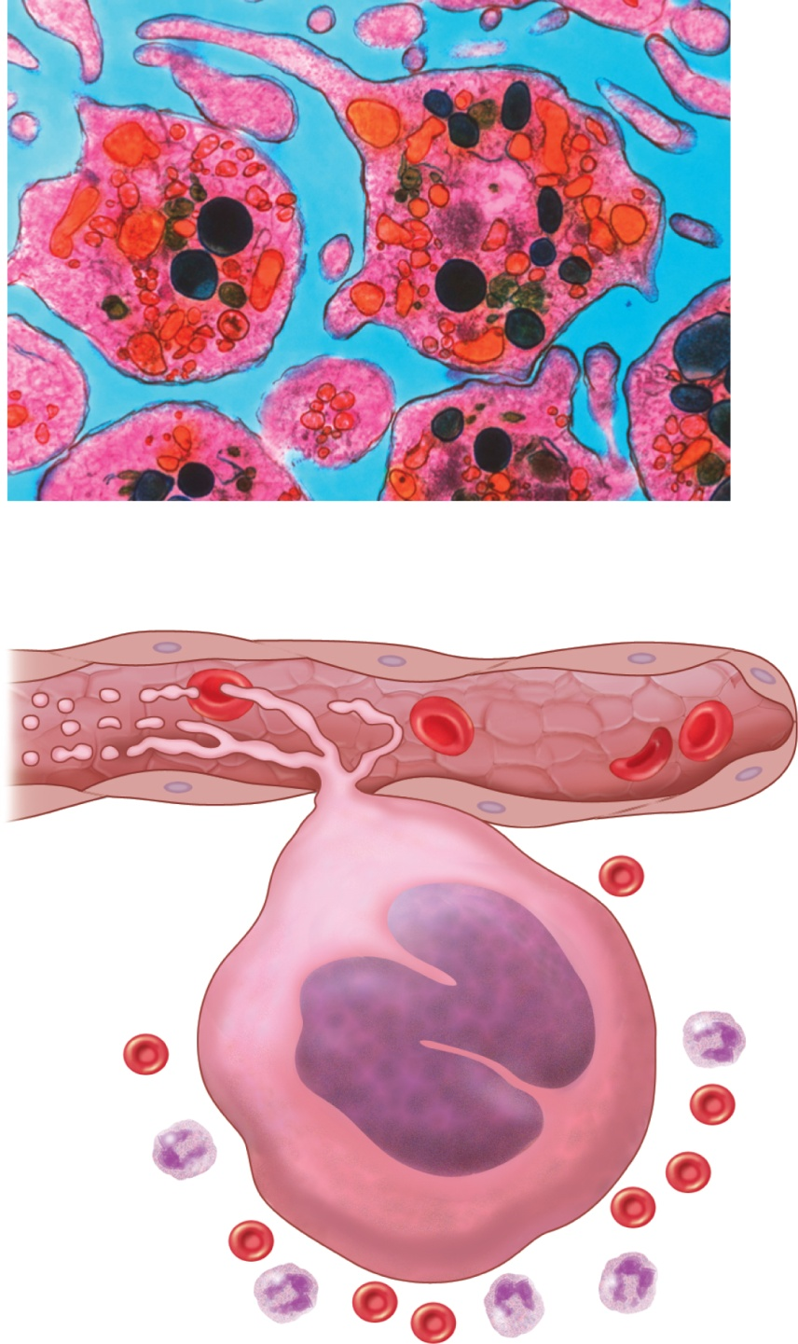
Fig. 18.20
Copyright © McGraw-Hill Education. Permission required for reproduction or display.
Pseudopod
Granules
Open
canalicular
system
Mitochondria
(a)
2 µm
Platelets
Bloodflow
Endothelium
Proplatelets
Sinusoid of
bone marrow
RBC
WBC
Megakaryocyte
(b)
a: ©NIBSC/Science Photo Library/Science Source
Notes:
19

Slide 20
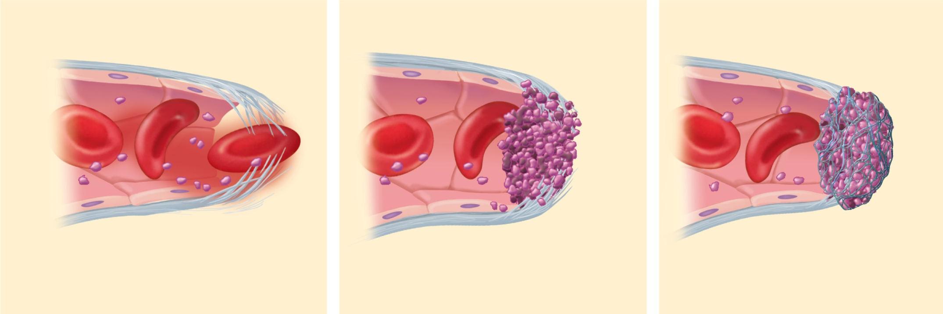
Fig. 18.21
Copyright © McGraw-Hill Education. Permission required for reproduction or display.
Vasoconstriction
Platelet
plug
Blood
clot
Platelet
Vessel
injury
Endothelial
cells
Collagen
fibers
(a) Vascular spasm
(b) Platelet plug formation
(c) Coagulation
Notes:
20

Slide 21
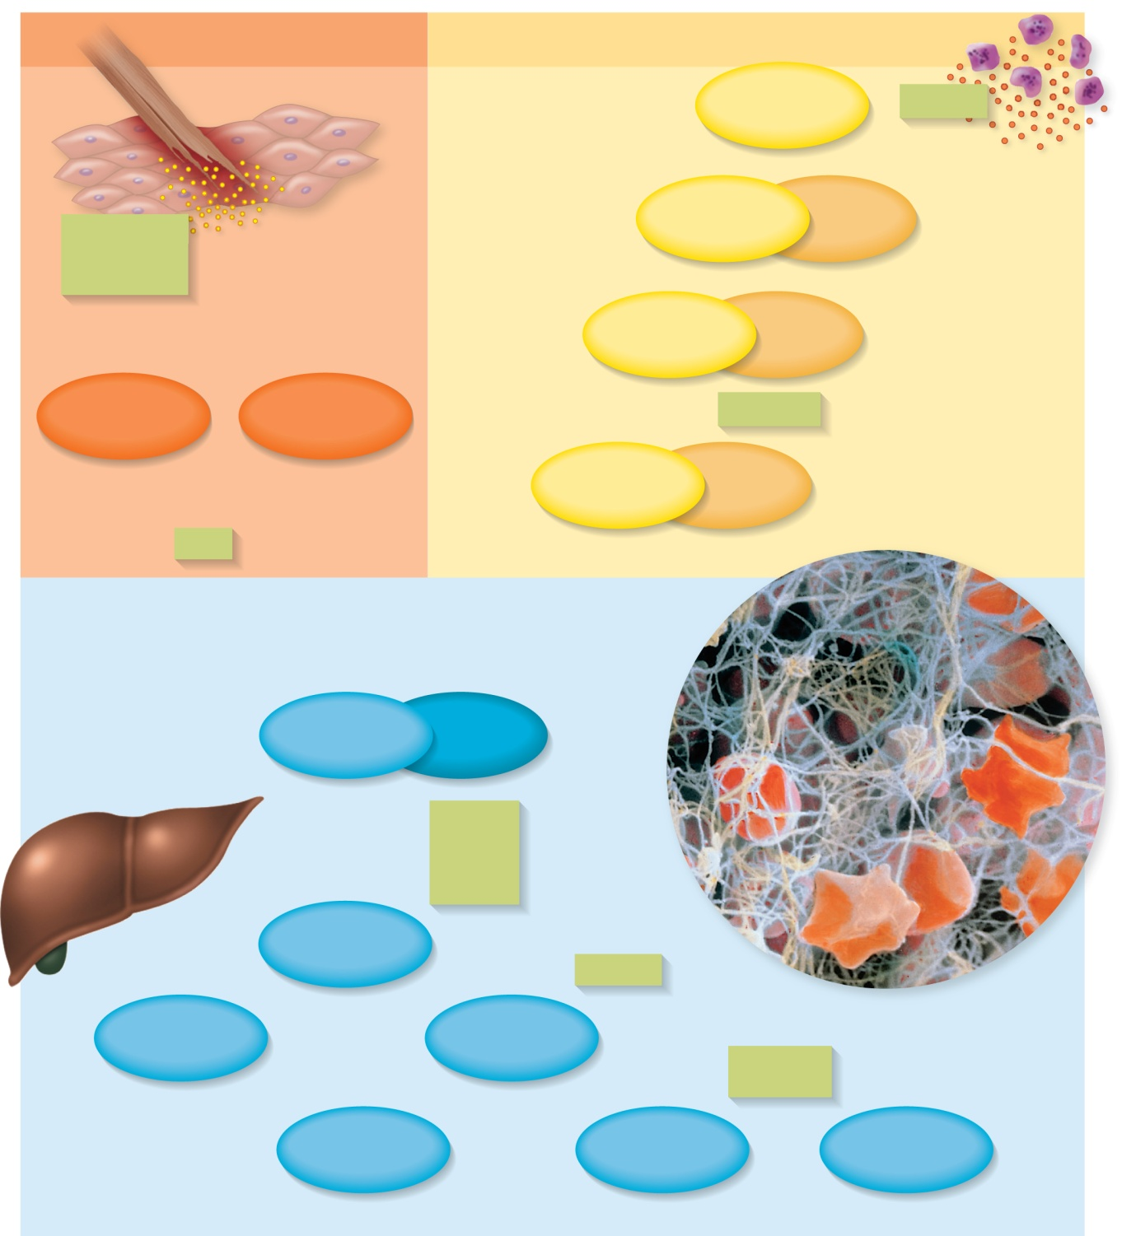

Fig. 18.22
Copyright © McGraw-Hill Education. Permission required for reproduction or display.
Extrinsic mechanism
Intrinsic mechanism
Factor XII
Platelets
Damaged
perivascular
tissues
Factor XI
(active)
Inactive
Factor IX
(active)
Inactive
Thromboplastin
(factor III)
Factor VII
Antihemophiliac
factor A
Ca²⁺, PF₃
Factor VIII
(active)
Inactive
Ca²⁺
Factor X
(active)
Inactive
Liver
Factor III
Factor V
Ca²⁺
PF₃
Prothrombin
activator
Factor V
Prothrombin
(factor II)
Thrombin
Blood clot
Factor XIII
Ca²⁺
Fibrinogen
(factor I)
Fibrin
Fibrin
polymer
©P. Motta/SPL/Science Source
Notes:
21

Slide 22

Fig. 18.23
Copyright © McGraw-Hill Education. Permission required for reproduction or display.
Factor
XII
Factor
XI
Factor
IX
Factor
VIII
Factor
X
Reaction cascade (time)
Prothrombin
activator
Thrombin
Fibrin
Notes:
22

Slide 23
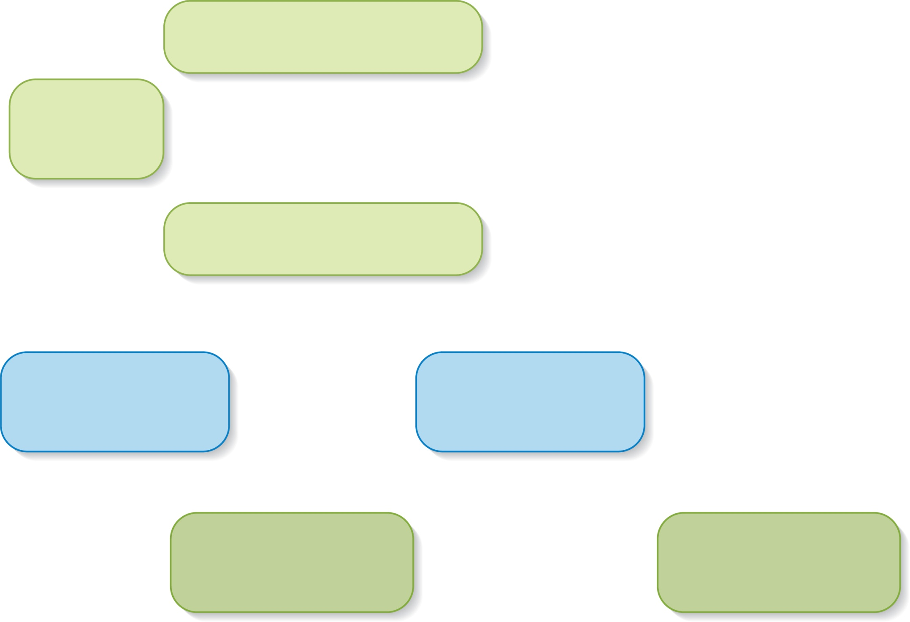
Fig. 18.24
Copyright © McGraw-Hill Education. Permission required for reproduction or display.
Prekallikrein
Factor
XII
Kallikrein
Positive
feedback
loop
Plasminogen
Plasmin
Fibrin
polymer
Fibrin degradation
products
Clot dissolution
Notes:
23

