Slide 1
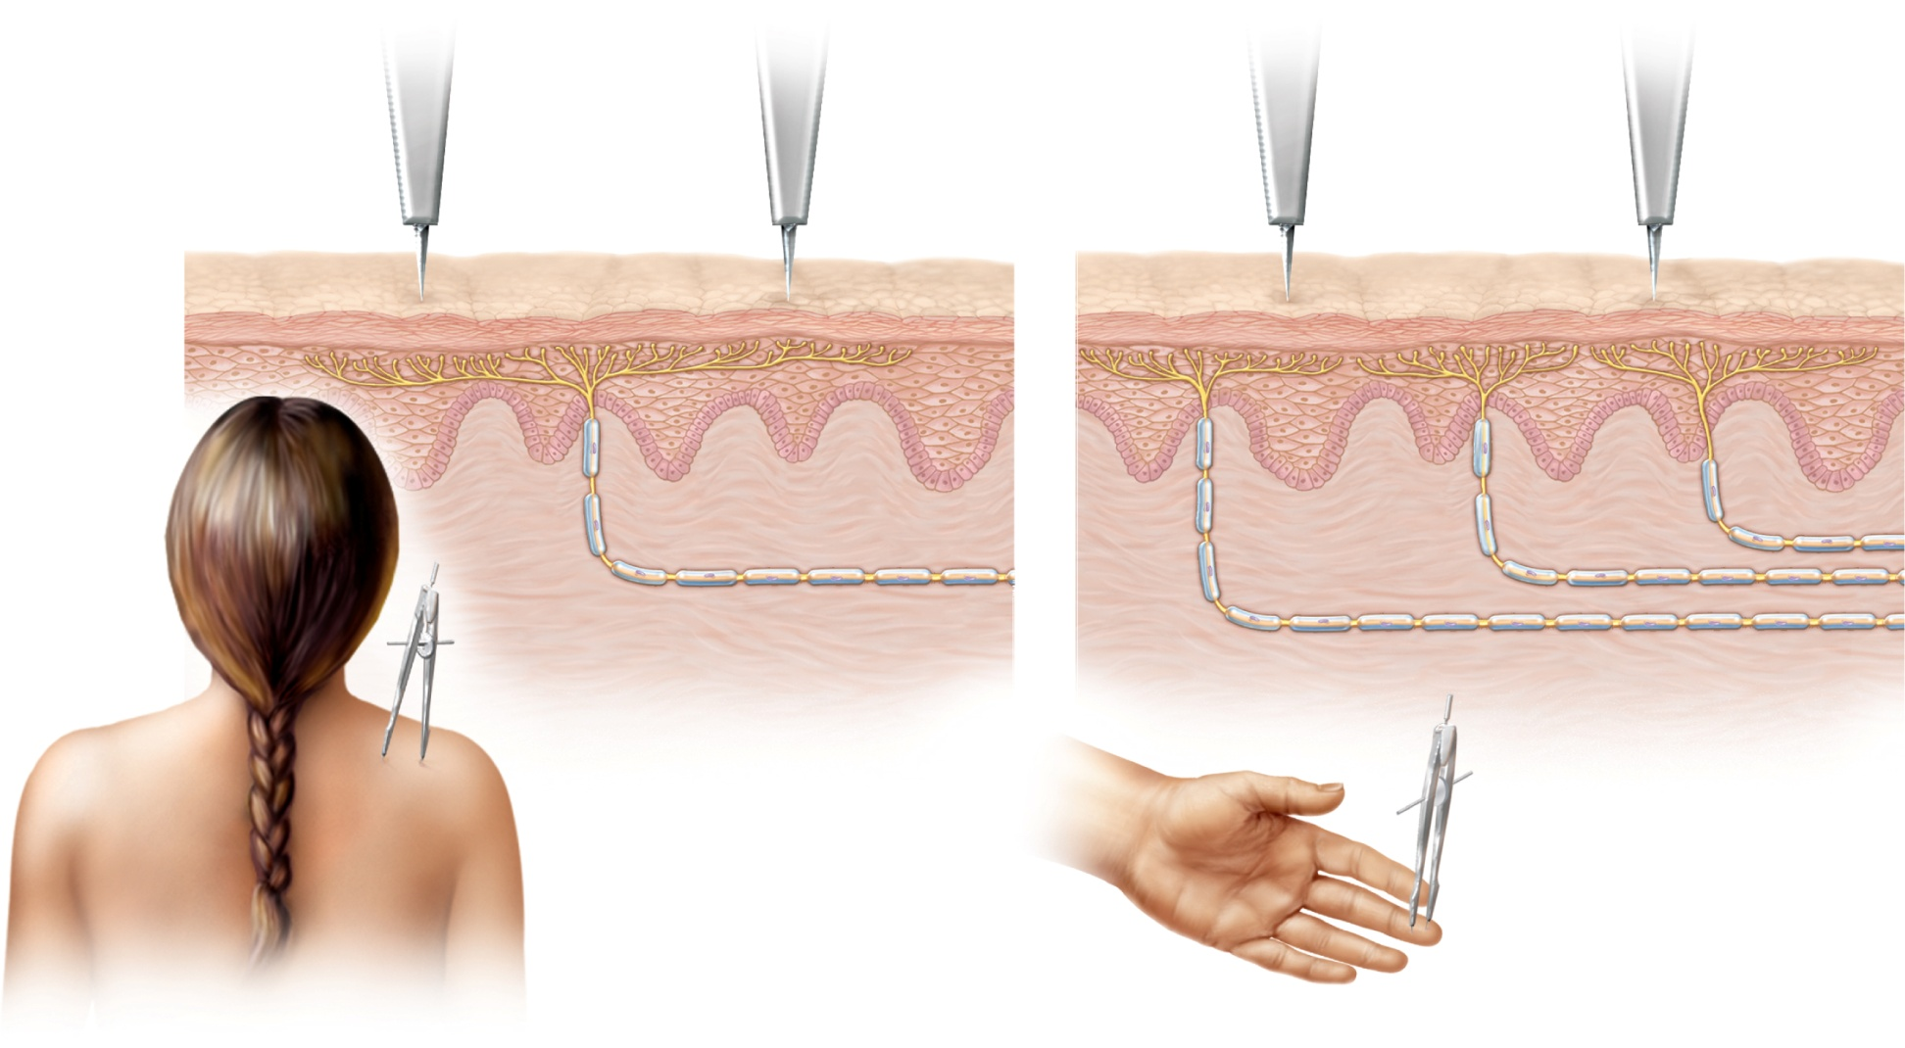
Fig. 16.1
Copyright © McGraw-Hill Education. Permission required for reproduction or display.
1
2
3
Neuron 3
Neuron
Neuron 2
Neuron 1
(a) One large receptive field (arrow)
(b) Three small receptive
fields (arrows)

Slide 2
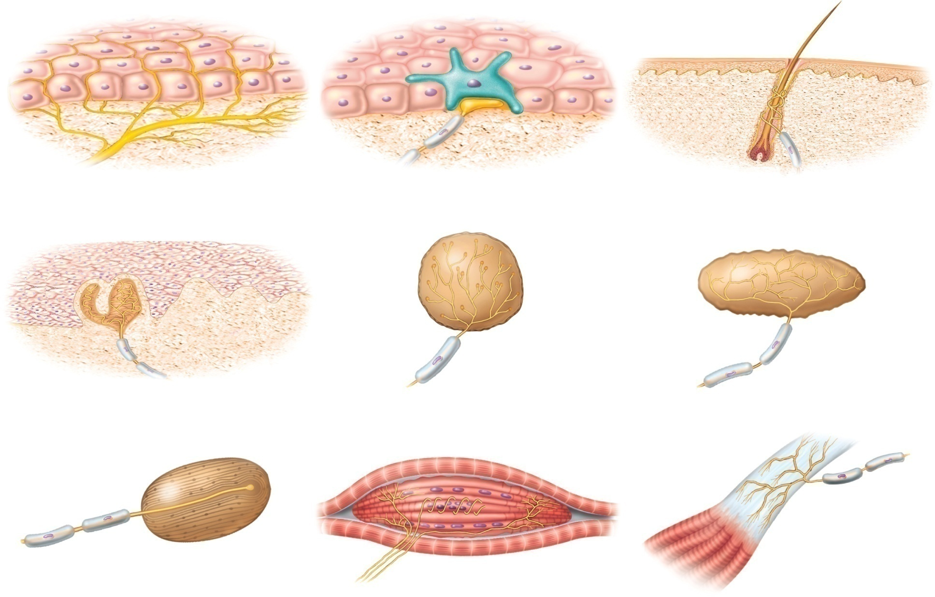
Fig. 16.2
Copyright © McGraw-Hill Education. Permission required for reproduction or display.
Tactile cell
Tactile cell
Nerve ending
Nerve ending
Free nerve endings
Tactile disc
Hair receptor
Tactile corpuscle
End bulb
Bulbous corpuscle
Lamellar corpuscle
Muscle spindle
Tendon organ

Slide 3
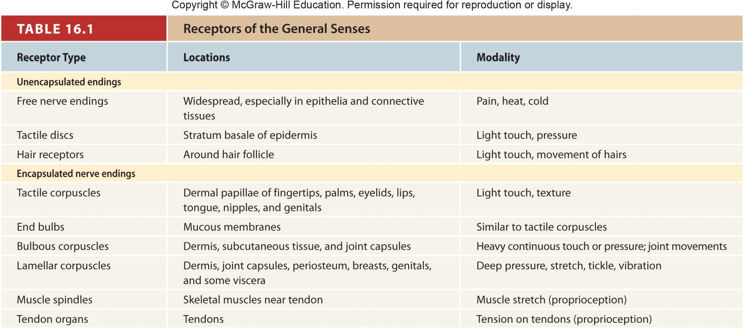
Table 16.1

Slide 4
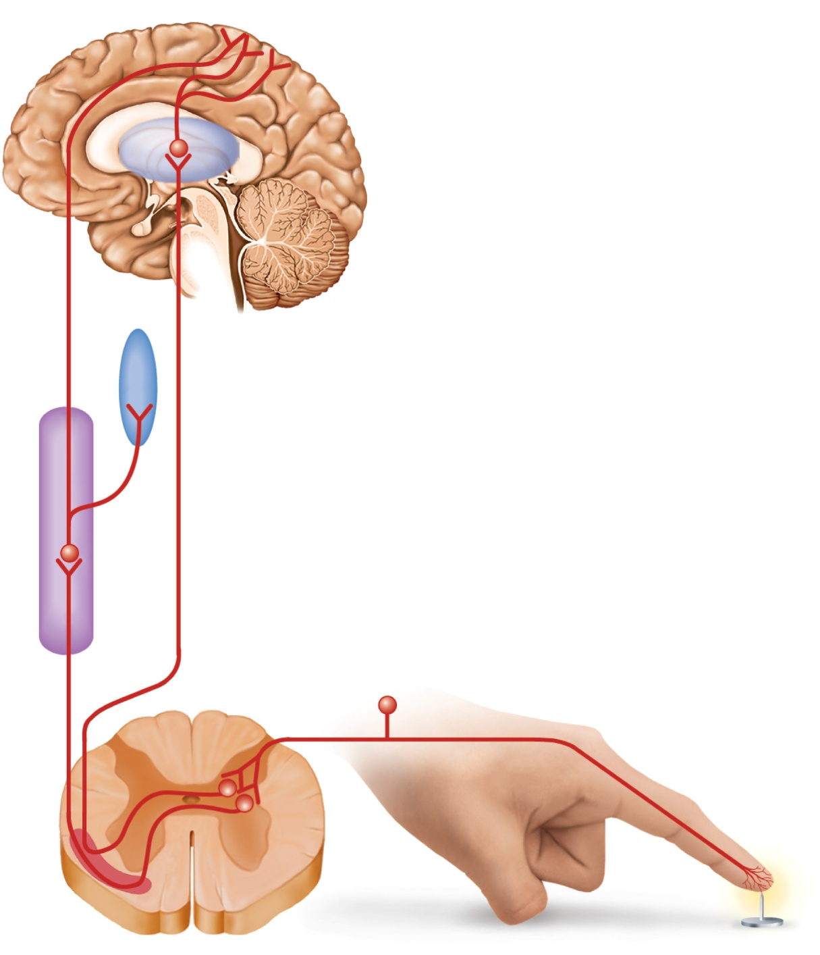



Fig. 16.3
Copyright © McGraw-Hill Education. Permission required for reproduction or display.
Primary somesthetic cortex
Somesthetic association area
Thalamus
Third-order nerve fibers
Hypothalamus and
limbic system
Reticular formation
Second-order nerve fibers
Spinothalamic tract
Spinoreticular tract
First-order
nerve fiber
Nociceptor
Spinal cord
Anterolateral system

Slide 5
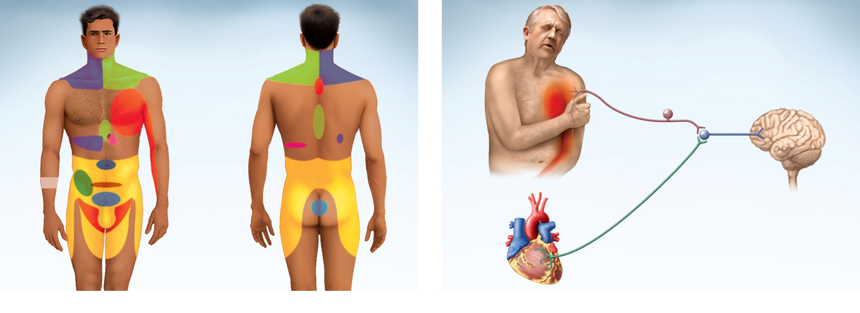
Fig. 16.4
Copyright © McGraw-Hill Education. Permission required for reproduction or display.
Liver and
gallbladder
Liver and
gallbladder
Lung and diaphragm
Heart
Stomach
?
Pancreas
Small intestine
Appendix
Colon
Ureter
Urinary
bladder
Kidney
(a)
(b)

Slide 6
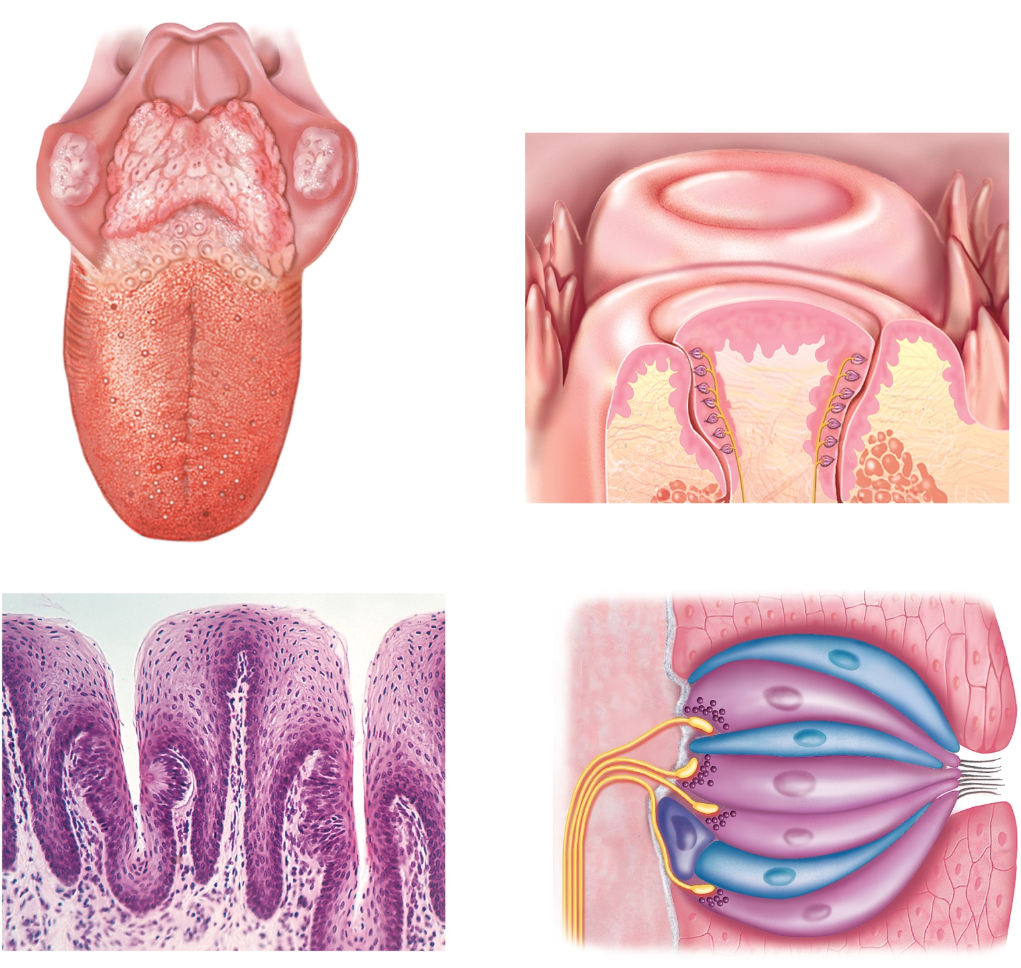



Fig. 16.6
Copyright © McGraw-Hill Education. Permission required for reproduction or display.
Epiglottis
Lingual tonsil
Palatine tonsil
Vallate
papillae
Vallate
papillae
Filiform
papillae
Foliate
papillae
Taste
buds
Fungiform
papillae
(a) Tongue
(b) Vallate papillae
Foliate
papilla
Synaptic
vesicles
Supporting
cell
Sensory
nerve
fibers
Taste
cell
Taste pore
Taste
pore
Taste bud
Basal
cell
Taste
hairs
Tongue
epithelium
(c) Foliate papillae
100 µm
(d) Taste bud
c: ©Ed Reschke

Slide 7
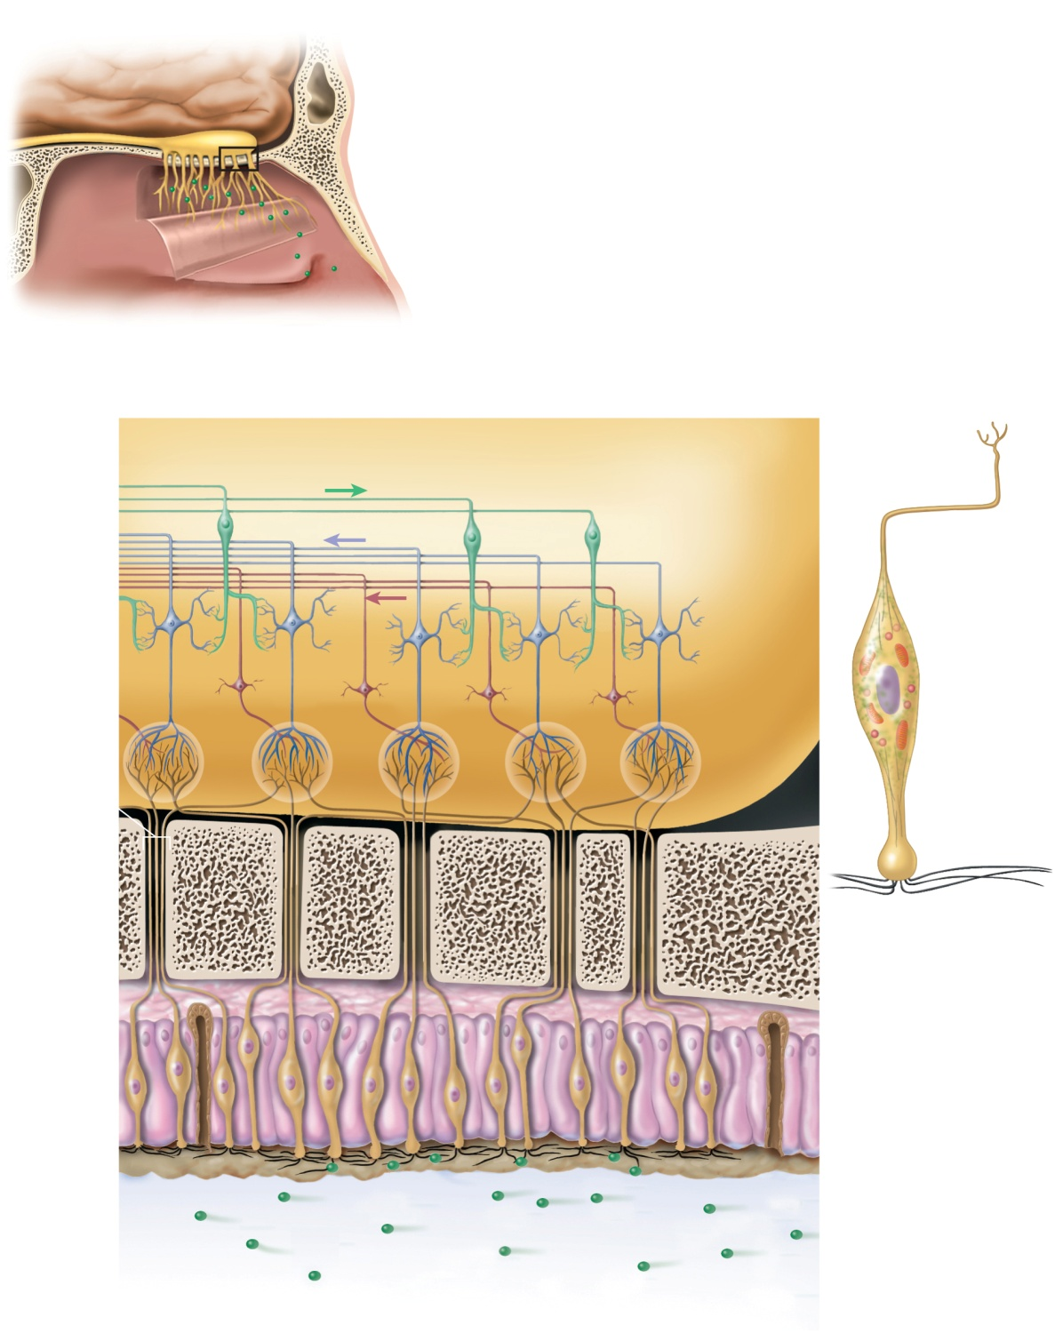



Fig. 16.7
Copyright © McGraw-Hill Education. Permission required for reproduction or display.
Olfactory tract
Olfactory bulb
Olfactory nerve
fascicle
Olfactory
mucosa (reflected)
(a)
Olfactory bulb
Granule cell
Olfactory tract
Axon
Mitral cell
Tufted cell
Neurosoma
Glomerulus
Olfactory
nerve fascicle
Dendrite
Cribriform
plate of
ethmoid bone
Olfactory
hairs
(c)
Basal cell
Supporting
cells
Olfactory cell
Olfactory gland
Olfactory hairs
Mucus
Odor
molecules
Airflow
(b)

Slide 8
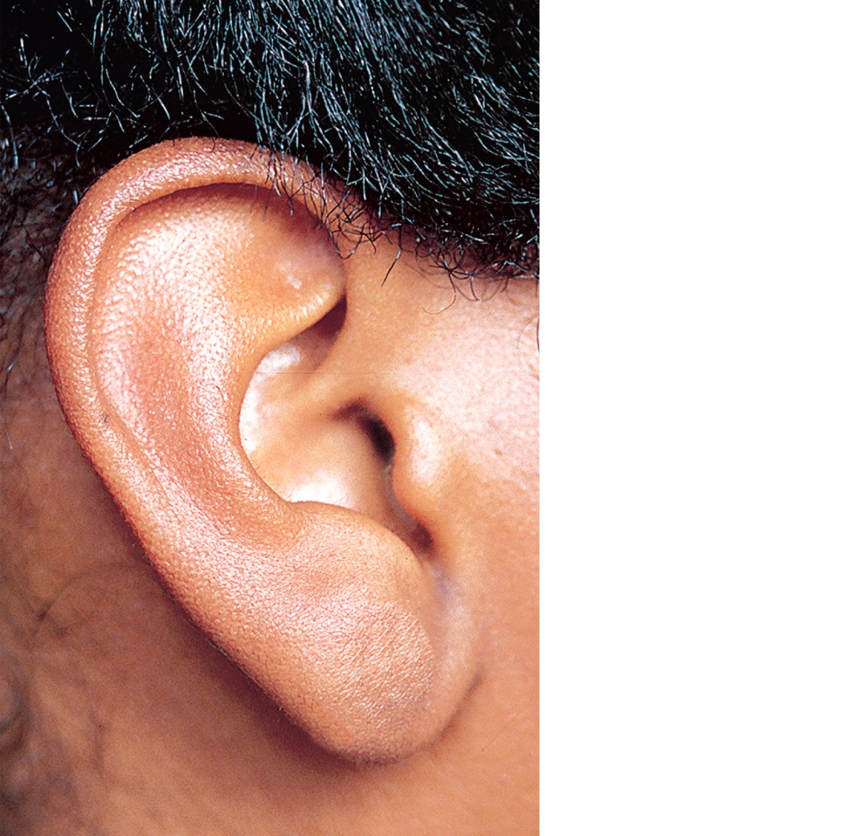
Fig. 16.10
Copyright © McGraw-Hill Education. Permission required for reproduction or display.
Helix
Triangular fossa
Antihelix
Concha
External acoustic meatus
Tragus
Antitragus
Lobule (earlobe)
©McGraw-Hill Education/Joe DeGrandis

Slide 9
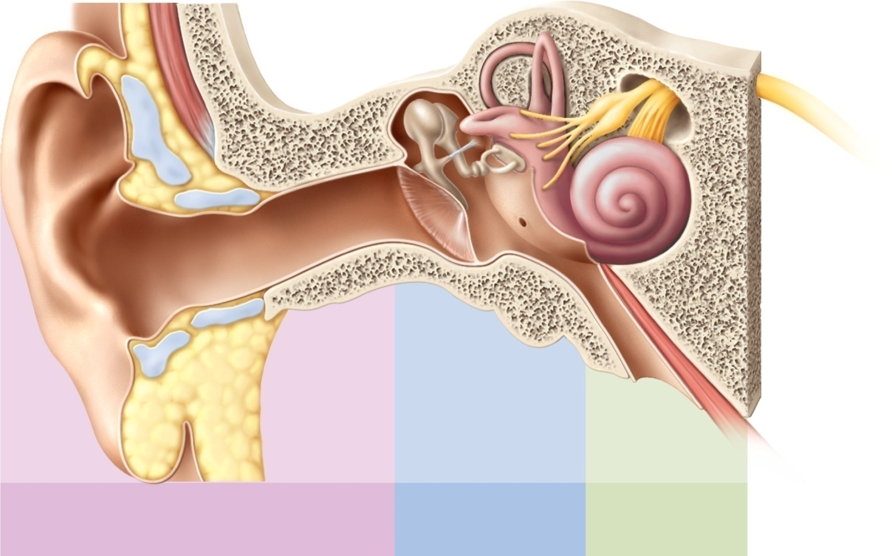
Fig. 16.11
Copyright © McGraw-Hill Education. Permission required for reproduction or display.
Ossicles:
Semicircular ducts
Helix
Stapes
Oval window
Incus
Vestibular nerve
Malleus
Cochlear nerve
Vestibule
Auricle
Cochlea
Tympanic
membrane
Round window
Auditory
canal
Tympanic cavity
Tensor tympani
muscle
Auditory tube
Lobule
Outer ear
Middle ear
Inner ear

Slide 10
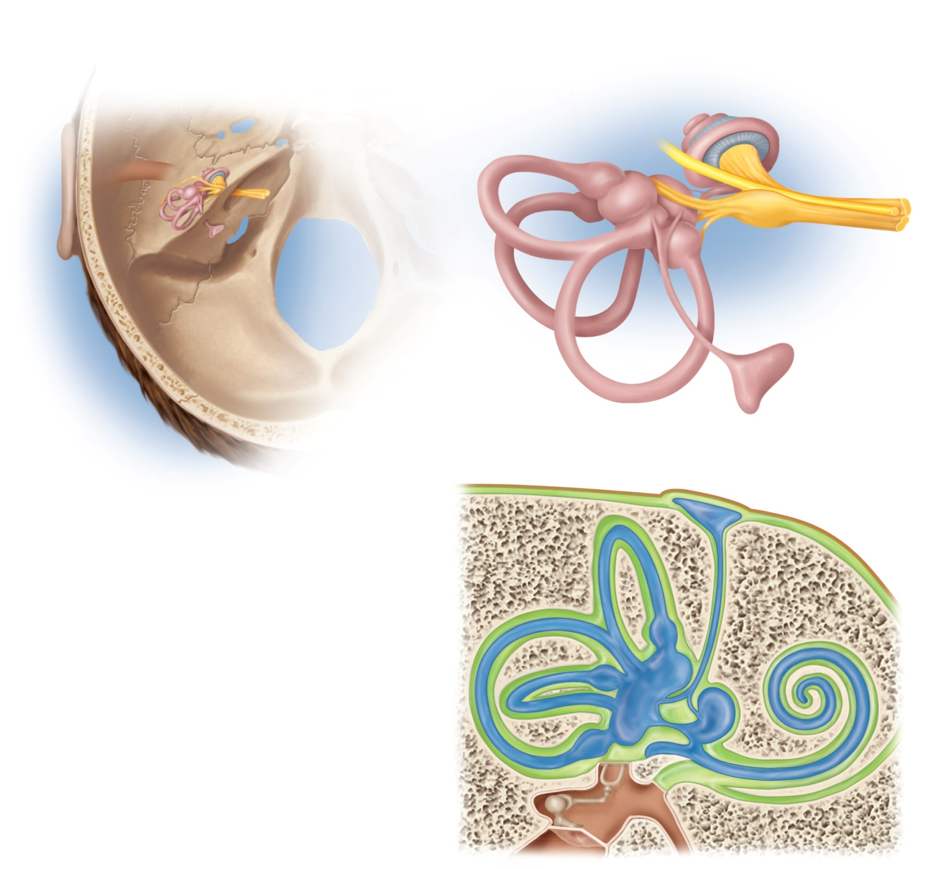
Fig. 16.12
Copyright © McGraw-Hill Education. Permission required for reproduction or display.
Vestibule:
Saccule
Cochlea
Utricle
Spiral ganglion
of cochlea
Ampullae
Cochlear nerve
Facial nerve
Semicircular ducts:
Vestibular nerve
Anterior
Vestibular
ganglion
Temporal
bone
Lateral
Posterior
Endolymphatic
sac
(b)
(a)
Endolymphatic
sac
Temporal bone
Semicircular ducts:
Dura mater
Anterior
Posterior
Lateral
Scala vestibuli
Semicircular canal
Scala tympani
Ampulla
Cochlear duct
Vestibule:
Saccule
Tympanic
membrane
Utricle
Stapes
in oval window
Secondary tympanic membrane
in round window
(c)

Slide 11
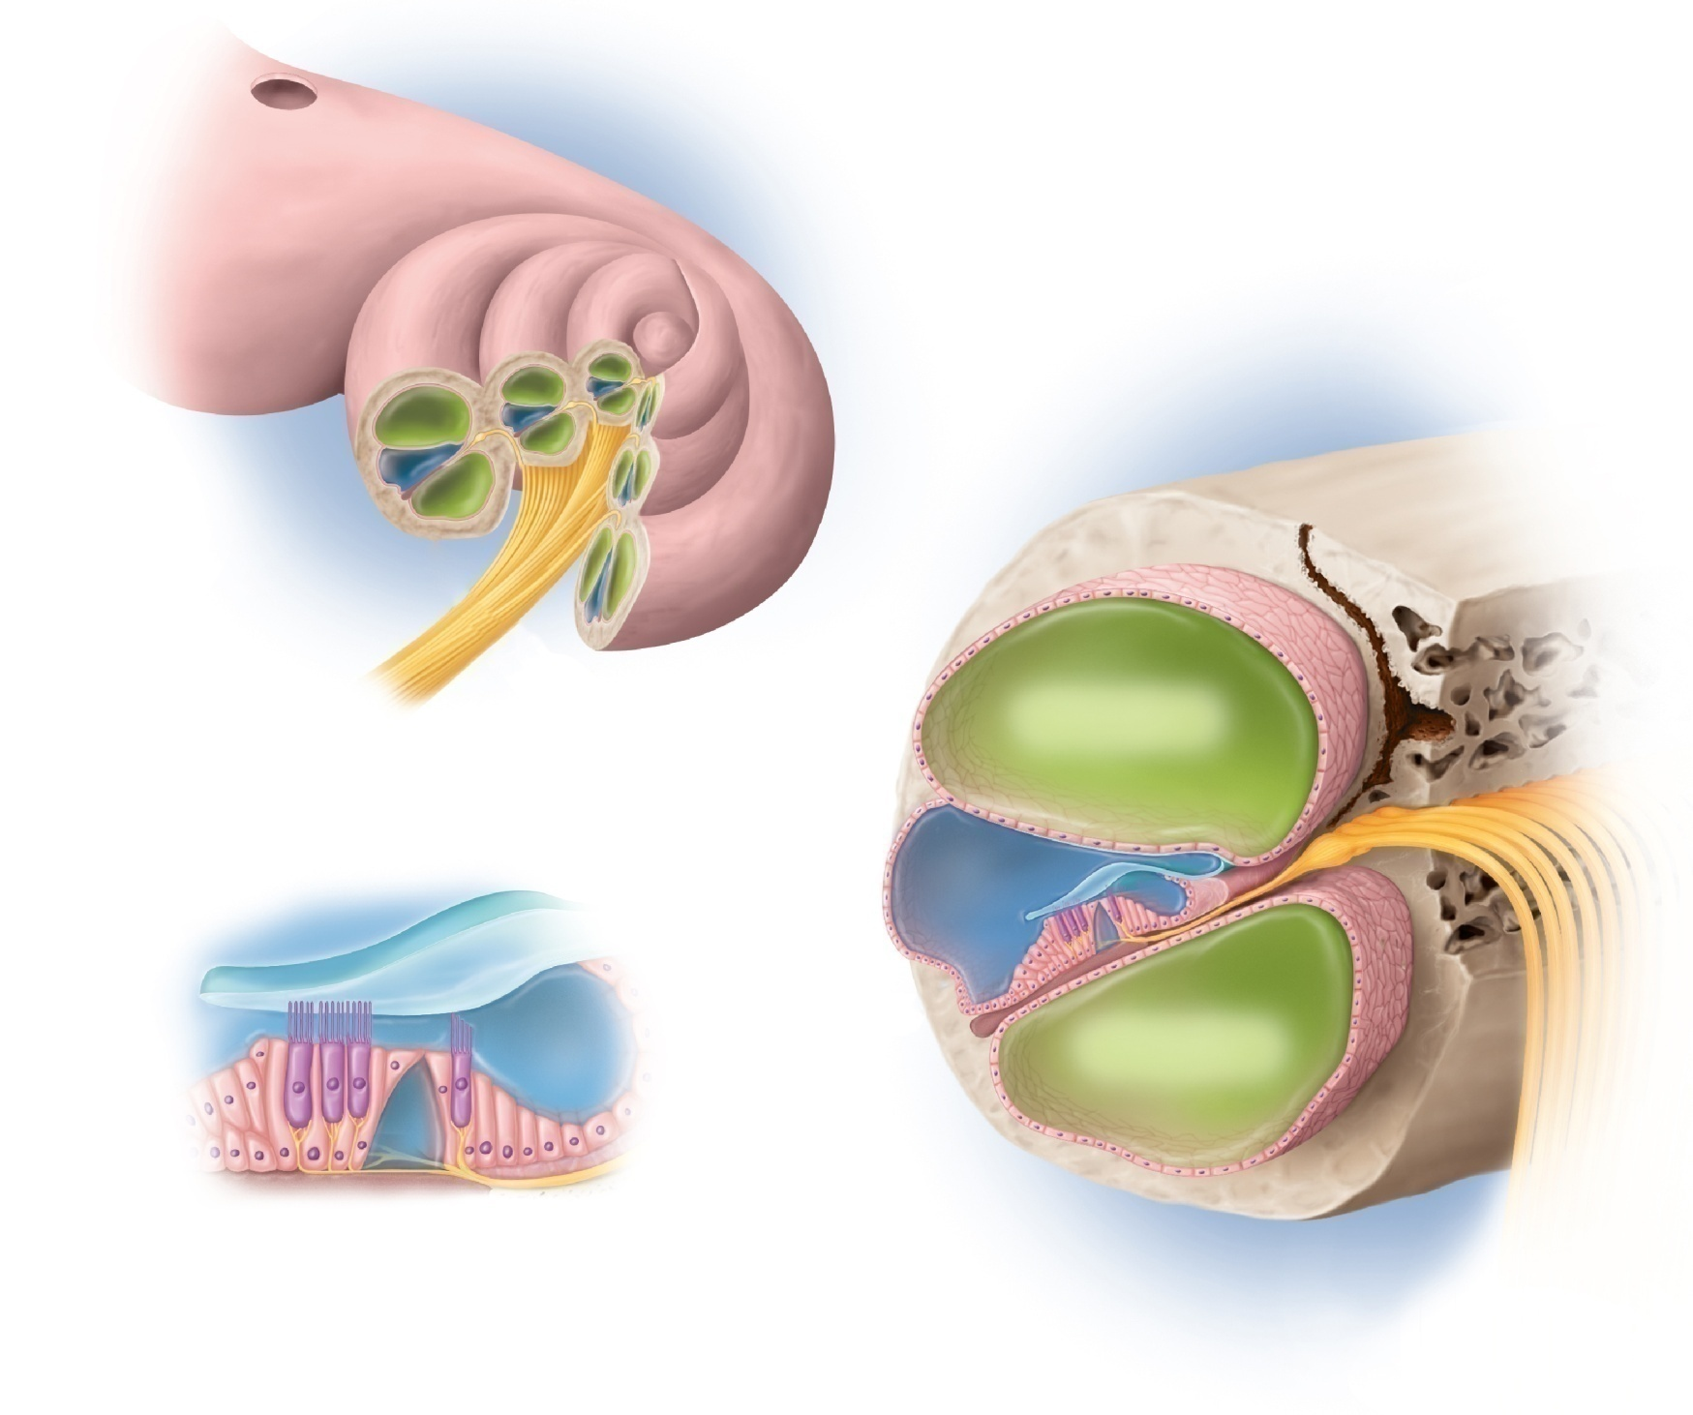
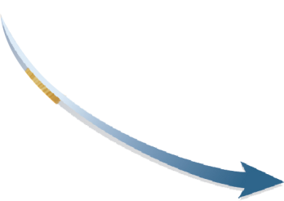
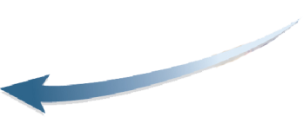
Fig. 16.13
Copyright © McGraw-Hill Education. Permission required for reproduction or display.
Oval window
Vestibular
membrane
Cochlear duct
(scala media)
Spiral ganglion
Cochlear nerve
(a)
Scala vestibuli
(with perilymph)
Vestibular
membrane
Tectorial
membrane
Cochlear duct
(with
endolymph)
Hairs
(stereocilia)
Outer
hair cells
Scala tympani
(with perilymph)
Supporting
cells
Tectorial
membrane
Basilar
membrane
Sprial
organ
Inner hair
cell
Basilar
membrane
Fibers of
cochlear nerve
(b)
(c)

Slide 12
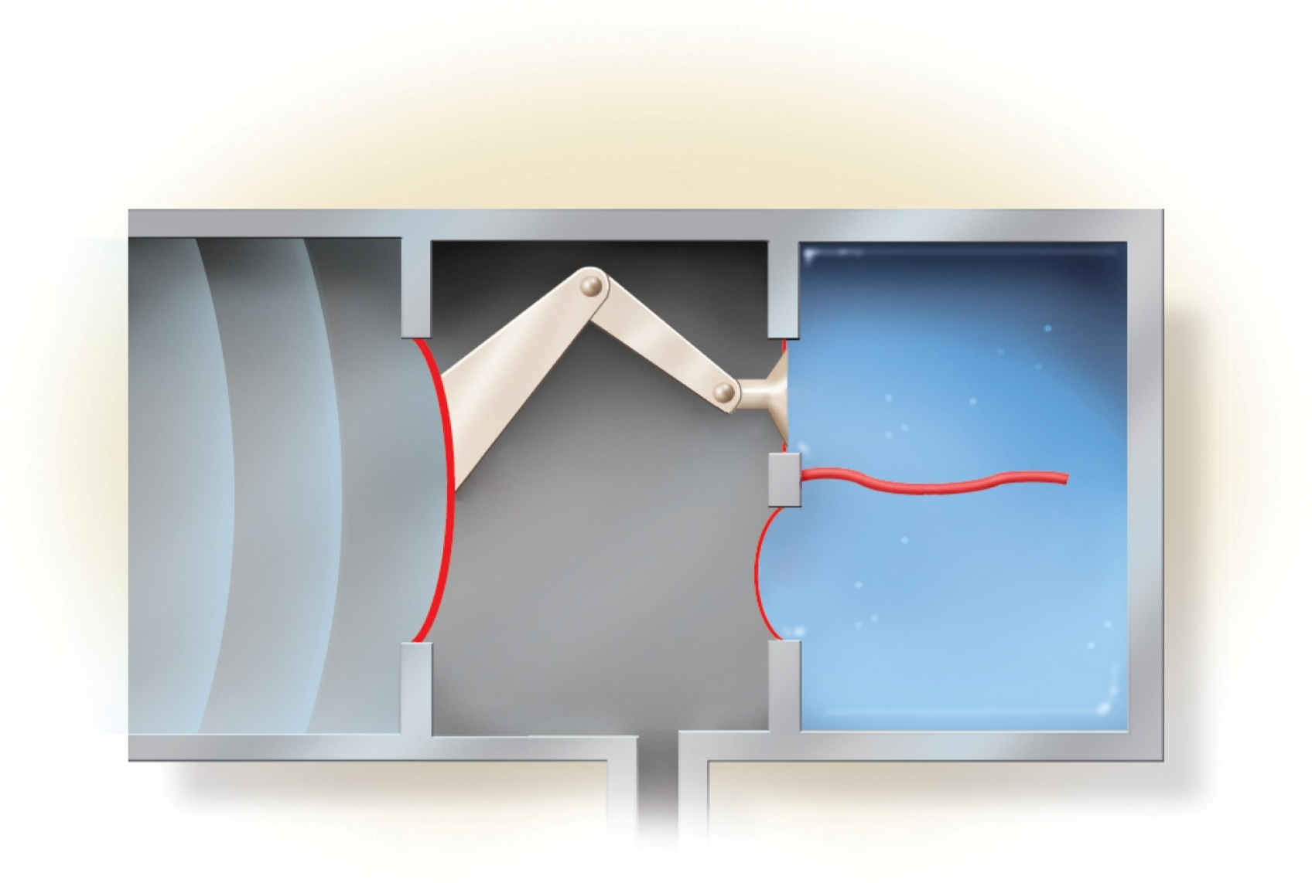





Fig. 16.15
Copyright © McGraw-Hill Education. Permission required for reproduction or display.
Outer ear
Middle ear
Inner ear
Stapes
Oval
window
Incus
Malleus
Sound
wave
Basilar
membrane
Tympanic
membrane
Secondary
tympanic
membrane
(in round
window)
Air
Fluid
Auditory
tube

Slide 13
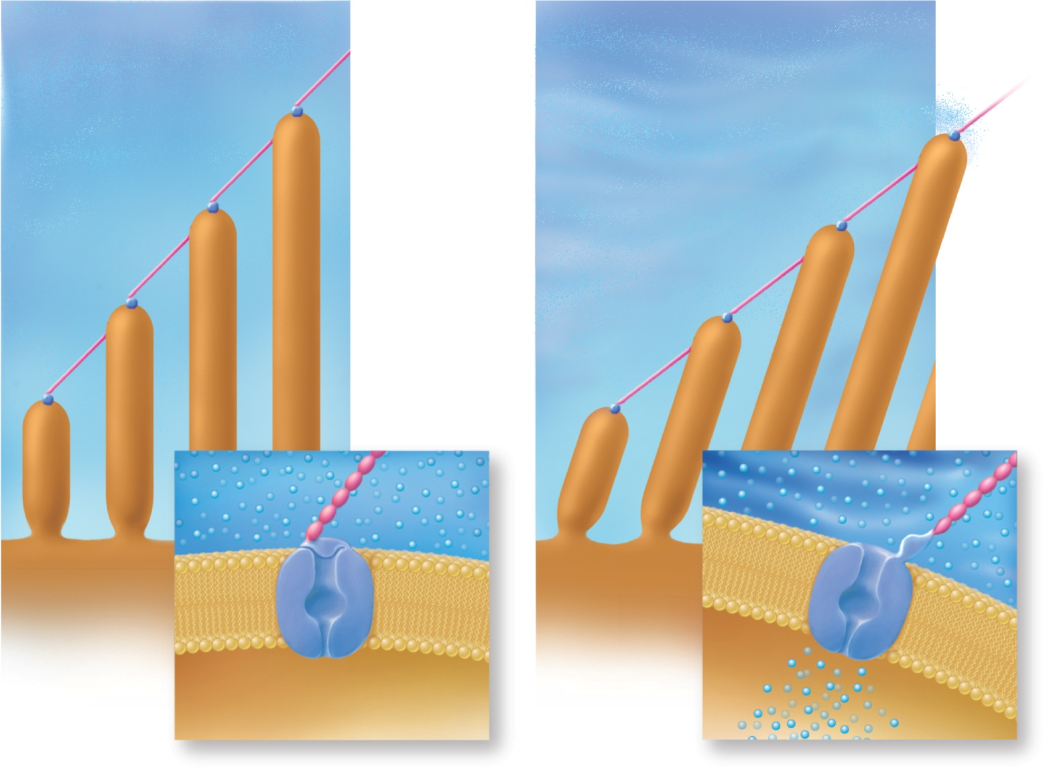
Fig. 16.16
Copyright © McGraw-Hill Education. Permission required for reproduction or display.
Unstimulated
Stimulated
Tip link
Mechanically
gated K⁺
channel
Stereocilia
K⁺
Surface of
hair cell
K⁺
K⁺ gate
closed
K⁺ gate
open

Slide 14
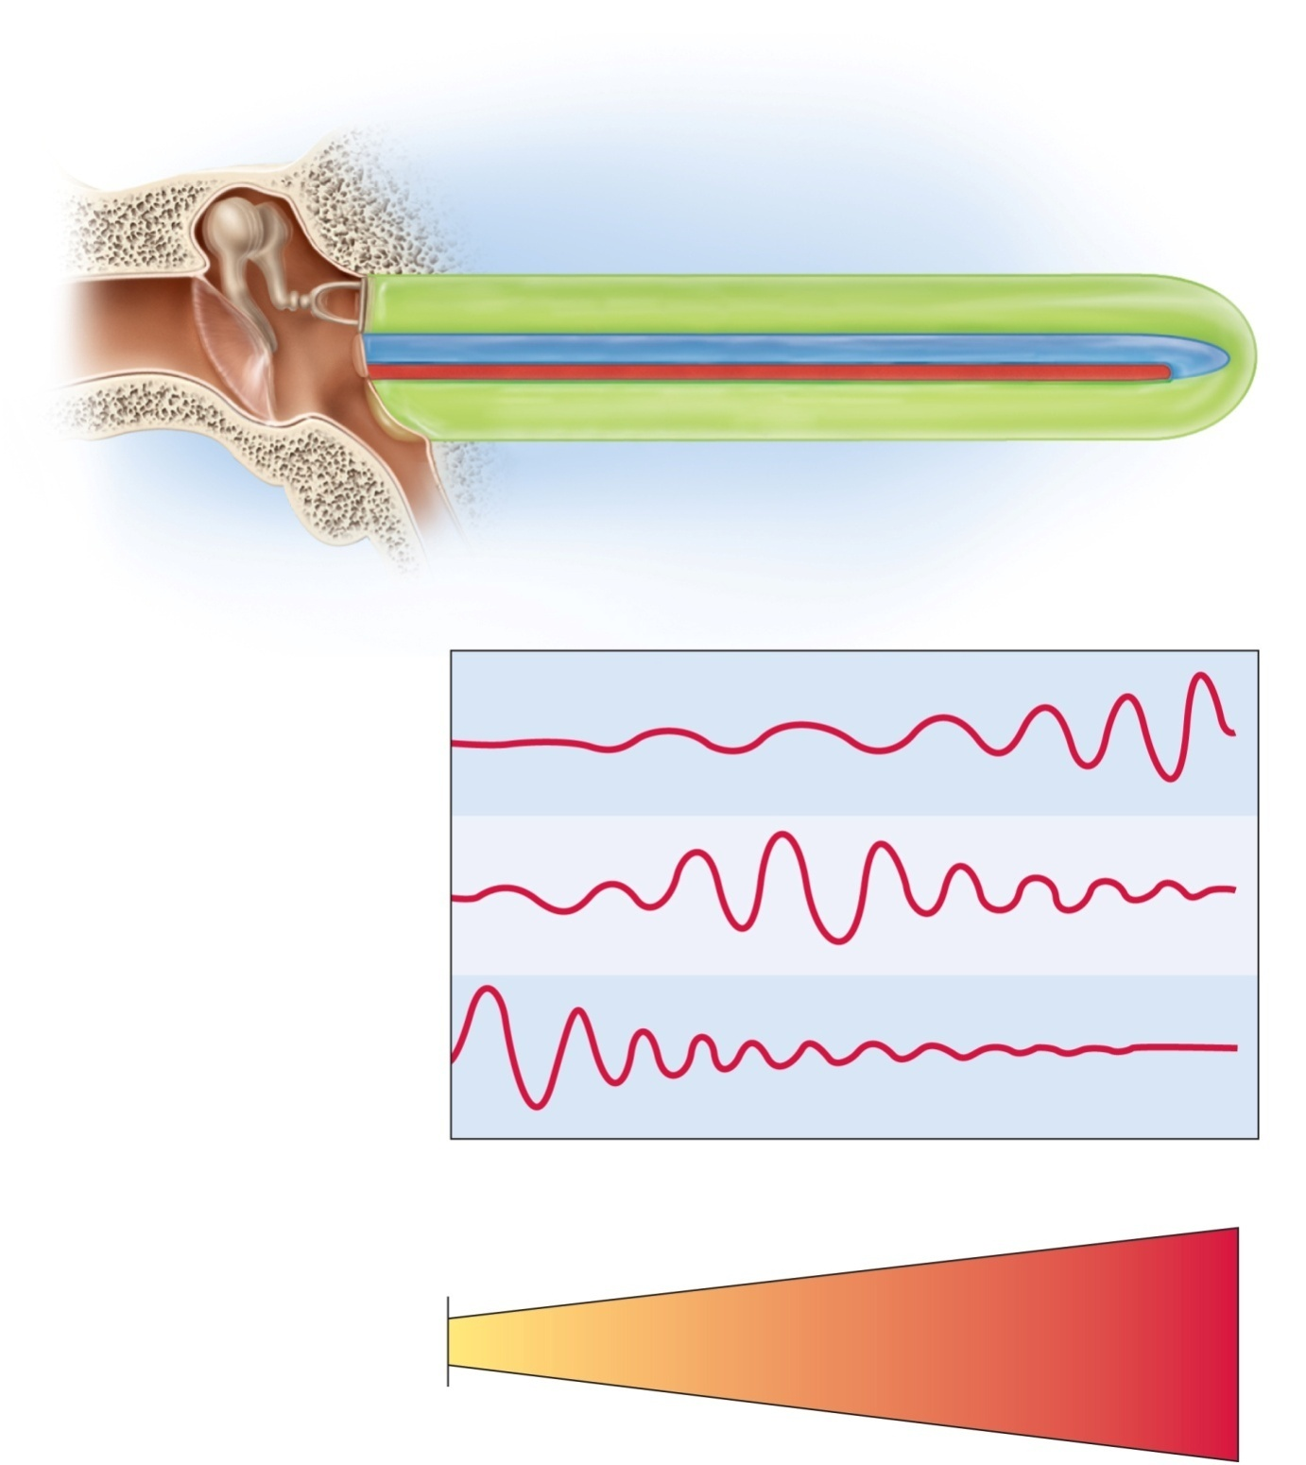


Fig. 16.17
Copyright © McGraw-Hill Education. Permission required for reproduction or display.
Tympanic membrane (vibrating)
Stapes footplate (vibrating)
Scala vestibuli
Scala tympani
Cochlear
duct
Secondary
tympanic
membrane
Basilar
membrane
(vibrating)
Helicotrema
(a)
Low-frequency sound
(20–800 Hz)
Medium-frequency sound
(1,500–4,000 Hz)
High-frequency sound
(7,000–20,000 Hz)
(b)
Proximal end
(attached)
Distal end
(free)
(c)
20,000
5,000
1,000
500
200 Hz

Slide 15
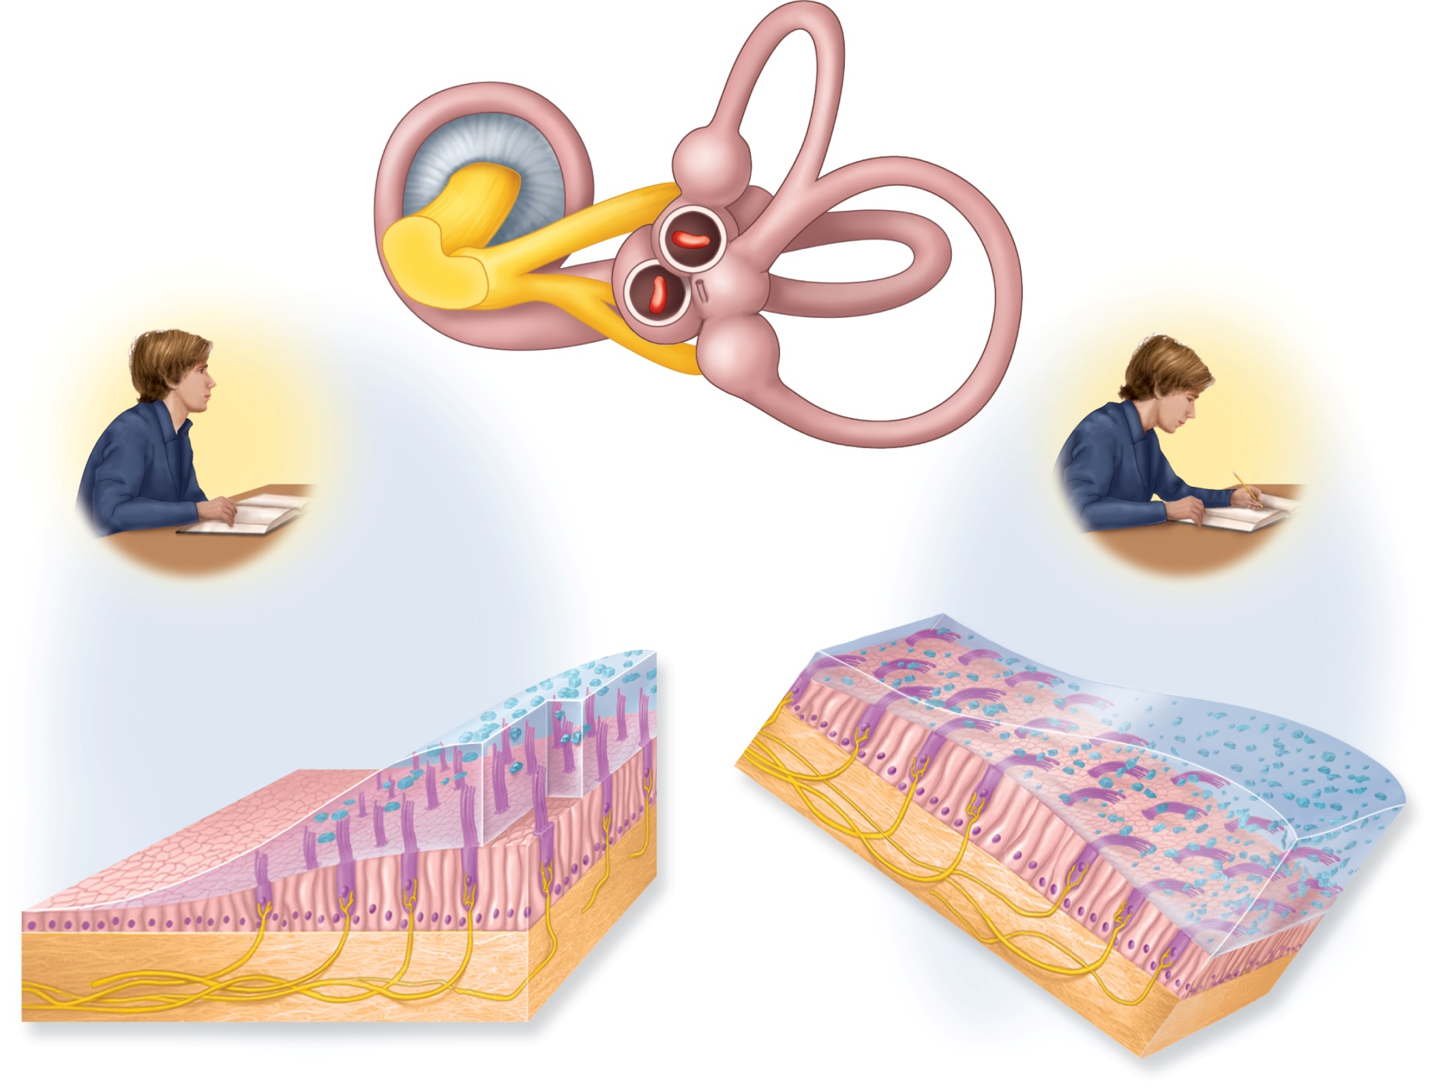

Fig. 16.19
Copyright © McGraw-Hill Education. Permission required for reproduction or display.
Base of
cochlea
Utricle
(cut open)
Semicircular
ducts
Cochlear
nerve
Saccule
(cut open)
(a)
Vestibular
nerve
Macula
sacculi
Macula
utriculi
Otolithic
membrane
Otoliths
Supporting
cell
Gravitational
force
Hair cell
Vestibular
nerve
Stereocilia
of hair
cells bend
Otolithic
membrane
sags
(b)
(c)

Slide 16
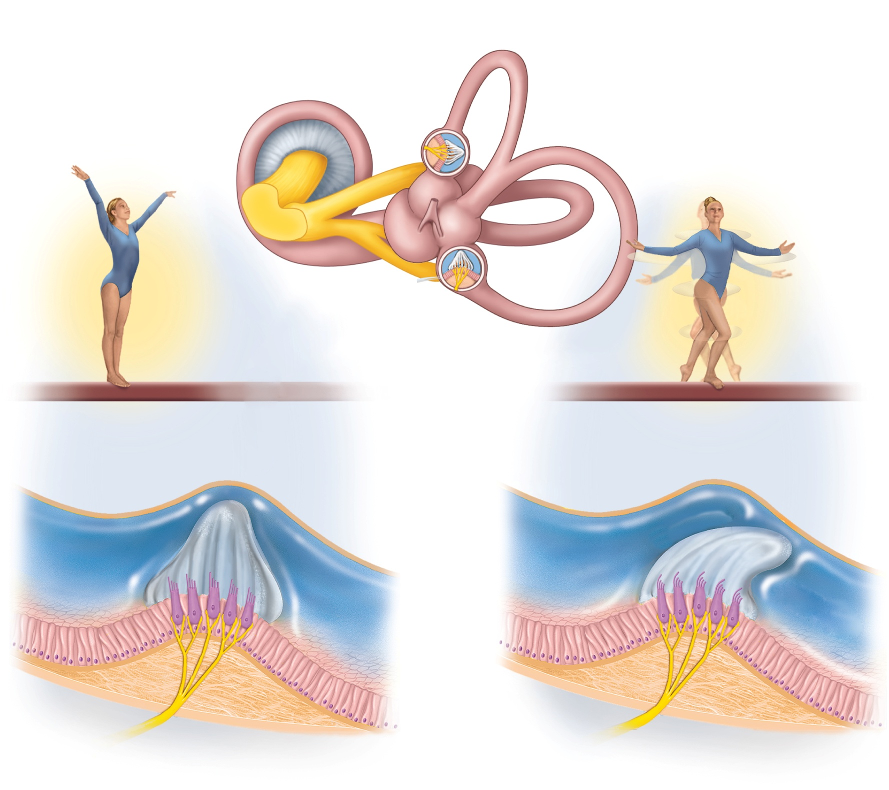





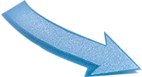
Fig. 16.20
Copyright © McGraw-Hill Education. Permission required for reproduction or display.
Ampullae
(cut open)
Semicircular ducts:
Anterior
Lateral
Posterior
(a)
Crista ampullaris
Cupula
Direction of
head rotation
Cupula is
pushed over
and stimulates
hair cells
Endolymph
Hair cells
Endolymph lags
behind because
of inertia
Supporting
cells
Crista
ampullaris
Sensory
nerve fibers
(b)
(c)

Slide 17
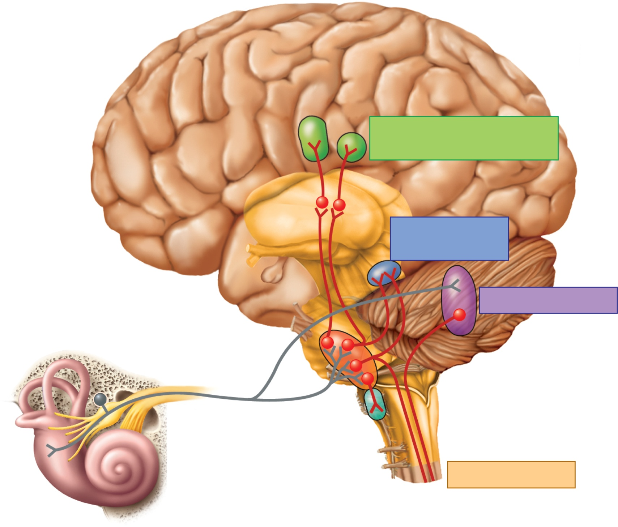
Fig. 16.21
Copyright © McGraw-Hill Education. Permission required for reproduction or display.
Central sulcus
Postcentral
gyrus
Vestibular
cortex
Awareness of spatial
orientation and movement
Thalamus
Compensatory
eye movements
Nuclei for
eye movement
Cerebellum
Motor coordination
Vestibulocochlear nerve
Vestibular
nuclei
Vestibulospinal
tracts
Reticular
formation
Postural reflexes
Vestibular apparatus

Slide 18
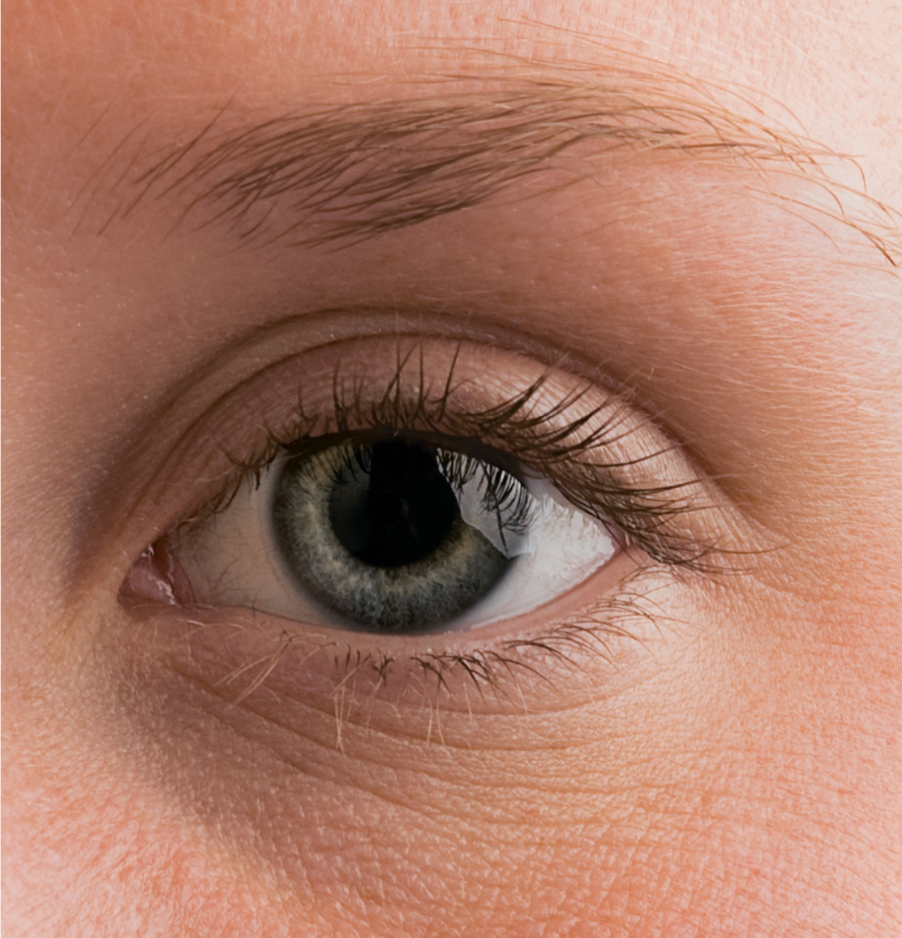
Fig. 16.22
Copyright © McGraw-Hill Education. Permission required for reproduction or display.
Pupil
Eyebrow
Superior
palpebral
sulcus
Iris
Eyelashes
Palpebral
fissure
Lacrimal
caruncle
Lateral
commissure
Medial
commissure
Sclera
Inferior
palpebral
sulcus
Tarsal plate
©McGraw-Hill Education/Joe DeGrandis

Slide 19
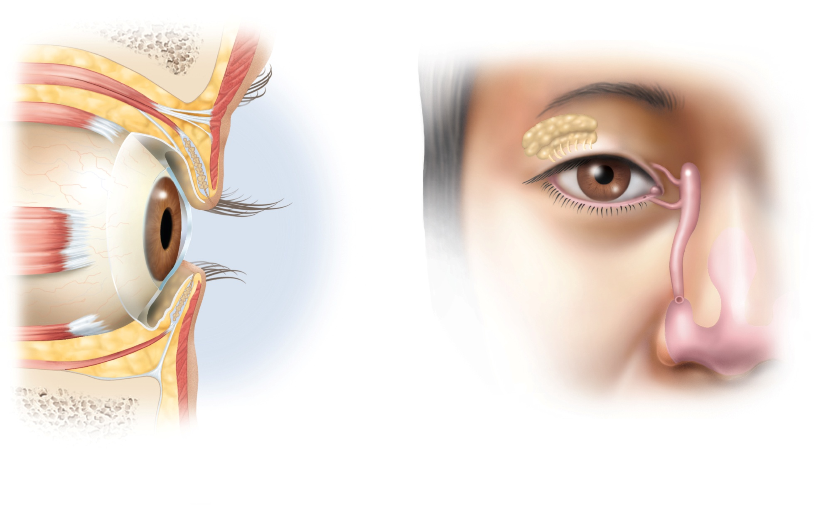
Fig. 16.23
Copyright © McGraw-Hill Education. Permission required for reproduction or display.
Frontal bone
Levator palpebrae
superioris muscle
Orbicularis
oculi muscle
Lacrimal
gland
Superior rectus
muscle
Ducts
Tarsal plate
Tarsal glands
Lacrimal
sac
Cornea
Lacrimal
punctum
Conjunctiva
Lacrimal
canaliculus
Nasolacrimal
duct
Inferior
meatus
of nasal
cavity
Lateral rectus
muscle
Inferior rectus
muscle
Nostril
(a)
(b)

Slide 20
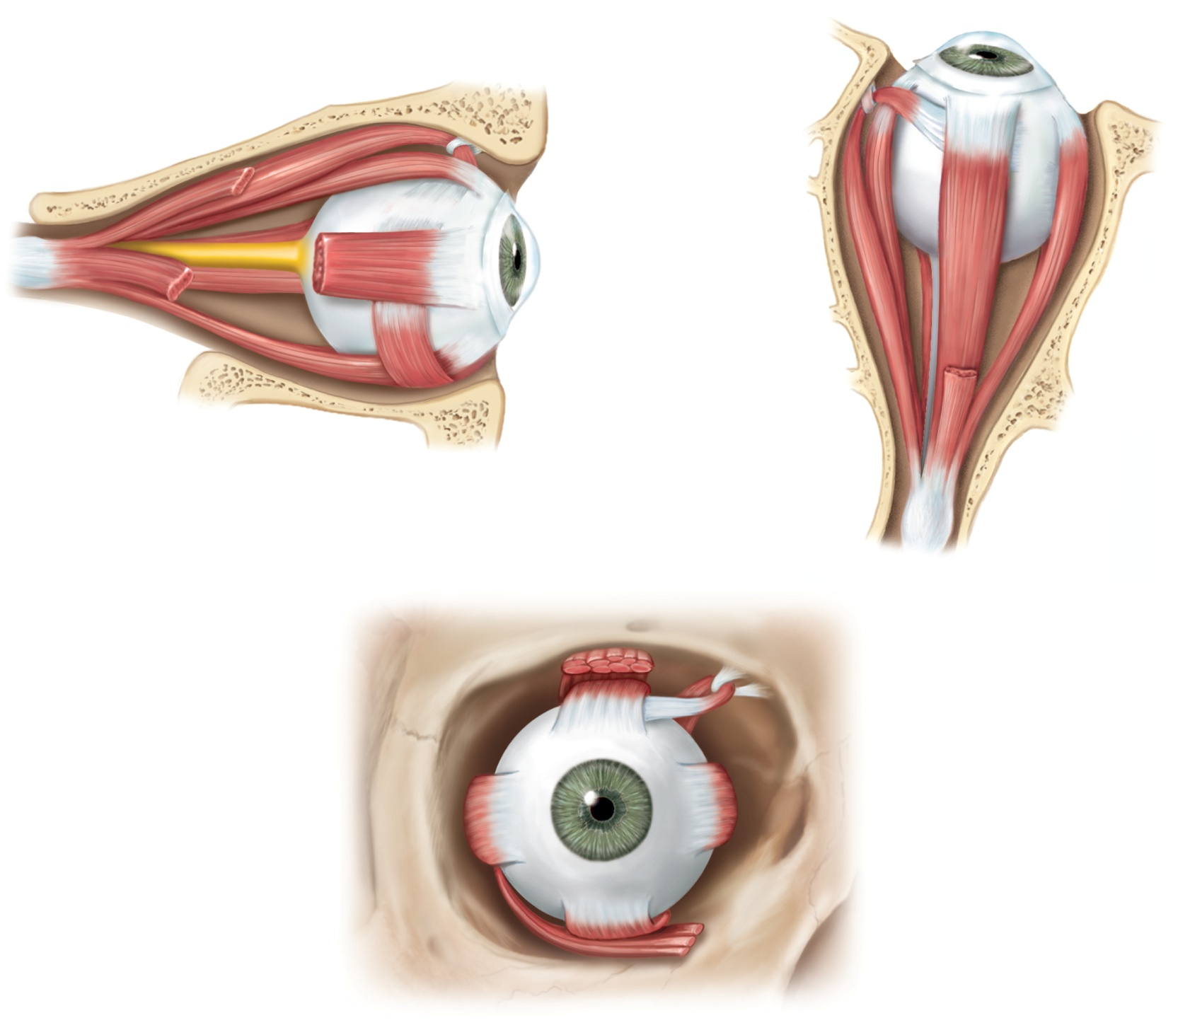
Fig. 16.24
Copyright © McGraw-Hill Education. Permission required for reproduction or display.
Trochlea
Optic nerve
Superior oblique
tendon
Muscles:
Superior oblique
Superior rectus
Muscles:
Medial rectus
Superior rectus
Lateral rectus
Inferior rectus
Inferior oblique
Inferior rectus
Levator palpebrae
superioris (cut)
(a) Lateral view
(b) Superior view
Superior
oblique
muscle
Levator palpebrae
superioris muscle
Trochlear nerve (IV)
Superior rectus
muscle
Lateral
rectus
muscle
Medial rectus
muscle
Oculomotor nerve (III)
Abducens nerve (VI)
Inferior rectus
muscle
Inferior oblique
muscle
(c) Frontal view

Slide 21
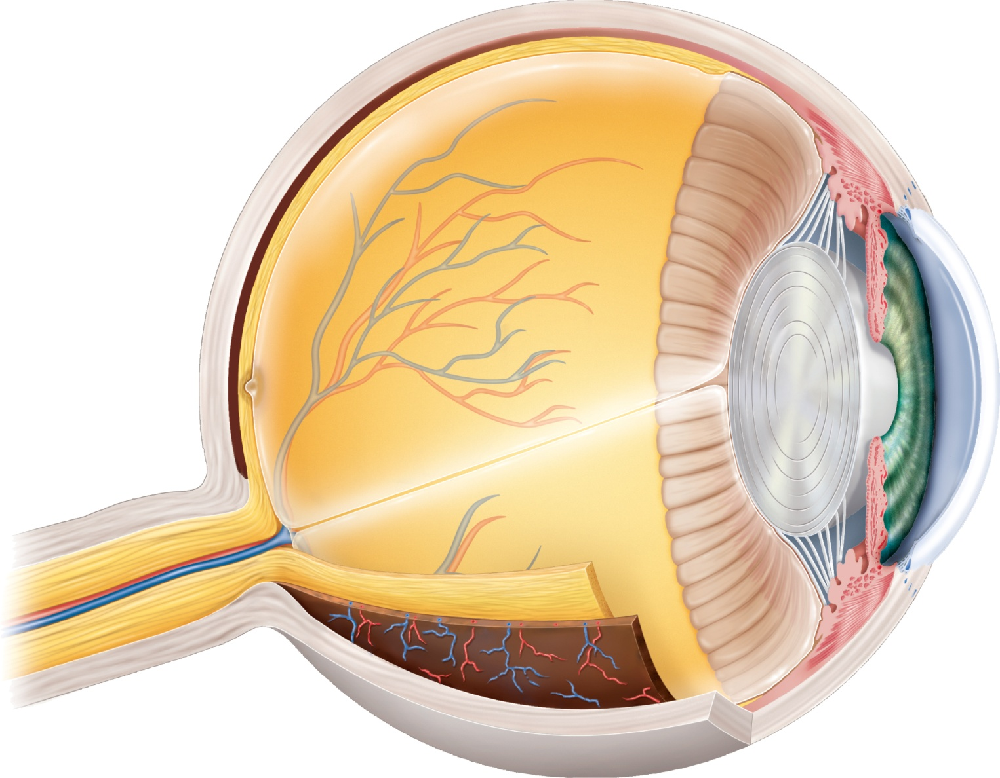
Fig. 16.25
Copyright © McGraw-Hill Education. Permission required for reproduction or display.
Sclera
Ora serrata
Choroid
Retina
Ciliary body
Macula lutea
Suspensory
ligament
Fovea centralis
Optic disc
(blind spot)
Iris
Cornea
Optic nerve
Pupil
Central artery
and vein
of retina
Lens
Anterior
chamber
Posterior
chamber
Hyaloid canal
Vitreous body

Slide 22
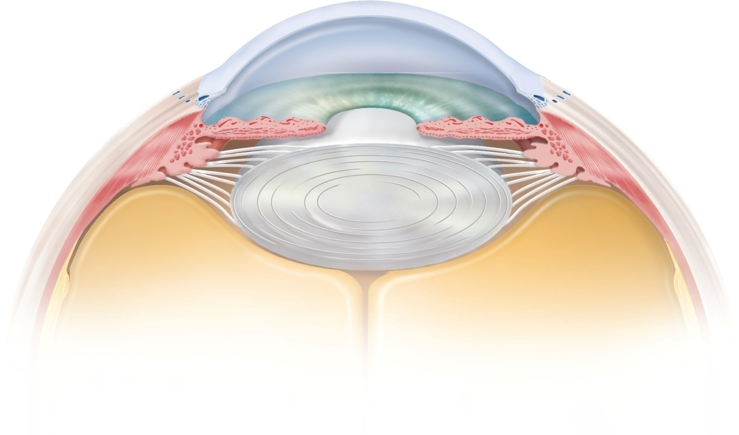
Fig. 16.26
Copyright © McGraw-Hill Education. Permission required for reproduction or display.
Cornea
Anterior chamber
Scleral
venous sinus
Iris
Ciliary body:
Posterior
chamber
Ciliary
process
Lens
Ciliary
muscle
Vitreous
body

Slide 23
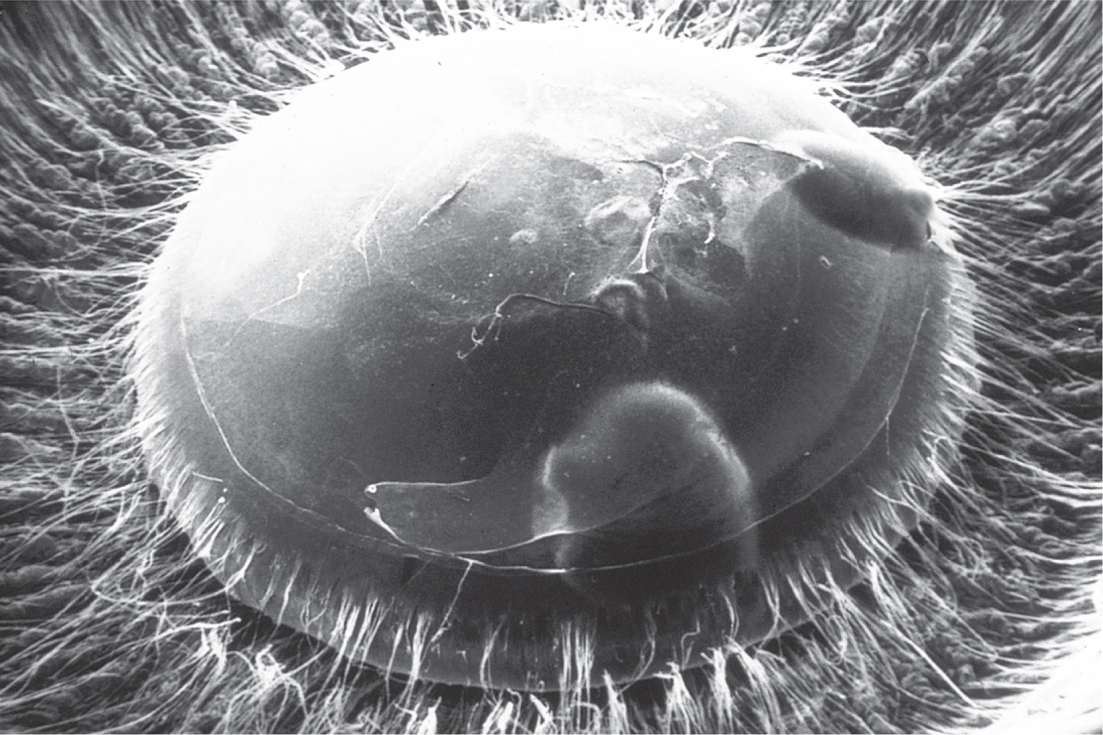
Fig. 16.27
Copyright © McGraw-Hill Education. Permission required for reproduction or display.
Suspensory ligament
Lens
2 mm
©Ralph C. Eagle/MD/Science Source

Slide 24
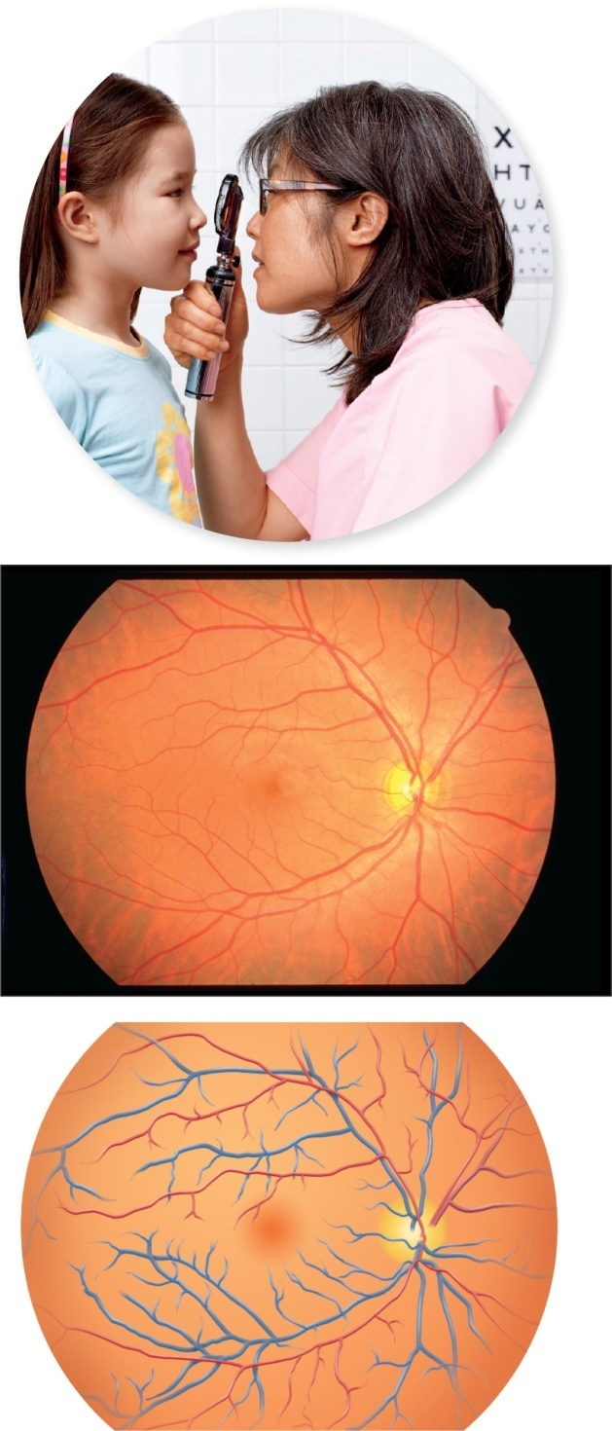
Fig. 16.28
Copyright © McGraw-Hill Education. Permission required for reproduction or display.
(a)
(b)
Arteriole
Venule
Fovea
centralis
Macula
lutea
Optic disc
(c)
a: ©Peter Dazeley/Getty Images; b: ©Lisa Klancher

Slide 25
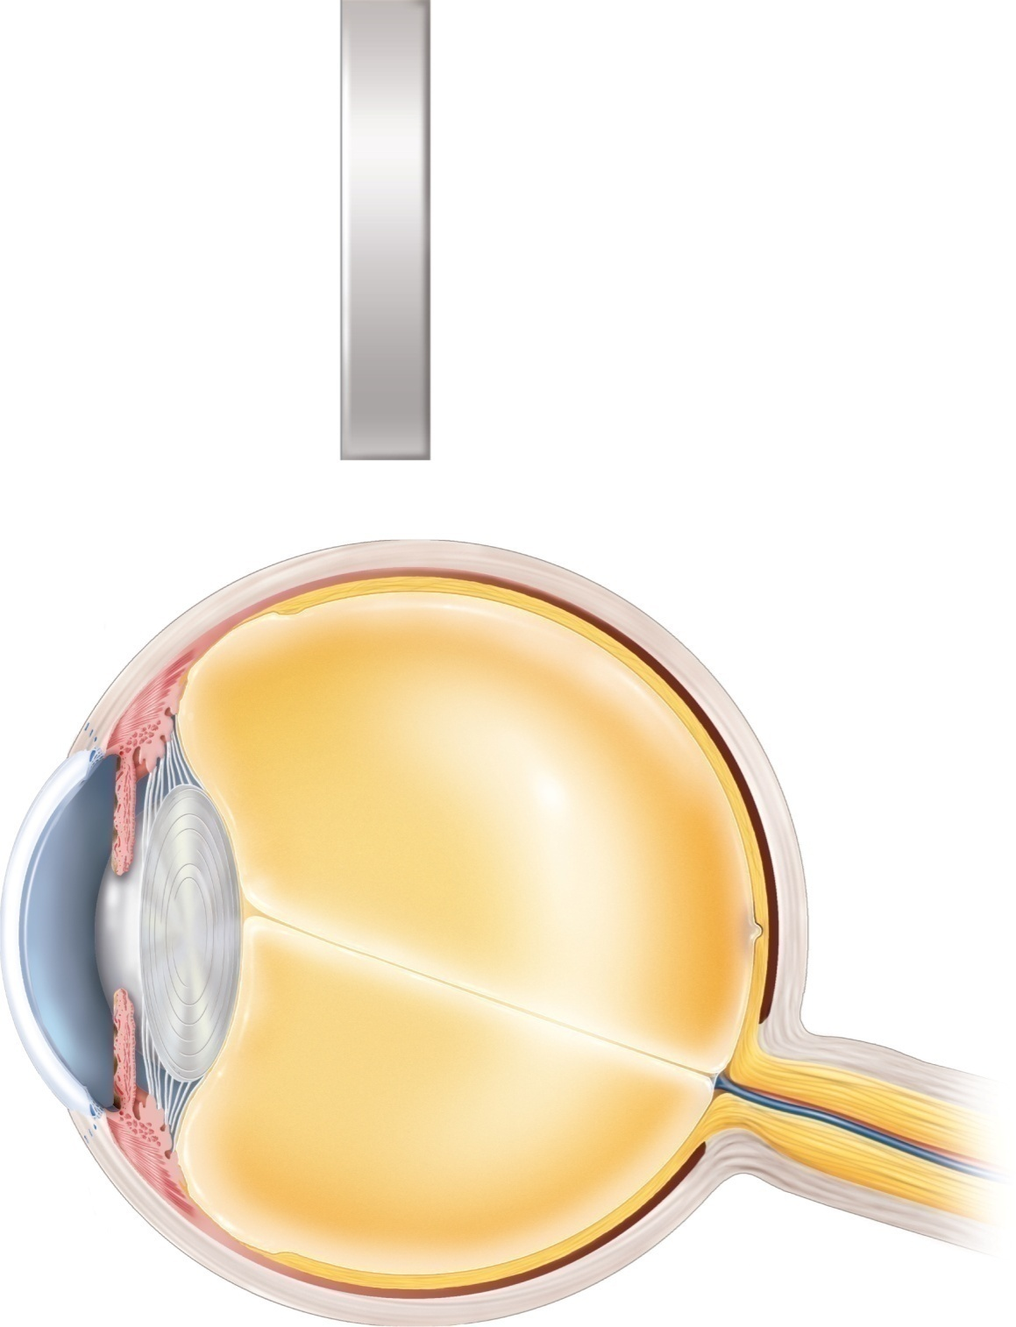
Fig. 16.30
Copyright © McGraw-Hill Education. Permission required for reproduction or display.
(a)
Air
n = 1.00
Lens
n = 1.40
Vitreous body
n = 1.33
Retina
Cornea
n = 1.38
Aqueous humor
n = 1.33
(b)

Slide 26
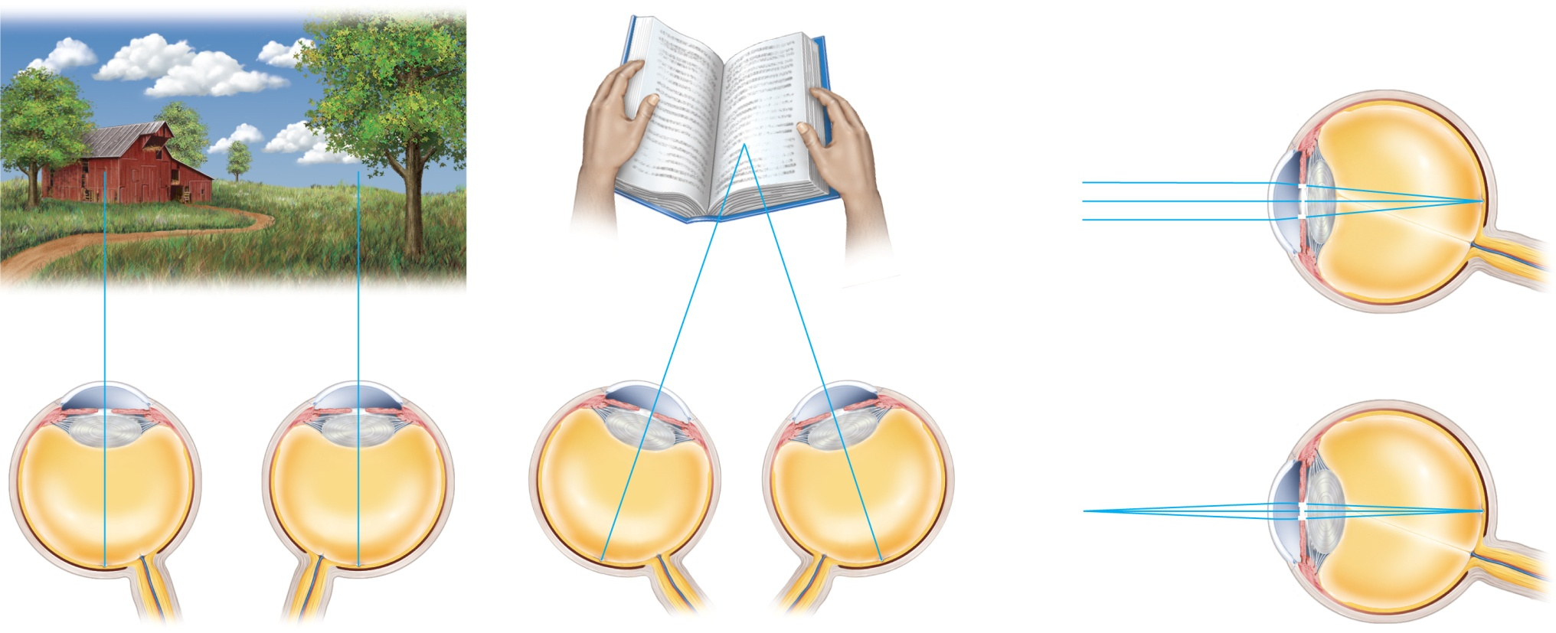
Fig. 16.31
Copyright © McGraw-Hill Education. Permission required for reproduction or display.
Relatively
thin lens
Fovea
Relatively
dilated pupil
Emmetropia
Relatively
thick lens
Relatively
constricted pupil
Emmetropia
Convergence
Pupillary miosis and
lens accommodation
(a)
(b)

Slide 27
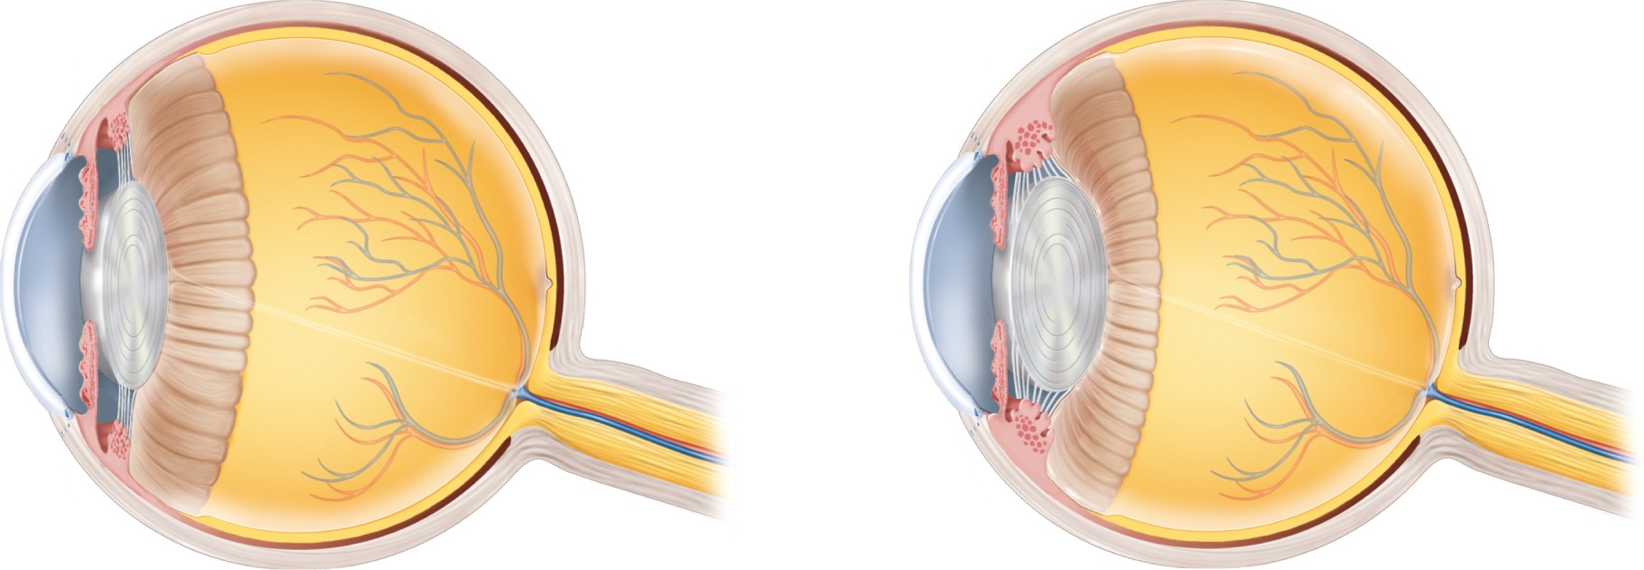
Fig. 16.32
Copyright © McGraw-Hill Education. Permission required for reproduction or display.
Ciliary muscle
relaxed
Ciliary muscle
contracted
Suspensory
ligament taut
Suspensory
ligament relaxed
Lens thins
Lens thickens
(a) Distant vision (emmetropia)
(b) Near vision (accommodation)

Slide 28
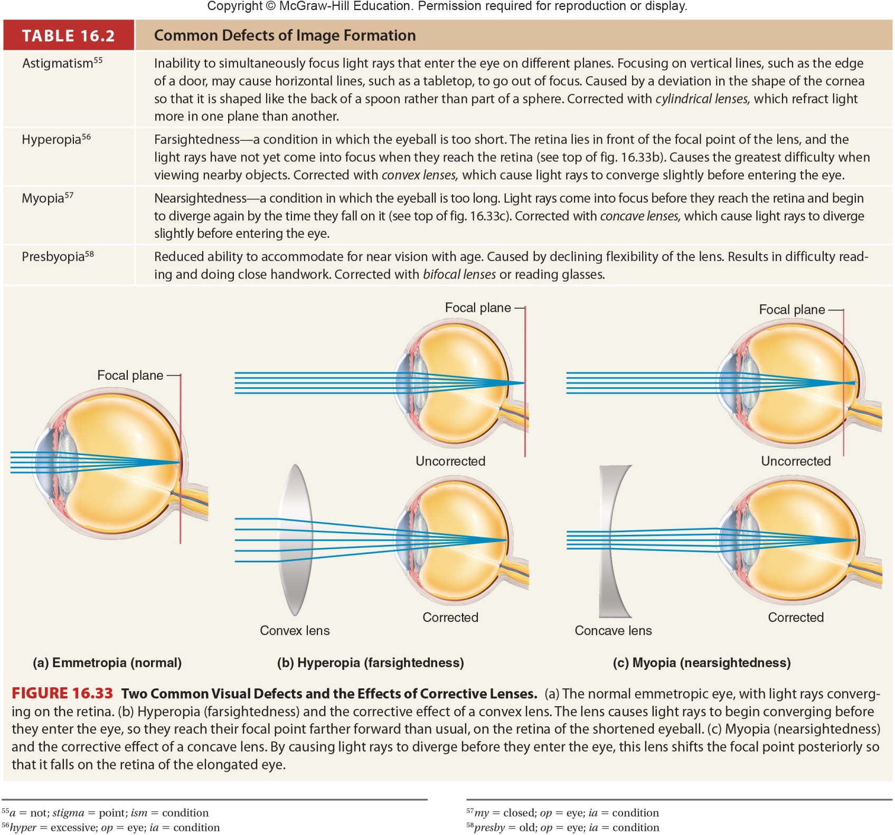
Table 16.2

Slide 29
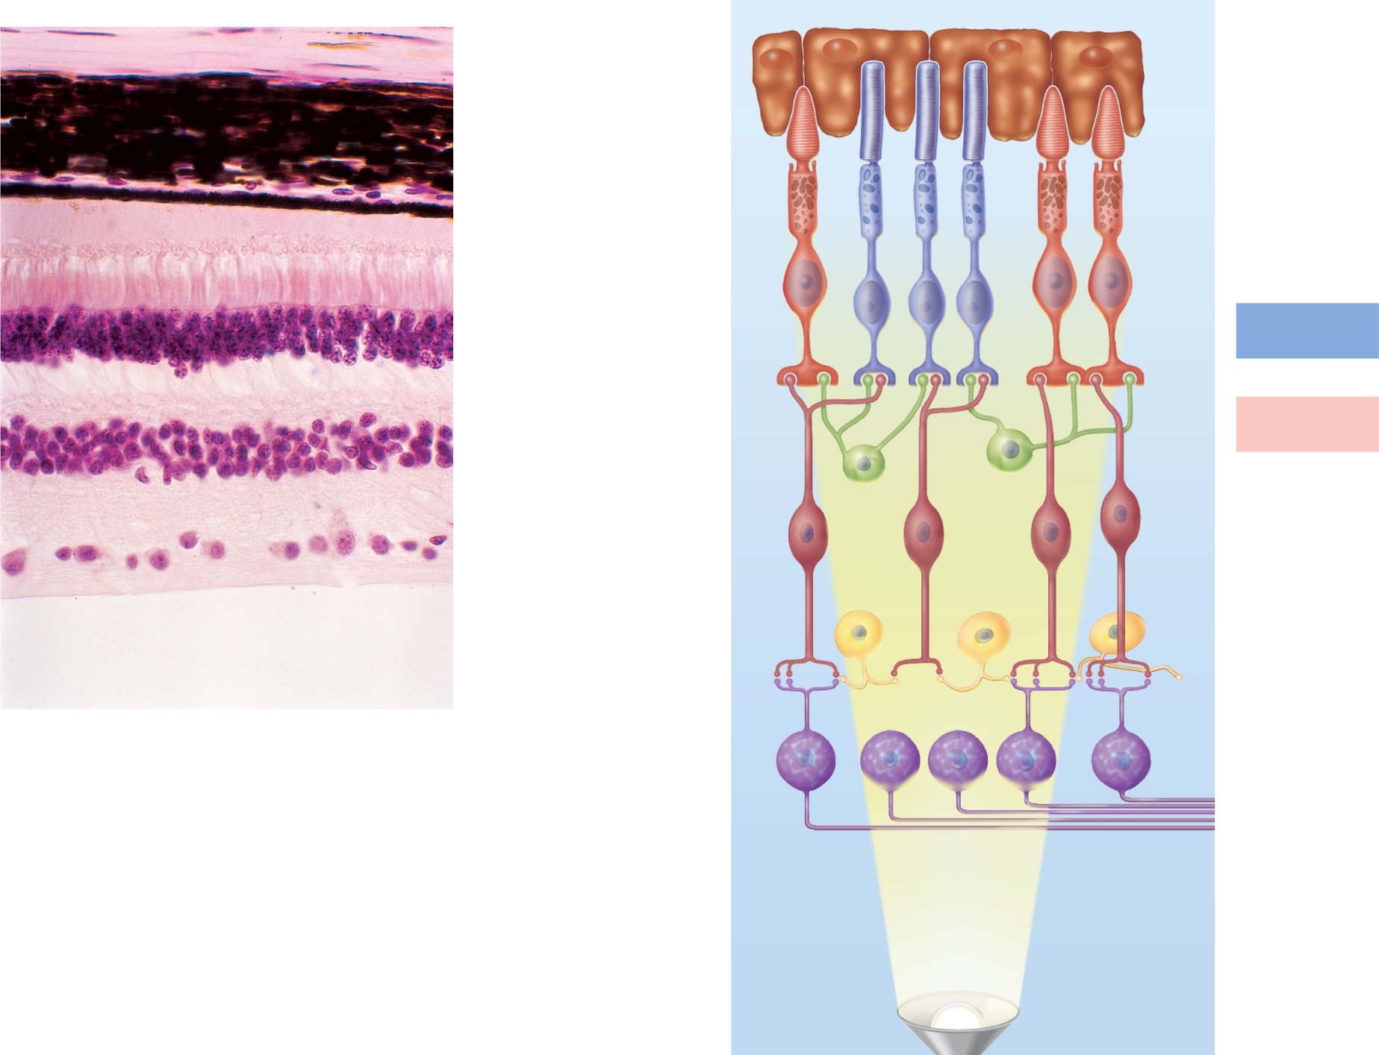


Fig. 16.34
Copyright © McGraw-Hill Education. Permission required for reproduction or display.
Back of eye
Back of eye
Sclera
Pigment
epithelium
Choroid
Photoreceptors:
Pigment epithelium
Rod
Cone
Rod and cone outer
segments
Rod and cone nuclei
Transmission
of rod signals
Transmission
of cone signals
Bipolar cells
Horizontal cell
Ganglion cells
Nerve fibers to optic
nerve
Bipolar cell
Amacrine cell
Vitreous body
Ganglion cell
(a)
Front of eye
25 µm
To optic nerve
Nerve fibers
Direction of light
(b)
a: ©McGraw-Hill Education/Dennis Strete

Slide 30
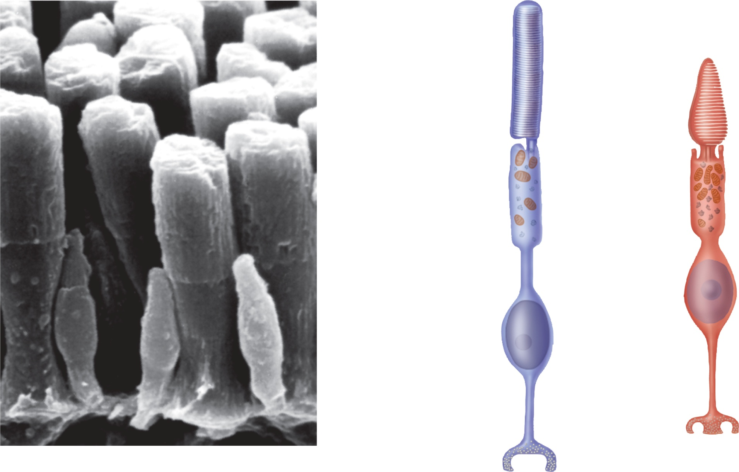
Fig. 16.35
Copyright © McGraw-Hill Education. Permission required for reproduction or display.
Rod
Cone
Outer
segment
Stalk
Rod
Inner
segment
Mitochondria
Nucleus
Cone
Cell
body
Synaptic
vesicles
(a)
2 µm
(b)
a : ©McGraw-Hill Education/Dennis Strete

Slide 31
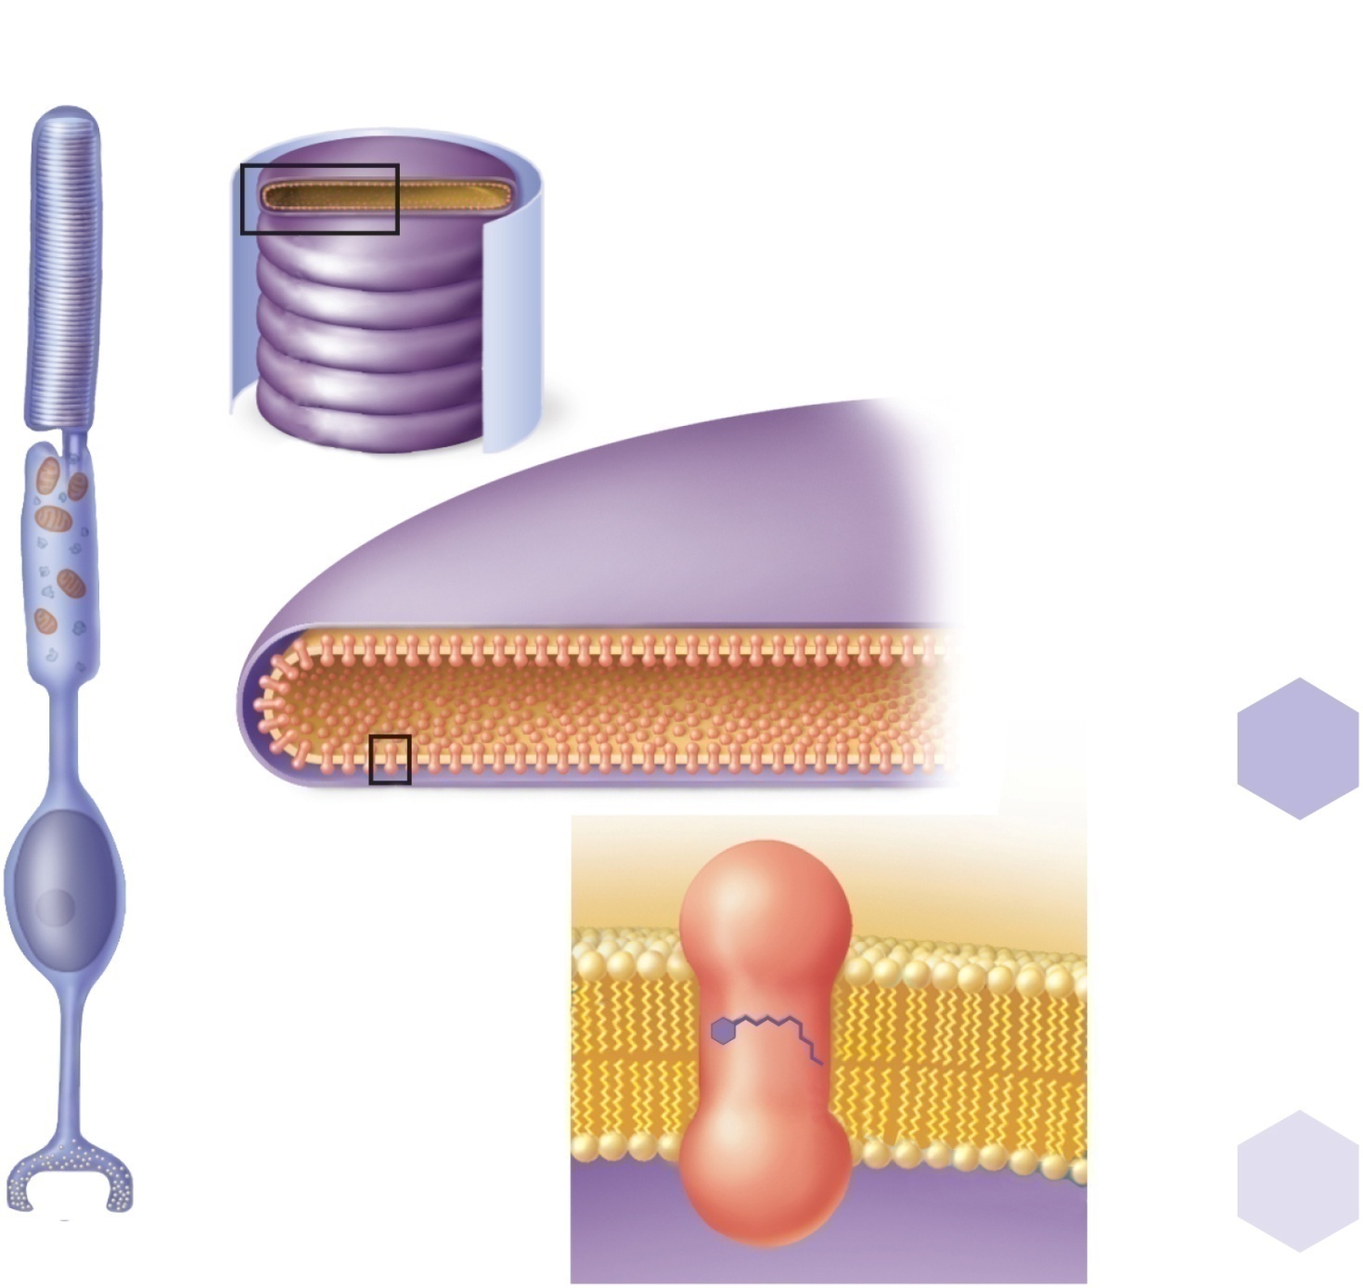



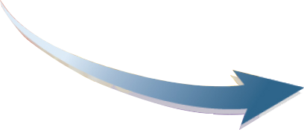
Fig. 16.36
Copyright © McGraw-Hill Education. Permission required for reproduction or display.
Disc
Cell membrane
(b)
Pigment
molecule
CH₃
CH₃
H
H
C
C
C
C
H₂C
C
C
C
CH
H
H
H₂C
C
C
(c)
C
CH₃
H₃C
CH
Pigment
molecule
H₂
CH₃
(e)
Cis-retinal
HC
O
Retinal
CH₃
CH₃
CH₃
H
H
H
C
C
C
C
C
C
Opsin
H₂C
C
C
C
C
C
O
H
H
H
H
H₂C
C
(a)
C
CH₃
H₂
CH₃
(d)
(f)
Trans-retinal
(bleached)

Slide 32
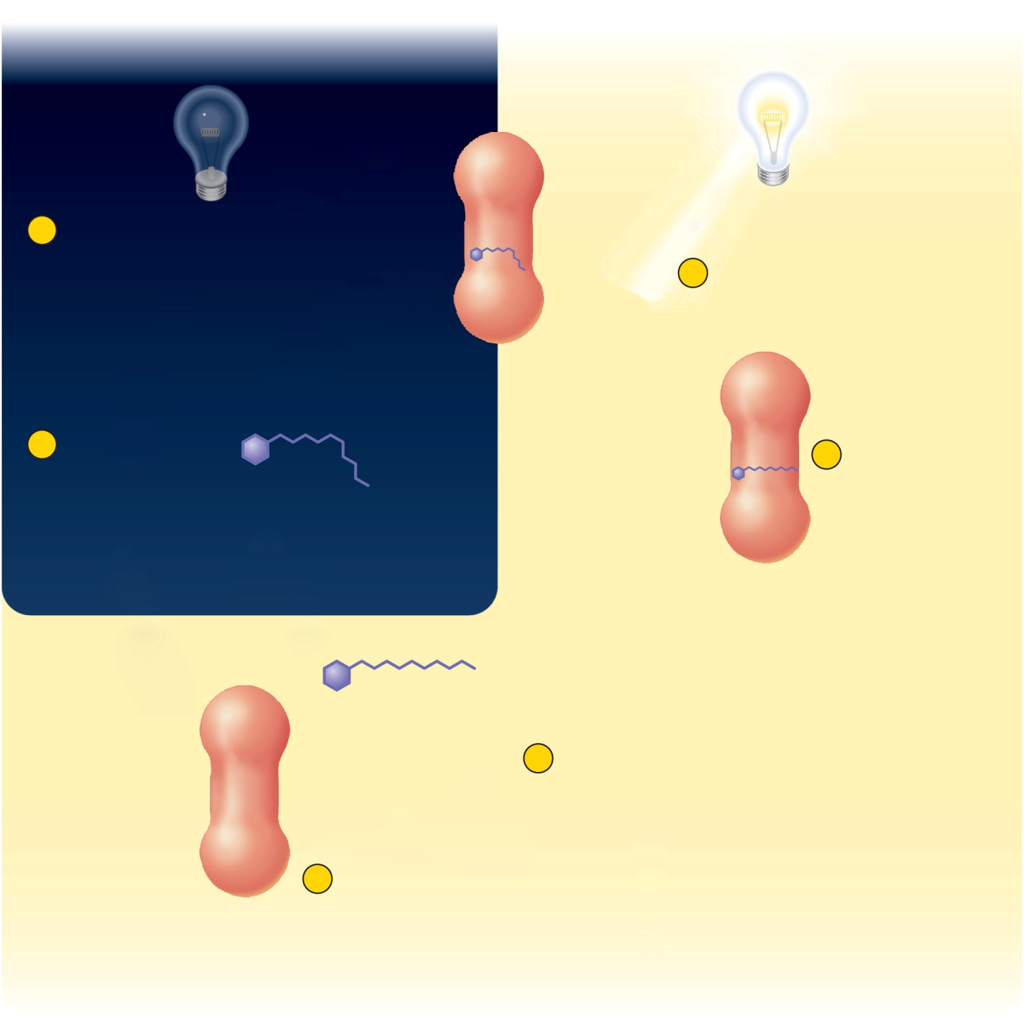









Fig. 16.37
Copyright © McGraw-Hill Education. Permission required for reproduction or display.
In the dark
In the light
Opsin
6
Opsin and cis-retinal
enzymatically combine
to regenerate rhodopsin
cis-retinal
1
Rhodopsin absorbs
photon of light
5
Trans-retinal is
enzymatically
converted back
to cis-retinal
2
Cis-retinal
isomerizes to
trans-retinal
3
Opsin triggers reaction
cascade that breaks
down cGMP
4
Trans-retinal
separates
from opsin
Cessation of dark current
Signals created in optic nerve

Slide 33
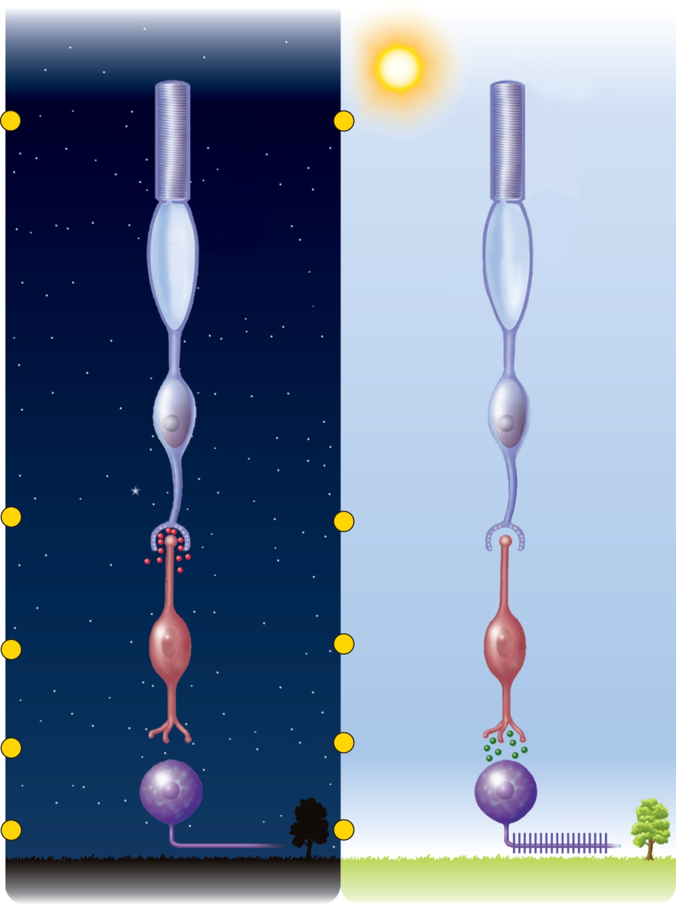
Fig. 16.38
Copyright © McGraw-Hill Education. Permission required for reproduction or display.
1
Rhodopsin
absorbs no light
1
Rhodopsin
absorbs light
Rod cell
2
Rod cell releases
glutamate
2
Glutamate
secretion
ceases
3
Bipolar cell
inhibited
Bipolar cell
3
Bipolar cell
no longer
inhibited
4
No synaptic
activity here
4
Bipolar cell
releases
neurotransmitter
Ganglion cell
5
No signal in
optic nerve fiber
5
Signal in
optic nerve fiber
(a) In the dark
(b) In the light

Slide 34
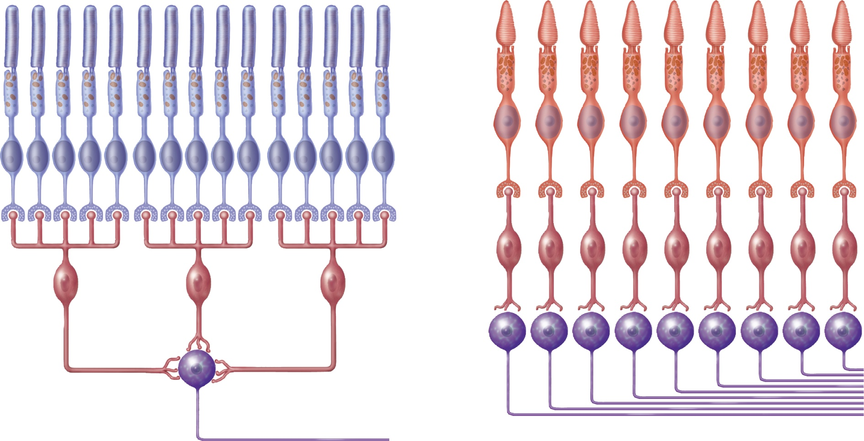
Fig. 16.39
Copyright © McGraw-Hill Education. Permission required for reproduction or display.
2 µm²
of retina
1 mm² of retina
Rods
Cones
Bipolar
cells
Bipolar
cells
Ganglion
cells
Ganglion
cell
Optic
nerve
fibers
Optic
nerve
fiber
(a) Scotopic system
(b) Photopic system

Slide 35
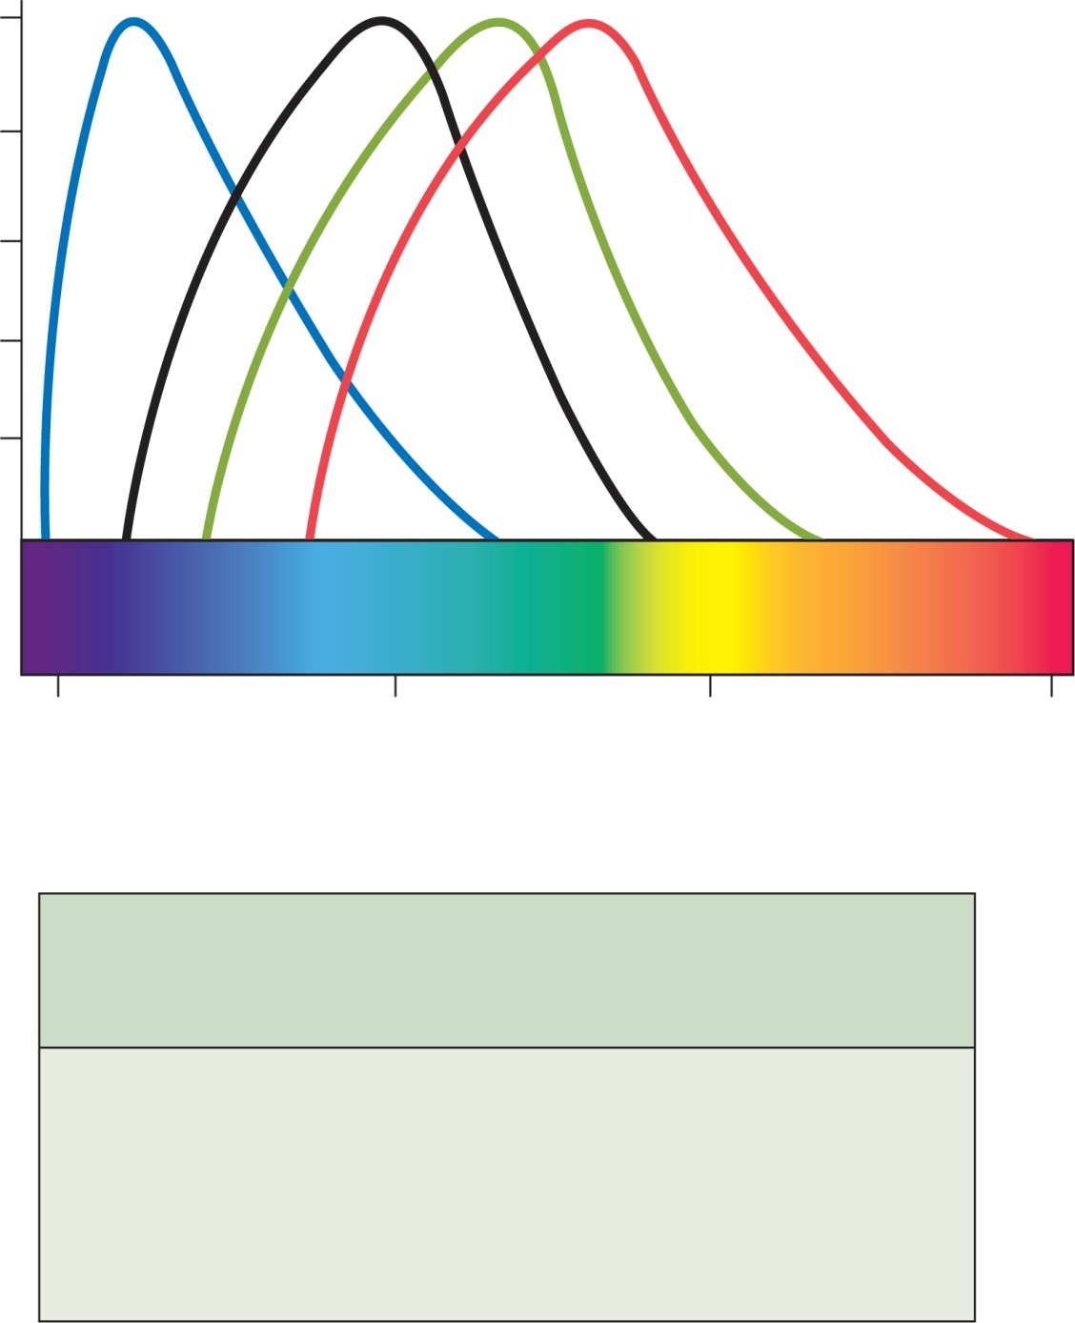
Fig. 16.40
Copyright © McGraw-Hill Education. Permission required for reproduction or display.
S cones
420 nm
Rods
500 nm
M cones
531 nm
L cones
558 nm
100
80
60
40
20
400
500
600
700
Wavelength (nm)
Percentage of maximum
cone response
( S : M : L )
Wavelength
(nm)
Perceived hue
400
50 : 0 : 0
Violet
450
72 : 30 : 0
Blue
500
20 : 82 : 60
Blue-green
550
0 : 85 : 97
Green
625
0 : 3 : 35
Orange
675
0 : 0 : 5
Red

Slide 36
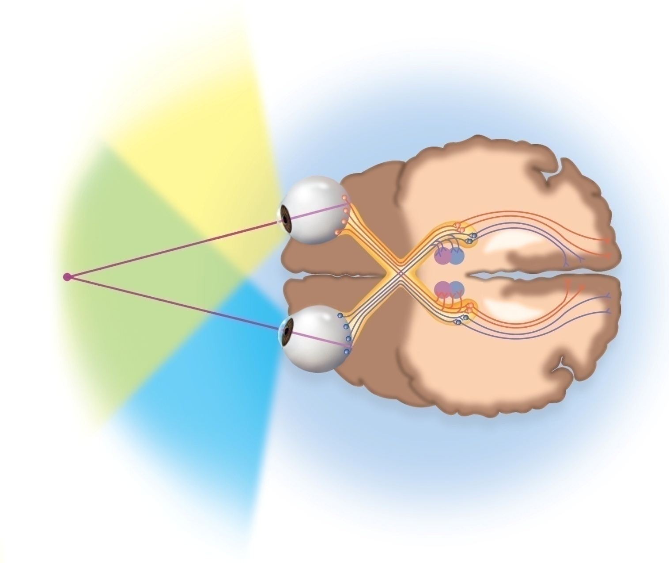
Fig. 16.43
Copyright © McGraw-Hill Education. Permission required for reproduction or display.
Uncrossed
(ipsilateral)
fiber
Crossed
(contralateral)
fiber
Optic radiation
Right eye
Fixation
point
Occipital lobe
(visual cortex)
Left eye
Optic
nerve
Optic
chiasm
Pretectal
nucleus
Lateral
geniculate
nucleus of
thalamus
Superior
colliculus
Optic tract

