Slide 1
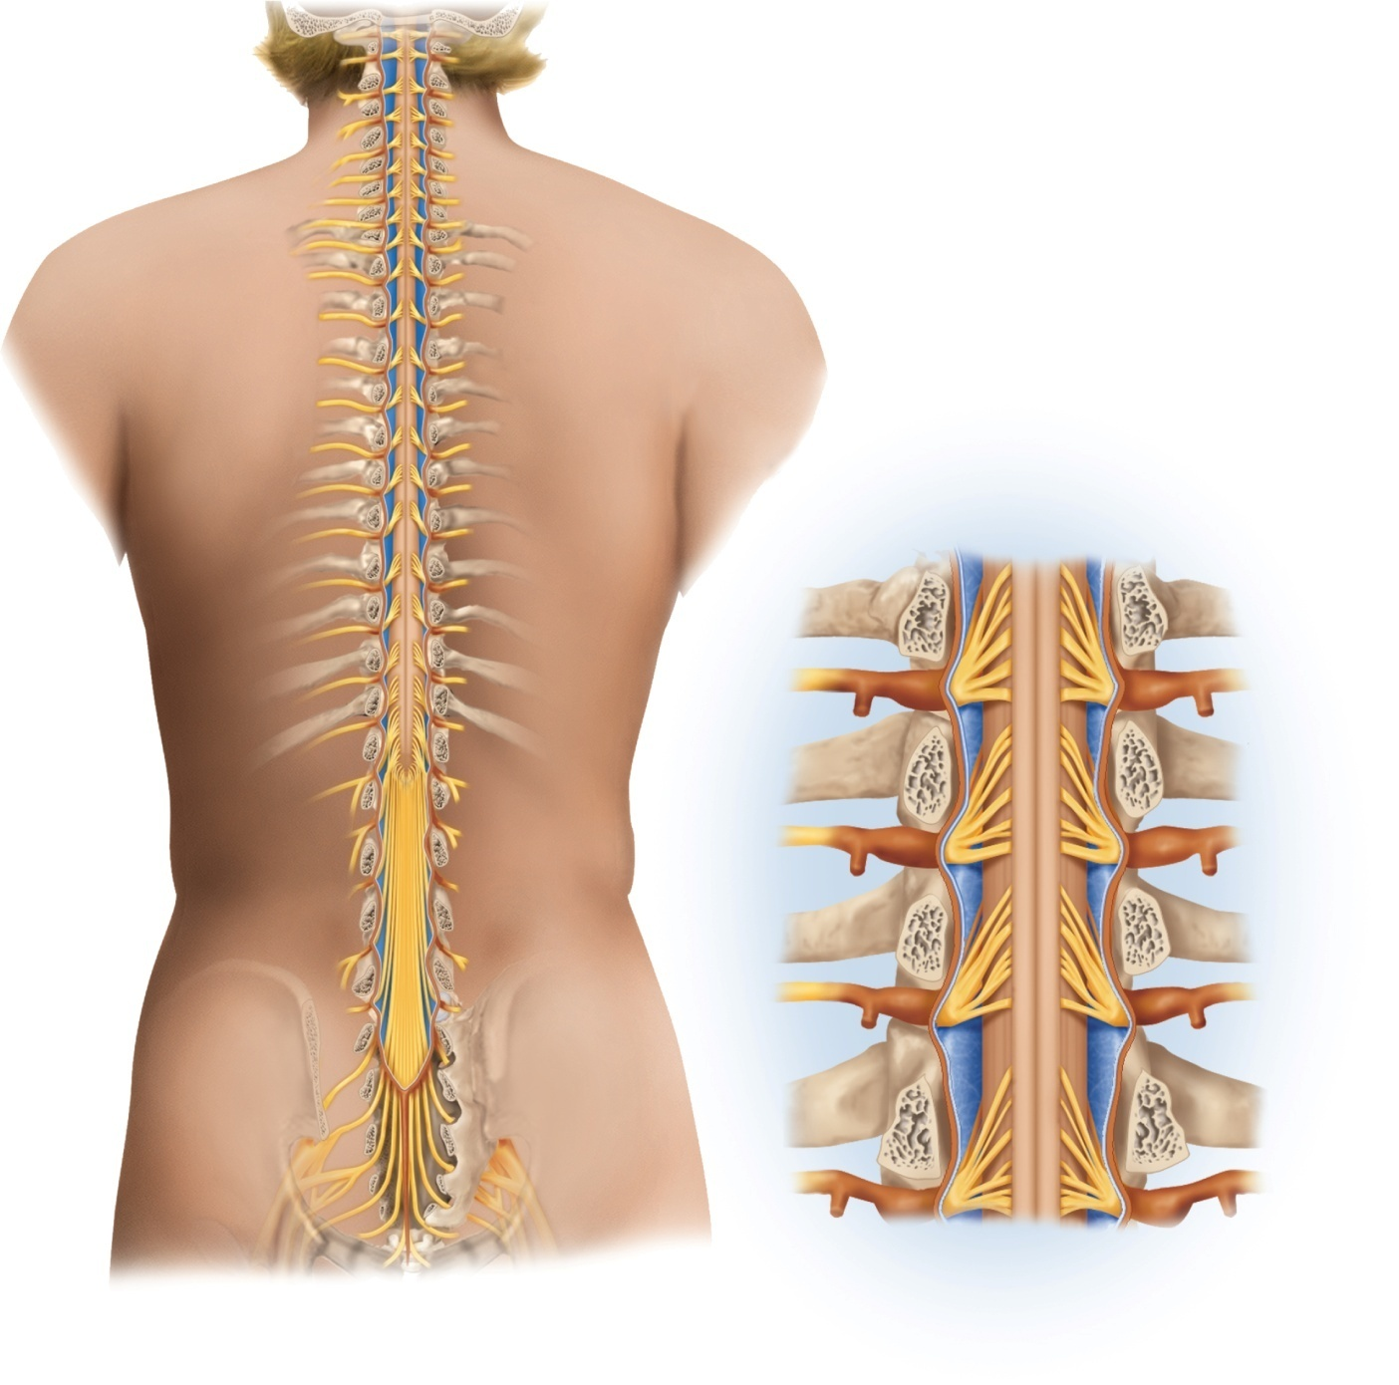
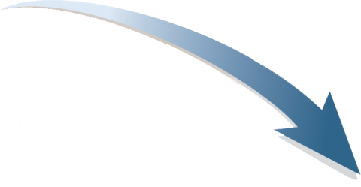
Fig. 13.1
Copyright © McGraw-Hill Education. Permission required for reproduction or display.
C1
C1
Cervical
enlargement
Cervical
spinal
nerves
C7
C7
Dural
sheath
Subarachnoid
space
Thoracic
spinal
nerves
Spinal cord
Vertebra (cut)
Lumbar
enlargement
Spinal nerve
T12
T12
Spinal nerve rootlets
Medullary
cone
Posterior median sulcus
Lumbar
spinal
nerves
Subarachnoid space
Cauda equina
Epidural space
L5
Posterior root ganglion
L5
Rib
Arachnoid mater
Terminal
filum
Sacral
spinal
nerves
Dura mater
S5
S5
Col
Col
(a)
(b)

Slide 2
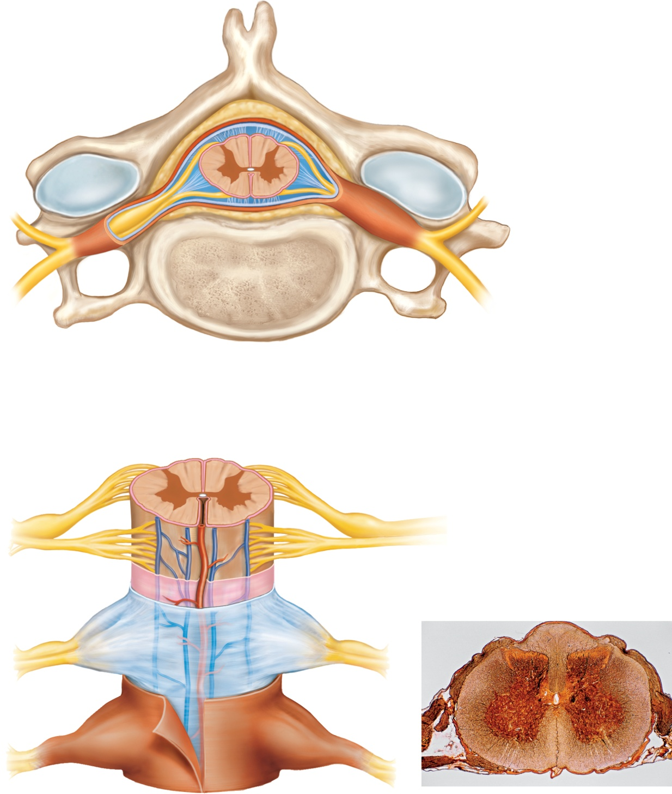
Fig. 13.2
Copyright © McGraw-Hill Education. Permission required for reproduction or display.
Posterior
Spinous process of vertebra
Meninges:
Dura mater (dural sheath)
Arachnoid mater
Fat in epidural space
Pia mater
Subarachnoid space
Spinal cord
Denticulate ligament
Posterior root ganglion
Spinal nerve
Vertebral body
(a) Spinal cord and vertebra (cervical)
Anterior
Central canal
Posterior
median sulcus
Gray matter:
White matter:
Posterior horn
Posterior column
Gray commissure
Lateral column
Lateral horn
Anterior column
Anterior horn
Posterior root of spinal nerve
Posterior root ganglion
Spinal nerve
Anterior median fissure
Anterior root
of spinal nerve
Meninges:
Pia mater
Arachnoid mater
Dura mater (dural sheath)
(b) Spinal cord and meninges (thoracic)
(c) Lumbar spinal cord
c: ©Ed Reschke/Getty Images
Notes:
2

Slide 3
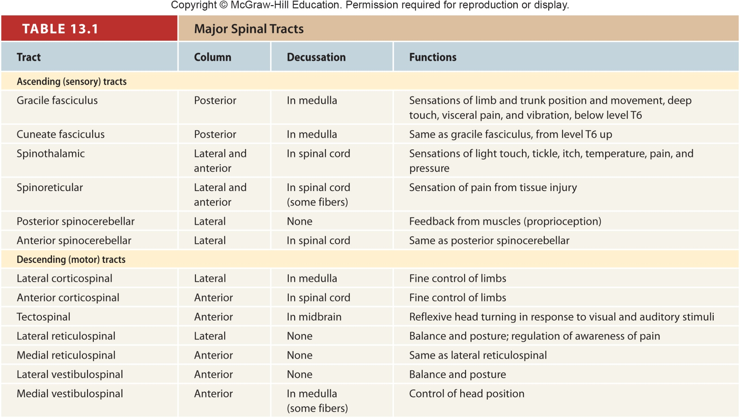
Table 13.1
Notes:
3

Slide 4
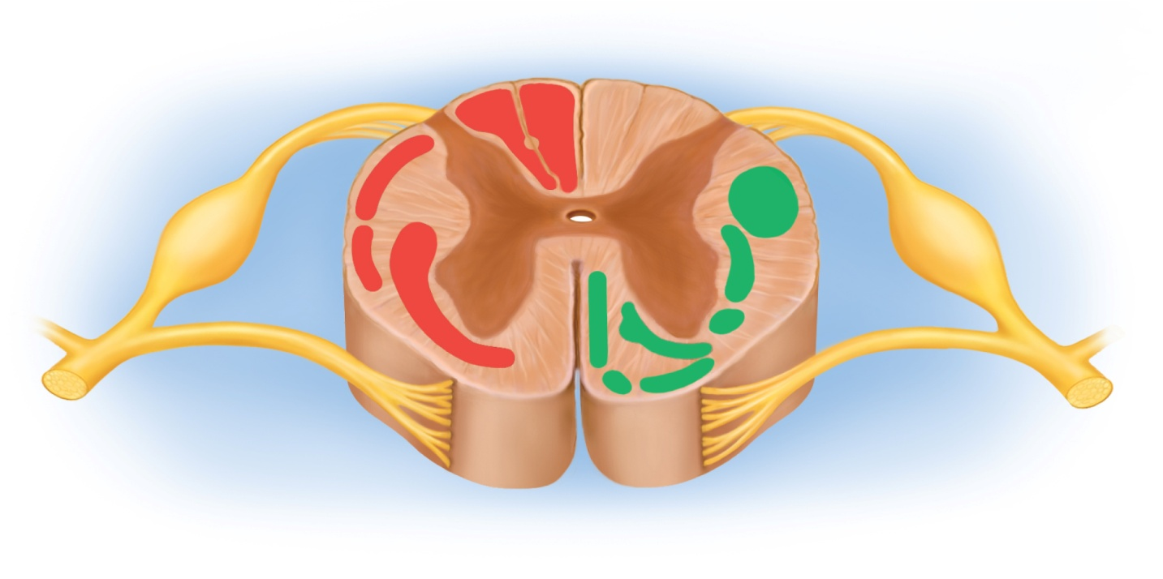
Fig. 13.4
Copyright © McGraw-Hill Education. Permission required for reproduction or display.
Ascending
tracts
Descending
tracts
Posterior column:
Gracile fasciculus
Cuneate fasciculus
Anterior corticospinal tract
Posterior spinocerebellar tract
Lateral
corticospinal tract
Anterior spinocerebellar tract
Lateral reticulospinal tract
Tectospinal tract
Anterolateral system
(containing
spinothalamic
and spinoreticular
tracts)
Medial reticulospinal tract
Lateral vestibulospinal tract
Medial vestibulospinal tract
Notes:
4

Slide 5
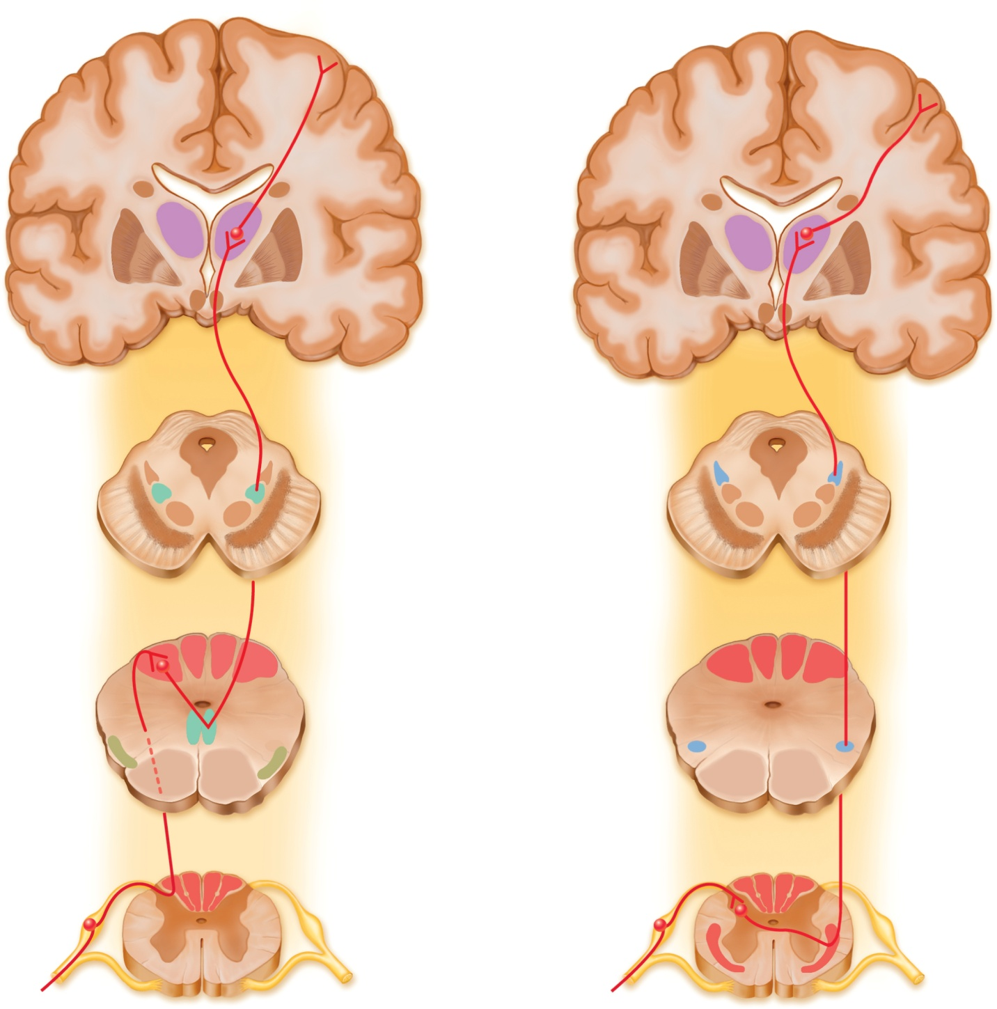
Fig. 13.5
Copyright © McGraw-Hill Education. Permission required for reproduction or display.
Somesthetic cortex
(postcentral gyrus)
Somesthetic cortex
(postcentral gyrus)
Third-order
neuron
Third-order
neuron
Thalamus
Thalamus
Cerebrum
Cerebrum
Midbrain
Medial
lemniscus
Midbrain
Second-order
neuron
Second-order
neuron
Gracile
nucleus
Cuneate
nucleus
Medulla
Medial
lemniscus
Medulla
First-order
neuron
Gracile fasciculus
Spinothalamic
tract
Cuneate fasciculus
Spinal cord
Spinal cord
First-order
neuron
Anterolateral system
Receptors for body movement, limb positions,
fine touch discrimination, and pressure
Receptors for pain, heat, and cold
(a)
(b)
Notes:
5

Slide 6
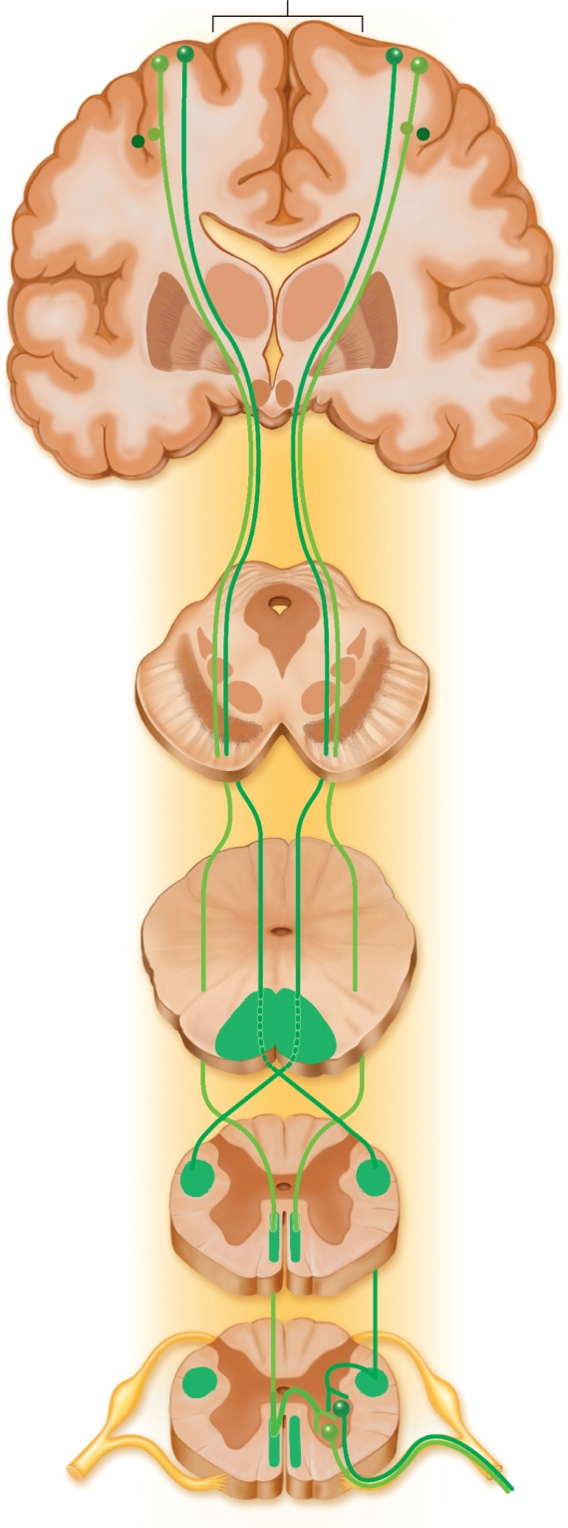
Fig. 13.6
Copyright © McGraw-Hill Education. Permission required for reproduction or display.
Motor cortex
(precentral gyrus)
Internal
capsule
Cerebrum
Midbrain
Cerebral
peduncle
Upper motor
neurons
Medulla
Medullary
pyramid
Decussation
in medulla
Lateral
corticospinal
tract
Spinal cord
Anterior
corticospinal
tract
Decussation in
spinal cord
Spinal cord
Lower motor
neurons
To skeletal muscles
Notes:
6

Slide 7
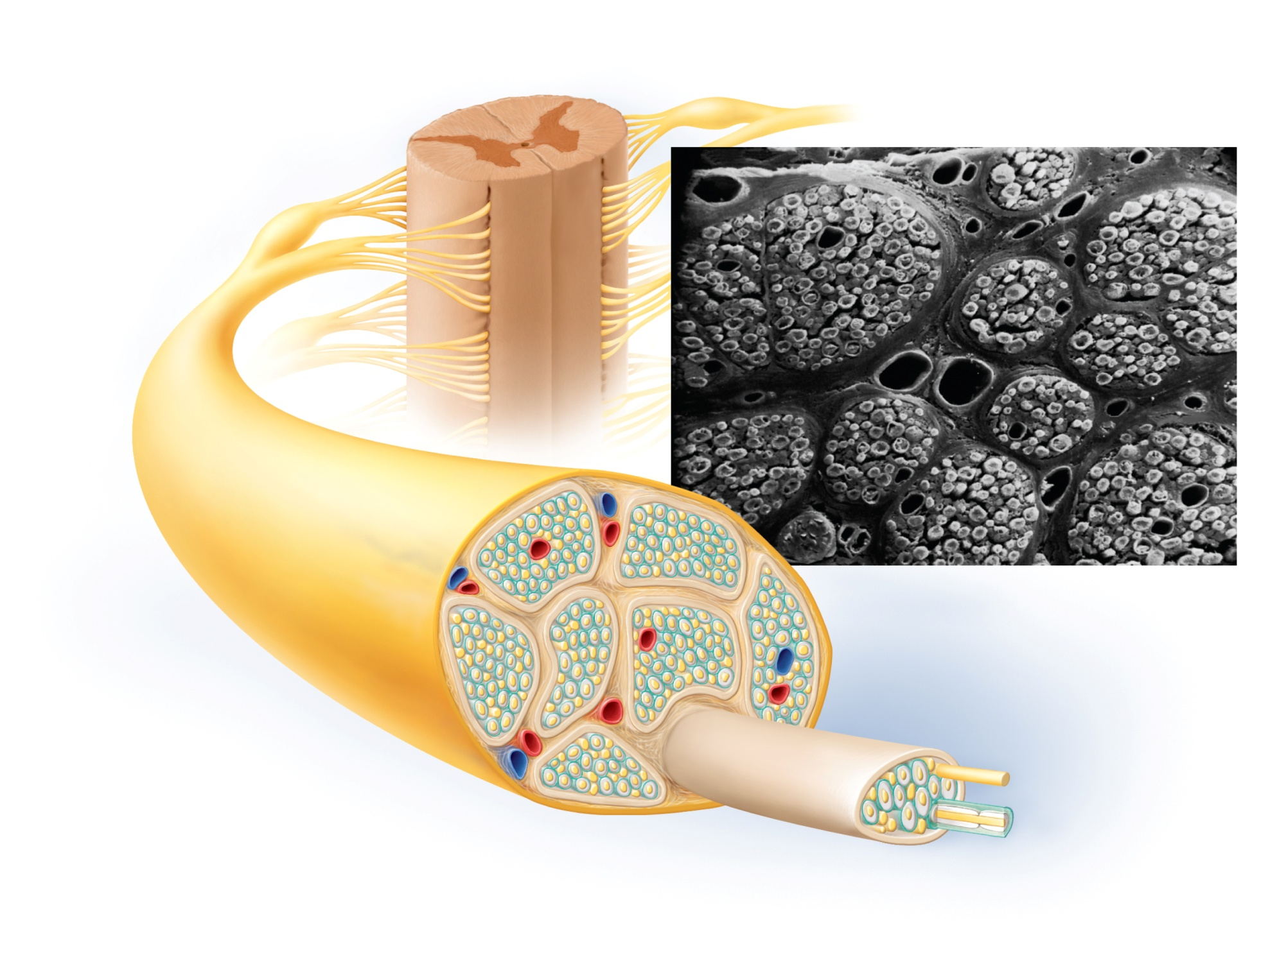
Fig. 13.8
Copyright © McGraw-Hill Education. Permission required for reproduction or display.
Epineurium
Perineurium
Endoneurium
Rootlets
Posterior root
Nerve
fiber
Posterior root
ganglion
Anterior
root
Fascicle
Spinal
nerve
Blood
vessels
Blood
vessels
(b)
Fascicle
Epineurium
Perineurium
Unmyelinated nerve fibers
(a)
Myelinated nerve fibers
Endoneurium
Myelin
b: ©Dr. Kessel & Dr. Kardon/Tissues and Organs/Visuals Unlimited, Inc
Notes:
7

Slide 8
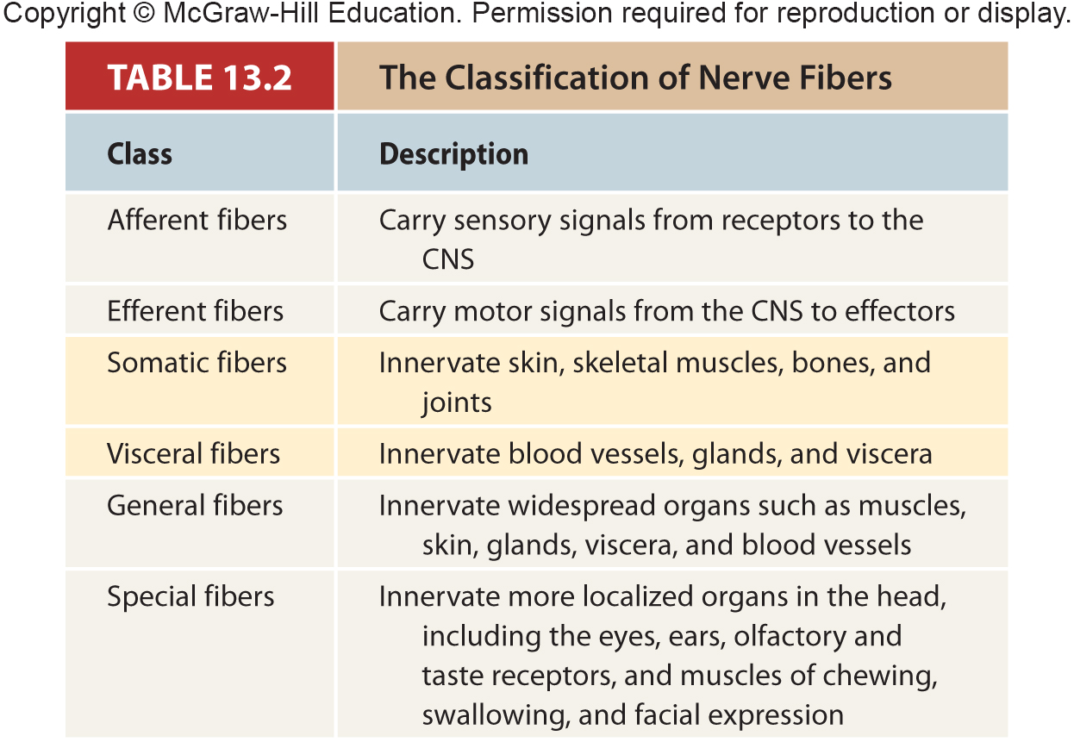
Table 13.2
Notes:
8

Slide 9
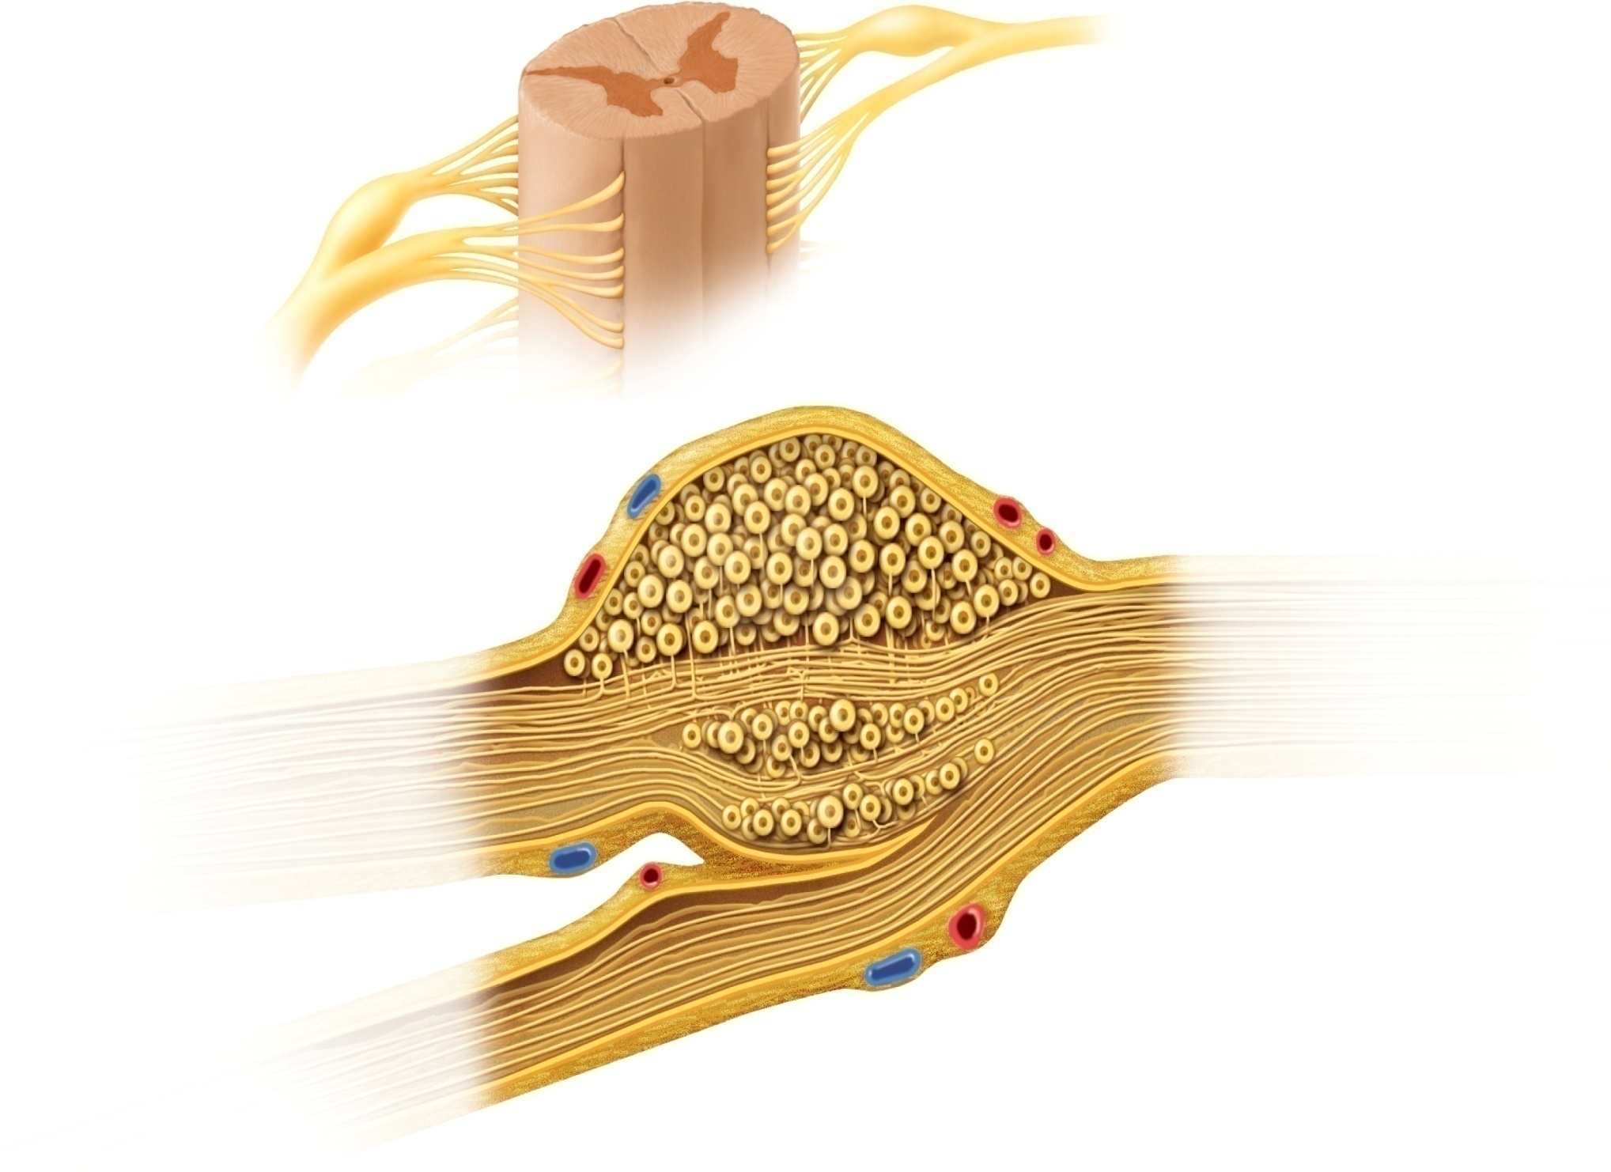

Fig. 13.9
Copyright © McGraw-Hill Education. Permission required for reproduction or display.
Direction of
signal conduction
Spinal cord
Posterior root
ganglion
Anterior root
Posterior root ganglion
Somatosensory
neurons
Sensory nerve fibers
Sensory
pathway
Spinal nerve
Posterior root
Epineurium
Blood vessels
Anterior root
Motor nerve fibers
Motor
pathway
To spinal cord
To peripheral
receptors and effectors
Notes:
9

Slide 10
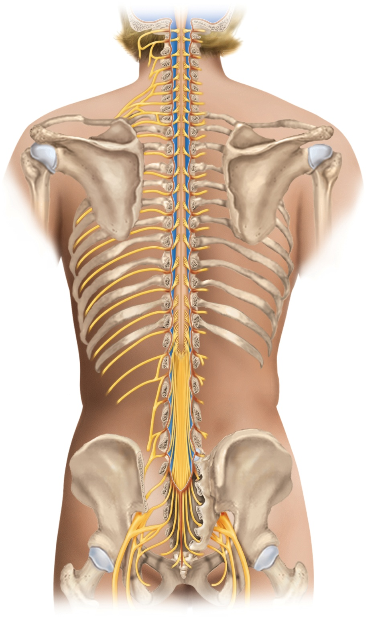
Fig. 13.10
Copyright © McGraw-Hill Education. Permission required for reproduction or display.
Vertebra C1 (atlas)
C1
C1
C2
Cervical plexus (C1–C5)
C2
C3
C3
Cervical nerves (8 pairs)
C4
C4
Cervical enlargement
C5
C5
C6
C6
C7
Brachial plexus (C5–T1)
C7
C8
C8
T1
T1
T2
Vertebra T1
T2
T3
T3
T4
T4
T5
T5
T6
T6
T7
T7
Thoracic nerves (12 pairs)
T8
Intercostal (thoracic)
nerves (T1–T12)
T8
T9
T9
Lumbar enlargement
T10
T10
T11
T11
T12
Vertebra L1
T12
Medullary cone
L1
L1
L2
Lumbar plexus (L1–L4)
L2
L3
L3
Lumbar nerves (5 pairs)
L4
L4
Cauda equina
L5
L5
S1
Sacral plexus (L4–S4)
S1
S2
S2
Sacral nerves (5 pairs)
S3
S3
S4
Coccygeal plexus
(S4–Co1)
S4
S5
S5
Coccygeal nerves (1 pair)
Sciatic nerve
Notes:
10

Slide 11
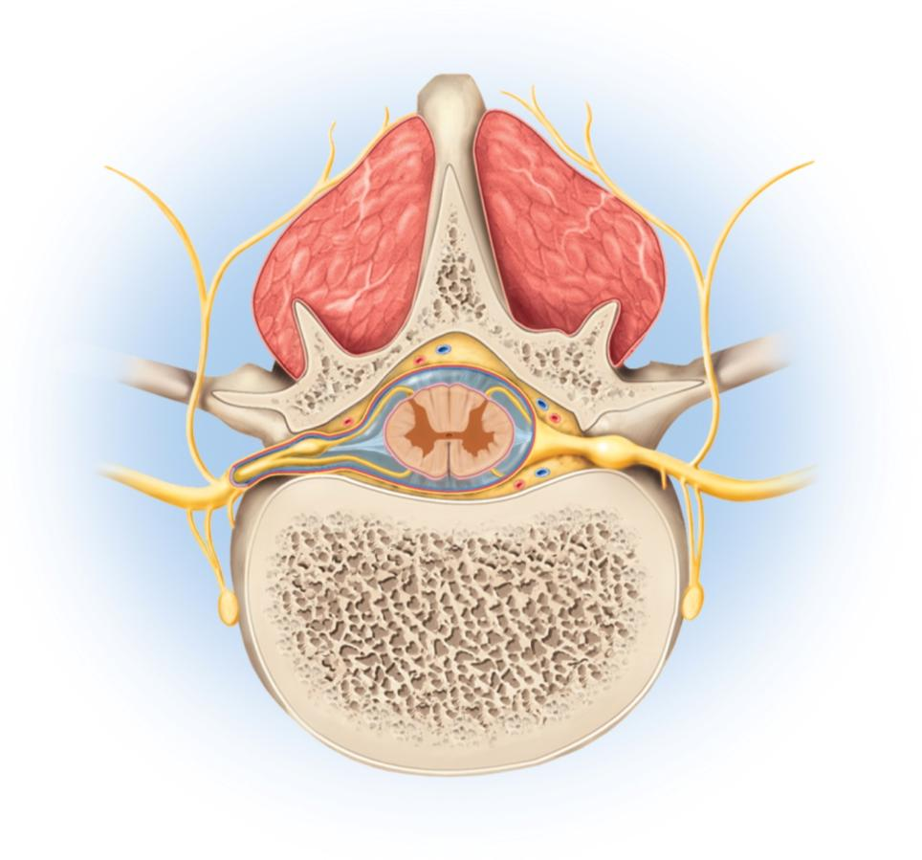
Fig. 13.11
Copyright © McGraw-Hill Education. Permission required for reproduction or display.
Posterior
Spinous process
of vertebra
Deep muscles of back
Posterior root
Posterior ramus
Spinal cord
Transverse process
of vertebra
Posterior root ganglion
Spinal nerve
Anterior ramus
Meningeal branch
Anterior root
Communicating rami
Vertebral body
Sympathetic ganglion
Anterior
Notes:
11

Slide 12
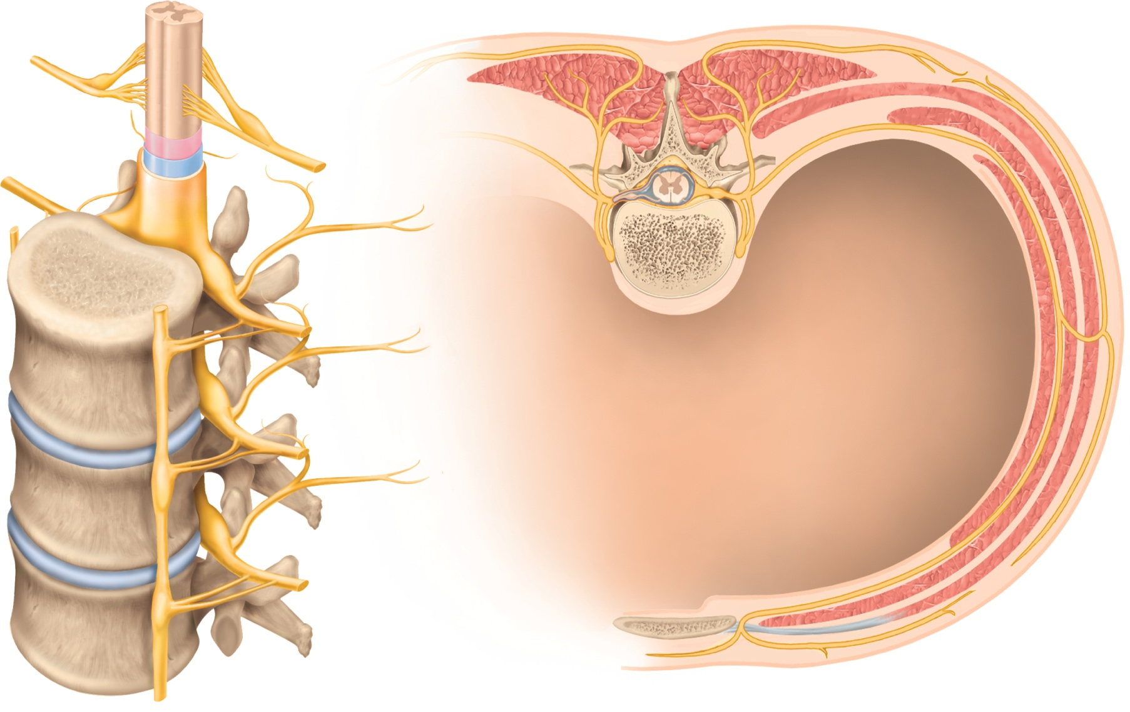
Fig. 13.13
Copyright © McGraw-Hill Education. Permission required for reproduction or display.
Posterior and anterior rootlets
of spinal nerve
Spinal nerve
Posterior ramus
Anterior ramus
Posterior root
Communicating
rami
Posterior root ganglion
Intercostal nerve
Anterior root
Sympathetic
chain ganglion
Spinal nerve
Anterior ramus
of spinal nerve
Thoracic cavity
Sympathetic chain
ganglion
Lateral
cutaneous nerve
Posterior ramus
of spinal nerve
Intercostal
muscles
Communicating rami
Anterior
cutaneous nerve
(a) Anterolateral view
(b) Cross section
Notes:
12

Slide 13
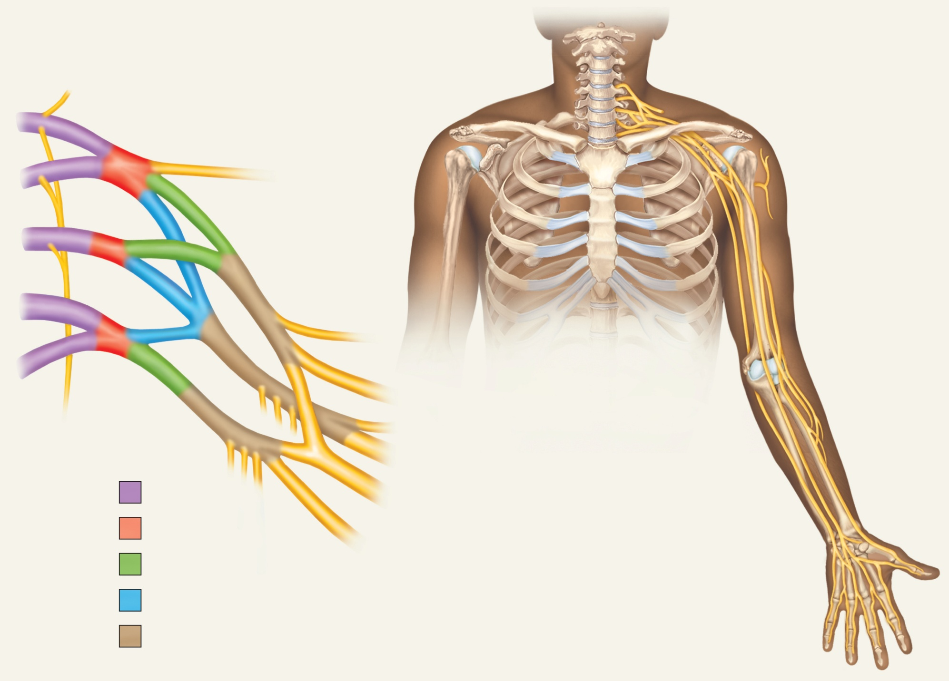
Fig. 13.15
Copyright © McGraw-Hill Education. Permission required for reproduction or display.
C5
Posterior scapular nerve
Suprascapular nerve
Lateral cord
Posterior cord
C6
Medial cord
Axillary nerve
Lateral cord
Musculocutaneous
nerve
C7
Posterior cord
Medial cord
Median nerve
C8
Radial nerve
T1
Musculocutaneous nerve
Ulna
Long thoracic
nerve
Axillary nerve
Ulnar nerve
Radial nerve
Median nerve
Roots
Median nerve
Radial nerve
Radius
Trunks
Ulnar nerve
Anterior divisions
Superficial branch
of ulnar nerve
Posterior divisions
Digital branch
of ulnar nerve
Cords
Digital branch
of median nerve
Notes:
13

Slide 14
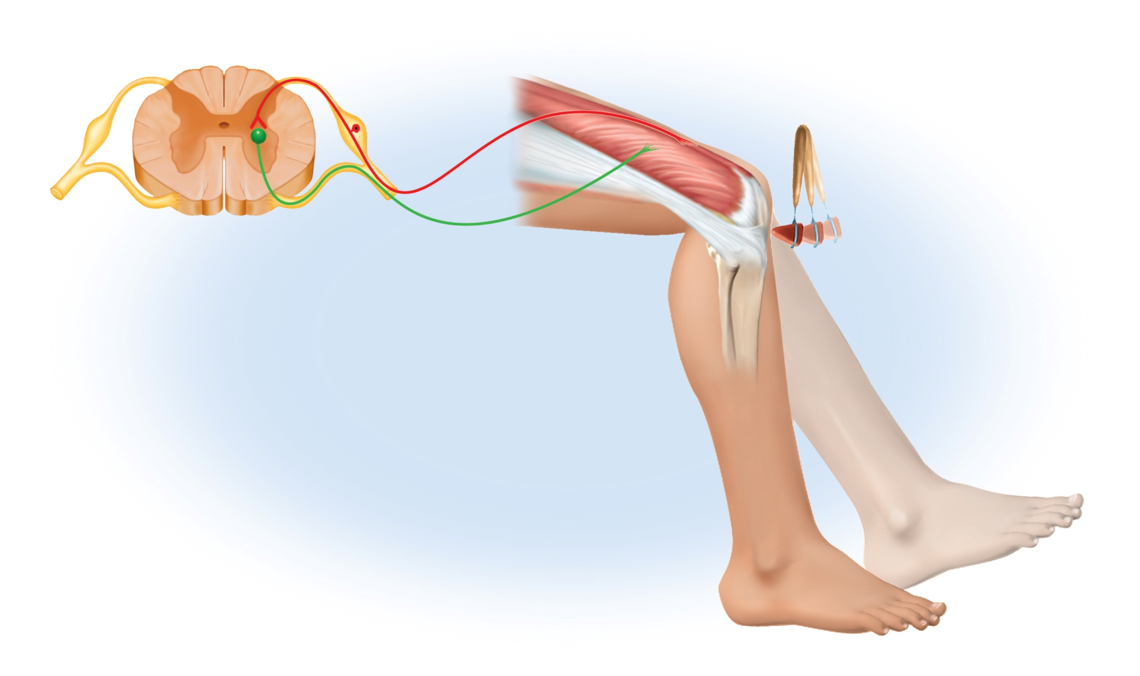
Fig. 13.20
Copyright © McGraw-Hill Education. Permission required for reproduction or display.
Integrating center
(spinal gray matter)
Afferent
nerve fiber
Receptor
(sensory nerve
endings in muscle)
Efferent nerve fiber
(motor neuron)
Effector
(quadriceps
muscle)
Notes:
14

Slide 15
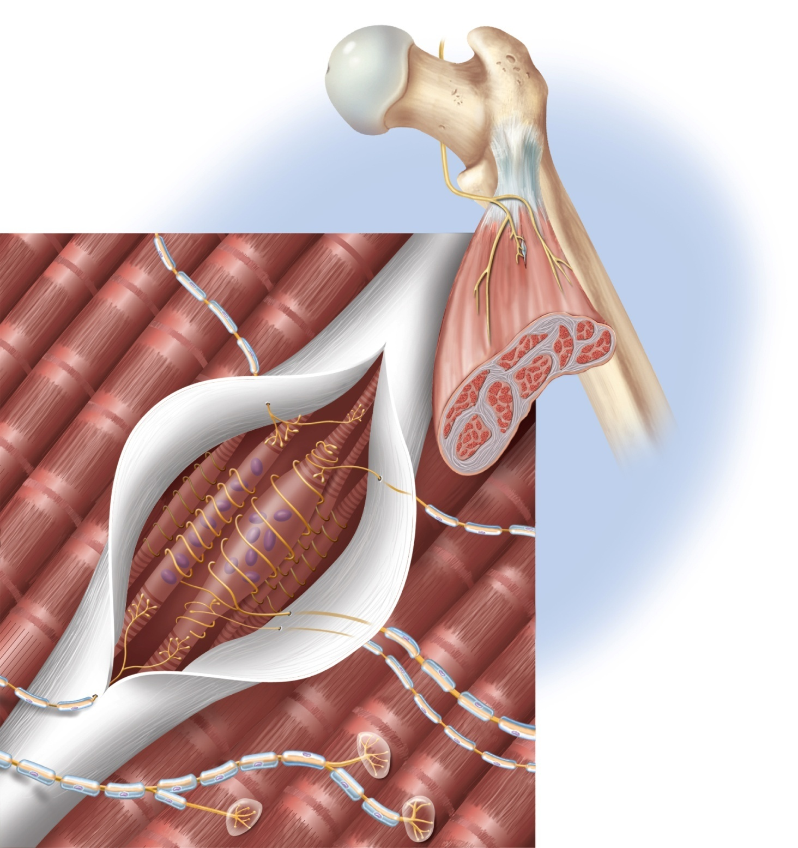

Fig. 13.21
Copyright © McGraw-Hill Education. Permission required for reproduction or display.
Bone
Peripheral nerve
(motor and sensory
nerve fibers)
Tendon
Muscle spindle
Gamma
motor fiber
Skeletal muscle
Extrafusal
muscle fibers
Connective tissue
sheath (cut open)
Intrafusal
muscle fibers
Motor nerve fibers:
Gamma
Sensory nerve fibers:
Alpha
Primary
Secondary
Notes:
15

Slide 16
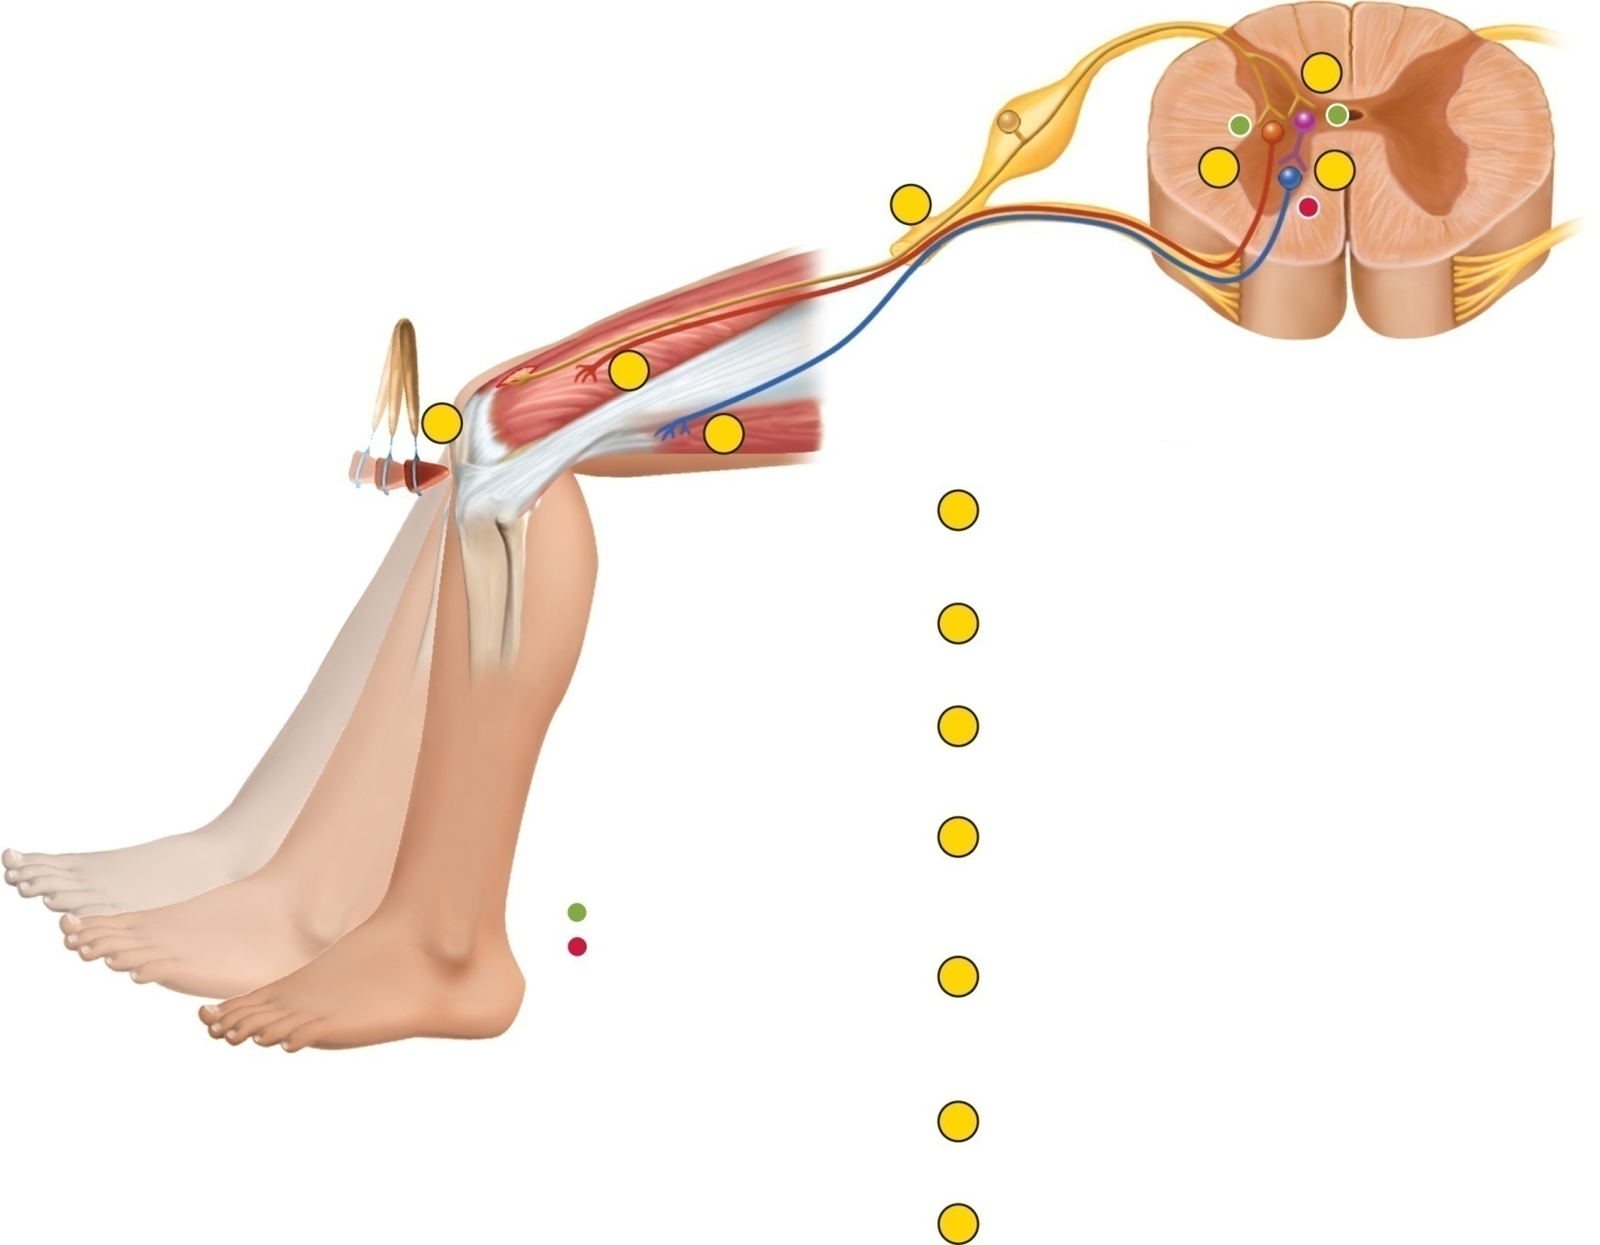
Fig. 13.22
Copyright © McGraw-Hill Education. Permission required for reproduction or display.
Primary
afferent
fiber
5
+
+
3
6
2
–
Muscle
spindle
Alpha motor
nerve fiber
to quadriceps
4
1
7
Alpha motor
nerve fiber to
hamstrings
1
Tap on patellar ligament excites nerve endings
of muscle spindle in quadriceps femoris.
2
Stretch signals travel to spinal cord via primary
afferent fiber and dorsal root.
3
Primary afferent neuron stimulates alpha motor
neuron in spinal cord.
4
Efferent signals in alpha motor nerve fiber
stimulate quadriceps to contract, producing
knee jerk.
+
EPSP
–
IPSP
5
At same time, a branch of the afferent nerve
fiber stimulates inhibitory motor neuron in spinal
cord.
6
That neuron inhibits alpha motor neuron that
supplies hamstring muscles.
7
Hamstring contraction is inhibited so hamstrings
(knee flexors) do not antagonize quadriceps
(knee extensor).
Notes:
16

Slide 17
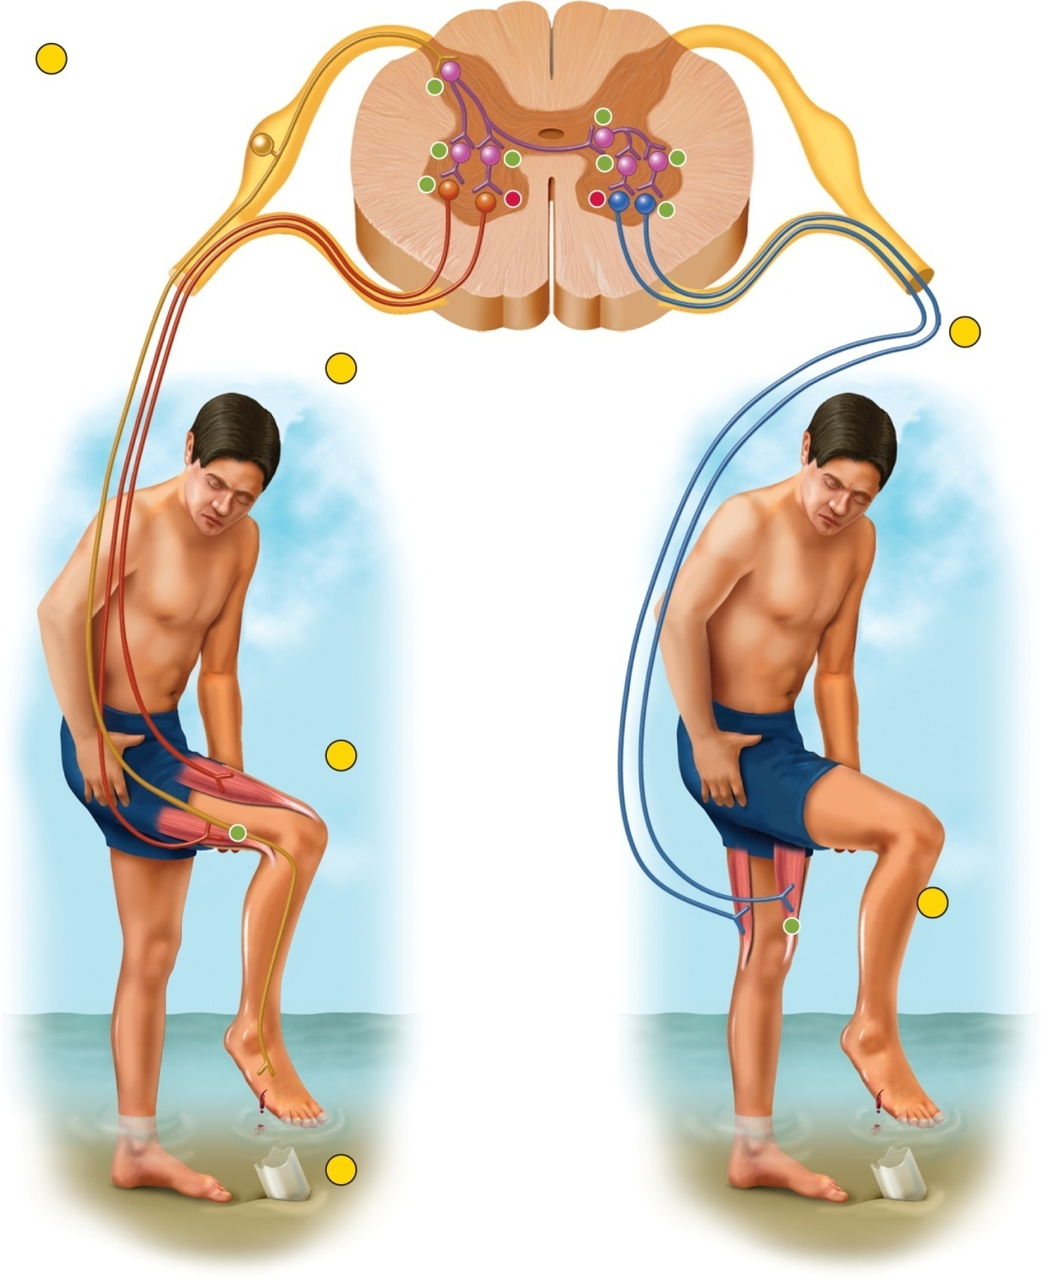
Fig. 13.23
Copyright © McGraw-Hill Education. Permission required for reproduction or display.
2
Sensory neuron
activates multiple
interneurons
+
+
+
+
+
+
+
–
–
+
5
3
Ipsilateral motor
neurons to flexor
excited
Contralateral
motor neurons
to extensor
excited
4
Ipsilateral flexor
contracts
+
+
6
Contralateral
extensor
contracts
1
Stepping on glass
stimulates pain receptors
in right foot
Withdrawal of right leg
(flexor reflex)
Extension of left leg
(crossed extension reflex)
Notes:
17

Slide 18
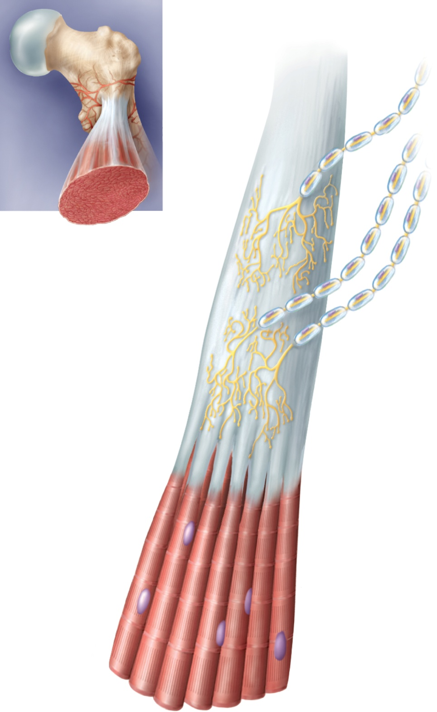

Fig. 13.24
Copyright © McGraw-Hill Education. Permission required for reproduction or display.
Nerve fibers
Tendon organ
Tendon bundles
Muscle fibers
Notes:
18

