Slide 1
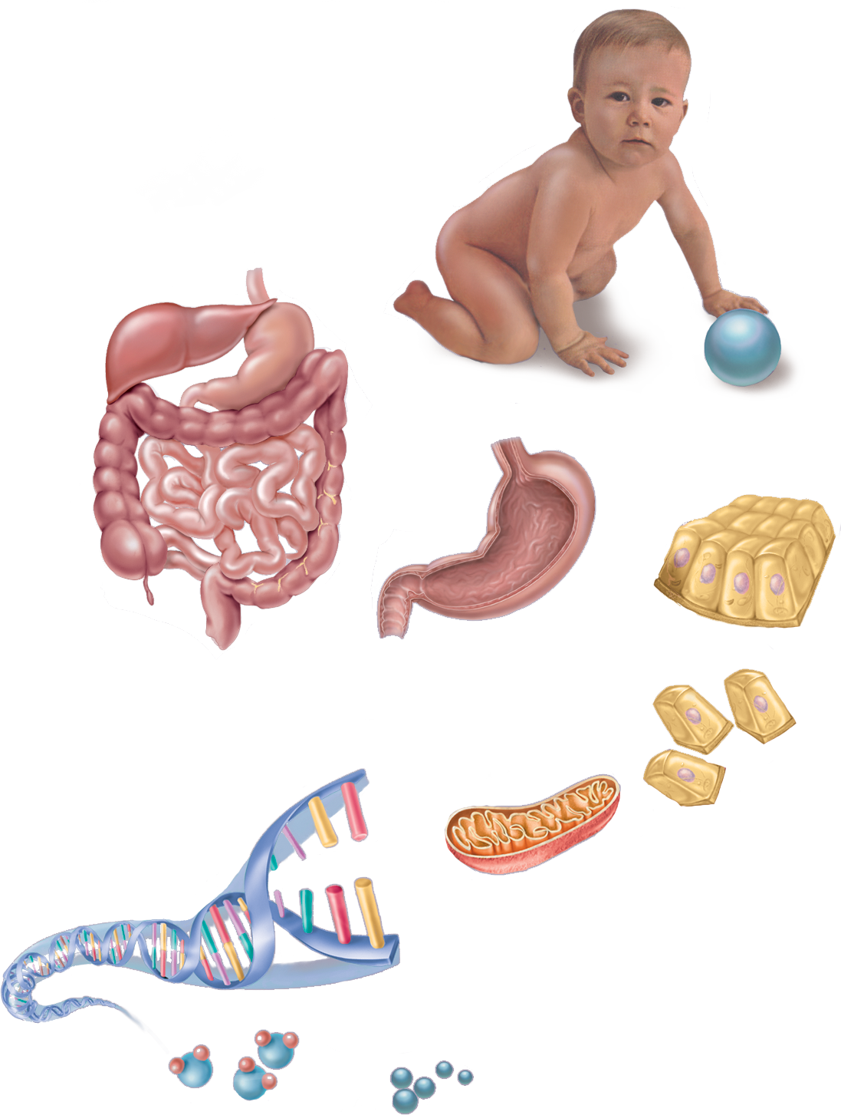
Fig. 1.4
Copyright © McGraw-Hill Education. Permission required for reproduction or display.
Organism
Organ system
Organ
Tissue
Cell
Macromolecule
Organelle
Atom
Molecule

Slide 2
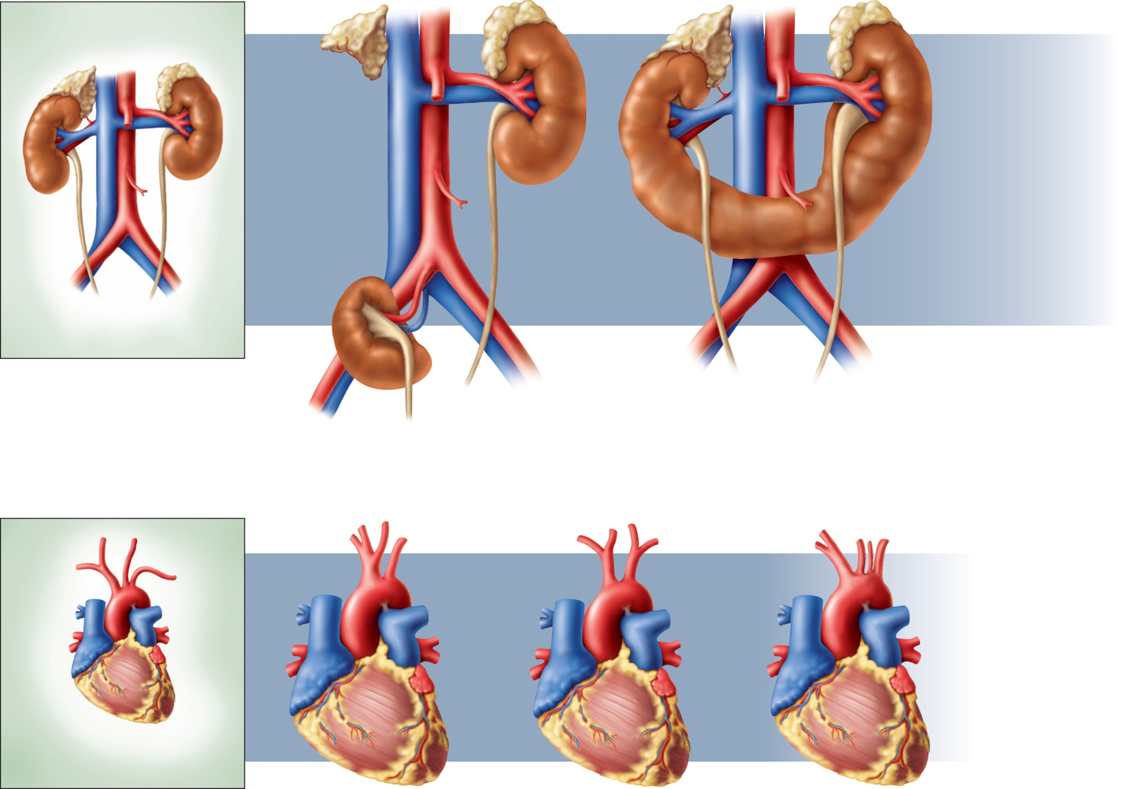
Fig. 1.5
Copyright © McGraw-Hill Education. Permission required for reproduction or display.
Normal
Pelvic kidney
Horseshoe kidney
Normal
Variations in branches of the aorta

Slide 3
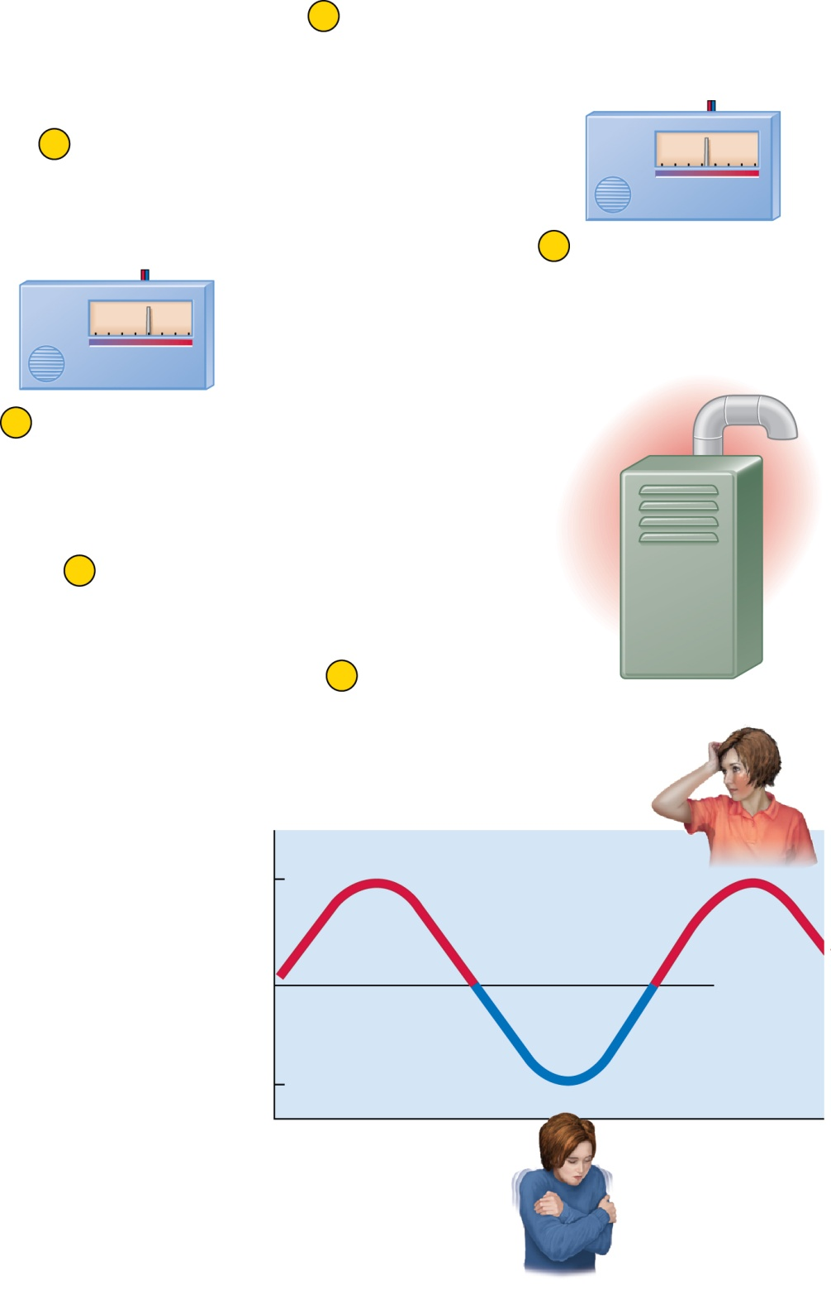
Fig. 1.6
Copyright © McGraw-Hill Education. Permission required for reproduction or display.
1
Room temperature
falls to 19°C (67°F)
6
Room cools down
C10°
15°
20°
25°
F 50°
60°
70°
80°
2
Thermostat activates
furnace
C10°
15°
20°
25°
F 50°
60°
70°
80°
5
Thermostat shuts
off furnace
4
Room temperature
rises to 20°C (68°F)
(a)
3
Heat output
Sweating
37.5°C
(99.5°F)
Vasodilation
Core body temperature
37.0°C
(98.6°F)
Set point
36.5°C
(97.7°F)
Vasoconstriction
Time
Shivering
(b)

Slide 4
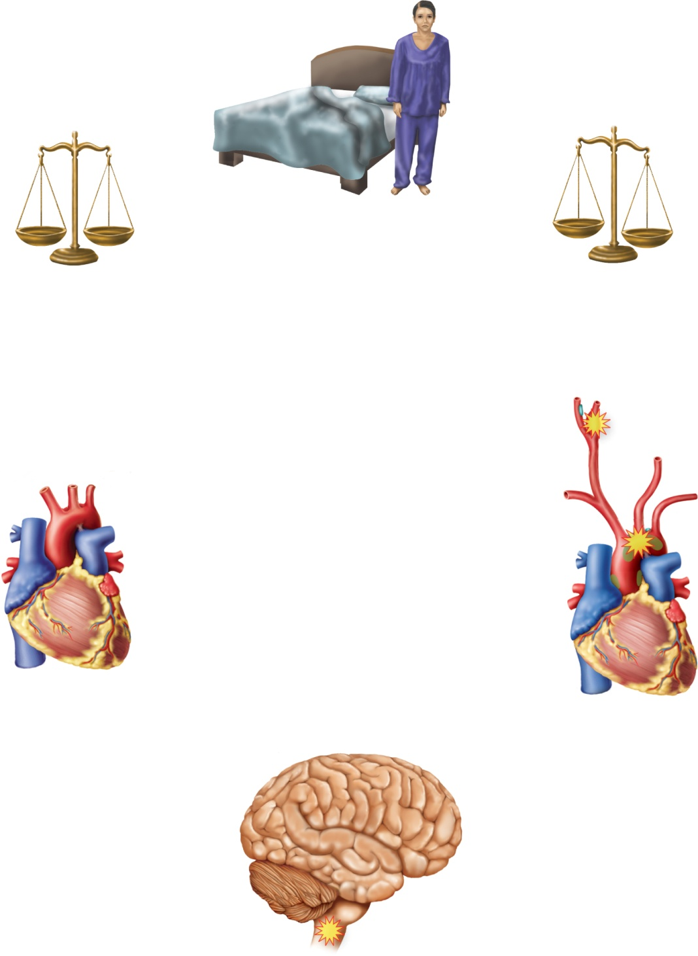
Fig. 1.7
Copyright © McGraw-Hill Education. Permission required for reproduction or display.
Person rises
from bed
Blood pressure rises
to normal; homeostasis
is restored
Blood drains from
upper body, creating
homeostatic imbalance
Cardiac center
accelerates heartbeat
Baroreceptors above
heart respond to drop
in blood pressure
Baroreceptors send signals
to cardiac center of brainstem

Slide 5
Fig. 1.8
Copyright © McGraw-Hill Education. Permission required for reproduction or display.
3
Brain stimulates
pituitary gland to
secrete oxytocin
4
2
Nerve impulses
from cervix
transmitted
to brain
Oxytocin stimulates
uterine contractions
and pushes fetus
toward cervix
1
Head of fetus
pushes against cervix

Slide 6
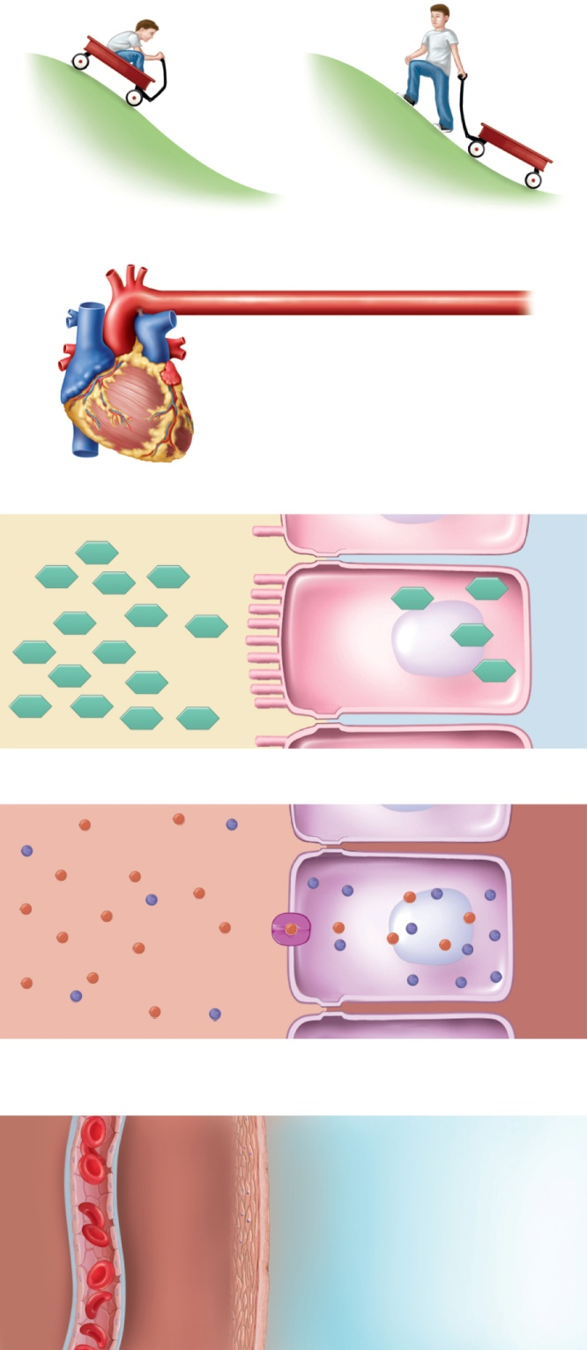
Fig. 1.9
Copyright © McGraw-Hill Education. Permission required for reproduction or display.
Down gradient
Up gradient
(a)
High
pressure
Low pressure
Blood flow down
pressure gradient
(b)
Dietary glucose
Intestinal cells
Chemical flow down
concentration gradient
(c)
+
+
–
Cell membrane channel
–
Sodium ions (+)
+
+
–
+
–
–
+
–
–
+
+
+
+
+
+
+
–
+
–
+
–
+
–
+
Ion flow down
electrical gradient
–
–
+
–
–
+
–
(d)
Warm blood
Skin
Cool air
Heat flow down
thermal gradient
(e)

Slide 7
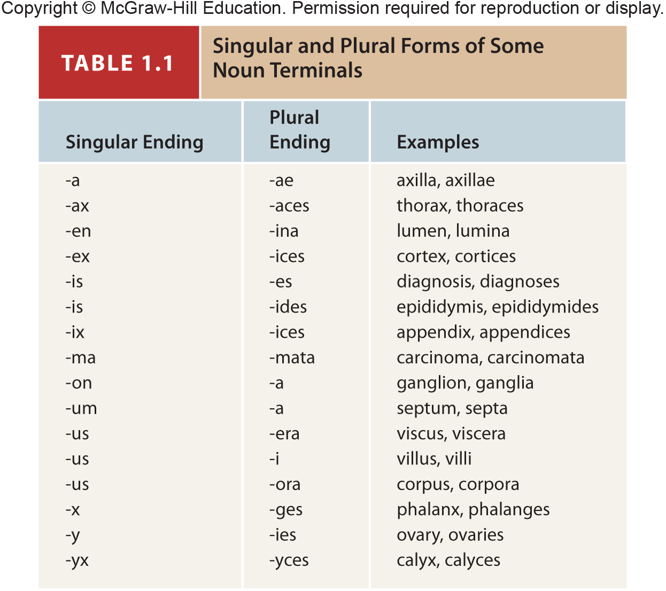
Table 1.1

